Slide 1
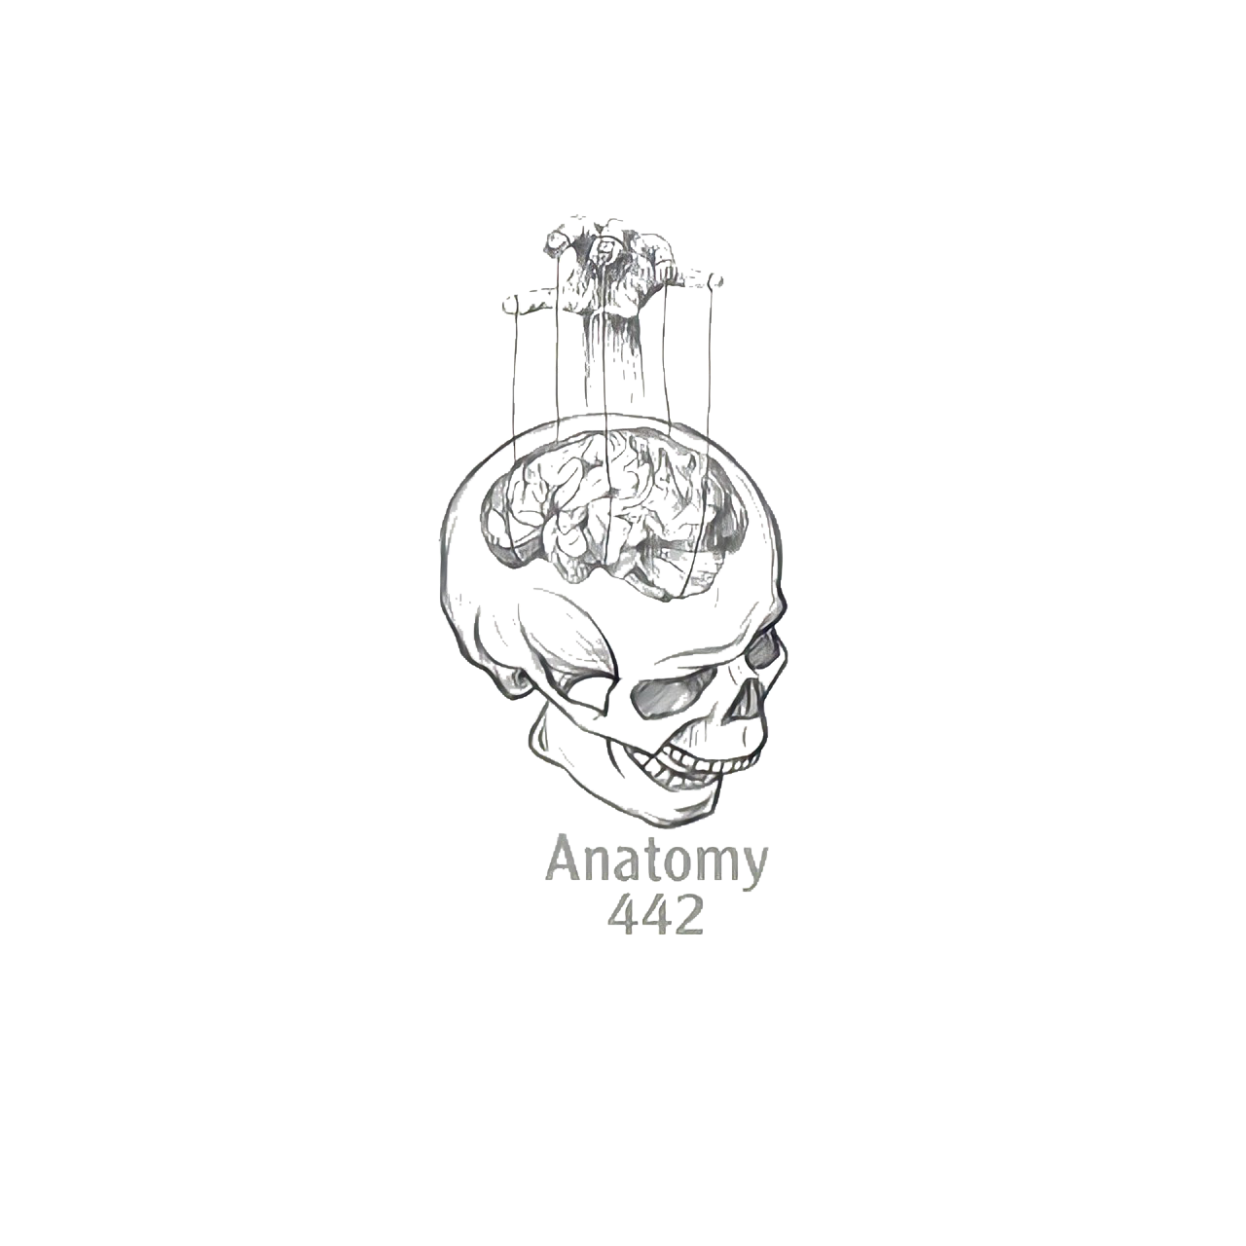
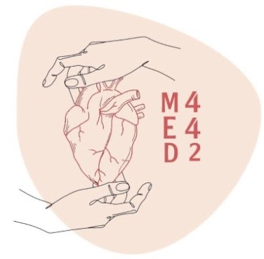
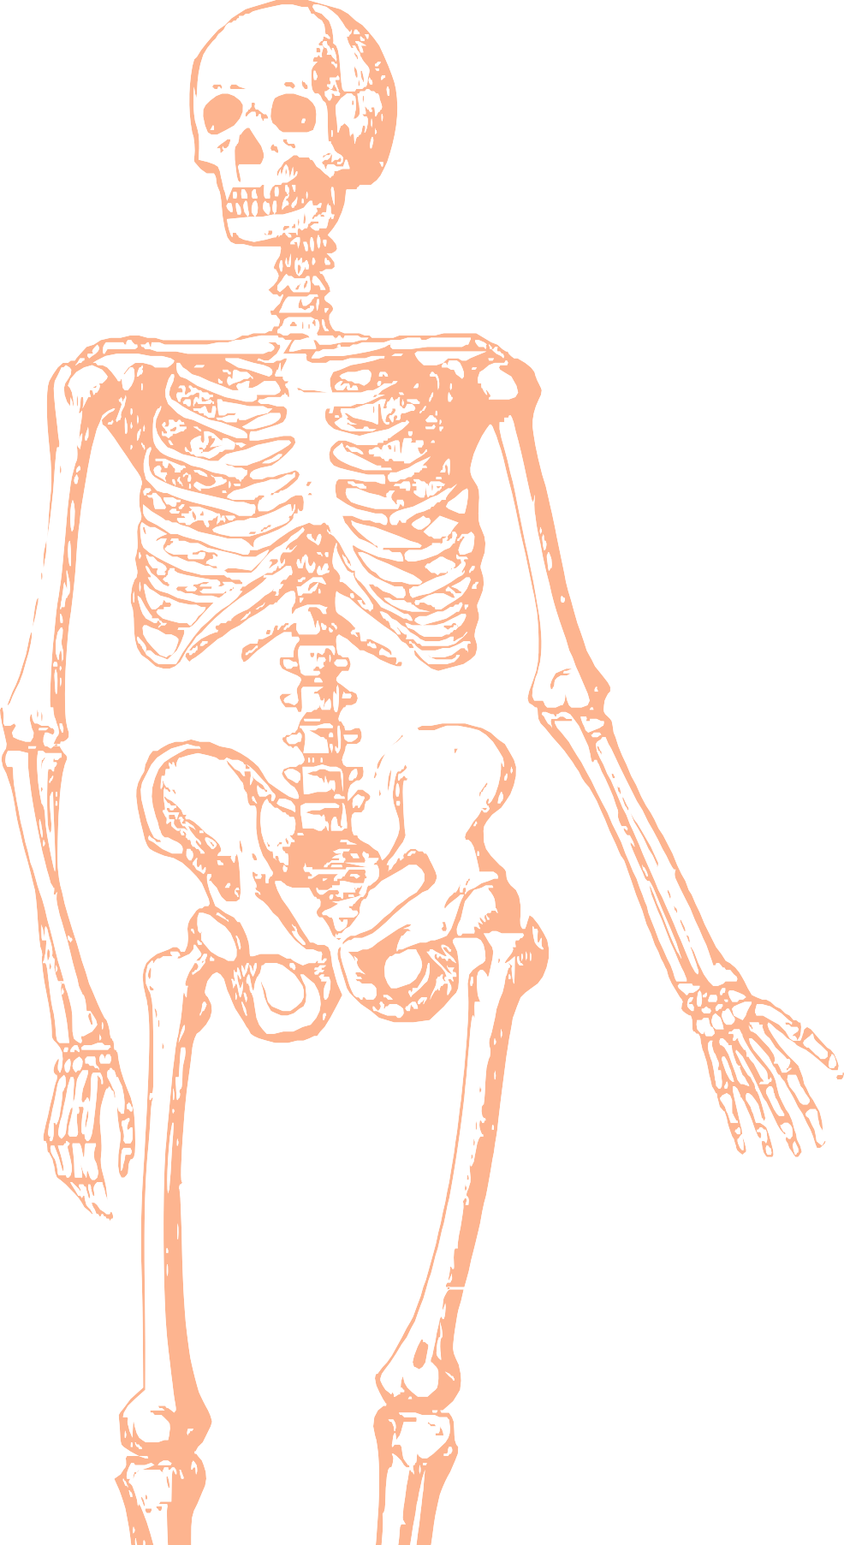
L3
Muscles of back
Editing file
Color index:
Mine text
Important
Doctors notes
Female slides only
Male slides only
Extra

Slide 2
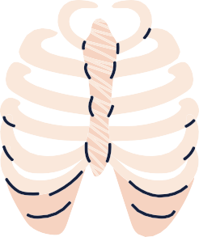
Objectives :
Distinguish between the different groups of back muscles.
Compare between groups of back muscles as regard their nerve supply and action.
List the back muscles of each group.
Describe the attachments of each muscle of the superﬁcial group, as well as, its nerve supply and action.
Describe the triangles of back and their clinical signiﬁcance.

Slide 3
Back muscle are organized into 3 groups :
 | Development | Attached | Function | Nerve supply
Deep group | Intrinsic muscle (develop in the back ) | Attached to the vertebral column and head | Moves vertebral column and the head | Supplied by posterior rami of spinal nerves
Intermediate group | Extrinsic muscle (not developed in the back) No fascia between extrinsic group Explanation: the deep muscles have fascia between the group itself to stabilize the muscles , but the intermediate and superficial don’t have | Attached to ribs | May serve in respiratory function Associated with thoracic cage movement | Supplied by the anterior rami of spinal nerves
Superficial group | Extrinsic muscle (not developed in the back) No fascia between extrinsic group | Attached to upper limb ( shoulder) | Involved in the movement of the upper limb ( shoulder ) | Supplied by the anterior rami of spinal nerves

Slide 4
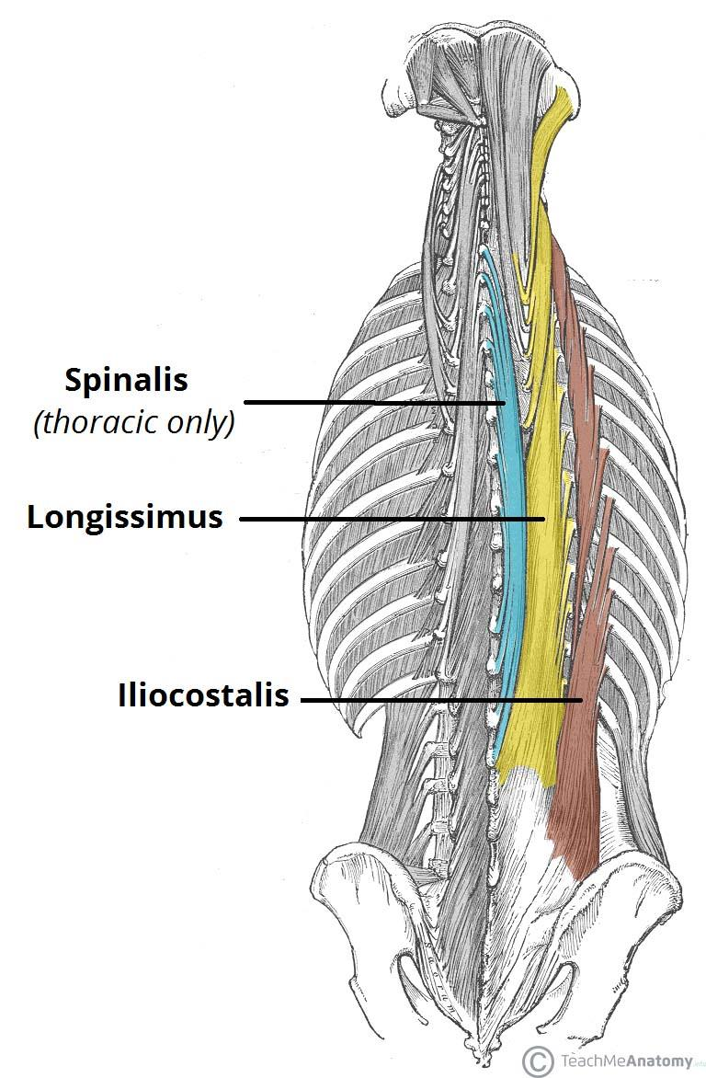
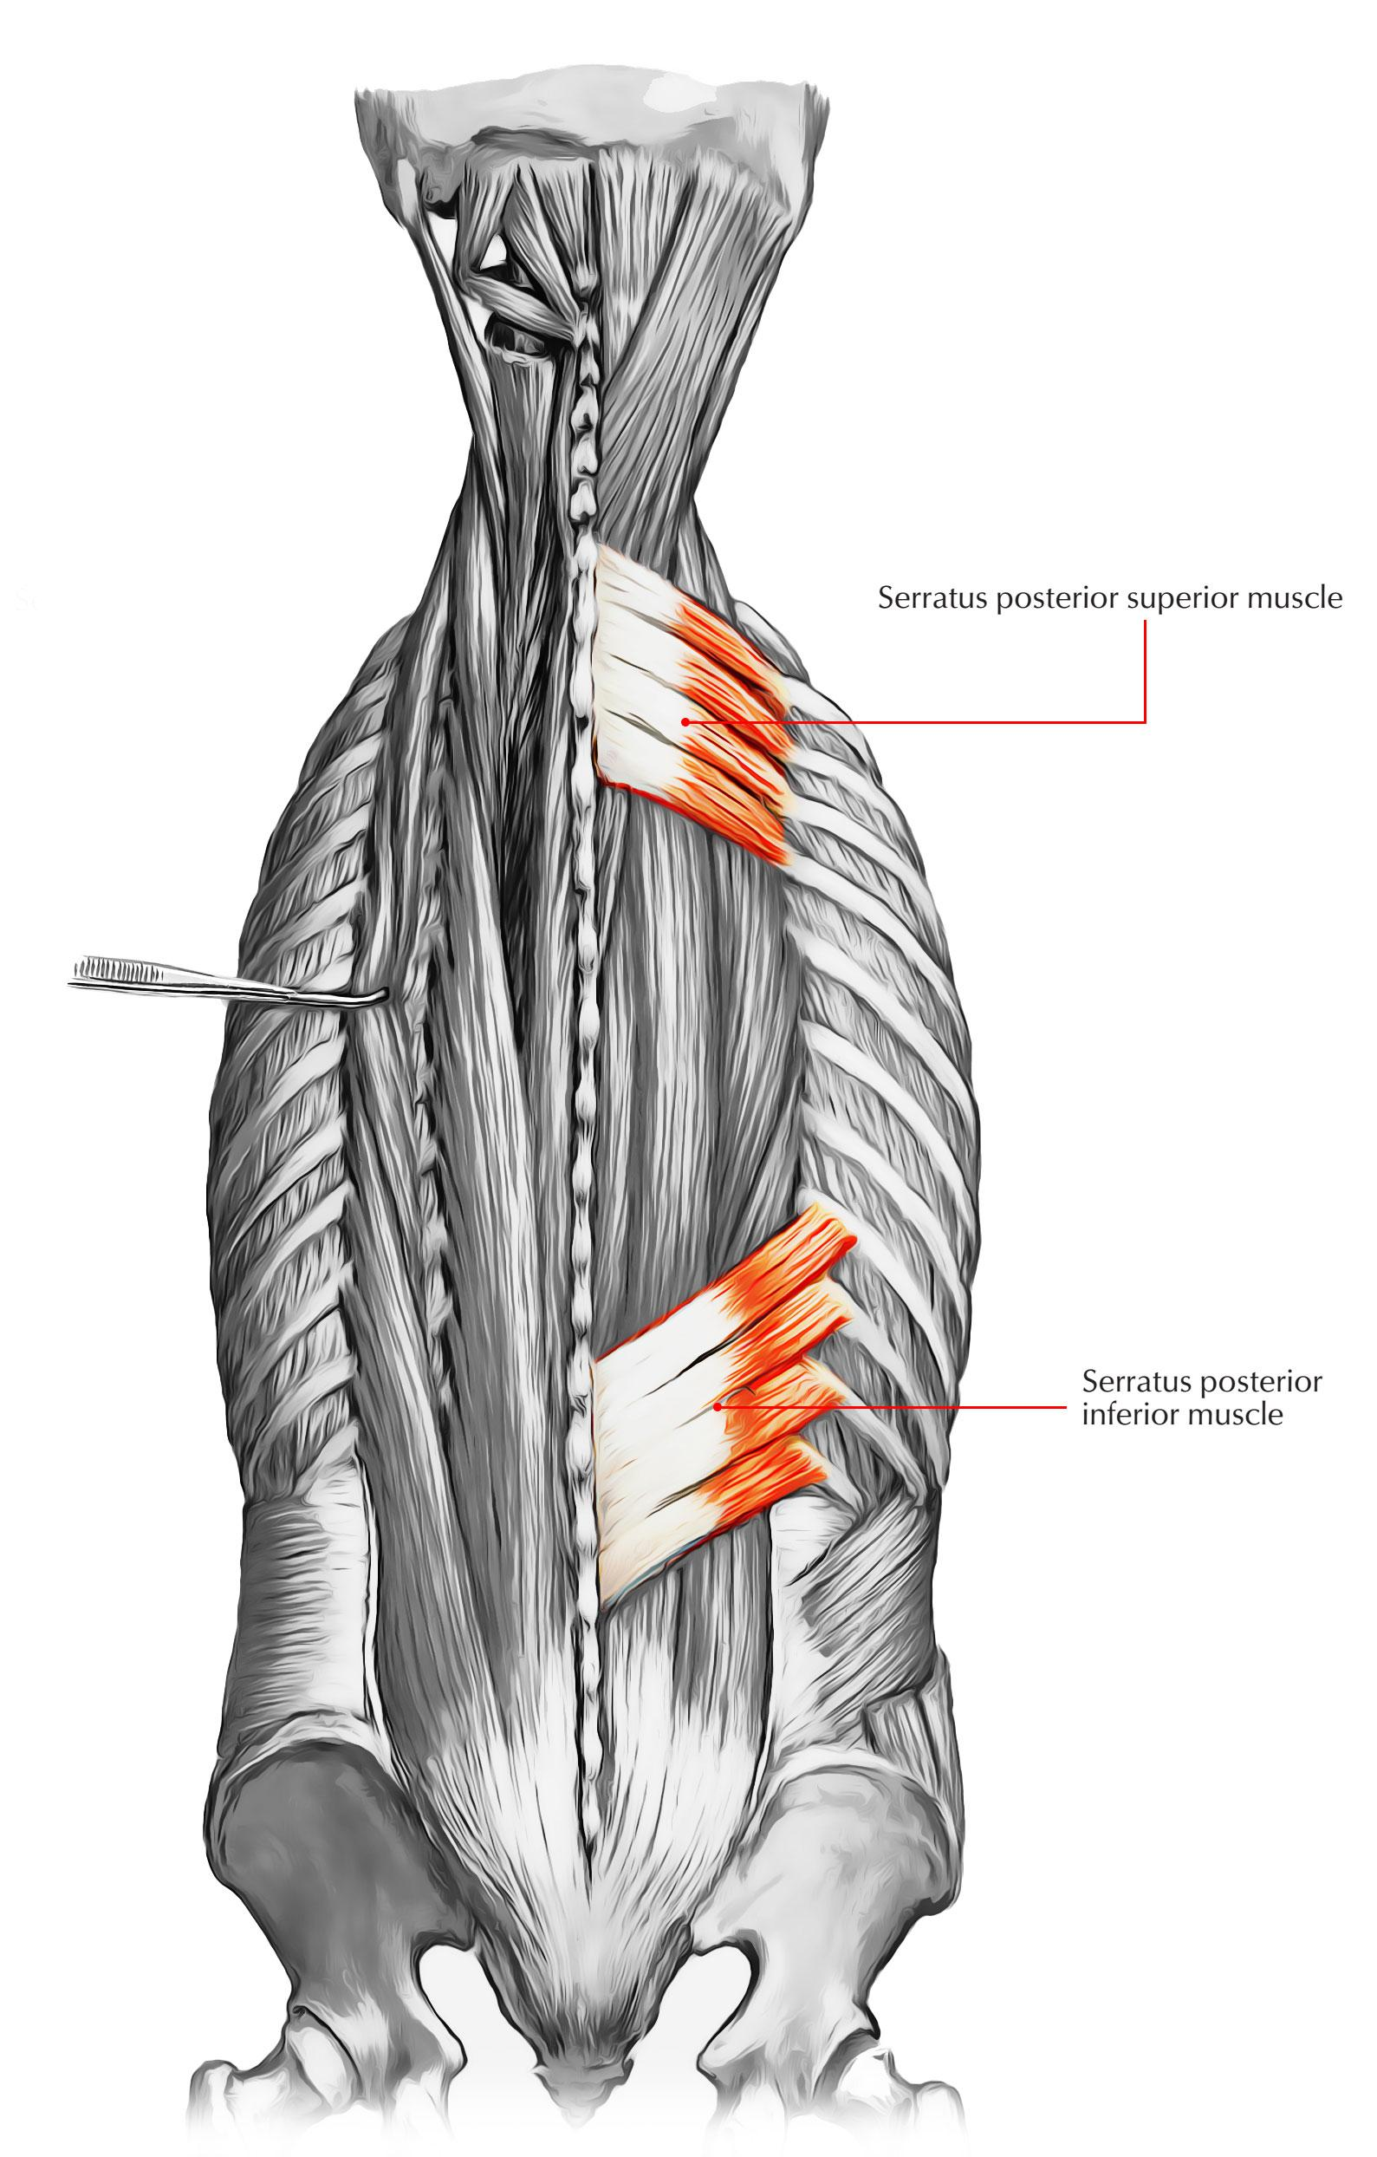
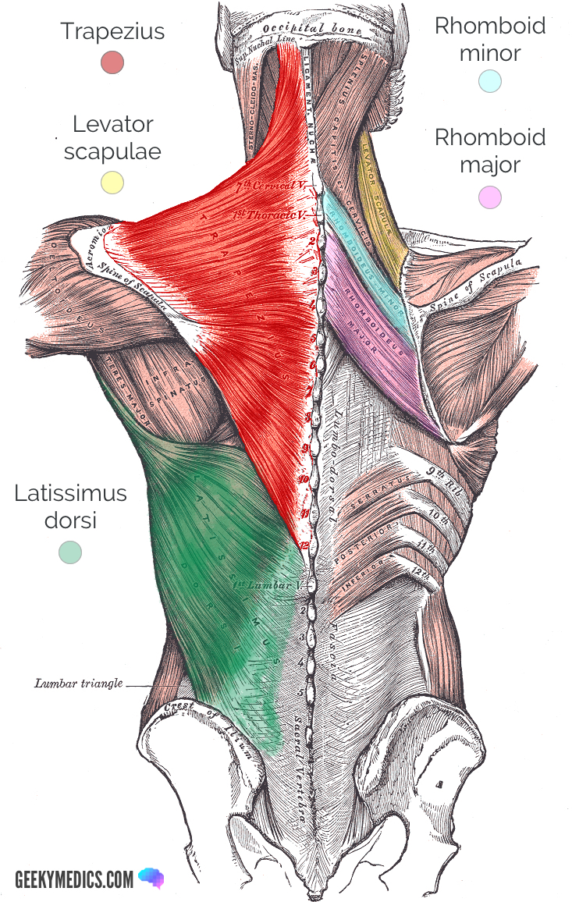
Muscles:
Helpful video
Deep group | Intermediate group | Superficial group
Iliocostalis Longissimus Spinalis (I Like Standing ) | Serratus posterior superior Serratus posterior inferior | Trapezius Levator scapulae Rhomboid Minor Rhomboid Major Latissimus Dorsi

Slide 5
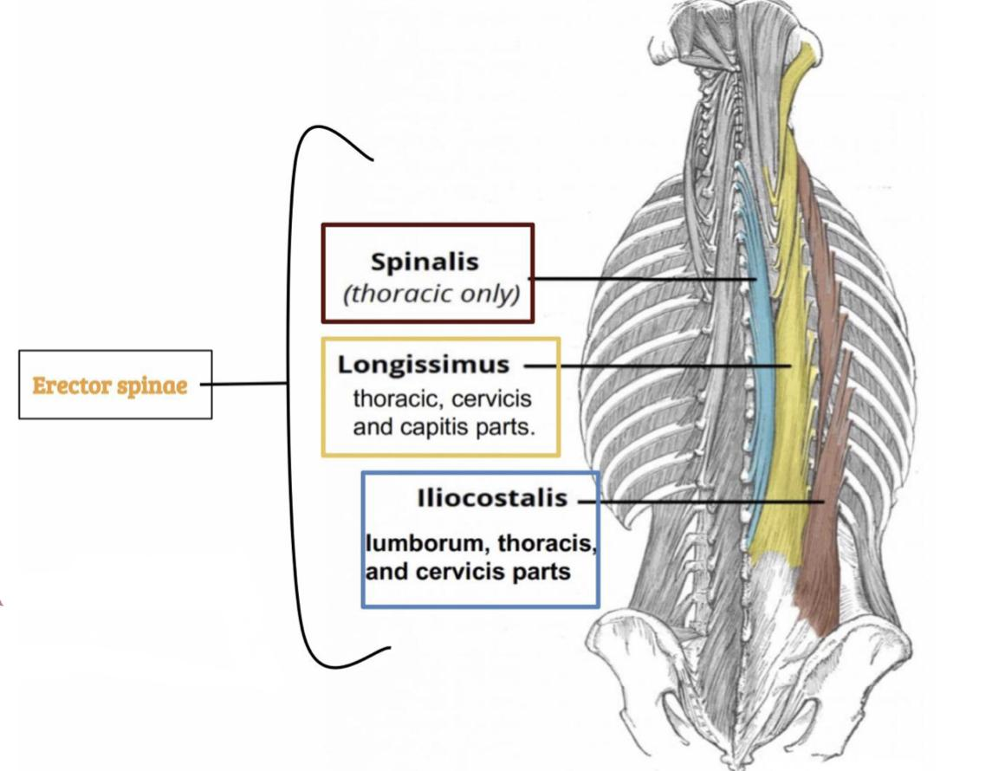
Deep muscle of Back
Extension of the head
They extend from sacrum to the skull.
They include extensors and rotators of the head and vertebral column. So, It is a set of muscles that straighten and rotate the back .
Extension for the vertebral column :
زي لما الواحد يرفع من الركوع وممكن يصير اكسترا اكستنشن لما يرجع على ورا زياده نفس الصوره
2
1
Their tone is responsible for the maintenance of normal curvature of the vertebral column.in state of relaxation not all muscles are relaxed and these contracted fibers maintain the muscle tone
3
4
The largest muscle of this group is Erector spinae, which is formed of 3 vertical columns (from lateral to medial). Iliocostalis, Longissimus, Spinalis.
Note: (the length and attachment of the muscle fibres).

Slide 6
Intermediate muscle of Back ( Serratus posterior muscle ) :
-It is separated from the deep group by Thoracolumbar fascia.
note: the thoracolumbar fascia is a sheet of connective tissue covering or binding together body structure. الطبقة البيضاء اللي تغطي العضلة
The intermediate group includes 2 muscles:
Muscle | Serratus posterior superior | Serratus posterior inferior
Origin | Spinous process C7-T3 | Spinous process T11-L2
Insertion | Ribs from 2-5 | Ribs from 9-12
Action | (Rib elevator) (=raise up شهيق قوي) | (Rib depressor) (=pull downزفير قوي)
Contributes in | Deep inspiration | Forced expiration
Nerve supply (innervation) | Anterior rami of thoracic spinal nerve ( intercostal Nerve) | Anterior rami of thoracic spinal nerve ( intercostal Nerve)

Slide 7
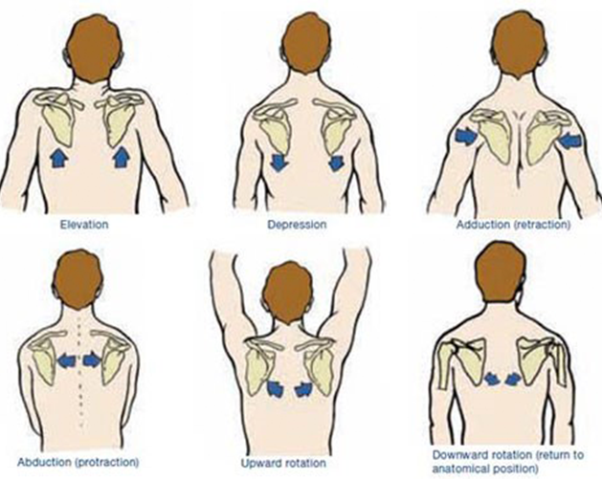
Superficial group of Back muscles:
Here is a video done by the leader: Razan alnufaie
-They originate from the vertebral column and attached to the bone of
the shoulder, the clavicle, scapula and the humerus.
1
2
Muscles connecting vertebral column to scapula ( move the scapula through shoulder girdle joint) & include:
1- Trapezius
2-Levator scapulae
3-Rhomboid Minor
4-Rhomboid Major
Muscles connecting vertebral column to humerus ( move the humerus through shoulder joint) & include:
1- Latissimus dorsi.
صور توضيحية لمعاني الحركات المذكوره بالسلايدز الجايه

Slide 8
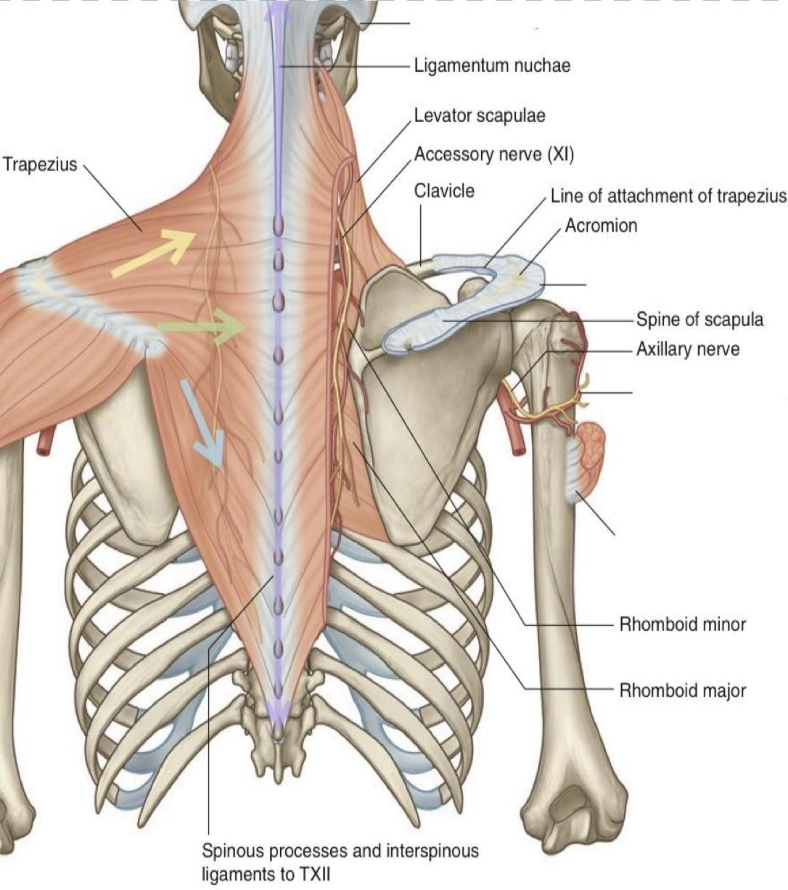
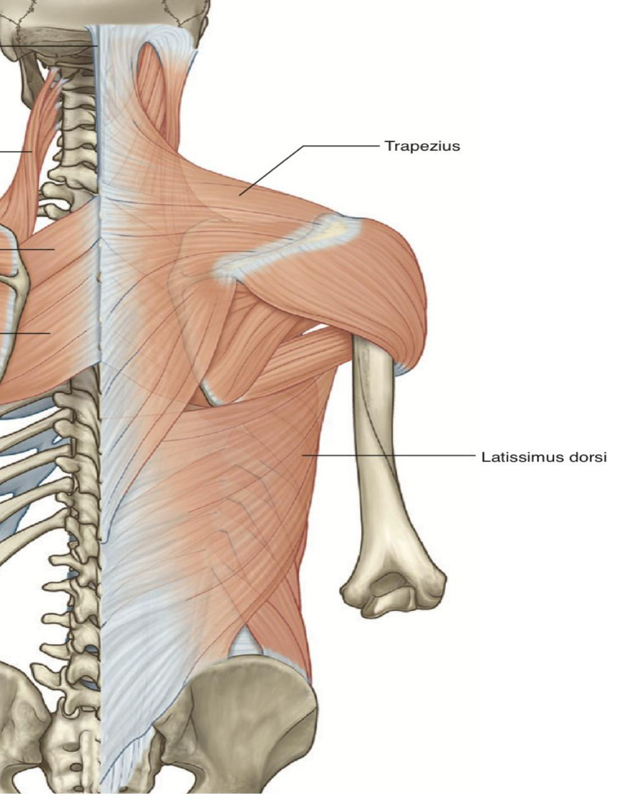
Superficial group of back muscles
muscles | Origin | Insertion | Action (Movement) | Nerve supply | Pictures
Trapezius To test the accessory nerve, trapezius function can be assessed by shoulders shrug Shoulder shrug: زي الحركه اللي تسوينها لما تقولين I don’t know | -Skull -ligamentum nuchae -spinous processes of cervical & thoracic vertebrae (C7-T12) | lateral 1/3 of the clavicle, acromion & spine of the scapula. | rotation of scapula during abduction of humerus above horizontal. - upper ﬁbers: elevate the scapula and rotates it during abduction of the arm (humerus) - middle ﬁbers: retract scapula - lower ﬁbers: depress scapula | - motor innervation: spinal root of accessory (11th cranial) nerve - proprioceptor (sensory): ﬁbers from C3 & C4 spinal nerves
Latissimus Dorsi | - Spinous processes of (T6-T12) /spines of thoracic vertebrae - Iliac crest - Thoracolumbar fascia - inferior 3 or 4 ribs | tendon attaches to the intertubercular sulcus of the humerus. /bicipital groove of humerus. Intertubercular sulcus and bicipital groove of the humerus are the same just different names for the same area on the humerus | - extension - adduction - medial rotation of upper limb/of humerus (arm, shoulder joint). Any muscle to move shoulder joint should be attached to humerus It is also called the climbing muscle. | thoracodorsal nerve (C6,7,8) from posterior cord of brachial plexus
Insertion
Origin

Slide 9
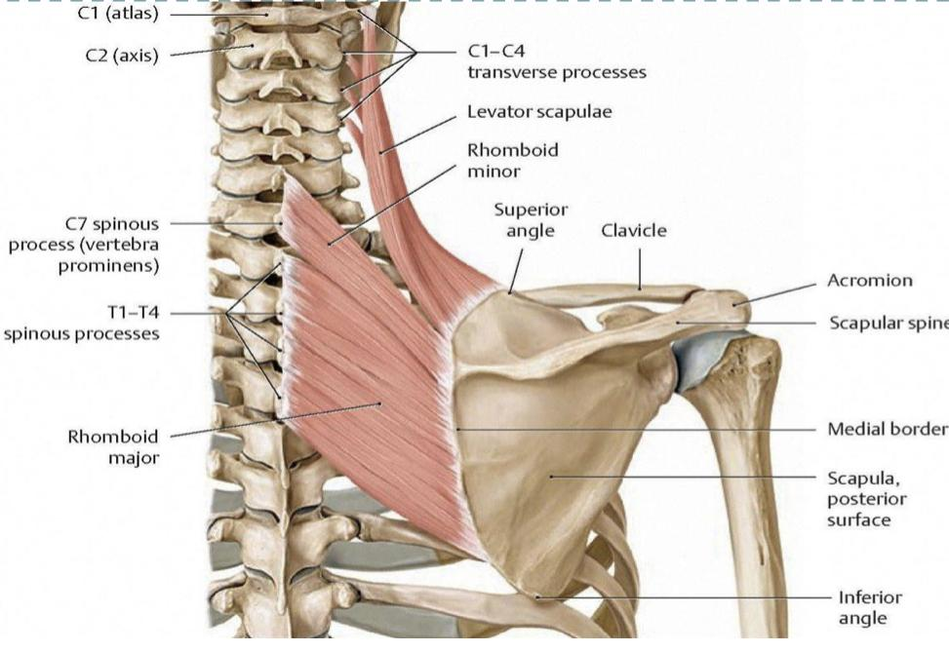
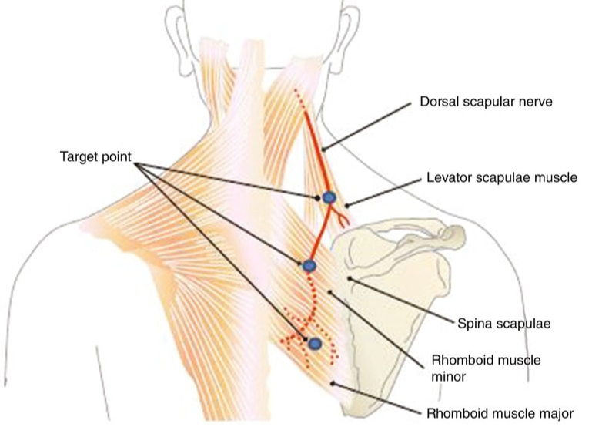
Note from males doctor: specific origin of back muscles isn’t important (I.e you don’t have to memorize C1-C4 )
Superficial group of back muscles
muscles | Origin | Insertion | Action (Movement) | Nerve supply | Pictures
Levator Scapulae | cervical transverse processes (C1-C4) | medial border of scapula. Levator scapula attached to scapula to the superior angle of scapula | elevates scapula | Dorsal scapular nerve The root of dorsal scapular nerve is anterior C5 ramus
Rhomboid Major | thoracic spinous processes of (T2-T5 ) vertebrae | medial border of the scapula between the scapula spine and inferior angle. Rhomboid major attached inferomedial to the medial border of scapula | Retract and Rotate the ( scapula ) ,
Rhomboid Minor | thoracic spinous processes the spinous processes of (C7-T1 )vertebra | medial border of scapula at the level of the spine of scapula. Rhomboid minor attached directly in front of the scapula .
Three other superficial muscles are deep to trapezius
يعني ذولي الثلاث تعتبر سوبرفشيال بس انها تحت الترابيزيس

Slide 10
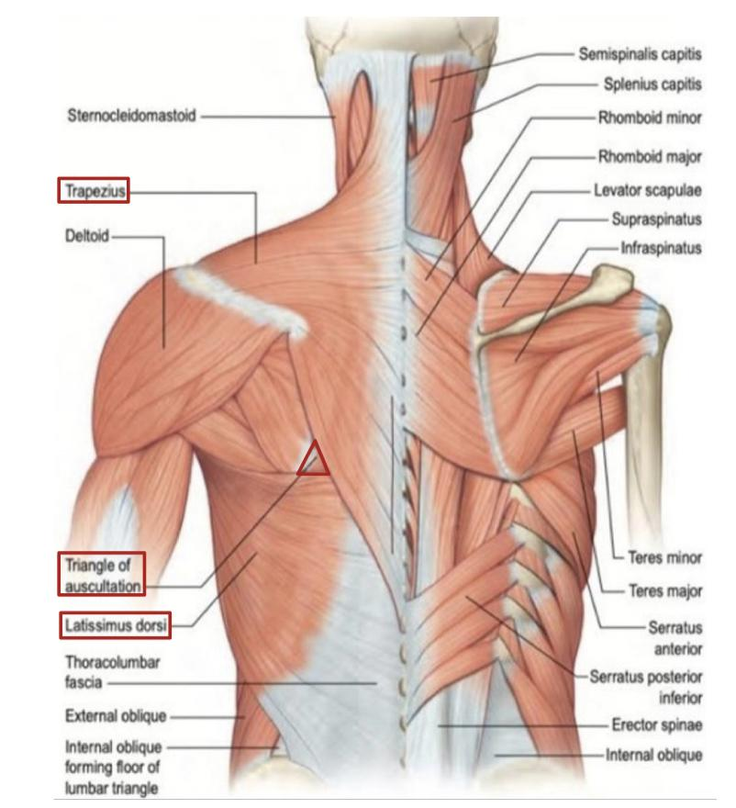
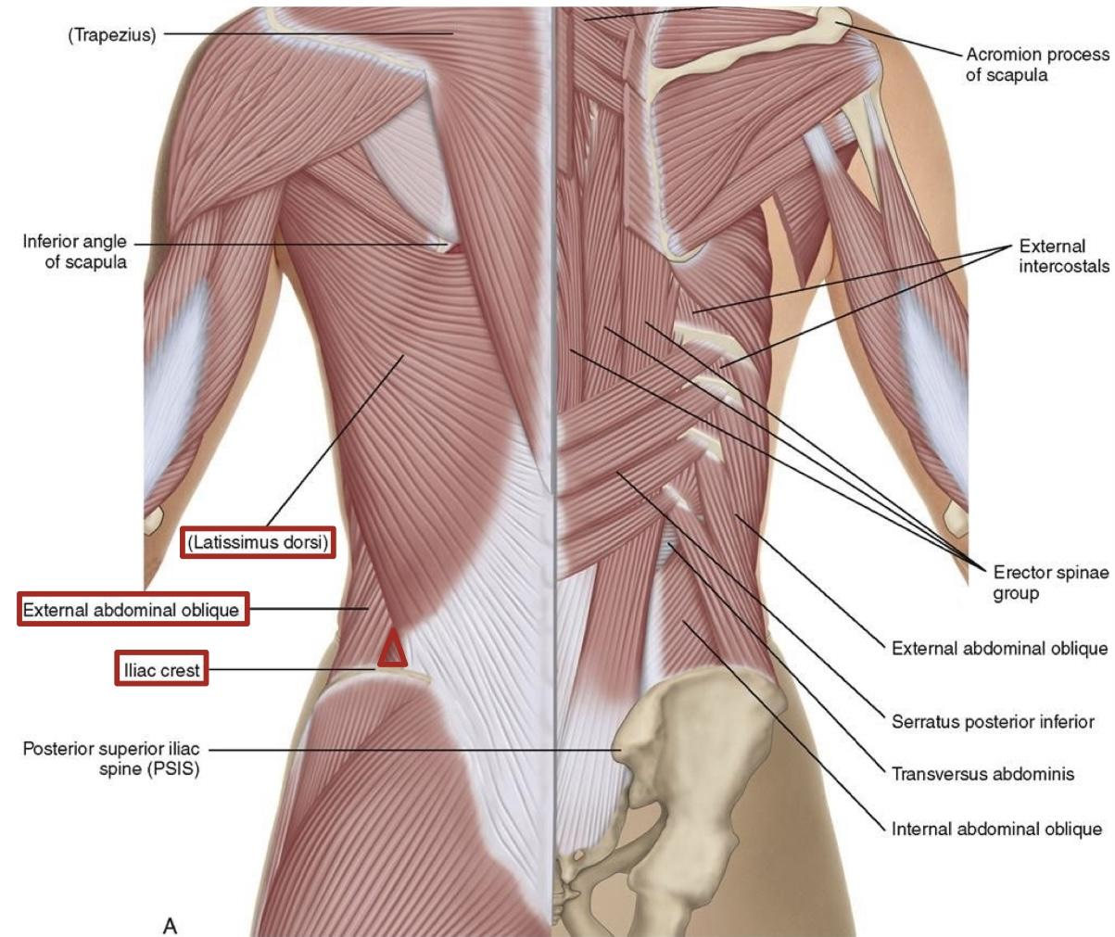
Muscular triangles of back
Auscultatory Triangle:
Lumbar triangle(Triangle of Petit):
Boundaries : يعني وش العضلات اللي تحد هذا المثلث من جميع الجهات
Boundaries :
latissimus dorsi
Trapezius
Medial border of scapula
latissimus dorsi
Posterior border of external oblique muscle of the abdomen
iliac crest
Site : هذا المكان هو افضل مكان يقدر من خلاله الدكتور يسمع الاصوات بوضوح ويكون دايركت للرئتين
Site :
-Site of an abdominal hernia (فتق)
-where pus may emerge from the abdominal wall in extra-abdominal lumbar abscess
Where breath sounds are most easily heard with a stethoscope

Slide 11
Summary
Here is a revision video to show you the origins and insertions for the superficial muscles and intermediate muscles from atlas , done by : Razan alnufaie
Summary : back muscles
Deep group
Intermediate group
Superficial group
Attached to and moves vertebral column
supplied by posterior rami of spinal nerves
Attached to and moves ribs
supplied by anterior rami of spinal nerves
Origin : vertebral column
Insertion : scapula except latissimus dorsi -> humerus
Action : moves scapula
except latissimus dorsi ->moves humerus
Nerve supply : anterior rami of spinal nerves through brachial plexus except trapezius : 11th cranial nerve

Slide 12
Here is a helpful mind map for the whole lecture made by the leader : Razan alnufaie
Click here
Questions from the slides
Q1
Which one of the following muscles of back that rotates the humerus medially ?
A
Trapezius
B
Latissimus dorsi.
C
Rhomboid major.
D
Serratus posterior superior.
Q2
Regarding back muscles, which one of the following statements is correct?
A
All back muscles are supplied by posterior rami of spinal nerves.
B
Muscles of intermediate group move vertebral column.
C
Muscles of superficial group are involved in upper limb movements.
Muscles of deep group serve respiratory functions.
D
Here is another summary that made by Sara alhamlan med441 thanks to her 💙
Click here
1- B
2-C

Slide 13
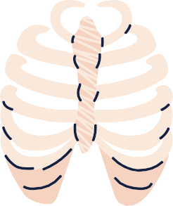
Questions from QBank that done by med441 ,thanks to them
MCQs:
Q3
Which of the following is a superficial (or extrinsic) back muscle?
A
B
C
D
Levator Scapulae
Iliocostalis
Longissimus
Serratus posterior superior
Q4
A 34-year-old woman crashes into a tree during a skiing lesson and is brought to a hospital with multiple injuries that impinge the posterior primary rami of several spinal nerves. Such lesions could affect which of the following muscles?
A
B
C
D
Rhomboid major
Levator scapulae
Iliocostalis
Latissimus dorsi
Q5
Which of the following is supplied by the 11th cranial nerve?
A
B
C
D
Rhomboid major
Trapezius
Latissimus dorsi
None of the above
3-A
4-C
5-B

Slide 14
Done by the amazing team
Team leaders:
Arwa Alghamdi
Deema Aljuribah
Razan Alnufaie
Team leaders:
Mishal Alsuwayegh
Mohammed Alghamdi
Members:
Members:
Aljazi Albabtain
Atheer Alkanhal
Arob Alasheikh
Ajwan Aljohani
Deema alqahtani
Dena Alsuhaibani
Jana Alhazmi
Kadi aldosari
Mashael Alasmari
Noura Bin hammad
Najla aldhbiban
Nouf aldalaqan
Razan alasmari
Roaa alharbi
Raghad Mohammed
Shaden albassam
Waha Almathami
Walaa AlMutawa
Yara Ameer Alalwan
Othman Aldraihem
Faisal Alomar
Abdullah Alturki
Othman Alabdullah
Omar Alkadhi
Abdullah Ali
Meshari Alshathri
Yazeed Alsanad
Fahd Mobaireek
Emad Almutairi
Nasser Alghaith
Saad Almogren
Azzam Abdullah Alotaibi
Hassan Ali Alabdullatif
Rayan Alotaibi
Mohammed Nasser
Luay Almutair
Mohammed Fahad
Mohammed Majed
Abdulkarim Salman
anatomyteam442@gmail.com
Thanks to Faisal Alomar for his design of the team logo

