Slide 1
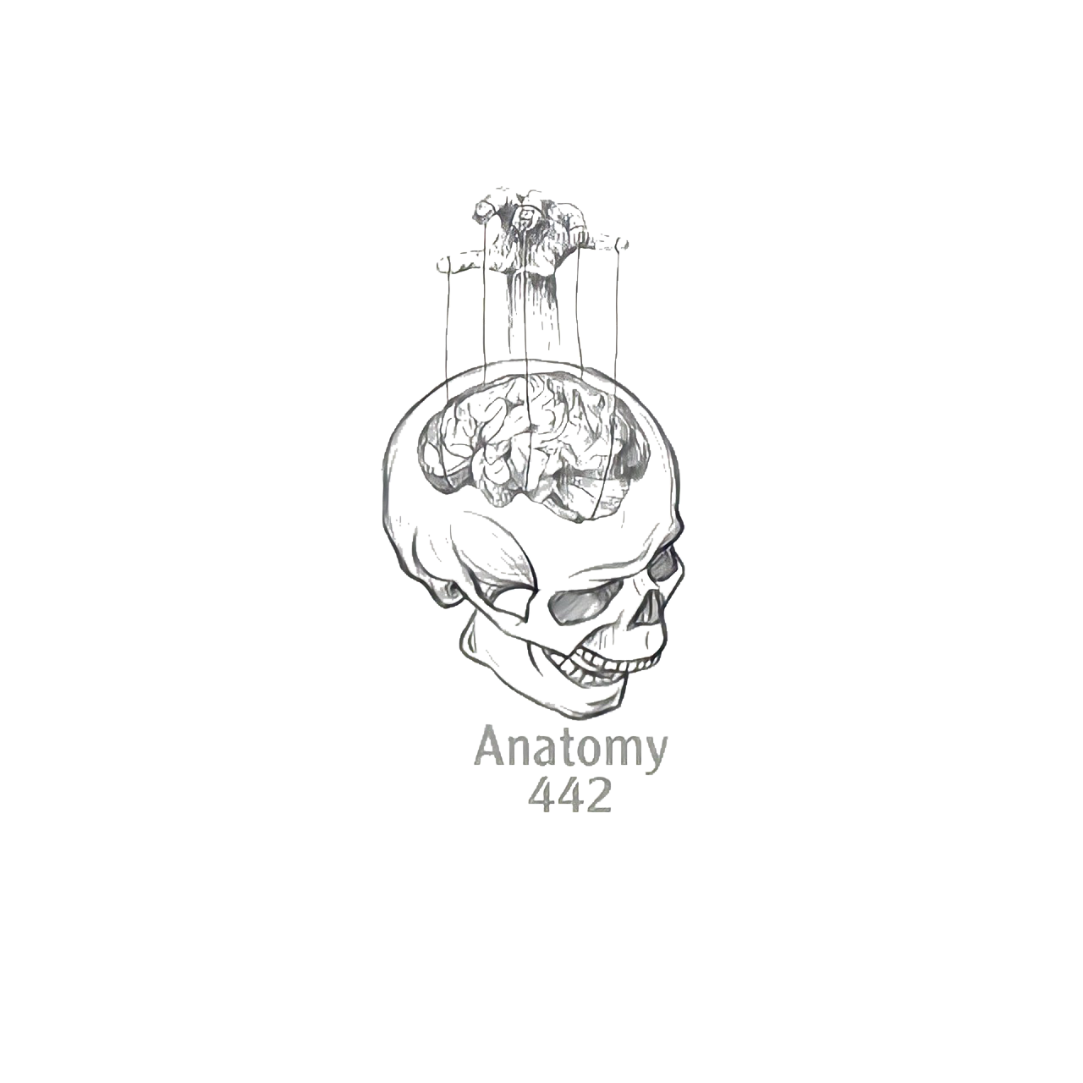
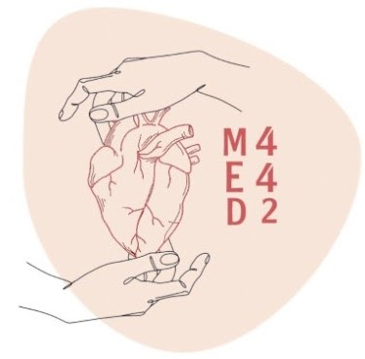
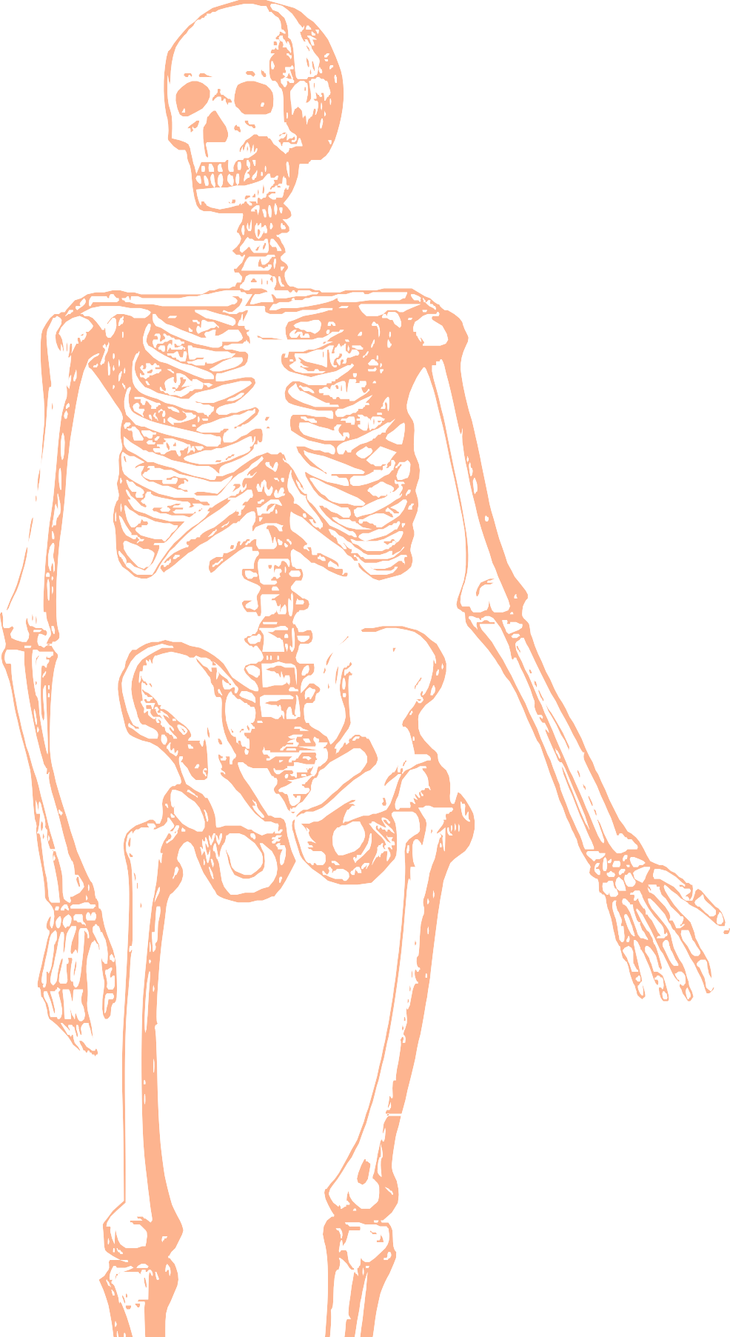
L4
Pectoral Region and Axilla
Editing file
Color index:
Main text
Important
Doctors notes
Female slides only
Male slides only
Extra

Slide 2
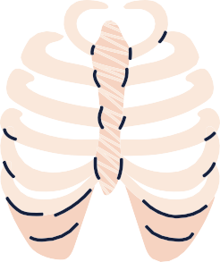
Objectives:
By the end of the lecture the students should be able to :
Identify and describe the muscles of the pectoral region. Pectoralis major.Pectoralis minor, Subclavius, Serratus anterior.
Describe and demonstrate the boundaries and contents of the axilla
Blood supply
Brachial plexus
Clinical significance
Describe the formation of the brachial plexus and its branches.

Slide 3
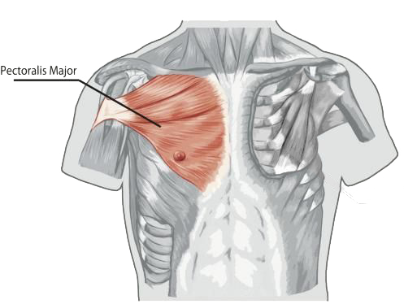
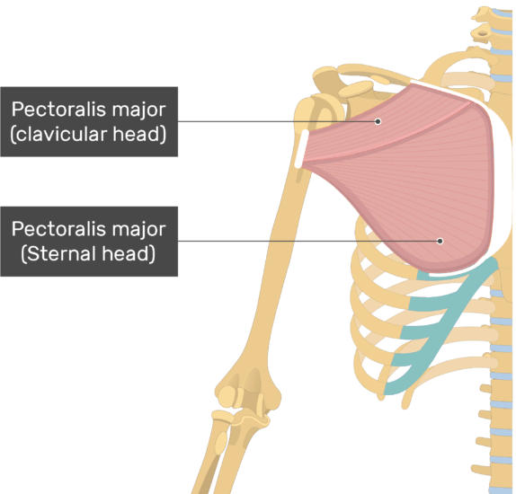
Pectoral Region
Pectoralis Major
+
Most superficial muscle in the pectoral region
Large, fan shaped. Composed of sternal & clavicular heads
Origin | Insertion | Nerve Supply | Action
2 heads: Clavicular head: front medial ½ of clavicle Sternocostal head: Sternum, Upper 6 costal cartilages & Aponeurosis of external oblique muscle | Lateral lip of bicipital groove (Humerus). | Medial (C8&T1) & lateral (C5,6,7) pectoral nerves. | Adduction & medial rotation of the arm. Clavicular head helps in flexion of arm (shoulder)
 |  | - | -

Slide 4
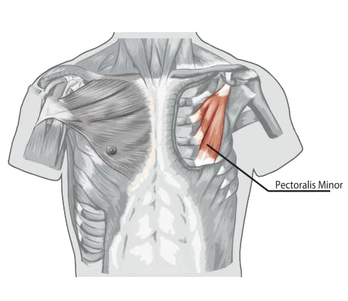
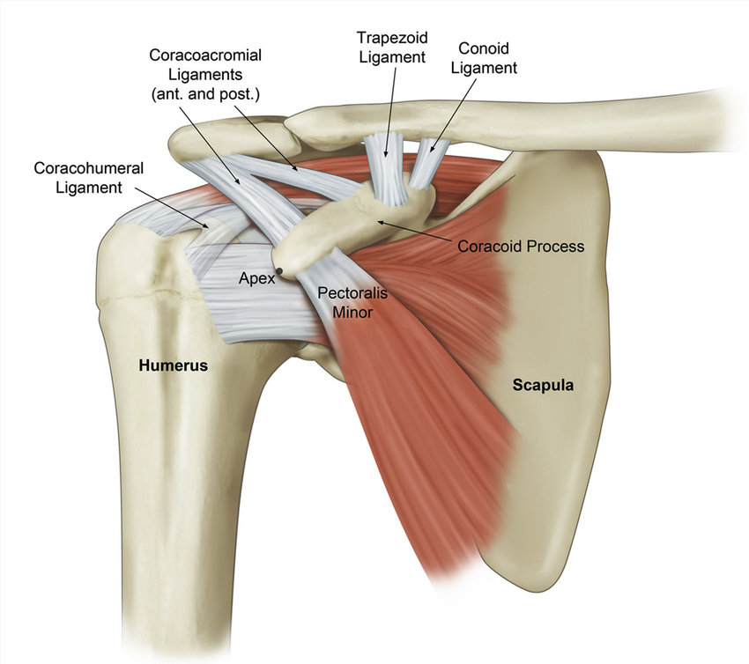
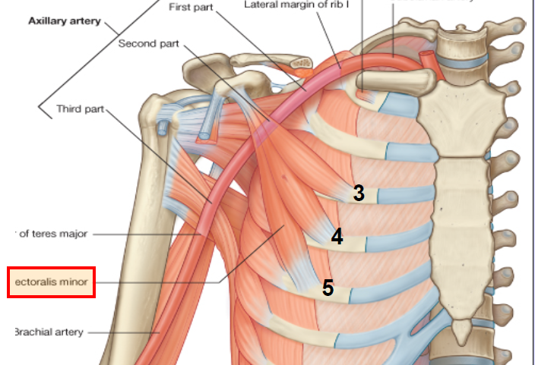
Pectoral Region
Pectoralis Minor
Lies underneath Pectoralis Major
Both of these muscles form part of the anterior wall of the axilla region
( more details in slide 8)
Origin | Insertion | Nerve Supply | Action
From 3rd ,4th, & 5th ribs close to their costal cartilages. | Coracoid process (scapula). | Medial (C8&T1) pectoral nerves. | Depression of the shoulder. Draw the ribs upward and outwards during deep inspiration.
 |  | - | -

Slide 5
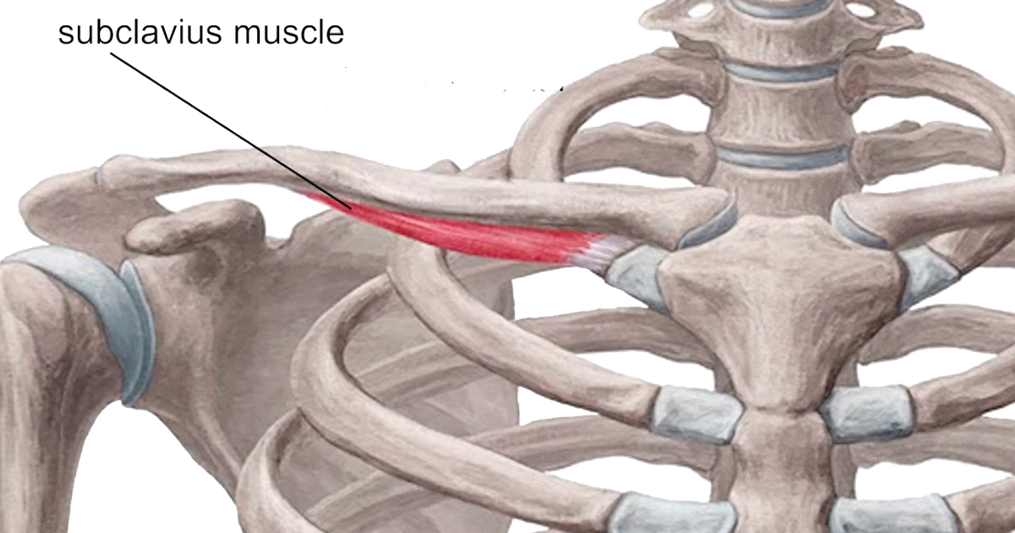
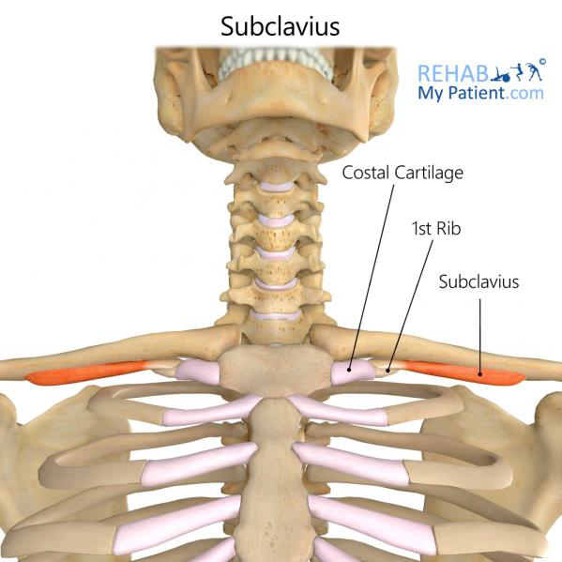
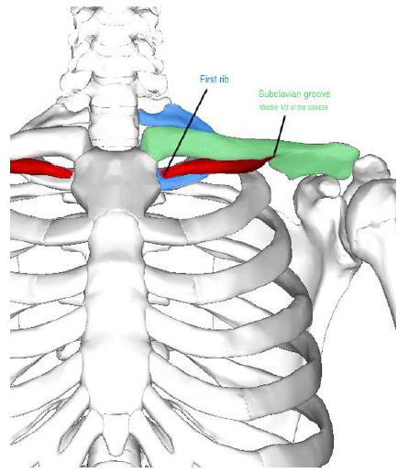
Pectoral Region
Subclavius
Small muscle which lies directly underneath clavicle horizontally
Origin | Insertion | Nerve Supply | Action
1st rib at its costal cartilage (the 1st costochondral junction) | Subclavian groove in the middle 1/3 of inferior surface of clavicle | Nerve to subclavius (C5,6) from upper trunk of brachial plexus. | Fixes the clavicle during movement of shoulder joint
 |  | - | -

Slide 6
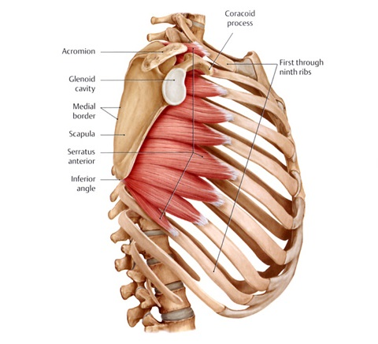
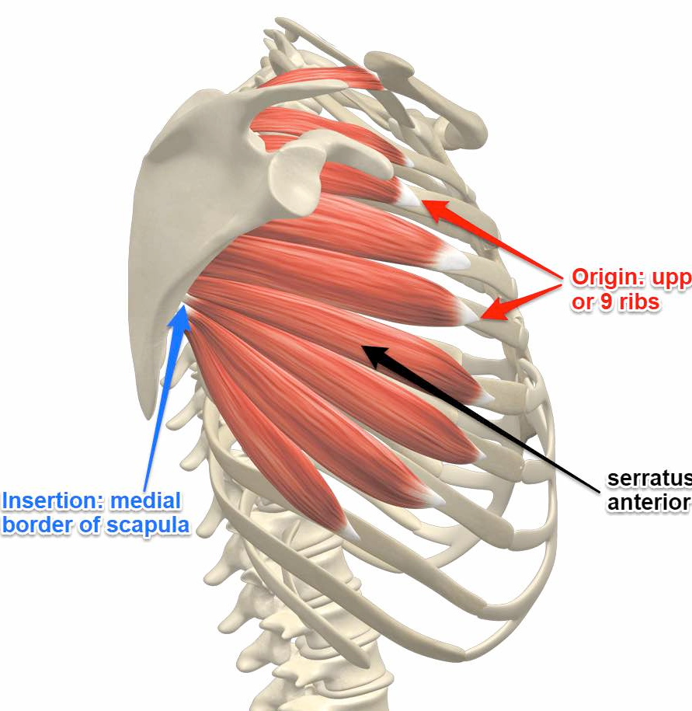
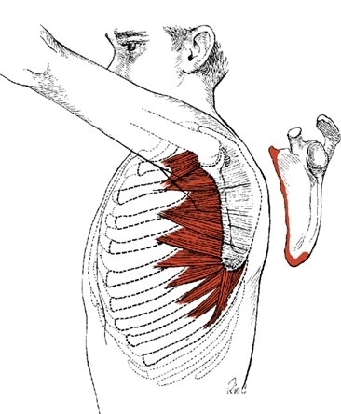
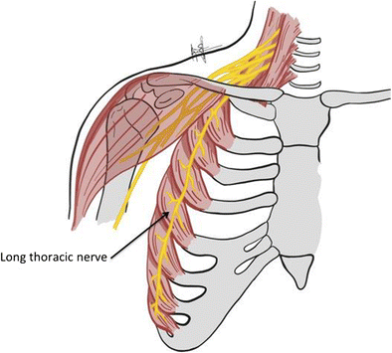
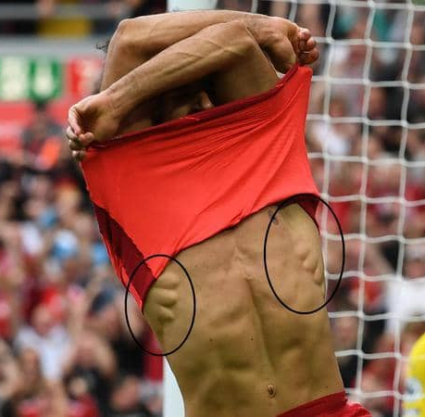
Pectoral Region
Serratus Anterior
It lies more laterally in the chest wall, and forms the
medial border of the axillary region
Origin | Insertion | Nerve Supply | Action
The eight OR nine upper ribs | Anterior aspect of the medial border and inferior angle of scapula | Long thoracic nerve (from roots of brachial plexus,C5,6,7) Mnemonic: SALT (Serratus Anterior Long Thoracic) | Draws the scapula forward in boxing (protrusion or protraction) "boxer's muscle" Rotates scapula outwards in raising the arm above 90 degree (Abduction above 90)
 |  | - | -

Slide 7
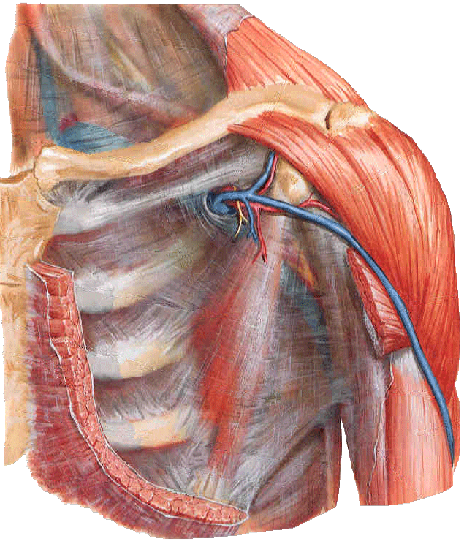
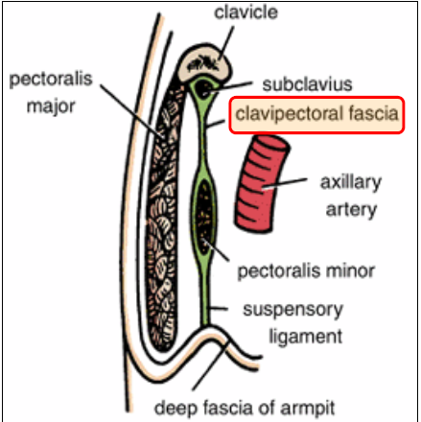
Pectoral Region
Clavipectoral Fascia
Fascia: fibrous connective tissue that can be found throughout the body
They wrap around neurovascular structures, organs & muscles to protect them (تغلفه زي الهدية وتحميه)
Clavipectoral fascia is a bilateral thickened membrane of deep fascia between subclavius & pectoralis minor
Extends superiorly from the clavicle, medially from the costochondral joints and superolaterally from the coracoid process
It’s pierced by: CALL
Cephalic vein
Thoraco-Acromial artery
Lymph vessels
Lateral pectoral nerve
Lymph vessels
Lateral pectoral nerve
Cephalic vein
Thoraco-Acromial artery

Slide 8
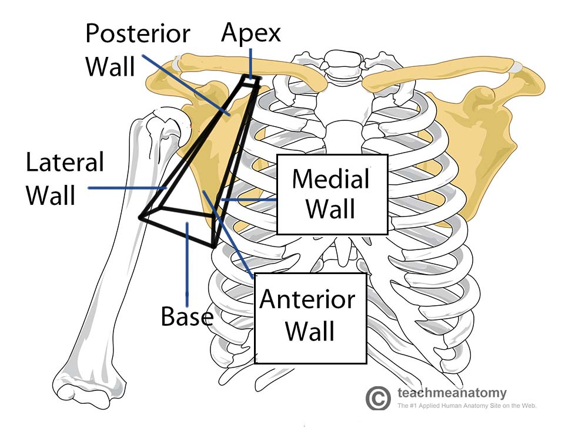
Axilla
Axilla
Axilla is a name given to an area that lies underneath the glenohumeral joint at the junction of the upper limb and the thorax.
Pyramid-shaped space between the upper part of the arm & the side of the chest.
It’s the space (passageway), through which major neuro (brachial plexus), vascular, and muscular structures including long thoracic nerve pass between neck, thorax and upper limbs (enter and leave).
● The Axilla has:
○ Two Boundaries: Apex & Base.
○ Four Walls: Anterior, Posterior, Medial & Lateral.

Slide 9
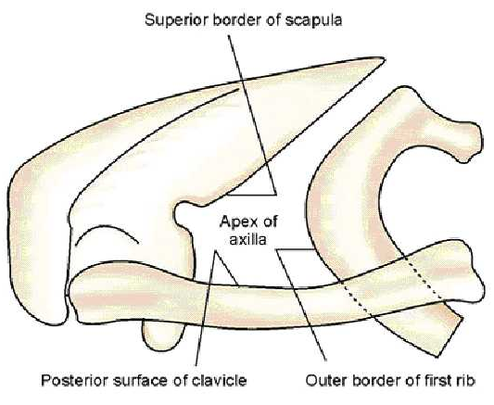
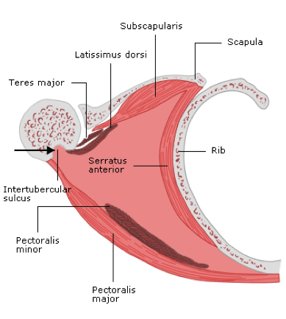
Axilla
Boundaries of Axilla
Apex
Also called Cervicoaxillary Canal
Directed upwards & medially into the root of the neck
It is called cervicoaxillary canal
Bounded by 3 bones:
Anteriorly: clavicle
Posteriorly: upper border of scapula
Medially: outer border of first rib
Base (Floor):
Formed by skin stretching between the anterior & posterior walls
Bounded by:
Front: Anterior Axillary Fold (formed by lower border of the Pectoralis Major)
Behind: Posterior Axillary Fold (formed by tendons of Latissimus Dorsi & Teres Major muscles)
Medially: upper 4 or 5 ribs & chest wall

Slide 10
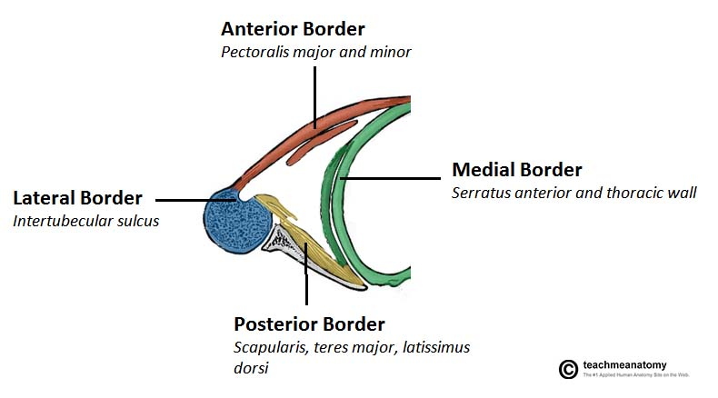
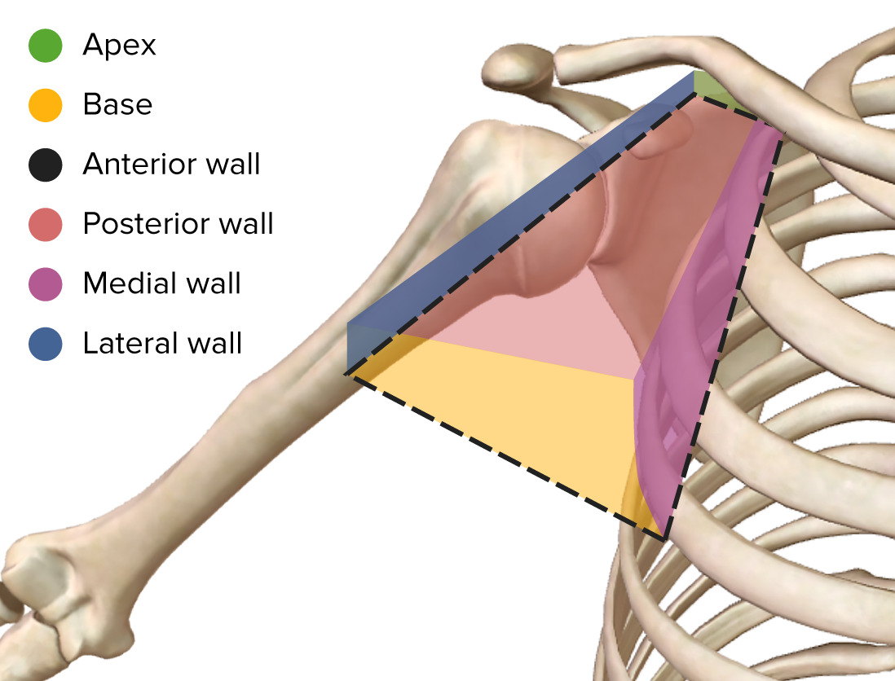
Axilla
Walls of Axilla
Anterior | Posterior | Medial (Wide) | Lateral (Narrow)
Pectoralis Major Pectoralis Minor Subclavius Clavipectoral Fascia | Subscapularis Teres Major Latissimus Dorsi | Serratus Anterior Upper 4-5 ribs & Intercostal | Coracobrachialis Biceps Brachii Bicipital groove of the Humerus

Slide 11
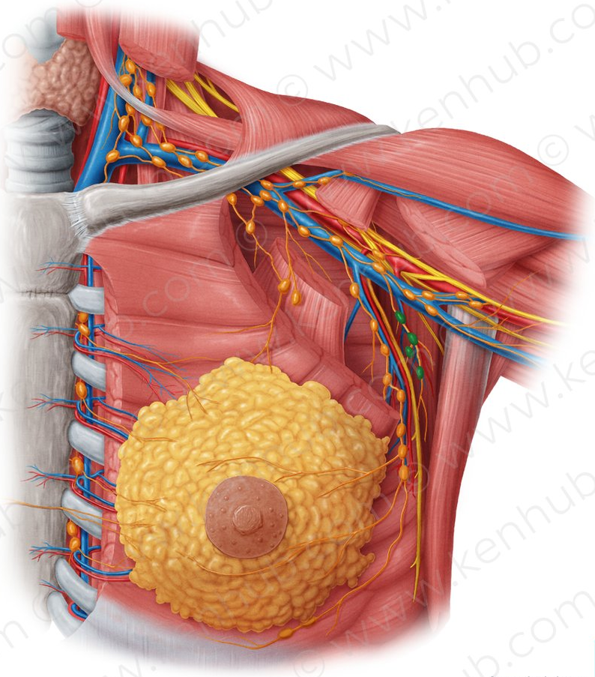
Contents of Axilla
(Important)
Axilla
The neurovascular bundle (the contents of axilla) is enclosed in connective tissue sheath, called “axillary sheath”
Axillary sheath contains: cords & branches of brachial plexus, axillary artery and its branches
Axillary artery: main artery supplying upper limb & its branches
Axillary vein:
main vein draining upper limb
Its two largest tributaries are the cephalic & basilic veins
Brachial plexus: collection of spinal nerves that form peripheral nerves of upper limb (explained later in details)
Axillary lymph nodes:
filter lymph that has drained from upper limb & pectoral region
In women, axillary lymph node enlargement is a non-specific indicator of breast cancer
Biceps brachii & coracobrachialis: these muscle tendons pass through axilla, where they attach coracoid process of scapula
Axillary fat
loose connective tissue

Slide 12
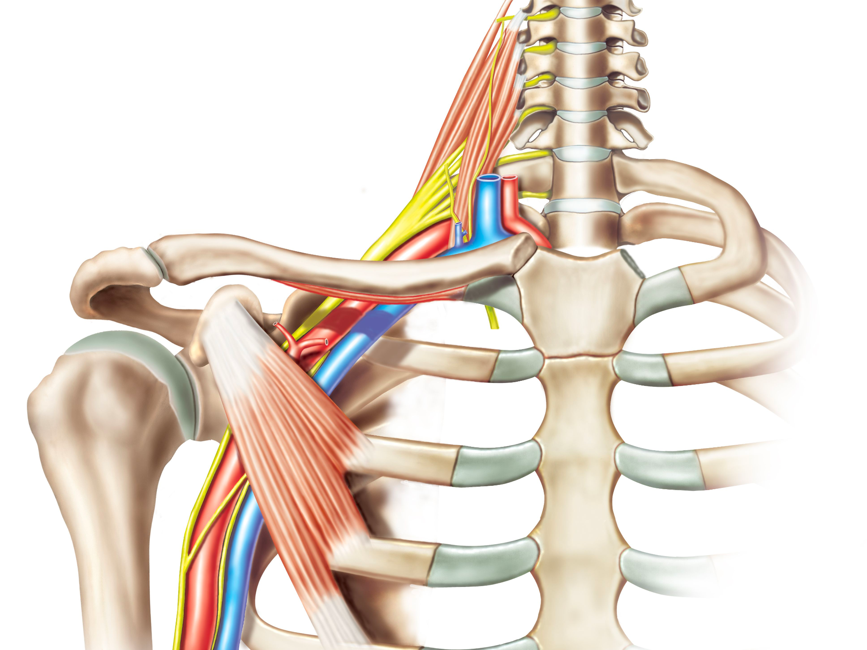
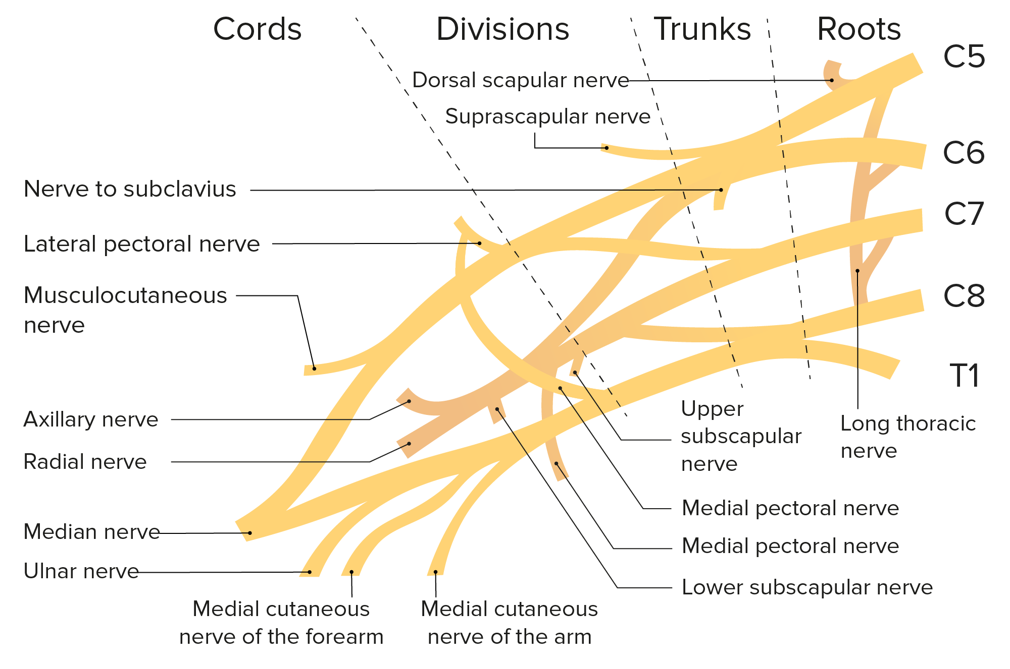
Brachial Plexus
Brachial Plexus
Very important
Definition: network of nerves at root of neck to enter the upper limb
Network of nerve fibers that supply skin & musculature of upper limb
At each vertebral level, paired spinal nerves arise, leaving spinal cord by intervertebral foramina divide into posterior/anterior nerve fibers
Formed by union of anterior rami of C5, C6, C7, C8 AND T1 spinal nerves
C8: indicates a cervical nerve BETWEEN C7&T1
posterior division go on to innervate the skin & musculature of the trunk.
Location: Posterior triangle of the neck and axilla
Divided into 5 stages:
Roots
Trunks
Divisions: behind clavicle (cervico-axillary canal)
Cords
Branches
in posterior triangle of the neck
in axilla

Slide 13
Brachial Plexus
Brachial Plexus
C5
Musculocutaneous
Roots of C5 & C6 unite
to form Upper trunk
Anterior
Upper trunk
Lateral
Cord
C6
Posterior
Axillary
Anterior
C7
Root of C7 continues
as the Middle trunk
Middle trunk
Posterior
Cord
Median
Posterior
Radial
C8
Posterior
Roots of C5 & C6 unite to
form Lower trunk
Lower trunk
T1
Anterior
Medial
Cord
Ulnar
Each trunk will branch into anterior & posterior divisions
The anterior divisions of the upper and middle trunks unite to form the lateral cord
The anterior division of the lower trunk continues as the medial cord
All posterior divisions of three trunks join to form the posterior cord
If roots are injured the extent of damage is greater

Slide 14
Brachial Plexus
Brachial Plexus
BRANCHES
FROM ROOTS | FROM TRUNKS | FROM CORDS
 |  | 3 LATERAL CORDS | 5 MEDIAL CORDS | 5 Posterior CORDS
Dorsal scapular nerve 9 (C5) Long thoracic nerve ( C5,6,7) | Suprascapular nerve (C5,6) Nerve to subclavius muscle (C5,6) | Musculocutaneous nerve Lateral pectoral nerve. Median nerve (lateral root) | Ulnar nerve Median nerve Medial pectoral nerve Medial cutaneous nerve of arm. Medial cutaneous nerve of forearm | Axillary nerve Radial nerve Upper subscapular nerve Lower subscapular nerves Thoracodorsal
MNEMONICS(thanks to team 433).
● Lateral cord branches, (LLM): LUCY LOVES ME
Lateral pectoral nerve, Lateral root of the median nerve,Musculocutaneous nerve.
● Medial cord branches, (MMUM): Most men use morphine
Medial pectoral, Medial cutaneous nerve of arm and forearm, Ulnar, Medial root of the median
nerve.
● Posterior cord branches, (STAR).
Subscapular(upper & lower), Thoracodorsal, Axillary, Radial

Slide 15
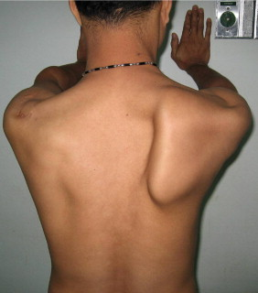
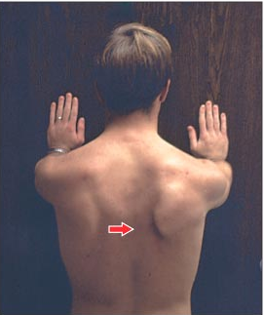
Brachial Plexus
Winging of Scapula
One of the actions of the serratus anterior is to hold the scapula against the rib cage
if the long thoracic nerve is damaged serratus anterior paralysed specific clinical sign is produced
Lesion of long thoracic nerve (C5,6,7), - which supplies SERRATUS ANTERIOR - causes backward projection of medial border of scapula
In cases such as this, the scapula is no longer held against the rib cage protrudes out of the back
This deformity is called Winging of scapula
Long thoracic nerve palsy is thought to most commonly occur from traction injuries, where the upper limb is stretched violently

Slide 16
In boys slides only
Doctor skipped this slide
MUSCULOCUTANEOUS
NERVE
AXILLARY NERVE
▪ Roots: C5, C6, C7.
▪ Motor Functions: Innervates the following muscles:
• Brachialis
• Biceps brachii
• Coracobrachialis
▪ Sensory Functions: Gives off the lateral cutaneous
branch of the forearm, which innervates the lateral half of the anterior forearm, and a small lateral portion of the posterior forearm.
▪ Roots: C5 and C6.
▪ Motor Functions: Innervates the following muscles:
• Teres minor
• Deltoid
▪ Sensory Functions: Gives off the superior lateral
cutaneous nerve of arm, which innervates the inferior region of the deltoid (“regimental badge area”).

Slide 17
In boys slides only
Doctor skipped this slide
MEDIAN NERVE
RADIAL NERVE
▪ Roots: C5 – T1.
▪ Motor Functions: Innervates the following muscles:
• Most of the flexor muscles in the forearm.
• The thenar muscles.
• The two lateral lumbricals that move the index and middle
fingers.
▪ Sensory Functions: Gives off the palmar cutaneous branch,
which innervates the lateral part of the palm, and the digital
cutaneous branch, which innervates the lateral three and a
half fingers on the anterior (palmar) surface of the hand.
▪ Roots: C5-C8 and T1.
▪ Motor Functions: Innervates the following muscles:
• The triceps brachii
• The extensor muscles in the posterior compartment of the forearm
▪ Sensory Functions: Gives off the palmar cutaneous branch,
which innervates the lateral part of the palm, and the digital cutaneous branch, which innervates the lateral three and a half fingers on the anterior (palmar) surface of the hand.

Slide 18
In boys slides only
ULNAR NERVE
Doctor skipped this slide
▪ Roots: C8 and T1.
▪ Motor Functions: Innervates the following muscles:
• The muscles of the hand (apart from the thenar muscles and two
lateral lumbricals)
• Flexor carpi ulnaris
• Medial half of flexor digitorum profundus
▪ Sensory Functions: Innervates the anterior and posterior
surfaces of the medial one and half fingers, and associated
palm area.

Slide 19
In boys slides only
BRACHIAL PLEXUS INJURY
Doctor skipped this slide
▪ Minor damage often occurs during contact sports such as football or wrestling when
the brachial plexus nerves get stretched or compressed.
▪ These are called stingers or burners, and can produce the following symptoms:
• A feeling like an electric shock or a burning sensation shooting down your arm.
• Numbness and weakness in your arm.
▪ More severe symptoms result from injuries that seriously injure or even tear or rupture
the nerves.
▪ The most serious brachial plexus injury (avulsion) occurs when the nerve root is torn
from the spinal cord.
▪ Signs and symptoms of more severe injuries can include:
• Weakness or inability to use certain muscles in your hand, arm or shoulder. • Complete lack of movement and feeling in your arm, including your shoulder and hand. • Severe pain.

Slide 20
MCQs:
Which of the following structures make up the anterior wall of the axilla?
Q1
A
B
C
D
Subclavius
Biceps brachii
Latissimus dorsi
Subscapularis
Q2
The brachial plexus is formed by?
A
C
C5-T1 spinal nerves
C5-T1 dorsal rami
C5-T1 ventral rami
C5-T1 dorsal roots
B
D
Q3
Brachial plexus roots of C5 & C6 unite to form?
A
B
C
D
Middle trunk
Upper trunk
Lower trunk
B&C
Q4
Action of Serratus anterior?
1- D
2- C
3- B
4- B
A
Draws the scapula forward
B
Draws the scapula outward
C
flexion of elbow
D
extension of elbow
Special thanks for 441 QBank!

Slide 21
MCQs:
Apex of axilla is bounded by?
Q5
A
B
C
D
4 bones
3 bones
2 bones
5 bones
Q6
All of the following branches originate from the lateral cords except for?
A
C
Lateral pectoral nerve
Ulnar nerve
Musculocuteaneous nerve
Median nerve
B
D
Q7
Winging of scapula can be caused by ?
A
Damage of axillary nerve
B
Damage of thoracodorsal nerve
C
Damage of long thoracic nerve
D
B&C
Q8
Where cords can be found ?
A
B
in anterior triangle of the neck
5- B
6- B
7- C
8- A
in posterior triangle of the neck
D
In axilla
B
C
Behind clavicle
Special thanks for 441 QBank!

Slide 22
Done by the amazing team
Team leaders:
Arwa Alghamdi
Deema Aljuribah
Razan Alnufaie
Team leaders:
Mishal Alsuwayegh
Mohammed Alghamdi
Members:
Members:
Aljazi Albabtain
Atheer Alkanhal
Arob Alasheikh
Ajwan Aljohani
Deema alqahtani
Dena Alsuhaibani
Farah alqazlan
Jana Alhazmi
Kadi aldosari
Mashael Alasmari
Noura Bin hammad
Najla aldhbiban
Nouf aldalaqan
Razan alasmari
Roaa alharbi
Raghad Mohammed
Shaden albassam
Waha Almathami
Walaa AlMutawa
Yara Ameer Alalwan
Othman Aldraihem
Faisal Alomar
Abdullah Alturki
Othman Alabdullah
Omar Alkadhi
Abdullah Ali
Meshari Alshathri
Yazeed Alsanad
Fahad Mobaireek
Emad Almutairi
Nasser Alghaith
Saad Almogren
Azzam Abdullah Alotaibi
Hassan Ali Alabdullatif
Rayan Alotaibi
Mohammed Nasser
Mohammed Fahad
Mohammed Majed
Abdulkarim Salman
Saleh Aldeligan
anatomyteam442@gmail.com
Thanks to Faisal Alomar for his design of the team logo

