Slide 1
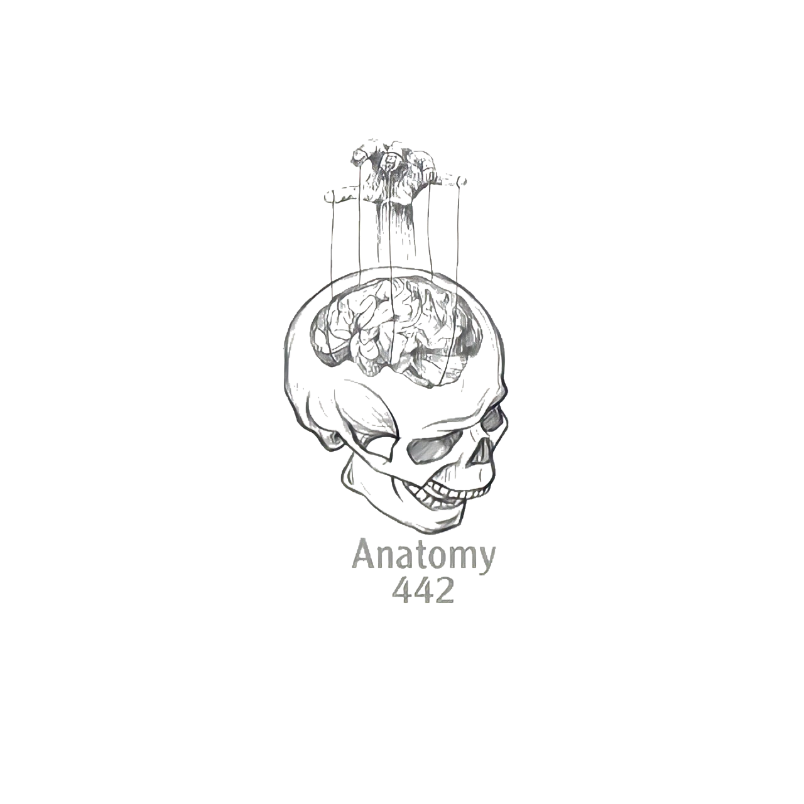
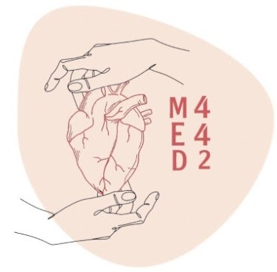
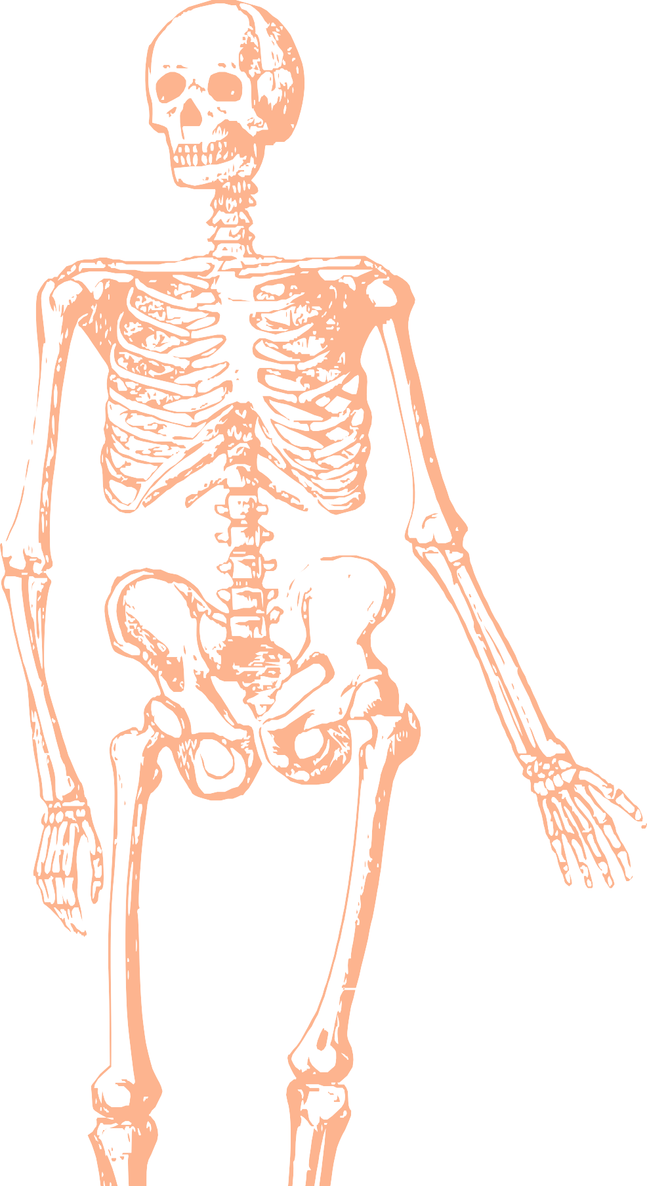
L5
Axillary and Median Nerve
Editing file
Color index:
Mine text
Important
Doctors notes
Female slides only
Male slides only
Extra

Slide 2
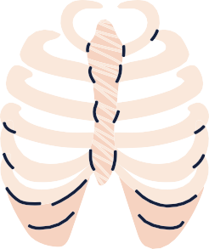
Objectives -
By the end of the lecture, you should be able to:
• Describe the origin, course, relations, branches and distribution of the axillary & median nerves.
• Describe the common causes, signs and effect of lesion to the axillary and median nerves.

Slide 3
In Boys’ Slides
Introduction to the Axillary Nerve
▪ The axillary nerve is a major peripheral nerve of the upper limb.
▪ It is formed within the axilla area of the upper limb.
▪ It is a direct continuation of the posterior cord from the brachial plexus, and therefore contains fibers from the C5 and C6 nerve roots.
▪ In the axilla, the axillary nerve is located posterior to the axillary artery and anterior to the subscapularis muscle.
▪ It exits the axilla at the inferior border of subscapularis via the quadrangular space, often accompanied by the posterior circumflex humeral artery and vein.
The only one of the five nerves to end in the arm, (Musculocutaneous, Axillary, Median, Radial, and Ulnar).

Slide 4
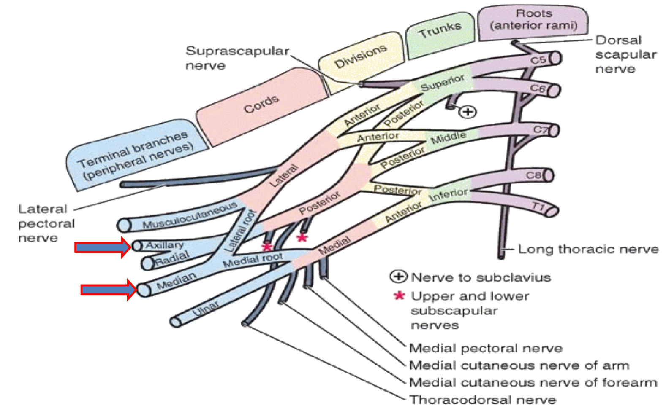
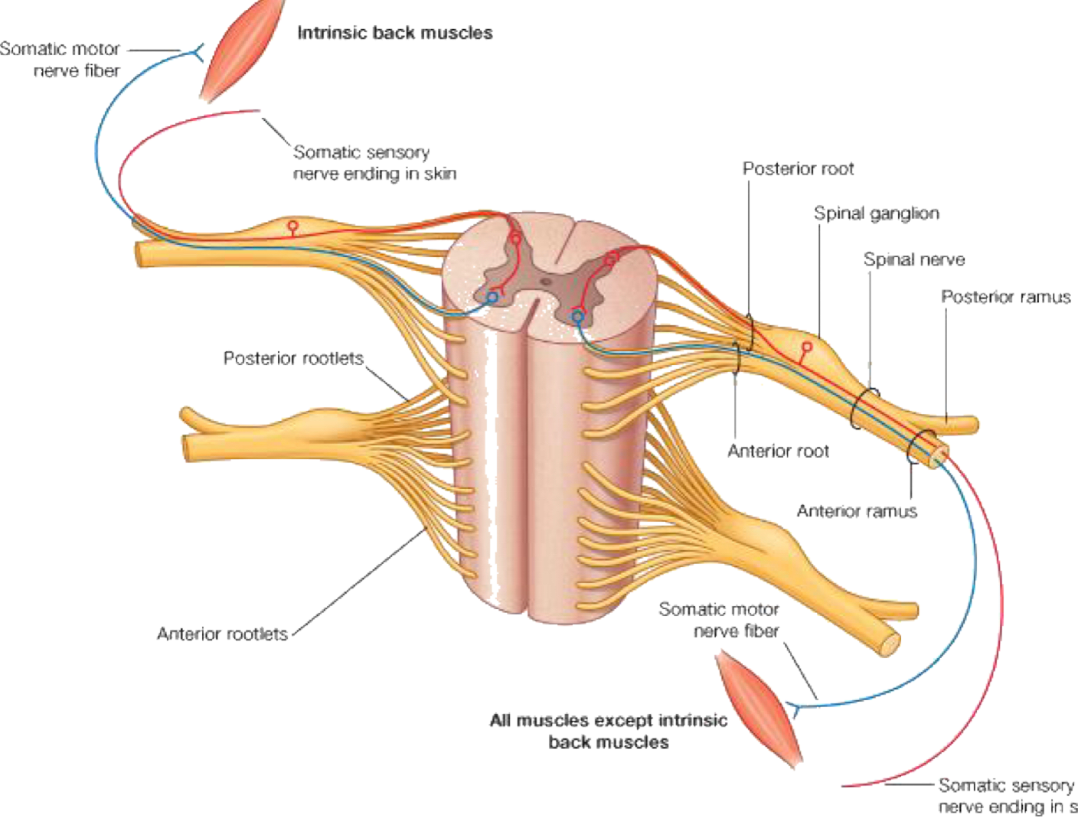
The Brachial Plexus
We are going to cover these two in this lecture
Axillary Nerve
Origin: (C5 & C6)
• Posterior cord of brachial plexus.
Course:
• It passes inferiorly and laterally along the posterior wall of the axilla, then it exits the axilla
• It then passes posteriorly around the surgical neck of the humerus
• It is accompanied by posterior circumflex humeral artery.

Slide 5
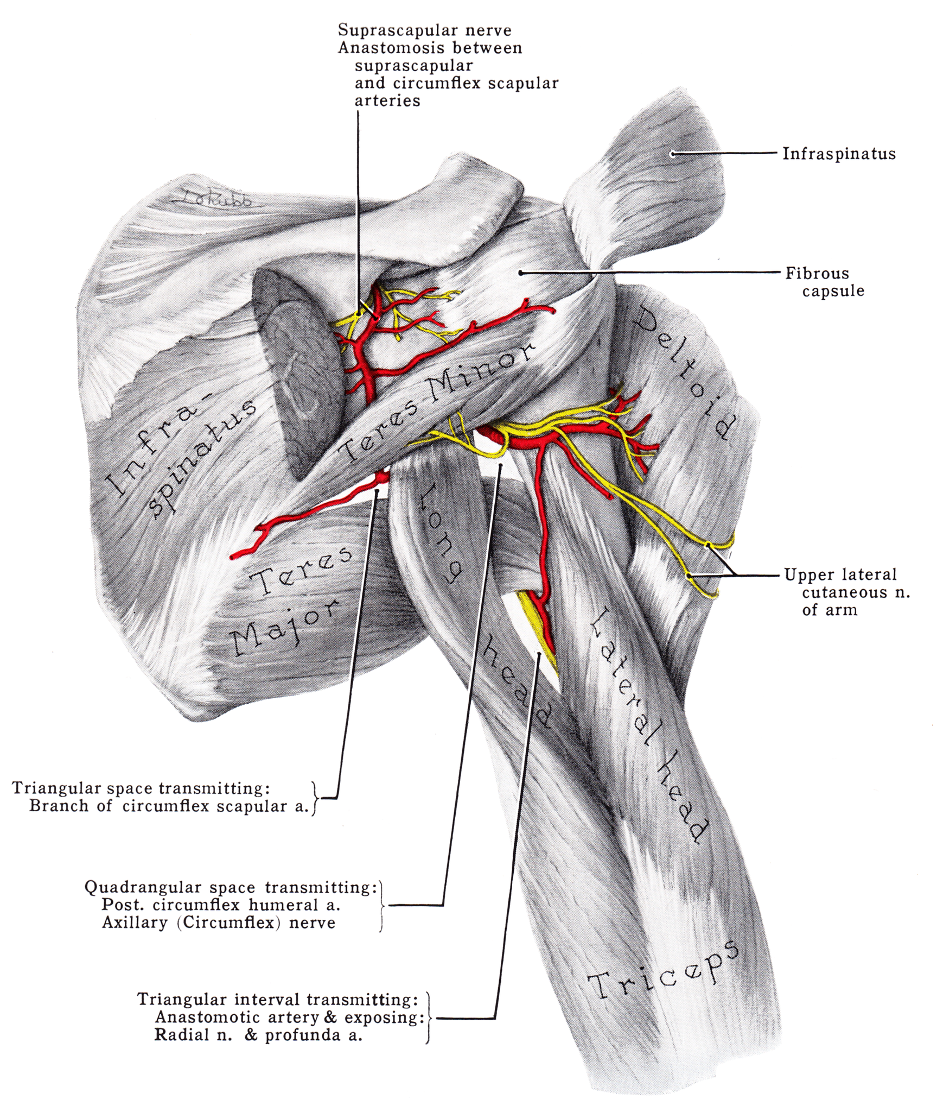
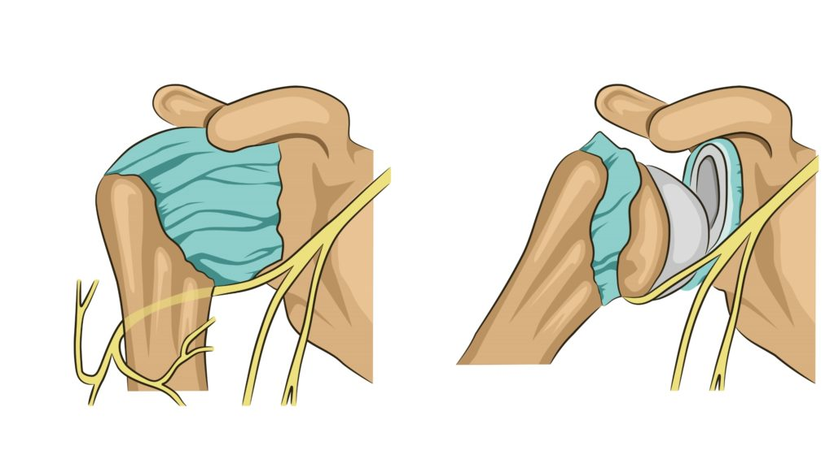
Branches
• Motor: to deltoid and teres minor muscles.
• Sensory: superior lateral cutaneous nerve of the arm that loops around the posterior margin of the deltoid muscle to innervate skin in that region.
Axillary Nerve Lesion
The axillary nerve is usually injured due to:
1- Fracture of surgical neck of the humerus.
2- Downward dislocation of the shoulder joint
3- Compression from the incorrect use of crutches.

Slide 6
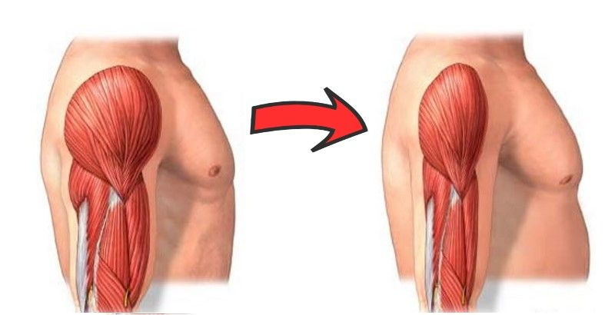
Effects of Axillary Nerve Lesion:
Motor:
• Paralysis of the deltoid and teres minor muscles.
• Impaired abduction of the shoulder (30-90̊).
• The paralyzed deltoid wastes rapidly.
• As the deltoid atrophies, the rounded contour of the shoulder is
flattened compared to the uninjured side.
Sensory:
• Loss of sensation over the lateral side of the proximal part of the arm.
helpful video

Slide 7
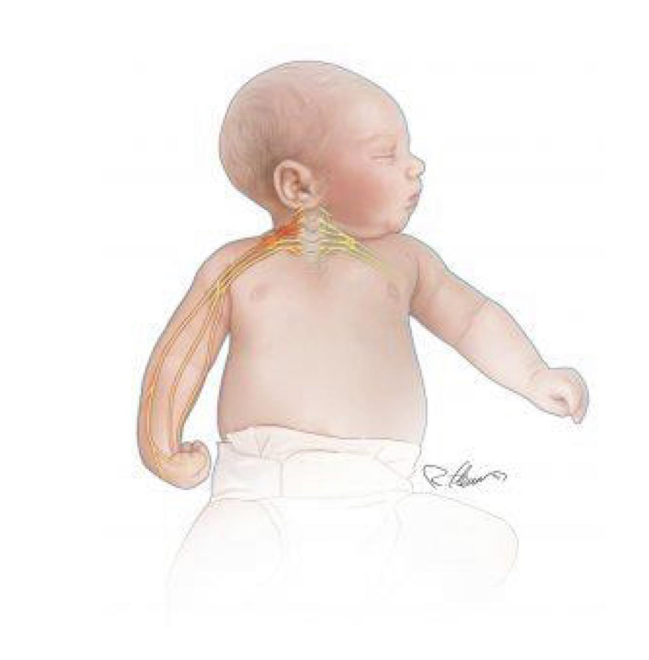
In Boys’ Slides
Erb’s palsy
▪ It is a condition resulting from damage to C5-C6 roots of
the brachial plexus.
▪ The axillary nerve is affected, and the individual is usually
unable to abduct or externally rotate the shoulder joint.
▪ It commonly occurs where there is an excessive increase
in the angle between the neck and shoulder, which
stretches (or even tears) the nerve roots.

Slide 8
In Boys’ Slides
Introduction to the Median Nerve
▪ The median nerve is a major peripheral nerve of the upper limb.
▪ It is derived from the medial and lateral cords of the brachial plexus.
▪ It contains fibers from roots C6-T1 and can contain fibres from C5 in some individuals.
▪ After originating from the brachial plexus in the axilla, the median nerve descends to the arm, lateral to the brachial artery.
▪ The median nerve enters the anterior compartment of the forearm via the cubital fossa.

Slide 9
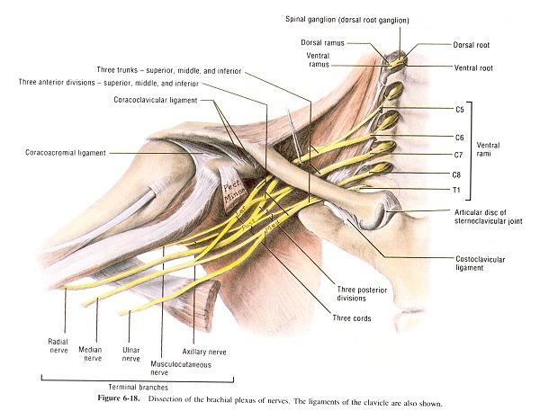
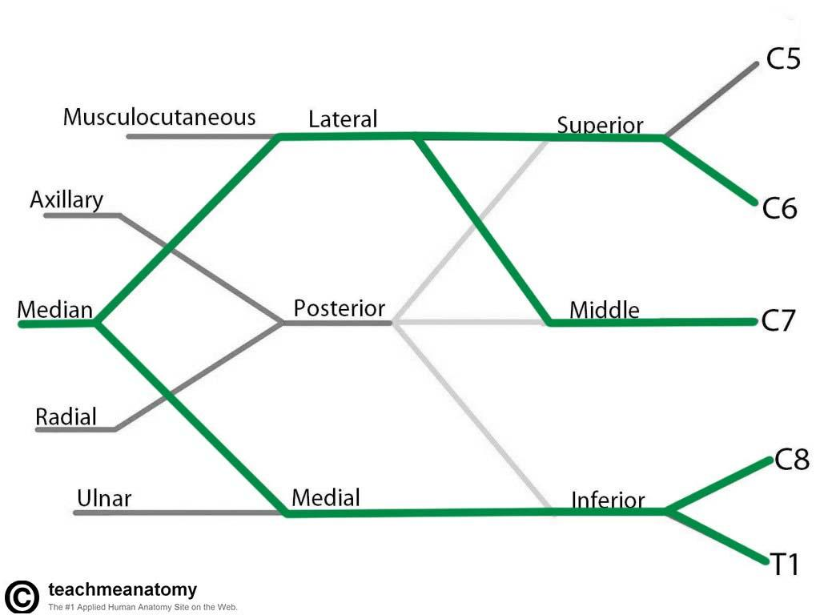
Median nerve
origin
(C5,C6,C7, C8, T1) Posterior cord of brachial plexus
-Course: the median nerve is formed anterior to the third part of the axillary artery by the union of lateral and medial roots originating from the lateral and medial cords of the brachial plexus..
- The lateral root (C5,6&7), arises from the lateral cord of the brachial plexus.
- The medial root (C8 & T1), arises from the medial cord of the brachial plexus.

Slide 10
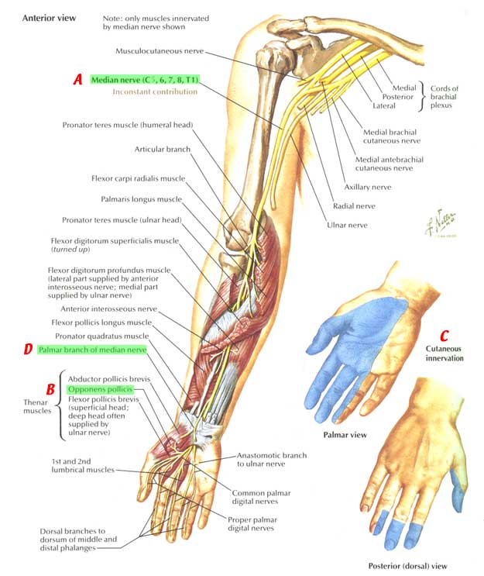
Median Nerve
In the Arm
● It enters the arm from the axilla at the inferior margin of the teres major muscle.
● It passes vertically down the medial side of the arm in the anterior compartment and is related to the brachial artery throughout its course:
In proximal regions, (in upper ½ of the arm) it lies immediately lateral to the brachial artery.
In more distal regions (in the middle of the arm) it crosses *the artery from lateral to medial* to the medial side of the brachial artery, and lies anterior to the elbow joint.
Note
The median nerve has no major branches in the arm, but a branch to one of the muscles of the forearm, the pronator teres muscle
This branch may originate from the nerve immediately proximal to the elbow joint.

Slide 11
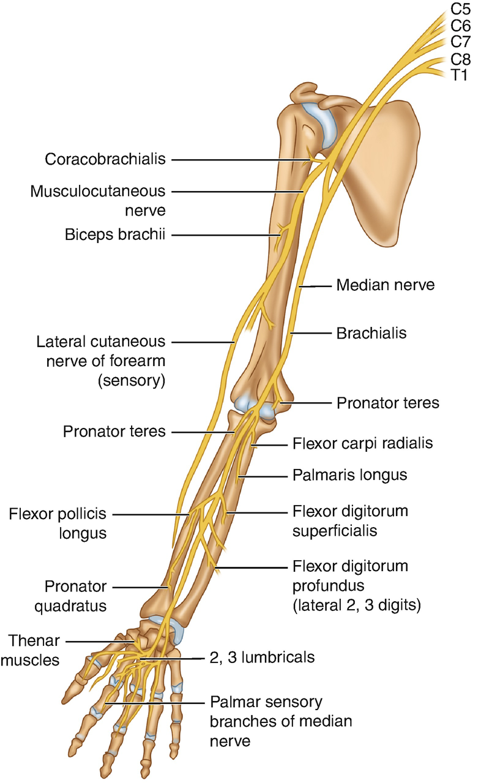
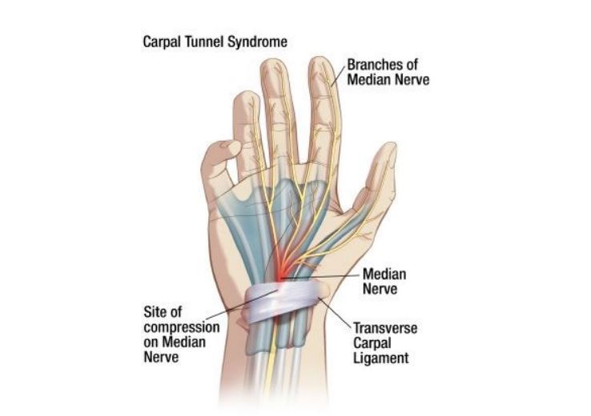
Median Nerve
In the Forearm
In the Hand
● Median nerve passes into the forearm anterior to the elbow joint, (between the 2 heads of pronator teres) where it innervates most of the muscles in the anterior compartment of the forearm (6.5 muscles)
Except the:
Flexor Carpi Ulnaris (note that it’s ulnaris NOT radials)
The medial half of the Flexor Digitorum Profundus
which are innervated by the ulnar nerve
The median nerve continues into the hand by passing deep to the flexor retinaculum.
It innervates:
Three thenar eminence muscles associated with the thumb.
Lateral two lumbrical muscles associated with movement of the index and middle finger.
Skin over the palmar surface of the lateral three and one-half digits and over the lateral side of the palm and middle of the wrist. It is associated with the thumb, index, middle, and half of the ring finger

Slide 12
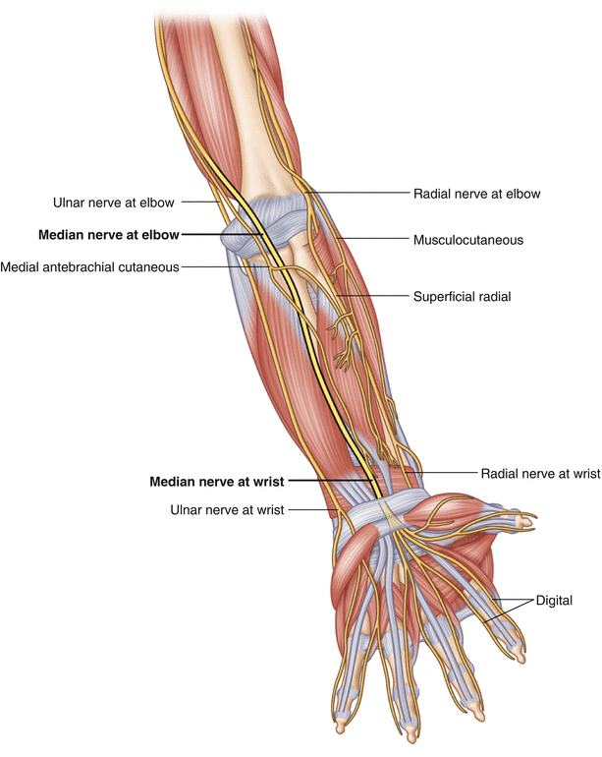
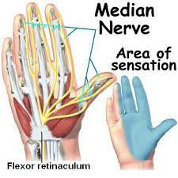
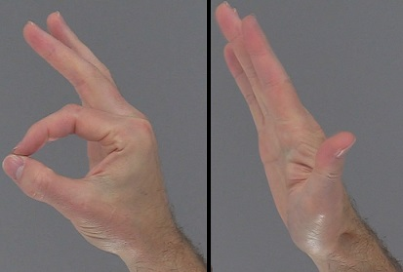
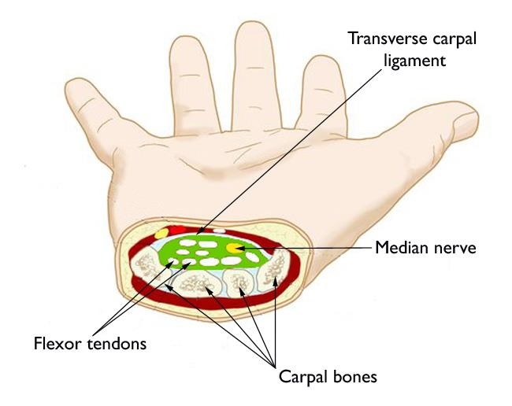
Median Nerve Lesions
Injury of the median nerve at different levels causes different syndromes.
In the arm and forearm the median nerve is usually not injured by trauma, why?
Because of its relatively deep position.
Site of Damage
Most Serious Disabilities
In the elbow region (supracondylar fracture of the humerus)
At the wrist above the flexor retinaculum
In the carpal tunnel (deep in the flexor retinaculum)
● Loss of opposition of the thumb. The delicate pincer-like action is not possible.
● Loss of sensation from lateral 3 ½ fingers & lateral ⅔ of the palm.

Slide 13
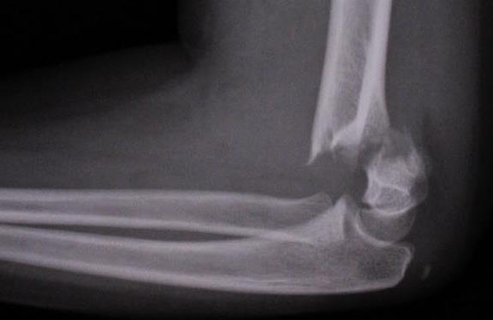
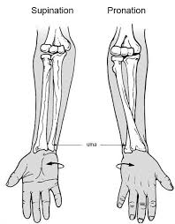
Median Nerve Lesions
Lesion | About | Effects
 |  | Motor | Sensory & Trophic
Median Nerve Lesion in the Elbow Region | Damaged in supracondylar fracture of humerus. Muscles affected are: ● Pronator muscles of the forearm (they will always be supinated) ● All long flexors of the wrist and fingers except flexor carpi ulnaris and medial half of flexor digitorum profundus. | Loss of pronation. Hand is kept in supine position. Wrist shows weak flexion, and ulnar deviation. Loss of flexion on the interphalangeal joints of the index and middle fingers. Weak flexion of ring and little fingers. Thumb is adducted and laterally rotated, with loss of flexion of terminal phalanx and loss of opposition. Wasting of thenar eminence. Hand looks flattened and “apelike”,and presents an inability to flex the three most radial digits when asked to make a fist. | Sensory: Loss of sensation from: ● The radial side of the palm. ● Palmar aspect of the lateral 3½ fingers. ● Distal part of the dorsal surface of the lateral 3½ fingers. Trophic Changes: ● Dry and scaly skin ● Easily cracking nails ● Atrophy of the pulp of the fingers.

Slide 14
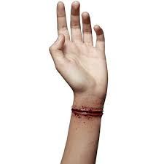
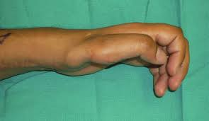
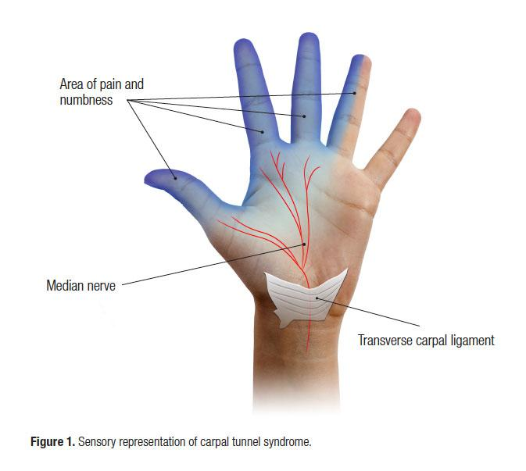
Median nerve Lesions
Lesion | About | Effects
 |  | Motor | Sensory & Tropic
Median Nerve Lesion at the Wrist | Often injured by penetrating wounds (stab wounds or broken glass) of the forearm. | Thenar muscles are paralyzed and atrophy happens with time so that the thenar eminence becomes flattened. Opposition and abduction of thumb are lost, and thumb and lateral two fingers are arrested in adduction and hyperextension position. “Apelike hand” | Same as in elbow region Sensory: Loss of sensation from: ● The radial side of the palm. ● Palmar aspect of the lateral 3½ fingers. ● Distal part of the dorsal surface of the lateral 3½ fingers. Trophic Changes: ● Dry and scaly skin ● Easily cracking nails ● Atrophy of the pulp of the fingers
Median Nerve Lesion deep in flexor retinaculum “Carpal Tunnel Syndrome” | The most common neurological problem associated with the median nerve is the compression beneath the flexor retinaculum at the wrist. | Weak motor function of thumb, index & middle fingers. | Sensory: Burning pain or ‘pins and needles’ along the distribution of median nerve to lateral 3½ fingers. No sensory changes over the palm as the palmar cutaneous branch is given before the median nerve enters the carpal tunnel.

Slide 15
MCQs:
Which of the following is formed of the posterior divisions of the three trunks ?
Q1
A
B
C
D
Axillary nerve
Ulnar nerve
Median nerve
Musculocutaneous nerve
Q2
A syndrome caused by the excessive increase of the angle between neck and shoulder common in infants ?
A
C
Carpal tunnel
saturday night palsy
Erb’s palsy
Cerebral palsy
B
D
Q3
Which of the following muscle does the Axillary nerve supply?
A
B
C
D
Deltoid
Biceps brachii
Triceps brachii
Brachialis
Q4
Which of the following accompanied with the posterior circumflex humeral artery through its course ?
A
B
D
Median nerve
B
C
Ulnar nerve
Radial nerve
Axillary nerve
1.A 2.C 3A 4.D

Slide 16
MCQs:
Lesion of …… nerve causes abelike hand
Q5
A
B
C
D
Ulnar nerve
Brachial plexus
Axillary nerve
Median nerve
Q6
Which of the following is usually accompanied with fractures of the supracondyle?
A
Weak flexion of the ring finger
C
LLoss of sensation in the elbow
B
Burning pain in lateral 3 ½ fingers
Loss of wrist extension
D
Q7
Patient came to the clinic with a stab at the wrist and he can’t flex lateral 3 fingers, what is his injury?
A
B
C
D
Injury of flexor tendons
injury in median nerve
injury of bone
infection in wound
Q8
Which of the following is lateral to the brachial artery in proximal regions of hand and medial to it in distal regions of hand?
A
B
D
Basilic vein
B
C
Median nerve
Axillary nerve
Ulnar nerve
5.D 6.B 7.B 8.B

Slide 17
Done by the amazing team
Team leaders:
Arwa Alghamdi
Deema Aljuribah
Razan Alnufaie
Team leaders:
Mishal Alsuwayegh
Mohammed Alghamdi
Members:
Members:
Aljazi Albabtain
Atheer Alkanhal
Arob Alasheikh
Ajwan Aljohani
Deema alqahtani
Dena Alsuhaibani
Farah alqazlan
Jana Alhazmi
Kadi aldosari
Mashael Alasmari
Noura Bin hammad
Najla aldhbiban
Nouf aldalaqan
Razan alasmari
Roaa alharbi
Raghad Mohammed
Shaden albassam
Waha Almathami
Walaa AlMutawa
Yara Ameer Alalwan
Othman Aldraihem
Faisal Alomar
Abdullah Alturki
Othman Alabdullah
Omar Alkadhi
Abdullah Ali
Meshari Alshathri
Yazeed Alsanad
Fahd Mobaireek
Emad Almutairi
Nasser Alghaith
Saad Almogren
Azzam Abdullah Alotaibi
Hassan Ali Alabdullatif
Rayan Alotaibi
Mohammed Nasser
Mohammed Fahad
Mohammed Majed
Abdulkarim Salman
Saleh Aldeligan
anatomyteam442@gmail.com
Thanks to Faisal Alomar for his design of the team logo

