Slide 1
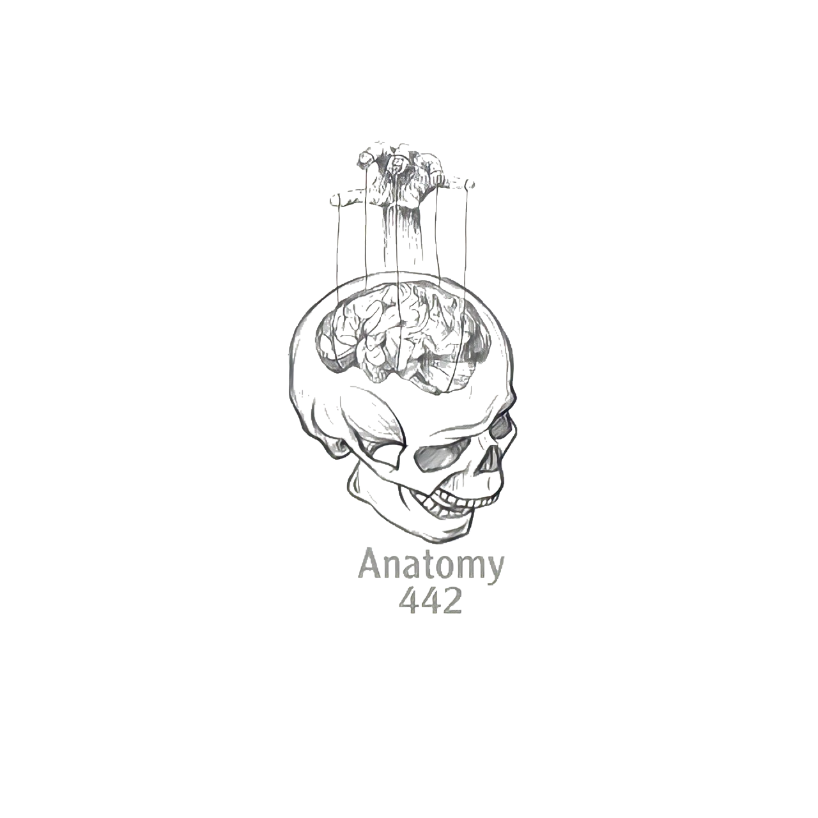
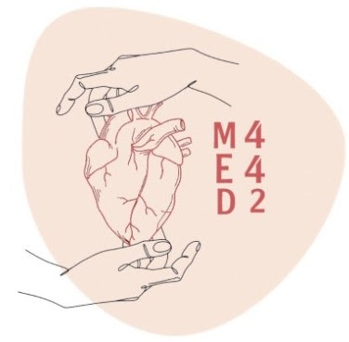
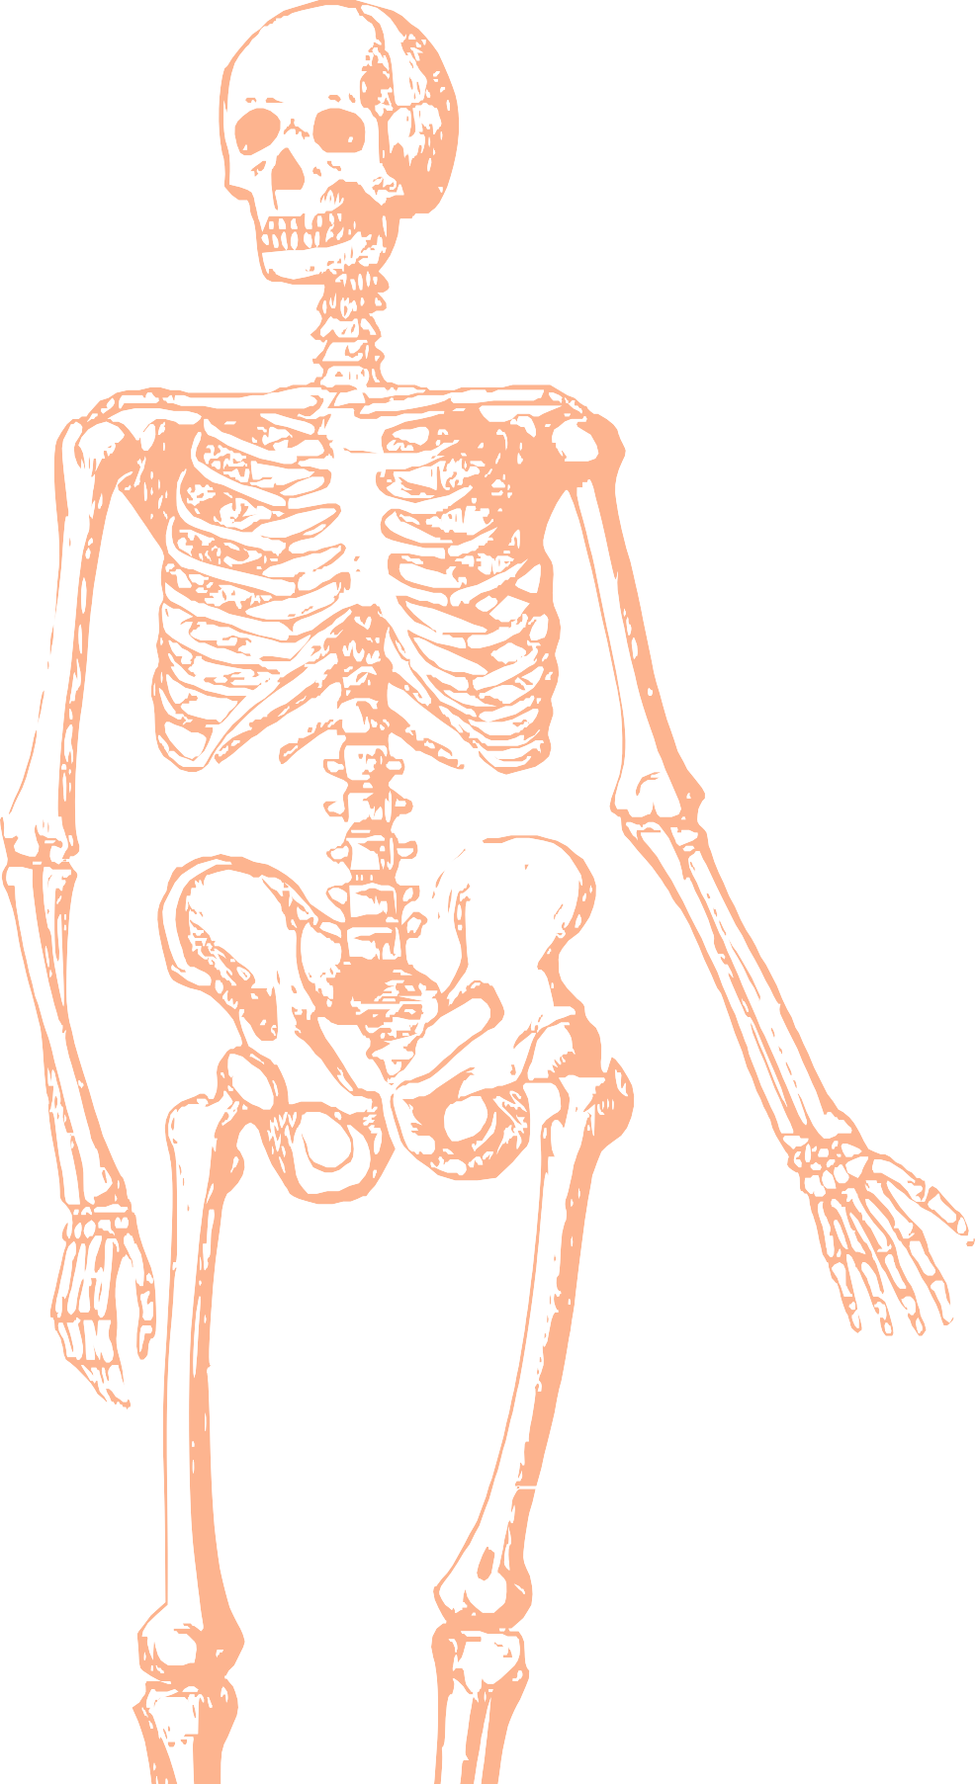
L6
ARM AND ELBOW
Editing file
Color index:
Mine text
Important
Doctors notes
Female slides only
Male slides only
Extra

Slide 2
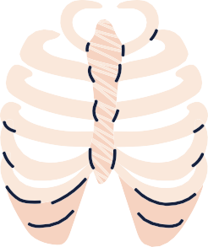
Objectives
Describe the attachments, actions and innervations of:
a. Biceps brachii
b. Coracobrachialis
c. Brachialis
d. Triceps brachii
Define the boundaries of the cubital fossa and enumerate its contents.
Demonstrate the following features of the elbow joint:
a. Articulating bones
b. Capsule
c. Lateral & medial collateral ligaments
d. Synovial membrane
Demonstrate the movements; flexion and extension of the elbow.
List the main muscles producing the above movements.

Slide 3
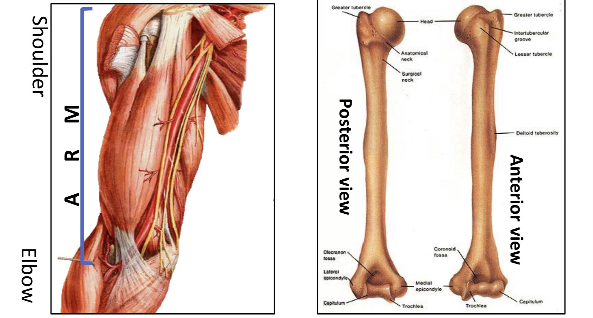
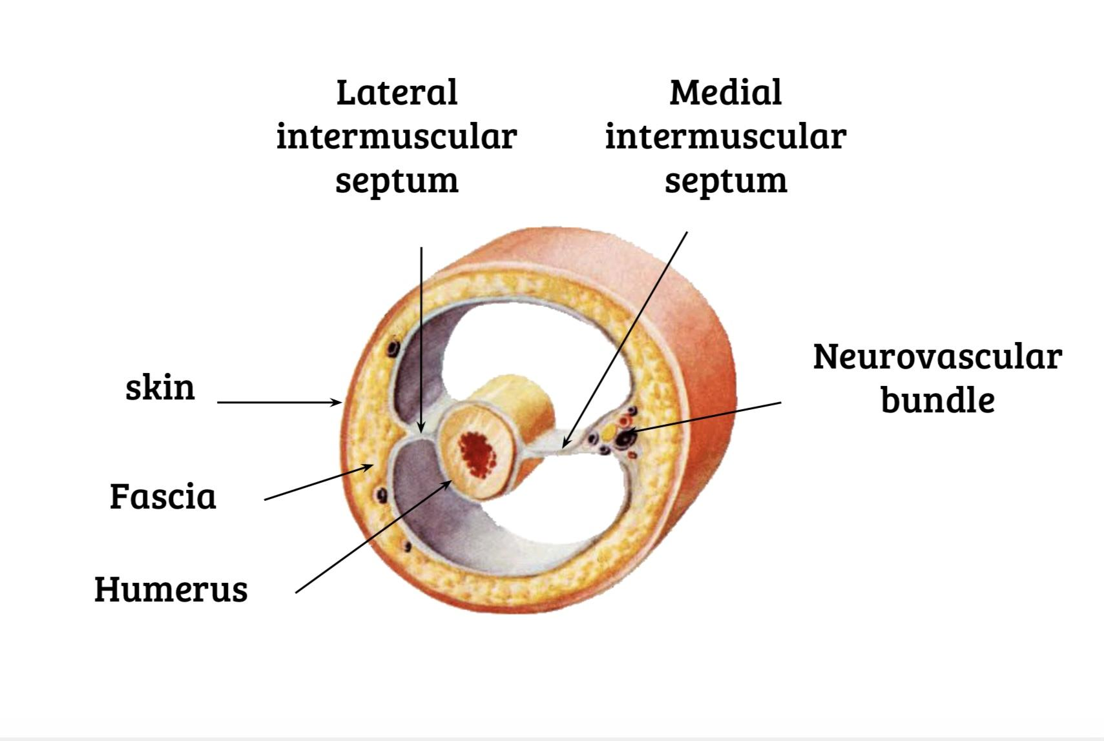
The Arm
An aponeurotic sheet separating various muscles of the upper limbs, including lateral and medial humeral septa.
The arm is located between the shoulder joint and elbow joint.
It contains four main muscles.
The lateral and medial intermuscular septa divide the distal part of the arm into two compartments
Arm
Humerus
Anterior
(Flexor compartment)
Posterior
(Extensor compartment)

Slide 4
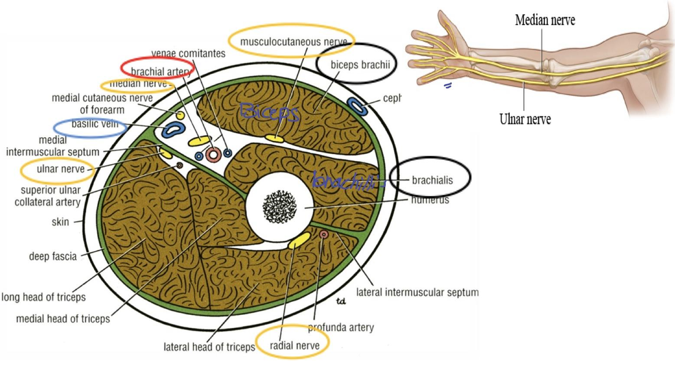
1-Anterior Fascial Compartment:
Muscles
2. Blood vessels
3. Nerves
Brachialis
Basilic vein
Radial
Biceps brachii
Brachial artery
Ulnar
Coracobrachialis
Median
Musculocutaneous

Slide 5
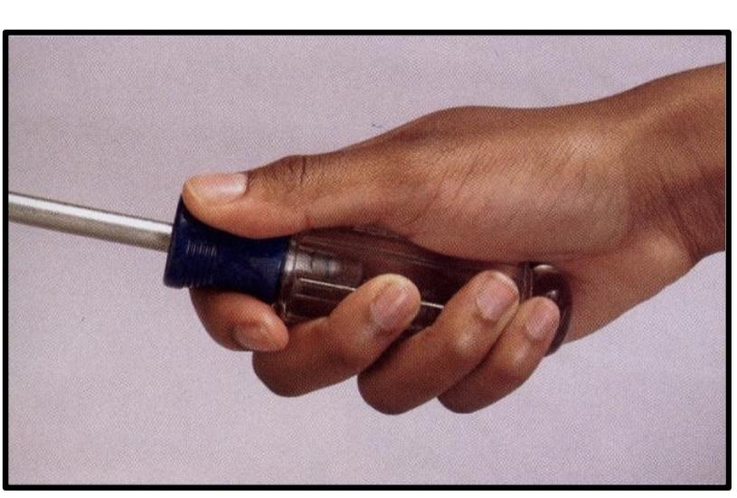
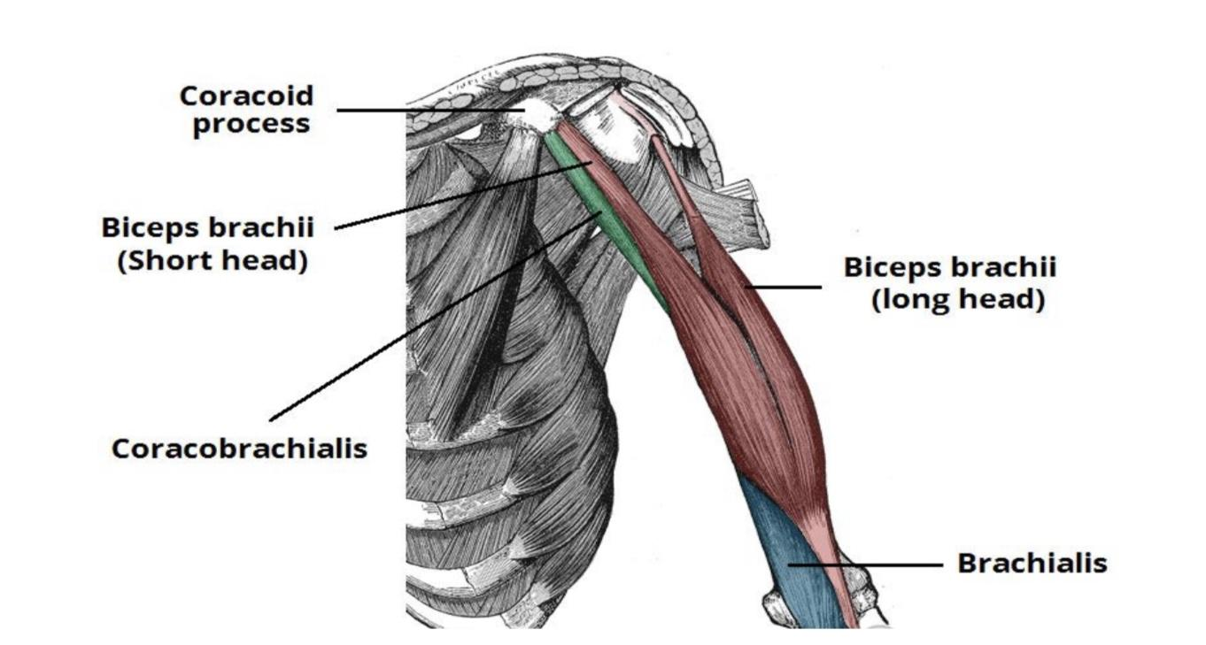
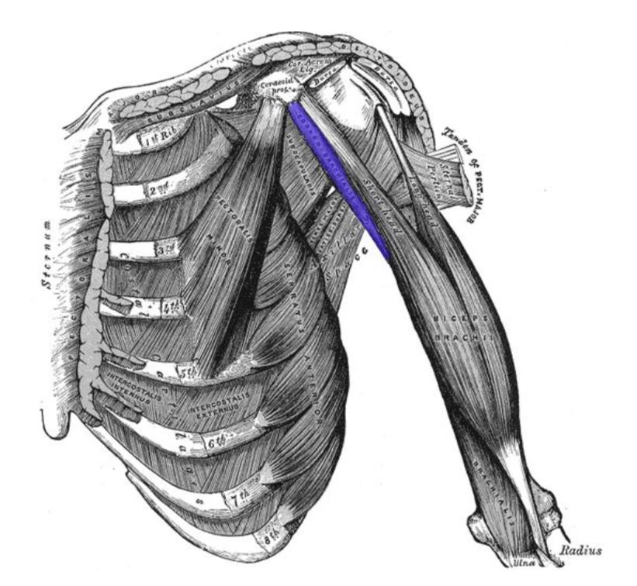
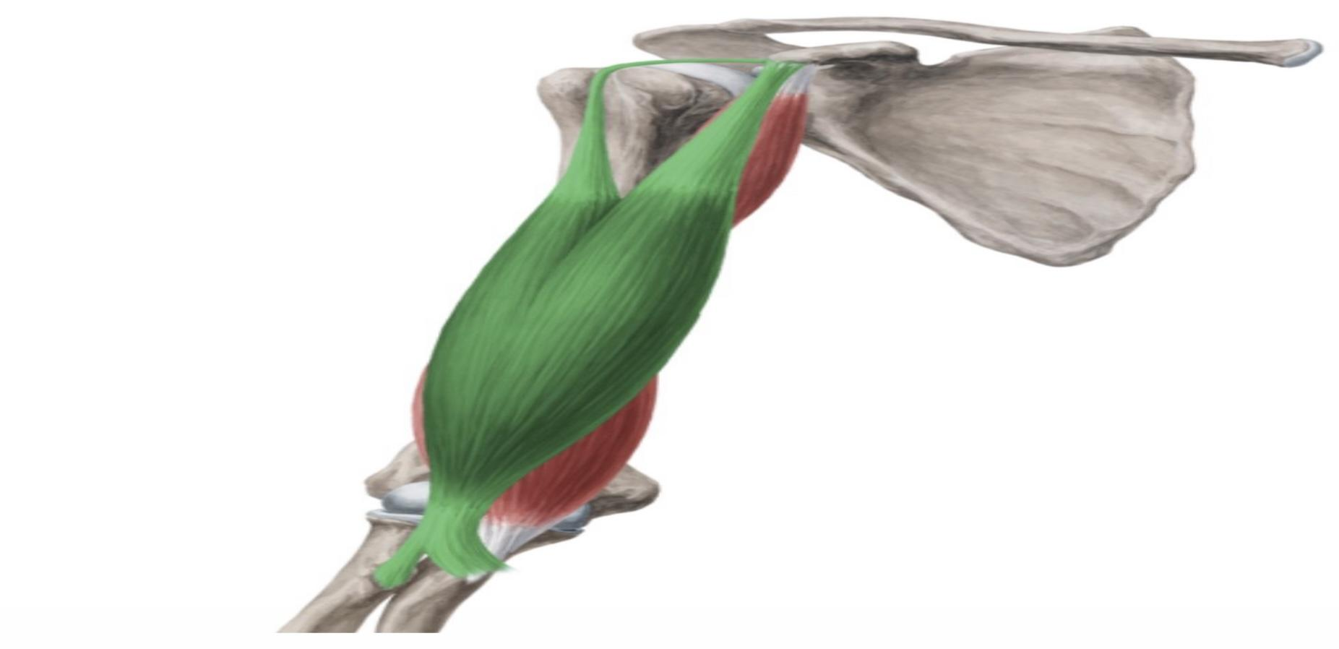
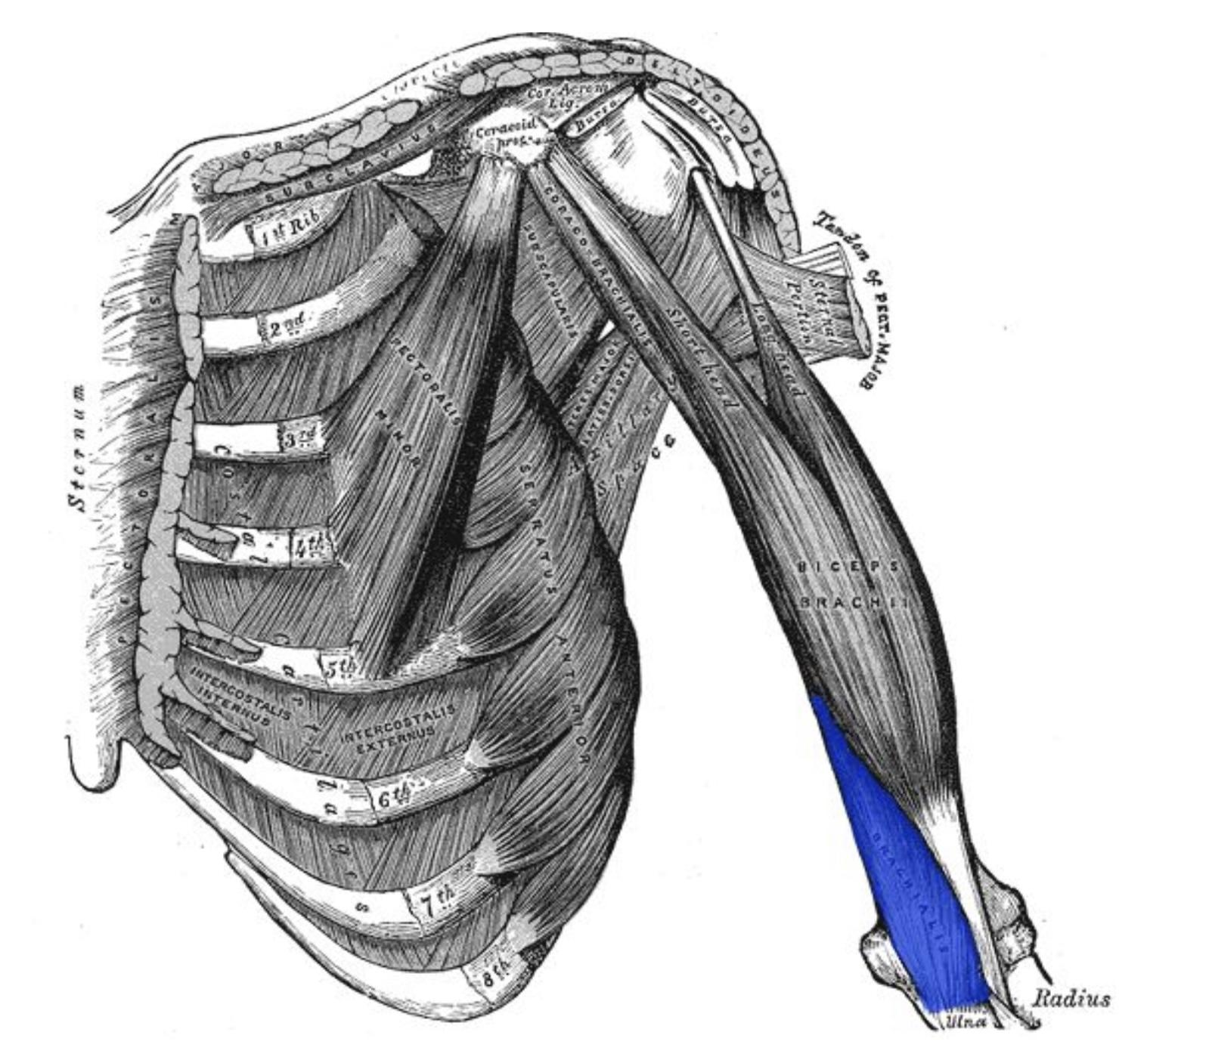
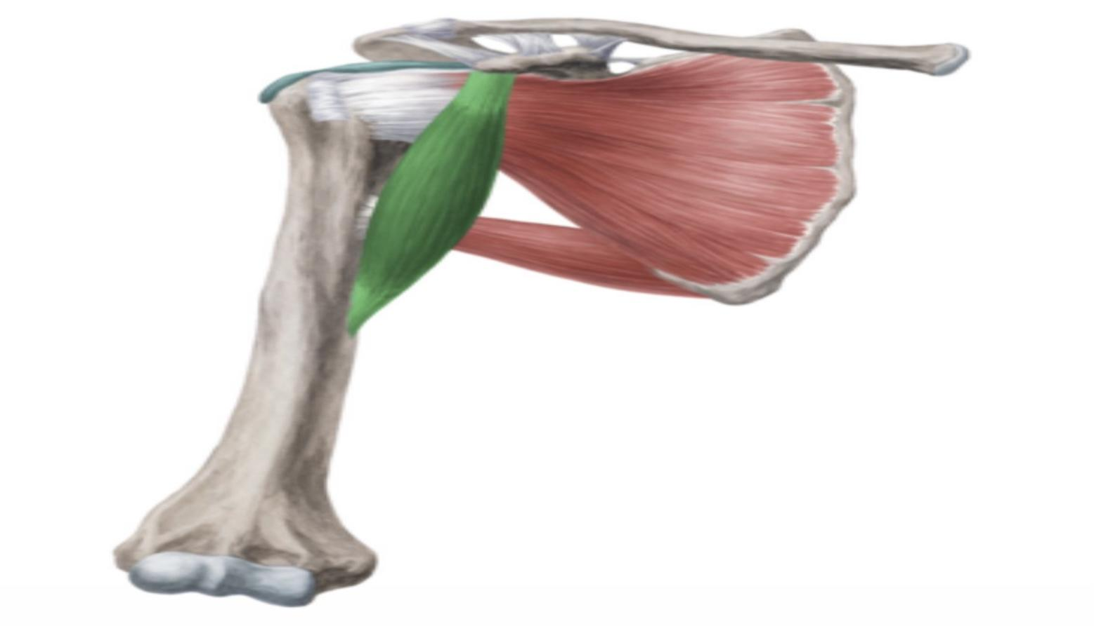
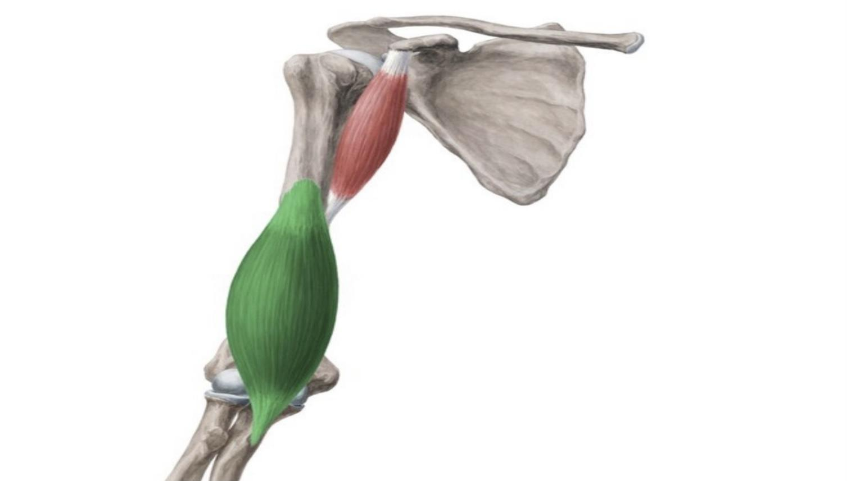
Muscles of anterior compartment
Muscles | Biceps Brachii | Coracobrachialis | Brachialis
Origin: | -Long Head (lateral head) from supraglenoid tubercle of scapula (intracapsular). -Short Head from the tip of coracoid process of scapula. -The two heads join in the middle of the arm. | Tip of the coracoid process of scapula (with short head of biceps brachii). | Front of the lower half of humerus.
Insertion: | -Into the posterior part of the radial tuberosity. -Into the deep fascia of the medial aspect of the forearm through bicipital aponeurosis. | Middle of the medial side of the shaft of the humerus. | Anterior surface of coronoid process of ulna.
Nerve supply: | Musculocutaneous |  | -Musculocutaneous (medial part). -Radial (lateral part).
Action: | Strong supinator of the forearm. used in screwing Powerful -flexor of elbow. -Weak flexor of shoulder. | -Flexor. -Weak adductor of the arm. | Strong flexor of the forearm.
Pictures:

Slide 6
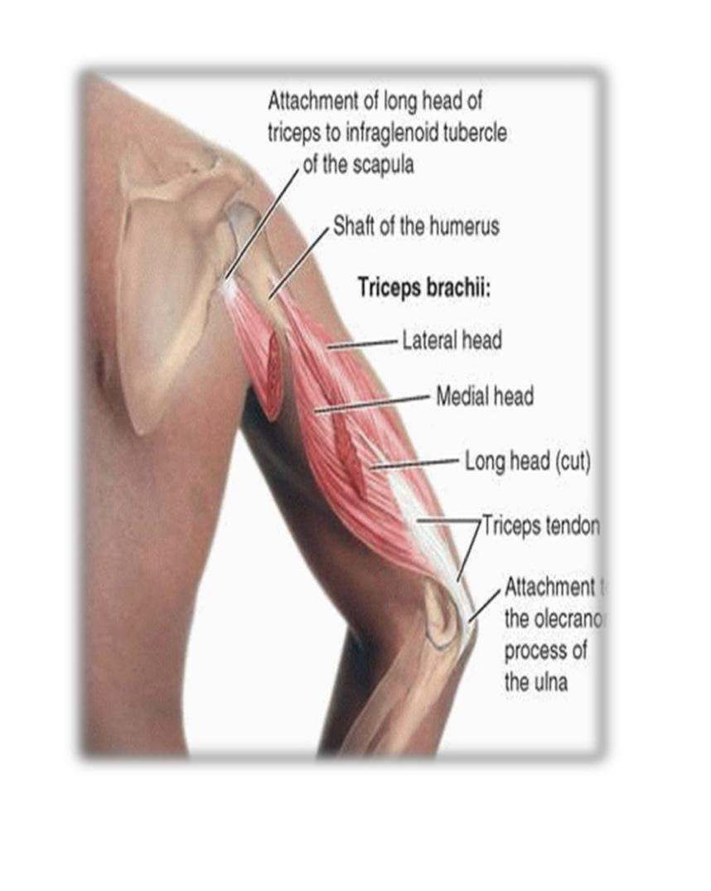
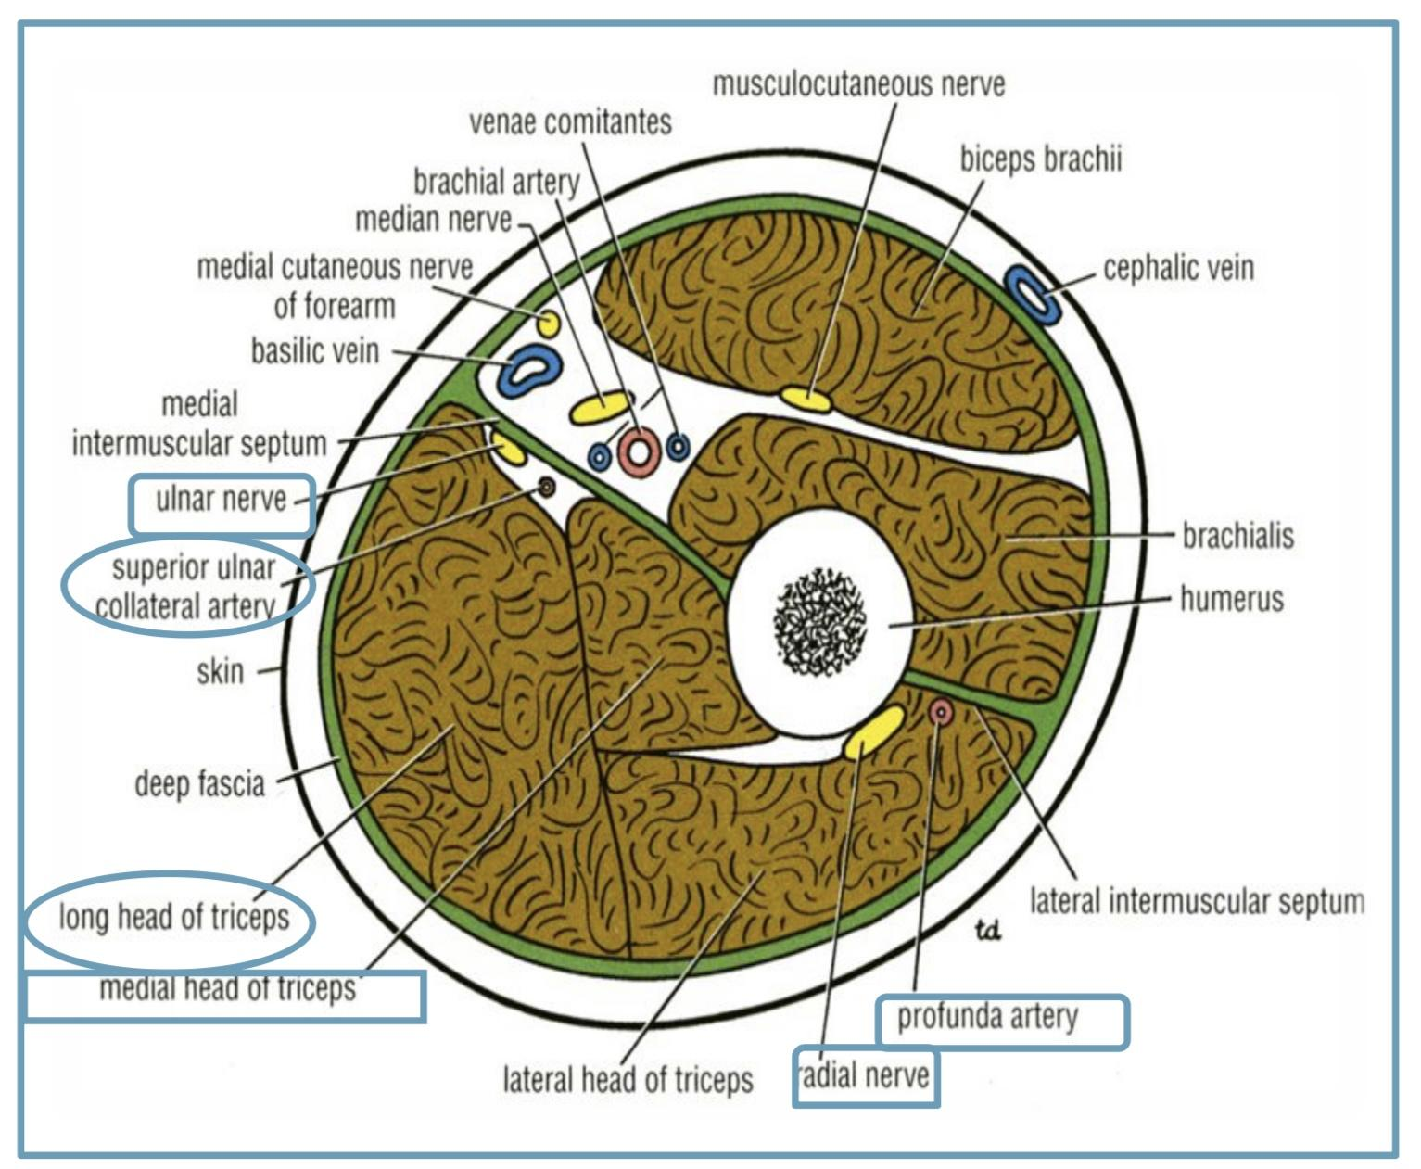
2-Posterior Fascial Compartment:
1. Muscles :
Triceps brachii.
2. Vessels :
- Profunda brachii.
-Ulnar collateral arteries.
3. Nerves :
-Ulnar nerve.
-Radial nerve.
Triceps brachii:
Origin: | Long head: from infraglenoid tubercle of the scapula.(1) lateral head: from the upper half of the posterior surface of the shaft of the humerus above the spiral groove.(2) Medial head: from the lower half of the posterior surface of the shaft of the humerus below the spiral groove.(3)
Insertion: | Common tendon inserted into the upper surface of the olecranon process of ulna .
Nerve supply: | Radial nerve.
Action: | Strong extensor of the elbow joint.
Pictures:

Slide 7
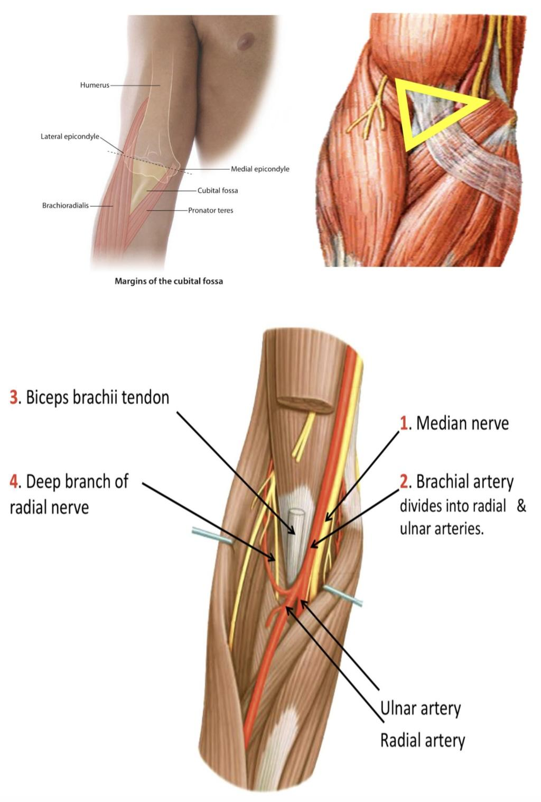
Cubital fossa:
is a an area of transition between the anatomical arm and the forearm, located as triangular depression on the anterior surface of the elbow joint.
It is a triangular depression that lies in front of the elbow.
Boundaries: | Base: Line drawn through the two epicondyles of humerus. Laterally: Brachioradialis. Medially: Pronator teres. Roof: Skin, superficial & deep fascia and bicipital aponeurosis. Floor: Brachialis Medially and supinator Laterally.
Contents ( from the medial to lateral): | 1. Median nerve. 2. Brachial artery divides into radial & ulnar arteries. 3. Biceps brachii tendon. 4. Deep branch of radial nerve.
pictures:

Slide 8
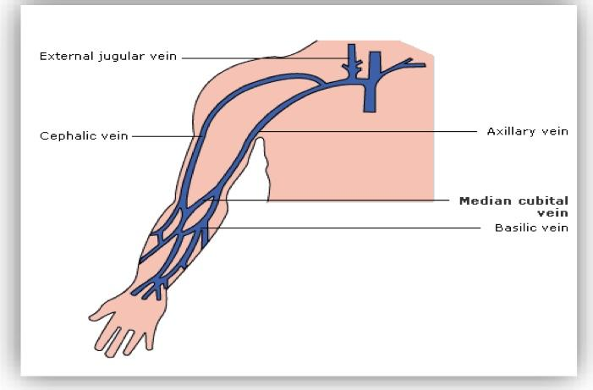
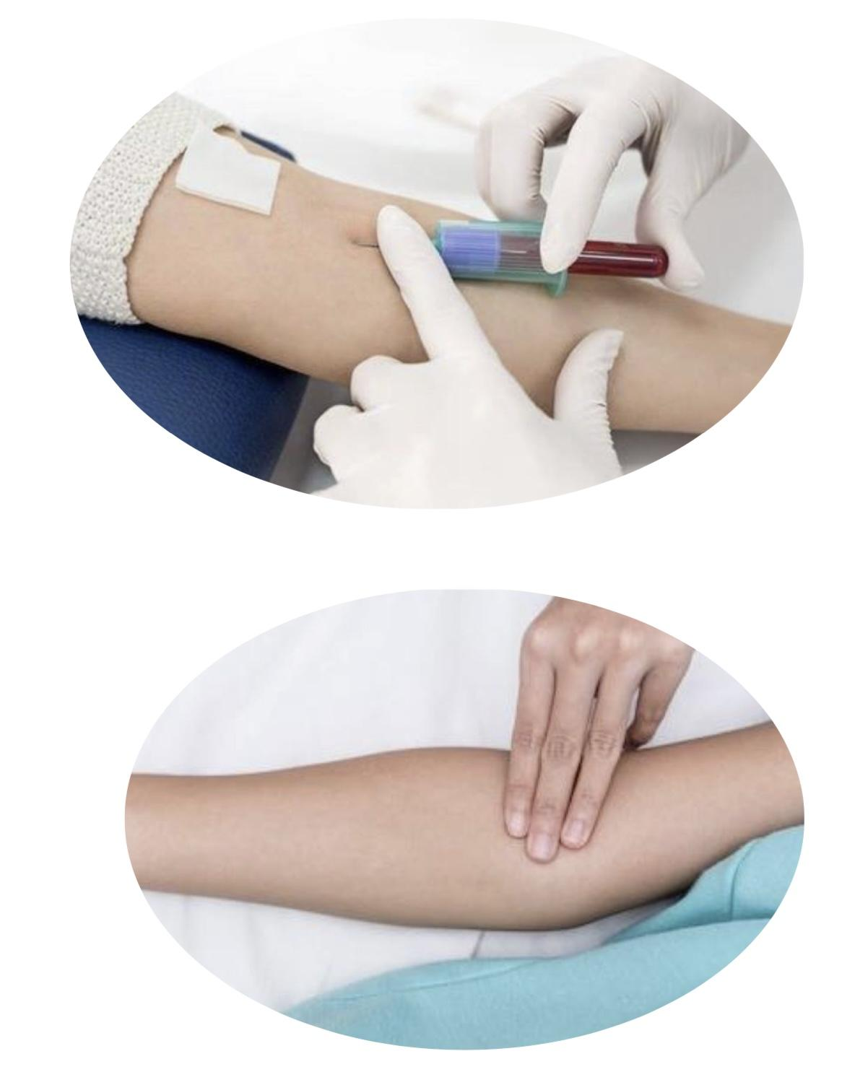
IN BOYS SLIDE ONLY
Cubital fossa:
Clinical significance:
● The brachial pulse can be felt by palpating immediately medial to the biceps tendon in the cubital fossa.
● The median cubital vein is located superficially within the roof of the cubital fossa.
● It connects the basilic and cephalic veins. And can be accessed easily-this makes it a common site for venipuncture.

Slide 9
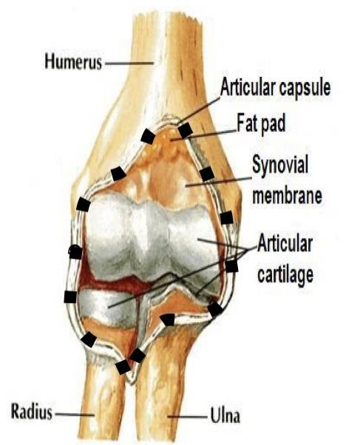
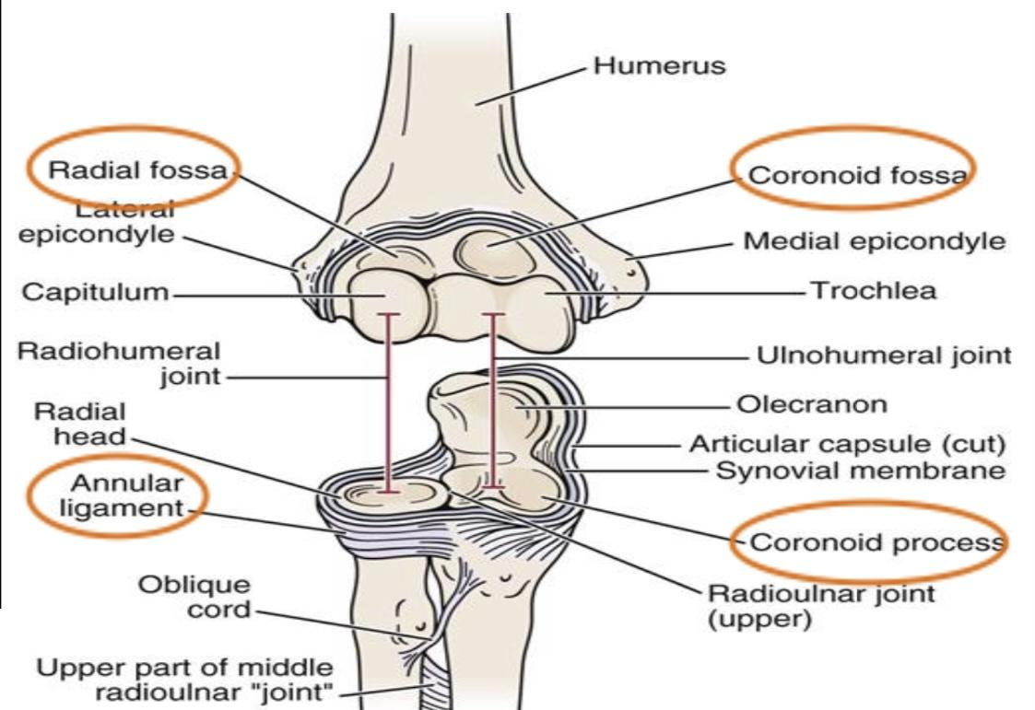
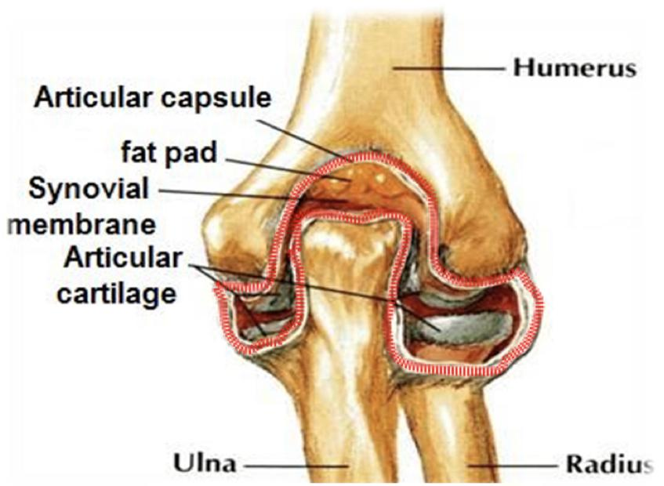
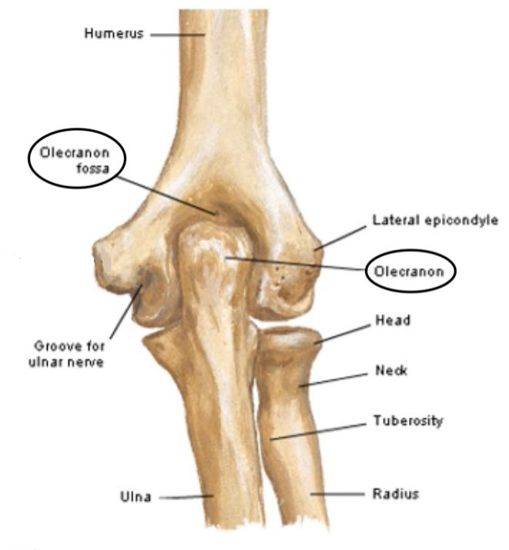
CAPSULE:
The elbow joint has a capsule enclosing the joint. This in itself is strong and fibrous, strengthening the joint.
The joint capsule is thickened medially and laterally to form collateral ligaments, which stabilize the flexing and extending motion of the arm.
Capsule | above | below
Anteriorly | To the humerus along the upper margins of the coronoid and radial fossa and to the front of the medial and lateral epicondyles. | To the margin of the coronoid process of the ulna and to the anular ligament, which surrounds the head of the radius.
Posteriorly | To the margins of the olecranon fossa of the humerus. | To the upper margin and sides of the olecranon process of the ulna and to the anular ligament.
unular ligament:is a strong band of fibers that encircles the head of the radius

Slide 10
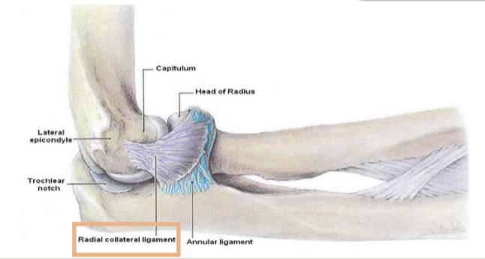
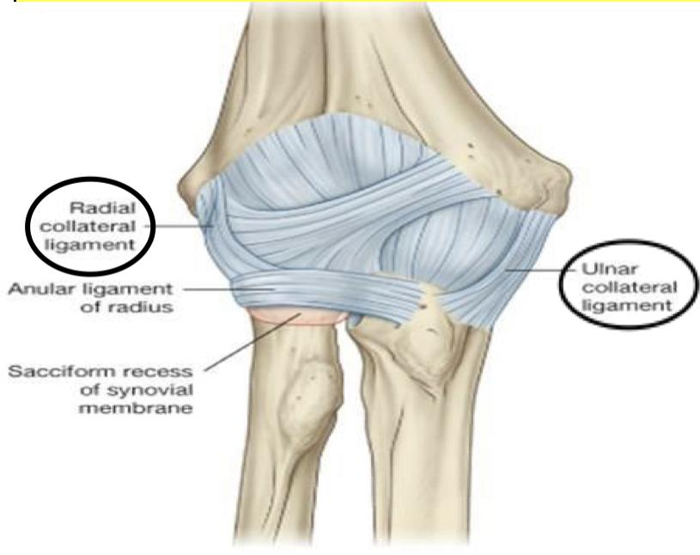
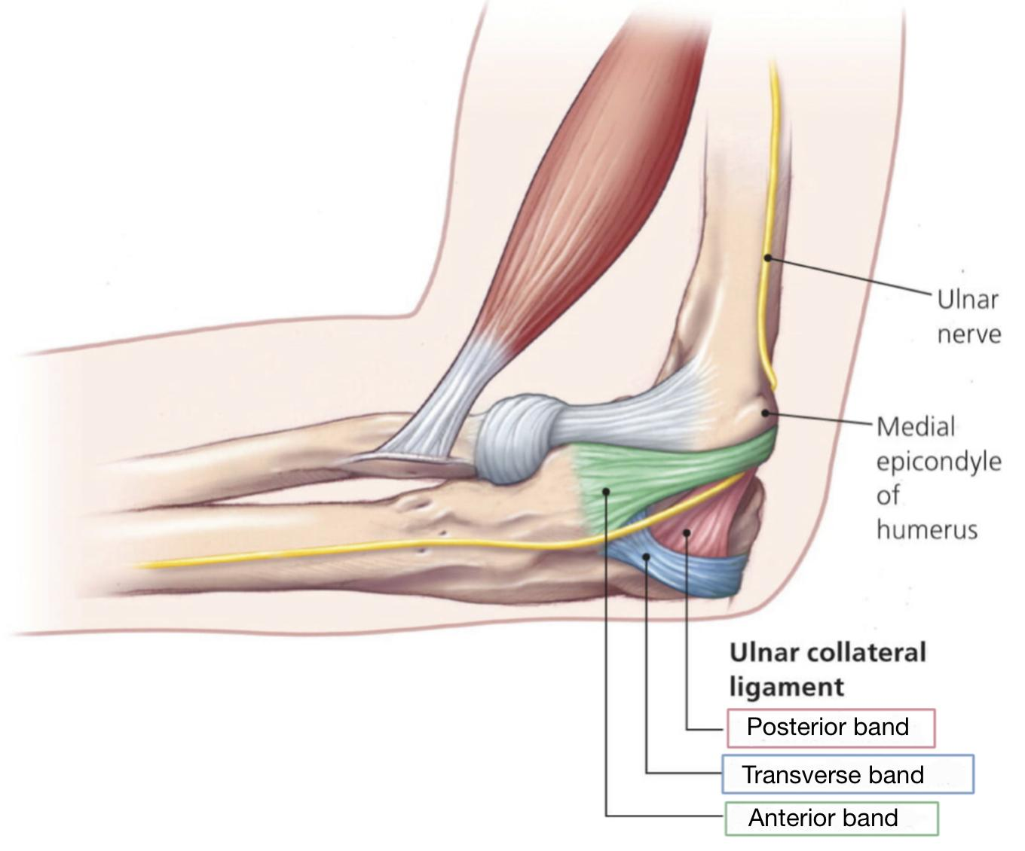
Ligaments of Elbow Joint:
Lateral ligament (radial collateral ligament):
Medial ligament (ulnar collateral ligament):
Shape | Triangular
Apex | Attached to the lateral epicondyle of humerus
Base | attached to the upper part of the annular ligament
Anterior strong cord-like band | Between medial epicondyle of humerus and the coronoid process of ulna
posterior weaker fan-like band | Between medial epicondyle of humerus and the olecranon process of ulna
Transverse band | Passes between the anterior and posterior bands

Slide 11
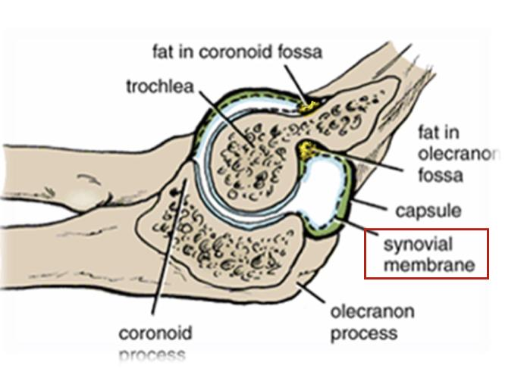
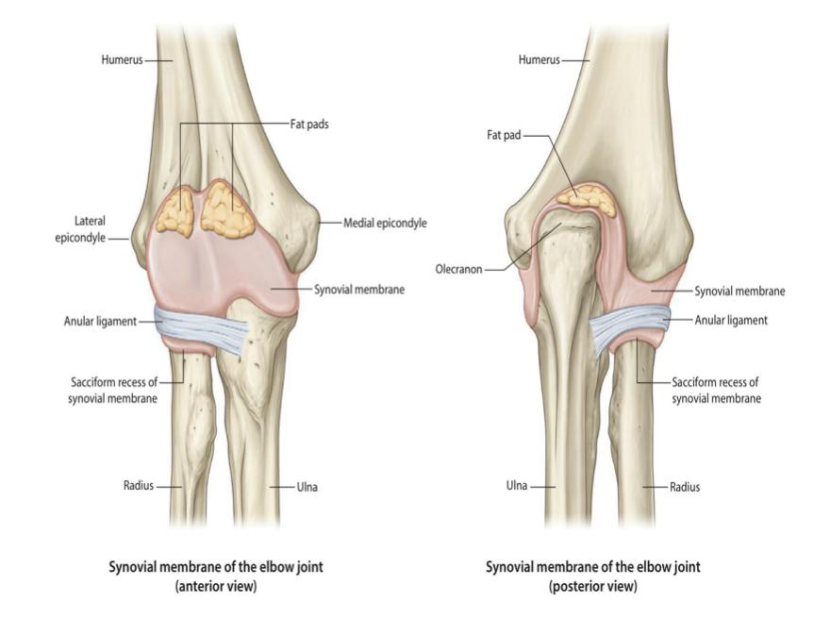
Synovial Membrane:
Remember from joint lecture: Synovial membrane produce synovial fluid
to minimize the friction of the joint
lines the inner surface of the capsule.
covers fatty pads in the floors of the coronoid, radial, and olecranon fossa.
Is continuous below with synovial membrane of the superior radioulnar joint
“superior and inferior radioulnar joints cause supination and pronation of forearm”
(راح يكمل مع ال synovial حق اللي تحته اللي هو radioulnar)

Slide 12
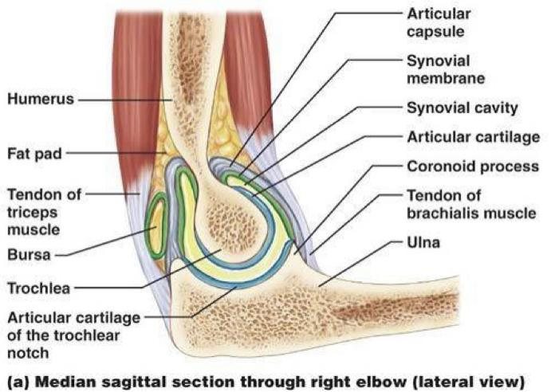
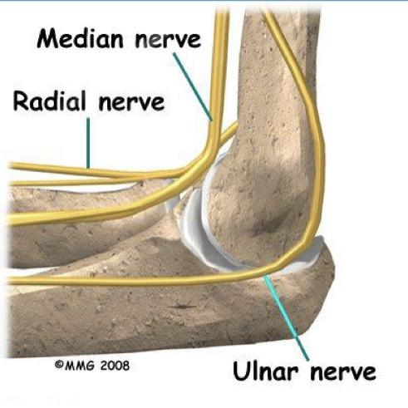
Relation:
Anterior:
Posterior:
Lateral:
Medial:
- Brachialis.
- Tendon of biceps.
- Median nerve.
- Brachial artery.
- Triceps muscle.
- Small bursa intervening.(between elbow joint and tendon of triceps)
- Common extensor
tendon(attached to
Lateral epicondyle of
the humerus)
- Supinator
- Ulnar nerve
“ Considered the
largest unprotected nerve by muscle or bone”.
( lies behind medial epicondyle)
Bursae around the elbow joint:
Subcutaneous olecranon bursa.
Subtendinous olecranon bursa.
Note: (Bursa in the joint is like an Airbag in the car that absorbed shocks)

Slide 13
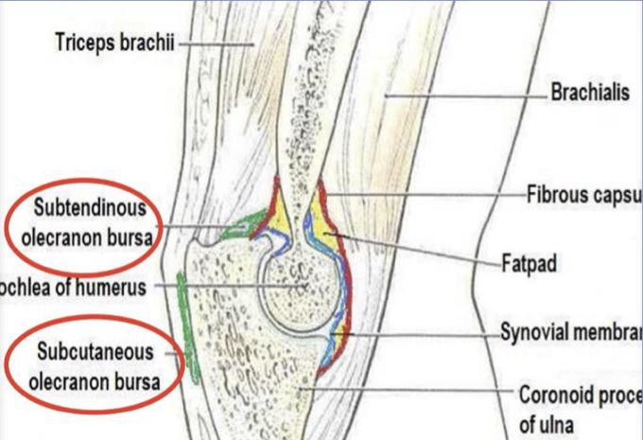
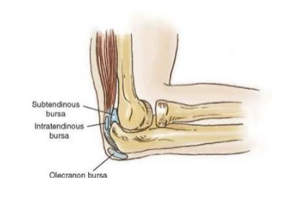
BURSA:
A bursa is a membranous sac filled with synovial fluid.
It acts as a cushion to reduce friction between the moving parts
of a joint, limiting degenerative damage.
There are many bursae in the elbow, but only a few have clinical
importance :
Subtendinous bursa
between the olecranon and the
tendon of the triceps brachii,
reducing friction between the two
structures during extension and
flexion of the arm.
Subcutaneous (olecranon)
bursa
between the olecranon and the
overlying connective tissue
(implicated in olecranon bursitis).
Intratendinous
located within the tendon of the triceps brachii.

Slide 14
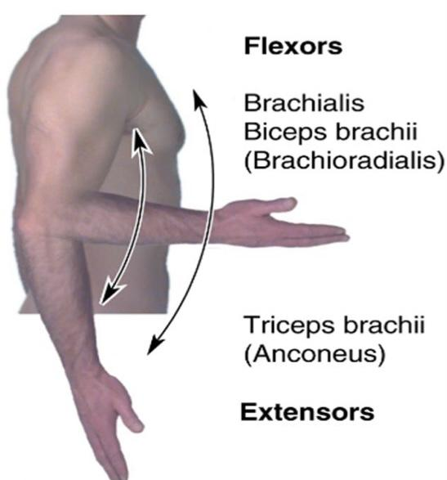
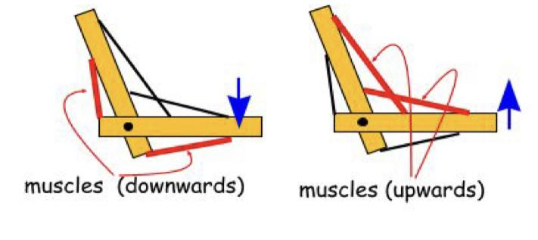
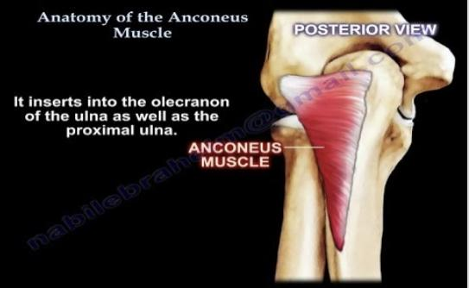
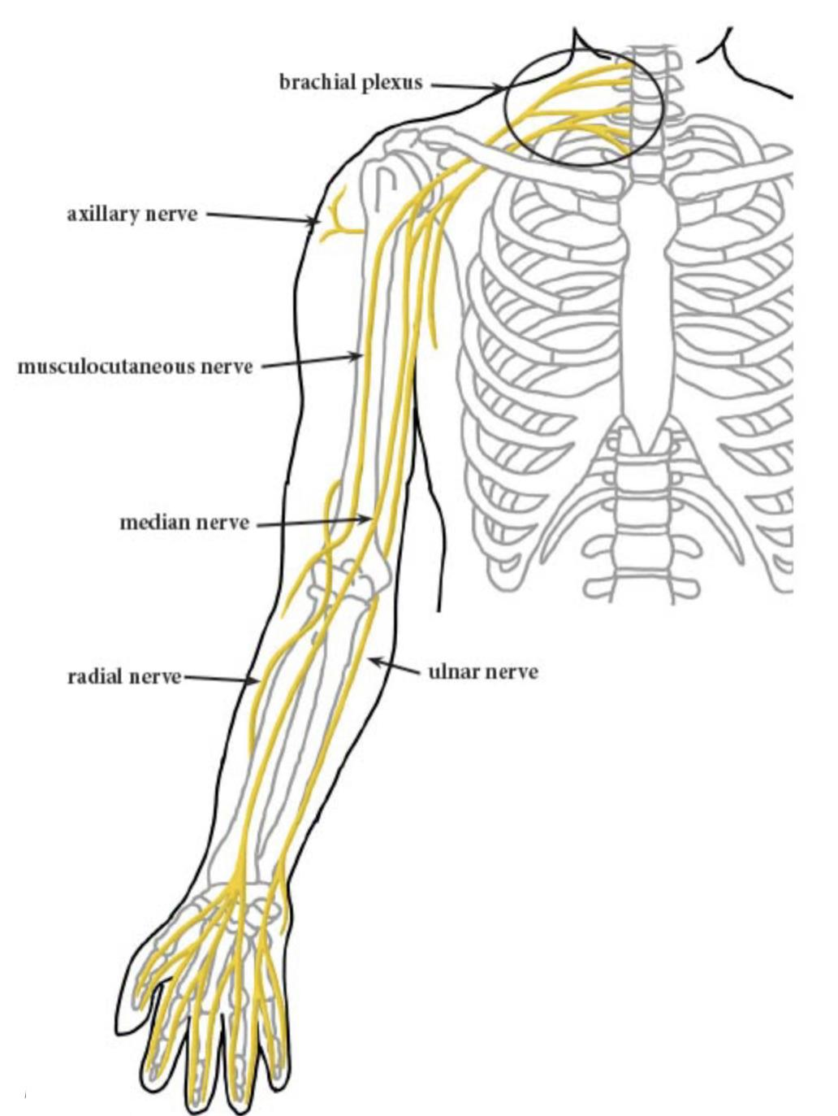
Movement:
Extension | Flexion
Is limited by the tension of the anterior ligament (medially) and the brachialis muscle. | Is limited by the anterior surfaces of the forearm and arm coming into contact.
Anconeus
The joint is supplied by branches from the:
- Median - Ulnar
- Musculocutaneous - Radial nerves

Slide 15
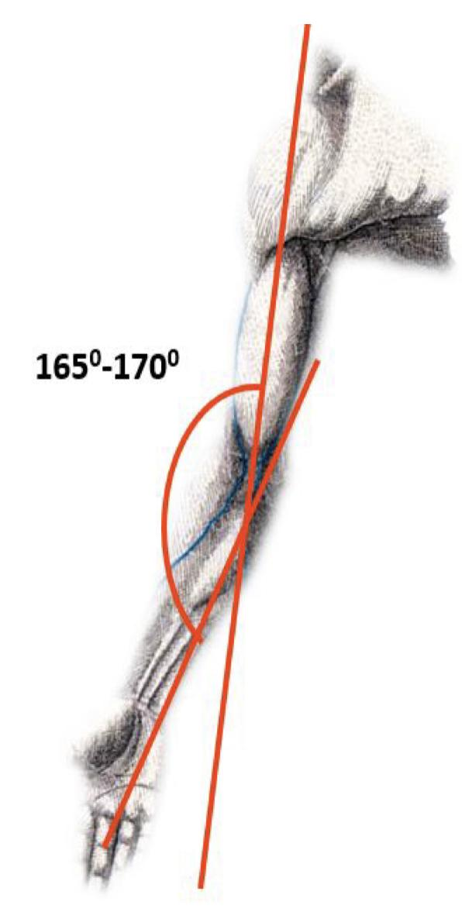
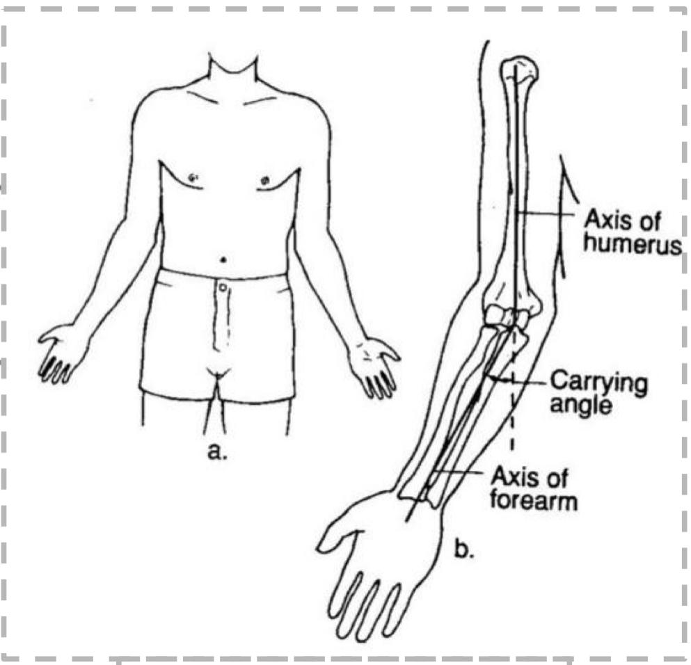
Carrying Angle:
(ميلان في الذراع فائدته منع اصطدام ال upper limb مع ال Trunk )
Angle:
Between the long axis of the extended
forearm and the long axis of the arm.
Opens:
Laterally
About:
170 degrees in male and 167 degrees in
females.
Disappears:
When the elbow joint is flexed.
Permits:
- The forearms to clear the hips in
swinging movements during walking.
- and is important when carrying objects.

Slide 16
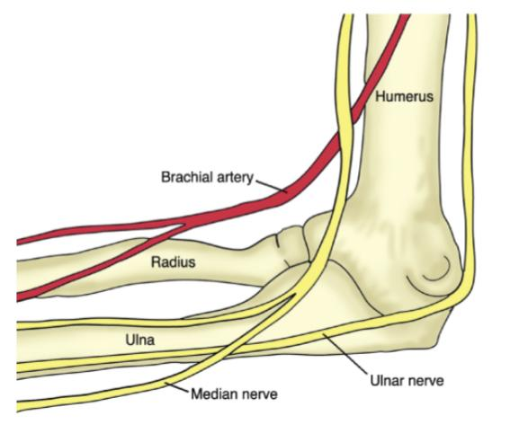
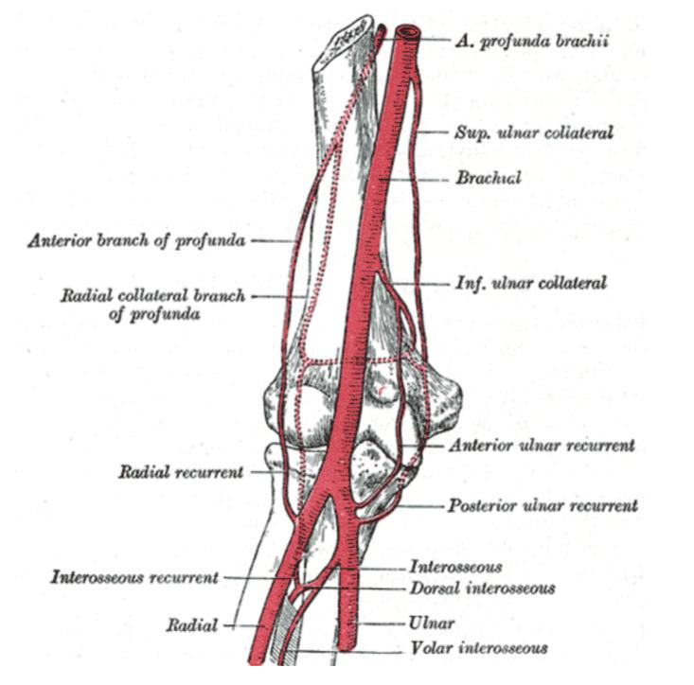
Blood Supply & Innervation
The arterial supply to the elbow joint is from the cubital anastomosis, which includes recurrent and collateral branches from the deep brachial arteries.
The innervation of elbow joint is provided by the median, musculocutaneous and radial nerves anteriorly, and the ulnar nerve posteriorly.

Slide 17
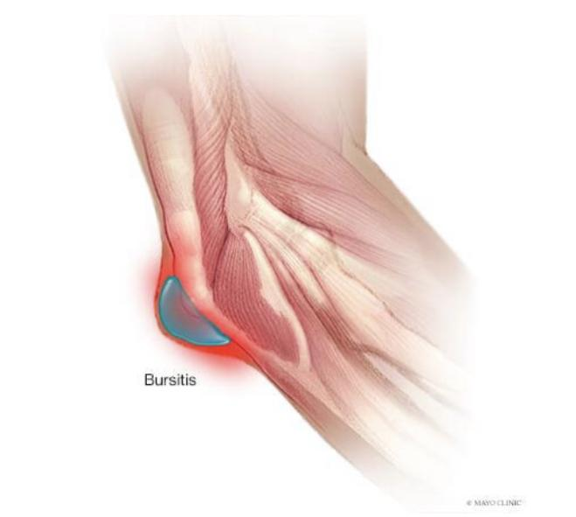
Bursitis
(Bursitis: is Inflammation caused by viral or bacterial infection or caused by overuse of the joint).
Subcutaneous bursitis:
- Repeated friction and pressure on the bursa can cause it to
become inflamed.
- Because this bursa lies relatively superficially, it can also
become infected (example, cut from a fall on the elbow.)
Subtendinous bursitis:
- This is caused by repeated flexion and extension of the
forearm, commonly seen in assembly line workers.
- Usually flexion is more painful as more pressure is put on
the bursa.

Slide 18
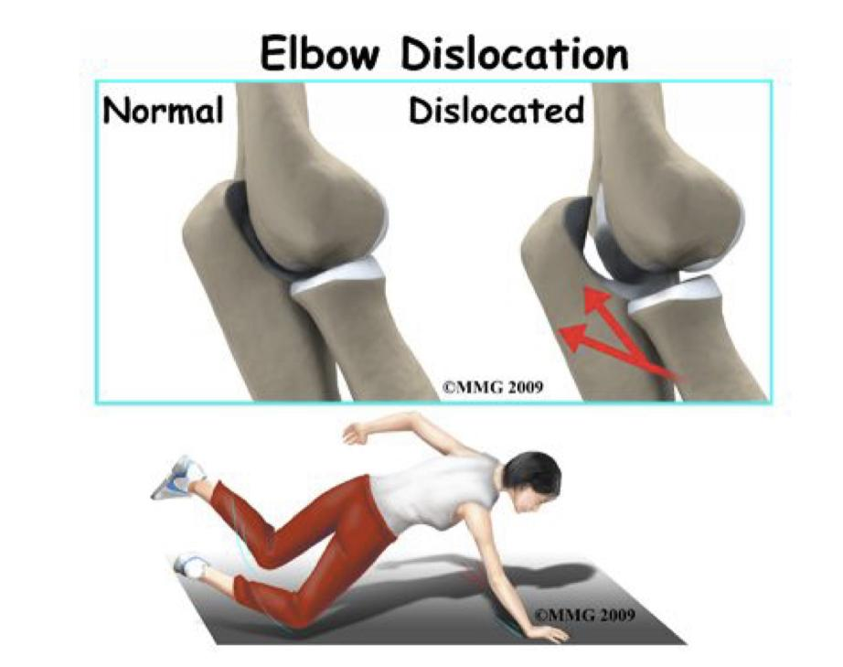
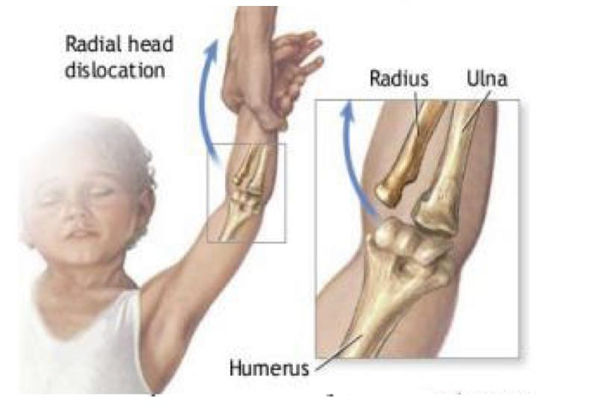
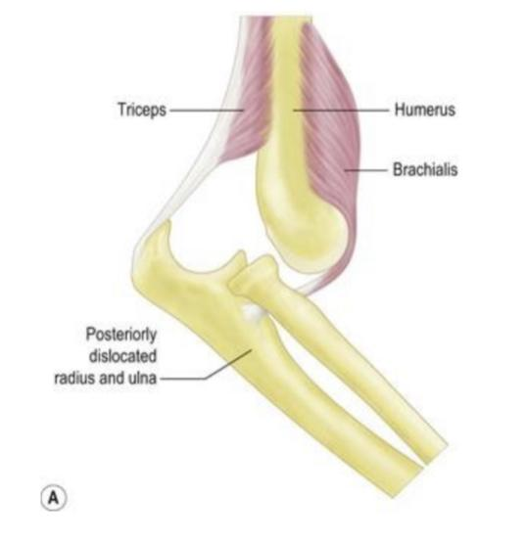
Articulations and applied anatomy:
The elbow joint is stable because of the:
1- Wrench-shaped articular surface of the olecranon and the pulley-shaped trochlea of humerus.
2-Strong medial and lateral ligaments. (Especially medial)
Dislocation:
Elbow dislocations are common & most are posterior, and it is important to note that elbow dislocations are named by the position of the ulna and radius, not the humerus.
Posterior dislocation usually follows falling on the outstretched hand.
Posterior dislocations of the joint are common in children because the parts of the bones that stabilize the joint are incompletely developed.
The distal end of the humerus is driven through the weakest part of the joint capsule, which is the anterior side.
The ulnar collateral ligament is usually torn and there can also be ulnar nerve involvement.

Slide 19
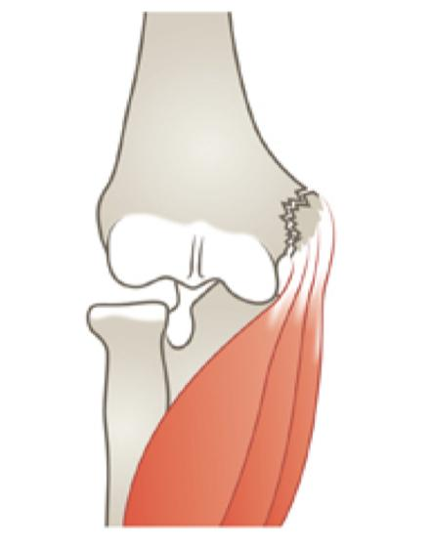
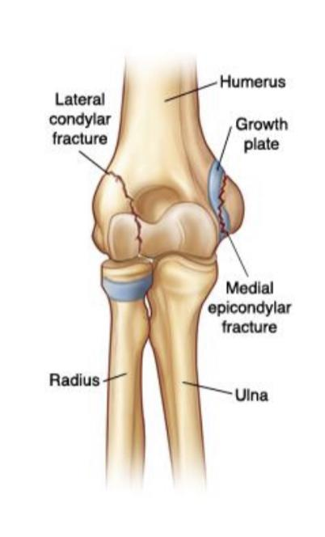
Articulations and applied anatomy:
Avulsion fracture of the epiphysis
of the medial epicondyle is also common in childhood because the medial ligament is much stronger than the bond of union between the epiphysis and the diaphysis.
They are usually a result from an avulsion (pull off) injury caused by :
a valgus stress at the elbow and contraction of the flexor muscles as in :
1- fall on an outstretched hand with the elbow in full extension.
2- posterior elbow dislocation.
3- direct blow.
Fractures:
Elbow fractures may result from a fall, a direct impact to the elbow, or a twisting injury to the arm.
Sprains, strains or dislocations may occur at the same time as a fracture.
X-rays are used to confirm if a fracture is present and if the bones are out of place.
Sometimes, a CT scan might be needed to get further investigation.

Slide 20
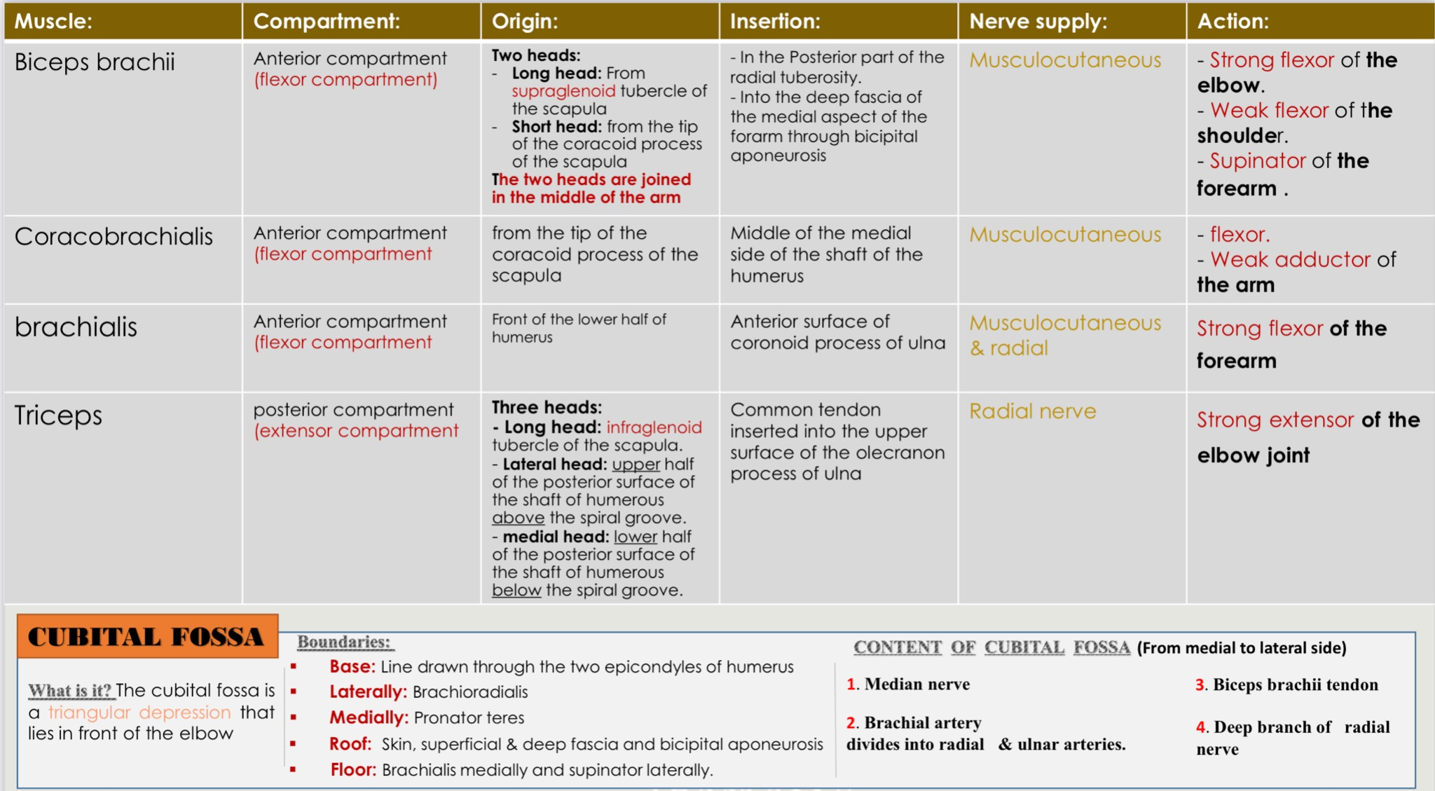
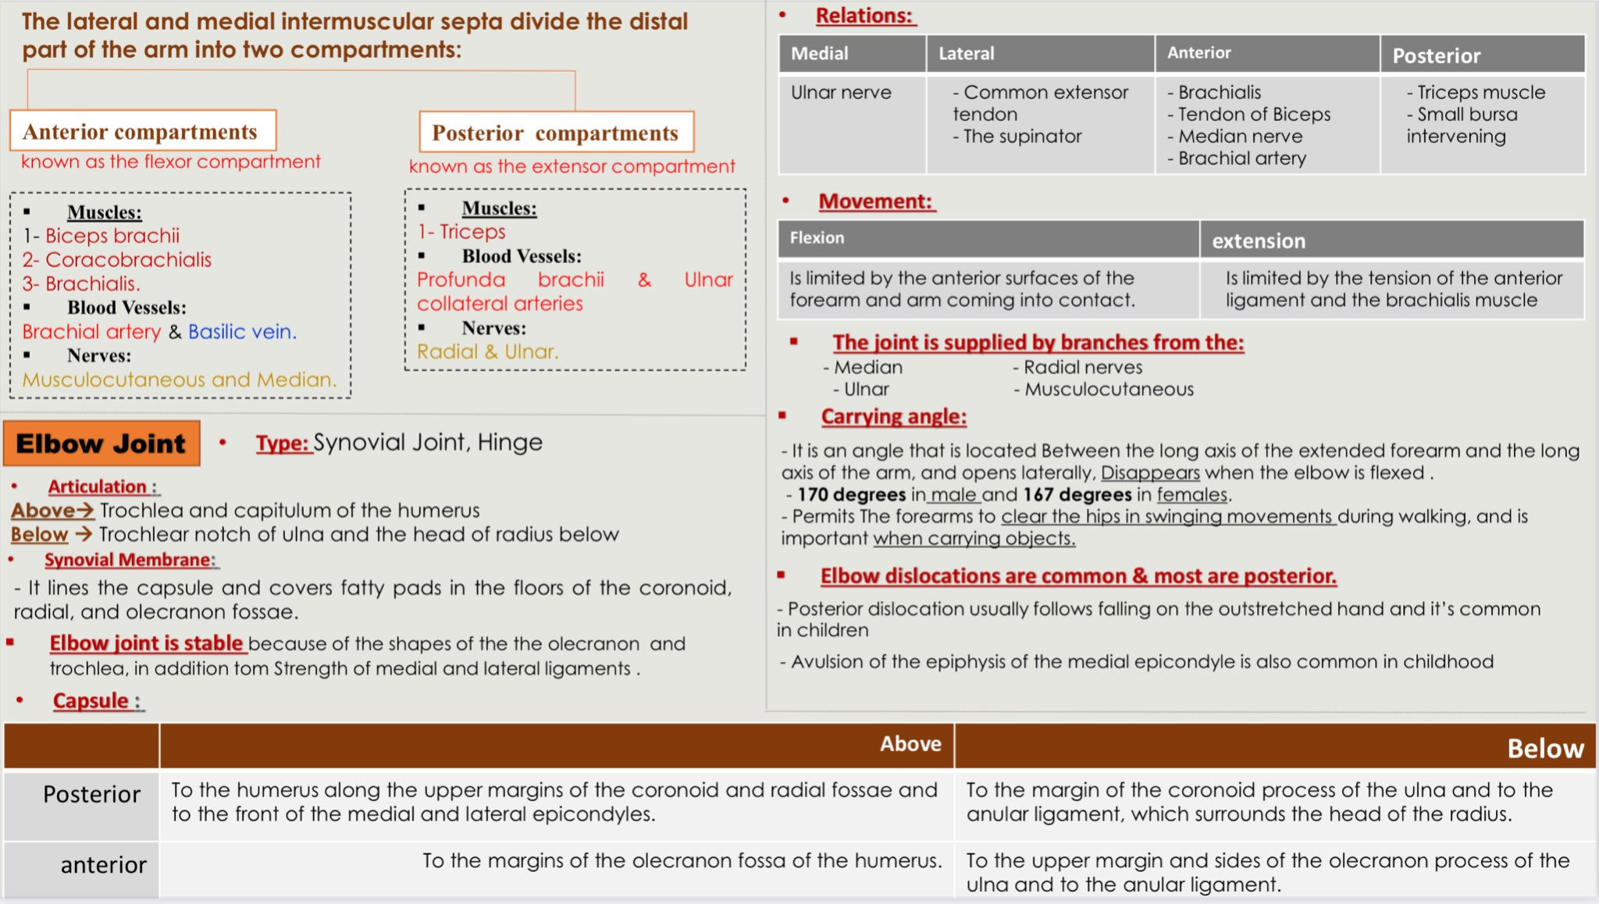
summary:
special thanks for team 435

Slide 21
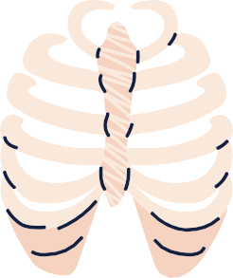
MCQs:
Q1
which of the following muscles has a double nerve supply ?
B
C
Brachialis
Biceps brachii
Triceps
D
A
Coracobrachialis
Q2
The weakness of biceps brachii muscle can indicate trauma to which of the following nerves?
Radial nerve
Musculocutaneous
Ulnar nerve
Median nerve
A
B
C
D
Q3
Which of the following muscles is responsible of screwing action?
A
Biceps brachii
D
Triceps brachii
B
Brachialis
Coracobrachialis
C
Q4
Which of the following nerves supply the elbow joint?
D
B
A,B and C
Ulnar nerve
Radial nerve
A
C
Median nerve
Answers: 1.A
2.B
3.B
4.D
5.A
Q5
Which of the following nerves is largest unprotected nerve by muscles or bones?
A
B
C
D
Ulnar nerve
Median nerve
Radial nerve
Musculocutaneous

Slide 22
MCQs:
Q6
which of the following is the type of elbow joint?
A
B
C
D
Saddle joint
Pivot joint
Hinge joint
Ball-and-Socket joint
Q7
It extends from the medial epicondyle to the coronoid process and the olecranon of the ulna?
A
C
Annular ligament
Ulnar collateral ligament
Radial collateral ligament
Transverse ligament
B
D
Q8
The carrying angle is formed________by the axis of the arm and the axis of the extended forearm.
A
B
C
D
Anteriorly
Posteriorly
Laterally
Medially
Q9
Which of the following muscles is a strong extensor of the elbow joint?
Answers:
6.C
7.B
8.C
9.A
A
B
D
Triceps brachii
B
C
Biceps brachii
Brachialis
Coracobrachialis

Slide 23
MCQs:
Question from girls slides
Q10
Which one of the following muscles forms the medial boundary of the cubital fossa?
A
B
C
D
Biceps Brachii
Pronator teres
Brachialis
Brachioradialis
Q11
Which one of the following muscles has double nerve supply?
A
C
Brachialis
Biceps Brachii
Coracobrachialis
Deltoid
B
D
Q12
Which one of the following muscles is powerful supinator of forearm?
A
B
C
D
Pronator teres
Biceps Brachii
Brachialis
Brachioradialis
Answers:
10.B
11.A
12.B

Slide 24
Done by the amazing team
Team leaders:
Arwa Alghamdi
Deema Aljuribah
Razan Alnufaie
Team leaders:
Mishal Alsuwayegh
Mohammed Alghamdi
Members:
Members:
Aljazi Albabtain
Atheer Alkanhal
Arob Alasheikh
Ajwan Aljohani
Deema alqahtani
Dena Alsuhaibani
Jana Alhazmi
Kadi aldosari
Mashael Alasmari
Noura Bin hammad
Najla aldhbiban
Nouf aldalaqan
Razan alasmari
Roaa alharbi
Raghad Mohammed
Shaden albassam
Waha Almathami
Walaa AlMutawa
Yara Ameer Alalwan
Othman Aldraihem
Faisal Alomar
Abdullah Alturki
Othman Alabdullah
Omar Alkadhi
Abdullah Ali
Meshari Alshathri
Yazeed Alsanad
Fahd Mobaireek
Emad Almutairi
Nasser Alghaith
Saad Almogren
Azzam Abdullah Alotaibi
Hassan Ali Alabdullatif
Rayan Alotaibi
Mohammed Nasser
Luay Almutair
Mohammed Fahad
Mohammed Majed
Abdulkarim Salman
anatomyteam442@gmail.com
Thanks to Faisal Alomar for his design of the team logo

