Slide 1
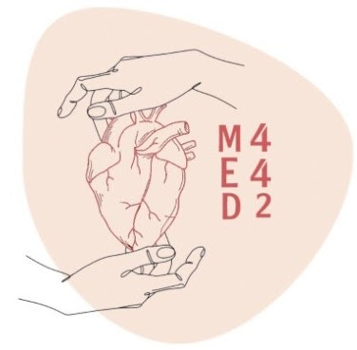
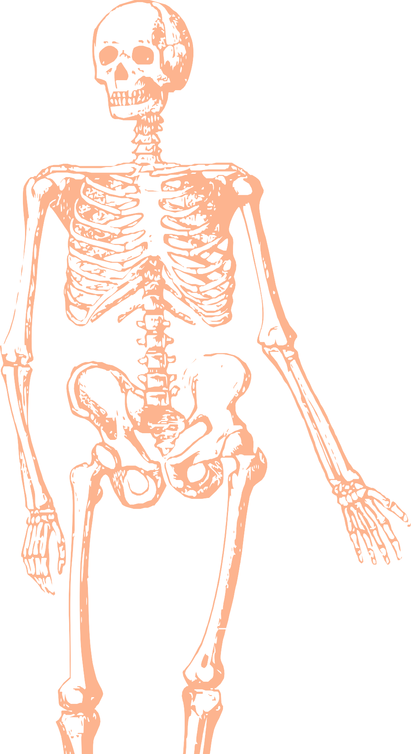
L7
Vascular Anatomy of the Upper Limb
Editing file
Color index:
Main text
Important
Doctors notes
Female slides only
Male slides only
Extra

Slide 2
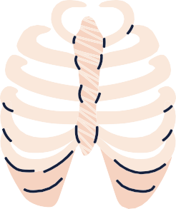
Objectives
At the end of the lecture, the students should be able
to:
• Identify the origin of the vascular supply for the
upper limb.
• Describe the main arteries and their branches of the
arm, forearm & hand.
• Describe the vascular arches for the hand.
• Describe the superficial and deep veins of the upper
limb

Slide 3
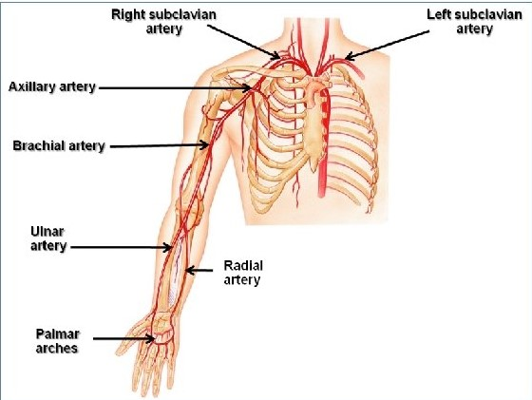
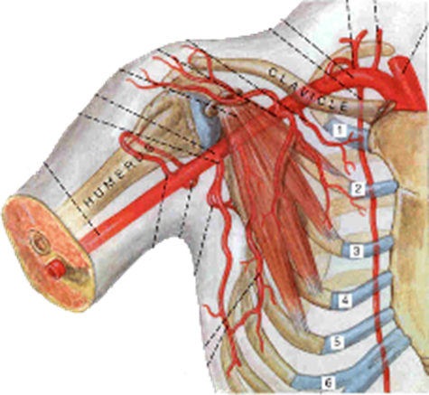
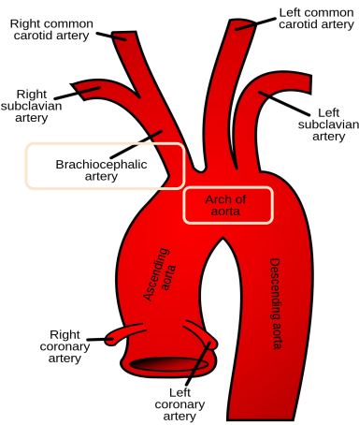
Arteries of the upper limb
1-Subclavian Artery
The right subclavian artery originates from the brachiocephalic artery.
The left subclavian artery originates from the arch of the aorta.
Both Continue as Axillary artery at the lateral (outer) border of the 1st rib.
Radial
artery
Ulnar
artery

Slide 4
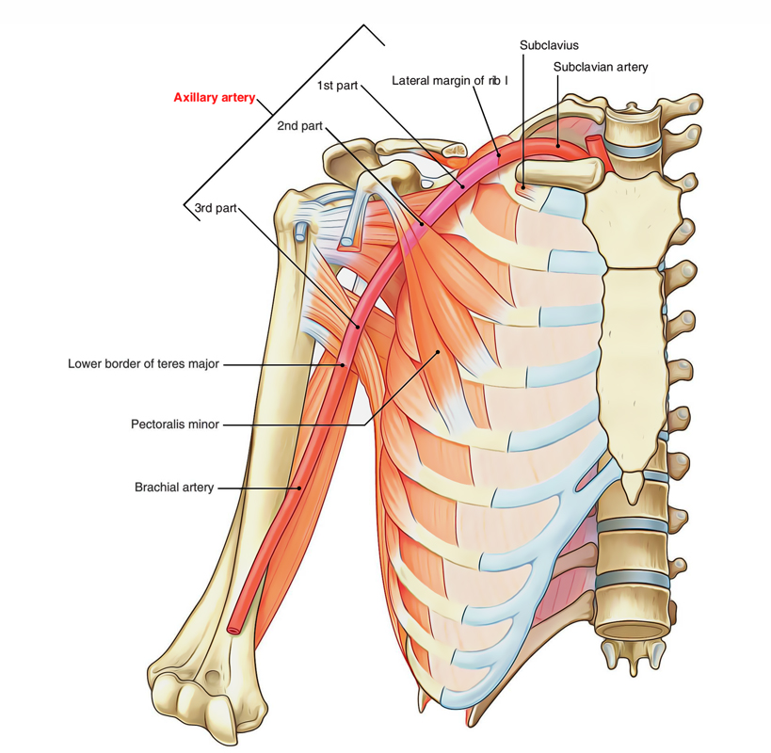
2- Axillary Artery
Helpful video
Begins at the lateral border of the 1st rib as continuation of the subclavian artery.
Continues as brachial artery at lower border of “teres major” muscle
Is closely related to the cords of brachial plexus and their branches
Is enclosed within the axillary sheath.(axillary sheath is a fibrous sheath that encloses the axillary artery and the three cords of the brachial plexus to form the neurovascular bundle )
Is crossed anteriorly by the pectoralis minor muscle, and is divided into three parts: 1st, 2nd & 3rd.

Slide 5
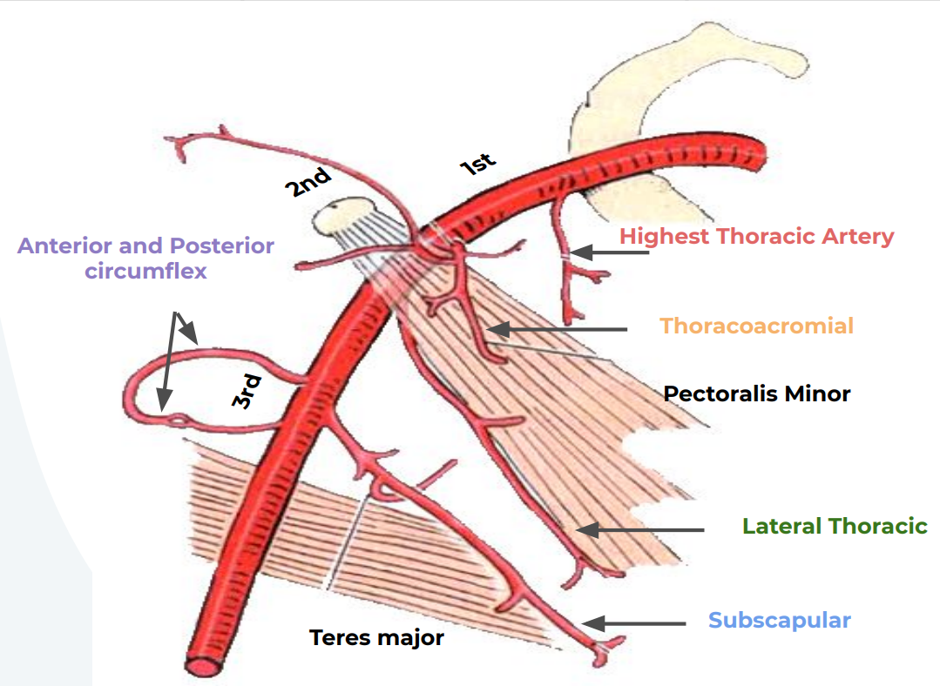
2-Axillary Artery
1st part | 2nd part | 3rd part
-Extends from the lateral border of 1st rib to upper border of the pectoralis minor muscle. | - Lies behind the pectoralis minor muscle. | - Extends from the lower border of pectoralis minor muscle to the lower border teres major muscle.
-Related: 1. Anteriorly: to the pectoralis major muscle, skin, and crossed by the cephalic vein. 2. Posteriorly: The long thoracic nerve. 3. Laterally: the three cords of the brachial plexus. 4. medially: the axillary vein | -Related: 1.Anteriorly: the pectoralis minor, the pectoralis major muscle, and, skin. 2.Posteriorly: the posterior cord of the brachial plexus, the subscapular muscles and, shoulder joint. 3.Laterally: the lateral cord of the brachial plexus, 4.Medially: the medial cord of the brachial plexus, and the axillary vein. | -Related: 1.Anteriorly: the pectoralis major muscle, lower down crossed by medial root of the median nerve 2.Posteriorly: the subscapular, latissimus dorsi, and the teres major muscles and, the axillary and radial nerves. 3.Laterally: the coracobrachialis, biceps, and humerus, lateral root of the median nerve and musculocutaneous nerves 4.Medially: the ulnar nerve, the axillary vein, and, the medial cutaneous nerve of the arm.
- It gives ONE branch: Highest thoracic artery (also called superior) | -It gives TWO branches: 1. Thoracoacromial 2. Lateral thoracic | It gives THREE Branches: 1. Subscapular 2. Anterior circumflex humeral 3. Posterior circumflex humeral
ONE branch → FIRST part
TWO branches → SECOND part
THREE branches → THIRD part
important
Helpful mnemonic: Save The Lions And Protect Species
Thanks Team441

Slide 6
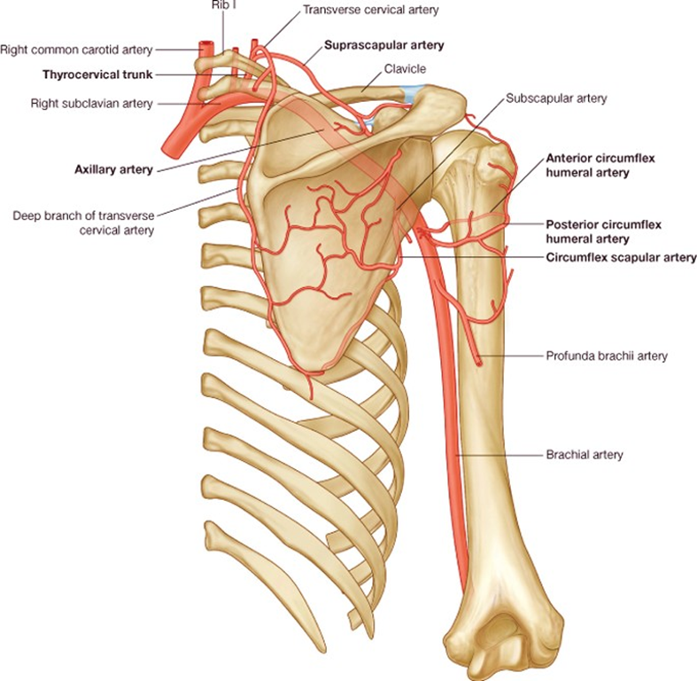
Helpful video
Anastomosis around shoulder joint (SCAPULA)
The wide range of movement of the shoulder may be accompany with kinking (التواء) of the axillary artery and a temporary occlusion (انسداد) of its lumen
Anastomosis occurs between branches of Subclavian and Axillary arteries:
شرح: فائدة الanastomosis بشكل عام انه في حالة ضعف النبض من أحد الشرايين يصير فيه شريان ثاني يعوض نبض الدم بحيث ما ينقطع الدم عن الجزئية اللي يغطيها, ففي حالة انسداد الaxillary artery فيه شرايين أخرى تضخ الدم وتعوض عن الشريان المنسد.
Subclavian Artery branches
Axillary Artery branches
Suprascapular artery
Subscapular artery
Transverse cervical artery
Another name: (superficial cervical artery).
Anterior circumflex humeral artery
Posterior circumflex humeral artery

Slide 7
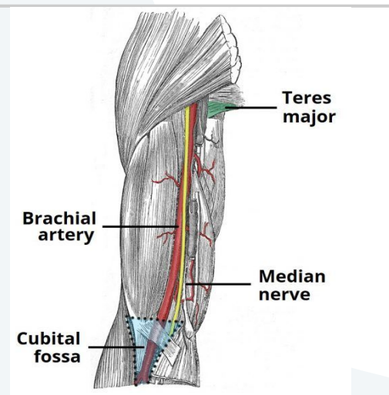
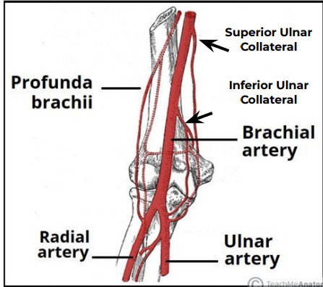
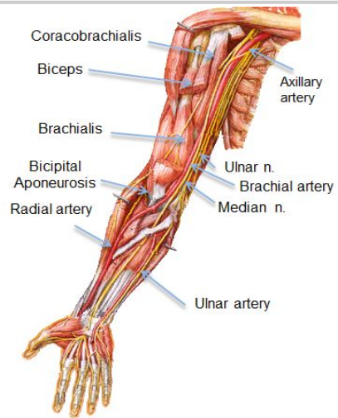
Helpful video
3- Brachial artery
- Is a continuation of the axillary artery at the lower border of teres major muscle. - Provides main arterial supply to the arm. - Terminates opposite of Neck of Radius by dividing into Radial & Ulnar arteries.
Relations | Branches
1- Anteriorly: it is superficial and overlapped from the lateral side by coracobrachialis and biceps, crossed from above downward by medial cutaneous nerve of the forearm, median nerve, and bicipital aponeurosis. 2- Posteriorly: triceps, coracobrachialis and brachialis. 3- Medially: in the upper part of the arm; basilic vein, and ulnar nerve, in the lower part of the arm; median nerves. 4- Laterally: above; the median nerve, coracobrachialis and biceps muscles, the biceps tendon, in the lower part | 1- Muscular 2- Nutrient to humerus 3- Profunda brachii: It arises from the brachial artery near its origin. It accompanies the radial nerve through the spiral groove, supplying the triceps muscle and sends anastomosis around the elbow joint 4- Superior ulnar collateral 5- Inferior ulnar collateral.

Slide 8
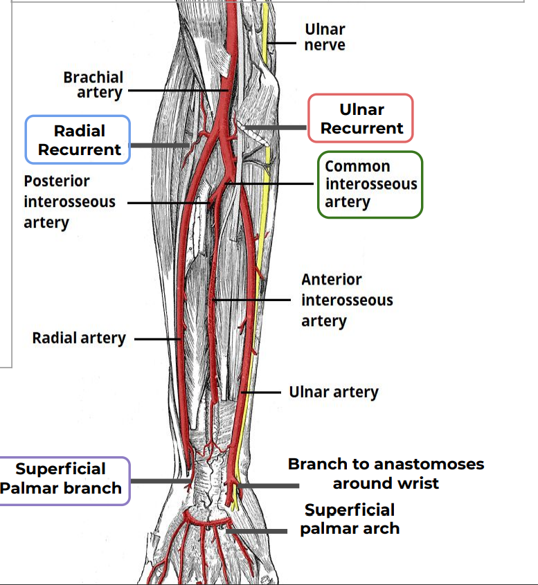
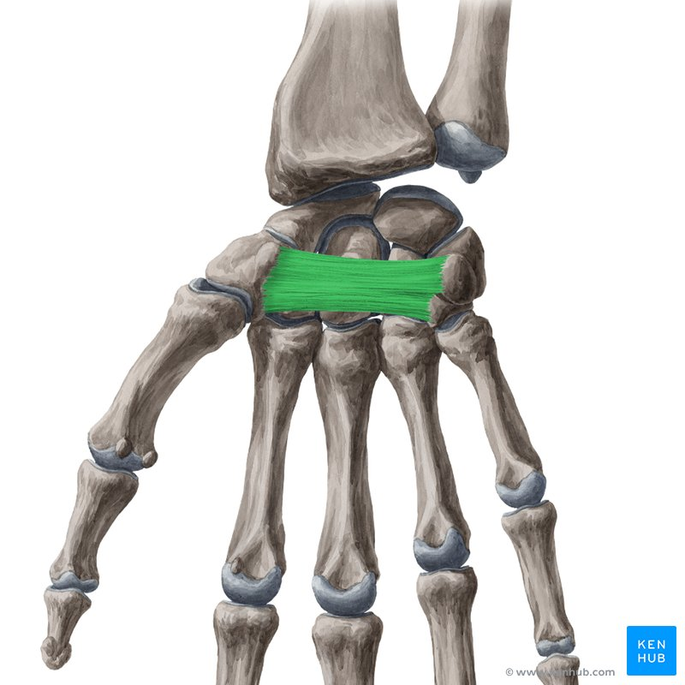
4- Ulnar Artery
- The larger of the two terminal branches of the brachial artery. - Begins in the cubital fossa at the level of neck of radius. - Descends through the anterior compartment of the forearm. - Enters the palm, in front of the flexor retinaculum, with the ulnar nerve. - Ends by forming the superficial palmar arch, by anastomosing with superficial palmar branch of radial artery.
Branches
- Muscular (Muscles of forearm). - Recurrent branch (for anastomosis around the elbow joint). (In front of the medial epicondyle where it meets the superior ulnar collateral) - Common Interosseous artery, which gives: Anterior and Posterior Interosseous arteries. - Branch to anastomoses around the wrist joint.
Helpful video
Ulnar recurrent
Common interosseous artery
(Common means it will divide)
Anterior View

Slide 9
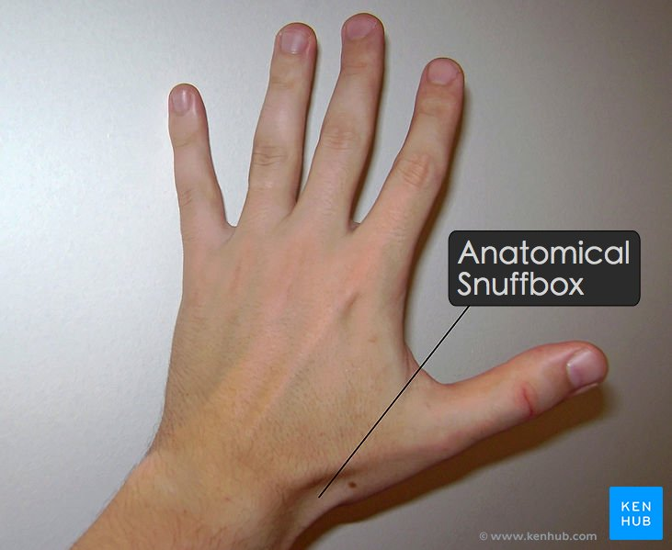
5-Radial Artery
- The smaller of the two terminal branches of the brachial artery. - Begins in the cubital fossa at the level of neck of radius. - Descends downward and laterally. - Leaves the forearm by winding around the lateral aspect of the wrist to reach the dorsum of the hand. (In anatomical snuff box)
Branches
- Muscular - Recurrent branch (for anastomosis around the elbow joint). - Superficial palmar branch , joins the ulnar artery to form the superficial palmar arch.
Radial recurrent
Superficial palmar branch
Anterior View

Slide 10
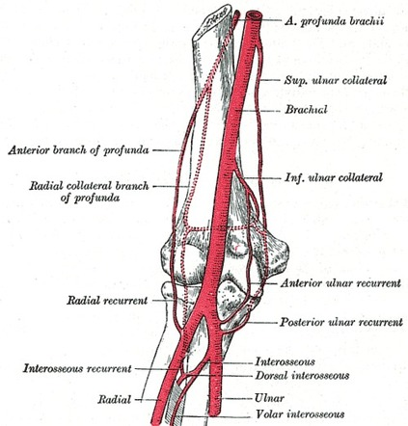
Anastomosis around Elbow Joint
Anastomosis occurs between branches of Brachial, Radial and Ulnar arteries
Brachial artery | Superior ulnar collateral. Inferior ulnar collateral.
Profunda brachii | Middle collateral artery. Radial collateral artery.
Ulnar Artery | Anterior ulnar Recurrent. Posterior ulnar Recurrent.
Posterior interosseous | interosseous recurrent.
Radial Artery | Radial Recurrent.

Slide 11
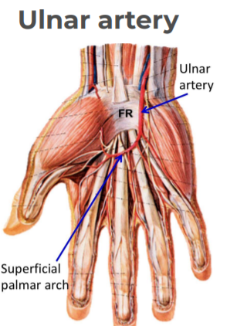
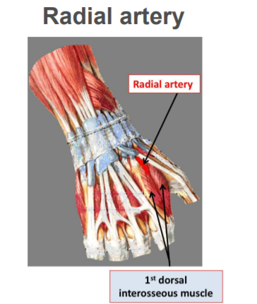
arteries of the palm
Ulnar artery | Radial artery
Enters the hand: Anterior to the flexor retinaculum On the lateral side of the ulnar nerve and pisiform bone. | Leaves dorsum of the hand by turning forward between the proximal ends of the 1st and 2nd metacarpal bones and two heads of the 1st dorsal interosseous muscle.
Gives a deep branch. | On entering the palm it continues as deep palmar arch.
Continue as the superficial palmar arch | It gives; arteria radialis indicis and arteria princeps pollicis.

Slide 12
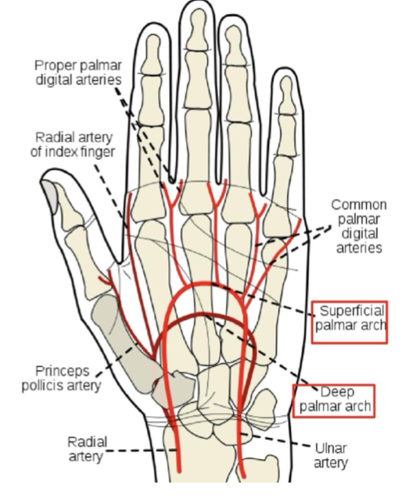
arteries of the palm
The Superficial Palmar Arch | The Deep Palmar Arch
Is the direct continuation of the ulnar artery, as it curves laterally behind the palmar aponeurosis | Is a continuation of the radial artery as it curves medially beneath long flexor tendons , in front of the metacarpal bones and interosseous muscles
Is completed by branch from the radial artery | Is completed on the medial side by deep branch of ulnar artery
Lies approximately at the level of the Distal Border of the Extended Thumb | Lies at a level of the Proximal Border of Extended thumb
Gives: digital arteries from its convexity to supply the fingers. | It sends branches: -superiorly: to share in anastomosis around the wrist joint -inferiorly: to join branches of the superficial palmar arch.
“The superficial palmar arch is more distal than the deep palmar arch”

Slide 13
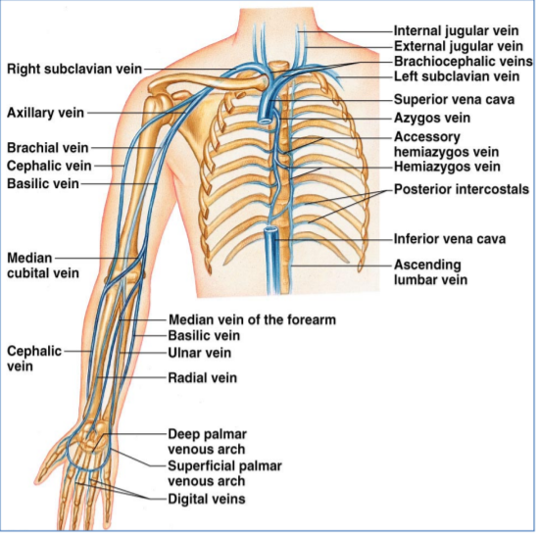
Veins of the Upper Limb
• The veins of the upper limb are divided into two sets: Superficial and Deep
• The two sets anastomose frequently with each other.
• The superficial veins are placed immediately beneath the skin, in the superficial fascia.
• The deep veins accompany the arteries, and constitute the venae comitantes of those vessels.

Slide 14
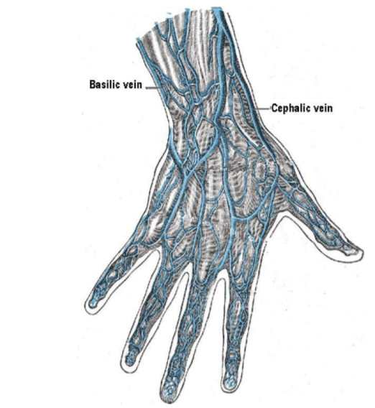
Superficial Veins of the Upper Limb(Dorsal Venous Arch (network) )
•The dorsal digital veins drain into dorsal metacarpal veins, which unite to form a dorsal venous arch or network.
•Dorsal venous network lies on the dorsum of the hand, in the subcutaneous tissue, proximal to the metacarpophalangeal joints.
•Drains into the Cephalic vein laterally, and Basilic vein medially.

Slide 15
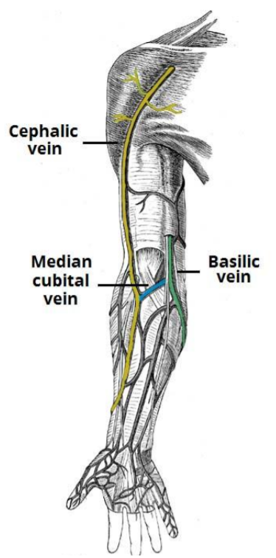
Superﬁcial Veins
Cephalic Vein | Basilic Vein | Median Cubital Vein
• Arises from the lateral end of the dorsal venous arch of hand. •Ascends on radial side of the forearm to the elbow and continues up the arm in the deltopectoral groove. • Pierces clavipectoral fascia to drain into the axillary vein. | •Arises from the medial side of the dorsal venous arch of hand. •Ascends on the ulnar side of forearm to the elbow. In the middle of the arm, it pierces the deep fascia and joins the brachial vein or axillary vein. | •Links cephalic vein and basilic vein in the cubital fossa. •Is a frequent site for venipuncture. A procedure in which a needle is used to take blood from a vein
superficial veins

Slide 16
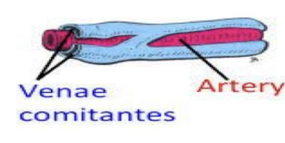
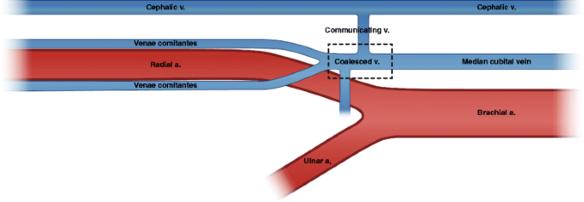
Deep Veins of the Upper Limb
•Accompany the arteries of the same region and bear similar names.
1- Venae comitantes: They are generally arranged in pairs, and are situated one on either side of the corresponding artery, and connected at intervals by short transverse branches.
•The superficial and deep palmar arterial arches are each accompanied by a pair of venæ comitantes which constitute the superficial and deep palmar venous arches, and receive the veins corresponding to the branches of the arterial arches.
•The deep veins of the forearm are the venae comitantes of the radial and ulnar arteries.
2-The brachial veins are placed one on either side of the brachial artery
Venae comitantes

Slide 17
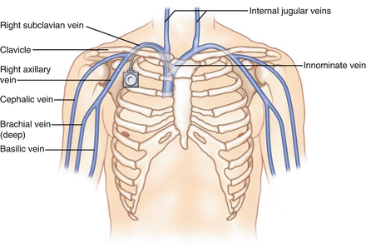
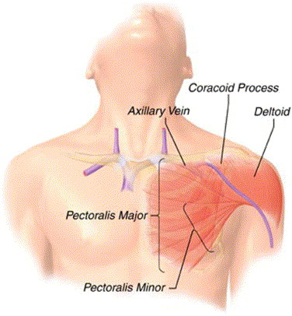
Deep Veins of the Upper Limb cont..
3-The Axillary vein | 4- The Subclavian vein
● Begins at the lower border of the Teres major, as the continuation of the basilic vein. ● Ends at the outer border of the first rib as the subclavian vein. ● Receives the brachial veins and, close to its termination, the cephalic vein. | ● Is the continuation of the axillary vein. ● Extends from the outer border of the first rib to the sternal end of the clavicle, where it unites with the internal jugular to form the Brachiocephalic (Innominate) vein

Slide 18
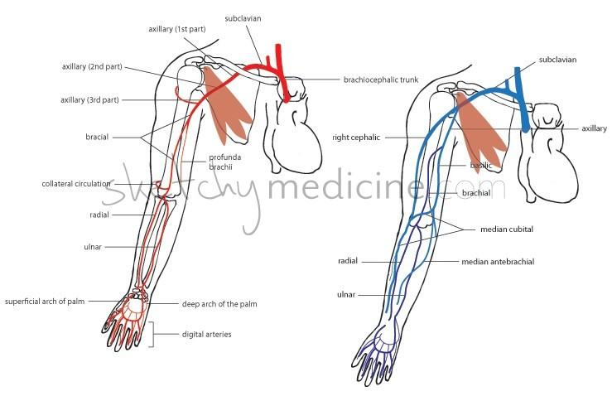
small summary

Slide 19
MCQs:
Q1
Axillary artery is divided into 3 parts by?
A
Teres major
B
Pectoralis minor
C
Triceps
D
Teres minor
Q2
Which one of the following branches is considered as subclavian artery branch?
A
Posterior circumflex
humeral artery
Common interosseous artery
D
Subscapular artery
B
C
Suprascapular artery
Q3
The superficial palmar arch lies approximately at the level of......the extended thumb?
A
C
Proximal border
The medial border
The distal border
The lateral border
B
D
Q4
Which of the following is the frequent site of the venipuncture is?
Answers1.B
2.D
3.C
4.C
A
Cephalic vein
B
Brachial vein
C
Median Cubital vein
D
Basilic vein
Thanks To Team 441 For Q-Bank!

Slide 20
MCQs:
Q5
Radial arteries leaves the dorsum hands by turning forward between the proximal ends of?
A
2nd and the 3rd
metacarpals
B
3rd and the 4th
metacarpals
C
1st and the 2nd
metacarpals
D
5th and 4th
metacarpals
Q6
The radial artery begins in the cubital fossa at the level of ?
A
The humerus
epicondyle
B
Neck of the radius
C
The styloid process
of ulna
D
The radial groove of the humerus
Q7
Which one of the following is a radial artery branch?
A
Superficial palmar
branch
B
Common
interosseous artery
C
Profunda brachii
D
Laterally
Answers
5.C
6.B
7.A
Thanks To Team 441 For Q-Bank!

Slide 21
Done by the amazing team
Team leaders:
Arwa Alghamdi
Deema Aljuribah
Razan Alnufaie
Team leaders:
Mishal Alsuwayegh
Mohammed Alghamdi
Members:
Members:
Aljazi Albabtain
Atheer Alkanhal
Arob Alasheikh
Ajwan Aljohani
Deema alqahtani
Dena Alsuhaibani
Farah alqazlan
Jana Alhazmi
Kadi aldosari
Mashael Alasmari
Noura Bin hammad
Najla aldhbiban
Nouf aldalaqan
Razan alasmari
Roaa alharbi
Raghad Mohammed
Shaden albassam
Waha Almathami
Walaa AlMutawa
Yara Ameer Alalwan
Othman Aldraihem
Faisal Alomar
Abdullah Alturki
Othman Alabdullah
Omar Alkadhi
Abdullah Ali
Meshari Alshathri
Yazeed Alsanad
Fahd Mobaireek
Emad Almutairi
Nasser Alghaith
Saad Almogren
Azzam Abdullah Alotaibi
Hassan Ali Alabdullatif
Rayan Alotaibi
Mohammed Nasser
Luay Almutair
Mohammed Fahad
Mohammed Majed
Abdulkarim Salman
anatomyteam442@gmail.com
Thanks to Faisal Alomar for his design of the team logo

