Slide 1
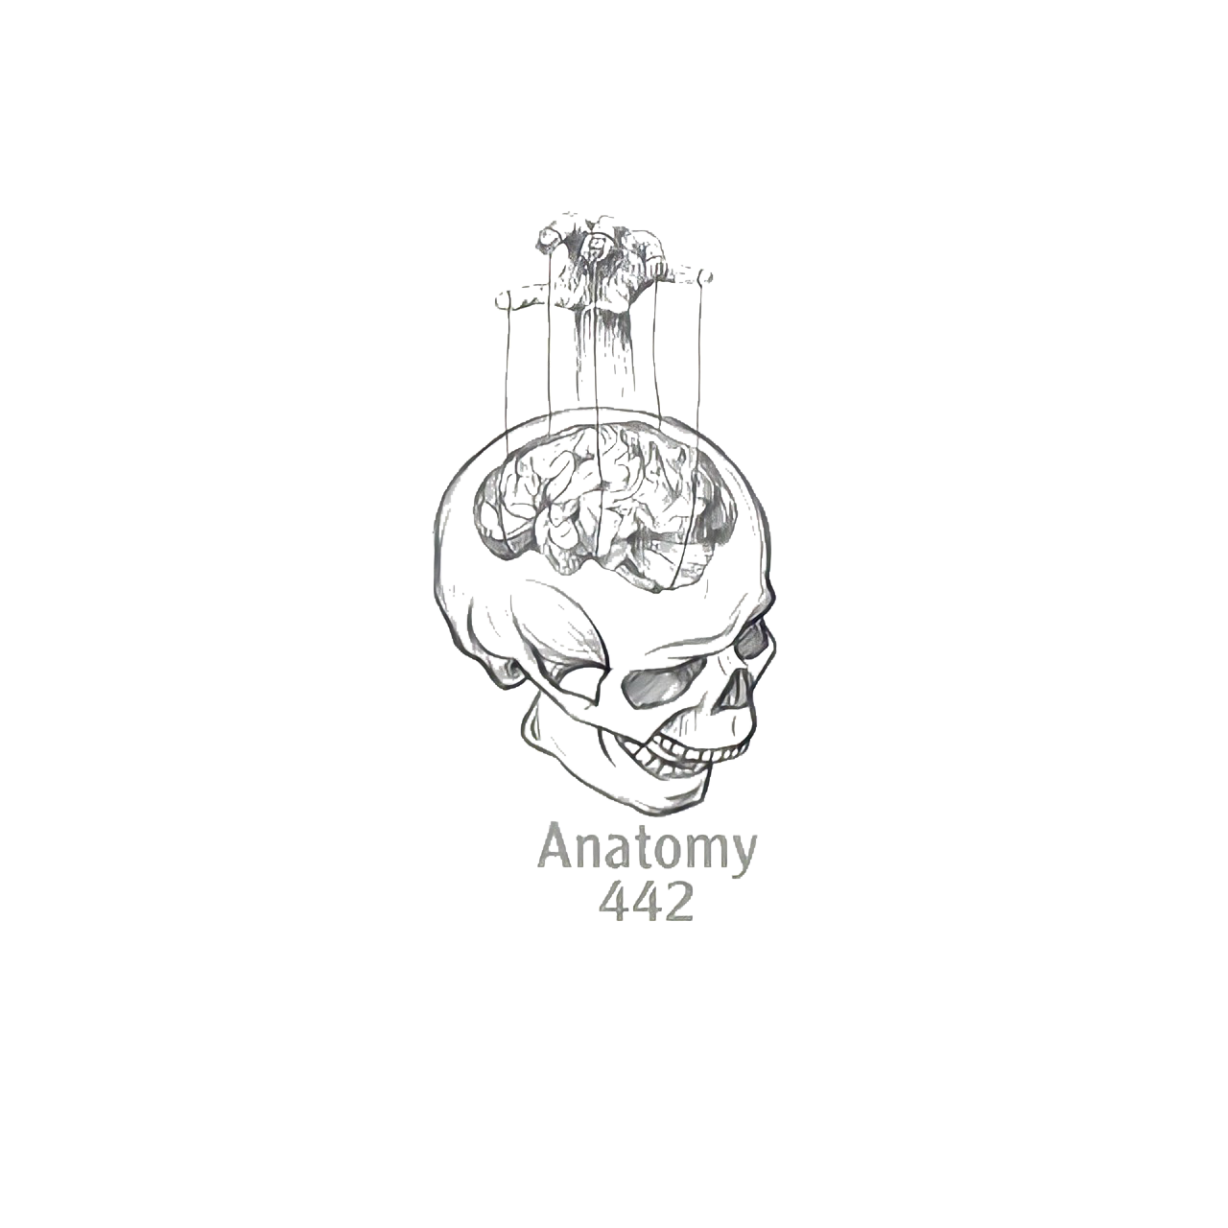
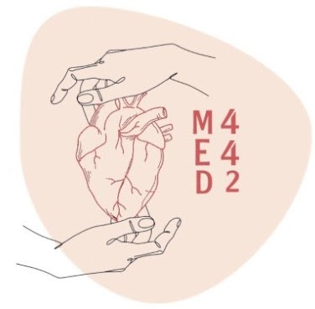
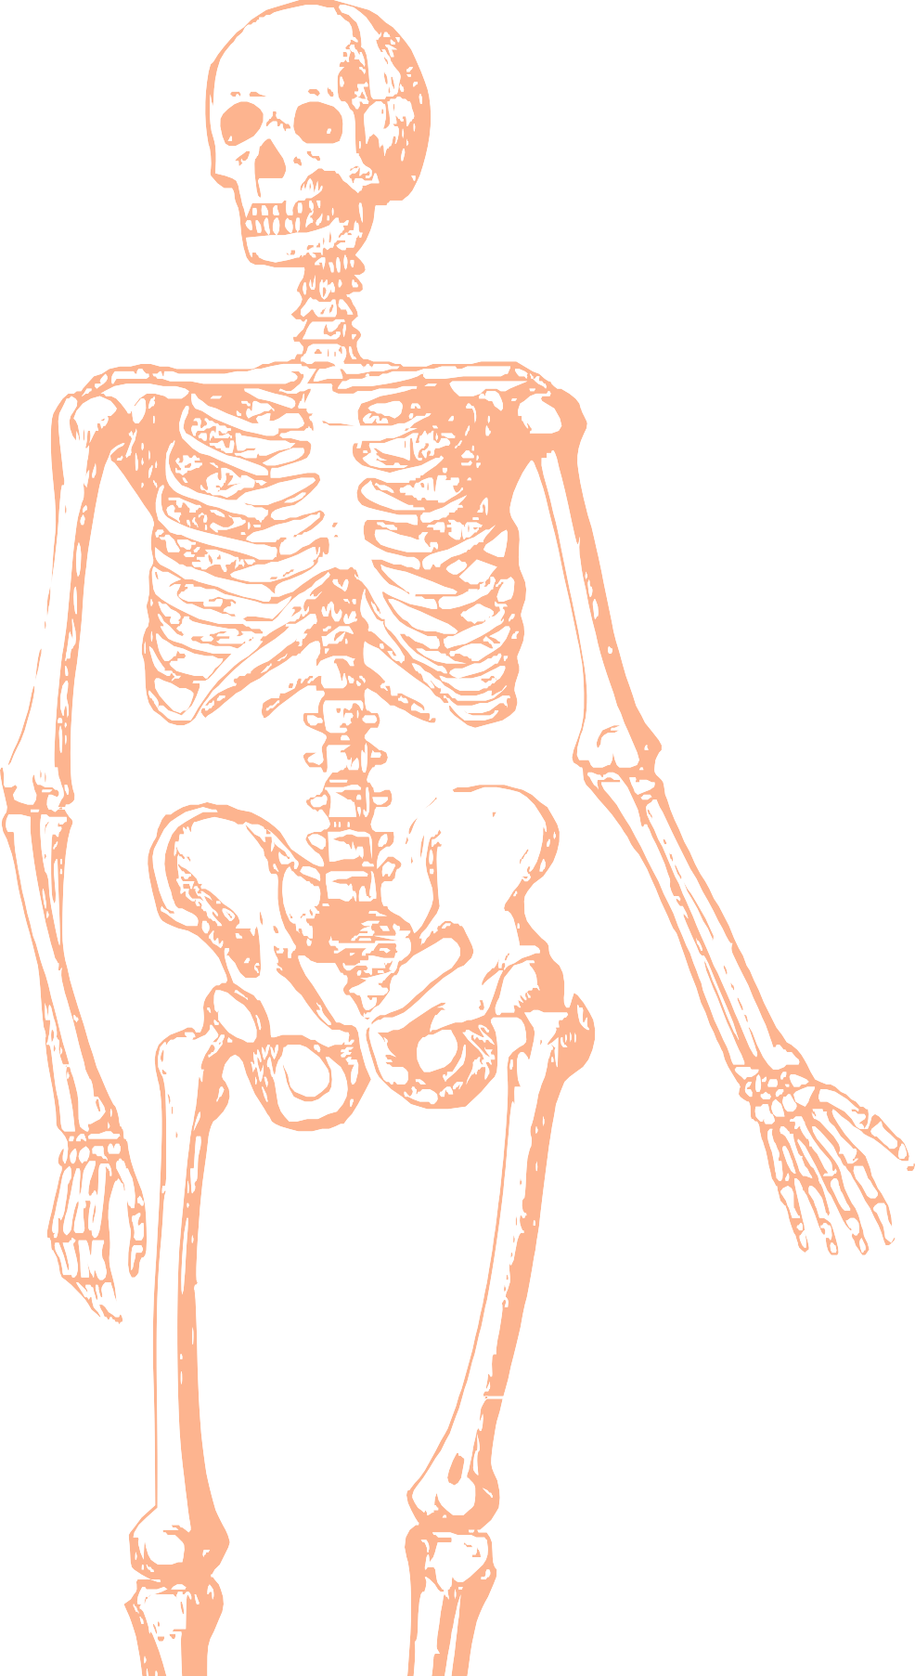
L8
Anatomy of the Forearm
Editing file
Color index:
Main text
Important
Doctors notes
Female slides only
Male slides only
Extra

Slide 2
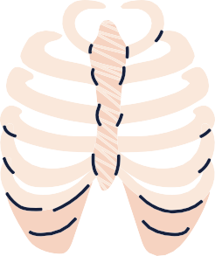
OBJECTIVES
●List the names of the Flexors Group of Forearm (superficial & deep muscles).
●Identify the common flexor origin of flexor muscles and their innervation & movements.
●Identify supination & pronation and list the muscles produced these 2 movements.
●List the names of the Extensor Group of Forearm (superficial & deep muscles).
●Identify the common extensor origin of extensor muscles and their innervation & movements.

Slide 3
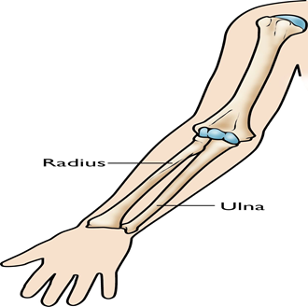
Skin
Helpful video
Helpful video
• Sensory nerve supply:
• Anterior and posterior branches of the lateral cutaneous nerve of the forearm, (continuation of the musculocutaneous nerve).
• Anterior and posterior branches of the medial cutaneous nerve of the forearm (medial cord of the brachial plexus).
• Posterior cutaneous nerve of the forearm, (of the radial nerve).
In Males’ Slides Only
Forearm
1- The forearm extends from the elbow to wrist.
2- It posses two bones radius laterally and ulna medially.
3- The two bones are connected together by the interosseous membrane.
4- This membrane allows movement of pronation and supination while the two bones are connected together.
5- It also gives origin to the deep muscles

Slide 4
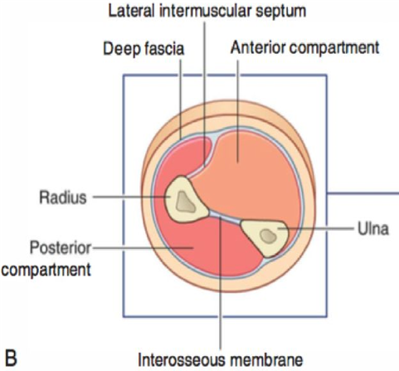
Fascial Compartment of the Forearm:
1- The forearm is enclosed in a sheath of deep fascia, which is attached to the posterior border of ulna (it encircle the forearm completely (Without touching the radius) and return again to the posterior border of the ulna)
2- This fascial sheath together with the interosseous membrane and fibrous intermuscular septa divides the forearm into (anterior and posterior) compartments each having its own muscles, nerves and blood supply. (The radius and ulna are connected by 3 structures: the interosseous membrane, superior radioulnar joint and inferior radioulnar joint).
1- These 8 muscles..
2- They act on the elbow and wrist joints and the fingers.
3- They form fleshy masses in the proximal part and become tendinous in the distal part of the forearm.
4- They are arranged in Three groups which are : Superficial - Intermediate - Deep

Slide 5
Anterior Compartment - Flexor Group:
Flexor group
Superficial : 4 muscles.
Pronator teres.
Flexor carpi radialis.
Palmaris longus
Flexor carpi ulnaris.
Intermediate : 1 muscle.
Flexor digitorum superficialis.
Deep 3 muscles.
Flexor digitorum profundus.
Flexor pollicis longus.
Pronator quadratus.
Females dr : you can include the intermediate muscle as a superficial muscle
Nerve supply :
• All muscles are supplied by the median nerve and its branches except flexor carpi ulnaris and medial half of flexor digitorum profundus by the ulnar nerve.
Arterial supply :
• Ulnar and radial arteries

Slide 6
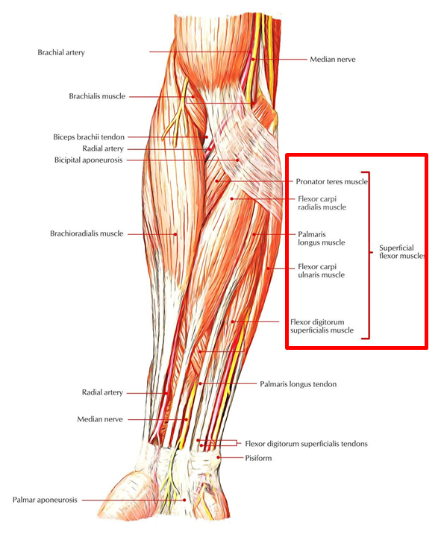
See the next slide
Superficial Flexors :
From lateral to medial:
1- pronator teres
2-flexor carpi radialis
3-palmaris longus
4- flexor digitorum superficialis
5-flexor carpi ulnaris
1-They arise - more or less - from the common flexor origin (front of medial epicondyle). Note : the medial for superficial flexors and the latera for the superficial extensors in the posterior compartment of the forearm
2-All are supplied by median nerve EXCEPT one, flexor carpi ulnaris (FCU) which is supplied by the ulnar nerve.
3-All cross the wrist joint EXCEPT one, pronator teres (PT).

Slide 7
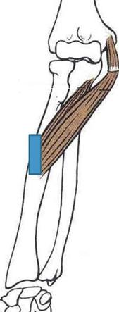
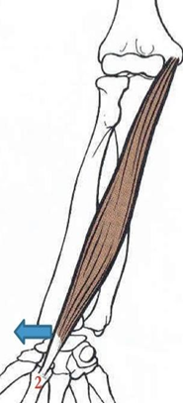
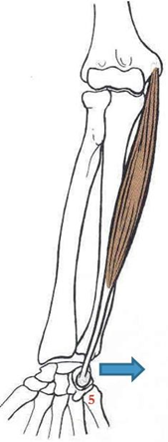
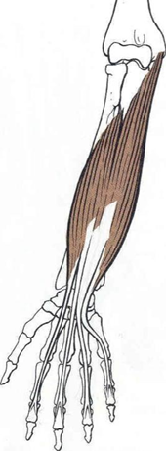
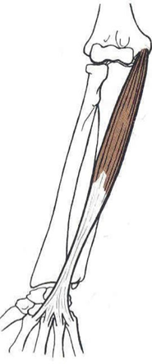
Superficial Flexors
muscle | 1) Pronator teres | 2)Flexor carpi radialis | 3)Palmaris longus (May be absent) | 4)Flexor carpi ulnaris | 5)Flexor digitorum superficialis (Intermediate group)
Origin | Common flexor origin (front of medial epicondyle) more or less |  |  |  | -Humeroulnar head: Common flexor origin. -medial border of -Coronoid process of ulna. -Radial head: Anterior surface of radius or Anterior oblique line of radius
 | Superficial head (humeral): lower part of the medial supracondylar line. Deep head (ulnar): medial border of the coronoid process. | Common flexor origin (front of the medial epicondyle). | Common flexor origin | Humeroulnar head: Common flexor origin.
Insertion | impression on the middle of lateral surface of the shaft of radius. (does not cross wrist | Deep to flexor retinaculum in to the Base of 2nd metacarpal bone | Superficial to/into the flexor retinaculum in wrist & in to the apex of the palmar aponeurosis in hand | - Pisiform -Hook of hamate -5th metacarpal bone | /Four tendons, deep to flexor retinaculum in to (Base of) the middle phalanges of the medial four fingers.
Nerve supply | Median nerve |  |  | Ulnar nerve | Median nerve
Action | pronation (main action )& flexion of forearm (Elbow) | flexion of wrist and elbow & abduction of the wrist | Flexes hand (wrist) and elbow and tightens (fixed) palmar aponeurosis | Flexion and adduction (with extensor carpi ulnaris) of the hand.(wrist) | Flexion of: the middle and proximal phalanges of medial 4 fingers + the hand. /Flexion of the wrest ,Flexion of interphalangeal and metacarpophalangeal joints of the medial four fingers.

Slide 8
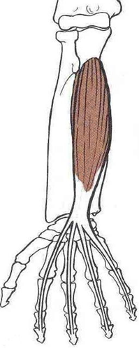
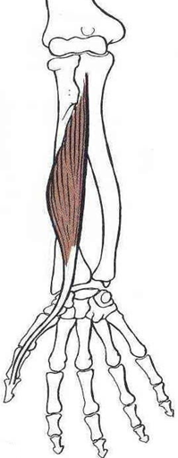
Deep Flexor Group of Forearm
Deep flexors of forearm | Flexor Digitorum Profundus (above ulna) | Flexor Pollicis Longus (above radius) | Pronator Quadratus (above the 2 bones) Looks like a clock
Origin | Upper 3/4 anterior and medial surfaces of ulna. | upper ⅔ Anterior surface of the radius | lower part of anterior surface of ulna. Oblique strip front of the lower part of shaft of radius.
Insertion | Deep to flexor retinaculum in to the bases of distal phalanges (terminal phalanx) of medial 4 digits. | Deep to flexor retinaculum in to the base of distal/terminal phalanx of thumb | distal fourth (lower part) of anterior surface (shaft) of radius.
Action | Flexion of interphalangeal and metacarpophalangeal joints (distal phalanges) of the medial four fingers. -flexes the hand (wrist). | flexes all joints of the thumb (interphalangeal, metacarpophalangeal, carpometacarpal). Flexion of the wrist. | -pronates the forearm (prime mover). -helps to hold the bones together (ulna and radius)
Nerve supply-all by anterior interosseous nerve EXCEPT medial half of flexor digitorum profundus | -Medial ½ : by ulnar Nerve. -Lateral ½ : by anterior interosseous nerve (branch of median N.) | anterior interosseous nerve (branch of median N.) | anterior interosseous nerve (branch of median N.)
Pictures

Slide 9
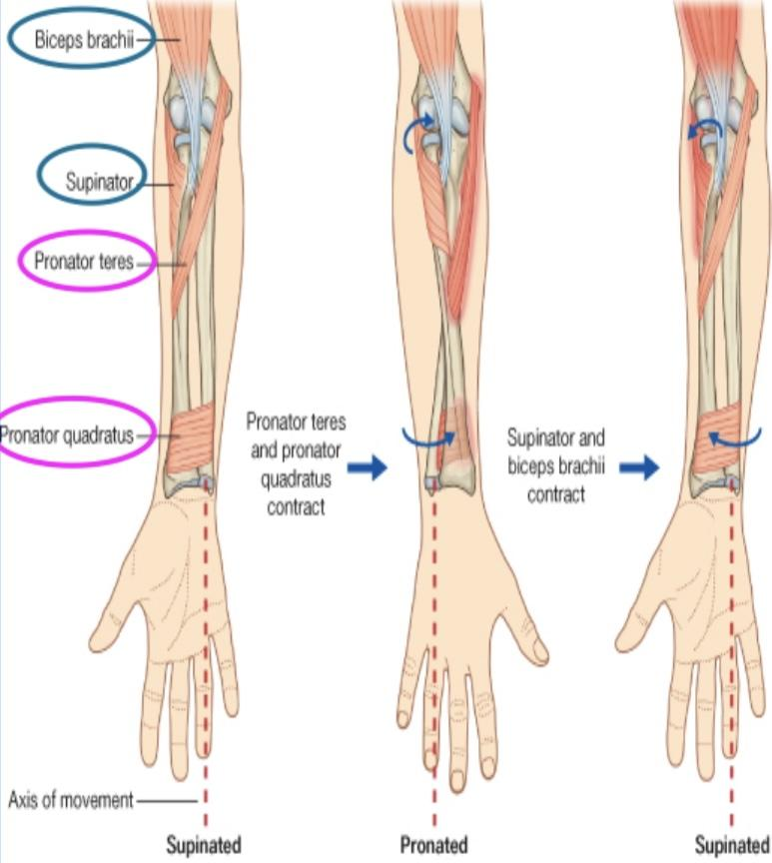
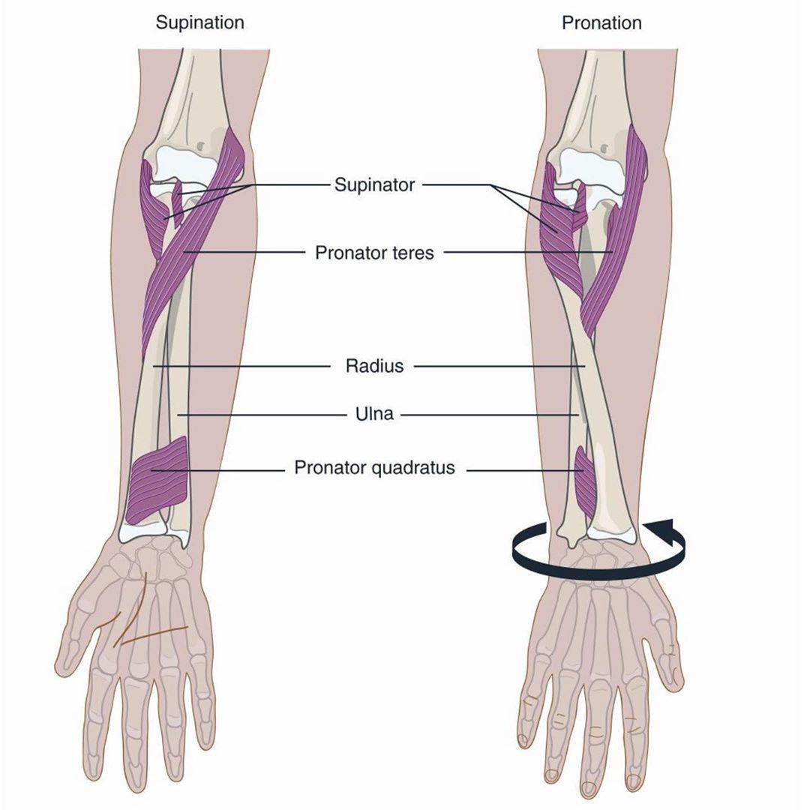
Supination and Pronation
In Males’ Slides Only
(Position of the arm)
Helpful video
It occurs in the superior and inferior radioulnar joints:
Muscle produce supination:
Biceps brachii (strong supinator)
Supinator.
Muscle produce pronation:
● Pronator
quadratus (prime mover).
● Pronator teres.
Brachioradialis
(posterior
compartment
of forearm but more in radial site)
put the forearm in mid-prone
position. (initiates pronation and
supination).
*Note from 441: in case of a fully extended arm the supinator muscle is the main muscle in supination, otherwise it’s the biceps.

Slide 10
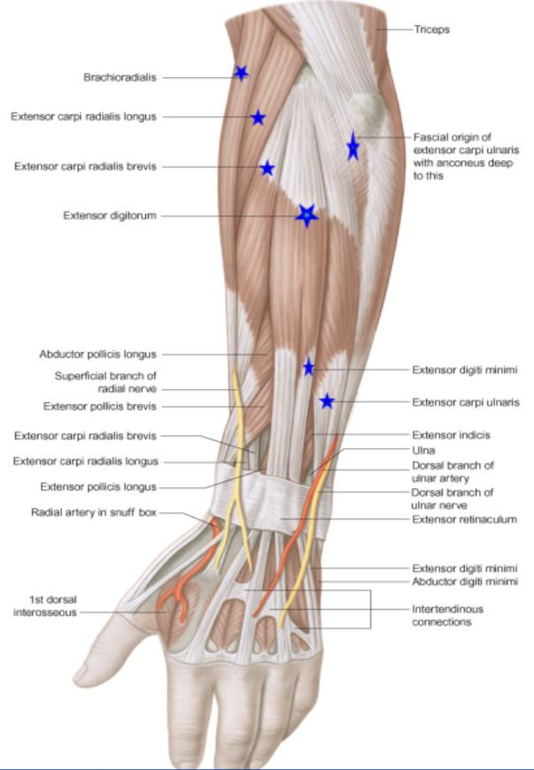
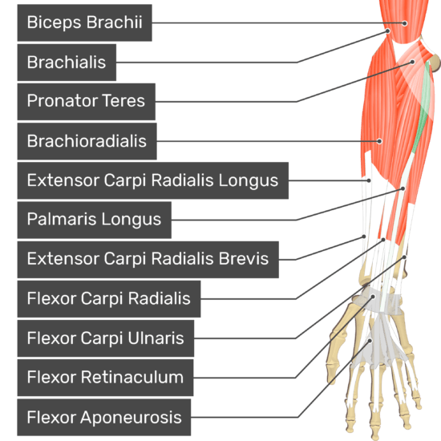
Posterior Compartment of Forearm:
Helpful video
-Brachioradialis. -Extensor carpi radialis longus.
-Origin: all arise from the common extensor origin (front of the lateral epicondyle).
-Except anconeus from back of lateral epicondyle.
Superficial Lateral Group: (2 muscles)
Deep Group: (5 muscles)
Superficial Group: (5 muscles)
From lateral to medial :
1-brachioradialis
2-extensor carpi radialis longus
3-extensor carpi radialis brivis
4-extensor digitorum
5-extensor digiti minimi
6-extensor carpi ulnaris
7-Anconeus
-Supinator
-(3) to the thumb:
-Abductor pollicis longus.
-Extensor pollicis longus.
-Extensor pollicis brevis.
-(1) to index:
-Extensor indicis.
-Extensor carpi radialis brevis.
-Extensor digitorum.
-Extensor digiti minimi.
-Extensor carpi ulnaris.
-Anconeus.

Slide 11
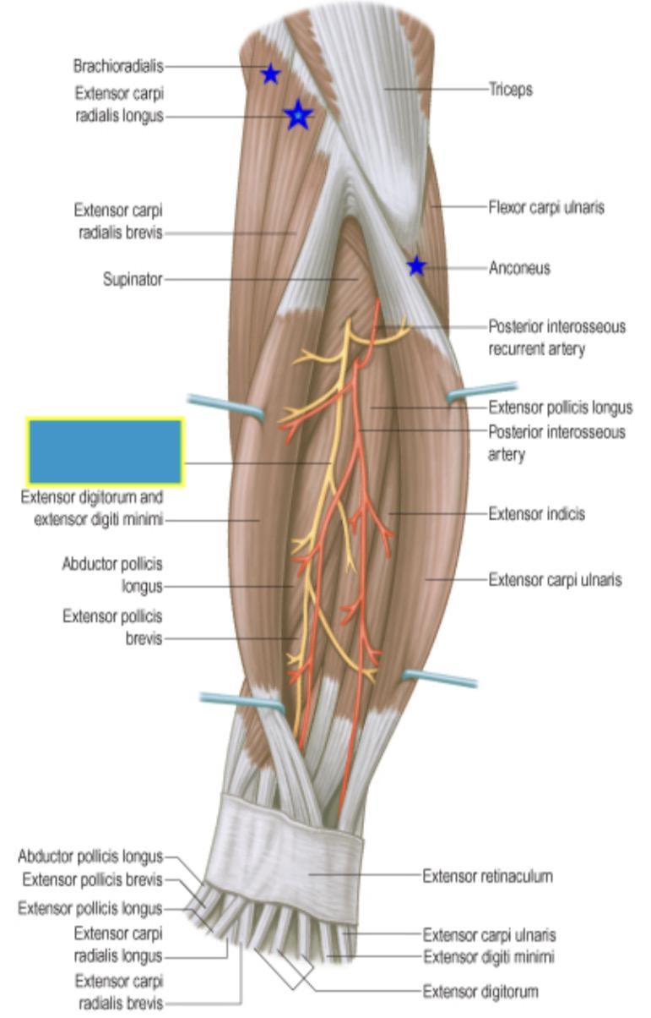
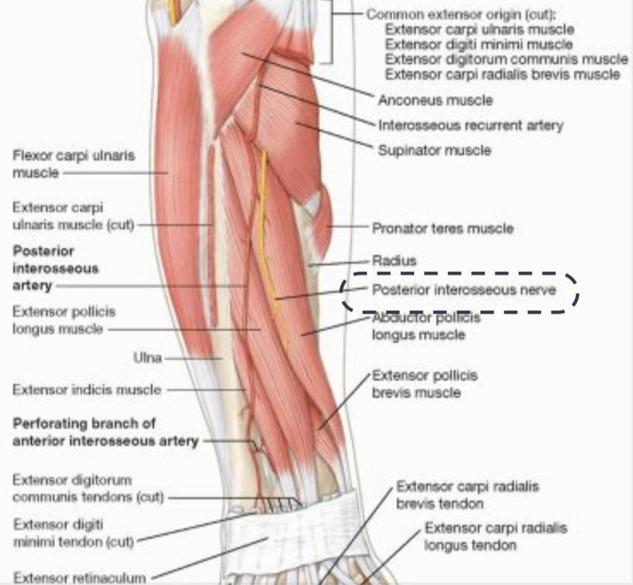
See the next slide
Superficial Extensors (7):
❖All arise from the common extensor origin, (front of lateral epicondyle of the humerus), EXCEPT 2 (BR & ECRL).
❖ All cross the wrist EXCEPT two, Brachioradialis, Anconeus.
❖ Nerve supply: All supplied by deep branch of radial nerve
(posterior interosseous nerve), EXCEPT ABE are supplied by the
radial nerve itself.
❖ ABE = Anconeus, Brachioradialis and
Extensor carpi radialis longus.

Slide 12
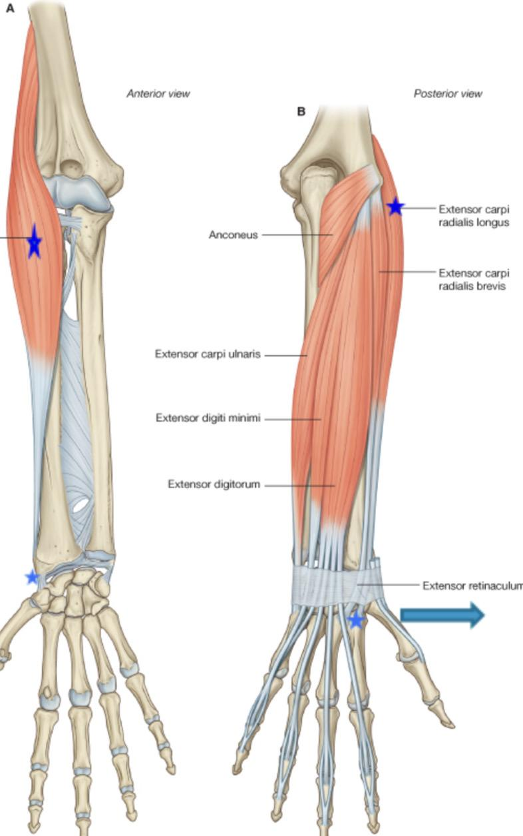
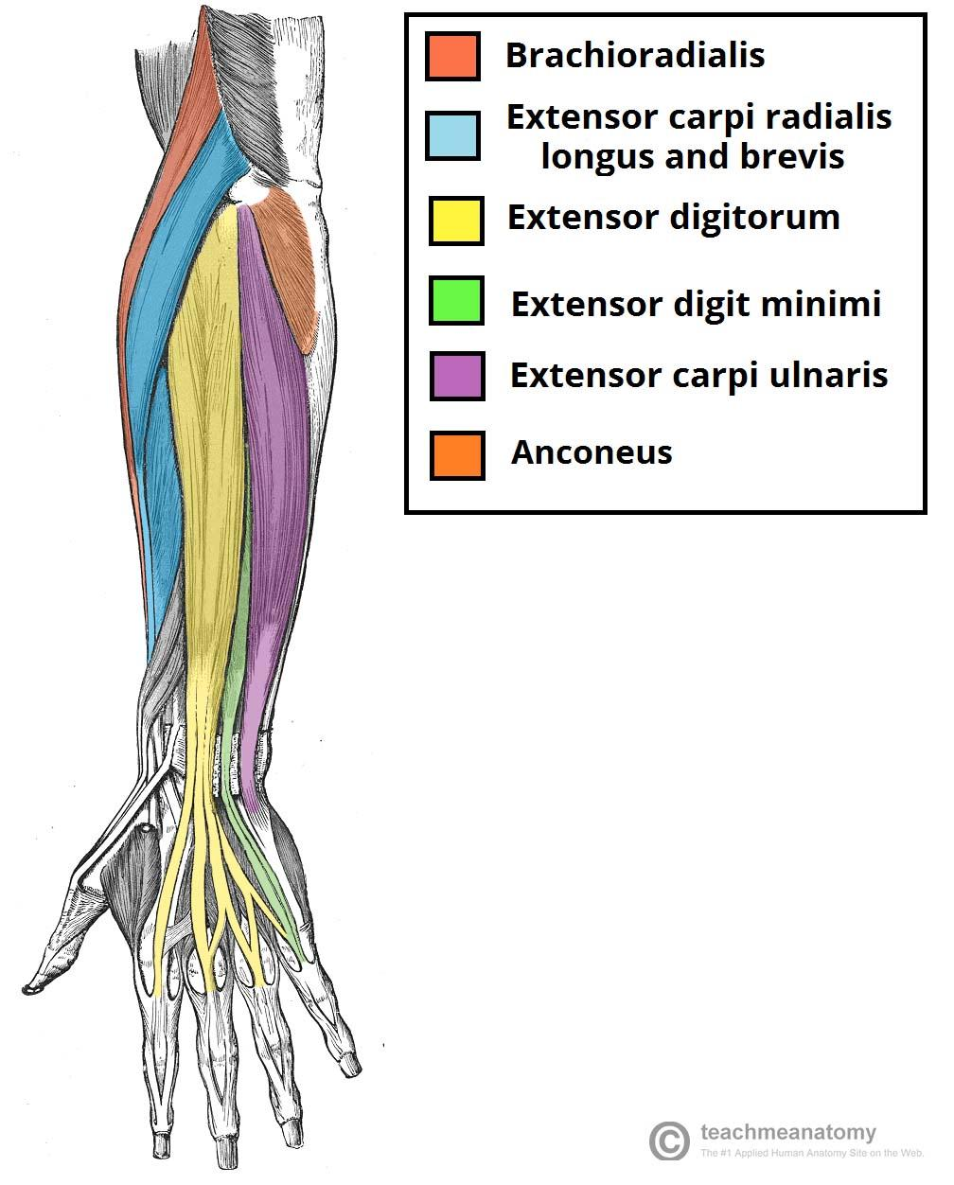
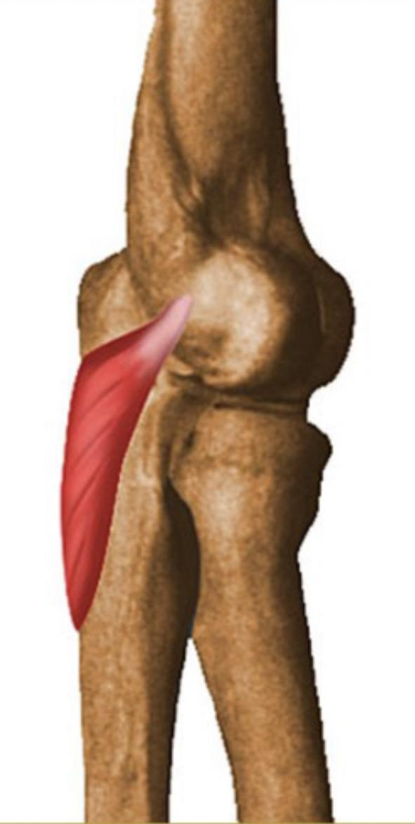
 | Muscle | Origin | Insertion | Action | Nerve supply | Photo
Lateral superficial group | Brachioradialis (BR) | Upper 2/3 of The Lateral supra- condylar ridge of humerus.. | Lateral side distal end at base of styloid process of the radius. | -Flexes forearm(elbow) -Rotates forearm to midprone position. | Radial nerve.
 | Extensor carpi radialis longus (ECRL) | Lower 1/3 of The Lateral supra- condylar ridge of humerus.. | Posterior surface of (Dorsum) base of 2nd metacarpal bone. | Extends and Abducts hand (radial rotation) at wrist joint.
Superficial group | Extensor carpi radialis brevis (ECRB) | Common extensor origin (the front of lateral epicondyle of the humerus ). | Dorsum of the Base of 3rd (middle finger) metacarpal bone. | Extension of the wrist | Posterior interosseous nerve.
 | Extensor digitorum (ED) |  | Extensor expansion of the medial 4 fingers. | Extension of the wrist, interphalangeal and metacarpophalangeal joints of the medial four fingers.
 | Extensor digiti minimi (EDM) |  | Extensor expansion of the little finger. | Extension of the wrist, interphalangeal and metacarpophalangeal joints of the little finger.
 | Extensor carpi ulnaris (ECU) | Common extensor origin posterior border of the ulna | Base of the 5th metacarpal bone. | Extension & adduction of the wrist (with flexor carpi ulnaris)
 | Anconeus (AN) | From the back of lateral epicondyle of the humerus. | Superior part of the posterior of ulna shaft and lateral side of the olecranon. | Extension of the elbow joint | Radial nerve (nerve to anconeus) and posterior interosseous nerve

Slide 13
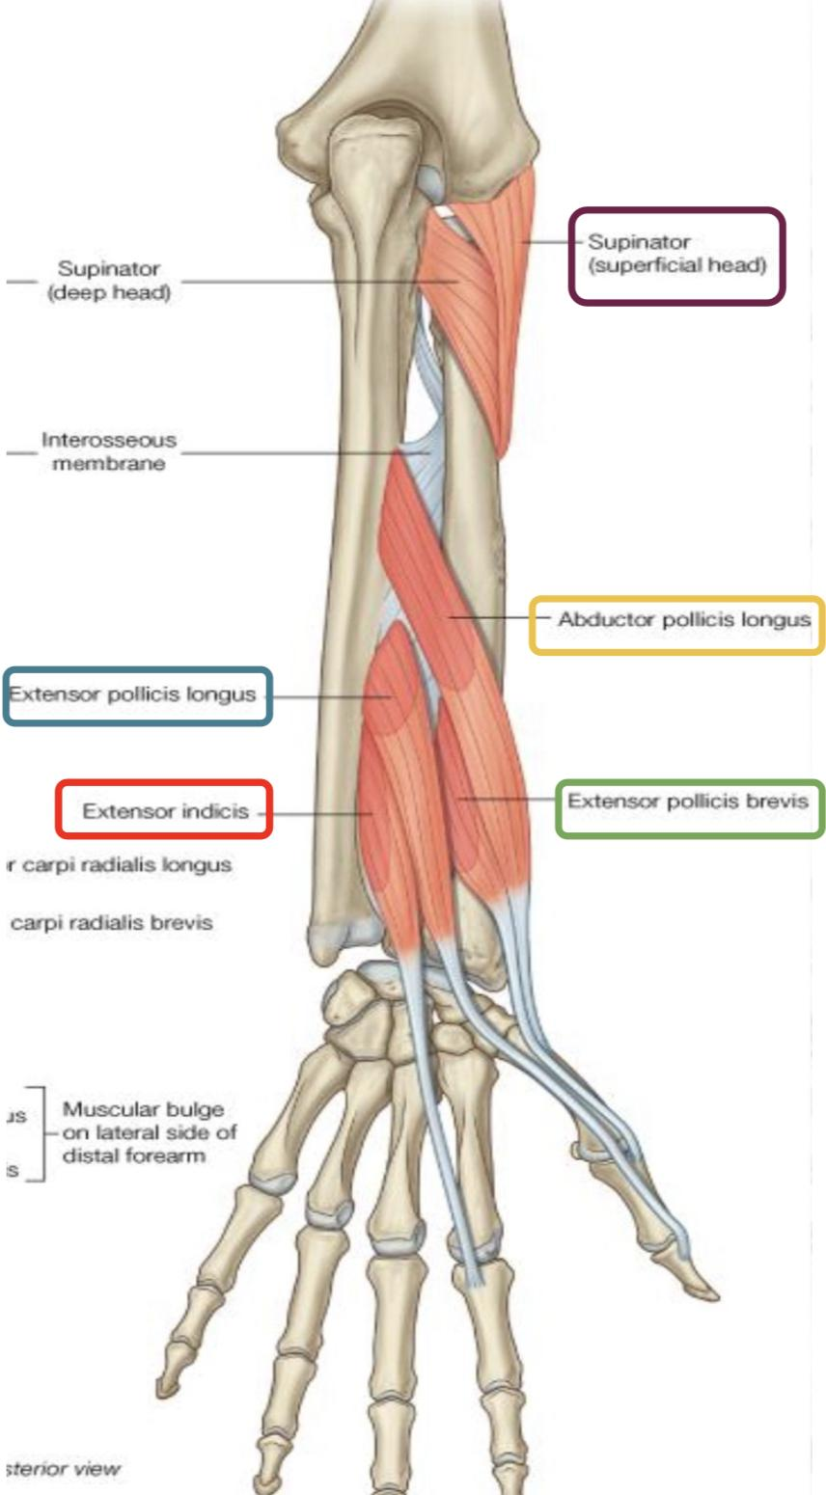
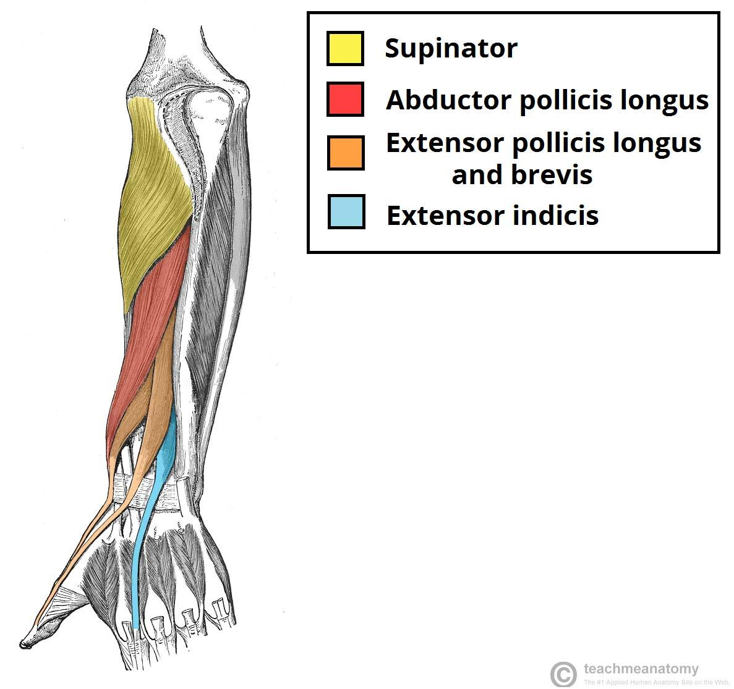
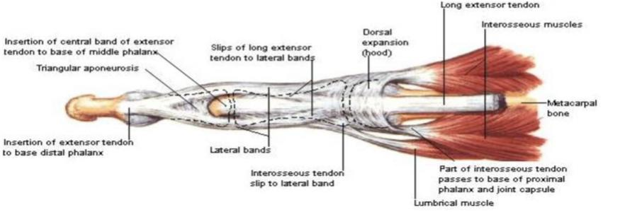
Posterior compartment (Deep group):
5 muscles : (3 to the thumb+1 to index & supinator)
Abductor pollicis longus, (APL).
Extensor pollicis brevis, (EPB).
Extensor pollicis longus, (EPL).
Extensor indicis (EI).
Supinator.
All back muscles of forearm are supplied by: posterior interosseous nerve, except ABE by Radial nerve .
Dorsal extensor expansion:
1
It is formed on the dorsum of medial 4 fingers by the union
of the long extensor tendons:
- Extensor digitorum
- Extensor digiti minimi
- Extensor indicis with palmar &
dorsal interossei & lumbricals muscles.
2
All these tendons unite to form one tendon (dorsal Extensor tendon) which divides into 3 slips, a median one attached to middle phalanges and 2 lateral attached to the terminal phalanges.

Slide 14
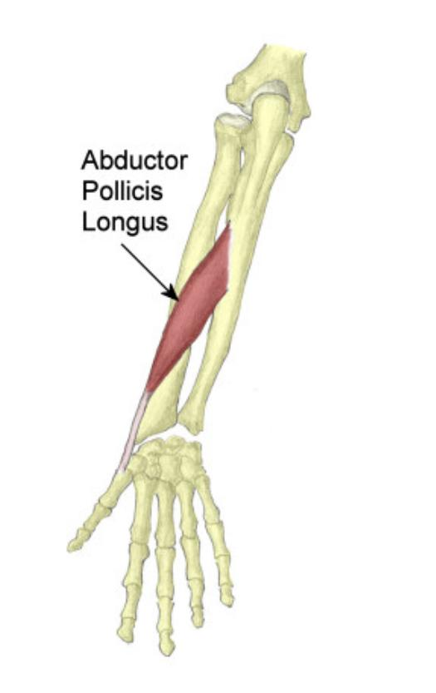
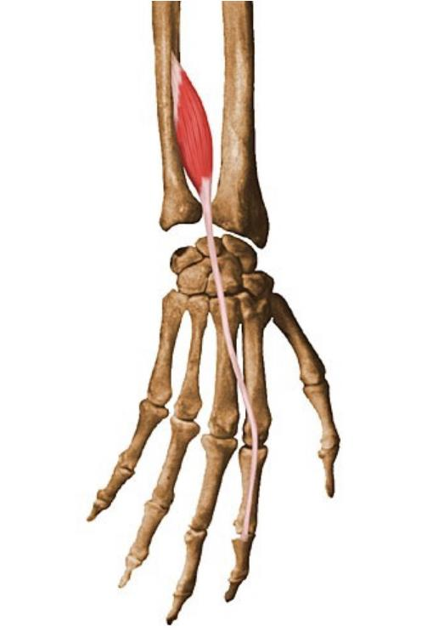
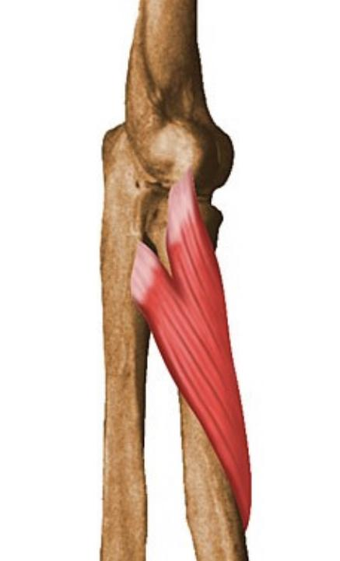
Muscle | Origin | Insertion | Nerve supply | Action | Photo
Abductor pollicis longus | 1-Upper part of the posterior surface of the ulna 2-Upper part of the posterior surface of the radius Back of the interosseous membrane | Dorsum of the base of the 1st metacarpal bone. | Posterior interosseous nerve | Abduction of the thumb Abduction of the wrist
Extensor pollicis brevis | Lower part of the posterior surface of the radius | Dorsum of the base of the 1st metacarpal bone. | Posterior interosseous nerve. | Extension of metacarpo- phalangeal joint of the thumb Helps abduction of the wrist
Extensor pollicis longus | Middle part of the posterior surface of the ulna | Base of the terminal phalanx of the thumb. | Posterior interosseous nerve. | Extension of all joints of the thumb Extension of the wrist
Extensor indicis | Lower part of the posterior surface of the ulna | Extensor expansion of the index. | Posterior interosseous nerve. | Extension of all joints of the index Extension of the wrist
Supinator | Supinator crest and fossa of the ulna | Upper 1/3 of front and lateral side and back of the radius . | Posterior interosseous nerve. | Supination of the forearm.
In
Males’
Slides
Only

Slide 15
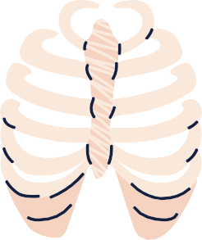
MCQs from the slides
Which one of the following muscles contributes as powerful supinator of forearm?
Q1
Palmaris longus
Click
B and C
A
B
Supinator
C
Biceps brachii
D
Q2
Which muscle is supplied by median nerve?
A
Anconeus
Brachioradialis
C
Extensor carpi radialis longus
D
Flexor digitorum superficialis
B
Q3
Which muscle is related to common flexor origin?
A
Flexor digitorum profundus
B
Flexor pollicis longus
C
Pronator quadratus
D
Pronator teres
Answers:
1-D
2-D
3-D
Here is a summary that made by Sara alhamlan med441 thanks to her 💙
Click here

Slide 16
MCQs:
(special thanks for Qbank team441 )
Q4
Which of the following muscles has a double nerve supply?
Flexor digitorum
profundus
Flexor Pollicis Longus
B
C
D
A
Pronator Quadratus
Palmaris longus
Q5
Which of the following muscles has three origins?
A
B
Pronator teres
Flexor Digitorum
superficialis
Flexor carpi ulnaris
C
D
Palmaris longus
Q6
Which of the following muscle does not flex the hand or the wrist ?
A
Pronator teres
B
C
D
Palmaris longus
Flexor carpi ulnaris
Flexor carpi radialis
Q7
All of the following muscles don’t cross the wrist joint except ?
A
Anconeus
B
Pronator teres
C
Brachioradialis
D
Extensor indicis
Q8
Answers:
4-A
5-C
6-A
7-D
8-C
Which muscle is bends the wrist and finger and it located on the lateral side of arm?
A
B
C
Flexor Carpi Radialis
Palmaris Longus
Supinator
Flexor Carpi Ulnaris
D

Slide 17
Done by the amazing team
Team leaders:
Arwa Alghamdi
Deema Aljuribah
Razan Alnufaie
Team leaders:
Mishal Alsuwayegh
Mohammed Alghamdi
Members:
Members:
Aljazi Albabtain
Atheer Alkanhal
Arob Alasheikh
Ajwan Aljohani
Deema alqahtani
Dena Alsuhaibani
Farah alqazlan
Jana Alhazmi
Kadi aldosari
Mashael Alasmari
Noura Bin hammad
Najla aldhbiban
Nouf aldalaqan
Razan alasmari
Roaa alharbi
Raghad Mohammed
Shaden albassam
Waha Almathami
Walaa AlMutawa
Yara Ameer Alalwan
Othman Aldraihem
Faisal Alomar
Abdullah Alturki
Othman Alabdullah
Omar Alkadhi
Abdullah Ali
Meshari Alshathri
Yazeed Alsanad
Fahd Mobaireek
Emad Almutairi
Nasser Alghaith
Saad Almogren
Azzam Abdullah Alotaibi
Hassan Ali Alabdullatif
Rayan Alotaibi
Mohammed Nasser
Luay Almutair
Mohammed Fahad
Mohammed Majed
Abdulkarim Salman
anatomyteam442@gmail.com
Thanks to Faisal Alomar for his design of the team logo

