Slide 1
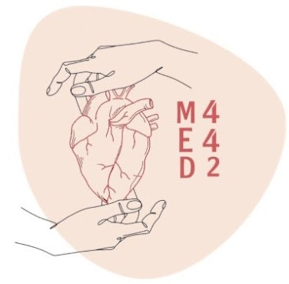
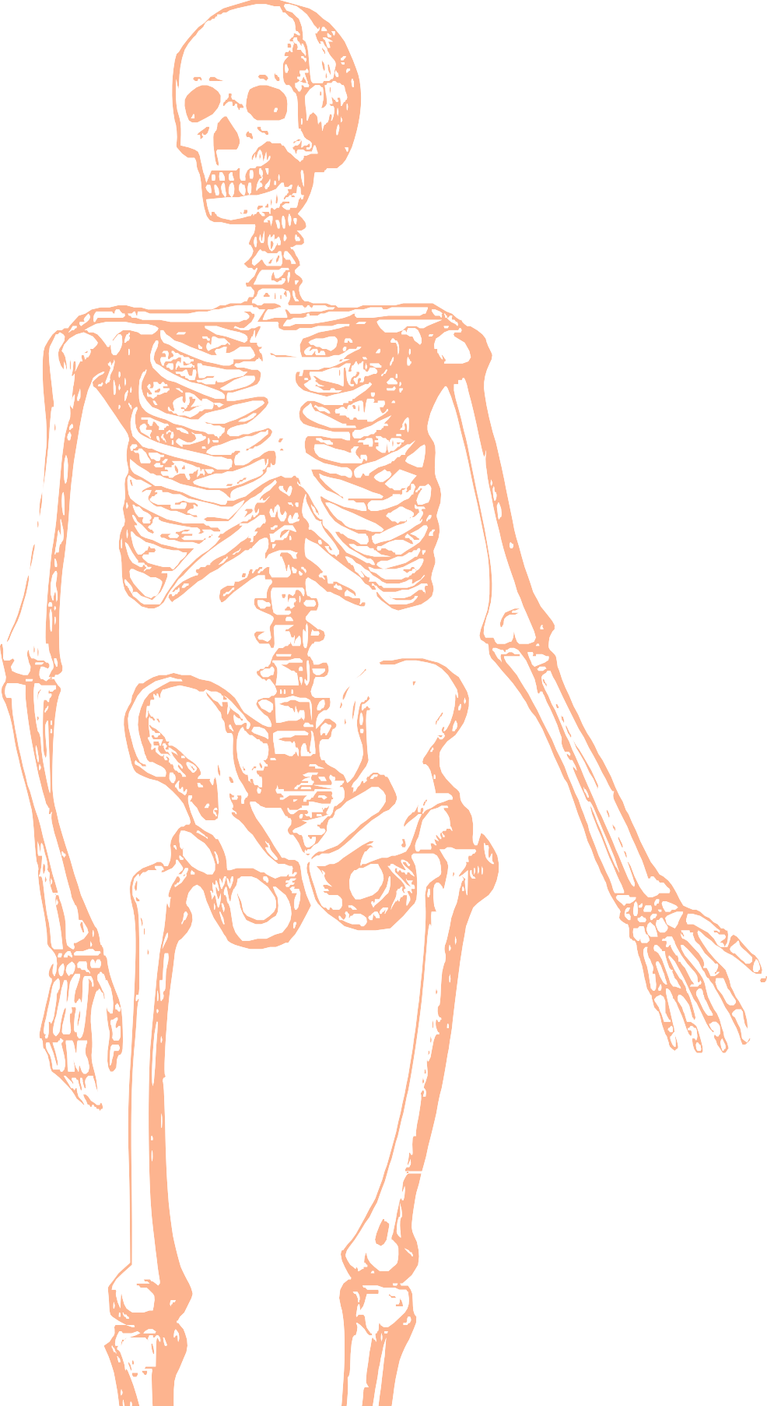
L9
Hand and wrist
Editing file
Color index:
Mine text
Important
Doctors notes
Female slides only
Male slides only
Extra

Slide 2
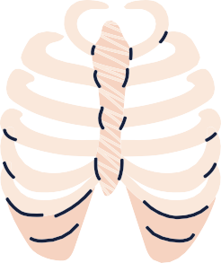
objectives
➔ Describe the anatomy of the deep
fascia of the wrist & hand (flexor &
extensor retinaculae & palmar
aponeurosis)
➔ List the structures passing
superficial & deep to flexor
retinaculum.
➔ Describe the anatomy of the
insertion of long flexor & extensor
tendons.
➔ Describe the anatomy of the small
muscles of the hand (origin,
insertion action & nerve supply)

Slide 3
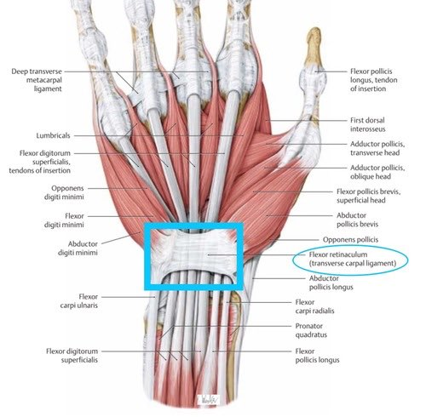
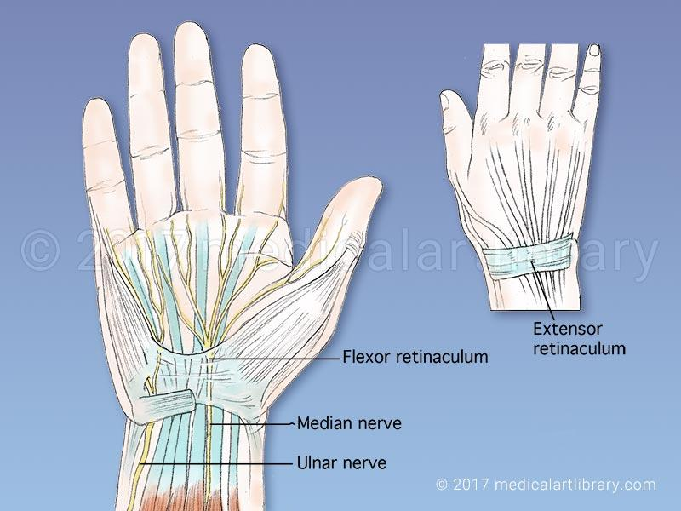
Retinacula
Attachment | Flexor Retinaculum
Medially | Both attach to Pisiform & Hook of Hamate
Laterally | Tubercle of Scaphoid & Trapezium
Flexor and Extensor Retinacula :
● Bands of Deep Fascia at the Wrist
Extensor Retinaculum
Distal end of Radius
function
Hold the long flexor
extensor tendons at the wrist in position.

Slide 4
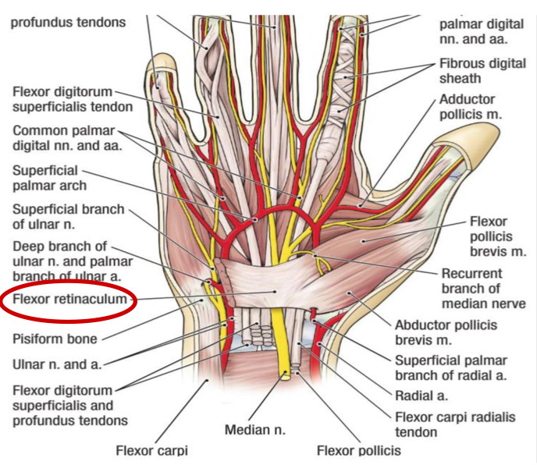
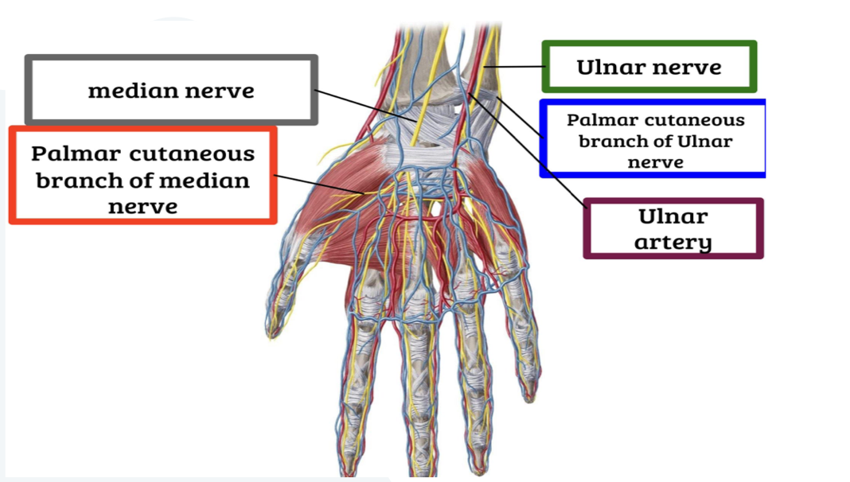
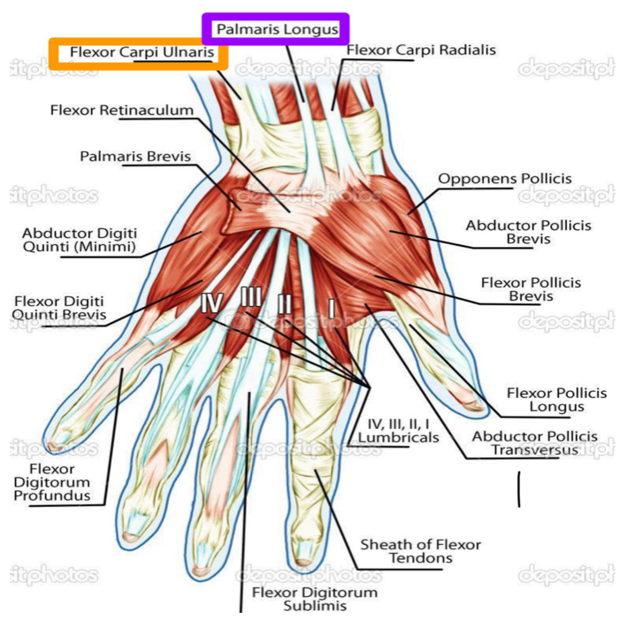
Structures Superficial to Flexor Retinaculum:
From Medial to Lateral:
1. Tendon of Flexor carpi ulnaris
2. Ulnar nerve
3. Ulnar artery
4. Palmar cutaneous branch of ulnar nerve
5. Palmaris longus tendon
6. Palmar cutaneous branch of median nerve

Slide 5
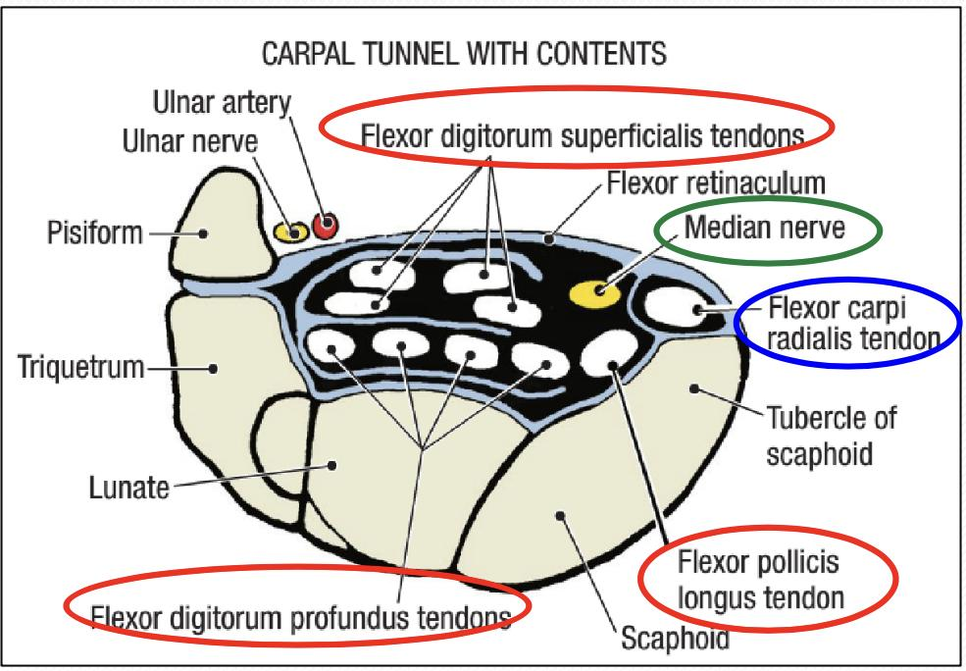
Carpal Tunnel
Formed from: Concave anterior surface of
the carpus (carpal bones) and the carpus is covered by Flexor Retinaculum.
Contents: (From Medial to Lateral) :
● Tendons of flexor digitorum
superficialis & profundus
● Median Nerve
● Tendon of flexor Pollicis Longus
● (Flexor carpi radialis)
Note the flexor carpi radialis is in between
brackets because it has a special
compartment in the fascia

Slide 6
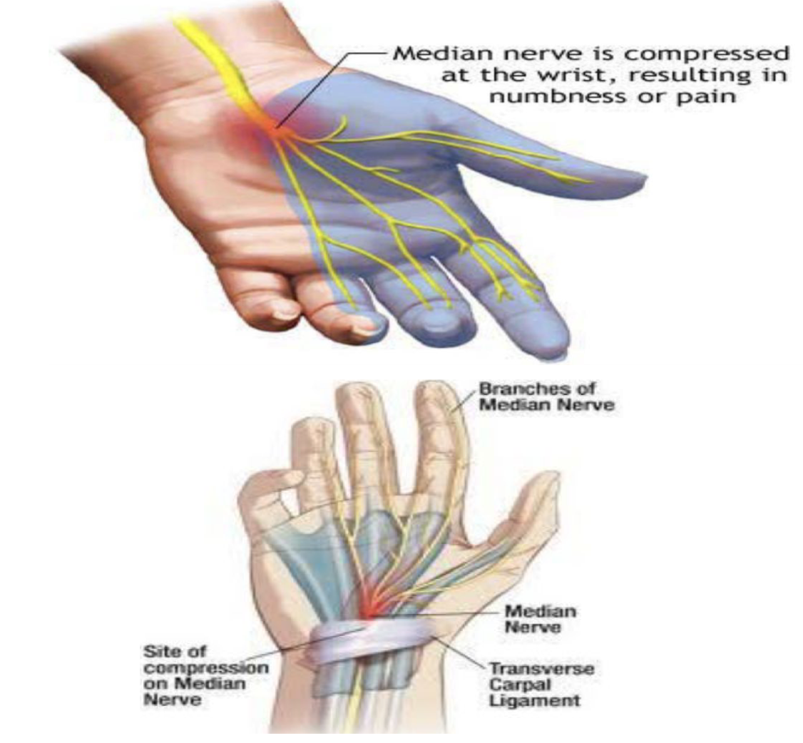
Carpal Tunnel syndrome
Manifestations:
Causes:
● Compression of the median
nerve within the carpal
tunnel.
1. Burning pain (pins and
needles) in the lateral
three and half fingers.
● No paresthesia over
thenar eminence?
Because NO Sensory changes over the Palm as the Palmer Cutaneous Branch Decenceds in front of Flexor Retinaculum to supply skin of Palmer, so it doesn’t enter the Carpal Tunnel.
2. Weakness or atrophy of
the thenar muscles (Ape
Hand).
● Inability to Oppose the
thumb.

Slide 7
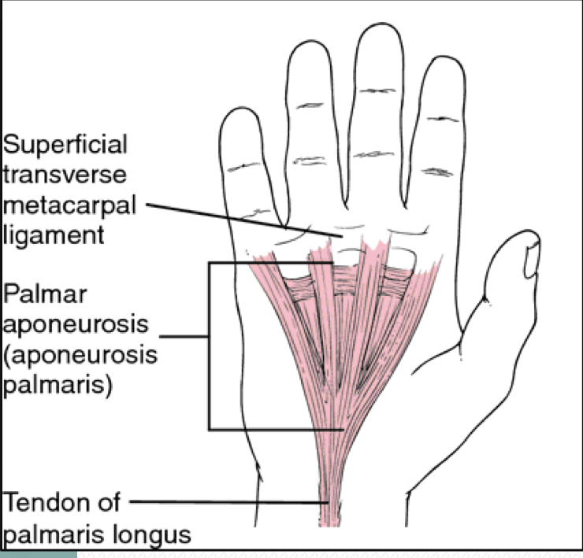
Palmar Aponeurosis
About
● The thickened deep fascia of the palm
● It is in triangular in shape, occupies the central area of the palm
It Has
Functions
1. Firmly attached to the
overlying skin and
improves the grip.
2. Protects the underlying
tendons, vessels &
nerves.
3. Gives origin to palmaris
brevis muscle.
1. Apex: attached to
the distal border
of flexor
retinaculum and
receives the
insertion of
palmaris longus
tendon.
2. Base: divides at
the bases of the
fingers into four
slips that pass into
the fingers.

Slide 8
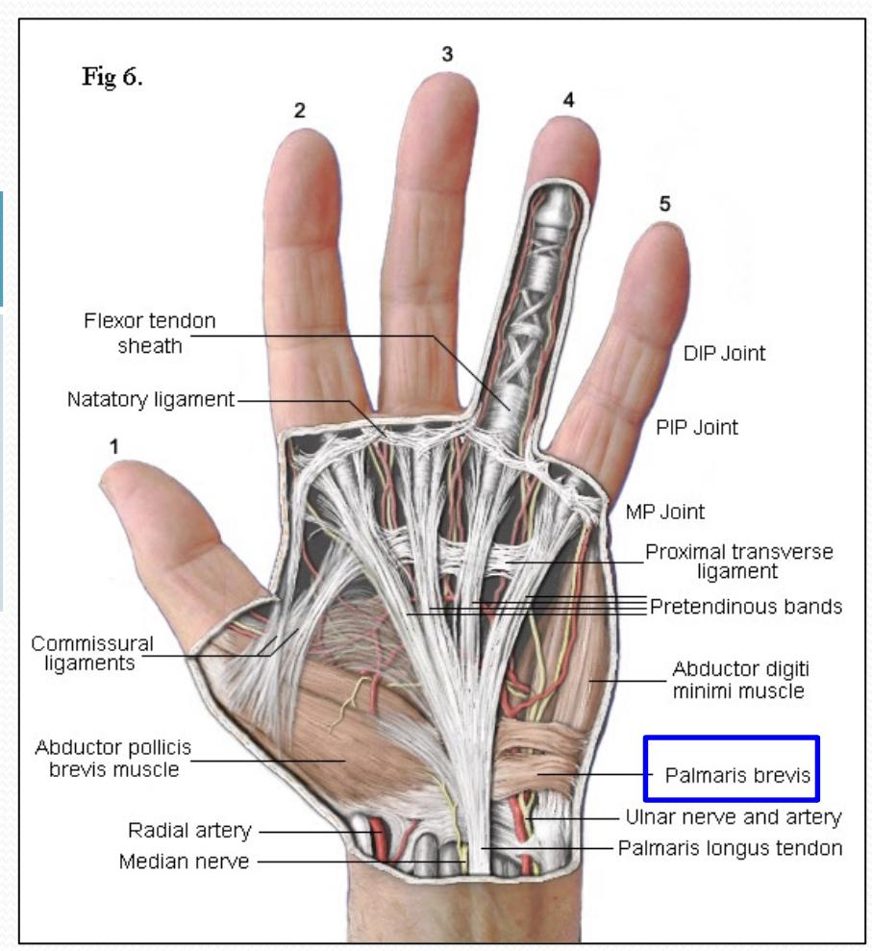
Palmaris Brevis
Origin
Flexor retinaculum (FR) &
Palmar aponeurosis (PA)
Insertion
Skin of the palm
Palmaris Brevis
Nerve Supply
Ulnar nerve (superficial branch)
(the only muscle supplied by the
superficial branch of ulnar nerve)
Action
Prevent corrugation of skin
to improve grip.

Slide 9
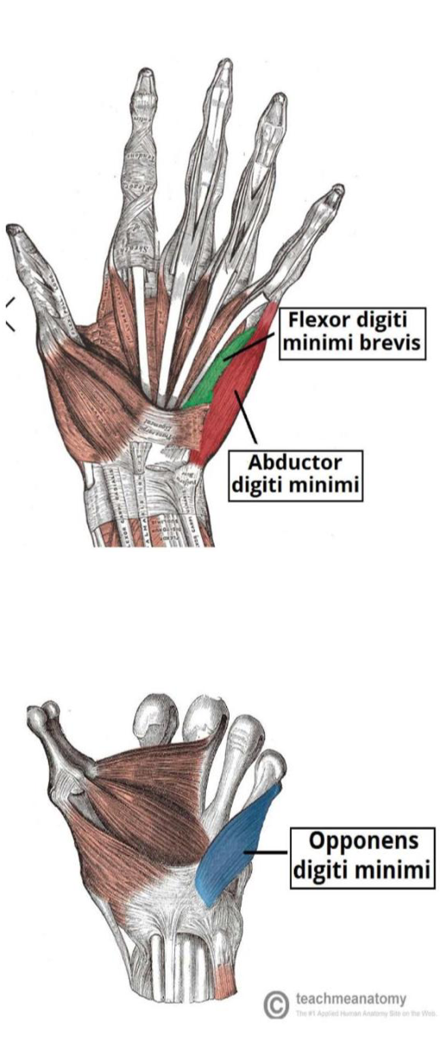
Short muscles of the hand (Little Finger )
Extra Information:
- Abductor digiti minimi abduct the little finger away from the fourth.
-Flexor digiti minimi produces flexion of the little finger at its metacarpophalangeal joint.
Hypothenar eminence (3 muscles)
 | Abductor digiti minimi | Flexor digiti minmi | Opponens digiti minimi
Origin | Pisiform | Flexor Retinaculum | Palmar surface of 5th metacarpal
Insertion | Base of proximal phalanx |  | whole length of the ulnar margin of 5th metacarpal
Nerve Supply | All by deep branch of ulnar nerve
Action | Abduction | Flexion | Pulls the 5th metacarpal forward (cup the palm)

Slide 10
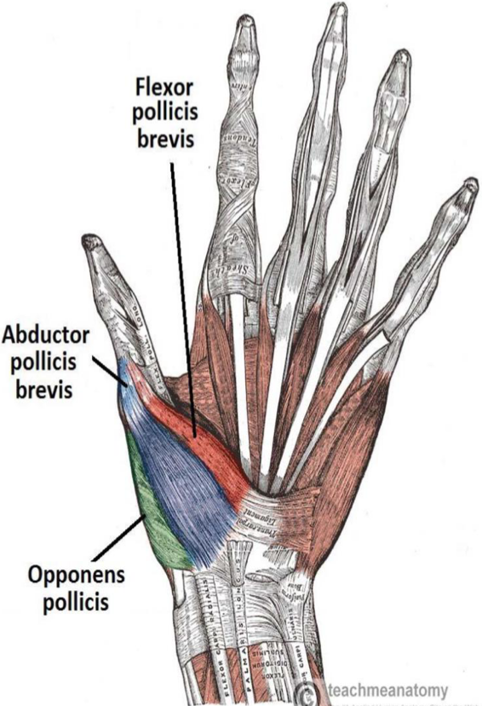
Short muscles of the hand (Thumb)
thenar eminence (3 muscles)
 | Abductor pollicis brevis | flexor pollicis brevis | opponens pollicis
Origin | Flexor retinaculum, Scaphoid & Trapezium | Flexor retinaculum
Insertion | Base of proximal phalanx |  | Lateral part of 1st metacarpal
Nerve Supply | All supplied by median nerve
Action | Abduction | Flexion | Opposition
Movements of the Thumb

Slide 11
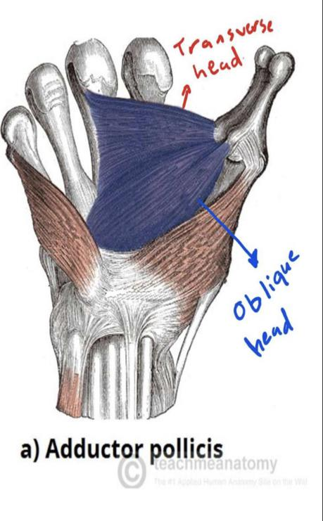
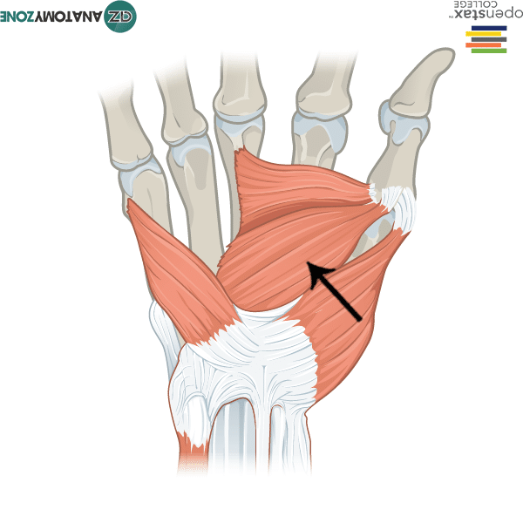
Short muscles of the hand (Thumb)
Adductor pollicis: Not considered as thenar part!!!
Origin | Oblique head: Anterior bases of 2nd& 3rd metacarpal Transverse head: 3rd metacarpal
Insertion | Medial side of base of proximal phalanx of thumb
Nerve Supply | Deep branch of ulnar
Action | Adduction

Slide 12
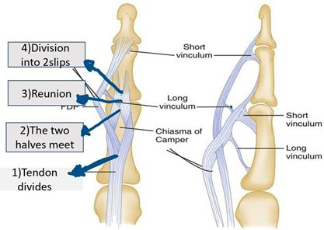
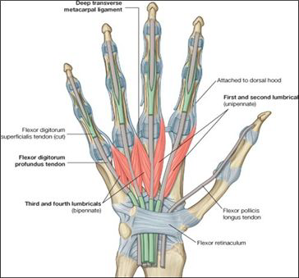
Insertion of flexor digitorum
(Superficialis & Profundus)
Each tendon Divides into two halves & pass around the Profundus tendon.
The two halves Meet on the posterior aspect of Profundus tendon (partial decussation of fibers).
Reunion of the two halves
Further Division into two slips attached to the borders of Middle phalanx.
Inserted into the Base of the Distal Phalanx
Important

Slide 13
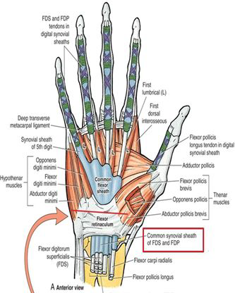
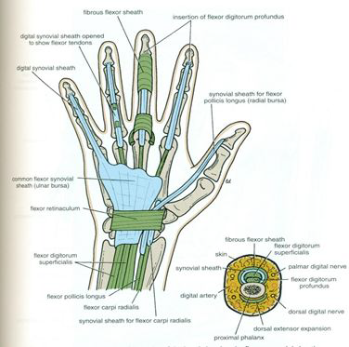
Fibrous Flexor (Digital) & synovial flexor Sheaths
A strong fibrous sheath, which covers the anterior surface of the fingers and attached to the sides of the phalanges.
Its Proximal end is opened, & Its Distal end is closed.
The sheath with the anterior surfaces of the phalanges & the interphalangeal joints form an Osteofibrous blind tunnel for the long flexor tendons of the fingers.
A-Common synovial sheath (Ulnar bursa):
Contains tendons of flexor digitorum superficialis & profundus.
The Medial part of the sheath extends distally (without interruption) on the tendons of the little finger.
The Lateral part of the sheath stops on the middle of the palm.
The distal ends of the long flexor tendons to (Index, Middle & Ring) fingers acquire digital synovial sheaths.
B- Flexor Pollicis Longus tendon has its own synovial sheath (Radial Bursa).
-Function of Synovial sheaths:
They allow the long tendons to move smoothly with a minimum of friction BENEATH the Flexor Retinaculum and the Fibrous Flexor Sheaths.

Slide 14
Deep muscles of the hand
total 12 muscles | Lumbrical Muscles (4) | Palmar Interossei (4) | Dorsal Interossei (4)
Origin | Tendon of flexor digitorum Profundus fingers | 1st :Base of 1st metacarpal. Other three: anterior surface of shafts of 2nd, 4th, & 5th metacarpals. | Contiguous sides of Shafts of Metacarpals
Insertion | Extensor expansion of medial four fingers | Proximal phalanges of thumb, index, ring, & little fingers and Extensor expansion | Proximal Phalanx of index, ring, mid finger & extensor expansion
Nerve Supply | 1st & 2nd (Lateral two): Median Nerve. 3rd & 4th: Ulnar nerve (Deep branch) | Deep Branch of ulnar nerve
Action | Flexes: metacarpophalangeal joints. Extends: interphalangeal joints of finger. Except thumb. |  | Abduction of fingers away from the 3rd one. (Dab: Dorsal= Abduction)
Adduction of fingers toward center of the 3rd one( the middle one ) . (Pad: Palmar = abduction)

Slide 15
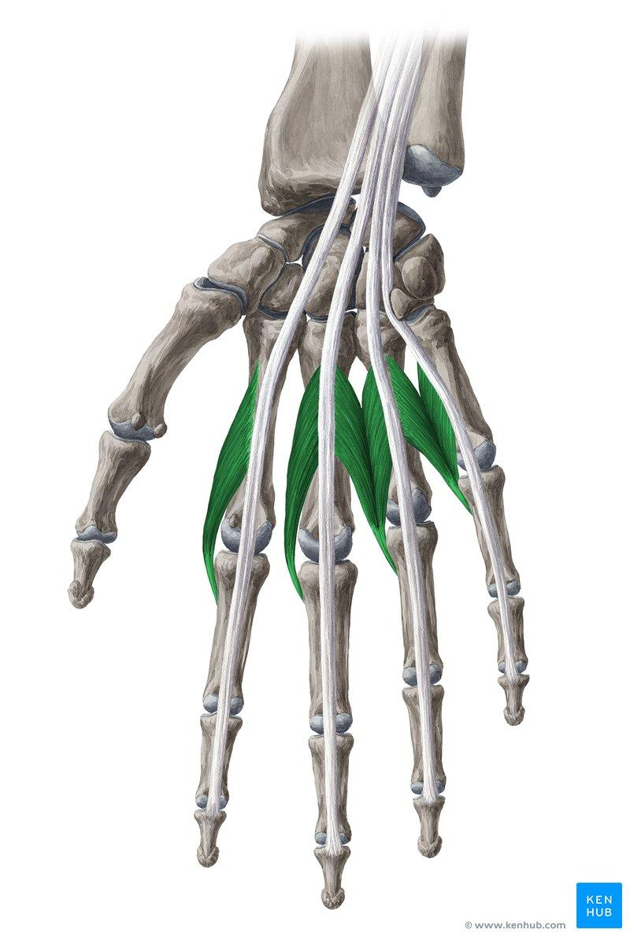
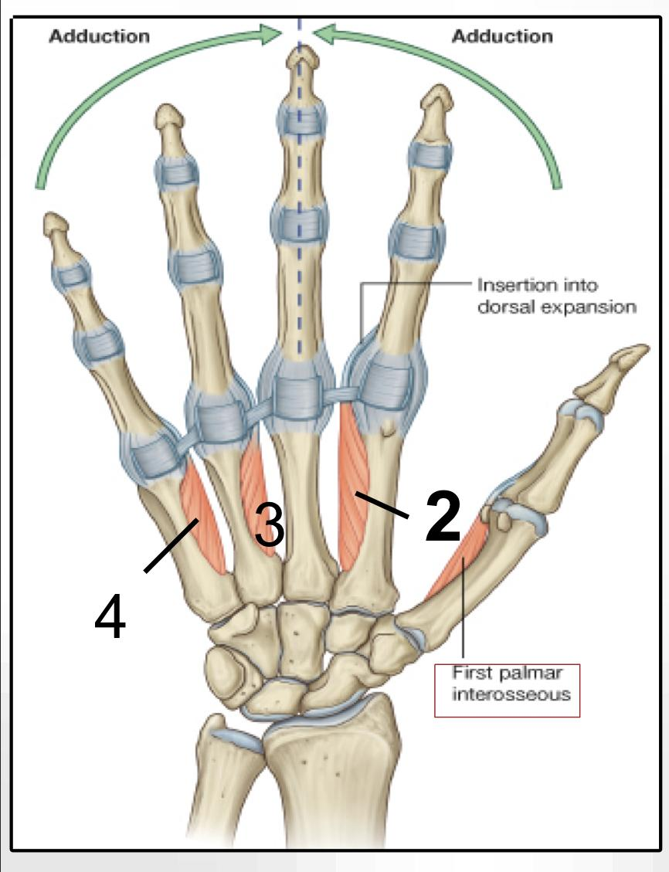
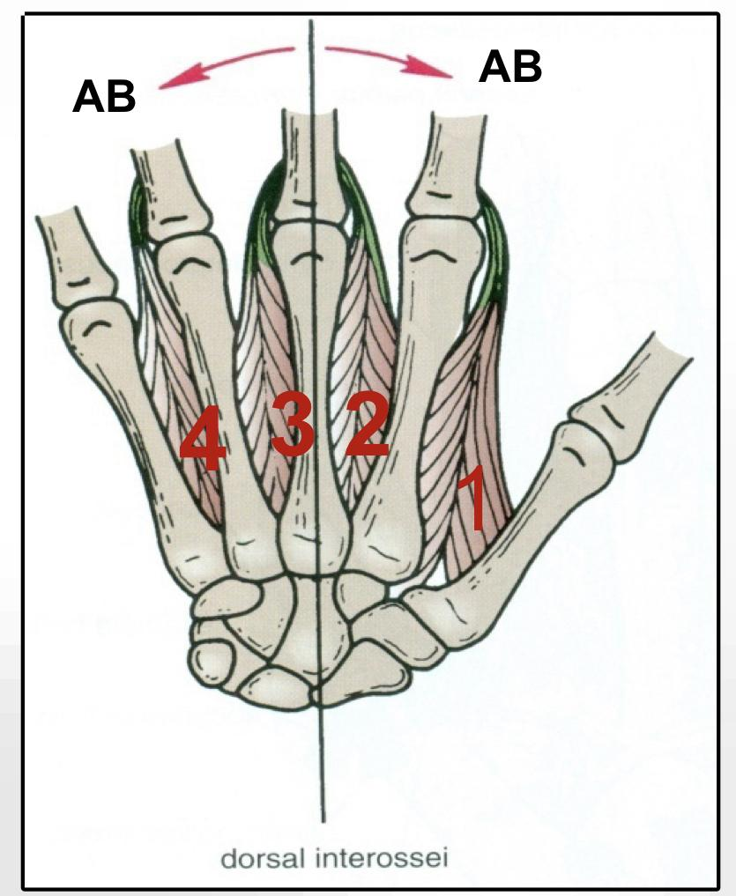
Deep muscles of the hand ,contd
Lumbrical Muscles (4)
Palmar
Interossei (4)
Dorsal
Interossei (4)

Slide 16
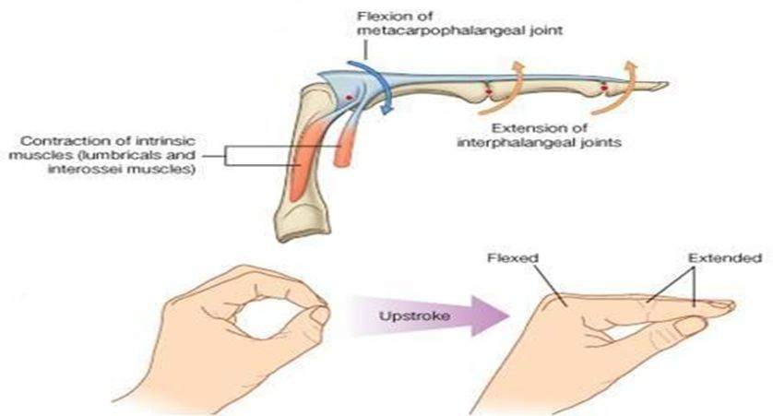
Action of Lumbricals & Interossei (Writing position)

Slide 17
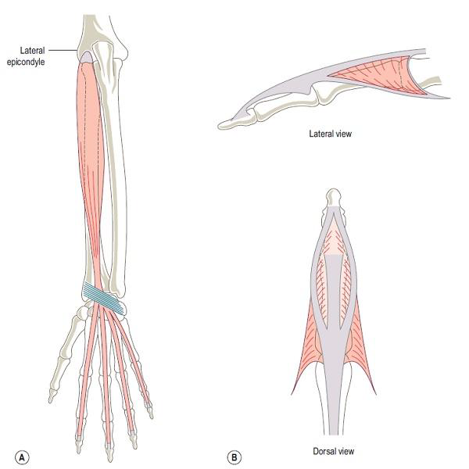
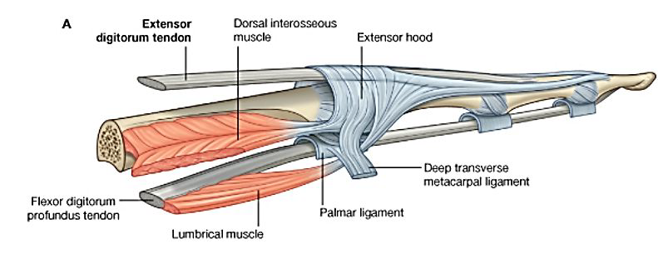
Extensor Expansion
Formed from the expansion of the tendons of extensor digits at the PIJ (proximal interphalangeal joint).
● The tendon splits into three parts:
1- One Central: inserted into the base of Middle phalanx.
2- Two laterals: inserted into the base of the Distal phalanx.
● The Expansion Receives the insertions of:
1- Corresponding Interosseous muscle (on each side)
2- Lumbrical muscle (on the lateral side).
This is the same as the extensor expansion mentioned in the last lecture.

Slide 18
MCQs:
what is the nerve damged carpel tunnel syndrome ?
Q1
A
B
C
D
Median nerve
Radialis nerve
Ulnaris nerve
Adductor pollicis
Which of the following has its own compartment in the flexor retinaculum ?
Q2
B
C
D
tendon of biceps brachii
A
Palmaris longus tendon
flexor carpi ulnaris tendon
Radial nerve
which of the following tendons pass above the flexor retinaculum?
Q3
A
B
C
D
Flexor carpi radialis
Flexor carpi ulnaris
palmaris longus
adductor pollicis
a band of thickened deep fascia around tendons that hold them in place?
Q4
A
B
C
D
Palmar Aponeurosis
Retinaculum
Ulnar tunnel
Tendon sheah
Answer Key:
1-A
2-B
3-A
4-B

Slide 19
MCQs:
In Fibrous Flexor (Digital) Sheath the proximal end is ______ and the distal end is______ ?
Q5
A
B
C
D
Closed, open
open, closed
closed , closed
open , open
Q6
Triangular fibrous layer continuous with the palmaris longus tendon and overly the tendons in the palm?
A
C
flexor retinaculum
Palmar Aponeurosis
Palmaris longus
Bicipital aponeurosis
B
D
Q7
The palmar interossei receive nerve supply from?
A
B
C
D
radial nerve
Median nerve
Deep branch of ulnar nerve
Brachial nerve
Q8
The lateral two lumbrical muscles are supplied by?
A
B
D
Deep branch of ulnar nerve
B
C
digital branches of
the median nerve
Superficial branch of
the ulnar nerve
axillary nerve
Answer Key:
5-A
6-B
7-C
8-B

Slide 20
Done by the amazing team
Team leaders:
Arwa Alghamdi
Deema Aljuribah
Razan Alnufaie
Team leaders:
Mishal Alsuwayegh
Mohammed Alghamdi
Members:
Members:
Aljazi Albabtain
Atheer Alkanhal
Arob Alasheikh
Ajwan Aljohani
Deema alqahtani
Dena Alsuhaibani
Jana Alhazmi
Kadi aldosari
Mashael Alasmari
Noura Bin hammad
Najla aldhbiban
Razan alasmari
Roaa alharbi
Raghad Mohammed
Shaden albassam
Waha Almathami
Walaa AlMutawa
Yara Ameer Alalwan
Othman Aldraihem
Faisal Alomar
Abdullah Alturki
Othman Alabdullah
Omar Alkadhi
Abdullah Ali
Meshari Alshathri
Yazeed Alsanad
Fahd Mobaireek
Emad Almutairi
Nasser Alghaith
Saad Almogren
Azzam Abdullah Alotaibi
Hassan Ali Alabdullatif
Rayan Alotaibi
Mohammed Nasser
Mohammed Fahad
Mohammed Majed
Abdulkarim Salman
Saleh Aldeligan
Thanks to Faisal Alomar for his design of the team logo
anatomyteam442@gmail.com

