Slide 1
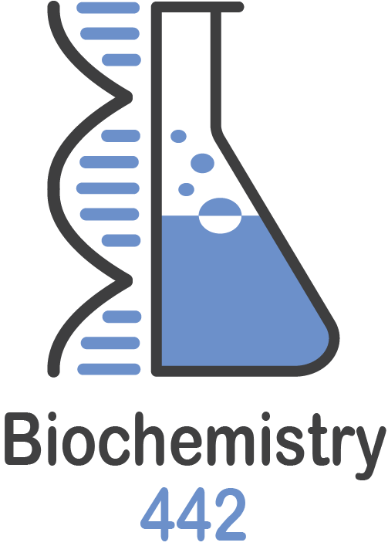
glycogen metabolism in muscles
Color index:
Black: Main text
Red: important
Blue: in boys slides only
Pink: in girls slides only
Green: Doctors Notes
Grey: Extra info
L 2
W 2
Editing file

Slide 2
objectives
The need to store carbohydrates in muscle
The reason for carbohydrates to be stored as glycogen
An overview of glycogen synthesis (Glycogenesis)
An overview of glycogen synthesis (Glycogenesis)
Key elements in regulation of both Glycogenesis and Glycogenolysis

Slide 3
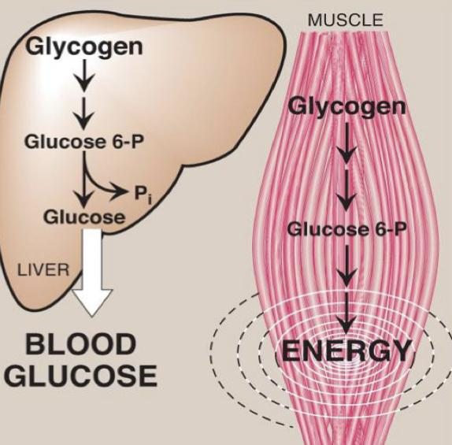
location and function of glycogen
Glycogenolysis,glycolysis
Location & functions of glycogen
1-the end product in the liver?
free glucose
2-The end product in the muscle?
glucose 6-phosphate
In liver
In skeletal muscle
100 g in liver (~ 10% of well-fed liver)
a source for blood glucose
(especially during early stages of fasting)
400 g in muscles (1-2% of resting muscles weight)
fuel reserve (ATP)
(during muscular exercise)
We store glucose in liver to maintain blood level

Slide 4
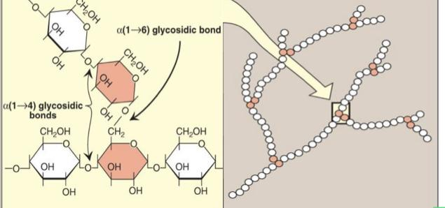
Structure of glycogen
Glucose residues are bound by a(1-4) glycosidic linkage
Branches (every 8-10 residue) are linked by a(1-6) glycosidic linkage
Glycogen
1- is a branched-chain homopolysaccharide made exclusively from a-D-glucose
2- it is present in the cytoplasm in the form of granules which contain most of the enzymes necessary for glycogen synthesis & degradation
Synthesis:in rest
Degradation:while exercising
Types of chains
a(1-4)bond is the
mainly abundant
bond in glycogen
Ty team 41
The orange ones have a(1-6) glycosidic bond.
The white ones have a(1-4) glycosidic bond.
why it is branched? because it will be easier and faster to synthesise or degradation of glycogen

Slide 5
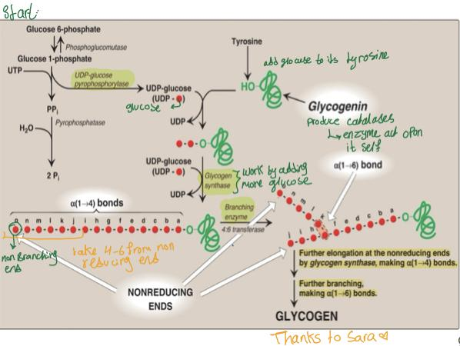
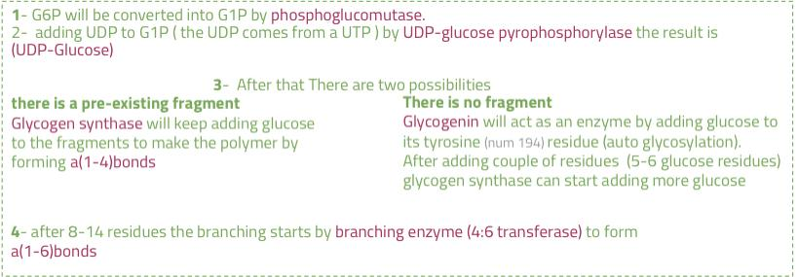
metabolism of glycogen in skeletal muscle
Glycogenesis: Synthesis of glycogen from glucose
-If there is small fragment remained after a degradation it can be used to initiate the Synthesis of glycogen by elongation
-If not, a glycogenin will initiate the Synthesis by creating the fragments
#41
-glycogenin is protein that make fragments
01
Building blocks:
UDP-GLUCOSE
02
Initiation of synthesis:
Elongation of pre-existing glycogen fragment
OR
The use of glycogen primer (glycogenin)
-The glucose is carried by the UDP ( Uridine diphosphate)
-The building enzyme recognize glucose because of UDP
03
ELONGATION: by Glycogen synthase for (a1-4 linkages)
Glycogen synthase cannot initiate synthesis but only elongates
pre-existing glycogen fragment or glycogen primer (glycogenin)
04
BRANCHING: Branching enzyme for (a1-6 linkages)
The branching enzyme ( 4-6 transferase) 🛑
team#41

Slide 6
Metabolism of glycogen in skeletal muscle
Glycogenolysis: Breakdown of glycogen in skeletal muscles by glycogen phosphorylase to glucose-6-phosphate
01
Shortening of glycogen chain:
–by glycogen phosphorylase
-Cleaving of a(1-4) bonds of the glycogen chain producing glucose 1-phosphate
-Glucose 1-phosphate is converted to glucose 6-phosphate (by mutase enzyme)
02
Removal of branches:
-by debranching enzymes
-Cleaving of a(1-6) bonds of the glycogen chain producing free glucose (few)
03
Fate of glucose 6-phosphate (G-6-P):
- G-6-P is not converted to free glucose ( because it’s in skeletal muscle, if it was in liver it’ll be converted to free glucose)
- It is used as a source of energy for skeletal muscles during muscular exercise (by anaerobic glycolysis starting from G-6-P step)
Further explanations
By ninja
Science bites

Slide 7
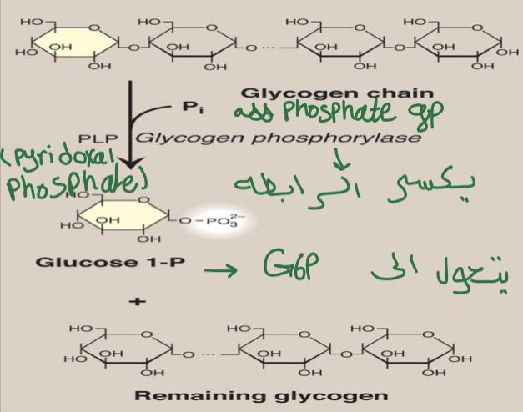
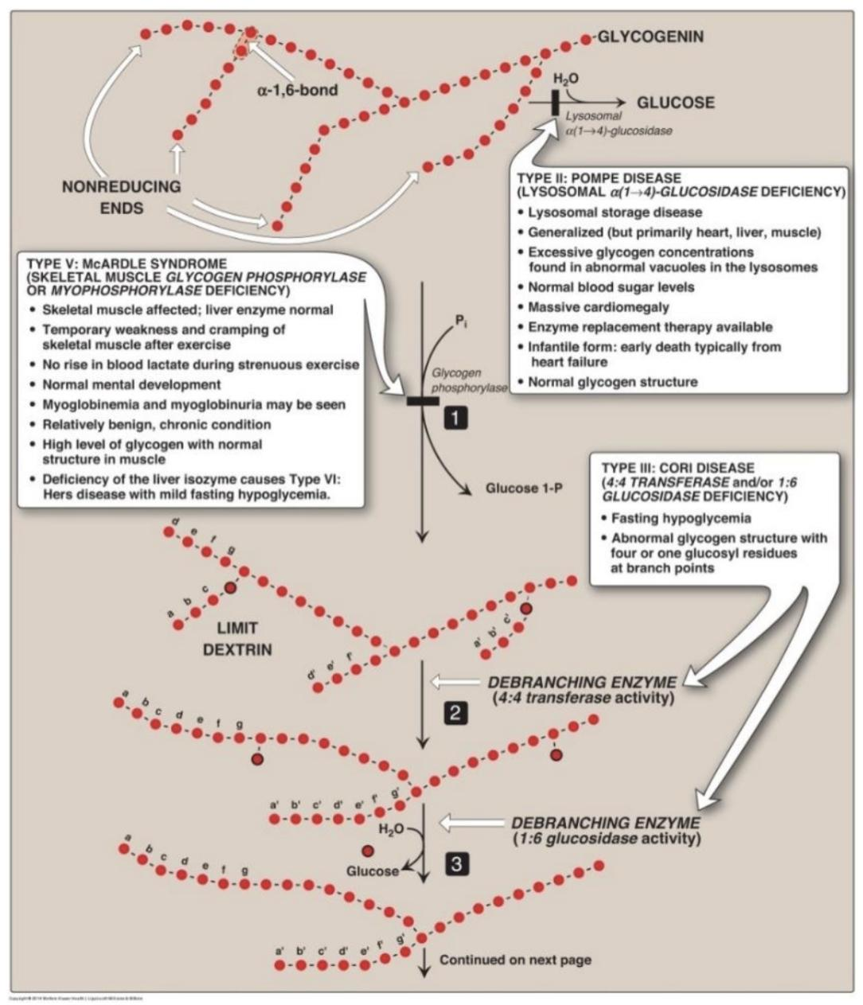
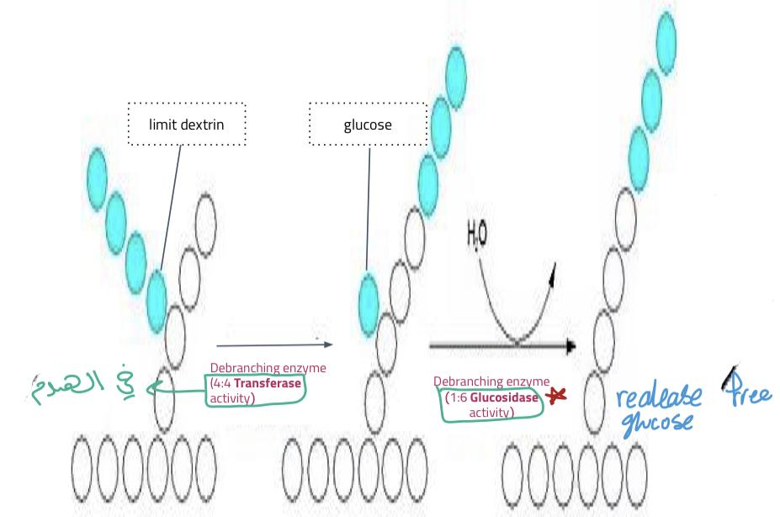
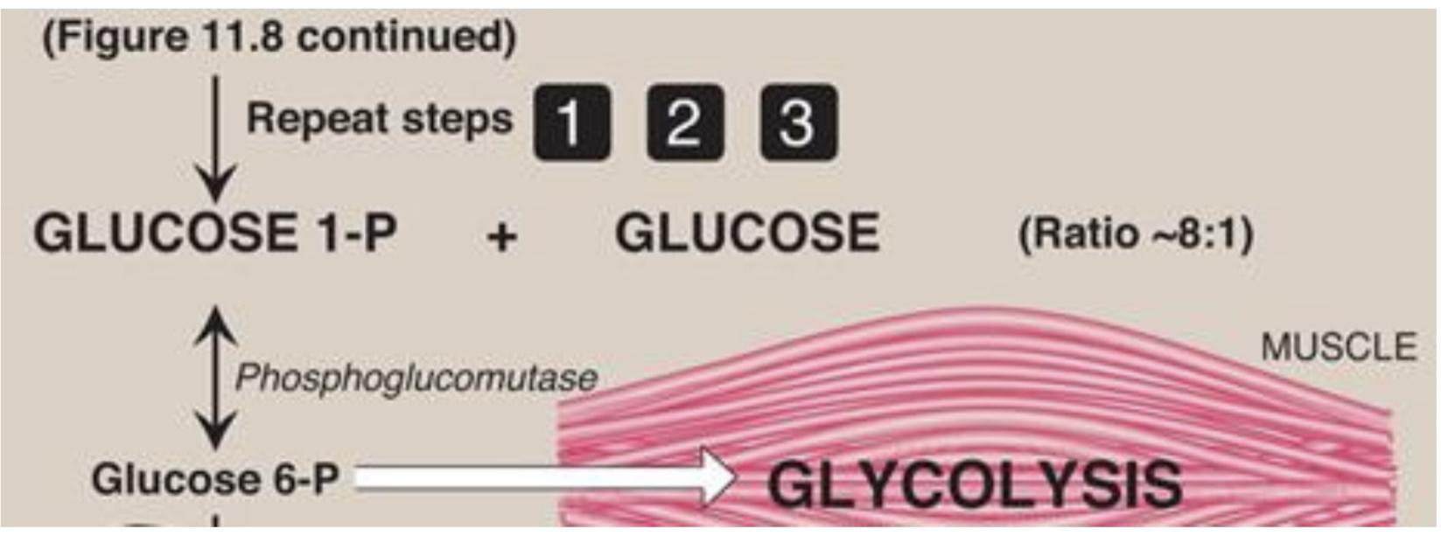
Metabolism of glycogen in skeletal muscle
don’t mix between:
(4:6 transferase) glycogenesis
(4:4 transferase) glycogenolysis
#41
The glycogen phosphorylase combined with pyridoxal phosphate
4:4 transferase: take three glucose molecules by breaking α(1→4) bonds from one end and bind it to the other end.
1 :6 glucosidase: it’s the same enzyme above except that it unbinds the α(1→6) bonds. And produces free glucose

Slide 8
metabolism of glycogen in skeletal muscle
Metabolism of Glycogen in Skeletal Muscles
Glycogenesis
The synthesis of glycogen from glucose
Glycogenolysis
Breakdown of glycogen in skeletal muscles by glycogen phosphorylase to glucose-6-phosphate
Building blocks (UDP-Glucose )
Initiation of synthesis
Elongation
Branching
Enzymes
Shortening of glycogen chain
Removal of branches
Enzymes
Phosphoglucomutase
UDP-glucose pyrophosphorylase
Glycogen synthase
Glycogenin
4:6 transferase
glycogen phosphorylase
debranching enzymes
4:4 transferase:
1:6 glucosidase

Slide 9
Regulation of glycogen metabolism
Synthesis & degradation of glycogen are tightly regulated
Ninja nerd video
in skeletal muscle
Glycogen degradation occurs during active exercise
Glycogen synthesis begins when the muscle is at rest
Very Important 🛑
• Regulation occurs by 2 mechanisms:
1- Allosteric regulation
2- Hormonal regulation
(Covalent modification)

Slide 10
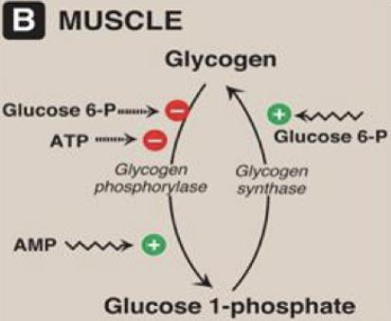
Regulation of glycogen metabolism (Important slide)🛑
Glucose 6-P
Is allosteric activator for Glycogen synthase
1- Allosteric Regulation:
Ca+2 activate Glycogen phosphorylase indirectly
#41
Note that:
ATP
is allosteric inhibitor for Glycogen phosphorylase
01
AMP
Is allosteric activator for Glycogen phosphorylase
02
(ATP is abundant, no need for more energy)
03
Glucose 6-P
Is allosteric inhibitor for Glycogen phosphorylase
(low energy signal).
04

Slide 11
Regulation of glycogen metabolism (Important slide)🛑
Working out increase ca
01
Increase of calcium during muscle contraction
02
Formation of Ca2+ -calmodulin complex
Activate certain enzyme such as:
Glycogen phosphorylase
03
Activation of Ca2+ -dependent enzymes,
e.g., glycogen phosphorylase
Or glycogenolysis

Slide 12
Regulation of glycogen metabolism (Important slide)🛑
2- Hormonal Regulation by Epinephrine
In skeletal muscle:
Epinephrine/receptor binding
(Epinephrine binds with G-protein and activate the second messenger)
-Epinephrine release while exercising
Second messenger:
cAMP
This second messenger then binds and activates PKA ( protein kinase A), which phosphorylates two enzymes
It phosphorylate glycogen synthase making it inactive
response:
It phosphorylate glycogen phosphorylase making the inactive form active
Enzyme phosphorylation:
Glycogen synthase messenger:
(Inactive form)
Glycogen phosphorylase
(Active form)
Inhibition of glycogenesis
Stimulation of glycogenolysis
breakdown of glycogen to glucose 6-P

Slide 13
Glycogen Storage Diseases (GSD)
A group of genetic diseases that result from a defect in an enzyme required for glycogen synthesis or degradation
They result in:
Formation of abnormal glycogen structure
OR
Excessive accumulation of normal glycogen in a specific tissue

Slide 14
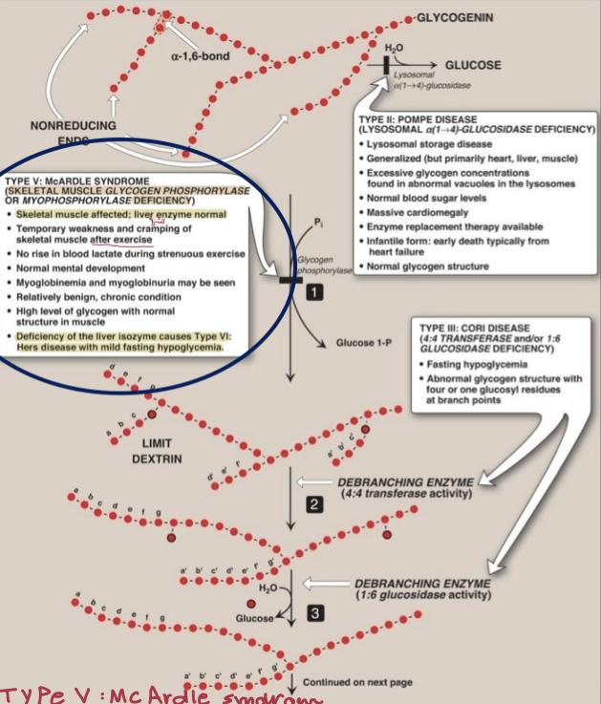
Glycogen Storage Diseases GSD
Type V : McARDLE SYNDROME
( Skeletal muscle Glycogen phosphorylase OR myophosphorylase deficiency)
When writing the name of the enzyme you must write( skeletal muscle …….)
Skeletal muscle affected; liver enzyme normal
Temporary weakness and cramping of skeletal muscle after exercise
No rise in blood lactate during strenuous exercise
Normal mental development
Myoglobinemia and myoglobinuria may be seen
Relatively benign, chronic condition
High level of glycogen with normal structure in muscle
Deficiency of the liver isoenzyme causes Type VI: Hers disease with mild fasting hypoglycemia

Slide 15
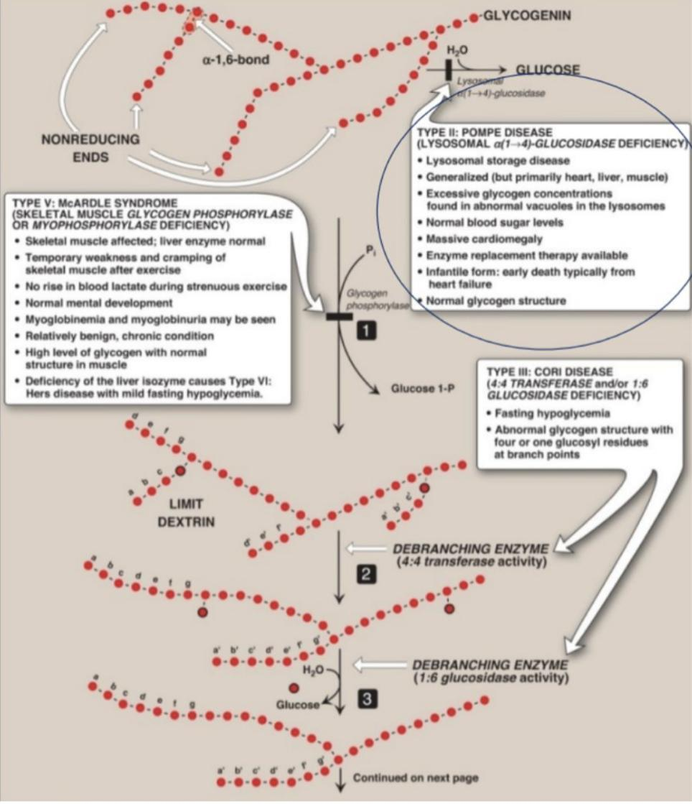
Glycogen Storage Diseases GSD
Type II (POMPE DISEASE)
(Lysosomal α(1 4)-Glucosidase Deficiency)
Lysosomal storage disease
Generalized (but primarily heart, liver ,muscle)
Excessive glycogen concentrations found in abnormal vacuoles in the lysosomes
Normal blood sugar levels
Massive cardiomegaly
Enzyme replacement therapy available
Infantile form: early death typically from heart failure
Normal glycogen structure

Slide 16
MCQ
SAQ
Q1- the building block of glycogen?
A) UDP | B) glycogen synthase | C)glycogenin | D) glycogen
Q2- glycogen phosphorylase produce which molecule?
A) glucose 6ph | B) glucose 1ph | C) glycogen | D) glucose
Q3-what is the function of 4;6 transferase?
A) branching enzyme | B)debranching enzyme | C)elongation enzyme | D) inhibition enzyme
Q4- What is the function of 4:4 transferase?
A) branching enzyme | B) debranching enzyme | C) building block | D) elongation enzyme
Q5- Deficiency of the liver isoenzyme causes?
A)Hers disease | B)heart failure | C)down syndrome | D)- liver cancer
Q6- What happens when Glycogen phosphorylase is in active form?
A)inhibition of Glycogenolysis | B)Stimulation of glycogenolysis | C)stimulation of glycogenesis | D)inhibition of glycogenesis
1- What enzyme is used for initiation of synthesis of glycogen ?
Glycogenin ( glycogen primer )
2- What is the Branching enzyme for (a1-6 linkages) ?
4-6 transferase
3- What enzyme is affected in GSD type 2 and 5?
Pompe disease (2) lysosomal alpha (1-4) glucosidase
Mc ardle syndrome (5) skeletal muscle glycogen phosphorylase
4- what is the effect of norepinephrine to glycogen ?
A-It phosphorylate glycogen synthase making it inactive
B-It phosphorylate glycogen phosphorylase making the inactive form active
Q1-A
Q2- B
Q3-A
Q4-B
Q5-A
Q6-B

Slide 17
Our team:
Girls
leader:
Sara alotaebe
Shahed Bukhari
Roaa alharbi
Raseel AlWehibi
Razan alnufaie
Ghada Binslmah
Boys
leader:
Mohamed Faisal ibn Saqyan
Abdullah Ali
Hassan Ali
Alabdullatif
Ibrahim alohail
Mishari nahar Alanezi
Saad Alahmari
من لم يذق مُرَّ التعلم ساعة
تجرعَ ذل الجهل طول حياتهِ
محمد بن إدريس الشافعي

