Slide 1
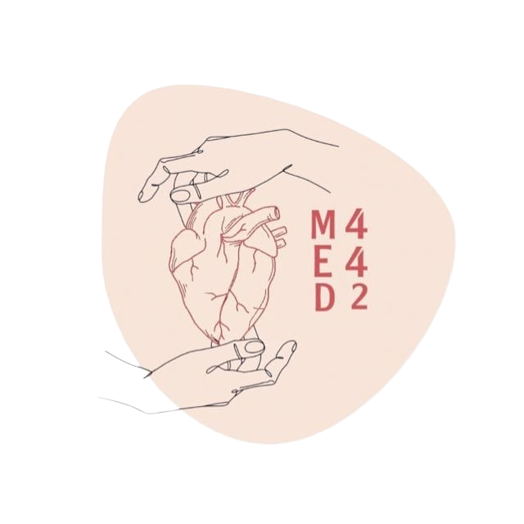
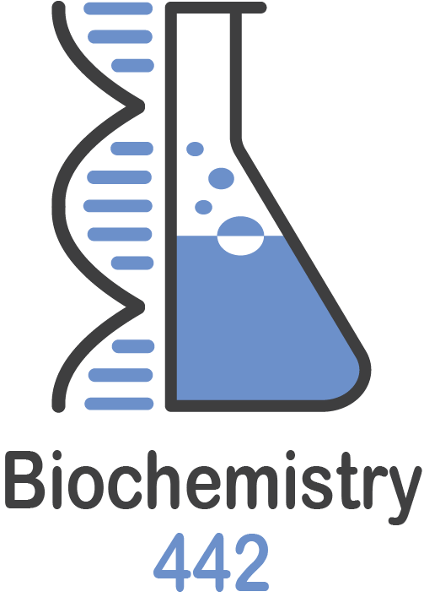
Aerobic and anaerobic metabolism in muscles
Color index:
Black: Main text
Red: important
Blue: in boys slides only
Pink: in girls slides only
Green: Doctors Notes
Grey: Extra info
L 2
W 2

Slide 2
Objectives
✦ Recognize the importance of ATP as energy source in skeletal muscle
✦Compare three systems of energy transfer in the body
✦Differentiate between energy metabolism in red and white muscle fibers
✦ Understand how skeletal muscles derive ATP from aerobic and anaerobic metabolism
✦Discuss the importance of Cori and glucose-alanine cycles in energy metabolism

Slide 3
Overview
•Three systems of energy transfer
•ATP as energy source
•Aerobic metabolism: red muscle fibers
•Anaerobic metabolism: white muscle fibers
•Cori cycle
•Glucose-alanine cycle
•Muscle fatigue and endurance in athletes

Slide 4
Three systems of energy transfer
● All Systems happen in the same time, But the predominant system in each duration/phase is:
Important Slide 🛑
Immediate System
(ATP-PCr)
Short-Term
System
(Glycolysis)
Long-Term
System
(Aerobic)
Anaerobic
Aerobic
Type of
Metabolism:
Anaerobic
Glucose
Fatty acids
Energy source
PhosphoCreatine
High intensity exercise
High intensity exercise
Type of Exercise:
Continuous exercise
3 - 15 sec
15 sec - 2 min
Duration:
Hours
Notes:
Energy
Source

Slide 5
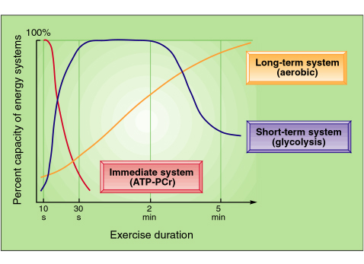
Three systems of energy transfer
- you should know couple of examples of high intensity and continuous exercise in case that you got a question with a different context.
high intensity exercise:
(weight lifting) continuous exercise: (marathon race)
Thanks to 441
(الترتيب مهم)

Slide 6
ATP as energy source
(The main pathway that produces large amount of energy is the aerobic)
1
Adenosine triphosphate (ATP): a nucleotide coenzyme, the most important form of chemical energy stored in cells.
2
Breakdown of ATP (ATP → ADP + PO4) releases energy (7.3 kcal/mol).
3
The energy from ATP is used for all body functions (biosynthesis -
membrane transport - muscle contraction, ...)
4
Main pathway for ATP synthesis: oxidative phosphorylation catalyzed by the respiratory chain(need oxygen)
(Electron transport chain).
5
ATP synthase catalyzes the synthesis of ATP
ADP + PO4 →ATP(by ATP Synthase)
3

Slide 7
Energy Metabolism in Muscle (important slide)🛑
● Muscle contraction requires high level of ATP consumption.
● Without constant resynthesis → The amount of ATP (immediate) is used up (consumed) in less than 1 sec of contraction.
(White fibers have a lot of glycogen > Anaerobic metabolism > Produce lactate>Lactate accumulate causing pain > Can’t exercise for a long duration)
Skeletal muscle
Red Fibers
(Type I /slow twitch)
White Fibers
(Type II/fast twitch)
Suitable For
Fast, strong contractions e.g. weight lifting
Prolonged effort e.g. marathon running
Aerobic metabolism
(With O2 supply)
Metabolism
Anaerobic metabolism
(Without O2 supply)

Slide 8
Overview of Energy Metabolism in Skeletal Muscle (An Extra Slide from Doctors’ Explanation)
1
In intestines: glucose is absorbed → enters blood circulation → enters muscle fibers.
In muscles:
At rest: glucose is converted into glycogen.
When exercising: glucose undergoes anaerobic glycolysis (glucose → pyruvate → lactic acid).1st method to generate ATP
● Lactic acid is transported to the liver through the blood.
2
3
In liver: glucose is produced either from:
1. Lactic acid from step 2 (by anaerobic glycolysis).
2. Liver glycogen
3. Amino acids
4
In muscles: acetyl CoA is produced either from:
1. Pyruvate from step 2 (if the glycolysis was aerobic).
2. Fatty acids from lipids in adipose tissues (β-Oxidation)
Acetyl CoA + O2(from lungs) → enter Krebs/Citric acid cycle (aerobic metabolism).2nd method to generate ATP
5
Fate of ATP in muscles:
At rest: converted into creatine phosphate (PCr).
When exercising:
1. Creatine phosphate is converted back into ATP + Creatine.
2. ATP is converted into ADP
● ATP is utilized (used) by:
○ Myosin-ATPase (in contraction).
○ Ca-ATPase (in relaxation).

Slide 9
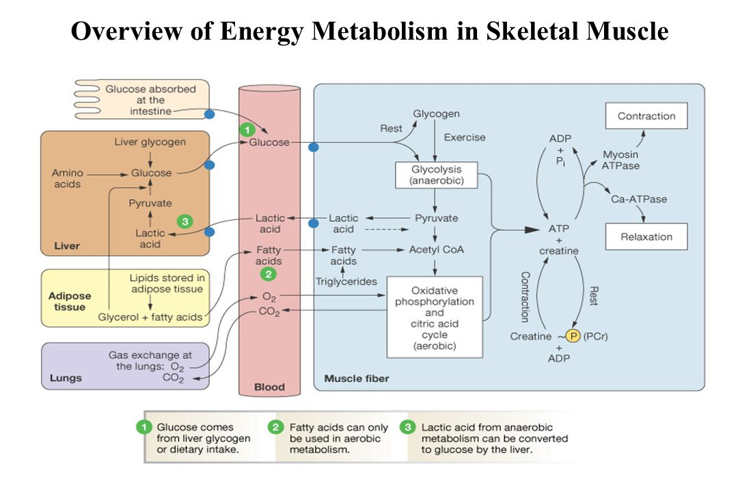
Fatty acid can only be used in aerobic
metabolism (β-Oxidation)

Slide 10
Aerobic Metabolism in Red Muscle Fibers
Red muscle fibers have a lot of blood vessels and mitochondria
Suitable for: prolonged muscle activity
Red color due to myoglobin
Obtain ATP mainly from: anaerobic glycolysis
Myoglobin:
- Higher O2 affinity than hemoglobin.
- Releases O2 when its level drops
Obtain ATP mainly from fatty acids by : aerobic glycolysis
Fatty acids are broken down by:
- β-oxidation
- Krebs cycle
- Respiratory chain
(Electron transport chain)
Metabolism:
- Mainly Aerobic
- Depends on
adequate supply of o2
Myoglobin: 🛑
Store o2
Have 1 subunit
Hemoglobin:🛑
transport o2
Have 4 subunits

Slide 11
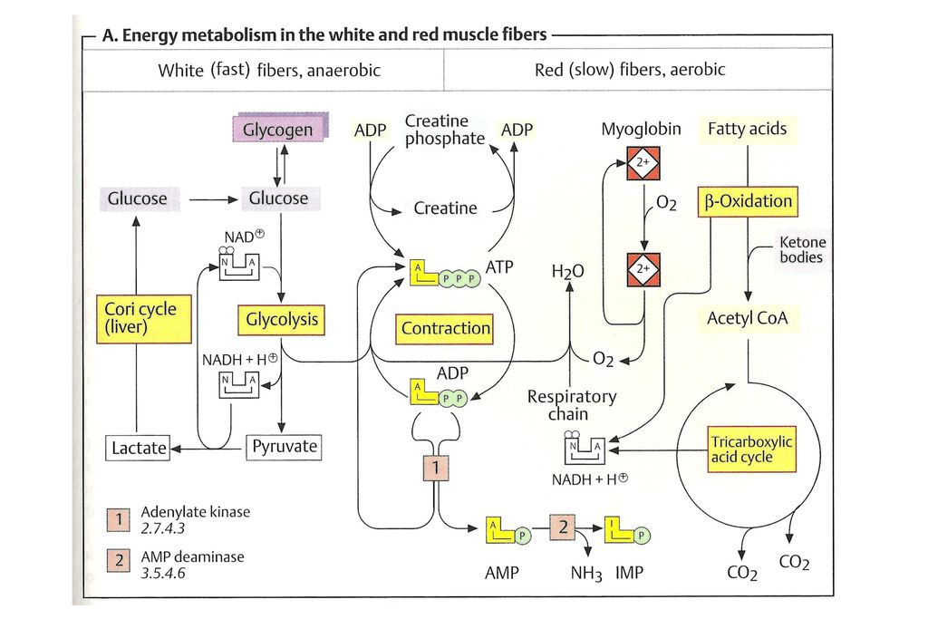
Aerobic Metabolism in Red Muscle Fibers
In red fibers:
Fatty acids break down by β-Oxidation
producing acetyl CoA
Acetyl CoA enters krebs cycle producing
NADH + H
NADH and O2 (from myoglobin) enters
electron transport chain to produce ATP
The muscle fiber at rest:
● Glucose → glycogen
● ATP → creatine phosphate
The muscle fiber during exercise:
● Glycogen → glucose → pyruvate
● Creatine phosphate → ATP + creatine
Not Important
● ATP → ADP
Thanks to 441
Dr. Sumbul
AMP deaminase not important
The fate of ATP in muscle fibers was explained in: slide 8, step 5

Slide 12
Anaerobic Metabolism in White Muscle Fibers
Obtain ATP mainly from: anaerobic glycolysis
Intense muscle activity (weightlifting) →O2
supply from blood quickly drops
Have supplies of glycogen that is catabolized & undergoes glycolysis
Suitable for: fast, strong contractions
NB: when we say glycogen we mean glucose also, because glycogen will be catabolized into glucose

Slide 13
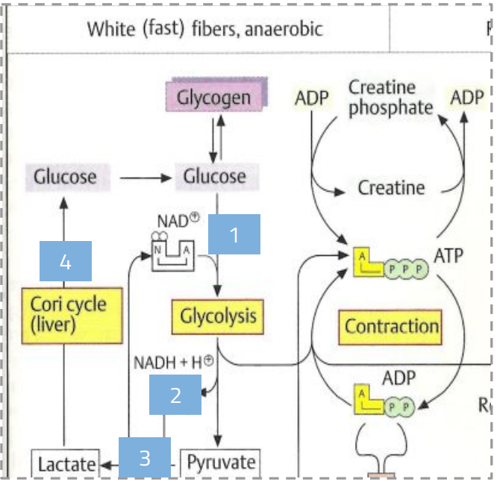
Anaerobic Metabolism in White Muscle Fibers
01
Glycogen → glucose-1-PO4 → glucose-6-PO4 → ATP (by glycolysis).
02
NADH and H+ are re-oxidized into NAD+ ( by converting pyruvate into lactate) to maintain glucose degradation + ATP formation.
(the reason why pyruvate is converted to lactate -Dr said it’s important
to know why -)
03
Lactate is resynthesized into glucose in the liver by Cori cycle
(next slide).
the enzyme responsible of converting pyruvate into lactate is
Lactate dehydrogenase
The Main Process:
Glycogen → glucose → glucose-1-PO4 → glucose-6-PO4 → glycolysis → pyruvate → lactate → go to liver “Cori cycle”
→
→
ATP
bind with NH2 → alanine

Slide 14
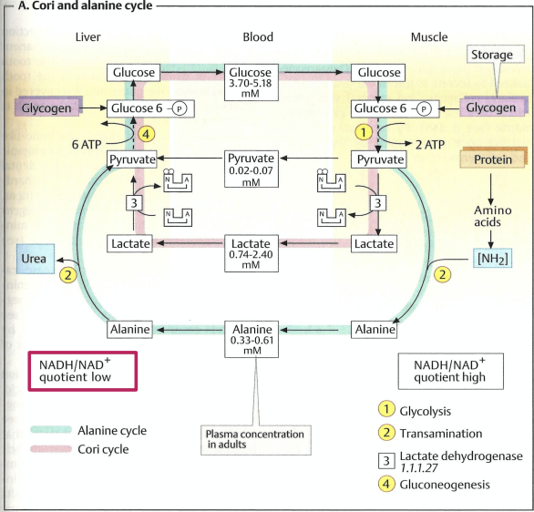
The Cori Cycle
• In anaerobic glycolysis
01
In the muscle: glucose is converted into lactate by
anaerobic glycolysis.
02
Lactate is released into the blood and is transported to the liver.
03
In the liver: Lactate → glucose (gluconeogenesis).
04
Glucose is transported to the muscles
(for energy again).
• Skeletal muscles can’t produce new glucose from lactate.
Why?
• Gluconeogenesis requires (6 ATP) much more ATP than is supplied by glycolysis (2 ATP) in muscle.
• O2 deficiencies don’t arise in liver even during intense exercise → liver always has sufficient ATP for
gluconeogenesis.

Slide 15
Glucose-Alanine Cycle
• Muscles produce:
1
Pyruvate
Pyruvate is either converted into lactate and enters cori cycle, or binds with NH2 forming alanine entering the Alanine cycle.
From glycolysis, during exercise.
2
Amino Nitrogen NH2
From normal protein degradation.
Pyruvate is converted into Alanine in muscles.
Alanine is converted into Pyruvate in liver.
Pyruvate forms glucose by gluconeogenesis in liver.
Glucose is transported to the muscles for energy.
Pyruvate + NH2 → Alanine
Alanine - NH2 → Pyruvate
Pyruvate → Glucose
Alanine is transported to the liver.

Slide 16
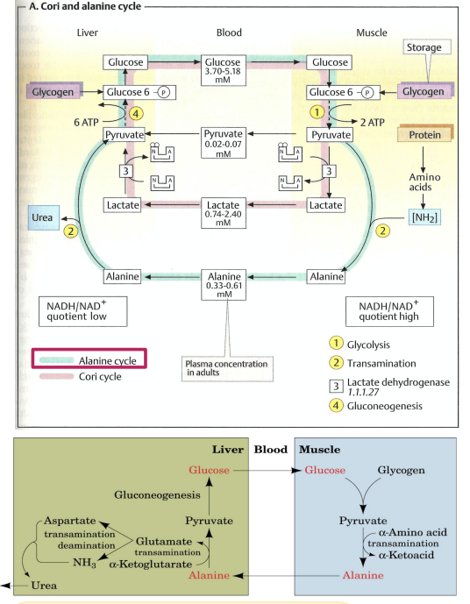
Glucose-Alanine Cycle
An Extra Slide from Doctors’ Explanation
1
In the muscles: pyruvate (from glycolysis during exercise) is converted into alanine by binding with NH2 .
An α-amino acid (from degraded/broken down protein) loses NH2 & becomes an α-ketoacid (it can be any amino acid).
2
Alanine is transported into the liver through blood.
3
In liver: alanine is converted back to pyruvate (when an
α-ketoglutarate binds with NH2 of the alanine forming glutamate)
● It is always α-ketoglutarate that binds with NH2 not any α-ketoacid.
● Glutamate is excreted by urea (look st the pic for more details).
4
In liver: pyruvate is converted into glucose by gluconeogenesis.
Glycogen stored in the muscle contributes in alanine formation as it is rapidly converted into glucose which is converted into pyruvate by glycolysis during exercise
5
The glucose is transported to the muscle by blood
and the cycle goes on.

Slide 17
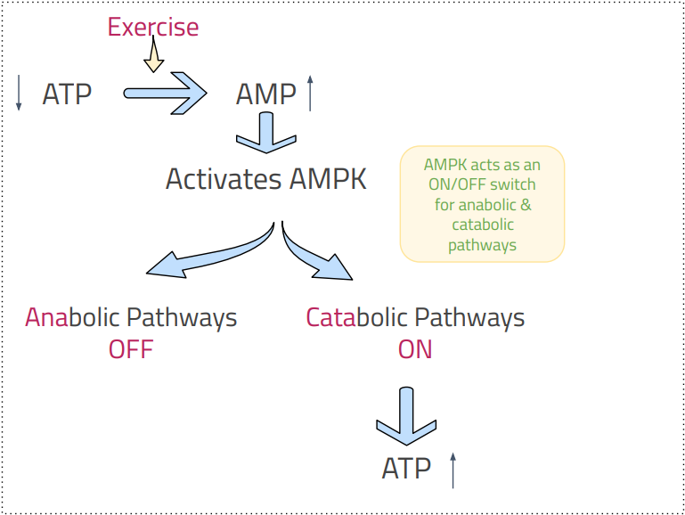
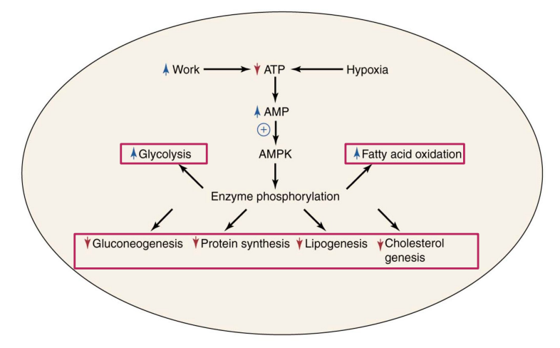
Exercise and AMPK (important slide)🛑
•Exercise = high energy demand.
•During exercise, metabolic enzymes are regulated through phosphorylation by AMP-activated protein Kinase (AMPK).
• AMPK activation shuts down ATP-requiring (they are decreased, not completely stopped) processes (anabolic) & stimulates ATP-producing (catabolic) processes.

Slide 18
Muscle Fatigue and Endurance Athletes
Muscle Fatigue
Effects of Training
Definition
Causes
Targeted training can change the proportions of red & white muscles.
Training can change the expression of muscle proteins.
Muscle Fatigue: Inability of a muscle to maintain a particular strength of contraction over time.
Muscle damage
Accumulation of lactic acid
Delayed fatigue
Efficient energy production & consumption
High endurance during muscle activity.
An athlete gets a targeted training to change the proportion of red & white fibers as required for the sport/exercise.
- Runners have more red fibers
- Weight lifters have more white fibers

Slide 19
Take home messages
✦ATP is an important source of chemical energy needed by the cells to perform body functions.
✦ Muscular activity requires constant supply of ATP for energy either from aerobic or anaerobic metabolism.
✦ Cori and glucose-alanine cycles play an important role in regenerating glucose for energy.

Slide 20
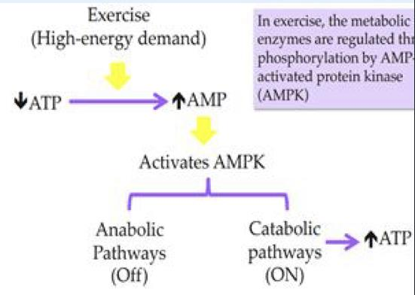
MCQ
SAQ
Q1 :The most rapid method to resynthesize ATP during exercises is:
A) Glycolysis | B) phosphocreatine | C)Krebs | D)Glycogenolysis
Q2:In all-out exercises such as sprinting, the first fibres type to fatigue is:
A) Type1 | B) Type2 | C) Type 1a | D) Type IIX
Q3:Fatty acids are broken down by:
A) Alpha oxidation | B) Beta oxidation | C) Glycogenolysis | D)Alpha reduction
Q4: Conversion of pyruvate to alanine requires the addition of which of the following compounds?
A) NH3 | B) NH2 | C) Lactate | D) Fatty acids
Q5:A by-product of glucose metabolism, produced primarily during intense exercise is:
A)Glycogen | B)AMP | C)Glucose | D) Lactic acid
Q6:Red muscle fibers obtain ATP mainly from which of the following?
A)Glycogen | B)Glucose | C) Fatty acids | D) Pyruvate
Q7:Which of the following regulate Metabolic enzymes during exercise?
A) Glucose levels | B) Lactate levels | C) ADP levels | D) AMPK
1-the system of each line, how much time does it take, which best exercise and which macromolecules is used?
Red line: Slide 5(try to write it not read it)
Blue line: Slide 5(try to write it not read it)
Yellow line: Slide5 (try to write it not read it)
2-Why skeletal muscles can’t produce new glucose from lactate?
*Gluconeogenesis requires much more ATP than is supplied by glycolysis in muscle
*O2 deficiencies do not arise in the liver even during intense exercise
*Therefore, liver always has sufficient ATP for gluconeogenesis
3-Explain muscles fatigue and endurance in athletes and enumerate causes of muscles fatigue?
Inability of a muscle to maintain a particular strength of contraction over time.
Causes: 1- Muscle damage, 2- Accumulation of lactic a
4-Explain how exercise and AMPK work?
Q1-B
Q2-B
Q3-B
Q4-B
Q5-D
Q6-C
Q7-D
Special Thanks to team441

Slide 21
Our team:
Girls
leader:
Sara alotaebe
Shahed Bukhari
Roaa alharbi
Raseel AlWehibi
Razan alnufaie
Ghada Binslmah
Boys
leader:
Mohamed Faisal ibn Saqyan
Abdullah Ali
Hassan Ali
Alabdullatif
Ibrahim alohail
Mishari nahar Alanezi
Saad Alahmari
العلم يبني بيوتاً لا عماد لها
والجهل يهدم بيت العز والكرمِ
أحمد شوقي

