Slide 1
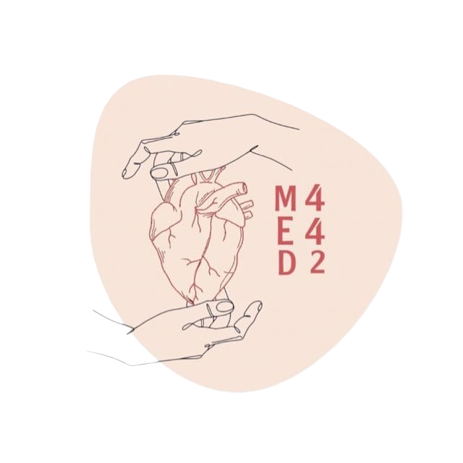
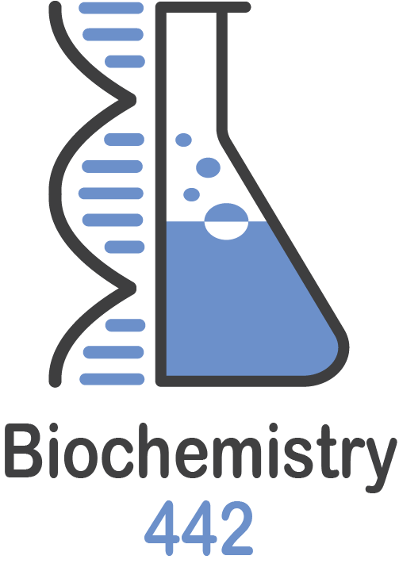
Purine Degradation & Gout
Color index:
Black: Main text
Red: important
Blue: in boys slides only
Pink: in girls slides only
Green: Doctors Notes
Grey: Extra info
L 3
W 3

Slide 2
Objectives
By the end of this lecture, students should be familiar with:
Purine degradation, uric acid formation and its association with gout.
Fate of uric acid in humans.
Recognize the importance of uric acid in the pathogenesis of gout.
Overview of Gout classification and treatment.

Slide 3
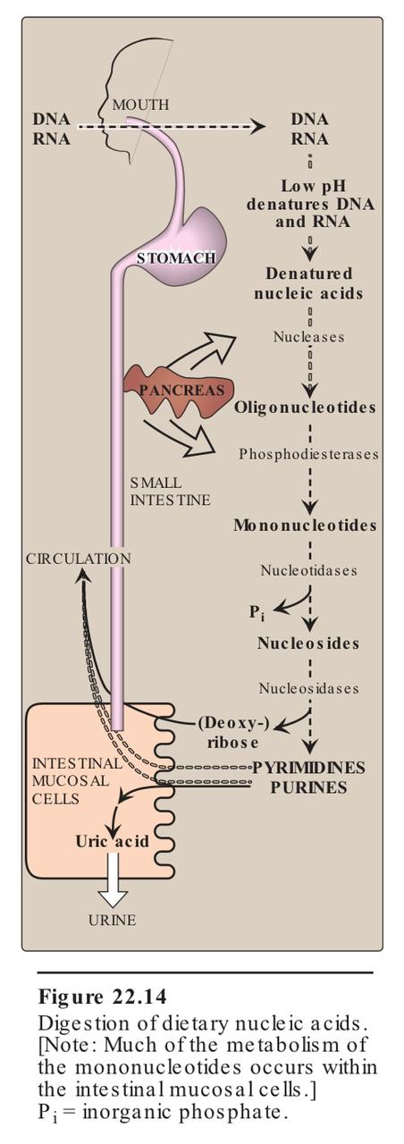
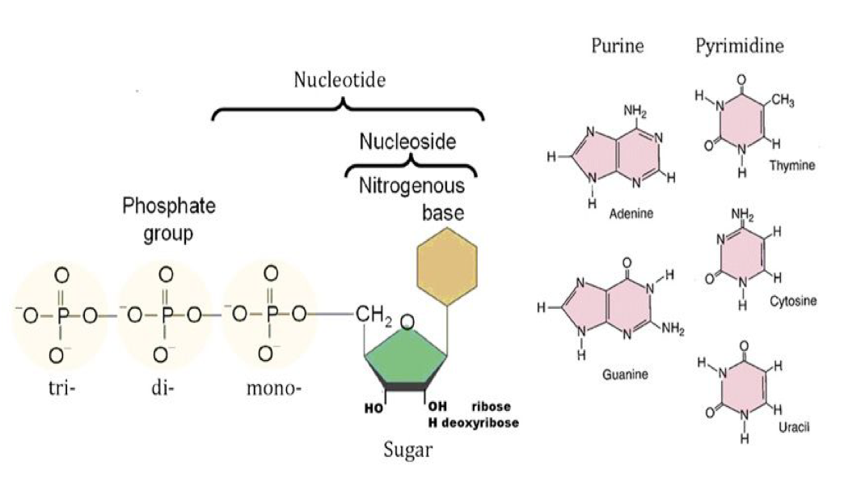
Purine degradation pathway
Purine and pyrimidine bases are absorbed by the intestine
The ingested
bases are mostly degraded into different products by
degradation pathways
These products are then excreted by the body
The major source
of dietary nucleic acids (purines and pyrimidines) is
meat

Slide 4
Purine degradation pathway
All of the Enzymes are important
Nitrogen base +ribose + phosphate
Nitrogen base+ribose
Dietary DNA / RNA
Nucleotides
Nucleosides
Pancreatic nucleases
And phosphodiesterases (this enzyme breaks the phosphodiesterase bond between the nucleotides)
Nucleotidases
(Remove the phosphate group)
Nucleosidases
(Remove the sugar /-ribose-1-P)
Free pyrimidine bases + Ribose
Free purine bases + Ribose
Pyrimidine Degradation pathway
Purine Degradation pathway
Malonyl CoA
Our lecture
Malonyl CoA: Important for fatty acid biosynthesis
Uric acid
The final product is uric acid, because the human body does not have the enzyme that oxidize the uric acid
Definition of phosphodiester bond
: a covalent bond in RNA or DNA that holds a polynucleotide chain together by joining a phosphate group at position 5 in the pentose sugar of one nucleotide to the hydroxyl group at position 3 in the pentose sugar of the next nucleotide.
Adenosine and guanosine (purines) are finally degraded to uric acid by:
• Purine degradation pathway

Slide 5
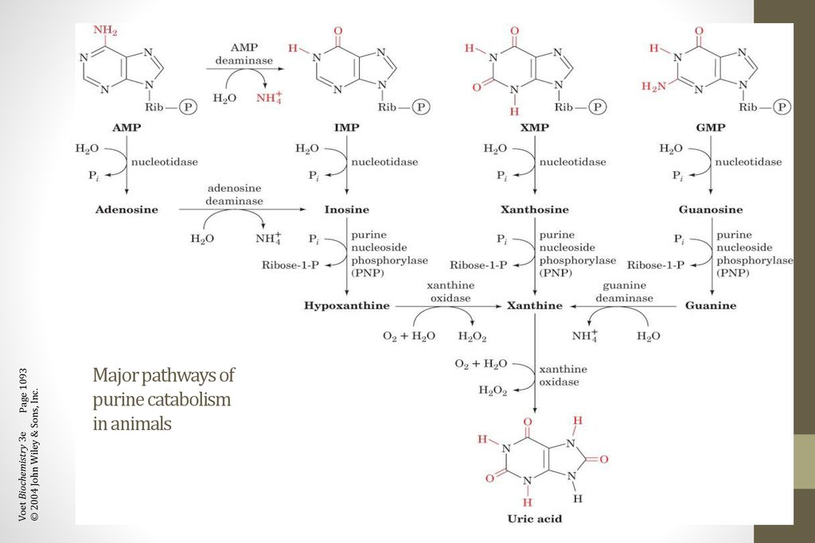
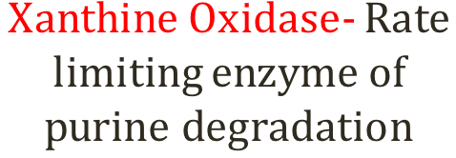
Major pathways of purine catabolism in animals
Don’t memorize the structures
All of the Enzymes are important
Very helpful video (from 2:50)
All the first raw are purine nucleic acids
Remove phosphate
Remove phosphate
Remove phosphate
Remove phosphate
Or you can say nucleosidase
(Sugar was removed)
Or you can say nucleosidase
Or you can say nucleosidase
Dr: you can say just sugar no need for saying ribose-1-P
Important enzyme
Extra

Slide 6
Purine degradation pathway
Same concept as the previous slide but in another way
All of the Enzymes are important
AMP deaminase
AMP
IMP
XMP
GMP
Nucleotidase
Nucleotidase
Nucleotidase
Nucleotidase
Adenosine deaminase
Adenosine
Inosine
Xanthosine
Guanosine
PNP or Nucleosidase
PNP or Nucleosidase
PNP or Nucleosidase
Ribose 1-P /sugar
Ribose 1-P /sugar
Ribose 1-P /sugar
Hypoxanthine
Xanthine
Guanine
Xanthine oxidase
deaminase Guanine
Xanthine oxidase: the rate limiting enzyme of the purine degradation
Xanthine oxidase
URIC ACID

Slide 7
Major pathways of purine catabolism in animals
Extra slide
Thanks to team441
Enzyme | examples | function
Deaminase | AMP Deaminase | AMP IMP
 | Adenosine Deaminase | Adenosine Inosine
 | Guanine Deaminase | Guanine Xanthine
Nucleotidase | Nucleotidase | GMP Guanosine
 |  | AMP Adenosine
 |  | IMP Inosine
 |  | XMP Xanthosine
Purine nucleoside phosphorylase (PNP) | PNP | Inosine Hypoxanthine
 |  | Xanthosine Xanthine
 |  | Guanosine Guanine
Xanthine oxidase | Xanthine oxidase | hypoxanthine Xanthine
 |  | Xanthine Uric acid

Slide 8
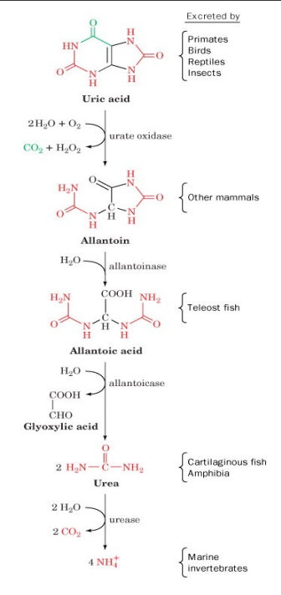
Fate of uric acid in humans
In humans, primates, birds and reptiles the final product of purine degradation is uric acid
Uric acid is excreted in the urine
Some animals convert uric acid to other products:
Allantoin
Allantoic acid
Urea
Ammonia
You don’t have to memorize anything here of the pathway
Urate oxidase is the enzyme that makes uric acid more soluble in animals
Uric acid is less soluble in water
Reptiles, insects and birds excrete uric acid as a paste of crystals,To save water
Humans excrete uric acid in urine
Team441:Humans don’t have urate oxidase. Therefore, they can’t degradate Uric acid into Allantoin
Humans do not have enzymes to further degrade uric acid
Excessive production of uric acid causes deposition of uric acid crystals in the joints leading to:
Gout
Hyperuricemia (High level of uric acid)

Slide 9
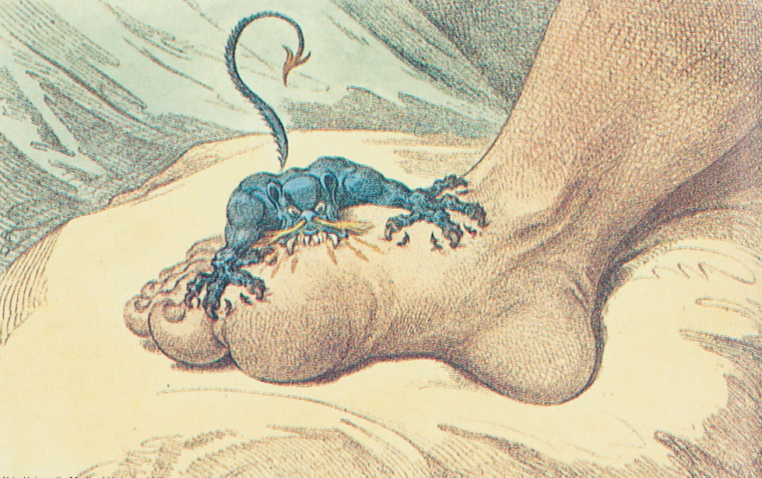
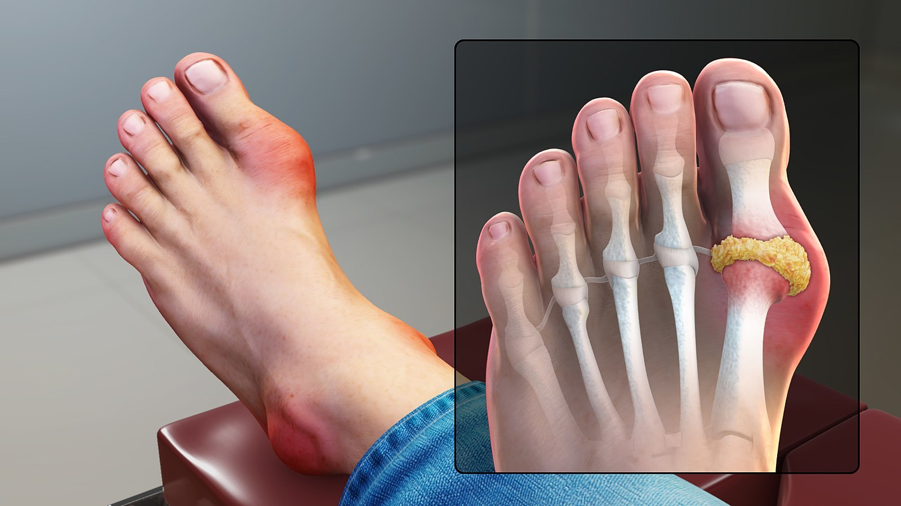
What is gout?
What causes uric acid levels to rise (two main causes)?
What is a symptom of gout?
What the prevalence of gout?
Where do sodium urate crystals accumulate in?
**Extra** How does a sodium urate crystal form?
Gout is a disease due to high levels of uric acid in body fluids
(7.0 mg/dL and above )
Osmosis video about Gout
Video about gout with visuals
The normal level of uric acid in males is higher than females this is why males get gout more commonly
( the saturation point is the same = 7)
Uric acid accumulates because of:
Overproduction (high consumption of meat) or Underexcretion (kidney impairment, dehydration)
Painful arthritic joint inflammation due to deposits of insoluble sodium urate crystals ( especially big toe)
Affects 3 per 1000 persons
Sodium urate crystals accumulate in kidneys, ureter, joints leading to chronic gouty arthritis
Uric acid, the final product of purine metabolism, is a weak acid that circulates as the deprotonated urate anion under physiologic conditions, and combines with sodium ions to form monosodium urate.

Slide 10
Some misconceptions about gout:
Treatment
Reducing of pain and inflammation → (analgesics, anti-inflammatory drugs)
Increasing uric acid excretion → (uricosuric agents)
Reducing uric acid production → Allopurinol (xanthine oxidase inhibitor)
Inaccurately associated with overeating and drinking
Why is gout associated with overeating?
Excessive meat consumption increases uric acid production in some individuals.
Why is gout associated with drinking?
Because alcohol used to be contaminated with lead during manufacture and storage
→ How does the lead affect the human body?
Lead decreases the excretion of uric acid from kidneys causing hyperuricemia and gout

Slide 11
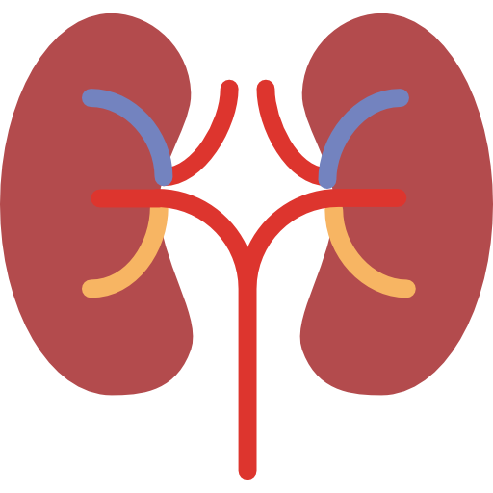
Primary Gout (90% of cases)
Secondary Gout (10% of cases )
(important slide)
Classification of Gout
It’s important to know the difference between complete and partial HGPRT
Important: causes of secondary gout
Clinical category: | Metabolic defect
Enzyme defects-Unknown (85% to 90% of cases ) | Overproduction of uric acid -Normal excretion (Majority) -Increased excretion (Minority ) Underexcretion of uric acid with normal production
Known enzyme defects – e.g., Partial HGPRT (responsible of recycling purine) deficiency (rare) | Overproduction of uric acid
**(HGPRT) = Hypoxanthine-guanine
phosphoribosyltransferase
Clinical category: | Metabolic defect
Associated with increase nucleic acid turnover – e,g. Leukaemia | Overproduction of uric acid with increase urinary excretion
Chronic renal disease | Reduced excretion of uric acid with normal production
Inborn errors of metabolism – e.g complete HGPRT deficiency (Lesch-nyhan syndrome) | Overproduction of uric acid with increased urinary excretion

Slide 12
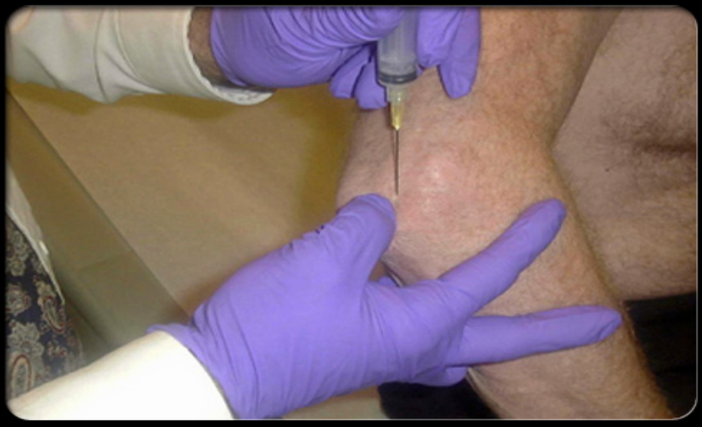
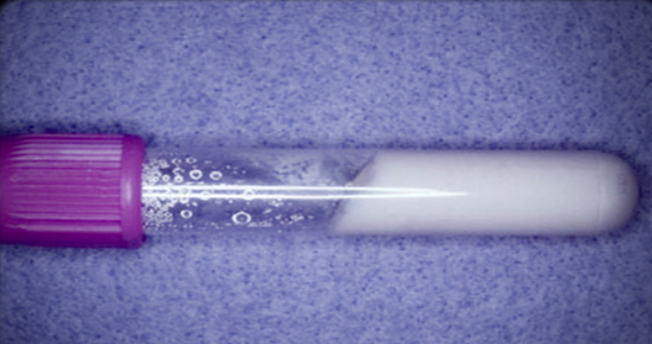
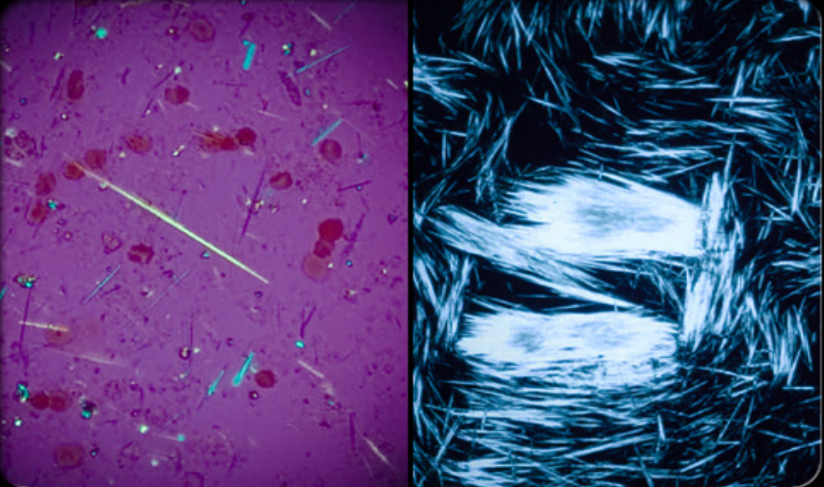
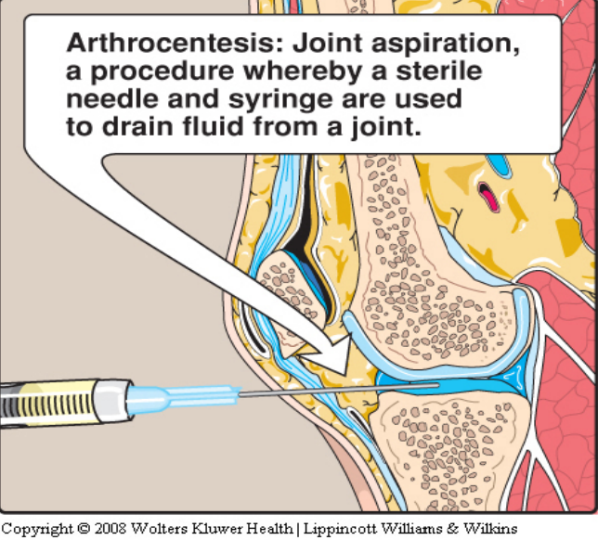
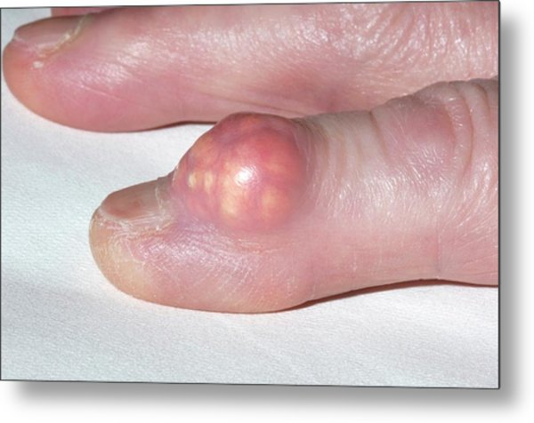
Biochemical Diagnosis
❑ Joint fluid test
The definitive diagnosis of gout requires (arthrocentesis) aspiration and examination of synovial fluid from an affected joint (or material from a tophus) using polarized light microscopy to confirm the presence of needle-shaped monosodium urate crystals.
Arthrocentesis → synovial fluid →monosodium urate crystals
❑Blood test (easiest)
It is used to measure the levels of uric acid.
High levels of uric acid = (7.0 mg/dL and above )
**High levels of uric acid (uricemia) does not always indicate that there is gout, so the joint fluid test is more definitive
Extra: Tophus:a deposit of monosodium urate crystals, in people with longstanding high levels of uric acid in the blood

Slide 13
Take home message
The biochemical causes that contribute to the development of gout and hyperuricemia are defects in purine degradation pathway and impaired excretion of uric acid.
Hyperuricemia does not always cause gout.
Gout **extra**

Slide 14
MCQ
SAQ
Q1- The correct order of the following enzymes in AMP catabolism to uric acid is: 1.AMP deaminase. 3. A nucleotidase. 2. A nucleoside phosphorylase. 4. Xanthine oxidase
A) 1, 2, 3, 4 | B) 1, 3, 2, 4 | C)1, 4, 2, 3 | D) 3, 2, 1, 4
Q2- Which of the following would NOT be expected to contribute to gout?
A) Inhibition of xanthine oxidase. | B) high turnover of nucleic acids. | C) High activity of adenosine deaminase. | D) Deficiency of HG-PRT.
Q3-The drug Allopurinol inhibits which of the following enzymes?
A) Adenosine Deaminase | B)Nucleotidase | C)Xanthine oxidase | D) Guanine Deaminase
Q4- What is the final product of purine degradation in mammals?
A) Guanine | B) Inosine | C) Uric acid | D) Hypoxanthine
Q5- Xanthine oxidase catalyses the formation of which of the following?
A)Xanthine | B)Uric acid | C)Hypoxanthine | D) Xanthine and uric acid
Q6- Which of the following is generally used to eliminate uric acid from the body?
A)Sweat | B)Breathing | C)Urine | D)Metabolization of liver
1- What are the main causes of gout?
- Overproduction of uric acid
- Underexcretion of uric acid
2- Mention the
Biochemical tests for the diagnosis of gout :
- Blood test
- Joint fluid test
3- Which enzyme is responsible for degradation of uric acid into Allantoin?
urate oxidase
3-What causes secondary gout ?
Slide 11
Q1-B
Q2- A
Q3-C
Q4-C
Q5-D
Q6-C

Slide 15
Our team:
Girls
leader:
Sara alotaebe
Shahed Bukhari
Roaa alharbi
Raseel AlWehibi
Razan alnufaie
Ghada Binslmah
Boys
leader:
Mohamed Faisal ibn Saqyan
Abdullah Ali
Hassan Ali
Alabdullatif
Ibrahim alohail
Mishari nahar Alanezi
Saad Alahmari
إذا غامَرْتَ في شرف مروم
فلا تقنع بما دون النجوم

