Slide 1
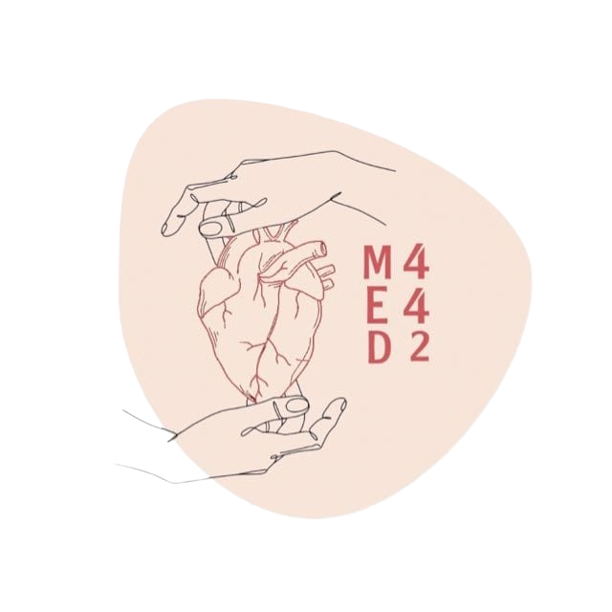
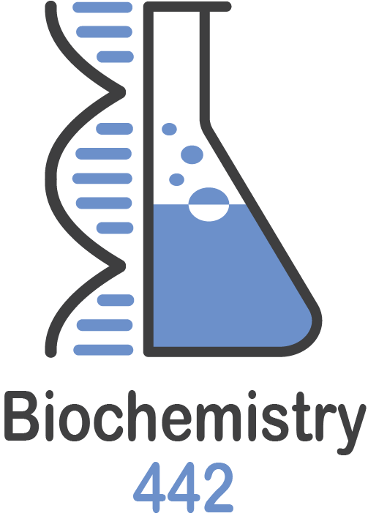
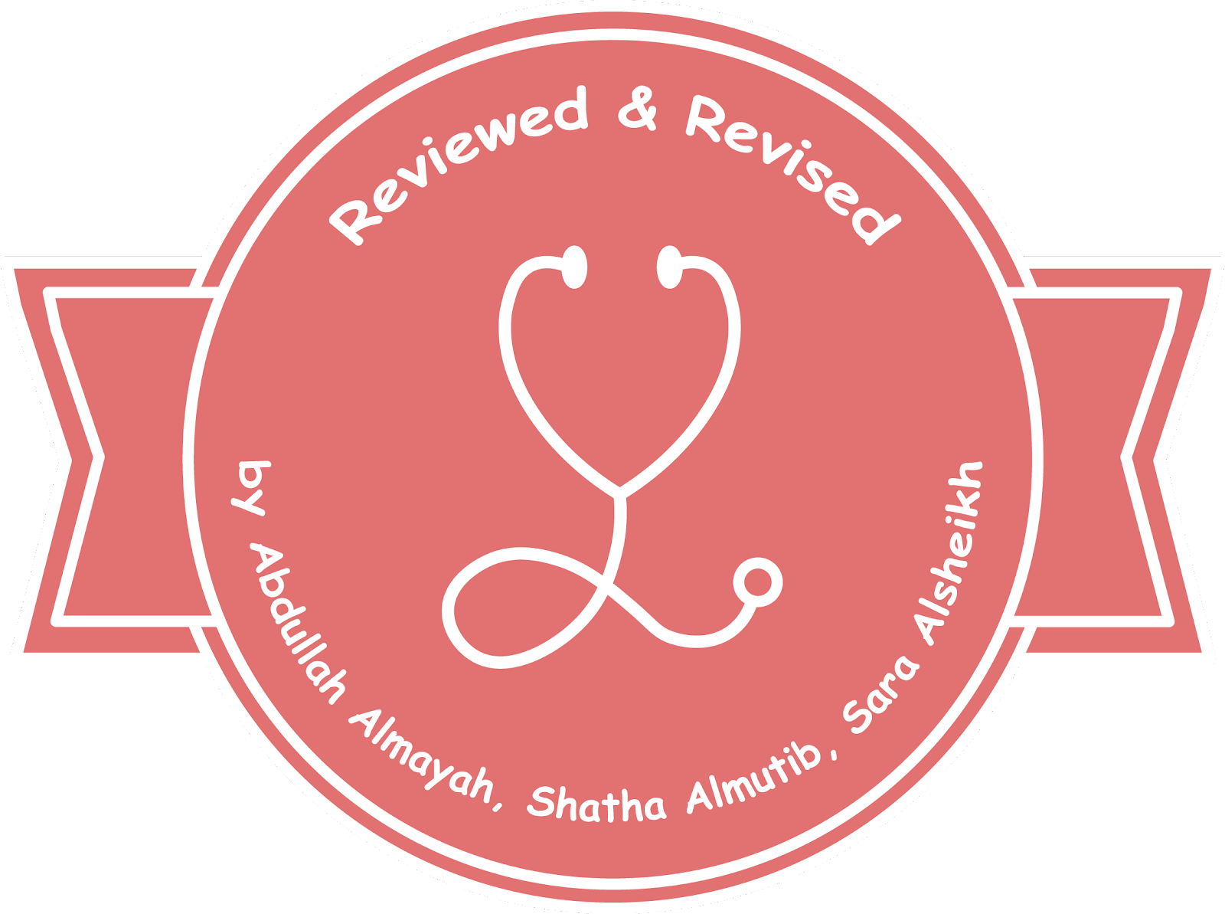
Creatine metabolism and collagen diseases
Color index:
Black: Main text
Red: important
Blue: in boys slides only
Pink: in girls slides only
Green: Doctors Notes
Grey: Extra info
L 4
W 4
Editing File

Slide 2
Objectives
By the end of this lecture the first year students will :
Study the importance of creatine in muscles as a storage form of energy.
Understand the biosynthesis of creatine.
Study the process of creatine degradation and formation of creatinine as an
end product.
Understand the clinical importance of the creatinine is a sensitive indicator
of kidney function.
Study the structure ,function, types and biosynthesis of collagen.
Understand different diseases associated with collagen

Slide 3
Creatine metabolism
1-Takes place in Kidney
Arginine + Glycine = Guanidinoacetate By Amidinotransferase
Ornithine will be produced as By-product
Arginine
+
Glycine
Amidinotransferase
2-Takes place in Liver
Guanidinoacetate + SAM = Creatine by Methyltransferase
SAH will be produced as By-product
- Addition of methyl group from SAM to GAA by Methyltransferase to
produce creatine
Ornithine
Guanidinoacetate
SAM
Methyltransferase
SAH
Creatine phosphate is the Energy Storage
Creatinine is the End Product
GAA= Guanidinoacetate
SAM = S-Adenosylmethionine
SAH = S-adenosylhomocysteine
Creatine
Creatine kinase
Creatine phosphate

Slide 4
Creatine biosynthesis
Kidneys
- Three amino acids are required: (important slide)🛑
1- Glycine
2- Arginine
3- methionine (as S-Adenosylmethionine) (SAM)
Arginine
Glycine
Amidinotransferase
Ornithine
- Sites of biosynthesis:
1- Kidney
2- Liver
Liver
Guanidinoacetate
- Enzymes required:(important)🛑
1- Amidinotransferase
2- Methyltransferase
3-Creatine kinase
- Products:
- Creatine
- By-product
1- SAH ( from SAM )
2- Ornithine (amino acid)
SAM
Methyltransferase
SAH
Creatine
441 doctor’s note :
- Arginine exist intensively in
kidneys
that’s why the first reaction occurs in kidneys, whereas GAA exist
intensively in liver that’s why the
second reaction occurs in liver

Slide 5
Distribution of body creatine
● Transported from liver to other tissues
Creatine
ATP
ATP
Creatine kinase
● 98% in skeletal and heart muscles
ADP
ADP
Creatine phosphate
● In skeletal muscle it is converted to high
energy source creatine phosphate
(phosphocreatine)

Slide 6
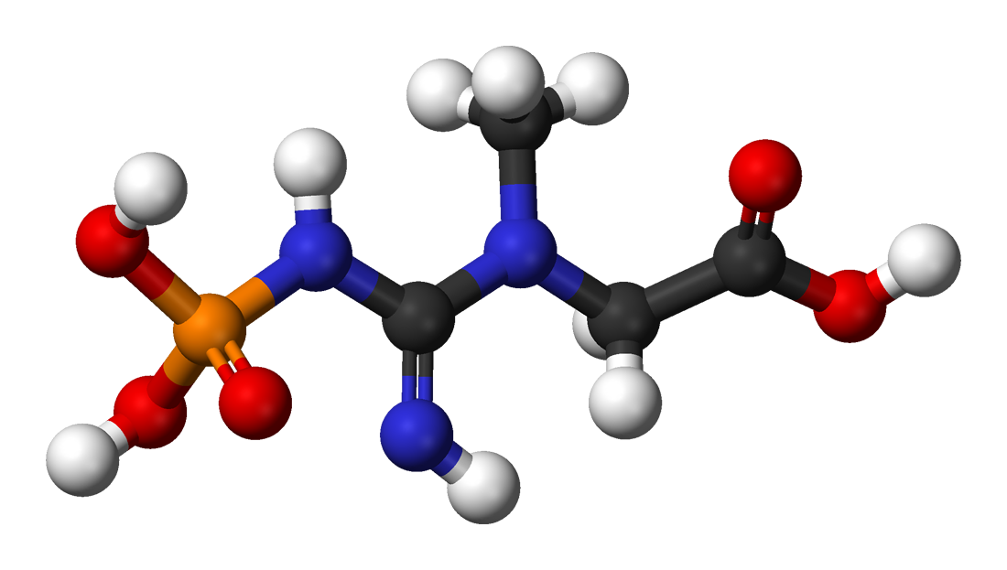
Creatine phosphate
High energy phosphate compound
Acts as a storage form of energy in the muscle
Provide small but ready source of energy during first few seconds of intense muscular contraction
It is stored in the muscle, and when intense muscle contraction is
needed, creatine phosphate gives the energy immediately
The amount of creatine phosphate in the body is proportional to the mass
Why does the body make creatine phosphate?
Because muscle fibers can’t store a lot of ATP So it stores creatine phosphate for the body’s
need of quick energy source by then creatine phosphate group to ADP to form ATP.

Slide 7
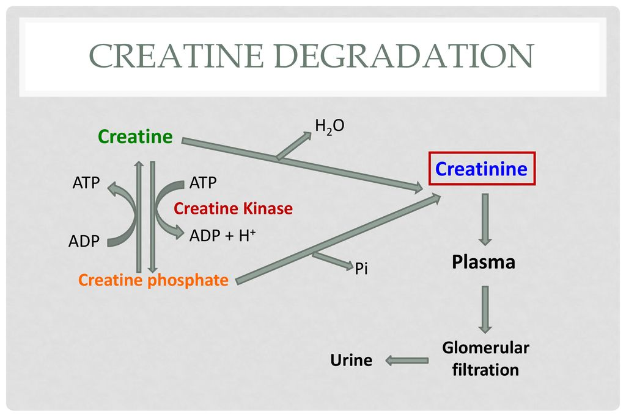
Creatine degradation
Creatine and Creatine phosphate spontaneously form Creatinine as an end product
Creatinine is excreted in the urine
Serum creatinine is a sensitive indicator of kidney disease (kidney function test)
Serum creatinine increases with the impairment of kidney function

Slide 8
Urinary creatinine
A typical male excrete about 15 mmol creatinine/day affected by mass
Decrease in muscle mass (in muscular dystrophy or paralysis) leads to decreased level of urinary creatinine ( because creatine and creatine phosphate are less )
The amount of creatinine in urine is used as an indicator for the proper collection of 24 hours urine sample
The level of creatinine depends on muscle mass, gender, and age
Creatine
Creatine kinase (CK)
CK is responsible for the generation of energy in contractile muscle tissues
CK level change in cardiac and skeletal muscle disorders
Creatine kinase
Creatine phosphate

Slide 9
Overview of Collagen
Most abundant protein in the human body.
Highly stable molecule with a half-life as long as several years.
Long rigid structure.
Classified as Fibrous Protein that serves structural functions.
Part of structural function:connective tissues, bone, teeth, cartilage, tendons, skin, blood vessels.

Slide 10
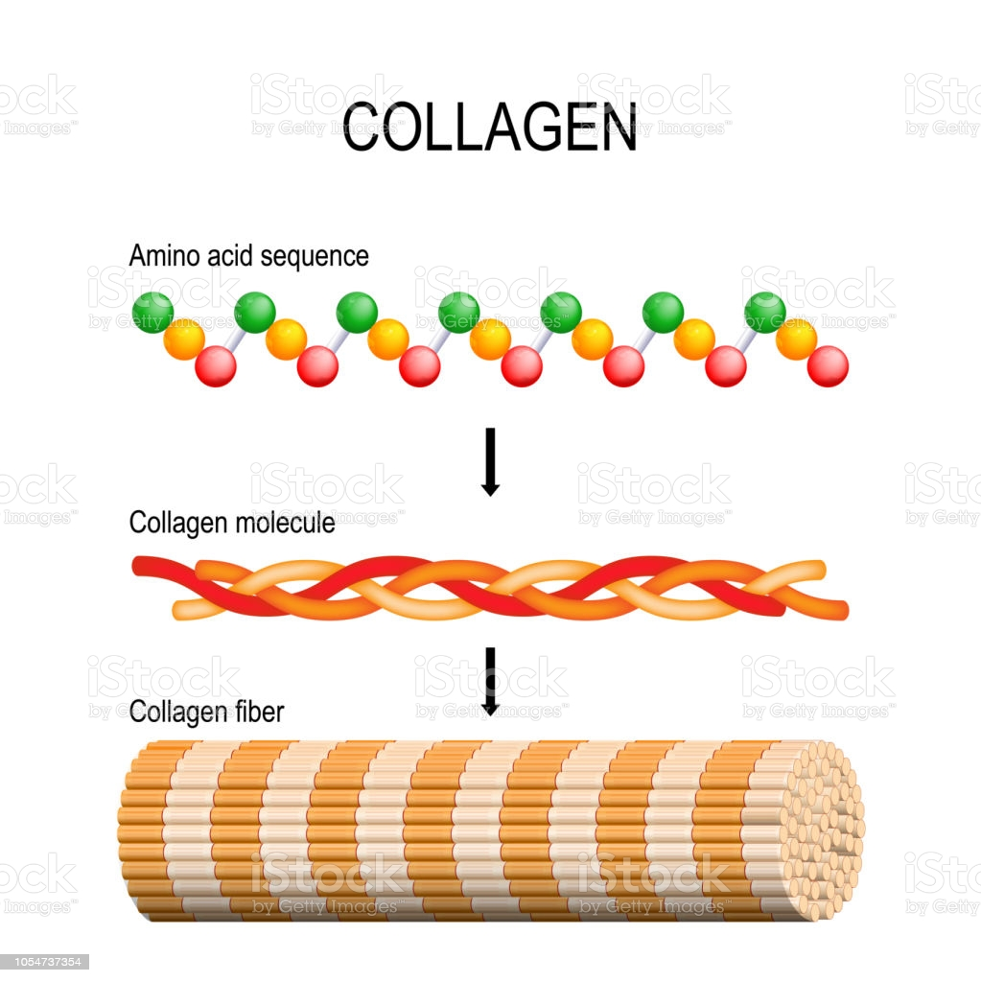
Collagen Structure
Collagen a-chain (~1,000 amino acids long) is rich in proline and glycine.
The glycine residues are part of a repeating sequence:
–Gly–X–Y–
glycine
Frequently proline
Often hydroxyproline
can be also hydroxylysine
(–Gly–Pro–Hyp–)333
كل ثلاث احماض واحد منها glycine
يصير شكله زي كذا

Slide 11
Collagen Structure
ثلاثة a-chain لافين على بعض
Collagen consists of three a-chains wound around one another in a rope-like triple helix.
The three polypeptide chains are held together by hydrogen bonds •
Two examples of protein secondary structure: collagen helix and a-helix.
Rich in proline and glycine amino acids.
—----------------------------------------------------------------------------------------------------------------------------------------------------------------------------------------------
Proline prevents collagen chains to form a-helix because:
Proline has no back bone amino group (it is a ring structure with secondary amino group).
Therefore hydrogen bonding within the helix is not possible.
ليه الa-helix حق الCollagen ما يصير زي a-helix حق الDNA

Slide 12
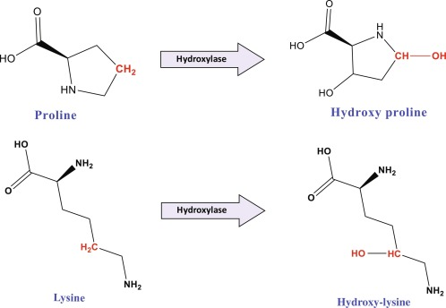
NON-STANDARD AMINO ACIDS IN COLLAGEN
Non-standard Amino Acids are amino acids that are not encoded within the genome. But can be made within the cell after the amino acid synthesis, when needed, they are made from the modification of non-essential amino acids.(TEAM 441)
During post-translational modifications
Hydroxylase
Proline
Hydroxyproline
Hydroxylase
Lysine
Hydroxylysine
Hydroxylase requires vitamin C (cofactor) for its function
so deficiency in Vit. C
leads to having inactivated enzymes therefore no functional Collagen. Such as
many diseases osteoporosis in the bones and scurvy in the teeth.
What does hydroxylase do in collagen ? (important)🛑
It adds a hydroxyl group to proline and lysine during post translational modification

Slide 13
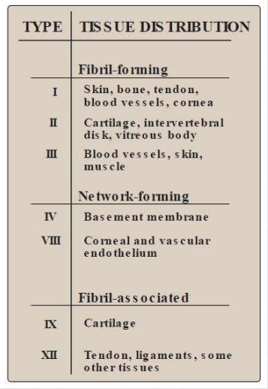
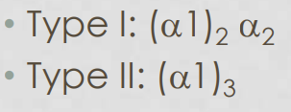
TYPES OF COLLAGEN
Types of collagen depend on function.
Variations in the amino acid sequence of a-chains result in different properties.
Examples:
Type I: (a1)2 a2
Type II: (a1)3

Slide 14
BIOSYNTHESIS OF COLLAGEN
• Synthesized in fibroblasts, osteoblasts, chondroblasts •
Pre-pro Pro Mature collagen
Polypeptide precursors are enzymatically modified to form triple helix.
Hydroxylation of proline and lysine residues.
(important)🛑Glycosylation of some hydroxylysine residues with glucose or galactose.
Secreted from Golgi vacuoles into the extracellular matrix as procollagen.
Cleaved by N- and C- procollagen peptidases to release triple helical tropocollagen molecules.
Tropocollagen molecules spontaneously associate to form collagen fibrils.
مراحل صناعته

Slide 15
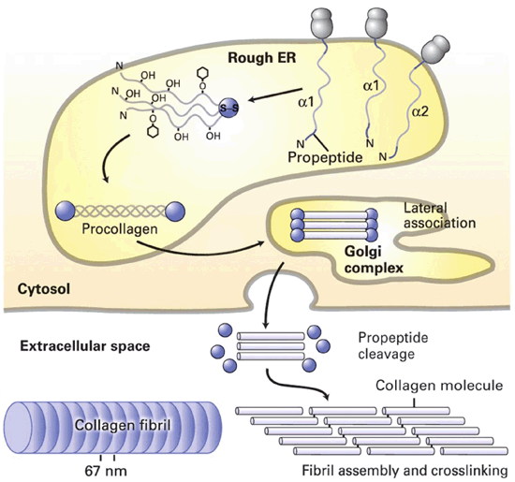
CROSSLINKING OF COLLAGEN FIBRILS
Lysyl oxidase oxidatively deaminates some of the lysine and hydroxylysine residues in collagen.
The reactive aldehydes – allysine and hydroxyallysine condense with lysine or hydroxylysine residues in neighbouring collagen molecules to form covalent cross-links .
This produces mature collagen fibres.

Slide 16
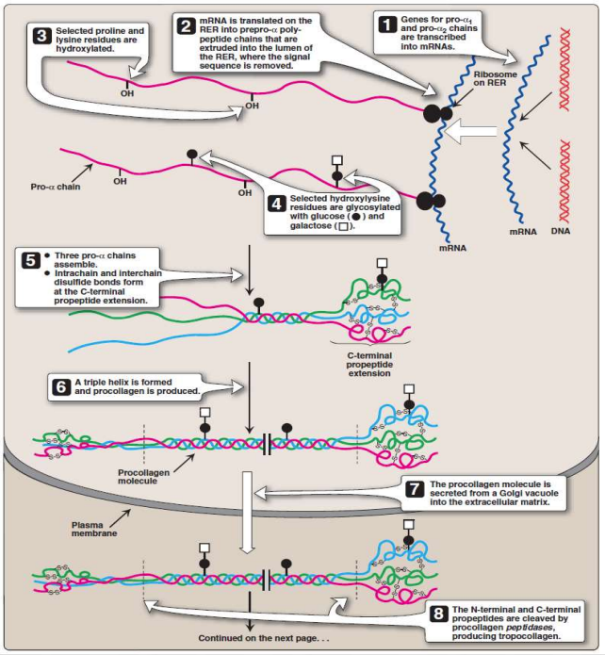
Biosynthesis of Collagen
1-Transcription of genes for pro α1&2-chains in the mRNA.
2-Translation on RER of Pro→ Pre-pro.
3-Hydroxylation of selected proline & lysine residues by hydroxylase enzyme + (Vitamin C).
4-Glycosylation of some hydroxylysine (only) residues with glucose or galactose.
5-Assemble of the three pro-α chains, intrachain and interchain disulfide bonds form at the C-terminal propeptide extension.
6-A triple helix is formed & procollagen is produced.
7-Procollagen is secreted from Golgi vacuoles into the ECM.
8-Cleavage of N- & C- terminals by procollagen peptidases to release triple helical tropocollagen molecules.
9-Self-assembly of tropocollagen into collagen fibrils.
10-Lysyl oxidase oxidatively deaminates some of the lysine & hydroxylysine residues in collagen.
11-Reactive aldehydes (allysine & hydroxyalllysine) condense with lysine or hydroxylysine residues in neighbouring collagen molecules to form covalent cross-links → mature collagen fibres.

Slide 17
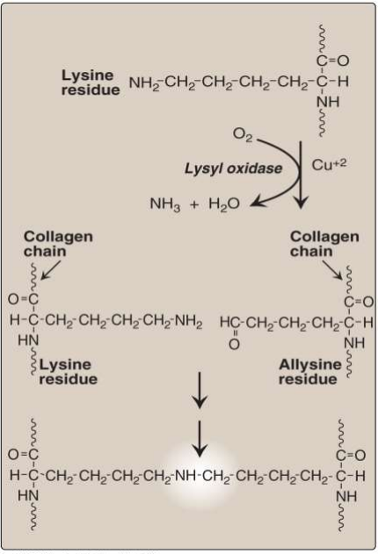
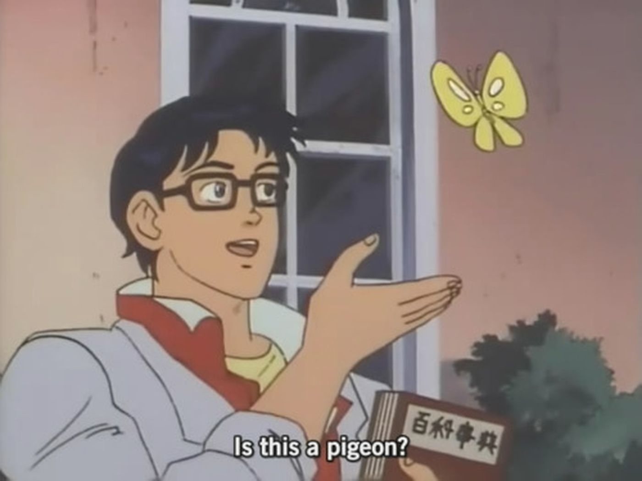
Summary of Collagen Synthesis Enzymes
Enzyme | Enzyme’s Function | Substrate | Product
Hydroxylase | Addition of OH | a. Proline b. Lysine | a. Hydroxyproline b. Hydroxylysine
N- and C- procollagen peptidases | Cleavage of N & C terminals | Procollagen | Tropocollagen
Lysyl oxidase | 1. Oxidation 2. Deamination | a. Lysine b. Hydroxylysine | a. Allysine b. Hydroxyalllysine
IS THIS A MEME

Slide 18
Overview of Collagen Diseases
Collagen
Diseases
Acquired
Inherited
Scurvy
OI
EDS
Type l
Type lI
Type lII
Scurvy due to vitamin C deficiency.
Ehlers-Danlos syndromes (EDS).
Osteogenesis imperfecta (OI).

Slide 19
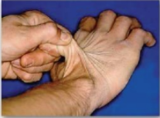
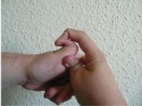
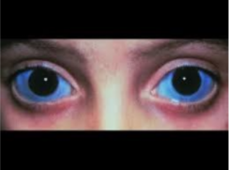
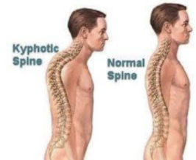
COLLAGEN DISEASES
1-Ehlers-Danlos syndrome: (Inherited)
● Due to deficiency of lysyl hydroxylase or N-procollagen peptidase.
● Mutations in the amino acid sequences of collagen I, III and V.
● Characterized by hyperextensibility of joints and skin.
—---------------------------------------------------------------------------------------------------------------------------
2-Osteogenesis imperfecta (brittle bone disease): (Inherited)
1. Bones fracture easily with minor or no trauma.
2. Mutations replace glycine with amino acids having bulky side chains
preventing the formation of triple helical conformation.
3. Type I (most common).
○ characterized by mild bone fragility, hearing loss and blue sclerae.
4. Type II (most severe).
○ lethal in the perinatal period (fractures in utero).
5. Type III (severe form).
○ Fractures at birth, short stature, spinal curvature.
○ Leading to a humped back (kyphotic) appearance and blue sclerae.

Slide 20
MCQ SAQ
Q1:Where Guanidinoacetate synthesized?
1-What are the amino acids required for creatine biosynthesis? 2-Why collagen structure is not supported by a-helix Structure?
Answer Q1:Glycine, Arginine, Methionine. (as s-Adenosylmethionine) Q2:Because it has Proline which has no backbone amino group, Therefore hydrogen bonding within the helix is not possible.
A- Skeletal muscle | B- Liver | C- Cardiac muscle | D- Kidneys
Q2:Serum creatinine is a sensitive indicator of:
A- Cardiac disease | B- Kidney disease | C- Liver disease | D- Bone disease
Q3:What is the enzyme responsible for generation of energy in contractile muscular tissues?
A- Methyltransferase | B- Creatine kinase | C- Aminotransferase | D- Hydroxylase
Q4:Collagen structure rich in:
A- Proline | B- Glycine | C- Leucine | D- Both A&B
Q5:Disease characterized by blue sclerae:
A- Osteogenesis imperfecta(TypeI) | B- Osteogenesis imperfecta (Type II) | C- Osteogenesis imperfecta (Type III) | D- Both A&C
1-D 2-B 3-B 4-D 5-D

Slide 21
Our team:
Boys
leader:
Mohamed Faisal ibn Saqyan
Abdullah Ali
Hassan Ali
Othman Al-Duraim
Ibrahim alohail
Mishari nahar Alanezi
Saad Alahmari
Girls
leader:
Sara alotaebe
Shahed Bukhari
Roaa alharbi
Raseel AlWehibi
Razan alnufaie
Ghada Binslmah
سَأَضرِبُ في طول البلاد وَعَرضِها
أَنالُ مُرادي أَو أَموتُ غَريبا
فَإِن تَلِفَت نَفسي فلله درها
وَإِن سَلِمَت كانَ الرجوع قَريبا
محمد بن إدريس الشافعي

