Slide 1
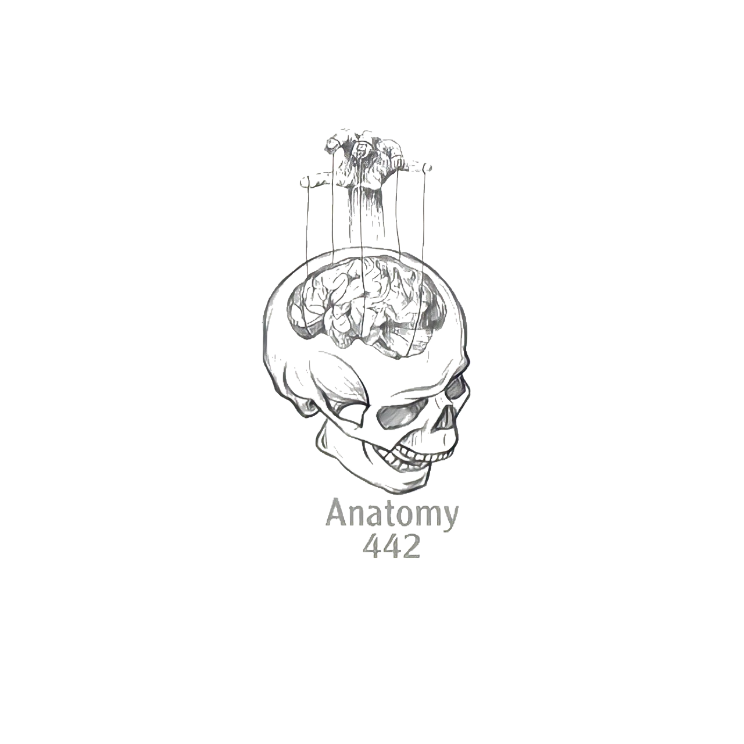
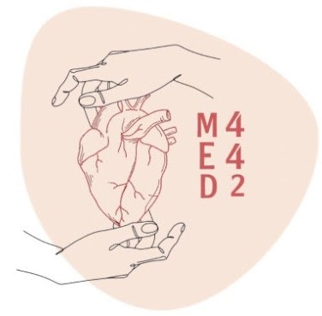
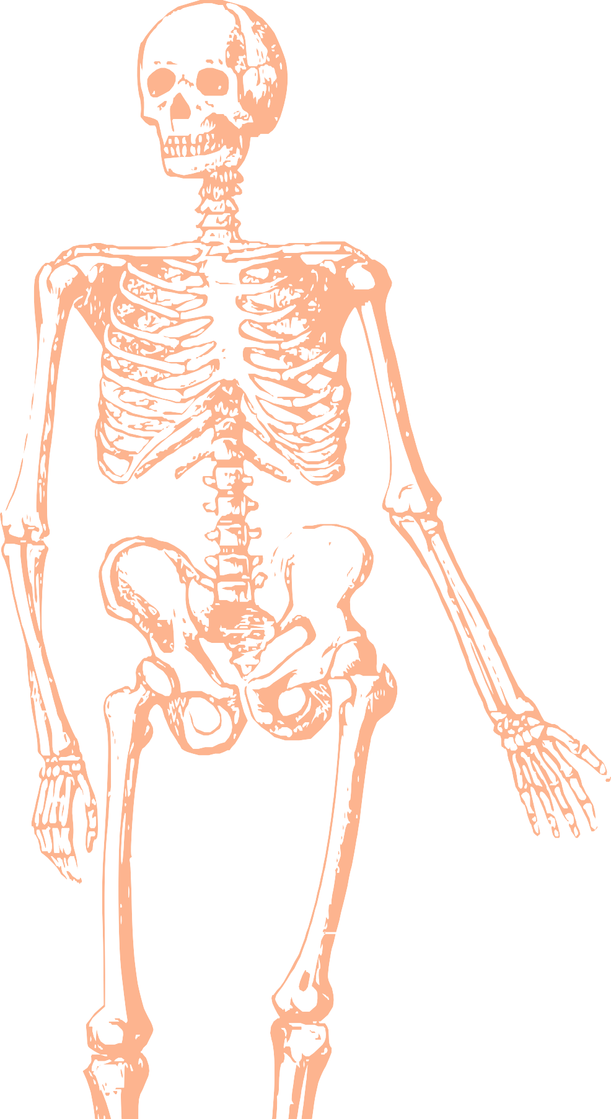
L1
Embryology of the Limbs
Editing file
Color index:
Mine text
Important
Doctors notes
Female slides only
Male slides only
Extra

Slide 2
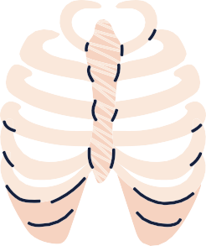
Objectives:
At the end of the lecture, student should be able to:
● List the different parts of mesoderm and the different divisions of somites.
● Differentiate bones according to their embryological origin and mode of ossification.
● Describe the ossification of long bones.
● Describe the main steps for development of limbs
● Differentiate muscles according to their embryological origin

Slide 3
Second Week
In Girls’ Slides Only

Slide 4
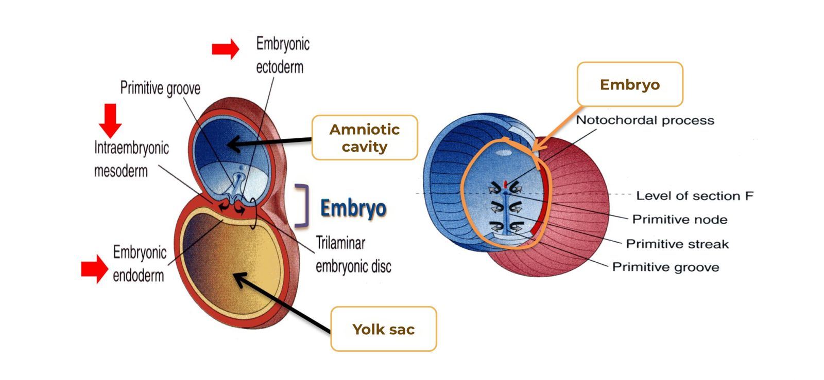
Revision:
Very useful video
لازم تكون فاهم الطبقات عشان تفهم الدرس

Slide 5
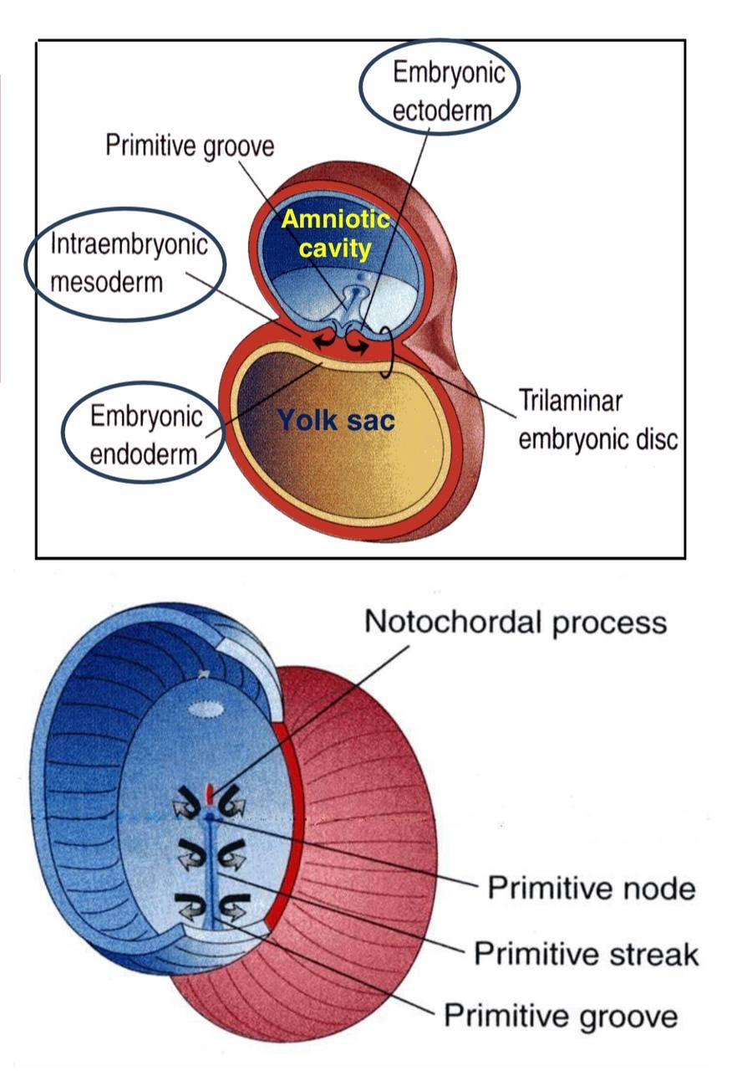
In Girls’ Slides Only
Three Germ Layers:
1- Ectoderm
2- Mesoderm
3- Endoderm
Notochord stimulates neural tube formation
which in turn stimulates development of the
vertebral column
- Neural tube is a derivative of the ectoderm

Slide 7
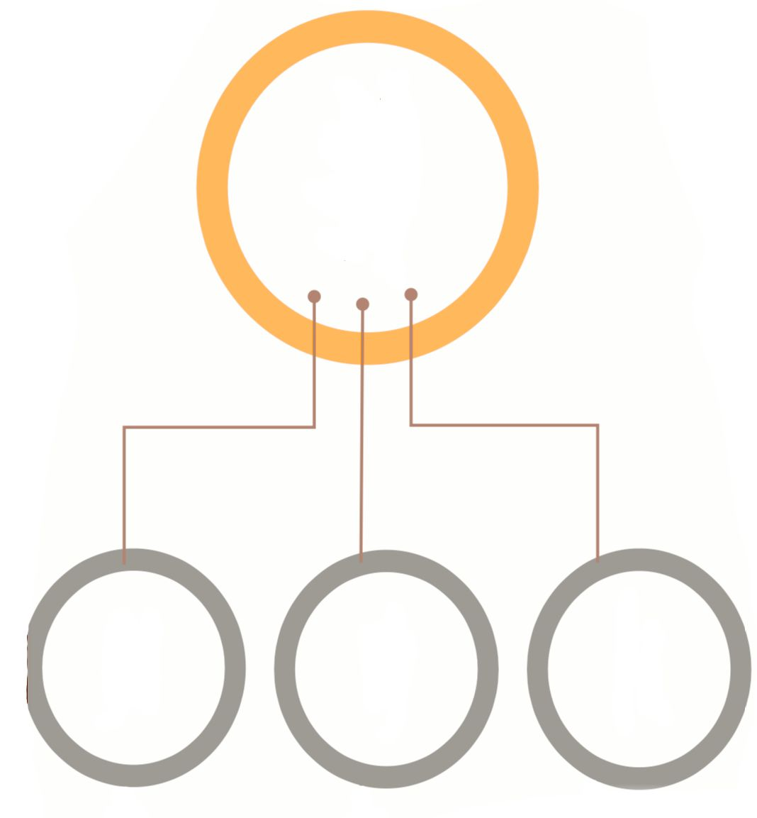
Intraembryonic Mesoderm
Proliferates between the ectoderm & endoderm except in the central axis of the embryo where notochord is found.
Differentiates into 3 parts
Paraxial mesoderm
Intermediate mesoderm
lateral mesoderm
Divided by an intraembryonic coelom into:
1- Somatic mesoderm (between ectoderm & coelom).
2- Splanchnic mesoderm (between endoderm & coelom).
439 note: Named for its intermediate position between the paraxial into 3 parts and lateral plate mesoderm
- On each side of the notochord.
- Divides into units (Somites)

Slide 8
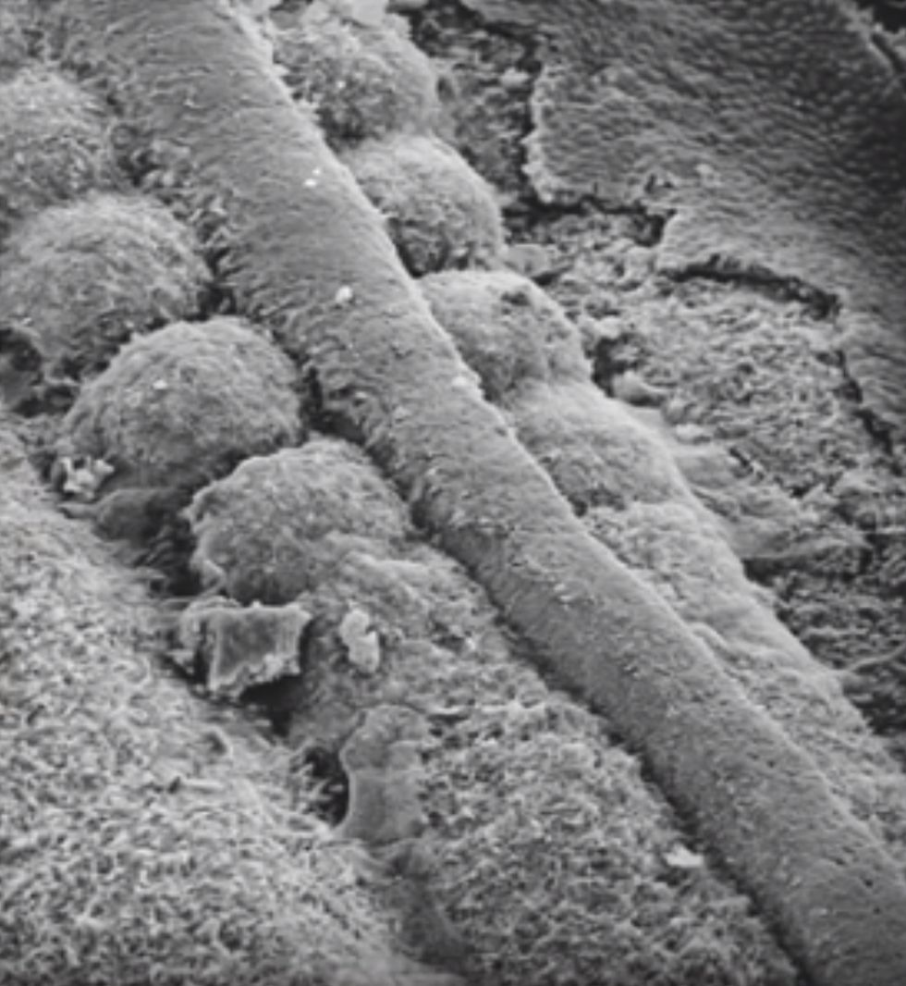
In Girls’ Slides Only
Specialization of Mesoderm
• Appearance of the notochord (first sign)
• Three collections of the mesoderm appear lateral to the notochord
-Somites
-Intermediate mesoderm
-Double sheets of lateral plate mesoderm

Slide 9
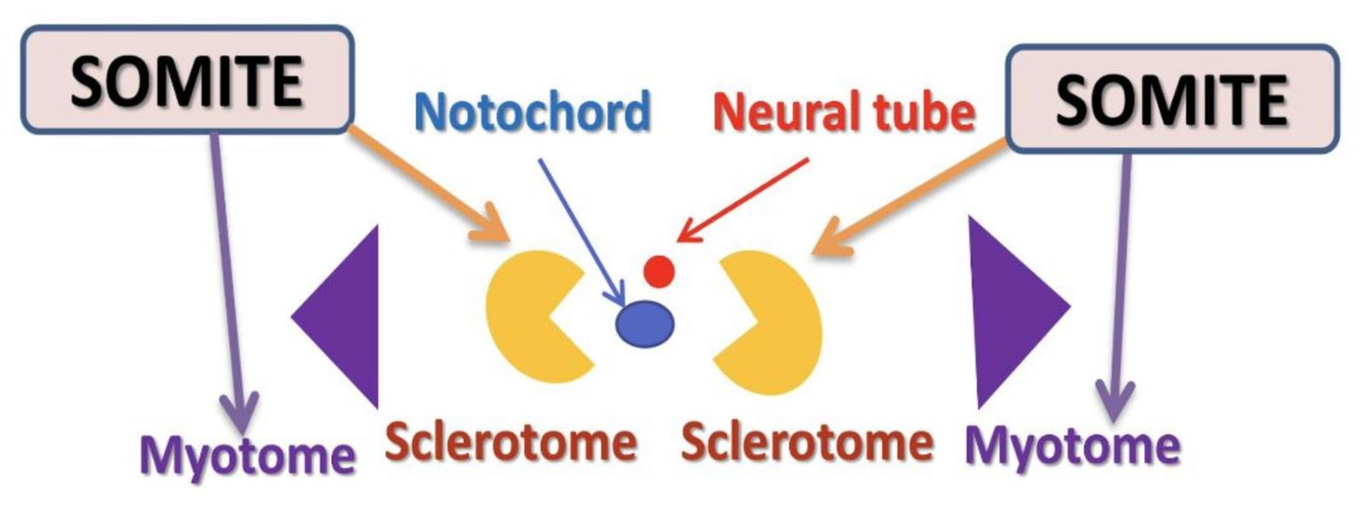
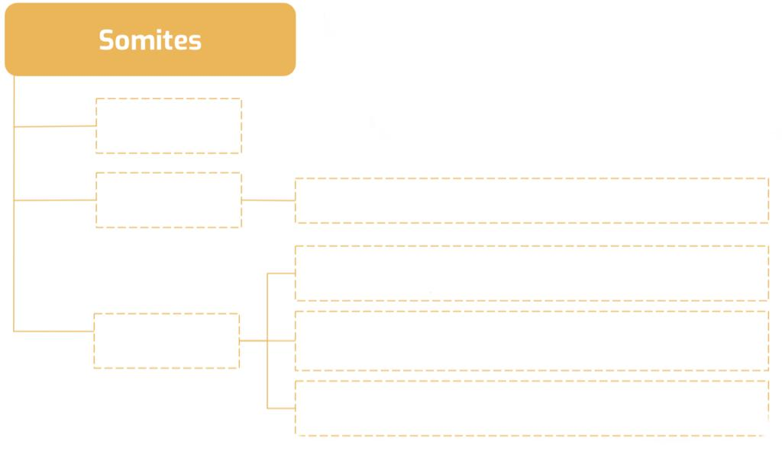
Dermatome
Forms the dermis of the skin on the dorsal part of the body
Sclerotome
Vertebral column, ribs & sternum
Hypaxial division: muscles of body wall (abdominal wall, pelvic wall, thoracic wall, etc..)
Myotome
Myoblasts migrate into limbs: Limb muscles (to form the flexor and extensor muscles of the limbs) in both the upper and lower limb.
Epaxial division: Muscles of back (Extensors of vertebral column & muscles of the neck)

Slide 10
Limb Buds
In Girls’ Slides Only
The upper & lower limbs develop from limb buds
The upper limb bud appears earlier than that of the lower
The upper bud: C4 - T1
The lower bud: L2 - S3

Slide 11
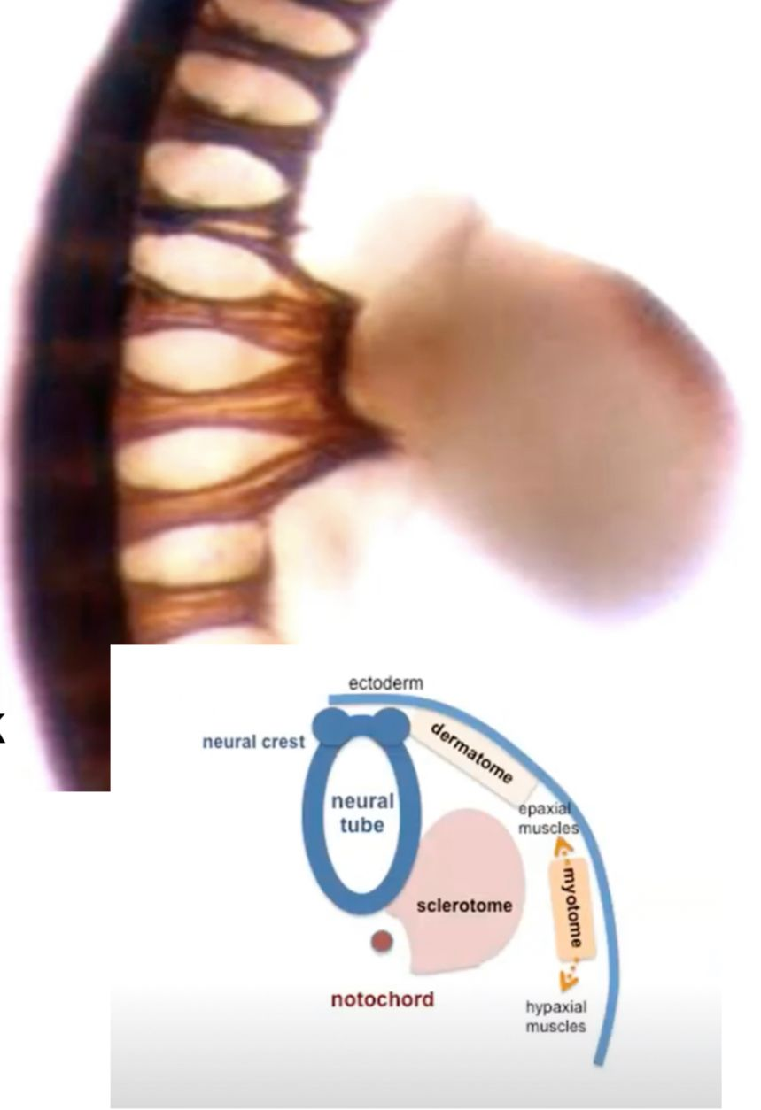
In Girls’ Slides Only
Muscle Formation
• Myoblasts form a dorsal (epaxial) and a ventral (hypaxial) blocks of muscle tissue (extensors and flexors)
-Hypaxial division:
Muscles of limbs & body wall
-Epaxial division: Extensors muscles of back, neck & spine
Then, the motor nerves invade the limb bud

Slide 12
Development of The Limbs:
The limb bud appears as an elevation on the ventrolateral body wall resulting from proliferation of mesenchyme of the somatic layer of the lateral mesoderm. Each limb bud is surrounded by an area of ectoderm
Upper Limb Buds
Appear at day 26 opposite the lower cervical segments
Lower Limb Buds
Appear at day 28 opposite the lumbar & sacral segments

Slide 13
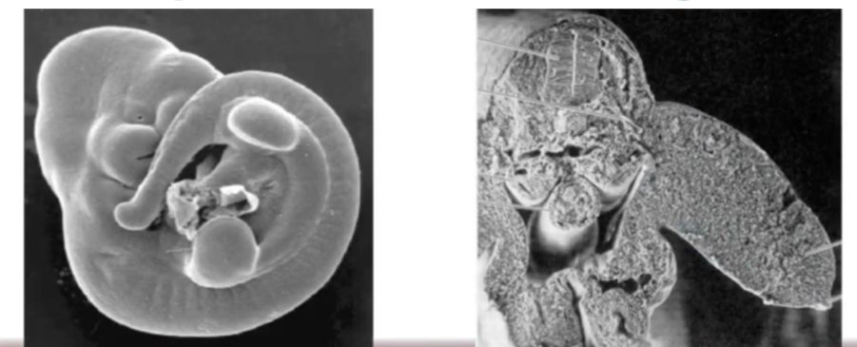
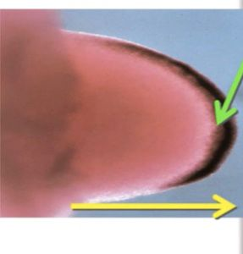
Apical Ectodermal Ridge
In Girls’ Slides Only
• Apical ectodermal ridge (AER) is a thick ectodermal area at the tip of the bud
• It stimulates the mesenchymal cells beneath It to divide (progress zone)
Limb bud grows

Slide 14
Development of the Limbs cont:
A & G | B & H | C & I | D & J | E & K | F & L
Apical ectodermal ridge appears at the apex of limb bud & stimulates proliferation of mesenchyme & elongation of limb bud | Distal ends of buds flatten into paddle-like hand & foot plates | Digital rays appear as mesenchymal condensations that outline the patterns of digits | Mesenchyme between rays disappears to form notches | Digits form inside rays, elongate, and appear webbed | Mesenchyme between digits disappears so digits are now separated

Slide 15
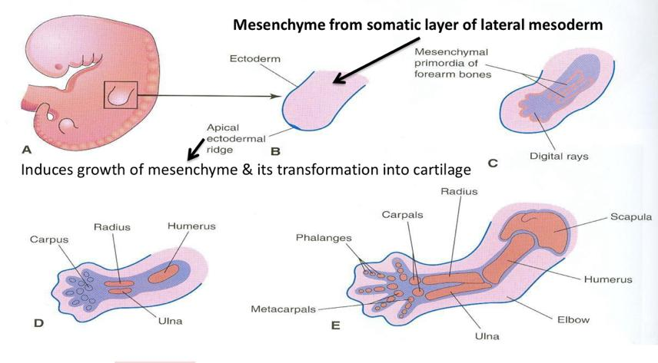
Development of The Limbs, Contd.
● Cartilage ossifies by: Endochondral ossification.
● Myoblasts migrate from myotomes to form: Muscles of limbs

Slide 16
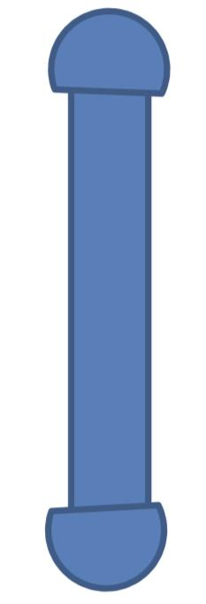
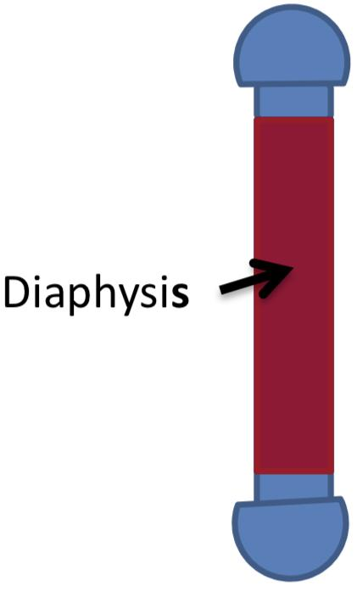
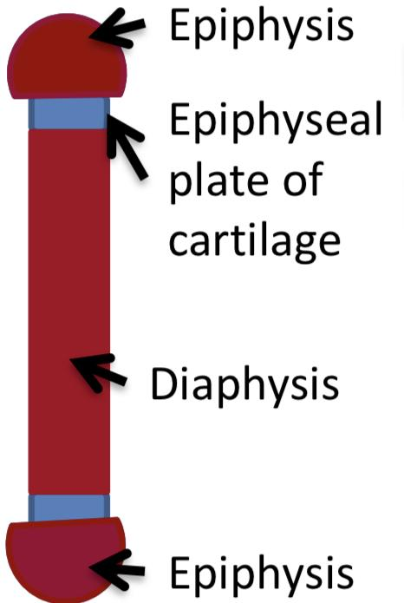
Ossification of Long Bones
Red: bone
Blue: cartilage
Before birth
After birth
After puberty
Birth
Puberty
bone in
Cartilaginous state
Appearance of primary ossific centers: ossification of diaphysis
Appearance of secondary ossific centers: ossification of epiphysis
Ossification of epiphyseal plate: Complete union of epiphysis & diaphysis
Bone increases in length by proliferation of epiphyseal plate
Bone age is a good index of general maturation. Bone age is determined by:
1. Appearance of ossific centers in diaphysis & epiphysis (specific for each bone & sex)
2. Disappearance of epiphyseal plate (specific for each bone & sex)

Slide 17
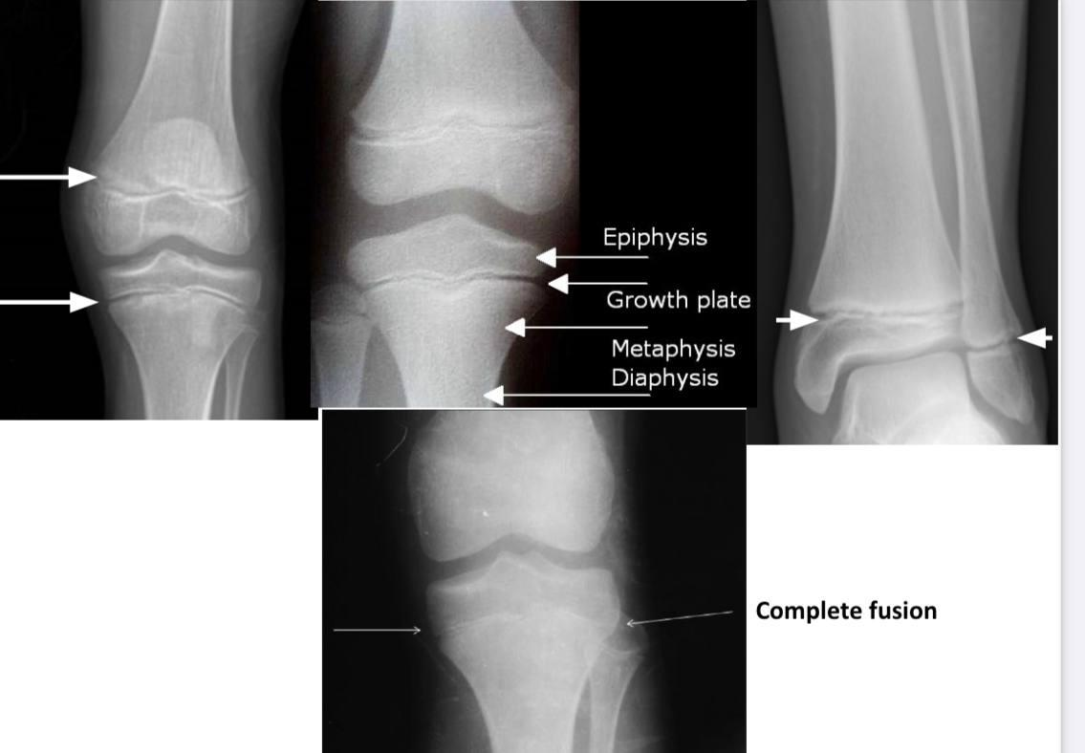
Ossification of Long Bones

Slide 18
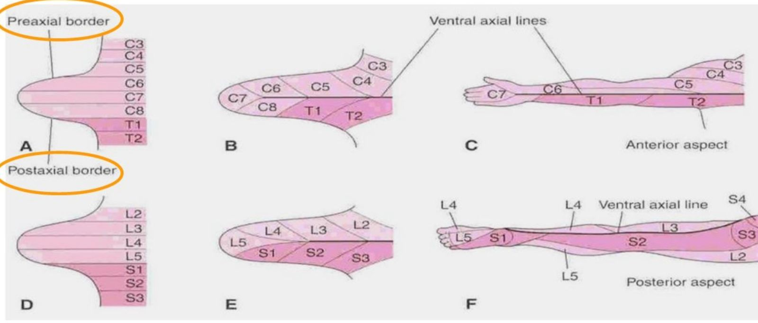
Development of The Limbs, Contd.
Originally, limb buds were at right angle of the trunk with:
1- Cranial (preaxial) & Caudal (postaxial) borders: radius and tibia are preaxial bones.
2- Ventral & Dorsal surfaces: flexor muscles are ventral.
During 7th week, adduction of limb buds occurs with 90° rotation:
1- In upper limb, rotation occurs laterally→ radius is lateral & flexor muscles are anterior.
2- In lower limb, rotation occurs medially→ tibia is medial & flexor muscles are posterior.

Slide 19
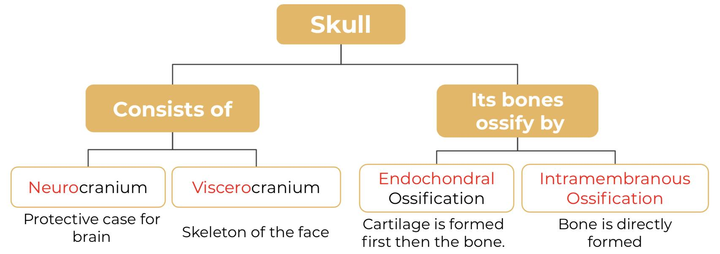
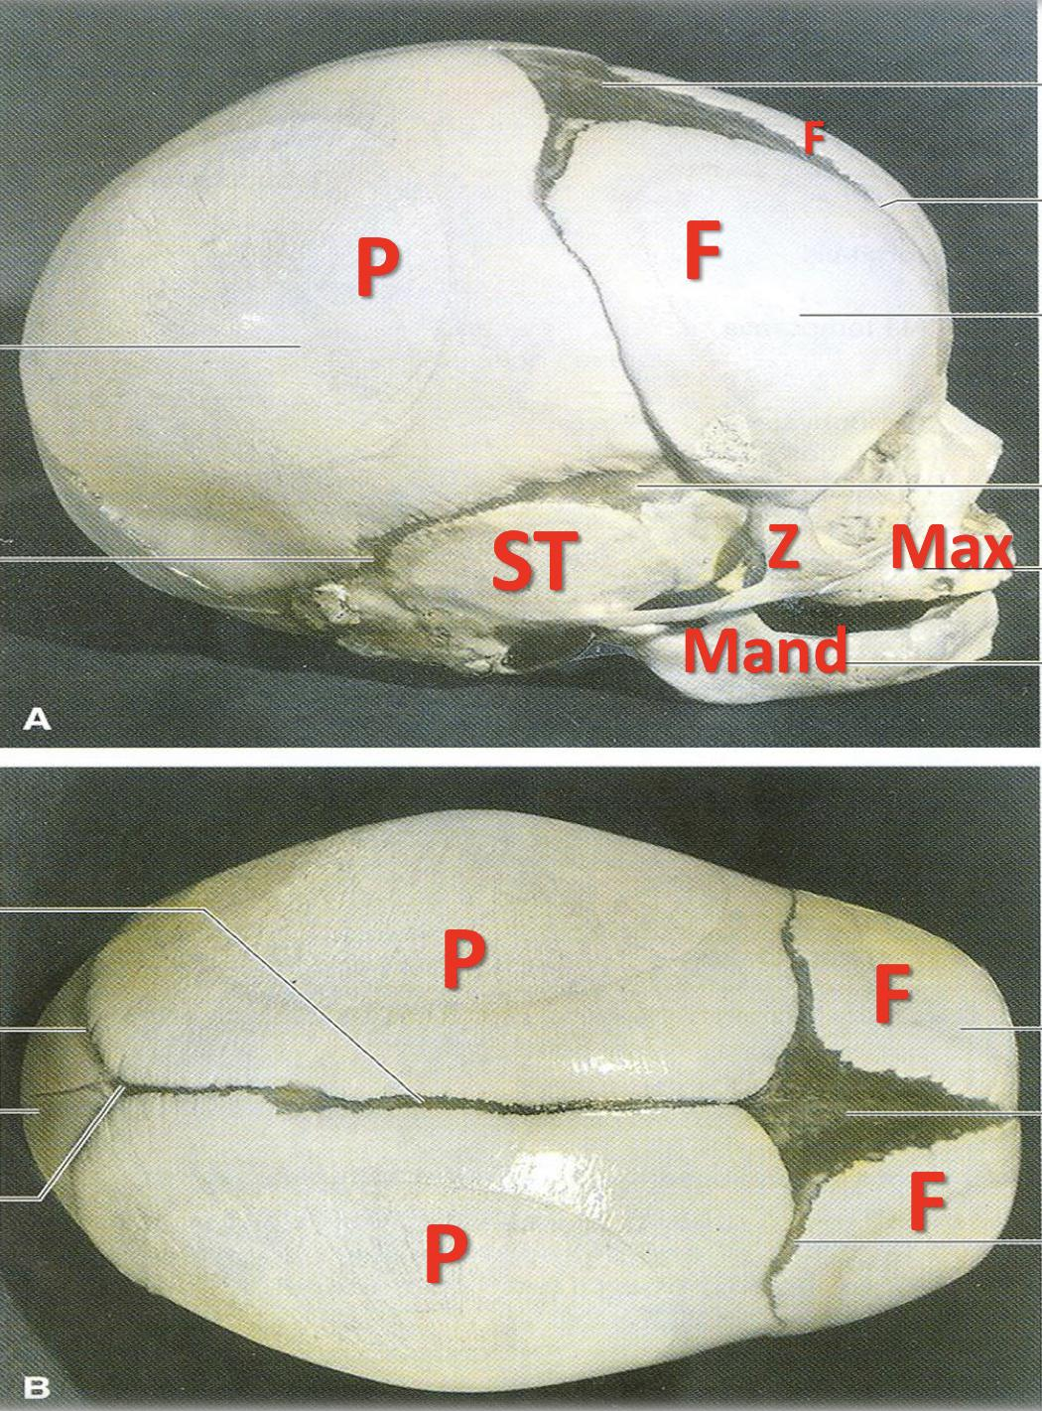
Development of Cranium (Skull):
The skull develops from mesoderm around the developing brain.
Bones of skull that ossify by intramembranous ossification:
1- F = Frontal. 2- P = Parietal. 3- Z = Zygomatic.
4- ST = Squamous temporal. 5- Mand = Mandible. 6- Max = Maxilla.

Slide 20
Joints:
They develop from mesoderm between bones:
A- In fibrous joints: mesoderm differentiates into dense fibrous connective tissue.
B- In cartilaginous joints: mesoderm differentiates into cartilage.
C- In synovial joints: a synovial cavity is formed inside mesoderm; mesoderm differentiates into synovial membrane, capsule & ligaments.

Slide 21
MCQs:
paraxial mesoderm is made out of units (cells) they are called ?
Q1
A
B
C
D
Splanchnic mesoderm
Somite
Somatic mesoderm
Coelom
Q2
All the following skull bones ossify by intramembranous ossification except?
A
B
C
D
Zygomatic
Parietal
Occipital
Frontal
Q3
Which of the following gives rise to the abdomen and thorax muscles ?
A
B
C
D
Notochord
Epaxial division
Migrating myoblasts
Hypaxial division
1-b 2-c 3-d

Slide 22
MCQs:
Which of the following is forming the CNS ?
Q4
A
B
C
D
Notochord
Paraxial mesoderm
Neural tube
Neurocranium
Q5
Which of the following is ossification of the diaphysis before birth ?
A
B
C
D
Secondary
Endochondral
Intramembranous
Primary
Q6
Which of the following is a protective case for the brain formed of a mesoderm ?
A
B
C
D
Sclerotome
viscerocranium
Notochord
Neurocranium
4- c 5- d 6- d

Slide 23
Done by the amazing team
Team leaders:
Arwa Alghamdi
Deema Aljuribah
Razan Alnufaie
Team leaders:
Mishal Alsuwayegh
Mohammed Alghamdi
Members:
Members:
Aljazi Albabtain
Atheer Alkanhal
Arob Alasheikh
Ajwan Aljohani
Deema alqahtani
Dena Alsuhaibani
Farah alqazlan
Jana Alhazmi
Kadi aldosari
Mashael Alasmari
Noura Bin hammad
Najla aldhbiban
Nouf aldalaqan
Razan alasmari
Roaa alharbi
Raghad Mohammed
Shaden albassam
Waha Almathami
Walaa AlMutawa
Yara Ameer Alalwan
Othman Aldraihem
Faisal Alomar
Abdullah Alturki
Othman Alabdullah
Omar Alkadhi
Abdullah Ali
Meshari Alshathri
Yazeed Alsanad
Fahd Mobaireek
Emad Almutairi
Nasser Alghaith
Saad Almogren
Azzam Abdullah Alotaibi
Hassan Ali Alabdullatif
Rayan Alotaibi
Mohammed Nasser
Mohammed Fahad
Mohammed Majed
Abdulkarim Salman
Saleh Aldeligan
anatomyteam442@gmail.com
Thanks to Faisal Alomar for his design of the team logo

