Slide 1
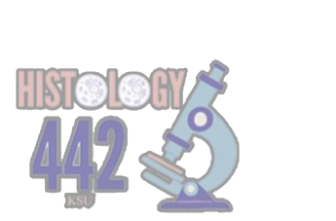
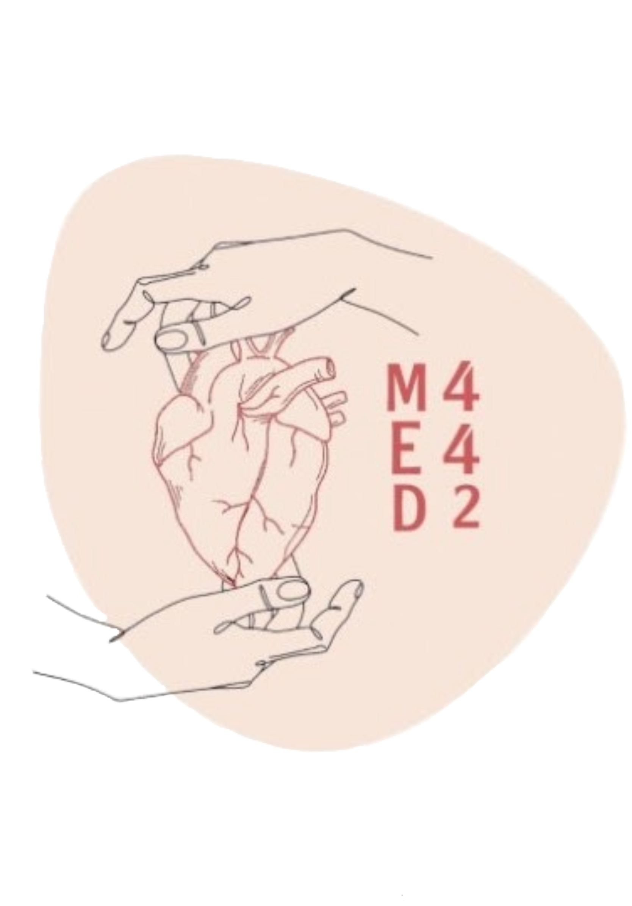
Cartilage & Bone
Musculoskeletal Block | Histology
Color index:
Main text
Important
Female’s slides
Male’s slides
Dr’s notes
Extra
Editing file

Slide 2
Objectives
By the end of this lecture, the student should be able to:
Describe the microscopic structure of cartilage and bone
Classify cartilage; hyaline, elastic and fibrocartilage.
Classify bone; compact and cancellous bone.
Describe the distribution of different types of cartilage and bone.
Describe the growth of cartilage and bone.

Slide 3
Cartilage
Cartilage is specialized type of C.T . With a Rigid matrix. all the cartilage contain collagen type || but they will be different in the abundant
it’s usually non vascular (Avascular). Cartilage is avascular like epithelium and doesn’t contain nerve and blood vessels.
Types
Fibrocartilage
“Collagen type 1”
Hyaline cartilage
“Collagen type ||” glass like
Elastic cartilage
“Rich in elastic fiber”

Slide 4
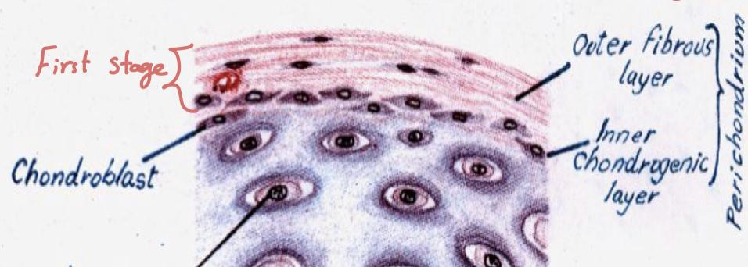
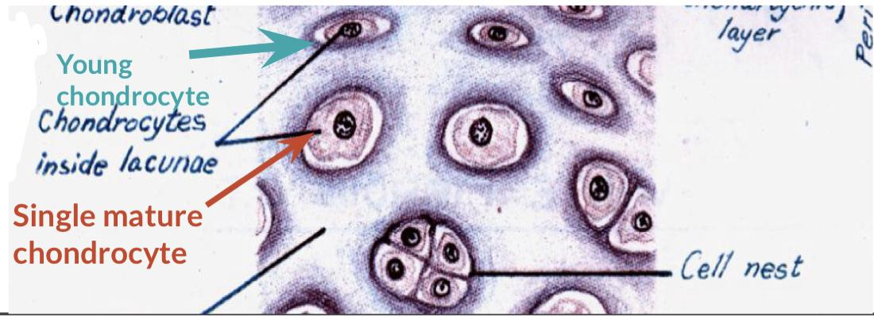
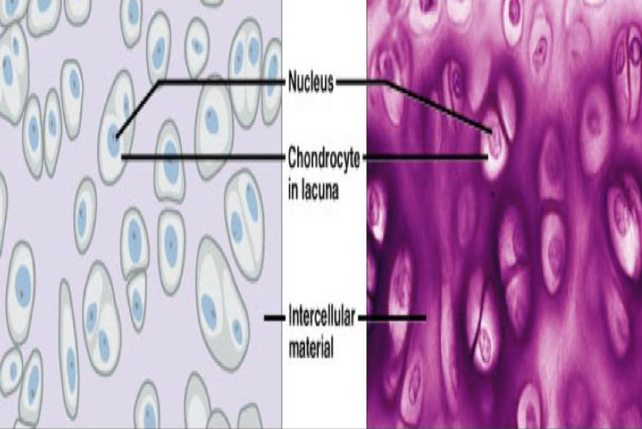
Hyaline Cartilage
Perichondrium | Cells (chondrocyte) | Matrix
Vascular C.T membrane formed of 2 layers: 1 -outer fibrous layer: Dense fibrous C.T irregular type with blood capillaries which supplies the cartilage with nutrients. 2-Inner chondrogenic layer: Chondroblast(No lacunae). They secrete Cartilage matrix and give rise to chondrocyte. Lacunae هو الفراغ الأبيض اللي حول الخلية | Found in space called Lacunae -Young Chondrocyte: Small & present singly in their Lacunae. Peripherally located in the cartilage -Mature Chondrocytes: Large,and found singly or in groups of 2,4 or 6 cells in their Lacunae (cell Nests) Mature chondrocyte are >=1 | -Homogeneous and basophilic “homogeneous يعني مافيه شوائب زي الموية” -Contain Collagen type ||
Sites:
1-Foetal skeleton
2-Costal cartilage
“The anterior part
of the ribs attached to the sternum.
3-Articular surface of the bone
4-Respiratory tract (nose trachea
& bronchi)

Slide 5
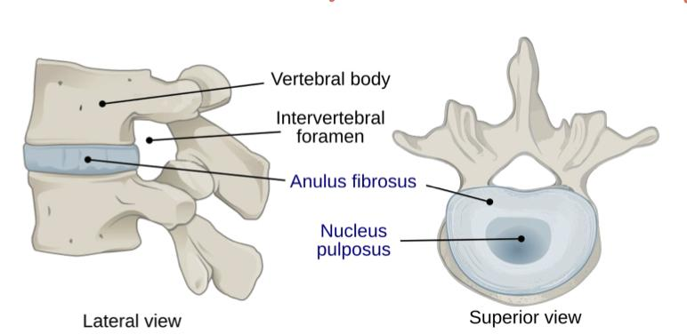
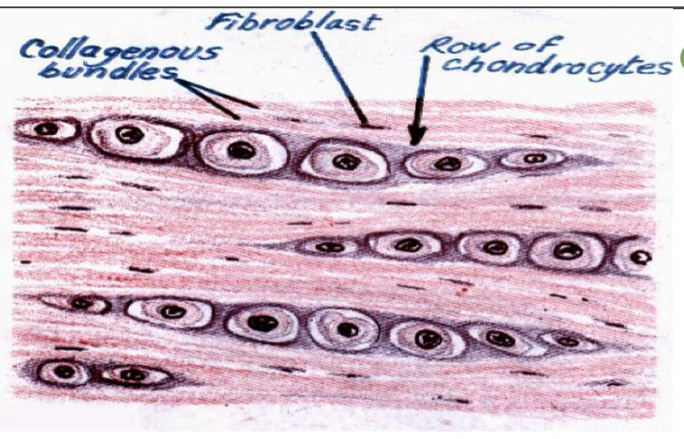
Elastic Cartilage & Fibrocartilage
Elastic cartilage | Fibrocartilage
Similar to hyaline cartilage + Elastic fiber in the matrix “ the matrix has collagen type || but it is rich in elastic fiber” -sites: 1-External ear 2-Epiglottis لسان المزمار | -No perichondrium no blood supply -Rows of Chondrocyte in lacunae separated by parallel bundles of collagen fiber type | most of the Matrix is occupied by bundles of collagen type | -sites: Intervertebral disks. Important note: the nutrient material comes from the spongy bone which the disk is between (by diffusion). There will be no healing due to low blood supply
Contain
● Collagen Type I rich
● Collagen Type II (Little)
Lack
● Elastic ﬁber
● Cell nests

Slide 6
Bones
Important note :Ca+2 is important in the contraction of the muscle
Bone is specialized type of C.T. With a hard matrix “ hardبسبب وجود الكالسيوم “
Types of bone
Function
Components
Bone cells
Bone matrix
1- Compact bone
1-Body support
Osteogenic cell
Osteoblasts
Osteocytes
Osteoclasts
1- Hard due to Calcified (Ca+2 Salt)
2-Has type | collagen fibers “ with pink color”
3- Forms Bone ( Lamellae & Trabeculae).
2- Spongy Bone
( Cancellous )
2-Protection of vital organ like brain and bone marrow
3-Store Ca+2
Periosteum
Endosteum

Slide 7
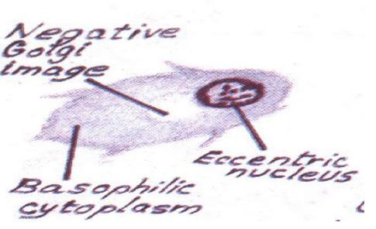
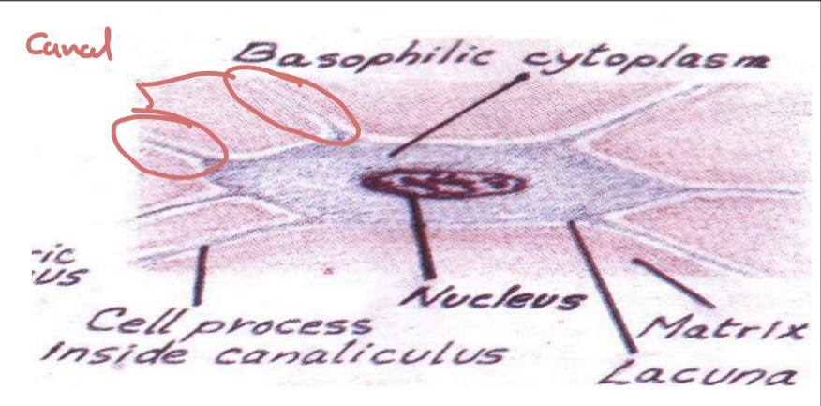
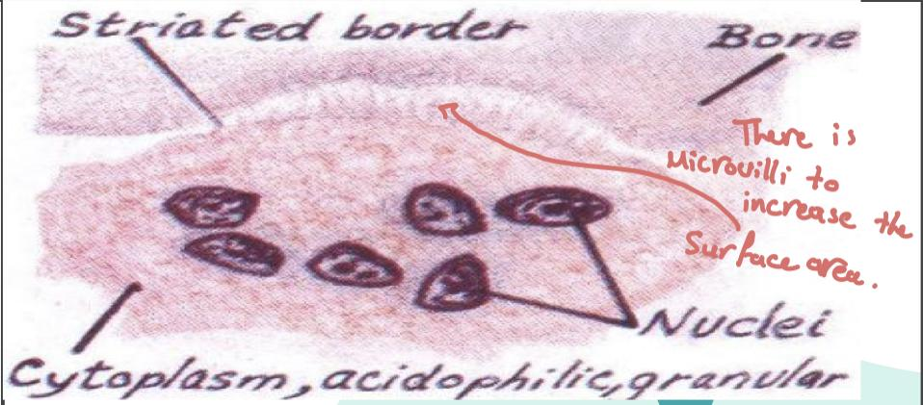
Bone cells
 | Osteogenic cells | Osteoblasts | Osteocytes | Osteoclasts
Site & characteristics | In periosteum & endosteum | In periosteum & endosteum | Branched cells. Present singly in lacunae. Their branches run in canaliculi Tiny(micro) channels | -large multinucleated cells on bony surface, in Howship’s lacunae. -they have striated or ruffled border. -cytoplasm is rich in lysosomes.
Origin | - | Osteogenic cells | Osteoblasts | Blood monocyte
Fate | Give rise to osteoblasts | Change to osteocytes | - | About 50 cells fused together to form a bag of nuclei in one cytoplasm
Function | - | They secrete the bone matrix & deposit Ca+2 salt in it | Maintain the bone matrix | Bone resorption
Image | -

Slide 8
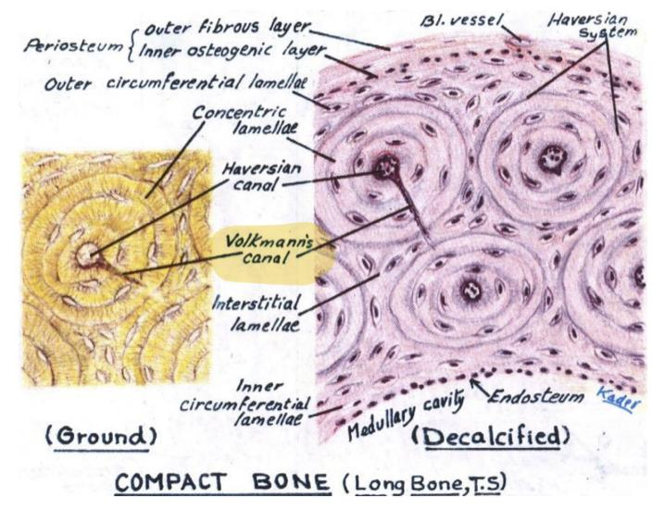
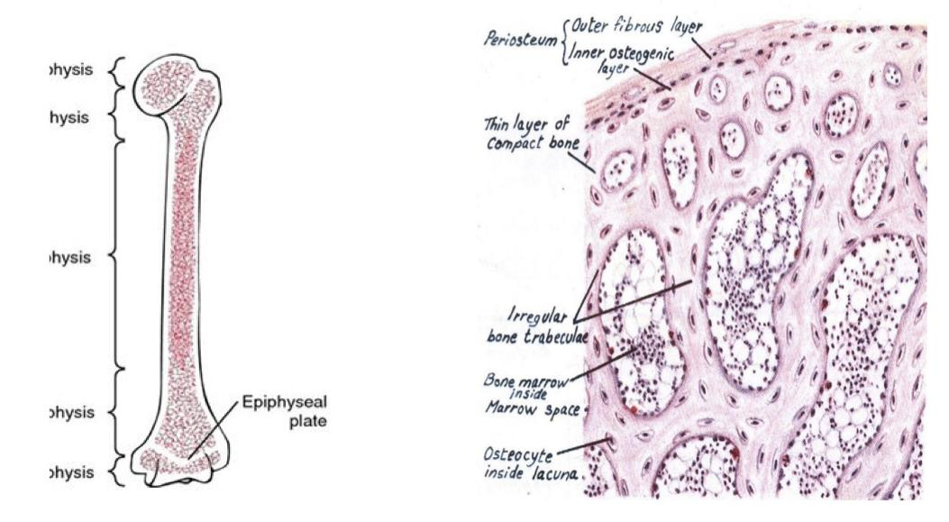
 | Compact bone | Spongy (cancellous) bone
Site | It is found in the Diaphysis of long bones. | In ﬂat bones & Epiphysis of long bones
Consist of | -Periosteum ○ Outer ﬁbrous layer. ○ Inner Osteogenic Layer. -Endosteum -Bone cells -Bone lamellae | -Periosteum -Endosteum -Many irregular Red Bone Marrow spaces. -Bone cells -Irregular bone trabeculae : ( Formed of irregular bone lamellae separated by Osteocytes inside lacunae )
Characteristics | Bone lamellae : 1-Haversian Systems (Osteons): ■ Longitudinal Cylinders ■ Each is formed of: -Haversian canal in the Center -Surrounded by concentrically arranged bone lamellae separated by Osteocytes in lacunae. ■ Volkmann’s canals: connect the Haversian canals together. They run obliquely or transversely. 2-External Circumferential Lamellae. 3-Internal Circumferential Lamellae. 4-Interstitial Lamellae: Between Osteons. | No Haversian systems (No Osteons)

Slide 9
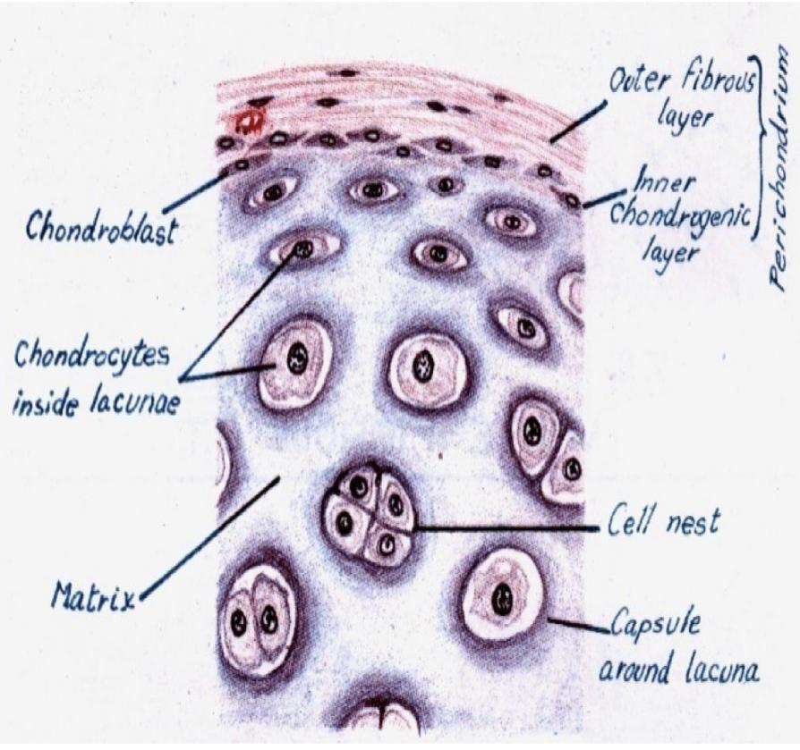
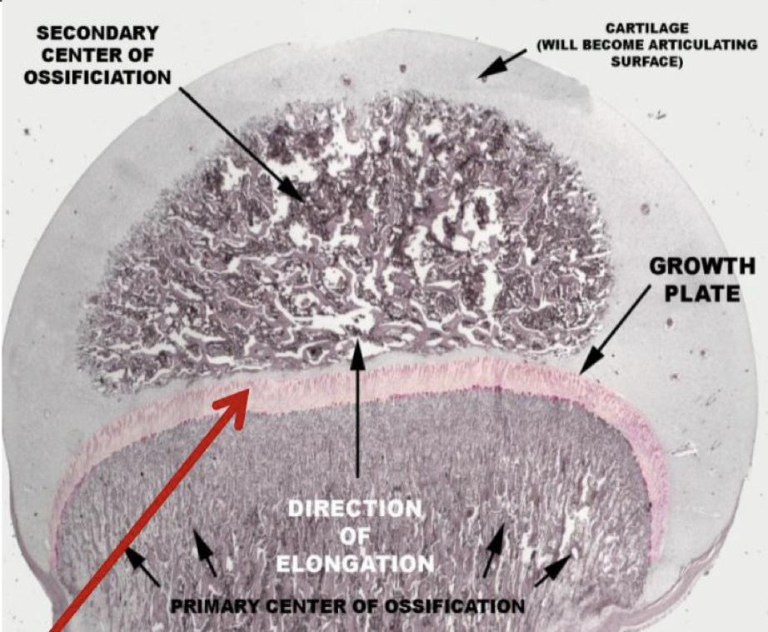
Growth of cartilage & bone
 | Cartilage | Bone
Appositional growth Increase in Width | Produced by the activity of chondroblasts in the inner chondrogenic layer Team439: layer of chondroblast تزيد في حالة الإصابة ومراحل الطفولة وتقل مع التقدم في العمر | Produced by the activity of osteoblasts
Interstitial growth Increase in Length | Produced by division and activity of Mature chondrocytes | Produced by the activity of Epiphyseal plate of cartilage

Slide 10
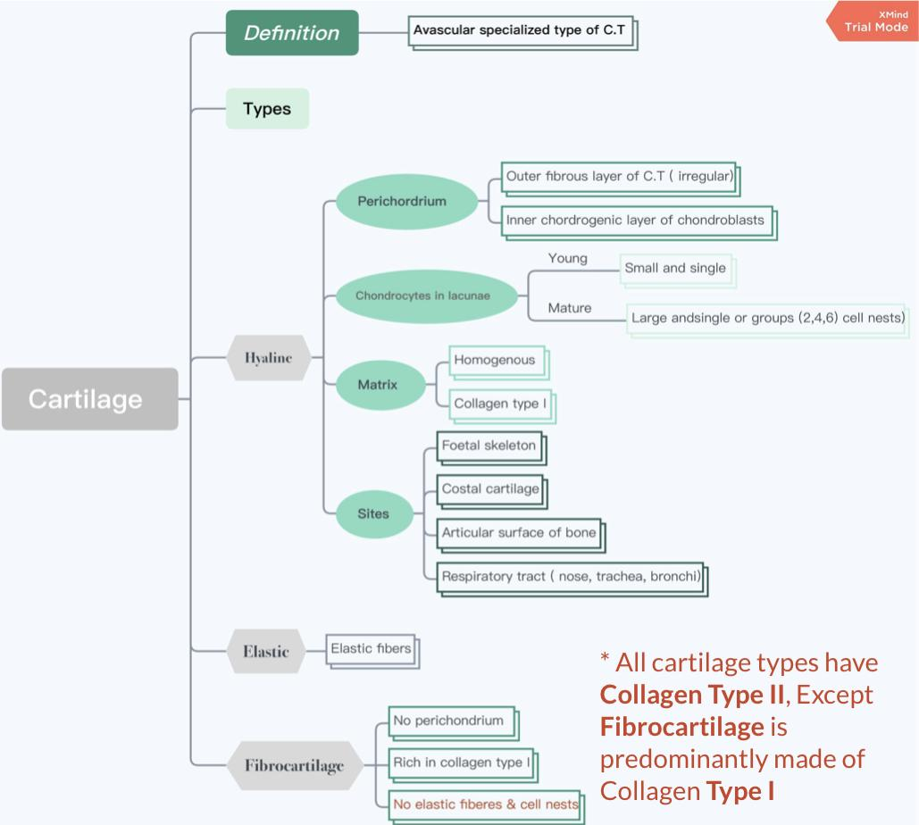
Cartilage summary (Thanks to Team441)

Slide 11
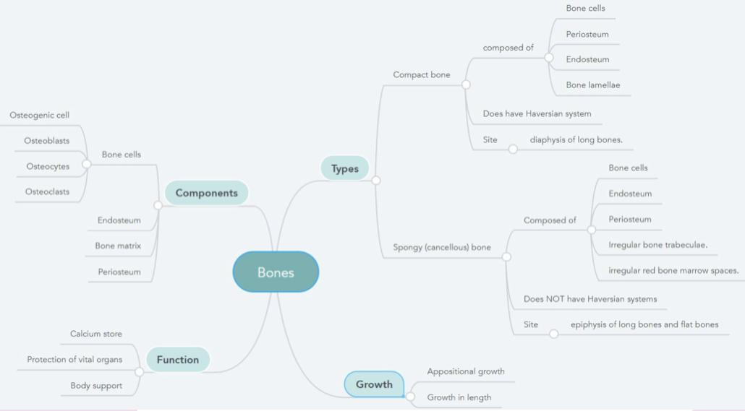
Bone summary (Thanks to Team441)

Slide 12
MCQs:
Q1: origin of osteoblasts?
A- osteogenic cell
2-Bone marrow
3-osteoclasts
Q2: “ maintain the bone matrix “ is the function of:
A- osteogenic cell
B-osteoclasts
C-osteocytes
Q3: Haversian systems are only found in ….?
A-Compact bone
B-spongy bone
C-both compact and spongy bone
Q4: The site of Hyaline cartilage?
A- Intervertebral discs
B- Foetal skeleton
C-Epiglottis
Q5: Appositional growth leads to :
A- decrease width
B-increase length
C- increase width
Q6: A branched cells present singly in lacunae?
A- chondroblasts
2-osteocytes
3-chondrocytes
Q7: The matrix of hyaline cartilage is?:
A- Homogeneous and basophilic
B-Heterogeneous and eosinophilic
C-Heterogeneous and basophilic
1-A
2-C
3-A
4-B
5-C
6-B
7-A

Slide 13
MCQs:
Q12:Calcium is stored in?
A-Elastic cartilage
B- bone
C- Spongy bone only
Q13: Interstitial growth of cartilage leads to?
A-Increase in width
B-Decrease in width
C-Increase in length
Q14:The function of osteoclasts is?
A-Bone resorption
B-Maintain bone matrix
C-Rise the osteoblasts
Q15:Which of the following is consist of many
irregular red bone marrow spaces?
A-Compact bone
B-Spongy bone
C-Hyaline cartilage
Q8: A type of cartilage has no perichondrium on its structure?
A-Elastic cartilage
B-Fibrocartilage
C-Hyaline cartilage
Q9: Which of the following is a unit of compact bone?
A- Endosteum
B- Periosteum
C-Osteon
Q10: Appositional growth of bone produced by?:
A-Activity of osteoblast
B-Activity of chondroblast
C-Activity of epiphyseal plate
Q11:The site of elastic cartilage is?
A-Foetal skeleton
B-Intervertebral
C-Epiglottis
8-B
9-C
10-A
11-C
12-B
13-C
14-A
15-B

Slide 14
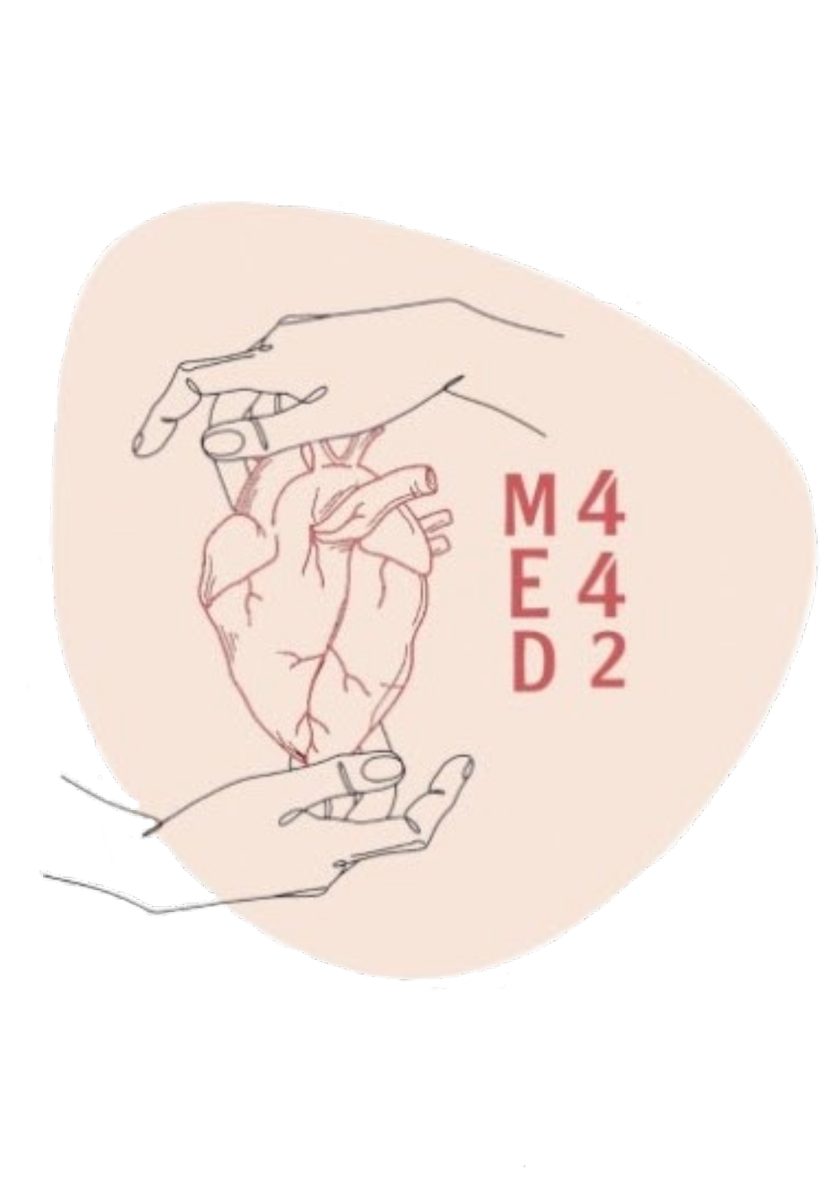
MSK block | Histology team 442
Team leaders:
Raneem AlWatban
Saleh Alkholaifi
Team members:
Nourah Alfawaz
Special thanks to Mohammed AL-Zeer
Reem AlHazmi
Noura bin hammad
Shahad AlJeri
442Histology@gmail.com

