Slide 1
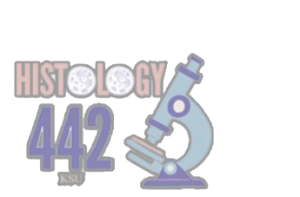
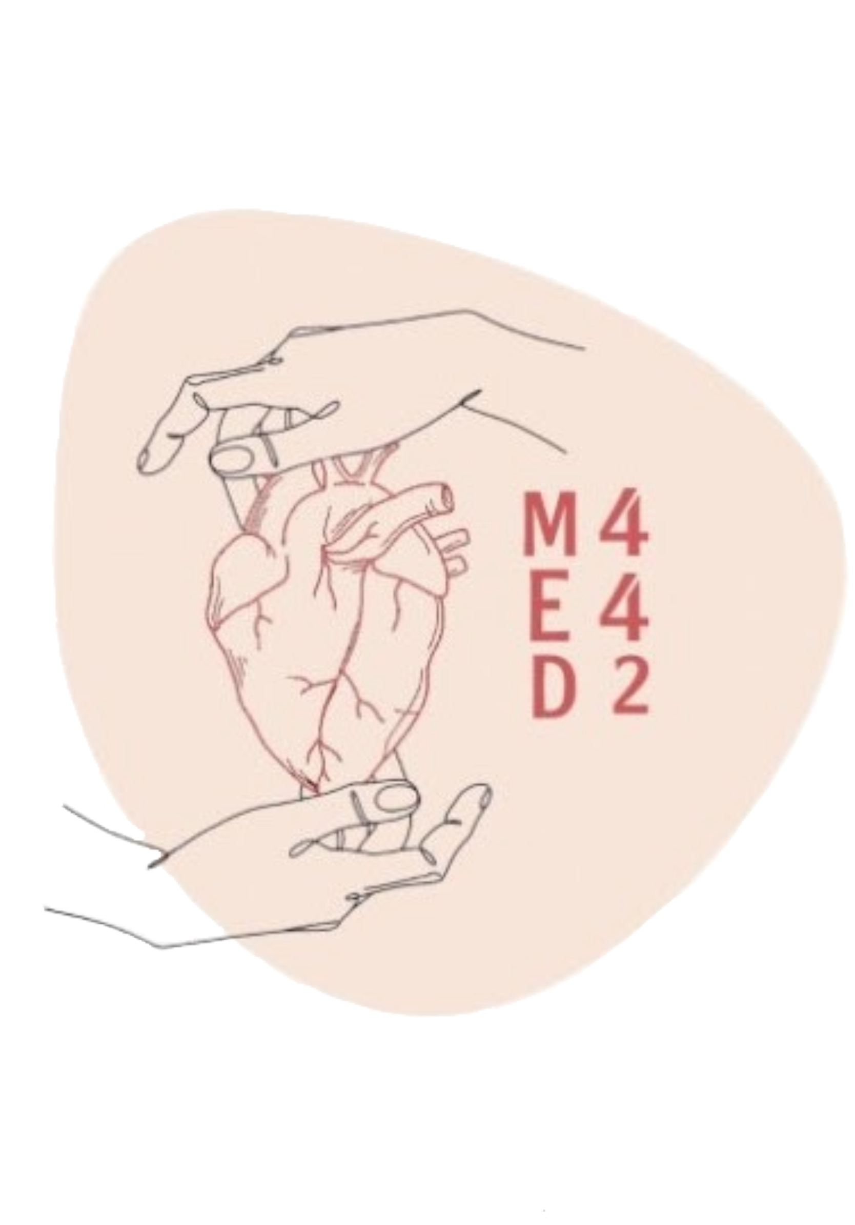
Muscular Tissue
Musculoskeletal Block | Histology
Color index:
Main text
Important
Female’s slides
Male’s slides
Dr’s notes
Extra
Editing file

Slide 2
Objectives:
By the end of this lecture you should be able to:
Identify and describe the histological structure of the three types of muscle cells and list the differences between them.

Slide 3
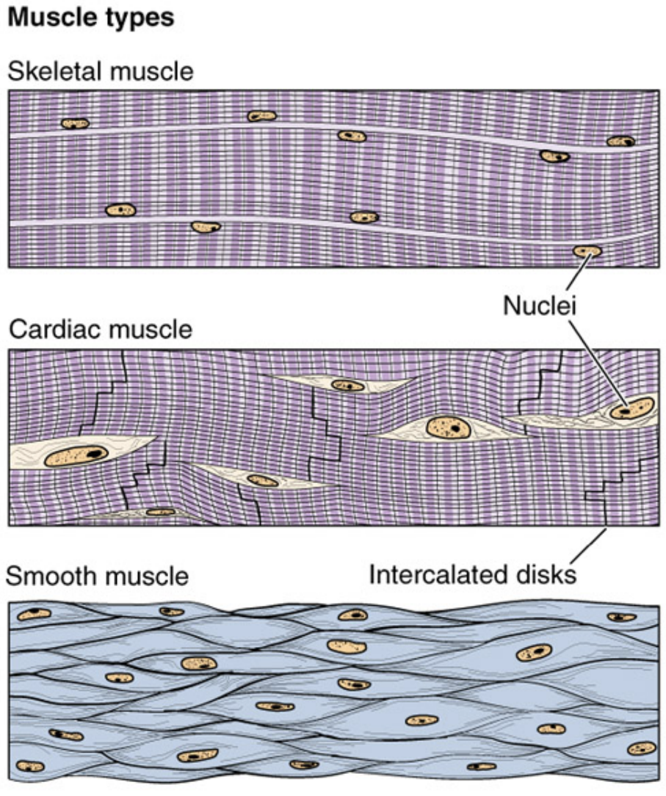
Muscular Tissue
3 types of muscles (muscle fibers):
Made of elongated muscle cells (fibers).
1- Skeletal
Striated, voluntary
2- Cardiac
Striated, involuntary
3- Smooth
Non striated, involuntary

Slide 4
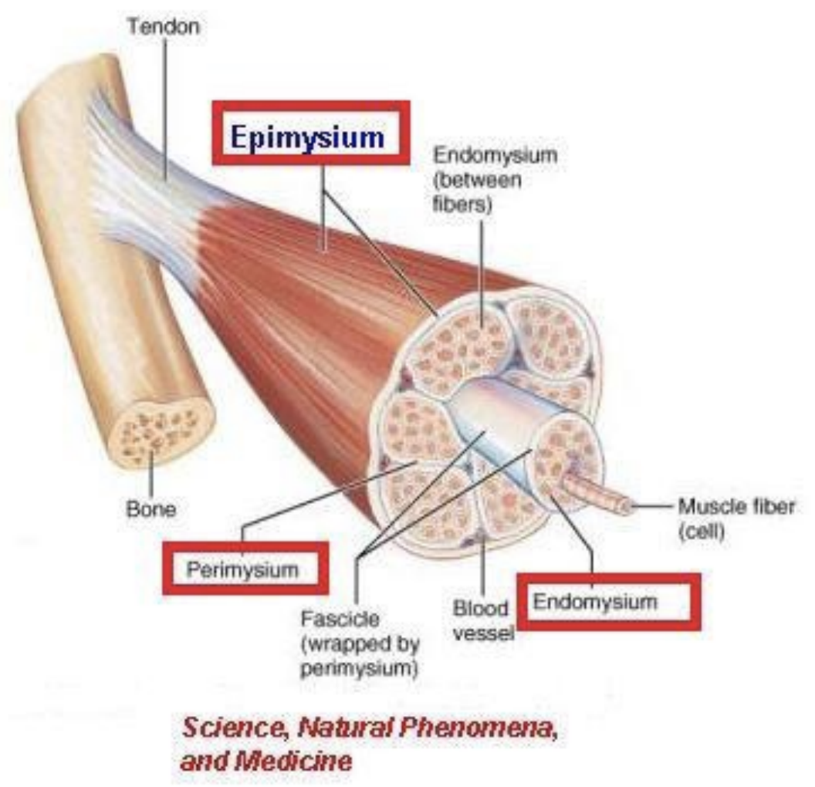
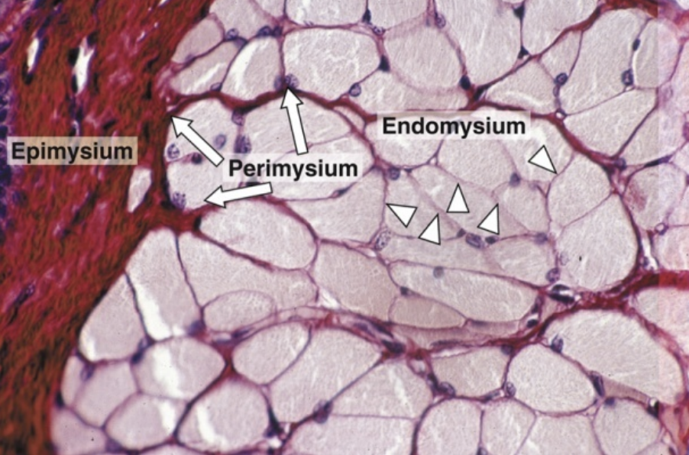
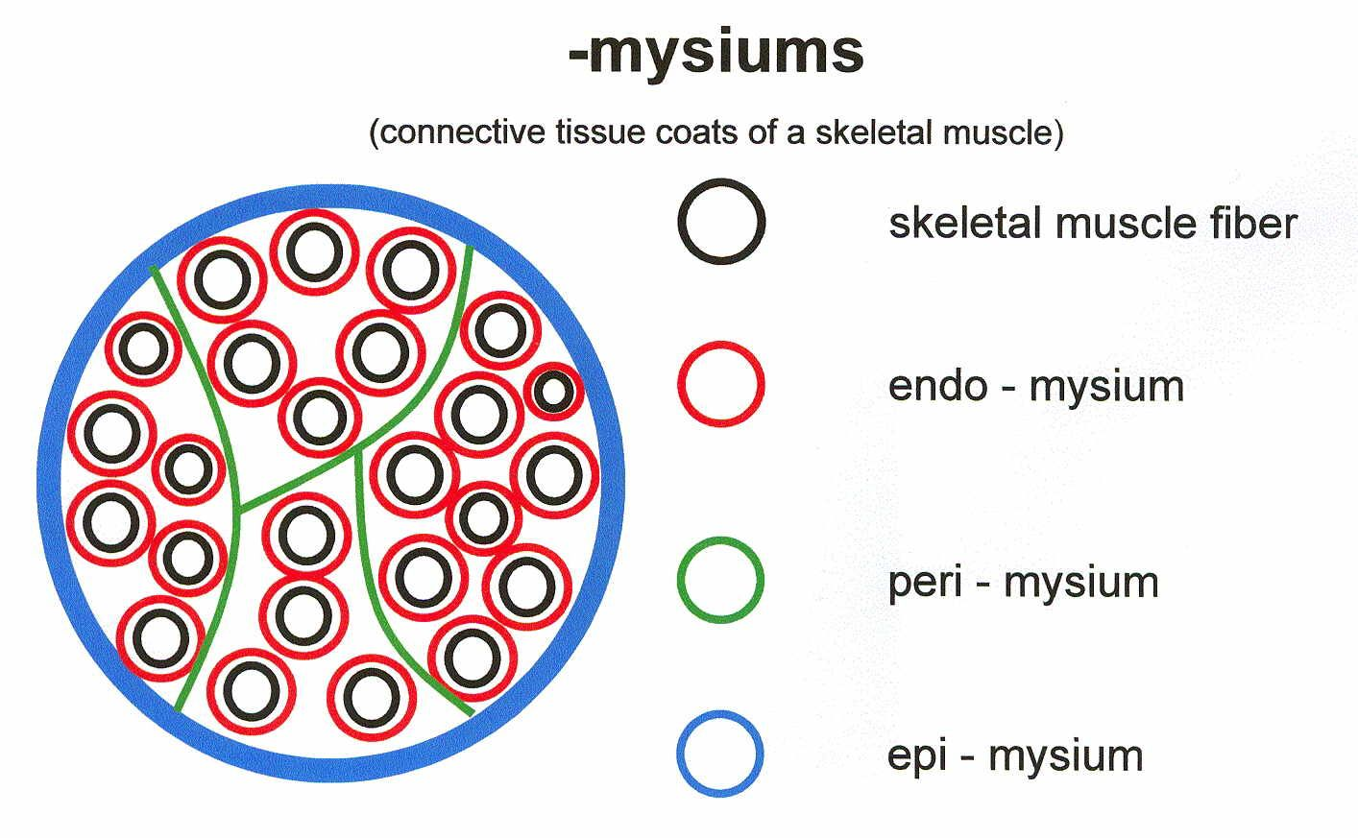
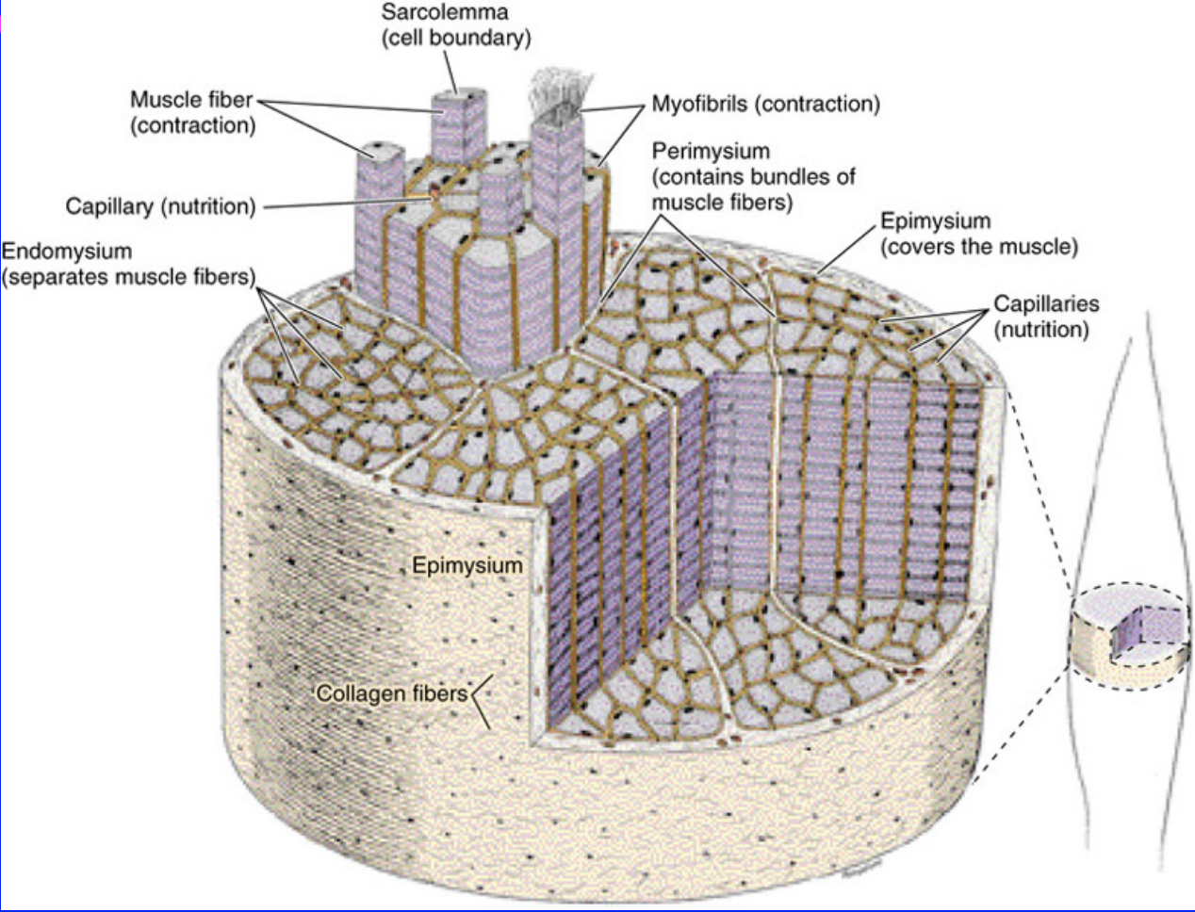
Skeletal Muscle Structure:
Striated - Voluntary
Site: Muscle attached to the skeleton
Epimysium:
(ِEpi=above all) (خارجي)
The whole muscle is covered by irregular (thick) C.T. covering, the epimysium.
Perimysium:
(Peri=around) (حول)
Consists of parallel skeletal muscle fibers, arranged in bundles, separated by (thinner) C.T. septa, the perimysium
Endomysium:
(Endo=within) (داخلي)
The individual fibers are separated by C.T. , endomysium
(between fibers)
Note from 441:
- Single fibers are covered by Endomysium and a bundle(group) of fibers are Covered by Perimysium and all the bundles are wrapped together by the epimysium
- epimysium and perimysium exist only in skeletal muscle
- endomysium exist in all types of muscle

Slide 5
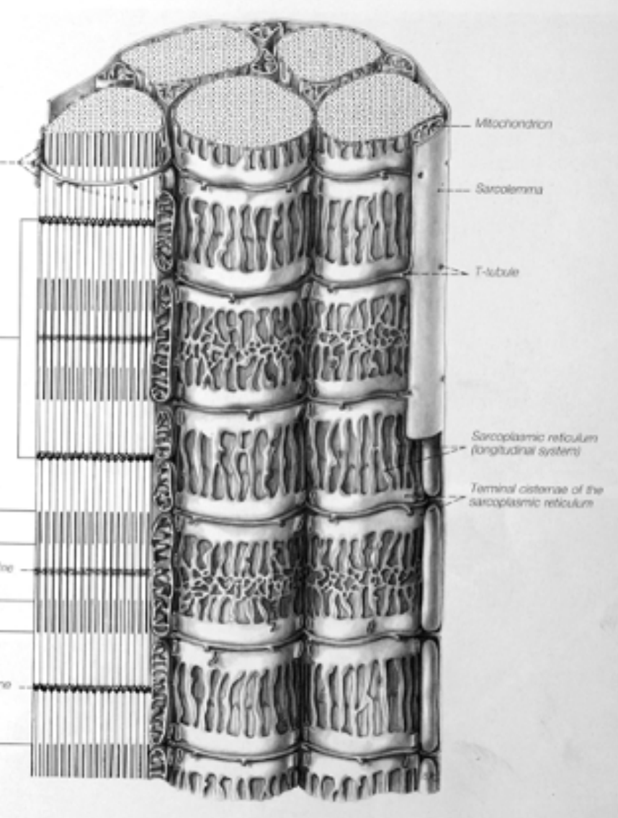
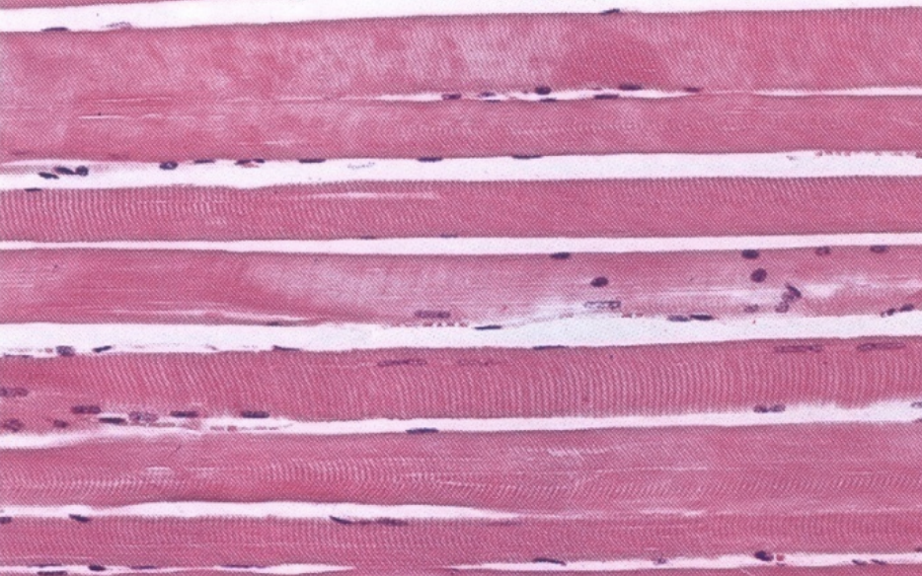
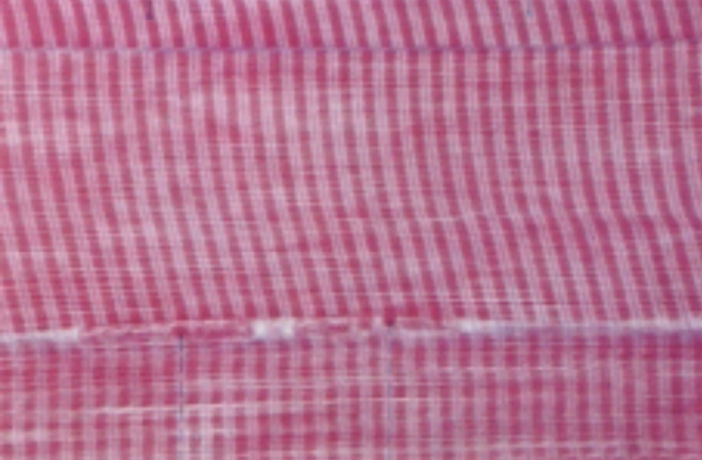
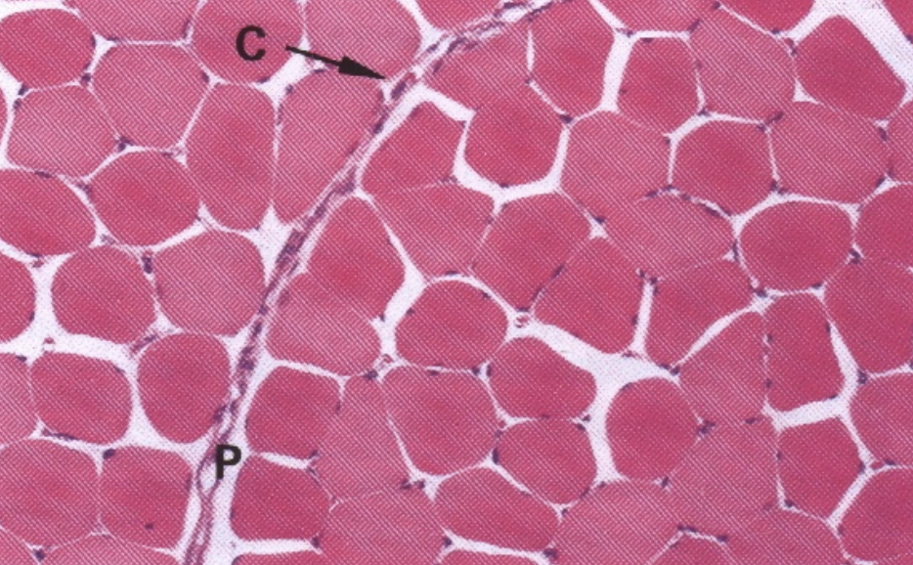
Skeletal Muscle under the microscope
L.M. Picture of Muscle Fibers: LM = light-microscopy | E.M. Picture of Muscle Fibers: EM = electron-microscopy
Cylindrical in shape.
Non-branched. (face muscles are branched)
Covered by a clear cell membrane, the sarcolemma.
Multinucleated: nuclei are multiple and are peripherally located (close to the sarcolemma).
Cytoplasm (sarcoplasm) is acidophilic and shows clear transverse striations. (dark, light lines)
Sarcoplasm contains:
Parallel myofibrils.
Numerous mitochondria, arranged in rows between the myofibrils.
Well developed smooth endoplasmic reticulum (sarcoplasmic reticulum-SR).
(SR pumps and absorbs calcium for contraction)
Myoglobin pigment.
Glycogen.

Slide 6
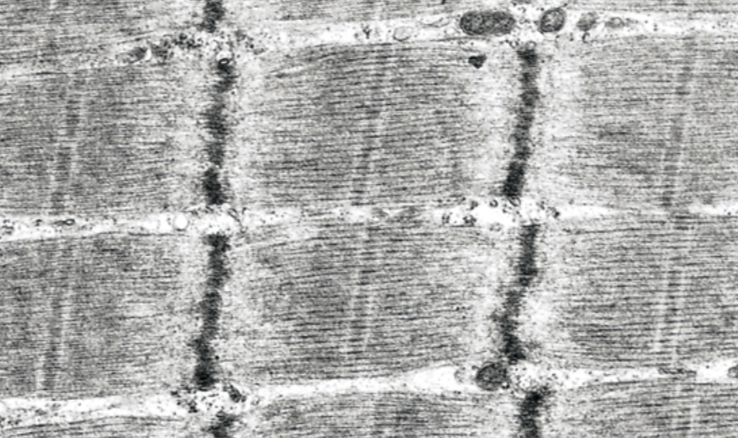
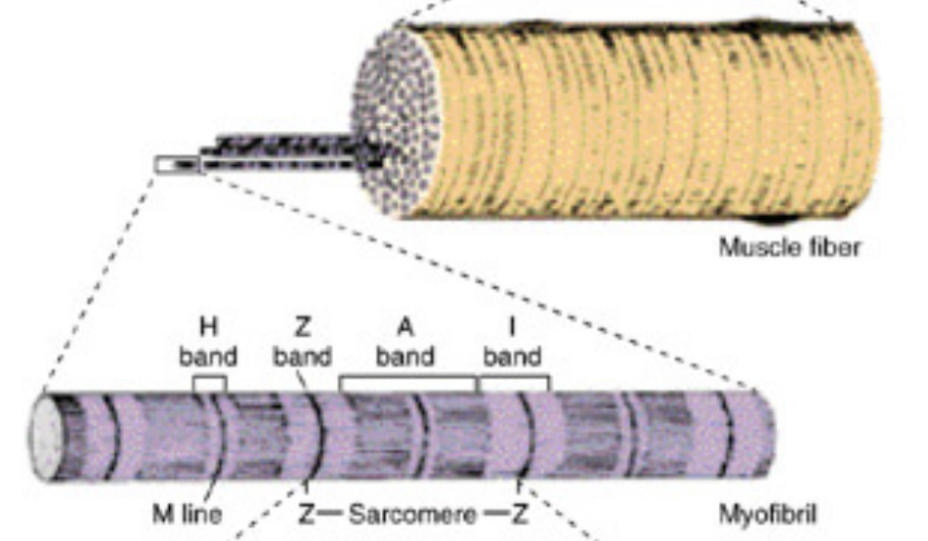
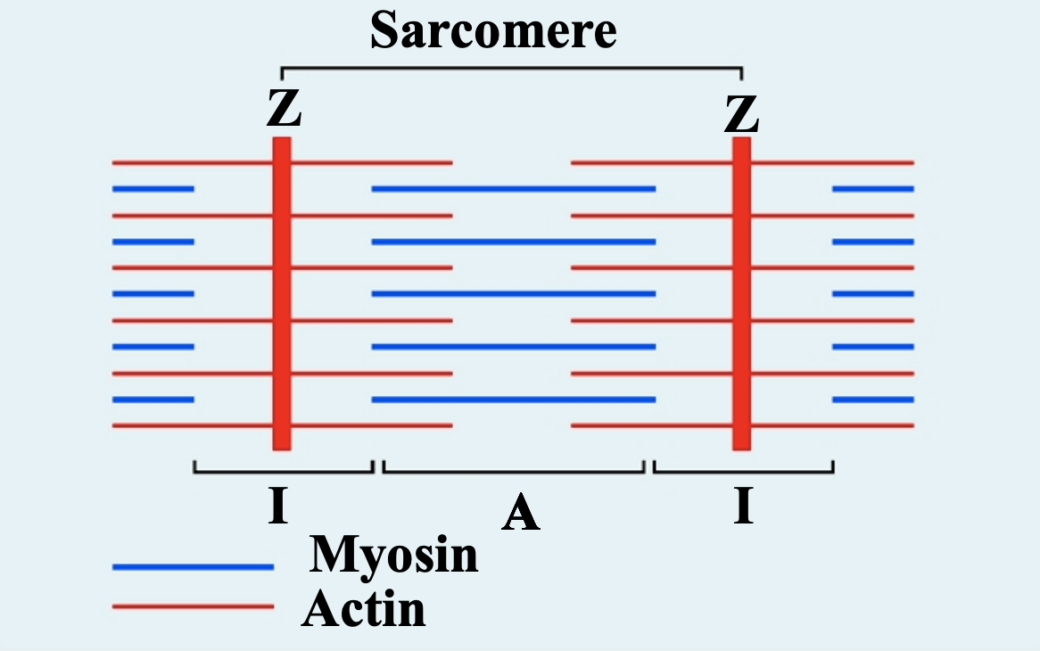
Skeletal Muscle under the microscope
E.M. Picture of Myofibers:
Contractile threads (organelles), arranged longitudinally in the sarcoplasm.
Each myofibril shows alternating dark (A) and light bands (I).
The (A) band shows a pale area in the middle (H band) which is divided by a dark line (M line).
The (I) band shows a dark line in the middle (Z line).
The sarcomere is the segment between 2 successive Z lines. It is the contractile unit of a myofibril.
The myofibrils are formed of myofilaments (thick myosin and thin actin).
The (A) band is formed of myosin myofilaments mainly and the terminal ends of actin myofilaments.
The (I) band is formed of actin myofilaments.

Slide 7
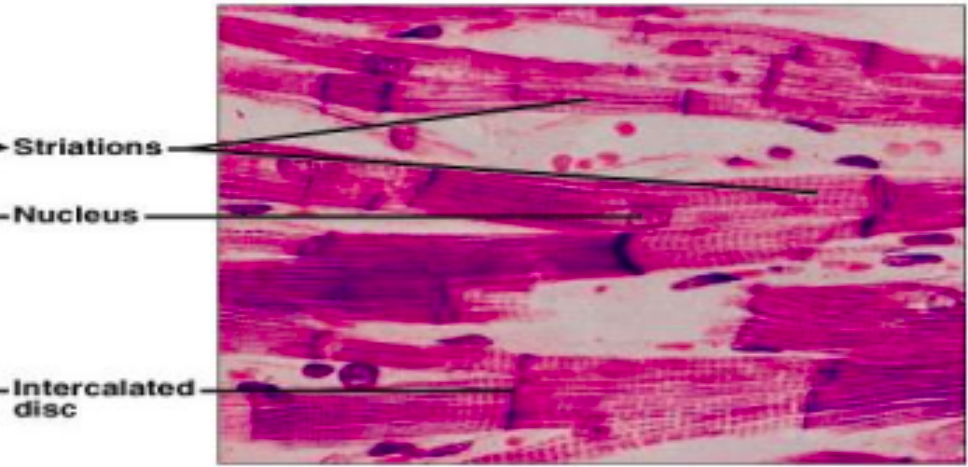
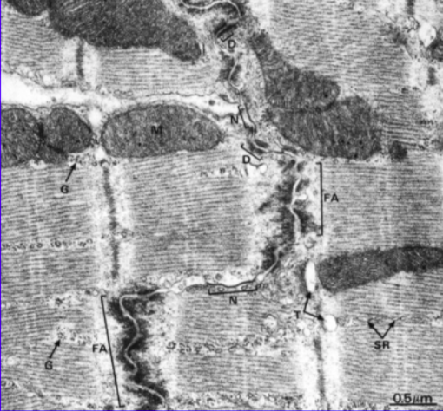
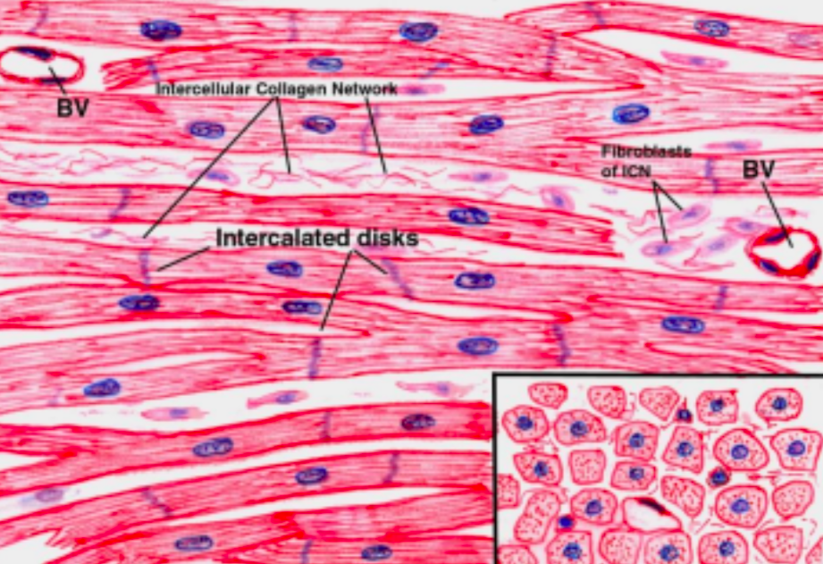
Cardiac muscle: Site: Found in the myocardium. Characteristics: 1-Striated 2-Involuntary Cardiac Muscle fibers under the microscope
L.M. Picture | E.M. Picture
– Cylindrical in shape. – Intermediate in diameter between skeletal and smooth muscle fibers. – Branch and anastomose. – Covered by a thin sarcolemma. – Cardiac muscle cells are mononucleated. (لانها صغيرة وكل ماصارت الخلية صغيرة تكون النواة وحدة) Nuclei are oval and central. – Sarcoplasm is acidophilic and shows non-clear striations (fewer myofibrils). – Cardiac muscle fibers are divided into short segments (cells) by the intercalated discs. | – Few myofibrils. – Numerous mitochondria. – Less abundant SR. – Glycogen & myoglobin. – Intercalated discs: are formed of the two cell membranes of 2 successive cardiac muscle cells, connected together by fascia adherens, desmosomes, and gap junctions.

Slide 8
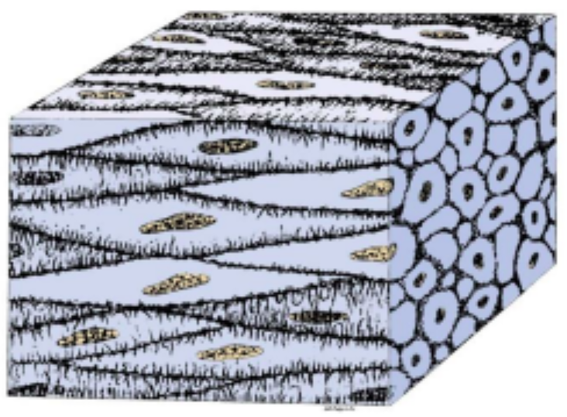
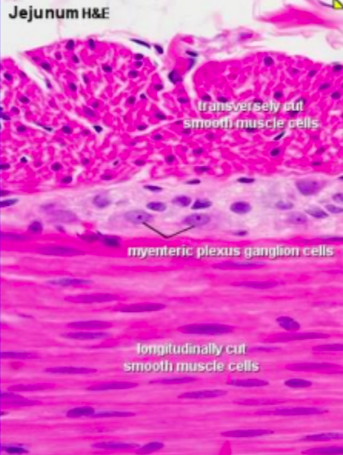
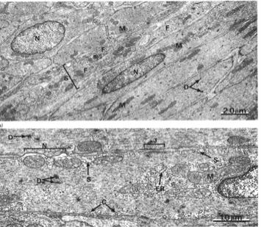
Smooth Muscle
Site : Present in walls of Blood vessels and Viscera (Digestive, Urinary, Genital). Characteristic : Non-striated and Involuntary.
Smooth muscle fibers under microscope
L.M. Picture | E.M. Picture
– Fusiform in shape (spindle-shaped). – Small diameter. – Non-branched. – Thin sarcolemma. – Mononucleated. Nuclei are oval & central in position. – Sarcoplasm is non-striated and acidophilic. | – Sarcoplasm contains mitochondria,sarcoplasmic reticulum,and glycogen. – Myosin & actin myofilaments do not form myofibrils; instead, they are irregularly arranged (that’s why no striations could be observed). – Cells are connected together by gap junctions for cell communication.

Slide 9
REGENERATION OF MUSCLE
Skeletal muscle cells
d,d
Can not divide
Limited regeneration by satellite cells ( stem cells on the muscle cell’s surface )
Cardiac muscle cells
No regenerative capacity
Smooth muscle cells
Can divide
Regenerate from pericytes ( stem cells that generate smooth muscle, found in blood vessels )
→ active regenerative response

Slide 10
Comparison between different types of muscle fibers
 | Skeletal | Cardiac | Smooth
Site | Muscle attached to skeleton | Myocardium of the heart | Viscera, e.g. stomach
Shape | Cylindrical | Cylindrical | Fusiform
Diameter | Largest | Medium-sized | Smallest
Branching | non- branched | Branched | Non-branched
Striations | Clear | Not clear | Absent
Intercalated discs | Absent | Present | Absent
Sarcomeres & myofibrils | Present | Present | Absent
Nuclei | Numerous and peripheral | One central nucleus | One central nucleus
Action | Voluntary | Involuntary | Involuntary
Regeneration | Limited | No | Active

Slide 11
QUIZ
The contractile unit of a myofibril?
A. Myofibrils B. (A)Band C. Sarcomere D. (I)Band
Which of the following has non-striated and acidophilic sarcoplasm?
A. Skeletal muscle B. Cardiac muscle C. Smooth muscle D. Both B&C
Cardiac muscle fibers divided into short segments by?
A. Sarcoplasm B. Intercalated disc C. Myofibrils D. Muscle fibers
Which of the following has peripheral and multiple nuclei?
A. Skeletal muscle B. Cardiac muscle C. Smooth muscle D. Fibrocartilage
Consist of parallel skeletal muscle fibers, arranged in bundles, separated by C.T. septa?
A. Myofibrils B. Perimysium C. Epimysium D. Myoglobin
From Team 441
1- C 2- C 3- B 4-A 5-B

Slide 12
QUIZ
6. Which of the following has no regenerative capacity?
A. Skeletal muscle B. Cardiac muscle C. Smooth muscle D. Elastic cartilage
7. Which of the following is a common feature in involuntary muscles?
A. Multinucleated B. Can divide C. Gap junction D. Intercalated disc
8. Which of the following is fusiform in shape?
A. Skeletal muscle B. Cardiac muscle C. Smooth muscle D. Both B&C
9. The (I) band is formed of ?
A. Actin B. Myosin C. Myofibrils D. Both A&B
10. The whole muscle is covered by C.T covering called?
A. Epimysium B. Perimysium C. Endomysium D. Myoglobin
From Team 441
6- B 7- C 8- C 9-A 10-A

Slide 13
MSK block | Histology team 442
Team leaders:
Raneem AlWatban
Saleh Alkholaifi
Team members:
Special thanks to Mohammed AL-Zeer
Nourah Alfawaz
Reem AlHazmi
Noura bin hammad
Shahad AlJeri
442Histology@gmail.com

