Slide 1
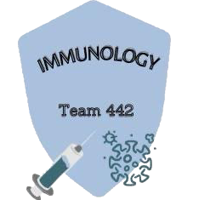
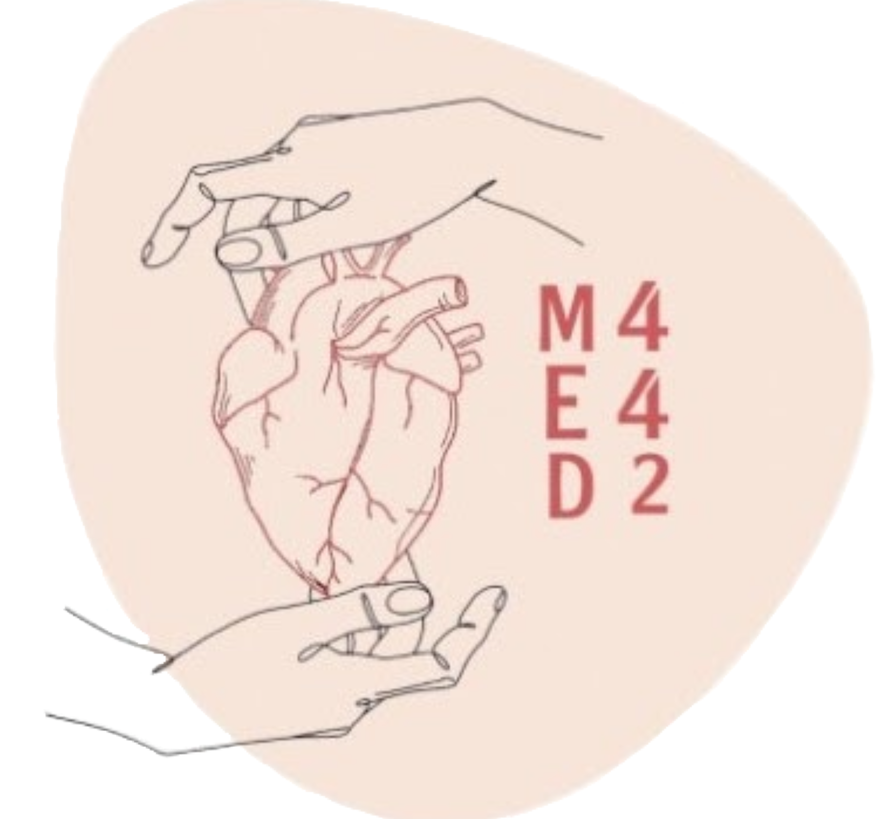
Autoimmune Diseases
Musculoskeletal block
KSU
Color index :
Main text
Important
Dr notes
Females slides
Male slides
Extra
W 1
L 2
Editing File

Slide 2
Objectives
To know that the inflammatory processes in autoimmune diseases are mediated by hypersensitivity reactions (type II, III and IV).
To know that autoimmune diseases can be either organ specific or may be generalized involving many organs or tissues.
To understand that the manifestations of autoimmune diseases depend upon the organ and the degree of damage inflicted on the target tissues.

Slide 3
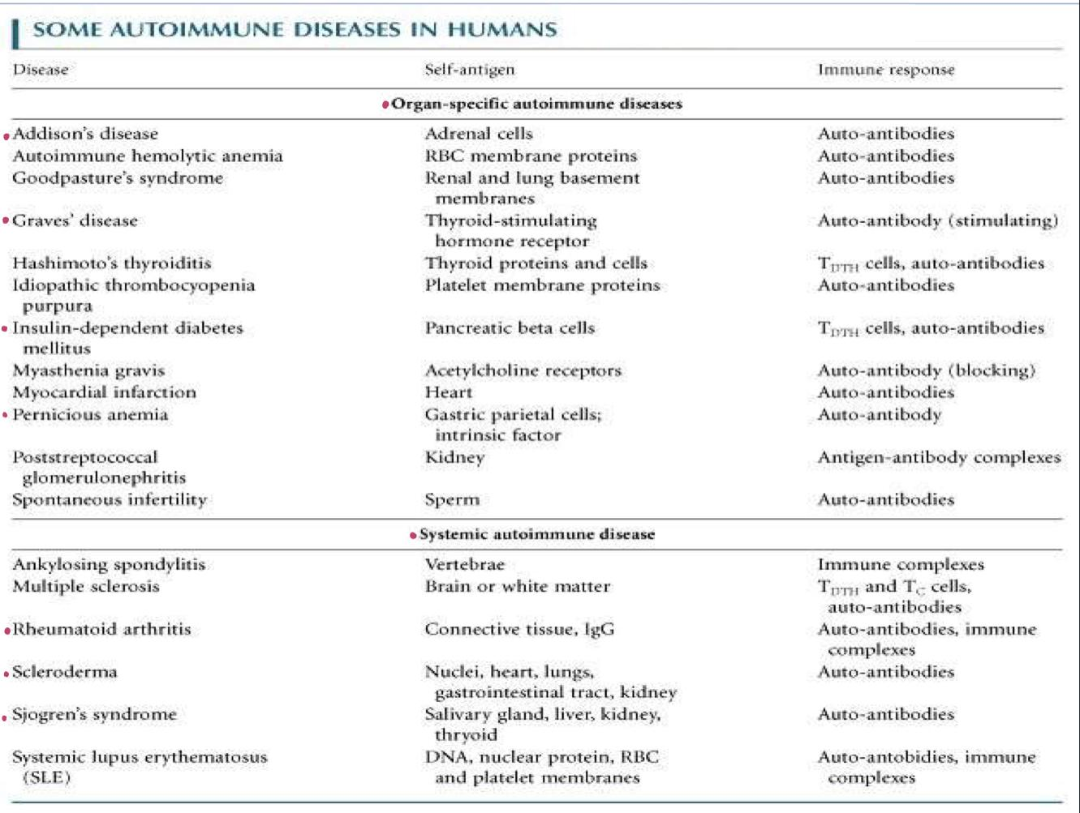
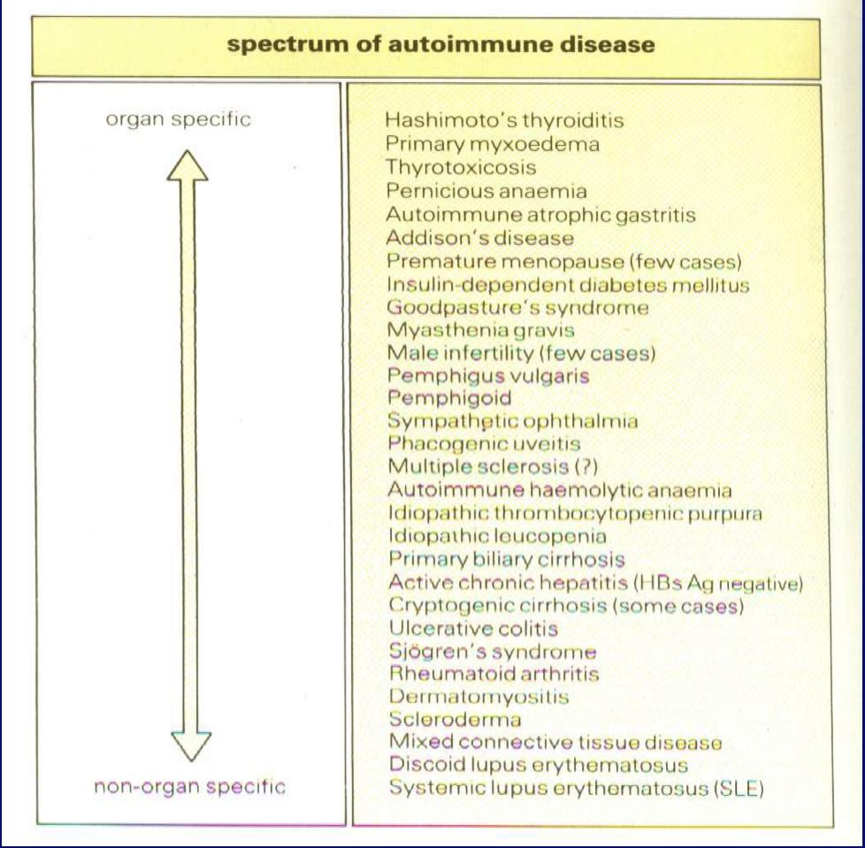
Disease processes and tissue damage are due to Type II Type III and Type IV hypersensitivity reactions
Tissue targeted by autoimmune
Different tissues are affected by autoimmune

Slide 4
Autoimmune Diseases
Organ Specific Autoimmune Diseases
Systemic Autoimmune diseases
Mediated by? Stimulating or blocking auto-antibodies
441.Characterized by dysregulation of immune system which give rise to activation of immune cells to attack autoantigens and resulted in inflammation and tissue damages
Graves’ disease (Stimulating antibodies)
Myasthenia gravis (Blocking Antibodies)
Different tissues are affected by autoimmune
Tissue targeted by autoimmune
TSH decreases in grave’s disease
TSH Increases in thyroid hormone

Slide 5
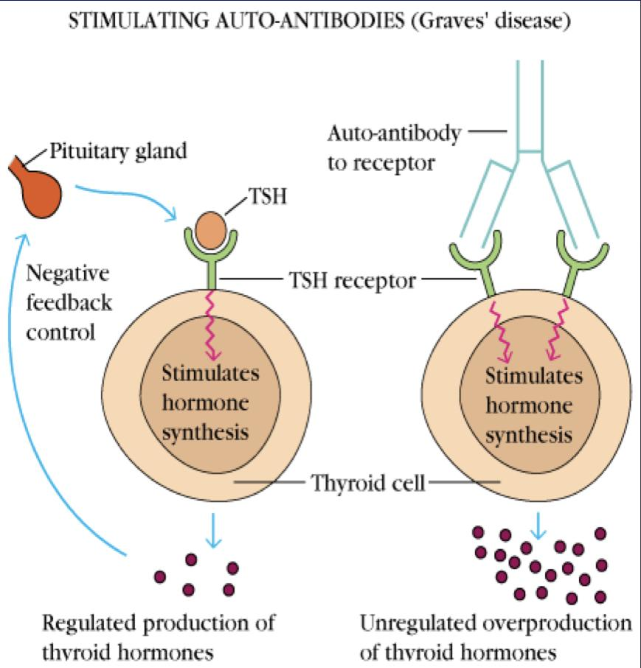
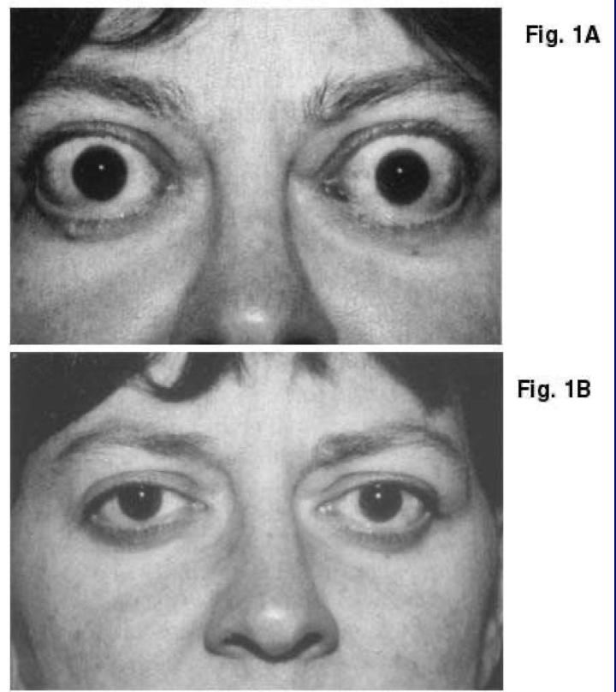
Organ specific autoimmune diseases
1.Graves’ disease (Thyrotoxicosis):
Normal state:
The production of thyroid hormones is regulated by thyroid- stimulating hormones (TSH). The binding of TSH to a receptor on thyroid cells stimulates the synthesis of two thyroid hormones: thyroxine and triiodothyronine.
Abnormal state:
A person with Graves’ makes auto-antibodies to the receptor for TSH, so binding of these autoantibodies to the receptor mimics the normal action of TSH leading to over stimulation of the thyroid gland (hyperthyroidism).
So when the Pituitary gland senses that there is enough Thyroxine in the blood (done by the auto-ab) it will stop the production of the TSH, and the Thyroxine is high and the TSH is low in the blood it is called Thyrotoxicosis (441)

Slide 6
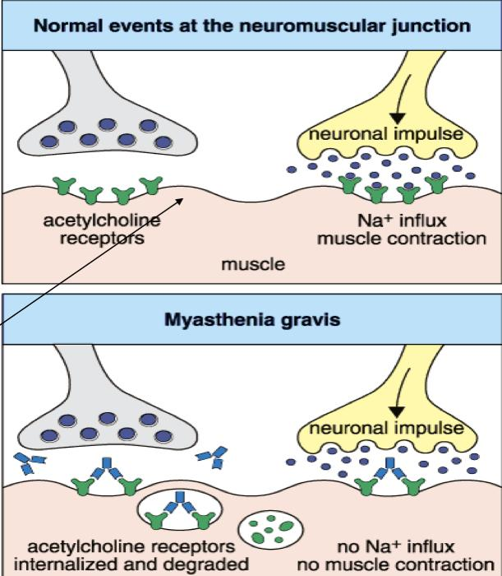
Organ specific autoimmune diseases
2.Myasthenia Gravis (blocking antibodies):
Abnormal state:
Clinical Characterized by:
Weakness and fatigability on sustained effort
IgG antibody which is directed against (ACh) receptor, interacts with the postsynaptic acetylcholine receptor (AchR) at the nicotinic neuromuscular junction (NMJ).
This leads to a reduction in the number of functional AChR by increasing degradation (complement mediated) of receptors.
Motor end plate of muscle

Slide 7
Systemic Autoimmune diseases
Systemic lupus erythematosus (SLE)
Definition: Systemic lupus erythematosus is the prototype of systemic autoimmune disorder.
Lupus is a potentially fatal autoimmune disease.
Characterized By: Butterfly rash,and it becomes worse by exposure to sunlight
Prevalence & incidence: Women are 90% more prevalent to the disease.
Treatment : NSAIDs (Non-steroidal anti-inﬂammatory drugs).
Antimalarials (Hydroxychloroquine).
Immunosuppressive agents.

Slide 8
Investigations
Antinuclear antibody (ANA) test is the best screening test for SLE, and it’s determined by immunofluorescence. The ANA is positive in significant titer (usually 1:160 or higher) in virtually all patients with
CRP | ESR
Complement Split products | Anti-double-stranded DNA titers
Complement Levels (CH50, C3, C4) | Decreased complement C1q

Slide 9
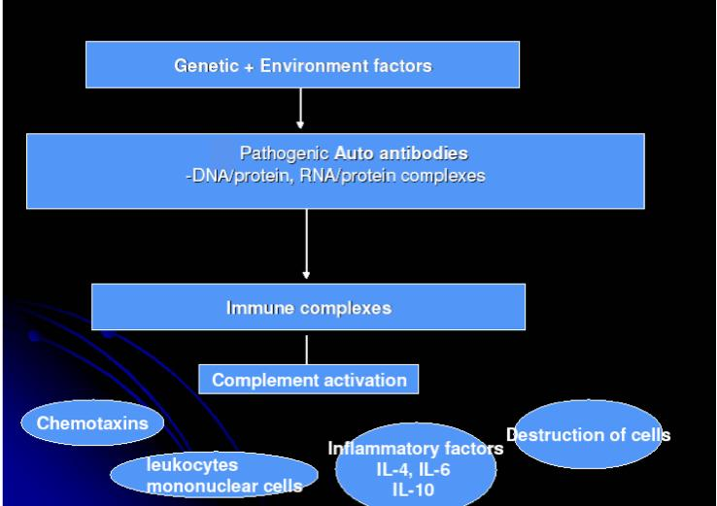
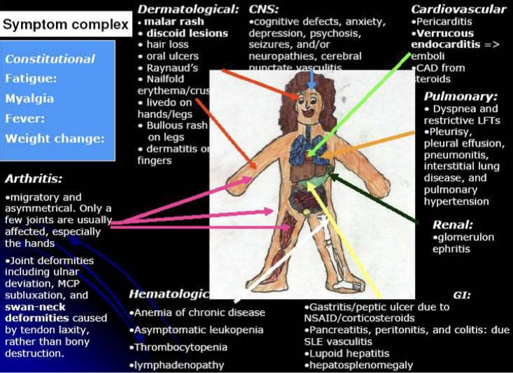

Slide 10
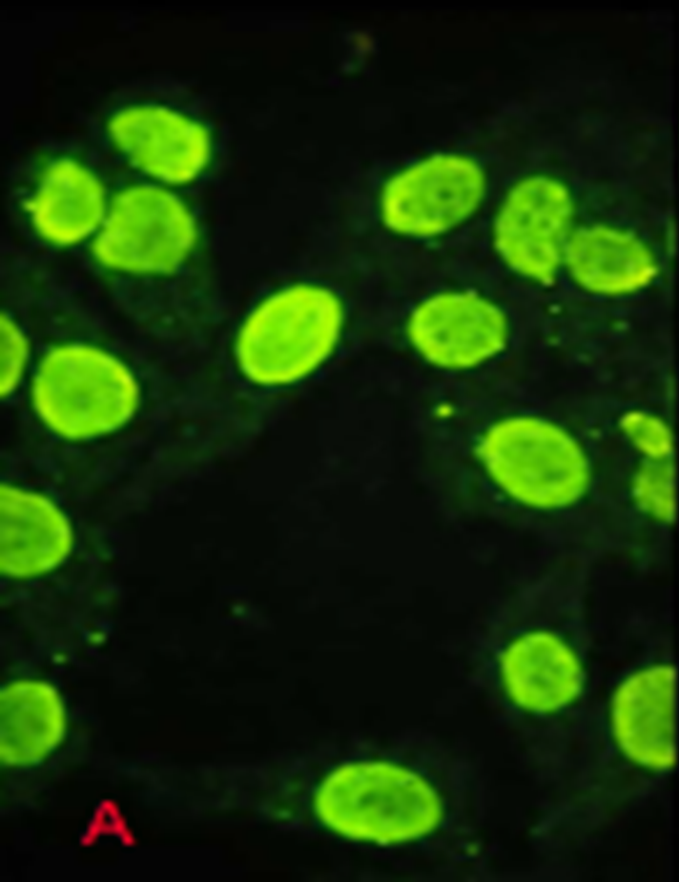
Autoantibodies
The anti-nuclear antibody (ANA) test is the best screening test for SLE and is determined by immunofluorescence
The ANA is positive in significant titer (usually 1:160 or higher) in virtually all patients with SLE
very sensitive but not specific

Slide 11
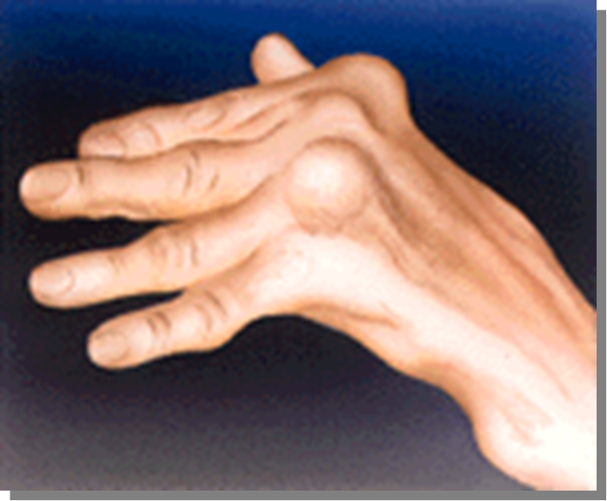
Rheumatoid Arthritis
Deﬁnition: Rheumatoid arthritis is a common autoimmune disease in which the normal immune response is directed against an individual's own tissue, including the Joints,Tendons and Bones.
Resulting in: 1-inflammation
2- tissues destruction
3- progressive disability
4-systemic complications (cardiovascular, pulmonary ..)
5- early death.
Both prevalence and incidence are 2-3 times greater in women than in men.
cause :The cause of rheumatoid arthritis is not known but may be the cause
related to :
complex interplay among genotype
environmental triggers.
genetic factors: HLA-DR B1 locus alleles that contain a common amino acid motif (QKRAA) in the HLA-DRB1 region, termed the shared epitope, confer particular susceptibility

Slide 12
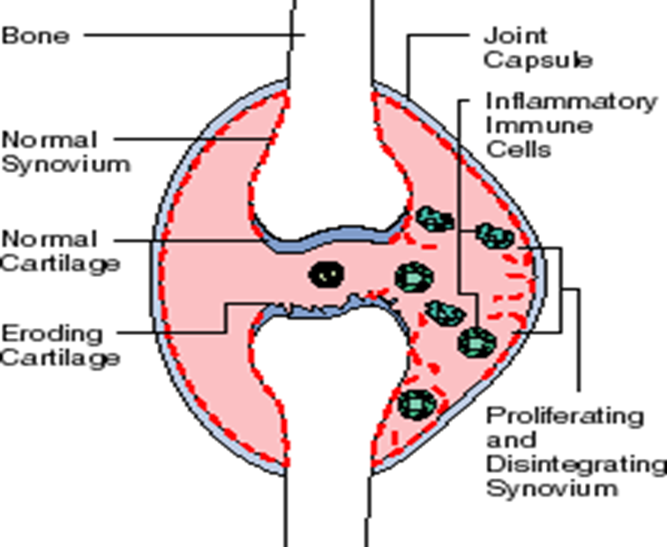
Rheumatoid Arthritis
helpful video
helpful video
Rheumatoid arthritis (RA) that affects peripheral joints, is characterized by inﬂammation of the Synovium (Synovitis) that may cause destruction of both cartilage and bone
439: There is sequence found on “HLA-DRB1” gene , shared on all Rheumatoid arthritis patients, but it doesn’t mean that everyone has this sequence must have Rheumatoid arthritis.

Slide 13
Pathogenesis
(Type III hypersensitivity reaction)
Inflammatory cells produce pro inflammatory cytokines/ TNF-α, IL-1, IL-6 that induce the secretion of metalloproteinases; which are known to cause joint destruction
T cell activation due to unknown antigens also contributes to the inflammation in RA
439:Citrullinated proteins: convert of the amino acid Arginine in a protein into the amino acid Citrulline Immune complex: integral binding of Ab with an antigen Metalloproteinases: cause joint destruction Anti-citrullinated proteins antibodies(ACP): Antibodies that attack the citrullinated proteins
There is a lack of tolerance to citrullinated proteins and the appearance of autoantibodies directed against citrullinated proteins

Slide 14
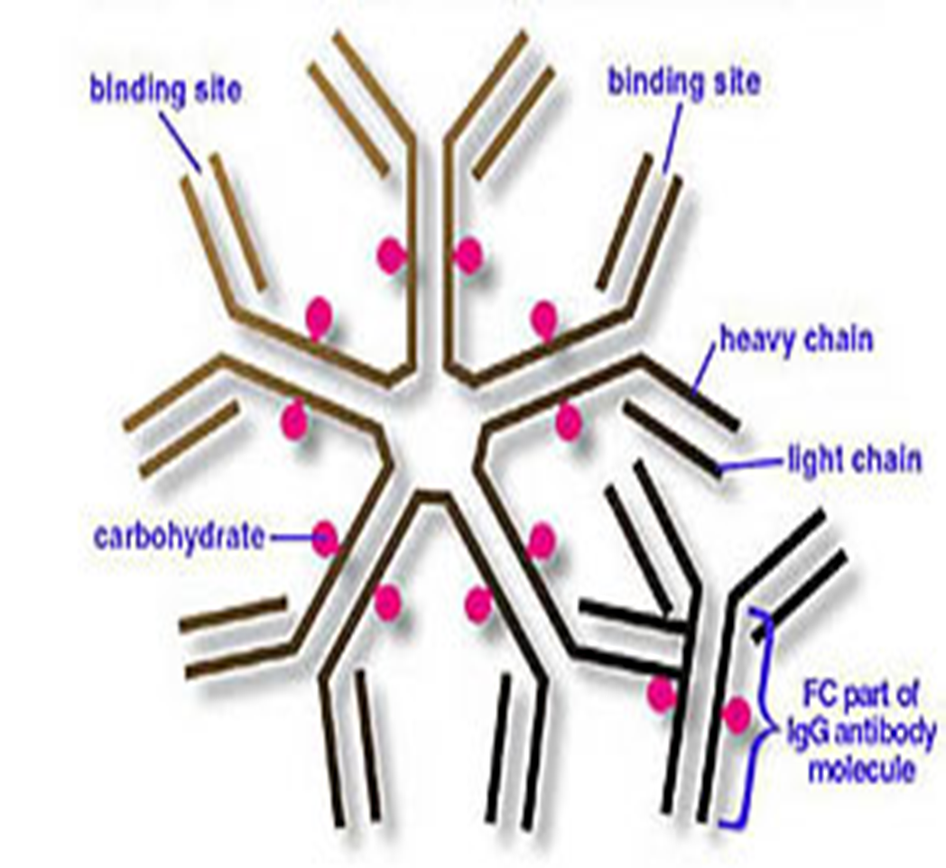
rheumatoid factor
Dr:very important
In rheumatoid arthritis, many individuals produce another group of auto-antibodies known as rheumatoid factor.
These antibodies will react with determinants in the FC region of IgG

Slide 15
rheumatoid factor
Diagnosis
•Anti–citrullinated protein/peptides(ACP) antibodies/ anti-CCP : specific markers
•Rheumatoid factor
The igM Ab is directed against their Fc region of igG Ab
forming the igM-igG complexes (Rheumatoid factor)
Medications
-Symptomatic: corticosteroids, NSAIDS (Non-steroidal anti-inflammatory drugs)
Disease-modifying antirheumatic drugs (DMARDs)
- Non biologic DMARDs:
Methotrexate, leflunomide,
hydroxychloroquine
- Biologic DMARDs: anti-TNF, anti-IL6R, anti-CD20
.-Physical therapy
-Surgery
This complex may be deposited in joints leading to activation of synovial macrophages (inﬂammatory cells)
The macrophages engulf the immune complexes and then release TNF and other pro-inflammatory cytokines e.g., IL-1

Slide 16
Take home message
•The spectrum of autoimmune disorders is wide ranging from single organ involvement to a systemic disease
•The disease process is usually prolonged and is generally associated with significant morbidity and mortality
•The mainstay of the treatment is to maintain immunosuppression

Slide 17
MCQs
Q1.Disease processes and tissue damage are due to which type of hypersensitivity?
II | B. III | C. IV | D. All above
Q2. Organ Specific Autoimmune Diseases Mediated by?
A. Stimulating autoantibodies | B.blocking auto-antibodies | C. A+B | D. Non
Q3. Systemic Autoimmune diseases Systemic lupus erythematosus (SLE)
A. Multiple sclerosis | B. Vitiligo | C. butterfly rash | D. Psoriasis
Special thanks to
Q bank 441
Q1.D
Q2.C
Q3.C

Slide 18
MCQs
Q4.Which of the following Autoimmune disease is associated with inflammation of the synovium?
A.Rheumatoid arthritis | B.SLE | C.Myasthenia Gravis | D.-
Q5.Antibodies directed against the Fc fragment of IgG are called?
A.Cytokines | B.Rheumatoid Factor | C.Citrullinated protein | D.Rheumatoid Arthritis
Q6.which of the following is not a treatment for RA:
A.NSAIDs | B.Surgery | C.Antimalarials | D.Immunosuppressive therapy
Q4.A
Q5.B
Q6.C

Slide 19
Special thanks to
Immunology Team 441
Team Leaders:
Mohamed ibn Saqyan - Reema Alshehri
Team members:
Moath Sallam
Abdulaziz AlNasser
Abdullah Ali
Meshari sami alshathri
Maha bakheet
Raneem Alwatban
Raghad Mohammed
تَغَرَّب عَنِ الأَوطانِ في طَلَبِ العُلا
وَسافِر فَفي الأَسفارِ خَمسُ فَوائِدِ
تَفَرُّجُ هَمٍّ وَاِكتِسابُ مَعيشَةٍ
وَعِلمٌ وَآدابٌ وَصُحبَةُ ماجِدِ
محمد بن إدريس الشافعي
immunologymed442@gmail.com

