Slide 1
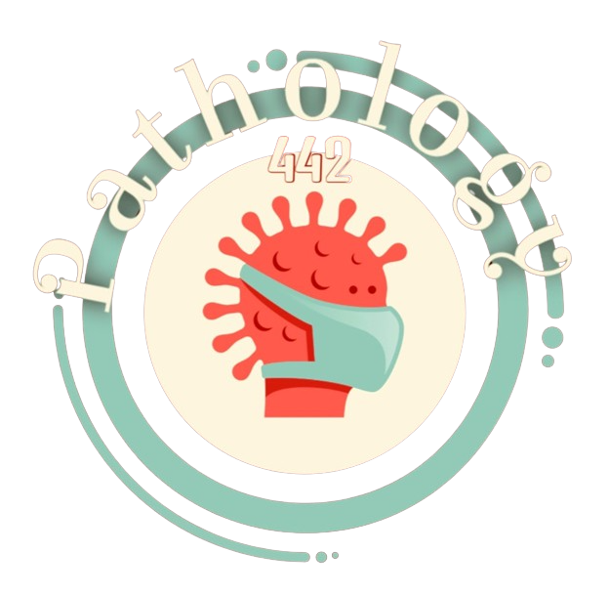
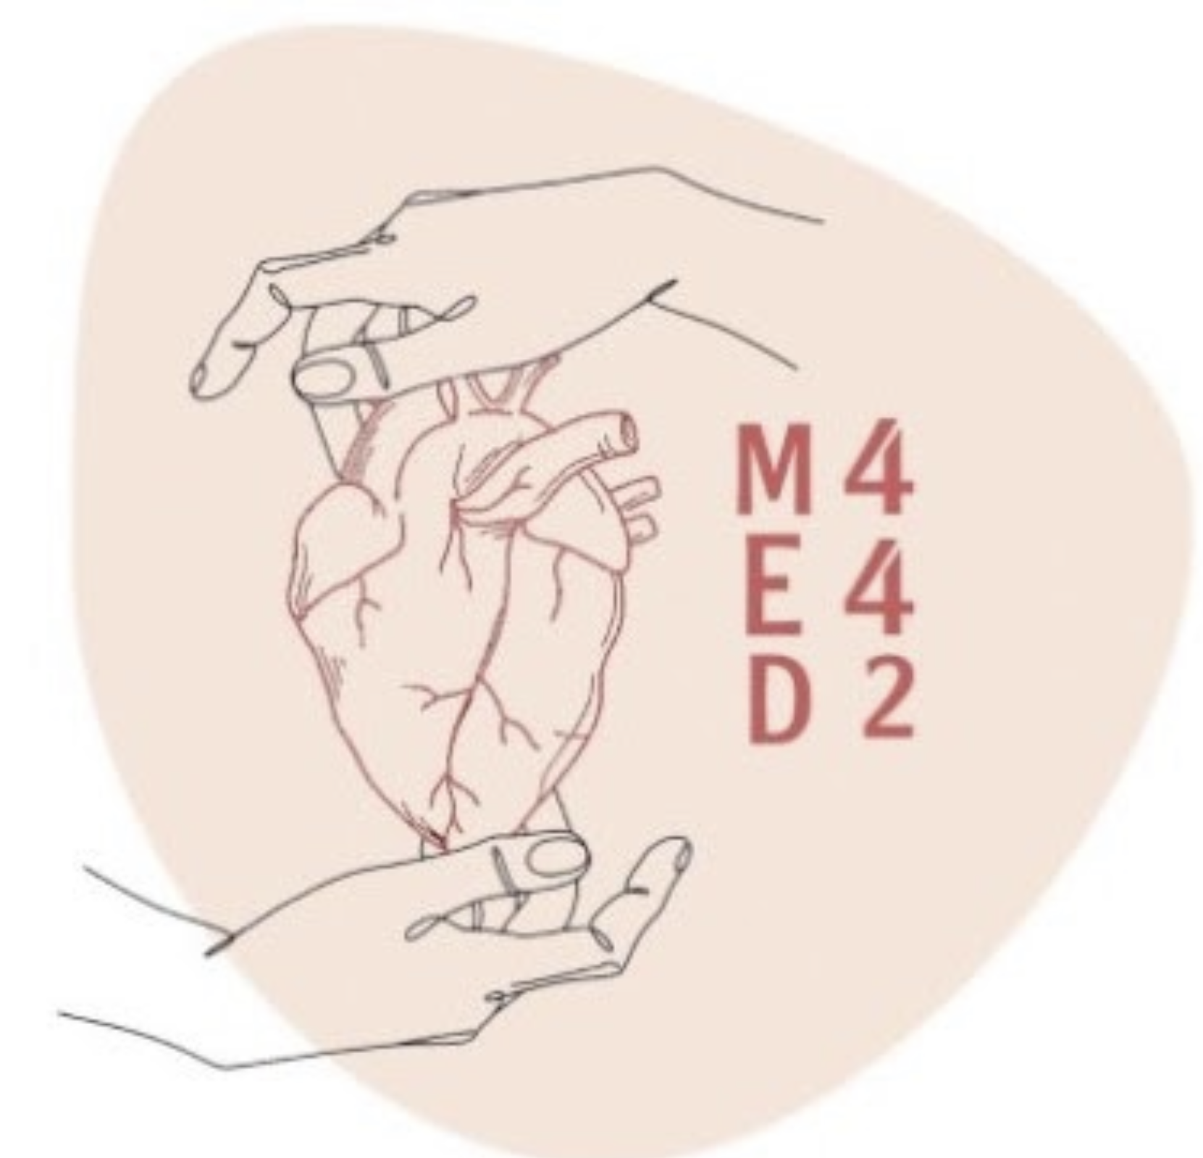
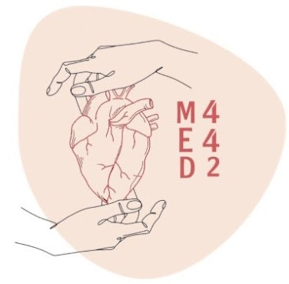
Fractures &
Bone Healing
Colour index:
Main text
Important
In girls slides only
In boys slides only
Doctor‘s notes
Extra info.

Slide 2
Objectives
• Know the basic anatomy and histology
• Know the different types of fractures
• Be aware of the mechanism and stages of fracture healing process
• Know the factors affecting healing process and the possible complications of
healing process
• Understands the difference between trauma induced and pathological
Fractures
• Appreciate the importance of Motor Vehicle Accidents (MVA) as a major
cause of disability in Saudi Arabia

Slide 3
OVERVIEW
Introduction
Basic Anatomy
&
Histology
Patterns of Bone Deposition
Bone Remodeling
Bone Fractures
Definition
&
Classification
Causes
Complications
Bone Healing
Phases of Healing
Factors Disrupting Healing

Slide 4
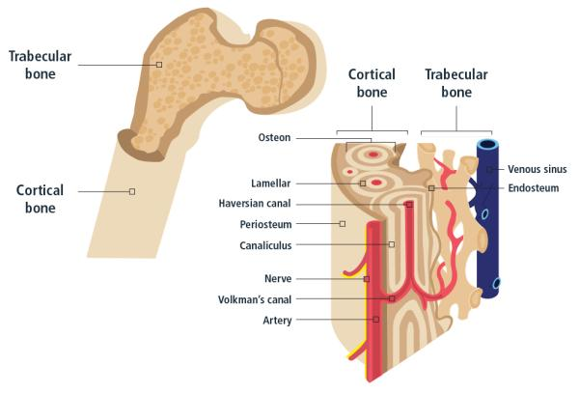
Basic Anatomy
Only in Males’ Slides
Two types of mature bone:
• Structural load-bearing function
• Thick and dense
• This is the area of bone to which ligaments and tendons attach
• Diaphyses (shafts) of long bones such as the femur and the outer surfaces of predominantly trabecular bones such as the vertebral bodies
Cortical/
Compact
• Some structural function
• Contributes to the metabolic functions of bone far more than cortical bone
• More prone to diseases involving or resulting from increased bone remodelling than cortical
bone (osteoporosis)
Spongy (Trabecular/ Cancellous)

Slide 5
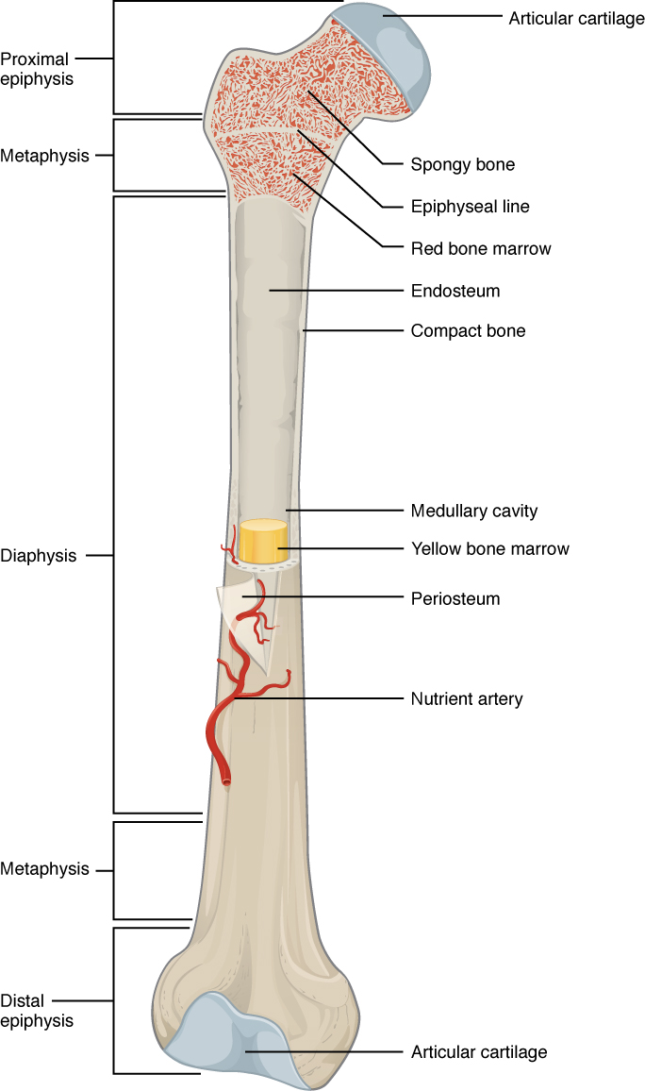
Basic Anatomy
Epiphysis: ends of bone, partially covered by articular cartilage.
Epiphyseal plate: cartilage plate in the metaphysis at each end of a long bone
Epiphyseal line: epiphyseal plate that has become ossified
Physis: the growth plate.
Metaphysis: junction of diaphysis and epiphysis.
Diaphysis: the shaft.
Periosteum: dense fibrous layer
Cortex: dense outer surface composed of cortical/compact bone.
Endosteum: layer of vascular connective tissue lining the medullary cavities of bone
Medullary space: composed of cancellous/spongy bone.
Function of Bones
12% of body weight
Mechanical support
Transmission of forces generated by muscles
Protection of viscera
Mineral homeostasis
Providing a niche (suitable environment) for production of blood cells
Only in Males’ Slides

Slide 6
BONE
MATRIX
CELLS
Organic osteoid
35%
Inorganic mineral 65%
hydroxyapatite
Osteoblasts
Osteocytes
Osteoclasts
Type I
collagen
Glycosaminoglycans
and other proteins

Slide 7
Types of bone cells
Osteoclasts
On surface of bone
Specialized multinucleated macrophages..circulating monocytes.
Bone resorption.
Attach to bone matrix,
sealed extracellular trench (resorption pit),
secrete acid and neutral protease/MMPs, resorb bone
Osteoblasts
On surface of bone matrix (synthesize, transport and regulate mineralization).
From mesenchymal stem cells, under periosteum (early), medullary space (later)
Over time, may become inactive and remain on the surface of trabeculae.
Osteocytes
Within the bone.
Located within matrix
Interconnected, network of cytoplasmic processes through tunnels (canaliculi).
Help control Ca and Ph,
detect mechanical forces and translate them into biologic activity (mechanotransduction)

Slide 8
Matrix
Only in Males’ Slides
• Bone matrix is the extracellular component of bone
• It is composed of an organic component known as osteoid (35%) and a mineral component (65%)
• Osteoid is made up of predominantly type I collagen with smaller amounts of glycosaminoglycans and other proteins
• Mineral component is composed of mainly inorganic moiety hydroxyapatite
[Ca10(PO4)6(OH)2]
• Serves as a repository for 99% of the body’s calcium and 85% of its phosphorus

Slide 9
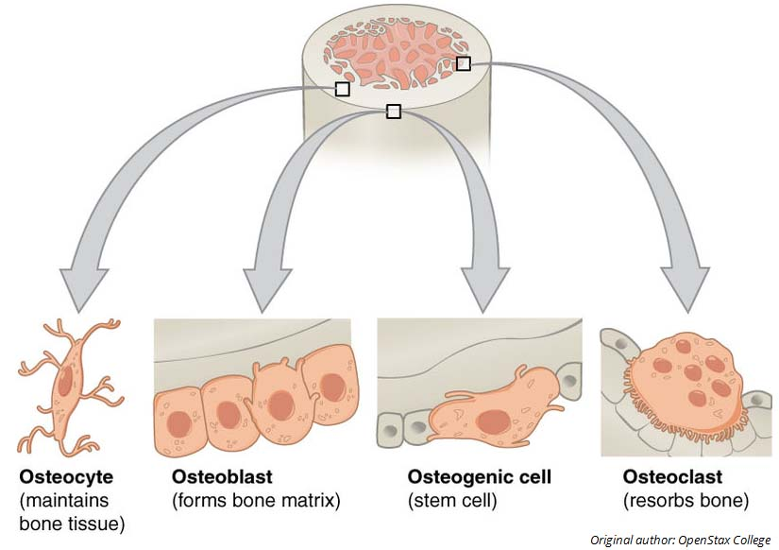
Only in Males’ Slides
Types of Matrices
Bone Cells
Woven
(rapid)
Produced rapidly, such as during fetal development or fracture repair, but the haphazard arrangement of collagen fibers imparts less structural integrity
In an adult, the presence of woven bone is always abnormal, but it’s not specific for
any particular bone disease since it can be found in a variety of pathologic settings.
Lamellar
Main type in adults
Characterized by an orderly arrangement of collagen bundles and their cells
Stronger than woven

Slide 10
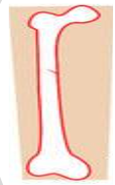
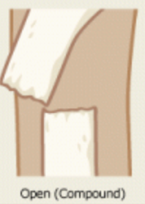
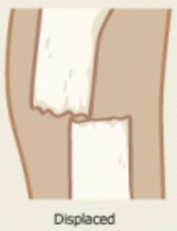
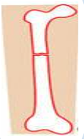
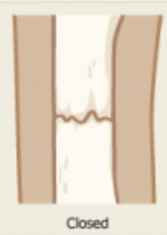
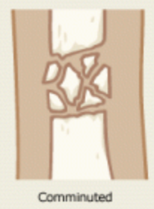
Definition & Classification of Fractures
Team 439
Fracture
Clinical Signs:
Swelling
Severe pain
Functio laesa
Break in the continuity of bone
Defined as loss of bone integrity due to mechanical injury and/or diminished bone strength
Complete
Simple
(Closed)
Comminuted
Pathologic
Greenstick
Incomplete
Compound
(Open)
Displaced
Hairline/Stress
Team 439
Many other types, include: avulsion (rare), and compression (in women with severe osteoporosis)

Slide 11
Type | Description
Complete | Bone is broken into two separate pieces
Incomplete | Bone is partly broken and still one piece | Hairline/Stress | Slowly developing fracture that follows a period of increased physical activity in which the bone is subjected to repetitive loads
 |  | Greenstick | Extend only partially through the bone, common in infants when bones are soft
Simple (Closed) | Overlying skin is intact (Does NOT communicate with external environment)
Compound (Open) | The bone communicates with the skin surface (external environment) Prone to infection
Displaced | The ends of the bone at the fracture site aren’t aligned Could rupture the skin compound fracture
Comminuted | Bone is fragmented (broken into more than two fragments)
Spiral | Twisted force
Pathologic | Bone weakened by underlying disease, e.g. tumor
Complicated | Associated with damage to nerves, vessels or internal organs
vs.
vs.

Slide 12
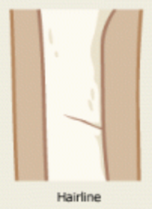
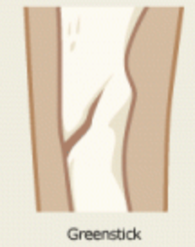
Spiral
Hairline
Greenstick
Incomplete
Complete
Team 439
Greenstick fracture will heal very well, because children have many osteoprogenitor cells

Slide 13
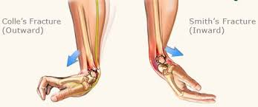
vs
Colles Fracture
Smith Fracture
Distal end of radius DORSALLY
Usually patients over 50
Dinner fork shaped
Occur as a result of a fall on outstretched hand
Distal end of radius VENTRALLY
Also called “reverse Colles fracture”
Less common
Extra Information
This is extra information but it was included in the homework in the girls slides. Recommended revision.

Slide 14
Causes of Fracture
Traumatic
Pathological
Stress
Severe trauma e.g. MVA (Motor Vehicle Accident)
“major cause”
minimal trauma (bone is weak)
Underlying bone is abnormal
Develops slowly over time
Collection of microfractures associated with increased physical activity (especially with new repetitive mechanical loads on bone).
Most common in weight-bearing bones of lower leg and foot
Track, field athletes & military recruits who carry heavy packs over long distances are more susceptible.
It’s usually linear.
Healthy bones are extremely resilient & withstand strong impacts
E.g. Sporting injuries, vehicle accidents and falls
Road accidents are 2nd leading cause of death & main one of premature death in KSA
e.g.
Osteoporosis
Osteosarcoma
Paget’s disease of bone
Primary/secondary metastatic tumor
Congenital bone diseases (e.g. Osteogenesis Imperfecta)
Osteomalacia

Slide 15
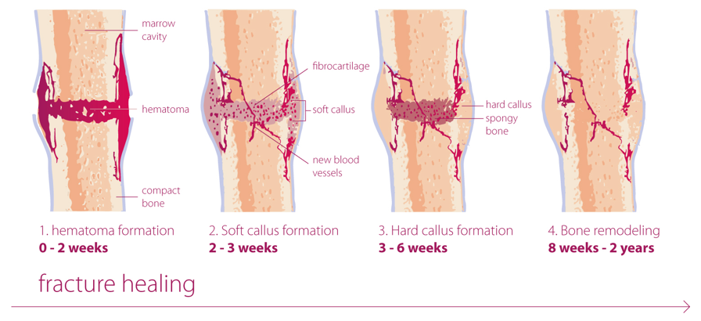
Healing of Fracture
1. Reactive phase:
2. Reparative phase:
3. Remodeling phase:
a) Hematoma and inflammatory phase
b) Granulation tissue formation
Callus formation (soft and bony)
Remodeling to original bone contour

Slide 16
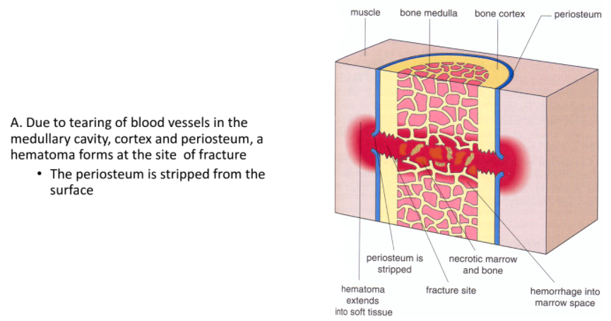
Reactive phase:
Bleeding causes swelling due to inflammation which is induced by chemical mediators produced
from macrophages and other inflammatory cells with granulation tissue formation.
Hematoma and inflammatory phase.

Slide 17
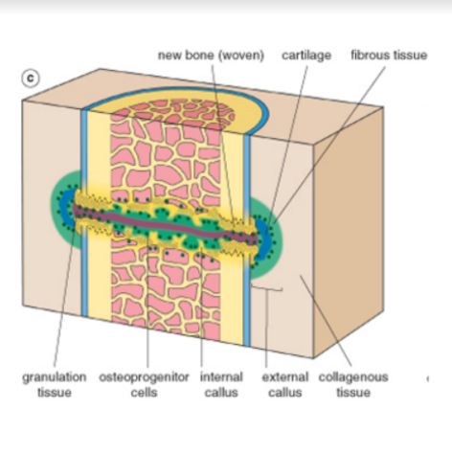
2. Reparative phase: (Callus stage)
• Degranulated platelets and marauding inflammatory cells subsequently release a host of
cytokines (e.g., platelet-derived growth factor, fibroblast growth factor, TGF-B)
• Cytokines activate bone progenitor cells, and within a week, the involved tissue is primed
for new matrix synthesis.
•This soft callus/procallus can hold the ends of the fractured bone in apposition but is noncalcified and cannot support weight bearing(end of first week).

Slide 18
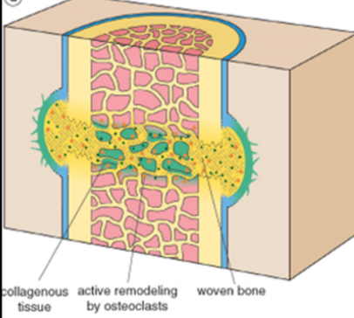
2. Reparative phase: (Callus stage)
after 2 weeks
HARD (BONY) CALLUS:
Activated osteoprogenitor cells deposit woven bone.
In some cases, the activated mesenchymal cells in the soft tissues and bone surrounding the fracture line also differentiate into chondrocytes that make fibrocartilage and hyaline cartilage.
In uncomplicated fractures, this early repair process peaks within 2 to 3 weeks.
The newly formed cartilage acts as a nidus for endochondral ossification, recapitulating the process of bone formation in epiphyseal growth plates. This connects the cortices and trabeculae in the juxtaposed bones.
With ossification, the fractured ends are bridged by a bony callus.

Slide 19
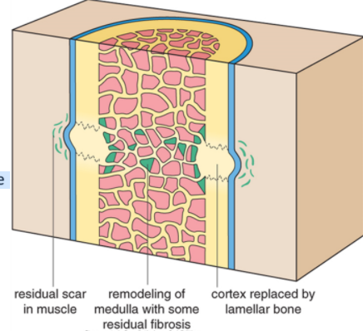
3. Remodeling phase:
Beginning about 8 to 12 weeks after the injury, the fracture site remodels itself, correcting any deformities that may remain as a result of the injury. This final stage of fracture healing can last up to several years.
Although excess fibrous tissue, cartilage, and bone are produced in the early callus, Subsequent weight bearing leads to remodeling of the callus, lamellar bone and restoration of medullary cavity.
The rate of healing and the ability to remodel a fractured bone vary tremendously for each person and depend on:
Age
Health
The kind of fracture
The bone involved.

Slide 20
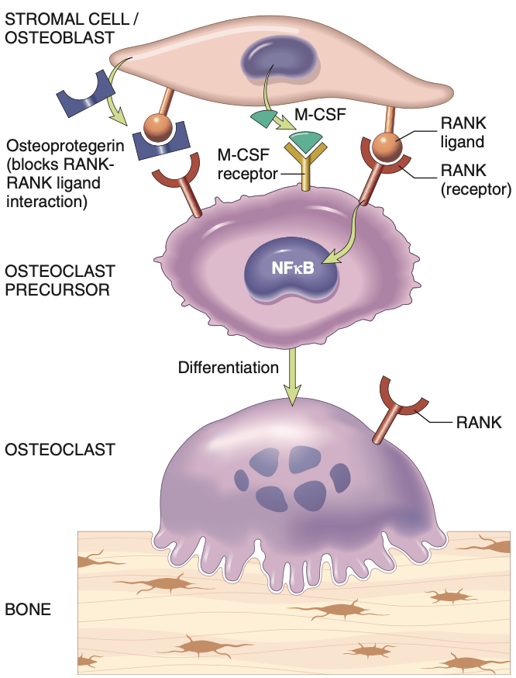
Bone Remodeling
Extra Information
RANK
Receptor activating nuclear factor-κB
Expressed on pre & mature osteoclasts
RANKL
Expressed by osteoblasts & marrow stromal cells
Osteoprotegerin (Blocker)
Receptor produced by bone, hematopoietic marrow, and immune cells
Blocks RANKL actions by competitive inhibition
Regulated by signals similar to those that stimulate RANKL. (hormones, cytokines, growth factors) to influence homeostasis of bone tissue & bone mass

Slide 21
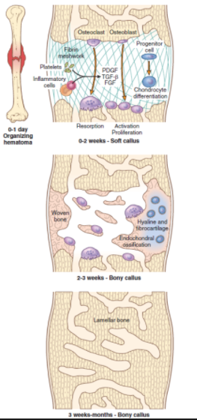
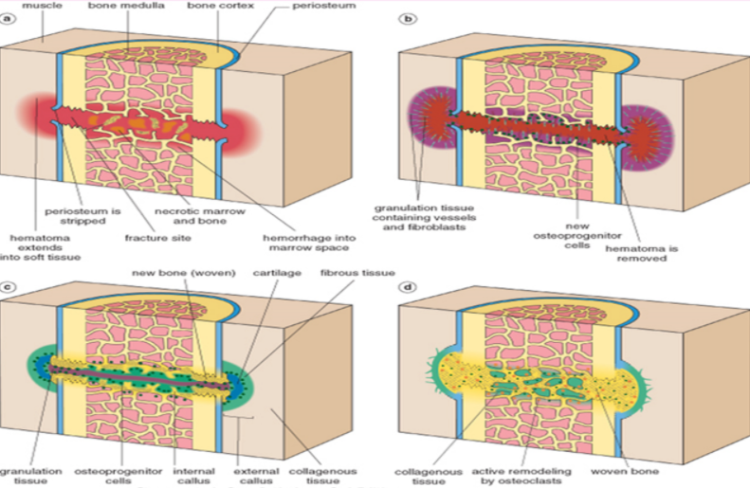

Slide 22
Factors Disrupting the Healing Process
Displaced and comminuted fractures
Infection
Vascular insufficiency
This is particularly important in certain areas such as the scaphoid bone in the wrist and the neck of the femur, both of which can be associated with avascular necrosis of fracture fragments.
Inadequate minerals and vitamins
Inadequate immobilization (movement of the callus and prevents its normal maturation, resulting in delayed union or Nonunion)

Slide 23
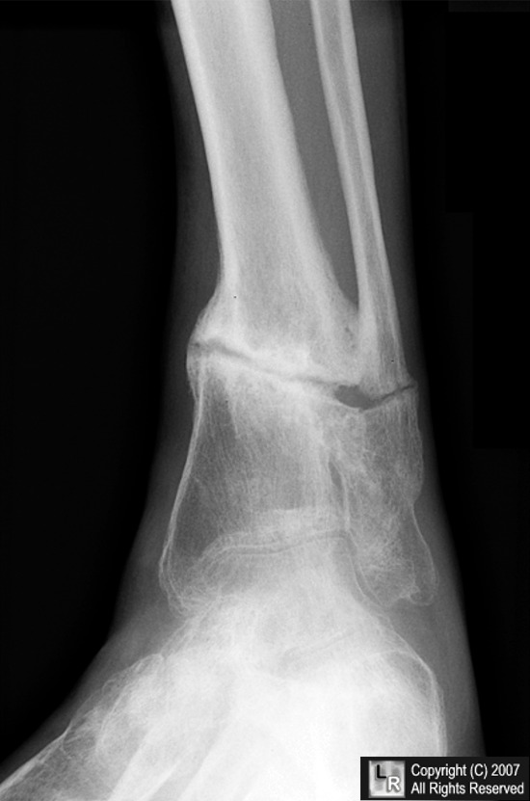
Complications of Fractures
takes longer to heal than expected
Does NOT heal in a normal alignment
causes avascular necrosis
fracture in the open physis, or growth plate, in a child, can cause many problems
Delayed Union
Malunion
Neurovascular Injury
Growth Abnormalities
Nonunion (Pseudoarthrosis)
Infection
Post-Traumatic Arthritis
fails to heal in a reasonable amount of time
Open fractures can be infected
Fractures that extend into joints (intra-articular fracture)
Pseudoarthrosis
false joint, resembles fibrinous one

Slide 24
Osteonecrosis (Avascular Necrosis)
➤Infarction (ischemic necrosis) of bone and marrow cells, peak 30-50, responsible for 10% of hip replacements
Drugs (corticosteroids)
Mechanism
Causes
Radiation
Mechanical disruption of vessel
Thrombotic occlusion
Vascular injury (trauma, vasculitis)
Systemic disease ( sickle cell disease)
Unknown (25%)
Extravascular compression

Slide 25
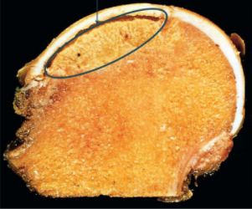
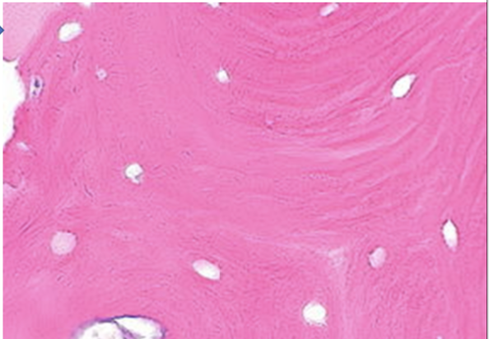
Osteonecrosis (Avascular Necrosis)
Medullary infarcts, are geographic and involve the trabecular bone and marrow
Cortex not affected .. Collateral blood flow.
Overlying cartilage is viable..
Synovial fluid
Dead bone.. Empty lacunae
Can lead to secondary osteoarthritis

Slide 26
Q1
Incomplete fracture; one side breaks & the other bends; occurs only in children?
A- Closed
B- Open
C- Greenstick
D- Comminuted
Q2
Fracture of the distal end of radius?
A- Pott’s fracture
B- Colles fracture
C- Hairline
D- Open
Q3
From team 441’s Q-Bank
The first stage of fracture healing is?
A- Remodeling
B- Hematoma
C- Callus
D- Inflammation
Q4
Bone fragments into three or more pieces; common in the elderly?
Team 441
A- Comminuted
B- Spiral
C- Compound
D- Avulsion
1- C
2- B
3- B
4- C

Slide 27
Q5
The second stage of Fracture healing is…….. where active phagocytosis absorbs the products of local necrosis.
A- Ossification
B- Hematoma
C- Granulation tissue
D- Callus Formation
Q6
A type of fracture where the bone is fragmented:
A- Greenstick
B- Complete
C- Comminuted
D- Crumbled
Q7
Which of the following is not a cause of bone fracture?
A- Trauma
B- Burns
C- Stress
D- Pathologic
1- C
2- C
3- B

Slide 28
Team Members
Omar Alkadhi
Abdullah Ali
Nawaf Alrefaei
Malik Halees
Khalid Alrasheed
Team Leaders:
Hassan Alabdullatif & Hissa Alshiqari
Norah Alrashoud Tharaa Alhowaish
Waad abunakha Haifa Alamri
Ajwan Aljohani Dena Alsuhaibani
Mashael Alasmri

