Slide 1
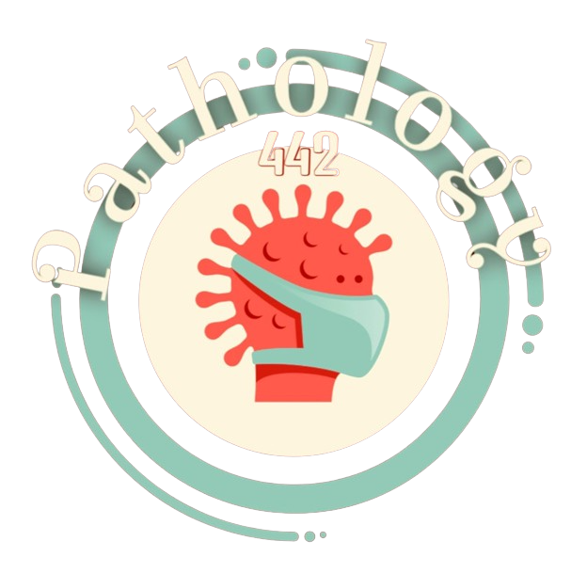
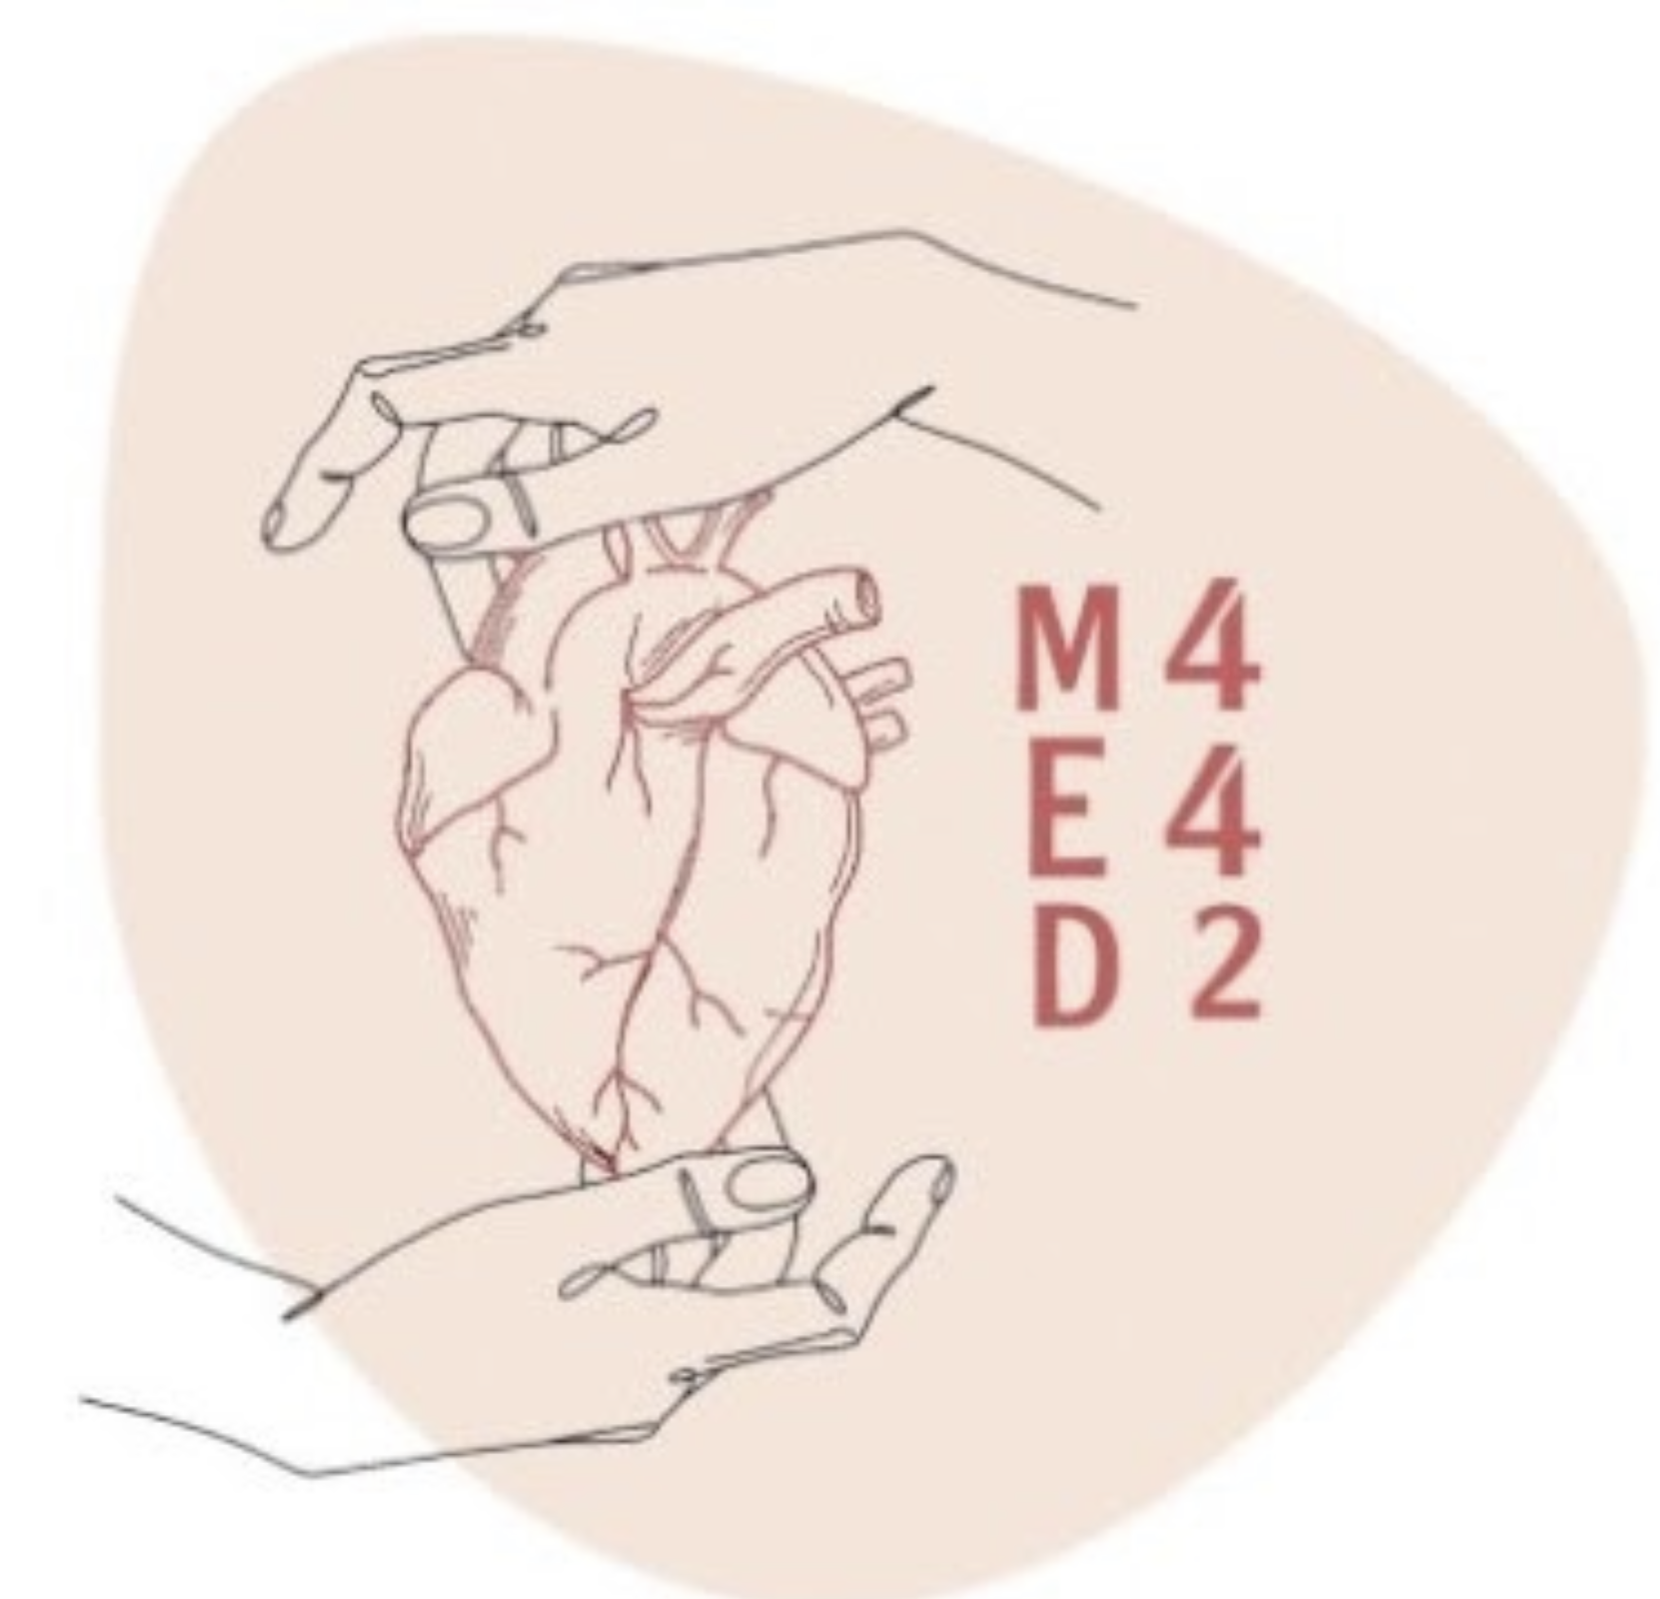
Non-infectious Arthritis
Colour index:
Main text
Important
In girls slides only
In boys slides only
Doctor‘s notes
Extra info.

Slide 2
Objectives
01.
02.
03.
Know the pathogenesis and clinicopathological features of osteoarthritis (degenerative joint disease).
Know the pathogenesis and clinicopathological features of rheumatoid arthritis.
Know the pathogenesis and clinicopathological features of gout and calcium pyrophosphate arthropathy [pseudogout].

Slide 3
Function of normal cartilage
1
weight-bearing joints, it spreads the load across the joint surface.
2
provides friction-free movement ( along with the synovial fluid)
These functions require the cartilage to be
-elastic + have high tensile strength
These attributes are provided by proteoglycans and type II collagen, both produced by chondrocytes.

Slide 4
Diseases of joints
Non infectious
Infectious
-Degeneration: Osteoarthritis -Autoimmunity rheumatoid arthritis and SLE
-Crystal deposition: gout, other crystalline
arthropathies
Infection, e.g. septic arthritis and TB arthritis
Osteoarthritis (OA):
called degenerative joint disease, is characterized by degeneration
of cartilage that results in structural and functional failure of synovial joints.
most common disease of joints.
Intrinsic disorder of cartilage in which chondrocytes respond to biochemical and mechanical stresses resulting in the breakdown of the matrix and failure of its repair.
Role of inflammatory mediators (cytokines, reactive oxygen species, nitric oxide…)are responsible for the progression of OA in synovial joints.

Slide 5
Type of OA
Primary(IDIOPATHIC)
-Insidious (progress
gradually), with aging
-oligoarticular (affect few
joint)
oligo=few
secondary(5%)
- Younger
-Previous trauma, developmental
anomaly, systemic disease (DM,
Hemochromatosis(iron overload)
, obesity, SCD(sickle cell disease)
Pathogenesis
Articular cartilage bears the brunt of the degenerative
changes in osteoarthritis.

Slide 6
Early osteoarthritis is marked by degenerating cartilage containing
more water and less proteoglycan
Chondrocyte function is affected by a variety of influences:
mechanical stresses , aging
and Genetic factors.
The type II collagen network also is diminished, presumably as a
result of decreased local
synthesis and increased
breakdown
Regardless of the inciting stimulus, there is an imbalance in the
expression, activity, and signaling of cytokines and
growth factors that
results in degradation and loss of matrix.

Slide 7
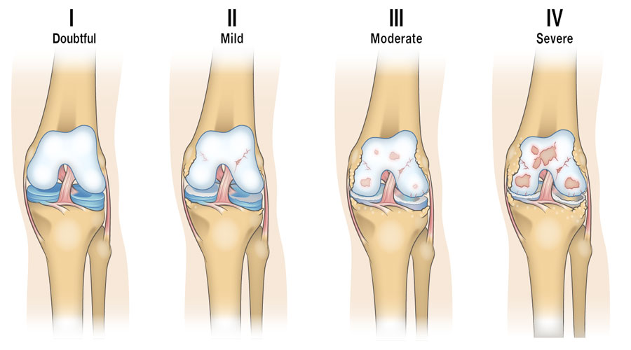
Stages of OA
Osteophytes bony outgrowth occurring usually
adjacent to an area of articular cartilage damage.

Slide 8
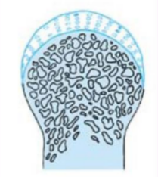
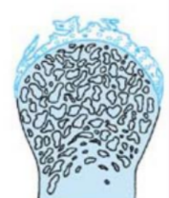
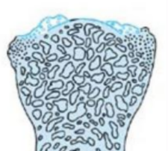
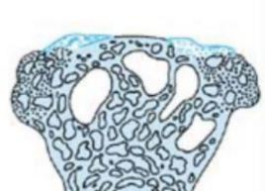
1
2
3
4
Normal Articular
cartilage
Fragmentation of
articular surface and
thinning of
cartilage
Calcification of cartilage margins. patchy loss of
cartilage revealing bare
bone. (Eburnation)
Formation of lips of new bone
(Osteophytes) extensive loss of
cartilage cystic degeneration of
underlying bone.(sever)

Slide 9
morphology
Fibrillation and cracking of the matrix occur as the superficial layers of the cartilage are
degraded.
Small fractures can dislodge pieces of cartilage and subchondral bone into
the joint, forming
loose bodies (joint mice).
Mushroom-shaped osteophytes (bony outgrowths) develop at the margins
of the articular surface.
Eventually, full-thickness
portions of the cartilage are
lost, and the subchondral
bone plate is exposed and
is smoothened by friction,
giving it the appearance of
polished ivory (bone
eburnation)مثل الشيء المصقول.
The fracture gaps allow synovial fluid to be forced into the subchondral
regions to form fibrous
walled (cysts).

Slide 10
Osteoarthritis. : Histologic demonstration of the
characteristic fibrillation of the articular cartilage.
Fibrillation: softening of the articular cartilage and development
of vertical clefts(شقوق)between groups of cartilage cells.
1-Eburnated articular surface exposing subchondral bone.
2-Subchondral cyst(fluid filled space inside the joint ).
3-Residual articular cartilage.

Slide 11
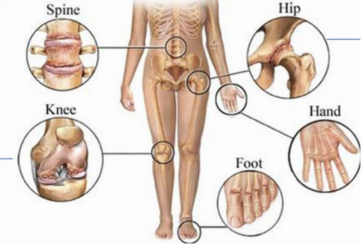
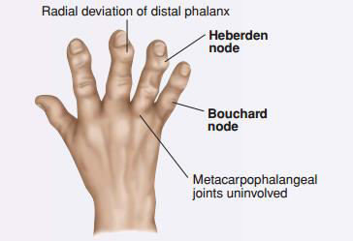
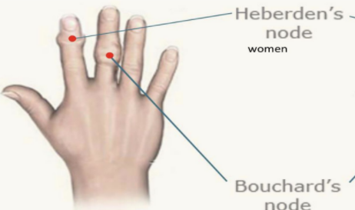
Common site
-Women: hand+knee
+spine +foot
-Men: hip
Bouchard’s node
(b) بروكسمل لأنها تبدأ بحرف.
-Bony bumps on the finger joint closest to the
fingernail are called Heberden's nodes.
-Bony bumps on the middle joint of the finger
are known as Bouchard's nodes.

Slide 12
Clinical course
Osteophyte impingement on spinal foramina can cause nerve root Compression with radicular pain and neurologic deficits.
2
Pain exacerbated by use, morning stiffness, crepitus (طقطقة grating or
popping sensation in the joint), and limitation in range of movement.
Hips, knees, lower lumbar and cervical vertebrae, proximal and distal
interphalangeal joints of the fingers, first carpometacarpal joints, and
first tarsometatarsal joints of the feet are commonly involved.
1
3

Slide 13
Prognosis
1
Slowly progressive
2
With time, significant joint deformity can occur,
Treatment usually is based on symptoms, with joint replacement in severe cases.
3
NSAIDs, intra-articular injection, arthroplasty

Slide 14
Rheumatoid Arthritis (RA)
It is a systemic, chronic inflammatory autoimmune disease affecting many tissues but principally attacking the joints.
It causes a
nonsuppurative
proliferative synovitis that
progresses to destroy
articular cartilage and
underlying bone with
resulting disabling
Arthritis and ankylosis
(adhesions).
RA is relatively common.
Has a
prevalence of
approximately
1%.It is 3x-5x
more common
in women than
in men.
The peak incidence is
between the
age 20 to 30, but no age is immune.
-Nonsuppurative: no pus formation.
Synovitis: inflammation of the synovial
membrane.
-Ankylosis: stiffness of the joint.

Slide 15
Pathogenesis of
Rheumatoid Arthritis
RA is an autoimmune disease interactions of
genetic risk factors, environment, and
the immune system.
These interactions are complex,
and poorly understood.
Pathologic
changes of
RA are caused
mainly by:
Cytokine-mediated
inflammation
(CD4+ T helper cells are
the principal source of
the cytokines)

Slide 16
Many patients also produce antibodies against cyclic citrullinated peptides (CCPs)
CCP antibodies can contribute to the joint lesions In RA (by forming immune
complexes).
Antibodies to citrullinated fibrinogen, type II collagen, α-enolase, and vimentin are
the most important and may form immune complexes that deposit in the joints.
These antibodies are:
1-diagnostic marker of RA.
2-may be involved in tissue injury.

Slide 17
Risk Factors That Can Cause RA:
1-Genetic Factors
2-Environmental Factors
It is estimated that 50% of the risk of developing RA is related to genetic
factors. Susceptibility to rheumatoid arthritis is linked
to the HLA-DRB1 locus.
Many candidate infectious agents whose antigens may activate T or B cells have been considered, but none has been conclusively implicated. Ex: Smoking.
(HLA-DRB1 is an MHC protein present on the surface of the cell, and is linked to RA autoimmune rxn.)
(Smoking promote citrullination of self-proteins, creating new epitopes triggering autoimmune rxns.)

Slide 18
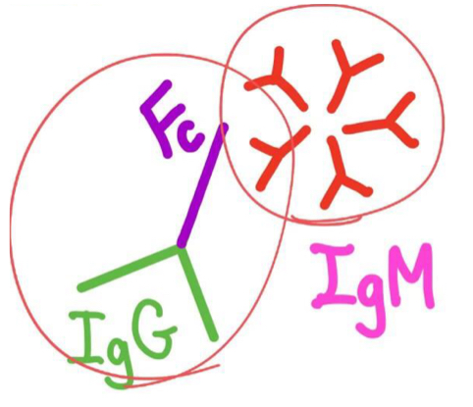
Immunoglobulins and RA
Laboratory Findings:
-About 80% of patients have serum IgM or IgA autoantibodies that bind to the Fc portions of their own IgG.
-These autoantibodies are called rheumatoid factor. They may form immune complexes with self-IgG that deposit in joints and other tissues, leading to inﬂammation and tissue damage.
-Although there are not uniformly present in all patients with RA and can be found in patients without the disease.
[IgM or IgA autoantibody + Fc of own IgG= immune complex(deposited in tissues and causing autoimmune disease]
1-Rheumatoid factor
80% have IgM autoantibodies to Fc portion of IgG(Not sensitive or specific)
2-Anti-CCP protein antibodies are most specific for a diagnosis of RA
3-ESR and C-reactive protein

Slide 19
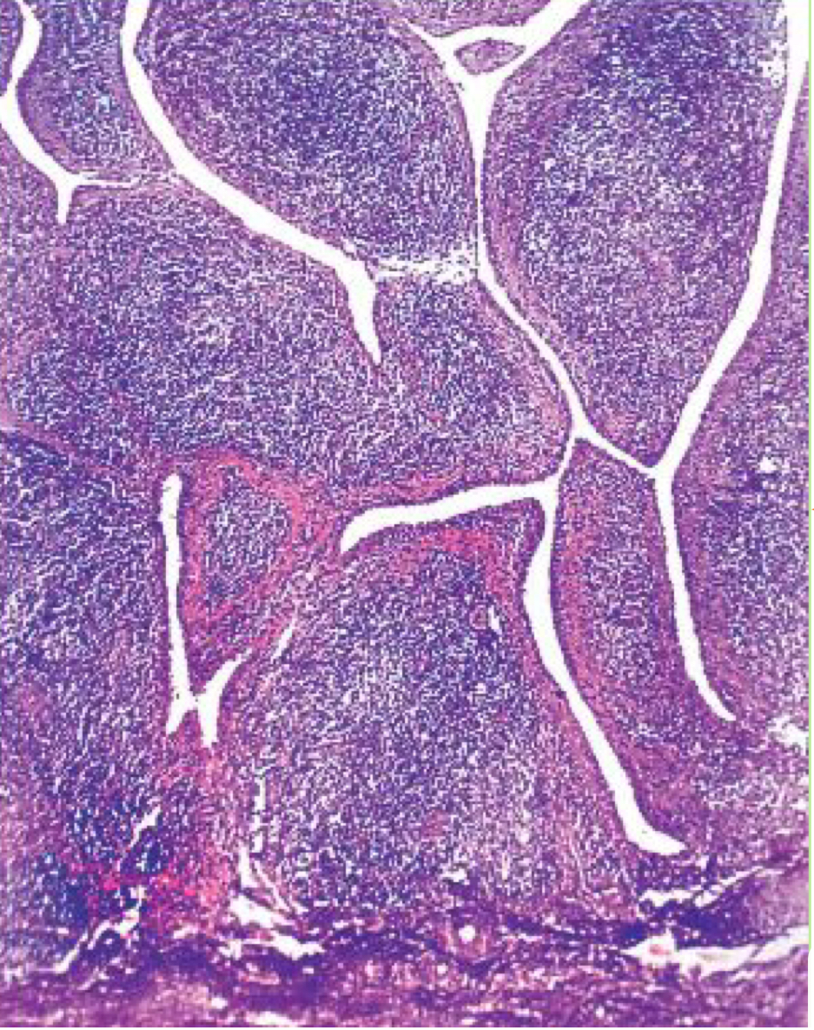
Characteristics of RA:
4
1
3
2
It is a symmetric arthritis
(Appears on both sides of the body)
It starts with changes in the synovium of the joint
Mostly aﬀects small
joints on hands and feet
Formation of pannus
(Discussed in the next slide)
Causing deformities in hands and ﬁngers.
Synovium is edematous, thickened and hyperplastic, its smooth contour turns to one covered by delicate and bulbous villi.

Slide 20
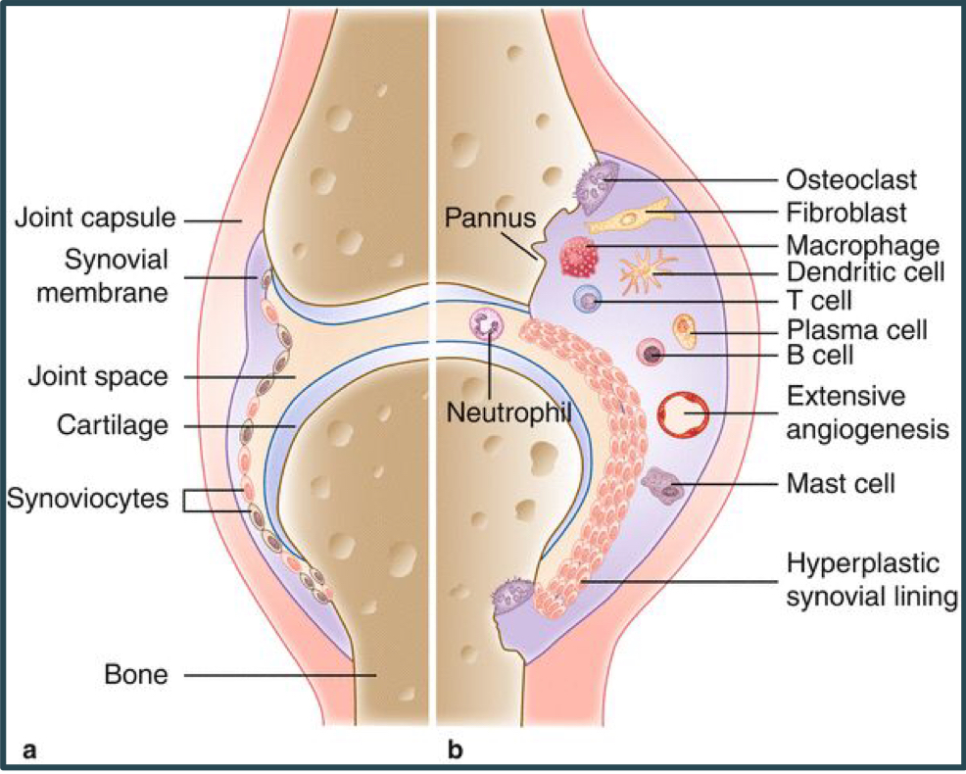
Pathological Features Of RA
(They lead to formation of pannus)
Synovial cell hyperplasia and proliferation.
neutrophils and aggregates of organizing ﬁbrin on the synovial surface.
Increased vascularity due to angiogenesis.
Dense inﬂammatory cell inﬁltrates of CD4+ T
cells, plasma cells, and macrophages.
This causes periarticular erosions and subchondral cysts.
Increased osteoclast activity in the underlying bone that allows synovium to penetrate bone.

Slide 21
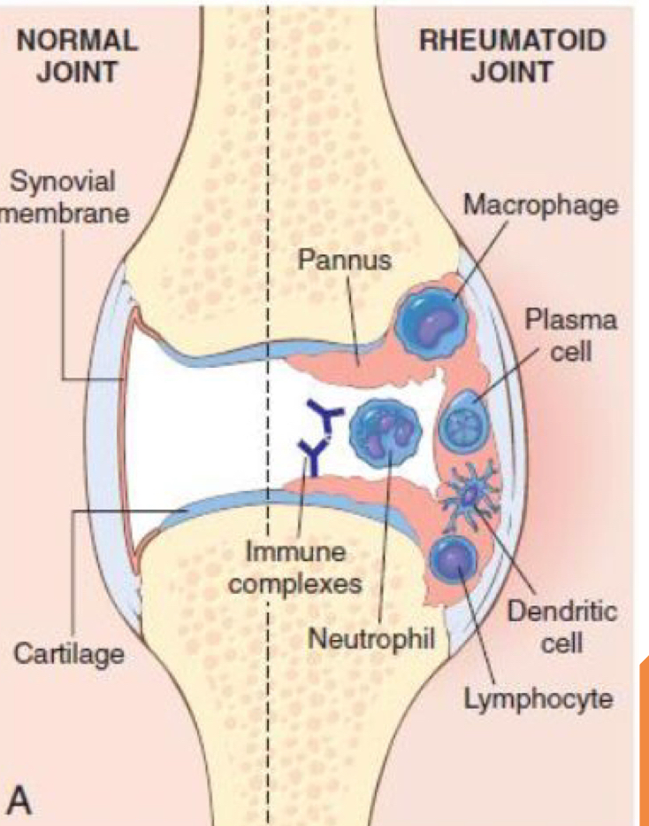
Pathological Features of RA :
Pannus: An important pathological feature formed by proliferating synovial-lining cells with inﬂammatory cells, granulation tissue, and ﬁbrous C.T.
When pannus ﬁlls the joint space subsequent ﬁbrosis and calciﬁcation can cause permanent ankylosis.

Slide 22
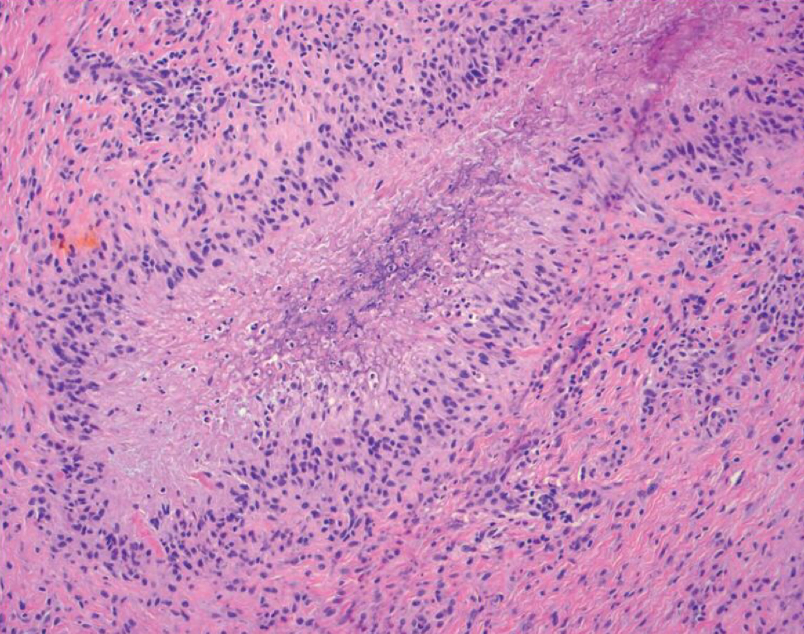
Rheumatoid Nodules
Occurance rate:In ¼ of patients. (infrequent)
Location:
-In subcutaneous tissue in forearm (extensor surface of
forearm), elbow, occiput, and lumbosacral area.
-Rarely can evolve in lungs causing interstitial lung disease.
Characteristics:
Rheumatoid nodules are ﬁrm, non-tender, oval or rounded
masses as large as 2 cm in diameter.
-Has a microscopic central focus of ﬁbrinoid necrosis
surrounded by a palisade of macrophages, which in turn is rimmed by granulation
tissue and lymphocytes. Resembling necrotizing granuloma.

Slide 23
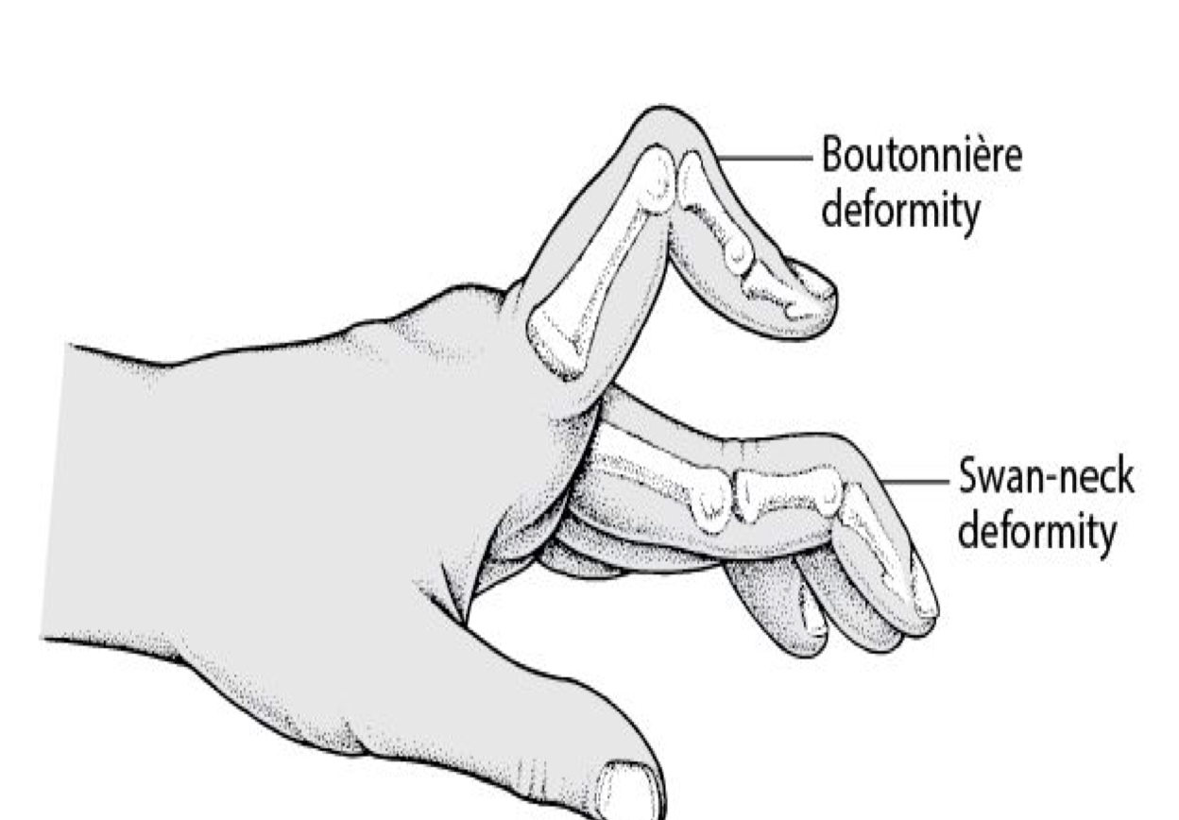
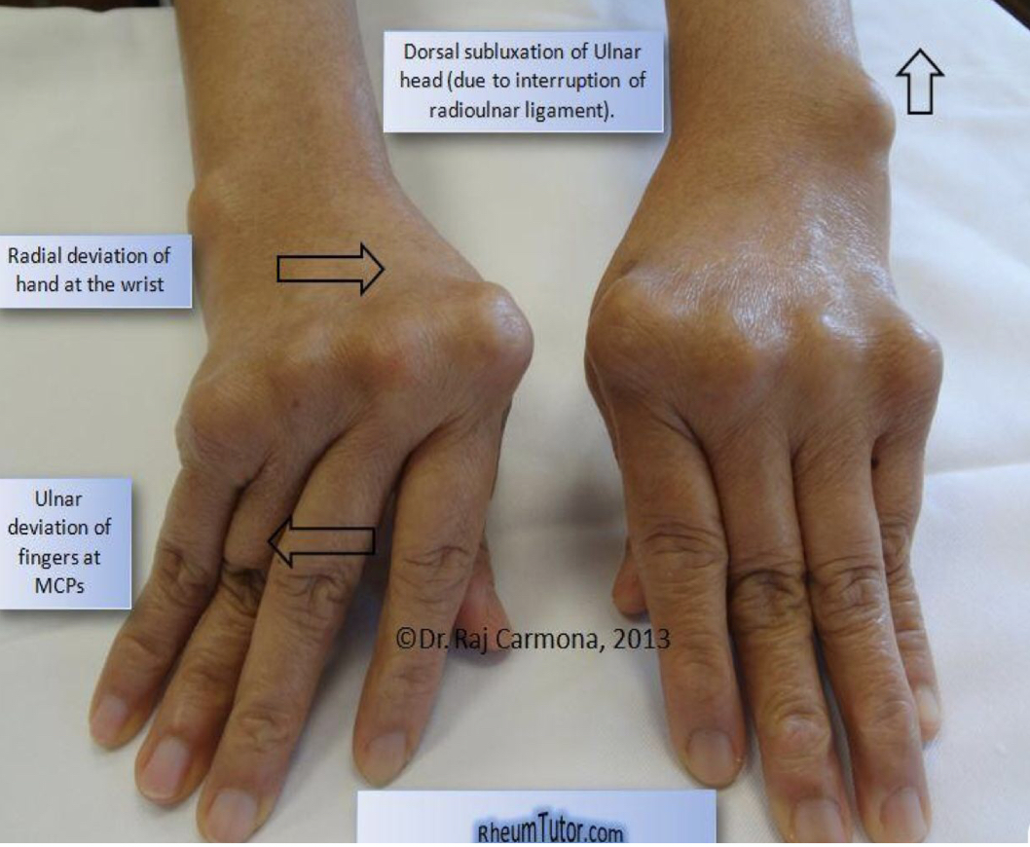
Characteristic Deformities
Boutonniere: PIP ﬂexed and DIP hyperextended
Swan neck: PIP hyperextended and DIP ﬂexed

Slide 24
Clinical Features Of RA
1 | Symmetric arthritis (aﬀecting the small joints: hands and feet, ankles, knees, wrists, elbows, and shoulders)
2 | Axial involvement limited to the upper cervical spine (hip joint involvement uncommon)
3 | More often aﬀected: proximal interphalangeal and metacarpophalangeal joints Less often aﬀected: distal interphalangeal joints
4 | Achiness and stiﬀness of the joints in the morning
5 | Weakness & low grade fever
6 | Joints enlarge as the disease develops, causing limited motion
7 (characteristic deformities) | -Radial deviation at fingers -Radial deviation at the wrist -Flexion and hyperextension deformities of the ﬁngers (swan neck and boutonniere deformities)

Slide 25
X-Ray Patients can show: Prognosis Of RA:
1-Clinical course of RA is highly variable.
2-In a minority of patients, the disease may stabilize or even regress. 3rd
Erosions (breaks in bone)
in most patients RA follows chronic, remitting-relapsing course (periods of improvement and worsening).
3-Progressive joint destruction leading to Corticosteroid
disability after 10 to 15 years.
4-RA is an important cause of reactive Long treatments with TNF antagonists carries amyloidosis, which develops in 5% to risk of infections with organisms such as M. 10% of RA patients, particularly those tuberculosis
with long-standing severe disease.
1-Loss of articular cartilage leading
to narrowing of the joint space
Clinical course of RA is highly variable.
2-Joint eﬀusions
3-Erosions (breaks in bone)

Slide 26
Treatment
1-Coriticosteroids
2-Immunosuppressants eg: Methotrexate,TNF antagonist
3-Long treatments with TNF antagonists carries amyloidosis, which develops in 5% to risk of infections with organisms such as M. 10% of RA patients, particularly those tuberculosis
with long-standing severe disease.

Slide 27
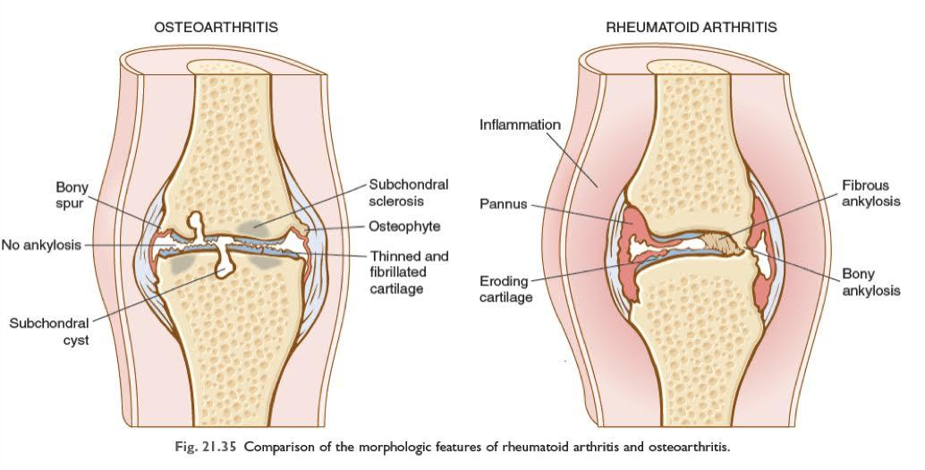
Osteoarthritis vs Rheumatoid Arthritis :
 | Osteoarthritis | Rheumatoid Arthritis
Basic process | Degenerative | Immunologic, inflammatory
Site of initial lesion | articular cartilage | synovium
Age | 50 plus | Any,but peaks at age 20-40
Sex | Males or Females | Females > Males
Joint involved | Especially knees, hips, spine; Asymmetric involvement | hands, later large joints ; Multiple symmetric involvement
Fingers | Heberden’s nodes | Ulnar deviations and spindle swelling
-Less inflammation
-No fusion
-more inflammation

Slide 28
Osteoarthritis vs Rheumatoid Arthritis cont.
 | Osteoarthritis | Rheumatoid Arthritis
Nodules | No | Rheumatoid nodules
systemic features | None | Uveitis, pericarditis, etc.
constitutional symptoms | None | Fever, malaise in some
laboratory findings | None | Rheumatoid factor; high erythrocyte sedimentation rate; anemia, leukocytosis; hyperglobulinemia
joint fluid | Clear, normally viscous; no inflammatory cells | Clear; low viscosity, high protein; neutrophils, some lymphocytes; immunoglobulins, complements, rheumatoid factor

Slide 29
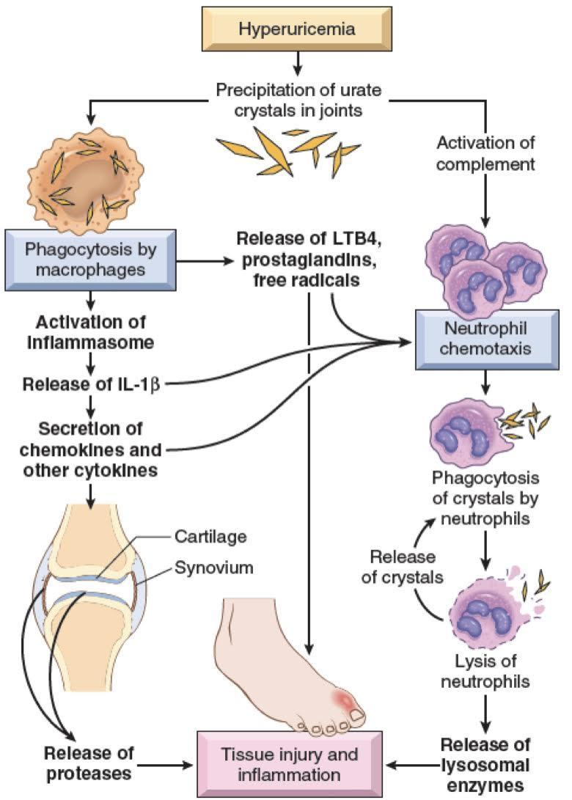
Crystal-induced arthritis
Gout and pseudogout
(Negatively means that
their color is yellow under polarised light)
Negatively birefringent
needle shape crystals
1) Gout (Podagra)
Gout is marked by transient attacks of acute arthritis initiated by urate crystals deposited within and around joints
caused by excessive amounts of uric acid. -Overproduction -Under excretion
affects about 1% of the population, and shows a
predilection for males.
Hyperuricemia (plasma urate level above 6.8 mg/dL) is
necessary, but not sufficient, for the development of gout.
Monosodium urate crystals precipitate from supersaturated
body fluids and induce an acute inflammatory reaction.
Is marked by recurrent episodes of acute arthritis, sometimes accompanied
by the formation of large crystalline aggregates (tophi), and
Eventual permanent joint deformity.
(يكون بكل المفاصل لكن اكثر شي الابهام )

Slide 30
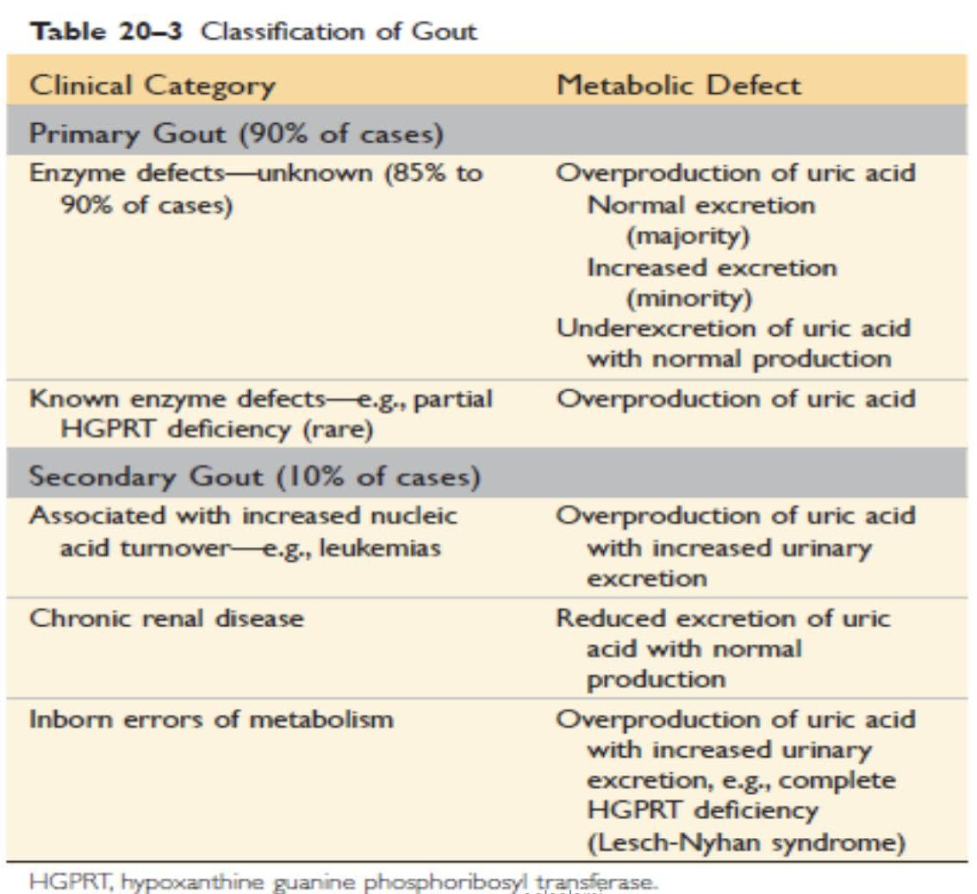
Risk factor:
Types of gout:
-age (more than 30)
-genetic
-obesity
-excess alcohol intake
-consumption of purine-rich foods (like red meat)
-diabetes
-the metabolic syndrome
-drugs
-and renal failure
(Due to mutation or hereditary)
مرضى السرطان مع العلاج الكيميائي تموت الخلايا السرطانية اللي تحتوي على DNA وداخل الDNA فيه الpurine Acid واذا تجمع يصير عنده Uric Acid كثير
(e.g. abnormalities in the kidney, leukemia, etc)
(Tumor lysis syndrome)
(Kidney is not able to get rid of the Uric acid)
(موجود عند اليهود كثير، فيكون عند العرب بعد)
(Uric acid is the end product of a purine catabolism)

Slide 31
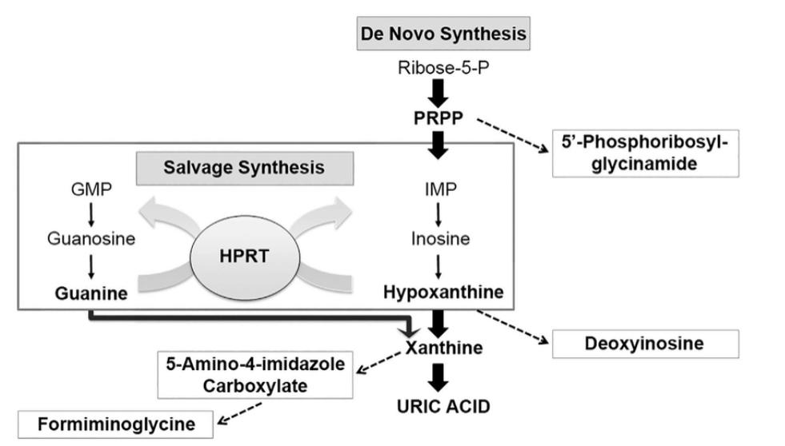
Formation Of Uric Acid
Boy’s slides only
Very similar to
Biochemistry,
Review it to
Understand this
slide.

Slide 32
Morphology:
Acute arthritis
Chronic tophaceous arthritis
TOPHI
Gouty nephropathy (in kidney)
-Dense inflammation in
synovium and synovial Fluid. (Most common in the big toe).
-Crystals in cytoplasm of
neutrophils and synovium.
-Long, slender, needile,
negative birefringence.
- Synovium is edematous
and congested with few
lymphocytes, plasma
cells and macrophages.
- Repetitive precipitation
Of crystals.
- Chalky deposits (from crystals aggregation) in synovium.
- Synovium: hyperplastic,
Fibrotic and thickened by inflammatory cells that form PANNUS destroy the cartilage.
-Large aggregation of urate
crystals surrounded by an
intense of foreign body
giant cell reaction
-Cartilage, ligaments, tendon, bursae are Pathognomonic of gout
-Tophi in the renal medullary
interstitium or tubule
-Uric acid nephrolithiasis(حصوات الكلى) and
pyelonephritis (التهاب الكلى)
Treatment: Lifestyle modification / Reduce symptoms (NSAIDs) / Lower urate level (medications)

Slide 33
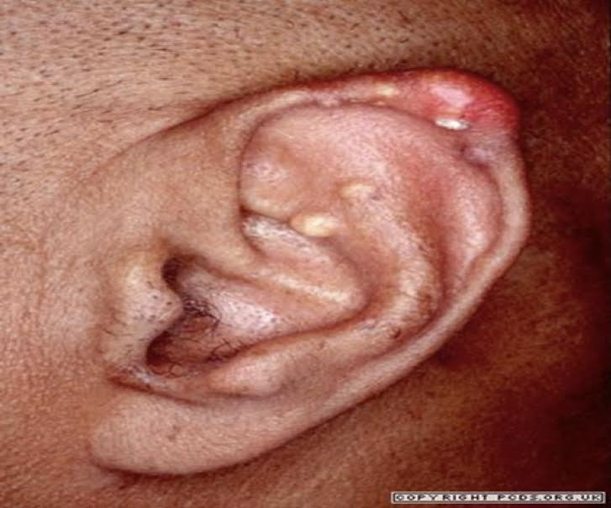
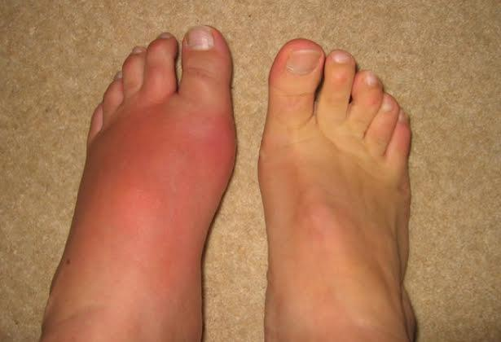
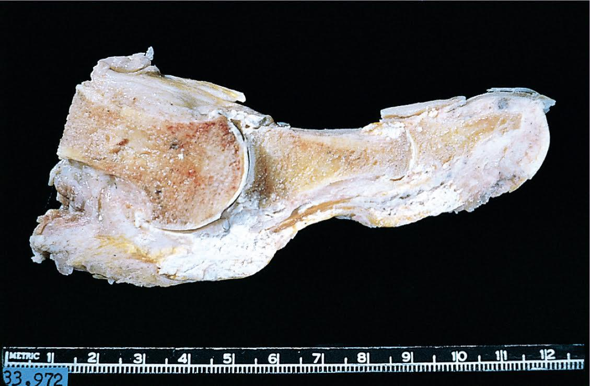
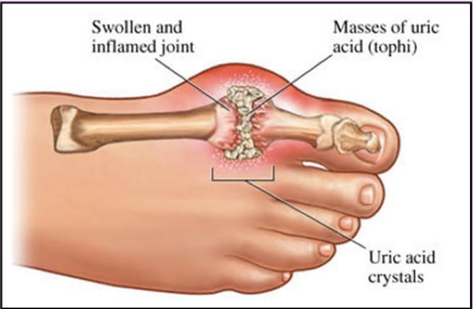
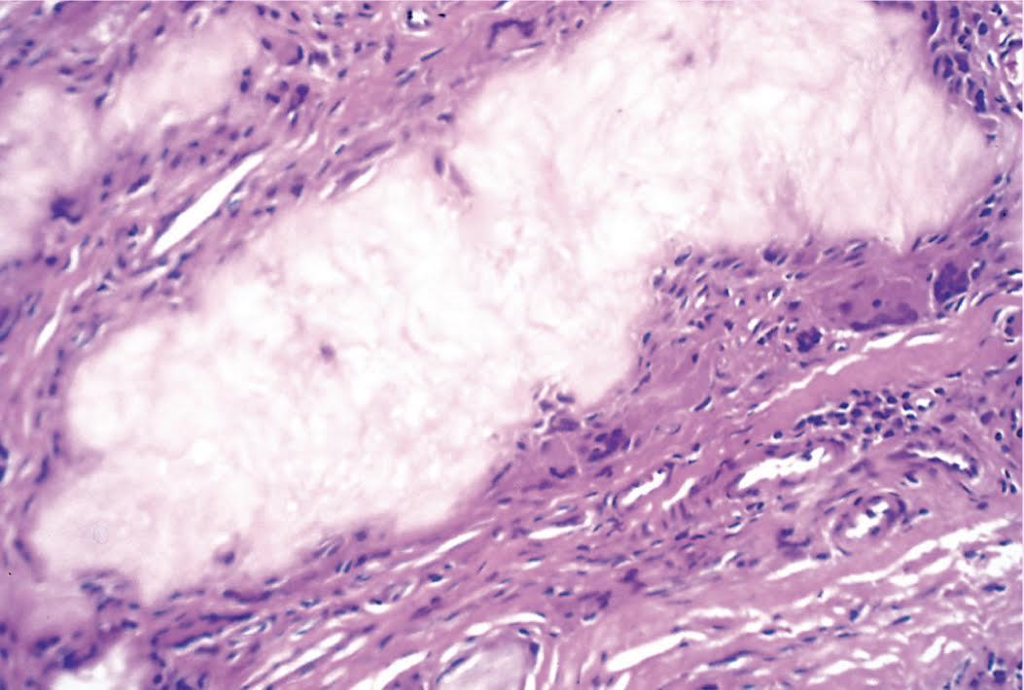
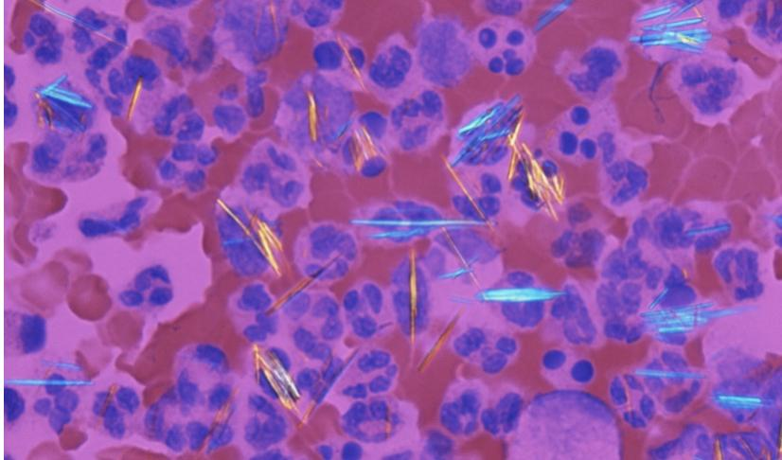
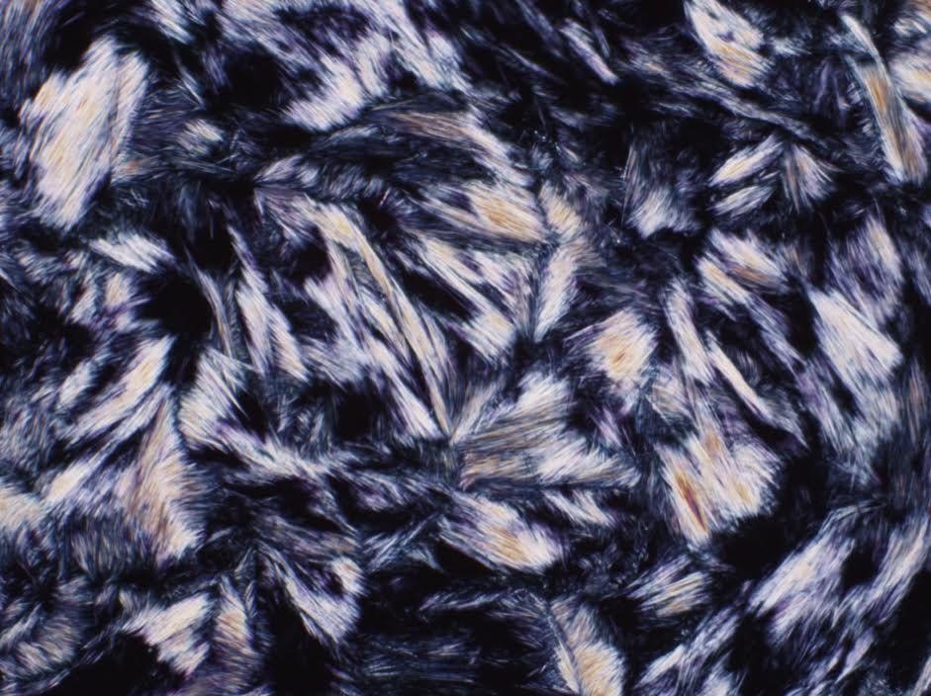
White tophi involving the joint and soft tissues
Clinical features
In boy’s slides
Giant cells
Gouty tophus: aggregations of dissolved urate crystals
surrounded by reactive fibroblast, macrophages,
mononuclear inflammatory cell and giant cells
Urate crystals are needle shaped and negatively
birefringent under polarized light

Slide 34
Clinical Course:
Asymptomatic
intercritical
period
Chronic tophaceous
gout
Asymptomatic
hyperuricemia
Acute arthritis
Men
Around puberty
Women- after
menopause.
(فقط ترتفع الأملاح بالدم بدون اعراض والم)
- Sudden, excruciating
joint pain, hyperemia
( an excess of blood in the vessels), warmth.
-metatarsophalangeal
Joint (50%)
- Last for hours to
Weeks.
(تبدأ الكرستال الان تترسب في المفاصل ويبدأ الالم والاعراض)
- Resolution of acute.
- Symptom free
- if Not treated..
Frequent attacks
and multiple joints.
- 12 years after
Initial attack.
- Radiology..loss
Of joint space.

Slide 35
pseudogout (CPPD)
(calcium pyrophosphate crystal deposition disease)
This condition is due to deposition of CPPD in the synovium (pseudogout) and
articular cartilage (chondrocalcinosis)
The crystals first develop in the articular cartilage (chondrocalcinosis), which is usually
asymptomatic. From here, the crystals may shed into the joint cavity resulting in an acute
arthritis, which mimics gout and is therefore called pseudogout.
It can occur in three main settings:
1) Sporadic ( common in the elderly).
2) Hereditary.
3) Secondary to other conditions, such as previous joint damage,
hyperparathyroidism, hypothyroidism, haemochromatosis and diabetes.

Slide 36
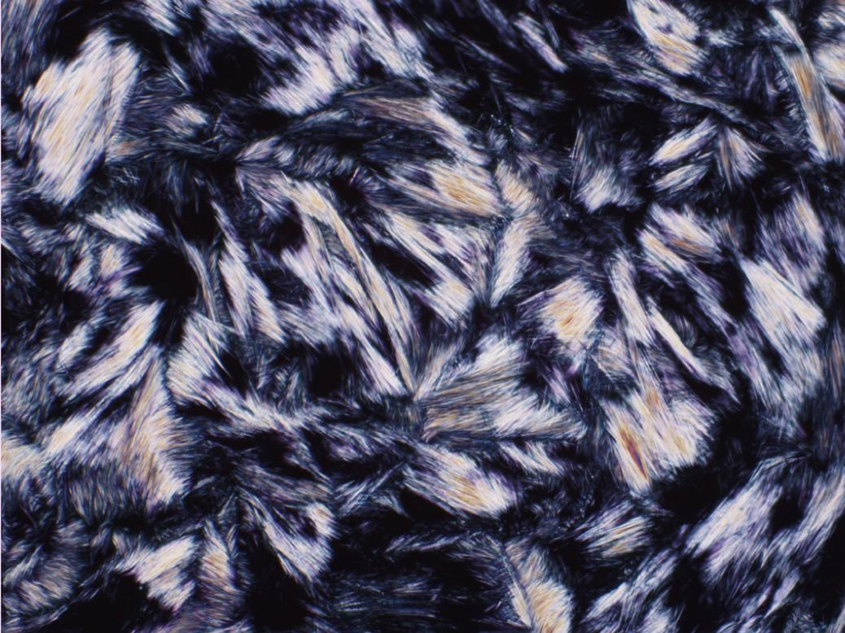
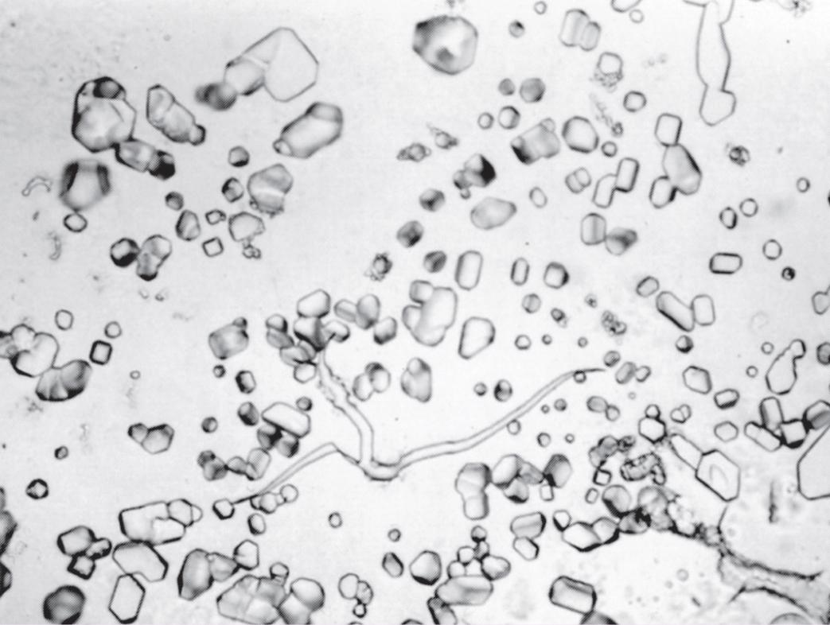
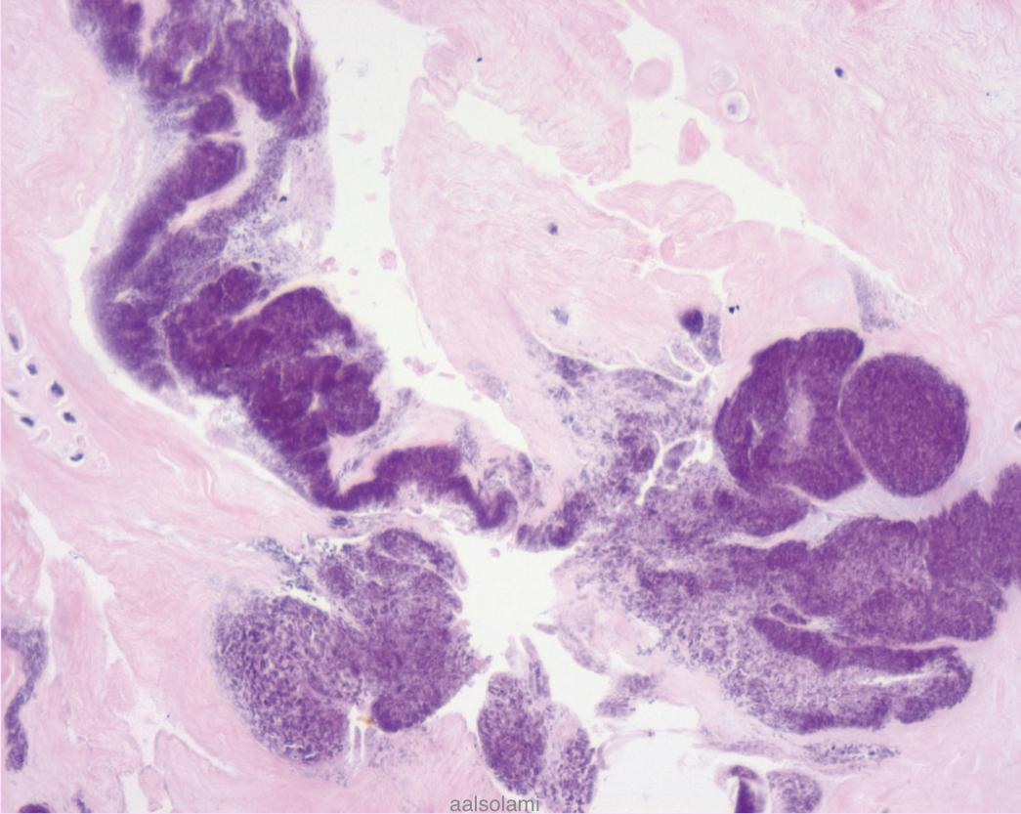
How Pseudogout can be differentiated from gout ?
Thanks to 439
team
Gout | Pseudogout
monosodium urate crystals | calcium pyrophosphate crystals
The most commonly affected site is: first metatarsophalangeal joint | The knee is most commonly involved.(cause it’s articular cartilage)
X-ray doesn’t show the MSU | X-rays show the characteristic line of calcification of the articular cartilage.
Long, slender, needle-shaped monosodium urate crystals | The crystals look different under polarizing microscopy, they are rhomboid in shape positively birefringent.
1-
2-
1-Smear preparation of calcium pyrophosphate crystals.
2-Deposits are present in cartilage and consist of amorphous basophilic material (blue-purple).

Slide 37
MCQs
Q1: An 85-years old man presents with 3-week history of painful swelling of his right knee. Aspiration of joint fluid returns numerous neutrophils and crystals. Chemical
analysis shows that these crystals are composed of calcium pyrophosphate. Which
of the following is the most likely diagnosis?
Q1
1.C 2.B 3. D
A-Ankylosing Spondylitis
B-Gout
C-Pseudogout
D-Rheumatoid Arthritis
A 74-year old obese women complains of chronic pain in her back, knees, and fingers. The pain typically subsides at rest. The distal interphalangeal joint are enlarged and
tender. Which of the following is the best describe the pathogenesis of joint pain in
this patient?
Q2
A-Acute inflammation
of ligament
B-Degeneration of
articular cartilage
C-Degeneration of articular cartilage
D-Reduction of synovial fluid
A 60-years old women with arthritis suffers a massive stroke and expires. At autopsy the
proximal phalangeal joint tissue shows pannus, synovial cell hyperplastic. Which of the
following best describe the pathogenesis of pannus formation in this patient?
Q3
A-Calcification of the
synovium
B-Degeneration of
cartilage
C-Dislocation
of bone
D-Chronic inflammation of synovium

Slide 38
MCQs
A 50-years old man complains of fever and severe pain in his great toe of 23 hours in duration. The pain develop in morning. Laboratory findings hyperuricemia and hyperlipidemia. An aspirate of joint
fluid returns urate crystals and neutrophils. Which of the following would be the most likely
pathologic findings with the periarticular soft tissue of the patient?
Q4
A-Osteophyte
B- Pannus
C-Rheumatoid nodule
D-Tophus
4.D 5.A 6. C 7. C
Q5
A 33-years old man comes to hospital with a swan neck deformity. Which of the following
disease does this deformity belong to?
A-Rheumatoid Arthritis
B- Osteosarcoma
C-Osteochondroma
D-Gout
Q6
is knowing as an osteophytes on the distal interphalangeal joints of the fingers?
A-Bouchard's node
B- RA nodules
C-Heberden’s node
D-Fibrillation
Q7
which of the following factor is mostly linked with the development of Rheumatoid Arthritis?
A-TP53
B- RB
C-HLA-DRB1 locus
D- CKIH3

Slide 39
MCQs
Q8
Which of the following will bind with FC portion of IgG to form immuno complex in RA?
8.B 9.A 10. D
A-IgA
B- IgM
C-IgG
D-IgE
Q9
Which of the following Formed by proliferating synovial-lining cells admixed with inflammatory
cells, granulation tissue, and fibrous connective tissue?
A-Pannus
B- Osteophytes
C-Heberden's node
D-eburnation
Q10
A 60-years old man with history of gout present with multiple rubbery nodules on his hand Which of
the following best explains the pathogenesis of the patient underlying
condition?
A-Autoimmune
Relapsing polychondritis
B- High dietary intake of purine-rich foods
C-Hypercalcemia
D-Impaired renal
excretion

Slide 40
Team members
Team Leader:
Hissa Alshiqari &
Hassan Alabdullatif &
Norah Alrashoud
Ajwan Aljohani
Dena Alsuhaibani
Haifa Alamri
Mashael Alasmri
Omar Alkadhi
Waad abunakha
Abdullah Ali
Tharaa Alhowaish
Khalid Alrasheed
Malik Halees
Nawaf Alrefaei

