Slide 1
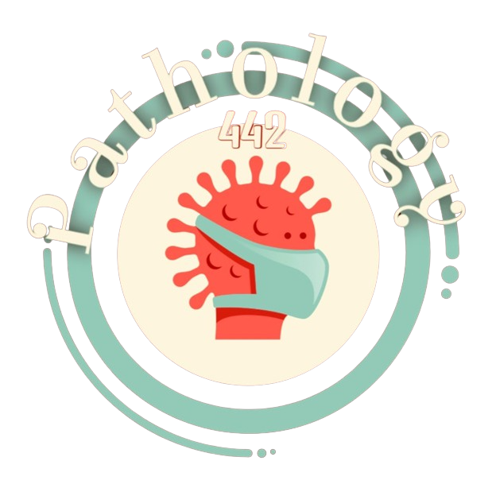
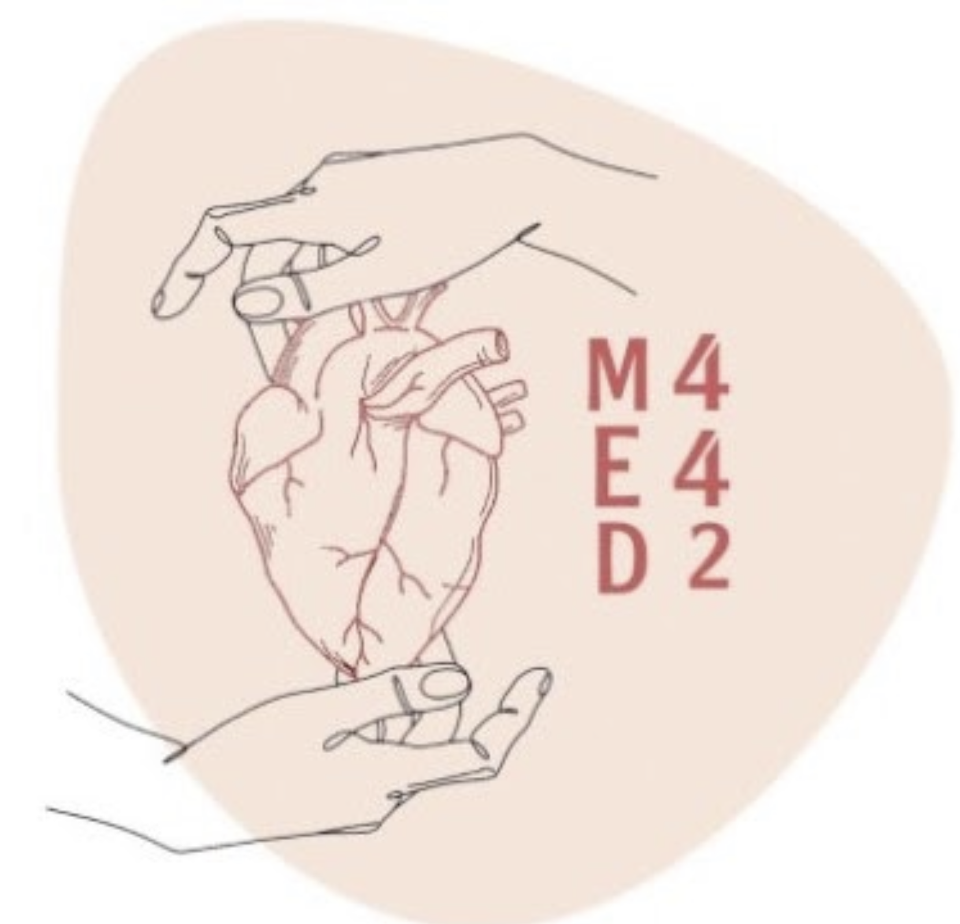
Osteomyelitis and Septic Arthritis
Colour index:
Main text
Important
In girls slides only
In boys slides only
Doctor‘s notes
Extra info.

Slide 2
Objectives
Understand the etiology, pathogenesis and clinical features of
osteomyelitis.
Be familiar with some of the terminology used in bone infections like:
sequestrum, involucrum, Brodie abscess and Pott’s disease.
Understand the clinicopathological features of tuberculous
Osteomyelitis
Identify the bacteria commonly involved in septic arthritis, the
clinicopathological features and the characteristics of the joint fluid

Slide 3
Osteomyelitis
هو inflammation للعظام ولكن يجي بسبب العدوى فيعتبر كأنه complication
Its an Inflammation of bone and marrow, virtually always secondary to infection.
Can be:
part of systemic infection
primary solitary focus of disease.
All organisms: viruses, fungi, parasite, bacteria can produce osteomyelitis but infections that are caused by Pyogenic bacteria
and Mycobacteria are the most common.

Slide 4
Pyogenic Osteomyelitis
IN HEALTHY CHILDREN
● Hematogenous
● develops in Long bones.
● from trivial mucosal injuries, such as may occur during defecation or vigorous chewing of hard foods, or from minor infections of skin
Almost always caused by bacteria and rarely by fungi.
Organisms Reach bone by :
Hematogenous (through the blood) spread
Extension from contiguous site
Direct implantation after compound fractures (the bone is out of the skin) or orthopedic procedures.
IN ADULTS
● As complication of open
fracture, surgical
procedures.
● Ex: Diabetic foot (because of poor blood supply).

Slide 5
Causative Organisms
In almost 50% of suspected cases, no organisms can be isolated.
Positive
80-90% of the cases is caused by STAPHYLOCOCCUS AUREUS
People with GUT infections or IV drug abusers:
E.Coli, pseudomonas,
and Klebsiella
In sickle cell disease (SCD) : salmonella
Neonates : Haemophilus influenzae and Group B.Streptococci
In case of direct spread, during surgery or open fracture:
Mixed bacteria including anaerobes.

Slide 6
Pyogenic
Osteomyelitis stages
Acute
Chronic
•first 48 hours: Bacteria proliferation, neutrophilic inflammatory reaction that cause necrosis of bone cells and marrow
• The bacteria and inflammation spread longitudinally and may percolate throughout the Haversian systems to reach the periosteum
• in Children it causes subperiosteal abscess that will lift the
periosteum and impair blood supply (periosteum loosely attached to cortex).
Subperiosteal abscesses may form that can dissect for long distances along the bone surface
Lifting of the periosteum further impairs the blood supply to the affected region, contributing to the necrosis
• Rupture of periosteum will open a channel on the skin for the abscess to go out as draining sinus.
• Dead bone (SEQUESTRUM).
• Viable organisms can persist in the sequestrum for years after the original
Infection (so sometimes in surgeries, they open the bone and remove the sequestrum because the organisms live in it)
• After first week.. Chronic inflammatory cell release cytokines that stimulate osteoclast bone resorption, ingrowth of fibrous tissue,
deposition of reactive bone at periphery
(shell/INVOLUCRUM).
• Protean.. Marrow fibrosis, sequestrum,
lymphocytes and plasma cell.
-Sequestrum: necrotic bone fragment
(Dead bone)
-Involucrum: periosteal new bone
surrounding a sequestrum

Slide 7
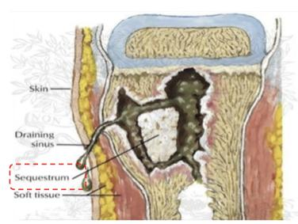
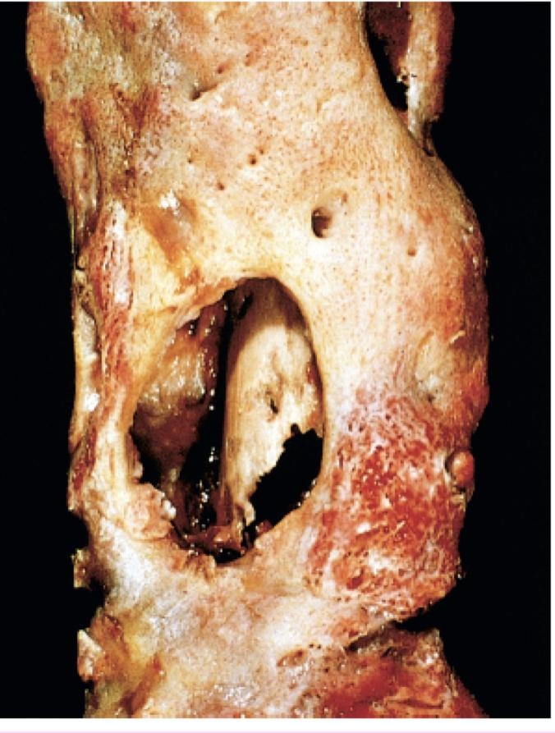
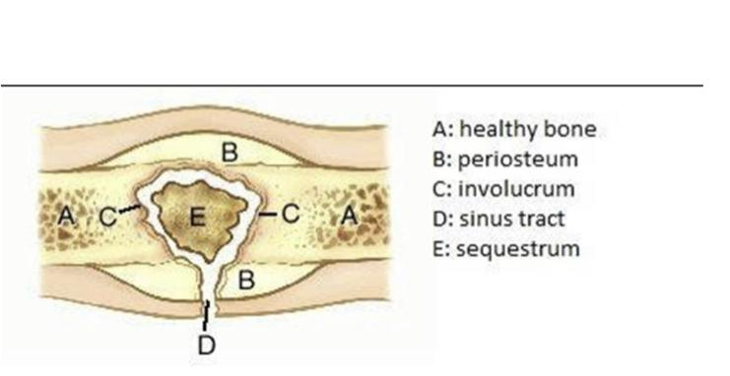
Draining sinus can be present in the skin
The focus of osteomyelitis is in the metaphysics
Chronic Osteomyelitis
Green color is the pus and it’s eating the bone sequestrum
Bacteria can stay here
Femur in person with draining osteomyelitis
Bone becomes deformed.
Rupture to outside of the skin (draining sinus)

Slide 8
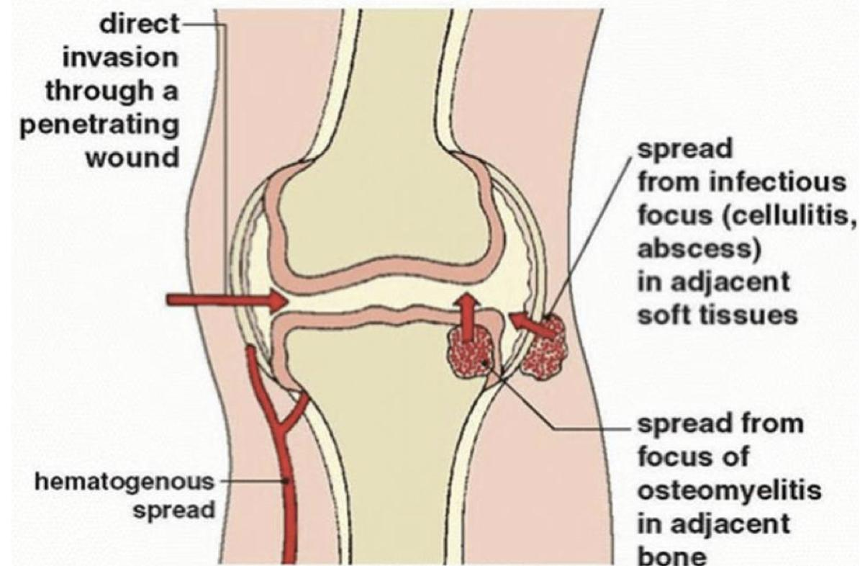
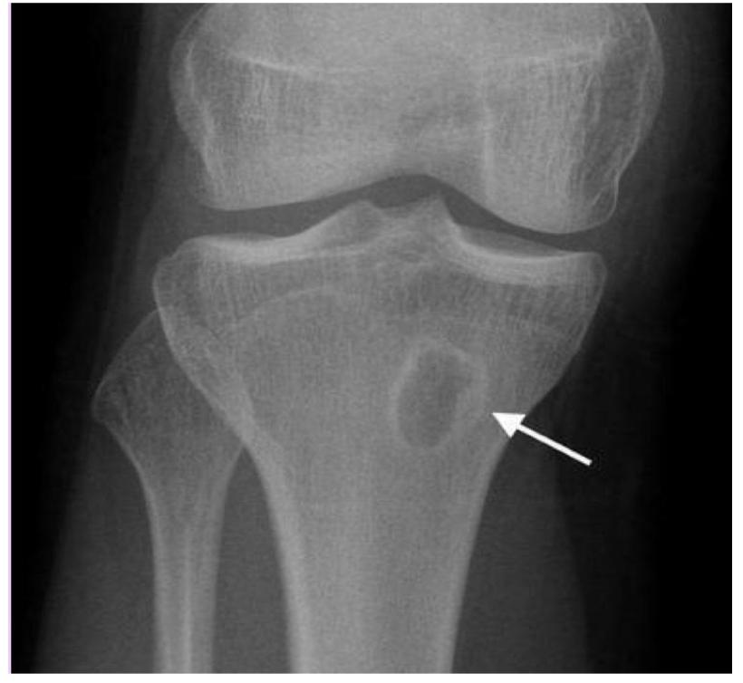
Septic (suppurative) arthritis
If the osteomyelitis is in the epiphysis (this area is very close to the joint) so the infection can spread from the bone to the joint , here we call it septic arthritis.
One of the most complications of
osteomyelitis.
Infants (uncommon in adults).
Infection of epiphysis will spread to
articular surface or along the capsule (tendoligamentous insertion) into a Joint producing septic / suppurative arthritis.
Cause destruction to the articular cartilage and permanent disability.
• An analogous (similar) process can involve vertebrae, with an
infection destroying intervertebral discs and spreading
into adjacent vertebrae.
• Brodie abscess is a small intraosseous abscess that
frequently involves the cortex.
Patient usually complains of pain.
Brodie abscess
يعني ممكن العمود الفقري يصير له مثل اللي صار مع المفاصل septic (suppurative) arthritis

Slide 9
Clinical features:
Acute systemic illness with malaise, fever, chills, leukocytosis, and marked throbbing pain over the affected region.
1st
Malaise : Discomfort
or illness.
Subtle, with only unexplained fever (infants) or localized pain (adults).
2nd
Diagnosis rely on :
1- Signs and symptoms.
2- Radiology ( lytic focus of bone destruction surrounded by a zone of sclerosis ).
3- Biopsy.
4- Bone culture.
Treatment:
-requires aggressive antibiotic therapy.
-Inadequate treatment of acute
osteomyelitis may lead to chronic
osteomyelitis which is notoriously
difficult to manage.
- Surgical removal of bony tissue may be required.
نستخدم مضادات حيوية لأن pyogenic osteomyelitis جاي من عدوى بكتيرية.
Sclerosis means hardening عشان كذا في مرض التصلب اللويحي المتعدد اسمه
Multiple sclerosis

Slide 10
Chronic osteomyelitis
The course of chronic infections may be punctuated by acute flare-ups; these are usually spontaneous and may occur after years of dormancy
Acute flare-ups(انتكاسات)has COMPLICATIONS :
extensive bone necrosis
weakened
host
defenses.
inadequate antibiotic therapy
Pathologic fracture
Rarely
sarcoma in the
affected bone
inadequate
surgical
debridement
Secondary amyloidosis
delay in
diagnosis
Sepsis
5-25% Causes of this percentage:
Squamous cell carcinoma
if the infection creates a sinus tract
Endocarditis

Slide 11
2-Mycobacterial Osteomyelitis
Routes of entry:
Usually blood borne and originate from a focus of active visceral disease.
Direct extension (e.g. from a pulmonary focus into a rib or from tracheobronchial nodes into adjacent vertebrae) or spread via draining lymphatics.
● The bone infection may persist for years before
being recognized.
● Approximately 1% to 3% of individuals with
pulmonary or extrapulmonary tuberculosis exhibit
osseous infection.
● Symptoms: pain, low-grade fever, chills, weight loss.
● Usually solitary except in immunocompromised
patients (AIDS).
● Caseous necrosis and granuloma are typical.
● It tend to be more destructive and resistant to
control compared to pyogenic osteomyelitis.
● The most common sites of skeletal involvement are: thoracic and lumbar vertebrae
(40%) followed by the knees and hips
● Pott’s disease is the involvement of spine.

Slide 12
Histopathology of tuberculous osteomyelitis collections of epithelioid histiocytes and lymphocytes with caseation necrosis
Ziehl Neelsen stain
(special for AFB)
Giant cells
Lymphocytes
Tuberculous osteomyelitis in patients with AIDS frequently multifocal.

Slide 13
Pott’s disease
Psoas abscess
The infection breaks through the
intervertebral discs and extends into the
soft tissues forming abscesses
The infection may breaks through the intervertebral discs and extends into the muscle forming Psoas abscess
Is the involvement of spine (tuberculosis of spine).
Complications:
• Destruction of discs and vertebrae results in
• Compression fractures that produce scoliosis or kyphosis
• Neurologic deficits secondary to spinal cord and nerve compression
• Tuberculous arthritis
• Sinus tract formation
• Psoas abscess
• Amyloidosis

Slide 14
Infectious Arthritis
1.microorganisms,
all types can seed
(infect) joint during
hematogenous
dissemination
(spreading through
blood)
5.usually (in order):
knee then, hip,
shoulder,elbow,
wrists, and
sternoclavicular
joints
7.Articular
structure can also
Become infected by direct
inoculation or from
contiguous spread from a
Soft-tissue abscess or
focus of osteomyelitis
9.Can be caused by bacterial (commonest), fungal, and viral infections
3.culture allows
identification of
causal agent
2.is potentially
serious (because
of rapid
destruction of the
joint producing
permanent
deformities)
4.involves only
a single joint
in 90% of nongonococcal cases
6.joint
aspiration is
typically
purulent.
8.Infection of one or more joints by microorganisms

Slide 15
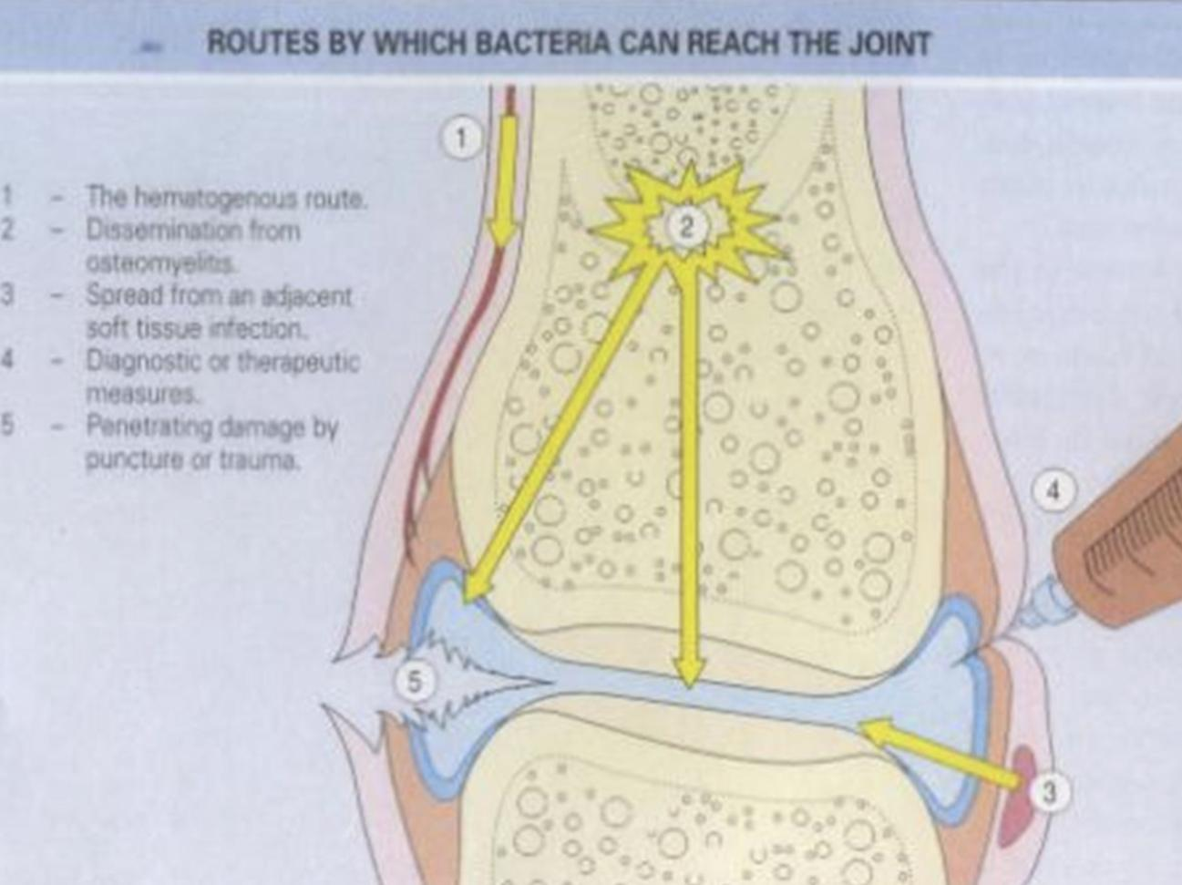
Routes of infection:
Hematogenous
contiguous spread from osteomyelitis
Iatrogenic
contiguous spread from soft-tissue abscess
Direct inoculation through skin (trauma)
In neonates, contiguous spread from underlying epiphyseal
osteomyelitis may occur

Slide 16
Bacterial infections almost always cause an acute suppurative arthritis
any bacteria can be casual:
prevalent during
late adolescence and young adulthood.
Sexually active
women
Disseminated gonococcal infection in individuals with deficiencies of complement
components ( C5,C6,C7
or C9)
main causative agents in
older children and adults
more prone to
Infect individuals with sickle cell disease at any age
prominent in children under
2 years of age
haemophilus
influenzae
S.aureus
gonococcus
salmonella

Slide 17
Joint
trauma
Debilitating
illness
Risk factors
Immune Deficiencies
(congenital &
acquired)
Intravenous drug
Abuse (axial joints)

Slide 18
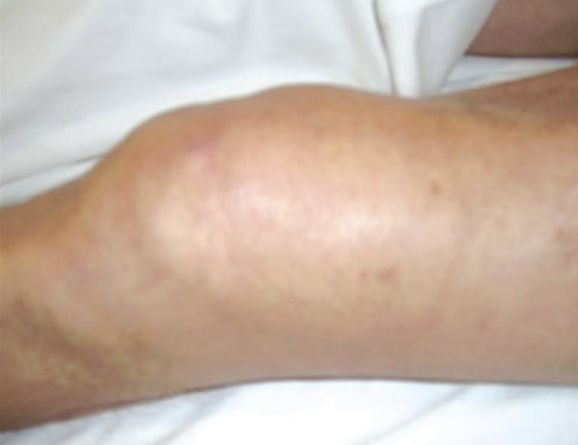
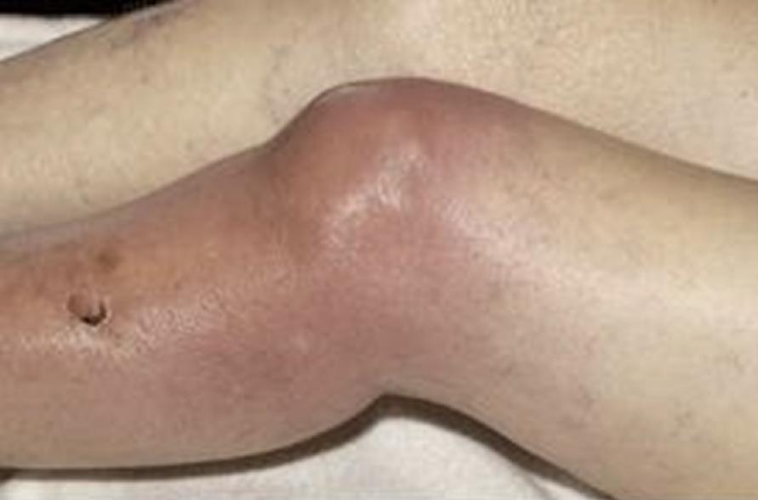
Clinical features:
Infection arthritis is
potentially
serious,because it can
cause rapid
destruction of the
joint & produce
permanent
deformities
1-sudden onset of pain
2-warmth, redness & swelling of the joint with restricted range of motion
3-fever, leukocytosis, and elevated
erythrocyte sedimentation rate
Infectious arthritis must be rapidly
diagnosed and treated promptly to
prevent irreversible and
permanent joint damage.
4-Cartilage has limited repair potential, so prompt recognition and effective anti-microbial therapy is vital to prevent permanent joint
destruction
Complications
septic arthritis can
lead to ankylosis and
even fatal septicemia.
however, prompt antibiotic therapy and joint aspiration or septicemia drainage cures most patients.

Slide 19
MCQs
patient came to orthopedist ,upon examination pt tell you i have pain in my leg bone
then you refer her to pathology lab and pathology lab report bacteria,neutrophil and
sequestrum . What is the most likely diagnosis?
Q1
A-Acute pyogenic
osteomyelitis
B-Chronic pyogenic osteomyelitis
C-Septic
arthritis
D-Mycobacterial
osteomyelitis
1.A 2.A 3. C 4. D
Q2
in previous question what is the most likely organism cause this condition ?
A-Staph aureus
B-E.coli
C-Salmonella
D-Klebsiella
Q3
what is the most complication of previous case?
A-SCD
B-Chronic pyogenic
osteomyelitis
C- Septic
arthritis
D-Mycobacterial
osteomyelitis
Q4
patient came to neurosurgeon complain from pain in her back,x-ray show psoas abscess involve
intervertebral disc. What is the most likely diagnosis?
A- Acute pyogenic
osteomyelitis
B- Chronic pyogenic
osteomyelitis
C-Septic
arthritis
D-Pott's
disease

Slide 20
MCQs
A 5 year old girl is brought to the clinic one day after she develops a fever and has increasingly severe left knee pain/swelling. Her parents explain she was unable to sleep last night due to the severity of the pain. She is unable to bear weight on her left leg in the clinic, and appears visibly uncomfortable. Her temperature is 102.0°F, pulse is 115min, respirations are 26/min, and her blood pressure is 100/55 mm Hg. A physical exam reveals a swollen, red, warm, and tender left knee. The patient constantly keep the knee bent during the exam. She refuses to move the knee and resists passive movement of the knee.
The rest of the physical exam is non contributory. What is the likely diagnosis?
5.C 6.A
Q5
A-Acute pyogenic
osteomyelitis
B-Chronic pyogenic
osteomyelitis
C-Septic
arthritis
D-Mycobacterial
osteomyelitis
Q6
what is the treatment of previous case?
A-Aggressive
antibiotic
B-NSAIDs
C-Direct cholinergic
drugs
D-Indirect cholinergic
drugs

Slide 21
MCQs
A 26 year-old female is seen for evaluation of diffuse polyarthralgias that began one week ago. At the time, she developed a flu-like illness with joint pain and low grade fever. She noticed a skin rash
over her face which resolved after 4 days. Her joints still continue to ache, particularly her
fingers, wrists, and feet, what is the most likely diagnosis?
Q7
A-Infectious
arthritis
B-Chronic pyogenic
osteomyelitis
C-Septic
arthritis
D-Pott's
disease
7.A 8.A 9. C 10. D
Q8
what is the most complication of previous condition ?
A-Septic arthritis
B-Pott's disease
C-Chronic osteomyelitis
D-Acute osteomyelitis
Q9
what is the treatment of previous case?
A-Antibiotic
B-Joint aspiration
C- Septicemia drainage
D-A,B and C
Q10
what is the most clinical features you may confirm your diagnosis of previous
case?
A- Elevated ESR
B- Redness and swelling of joint
C-Hyperpyrexia
D-A,B and C

Slide 22
Team members
Team Leader:
Hissa Alshiqari &
Hassan Alabdullatif &
Norah Alrashoud
Ajwan Aljohani
Dena Alsuhaibani
Haifa Alamri
Mashael Alasmri
Omar Alkadhi
Waad abunakha
Abdullah Ali
Tharaa Alhowaish
Khalid Alrasheed
Malik Halees
Nawaf Alrefaei

