Slide 1
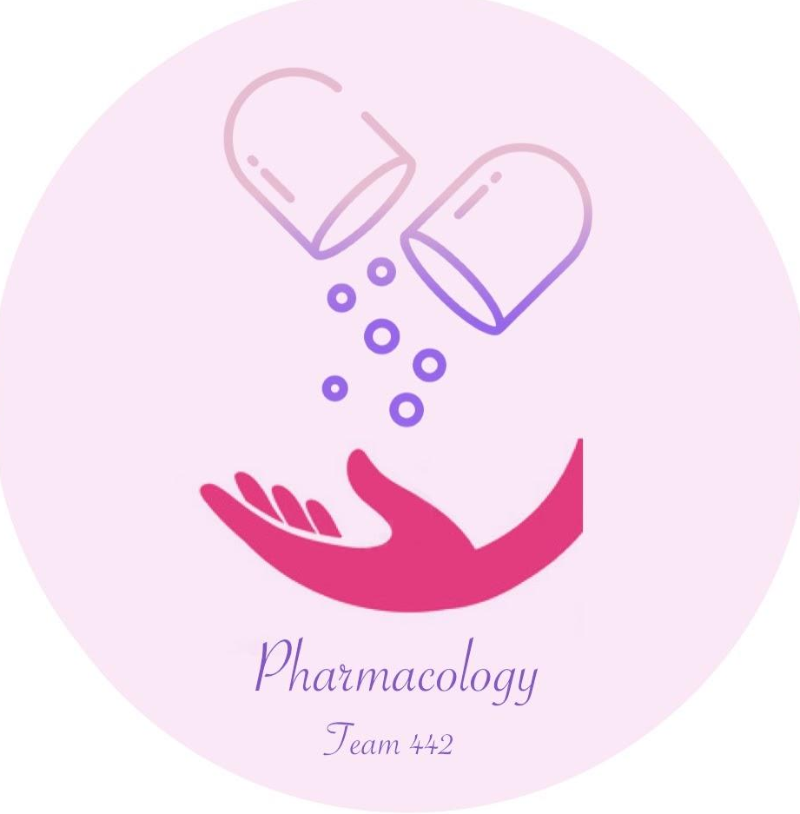
Muscle Relaxants
Important
Main text
Male slide
Female slide
Extra info
Doctor notes
EDITING FILE

Slide 2
Learning Objectives
By the end of this lecture, students should be able to:
Identify classification of skeletal muscle relaxants.
Describe the pharmacokinetics and dynamics of neuromuscular relaxants.
Recognize the clinical applications for neuromuscular blockers.
Know the different types of spasmolytics.
Describe the pharmacokinetics and dynamics of spasmolytic drugs.
Recognize the clinical applications for spasmolytic drugs.

Slide 3
Skeletal muscle relaxants (SKM relaxants):
Are drugs used to induce skeletal muscle relaxation.
Classification of SKM relaxants
(Classified according to side of action)
Peripherally acting
Centrally acting
Direct acting
(Acts on neuromuscular junction)
(Acts on CNS)
(Directly acting on muscle fibers)
e.g.
Baclofen
Diazepam
e.g.
Dantrolene

Slide 4
Neuromuscular Blockers Classification (Peripherally acting)
Competitive (non depolarizing blockers)
Depolarizing blockers (non competitive)
E.g.
d-tubocurarine (prototype)
Atracurium
Mivacurium
Pancuronium
Vecuronium
Rocuronium
E.g.
Succinylcholine
Depolarizing muscle relaxants act as acetylcholine (ACh) receptor agonists, whereas nondepolarizing muscle relaxants function as competitive antagonists.

Slide 5
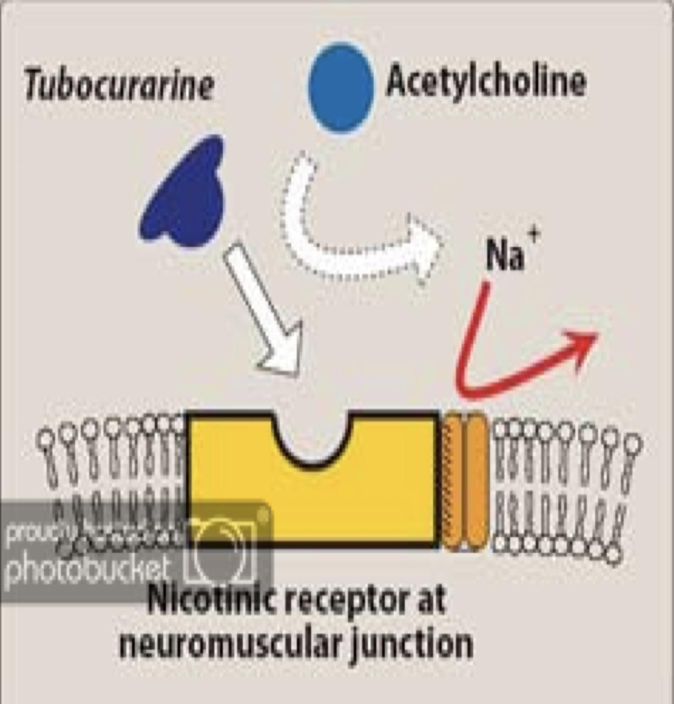
Peripheral acting SKM Relaxants (neuromuscular blockers)
Neuromuscular blockers | Act by blocking neuromuscular junction or motor end plate leading to Skeletal muscle relaxation.
 | Mechanism of action | Are competitive antagonists for Ach at the nicotinic receptors present in post junctional membrane of neuromuscular junction or motor end plate. No depolarization of post junctional membrane (non depolarizing). Action can be reversed by increasing by cholinesterase inhibitors (neostigmine) which increase Ach concentration at motor end plate. Acetylcholinesterase (AchE) breaks down or hydrolyzes Ach, so AchE inhibitors will increase Ach concentration.
 | Drugs If the drug ended with curium or curonium it means that it is a SKM relaxant acting peripherally and mainly competitive | Long action: -D-tubocurarine (prototype). First muscle relaxant used clinically -Pancuronium | Intermediate action -Atracurium -Vecuronium -Rocuronium | Short acting: -Mivacurium
Important
Competitive blocker
(non depolarising)
Peripherally acting

Slide 6
 | Pharmaco-kinetics | They are polar compounds. Inactive orally & taken parenterally. Do not cross BBB (no central action). Do not cross placenta. (can be used for pregnant women) Metabolism depend upon kidney or liver. EXCEPT: Mivacurium (degraded by acetyl cholinesterase). Atracurium (spontaneous degradation in blood).
 | Pharmaco- Logical action | Skeletal muscle relaxation (Small rapidly contracting muscles of face, eyes ,fingers ,neck ,trunk muscle ,intercostal muscles,diaphragm). Recovery comes from REVERSE MANNER starting with diaphragm, Last is face and eyes. They produce different effects on CVS (cardiovascular system). Some release histamine and produce hypotension. d-Tubocurarine (sever release of histamine) Atracurium Mivacurium Others produce tachycardia (Increase Heart rate) Pancuronium
Competitive blocker
(non depolarising)
Peripherally acting

Slide 7
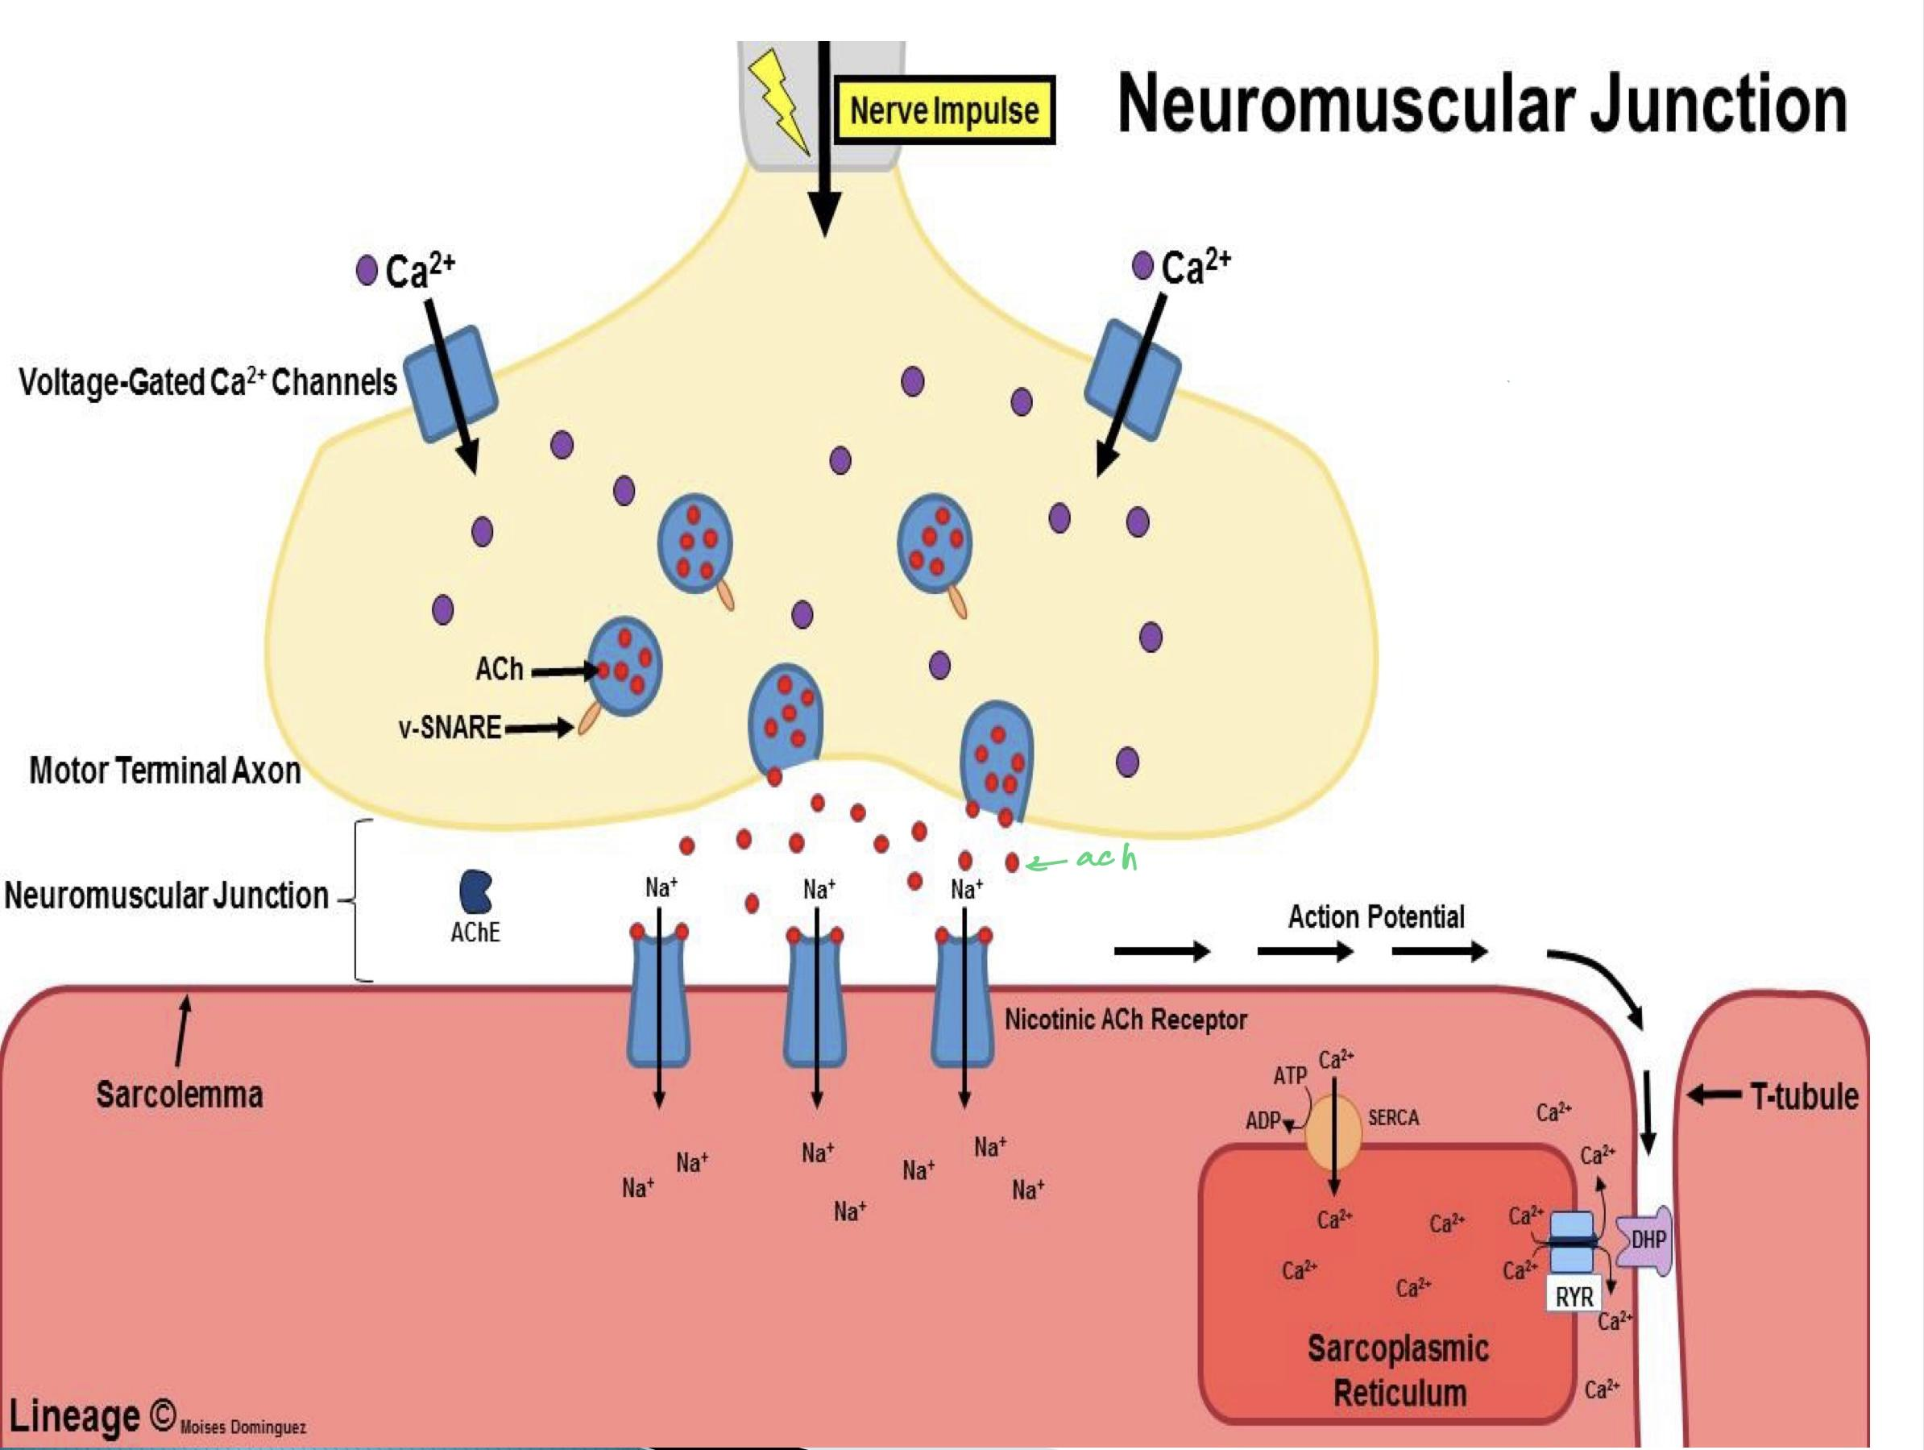
Mechanism of action of neuromuscular blockers (extra explanation) Normally in the neuromuscular junction, the acetylcholine will attach with the acetylcholine receptors (in skeletal muscle the receptors) are nicotinic receptors type 1 after that a lot of changes will happen so that the muscle contracts. However, the Neuromuscular blockers will block the nicotinic receptors so acetylcholine cannot bind with the receptors, thus, preventing its action (muscle contraction) and if the muscle won’t contract it’ll relax Thanks to Team441

Slide 8
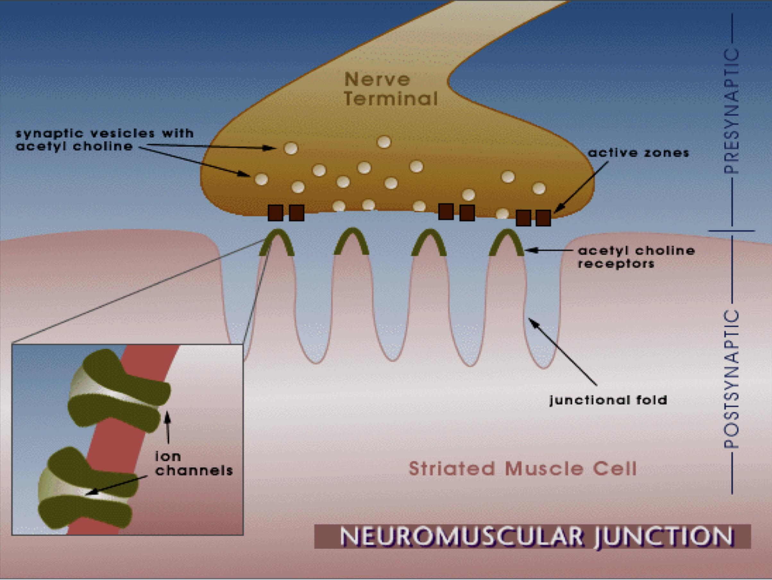
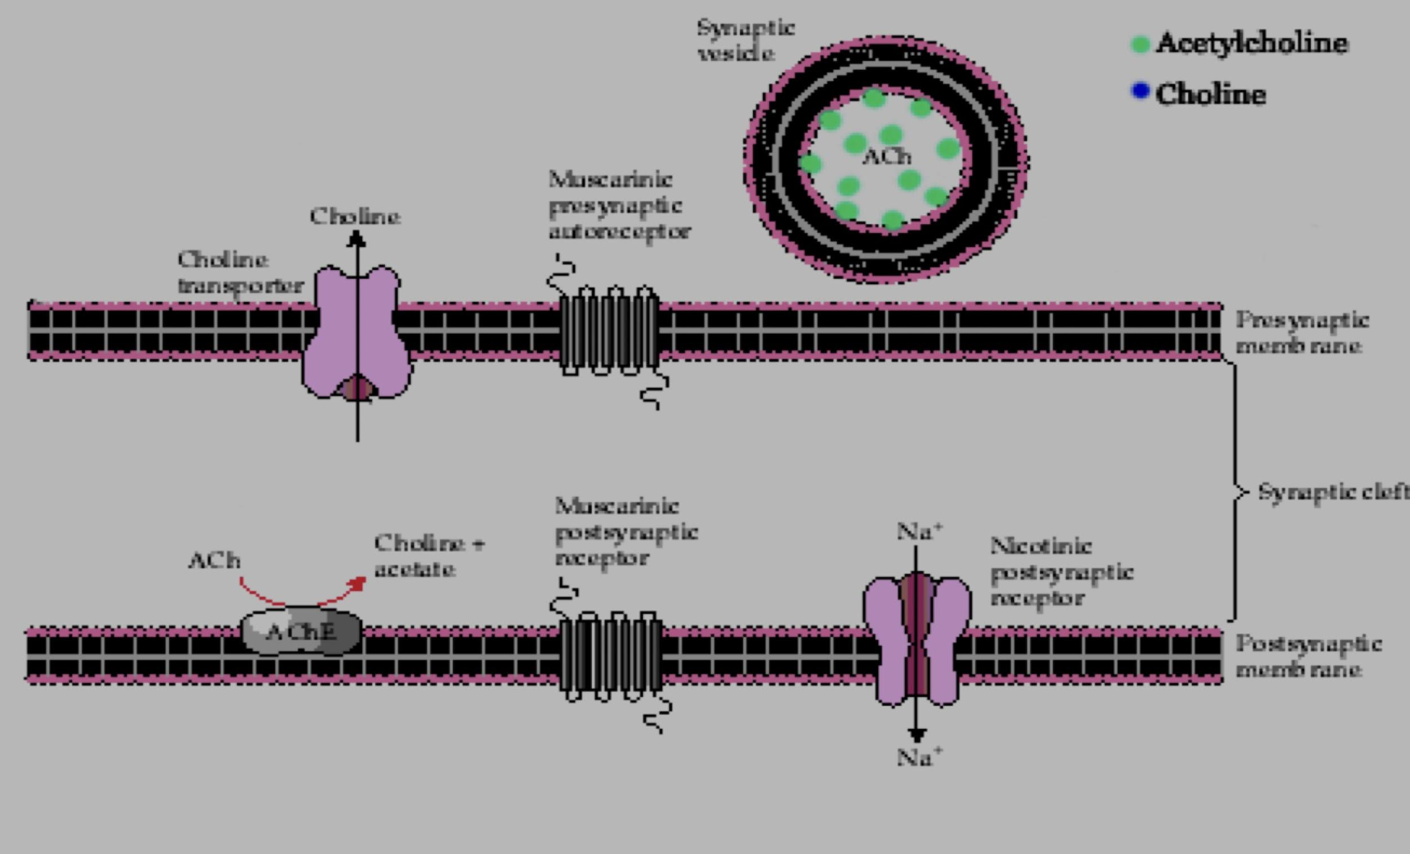
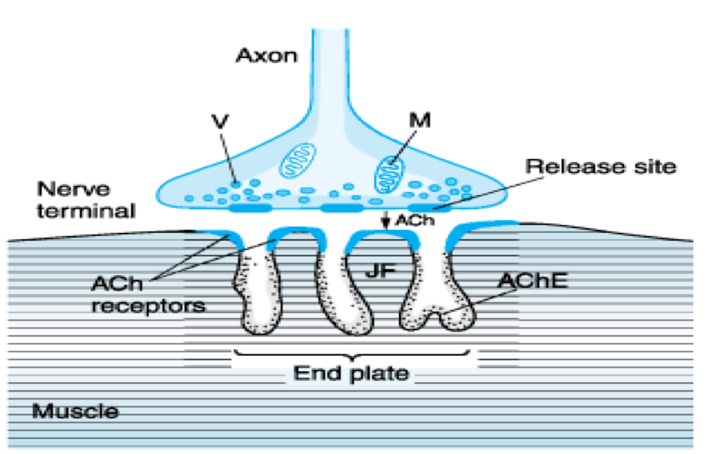
Neuromuscular junction
In boys slide
helpful video:
(mnemonic for non depolarizing NMBs)

Slide 9
 | Duration | 1-2 Hours ( long duration ) (if the excretion mainly in the Kidney( high percentage) this means long duration of action). All of them have relatively short half life
 | Metabolism and excretion | Eliminated by kidney 60% - 40% liver
 | Side effects | Histamine releaser leading to: Bronchospasm (constriction of bronchial smooth muscles) Hypotension (Blocks autonomic ganglia) Tachycardia
 | Uses | Not used clinically due to adverse effects. (side effects)
 | Contraindication (not good for) | ——
 | Potency | ——
 | Notes | More safer derivatives are now available to be used in clinical settings.
1-D-Tubocurarine

Slide 10
 | Duration | 30 min (intermediate duration)
 | Metabolism and excretion | Eliminated by non enzymatic chemical degradation in plasma (spontaneous hydrolysis at body pH) no enzymes involved يفكك نفسه
 | Side effects | Transient hypotension (due to histamine release), bronchospasm.
 | Uses | Used in liver failure and kidney failure (drug of choice)
 | Contraindication (not good for) | Asthmatic patients because it releases histamine leading to bronchospasm
 | Potency | As potent as curare (1.5)
 | Notes | Anti-histamine pretreatment may prevent these side effects. No effect on muscarinic receptor nor ganglia.
2- Atracurium

Slide 11
 | Duration | 15 min (The shortest duration) of all competitive neuromuscular blockers.
 | Metabolism and excretion | Fast onset of action Metabolized by pseudo cholinesterases.
 | Side effects | Transient hypotension (due to histamine release).
 | Uses | Used with liver or kidney failure patients. (Mivacurium & Atracurium don't depend on the kidney or liver for metabolism. Remember?)
 | Contraindication (not good for) | Longer duration in patient with liver disease (enzymes come from the liver, so liver diseases will prevent forming the enzyme that metabolize this drug) or genetic cholinesterase deficiency or malnutrition (lead to protein deficiency which is important to form enzymes)
 | Notes | Chemically related to atracurium Mivacuriuam induced prolonged muscle paralysis. can be reversed by acetycholinesterase inhibitors such as endrophonium. acetycholinesterase inhibitors increase the Ach level in NMJ and displace Mivacuriam from nicotinic receptors in NMJ.
Dr’s note:
Enzyme present in plasma that breaks down any ester
3-Mivacurium
Important

Slide 12
 | Duration | Long duration of action (metabolic products have some NM blocking activities)
 | Metabolism and excretion | Metabolized in liver and excretion by the kidney(80%) (renal)
 | Side effects | Hypertension, tachycardia. Increase norepinephrine release from adrenergic nerve endings. Antimuscarinic action (block parasympathetic action, atropine-like action) Blocks muscarinic receptor in SA sinoatrial node.
 | Uses | ——-
 | Contraindication (Not good for) | Patient with coronary diseases
 | Potency | More potent than curare (6 times)
 | Notes | ——-
4- Pancuronium

Slide 13
 | Duration | Intermediate duration
 | Metabolism and excretion | Metabolized mainly by liver. Excretion mainly in bile.
 | Advantages | No histamine release. No tachycardia. No atropine like actions. (No antimuscarinic action) No ganglion block.
 | Uses | Good for patients with renal failure because its excreted by the bile good for cardiac patients because it has no antimuscarinic effect (no release of norepinephrine therefore no tachycardia) Team439
 | Contraindication (not good for) | Liver failure patients since its metabolised by the liver and excreted in the bile
 | Potency | More potent than tubocurarine ( 6 times ).
5- Vecuronium

Slide 14
 | Duration | intermediate duration
 | Metabolism and excretion | Biliary excretion
 | Advantages | No histamine release. No tachycardia. No vagal blockade (No atropine like actions)
 | Uses | ——-
 | Contraindication (not good for) | ——-
 | Potency | ——-
ONLY IN GIRL SLIDES
6- Rocuronium

Slide 15
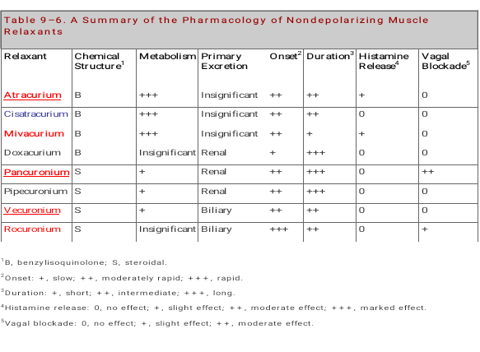
ONLY IN BOY SLIDES

Slide 16
 | Mechanism of action | Phase I: combine and active with nicotinic receptor in post-junctional membrane of neuromuscular junction initial depolarization of motor end plate muscle twitching. Phase II: Persistent depolarization Skeletal muscle relaxation paralysis (Phase II clinically resembles non-depolarizing muscle relaxants) helpful video
 | Drugs | Succinylcholine (suxamethonium)
 | Pharmacokinetics | Fast onset of action (1 min) Short duration of action (5-10 min.). Metabolized by pseudo-cholinesterase in plasma. Half life is prolonged in: Neonates (Low enzymes) Elderly (Liver function declined due to aging) Pseudo-cholinesterase deficiency (liver disease or malnutrition or genetic cholinesterase deficiency).
Depolarizing Peripherally Acting

Slide 17
 | Pharmacological action | ● Skeletal muscles: initial twitching relaxation Side effect: ● Hyperkalemia (due to muscle contraction): Cardiac arrest. ● CVS: arrhythmia ● Eye: intraocular pressure (due to contraction of extra-ocular muscle). ● Fasciculation Spastic paralysis. ● GIT: intragastric pressure regurgitation of gastric content to esophagus.
 | Contraindication (not good for) | ● Glaucoma (high eye pressure ) ● Patient with cardiac diseases
 | Side effects | ● Hyperkalemia (elevated levels of potassium in the blood serum) ● CVS arrhythmia ● Intraocular pressure contraindicated in glaucoma ● Can produce malignant hyperthermia (severe muscle contraction) ● May cause succinylcholine apnea* due to deficiency of pseudo-cholinesterase by liver disease, Malnutrition. ● Organophosphorus poisoning (acetylcholinesterase inhibition).(will increase the Ach in the body)
Depolarizing Peripherally Acting
*Prolonged apnea and paralysis can occur with succinylcholine and mivacurium in case of plasma cholinestrase deficiency.

Slide 18
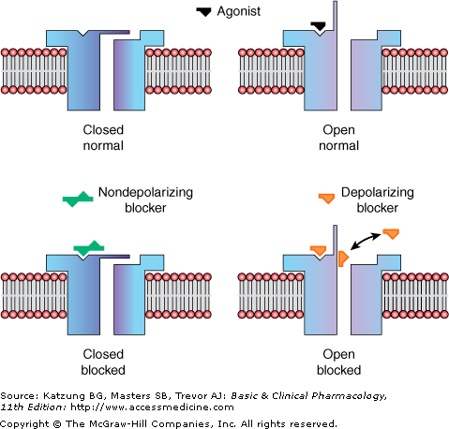
Mechanism of non-depolarizing and depolarizings muscle relaxants
ONLY IN BOY SLIDES
e.g Atracurium
Succinycholine

Slide 19
What is the Mechanism of this disease?
Is a rare inherited condition that occurs due to inability to bind calcium by sarcoplasmic reticulum in some patients due to genetic defect.
Increase Ca release lead to: muscular rigidity(spasm),metabolic acidosis tachycardia, hyperpyrexia. (hyperthermia)
Is a rare bizarre inherited condition of having body temperature greatly above normal Is an example of Idiosyncrasy*
Malignant hyperthermia
When did it occurs?
It occurs upon administration of drugs as (Sensitive to some drugs):
● general anesthesia e.g. halothane
● neuromuscular blockers e.g. succinylcholine
Treatment by : Dantrolene

Slide 20
Drug | Duration | Side Effects | Note
Tubocurarine | Long 1-2 h | Hypotension | Renal failure
Pancuronium | Long 1-2 h | Tachycardia | Renal failure
Atracurium | Short 30 min. | Transient hypotension Histamine release | -Spontaneous degradation Used in liver and kidney failure
Vecuronium | Short 40 min. | Few side effects | -Liver failure
Mivacurium | Short 15 min. | Similar to atracurium | -Metabolized by pseudocholinesterase -Choline esterase deficiency
Succinyl Choline | Short 10 min. | Hyperkalemia Arrhythmia Increase IOP | -CVS Diseases -Glaucoma -Liver disease

Slide 21
As adjuvant in general anesthesia to induce muscle relaxation.
Relieve of tetanus and epileptic(الصرع)convulsion.
Facilitate endotracheal intubation.
control convulsion (تشنجات)→electroshock therapy in psychotic patients.
Orthopedic surgery.
Uses of neuromuscular blockers
ركزو على النقطتين هذول
Drugs: as aminoglycosides (e.g. streptomycin),magnesium sulphate( antagonize the effect of muscle relaxants), general anesthetics can potentiate or enhance the effect of neuromuscular blockers. Cholinesterase inhibitors may enhance the effect of depolarizing relaxants but decrease the effect of nondepolarizing relaxants.
Diseases: Myasthenia gravis (already have muscle relaxation) and Parkinson increase the response to muscle relaxants (modify the response to muscle relaxants)
Magnesium sulphate may antagonize the effect of muscle relaxants.
Drugs and diseases that modify effects of neuromuscular blockers Diseases:

Slide 22
 | Muscle relaxant | Action | Act on | Clinical uses
 | Baclofen | Centrally acting | GABA agonist - acts on spinal cord | They reduce muscle spasm in spastic states produced by neurological disorders as: ● Spinal cord injury ● Cerebral stroke ● Cerebral palsy Multiple sclerosis
 | Diazepam (Benzodiazepines) | Centrally acting (مهم تعرفون إذا الدواء يأثر centrally or peripherally( | Facilitate GABA action on CNS
 | Dantrolene | Direct action on skeletal muscles. Mechanism of action: ● Acts directly on skeletal muscles. ● It inhibit excitation-contraction coupling in the muscle fiber by binding to ryanodine receptor 1. Ryanodine receptor mediate the release of calcium from sarcoplasmic reticulum, an essential step in muscle contraction. ● Calcium is released from the sarcoplasmic reticulum via acalcium channel, called the ryanodine receptor (RyR) channel and dantrolene blocks the opening of these channels |  | All the above + ● Orally, IV, (t 1⁄2 = 8 - 9 h) ● Used in the treatment of: 1.Spastic states 2.Malignant hyperthermia
Spasmolytic

Slide 23
MCQs:
1- Which of the following competitive neuromuscular blocker metabolised by pseudo-cholinesterase?
A)Rocuronium | B)Mivacurium | C)vecuronium | D)pancuronium
2- Which of the following spasmolytics it use to treat the malignant hyperthermia?
A)Dantrolene | B)Baclofen | C)Diazepam | D)succinctlycholine
3- which one of the following more release of histamine?
A)pancuronium | B)Mivacurium | C)Atracurium | D) d– Tubocurarine
4- Which of the following competitive neuromuscular blocker is spontaneous degradation in blood?
A)Rocuronium | B)Mivacurium | C)Atracurium | D)vecuronium
5- Which of the following competitive neuromuscular blocker produce tachycardia as side effect?
A)Mivacurium | B)d-Tubocurarine | C)Atracurium | D)Pancuronium
1-B 2-A 3-D 4-C 5-D

Slide 24
SAQ:
1- What the drug of choice (competitive neuromuscular blockers) in liver failure & kidney failure?
2-why Atracurium should be avoided in asthma?
3- Why avoid use pancuronium patient with coronary disease?
1- Atracurium
2-It cause bronchospasm due to histamine relase
3-
Hypertension, tachycardia.
Increase norepinephrine release from adrenergic nerve endings.
Antimuscarinic action (block parasympathetic action, atropine-like action).

Slide 25
THE LEADER OF PHARMACOLOGY AND MEMBERS
Mayssam Aljaloud
Reema Alhussein
Rahaf Almotairi
Layan Aldoukhi
Farah Alfayez
Reema Alquraini
Alhnouf Alyami
Alhatoun Alhawyan
Refal Alamry
Razan Almanjomi
Shatha Alshabani
Sara Alsuwaidan
Contact us: pharmacology442@gmail.com

