Slide 1
1
Physiology of the Bone
Editing File

Slide 2
Objectives
Define bone and differentiate cortical & trabecular bone (sites & function of each).
Identify the bone cells and the function of each.
Define bone remodeling and explain the mechanism of bone formation.
State the normal levels and forms of Ca²⁺ in the ECF and its relation to PO₄.
Interpret the importance of the exchangeable calcium.
Discuss the effect of different hormones on calcium homeostasis/bone physiology.
Define osteoporosis and state its causes.
Notes:
DONE
Size
Added “and forms” to objective 4
Modified “ca++” to “Ca²⁺”, “PO4” to “PO₄”
Color index

Slide 3
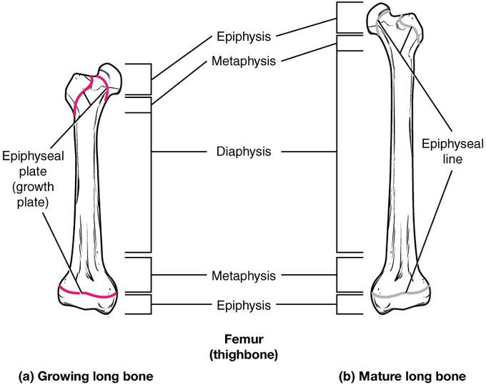
Physiology of the Bone
Video
Bone is a special form of connective tissue.
Bone is well vascularized (rich in blood supply).
Total blood flow: 200–400 mL/min in adult humans.
Epiphyseal plate: an actively proliferating cartilage plate, which
separates epiphyses (ends of each long bone) from shaft (diaphysis).
As long as the epiphyses are separated from the shaft → linear bone growth can occur.
Linear bone growth ceases/stops after epiphyses unite/combine with shaft at puberty (epiphyseal closure).
439:
إذا Epiphyses اتحد مع Shaft واختفى Epiphyseal plate اللي بينهم ← يوقف نمو العظم وهذا ما يحدث عند البلوغ.
Text
Text
Text
Text
Text
Notes:
Organization
Color index
Title
Removed the numbering of the diagram
Moved the text to the left
Enlarged the picture
Modified note’s box

Slide 4
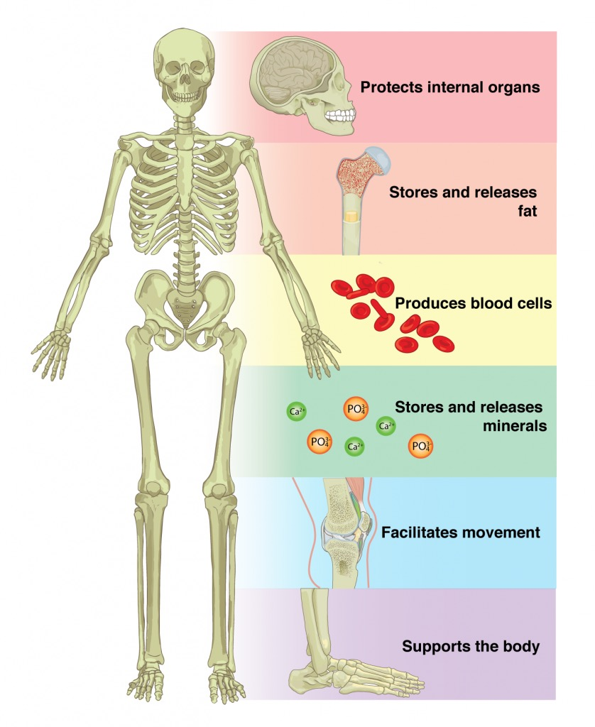
Functions of Bone
Involved in the overall Ca⁺⁺ and PO₄– homeostasis
Protects the
vital organs
Functions of Bones
Permits locomotion & support against gravity
Contains the
bone marrow
(blood cells formation)
Reservoir for
calcium & phosphate
Text
Text
Text
Text
Text
Notes:
DONE
Organization
Modified “ca++” to “Ca²⁺”, “PO4” to “PO₄”
Title
Font
Text alignment

Slide 5
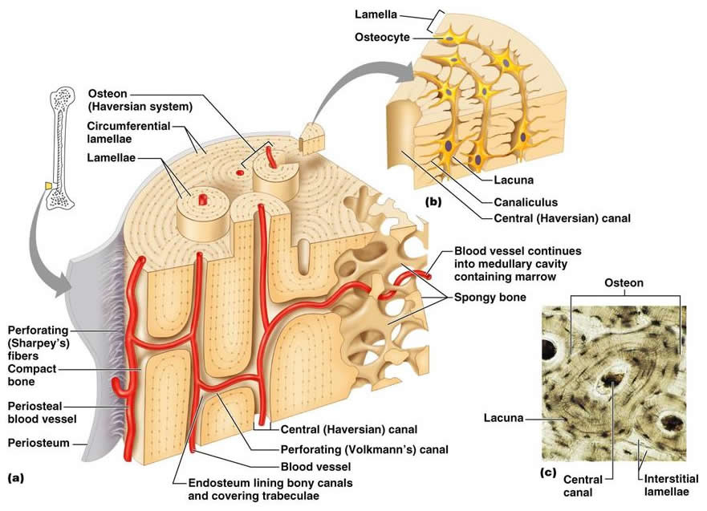
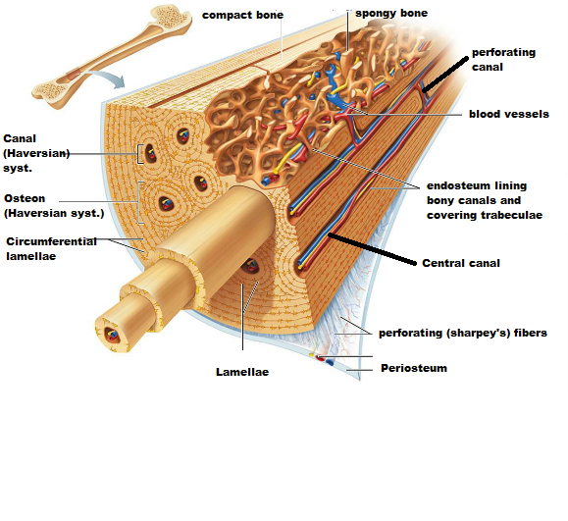
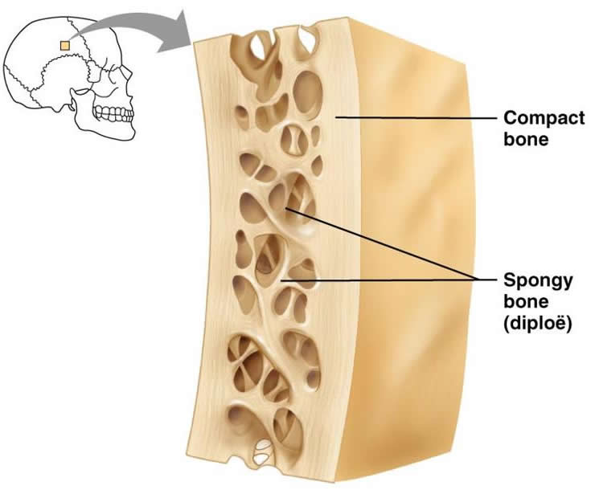
Types & Structure of Bones
Video
Cortical or Compact bones | Trabecular or Spongy bones
In the outer layer of most bones. 80% of the body bone. Bone cells lie in lacunae. Nutrients received by a way of canaliculi from haversian canals vessels. Has more bone tissue and less bone space. Has high resistance to bending and torsion. Composed of haversian systems/osteons. Haversian systems: overlapping circular structure/formation. Haversian systems: collagen that is arranged in concentric layers, around the haversian canals forming cylinders. Each osteon has osteonic/haversian canal (central canal). Osteonic/haversian canal: central canal that contain blood vessels (capillaries - arterioles - venules), nerves, and lymphatic. Composed of Matrix and Cells (next slide). | Inside the cortical bone. 20% of the body bone (skeletal mass). Made up of spicules or plates. Nutrients diffuse from bone extracellular. Has 5 times greater surface area than cortical bone Large surface → faster turnover rate than cortical bone → more important than cortical bone in terms of Ca⁺⁺ turnover. Compared to cortical bone, it is: Less dense More elastic Higher turnover rate Center of the bone contains: Red marrow Yellow marrow Bone cells Other tissue More space less tissue.
Compact Bone
Spongy Bone
Text
Text
Text
Text
Text
Notes:
DONE
Title → “&” instead of “and”
Organization
One male note
Deleted some full stops بالتعدادات (that are not sentences)

Slide 6
Overview (Detailed in the Next 2 Slides)
Composition
Matrix
Cells
Organic
(30%)
Inorganic/Bone Salts (70%)
Osteoprogenitors
Osteocytes
Osteoclast
Osteoblasts
Collagen
Ca⁺⁺
Non-collagenous Protein
PO₄⁻
Mucopolysaccharides
Notes:
DONE
Organization
Percentages
Added “Bone Salts”
Title
Fixed the mind map كانت خربانة مدري ليه

Slide 7
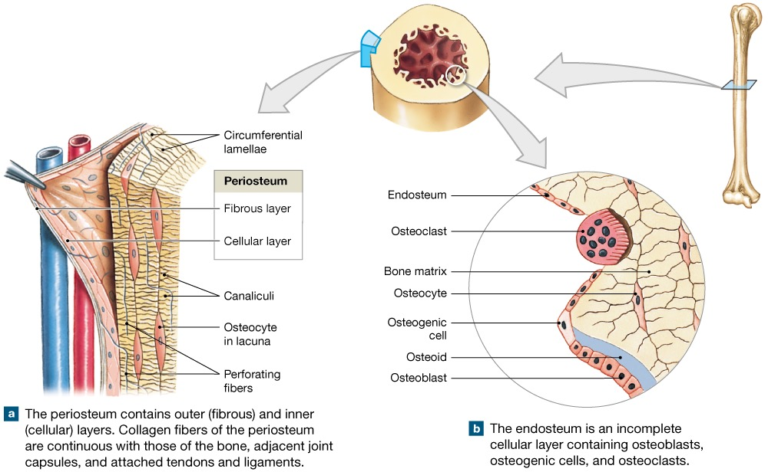
Matrix
Matrix
Organic Matrix
30%
Composed of:
1) Collagen fibers (90-95%):
Extend primarily along the lines of tensional force.
Gives the bone its powerful tensile strength.
2) Ground substance (5-10%):
Of ECF proteoglycans (chondroitin sulphate & hyaluronic acid)
Inorganic Matrix (Bone Salts)
70%
Crystalline salts: Ca⁺⁺ and PO₄⁻ (hydroxyapatite).
Ca/P ratio: (1.3 - 2).Ca is more than PO4
Mg⁺, Na⁺, K⁺, Carbonate ions.
NB: newly formed bone have a considerably higher percentage of organic matrix in relation to salts.
Notes:
DONE
Organization slight
Title
Color index (important)

Slide 8
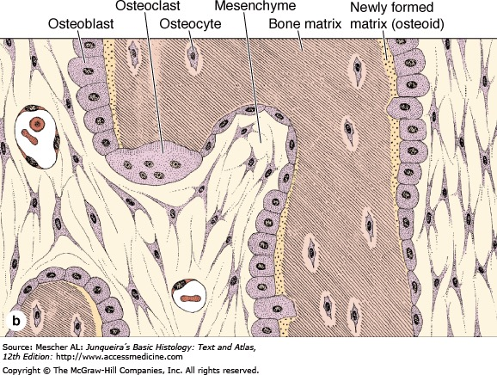
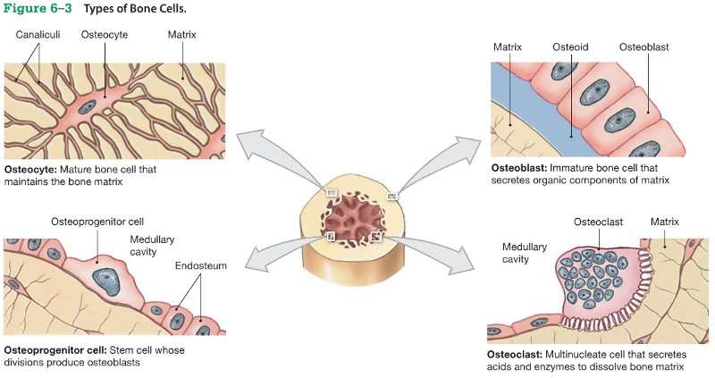
Cells
Video
Cells
when osteoblast surrounded by calcified matrix, they are called osteocyte
Osteoblasts
Bone forming cells.
Secrete collagen forming a matrix around themselves which then calcifies.
Regulate Ca and Phosphate concentration in bone fluid.
Osteocytes
When the osteoblasts get surrounded by osteoid, they are called osteocytes.
Send processes into the canaliculi that ramify throughout the bone.
Osteoclasts
Multinuclear cells that erode and resorb previously formed bone.
Phagocytose bone, digesting it in their cytoplasm.
Notes:
DONE
Organization
Color index
Title

Slide 9
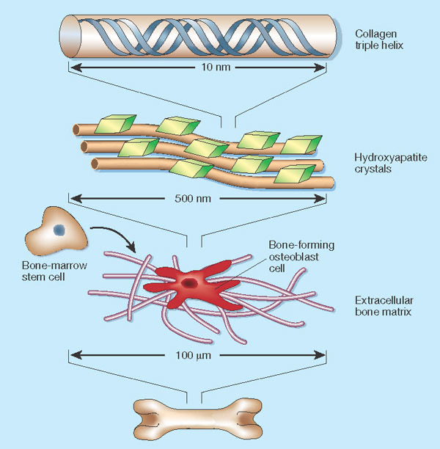
Mechanism of Bone Calcification
1
Video
1
Osteoblasts secrete collagen (monomers) and ground substance (proteoglycans).
Collagen monomers polymerize to collagen fibers.
2
2
Resultant tissue: osteoid.(bone without salts)
Osteoid: a cartilage-like material differing from cartilage in that calcium salts readily precipitate in it.
3
3
Osteoblasts become entrapped in the osteoid and are now called osteocytes.
4
4
After the osteoid is formed, calcium salts begin to precipitate on the collagen fibers forming hydroxyapatite crystals.
Pyrophosphate against calcf.
TNAP with calcf.
5
The mechanism that causes calcium salts to be deposited in osteoid is not fully understood.
The regulation of the calcification process depend to a great extent on pyrophosphate.
Pyrophosphate inhibits hydroxyapatite crystallization + calcification of bone
Regulated by TNAP.
6
Tissue Nonspecific Alkaline phosphatase (TNAP) breaks down pyrophosphate.
TNAP is secreted by the osteoblasts into the osteoid to neutralize pyrophosphate.
Once pyrophosphate has been neutralized, the natural affinity of the collagen fibers for calcium salts causes hydroxyapatite crystallization.
Notes:
DONE
Added the regulation part
Organization
Edited note’s box
Link of video is missing

Slide 10
Mechanism of Bone Calcification
Osteoblast secretes at least 2 other substances to regulate calcification:
Nucleotide pyrophosphatase phosphodiesterase 1 (NPP1): pro​duces pyrophosphate outside cells.
Ankylosis protein (ANK): transports pyrophosphate from the interior to the surface of the cell (contributes to extracellular pool of pyrophosphate).
Deficiencies of NPP1 or ANK results in:
Decreased extracellular pyrophosphate.
Excessive calcification of bone (Example: bone spurs).
Calcification of other tissues (tendons & ligaments of spine), occurs in people with ankylosing spondylitis (form of arthritis).

Slide 11
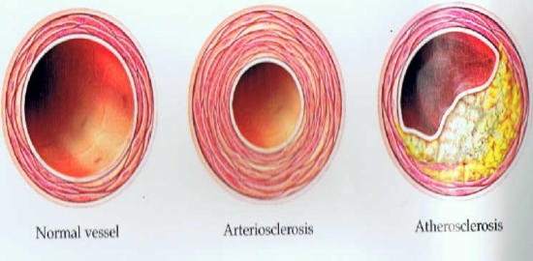
Precipitation of Ca⁺⁺ in Non-Osseous Tissues Under Abnormal Conditions
**In Female Slides Only
Hydroxyapatite crystal or calcium salts do not precipitate in plasma, ECF or normal tissues (except bone) despite the high levels of Ca & P ions.
Cause: presence of pyrophosphate (inhibitor factor) (normal).
Under abnormal conditions: pyrophosphate disappear from tissue → precipitation of calcium salts.
1
Arteriosclerosis in arterial walls
↳ arteries become bone-like tubes.
2
Degenerating tissues
3
Old blood clots
1
تصلب الشرايين
by calcification
تصلب الشرايين
by adipocytes
Atherosclerosis: specific type of arteriosclerosis.
Notes:
DONE
Excluded half of the slide
Organization
Edited the numbers (1,3,5) to (1,2,3) and modified the alignment slightly
Put the picture under arteriosclerosis

Slide 12
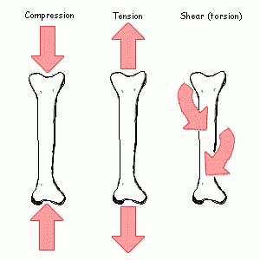
Tensile & Compressional Strength of Bone
Collagen fibers of bone (like those of tendons) have great tensile strength.
Tendons: C.T. that connect muscle to bone, capable of withstanding tension.
Calcium salts have great compressional strength.
These combined properties + degree of bondage between collagen fibers and crystals → bony structure that has: extreme tensile strength + extreme compressional strength.
Tensile → tension (شد).
Compressional → compression (ضغط).
الكولاجين فايبرز ← عظامنا ما تنكسر لما تنشد.
الكالسيوم ← العظام ما تنكمش لما تنضغط.
Notes:
DONE
Diagram resized as it took large space
Removed repeated point.
Organization
There was a mistake in the note. Both tension & compression were referred to as “ضغط” → modified tension to شد
Title → “&” instead of “and”
Text resized → larger
Color index “important”

Slide 13
Remodeling of Bone
Video
Bone is continually deposited by osteoblasts, and absorbed where osteoclasts are active.
Bone remodeling(هدم وبناء): the continuous processes of bone absorption (by osteoclasts) & then its deposition ( by osteoblasts).
Renewal rate: ≈ 4% / year for compact bone + 20% / year for trabecular bone(faster->greater surface area)
Process done by 2 cells
Bone resorption = bone absorption.
Osteoblasts → deposition
Osteoclasts → absorption
Found on:
Outer surface of bone.
Bone cavity.
Small amount of osteoblastic activity occurs on ≈ 4% of all bone surfaces at any given time in an adult → at least some new bone is being formed constantly.
Osteoclasts: large phagocytic multinucleated cells.
Normally active on < 1% of the bone surface of an adult.
Phagocytose minute particles of bone matrix and crystals, dissolute them, and release the products into the blood.
Secrete 2 substances:
Proteolytic enzymes from lysosomes → dissolve organic matrix.
Acids from mitochondria and secretory vesicles → solution of bone salts.
Notes:
Modified hyperlink icon
Color index
Added: “Bone remodeling: the continuous processes of bone absorption ( by osteoclasts) & then its deposition ( by osteoblasts).”
Organization
“Osteoblasts” are found on the outer surface of the bone and in the bone cavity not “osteoclasts”
Added “The osteoclastic cells also phagocytose minute particles of bone matrix and crystals, dissolute them and release the products into the blood.”
Added: “Osteoclasts are large phagocytic multinucleated cells”
Two → 2
Modified note’s box
Comment: the note better be in grey if it’s extra

Slide 14
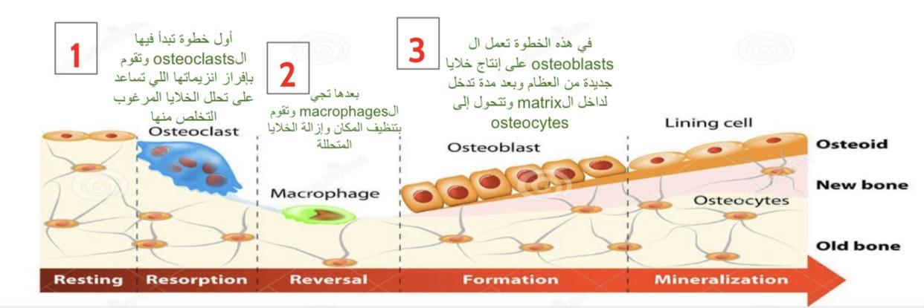
The Bone Remodeling Process
Special Thanks to 439 & 438
Osteoid
Notes:
Arrows
Thanks
Title
Adjusting the pictures

Slide 15
Importance of Continual Bone Remodeling
1
Bone adjusts its strength in proportion to the degree of bone stress → Thicken when subjected to heavy loads.
العظام تعدل على قوتها حسب الضغط عليها.
مثال: رافعي الاثقال عظامهم اقوى لأنها دائمًا تحت ضغط.
More stress = stronger bone.
2
The shape of the bone can be rearranged for proper support of mechanical forces by deposition and absorption of bone in accordance with stress patterns.
Old bone becomes relatively brittle and weak.
New organic matrix is needed as the old organic matrix degenerated to maintain the normal toughness of bone.
بسبب الاستعمال المتكرر للعظام، بتضعف وتصير هشة ← عملية التجديد تبدل العظام القديمة بجديدة أكثر قوة.
3
4
The bones of children are less brittle in comparison to bones in eldery, due to more remodeling in children.
عملية تجديد العظام للأطفال أعلى من الكبار بالسن ← يطيحون الأطفال كثير ولا تنكسر عظامهم.
Notes:
Diagram
Organization
Added text from male slides
Modified note’s box

Slide 16
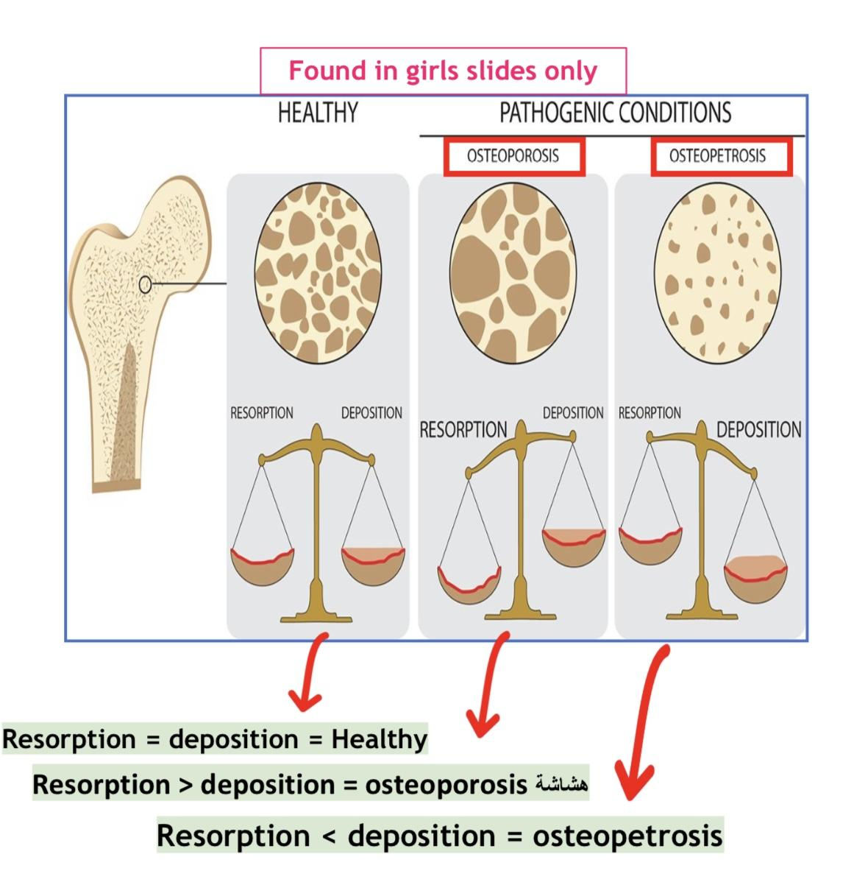
Control of the Rate of Bone Deposition by Bone “Stress”
Special Thanks to 438
1
Bone is deposited in proportion to the load that it must carry.
زيادة الضغط على العظام تحفز عملية ترسيب الكالسيوم عشان تصير أكثر صلابة وقوة.
2
Continual physical stress stimulates osteoblasts deposition and calcification of bone.
3
Bone of athletes → considerably heavier than non athletes.
Bone of leg in cast (الجبيرة) → thin + up to 30% decalcified within a few weeks.
4
Bone stress determines the shape of bones under certain circumstances.
Example: healing of fracture may start angulated in children then become straight.
Notes:
Title
Organization
Color index
Diagam
Thanks
Note’s box
Comment: “girls slides only” of the picture is very small

Slide 17
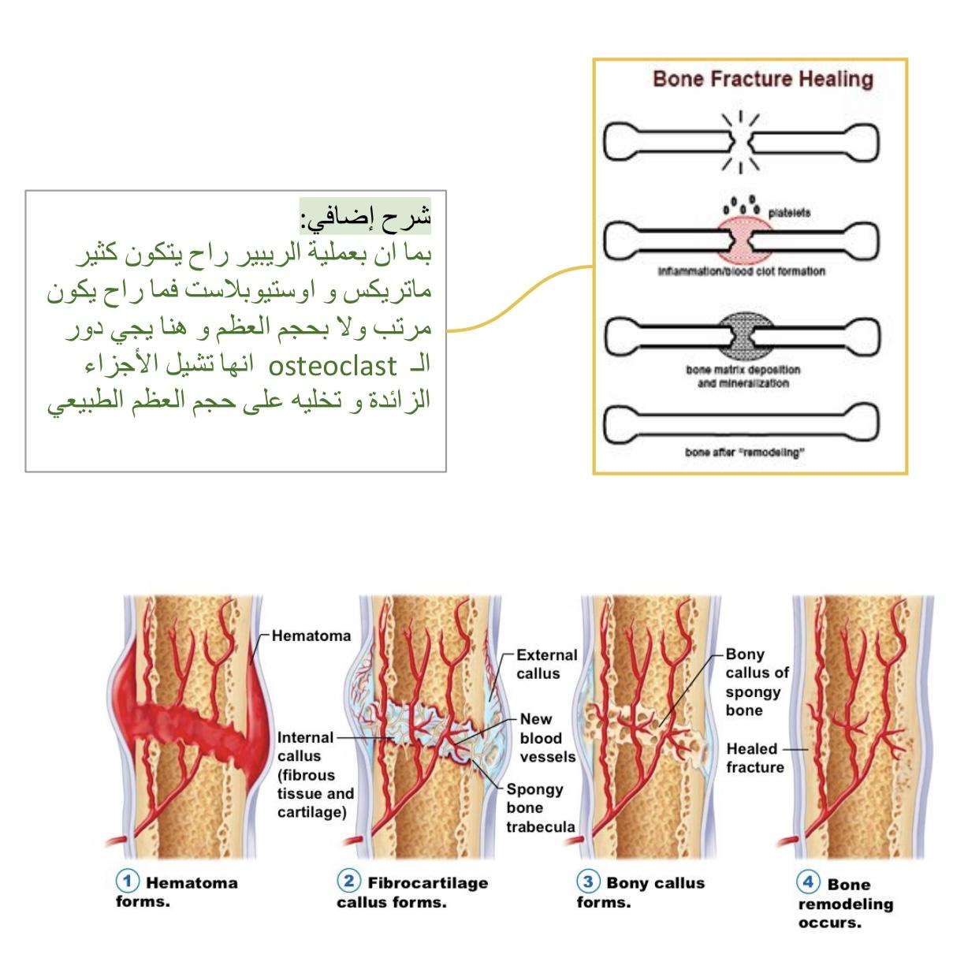
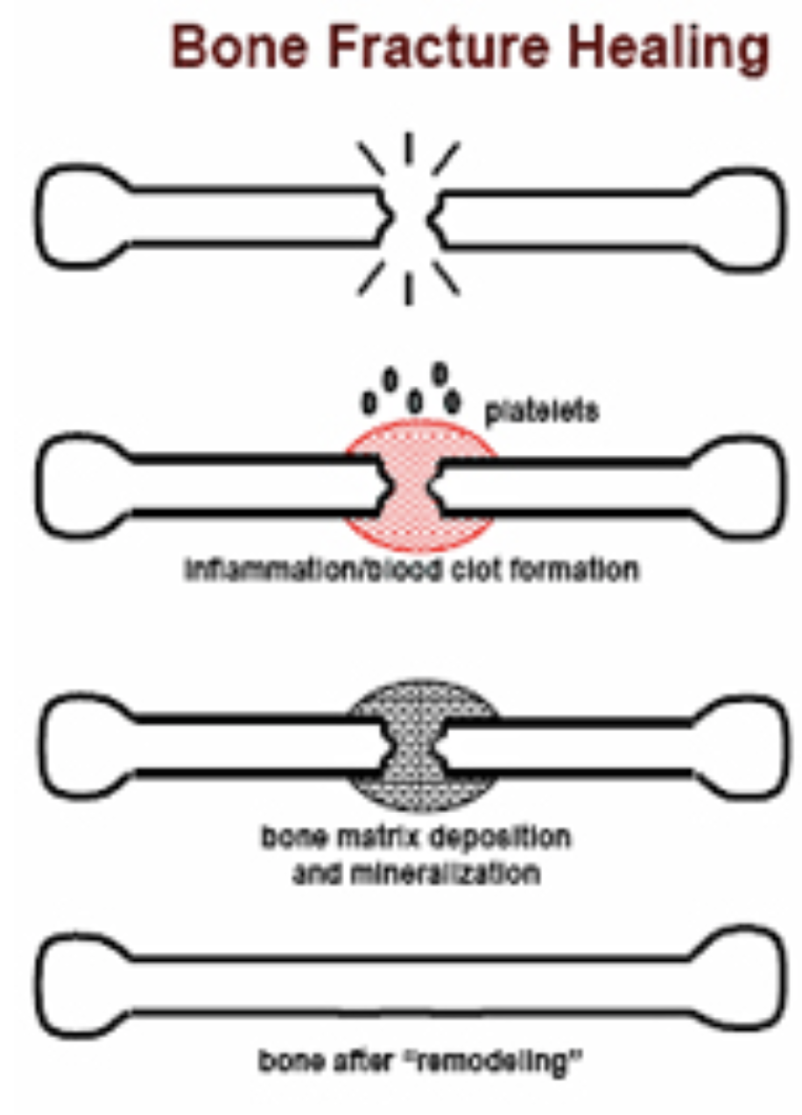
Repair of Fracture Activates Osteoblasts
Special Thanks to 439 & 438
Fracture->osteoprogenitor release more osteoblast->more matrix->calcification->callus
Fracture of a bone activates all the periosteal and intraosseous osteoblasts involved in the break.
Large numbers of new osteoblasts are formed from osteoprogenitor cells.
Osteoprogenitor: bone stem cells in bone membrane (surface tissue lining bone).
Shortly, a callus developed between broken bone ends.
Callus: large bulge of osteoblastic tissue and new organic bone matrix followed shortly by the deposition of calcium salt
Notes:
Title
Organization
Color index
Diagam
Thanks
Picture added

Slide 18
Calcium Exchange - Bone & ECF
Bone contains a type of exchangeable calcium that is always in equilibrium with the Ca⁺⁺ ions in the ECF.
This calcium is a form of readily mobilizable salt + other amorphous calcium salts.
Example: dicalcium phosphate (CaHPO₄).
The importance of exchangeable calcium:
Provide a rapid buffering mechanism(resist Ca+2 changing level in blood) to keep Ca⁺⁺ ions concentration in ECF from rising to excessive levels or falling to very low levels under transient conditions of excess or decrease availability of Ca⁺⁺.
الكالسيوم و الفوسفات يكونون مع بعض لكن عندنا في جسمنا كمية قليلة من الكالسيوم الحر Exchangeable calcium (اللي ينتقل من العظام إلى ECF أو العكس).
يساعدنا في عملية الـ homeostasis.
Notes:
Organization
Diagram
Color index
Title → “&” to “and”
Modified note’s box

Slide 19
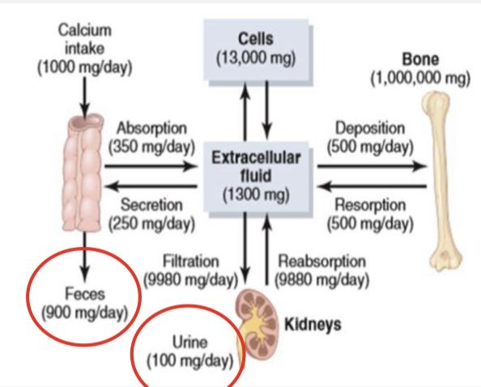
Body Calcium Levels
1.5% of body weight is Calcium.
 | Calcium | Phosphorus
Total Body Content | 1300 g | 600 g
Relative Tissue Distribution:
Bone and teeth | 99% | 86%
Extracellular fluid | 0.1% | 0.08%
Intracellular fluid | 1% | 14%
About 1100 - 1300 gm.
99% is in the skeleton.
Plasma calcium level: 9 - 11 mg/dl.
Average plasma calcium level: 9.4 mg/dl
in=out
Notes:
Organize slight
Title
Table
deleted “59% ( diffusible ) = ionized + complexed: & “41% ( non diffusible ) = protein bound” من وين؟
Deleted numbers of diagrams as the slide is already filled up with numbers

Slide 20
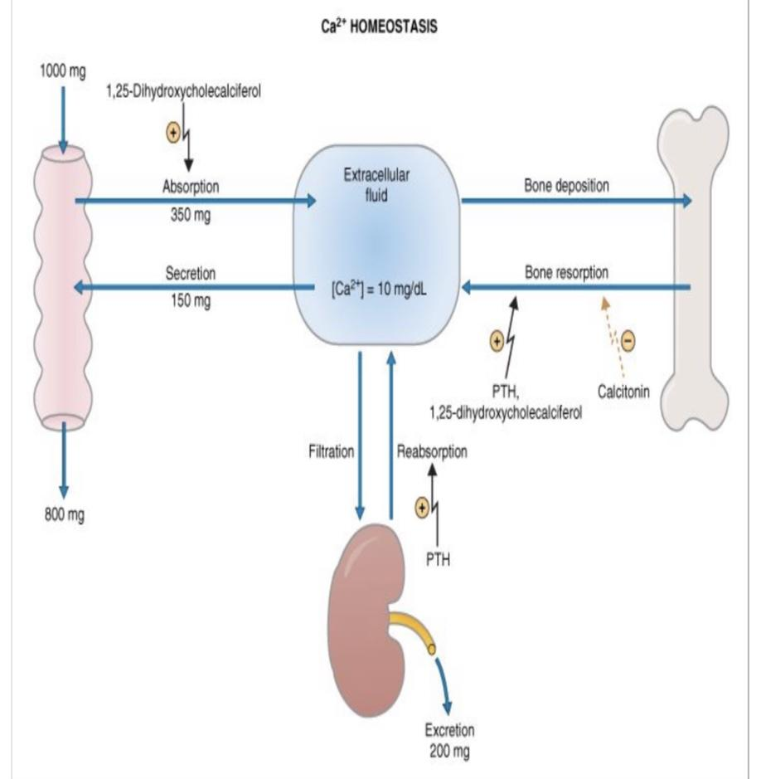
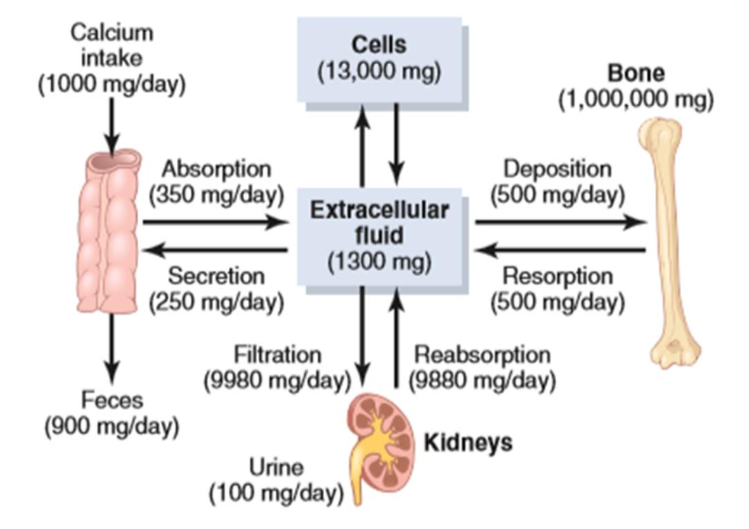
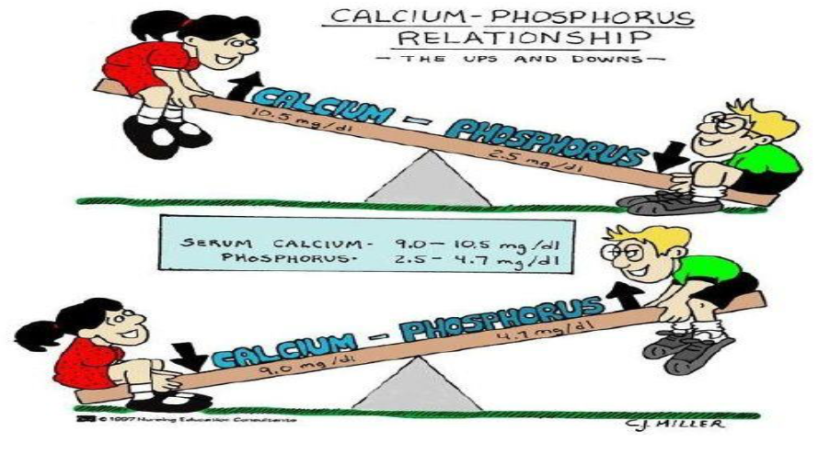
Calcium Homeostasis in Human Body
الكالسيوم و الفوسفات علاقتهم عكسية، ودائمًا احنا في جهة أن الكالسيوم أكثر والفوسفات أقل.
لو زاد الكالسيوم في الجسم ممكن يروح للكلية ويطلع برا الجسم أو من الامعاء او يروح للعظام ويخزن فيها.
لو قل الكالسيوم راح يتعوض النقص من العظام من خلال الكالسيوم غير المرتبط بالفوسفات و راح نحفز الكلية انها تعيد امتصاص الكالسيوم.
Notes:
Organization
Title → “&” to “and”
1 picture added
Picture size unified
Note’s box modified

Slide 21
Hormonal Control
مستوى الكالسيوم في الجسم لازم يكون ثابت بفعل من هذه الهرمونات.
ارتفع الكالسيوم في الدم ← يفرز الكالستونن عشان ينزله.
إذا نزل الكالسيوم في الدم ← يفرز الباراثايرويد الهرمون عشان يرفعه لمستواه الطبيعي
Major Hormones Controlling Ca⁺⁺ Metabolism
1, 25 dihydroxycholecalciferol
Parathyroid hormone (PTH)
Calcitonin
A steroid hormone formed from vitamin D.
Secreted by parathyroid gland.
When calcium level in the blood is low.
Increase Ca⁺⁺ absorption (indirect via 1,25 dihydroxycholecalciferol.
Secreted by c-cell in the thyroid gland.
When calcium level in the blood is high.
Inhibit osteoclasts while osteoblasts continue to lock calcium in bone matrix.
Active form of vitamin D
Glucocorticoid - GH - Estrogen - Various Growth Factors
To a Lesser Extent
Notes:
Secreted by parathyroid “gland” not “hormone’
Organized
Restated the note

Slide 22
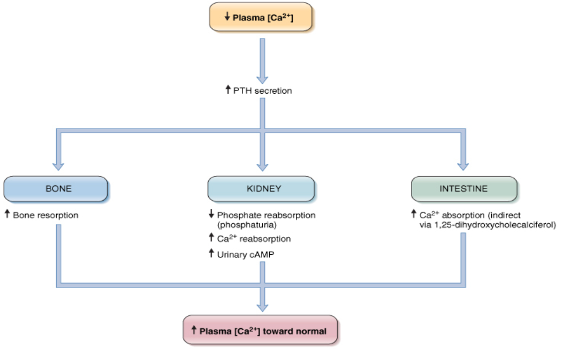
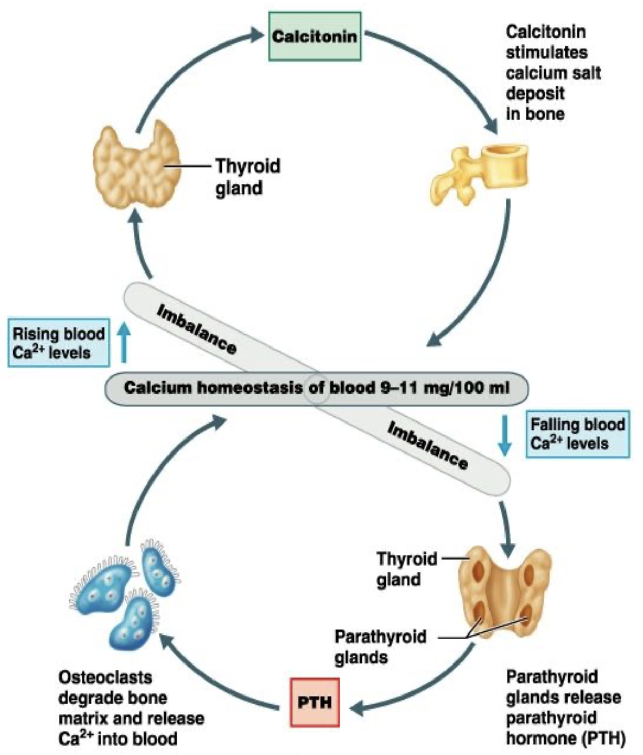
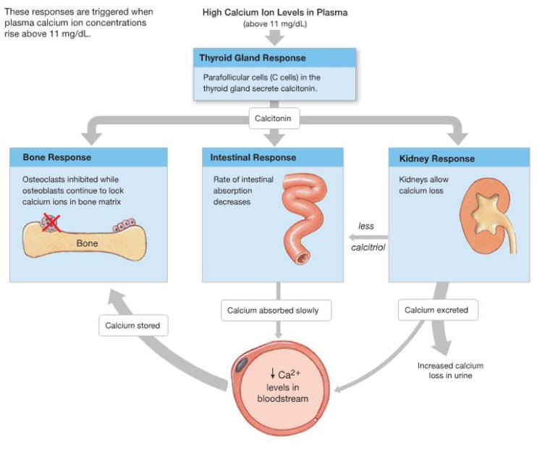
Notes:
Pictures collected
Rearranged pictures

Slide 23
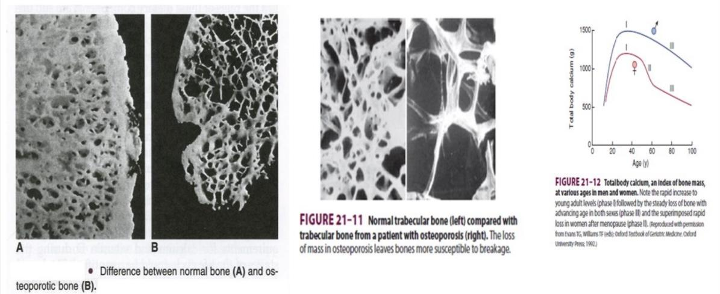
Osteoporosis
Osteoporosis: reduced bone density and mass.
Osteoblastic activity in the bone is usually less than normal → rate of bone osteoid deposition is depressed.
Results from diminished organic bone matrix rather than from poor bone calcification.
Cause: relative excess of osteoclasts function.
Loss of bone matrix is marked.
Matrix and mineral are both lost + loss of bone mass due to:
Lack of physical stress
Malnutrition
lack of vitamin C
Old age(low growth hormone)
Postmenopausal lack of estrogen
Cushing’s syndrome
Deposition < absorbtion
Notes:
Title
Color index
Added 2 points from girls slides

Slide 24
Complications of Osteoporosis
In Male Slides Only
1
Incidence of fracture is increased particularly in: distal forearm (colles fracture) + vertebral body + hip. These areas have a high content of trabecular bone (metabolically active → lost more rapidly).
2
Fracture of the vertebrae with kyphosis produces “widow’s hump” in elderly women with osteoporosis.
3
Fracture of the hip in elderly are associated with a mortality rate 12-20% and half of those who survive required prolonged expensive care.
4
Increased intake of calcium & moderate exercise may help prevent or slow the progress of osteoporosis.
Notes:
separated

Slide 25
MCQs:
A |  | B |  | C |  | D
A |  | B |  | C |  | D
A |  | B |  | C |  | D
A |  | B |  | C |  | D
A |  | B | 2.5% | C | 15% | D | 0.5%
Q1: What type of tissue are bones?
Muscle
Epithelial
Connective
Nervous
Q2: Which of the following is NOT a function of bones
Increase motor unit recruitment
Involved in Ca++ and PO4– homeostasis
Reservoir for
calcium & phosphate
Protects the
vital organs
Q3:Which of the following deposits new bone?
Osteoid
Osteoclasts
Osteoblasts
Osteocytes
Q4:Which of the following absorbs old bone?
Osteoid
Osteoclasts
Osteoblasts
Osteoblasts
Q5: Calcium body weight percentage
1.5%
Answers: 1.C 2.A 3.C 4.B 5.A
Notes:
New slide
Organized pictures
Combined 2 points:
“All-or-none” principle: impulse from motor neuron will cause contraction in all muscle fibers it innervates or none.
Motor Unit follows “all-or-none” principle.

Slide 26
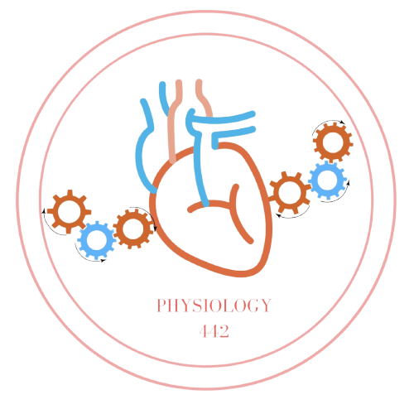
Team Leaders
Dema Alkhattabi
Waleed Alrashoud
Team Members
Nouf AlDalaqan
Farah Alqazlan
Masheal Alasmri
Amani Alotaibi
Maram Beyari
Maha Alkoryshy
Nouf Aldhalaan
Othman Alabdullah Khaled Bin-Arbeed
Rakan Alromayan
Talal Alharbi
Abdullah AlShehri
Mohammad Alrashed Saud Al-Taleb
Sultan Al-Abdullah Saad AlAngri
Abdullah Awartani
Special Thanks to Physiology Team441
Physio442@gmail.com

