Slide 1
2
Notes
Resting
Membrane Potential
Editing File

Slide 2
Objectives
Explain why some membranes are excitable.
Describe the electrochemical basis of RMP.
Describe the role of myelination & how nerve fibers are classified.
Notes:
Only the objectives of this lecture
Size

Slide 3
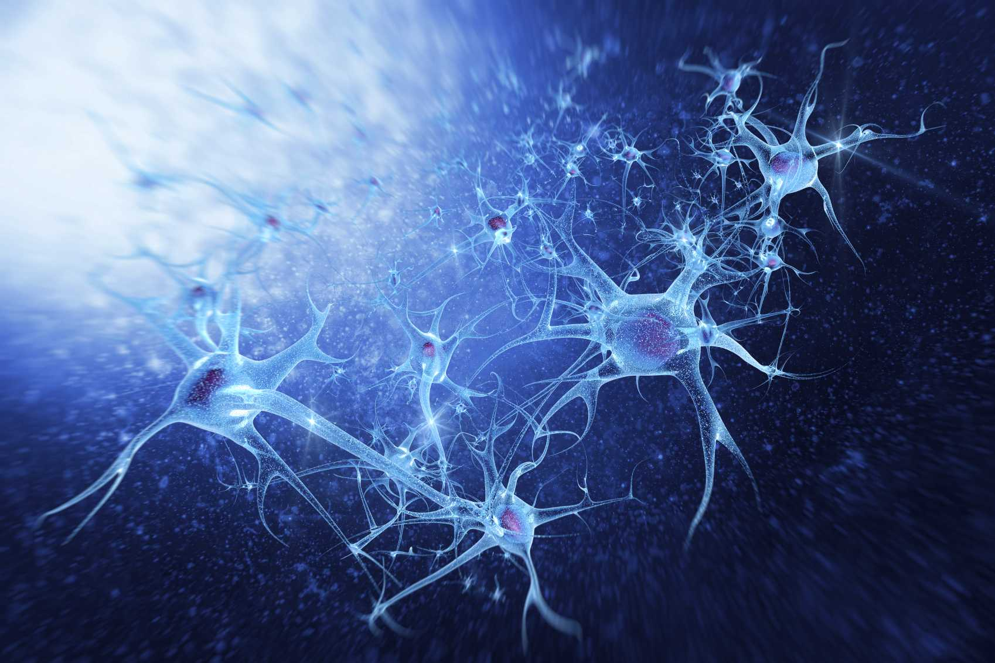
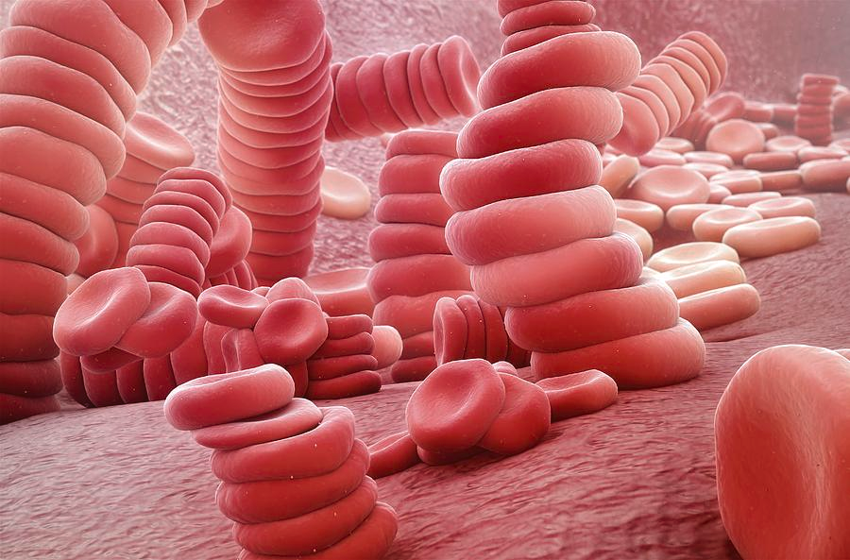
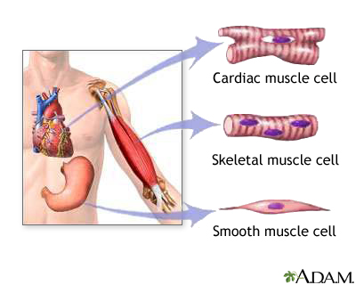
Excitable Tissues
Non-excitable Tissues
Excitable tissues: tissues which are capable of generation and transmission of electrochemical impulses along the membrane.
Non-excitable tissues: tissues which are NOT capable of generation and transmission of electrochemical impulses along the membrane.
More negative RMP (-70 to -90 mV)
Less negative RMP
Examples:
Examples:
Nerve
RBC -8.4 mV
Skeletal muscles
Epithelial cells -53 mV
Cardiac muscles
Adipocytes -58 mV
Smooth muscles
Fibroblasts -20 to -30 mV
Intestinal cells
Text
Text
Text
Text
Notes:
Diagram
Pictures added
Line dashes
Bolded voltage numbers
Flipped “negative RMP” & examples
Comment: titles are repeated 3 times; it’s neater to delete one if possible, preferably #2

Slide 4
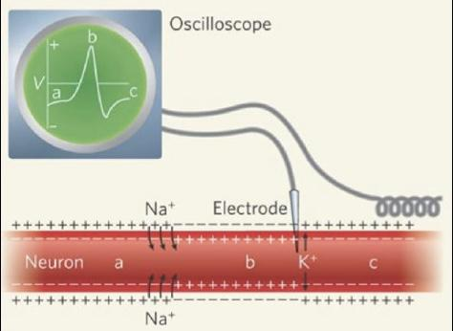
Membrane Potential
Resting Membrane Potential (RMP): a potential difference that exists between the inside and the outside of the membrane during rest,across all cell membranes.
RMP is about -70 to -90 mV.
+
+
+
+
+
—
—
—
—
—
—
—
—
—
—
+
+
+
+
+
Inside is negative
with respect to the outside.
RMP is measured using microelectrodes and oscilloscope (voltmeter).
RMP is the default state of the cell. It corresponds to the sum of all diffusion potentials of extracellular and intracellular ions.
Text
Text
Text
Text
Notes:
Dashes
Arrows
Size
This one is better, but شكل الأسهم كان مشتت → modified them
Modified colors of the black picture
Added an extra note

Slide 5
Resting Membrane Potential (RMP)
Video
Important slide , Why is the cell negative inside?
RMP depends on (Factors):
Factors contributing to negative RMP:
1
Ionic distribution across the membrane
1
One of the main factors is K⁺ efflux
(K⁺ leak channel - Nernst potential: -94 mV).
2
Membrane permeability
2
Contribution of Na⁺ influx is little
(Nernst potential: +61 mV).
3
Na⁺/K⁺) ATPase pump
3
Na⁺/K⁺ pump creates additional degree of negativity inside the membrane (-4 mV).
439 note:
Efflux = Exits the cell
Influx = Enters the cell
*Nernst potential = Equilibrium potential
4
Negatively charged protein ions remaining inside the membrane contributes to the negativity. Require ATP to diffuse outside the cell.
Net Result: -70 to -90 mV inside.
100 potassium efflux while 1 sodium influx causing the positive charge to decrease while the negative charge increase due to the increasing of electrons inside and the decreasing of proteins outside the cell.
Text
Text
Text
Notes:
Flipped the 2 diagrams
General organization
Added a note about “Nernst” potential
Added “negative” in the second diagram to differentiate the two
Isolated “net result”

Slide 6
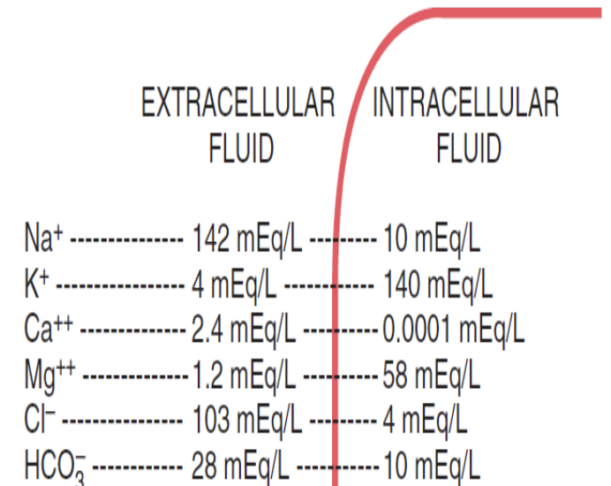
Ionic Distribution
The Charge of the Cell
Major Ions
Causes of the -ve charge of the cell
Extracellular Ions
Intracellular Ions
K⁺ leak channel outflux
(main reason)
Large molecules
Protein - RNA - DNA
Na⁺/k⁺ Pump
Na⁺
Cl⁻
K⁺
Proteins
Cell membrane عنده نفاذية عالية جدًا للبوتاسيوم الموجب ← إذا كان في حالة راحة بيفتح وبيطلع البوتاسيوم بكميات كبيرة جدًا بالنسبة للصوديوم (المتجه للداخل) ← تكون السالبية أعلى داخل الخلية مقارنةً بخارجها.
Because it’s from high concentration to low concentration there’s no need for any pump (so no energy needed).
كلها سالبة وموجودة داخل الخلية وما تطلع لانها كبيرة
ذو تأثير ضعيف جدًا فهو يزيد السالبية بمقدار -٤
Enter the cell in small quantity. Exit the cell in large amounts.
Restating the Previous Slide
Notes:
The excluded slide
Added 3 pictures
الجزء اليمين ودي احطه مع النوتس بس ماأعرف Agreed; it’s repetitive of the previous slide

Slide 7
Electrochemical Gradient
In Male Slides Only
Electrochemical Equilibrium
An exact balance between 2 opposing forces.
Electrical Driving Force
Chemical Driving Force
Electrical driving force: potential difference
across membrane.
Opposing electrical gradient that increasingly tends to stop the ion from moving across the membrane.
Chemical driving force: ratio of concentration on 2 sides of membrane
(concentration gradient).
The concentration gradient that causes the ion to move from area of higher conc to area of lower conc.
Equilibrium: when electrical driving force is balanced by chemical driving force.
Text
Text
Text
Text
Text
Notes:
Organization (+)
Males slides → bold
Two → 2

Slide 8
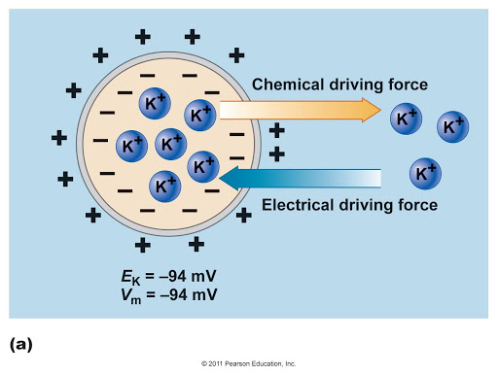
Chemical & Electrical Driving Forces of Potassium (K⁺)
In Male Slides Only
1
K⁺ concentration intracellular is higher.
2
Membrane is freely permeable to K⁺.
Chemical Forces
3
There is an efflux of K⁺ to ECF.
4
Efflux of positive ions creates positivity outside & negativity inside.
5
Outside positivity resists efflux of K⁺
(since K⁺ is a positive ion).
Electrical Forces
6
At a certain voltage, equilibrium is reached and K⁺ efflux stops.
Text
Text
Text
Text
Text
Notes:
Color index
Title
Males slides → bold
Color of the diagram
Text size (modified it to 20)

Slide 9
The Nernst Equation & Nernst/Equilibrium Potential
In Male Slides Only
Describes the balance of electrical and chemical forces across a cell membrane that will exactly prevent net diffusion of an ion.
Named after Walther Hermann Nernst.
Nernst potential(equilibrium potential): potential level across the membrane that will exactly prevent net diffusion of an ion.
Ion | Intracellular | Extracellular | Nernst Potential
Na⁺ | 14 | 140 | +61
K⁺ | 140 | 4 | -94
Cl⁻ | 4 | 103 | -86
Ca²⁺ | 0.0001 | 2.4 | +127
HCO₃⁻ | 10 | 28 | -27
(mmol/l)
Text
Text
Text
Text
Text
Notes:
Color index
Male slides
Walther Hermann Nernst
Title → modified slash (/) location
Table → resized
Added “named after”

Slide 10
The Goldman Equation
In Male Slides Only
When the membrane is permeable to several ions, the equilibrium potential that develops depends on:
1
Polarity of each ion
2
Membrane permeability
3
Ionic concentration
This is calculated using Goldman Equation:
Using this value in Goldman’s equation gives a resting potential inside the membrane of -86 mV.
Text
Text
Text
Text
Text
Notes:
Male slides → bold
Organization
Changed diagram
Added missing word “equation”

Slide 11
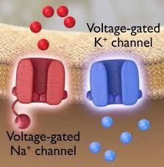
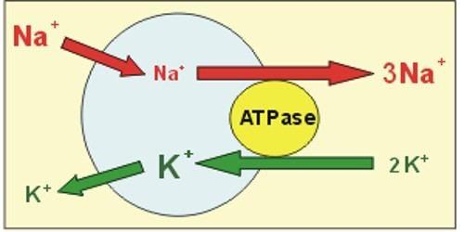
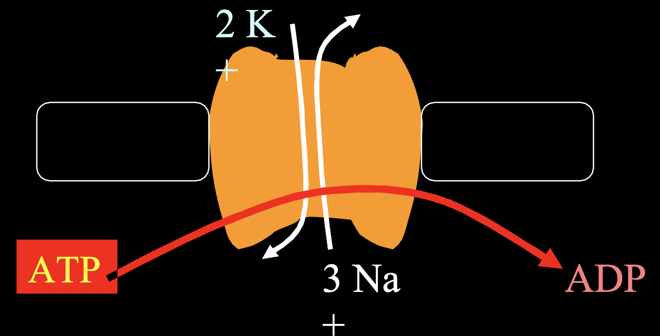
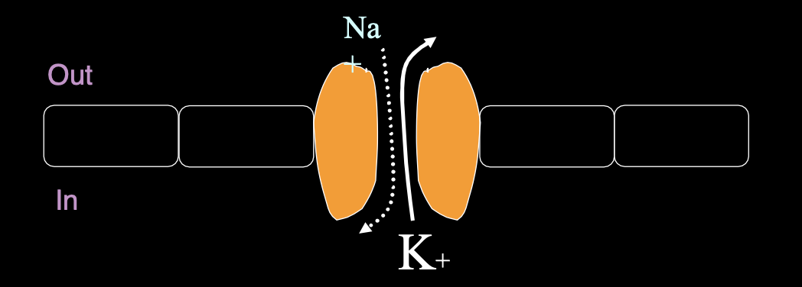
Na⁺/K⁺ ATPase Pump
Ionic Channels
Active transport system for Na⁺/K⁺ exchange using energy.
An electrogenic pump since 3 Na⁺ efflux are coupled with 2 K⁺ influx.
Net effect of causing negative charge inside the membrane (-4 mV).
Leaky Channels (K⁺/Na⁺ leak channels)
More permeable to K⁺
Allow free flow of ions
In Resting State:
K⁺ permeability is 100 times > than Na⁺
Against its electrochemical gradient, so it requires ATP
Text
Text
Text
Text
Notes:
Excluded 1 slide
Added 3 pictures (I suggest to delete the repetitive ones)
Compressed voltage gated channels picture as text was ممطوط

Slide 12
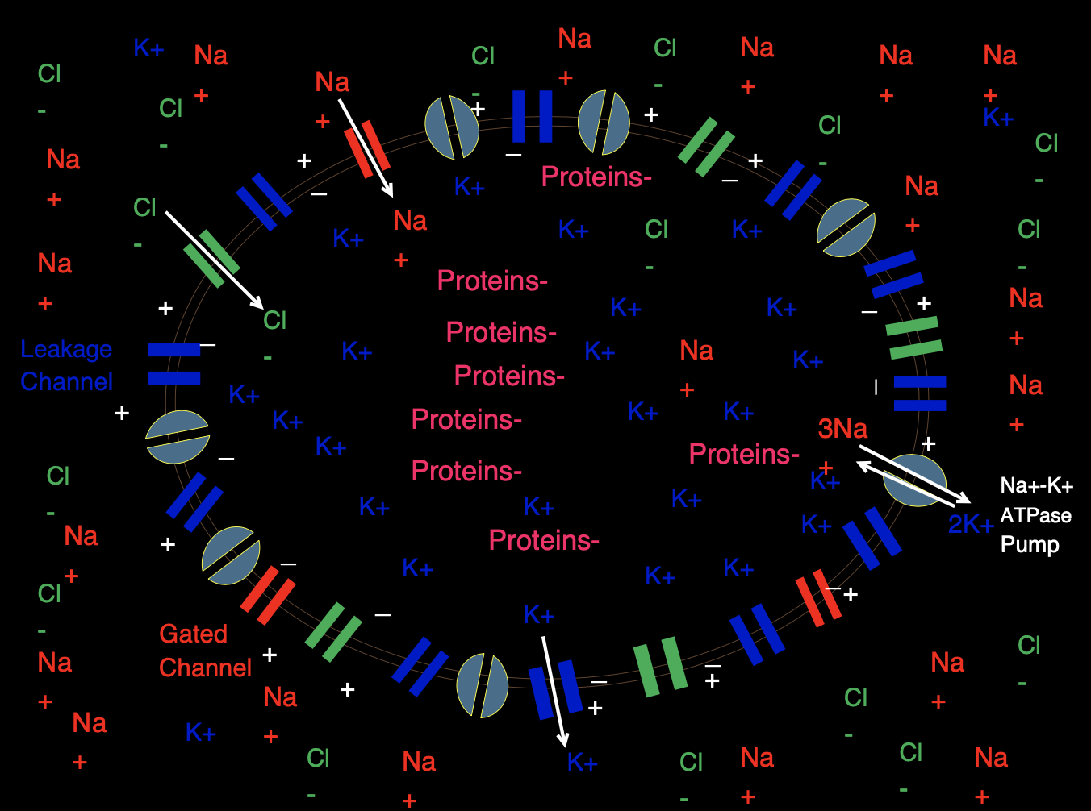
A picture that compiles all types of molecules & channels contributing to RMP
Text
Text
Text
Text
Text
Notes:
New slide

Slide 13
MCQs:
A |  | B |  | C |  | D
A | -90 | B |  | C |  | D
A |  | B |  | C |  | D
A |  | B |  | C |  | D
A |  | B | -70 | C | -4 | D | +4
Q1: The major ion in the resting membrane potential is?
k+
Cl−
Na+
ca2+
Q2:the resting membrane potential of a large nerve fiber is most likely?
-70
70
-85
Q3: concentration of Na+ ions in the extracellular fluid is........ mEq/L?
4
10
142
85
Q4: overall the net result inside the cell during rest is?
-70 to -90
-55 to -70
70 to 90
-85 to -95
Q5:the Na+/K+ ATPase channel contributes to the overall net charge with?
-55
Answers: 1.A 2.B 3.C 4.A 5.C
Notes:
New slide
Organized pictures
Combined 2 points:
“All-or-none” principle: impulse from motor neuron will cause contraction in all muscle fibers it innervates or none.
Motor Unit follows “all-or-none” principle.

Slide 14
MCQs:
A |  | B |  | C |  | D
A |  | B |  | C |  | D
A |  | B |  | C |  | D
A |  | B |  | C |  | D
A |  | B |  | C | RBC | D | Epithelial
Q6: the nernst potential of K+ ions is?
+61
+35
-94
-70
Q7: leaky channels are more permeable to?
Na+
K+
Cl-
Ca2+
Q8: resting membrane potential of a skeletal muscle cell?
-70
-85
-90
80
Q9: a measuring device for the cell membrane potential?
Voltmeter
ohmmeter
ammeter
electricity meter
Q10: all of the following are non excitable tissues except?
adipocytes
Neuron
Answers: 6.D 7.B 8.C 9.A 10.B
Notes:
New slide
Organized pictures
Combined 2 points:
“All-or-none” principle: impulse from motor neuron will cause contraction in all muscle fibers it innervates or none.
Motor Unit follows “all-or-none” principle.

Slide 15
Team Leaders
Team Leaders
Dema Alkhattabi
Dema Alkhattabi
Waleed Alrashoud
Waleed Alrashoud
Team Members
Team Members
Nouf Aldalaqan
Farah Alqazlan
Masheal Alasmri
Amani Alotaibi
Maram Beyari
Maha Alkoryshy
Nouf Aldhalaan
Othman Alabdullah Khaled Bin-Arbeed
Rakan Alromayan
Talal Alharbi
Abdullah AlShehri
Mohammad Alrashed Saud Al-Taleb
Sultan Al-Abdullah Saad AlAngri
Abdullah Awartani
Special Thanks to Physiology Team441
Special Thanks to Physiology Team441
Physio442@gmail.com
Physio442@gmail.com

