Slide 1
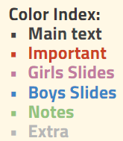
3
Notes
Nerve Action Potential &
Properties of Nerve Fibers
Editing File

Slide 2
Objectives
Describe the mechanism of generation & propagation of AP.
Describe conduction along nerve fibers.
Describe the role of myelination & how nerve fibers are classified.
Notes:
Only the objectives of this lecture

Slide 3
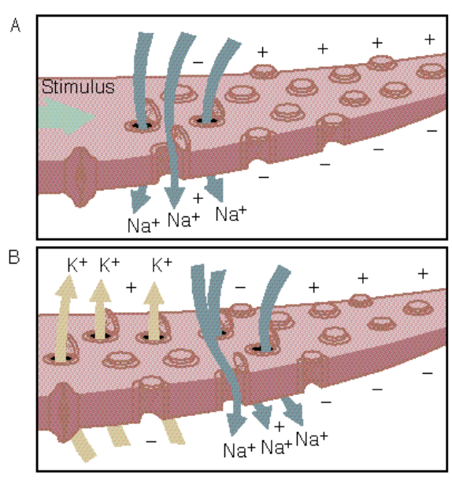
The Action Potential
Video
Nerve signals are transmitted by action potentials.
Action potentials: rapid changes in the membrane potential that spread rapidly along the nerve fiber membrane to produce physiological effects.
Examples of physiological effects:
1
Transmission of impulse along nerve fibres.
3
Muscle contraction.
2
Release of neurotransmitters (e.g. Ach).
4
Activation or inhibition of glandular secretion.
Each action potential:
Begins with: sudden change from the normal resting negative membrane potential to a positive potential.
Ends with: almost equally rapid change back to the negative potential.
Text
Text
Text
Text
Text
Notes:
Organization (slight)
Picture
Title
Modified hyperlink
Resize text “begins/ends” to fit sentence in 1 line

Slide 4
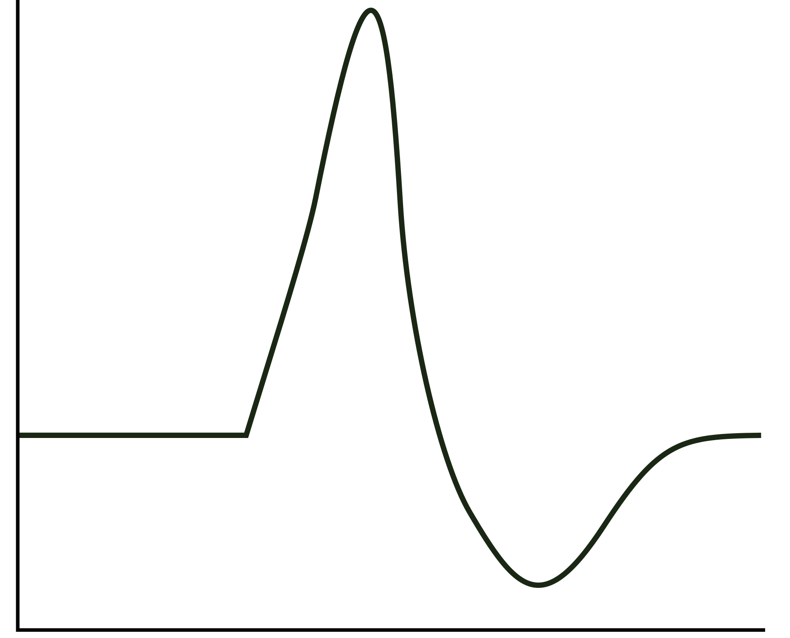
Extra Slide
Stages of the Action Potential
-ve
+ve
-ve
-ve
-ve
+ve
-ve
+ve
+ve
-ve
+ve
mV
+35
--------------------------
Depolarization Stage
Repolarization Stage
-55
Threshold point
--------------------
-70
Resting (Polarized) Stage
Hyperpolarization Stage
Time
Text
Text
Text
Text
Text
Notes:
Organization
Extra slide
Title
ودي بعد اشيلها ونحطها بالنوتس better kept as a summary at the end
Deleted picture (repetitive)

Slide 5
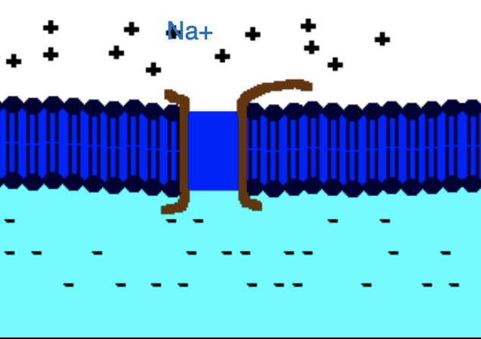
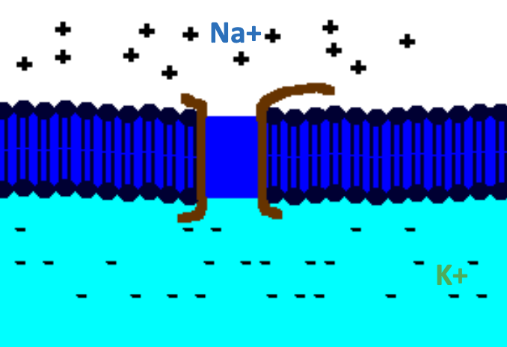
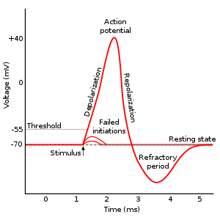
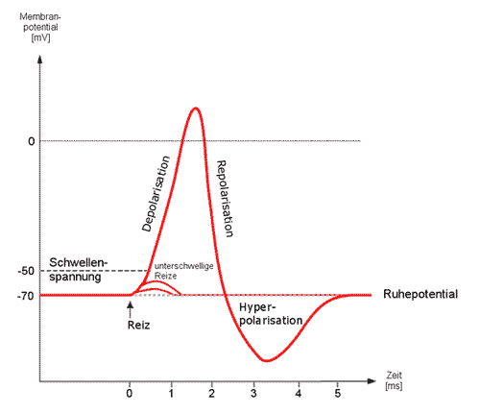
Stages of the Action Potential
Stages of Action Potential
Depolarization
Repolarization
Resting/Polarized
Depolarization
Repolarization
Hyperpolarization
The resting membrane potential before action potential begins.
Membrane is polarized.
Membrane suddenly becomes permeable to Na⁺ ions → tremendous numbers of +ve charged Na⁺ to diffuse to the interior of the axon.
Upstroke.
Na⁺ channels begin to close.
K⁺ channels open.
Rapid diffusion of K⁺ ions to the exterior → re-established normal -ve RMP.
For a brief period following repolarization, the K⁺ conductance is higher than at rest.
Na⁺/K⁺ ATPase pump starts moving Na⁺ out and K⁺ in (against conc. gradient).
Hyperpolarization may or may not happen.
Notes:
Organization
2 pictures added
2 slides merged
الهايلايت بالسلايدز اللي قبل اظن نوتس الدكتورة بنحطها بالنوتس

Slide 6
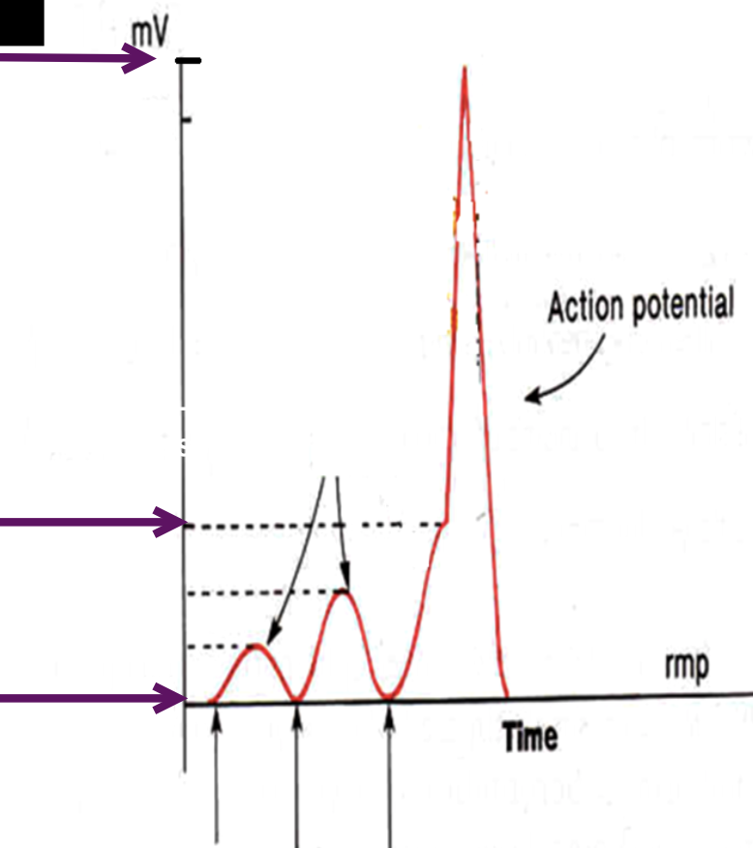
Stimuli & Potentials
1
Threshold Stimulus (Firing Level):
Reversal Potential:
+ 35 mV
The membrane potential at which occurrence of the action potential is inevitable.
Threshold Potential:
- 50 to - 65 mV
2
Acute Subthreshold Potential:
RMP:
- 90 mV
Stimulus that results only in local depolarisation (acute local potentials) when stimulus is below the threshold.
3
All-or-Nothing Principle:
Once threshold value for excitation is reached a full AP is produced.
AP intensity can not be increased by increasing stimulus intensity.
Notes:
Organization
Added a slide
Title

Slide 7
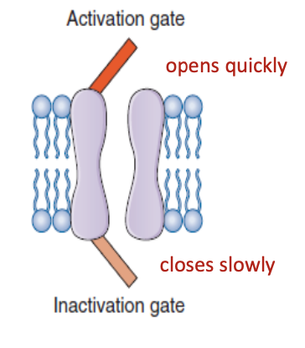
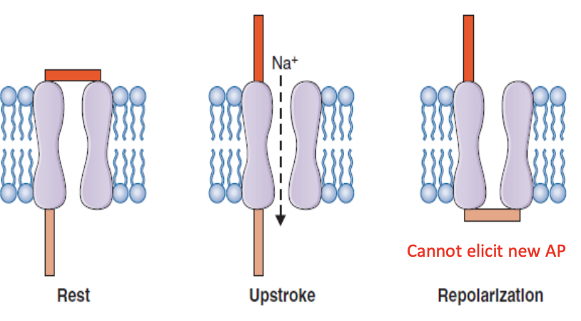
Transport Channels Through the Nerve Membrane
Voltage Gated Na⁺ Channels | Voltage Gated K⁺ Channels
Has 2 gates: Activation → outside. Inactivation → inside. | Has one gate only.
At rest: Activation gate: closed. Inactivation gate: open. During upstroke of AP (depolarization): Activation gate: open. Inactivation gate: open. Na⁺ flows into the cell (down the electrochemical potential gradient → no energy). During repolarization: Activation gate: open. Inactivation gate: closed. Can’t elicit new AP. lidocaine (local anesthetic) blocks this channel. There is: activation - inactivation - deactivation. | Resting State: Gate of the K⁺ channel: closed. K⁺ ions are prevented from passing through the channel to the exterior. After depolarization: Na⁺ channel: begins to be inactivated (reach +35 mV). K⁺ channel: opens. K⁺ exits (efflux) → repolarization (return -90 mV).
Voltage Gated Na⁺ Channel
Notes:
Title
Organization (slight; فصلت عدد القيتس عن الستيجز)
هايلايت → بتأكد من النوتس حقتي I think it’s correct
Added picture
Modified picture
Added note

Slide 8
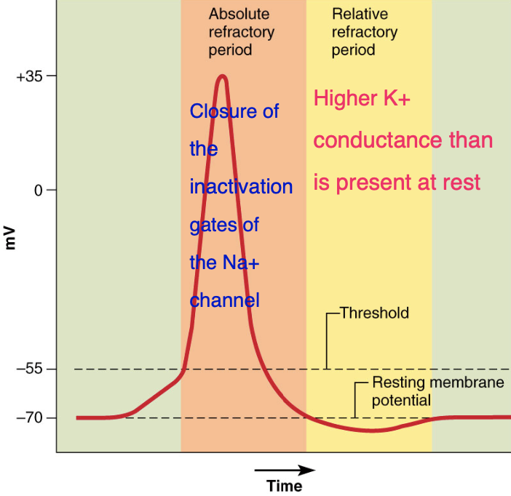
Refractory Periods
Two Stages:
1
1
Absolute Refractory Period:
The period during which a second action potential cannot be elicited, even with strong stimulus.
It will not open at all, needs to go back in RMP to start another AP.
2
Relative Refractory Period:
Can trigger new action potential if stimulus is very strong.
When the potential difference reach RMP it will be able to be stimulated.
Needs a strong (suprathreshold) stimulus to cross the threshold.
Notes:
Organization
Replaced picture
Added word to note “suprathreshold”

Slide 9
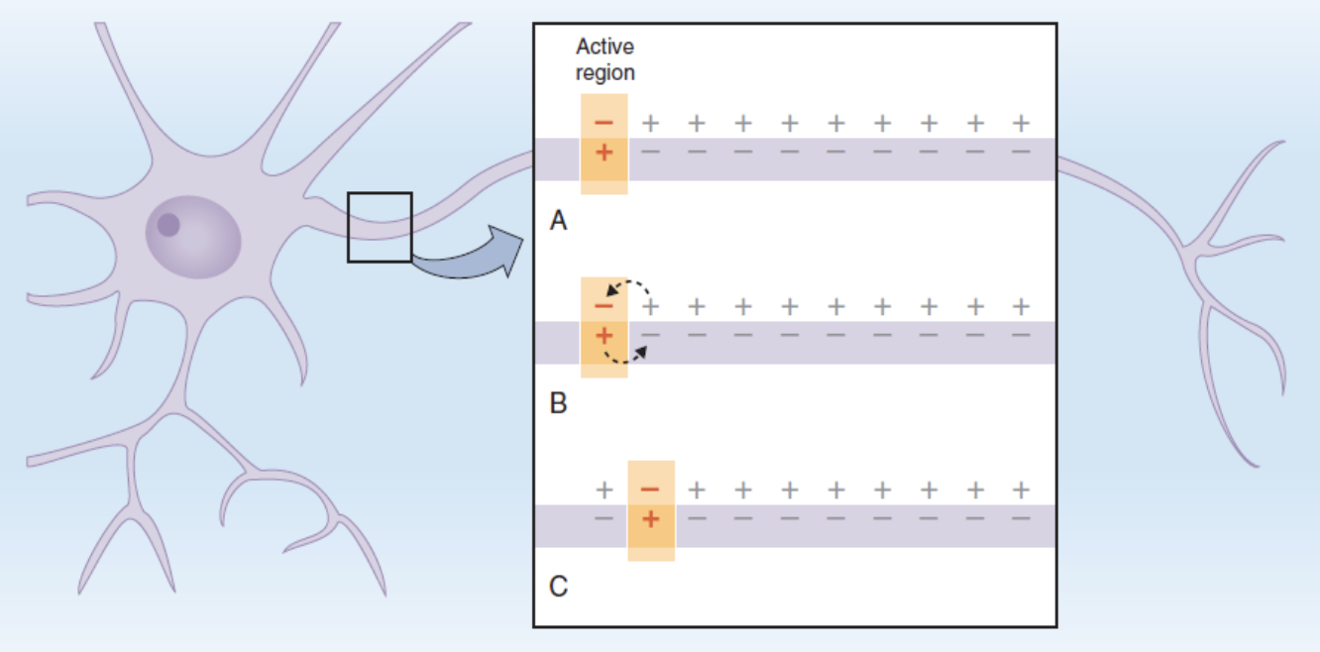
Propagation of Action Potential
Video
Propagation of Action Potential: the spread of depolarization down nerve fiber by local currents
A
The initial segment of the axon is fires an AP.
Potential difference will be reversed (inside → +ve & outside→ -ve due to depolarization).
The adjacent area (neighbouring segment) is inactive.
1
B
At the active site: +ve charges inside the nerve flow to the adjacent inactive area.
C
1
Local current flow causes the adjacent area to be depolarized to threshold and fire an AP.
The original active region has repolarized back to RMP.
Notes:
Organization (changed diagram; modified the steps to ABC to be consistent with the picture)
Title
Color index
Link added
Deleted picture (the doctor’s picture is neater & conveys the idea in a simpler way)

Slide 10
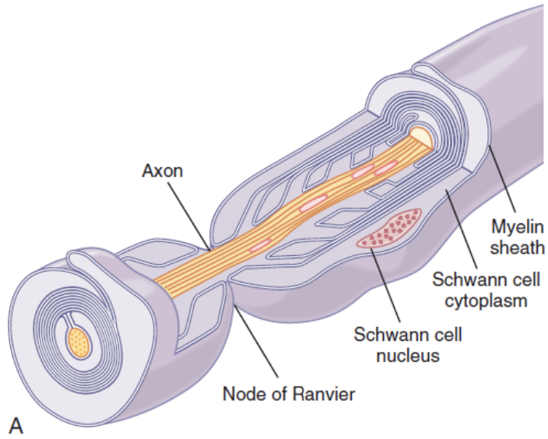
Conduction Velocity
Conduction velocity: speed at which action potentials are conducted (propagated) along a nerve or muscle fiber.
Mechanisms that increase conduction velocity along a nerve:
(1) Nerve diameter | Larger diameter → faster transmission. Because: large fibre offers less internal resistance (R_{i}) to local current flow → more ions will flow. Internal resistance is inversely proportional to cross sectional area.
(2) Myelination | Increase membrane resistance, which forces currents to flow along the path of least resistance of the axon interior. Myelin: a lipid insulator that makes it more difficult for charges to flow between ICF & ECF. The layers of schwann cell membrane contain sphingomyelin (lipid), which is excellent electrical insulator that decrease ion flow through membrane. Node of Ranvier: small uninsulated area where ions can flow with ease.
Notes:
(reorganized text into 2 boxes)

Slide 11
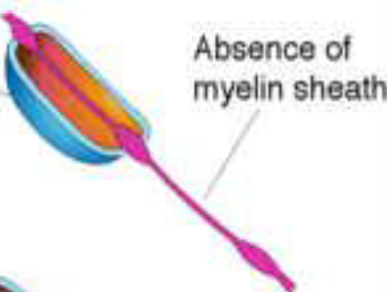
Saltatory Conduction
Lost Myelination
Video
Saltatory conduction: jumping of action potentials from one node of ranvier to next as they propagate along myelinated fiber.
Loss of myelin sheaths around nerve causes a decrease in membrane resistance → current (impulse) can leak out across the membrane during conduction of local currents.
Values
Multiple Sclerosis
التصلب اللويحي
Conserves energy for axon (only nodes are depolarized)
Prevents ions from flowing outside
Increase conduction velocity
Autoimmune disease
Immune system attacks: myelin sheaths around axon + axon itself.
Usually young adult are affected.
Blindness & problems controlling muscles (ultimately paralysis)
Scar tissue (sclerosis)
replace some damaged cells.
Notes:
Organization (slight; resized boxes; enlarged picture)
Modified link added
The note’s location is better at myelin sheath rather than at saltatory conduction
Added the translation “التصلب اللويحي”
Added part of missing picture from slides

Slide 12
MCQs:
A |  | B |  | C |  | D
A |  | B |  | C |  | D
A |  | B | Inactivation gate | C |  | D
A |  | B |  | C |  | D
A | Expends a lot of energy from axon | B | Increases conduction velocity | C | Increases flow of ions outside of axon | D | Lower speed of reflex
Q1: At what voltage do the voltage gated Na+ channels usually open?
+35
+4
-55
-70
Q2: When does the relative refractory period occur?
Resting potential
Depolarization
Repolarization
Hyperpolarization
Q3: At rest, which voltage gated Na+ channel(s) is/are open?
Activation gate
Both gates
None of the gates
Q4: Larger diameter neurons are faster because
They offer less internal resistance
The action potential will be more positive
More Na+ can come in through the channels
There are more ion channels
Q5: What effect does the myelination of neurons have
Answers: 1. C 2.D 3.B 4.A 5.B
special thanks to team 441 Qbank
Notes:
New slide
Organized pictures
Combined 2 points:
“All-or-none” principle: impulse from motor neuron will cause contraction in all muscle fibers it innervates or none.
Motor Unit follows “all-or-none” principle.

Slide 13
Team Leaders
Dema Alkhattabi
Waleed Alrashoud
Team Members
Nouf Aldalaqan
Farah Alqazlan
Masheal Alasmri
Amani Alotaibi
Maram Beyari
Maha Alkoryshy
Nouf Aldhalaan
Othman Alabdullah Khaled Bin-Arbeed
Rakan Alromayan
Talal Alharbi
Abdullah AlShehri
Mohammad Alrashed Saud Al-Taleb
Sultan Al-Abdullah Saad AlAngri
Abdullah Awartani
Special Thanks to Physiology Team441
Physio442@gmail.com

