Slide 1
4
Notes
Color index:
Main text
Important
Girls slides
Boys slides
Dr notes
Extra
Neuromuscular Transmission
Editing File

Slide 2
Objectives
The physiologic anatomy of the skeletal muscle and NM junction.
Motor end plate potential and how action potential and excitation-contraction coupling are generated in skeletal muscle.
Drugs/diseases affecting the neuromuscular transmission.
Notes:
Only the objectives of this lecture
Size

Slide 3
Chemical Signals
In Female Slides Only
One neuron will transmit info to another neuron or to a muscle or gland cell by releasing neurotransmitters (chemicals).
Neurotransmitters: chemicals released from a neuron to another neuron/muscle/gland to transmit information.
Axon
1
Synapse*: the site of chemical interplay (where neurons release neurotransmitters to transmit info).
ECF
Pre-synaptic neuron
(synaptic knob)
2
Synaptic knob*: axon terminal.*
Synaptic knob will meet another cell (neuron - muscle fiber - gland cell).
3
Transduction: conversion of an electrical signal into a chemical signal.
Transduction site: synapse
Synapse (synaptic cleft)
Receptors
Post-synaptic neuron
Text
Text
Text
Text
Text
Notes:
Organization
added “Transduction site: synapse” مو ١٠٠٪ متأكدة لو ترجع للساينابس أو الساينابتك نوب same; not sure
restated the definition of neurotransmitter (أحسه مكرر ومو ضروري)
Added picture from male slides
Deleted a picture ما لقيتها بالسلايدز الأصلية ومو مرة مفيدة؛ حطيتها بالسلايد اللي قبل
Replaced the doctor’s picture with a neater drawing (same labelling)

Slide 4
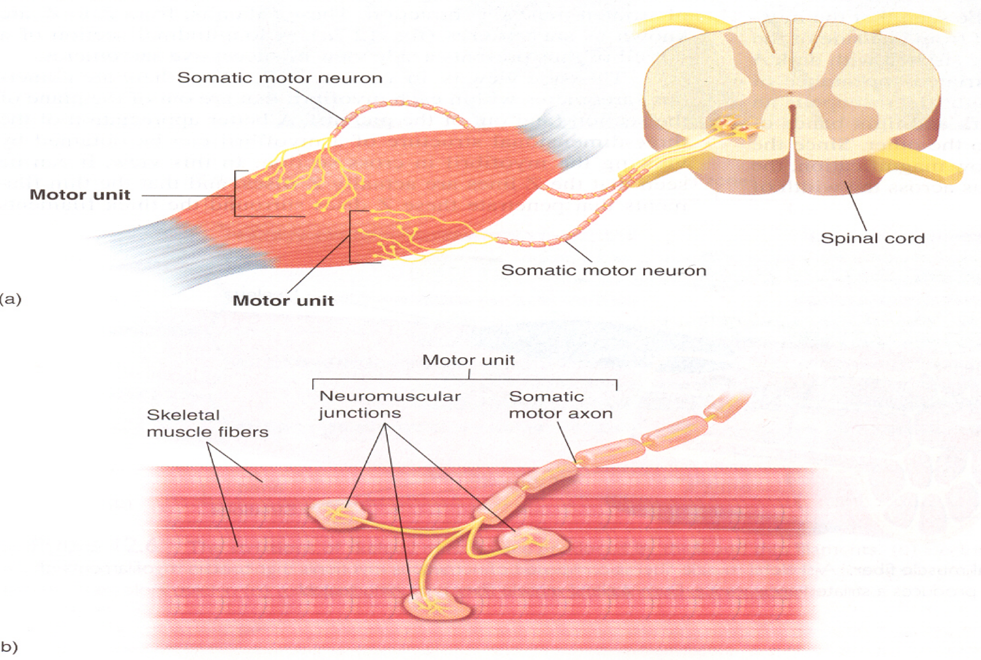
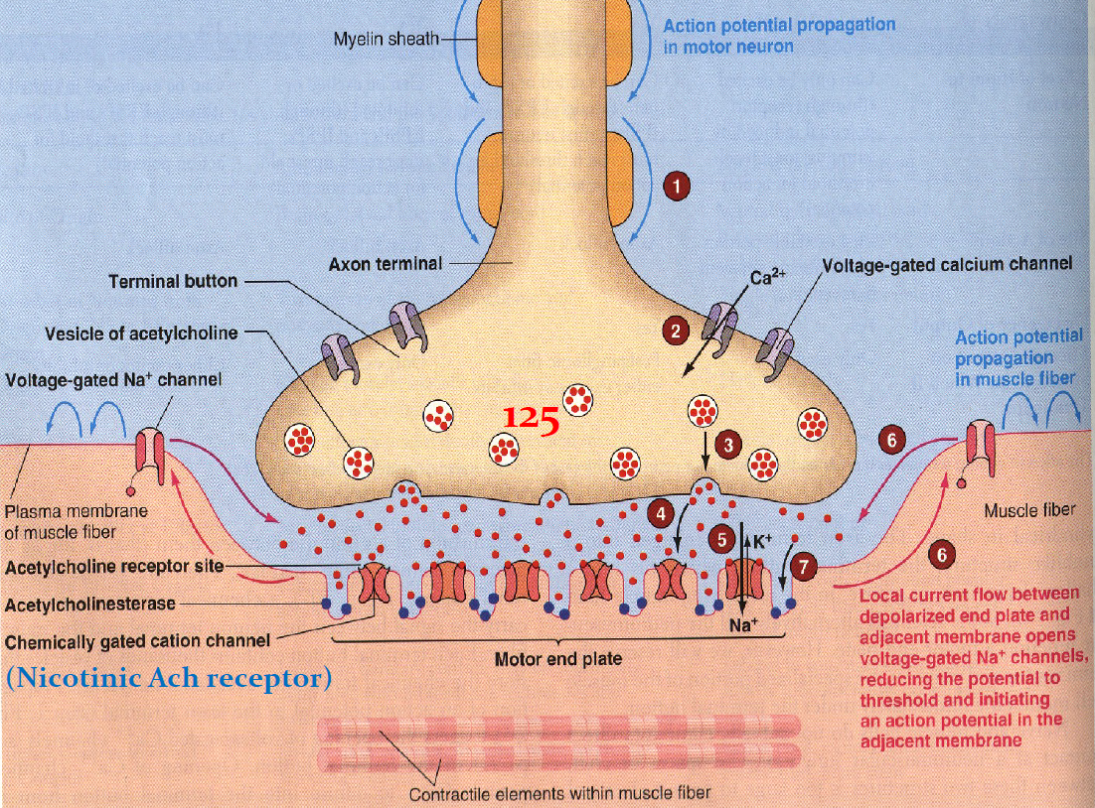
Neuromuscular Junction (NMJ)
Neuromuscular junction (NMJ): where the transmission of impulses from nerve endings to skeletal muscle fibers occurs.
439:
Neuromuscular junction: a chemical synapse formed by the contact between a motor neuron and a muscle fiber (part of a motor unit).
Motor unit: made up of a motor neuron and the skeletal muscle fibers it innervates.
Notes:
Organization
Note background
Female slides
Added missing picture from males slides

Slide 5
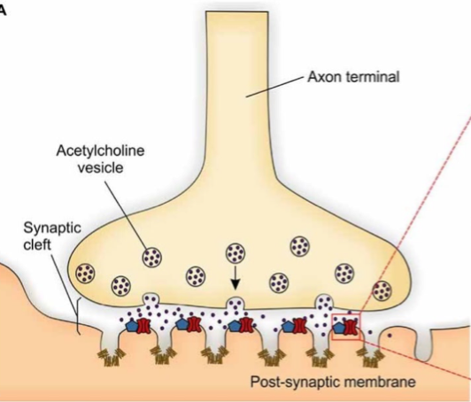
Physiologic Anatomy of the Neuromuscular Junction
Presynaptic terminal
Synaptic vesicles
Acetylcholine (Ach)
Synaptic trough / gutter
Synaptic space/cleft
Acetylcholinesterase
Postsynaptic terminal
Subneural cleft
Notes:
Organization (Arrows thickness & colour + Text size & colour)
Title

Slide 6
Physiologic Anatomy of the Neuromuscular Junction
Neuromuscular Junction
Detailed Next Slide
Motor End Plate
Presynaptic terminal
Postsynaptic Terminal
Synaptic Trough/Gutter
The invaginated membrane
Synaptic Cleft/Space
Space between terminal & fiber membrane
Axon Terminal
Subneural Clefts
Acetylcholinesterase
Synaptic Vesicles
Numerous smaller folds of the muscle membrane.
Acetylcholine (Ach)
Notes:
Added picture
Title
Organization
Ach was pink while it’s mentioned in both slides

Slide 7
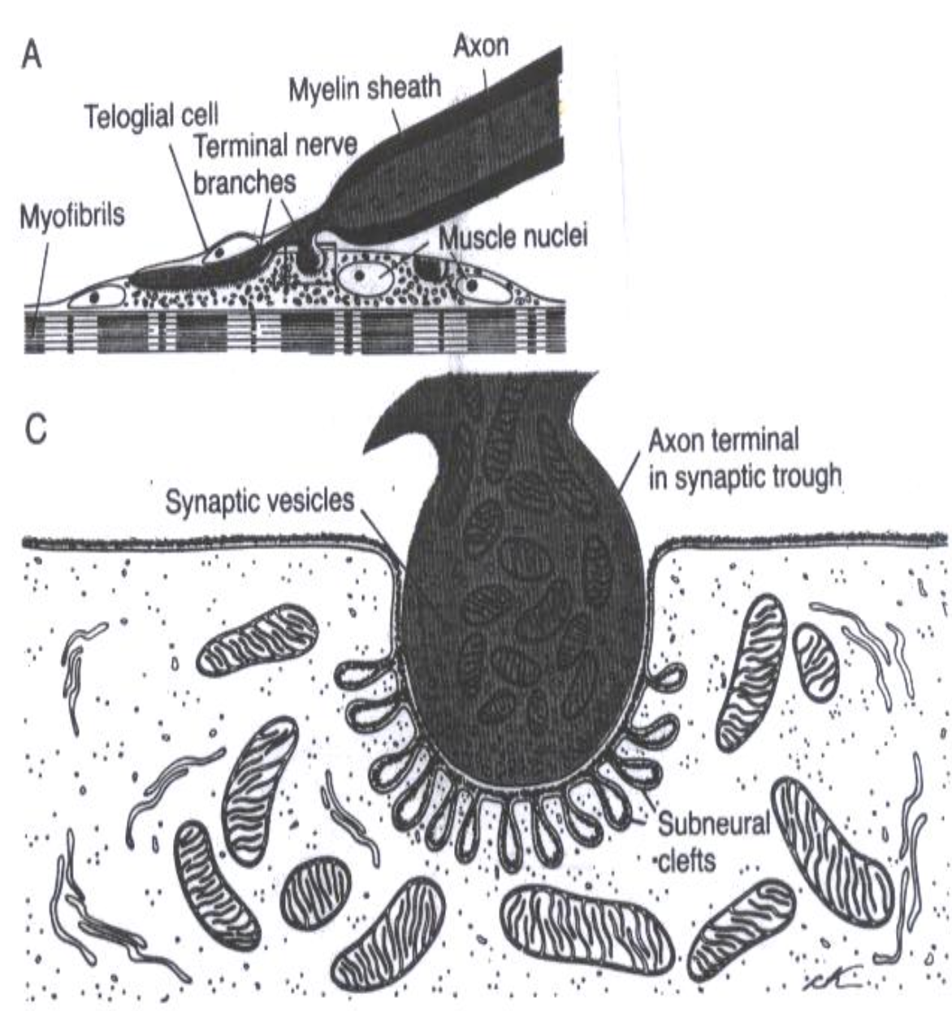
Motor End Plate
In Female Slides Only
Motor End Plate
Entire structure of axon terminal, synaptic cleft & synaptic gutter
Synaptic Gutter/Trough
Synaptic Cleft/Space
Axon Terminal
Synaptic Gutter: muscle cell membrane which is in contact with the nerve (axon) terminal.
Contains nicotinic Ach receptors
Has subneural clefts.
Subneural Clefts: many folds in the synaptic gutter.
Ach receptors are located here.
Greatly increase surface area → allow accommodation of large numbers of Ach receptors.
Synaptic Cleft: 20 – 30 nm space between axon terminal & muscle cell membrane.
Contains cholinesterase (enzyme) → can destroy Ach.
Contains around 300,000 vesicles which contain the neurotransmitter acetylcholine (Ach).
Notes:
Added Motor end plate
Added missing fact from males slides “contains nicotinic Ach receptors” slide #10 [not sure about the location]

Slide 8
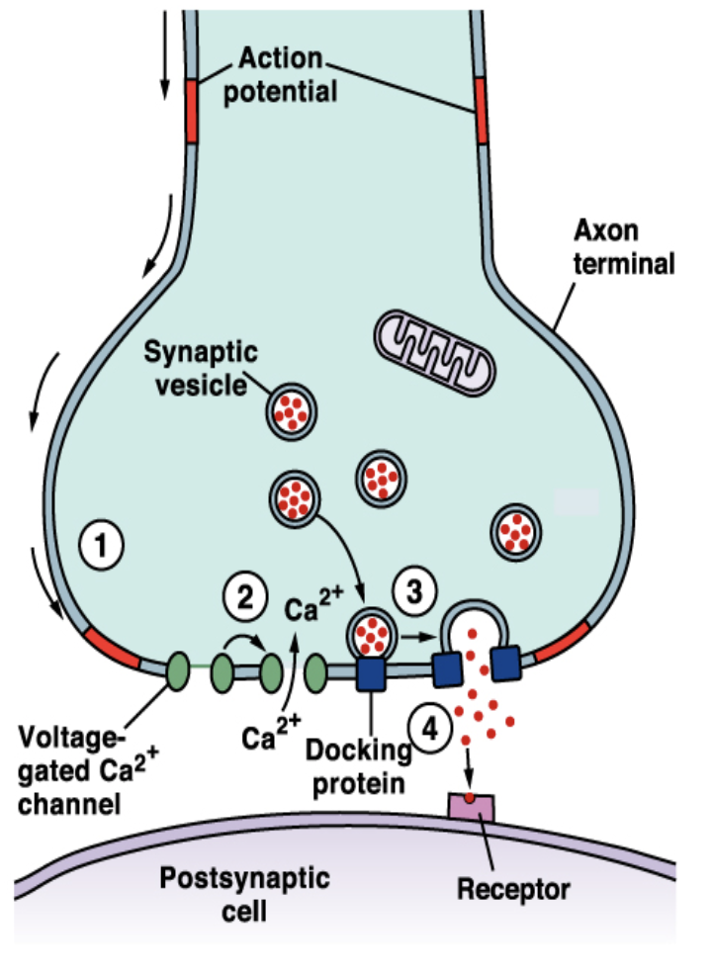
Acetylcholine
In Female Slides Only
1
Ach synthesized locally in the cytoplasm of the nerve terminal, from active acetate (acetyl coenzyme A) + choline.
1
A nerve impulse reaches the nerve terminal → opening voltage-gated Ca⁺⁺ channels.
2
Ach is rapidly absorbed into the synaptic vesicles and stored there.
2
Ca⁺⁺ diffuses from the ECF into the axon terminal.
3
Synaptic vesicles are made by Golgi Apparatus in the nerve soma (cell body).
3
Ca⁺⁺ releases Ach from vesicles by process of exocytosis.
4
Synaptic vesicles are carried by axoplasmic transport to the nerve terminal (contains around 300,000 vesicles).
One nerve impulse can release 125 Ach vesicles.
The quantity of Ach released by one nerve impulse is more than enough to produce one End-Plate Potential.
5
Each vesicle is filled with around 10,000 Ach molecules.
Notes:
Merge 2 slides
Added note: “voltage-gated”

Slide 9
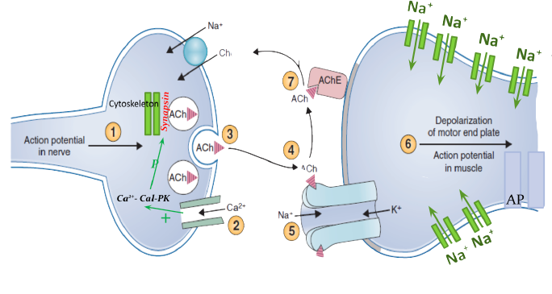
Effect of Ach on the Postsynaptic Muscle Membrane
Male’s Dr: Important Slide, Possible SAQ
The process of Ach release, action, and destruction takes about 5 -10 ms.
1
Ach combines with its receptors in the subneural clefts. Two molecules of Ach must attach to the receptor
Ach-gated channels open → sudden influx of Na⁺ → increase electrical potential in +ve direction (50 -75 mV) → local EPP created → voltage gated Na⁺ channels open.
6
2
Sodium (Ach) channels open → Na⁺, Ca⁺⁺, or K⁺ ions to move through easily. But not -ve ions (e.g. Cl⁻).
3
Na⁺ diffuses into the muscle (More Na⁺ ions will pass through) → End-Plate Potential (EPP - local, non-propagated potential)
4
EPP triggers a muscle AP which spreads down inside the muscle → it contracts.
5
Ach is hydrolyzed by Acetylcholinesterase / cholinesterase (enzyme) into Acetate + Choline.
Choline → actively reabsorbed into the nerve terminal (used again to form Ach).
Calcium will bind to Cal-Pk → Inhibits synapsin (which stores Ach)
AP Spreads along the T Tubules
Text
Text
Text
Text
Text
Notes:
Color index.
Merged 2 slides.

Slide 10
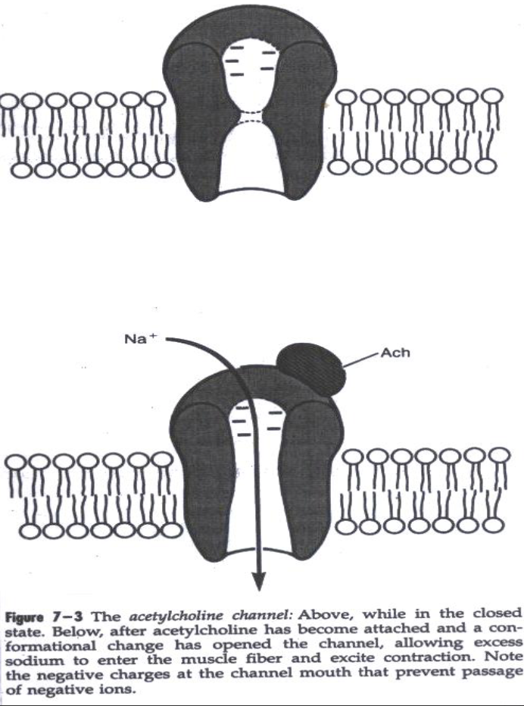
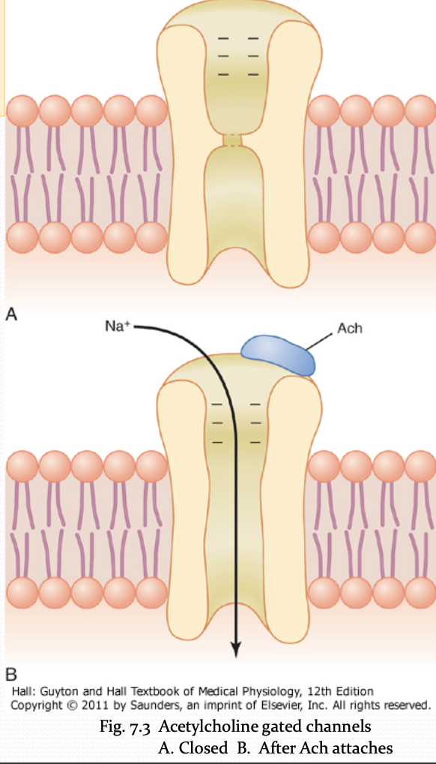
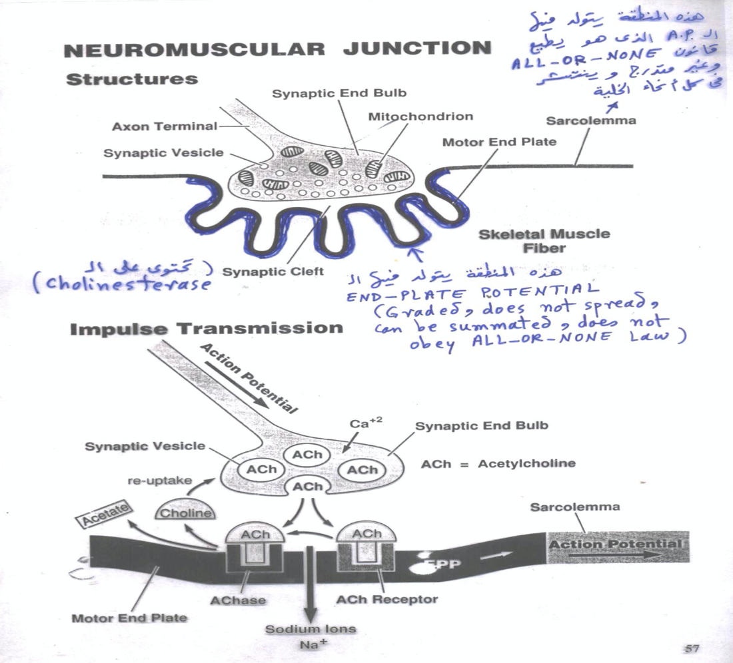
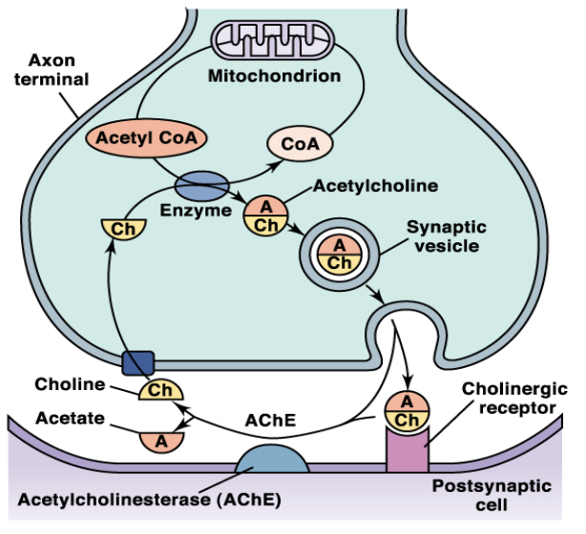
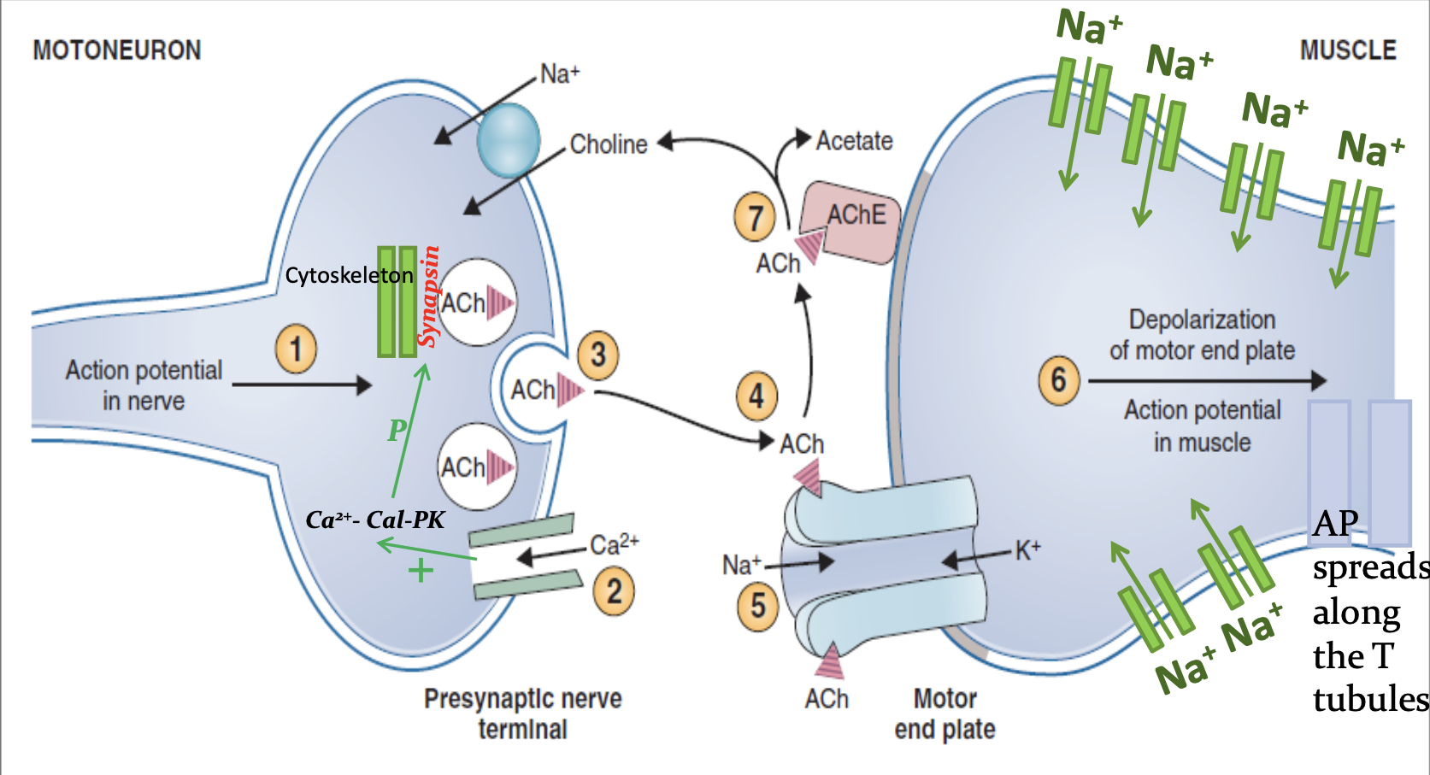
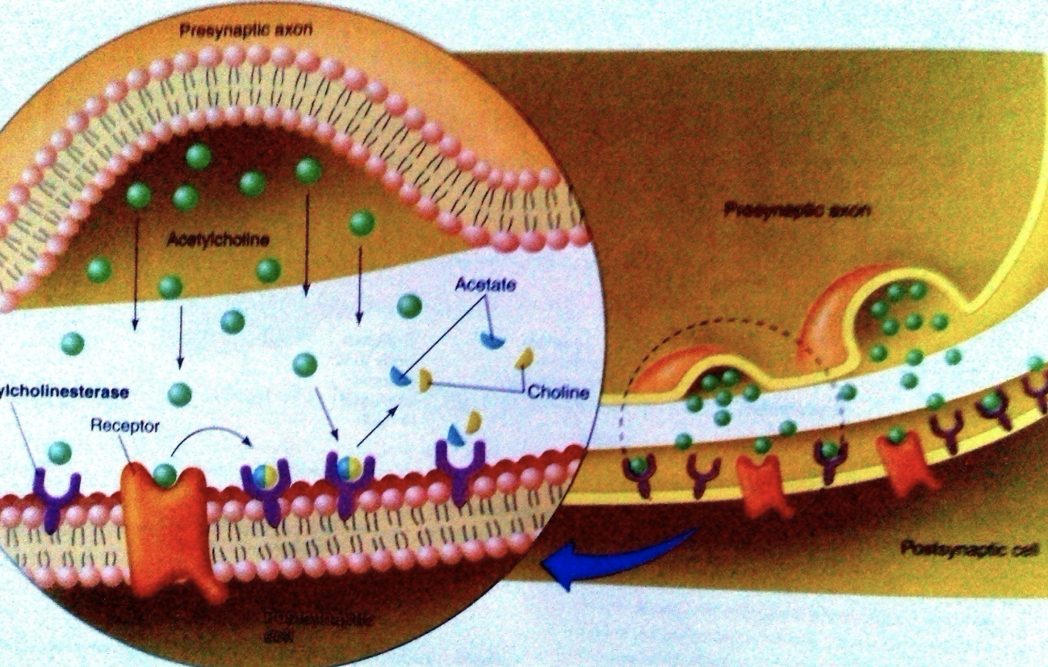
Destruction of Ach
Notes:
New slide (collected pictures) → organized

Slide 11
Muscle Action Potential (AP)
In Male Slides Only
 | Skeletal Muscle | Large Nerves
Resting Membrane Potential | -80 to -90 mV | -80 to -90 mV
Duration of the Action Potential | Lasts 1 - 5 msec | Lasts 0.2 - 1 msec
Velocity of Conduction | 3 - 5 m/sec | 39 - 65 m/sec
Text
Text
Text
Text
Text
Notes:
Male slides
Capitalization

Slide 12
Drugs that Enhance Transmission at the neuromuscular junction | Drugs that Stimulate the muscle fiber by Ach-like action: | Methacholine | They act for minutes or hours Not destructed by cholinesterase
 |  | Carbachol
 |  | Nicotine.
 | Drugs that Stimulate the NMJ by inactivating Acetylcholinesterase: | Neostigmine | They inactivate acetylcholinesterase for several hours
 |  | Physostigmine
 |  | Diisopropyl fluorophosphate (nerve gas poison) | They inactivate acetylcholinesterase for weeks Can cause death because of respiratory muscle spasm
Drugs that Block Transmission at the neuromuscular junction | Curare | Prevent passage of impulses from the nerve ending into the muscle by blocking the action of Ach on it’s receptors MEP
 | Curariform like-drugs
 | Botulinum toxin | Bacterial poison that decreases the quantity of Ach release by the nerve presynaptic terminals.
(Cause muscle contraction)
(Cause muscle Relaxation)

Slide 13
Myasthenia-Gravis Disease
Definition
An autoimmune disease usually in adult females.
Patients develop antibodies against their own Ach receptors → decreased/unformed EPP → weakness/paralysis of muscles (depends on severity of disease).
EPP are too small to initiate opening of voltage-gated Na⁺ channels → no AP → muscles can’t contract.
Occurs in 1/20,000 persons.
Patients have 20% of Ach receptors.
Symptoms
Ptosis (drooping eyelid)
Dysarthria
Dysphagia
Proximal limb weakness in hands & feet.
Affects: eyelids - extraocular bulbar - proximal limb muscles.
Muscle weakness from NMJ inability to transmit enough signals from nerve fibers to muscle fibers.
Patient may die from respiratory failure from respiratory muscle paralysis.
Treatment
Anti-cholinesterase drugs
(eg: Neostigmine)
Corticosteroids and immunosuppressant drugs inhibit the immune system, limiting antibody production.
Drug inactivates cholinesterase (destroys Ach) → allows large amounts of Ach to accumulate in the synaptic space → act on remaining healthy receptors → good EPP formed → contraction.
Definition
An autoimmune disease usually in adult females.
Patients develop antibodies against their own Ach receptors → decreased/unformed EPP → weakness/paralysis of muscles (depends on severity of disease).
EPP are too small to initiate opening of voltage-gated Na⁺ channels → no AP → muscles can’t contract.
Occurs in 1/20,000 persons.
Patients have 20% of Ach receptors.
Symptoms
Ptosis (drooping eyelid)
Dysarthria
Dysphagia
Proximal limb weakness in hands & feet.
Affects: eyelids - extraocular bulbar - proximal limb muscles.
Muscle weakness from NMJ inability to transmit enough signals from nerve fibers to muscle fibers.
Patient may die from respiratory failure from respiratory muscle paralysis.
Treatment
Anti-cholinesterase drugs
(eg: Neostigmine)
Corticosteroids and immunosuppressant drugs inhibit the immune system, limiting antibody production.
Drug inactivates cholinesterase (destroys Ach) → allows large amounts of Ach to accumulate in the synaptic space → act on remaining healthy receptors → good EPP formed → contraction.
Notes:
Moved “affects: …” to symptoms
“respiratory failure” → blue
Added tiny picture of ptosis + its meaning (drooping eyelid)

Slide 14
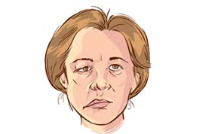
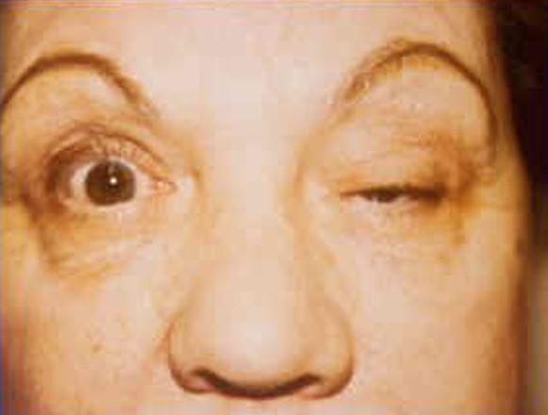
Myasthenia-Gravis Disease
Facial muscle weakness
Ptosis
Notes:
-Deleted-

Slide 15
MCQs:
Answers: 1. A 2. A 3. B 4. D 4. B
Q1: Which of the following drugs decrease the quantity of Ach release by the nerve terminal?
A | Botulinum Toxin | B | Methacholine | C | Neostigmine | D | Both A and C
Q2: What enzyme breaks down acetylcholine into acetic acid and choline?
A | Acetylcholinesterase | B | Creatine Kinase | C | Fumarase | D | Esterase
Q3: Which of the following ions stimulates neurotransmitter secretion?
A | Sodium | B | Calcium | C | Magnesium | D | Potassium
Q4: What part of the muscle cell allows an action potential to spread uniformly throughout the cell?
A | Neuromuscular junctions | B | Sarcolemma | C | Sarcoplasmic reticulum | D | T-Tubules
Q5: A 12-year-old boy presents the patient has dysarthria and ptosis of the left eye. Additional testing indicates the presence of anti-acetylcholine antibodies in the plasma. What is the initial diagnosis?
A | Multiple Sclerosis | B | Myasthenia Gravis | C | Astrocytoma | D | Grave’s Disease
Notes:
New slide
Organized pictures
Combined 2 points:
“All-or-none” principle: impulse from motor neuron will cause contraction in all muscle fibers it innervates or none.
Motor Unit follows “all-or-none” principle.

Slide 16
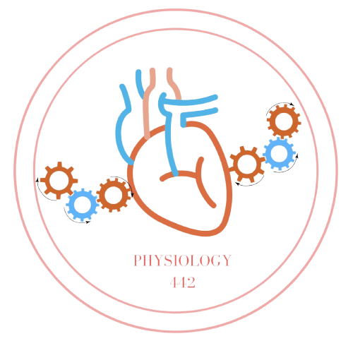
Team Leaders
Dema Alkhattabi
Waleed Alrashoud
Team Members
Nouf Aldalaqan
Farah Alqazlan
Masheal Alasmri
Amani Alotaibi
Maram Beyari
Maha Alkoryshy
Nouf Aldhalaan
Othman Alabdullah Khaled Bin-Arbeed
Rakan Alromayan
Talal Alharbi
Abdullah AlShehri
Mohammad Alrashed Saud Al-Taleb
Sultan Al-Abdullah Saad AlAngri
Abdullah Awartani
Special Thanks to Physiology Team441
Physio442@gmail.com

