Slide 1
5
Notes
Physiology of
Muscle Contraction
Editing File

Slide 2
Objectives
The physiologic anatomy of the skeletal muscle and NM junction.
Motor end plate potential and how action potential and excitation-contraction coupling are generated in skeletal muscle.
The molecular mechanism of skeletal muscle contraction & relaxation.
Sliding filament mechanism.
The general mechanism of skeletal muscle contraction.
Drugs/ diseases affecting neuromuscular transmission.
Notes:
DONE
Size
deleted “Drugs/ diseases affecting the neuromuscular transmission”
Added “the general mechanism of skeletal muscle contraction”

Slide 3
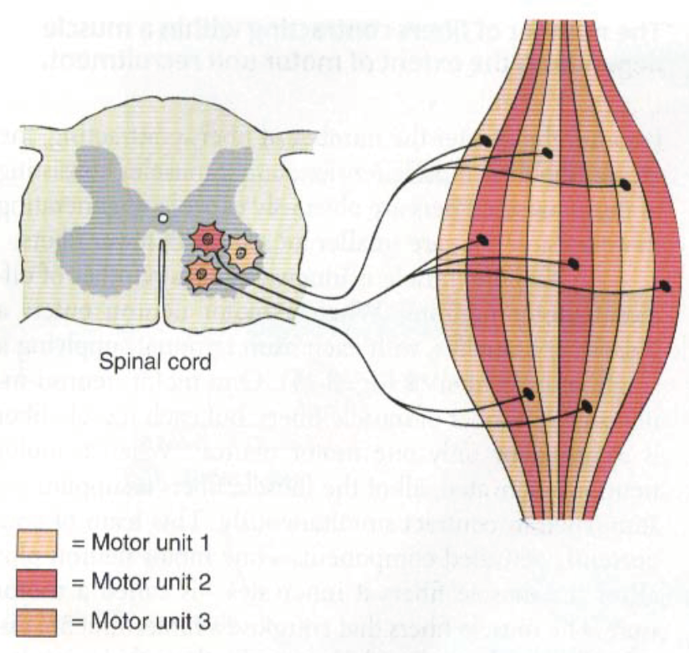
Muscle Action Potential (AP)
The Motor Unit
Motor unit: Somatic motor neuron (Anterior Horn Cell, Axon) and all the muscle fibers it innervates.
The Muscle Action Potential (AP)
Muscle RMP = -90 mV
(same as in nerves).
Duration of AP = 1 - 5 ms
(longer duration than nerve AP “about 1 ms”).
Conduction Velocity = 3 - 5 m/s
(slower than big nerves).
Text
Text
Text
Text
Text
Notes:
Added “Few thousands
Added boys slide
“above” 1 ms → “about” 1 ms
Moved “40% of the body are skeletal muscles” to the slide that’s full of pictures
Deleted “In Males Slides Only” أخاف يحسبون السلايدة كاملة منهم يكفي أن لونه أزرق
Added picture from males slides

Slide 4
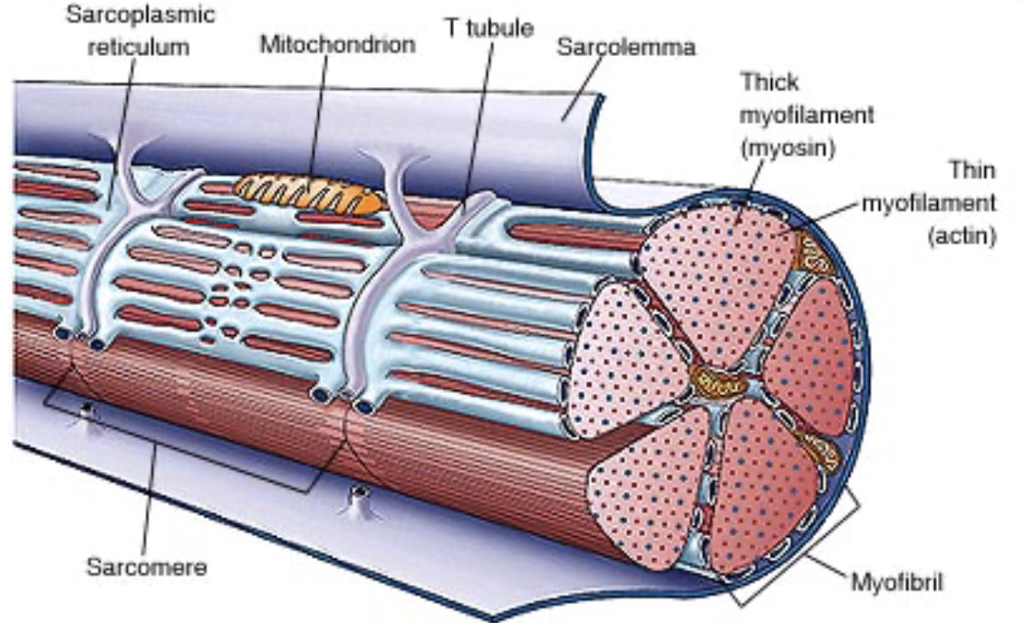
The Histology of the Muscle
Each muscle fiber (cell) has a few hundreds - thousands of myofibrils.
Video
Each muscle cell fiber is covered by sarcolemma (cell-membrane).
Each myofibril contains actin filaments (thin) & myosin (thick) filaments.
Sarcoplasm: the matrix inside muscle fiber, in which myofilaments suspended (cytoplasm).
Each myofibril (skeletal & cardiac) is striated: consisting of dark bands (A-bands) and light (I-bands).
I Band:
Actin only
T-tubules: extend from one side of muscle to other (to allow AP to travel into the cell).
H Band:
Myosin only
Sarcomere: the functional/contractile unit of muscle (myofibril) - the zone between two Z lines/discs = 2 μm in length in resting state.
Sarcoplasmic reticulum: endoplasmic reticulum in sarcoplasm, full of Ca (Ca store).
A band:
Actin & myosin
Z discs/lines: lines extend all way across myofibrils.
(This side is related to the myofibril)
Bands: region in the sarcomere that contains protein → can change in length (because Z lines will come together).
Filaments: actual proteins (actin & myosin) → NEVER change in length.
During contraction: I & H bands get shorter (the filaments length is not affected), while A band length isn’t affected.
Text
Text
Text
Text
Text
Notes:
Added “Few hundreds to few”
Separated 2 slides and merged 2
Added “skeletal and cardiac”
Moved “This slide is related to the myofibril”
Deleted 438’s note: “Function of muscle: contraction. Sarcomere (the functional contractile unit) is responsible for contraction” - repetitive of the slides
Merged 2 notes in 1 box
Added a sentence “can change in length” to “bands” note
Added “cytoplasm” to sarcoplasm
Added function of T-tubules
Added picture from female slides

Slide 5
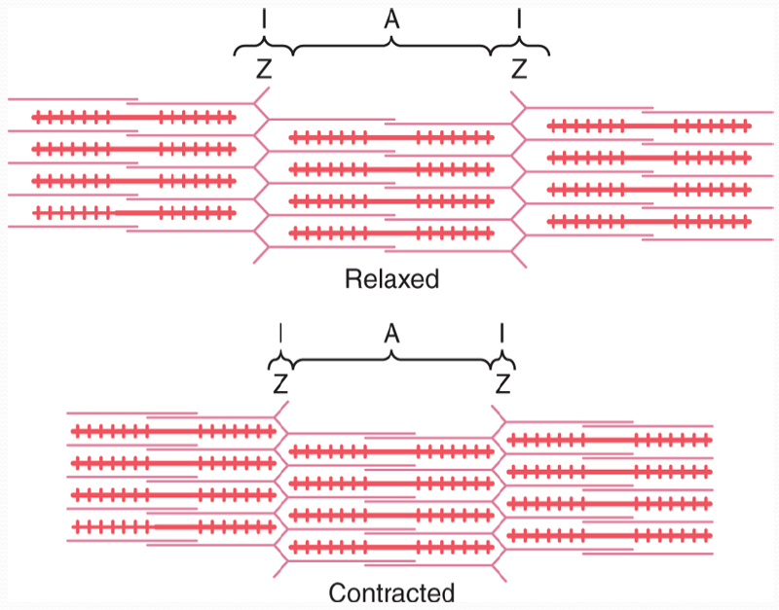
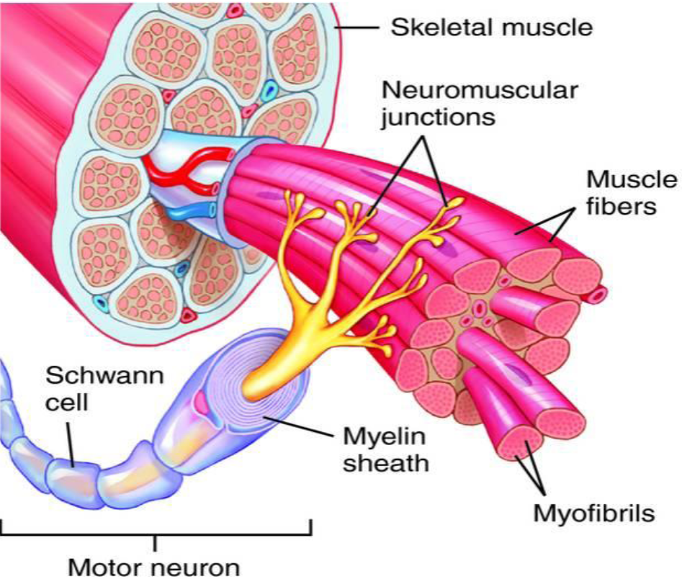
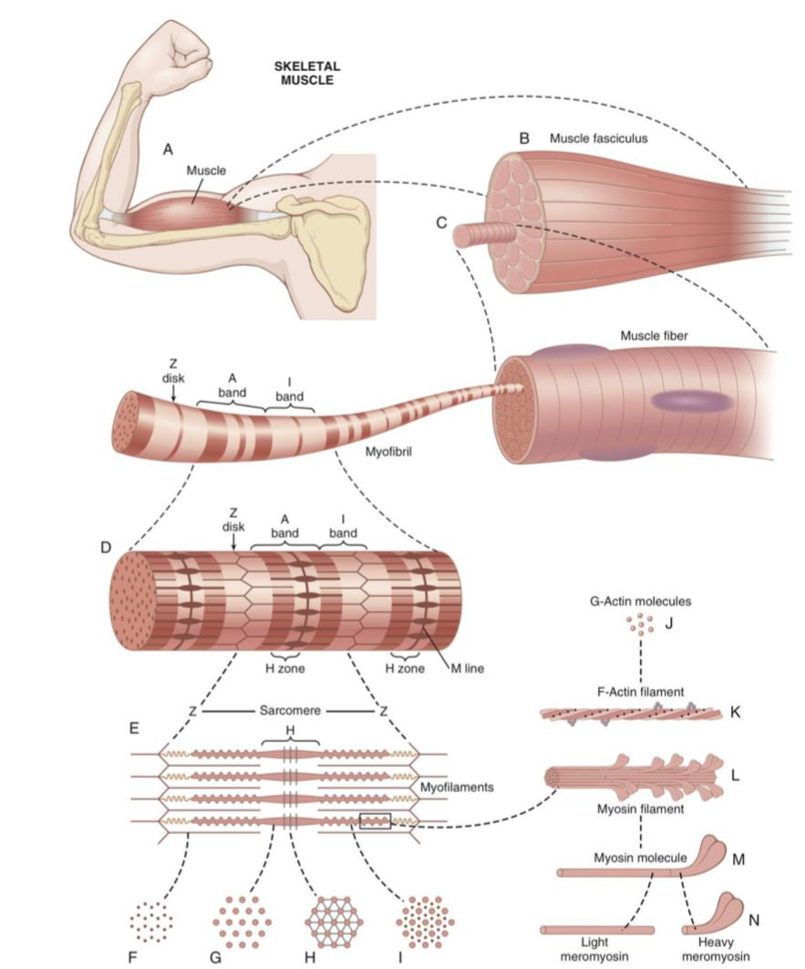
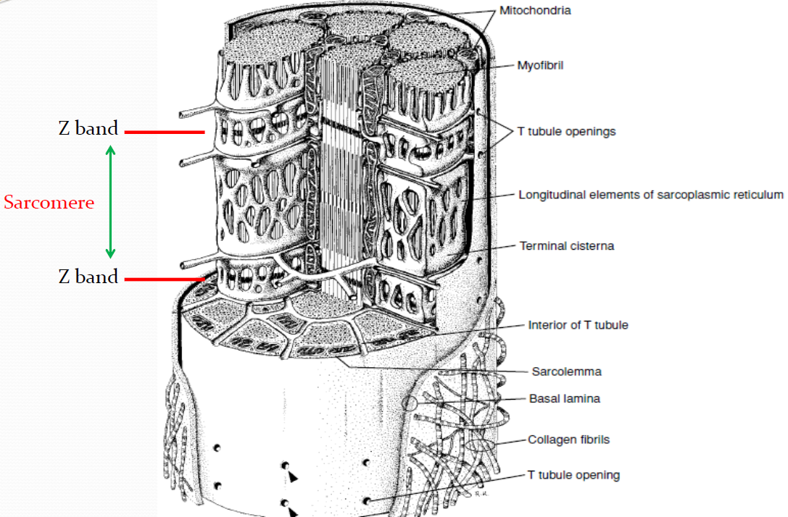
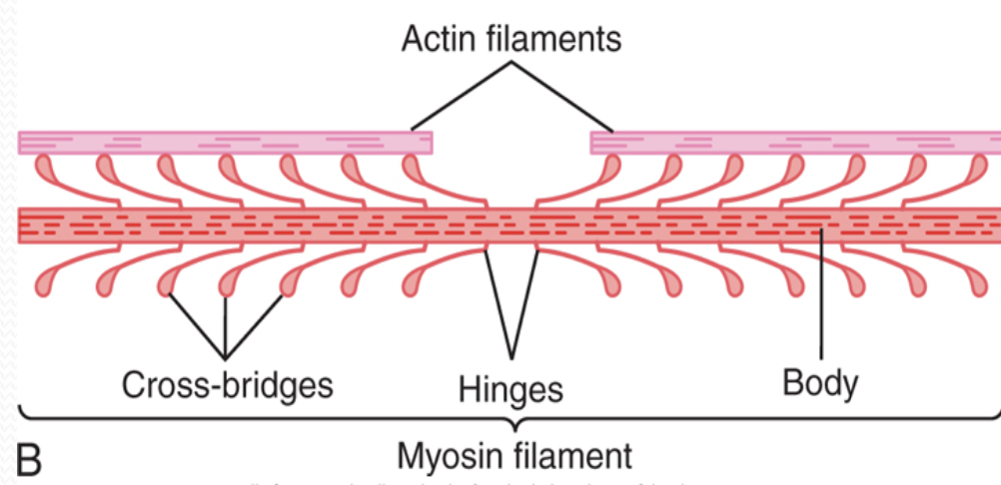
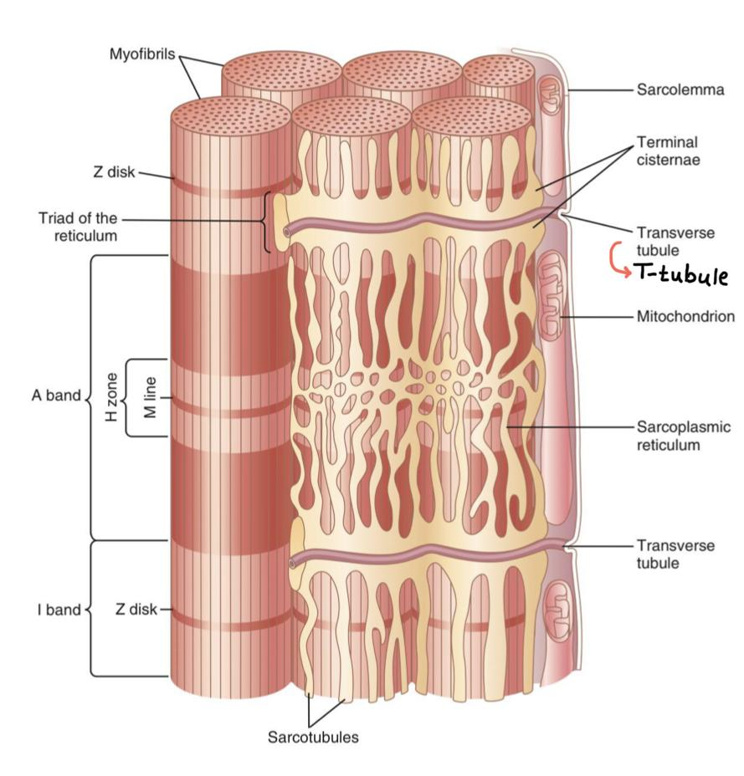
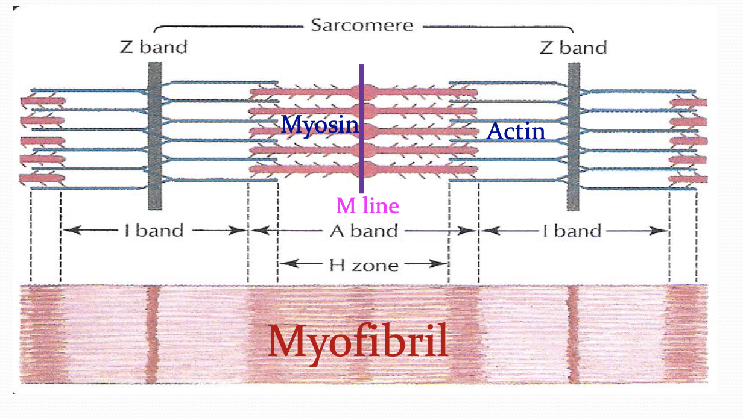
In Male Slides Only
The Histology of the Muscle
40% of the body are skeletal muscles.
Notes:
Added pictures (added 2 more from males slides)
Organized the pictures
“In Males Slides Only”
Moved “40% of the body are skeletal muscles” here

Slide 6
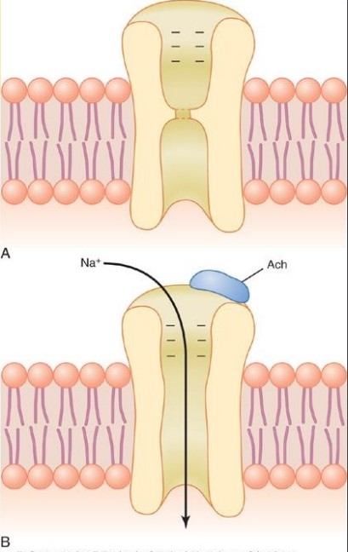
Effect of Ach on the postsynaptic muscle membrane
Two molecules of Ach must attach to the Ach receptors.
Ach-channels open and allow Na⁺ ,Ca⁺, or K⁺ ions to move through easily; but not negative ions such as Cl⁻ .
More Na⁺ ions will pass through which creates a local positive potential change inside the muscle fiber membrane, Called the End Plate Potential (EPP). (EPP is the threshold potential of skeletal muscles)
EPP spreads along the muscle fiber membrane.
A: Closed
B: after Ach attaches

Slide 7
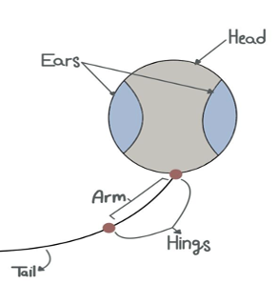
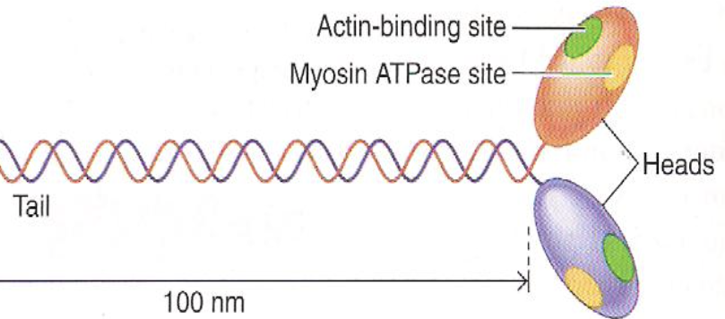
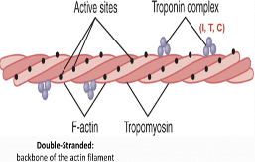
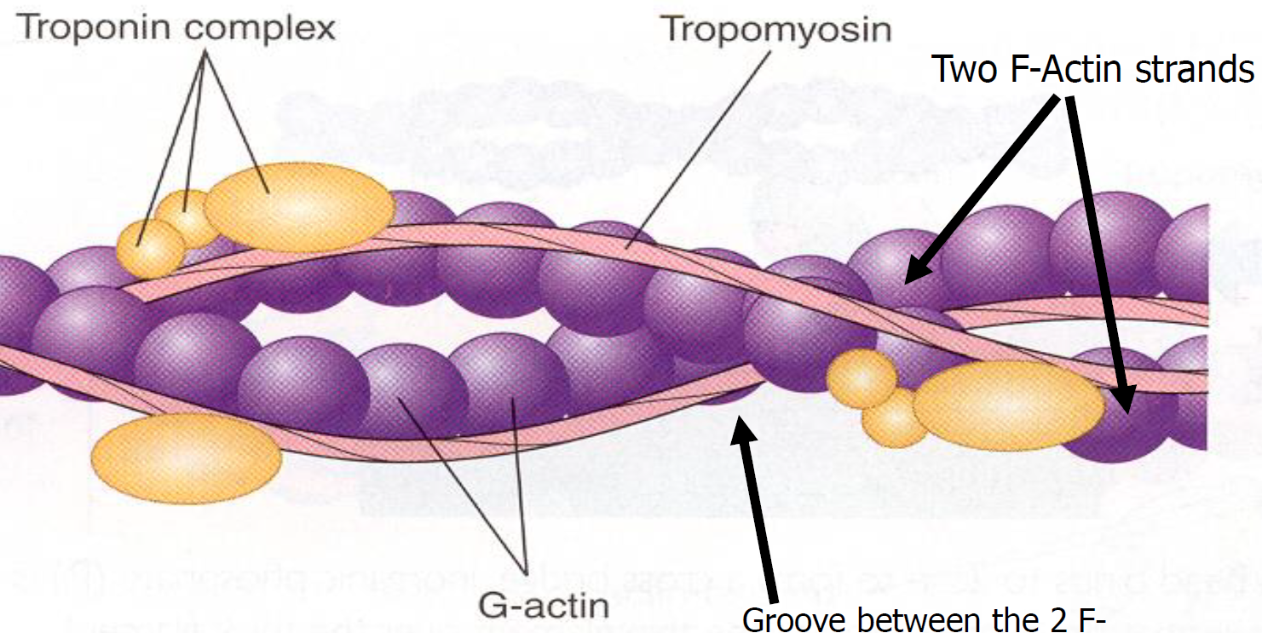
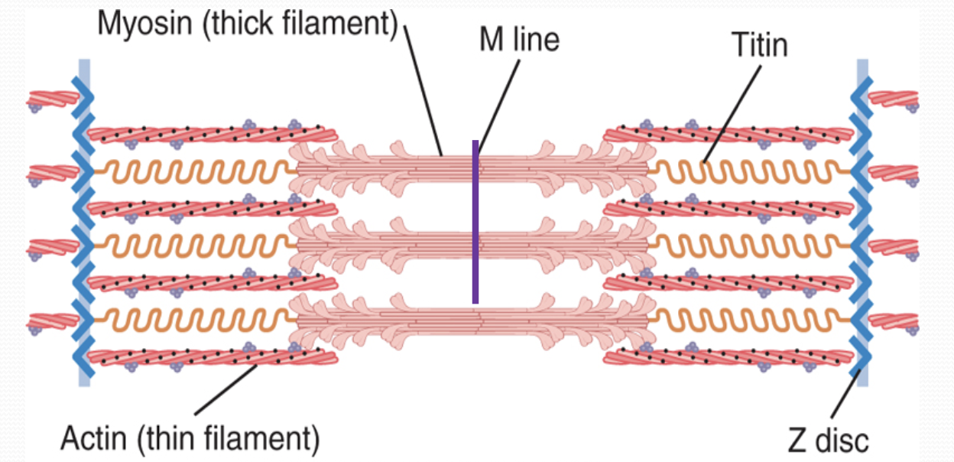
Molecular Characteristics of the Contractile Filaments
Video
Muscle Proteins
Myosin Thick Filament
Each 200 myosin molecules aggregate to form a myosin filament, from the sides of which project myosin heads in all directions
Actin Thin Filament
Double stranded backbone
Titin Filaments
Composed of multiple myosin molecules, each has:
Head (has ATP site)
Arm
Tail
Hinge (joint)
Arm + head = cross bridge.
عبارة عن نتوءات طالعة من الميوسين
Each myosin head contains:
Actin binding site
Myosin ATPase site
Composed of:
Keep the myosin & actin filaments in place.
Actin
Troponin
Tropomyosin
كأنه عقدين من اللؤلؤ لافين على بعض
Contains binding sites for myosin head (activated by Ca+) during contraction.
Complex (I - T - C)
T binds with tropomyosin.
I binds with actin.
C binds with Ca.
String which covers the active site.
تشبه عصا القولف ولها أذنين:
• الأولى: ترتبط مع ATP
• الثانية: ترتبط مع الأكتين
Notes:
Comment: I think this is in females slides only (except the blue)
Title
Color code
Background behind the notes
Fixed text boxes
Size
Added male notes
Added 2 videos
Moved a note
Deleted 438’s note as it’s repetitive of the text: 438: AP is transmitted into T-tubule next to sarcoplasmic reticulum to release Ca by opening of voltage gated Ca channels.
Moved (Ca is the hero)’s note from later slide to this slide
Slight organization

Slide 8
(Excitation – Contraction Coupling)
Molecular Mechanism of Muscle Contraction
Video
Video
Dr. Manan’s
Actin & myosin bind → contraction process starts (not the contraction it self).
Ach released by motor nerve EPP* → depolarization of CM* (muscle AP*).
Ca combines with troponin → troponin pull tropomyosin sideway → actin’s active site exposed → myosin heads (with ATP) attach to active site.
A new ATP occupies the vacant site on myosin head → triggers detachment (is an active process) of myosin from actin.
1
2
3
4
5
6
Spread of AP into T-tubule sensed by voltage-gated calcium channel dihydropyridine receptors (DHP) linked to Ryanodine receptors (calcium release channels) release
of Ca from sarcoplasmic reticulum (SR) into cytoplasm.
Myosin cross bridges bend/tilt pulling actin toward center of sarcomere (Power stroke) using ATP ADP & P released linkage between actin & myosin broken (as new ATP binds to cross bridge) ATP hydrolyzed + cross bridge go back to its original conformation.
Free myosin swings back to its original position & attached to another actin → cycle repeat itself.
Actin sticks to myosin in order for the muscle contraction to take place. How? By the Power Stroke, the actin will forward using ATP, therefore only the myosin head will move
عشان كذا الـ T-tubule مكانها جنب مخزن Ca (الـSR)
Ca is the hero of contraction process:
1) Present → contraction starts.
2) Absent → contraction stops (relaxation).
End Plate Potential
Compound Muscle
Action Potential
Myosin & actin bind → myosin changes energy from chemical to mechanical)
Notes:
Comment: I think this is in females slides only (except the blue)
Title
Color code
Background behind the notes
Fixed text boxes
Size
Added male notes
Added 2 videos
Moved a note
Deleted 438’s note as it’s repetitive of the text: 438: AP is transmitted into T-tubule next to sarcoplasmic reticulum to release Ca by opening of voltage gated Ca channels.
Moved (Ca is the hero)’s note from later slide to this slide
Slight organization

Slide 9
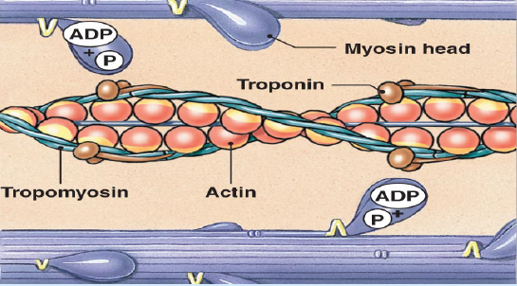
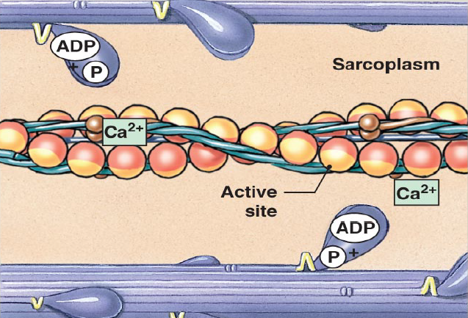
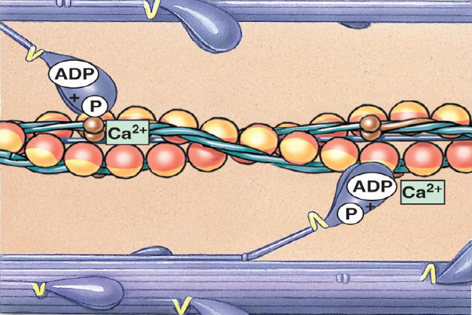
In Male Slides Only
Muscle Contraction
Video
Resting sarcomere (Inactive Factors)
Step 1: Active Site Exposure
Step 2: Cross-Bridge Formation
Heads of cross bridges bind with ATP.
ATPase activity of the myosin head immediately cleaves ATP (releasing energy which is used in the power stroke) but leaves the cleavage products (ADP + phosphate ion) bound to the head.
Troponin-tropomyosin complex binds with Ca⁺⁺ → active sites on the actin filament are uncovered → myosin heads bind with these sites.
Active sites on the actin exposed → myosin heads bind to the actin, forming cross-bridges.
*Possible SAQ ( explain 1,2,3 etc.. )*

Slide 10
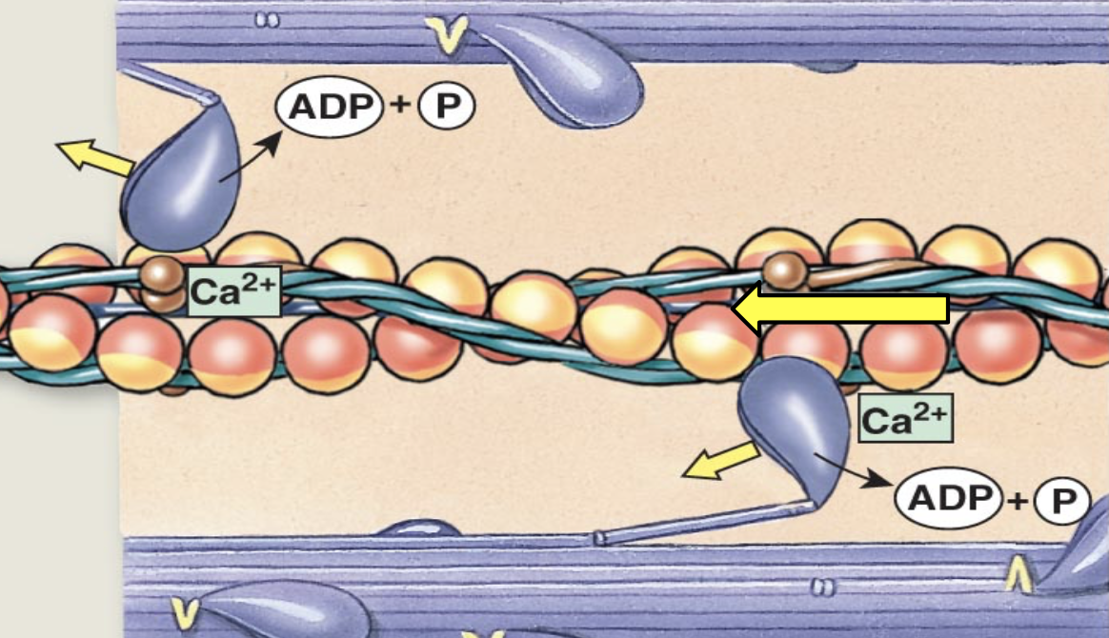
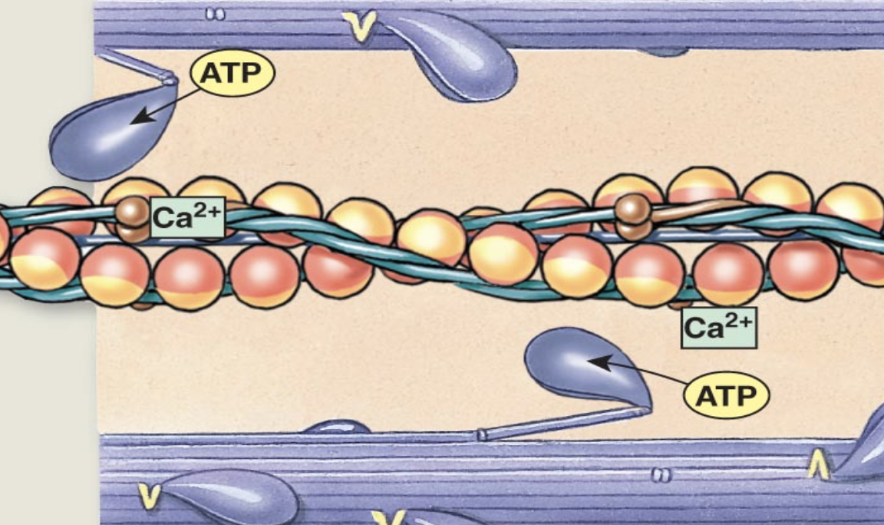
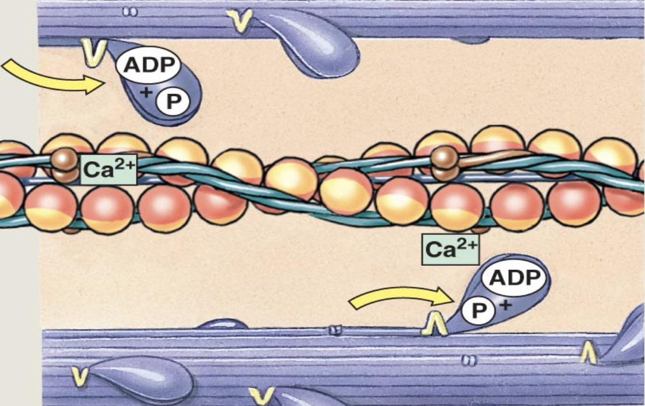
In Male Slides Only
Muscle Contraction
Step 3: Pivoting of Myosin Head
Step 4: Cross-bridge Detachment
Step 5: Myosin Reactivation
Binding head of the crossbridge with active site → conformational change in head → head tilt toward the arm of the crossbridge → power stroke is provided for pulling the actin filament.
Head of the cross-bridge tilts
→ ADP & phosphate ion are released → new molecule of ATP binds
→ detachment of head from actin.
New ATP is cleaved to begin the next cycle which “cocks” the head back to its perpendicular condition, ready to begin the new power stroke cycle.

Slide 11
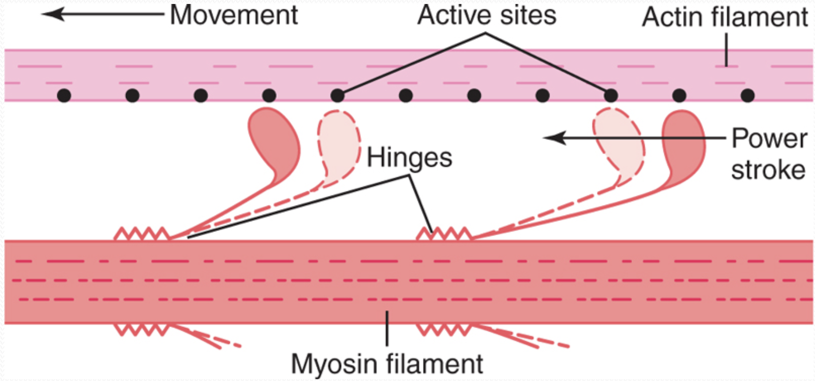
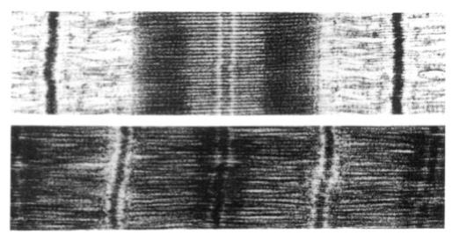
Walk-Along Mechanism
Sliding Filament Mechanism
Heads of cross-bridges bend back and forth and step by step walk along the actin filament → ends of 2 actin filaments are pulled toward the center of the myosin filament.
Muscle contraction occurs by a sliding filament mechanism.
Forces generated by interaction of the cross-bridges from the myosin filaments with the actin filaments → actin filaments slide inward among the myosin filaments.
When contraction takes place actin & myosin slide upon each other, and the distance between two z-discs decreases.
EM evidence for sliding filaments:
Notes:
New slide
Moved “excitation-contraction coupling in skeletal muscle” picture to next slide
Deleted “males slides only” and colored males text in blue, girls in pink
Added “EM evidence for sliding filaments”

Slide 12
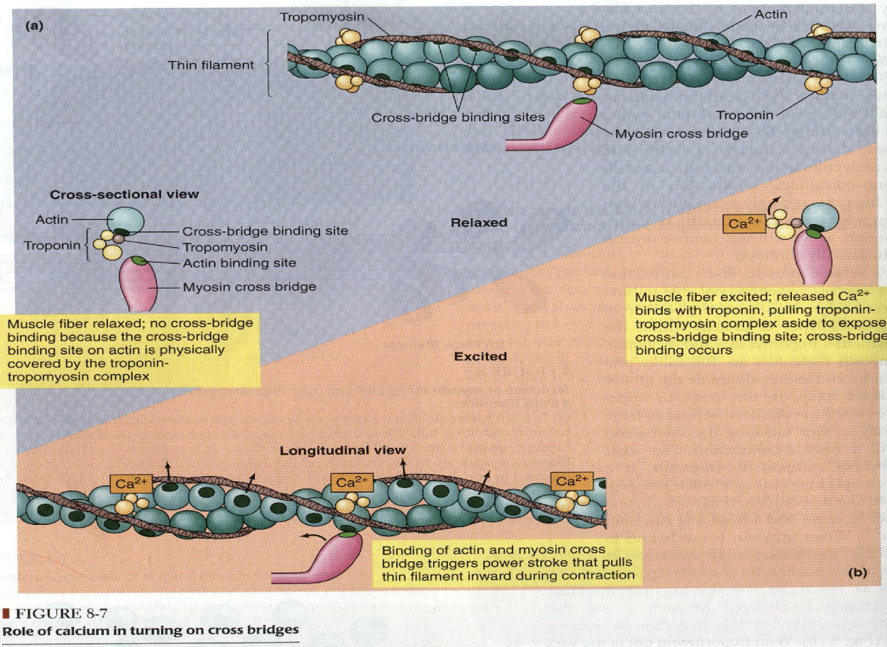
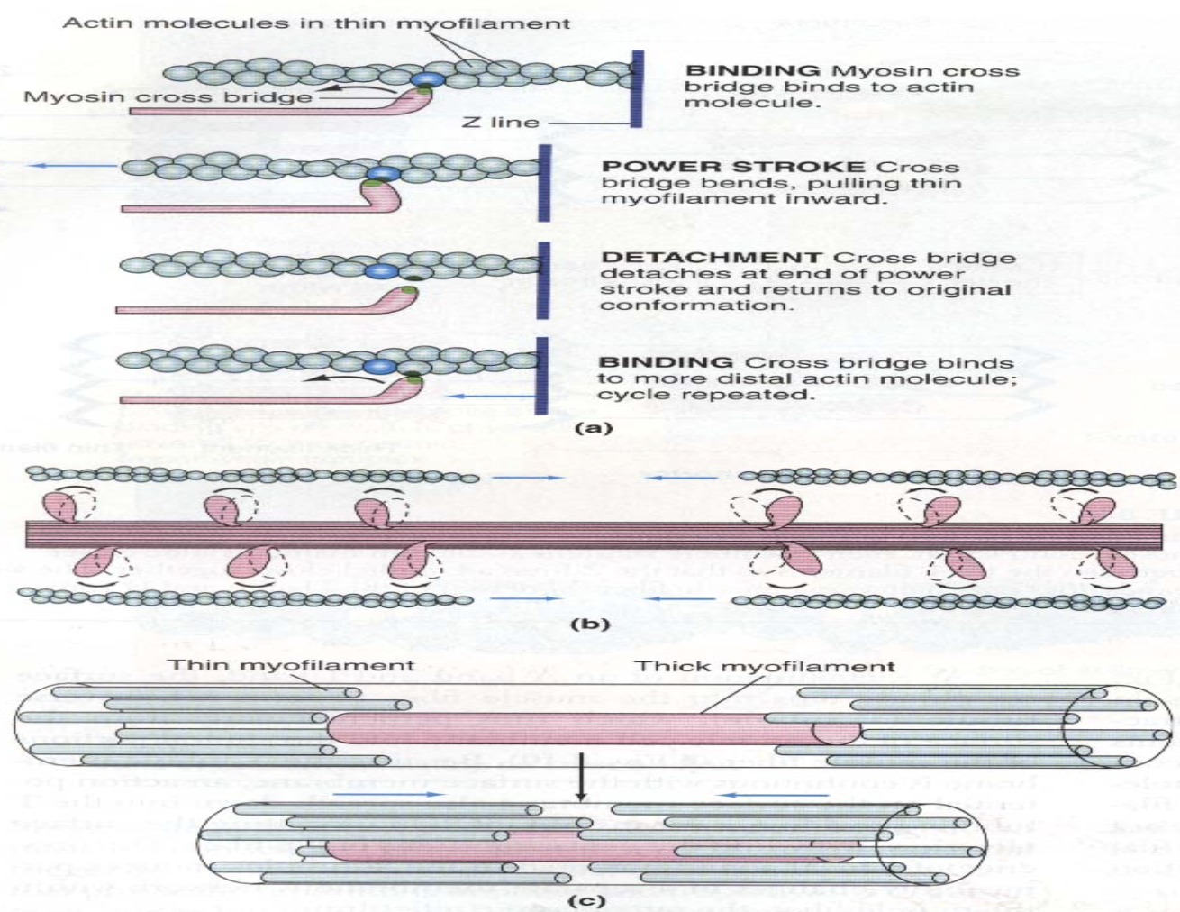
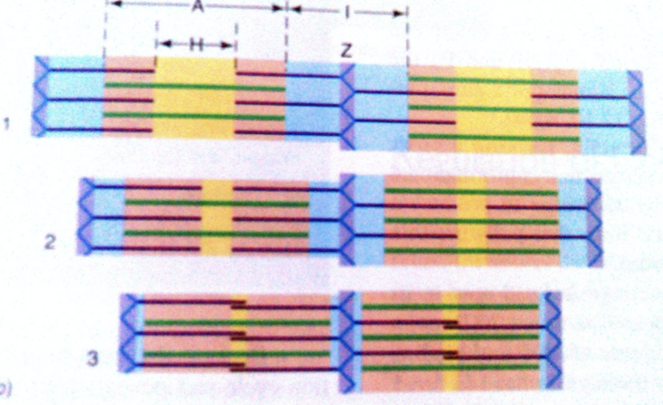
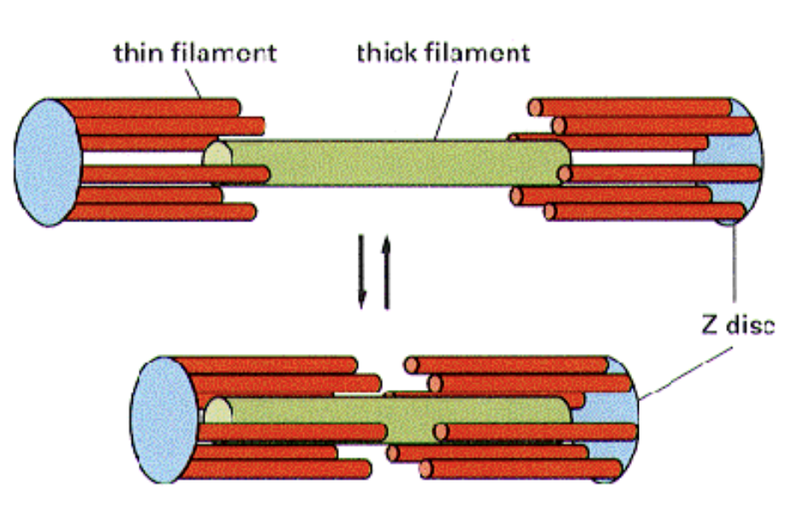
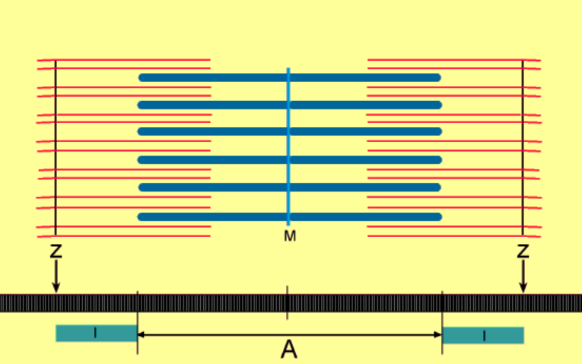
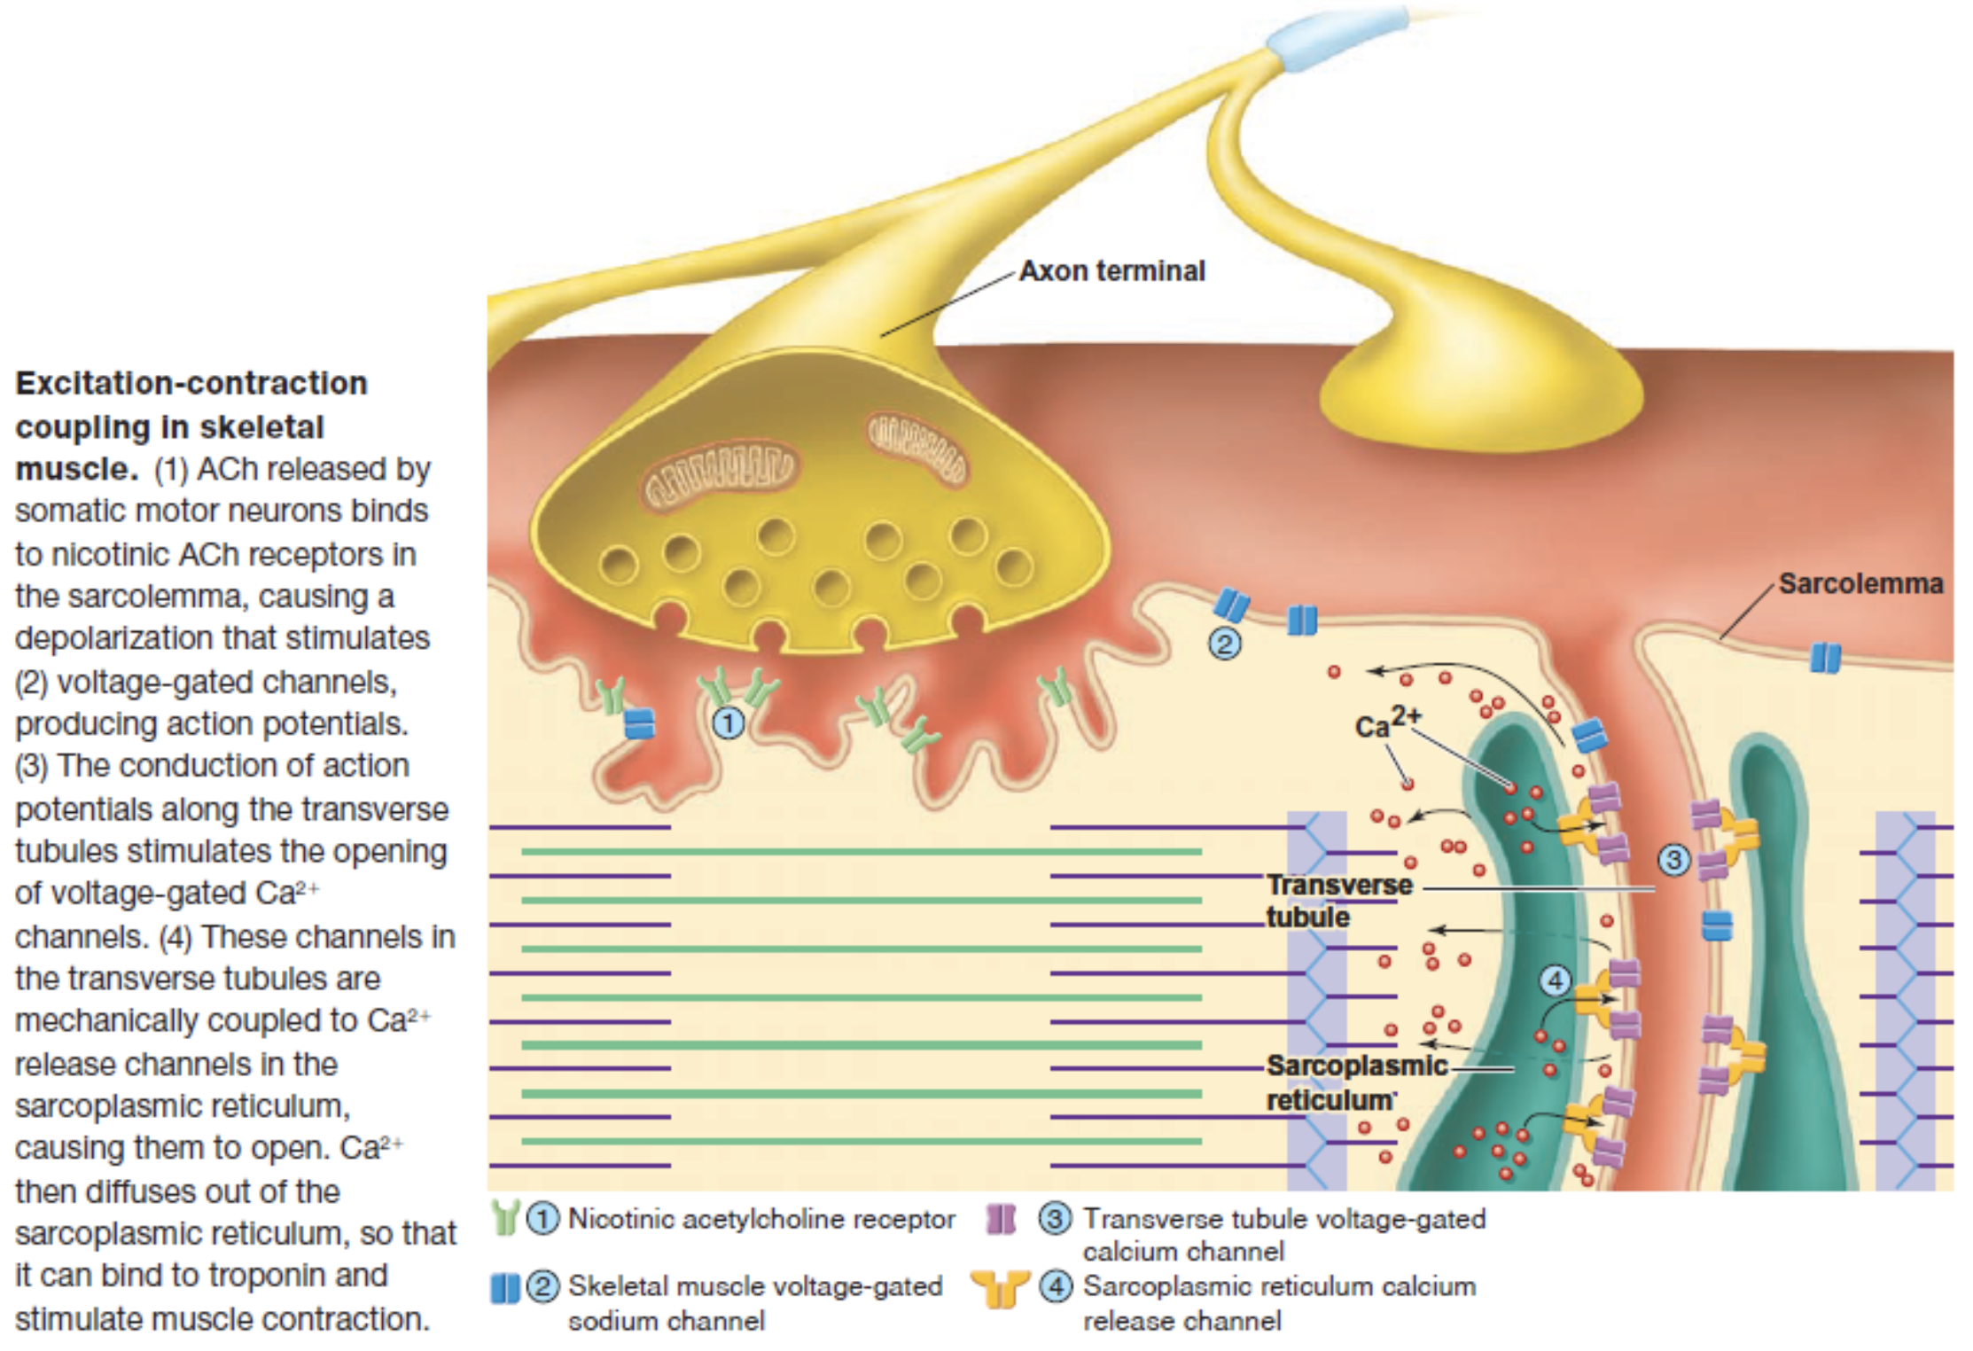
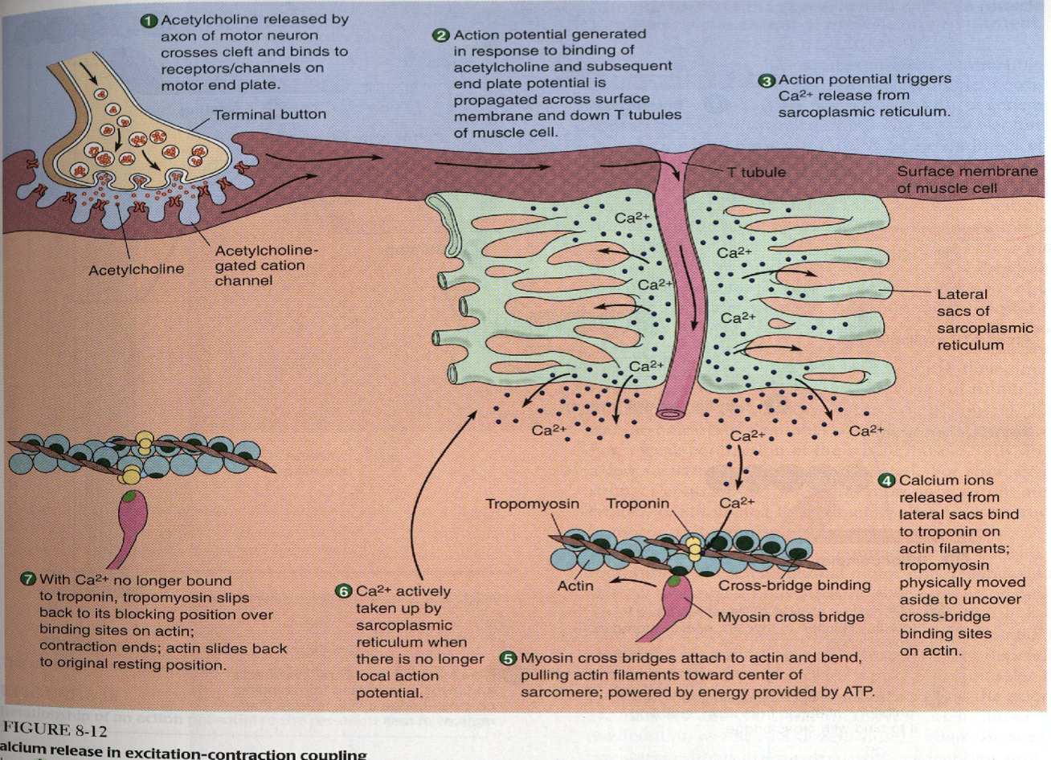
(Excitation – Contraction Coupling)
Molecular Mechanism of Muscle Contraction
Notes:
Arrow
Added picture
Background behind note
Added note
Moved EM Evidence for sliding filaments to previous slide
Added missing pictures

Slide 13
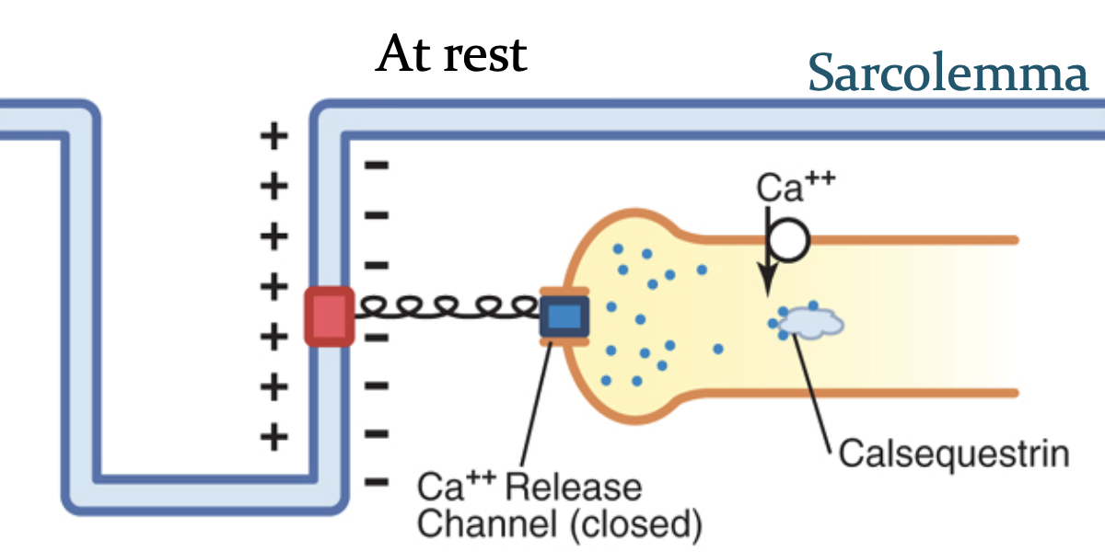
In Female Slides Only
Events of Muscle Relaxation
ATP Importance
1
Ca is pumped back by Calcium pump into sarcoplasmic reticulum after contraction occurs.
Calcium binds to calsequestrin.
Video
1
Power stroke.
Ca moves from sarcoplasmic reticulum to cytoplasm:
High conc. → lowc onc. (no energy required).
Ca moves from cytoplasm to sarcoplasmic reticulum:
Low conc. → high onc. (energy required).
طول ما الكالسيوم في الـsarcoplasmic reticulum راح يمسك في calsequestrin اللي هو binding protein.
Detachment of myosin from actin active sites.
2
3
Pumping Ca⁺⁺ back into the sarcoplasmic reticulum.
2
Ca detached from troponin tropomyosin return to its original position.
3
Covering active site on actin prevent formation of cross bridge relaxation.
4
In order to release the head of myosin from actin, a new ATP is needed to come & combine with head of myosin.
Notes:
Added 2 notes from males
Added 2 pictures
Organization
Added calsequestrin to step 1
Added step 4 from female slides
Moved picture to another slide

Slide 14
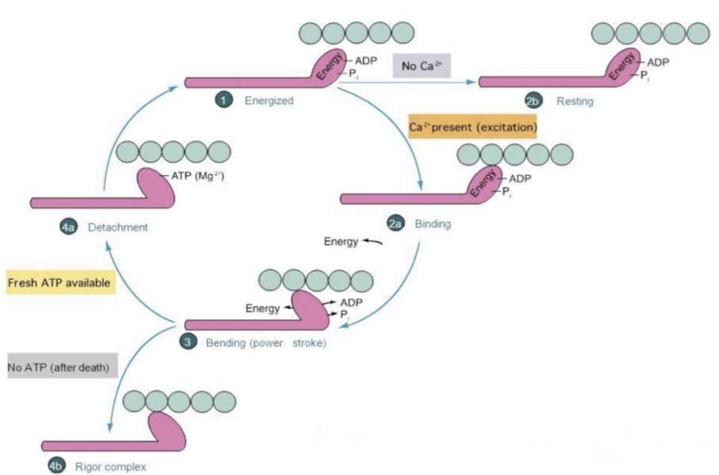
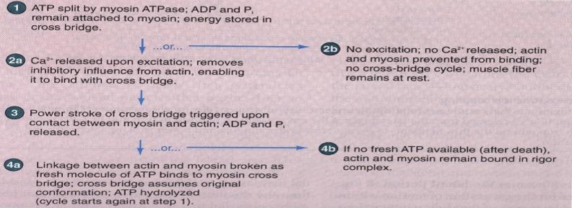
Rigor Mortis (Complex)
Rigor Mortis: the contracture of skeletal muscles that begins several hours after death due to the loss of ATP.
العضلة عشان تسوي relaxation لازم يصير عندها ATP (عشان ينفصل الـmyosin عن الـactin).
لما الإنسان يموت، الجسم يوقف تصنيع الـ ATP لذلك وقتها يكون الإنسان مبتسم (العضلة في حالة contraction).
يظل الشخص مبتسم حتى وهو ميت لأن العضلة ما وصلها ATP،
فبالتالي ما راح يصير لها relaxation إلا بعد يومين لما تتحلل البروتينات.
Notes:
Added male note
Organization
Added a sentence to the note “(عشان ينفصل الـmyosin عن الـactin)”

Slide 15
Take Home Messages
During contraction, I and H bands become shorter, while the A band does not change.
Calcium is needed in nerves for exocytosis & release of Ach.
Calcium is needed in muscles for contraction.
Muscle relaxation is an active process (needs ATP).
Notes:
Resized text → 20
Color: pink (خليته هالسلايدة كإجابة على الأسئلة اللي كانت بآخر سلايد لد. منان)
Deleted:
RMP is the same in skeletal muscle and nerves.
The duration of the AP is slower in skeletal muscle while in nerves is faster.
The conduction velocity is slower in skeletal muscle while in big nerves is faster.

Slide 16
MCQs:
Answers: 1.C 2.A 3.B 4.C 5.D
Q1: The matrix inside muscle fiber is known as?
A |  | B |  | C |  | D
A |  | B |  | C |  | D
A | Troponin | B | Titin | C | Tropomyosin | D | Actin
A |  | B |  | C |  | D
Q5: which of the following is NOT a reason for the importance of ATP
A |  | B | Detachment of myosin from actin | C | Pumping of Ca into sarcoplasmic reticulum | D | none of the above
Sarcoplasmic reticulum
Sarcoplasm
Sarcolemma
Sarcomere
Q2: Where in the myosin thick filament is the ATP site located?
Head
Tail
Arm
Hinge
Q3: Which of the following is part of the actin thin filament?
Q4: Calcium combines with which of the following
Myosin
Tropomyosin
Troponin
Actin
Power stroke
Notes:
New slide
Organized pictures
Combined 2 points:
“All-or-none” principle: impulse from motor neuron will cause contraction in all muscle fibers it innervates or none.
Motor Unit follows “all-or-none” principle.

Slide 17
MCQs:
Special Thanks to Team441
Answers: 1. B 2. B 3. B 4. D 5. C
Q1: Which of the following decreases in length during the contraction of a skeletal muscle fiber?
A | A band of the sarcomere | B | I band of the sarcomere | C | Thick filaments | D | Thin filaments
Q2: What is the contractile unit of the muscle?
A | Sarcolemma | B | Sarcomere | C | Actin | D | Myosin
Q3: Which of the following component stimulate opening Sodium channel?
A | Calcium | B | Ach | C | Cholinesterase | D | All
Q4: A single contraction of skeletal muscle is most likely to be terminated by which of the following actions?
A | Closure of the postsynaptic nicotinic Ach receptor | B | Removal of Ach from the neuromuscular junction | C | Removal of Ca from the terminal of the motor neuron | D | Removal of sarcoplasmic Ca++
Q5: Which of the following does not change during Power Stroke?
A | Z lines | B | A Bands | C | I Bands | D | None of them
Notes:
New slide
Organized pictures
Combined 2 points:
“All-or-none” principle: impulse from motor neuron will cause contraction in all muscle fibers it innervates or none.
Motor Unit follows “all-or-none” principle.

Slide 18
MCQs:
Special Thanks to Team441
Answers: 6. B 7. A 8. A 9. D 10. B
Q6: Which of the following covers the active sites on actin?
A | Troponin | B | Tropomyosin | C | Calcium | D | F-Actin
Q7: skeletal muscle, which of the following events occurs before depolarization of the T tubules in the mechanism of excitation–contraction coupling?
A | Depolarization of the sarcolemmal membrane | B | Opening of Ca2+ release channels on the SR | C | Uptake of Ca2+ into the SR by Ca2+ATPase | D | Binding of actin and myosin
Q8: Detachment the head of myosin from the actin require?
A | New ATP | B | Action potential | C | ADP | D | Calcium
Q9: Action potential is transferred to Sarcoplasmic reticulum through which of the following?
A | Myofibril | B | Sarcolemma | C | Longitudinal tubules | D | Transverse tubules
Q10: Which of the following will bind with troponin-tropomyosin complex leading to exposure the active site on actin?
A | Ach | B | Calcium | C | Sodium | D | Esterase
Notes:
New slide
Organized pictures
Combined 2 points:
“All-or-none” principle: impulse from motor neuron will cause contraction in all muscle fibers it innervates or none.
Motor Unit follows “all-or-none” principle.

Slide 19
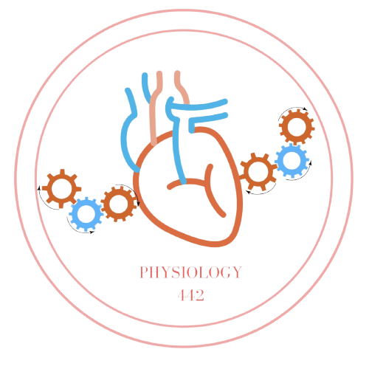
Team Leaders
Dema Alkhattabi
Waleed Alrashoud
Team Members
Nouf AlDalaqan
Farah Alqazlan
Masheal Alasmri
Amani Alotaibi
Maram Beyari
Maha Alkoryshy
Nouf Aldhalaan
Othman Alabdullah Khaled Bin-Arbeed
Rakan Alromayan
Talal Alharbi
Abdullah AlShehri
Mohammad Alrashed Saud Al-Taleb
Sultan Al-Abdullah Saad AlAngri
Abdullah Awartani
Special Thanks to Physiology Team441
Physio442@gmail.com

