Slide 1
6
Physiology of
the Motor Unit
Editing File

Slide 2
Objectives
Recognise the organization of the Nervous System
Identify the differences between central nervous system (CNS) & peripheral nervous system (PNS)
Discuss the functions and recruitment of the motor unit
Interpret the effect of motor units number and size on the motor action performance
Explain the importance of development of macromotor units in poliomyelitis.
Compare between rate coding and recruitment.

Slide 3
Neurons
Neuron: the building unit of the nervous system.
1
Cell body
Contains: the nucleus.
2
Dendrites
Short processes
3
Axon
Contains: myelination + nodes of ranvier
Long processes
4
Axon Terminals
5
Synaptic End Bulbs
6
Neurotransmitter
Acetylcholine (Ach)
Synaptic End Bulbs
Text
Text
Text
Text
Text
Notes:
Organization
color index
Definition of neuron was blue while it’s found in both girls & boys → black
end not and
Added labelling of synaptic end bulbs

Slide 4
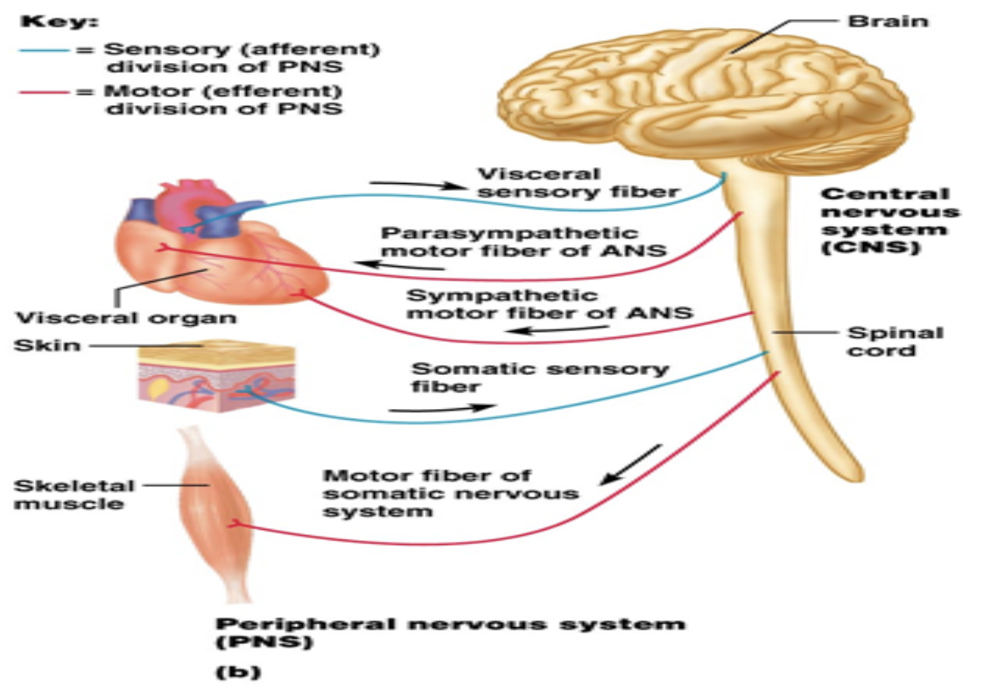
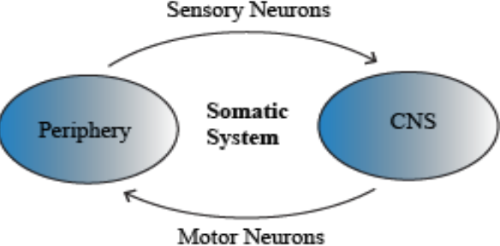
Nerve - Muscle Interaction
Nervous System
Peripheral Nervous System
Central Nervous System
Autonomic
Somatic
Brain
Spinal Cord
Sensory Neurons
Collect information from
various receptors/sensors located throughout the body and transmits them to the brain.
Motor Neurons
Conduct signals to activate muscle contraction.
Division of PNS in terms of function: motor & sensory activity
Skeletal muscle activation is initiated through neural activation.
Nerve: made up of a group of axons of neurons.
Skeletal muscles > neurogenic in function (depend on nerve supply) .
Cardiac muscles > myogenic in function.
Text
Text
Text
Text
Text

Slide 5
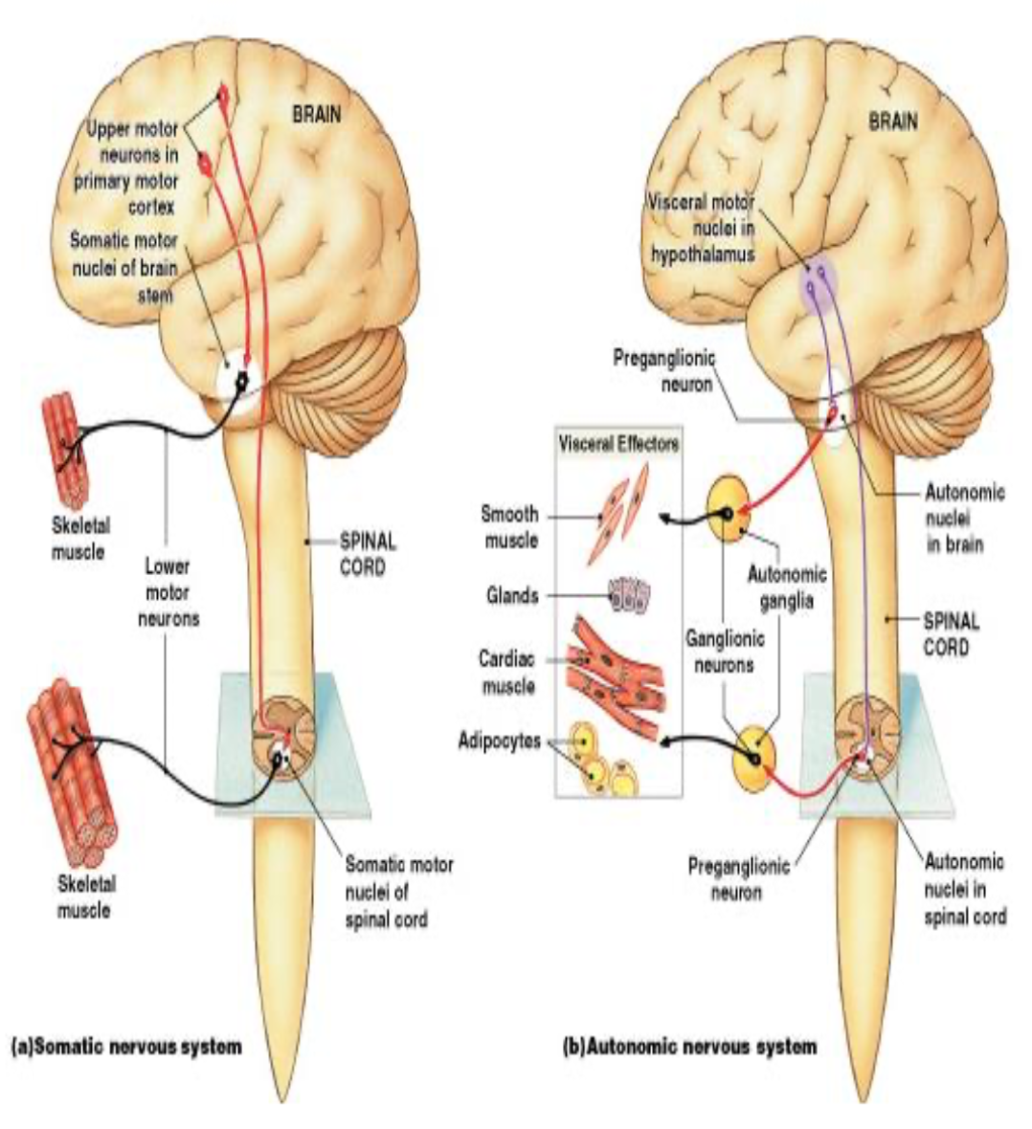
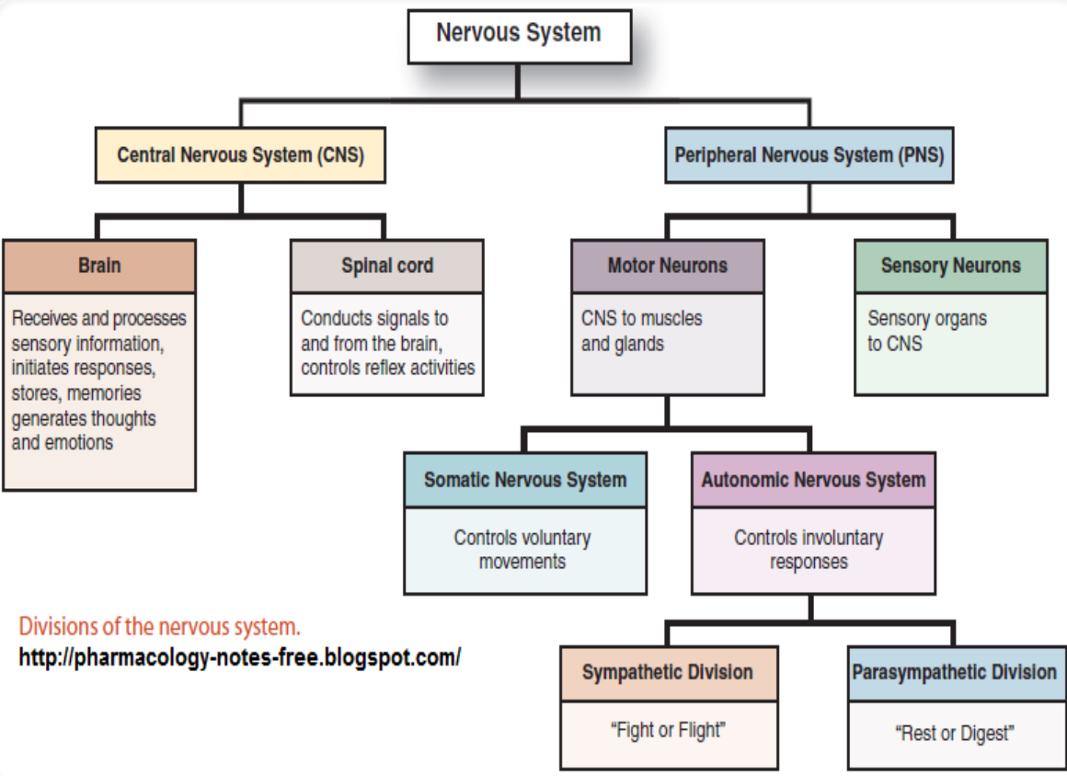
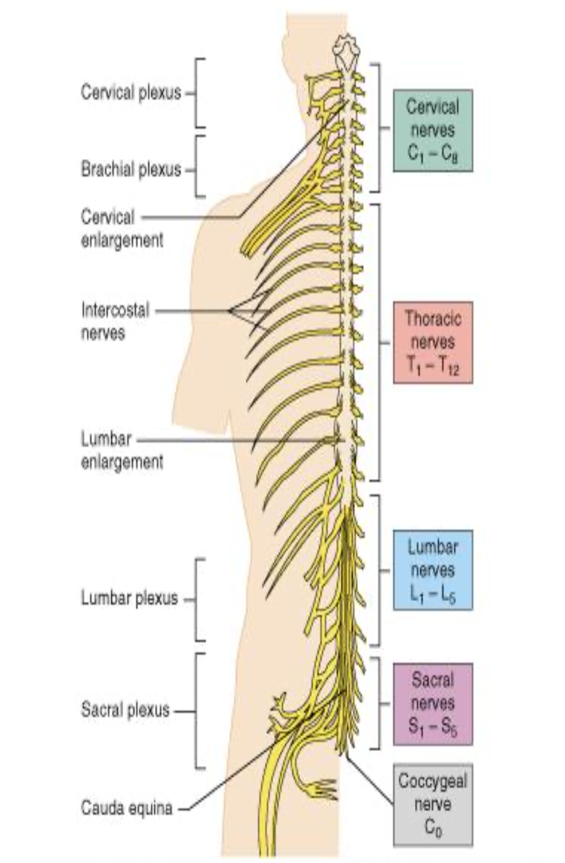
Organization of the Nervous System
In Males Slides Only
Text
Text
Text
Text
Text

Slide 6
Central Nervous System
In Male Slides Only
Central nervous system: the part that integrates the sensory information that it receives from different parts of body and coordinates the activity of all parts of the body.
Central Nervous System
Brain
Spinal Cord
Both
Protected by
the skull
Enclosed in
the meninges
Protected by
the vertebrae
Text
Text
Text
Text
Text

Slide 7
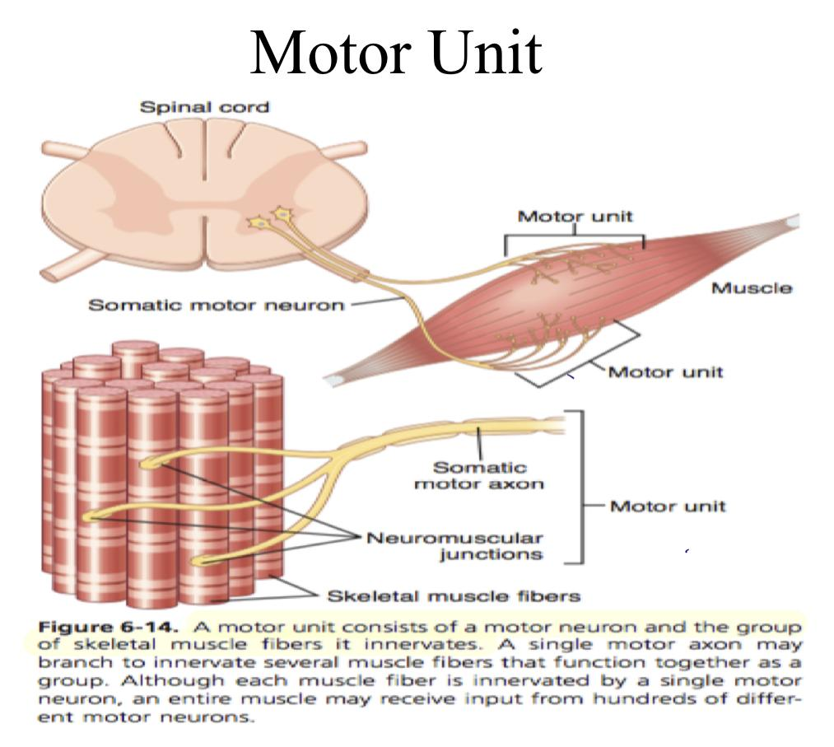
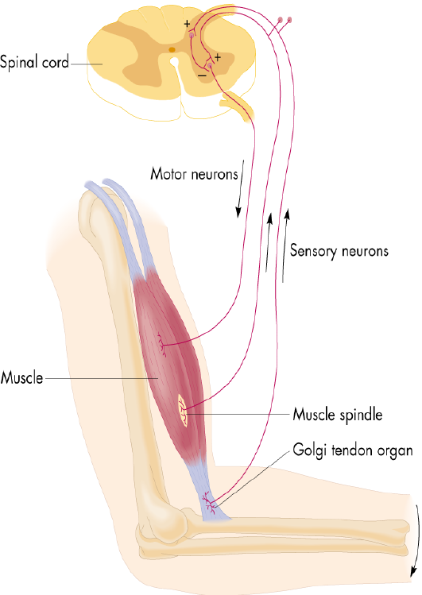
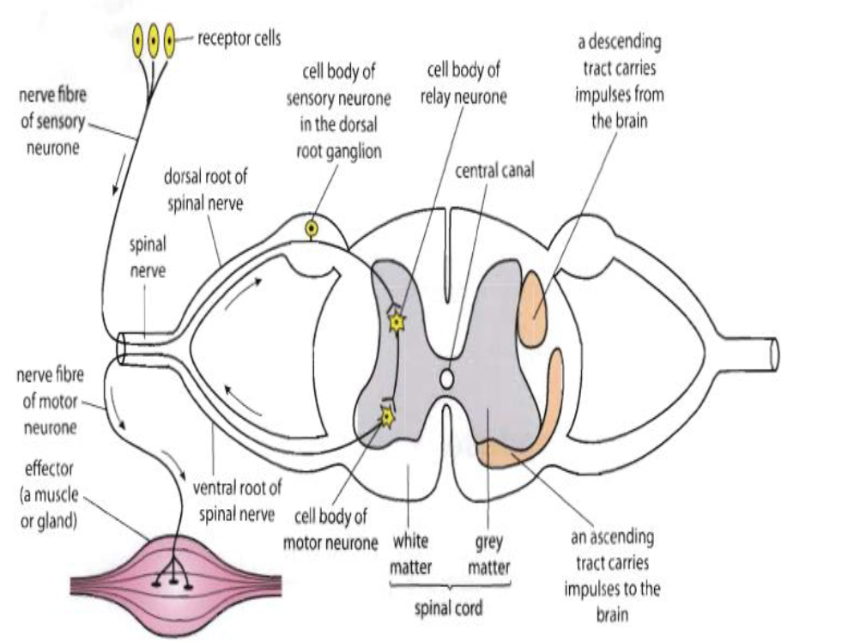
What is a Motor Unit?
Motor unit: α-motor neuron in the anterior horn cell (AHC) + all muscle fibers it innervates (supplies).
All of these muscle fibers of a motor unit will be of the same type of motor fibers :
Fast twitch fibers
Slow twitch fibers
Each muscle consist of a number of motor units.
When a motor neuron is activated, all the muscle fibers it innervates are stimulated and will contract.
The muscle fibers in different motor units overlap( تتداخل أنواع مختلفة مع بعض) . Therefore, separate motor units contract in support of one another rather than entirely as individual segments.
Text
Text
Text
Text
Text
Notes:
Merged 2 slides
Removed numbers (not needed)
Added 2 pictures from males slides

Slide 8
Motor Unit (MU)
Extraocular muscles: < 10 muscle fibers/motor neuron.
Laryngeal muscles: 2 - 3 muscle fibers/MU.
It needs precision
The number of muscle fibers in a motor unit (innervated by 1 motor neuron) varies.
Leg muscles: 600 muscle fibers/motor neuron.
Gastrocnemius: 2,000 muscle fibers/motor neuron.
Average all over the body: 80-100/MU.
Group of motor units often work together to help the contractions of a single muscle.
Motor Unit Pool: group of motor units supplying a single muscle.
The number of muscle fibers per each motor unit affects the precision of movement i.e small number is associated with more precise movements and vice versa.
Muscles that perform precise movements (hand & eye muscles) consist of:
Large number of MU + few muscle fibers in each MU.
Small number → more precise movement.
MU are smaller in size
Less precise movements (trunk muscles) consist of:
Fewer number of MU units + many muscle fibers per unit.
Large number → less precise movement (stronger contraction).
MU are larger in size
As motor units in a muscle increases, the movement gets more precise.
Text
Text
Text
Text
Text
Notes:
organization
color index
added males note
combined the extra notes
Fixed arrow
Deleted numbering of diagram
Part of the extra note is repetitive so I added the new info directly to the slides “stronger contraction”
Added missing fact from female slides “The average all over the body is 80-100/MU”

Slide 9
Motor Unit (MU)
The force produced by a single motor unit is determined by:
The ways the nervous system increases force production:
Number of muscle fibers in the unit
Recruitment of new motor units
Frequency(times of stimulation/ sec.) with which the muscle fibers are stimulated by innervating axon
Increasing stimulation frequency
(Rate Coding)
Allows a 2 - 4 fold change in force.
زي المكتب يعتمد على:
عدد الموظفين
كمية العمل المكلف لهم
Notes:
Excluded part from slide 15
Added pictures

Slide 10
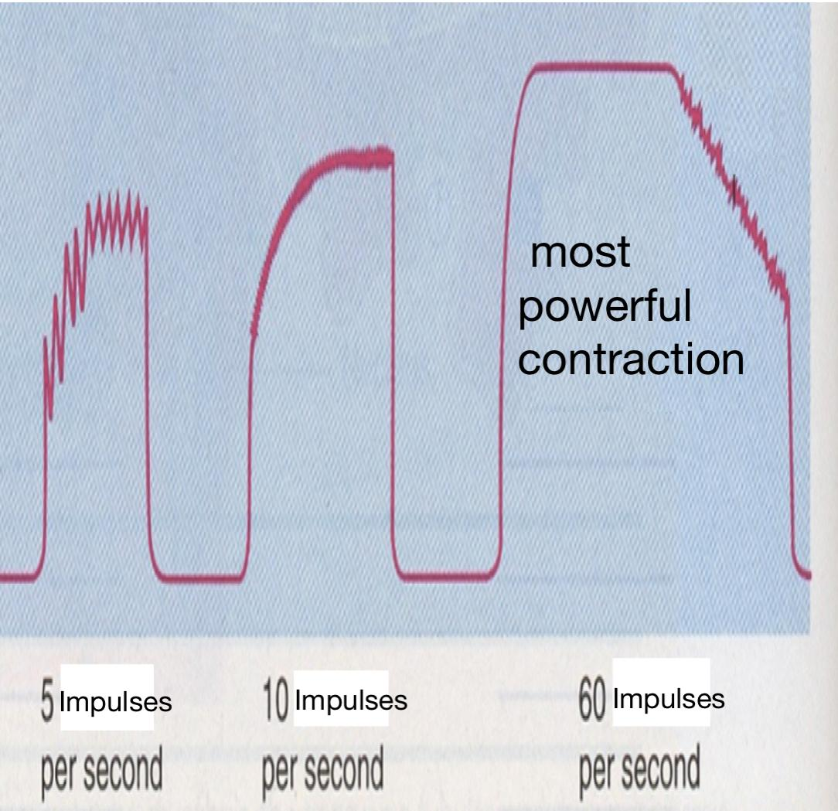
Force Summation
In Female Slides Only
Summation: adding together of individual twitch contractions to increase the intensity of overall muscle contraction.
Force Summation
Rate coding :refers to the motor unit firing rate.
Active motor units can discharge at higher
frequencies to generate greater tensions
(contraction force).
Frequency Summation
(Rate Coding)
Multiple Fiber Summation
(Recruitment of MU)
Increasing the
frequency of contraction.
Increasing the number of motor units contracting simultaneously.
Repeated/frequent stimulus.
Increase number of working MU.
Notes:
Excluded part from slide 15
Added pictures

Slide 11
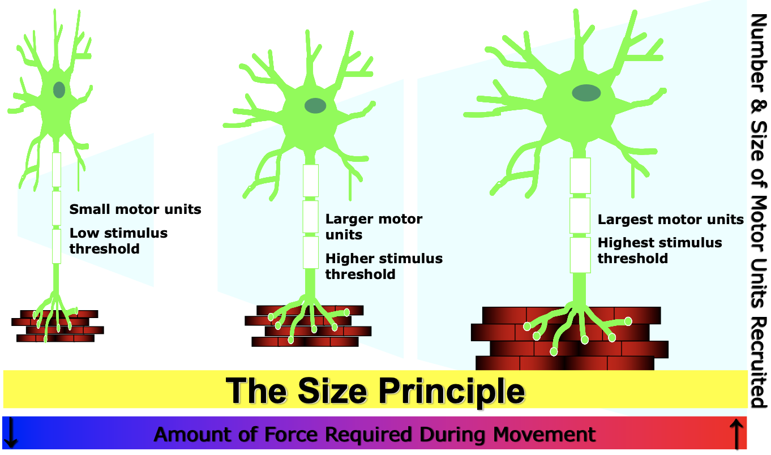
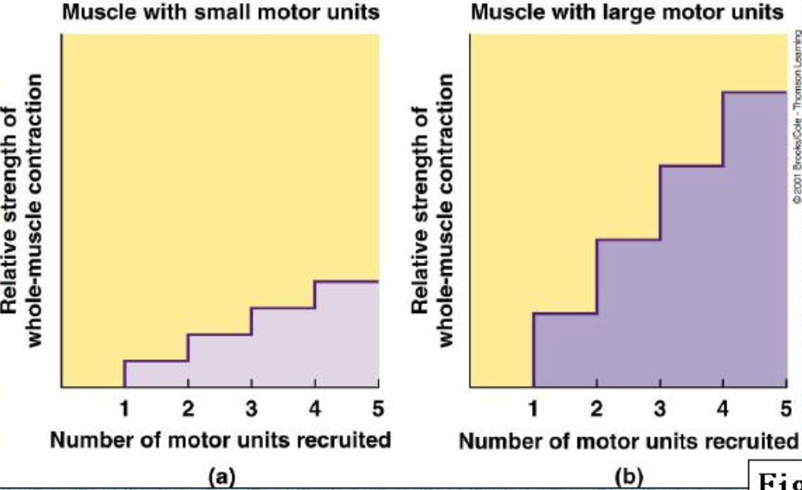
Multiple Fiber Summation (Motor Unit Recruitment)
Recruitment: varying the number of motor units activated.
Recruitment of MU: progressive activation of a muscle by successive recruitment of contractile units (MU) to accomplish increasing degrees of contractile strength (force).
Higher motor unit recruitment → stronger muscle contraction.
Activation of 1 motor neuron → weak muscle contraction.
Activation of more motor neurons → more activated muscle fibers → stronger contraction.
Notes:
Excluded part from slide 15
Added pictures

Slide 12
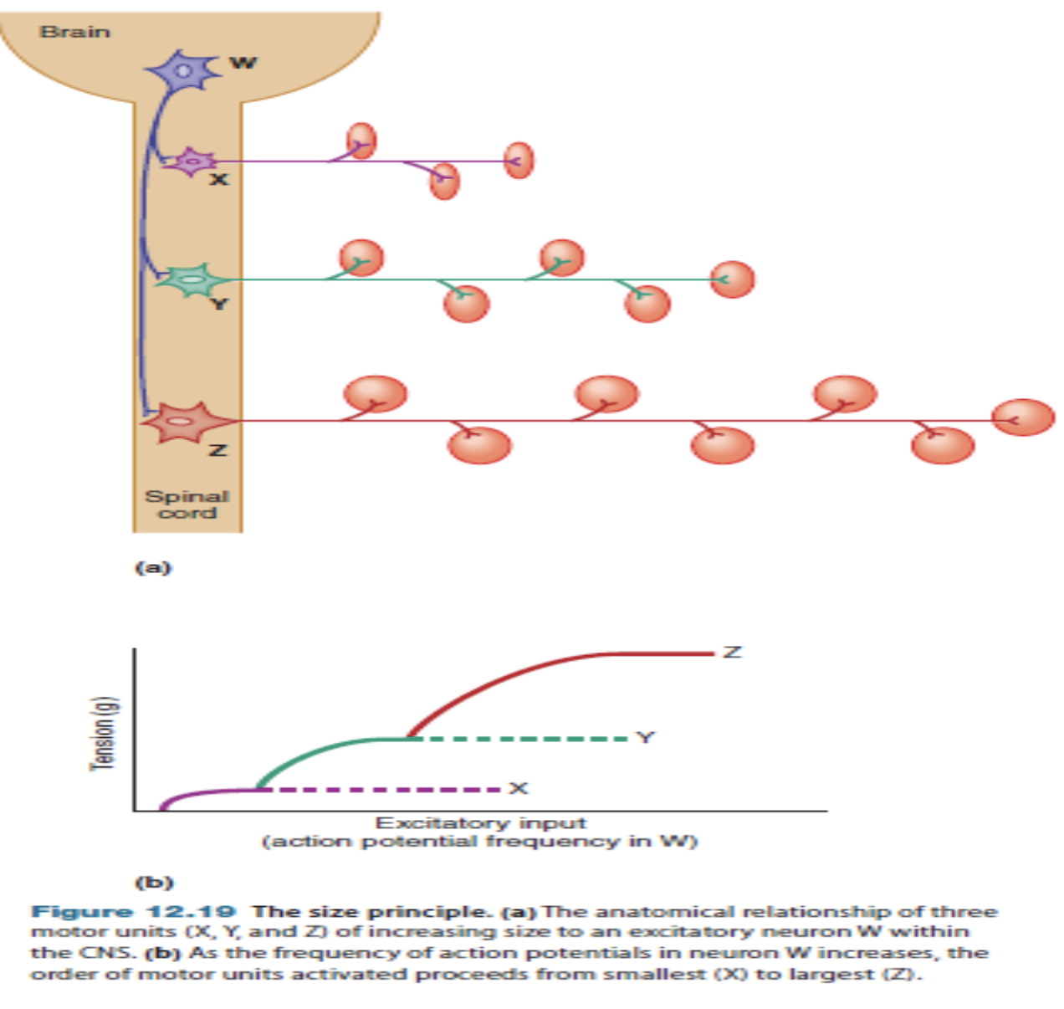
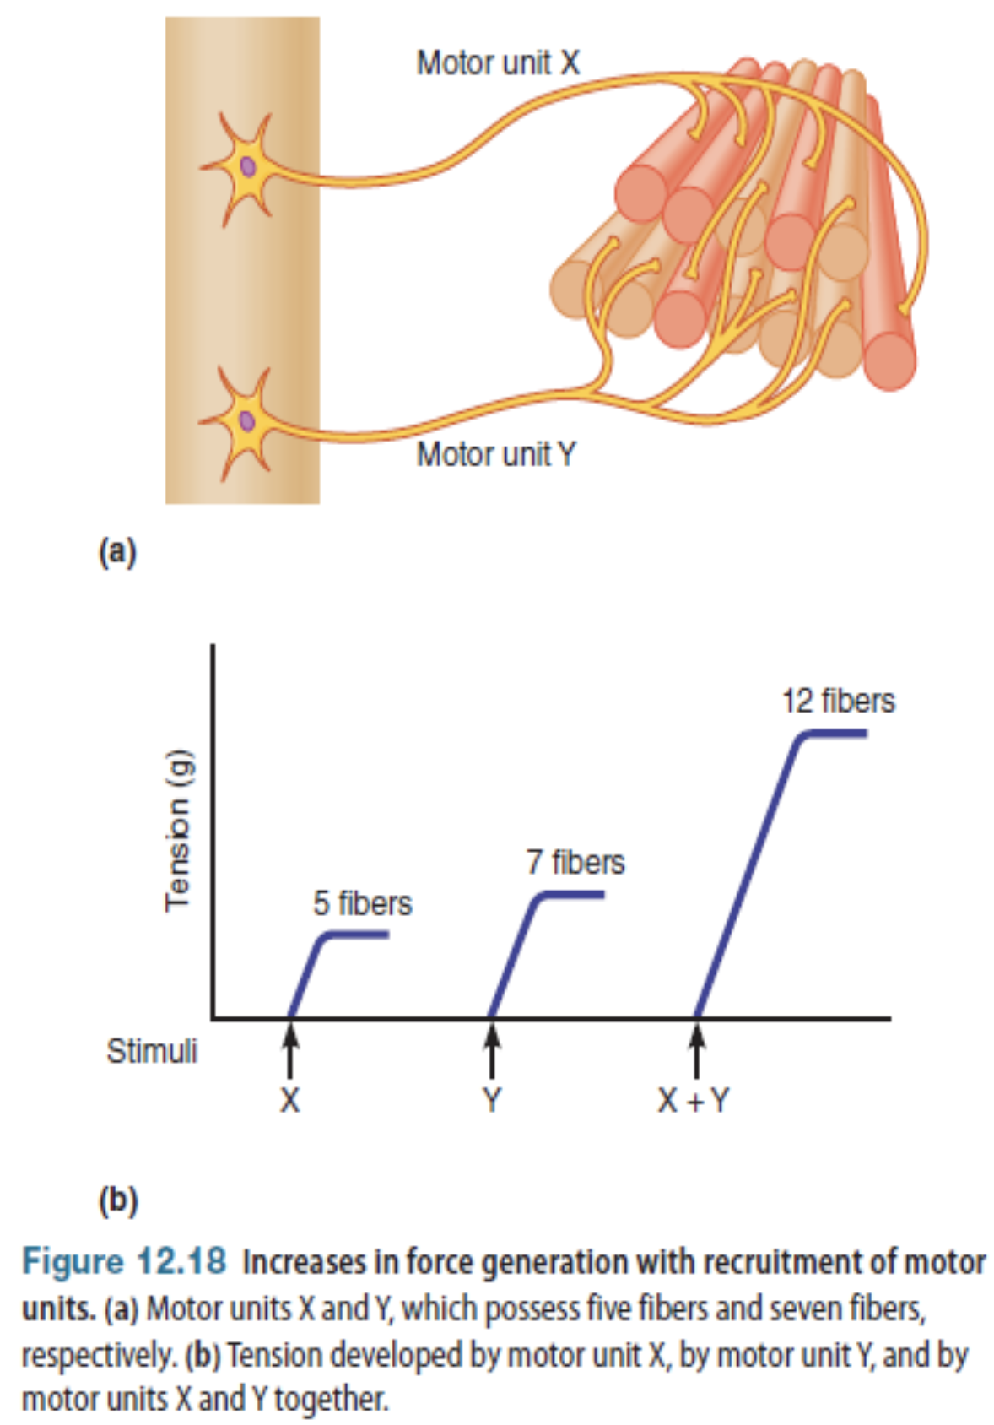
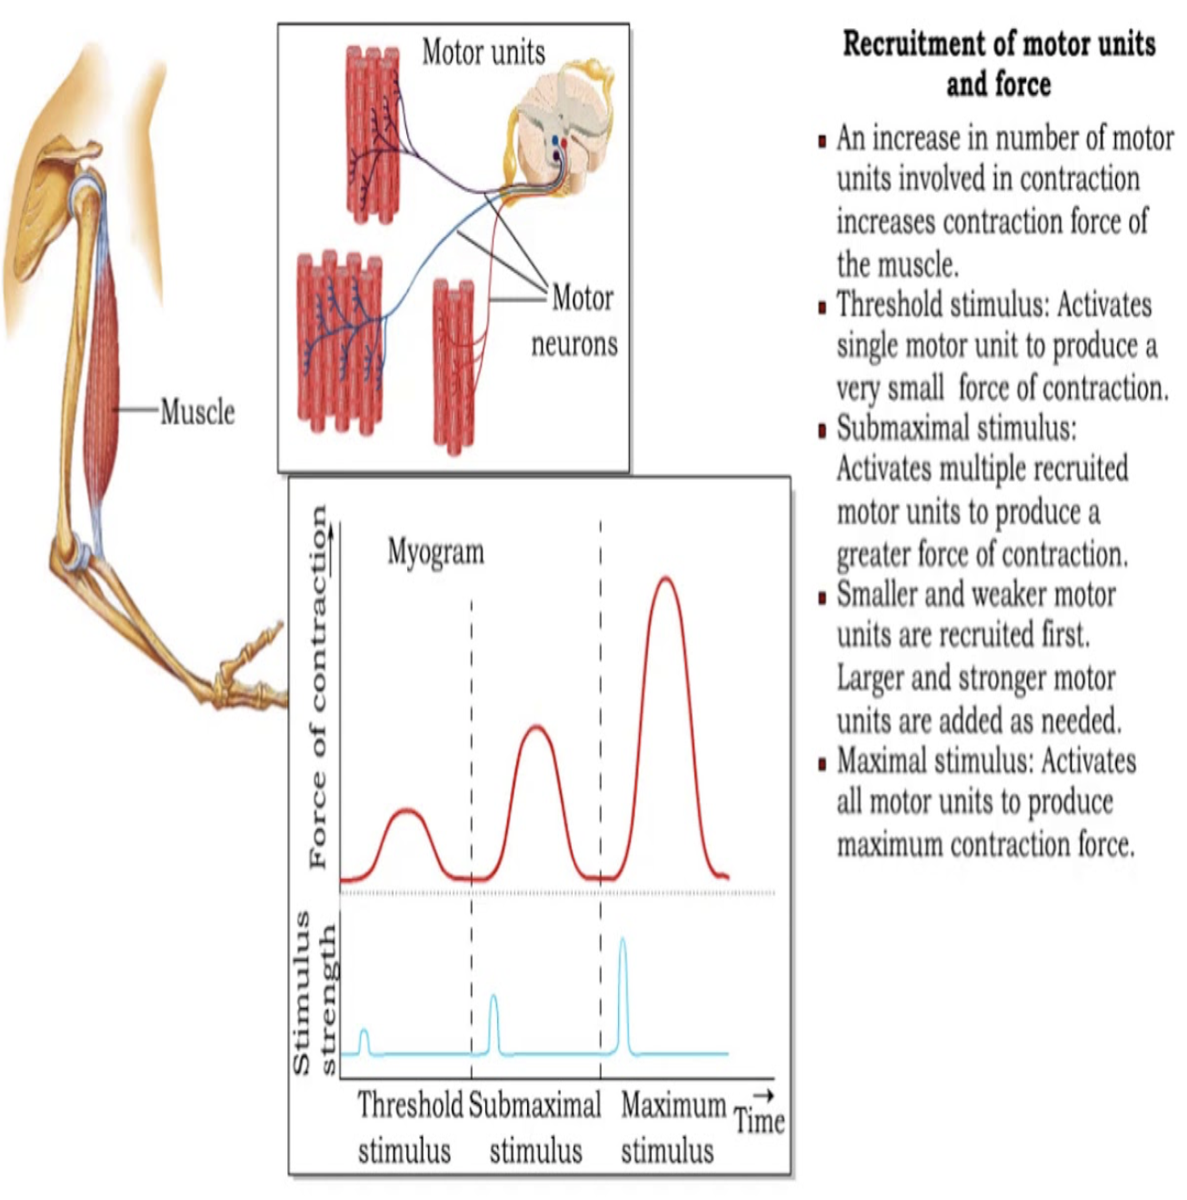
The Size Principle
Stimulation increases → motor neurons get activated >increases contraction force.
CNS sends a weak signal to contract a muscle → smaller MU of the muscle stimulated in preference to larger MU.
As the strength of the signal increases, larger and larger motor units begin to be excited as well.
Largest motor units have as much as 50 times the contractile force of the smallest units.
Occurs because: smaller MU are driven by small motor nerve fibers.
Small motor neurons in spinal cord are more excitable than the larger ones → naturally excited first.
Importance:
Allows gradations of muscle force during weak contraction to occur in small steps.
Steps become progressively greater when large amounts of force are required.
Text
Text
Text
Text
Notes:
Note background
title
Modified pictures
Color index
Added picture
Organization +
Deleted a sentence repeated by mistake
Added a missing word “naturally”
Removed numbering of diagram

Slide 13
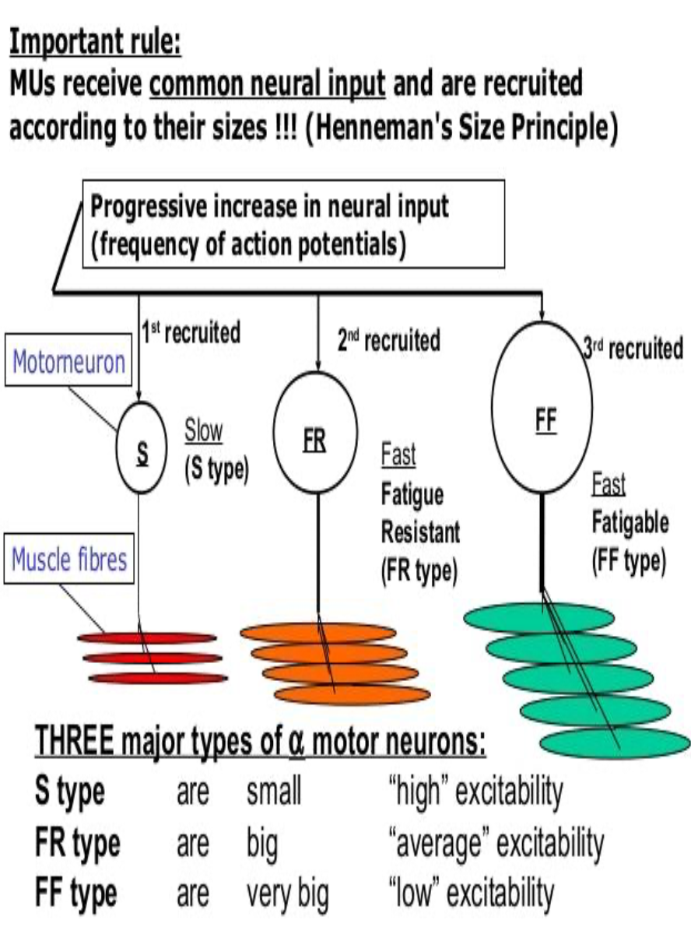
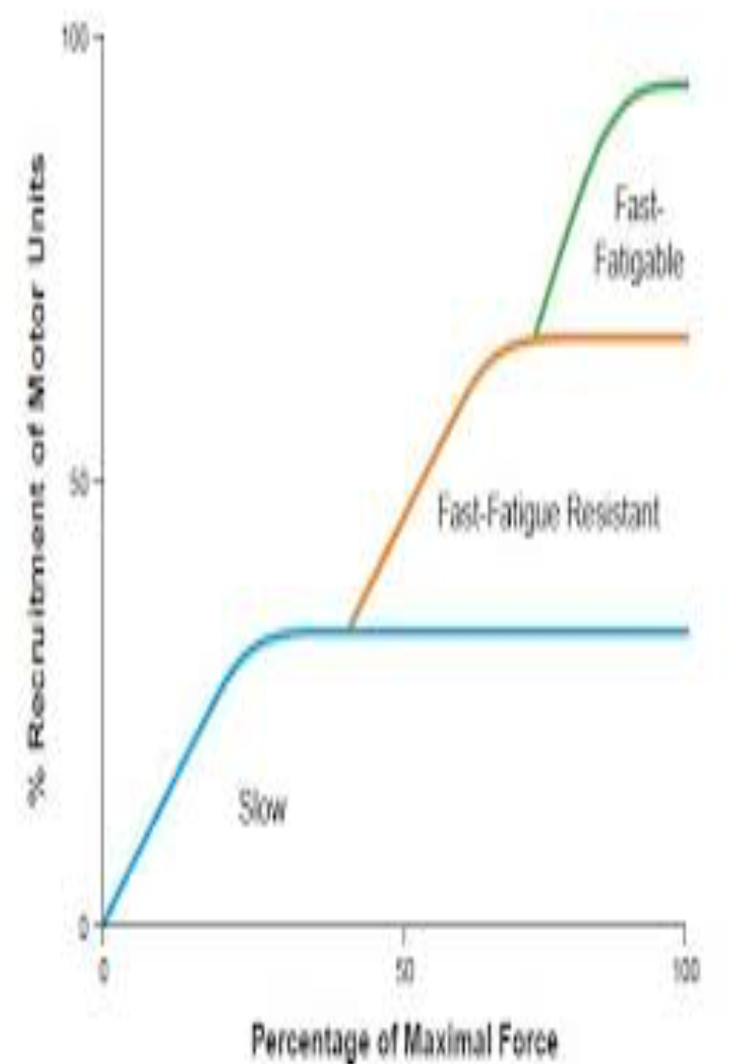
Types of Motor Neurons
In Male Slides Only
Fast Fatigable
Fast Fatigue Resistant
Slow
Notes:
New slide
Organization
Title

Slide 14
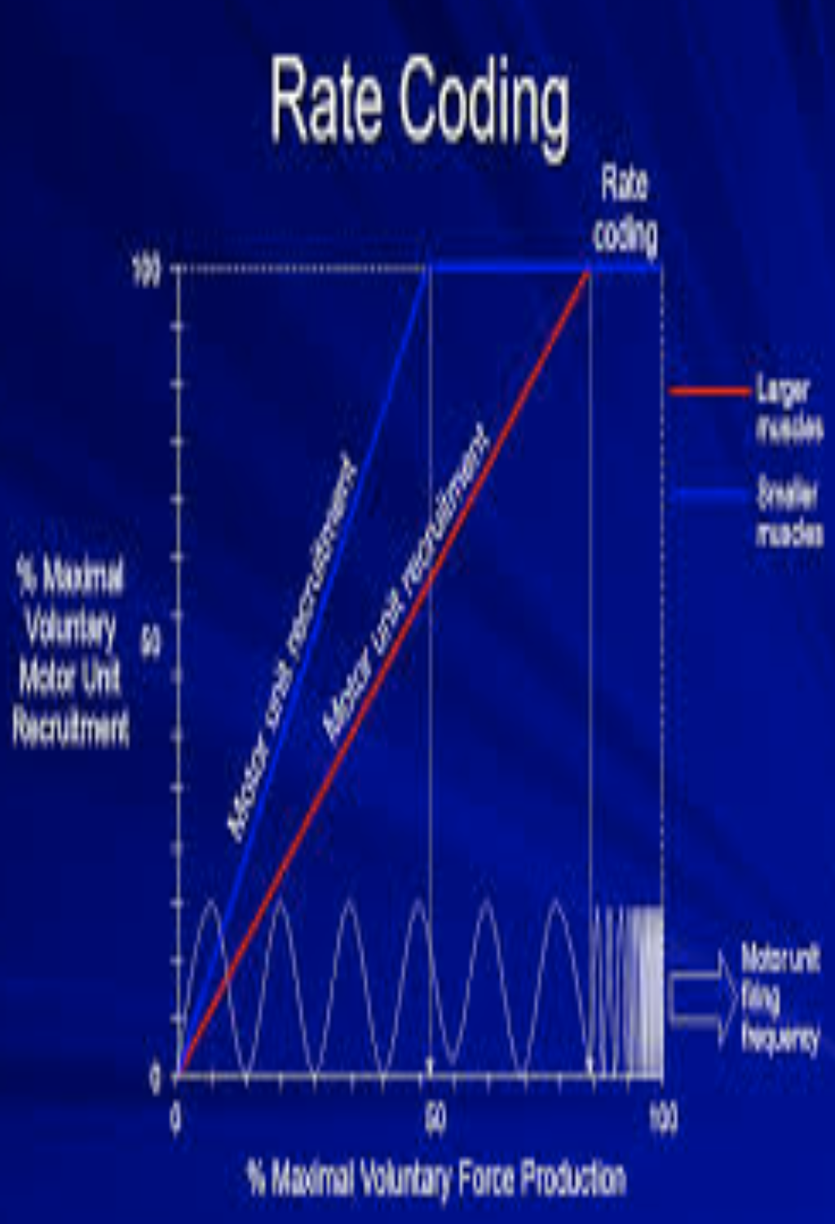
Frequency Summation (Rate Coding) & Tetanization
Rate Coding: motor unit firing rate. Active MU can discharge at higher frequencies → generate greater tensions.
there will be relaxation after each stimulation
Increasing frequency of action potentials → stronger force of contraction.
AHC fires at slow rate → motor Unit potentials (MUPs) at slow rate → force of muscle contraction is weak.
If AHCs fire at very fast rates → fast MUPs → stronger contraction.
Thus the total strength of contraction rises
Rate Coding vs. Recruitment
Small muscles rely more on rate coding
Large muscles of mixed fiber types rely more on recruitment
Example: first dorsal interosseous.
Example: deltoid.
Text
Text
Text
Text
Text
Notes:
New slide
Title “and” → “&”
Slight organization of diagrams

Slide 15
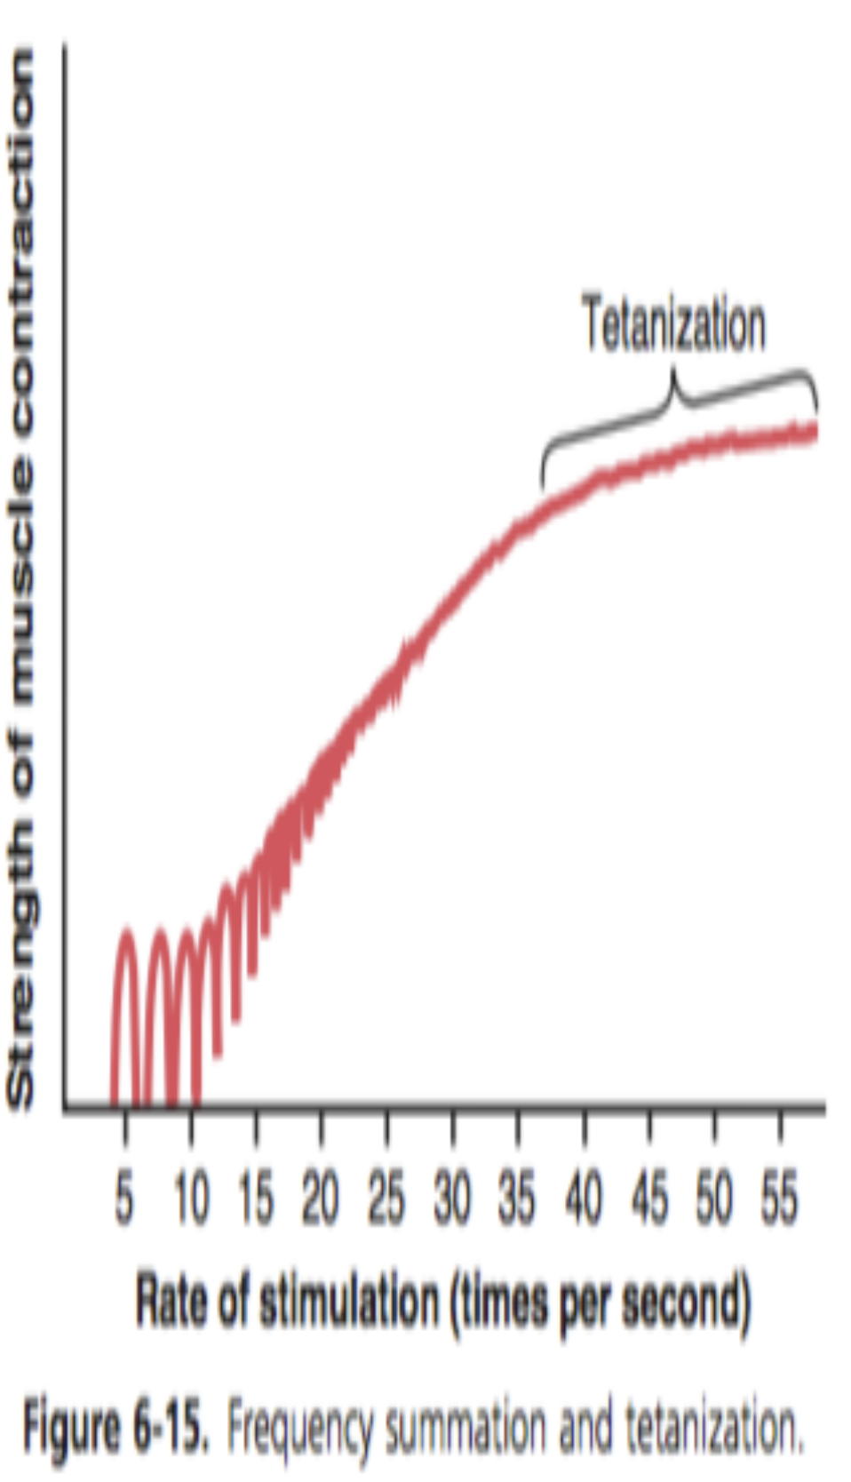
Tetanization
In Female Slides Only
high frequency of stimulation
1
Individual twitch contractions occurring one after another at low frequency of stimulation (separate twitches).
2
As the frequency increases, there comes a point when each new contraction occurs before the preceding one is over (summation).
3
Tetanization: when frequency of muscle stimulation reaches a critical level where successive contractions become so rapid and fuse together and the muscle contraction appears to be completely smooth and continuous.
Tetany occurs because:
Enough Ca⁺⁺ are maintained in muscle sarcoplasm, even between APs
→ full contractile state is sustained without allowing any relaxation between the APs.
Notes:
New slide

Slide 16
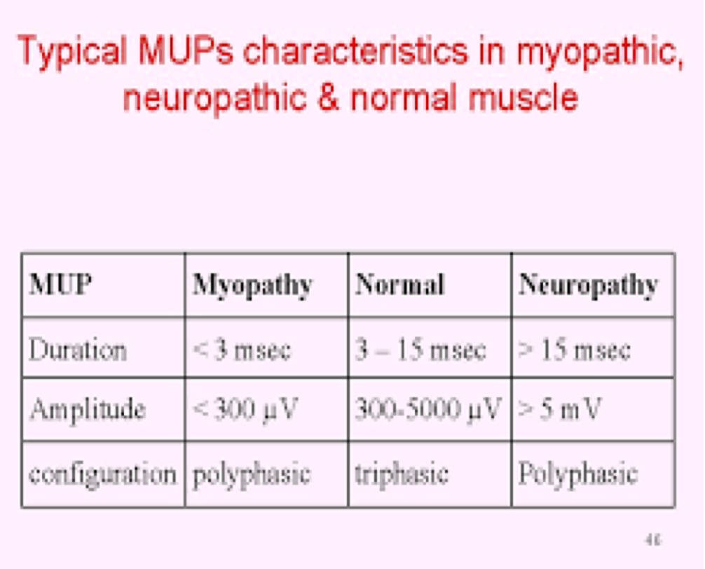
All or None Role
1
“All-or-none” principle: impulse from motor neuron will cause contraction in all muscle fibers it innervates or none.
It is followed by motor units.
2
In an electrodiagnostic testing (e.g. electromyography - EMG) for a patient with weakness, careful analysis of the Motor Unit Action Potential (MUAP) size, shape, and recruitment pattern can help in distinguishing a myopathy from neuropathy.
Normal MUAP
Neuropathic MUAP
Myopathic MUAP
Notes:
New slide
Organized pictures
Combined 2 points:
“All-or-none” principle: impulse from motor neuron will cause contraction in all muscle fibers it innervates or none.
Motor Unit follows “all-or-none” principle.

Slide 17
MCQs:
A |  | B |  | C |  | D
A |  | B |  | C |  | D
A |  | B |  | C |  | D
A |  | B |  | C |  | D
A |  | B | 50-80 | C | 80-100 | D | 300-600
Q1: Myelination are found in?
Dendrites
Cell body
Axon
None of them
Q2: A way to increase muscle contraction?
Increase motor unit recruitment
Decrease motor unit recruitment
Increase the length of muscle
Decrease the length of muscle
Q3:The location of α-Motor Neuron is in ?
Anterior horn cell
Posterior horn cell
Lateral horn cell
Medial horn cell
Q4:The motor unit composed of?
Motor horn only
Muscle fibers only
Single β motor neuron
+ muscle fibers
Single α motor neuron
+ muscle fibers
Q5:The average motor unit all over the body?
2-3
Answers: 1.C 2.A 3.A 4.D 5.C
Notes:
New slide
Organized pictures
Combined 2 points:
“All-or-none” principle: impulse from motor neuron will cause contraction in all muscle fibers it innervates or none.
Motor Unit follows “all-or-none” principle.

Slide 18
MCQs:
Q6:Comparing between two muscles A and B, The ratio of muscle fibers to motor neurons of muscle A is 10. and B is 19. which of these statements is correct ?
A |  | B |  | C |  | D
A |  | B |  | C |  | D
A |  | B |  | C |  | D
A |  | B |  | C |  | D
A |  | B | Recruitment | C | A and B | D | neither A and B
Muscle B is more precise than A
Muscle A is more precise than B
The two muscles have the same precision
The information given isn’t enough
Q7:Muscles that composed of fewer motor units with many fibers per unit ?
Trunk muscles
Hand muscles
Eye muscles
Laryngeal muscles
Q8:Which motor units in the spinal cord are more excitable and excited first?
small motoneurons
large motoneurons
branched motoneurons
None of them
Q9:Repeated stimulation of a skeletal muscle fiber causes a sustained contraction (tetanus). Accumulation of which solute in intracellular fluid is responsible for the tetanus?
K+
Cl-
Ca2+
Na+
Q10:First dorsal interosseous muscles rely more on ?
Rate Coding
Answers: 6.B 7.A 8.A 9.D 10.A
special thanks to team 441 Qbank
Notes:
New slide
Organized pictures
Combined 2 points:
“All-or-none” principle: impulse from motor neuron will cause contraction in all muscle fibers it innervates or none.
Motor Unit follows “all-or-none” principle.

Slide 19
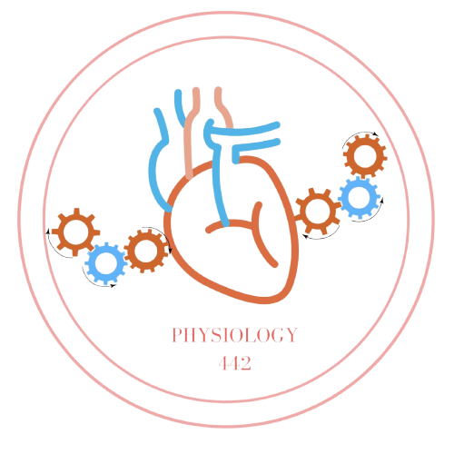
Team Leaders
Dema Alkhattabi
Waleed Alrashoud
Team Members
Nouf Aldalaqan
Farah Alqazlan
Masheal Alasmri
Amani Alotaibi
Maram Beyari
Maha Alkoryshy
Nouf Aldhalaan
Othman Alabdullah Khaled Bin-Arbeed
Rakan Alromayan
Talal Alharbi
Abdullah AlShehri
Mohammad Alrashed Saud Al-Taleb
Sultan Al-Abdullah Saad AlAngri
Abdullah Awartani
Special Thanks to Physiology Team441
Physio442@gmail.com

