Slide 1
7
Physical & Physiological Factors in Athletic Performance
Editing File
Theme By: Arwa Almobeirek

Slide 2
Objectives
Identify the muscle metabolic systems and the nutrients used in exercise to regenerate ATP:
Phosphocreatine-creatine system,
Glycogen-lactic acid system,
Aerobic system.
Explain the recovery of the muscle metabolic systems after exercise and the phenomena of oxygen debt
Notes:
Size

Slide 3
Metabolic Pathways in Skeletal Muscle
1
1
4
3
Adenosine triphosphate (ATP) is the only energy source used directly by the muscles for contractile activities.
2
The demand and the mechanism of ATP production vary according to the type of work done.
Amount of ATP is determined by
Duration of exercise
Type of exercise
3
At rest: muscle cell contains a small store of ATP, but it cannot rely on this ATP once it begins contracting.
3
العضلة عندها مخزون جاهز من ATP تستطيع أنها تستخدمه، لكنه قليل وينفد بسرعة، لذا تتطرق إلى طرق لإنتاج ATP
4
4
3
Muscle cell must get ready to ATP production to keep pace with the increased rate of utilization.
Notes:
Organization
Color index
Background behind the notes
Changed the arrow
Moved the pictures

Slide 4
Energy for Muscle Contraction
Mitochondria in muscles convert glucose, fatty acids, and amino acids into ATP.
Adenosine-PO₃ ~ PO₃ ~ PO₃
All ATP stored in muscle is sufficient for only 1- 2 seconds of muscle power.
Enough for half of a 50-meter dash
1
3
Each of the last 2 high energy phosphate bonds in ATP stores 12,000 calories per mole of ATP.
Resting muscles must have energy stored in other forms (Creatine Phosphate (CP) - glycogen - etc.) to convert ADP into ATP.
2
4
Energy released
Energy released
ATP
ADP
+ PO₃
AMP
+ PO₃
439:
الـ ATP یحتوي على رابطتين فوسفات طاقتهم عالية
إذا انكسرت الأولى راح یصیر ADP ویعطیني ١٢٠٠٠ كالوري/مول
إذا انكسرت الثانیة راح یصیر AMP ویعطیني ١٢٠٠٠ كالوري/ مول أخرى
Recycle
Recycle
Energy consumed
Energy consumed
Text
Text
Text
Text
Text
Notes:
Organization
Color index
Background behind the notes
Size (16 → 18)
Converted picture to diagram

Slide 5
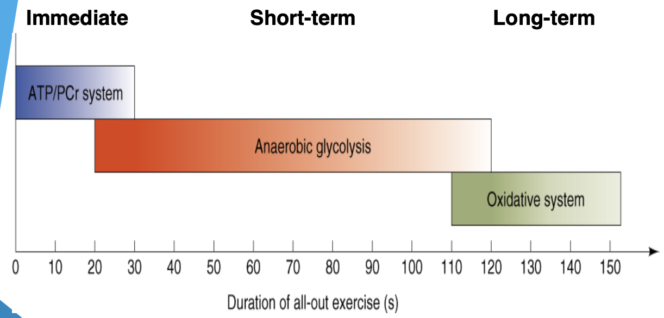
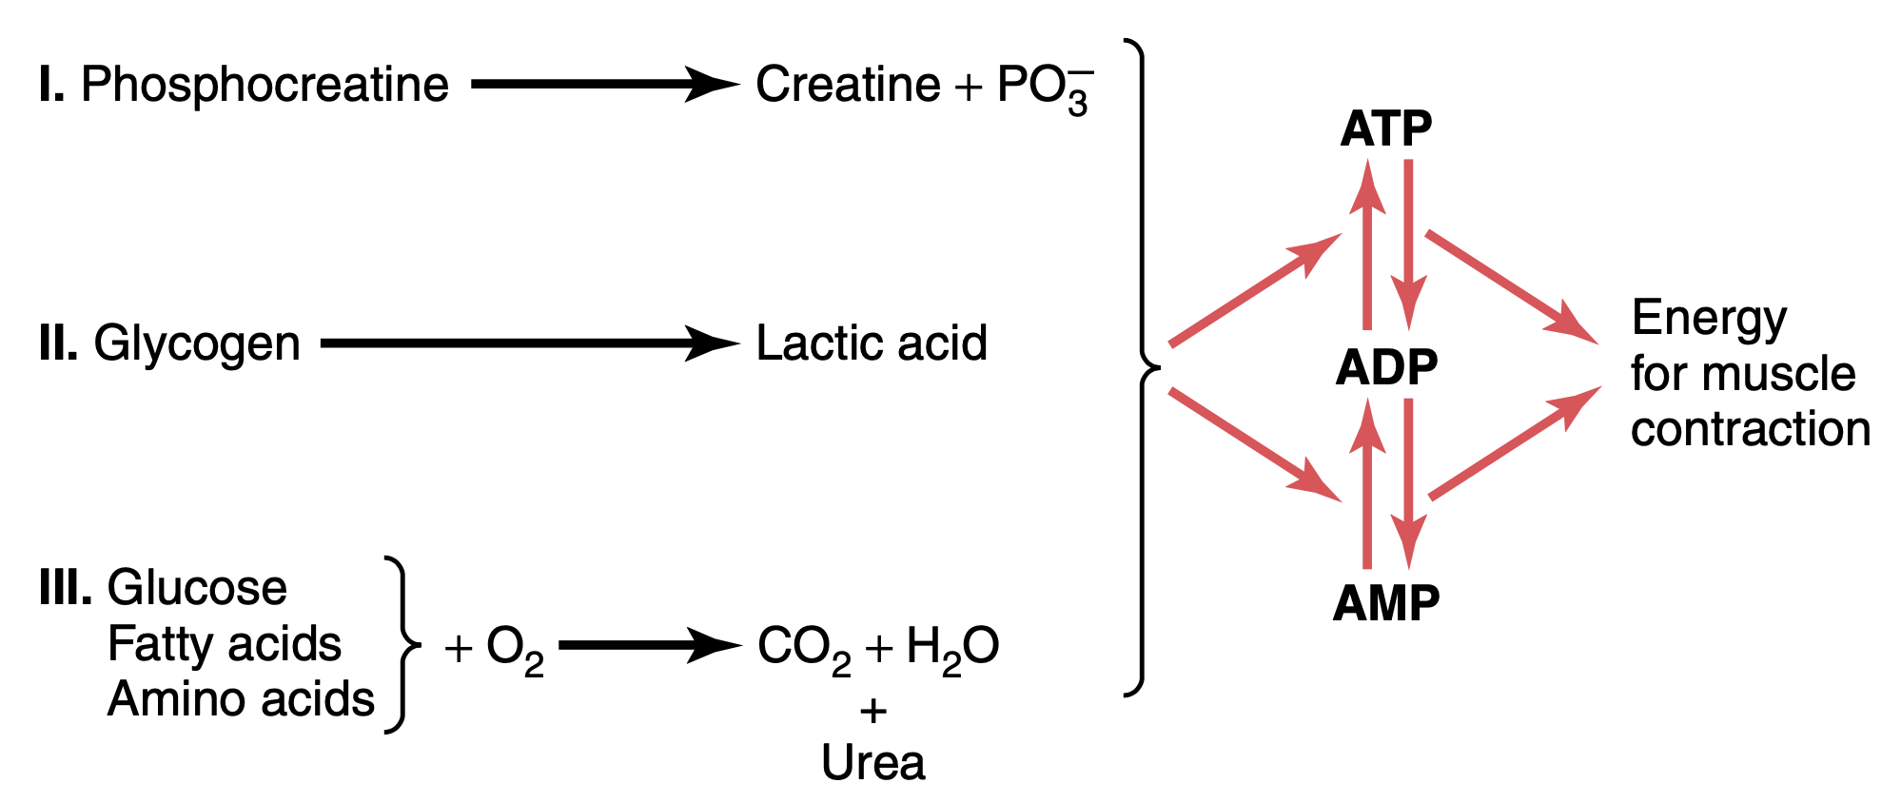
ATP Regeneration
As we begin to exercise, we almost immediately use our stored ATP within few seconds and it will changed into ADP.
ATP is regenerated from ADP by 3 pathways:
Muscle Metabolic Systems in Exercise
Dr: very important
Direct phosphorylation of ADP by creatine phosphate (CP)
Anaerobic pathway
(glycolysis → lactic acid)
Aerobic oxidation of fatty acids in mitochondria
Immediate
Exercise for seconds
Short-term
60-90 seconds of exercise
Long-term
1 hour or more of exercise
Notice that the systems can be integrated.
Notes:
Organization
Mind map
Added picture
Replaced the picture
Moved the picture down
Added note

Slide 6
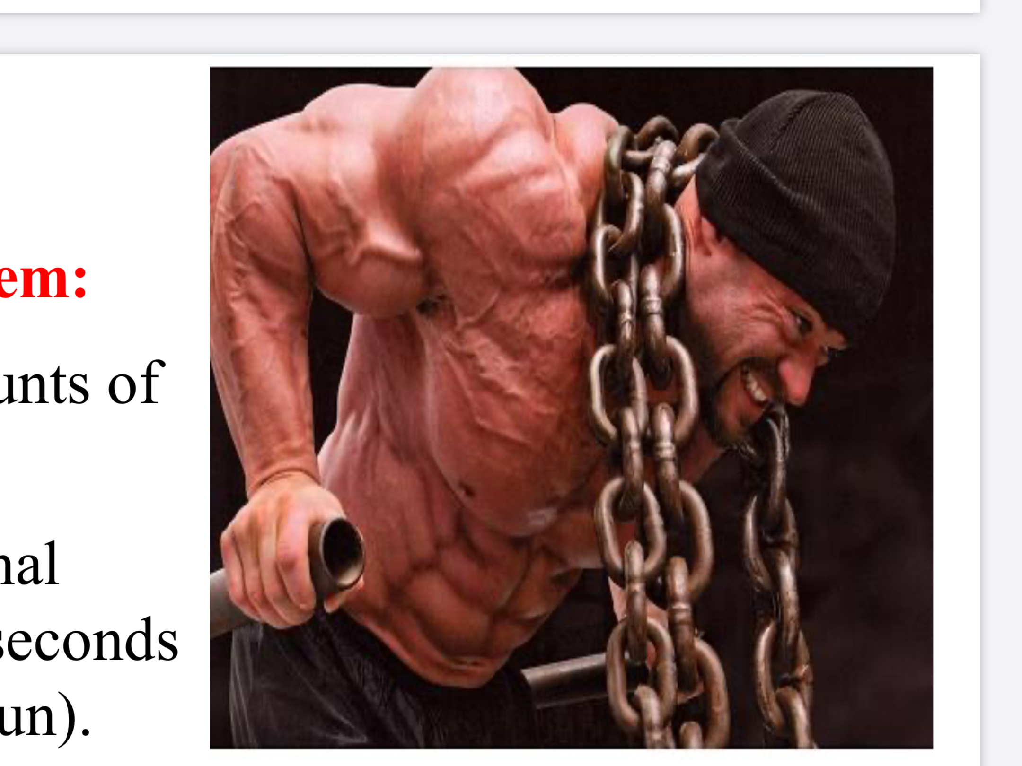
1) Phosphocreatine-Creatine System (Creatine-PO₃ or CP)
(Direct Phosphorylation)
Phosphocreatine = Creatine Phosphate
CP: contain high energy phosphate bond of 13,000 calories/mole.
Phosphocreatine + ADP
Most muscle cells have 3 - 8 times as much CP as ATP.
ATP + Creatine
Energy transfer from CP to ATP occurs within a small fraction of a second.
Energy of muscle CP is immediately available for contraction just as stored energy of ATP.
Phosphagen Energy System
Phosphagen energy system: combined amounts of cell ATP + cell phospho-creatine.
These together provide maximal muscle power for 5 to 10 seconds (enough for 100-meter run).
Energy of phosphagen system is useful for maximal short bursts of muscle power (5 - 10 secs).
تمرين عنيف لكن ما يطول.
لما نتكلم عن الـATP والـCP سوا نسميهم "Phosphagen system".
• Jumping
• Diving
• Weight lifting
Text
Text
Text
Text
Notes:
Organization
Merged 2 slides
Deleted extra picture as it’s repetitive
Converted picture to diagram
Text size 18 → 20
Added 2 notes

Slide 7
O₂ is absent.
2) Glycogen-Lactic Acid System
(Anaerobic Glycolysis/Metabolism)
Anaerobic glycolysis: the primary energy source for peak (sever) muscular activity.
Provides 1.3 - 1.6 minutes of maximal muscle activity.
Produces 2 ATP molecules per molecule of glucose coming from blood.
Glycogen → glucose → 2 pyruvic acid (2 ATP + 2 NADH) → 2 lactic acid (2 NAD⁺)
Lactic acid diffuses out of muscles → blood → liver (lactic acid → glucose by gluconeogenesis) → blood → muscle.
Types of sports using anaerobic glycolysis:
sports that require bursts of speed & activity (e.g. tennis).
Text
Text
Text
Text
Text
Notes:
Organization
Merged 2 slides
Note size
Pictures’ locations & sizes

Slide 8
2) Glycogen-Lactic Acid System
(Anaerobic Glycolysis/Metabolism)
Why is it inefficient?
Large amounts of glucose used for very small amounts of ATP return.
Lactic acid is produced → muscle fatigue.
Which type of sports uses anaerobic metabolism?
• 400-meter dash
• 100-meter swim
• Tennis
• Soccer
Text
Text
Text
Text
Text
Notes:
Organization
Merged 2 slides
Note size
Pictures’ locations & sizes

Slide 9
3) Aerobic System/Metabolism
Aerobic metabolism: the primary energy source of resting muscles to convert glucose into glycogen and to create energy storage compounds as CP.
.
During rest and light to moderate exercise: aerobic metabolism contributes 95% of the necessary ATP.
Breaks down fatty acids, pyruvic acid (from glycolysis), and amino acids.
Produces maximum 38 ATP molecules per glucose molecule.
Text
Text
Text
Text
Text
Notes:
Organization
Text size 18 → 20
Deleted picture

Slide 10
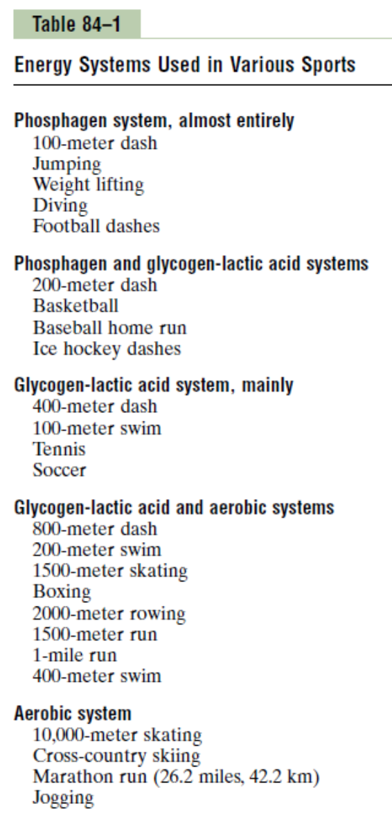
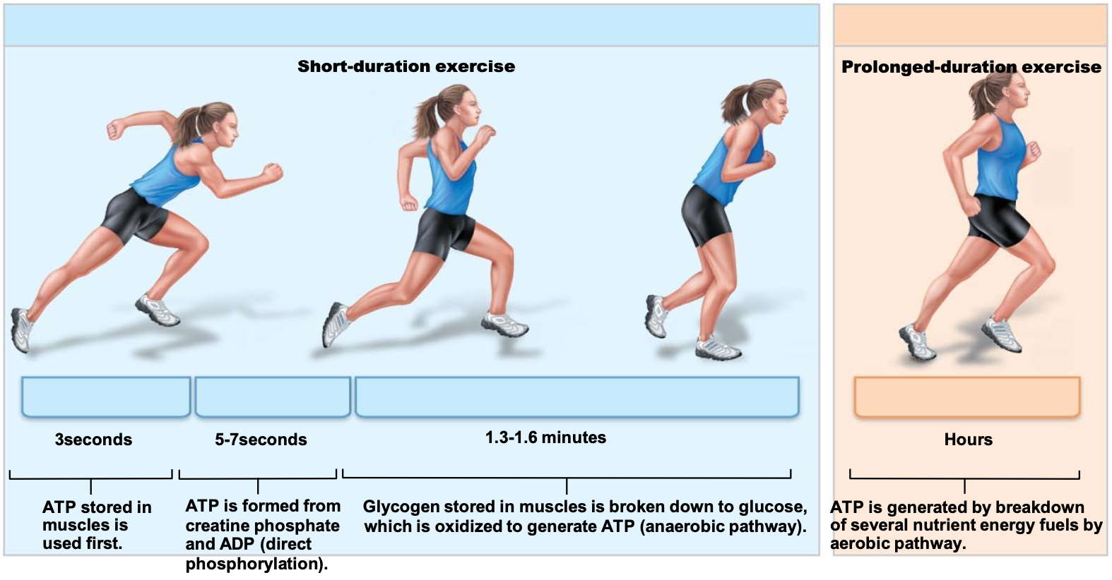
Comparing the Energy Supply of the 3 Systems:
(Phosphagen - Anaerobic - Aerobic)
Systems | ATP Generation (moles of ATP/min) | Time (endurance) | Example
Phosphagen | 4 | 8 - 10 sec | 100-m run
Anaerobic | 2.5 | 1.3 - 1.6 min | Sports that require burst of speed & activity (basketball)
Aerobic | 1 | unlimited (as long as nutrients last) | Marathon run
Dr: don't memorize the examples but it's important to understand them
Notes:
Organization
Table
Deleted the word “system” from each in the table

Slide 11
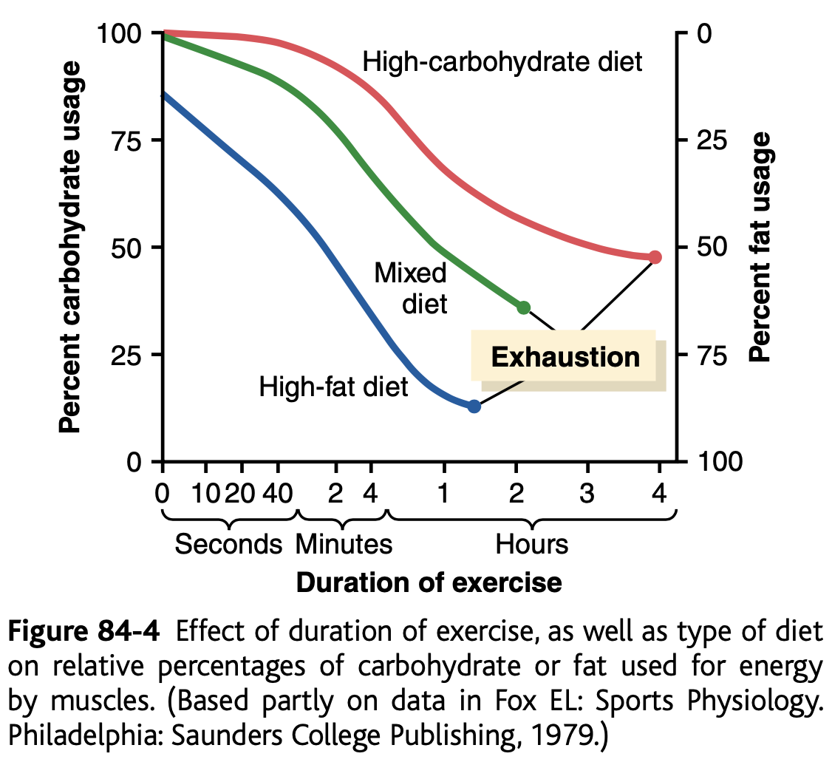
Nutrients Used During Muscle Activity
Early stages of exercise:
body uses CHO from muscles & glycogen from liver.
Intense muscle activity:
body uses fat + very little amount of amino acids.
Endurance athletic lasts longer than 4-5 hours + during exhaustion: muscle glycogen is depleted + muscle depend on fat.
Extra graph to understand:
• بداية التمرين: يحرق الجسم الكربوهيدرات
• بعد فترة الإعياء: يبدأ يحول على الدهون
Glucose solution is given to athletes to drink during athletic events supply 30 - 40% of the energy required during prolonged events as marathon race.
Notes:
Organization
Picture replaced
Diagram added
Deleted picture
Added note to graph

Slide 12
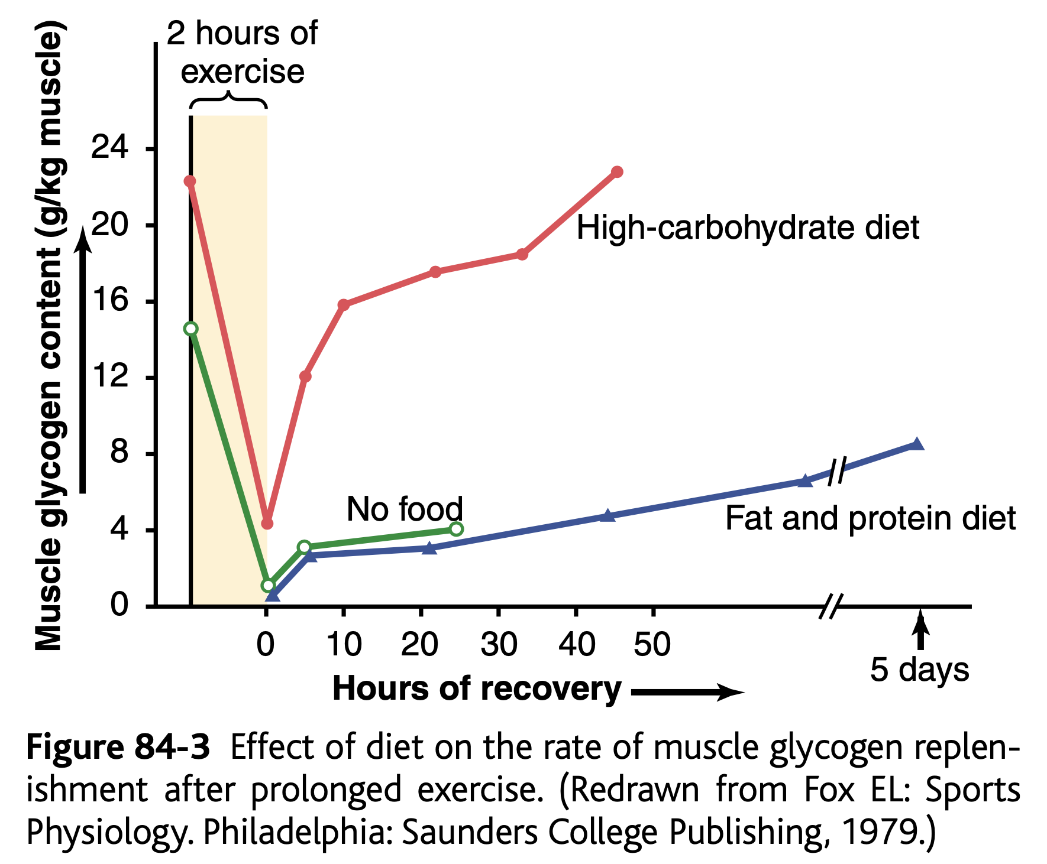
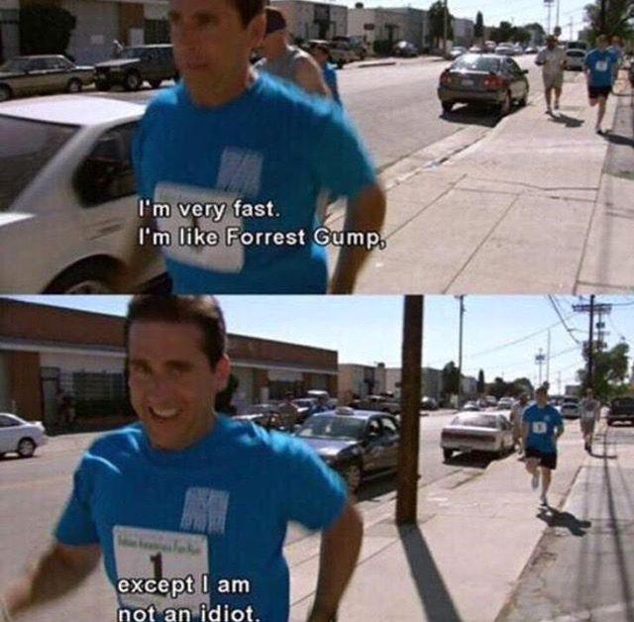
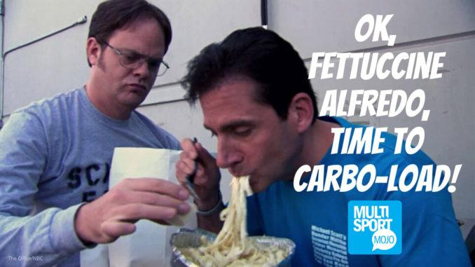
Recovery of Muscle Glycogen
An extra graph to understand:
يحتاج الـglycogen أيام حتى يتعوض. عشان كذا، نلاحظ أن الرياضيين اللي ياكلون وجبات غنية بالكربوهيدرات يسترجعون الـglycogen أسرع بكثير من اللي يعتمدون على الدهون والبروتين في نظامهم الغذائي.
Reduction of glycogen stores by heavy exercise needs days to be replenished (refill) unlike ATP, CP, and removal of lactic acid which takes shorter periods.
On high CHO (carbohydrates) diet → recovery occurs in 2 days.
On high fat, high protein or no food at all diet → very little recovery even after as long as 5 days.
Athlete should have high CHO diet before exercise.
Athletes should avoid participating in exhausting exercise during the 48 hours preceding (before) the event.
Notes:
Organization
Added graph from resource
Diagram added
Color codes
Added missing text from updated female slides
Deleted text كانت زرقاء بس ما لقيتها: Takes more time than ATP, CP, and removal of lactic acid.
Added note to graph

Slide 13
Recovery of Muscle Metabolic Systems After Exercise
Energy from CP reconstitute (restore) ATP.
Energy from glycogen-lactic acid system reconstitute the phosphagen system (CP + ATP).
Energy from oxidative metabolism of aerobic system reconstitute all other systems: glycogen - lactic acid system + CP + ATP.
1) Portion converted into pyruvic acid that is oxidized by all body tissues.
Lactic acid causes fatigue → should be removed by:
2) Major remaining part is changed into glucose in the liver to replenish glycogen stores of muscles. (Cori’s cycle)
Notes:
Organization
Diagram replaced
Colour index
Text size 18 → 20

Slide 14
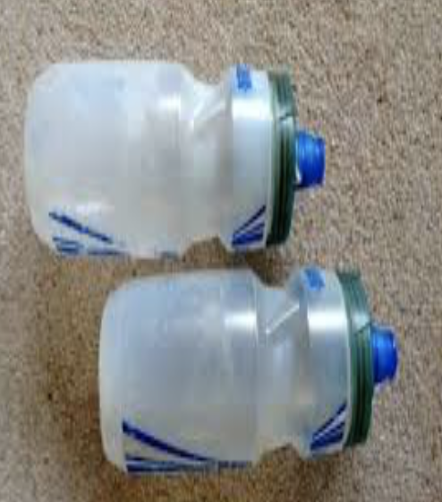
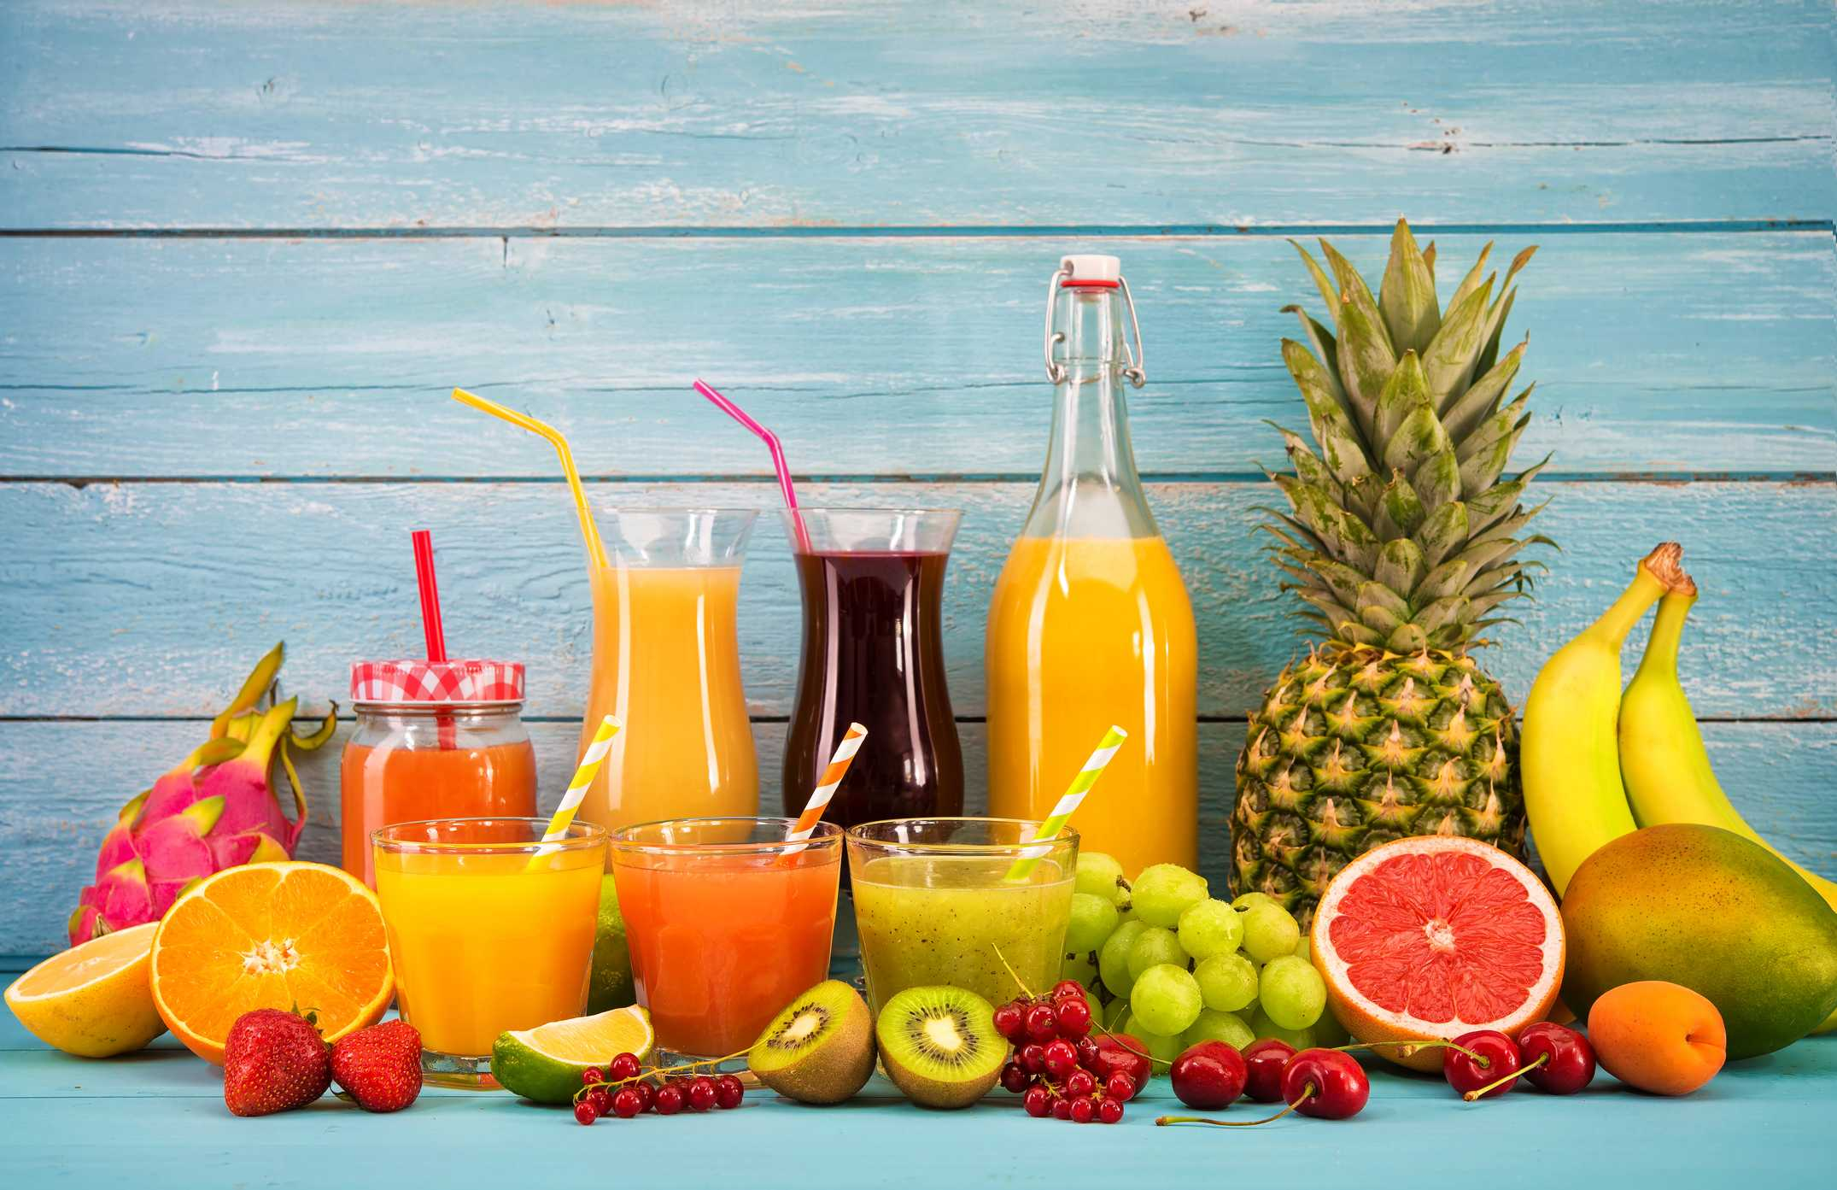
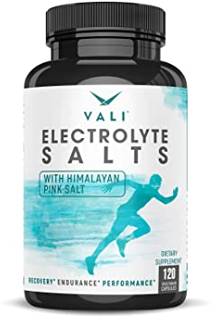
Body Fluids and Salts in Exercise
Exercise for 1 hour during endurance athletic event → 5 - 10 pounds of weight loss in hot humid atmosphere due to sweat loss.
Loss of enough sweat:
Reduce performance 5-10%.
May lead to: cramps, nausea & serious effects.
Sweat lost should be replaced.
Sodium tablets + supplemental fluids containing potassium in the form of fruit juice is required to athletes.
Acclimatization (تأقلم) to exercise by gradual increase over 1-2 weeks instead of maximal exposure is needed.
Notes:
Diagram colour
icons replaced
Title
Organization
Added picture
Text size → 20
Moved + resized pictures

Slide 15
Drugs & Athletes
1
Caffeine:
2
Androgens Used by Women:
Increase athletes’ performance.
Develop facial hair + ruddy skin + bass voice.
Menses stop.
3
Androgens & Anabolic Steroids:
4
Amphetamine & Cocaine:
Male sex hormones.
Increase athletes’ performance.
Increase risk of heart attacks.
Due to:
Hypertension
High LDL
Low HDL
Decrease testicular functions.
Decrease natural testosterone secretion in males.
Psychic stimuli.
Improve performance.
Overuse → reduce performance.
The action of these drugs + hormones of adrenal medulla secreted during exercise (epinephrine & norepinephrine) → death by ventricular fibrillation.
Notes:
Organization
Title: And → &
Text size 16 → 18
Moved pictures next to their points

Slide 16
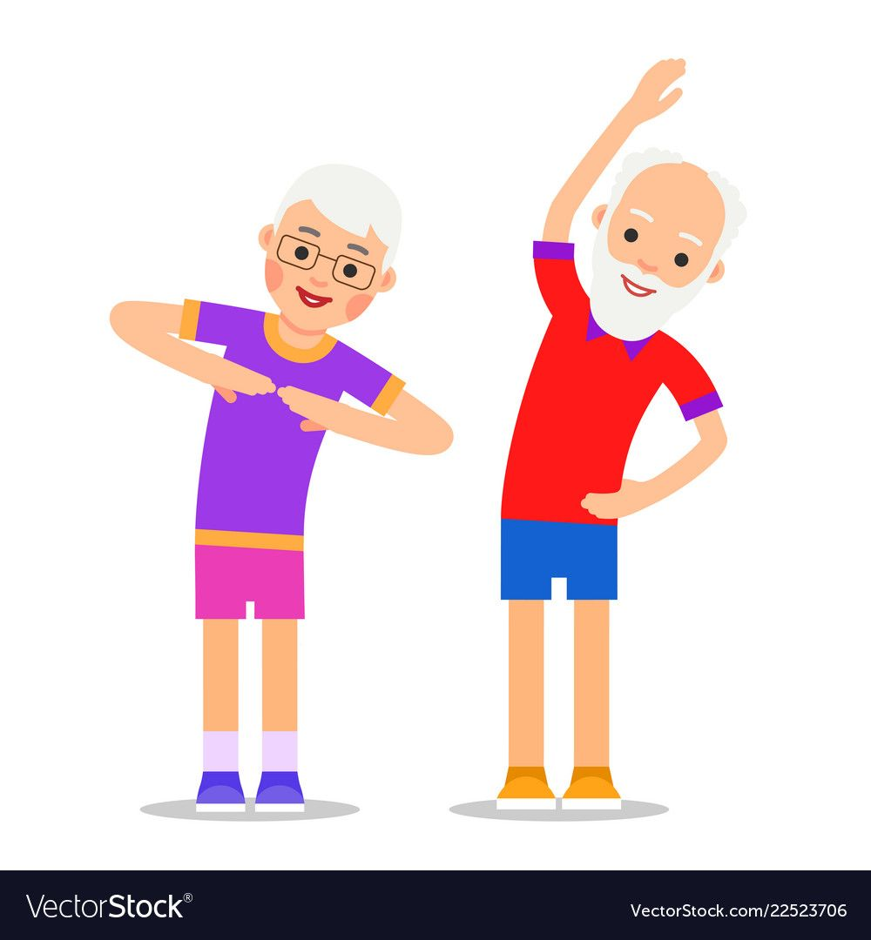
Body Fitness Prolongs (Improves) Life
Studies show that: body fitness, exercise & weight control have additional benefit of prolonged life (between 50 - 70 years).
Reasons:
Low blood pressure + low blood cholesterol + low LDL + high HDL
→ reduced risk of CVD + heart attacks + brain stroke + kidney disease.
LDL: Bad cholesterol.
HDL: Good cholesterol.
Reduces insulin resistance + type 2 diabetes.
Reduces the risk of breast, prostate, and colon cancers.
Reduces obesity.
Notes:
Organization
Diagram
Separated the slides
Added “show that” after studies
Color index
Background behind the note
Deleted 2 pictures
Text size: 20

Slide 17
Take Home Messages
Resting muscle cell contains a small store of ATP, but it cannot rely once it begins contraction .
Each of the last 2 high energy phosphate bonds in ATP stores 12,000 calories per mole of ATP.
ATP is regenerated from ADP by 3 pathways.
Anaerobic glycolysis produces 2 ATP molecules per molecule of glucose.
Aerobic metabolism produces 36 * ATP molecules per glucose molecule.
Notes:
Title
Organization

Slide 18
MCQs:
Answers: 1.C 2.B 3.C 4.D 5. A
Q1: Direct energy source for muscle contraction?
A |  | B |  | C |  | D
Q2: Which of the following is not a way of converting ADP to ATP?
A |  | B |  | C |  | D
Q3: Anaerobic pathway is …….
A |  | B | Immediate | C |  | D
Q4: How much ATP is produced via the aerobic method?
A |  | B |  | C |  | D
Q5: Which of the following is NOT an effect of nicotine on exercise?
A |  | B | increases resistance of airflow. | C | Paralyze the cilia of the respiratory epithelial cell | D | Constricts terminal bronchioles
Glucose
Glycogen
ATP
Lipids
Direct phosphorylation of ADP by CP
indirect phosphorylation of ADP by CP
Anaerobic pathway
Aerobic oxidation of FA
Long term
Short term
None of the above
24
12
8
38
Fluid and waste accumulation
Notes:
New slide
Organized pictures
Combined 2 points:
“All-or-none” principle: impulse from motor neuron will cause contraction in all muscle fibers it innervates or none.
Motor Unit follows “all-or-none” principle.

Slide 19
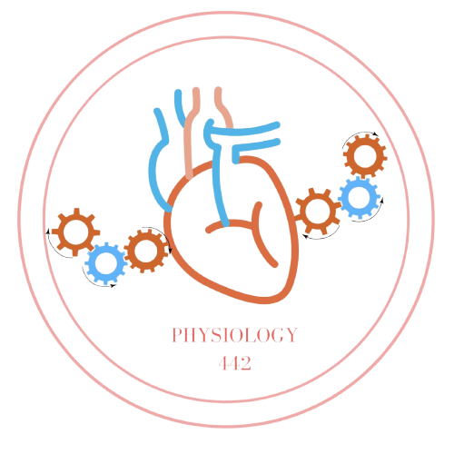
Team Leaders
Dema Alkhattabi
Waleed Alrashoud
Team Members
Nouf AlDalaqan
Farah Alqazlan
Masheal Alasmri
Amani Alotaibi
Maram Beyari
Maha Alkoryshy
Nouf Aldhalaan
Othman Alabdullah Khaled Bin-Arbeed
Rakan Alromayan
Talal Alharbi
Abdullah AlShehri
Mohammad Alrashed Saud Al-Taleb
Sultan Al-Abdullah Saad AlAngari
Abdullah Awartani
Special Thanks to Physiology Team441
Physio442@gmail.com

