Slide 1
8
Nerve Conduction Studies & EMG
Editing File

Slide 2
Objectives
Define nerve conduction study (NCS) and electromyography (EMG).
Explain the procedure of NCS.
Define the normal conduction velocity in upper limb and lower limb nerves.
Define the motor unit potentials (MUPs) and how they are changed in muscle and nerve diseases.
Notes:
Size
color index

Slide 3
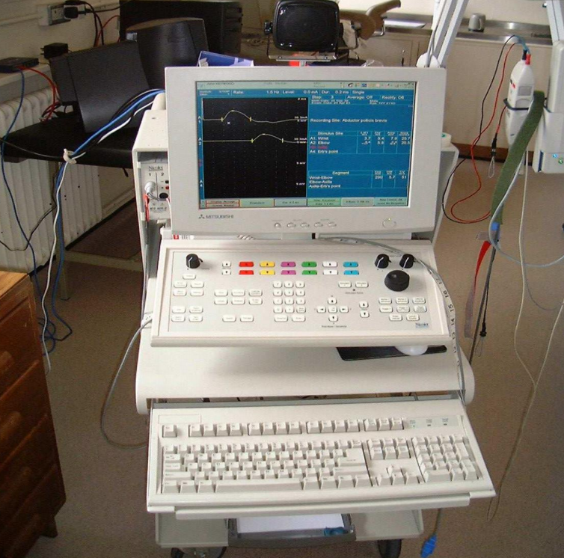
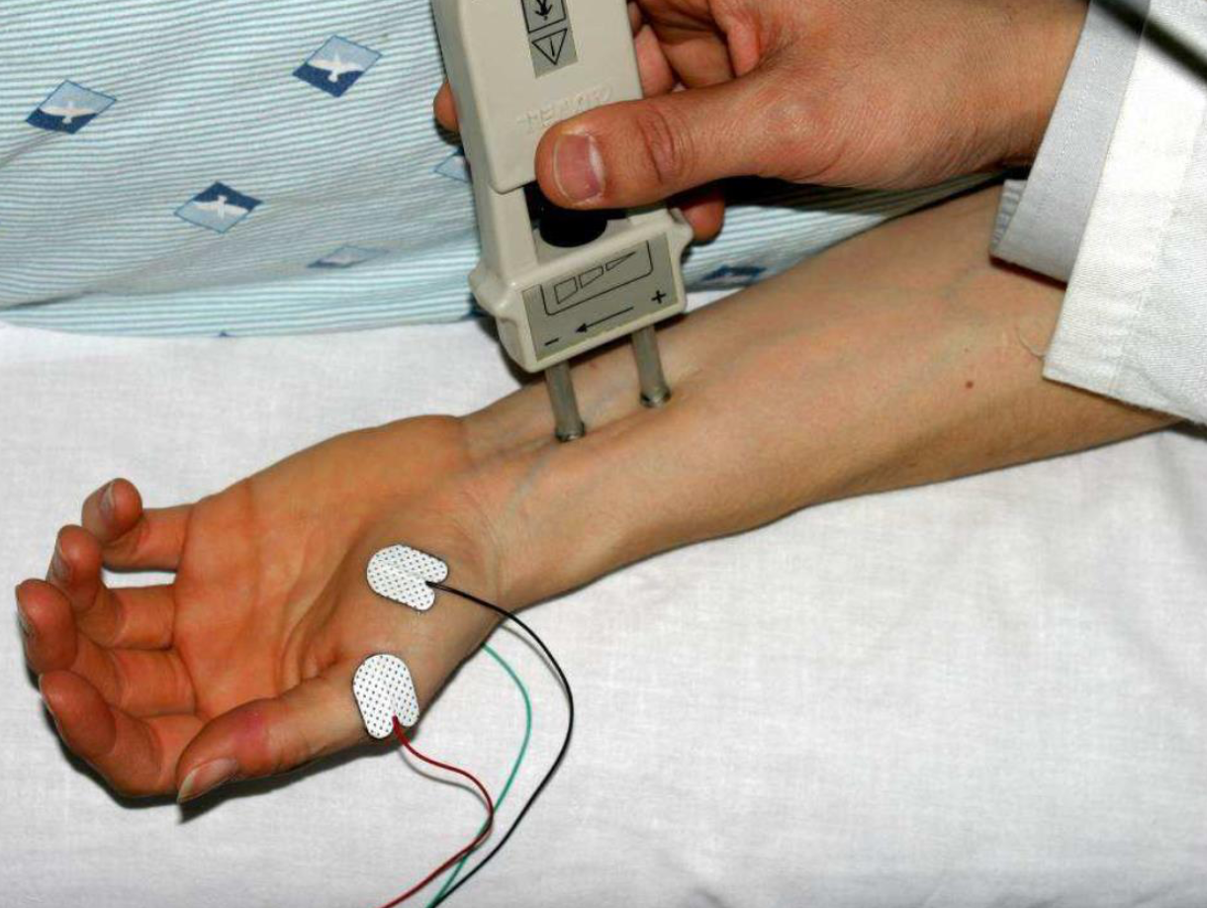
Nerve Conduction Studies
Nerve conduction study (NCS): a test commonly used to evaluate the function of the motor and sensory nerves of the human body.
It especially evaluates the ability of electrical conduction of the nerves.
Involve analysis of specific parameters:
Latency
Conduction velocity
Amplitude
Nerve conduction velocity (NCV): a common measurement made during the NCS test.
439:
• NCS: اختبار يقيس قدرة توصيل الكهرباء للأعصاب (sensory + motor).
• NCV: هو القياس الشائع لھذا الاختبار (سرعة التوصيل).
The most common nerves tested in the upper limb are the median, ulnar, and radial nerves. In this lecture, the median nerve is the prototype.
Text
Text
Text
Text
Text
Notes:
Organization
احس “Typically includes motor and sensory nerve conductions.” مكرره ولا؟ أتفق، حذفتها
Added arrow
Added note
Moved picture from next slide to here

Slide 4
Motor Nerve Conduction Velocity
Motor nerve conduction velocity of peripheral nerves may be closely correlated to: their functional integrity or to their structural abnormalities.
Types of peripheral nerve lesions: (based on the nature of conduction abnormalities)
Axonal degeneration
Segmental demyelination
يفيدنا الاختبار في تشخيص ال peripheral neuropathies، واللي تنقسم لنوعين؛ كل نوع له خصائص معينة تتضح في الرسم البياني.
Text
Text
Text
Text
Text
Notes:
Moved the picture to the previous slide
Added extra pictures of nerve lesions
Added note.

Slide 5
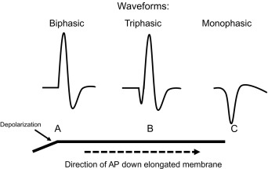
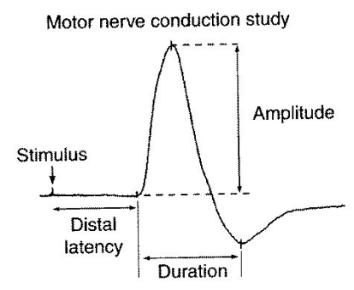
Motor Conduction Studies (MCS)
Compound muscle action potential (CMAP): the recorded potential that represent the summation of all underlying individual muscle fiber action potentials.
• It is a biphasic potential with an initial
upward deflection from the baseline.
Motor conduction velocity can be calculated after 2 sites of stimulation:
• One distal (wrist)
• One proximal (elbow)
For each stimulation site (proximal & distal) the following parameters of CMAP are measured:
• Latency
• Amplitude
• Duration
Text
Text
Text
Text
Text
Notes:
Added “of CMAP” after “parameters” and deleted the repeated ones
Combined some info to enlarge graphs
Added notes

Slide 6
MCS Procedure
1
Active recording electrode is placed on the center of the muscle belly (over motor endplate).
Reference electrode is placed distally about 3 - 4 cm.
2
Stimulator is placed over the nerve that supplies the muscle.
3
As current is slowly increased from a baseline: more of the underlying nerve fibers are brought to action potential → more muscle fiber action potentials are generated.
4
Most nerves require a current in the range from 20 to 50 mA to achieve supramaximal stimulation.
5
The recorded potential (CMAP) represents the summation of all underlying individual muscle fiber action potentials.
6
When current is increased to the point that the CMAP no longer increases in size: one presumes (يفترض) that all nerve fibers have been excited and that supramaximal stimulation has been achieved.
7
Current then is increased by another 20% to ensure supramaximal stimulation.
Text
Text
Text
Text
Text
Notes:
Organization
Added step 5
Separated step 6 (step 5 in the draft slide) into steps 6 and 7
Background to the note
Arranged picture labeling
Moved the pictures to the next slide لأنها فاضية بزيادة وهذي مزحومة بزيادة
Text size 18

Slide 7
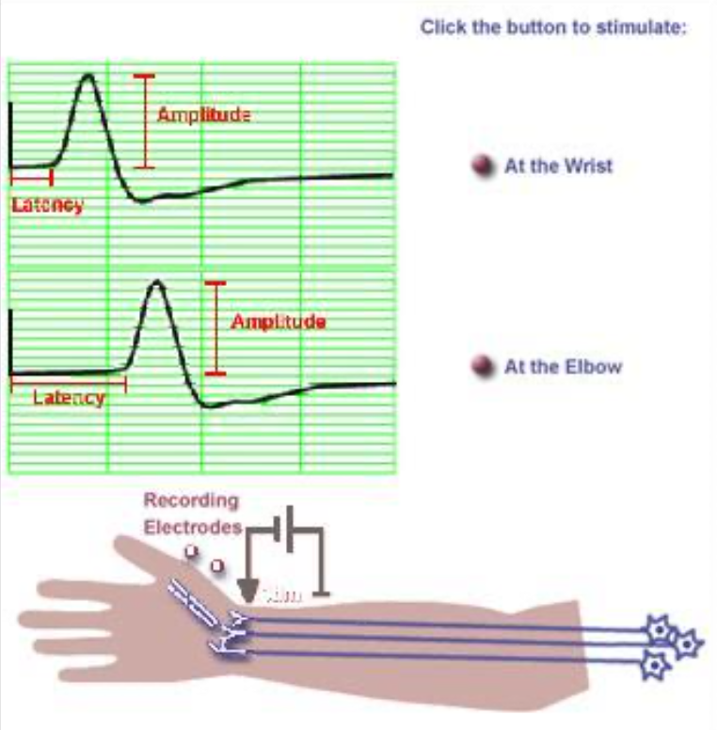
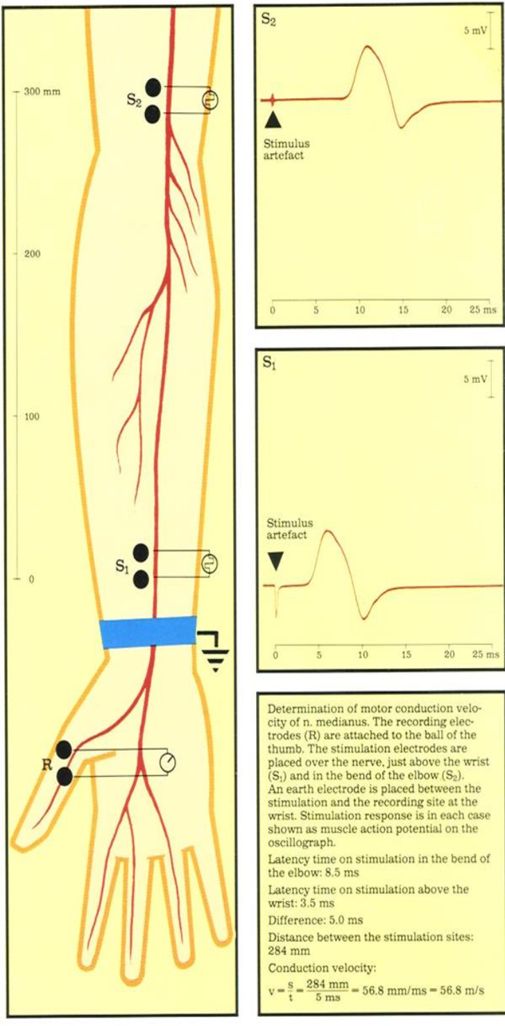
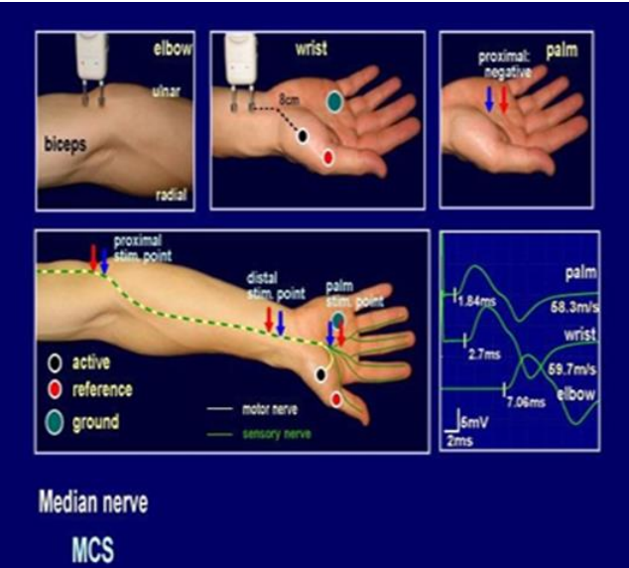
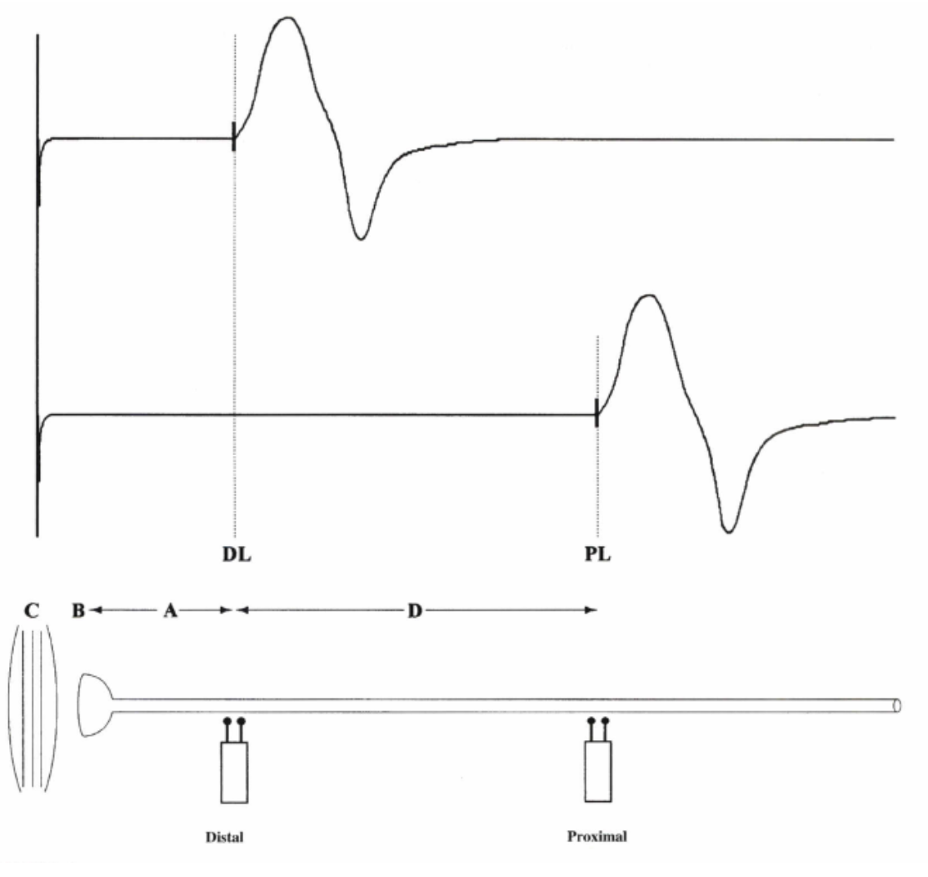
MCS Procedure
Stimulator
Electrodes
This chart will appear when we do not put the ground electrode → electrical signals in the room interrupt the graph. (The ground electrode provides a zero voltage reference point).
Notes:
New slide
Moved pictures from previous slide to here
Edited grammar of note + added extra info
Moved 2 pictures from later slide to here

Slide 8
Vectors of NCS/MCS
Vectors of NCS/MCS
Amplitude =ارتفاع النبضة نفسها
Conduction Velocity
Amplitude
Duration
Latency
Conduction velocity: measurement of the speed of conducting nerve axons.
Commonly: measured from baseline to peak.
Less commonly: peak to peak (first upward peak → next downward peak).
Duration: measured from initial deflection from baseline to final return.
Latency: time from the stimulus to the initial deflection from baseline.
Calculated by:
Check the Next Slide
Normal Values:
Arm: 50 - 70 m/sec
Leg: 40 - 60 m/sec
CMAP amplitude reflects the number of muscle fibers that depolarize.
Average amplitude: 3 mv.
Loss of axons (typical axonal neuropathy) → low CMAP amplitude.
Characteristically increases in conditions that result in slowing of some motor fibers (e.g. demyelinating lesion).
Measurements
usually are made in milliseconds (ms) or (mSec).
Text
Text
Text
Text
Notes:
Merged 3 slides
Excluded the calculation of CV into a separate slide with examples and pictures
Excluded the normal study table into a new slide

Slide 9
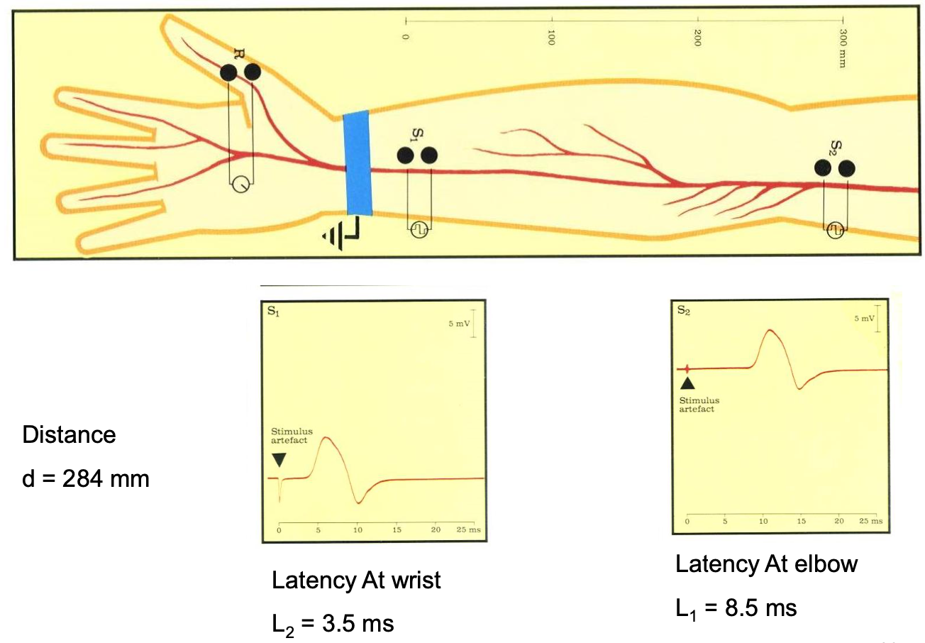
Motor Nerve Conduction Velocity (MNCV)
Dr: very important
calculations / graph
MNCV can be calculated by:
Distance (mm)
Distance between proximal & distal stimulation site
Change in time [proximal latency - distal latency].
MNCV (m/sec) =
L₁ - L₂ (mSec)
L₁: Latency at the elbow (proximal).
L₂: Latency at the wrist (distal).
We know from physics that velocity is distance/time.
If the following is given:
Distance = 284 mm
L₁ = 8.5 ms
L₂ = 3.5 ms
We can calculate velocity:
MNCV = (284) / (8.5 - 3.5) = 56.8 m/sec
→ It is within the normal range of arm (50 - 70)
Text
Text
Text
Text
Notes:
Organization
Added “Distance between proximal … distal latency].”
Added 3 pictures → moved 2 of them to a previous slide (MCS procedure)
Added note
Added arrows & put the definitions next to them

Slide 10
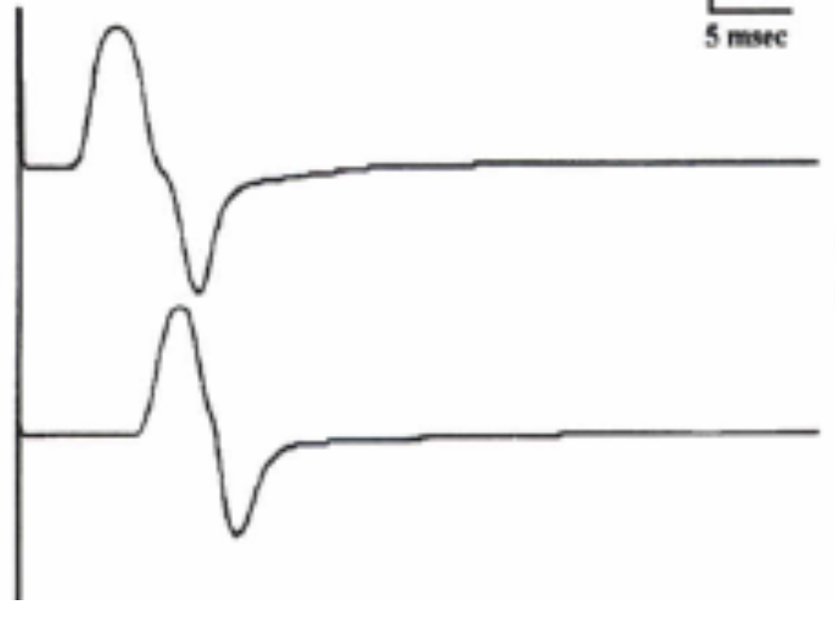
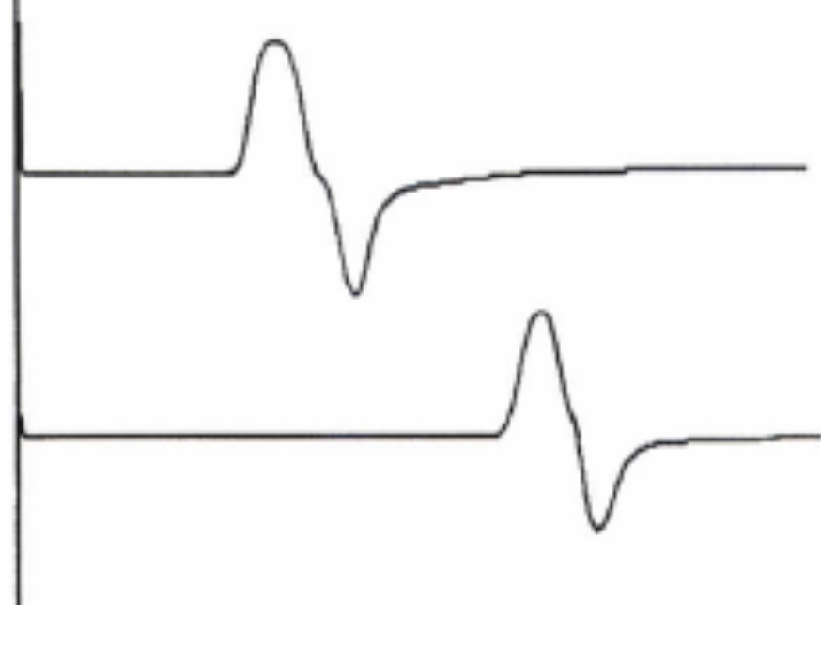
Patterns of Nerve Conduction
Demyelination = تحلل Myeline
 | Normal | Axon Degeneration or Loss Neuropathy | Demyelinating Neuropathy Associated with inherited disorders
Amplitude | > 4 mV | Decreased (low) | Normal
Distal Latency (DL) | 3 ms | Normal or slightly prolonged (delay) | Markedly prolonged (delay) (> 130% upper limit of normal)
Conduction Velocity (CV) | > 49 m/s | Normal or slightly slowed | Markedly (significantly) slowed (< 75% lower limit of normal)
Morphology of Potential Between Proximal & Distal Sites | - | Not changed | Not changed
Graph
5 mV
5 msec
(Median Nerve)
DL = 3 msec | CV = 59 m/sec
DL = 4.4 msec | CV = 51 m/sec
DL = 12.7 msec | CV = 12 m/sec
Small peak
Prolonged latency
Text
Text
Text
Notes:
New slide
Added picture
احس هذي تكفي عن ال٣ اللي بعدها ولا؟ yes, perfect
Color code → red
Organized graphs & added small notes/labels

Slide 11
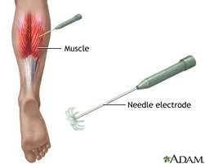
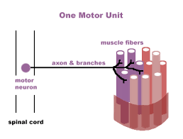
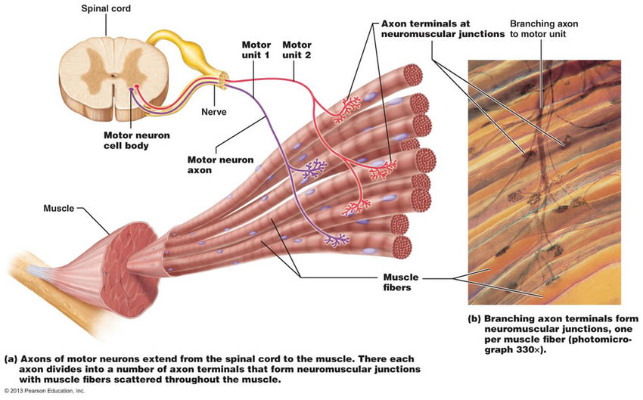
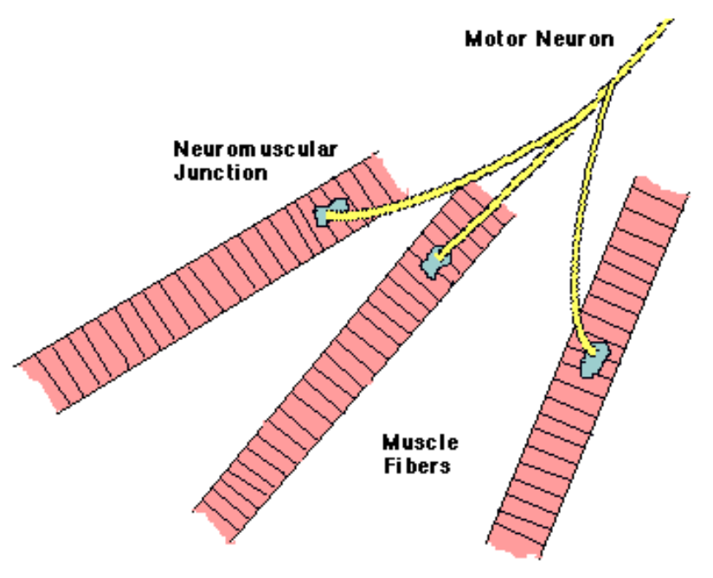
ElectroMyoGraphy (EMG)
EMG is measured by small needles called electrode.
Electromyography (EMG): a recording of electrical activity of the muscle by inserting needle electrode in the belly of the muscle or by applying the surface electrode.
Motor Unit Potentials (MUPs): potentials recorded on volitional (اختياري) effort derived from motor units of the muscle
Motor unit: one motor neuron and all of the muscle fibers it innervates.
Notes:
Organization
Added picture
Note background
Arranged pictures
Added translation of “volitional”

Slide 12
EMG Analysis
 |  | Definition | Findings
 |  |  | Normal | Abnormal
 | Insertional Activity | Electrical activity present as the electrode is passed through muscle cells. These are discharge potentials provoked by the disruption of the cell membrane itself. | Present | • Decreased in atrophied muscle or fatty tissue. • Increased in many abnormal conditions that cause membrane instability (neuropathies - radiculopathies - inflammatory myopathies).
 | Spontaneous Activity | Activity recorded when the skeletal muscle is silent at rest. | Absent | Present [detailed in next slides]
 | Motor Unit Potential | Potentials recorded on volitional effort derived from motor units of the muscle (slight effort) | Check next slides
 | Full Recruitment | Potentials recorded when the patient makes strong muscle contractions (maximum activity)
Rest
Activity
ينقسم الـEMG إلى 4 مراحل تحليلية، لكل وحدة رسم بياني خاص:
1) Insertional activity: عملية إدخال الإلكترود نفسها تنتج حركة طبيعية قصيرة، إذا زادت أو قلت معناها فيه مشكلة
2) Spontaneous activity: أثناء جلوس المريض (بدون أي حركة) يكون الرسم البياني مستقيم في الحالة الطبيعية
3) Motor Unit Potential: نطلب من المريض يحرك عضلاته
4) Recruitment: نطلب من المريض يشد عضلاته بقوة
Text
Text
Text
Text
Text
Notes:
Comment: أحس السلايد زحمة بس مدري كيف أحل المشكلة
Changed diagram into table
Deleted pictures
Deleted Electromyography from title (EMG is enough)

Slide 13
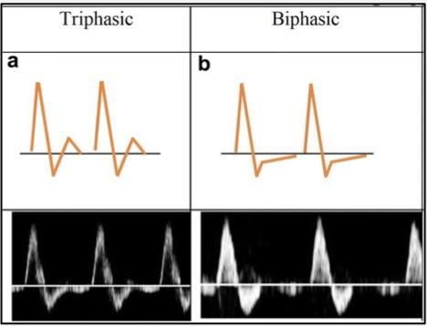
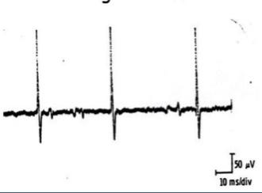
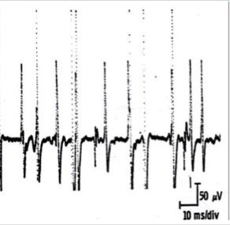
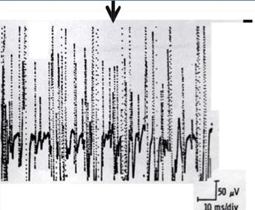
Normal MUPs
3
Amplitude:
1
Duration:
2
Morphology:
300 - 5000 µV (5 mV)
3 - 15 mSec
Bi/Triphasic
4
Recruitment (Interference) pattern:
Normally number of MUPs activated and their frequency rises with increased exertion until it become full with maximal voluntary contractions.
Reduced and incomplete (partial) recruitment signifies neurogenic lesion.
Early and full recruitment with a small voluntary force can be seen in myopathy.
During mild effort
Muscle is at rest (silent)
During moderate effort
Note recruitment of additional motoneurons
During full voluntary effort
Full recruitment → you can’t see the baseline
Text
Text
Text
Text
Text
Notes:
Organized
Color code (red)
Moved picture next to bi/triphasic

Slide 14
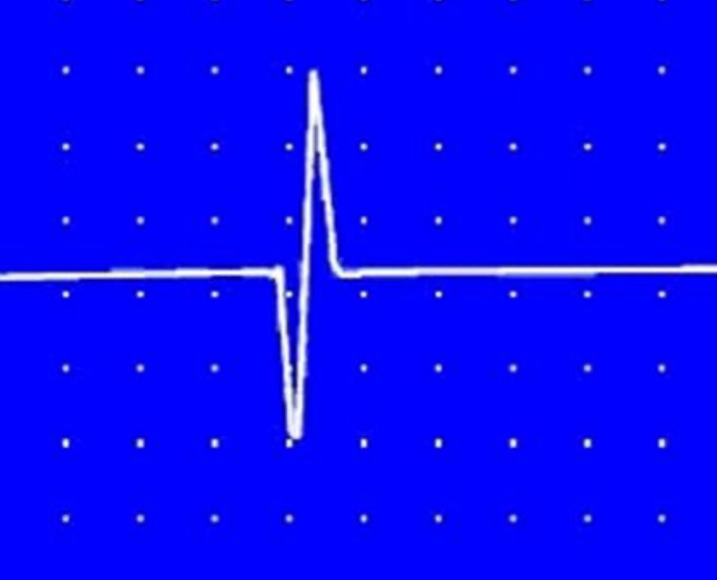
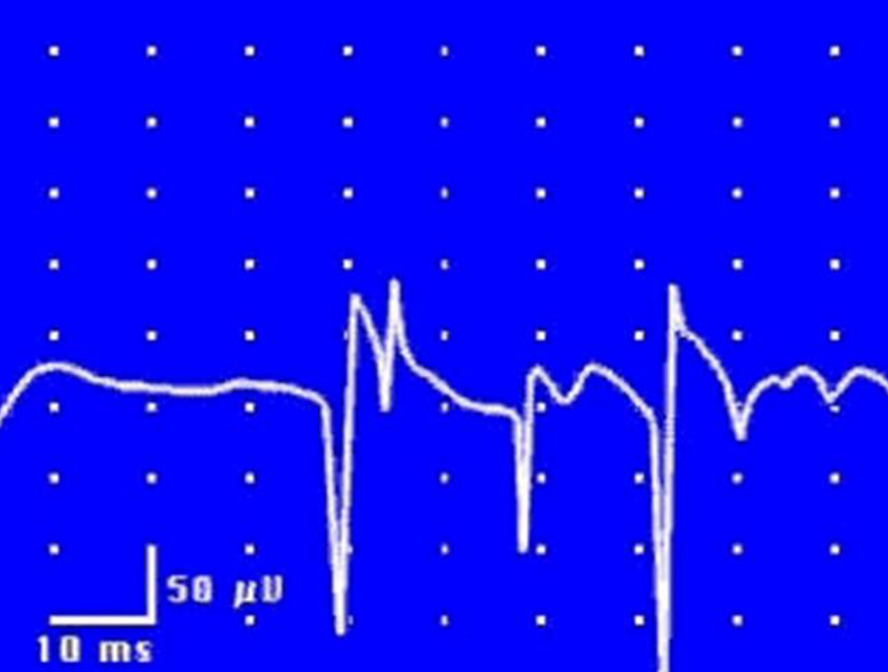
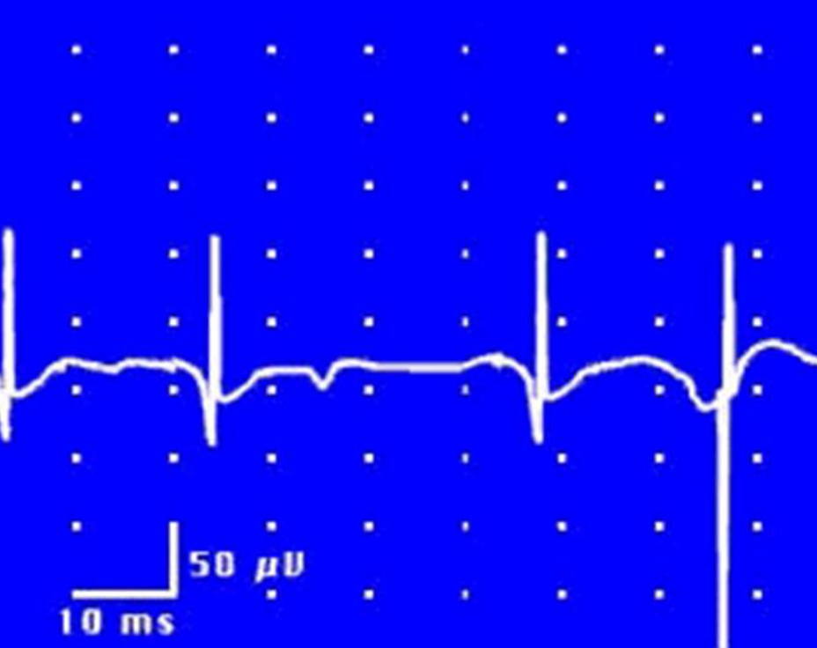
Fasciculation: نلاحظ يد المريض تنبض (large impulse)
Fibrillation: ما نلاحظ أي انقباض أو حركة (tiny impulse)
Abnormal MUPs
Abnormal MUPs
Presence of resting activity in the form of:
Positive Sharp Wave
Fibrillation Potential
Fasciculation Potential
A small potential of 50 - 100 μV, 5 - 10 msec duration with abrupt (sudden), slow outset.
The earliest manifestation (action) of axonal denervation.
Fibrillation potentials: randomly occurring small amplitude potentials or may appear in runs.
Audioamplifier gives sounds as if somebody listen sounds of rains in a tin shade house.
These potentials are generated from the single muscle fiber of a denervated muscle (due to denervation hypersensitivity to acetylcholine).
Not visible through the skin.
Fibrillations are found in neurogenic disease and inflammatory and dystrophic muscle disease (not exclusive in neurogenic disease).
Fasciculation potentials: high voltage, polyphasic, long duration potentials appear spontaneously.
These potentials are associated with visible contraction of the muscle.
Visible through the skin.
Occur in motor neuron disease, radiculopathy and neuropathy
May be benign.
Text
Text
Text
Text
Text
Notes:
Organization
Color index
Added “sudden” and “action” in grey
Removed “Not visible through the skin” from +ve sharp wave
“Fibrillations are found in neurogenic disease and …” عند العيال موجوده تحت positive sharp wave وعند البنات موجوده تحت fibrillation potential احس نخليها زي ما هي دام مكتوب fibrillation
Added doctor’s note

Slide 15
Analysis of a MUP & Typical MUAP Characteristics
Very important ( summary)
Nerves مشكلة في
Muscles مشكلة في
 | Neurogenic | Normal | Myopathic
Duration | Longer > 15 msec | 3 - 15 msec | Shorter < 3 msec
Amplitude | Larger > 5 mV | 300 - 5000 μV | Smaller < 300 μV
Phases/Configuration | Polyphasic | Biphasic / Triphasic | Polyphasic
Resting Activity | Present | Absent | Present
Interference pattern | Partial | Full | Full
ما نقدر نعتمد عليه
Text
Text
Notes:
Title
Organization
ما اعرف لو يمدي ادمج الجدولين كذا او لا بتأكد من الدكتوره لان الphases بالجدول الأول غير الثاني عند خانة الnormal أحس أفضل الدمج، والـphases فرق بسييط كنها مختصرة الجدول الثاني

Slide 16
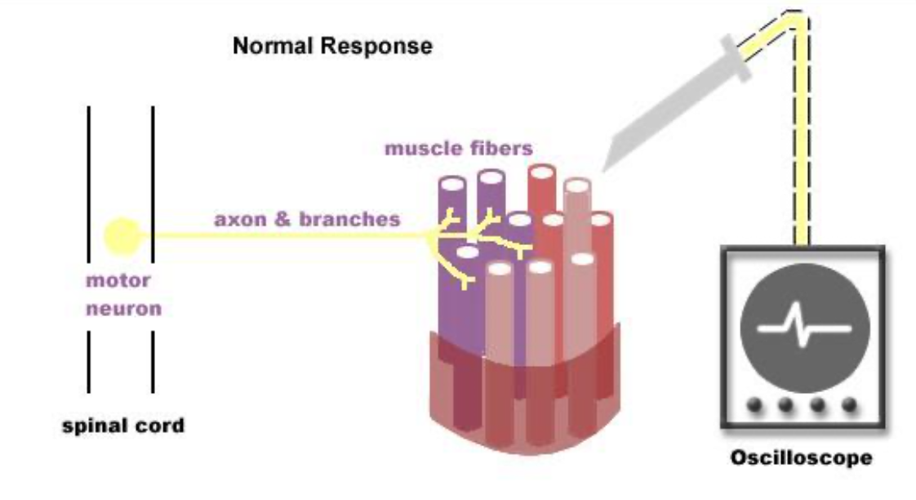
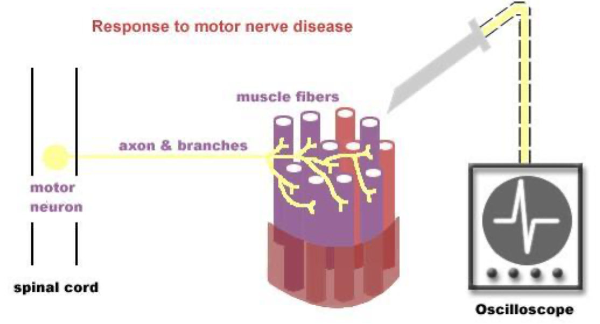
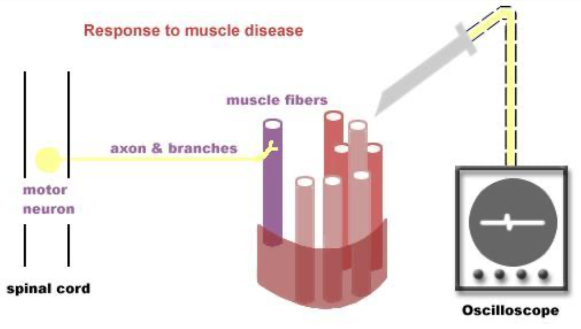
Normal, Neuropathic, & Myopathic EMG
Video
Video
Normal EMG
Neuropathic EMG Change
Myopathic EMG Change
No activity
Triphasic
Full interference (cannot see baseline)
Slight activity
(fibrillation)
Polyphasic with high amplitude (giant unit)
Less interference
Slight activity
(fibrillation)
Polyphasic with
low amplitude
Full interference
Text
Text
Text
Text
Text
Notes:
Title
Organization
Fixed youtube symbols
Added notes + red outlines
Title (and → &)

Slide 17
Take Home Messages
Sensory and motor nerve conduction studies involve analysis of specific parameters, including latency, conduction velocity, and amplitude.
Conduction abnormalities can be identified: axonal degeneration and segmental demyelination.
Amplitude reflects the number of muscle fibers that depolarize, and it’s measured from baseline to peak.
EMG is a recording of electrical activity of the muscle by inserting needle electrode.
EMG changes include neuropathic and myopathic.
Abnormal MUPs: positive sharp wave, fibrillation potential, and fasciculation potentials.
Notes:
Title
Organization

Slide 18
MCQs:
Q1: What is the normal values for conduction velocity of the arm?
30-40 m/ sec | B) 40-50 m/ sec | C) 50-60 m/ sec | D) 50-70 m/ sec
Q2: Low CMAP amplitude result from?
Increase in axons number | B) Loss in axons number | C) Decrease in latency | D) Increase in latency
Q3: Calculate the MNCV if distance:326 mm , latency at wrist: 4 ms , latency at elbow: 9 ms
56.8 | B) 65.2 | C) 44.7 | D) 69.4
Q4:Which of the following is a result from Demyelination?
Answers:
1.D
2.B
3.B
4.D
Normal Amplitudes | B) Significant delay in latency | C) Significant low conduction velocity | D) All of them

Slide 19
Q5: It’s a recording of electrical activity of the muscle by inserting needle electrode in the belly of the muscles or by applying the surface electrodes ?
EMG | B) NCV | C) CMAP | D) MUPs
Q6: Which one of the following is not features of Axonal degeneration neuropathy?
Slight delay in latency | B) Significant delay in latency | C) Low amplitudes | D) A and C
Q7: Is The time from the stimulus to the initial deflection from baseline?
Duration | B) Latency | C) Amplitude | D) Non of them
Q8: Is a test commonly used to evaluate the function, especially the ability of electrical conduction, of the motor and sensory nerves of the human body
Answers:
5.A
6.B
7.B
8.A
Nerve conduction Study | B) Electromyography | C) Compound muscle action potential | D) Non of them

Slide 20
Team Leaders
Dema Alkhattabi
Waleed Alrashoud
Team Members
Nouf Aldalaqan
Farah Alqazlan
Masheal Alasmri
Amani Alotaibi
Maram Beyari
Maha Alkoryshy
Nouf Aldhalaan
Othman Alabdullah Khaled Bin-Arbeed
Rakan Alromayan
Talal Alharbi
Abdullah AlShehri
Mohammad Alrashed Saud Al-Taleb
Sultan Al-Abdullah Saad AlAngri
Abdullah Awartani
Special Thanks to Physiology Team441
Physio442@gmail.com

