Slide 1
9
Muscle Adaptation
to Exercise
Editing File

Slide 2
Objectives
Define strength, power, and endurance of muscles.
Analyze the effect of athletic training on muscle structure and muscle performance.
Explain the different forms of muscle remodeling E.g
-muscle hypertrophy and muscle atrophy.
-Adjustment of Muscle Length
-Hyperplasia of Muscle Fibers.
- Muscle atrophy caused by denervation
Contrast Fast-twitch and Slow-twitch muscle fibers.
Describe the changes in body fluids and salts in exercise.
Explain the body heat changes in exercise and the heatstroke.
Mention the effects of drugs on athletes.
Demonstrate how body fitness improves life.
Describe the effects of heart diseases on the exercise performance in old age.
Notes:
DONE
Size
Organization
VO2 → VO₂

Slide 3
Muscle Strength
Muscle strength: the amount of force (push or pull) a muscle can produce against resistance in a single maximal effort.
Mechanical work of muscle (W):
W = force applied by muscle (L) x distance over which force is applied (D)
W = L x D
Unit: (kg-m)
Size of the muscle influences the maximal contractile force.
Normal maximal contractile force: 3 - 4 kg/cm² of the cross section of the muscle.
The size of the muscle can be increased by: weight lifting - digging.
A man who is well supplied with testosterone or who has enlarged his muscles through an exercise training program will have increased muscle strength.
Example:
Cross-sectional area of quadriceps in a world class weight lifter: 150 cm² (larger than normal).
→ maximal contractile strength: 525 kg (by multiplying 150 x 3.5).
Larger muscle size → stronger muscle.
Notes:
Organization
Added a point from the resource
Added a
Added note

Slide 4
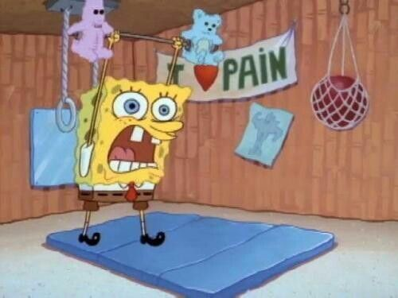
Muscle Power
Muscle power: the amount of work the muscle performs in a period of time.
Unit: (kg-m/min)
The maximal power achievable by all muscles in the body of a highly trained athlete working together:
 | Power (kg-m/min)
First 8 - 10 seconds | 7000
Next 1 minute | 4000
Next 30 minutes | 1700
Notice that power decreases over time (inverse relationship)
Notes:
Organization
Added a point from the resource
Added a
Added note

Slide 5
Muscle Endurance
Muscle endurance: the ability of the muscle to sustain repeated contractions against a resistance for a period of time.
Depends on the glycogen stored in muscle before the exercise → endurance is enhanced by a high-carbohydrate diet.
Types of endurance:
Types of Endurance
Static Endurance
Muscle’s ability to remain contracted for a long period.
Dynamic Endurance
Muscle’s ability to contract and relax repeatedly.

Slide 6
Muscle Performance Summary
Muscle Performance
Muscle Strength
Muscle Power
Muscle Endurance
The amount of force a muscle can produce against resistance in a single maximal effort.
The amount of work the muscle performs in a period of time.
The ability of the muscle to sustain repeated contractions against a resistance for a period of time.
Improved by:
weight lifting - digging
Power decreases over time
Dynamic
Static
Depend on glycogen stored
Time isn’t a variable in muscle strength
Improved by:
push ups - plank
Notes:
The note was too long for a summary → اختصرتها
Original: The high amount of power achievable by an athlete in the first few seconds decreases as time proceed (slide 4)

Slide 7
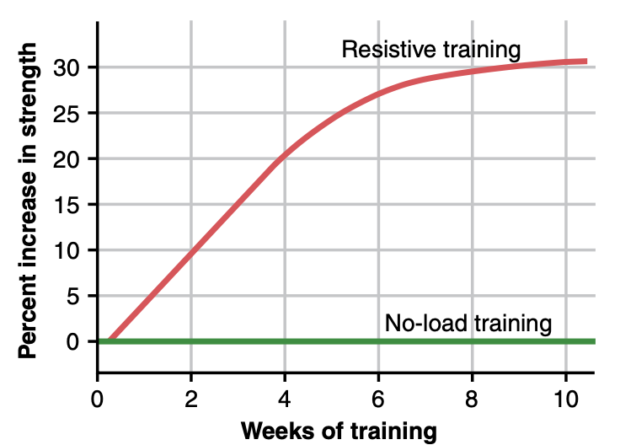
Effect of Training on Muscle Structure & Performance
Maximal Resistance Training:
Muscles that function under no load (even if they are exercised for hours) → increase little in strength.
Muscles that contract at > 50% maximal force of contraction (even if contractions were performed few times each day) → develop strength rapidly.
Example:
6 maximal muscle contractions / 3 times daily / 3 days a week → optimal increase in muscle strength, in first 6-8 weeks without producing chronic muscle fatigue.
Multiple weeks of increased muscles function under no load → little increase in strength.
Approximate effect of optimal resistive exercise training on increase in muscle strength over a training period of 10 weeks.
Notes:
More than = >

Slide 8
Muscle Hypertrophy
Video
Hypertrophied muscle fibers produce
Muscle hypertrophy: the increase of the total mass of a muscle.
Increased actin & myosin filaments numbers
Occurs to a much greater extent when muscle is loaded during the contractile process.
Increased mitochondrial enzymes by 120%
With training, muscles hypertrophied 30-60% due to:
Increased aerobic & anaerobic metabolisms
1
Increase diameter of the muscle fibers.
Increased efficiency of oxidative metabolic system by 45%
Increased ATP & phosphocreatine
2
Increase in number of fibers.
Increased stored glycogen by 50%
& stored triglycerides by 75-100%.
Text
Text
Text
Text
Text
Notes:
Organization
Fixed the video icon

Slide 9
Adjustment of Muscle Length
Another type of hypertrophy occurs when muscles are
stretched to greater than normal length.
stretching causes new sarcomeres to be added at
the ends of the muscle fibers, where they attach to the
tendons.
New sarcomeres can be added as rapidly as several per
minute in newly developing muscle.
Conversely, when a muscle continually remains
shortened to less than its normal length, sarcomeres at
the ends of the muscle fibers can actually disappear.
by these processes that muscles are continually
remodeled so they have the appropriate length for
proper muscle contraction.

Slide 10
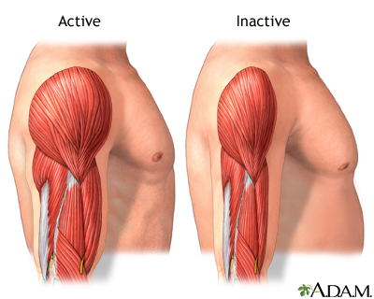
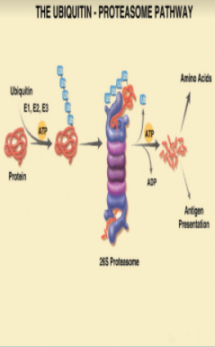
Muscle Atrophy
When a muscle remains unused for many weeks, the rate of degradation of the
contractile proteins is more rapid than the
rate of replacement (muscle atrophy occurs).
The pathway of the protein degradation in a muscle atrophy is the
ATP-dependent ubiquitin-proteasome pathway.
-Proteasomes are protein that
degrade damaged or unneeded
proteins by proteolysis .
-Ubiquitin is a regulatory protein that
labels which cells will be targeted for
proteasomal degradation.

Slide 11
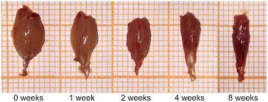
Muscle Denervation Causes Rapid Atrophy
When a muscle loses its nerve supply, it no longer receives contractile signals required to maintain normal muscle size.
Atrophy begins immediately, and after 2 months, degenerative changes appear in the muscle fibers.
If the nerve supply returns, full function can return in 3 months.

Slide 12
Fast-Twitch & Slow-Twitch Muscle Fibers
Video
In the human being, all muscles have varying percentages of fast-twitch and slow-twitch muscle fibers. Some people have considerably more fast-twitch than slow-twitch fibers, others have more slow-twitch fibers → determine the athletic capabilities of different individuals.
Slow-twitch (red / type I) fibers
Fast-twitch (white / type II) fibers
“Organized for generation of aerobic energy”
Provide endurance, prolonged strength of contraction minutes to hours.
Function
“Adapted for forceful & rapid contraction”
Achieves maximal power in very short periods of time.
Soleus muscle (lower leg) in standing
(aerobic metabolism)
Example
Gastrocnemius muscle in jumping
(anaerobic metabolism)
Provide endurance, delivering prolonged strength of contraction over many min to hours.
Summary
Deliver extreme amounts of power for a few seconds to a minute.
Smaller in diameter
Enzymes (of phosphagen & glycogen-lactic acid systems) are less active
More mitochondria
More myoglobin → increased rate of O₂ diffusion
Enzymes (of aerobic metabolic system) are more active
Number of capillaries is greater
Extra Notes from the Resource
(Important)
Larger in diameter (twice)
Enzymes (of phosphagen & glycogen-lactic acid energy systems) are 2 - 3 more active → max power achieved for short period is twice greater than slow-twitch
Less mitochondria & myoglobin
Enzymes (of aerobic metabolic system) are less active
Number of capillaries is less
both doctors girls and boys said it is an important comparison, girl’s doctor said may come as SAQ!
Text
Text
Text
Text
Text
Notes:
Organization
fixed video icon
Added resource notes
color index
قلبت الجدول حسيت احسن

Slide 13
Body fluids and salts in exercise
Exercise for 1 hour during an endurance athletic event in hot humid environment, can cause weight loss of 5-10 pounds due to sweat loss.
Loss of enough sweat reduces performance (by 5-10%) and can lead to cramps, nausea and serious effects.
Therefore, it should be replaced by sodium tablets and supplemental fluids containing potassium such as fruit juice.
Acclimatization: to exercise by gradual increase over 1-2 weeks instead of maximal exposure.
Acclimatization decreases salt loss in sweat by increasing aldosterone secretion by adrenal cortex.
Aldosterone increases the reabsorption of sodium chloride from sweat before it is secreted.
After an athlete is acclimatized , they rarely need salt supplements during exercise.

Slide 14
Body Heat in Exercise
Almost all the energy released by the body's metabolism of nutrients is converted into body heat.
Working muscle use only 20 - 25 % of energy in work production for:
ATP
20-25%
1
Overcoming viscous resistance to the movement of the muscles & joints.
2
Overcoming the friction of the blood ﬂowing through the blood vessels.
Overcoming resistance
Overcoming friction
3
Other similar effects - all of which convert muscle contractile energy into heat.
Other
Almost all the energy that does go into creating muscle work still becomes body heat.
What will happen if the sweating mechanism can’t eliminate heat? Heatstroke can develop
++ Even if the person has stopped exercising, the temperature does not easily decrease by itself in the heatstroke because:
Temperature-regulating mechanism often fails.
Very high body temperature → increased KE → double rates of all chemical reactions → liberating still more heat.
Text
Text
Text
Text
Text
Notes:
Organization
fixed the diagram “over” → “overcoming” x2 and “contraction” → other أظن كذا أصح ولا؟ Agreed
Corrected the answer لكن لسا احس مو ١٠٠& متأكدة
مكتوب بقايتون “With a vast rate of heat flow into the body, on a very hot and humid day that prevents the sweating mechanism from eliminating the heat, an intolerable and even lethal condition called heatstroke can develop in athletes”.
فأحس أتفق مع تعديلك بس نحذف كلمة easily → “can” develop أدق
color index

Slide 15
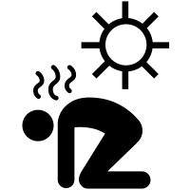
Heatstroke
During endurance training body temperature rises from 37° to 40°C.
In hot & humid conditions, body temperature rise up to 41 - 42°C.
High temperature is destructive to tissue cells (mainly brain cells).
Symptoms
Treatment
1
Body weakness & exhaustion
1
Remove all clothes.
2
Headache & dizziness
2
Maintain a spray of cool water on all surfaces of body or continually sponge the body.
3
Nausea (disgust) & alteration in sweating
3
Blow air over the body with a fan.
لخبطة في نظام التبريد أو التعرق ← المصاب ما يتعرق بالرغم من حرارة المكان.
4
Confusion & unconsciousness
4
Total immersion of body in water containing a mush of crushed ice if available (preferred).
5
Uncontrolled gait (balance) & collapse
6
May lead to death
Text
Text
Text
Text
Notes:
Option 1 حلو تغيير
organization
fixed note background
removed pictures
color index
“Heatstroke” مدموجة ككلمة وحدة بقايتون فنسوي زيهم أحسن

Slide 16
Drugs & Athletes
1
Caffeine:
2
Androgens Used by Women:
Increase athletes’ performance.
Develop facial hair + ruddy skin + bass voice.
Menses stop.
3
Androgens & Anabolic Steroids:
4
Amphetamine & Cocaine:
Male sex hormones.
Increase athletes’ performance.
Increase risk of heart attacks.
Due to:
Hypertension
High LDL
Low HDL
Decrease testicular functions.
Decrease natural testosterone secretion in males.
Psychic stimuli.
Improve performance.
Overuse → reduce performance.
The action of these drugs + hormones of adrenal medulla secreted during exercise (epinephrine & norepinephrine) → death by ventricular fibrillation.
Notes:
Organization
Title: And → &
Text size 16 → 18
Moved pictures next to their points

Slide 17
Effects of heart disease and old age on athletic performance
found in boys slides only
Cardiac diseases that reduce cardiac output (C.O.P) will reduce muscle power.
Patient with congestive heart failure has little muscle power to even walk on the floor.
There is 50% in C.O.P between age 18-80 years, in maximal breathing capacity, in muscle mass and therefore in muscle power with age.

Slide 18
MCQs:
A |  | B |  | C |  | D
A |  | B |  | C |  | D
A |  | B |  | C |  | D
A |  | B |  | C |  | D
A |  | B | Proteasomes | C | Microsomes | D | Ubiquitin
Q1: Normal maximal contractile force by a cross section of the muscle
4-5 kg/cm²
3 - 4 kg/cm²
5-6 kg/cm²
6-7 kg/cm²
Q2: the amount of force a muscle can produce against resistance in a single maximal effort
Muscle Hypertrophy
Muscle Endurance
Muscle power
Muscle strength
Q3: Muscle Endurance Depends on what molecule that stored in muscle before the exercise
glycogen
glucose
ATP
fat
Q4: Fast-twitch fibers metabolism mainly is
aerobic
anaerobic
both
neither
Q5: protein that degrade damaged or unneeded proteins by proteolysis
lysosomes
Answers: 1-B. 2-D. 3-A. 4-B. 5-B.
Notes:
New slide
Organized pictures
Combined 2 points:
“All-or-none” principle: impulse from motor neuron will cause contraction in all muscle fibers it innervates or none.
Motor Unit follows “all-or-none” principle.

Slide 19
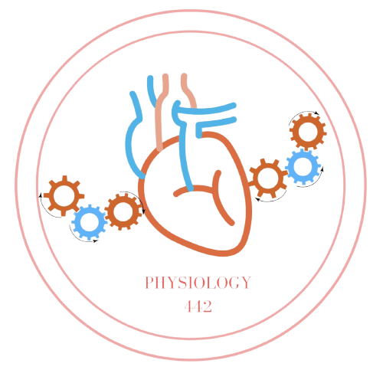
Team Leaders
Dema Alkhattabi
Waleed Alrashoud
Team Members
Nouf AlDalaqan
Farah Alqazlan
Masheal Alasmri
Amani Alotaibi
Maram Beyari
Maha Alkoryshy
Nouf Aldhalaan
Othman Alabdullah Khaled Bin-Arbeed
Rakan Alromayan
Talal Alharbi
Abdullah AlShehri
Mohammad Alrashed Saud Al-Taleb
Sultan Al-Abdullah Saad AlAngri
Abdullah Awartani
Special Thanks to Physiology Team441
Physio442@gmail.com

