Slide 1
Radiology of the vertebrae
Colour index:
Main text
Important
In girls slides only
In boys slides only
Doctors notes
Extra info.
Lecture one
Editing file

Slide 2
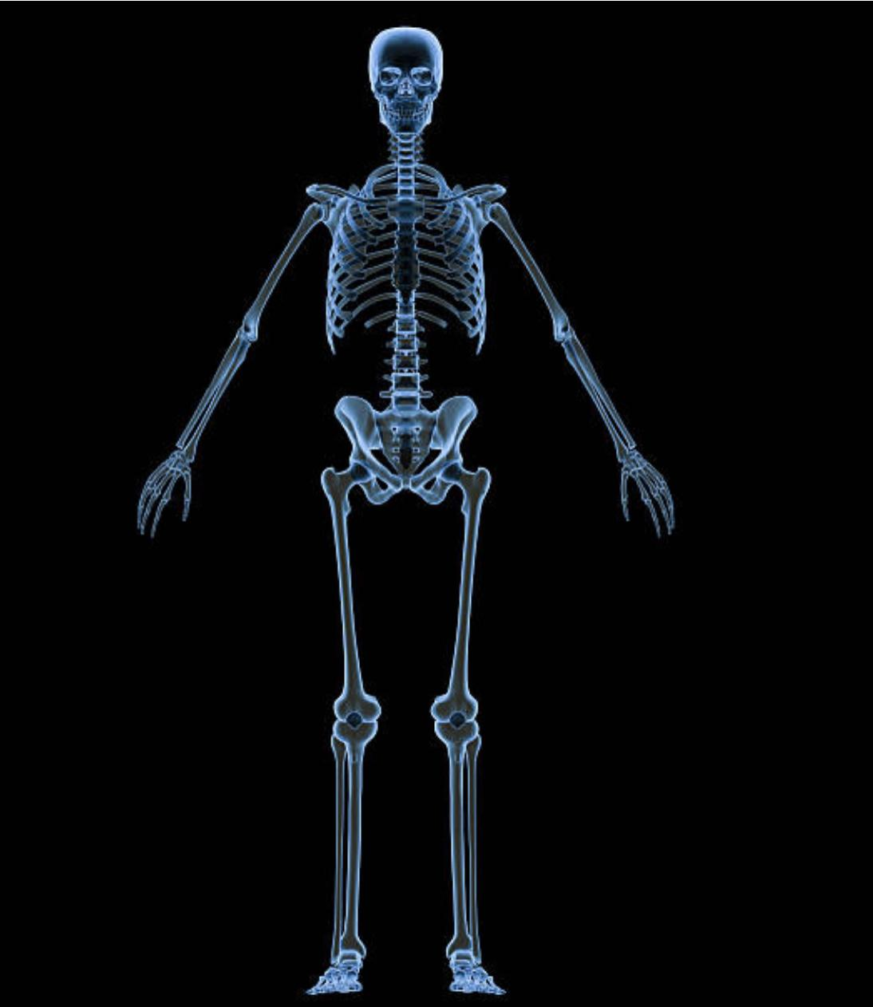
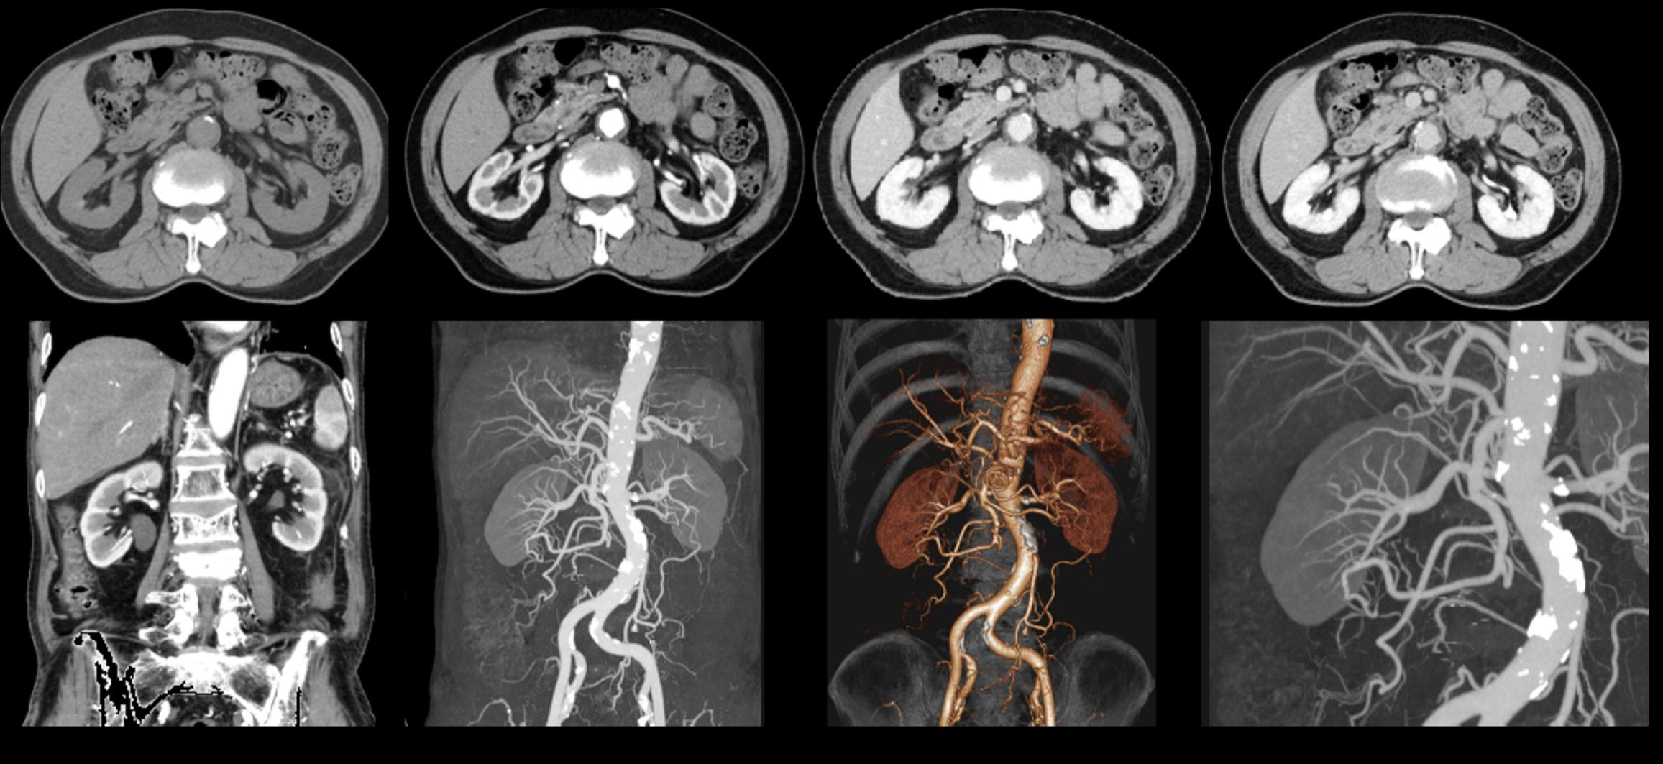
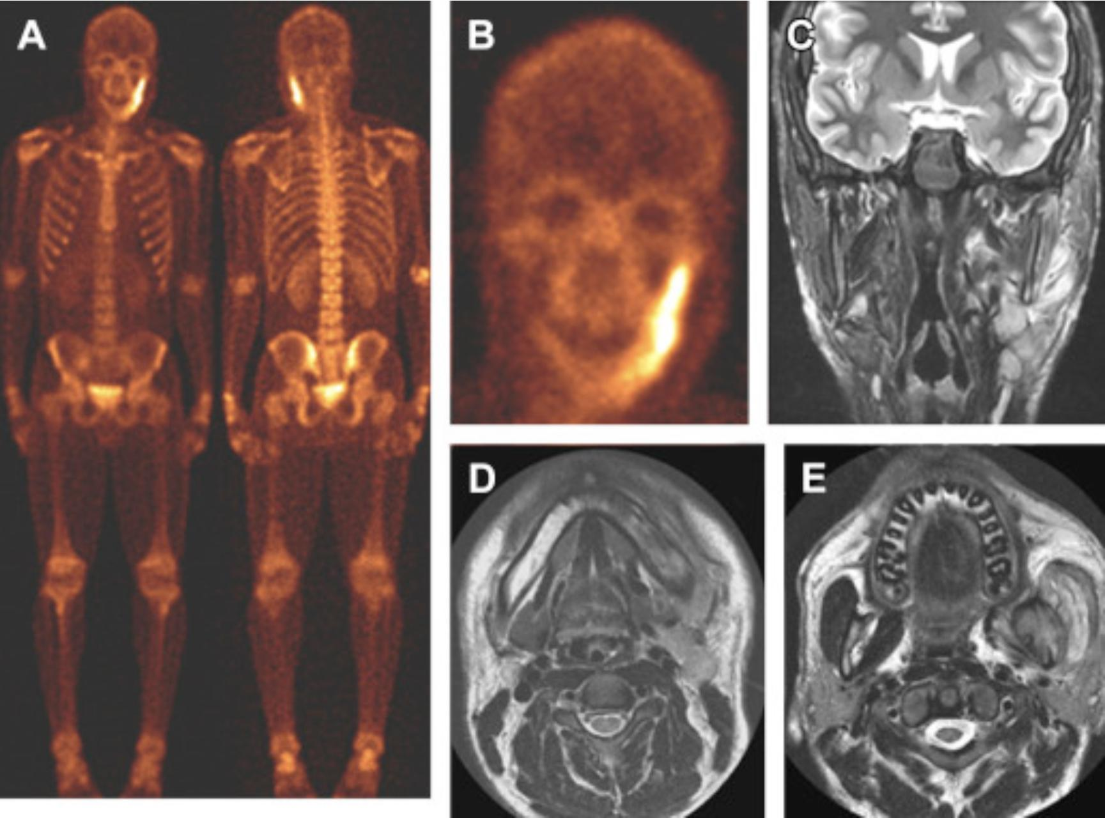
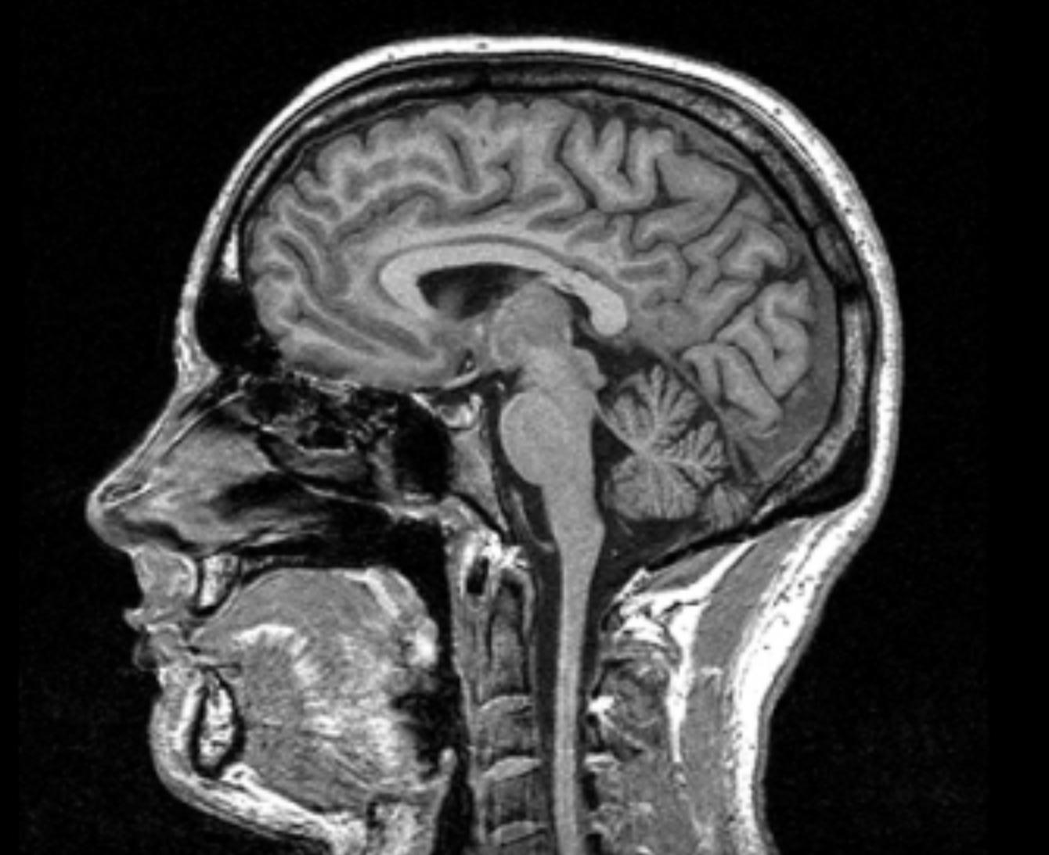
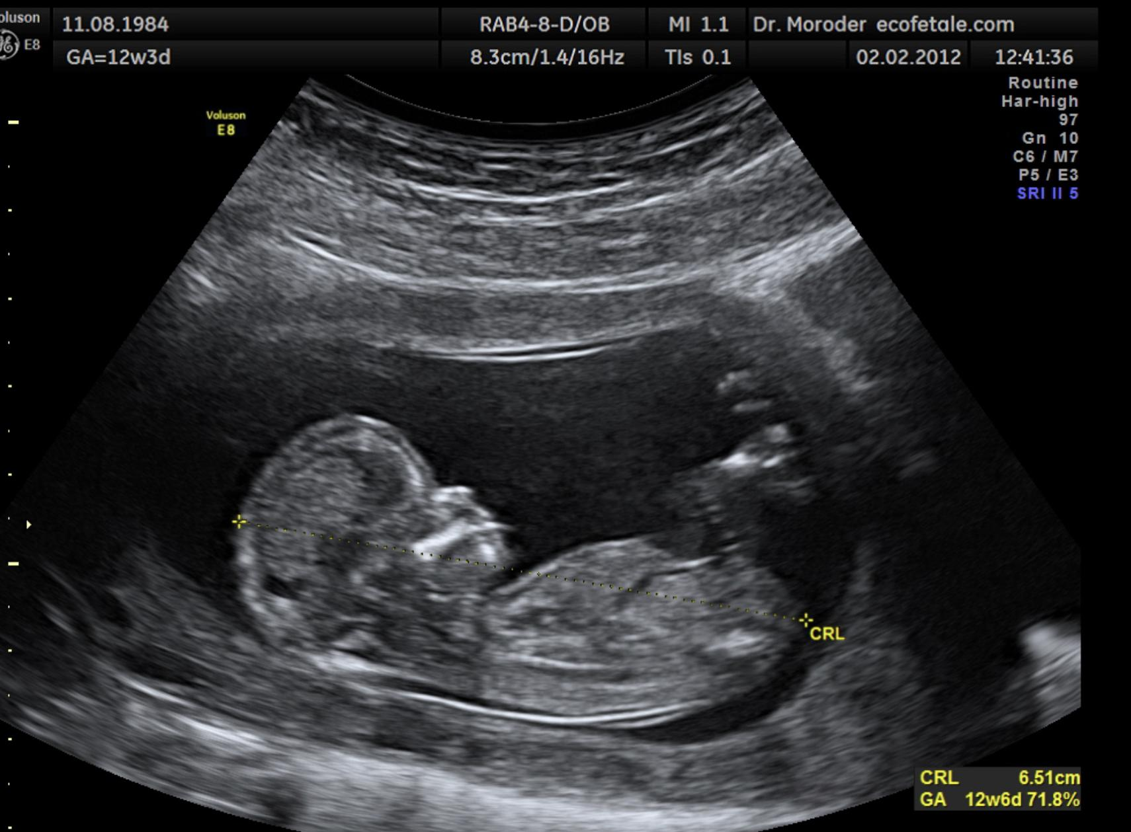
Which of following radiological modalities can be used in imaging the vertebra?
A
B
C
D
E
Answer: all can be used
X ray
CT scan
Nuclear scan
MRI
US

Slide 3
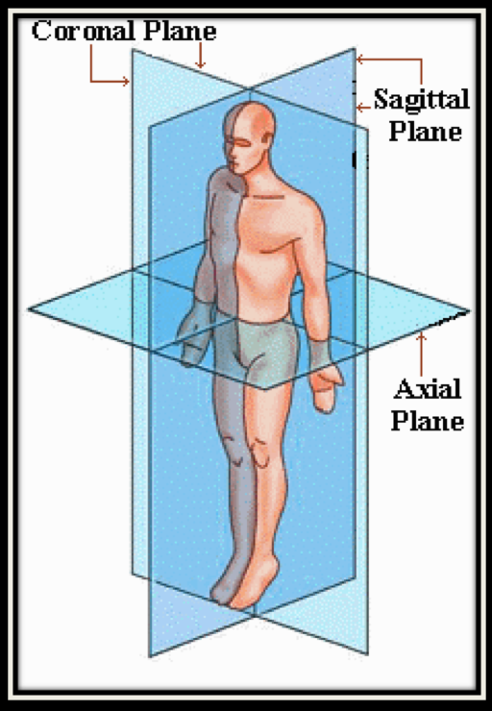
Coronal plane : divide the body into anterior and posterior part (like a crown)
Sagittal plane: divides the body into two equal halves
Axial plane: transversely

Slide 4
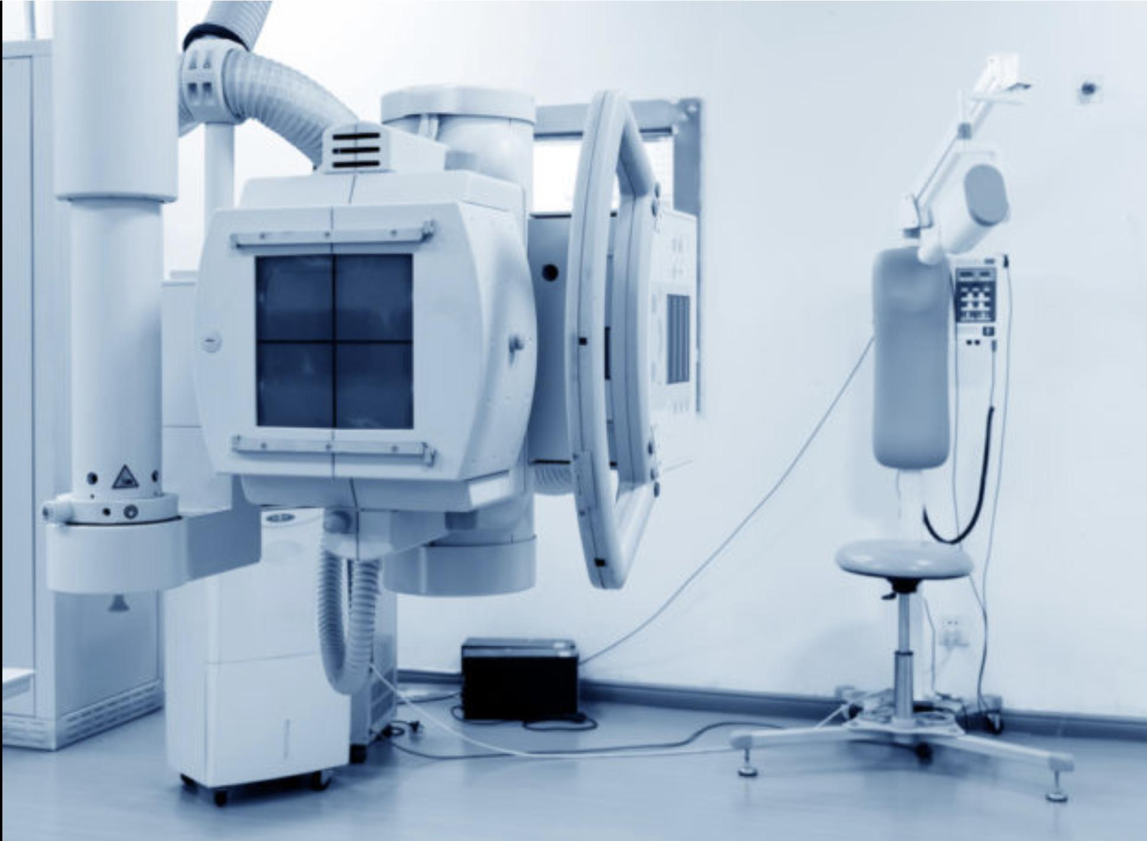
X-ray

Slide 5
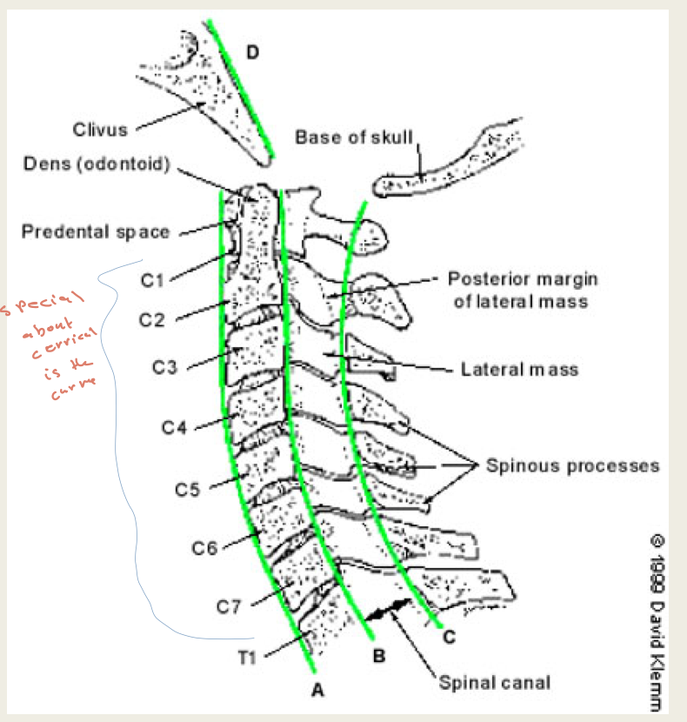
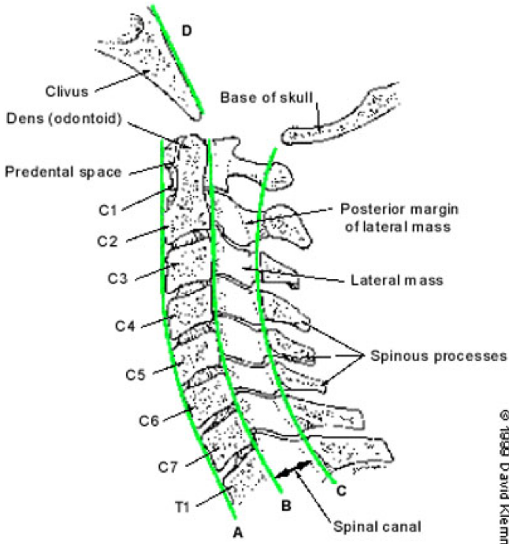
X-ray of cervical spine
Boys Dr.: Questions
About this picture will come as arrows on the imaginary lines and you will have to name them.

Slide 6
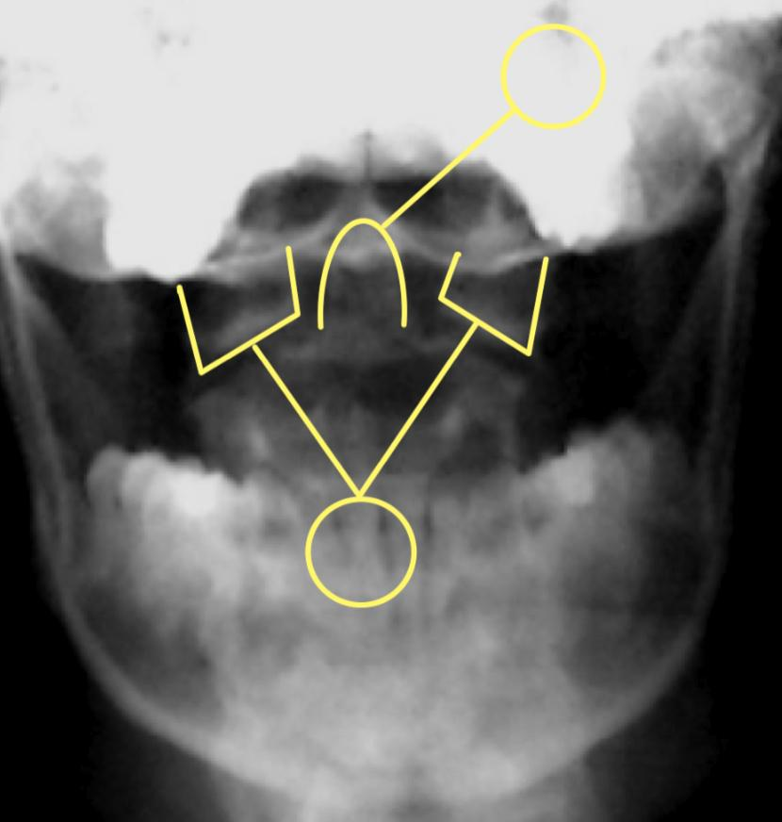
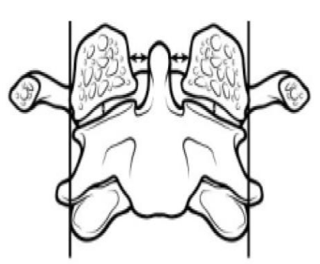
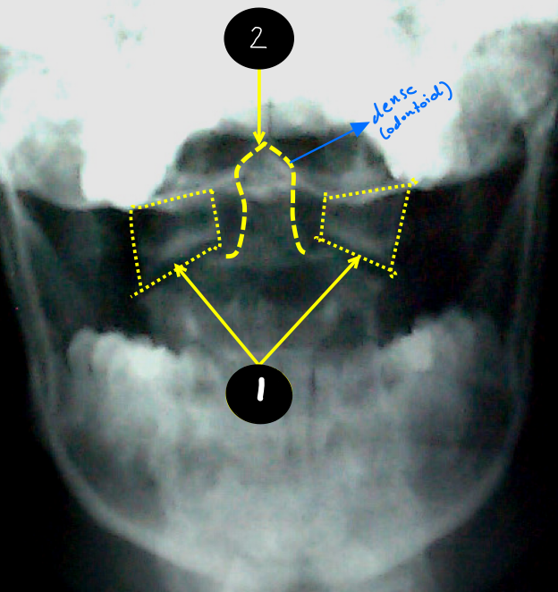
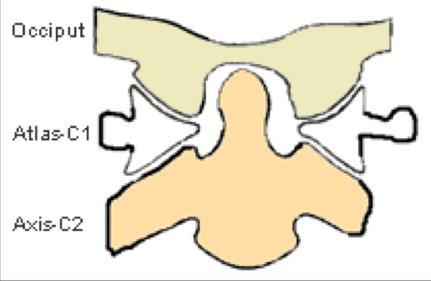
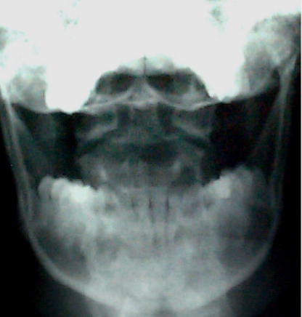
X-ray of cervical spine
C1-atlas
C2-axis
2
1
2
1
Lateral masses
Open mouth x-ray

Slide 7
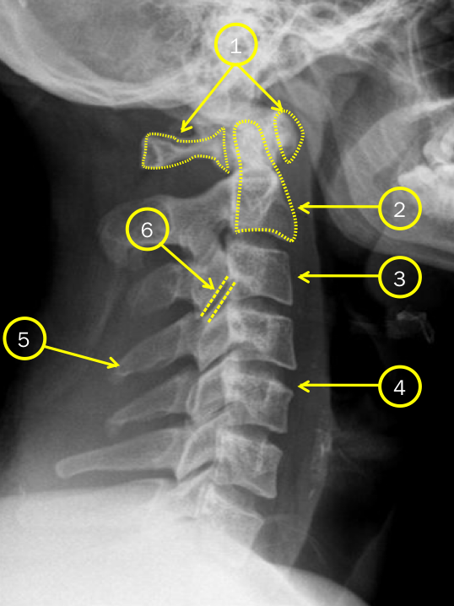
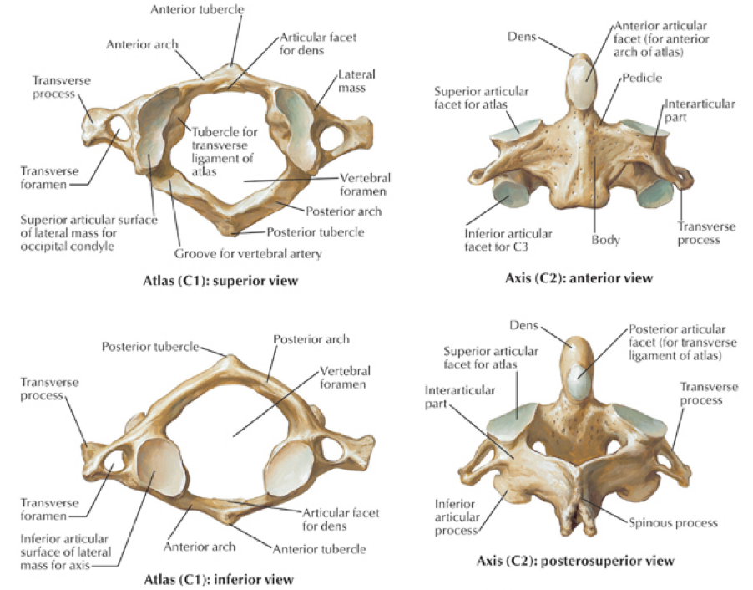
X-ray of cervical spine
C1-atlas
C2-axis
C3
Intervertebral disc
Spinous process of C4
Facet joint
1
2
3
4
In X-ray The denser the structure is the whiter it appears, which explains why bones appear white, and why cartilages are not visible.
5
6

Slide 8
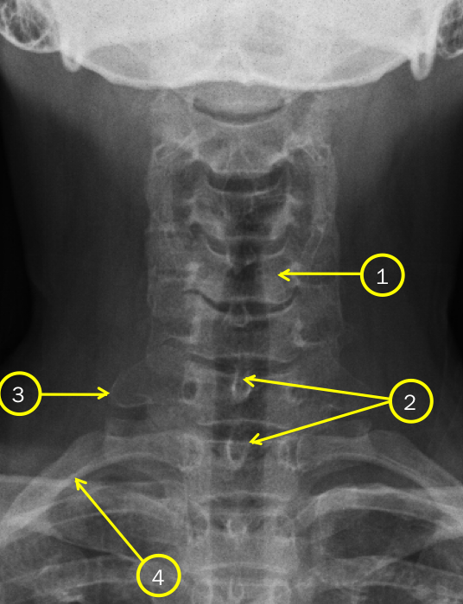
X-ray of cervical spine
Vertebral body C5
Spinous process
Transverse process
First rib
It will be easier to count from the bottom to the top
This is called the AP View (Antero-Posterior View).
Boys Dr.:
You don’t have to know the type of view just extra Info.
1
2
3
4

Slide 9
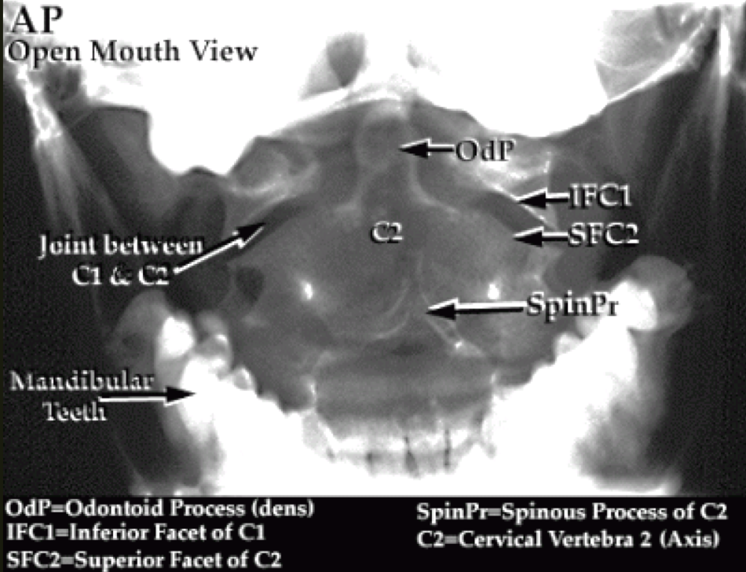
X-ray of cervical spine
(Open mouth view)

Slide 10
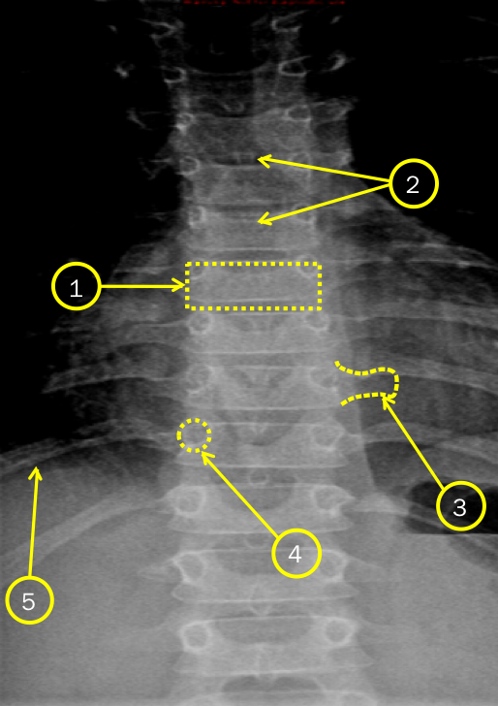
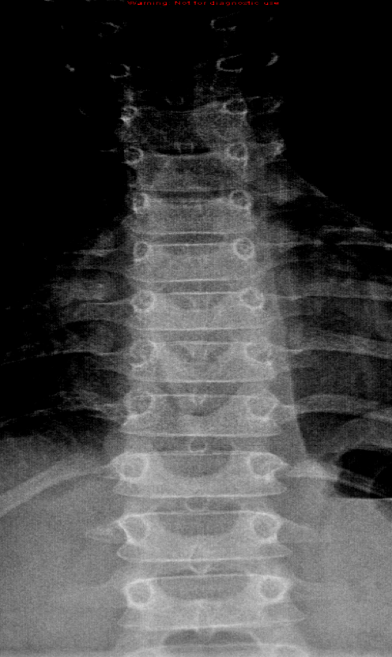
X-ray of thoracic spine
Vertebral body
Spinous process
Transverse process
Pedicle
Rib
1
2
3
4
5

Slide 11
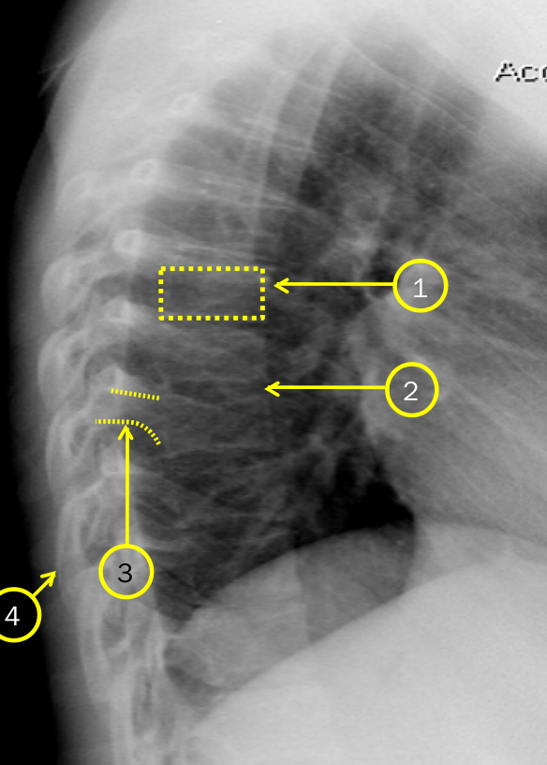
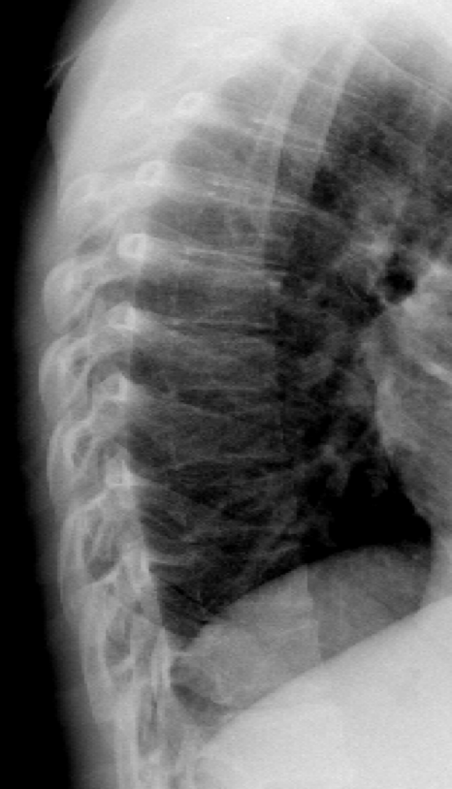
X-ray of thoracic spine
Vertebral body
Intervertebral disc
Pedicle
Rib
Lateral View
1
2
3
4

Slide 12
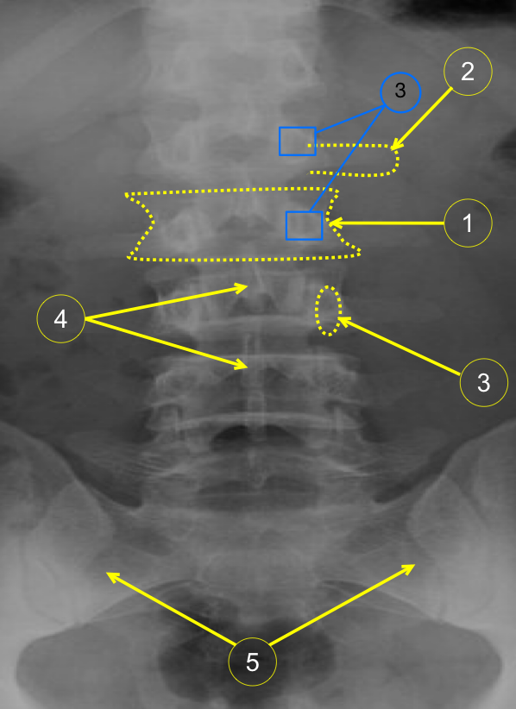
X-ray of lumbar spine
Vertebral body
Transverse process
Pedicle
Spinous process
Sacrum
1
2
3
4
5

Slide 13
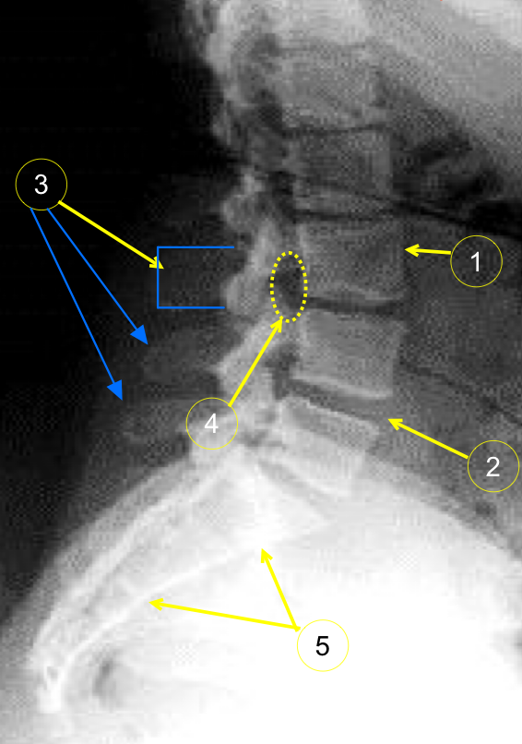
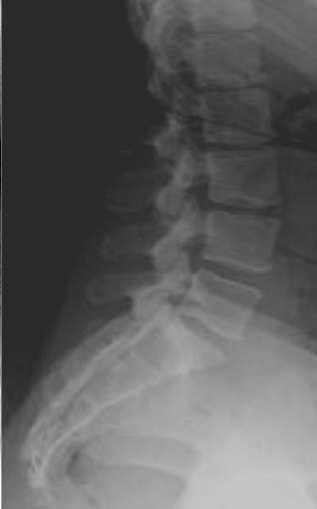
X-ray of lumbar spine
Vertebral body L3
Intervertebral disc
Spinous process
Neural foramen
Sacrum
Lateral (sagittal) view
1
2
3
4
5

Slide 14
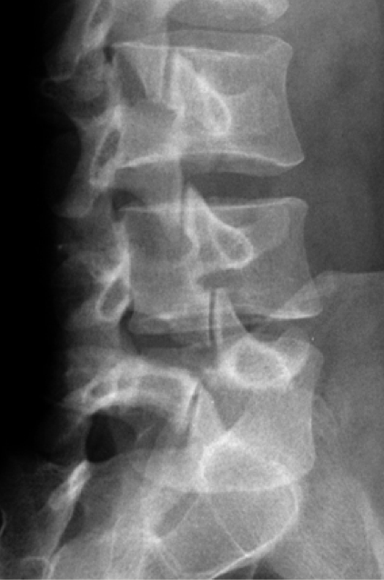
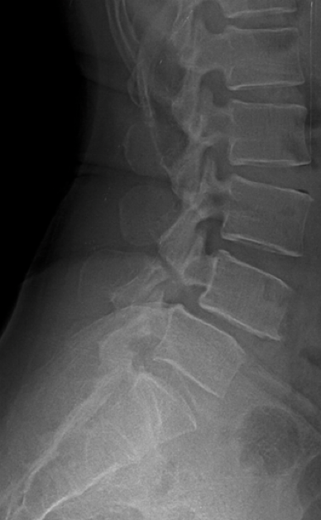
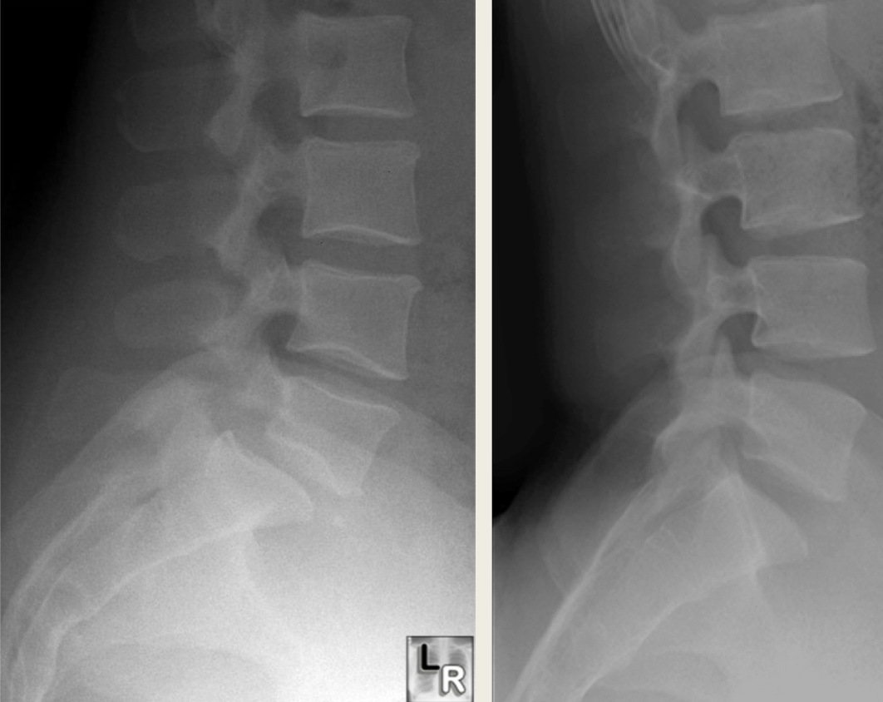
X-ray of lumbar spine
Boys Dr.:You will not be asked about Pathology just Anatomy.
Fracture
Displacement

Slide 15
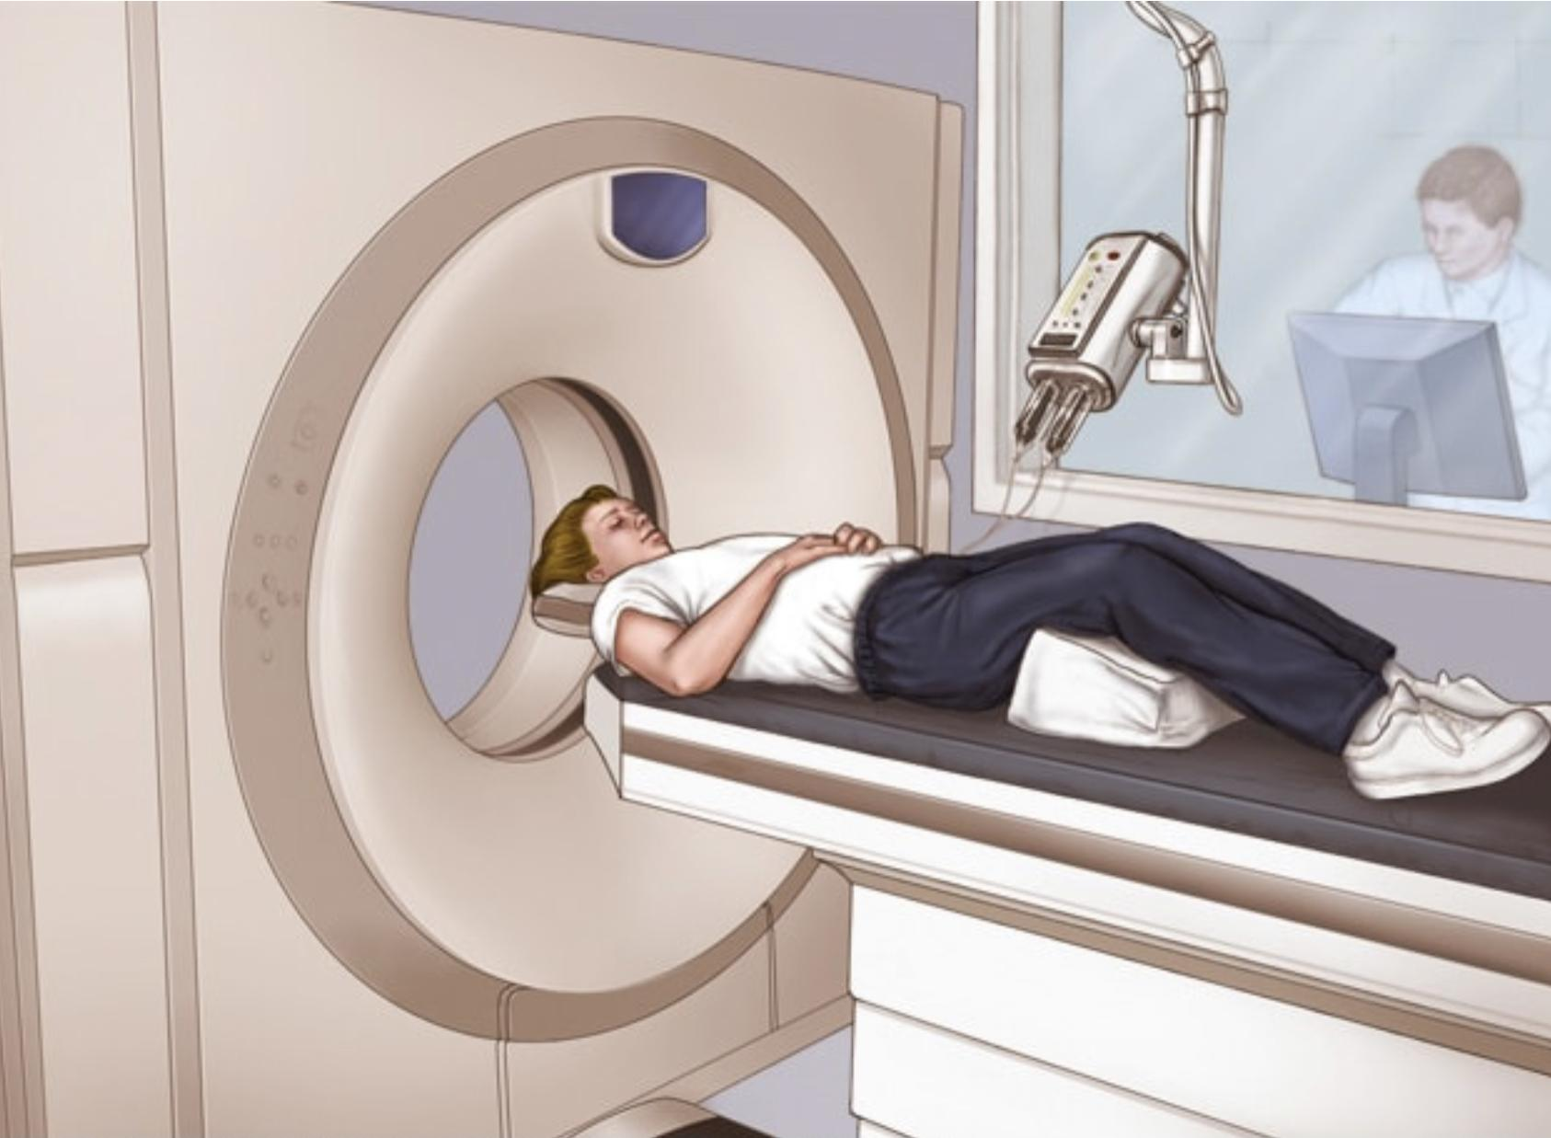
CT scan
3 Planes (X-Ray 2 Planes only)
- It is taken when the patient is looking down “ from the feet to the head”
- spine is always included

Slide 16
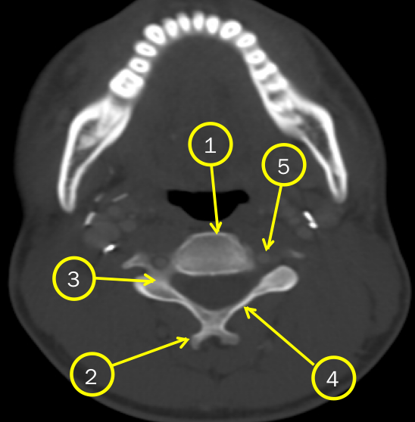
CT scan of cervical spine
Vertebral body
Spinous process
Pedicle
Lamina
Transverse foramen
1
2
3
4
5

Slide 17
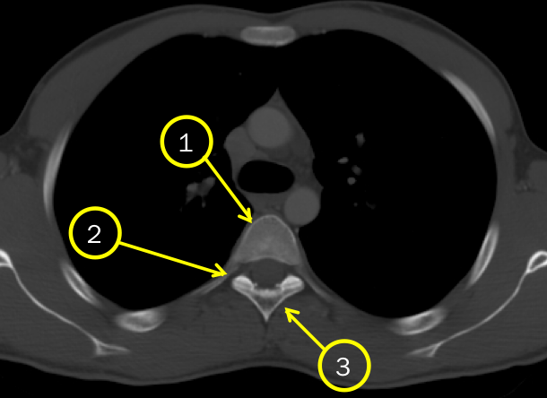
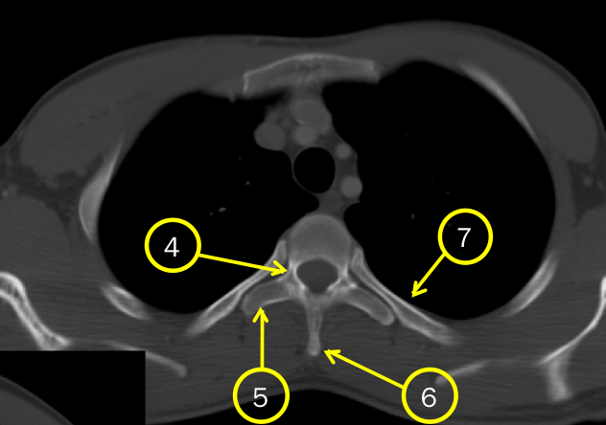
CT scan of thoracic spine
Vertebral body
Neural foramen
(Dark space)
Lamina
Pedicle
Transverse process
Spinous process
Rib
1
2
3
4
5
6
7

Slide 18
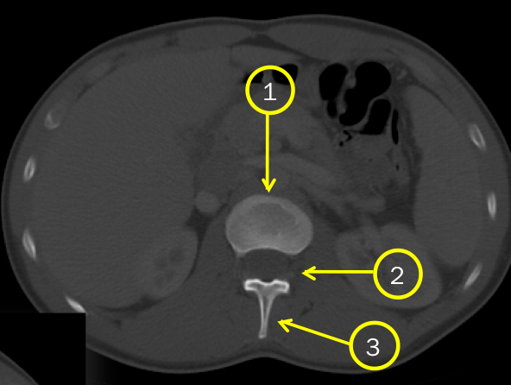
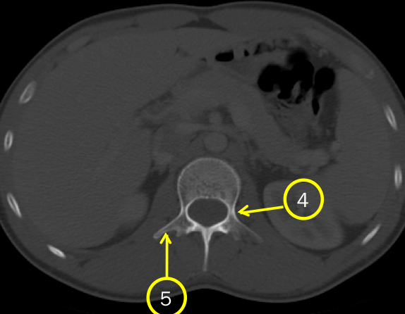
CT scan of lumbar spine
Vertebral body
Neural foramen
Spinous process
Pedicle
Transverse process
1
2
3
4
5

Slide 19
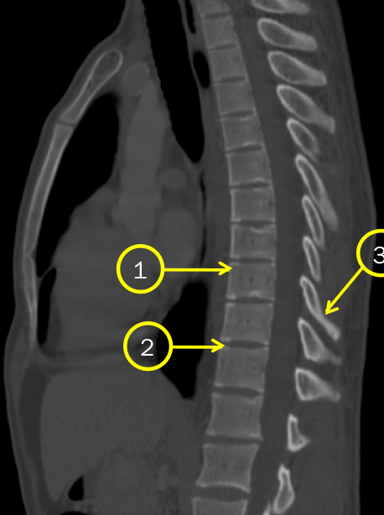
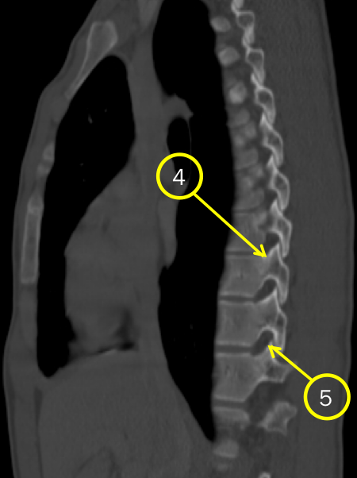
CT scan of dorsal (thoracic) spine
Vertebral body
Intervertebral disc
Spinous process
Pedicle
Neural foramen
1
2
3
4
5

Slide 20
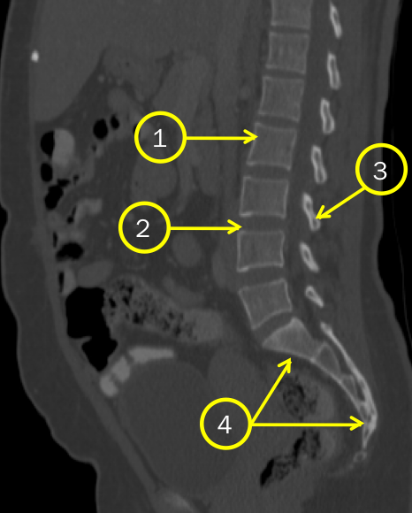
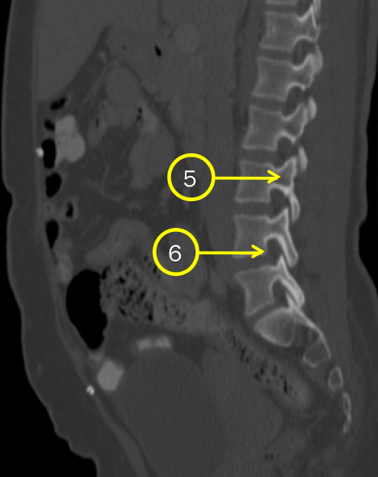
CT scan of lumbosacral spine
Vertebral body
Intervertebral disc
Spinous process
Sacrum
Pedicle
Neural foramen
1
2
3
4
5
6

Slide 21
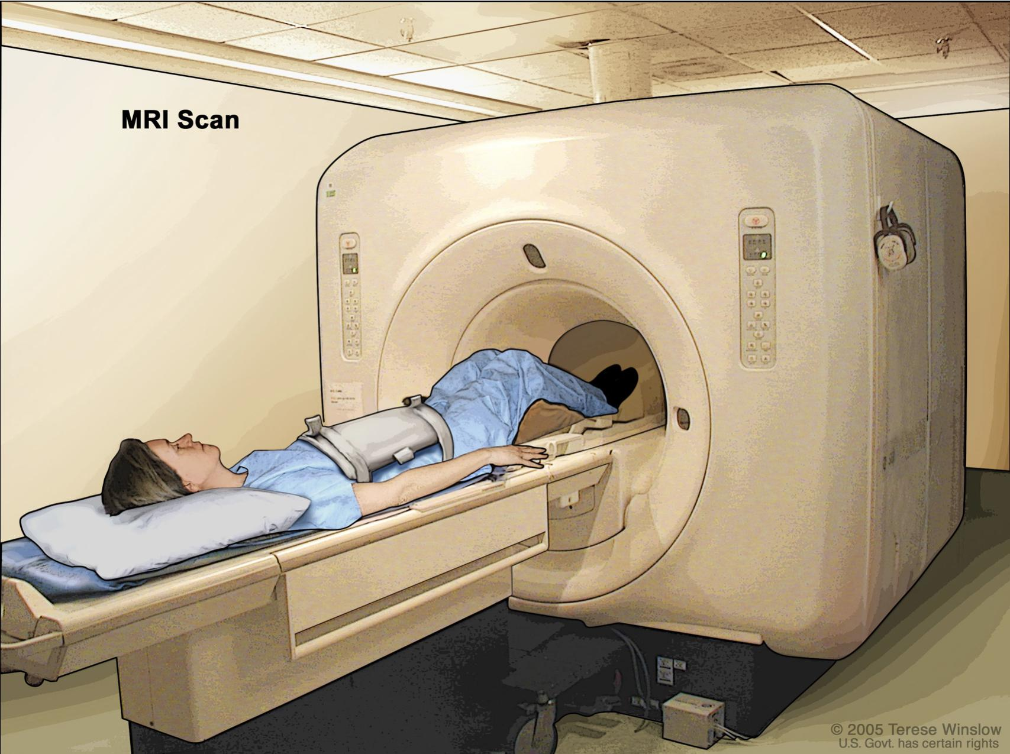
MRI
Dark area: bones
Light area: foramen

Slide 22
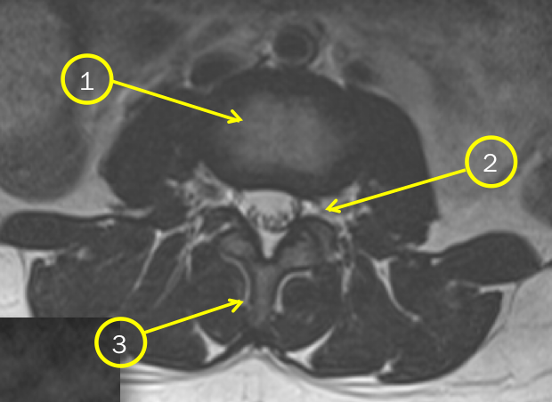
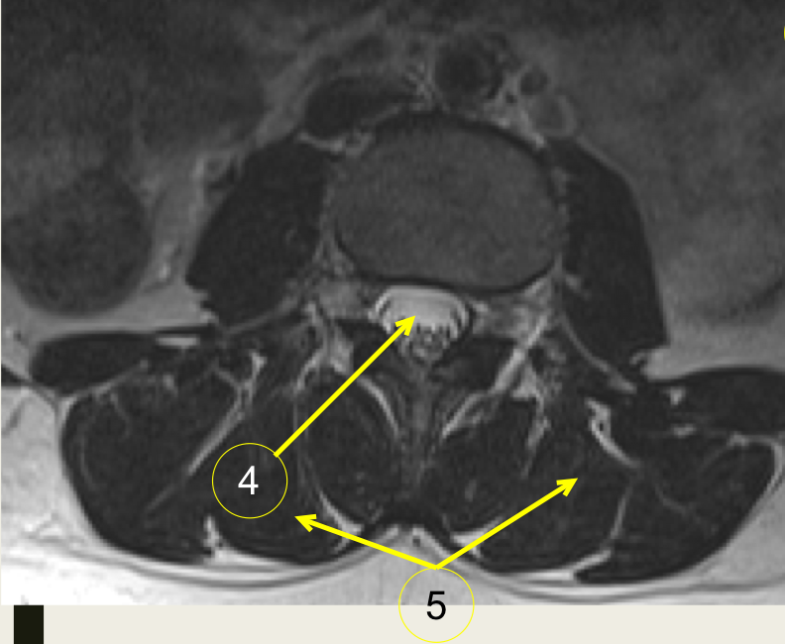
MRI of lumbar spine
Vertebral body
Neural foramen
Spinous process
Thecal sac
Para-spinal muscles
1
2
3
4
5
thecal sac: membranous that surrounds the spinal cord
contains the spinal canal “ CSF”

Slide 23
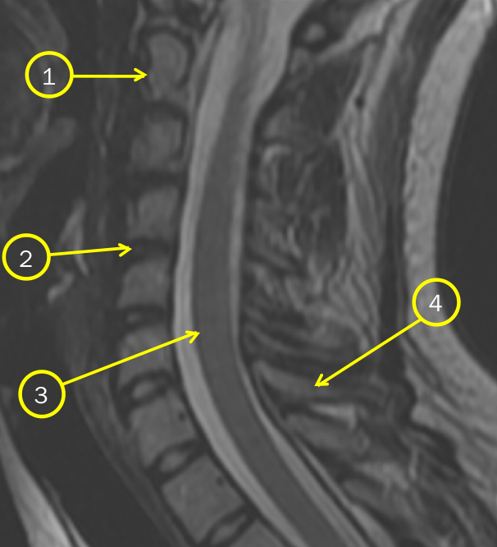
MRI of cervical spine
C2-axial
Disc
Spinal cord
Spinous process
Sagittal plane
1
2
3
4

Slide 24
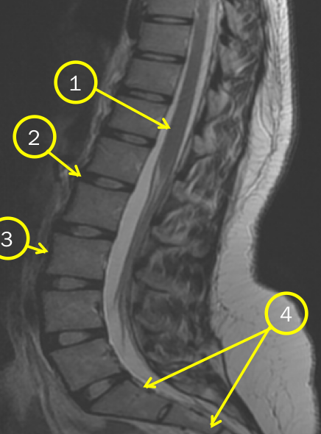
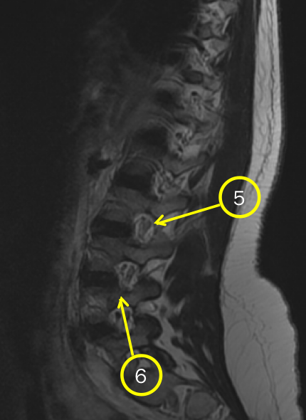
MRI of lumbosacral spine
Spinal cord
Disc
Vertebral body
Sacrum
Neural foramen
Notice the different colour
Pedicle
1
2
3
4
5
6

Slide 25
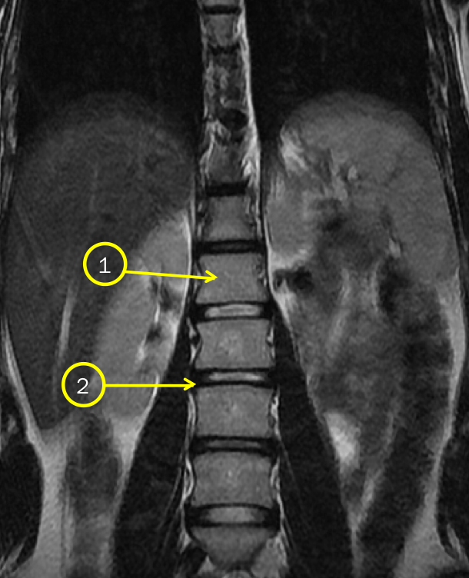
MRI of lumbar spine
Vertebral body
Disc
Coronal plane
1
2

Slide 26
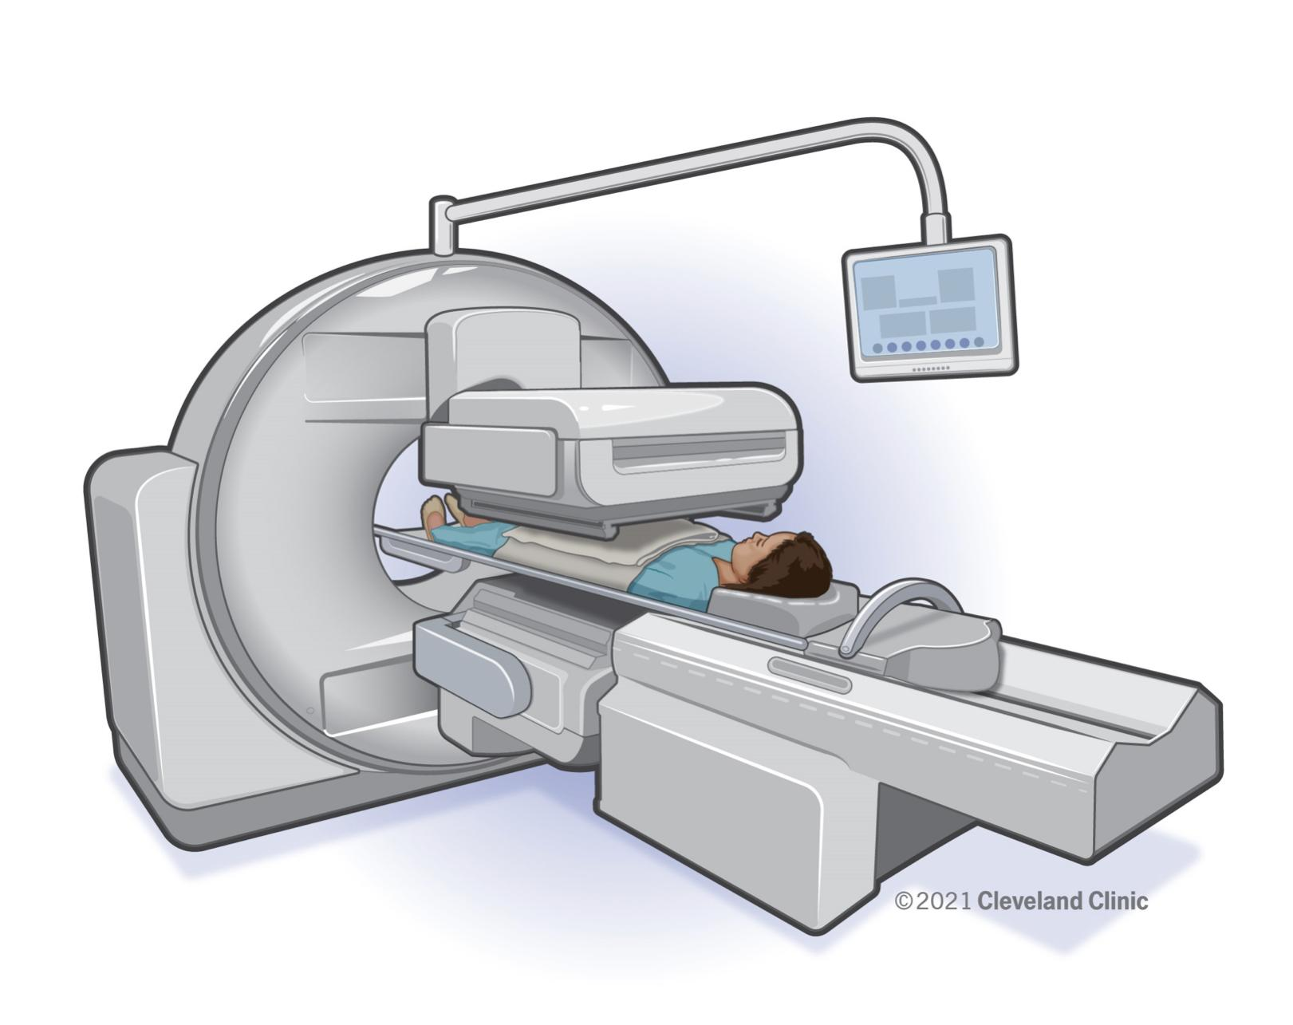
Nuclear scan
Used to diagnose:
Breast cancer that is metastasised to the bone
Bone tumors
Whole body scan “ whole skeleton”
-we use gamma rays
-the scan is functional not anatomical

Slide 27
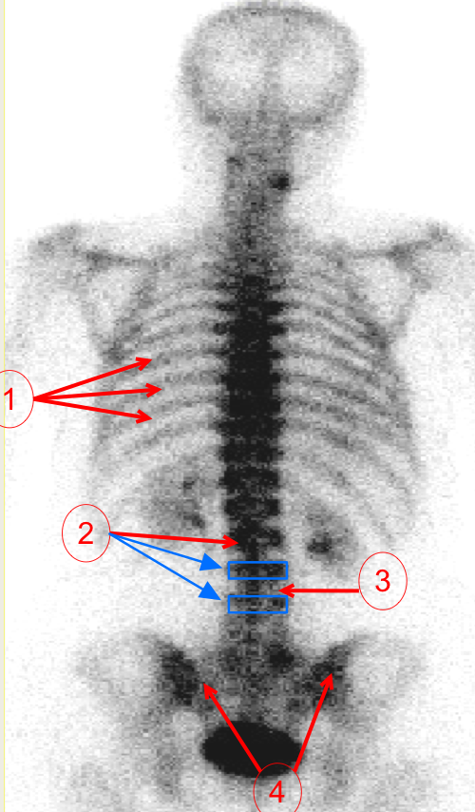
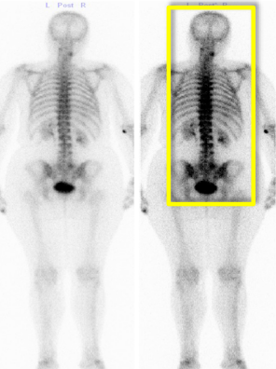
Nuclear scan
Ribs
Vertebral body
Disc
Sacrum
1
2
3
4

Slide 28
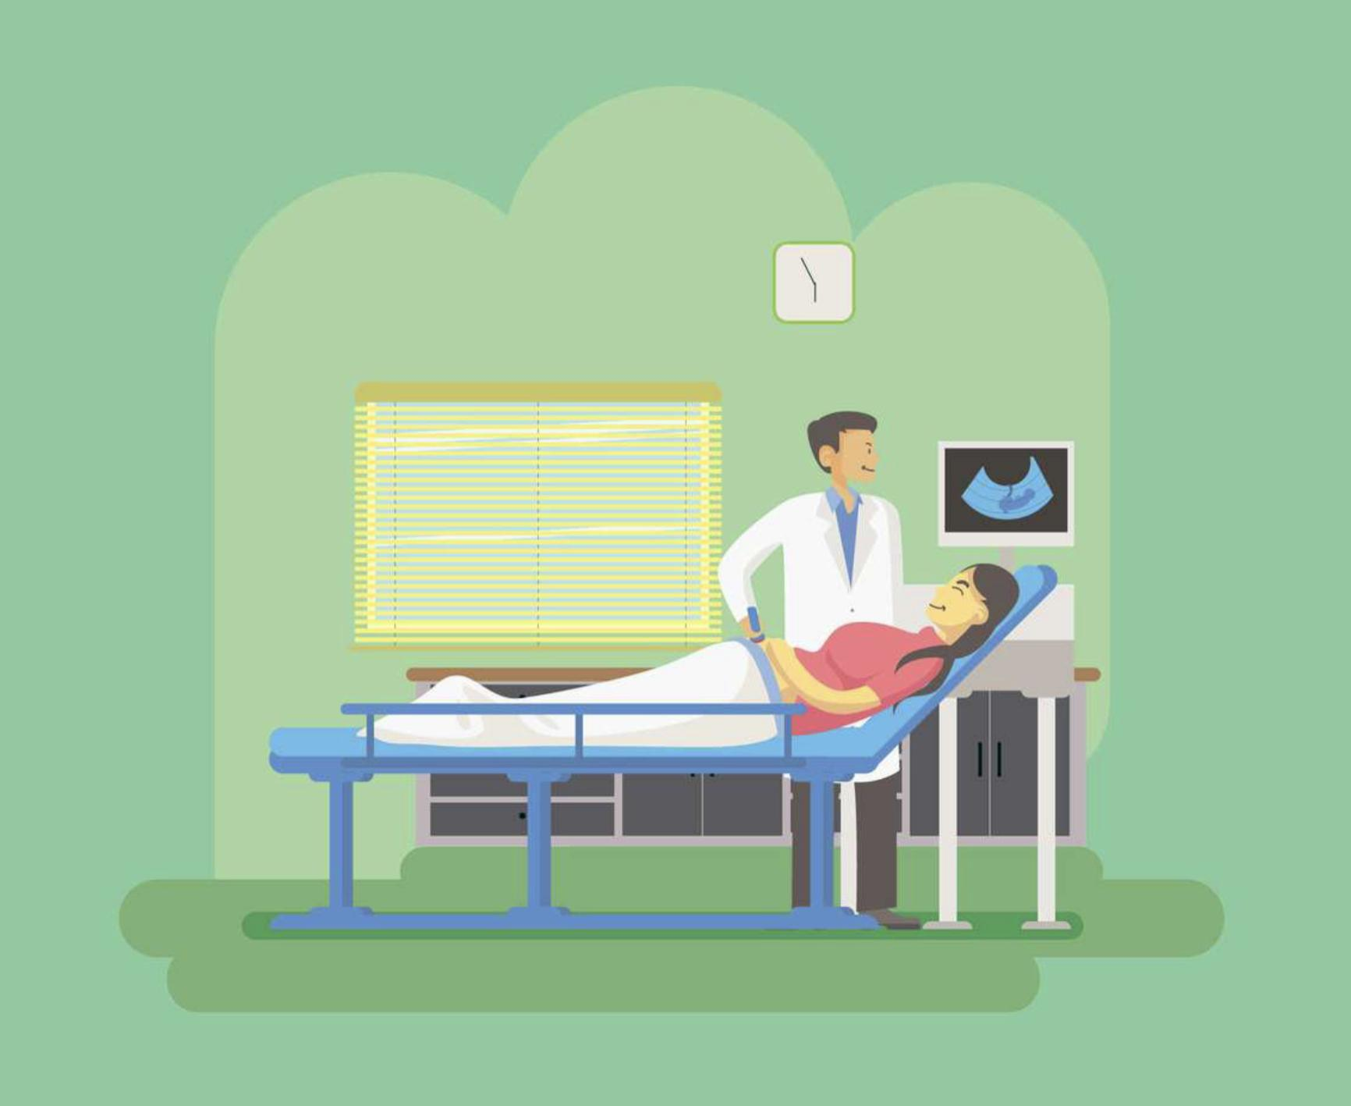
Ultrasound
it has no radiation
Safe for pregnant women
Not able to define anatomy

Slide 29
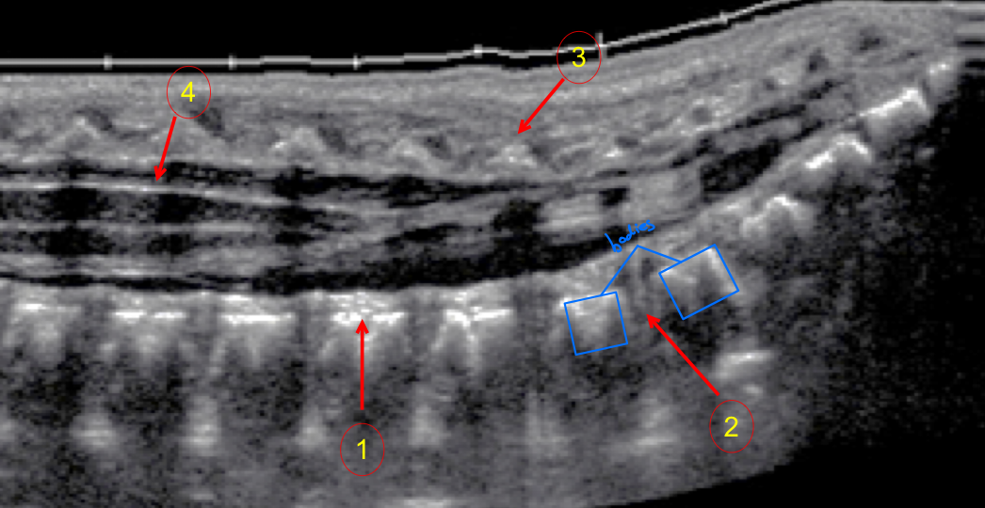
Ultrasound
Vertebral body
Disc
Spinous process
Spinal cord
Sagittal
1
2
3
4

Slide 30
QUESTIONS
Identify A,B, C, D and E
A —> vertebral body
B —>spinous process
C —> pedicle
D —> transverse process
E —> neural foramen

Slide 31
Team leaders
The end
Maram Beyari
Abdulaziz Al-Nasser
Team members
Razan Almohanna
Razan Alnufaie
Abdullah Alshehri
Fahad Mubaireek
Meshari Alshathri
Mohammed Alamry
Lecture was Done by :
Notes taker
Nada Albedaiwi

