Slide 1
Radiology of the lower limb
Colour index:
Main text
Important
In girls slides only
In boys slides only
Doctors notes
Extra info.
Lecture two
Special thanks to Noor Jamal
Editing file

Slide 2
Objective
01
02
03
04
Know the high yield functional anatomy of the lower extremity joints ( sacroiliac, Hip, Knee, Ankle/Foot)
Develop simplified approach to read MSK images
Know the limitation of the imaging modalities.
Know the high yield MSK injuries/ abnormalities of the lower extremity

Slide 3
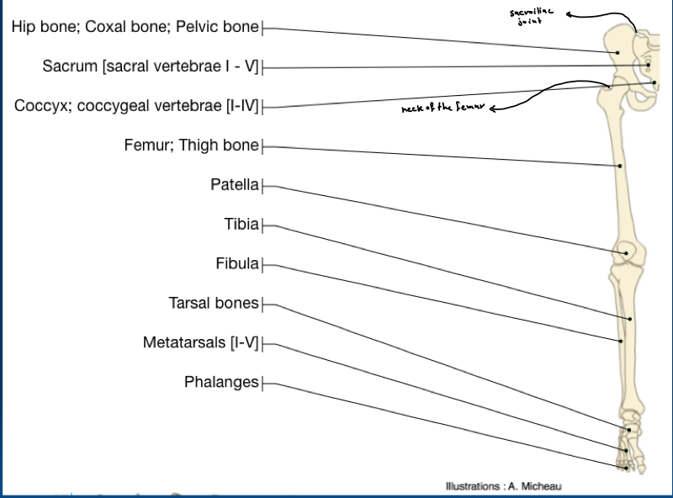
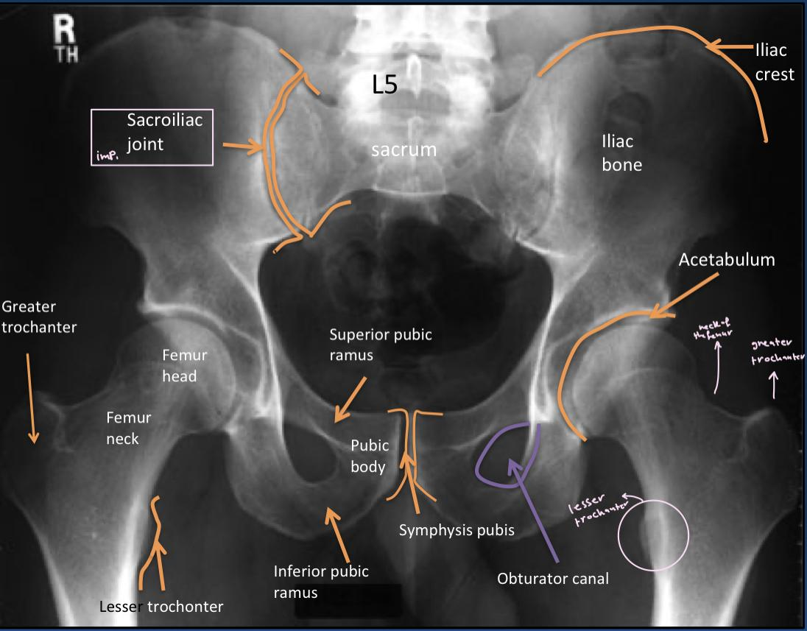
Overview
1-Hip
Click here
Fracture of neck of the femur is common

Slide 4
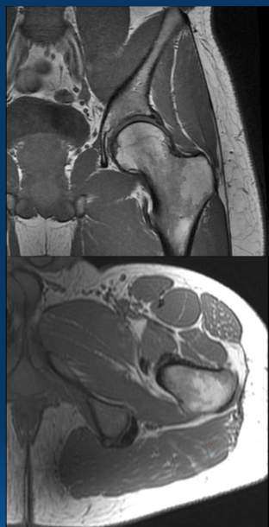
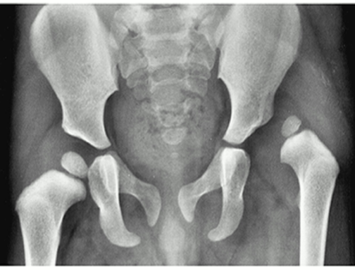
1-Hip | •High yield tendons • High yield ligaments • High yield Neurovascular structures • High yield injuries 1)Lesser trochanter -if there is a fracture here it will always be a pathologic fracture 2)Greater trochanter -gluteus minimus and medius tendons are inserted 3)ischial tuberosity 4) sciatic nerve
 | •High yield tendons 1) ischial tuberosity hamstrings tendons are inserted here • High yield ligaments • High yield Neurovascular structures medial to the iliopsoas tendon • High yield injuries —— CONGENITAL HIP DISLOCATION 2) In the left side , the epiphysis is superior lateral so it is a dislocation. Most common in infants
2
1
3
4
2
1

Slide 5
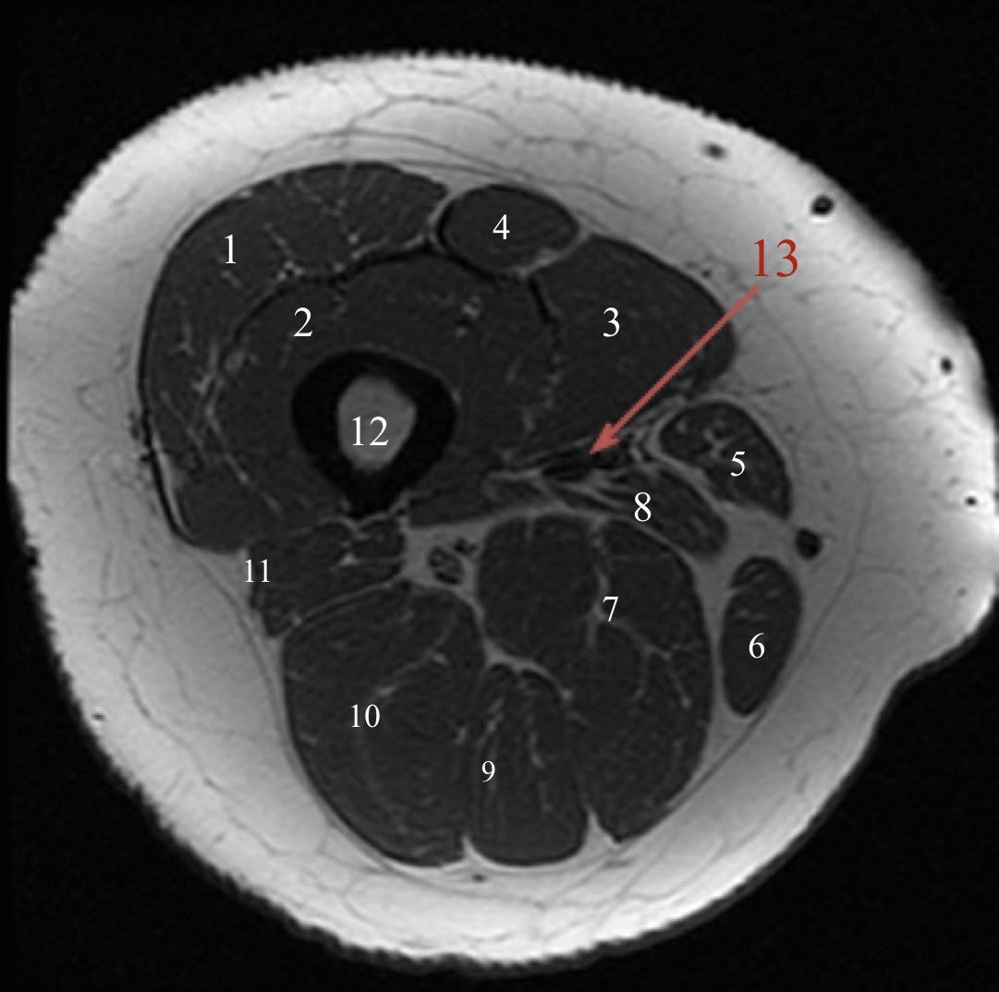
2-Thigh | 1- Vastus lateralis muscle 2- Vastus intermedius muscle 3- Vastus medialis muscle 4- Rectus femoris muscle 5- Sartorius muscle 6- Gracilis muscle 7- Adductor magnus muscle 8- Adductor longus muscle 9- Semimembranosus muscle 10- Semitendinosus Muscle 11- Biceps femoris muscle 12- Femur 13- Femoral artery
IMPORTANT: Boys Dr. Focused on this slide.

Slide 6
3-Knee
1. Femur
2. lateral condyle
3. medial condyle
4. patella
5. tibia
6. fibula
7. lateral tibia spine
8. medial tibia spine
9. intercondyle notch between lateral tibia spine and medial tibia spine
1. Femur
2. femur condyle
3. patella
4. Tibia
5. fibula
6. tibial tuberosity
7. tibial spine
8. Quadriceps tendon
8
Tibial tuberosity , the insertion of patellar ligament

Slide 7
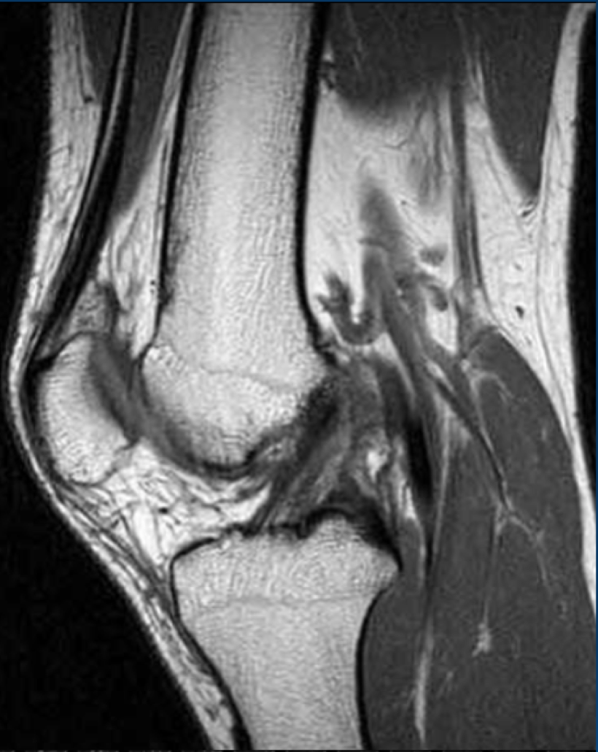
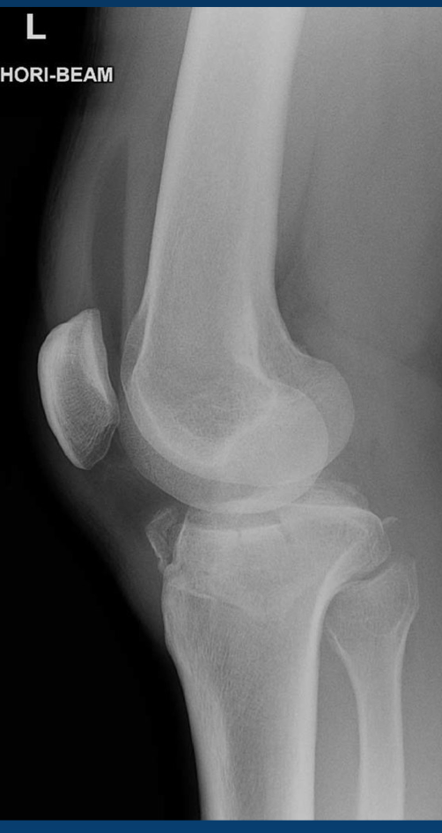
3-Knee
Quadriceps tendon
•High yield tendons
• High yield ligaments , anterior cruciate ligament (ACL)
• High yield Neurovascular structures , sciatic nerve , popliteus vessel
• High yield injuries
Blood and fat from bone marrow due to fracture (fluids)
lipohemarthrosis

Slide 8
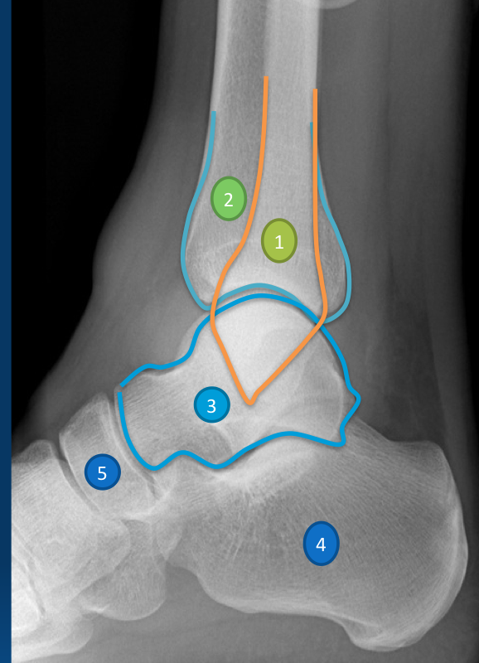
4-Ankle | 1- Tibia 2- Medial malleolus 3- Fibula 4- Lateral melleolus 5- Dome of talus
 | 1- Fibula 2- Tibia 3- Talus 4- Calcenous 5- Navicular
Tibiofibular ligament
Syndesmosis
The widening in this area is caused by a fracture in the proximal fibula
If there is a fracture in fibula :
-if the fracture is above syndesmosis it is unstable fracture
-if at the same level it could be stable or not
-if below syndesmosis it is a stable fracture
tibiotalar Joint
fracture in calcaneum is called lover fracture
-lumbar spine is associated with lover fracture

Slide 9
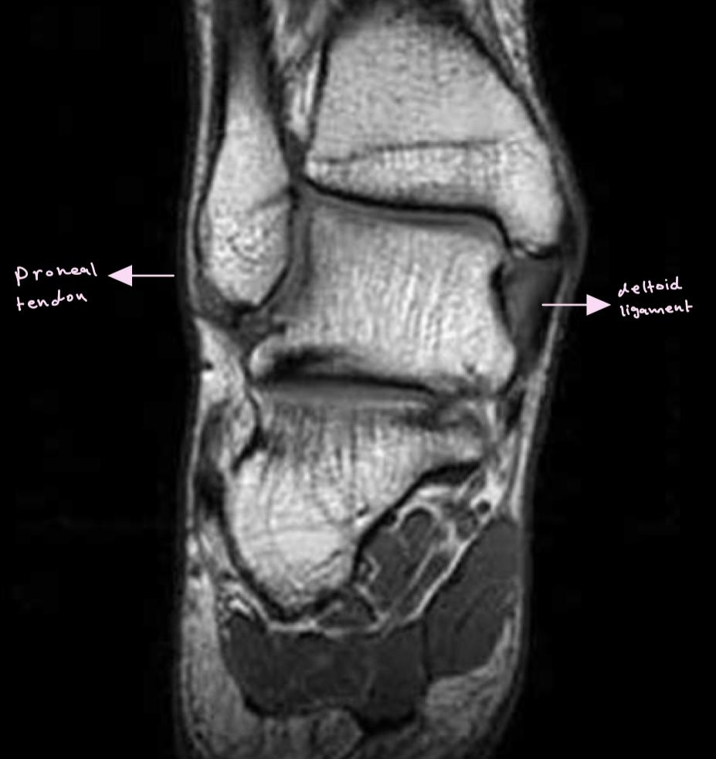
4-Ankle | •High yield tendons (posterior tibialis) • High yield ligaments (deltoid ligament (medially) Anterior talofibular ligament (laterally) “most common injured ligament “ • High yield Neurovascular structures • High yield injuries
In girls’ slides only

Slide 10
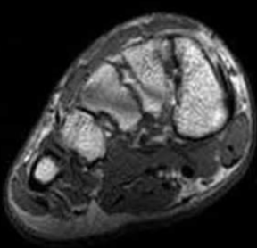
5-FOOT | 1-Medial cuneiform bone 2- Intermediate cuneiform bone 3- Lateral cuneiform bone 4- Cuboid bone 5- Navicular bone 6- Calceneal bone 7- Talus 8- Metatarsal bone (1st toe) 9- Proximal phalanx (1st toe) 10- Distal phalanx (1st toe)
 | •High yield tendons posterior tibialis it goes along the medial aspect and inserted into the navicular bone • High yield ligaments • High yield Neurovascular structures • High yield injuries
Lots of Fractures happen in the 5th metatarsal bone
(Dancer’s fracture)

Slide 11
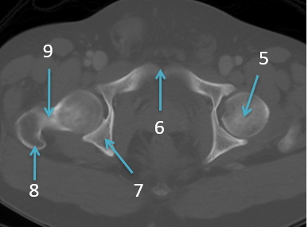
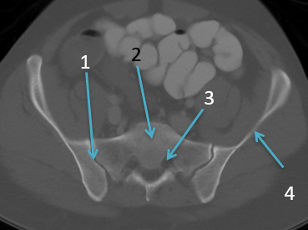
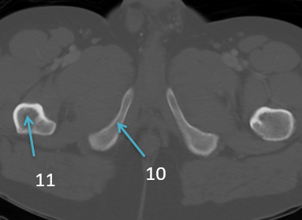
6-C.T scan of lower limb
In boys slides only
1- Sacroiliac joint
2- Sacrum
3- Sacral neural foramen
4- Iliac bone
5- Femur head
6- Symphysis pubis
7- Ischium
8- Greater trochanter
9- Femur neck
10- Pubic bone (inferior ramus)
11-Femur shaft

Slide 12
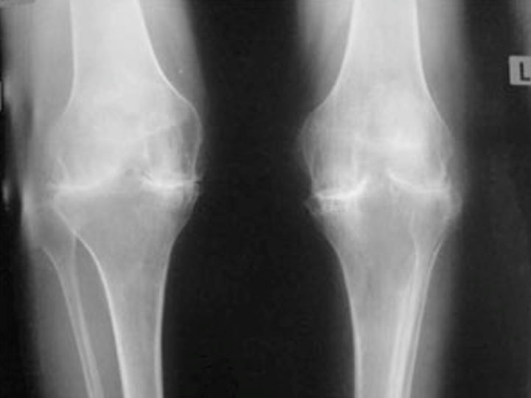
7-SEVERE OSTEOARTHRITIS
In boys slides only

Slide 13
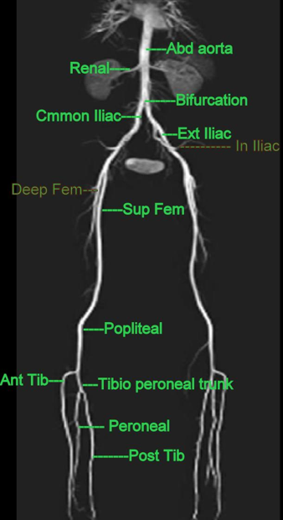
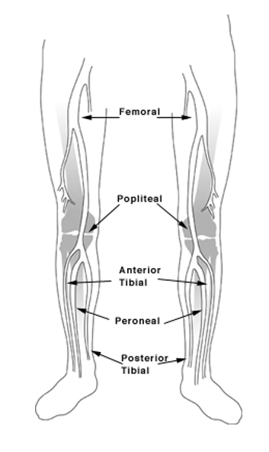
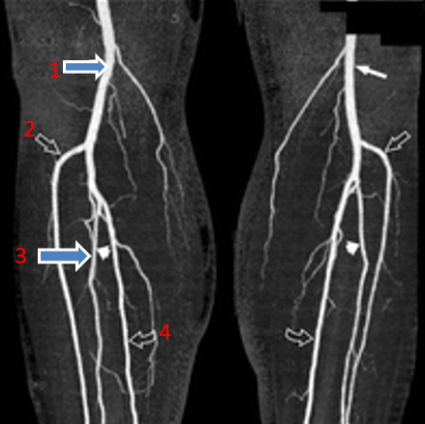
8-LOWER LIMB ARTERIES
In boys slides only
Know arteries related to the lower limb only.
1- Popliteal artery
2- Anterior tibial artery
3- Peroneal artery
4- Posterior tibial artery

Slide 14
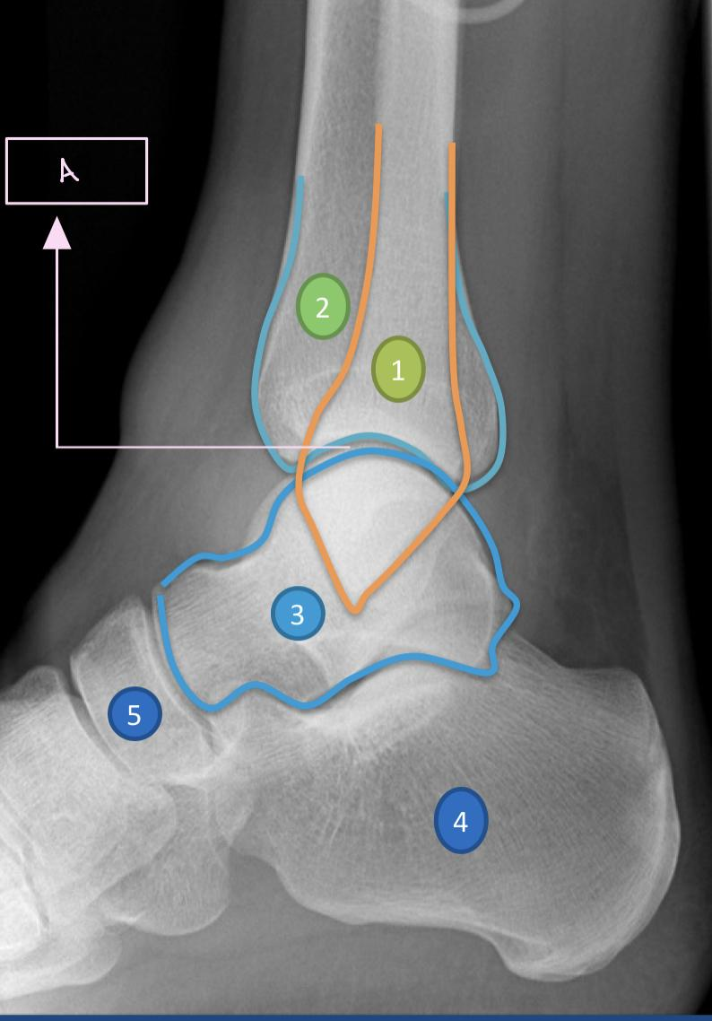
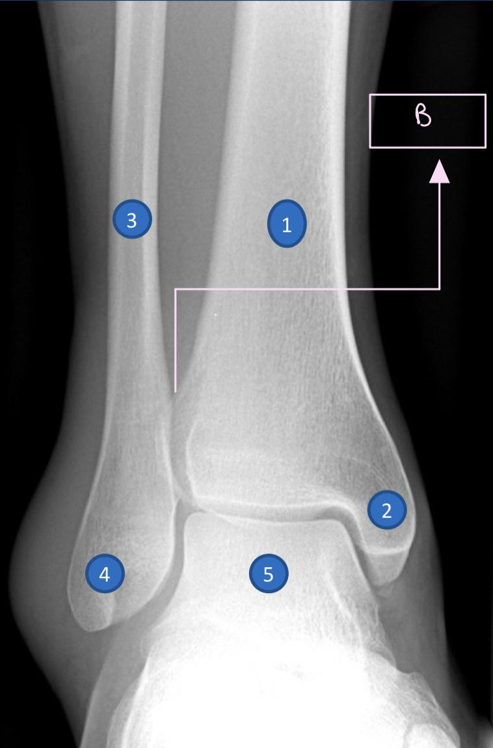
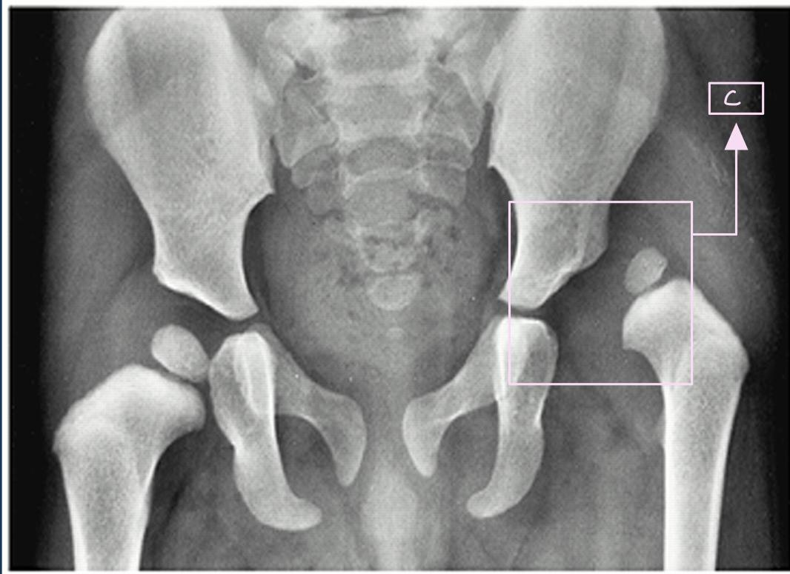
Questions
Identify A,B and C
Tibiotalar joint
B. Tibiofibular ligament
C. Congenital hip dislocation

Slide 15
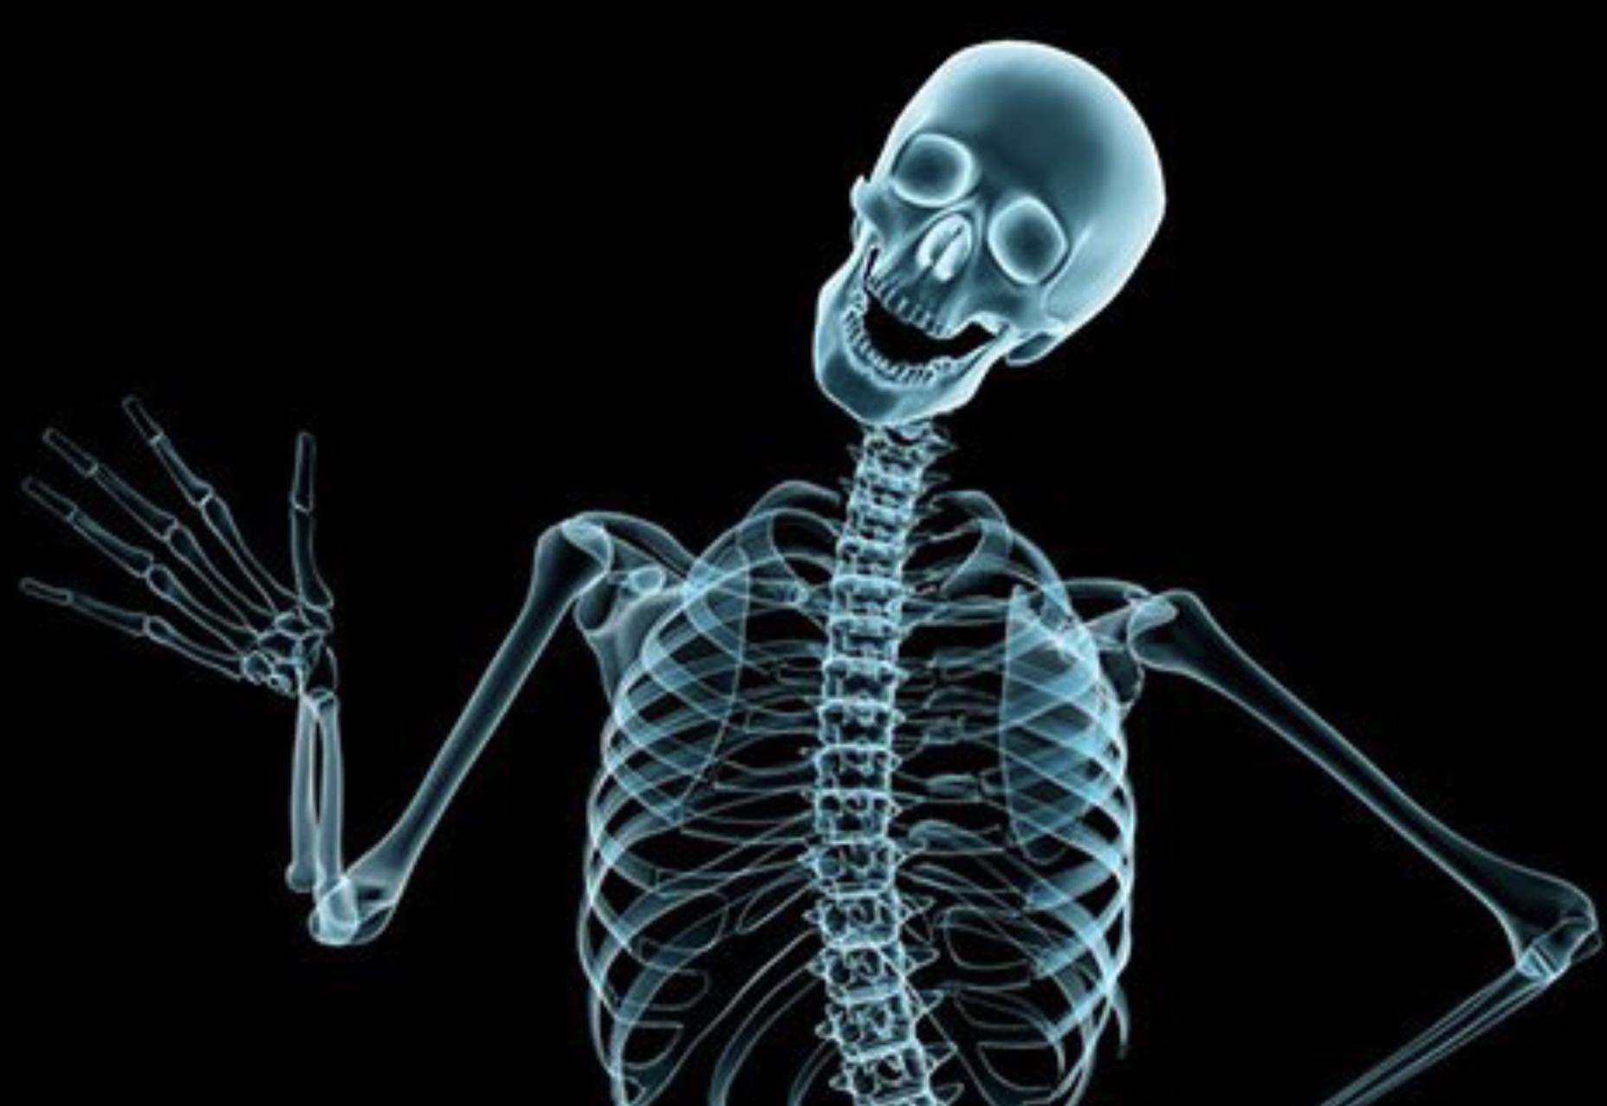
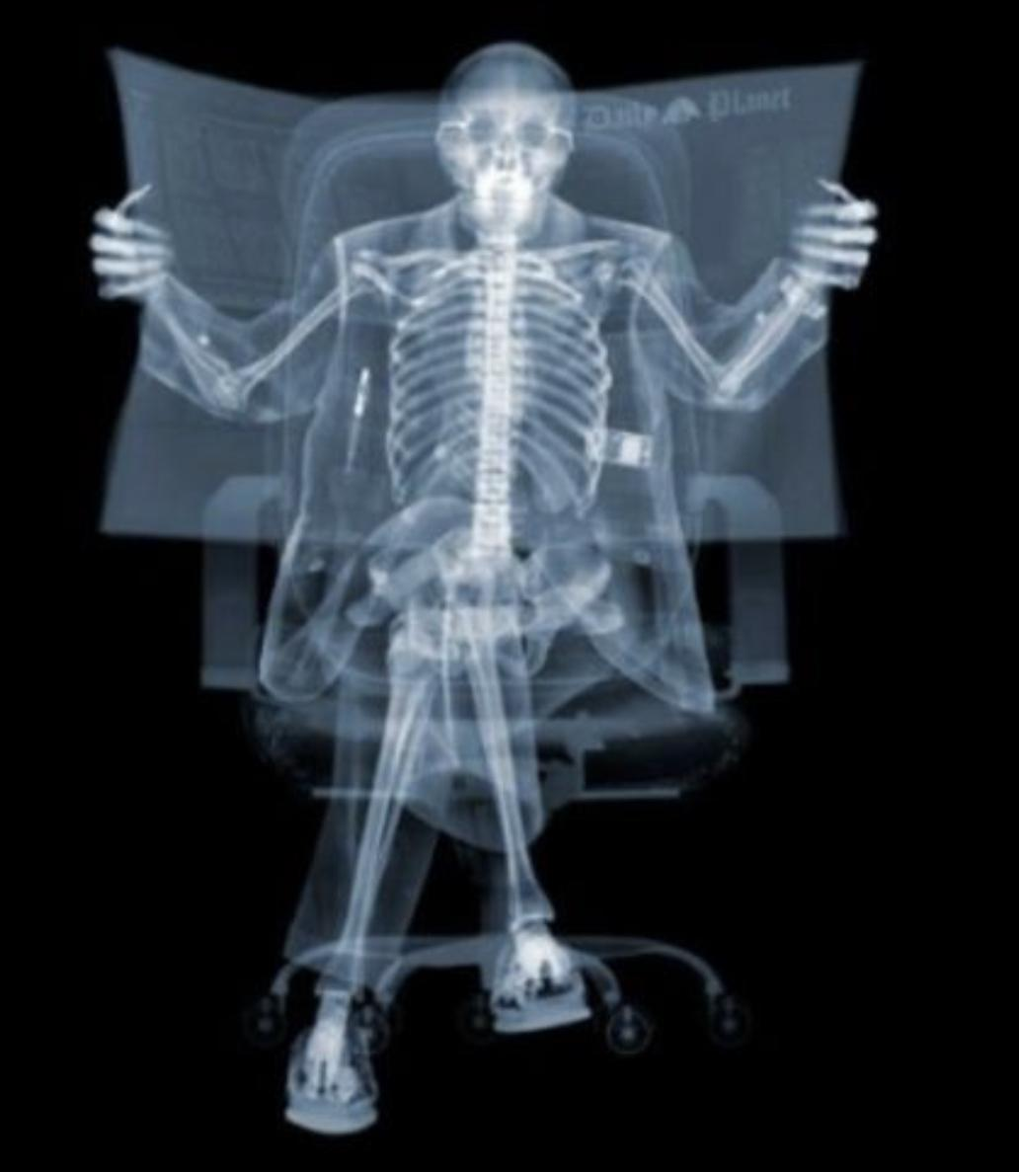
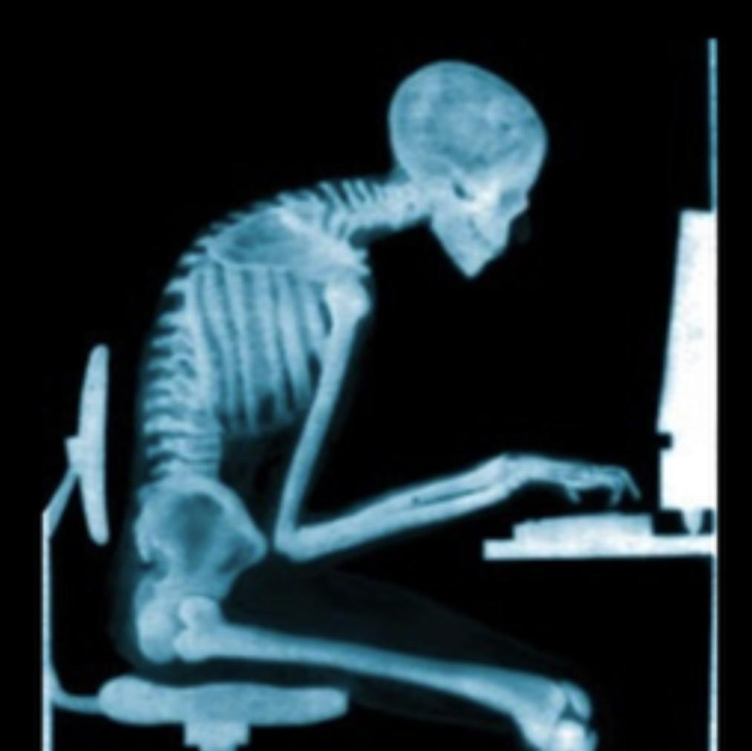
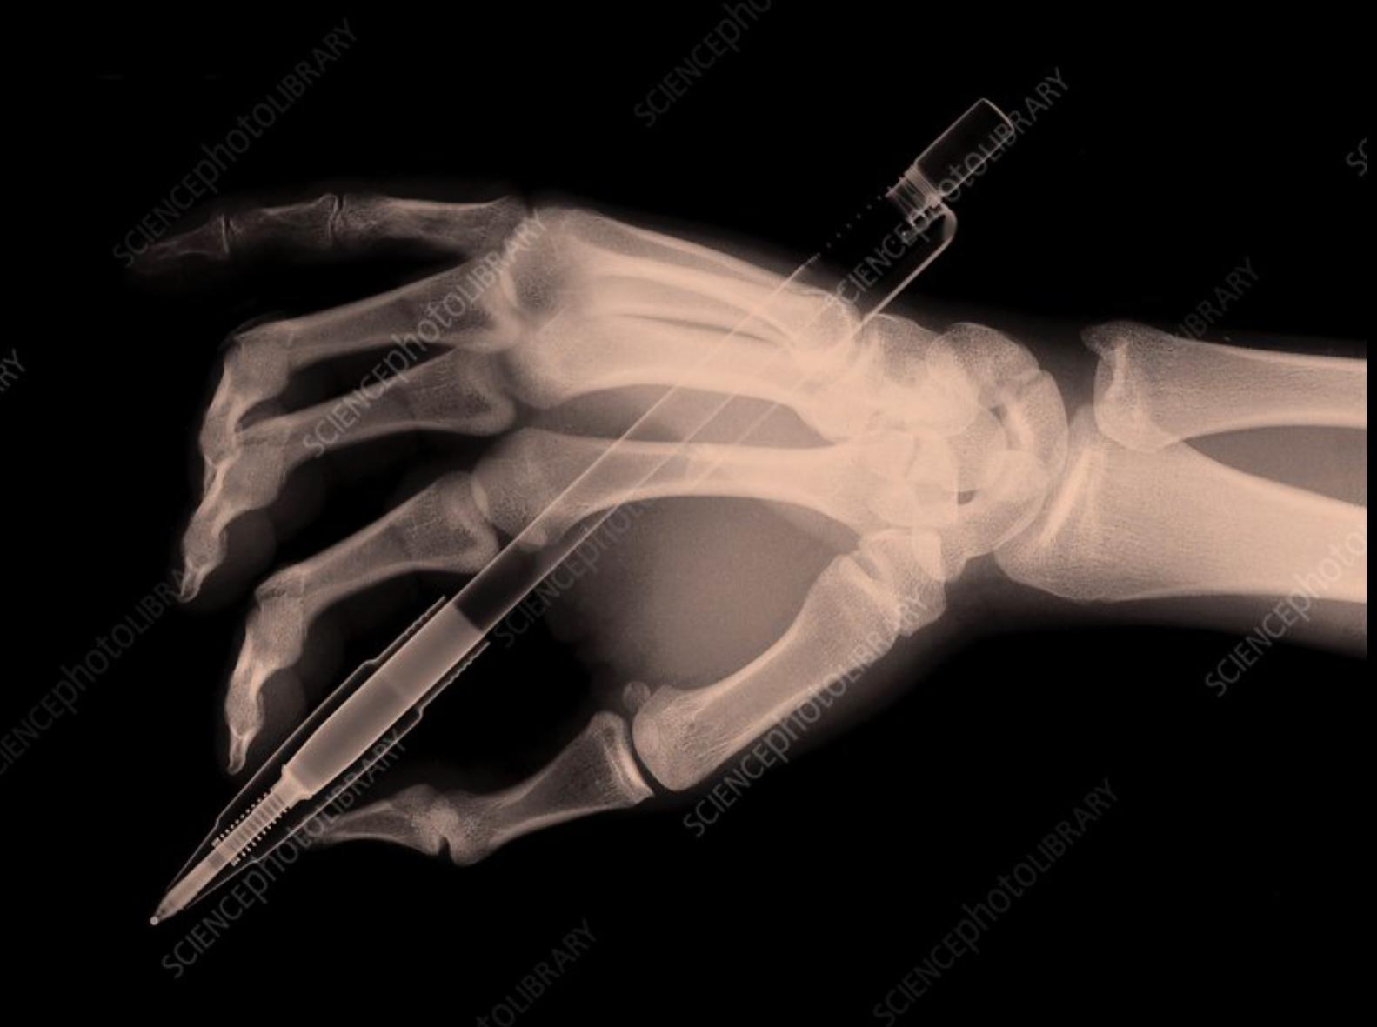
Team leaders
The end
Maram Beyari
Abdulaziz Al-Nasser
Team members
Razan Almohanna
Razan Alnufaie
Abdullah Alshehri
Fahad Mubaireek
Meshari Alshathri
Mohammed Alamry
Lecture was Done by :
Notes taker
Nada Albedaiwi

