Slide 1
Radiology of the Upper Limbs
Colour index:
Main text
Important
In girls slides only
In boys slides only
Doctors notes
Extra info.
Lecture Three
Special thanks to Noor Jamal
Editing file

Slide 2
Table of Contents
01
02
03
04
SHOULDER
ARM
ELBOW
Hand
-X ray
-MRI
-X ray
-MRI
-X ray
-X ray
-MRI
UPPER LIMB VESSELS

Slide 3
Objectives
Know the high yield functional anatomy of the upper extremity joints (Shoulder, Elbow, Wrist/Hand)
Develop simplified approach to read MSK images
Know the limitation of the modalities
Know the high yield MSK injuries/ abnormalities of the upper extremity

Slide 4
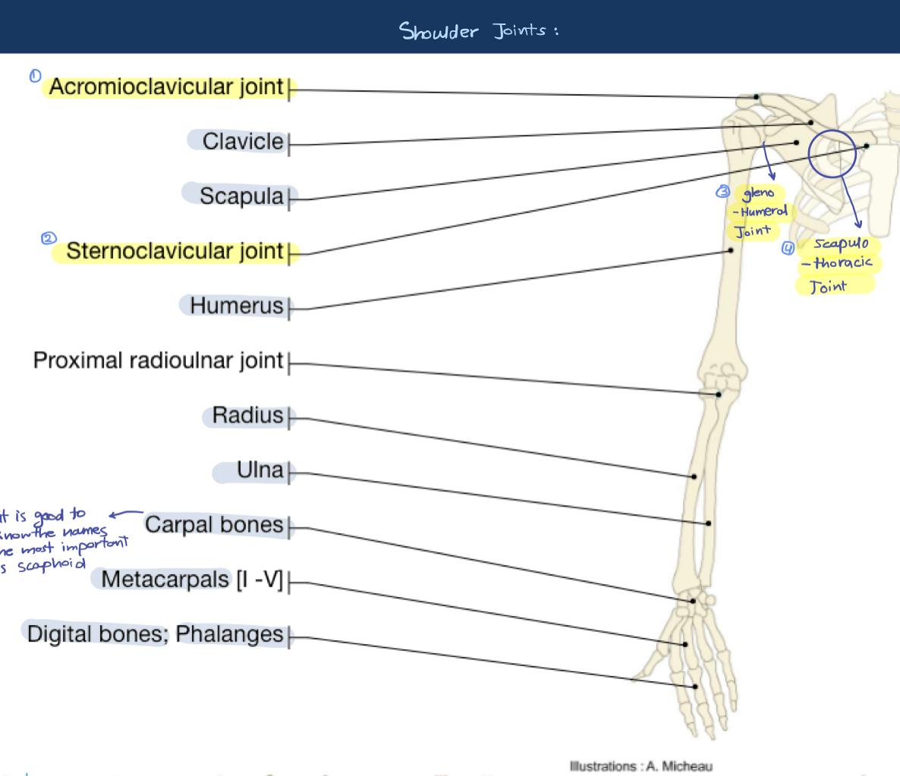
Overview:
Below bare minimum knowledge:
Girls’ Slide Only

Slide 5
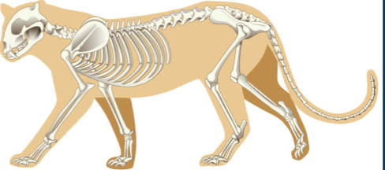
Overview:
Why do we need clavicle and cats don’t?
Girls’ Slide Only
We need clavicle to stabilize the glenohumeral joint
The function of the upper limb is to use your hands and thumb especially for over head activity like holding your hair

Slide 6
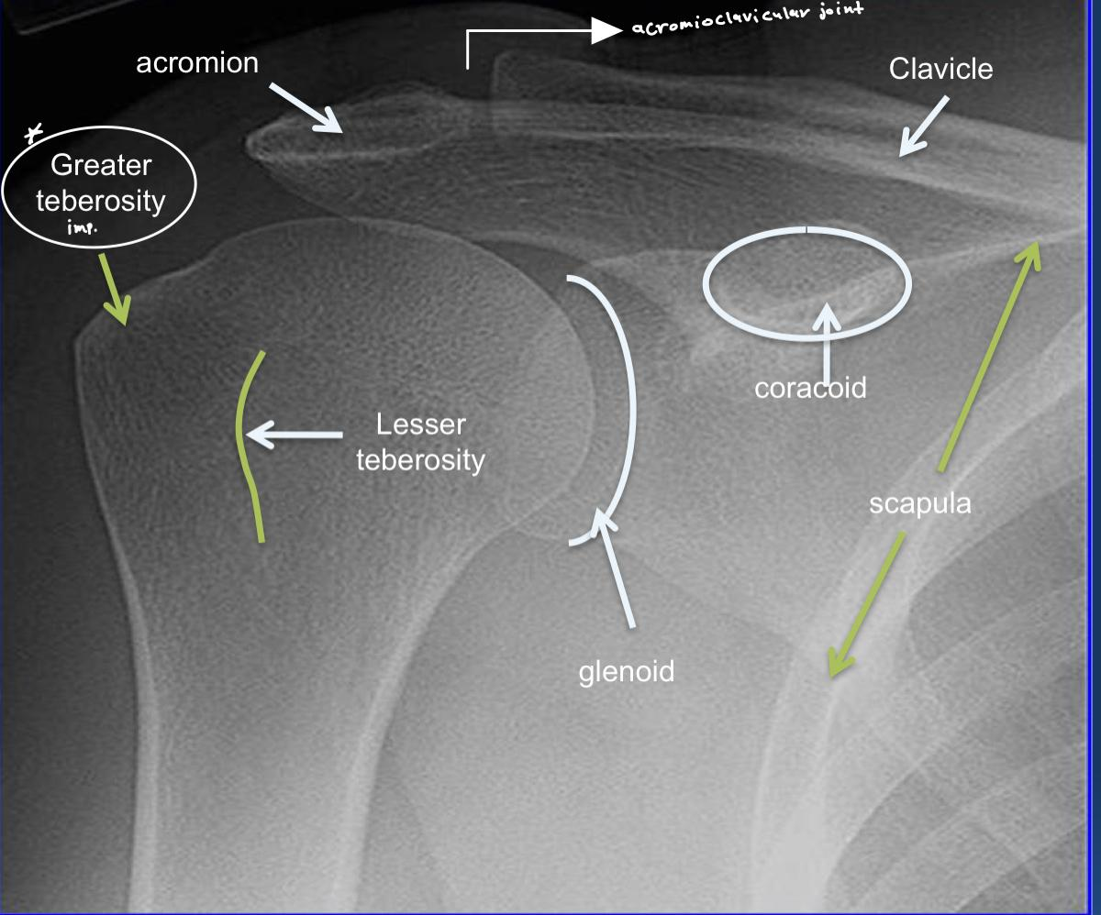
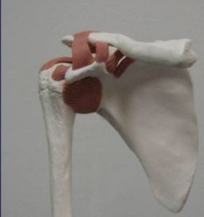
Shoulder
Know the shoulder joints
X-ray
-The rotator cuff
is the most important tendon group in the shoulder,
You have to know their location
-The proximal long head biceps
Tendon is important to know the location

Slide 7
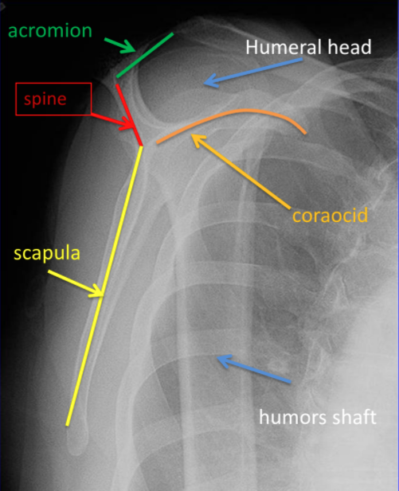
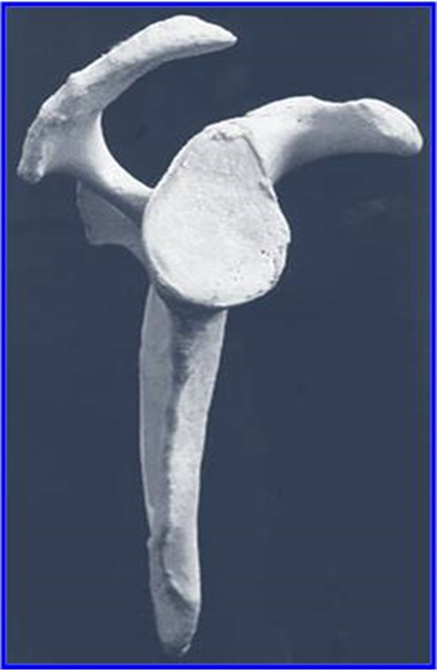
Y view
It is used to evaluate or as an indicator of shoulder dislocation
scapula lateral view

Slide 8
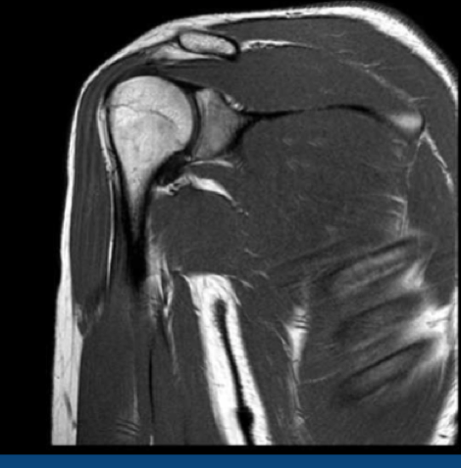
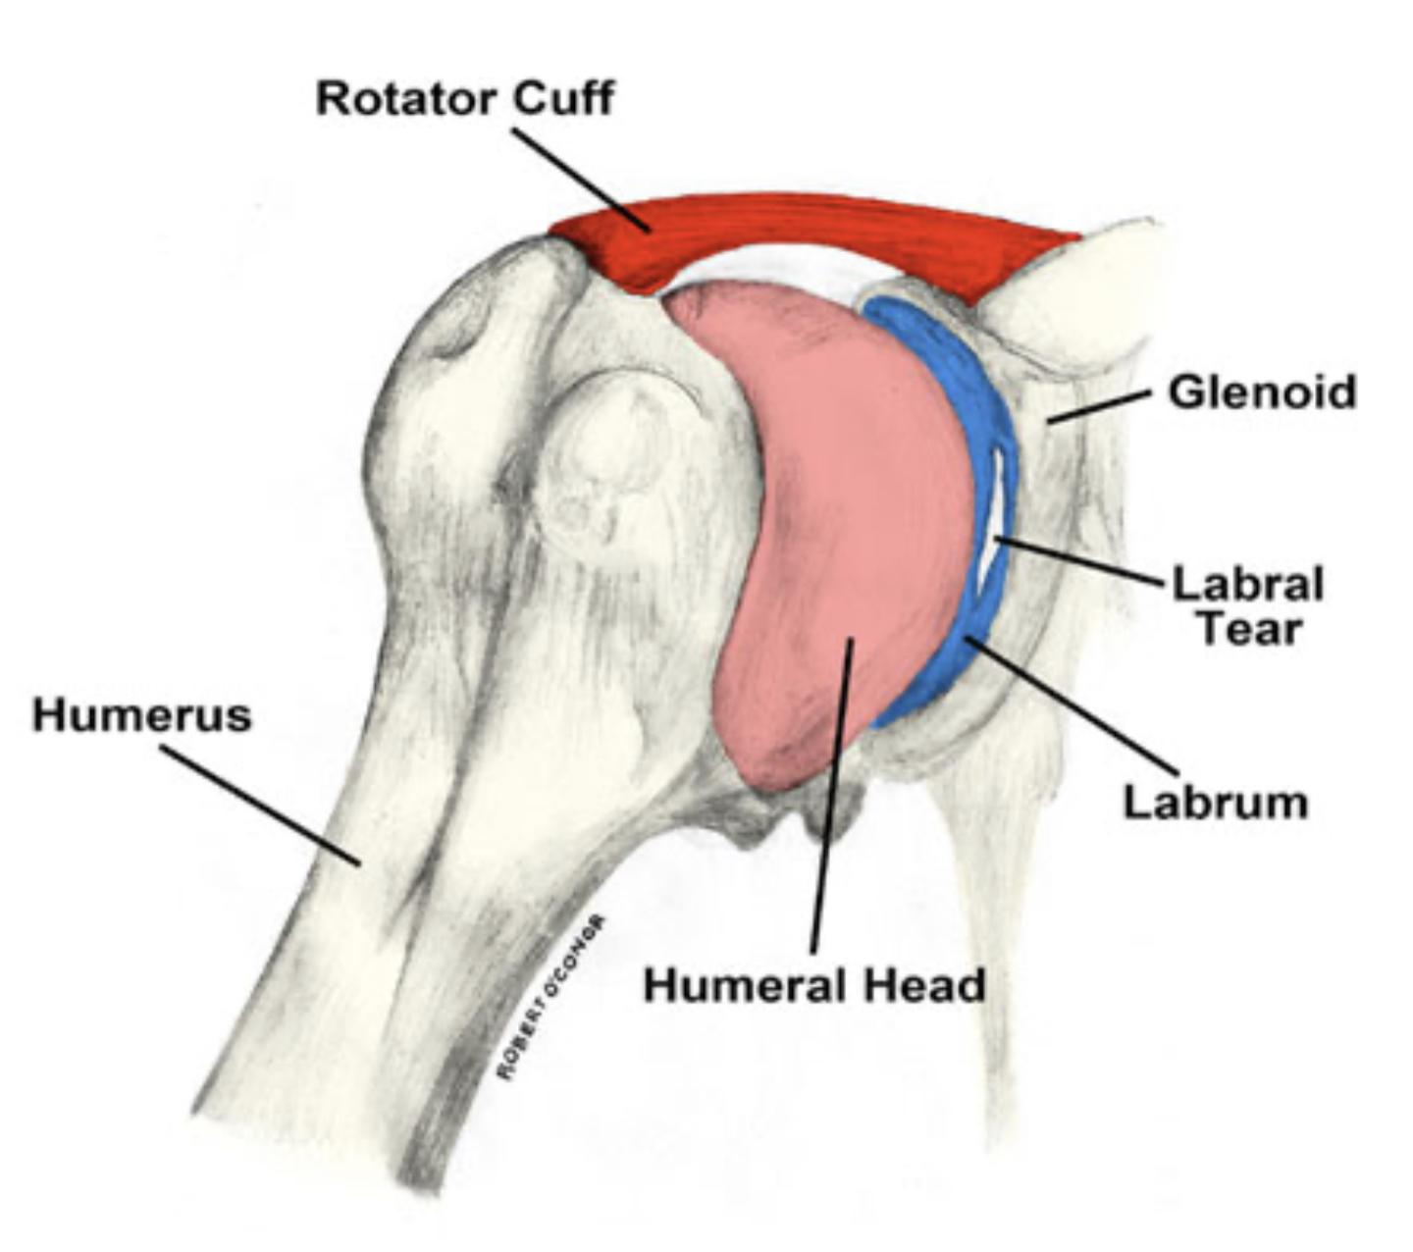
Shoulder
Girls’ Slide Only
High yield ligaments
labrum in the glenohumeral joint to increase the stability
High yield tendons
High yield neurovascular structures
High yield injuries

Slide 9
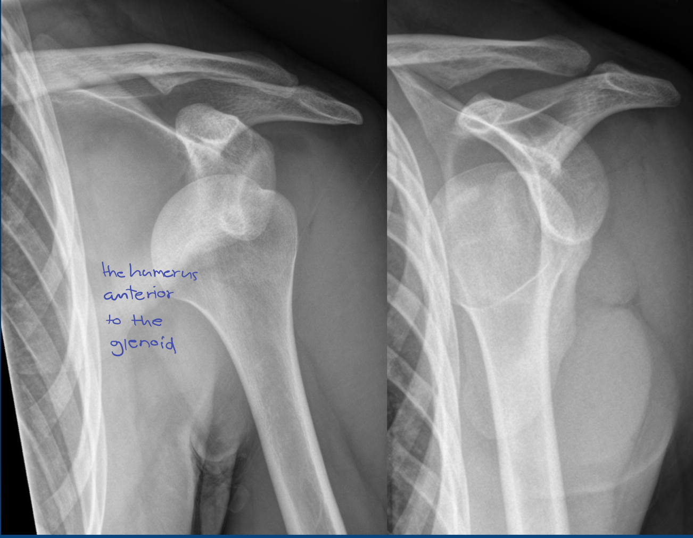
Shoulder
Girls’ Slide Only
Anterior shoulder dislocation

Slide 10
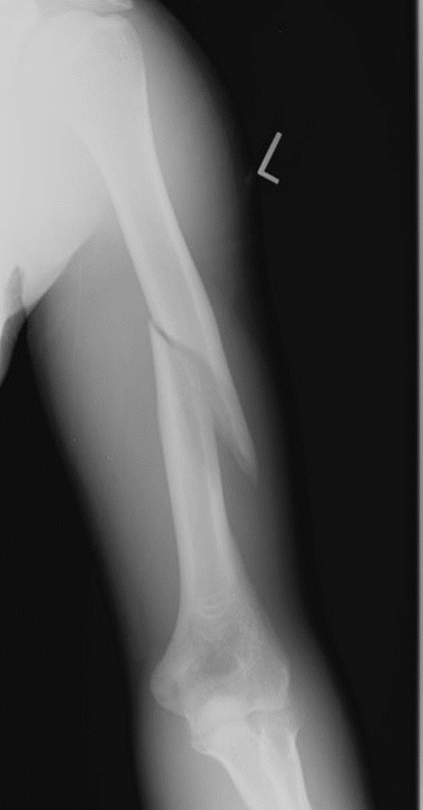
Humerus fracture
Boys’ Slide Only
This is called a Spiral fracture

Slide 11
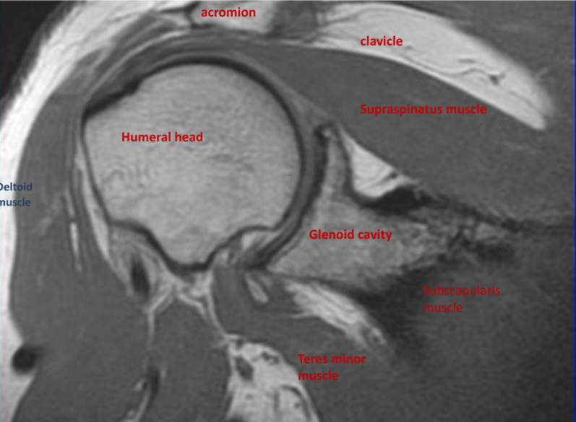
Shoulder
MRI
Boys’ Slide Only
You will not be asked if the the picture is MRI or X-Ray or CT Scan, just know the Anatomy.

Slide 12
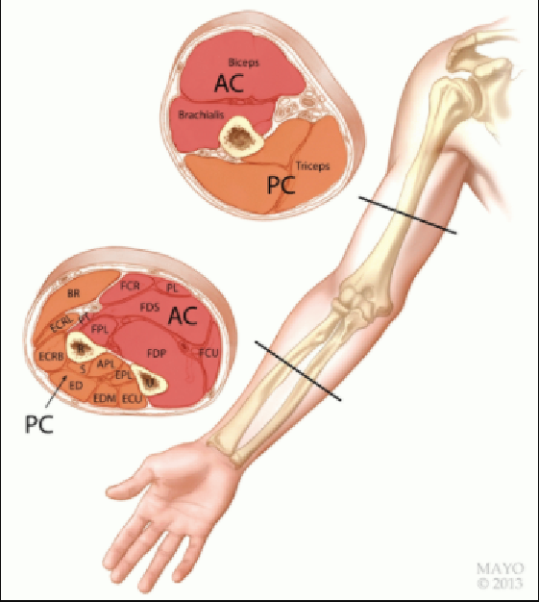
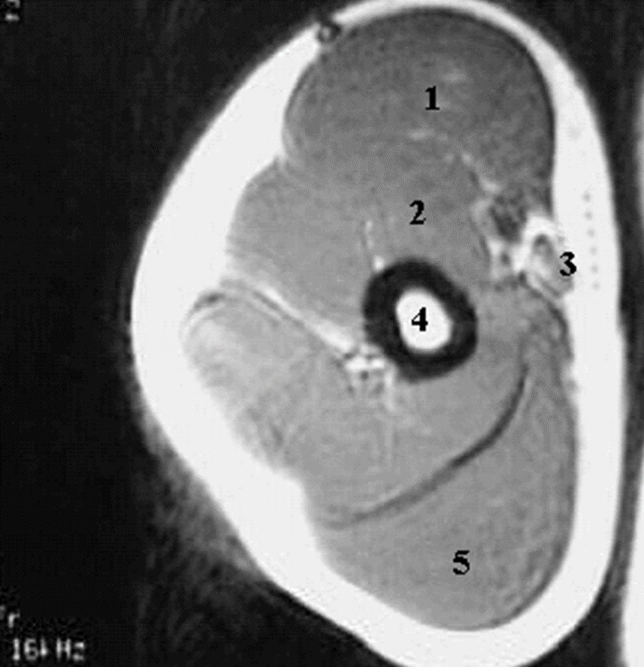
Arm
MRI
Boys’ Slide Only
للتوضيح فقط
1-Biceps Muscle.
2-Brachialis Muscle.
3-Brachial Artery.
4-Humerus.
5-Triceps Muscle

Slide 13
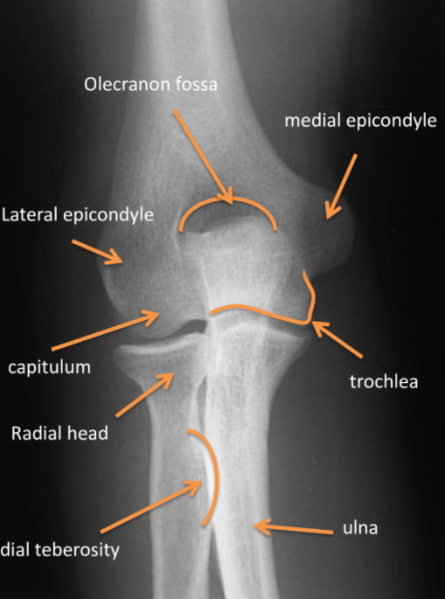
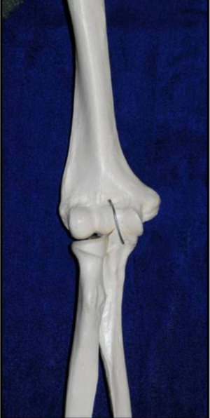
Elbow
X-ray
Ra
anterior view of the elbow

Slide 14
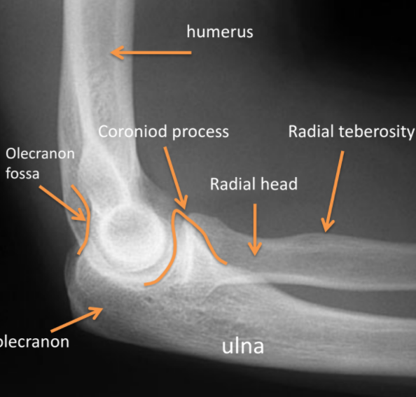
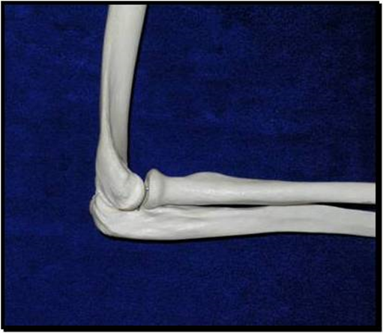
Elbow
X-ray
The flexor and extensor tendons are inserted here
Distal long head
Biceps tendon is inserted here
The bony ridges here are anterior to the surface of the shaft
Lateral view of the elbow

Slide 15
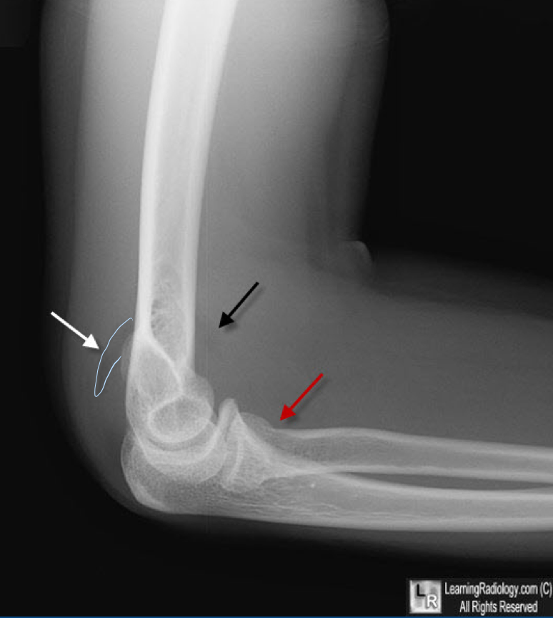
Elbow
Girls’ Slide Only
Subtle radial head fracture, posterior fat pad sign
It’s a secondary sign for the subtle radial head fracture

Slide 16
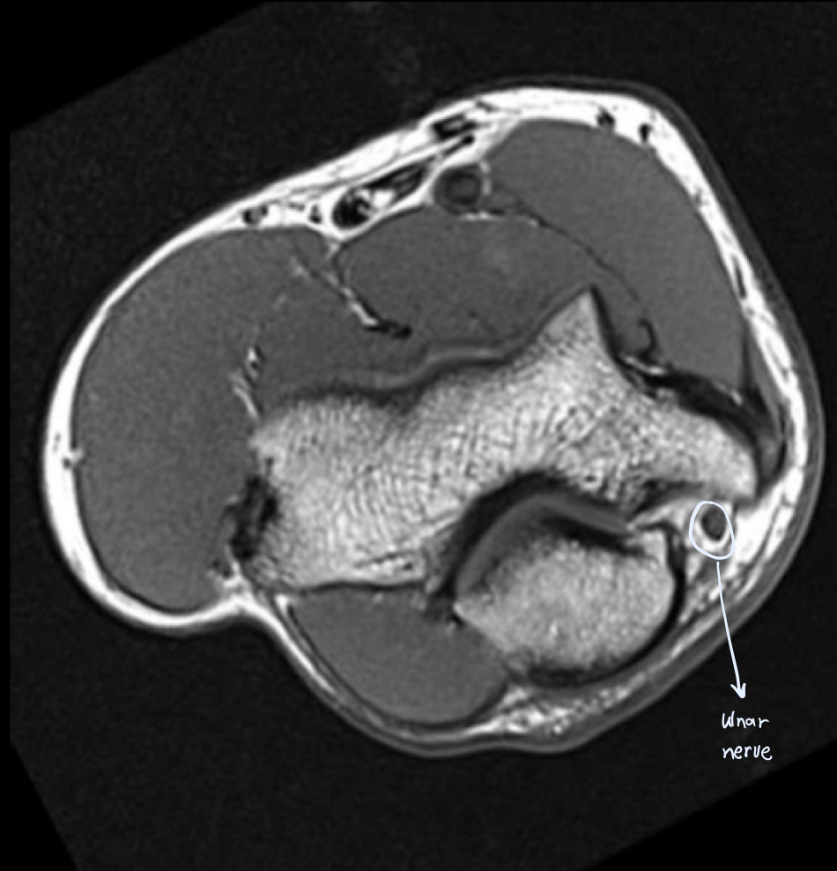
Elbow
Girls’ Slide Only
High yield tendons
High yield ligaments
High yield neurovascular structures
High yield injuries
tennis and golf elbow are irritations and tendinitis of the flexor and extensor tendons

Slide 17
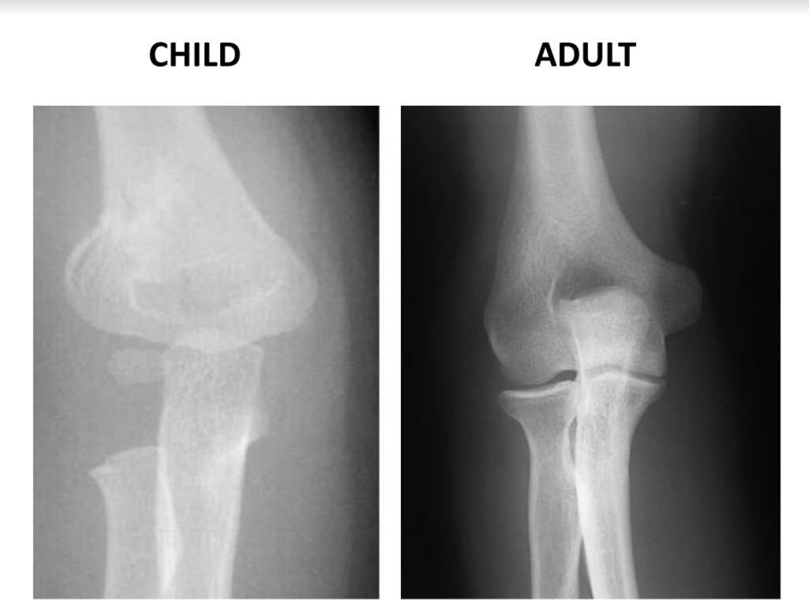
Elbow
X-ray
Anterior posterior view

Slide 18
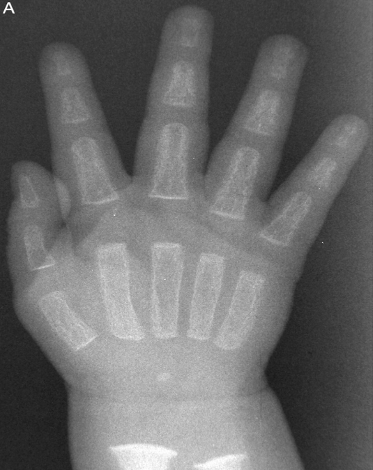
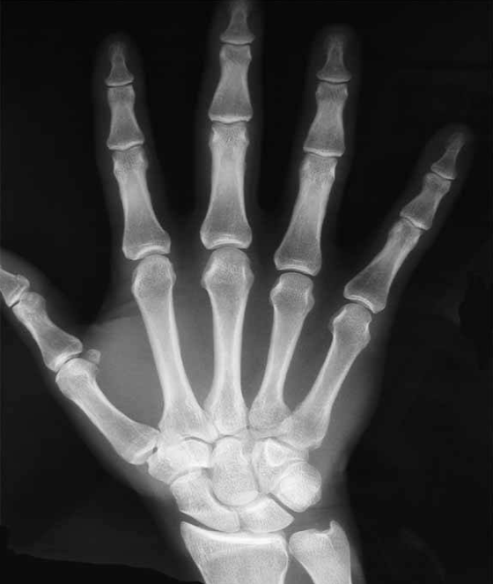
Hand
X-ray
Boys’ Slide Only
Child’s Hand
Adult’s Hand

Slide 19
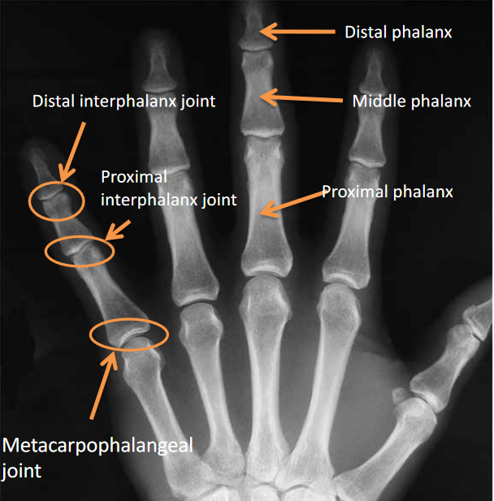
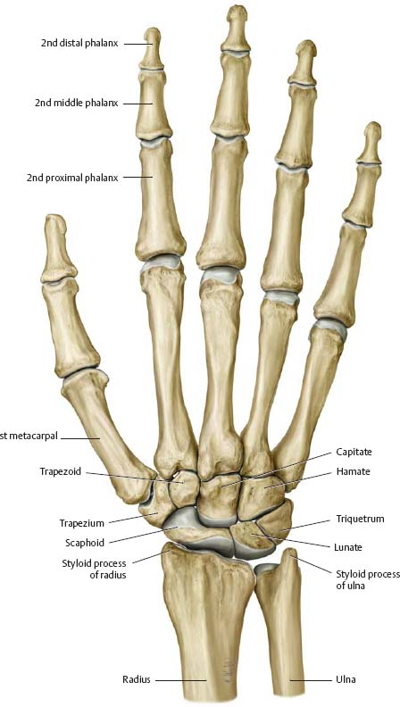
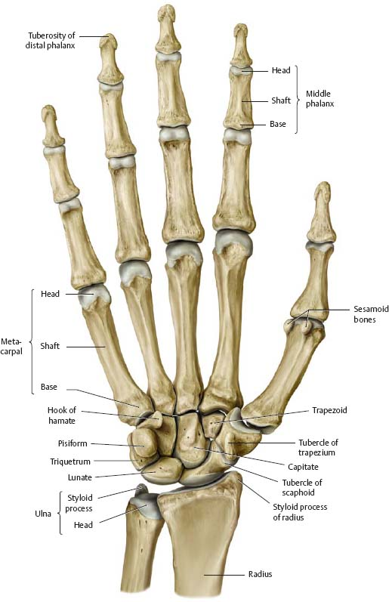
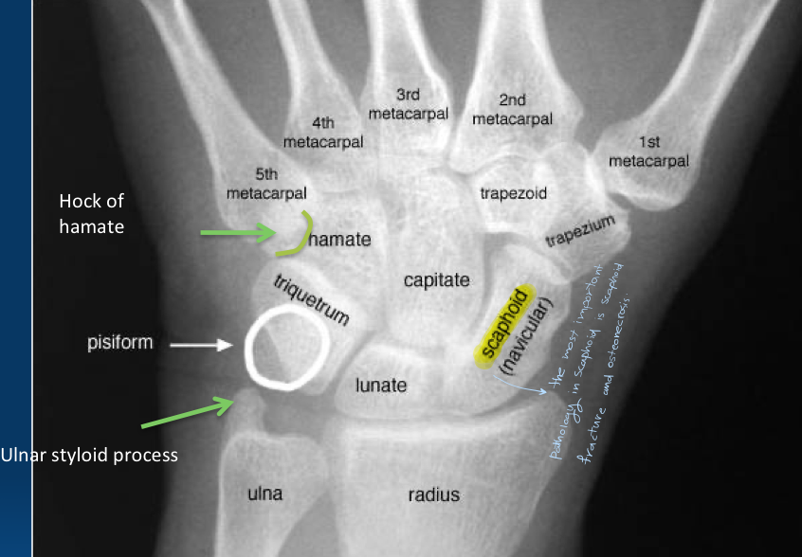
Hand
X-ray
Posterior
Anterior
-Know the names of the Carpal Bones
These diagrams are extra just so you can imagine what it looks like

Slide 20
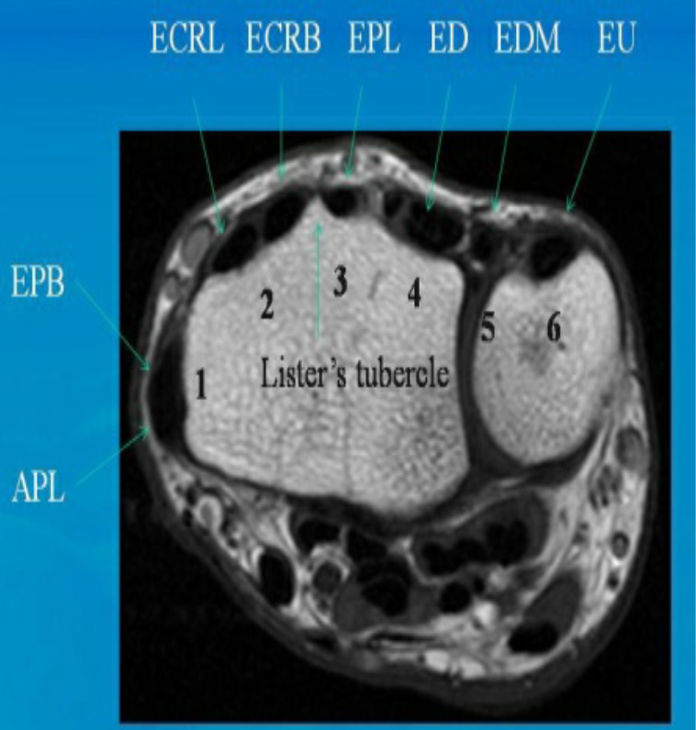
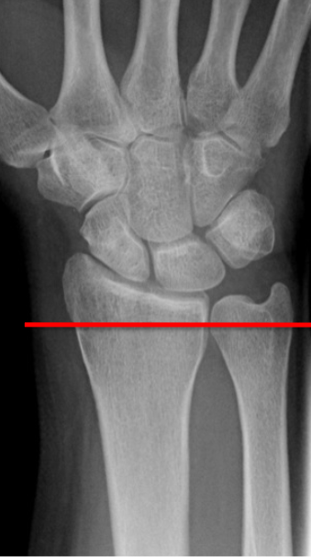
Hand
MRI
No need to memorize the names just know that the flexor muscles are in the anterior compartment and extensor muscles are in the posterior compartment.

Slide 21
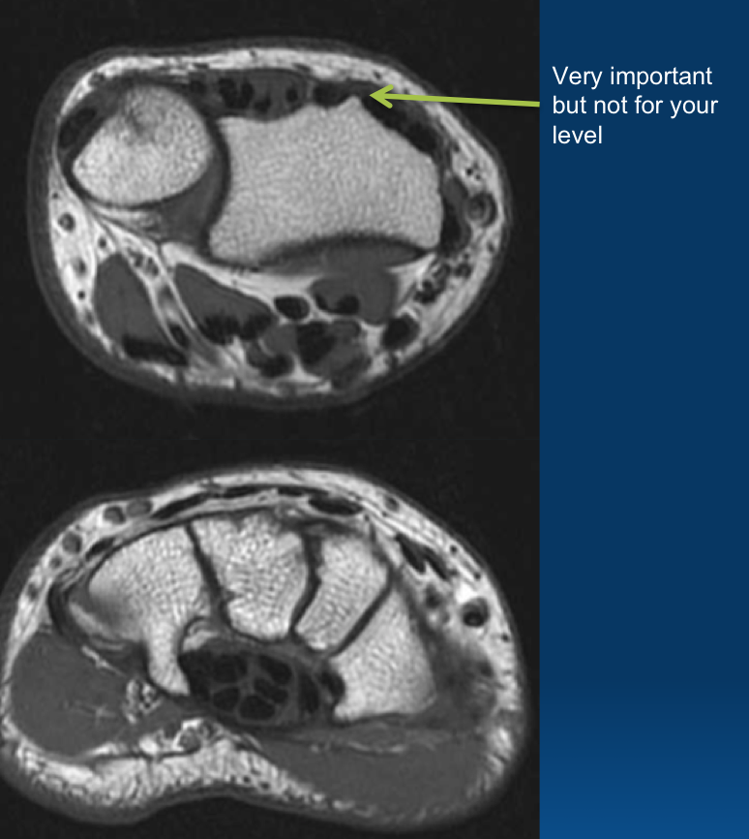
Wrist/ Hand
Girls’ Slide Only
High yield tendons
High yield ligaments
High yield Neurovascular structures
median nerve
High yield injuries

Slide 22
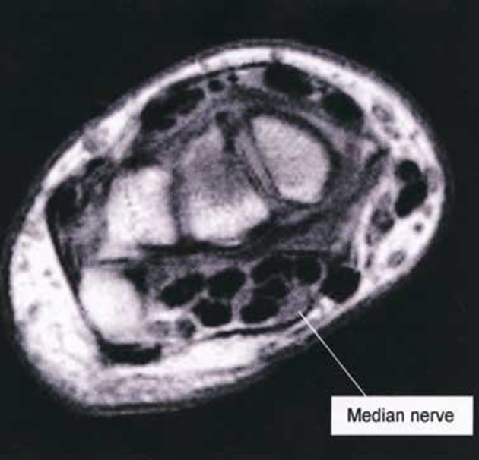
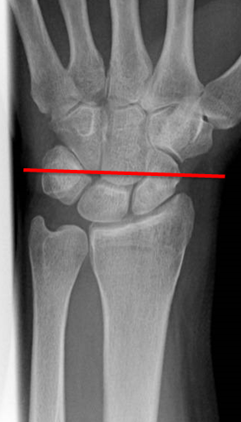
Hand
MRI

Slide 23
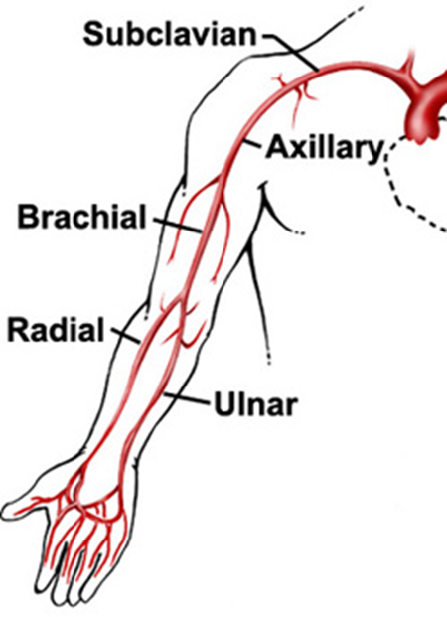
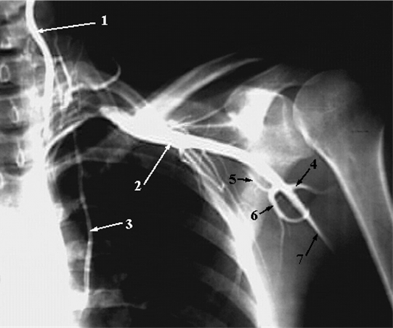
Upper Limb
Vessels
Boys’ Slide Only
Just know the arteries related to the upper limb.
Vertebral Artery.
1-Vertebral Artery
2-Axillary Artery
3-Internal Thoracic Artery
arteries related to the upper limb:
4-Posterior Humeral Circumflex Artery
5-Circumflex Scapular Artery
6-Subscapular Artery
7-Brachial artery
Axillary Artery
Internal Thoracic Artery

Slide 24
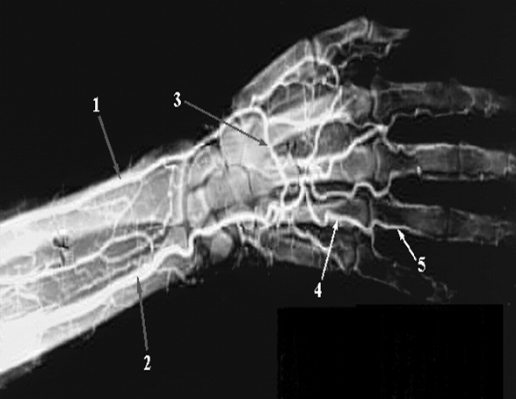
Upper Limb
Vessels
Boys’ Slide Only
Deep Palmar Arch
Radial Artery.
1-Radial Artery
2-Ulnar Artery
3-Deep Palmar Arch
4-Common Palmar Digital Artery
5-Proper Palmar Digital Artery
Proper Palmar Digital Artery
Common Palmar Digital Artery.
Ulnar Artery

Slide 25
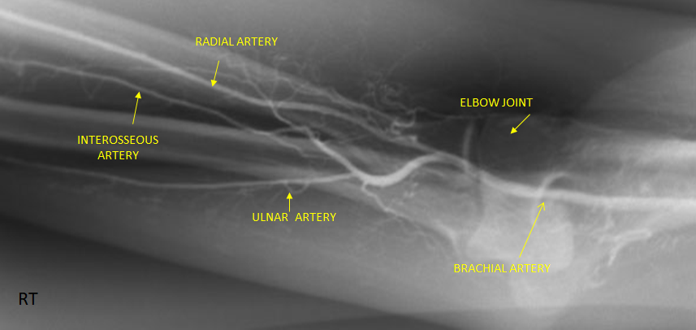
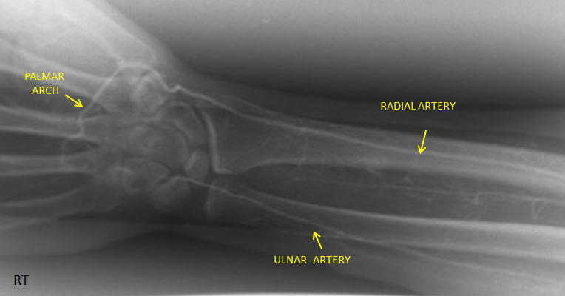
Upper Limb
Vessels
Boys’ Slide Only
RT. UPPER EXTREMITY ANGIOGRAM

Slide 26
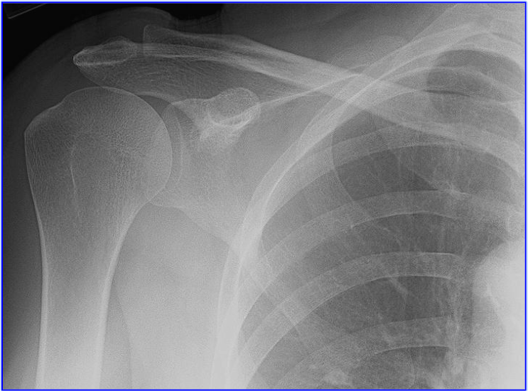
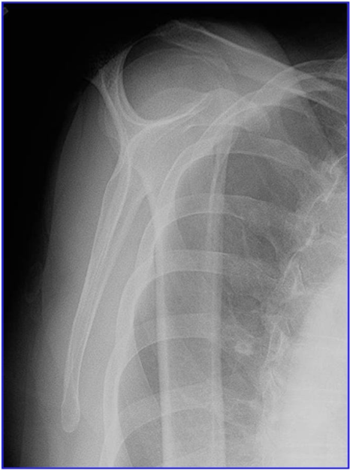
Test Yourself:

Slide 27
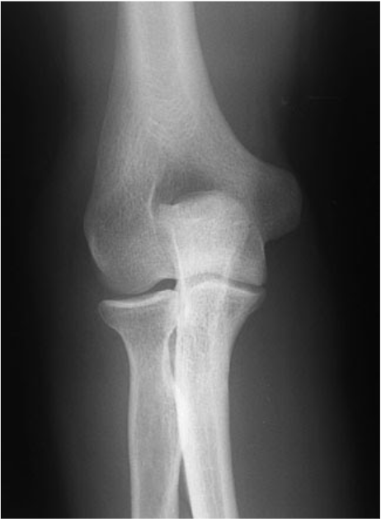
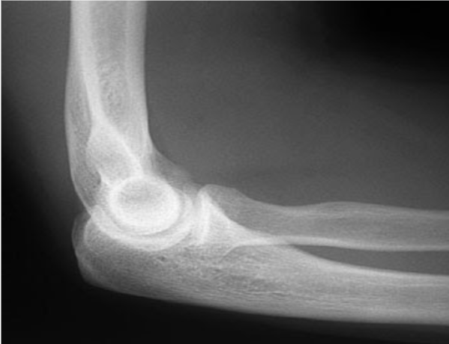
Test Yourself:

Slide 28
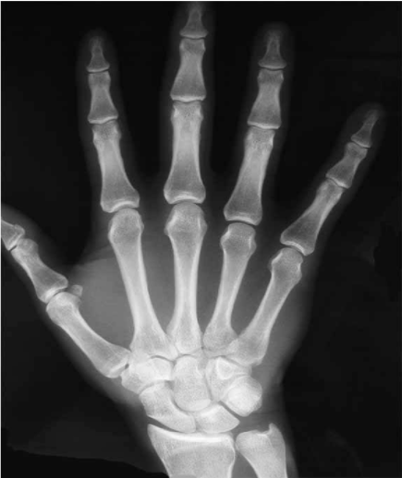
Test Yourself:

Slide 29
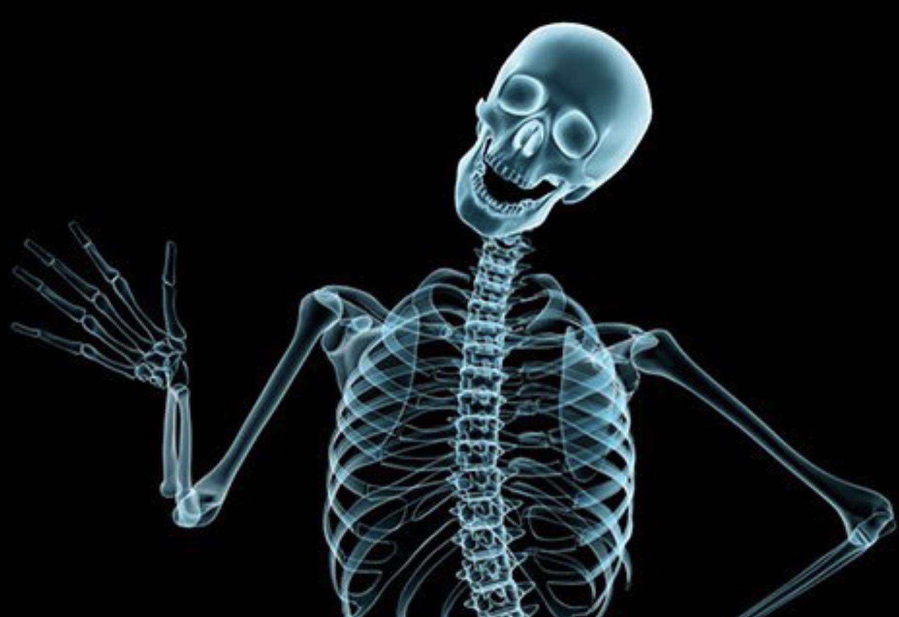
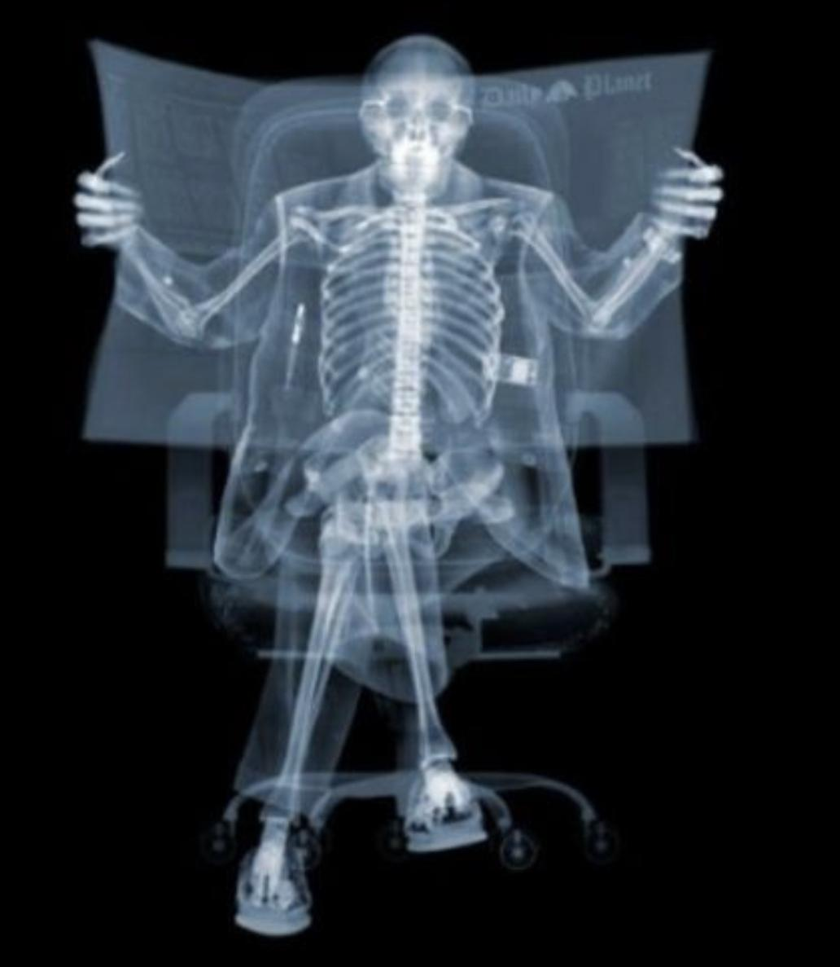
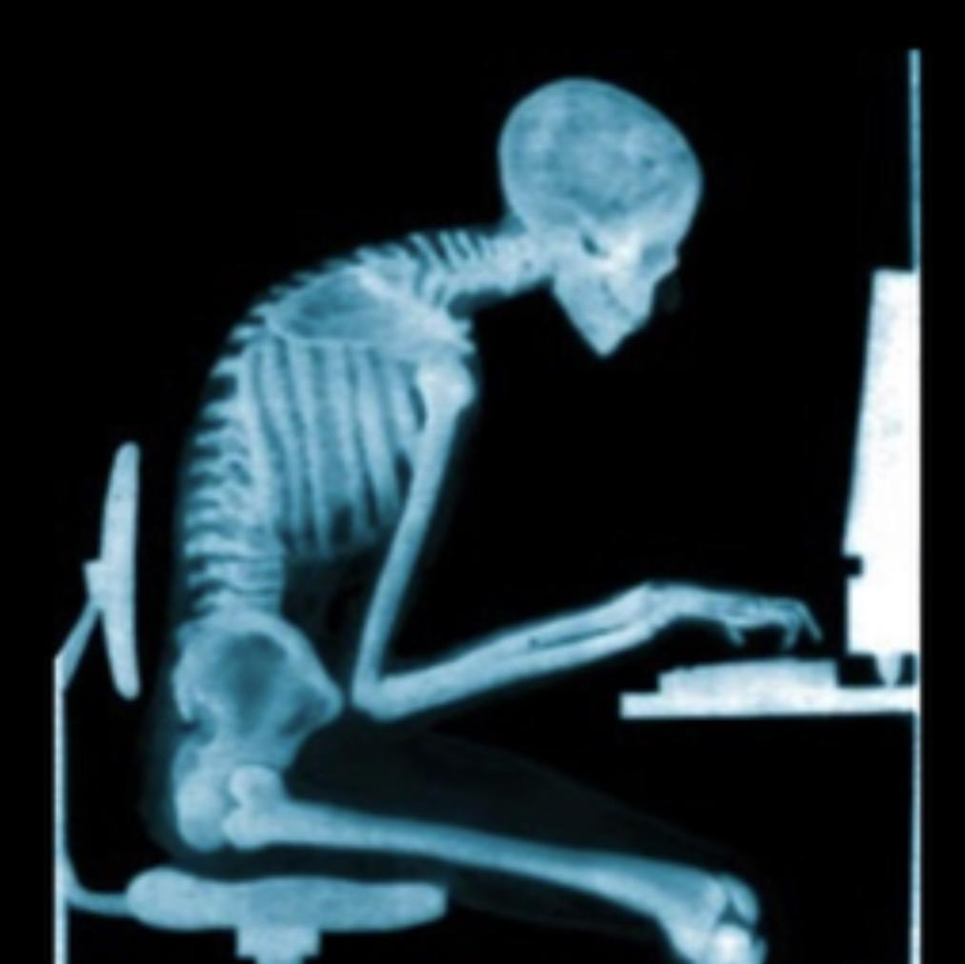
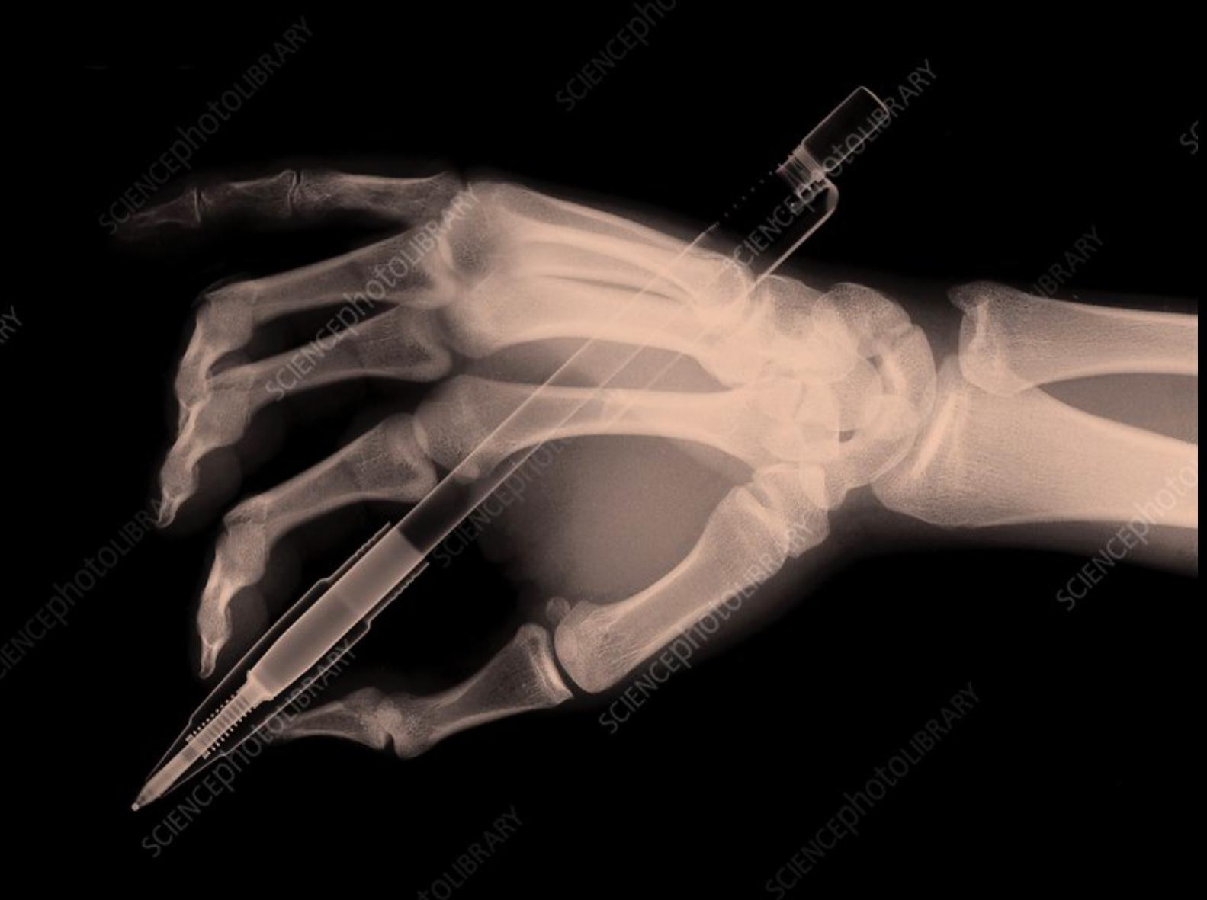
Team leaders
The end
Maram Beyari
Abdulaziz Al-Nasser
Team members
Razan Almohanna
Razan Alnufaie
Abdullah Alshehri
Fahad Mobaireek
Meshari Alshathri
Mohammed Alamry
Lecture was Done by :
Notes taker
Nada Albedaiwi

