Slide 1
Globular Proteins
Respiratory Block | 1 Lecture

Slide 2
Objectives
To describe the globular proteins using common examples like hemoglobin and myoglobin.
To study the structure and functions of globular proteins like-
Hemoglobin (a major globular protein)
Myoglobin, and
γ-globulins (immunoglobulins)
To know the different types of hemoglobin and difference between normal and abnormal hemoglobin
To understand the diseases associated with globular proteins

Slide 3
Globular proteins
Amino acid chains fold into shapes that resemble spheres are called globular proteins
This type of folding increases solubility of proteins in water
Polar groups on the protein’s surface
Hydrophobic groups in the interior
Fibrous proteins are mainly insoluble structural proteins

Slide 4
Globular proteins
Hemoglobin: oxygen transport function
Myoglobin: oxygen storage/supply function in
heart and muscle
α₁, α₂, β-globulins: various functions
γ-globulins (immunoglobulins): immune function
Enzymes: catalysis of biochemical reactions

Slide 5
Hemoglobin
A major globular protein in humans
Composed of four polypeptide chains:
Two α and two β chains
Contains two dimers of αβ subunits
Held together by non-covalent interactions
Each chain is a subunit with a heme group in the center that carries oxygen
A Hb molecule contains 4 heme groups and carries 4 molecules of O₂

Slide 6
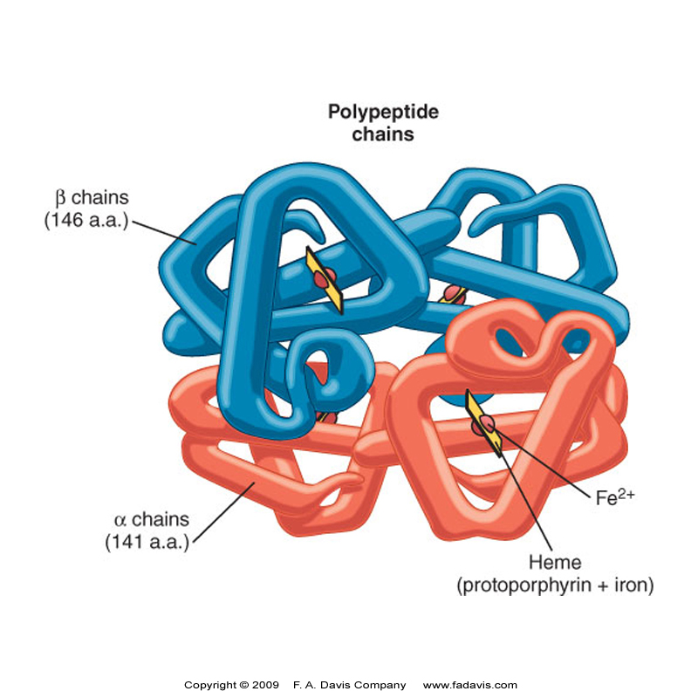

Slide 7
Types of Hb
Normal: | HbA (97%)
 | HbA₂ (2%)
 | HbF (1%)
 | HbA_{1c}
Abnormal: | Carboxy Hb
 | Met Hb
 | Sulf Hb

Slide 8
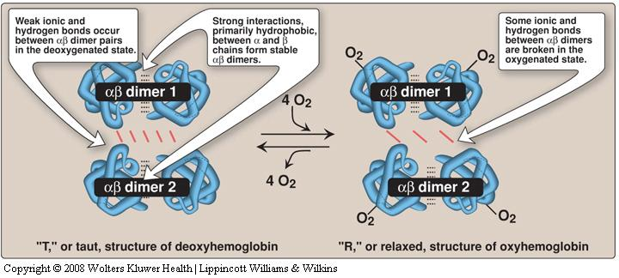
HbA structure
Oxygen binding to hemoglobin

Slide 9
Hemoglobin function
Carries oxygen from the lungs to tissues
Carries carbon dioxide from tissues back to the lungs
Normal level (g/dL):
Males: 14-16
Females: 13-15

Slide 10
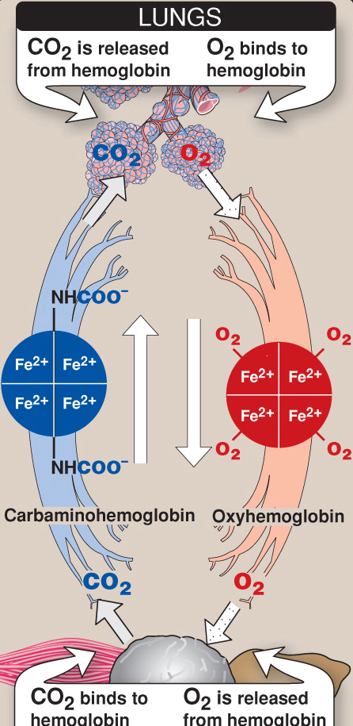

Slide 11
Types of hemoglobin
Fetal hemoglobin (HbF):
Major hemoglobin found in the fetus and newborn
Tetramer with two α and two γ chains
Higher affinity for O₂ than HbA
Transfers O₂ from maternal to fetal circulation across placenta

Slide 12
Types of hemoglobin
HbA₂:
Appears shortly before birth
Constitutes ~2% of total Hb
Composed of two α and two δ globin chains

Slide 13
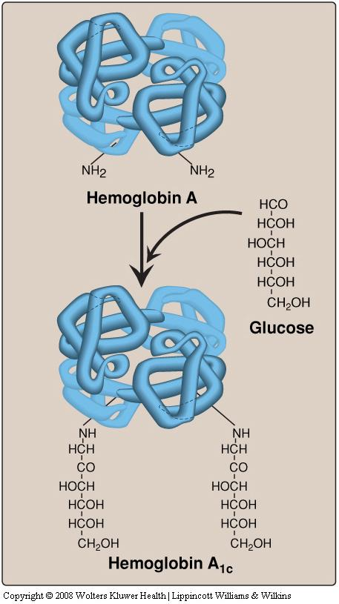
Types of hemoglobin
HbA_{1c}:
HbA undergoes non-enzymatic glycosylation
Glycosylation depends on plasma glucose levels
HbA1c levels are high in patients with diabetes mellitus
NH2 groups of the
N-terminal valines
of β chains

Slide 14
Abnormal Hbs
Unable to transport O₂ due to abnormal structure:
Carboxy-Hb: CO binds 200X tighter than O₂ (in smokers) and stabilizes the oxyhemoglobin
Met-Hb: Contains oxidized Fe³⁺ (~2%) that cannot carry O₂
Sulf-HB: Forms due to high sulfur levels in blood (irreversible reaction)

Slide 15
Hemoglobinopathies
Disorders of hemoglobin caused by:
Synthesis of structurally abnormal Hb
Synthesis of insufficient quantities of normal Hb
Combination of both

Slide 16
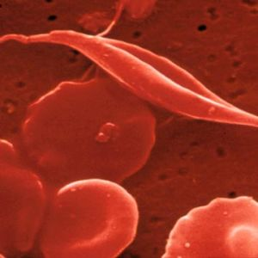
Hemoglobinopathies
Sickle cell (HbS) disease
Caused by a single mutation in β-globin gene
Glutamic acid at position 6 in HbA is replaced by valine
The mutant HbS contains β^{s} chain
The shape of RBCs become sickled
Causes sickle cell anemia

Slide 17
Hemoglobinopathies
Hemoglobin C disease:
Caused by a single mutation in β-globin gene
Glutamic acid at position 6 in HbA is replaced by lysine
Causes a mild form of hemolytic anemia

Slide 18
Hemoglobinopathies
Methemoglobinemia:
Caused by oxidation of Hb to ferric (Fe³⁺) state
Methemoglobin cannot bind oxygen
Caused by certain drugs, reactive oxygen species and NADH-cytochrome b5 reductase deficiency
Chocolate cyanosis: brownish-blue color of the skin and blood

Slide 19
Hemoglobinopathies
Thalassemia:
Defective synthesis of either α or β-globin chain due to gene mutation
α-thalassemia:
Synthesis of α-globin chain is decreased or absent
Causes mild to moderate hemolytic anemia
β-thalassemia:
Synthesis of β-globin chain is decreased or absent
Causes severe anemia
Patients need regular blood transfusions

Slide 20
Myoglobin
A globular hemeprotein in heart and muscle
Stores and supplies oxygen to the heart and muscle only
Contains a single polypeptide chain forming a single subunit with eight α-helix structures
The interior of the subunit is composed of nonpolar amino acids

Slide 21
Myoglobin
The charged amino acids are located on the surface
The heme group is present at the center of the molecule
Myoglobin gives red color to skeletal muscles
Supplies oxygen during aerobic exercise

Slide 22
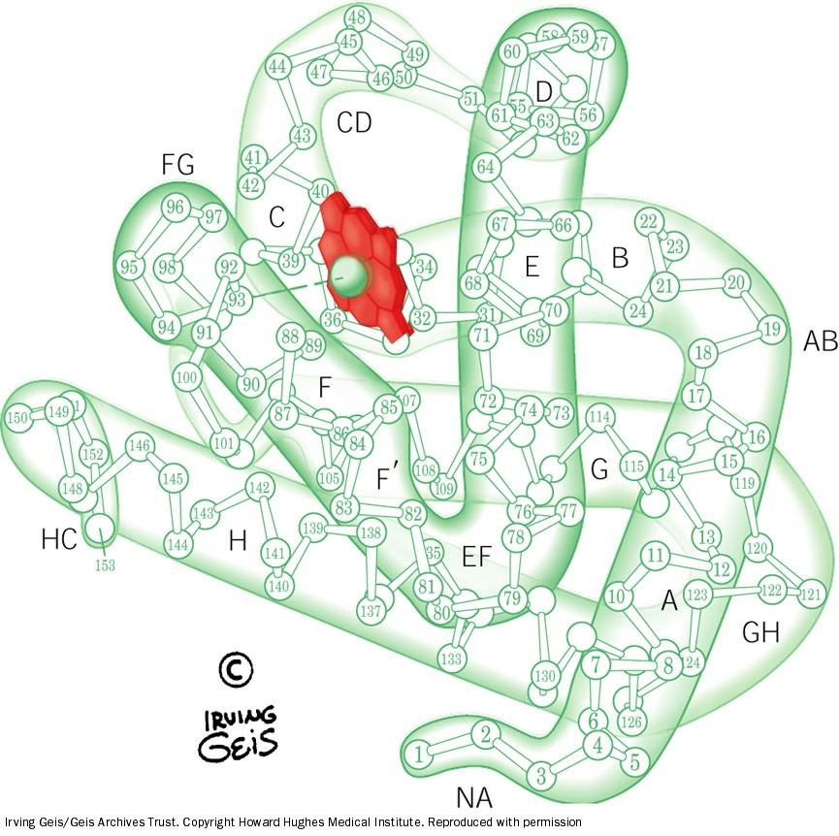
Structure of myoglobin

Slide 23
Myoglobin in disease
Myoglobinuria: Myoglobin is excreted in urine due to muscle damage (rhabdomyolysis)
May cause acute renal failure
Specific marker for muscle injury
Less specific marker for heart attack

Slide 24
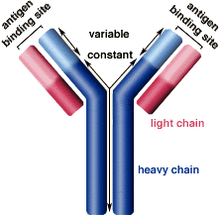
Immunoglobulins
Defensive proteins produced by the B-cells of the immune system
Y-shaped structure with 2 heavy and 2 light polypeptide chains
Neutralize bacteria and viruses
Types: IgA, IgD, IgE, IgG, IgM

Slide 25
Take Home Messages
Amino acid chains fold into shapes that resemble spheres are called globular proteins.
Fibrous proteins are mainly insoluble, while globular proteins are soluble structural proteins.
Hb, Myoglobin, globulines and enzymes are examples of globular proteins.
Functionally, Hb is for O₂ and CO₂ transport.
HbA, HbA2 and HbF are examples of normal Hb, in which the tetrameric structure is composed of 2α constant subunits with 2 changeable β subunits according to Hb type.

Slide 26
Take Home Messages
HbA1C is a HbA which undergoes non-enzymatic glycosylation, depending on plasma glucose levels.
Carboxy-Hb, Met-Hb and Sulf-Hb are examples of abnormal Hb, in which O₂ molecules are not transported due to abnormal Hb structure.
Disorders of Hb caused by synthesis of structurally abnormal Hb and/or insufficient quantities of normal Hb.
Sickle cell (HbS) and HbC diseases are caused by a single mutation in β-globin gene.

Slide 27
Take Home Messages
Glu6 in HbS is replaced by Val, while it is replaced by Lys in HbC.
Methemoglobinemia is caused by oxidation of Hb, inhibiting O₂ binding leading to chocolate cyanosis.
Thalassemia is caused by a defect in synthesis of either α- or β-globulin chain, as a result of gene mutation.
α-Thalassemia causes less sever anemia than β-Thalassemia.
Myoglobin is a globular hemeprotein, which stores and supplies O₂ to the heart and muscle only.

Slide 28
Take Home Messages
Hb is composed of 4 chains (subunits), while Myoglobin is composed of a single chain.
Myoglobinuria is a specific marker for muscle injury and may cause acute renal failure.
Immunoglobulins are defensive proteins produced by the B-cells.
Immunoglobulins consist of 5 types: IgA, IgD, IgE, IgG and IgM.

Slide 29
References
Illustrations in Biochemistry by Lippincott 6th edition.

