Slide 1
Tobacco Smoking
Dr Shatha Alduraywish, MBBS; MEpi; PhD; TTS
Assistant Professor, Epidemiologist
Department of Family and Community Medicine
King Saud University
Riyadh – Saudi Arabia
salduraywish@ksu.edu.sa

Slide 2
Objectives
Epidemiology of smoking in Saudi Arabia.
Risks of smoking (Morbidity and Mortality).
Effect of passive smoking on pregnancy, children …
How are you going to help the smoker to quit and how to overcome withdrawal symptoms.
Update in pharmacological management, smoking cessation medication.

Slide 3
Types of Tobacco Products
Smoking Tobacco
Smokeless Tobacco
Tobacco smoking is the act of burning dried leaves of the tobacco plant and inhaling the smoke
Smokeless tobacco is usually consumed orally or nasally, without burning

Slide 4
Smoking Tobacco

Slide 5
Smoking Tobacco

Slide 6
Smokeless Tobacco

Slide 7
Content of Cigarette
Tobacco smoke is made up of thousands of chemicals, including at least 70 known to cause cancer. These cancer-causing chemicals are referred to as carcinogens. Some of the chemicals found in tobacco smoke include:
Nicotine (the addictive drug that produces the effects in the brain that people are looking for)
Hydrogen cyanide
Formaldehyde
Lead
Arsenic
Ammonia
Radioactive elements, such as polonium-210
Benzene
Carbon monoxide
Tobacco-specific nitrosamines (TSNAs)
Polycyclic aromatic hydrocarbons (PAHs)

Slide 8
Electronic Cigarette
An electronic cigarette or electronic Nicotine delivery system (ENDS) is a battery-powered vaporizer which has a similar feel to tobacco smoking.
Electronic cigarettes do not contain tobacco, although they do use nicotine from tobacco plants. They do not produce cigarette smoke but rather an aerosol, which is frequently but inaccurately referred to as vapor.

Slide 9
Content of Cigarette Nicotine
Nicotine is the major chemical component responsible for addiction in tobacco products
Nicotine in tobacco smoke inhaled into the lung is rapidly absorbed because of the large surface area of the alveoli and small airways
Nicotine from oral tobacco products that have an alkaline pH is readily absorbed through the oral mucosa, but more gradually than via the lungs

Slide 10
Content of Cigarette Nicotine
Nicotine distributes extensively to body tissues, including the liver, kidney, spleen, lung, and brain and also accumulates in gastric juice and saliva, breast milk, skeletal muscle, and fetal serum and amniotic fluid
The time between a puff on a cigarette until nicotine reaches the brain is 10 – 20 seconds
Dependence on nicotine is characterized by both the persistence of a drug-taking behavior and the emergence of withdrawal symptoms upon the abrupt cessation of nicotine administration

Slide 11
Tobacco Use Disorder Epidemiology
The World Health Organization describes smoking as an Epidemic that causes nearly 6 million deaths per year and will lead to 8 million deaths annually by 2030 if current trends continue

Slide 12
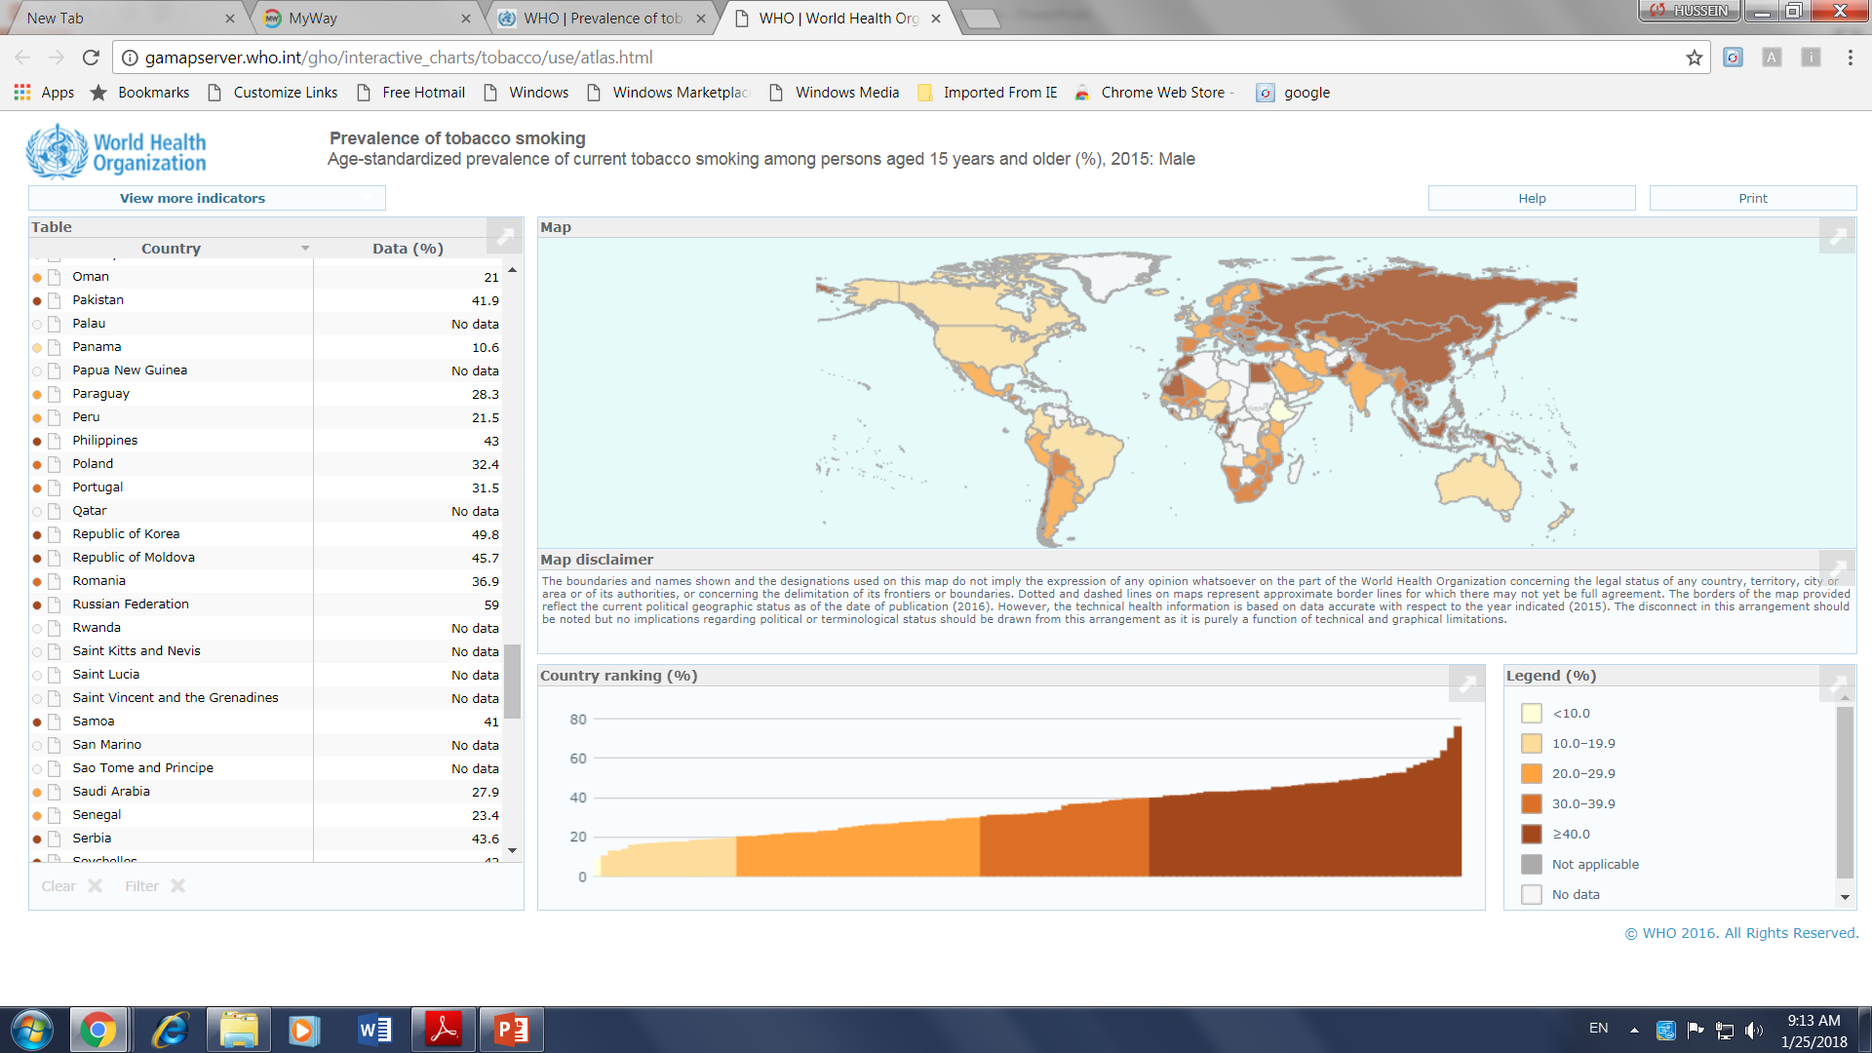
Prevalence of Tobacco smoking among persons aged 15 years and above % (Male) – 2015
WHO SA 27.9%

Slide 13
Smoking in the Kingdom of Saudi Arabia: Findings from the Saudi Health Interview Survey
Findings are representative of the Saudi population aged 15 years and older.
Overall, 12.1% of Saudis reported that they currently smoke tobacco.
This prevalence was 23.7% among males and 1.5% among females.
The prevalence of tobacco smoking varied by age;
Saudis aged 55 to 64 years had the highest prevalence of current smoking (15.6%) with 24.7% among males and 4.2% among females.

Slide 14
Risks of Smoking (Morbidity and Mortality)
Cigarette smoking causes more than 480,000 deaths each year in the United States.
This is about one in five deaths.
Smoking causes more deaths each year than all of these combined:
Human immunodeficiency virus (HIV)
Illegal drug use
Alcohol use
Motor vehicle injuries
Firearm-related incidents

Slide 15
Risks of Smoking (Morbidity and Mortality)
Smokers are more likely than nonsmokers to develop:
Heart disease, Stroke, and Lung cancer.
Smoking is estimated to increase the risk of:
Coronary heart disease by 2 to 4 times
Stroke by 2 to 4 times
Lung cancer by 25 times

Slide 16
Smoking and Cardiovascular System
Smoking causes stroke and coronary heart disease —the leading causes of death in the United States.
Smoking damages blood vessels.
Walls of Arteries are thicken and lumen grow narrower (Atherosclerosis)
The heart beat faster and blood pressure goes up.
Thrombosis can also form and lead to; IHD, Peripheral Vascular Disease and Stroke.
Even people who smoke fewer than five cigarettes a day can have early signs of cardiovascular disease.

Slide 17
Smoking and Respiratory System
Lung diseases caused by smoking include:
COPD, which includes emphysema and chronic bronchitis.
Smoking can cause lung disease by damaging the airways and the alveoli.
In presence of asthma, tobacco smoke can trigger an attack or make an attack worse.
Smokers are 12 to 13 times more likely to die from COPD than nonsmokers.
Cigarette smoking causes most cases of lung cancer.

Slide 18
Smoking and Cancer
Nicotinic receptors are found not only in the brain but throughout the body; for example, in muscle, lung, endothelia, kidney, and skin. These receptors trigger a number of cellular pathways involved in carcinogenesis.
There is evidence that nicotine may promote metastases because of stimulation of cell motility and migration, loss of adhesion
A variety of mechanisms are stimulated by nicotine to promote angiogenesis; for example, promoting endothelial cell migration, proliferation, survival, and tube formation

Slide 19
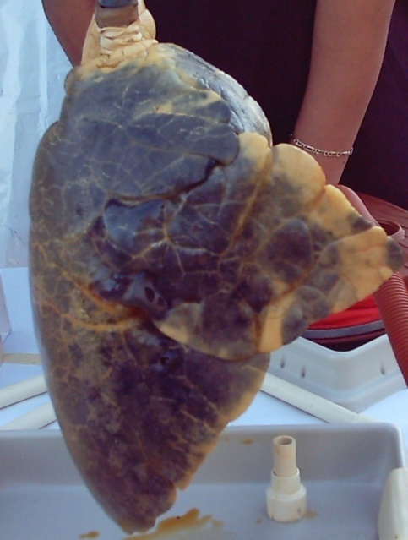
Smoking and Cancer
Smoking can cause cancer almost anywhere in your body:
Trachea, bronchus, and lung
Bladder
Esophagus
Larynx
Oropharynx (includes parts of the throat, tongue, soft palate, and the tonsils)
If nobody smoked, one of every three cancer deaths in the United States would not happen.

Slide 21
Active vs. Passive Smoking

Slide 22
Effect of Passive Smoking
What is passive smoking (Secondhand smoking)?
Secondhand smoke is smoke from burning tobacco products, like cigarettes, cigars, hookahs, or pipes.
Secondhand smoke also is smoke that has been exhaled, or breathed out, by the person smoking
Most people are exposed to secondhand smoke in their homes or the places they work.
People may also be exposed to secondhand smoke in public places like restaurants as well as in vehicles

Slide 23
Effect of Passive Smoking
What is passive smoking (Secondhand smoking)?
Exposure to secondhand smoke, even for a short time, can be harmful to both children and adults.
Since 1964, about 2,500,000 people who do not smoke have died from health problems caused by secondhand smoke exposure
Smoke-free laws for all workplaces and public areas protect people who do not smoke.

Slide 24
Effect of passive smoking on pregnancy and children

Slide 25
Effect of passive smoking on children
Kids are particularly at risk for the effects of secondhand smoke because their bodies are still growing and they breathe at a faster rate than adults.
Conditions have been linked to secondhand smoke exposure in children:
Sudden infant death syndrome (SIDS)
More respiratory infections (such as bronchitis and pneumonia)
More severe and frequent Asthma attacks
Ear infections
Chronic cough

Slide 26
Effect of passive smoking on children
38% of children aged 2 months to 5 years are exposed to SHS in the home.
Up to 2,000,000 ear infections each year
Nearly 530,000 doctor visits for asthma
Up to 436,000 episodes of bronchitis in children under five
Up to 190,000 cases of pneumonia in children under five
Notes:
More upper respiratory infections
More bronchitis and pneumonia
More ear infections and hearing problems
Higher rate of SIDS
More cases of asthma
More severe symptoms in children who already have asthma

Slide 27
Effect of passive smoking on pregnancy
Smoking during pregnancy can lead to:
Premature delivery,
Low birth weight,
Sudden Infant Death Syndrome (SIDS),
Limited mental ability, trouble with learning.
The more cigarettes a mother-to-be smokes, the greater the danger to her baby causing 5 % of infant deaths and 10 % of preterm births.

Slide 28
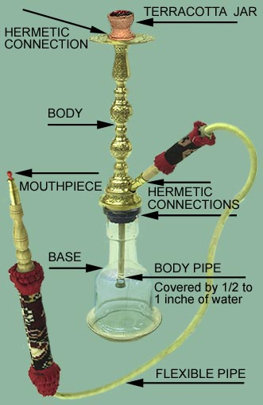
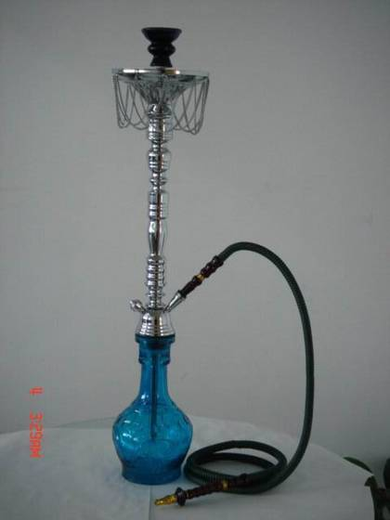
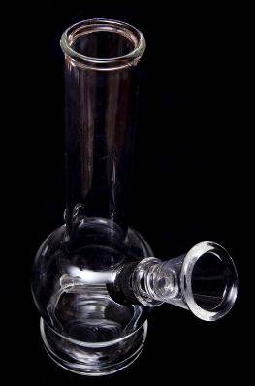
Water-Pipe: Sheesha
Not safer than regular tobacco smoke.
Causes the same diseases but more Polycythemia (RBCs and Hemoglobin).
Raises the risk of lip cancer, spreading infections like Tuberculosis.
Users ingest about 100 times more lead from hookah smoke than from a cigarette.

Slide 29
How are you going to help the smoker to Quit? How to overcome withdrawal symptoms?

Slide 30
Why Quit Smoking NOW?
No matter how old or how long a person’s smoked, quitting can help live longer and be healthier.
People who stop smoking before age 50 cut their risk of dying in the next 15 years in half compared with those who keep smoking.
Ex-smokers enjoy a higher quality of life – they have fewer illnesses.

Slide 31
Why Quit Smoking NOW?

Slide 32
Why is it so hard to quit smoking?
Nicotine
Found naturally in tobacco, which is as addictive as heroin or cocaine.
Over time, a person becomes physically dependent on and emotionally addicted to nicotine.
The physical dependence causes unpleasant withdrawal symptoms when you try to quit.
The mental dependence (addiction) make it hard to stay away from nicotine after quit.

Slide 33
Withdrawal symptoms can include any of the following: Peak: first to second week where the relapse rate is high
Dizziness (which may last 1 to 2 days after quitting)
Feelings of frustration, impatience, and anger
Depression, Anxiety, Tiredness and Irritability
Sleep disturbances
Trouble concentrating
Restlessness
Headaches
Increased appetite and Weight gain
Constipation and gas
Cough, dry mouth, sore throat, and nasal drip
Chest tightness

Slide 35
Tips to Overcome Withdrawal Symptoms
Avoid temptation. Stay away from people and places that tempt you to smoke.
Change your habits. Switch to juices instead of coffee. Take a brisk walk instead.
Choose other things for your mouth: such as sugarless gum or hard candy, raw vegetables such as carrot.
Get active with your hands: Do something to reduce your stress like Exercise or keeps your hands busy.

Slide 36
Tips to Overcome Withdrawal Symptoms
Breathe deeply: as you inhaled the smoke.
Delay: If you feel that you’re about to light up, hold off. Tell yourself you must wait at least 10 minutes.
Reward yourself. Put the money you would have spent on tobacco in a jar every day and then buy yourself a gift.

Slide 37
Pharmacotherapy for the Treatment of Smoking
Smokers who quit cold turkey (no pharmacotherapy) have a 5-15% (avg 7%) chance of long term success
In general, pharmacotherapy more than doubles the chances of success
Pharmacotherapy + counseling increases success

Slide 38
Pharmacotherapy for the Treatment of Smoking

Slide 39
Pharmacotherapy for the Treatment of Smoking
Nicotine Replacement Therapy
Gum
Patch
Inhaler
Lozenge
Spray

Slide 40
Pharmacotherapy for the Treatment of Smoking
Nicotine Replacement Therapy
Mechanism of Action
Provides ‘medicinal’ or ‘clean’ nicotine
Cigarettes use the best drug delivery system in our body (i.e., our lungs).
Reaches the brain/reward pathway within 8 seconds.
Reduces withdrawal symptoms and craving
May provide some positive effects of nicotine:
Desirable mood
Improved attention
Replaces oral/handling aspects of habit

Slide 41
Pharmacotherapy Varenicline
Varenicline (Champix)
Varenicline is a prescription medicine approved by FDA in 2006 to help adults in the treatment of tobacco dependency
Mechanism of Action
Varenicline acts as a partial agonist/antagonist on the nicotinic acetylcholine receptors :
Providing some nicotine effects to ease the withdrawal symptoms and
Blocking the effects of nicotine from cigarettes if they resume smoking

Slide 42
Tobacco dependence is “ a chronic disease with remission and relapse”
There are several Biological, social and psychological factors that contribute to initiation and maintenance of smoking
Tobacco products have several health sequences on the body
FDA has approved 7 first line medications to use for smoking cessation
Counselling and pharmacotherapy has additive effects

