Slide 1
Bacterial Upper Respiratory Tract Infections (URTI)
Dr. Khalifa Binkhamis

Slide 2
Objectives
Discuss the epidemiology and various clinical presentations of URTIs
Identify the most important etiological agents causing different URTIs, and discuss their virulence factors, laboratory diagnosis and potential preventative strategies
Determine the antibiotic of choice for the different URTIs
Discuss complications of GAS and C. diphtheriae infections

Slide 3
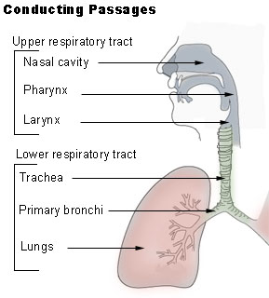
Outline
Pharyngitis
GAS
Diphtheria
Epiglottitis
Whooping cough
Otitis Media
Sinusitis
Deep neck space
infections

Slide 4
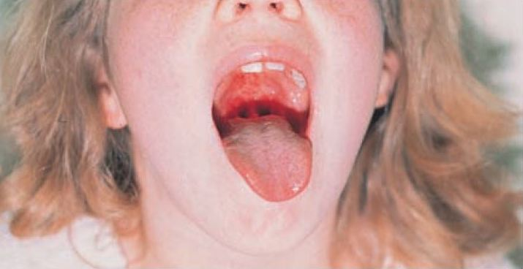
Pharyngitis
Epidemiology
Late fall, winter, early spring
5 to 15 years
Etiology
Viruses (i.e. respiratory viruses) are the most common cause
Streptococcus pyogenes is the most important bacterial cause

Slide 5
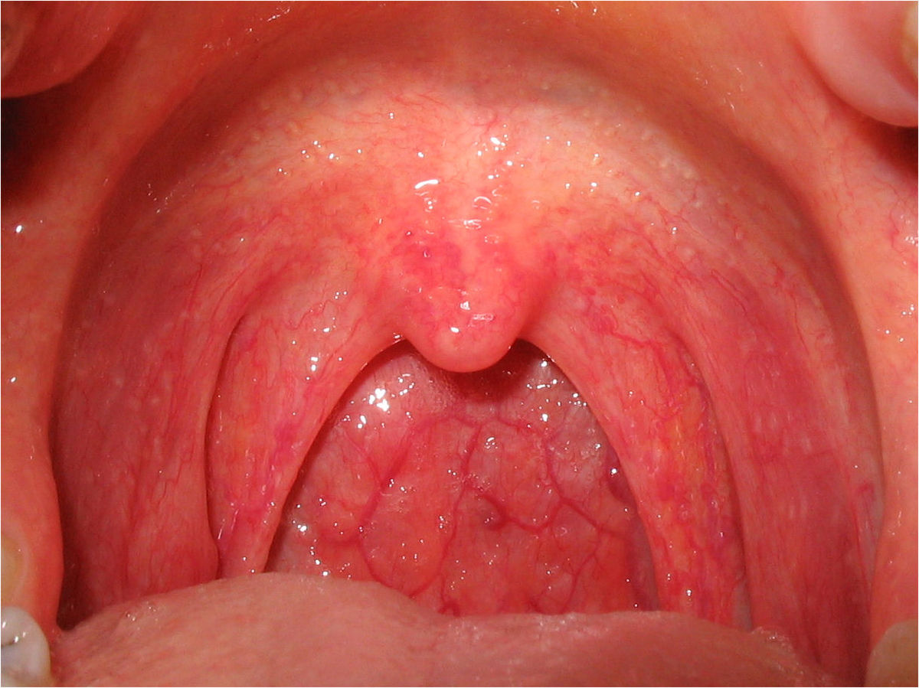
Pharyngitis
Bacterial causes include:
Group A streptococcus *
Corynebacterium diphtheriae
Fusobacterium necrophorum (Anaerobic bacteria, cause of Lemierre's syndrome)
Neisseria gonorrhoeae

Slide 6
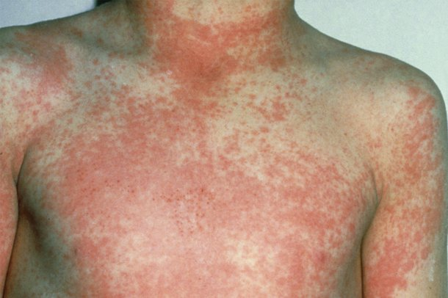
Pharyngitis
Signs and symptoms:
Sore Throat
Pharyngeal erythema, edema
Fever
More consistent with viral:
Coryza
Cough
Conjunctivitis
More consistent with bacterial (GAS):
Tonsillar exudates
Tender, enlarged >1 cm lymph nodes
Fever 38.4 to 39.4º C
Notes:
GAS pharyngitis may present with a scarlatiniform rash, described as sandpaper-like

Slide 7
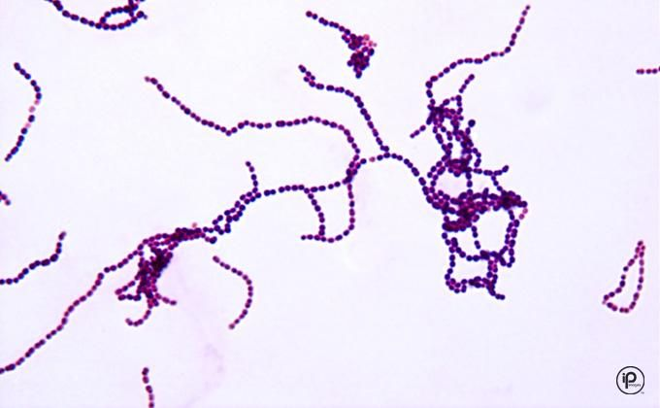
GAS
Gram positive cocci in chains
Facultative anaerobe
Beta haemolytic
Catalase negative
Causes:
Respiratory infections
Pharyngitis
Otitis
Sinusitis
Other infections
Skin and soft tissue
Virulence factors
Capsule
M protein in cell wall
Streptolysin O & S
Streptococcal pyrogenic exotoxins (SPE)
Notes:
-Capsule: anti-phagocytosis & specific attachment to specific tissues
-M protein in cell wall: anti-phagocytosis & specific attachment to specific tissues
-Streptolysin O and S (haemolysins): toxic to a variety of different cell types
-Streptococcal pyrogenic exotoxins (SPE): “superantigens” directly stimulate T-cells (~1000X more than a normal immune response) and cause them release high levels of the cytokines that are responsible for fever and shock
-SPE is also responsible for various tissue destruction, including skin lesions, and perhaps scarlet fever

Slide 8
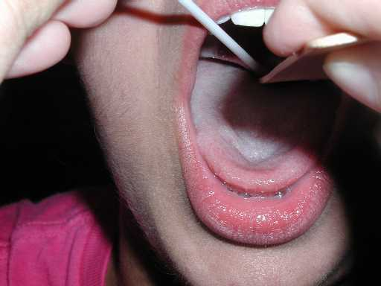
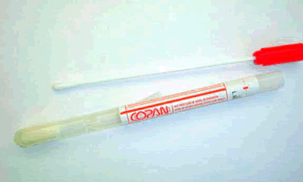
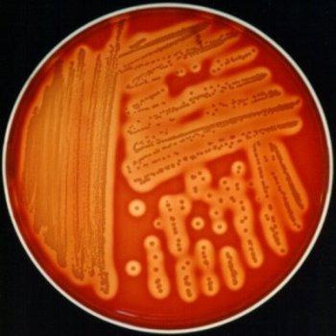
GAS Pharyngitis
Diagnosis:
Throat swab
Rapid Bacterial antigen detection
Culture on blood agar
Antistreptolysin O
Treatment:
Penicillin x 10 days
Allergy?
Clindamycin or macrolide (e.g. Clarithromycin)
Notes:
We will discuss the antigen detection method more during the practical
Antibodies against Streptolysin O is a useful serological test to assess for prior group A strep infection
GAS predictably susceptible to penicillin

Slide 9
GAS Pharyngitis Complications
Suppurative
E.g. Peritonsillar abscess, parapharyngeal space abscess
Non suppurative
Occurs 1-6 weeks after acute S. pyogenes infection
Rheumatic fever
Glomerulonephritis
Notes:
Suppurative: pus forming

Slide 10
GAS Pharyngitis Complications
Rheumatic fever:
After infection of the respiratory tract.
Inflammation of heart (pancarditis), joints, blood vessels, and subcutaneous tissue.
Results from cross reactivity of anti-M protein Ab and the human heart tissue.
Acute glomerulonephritis:
After infection of the skin or the respiratory tract.
Symptoms: edema, hypertension, hematuria, and proteinuria.
Initiated by Ag-Ab complexes on the glomerular basement membrane.
Notes:
Poststreptococcal diseases (occurs 1-4 weeks after acute S. pyogenes infection, hypersensitivity responses)
Rheumatic fever: most commonly preceded by infection of the respiratory tract. Inflammation of heart (pancarditis), joints, blood vessels, and subcutaneous tissue. Results from cross reactivity of anti-M protein Ab and the human heart tissue. This disease can be reactivated by recurrent streptococcal infections, whereas nephritis does not. Penicillin used as prophylaxis for years after
Acute glomerulonephritis: preceded by infection of the skin (more commonly) or the respiratory tract. Symptoms: edema, hypertension, hematuria, and proteinuria. Initiated by Ag-Ab complexes on the glomerular basement membrane.

Slide 11
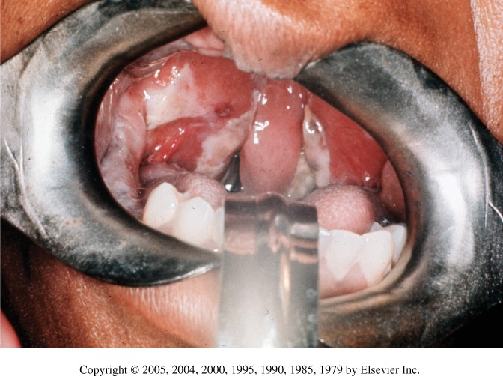
Corynebacterium diphtheriae
Rare in developed countries
Why? How is it prevented?
Mainly presents as URTI
Formation of membranes in the throat is characteristic
Virulence
Diptheria toxin
Notes:
-Can also present as cutaneous lesions
-Membranes only appear in 1/3 of cases
-Diptheria toxin is an exotoxin that inhibits protein synthesis

Slide 12
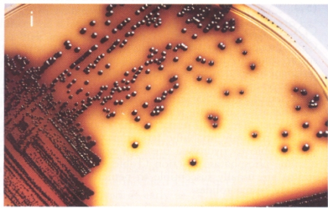
Corynebacterium diphtheriae
Diagnosis:
Throat swab
Culture on special media containing tellurite (e.g. Tinsdale media)
ELEK’s Test for confirmation of toxin production
Treatment:
Antitoxin + antibiotic
Penicillin or erythromycin
Notes:
Can obtain throat swab for culture
Complications can lead to death

Slide 13
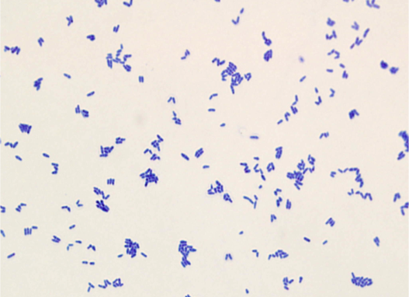
Corynebacterium diphtheriae
Prevention:
Vaccination with diphtheria toxoid containing vaccine
Complications:
Myocarditis
Neuritis
Notes:
Diptheria toxoid containing vaccine is part of routine childhood immunization

Slide 14
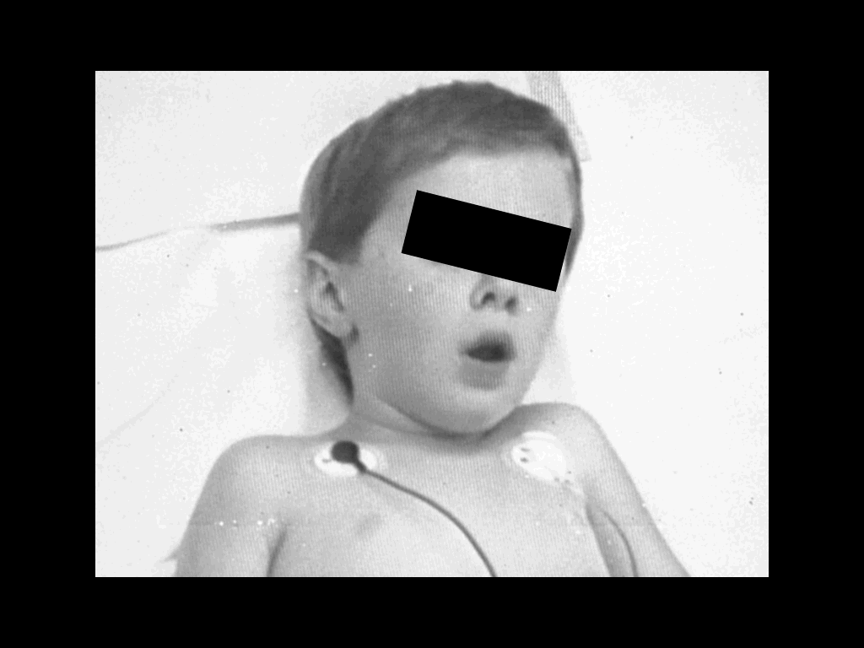
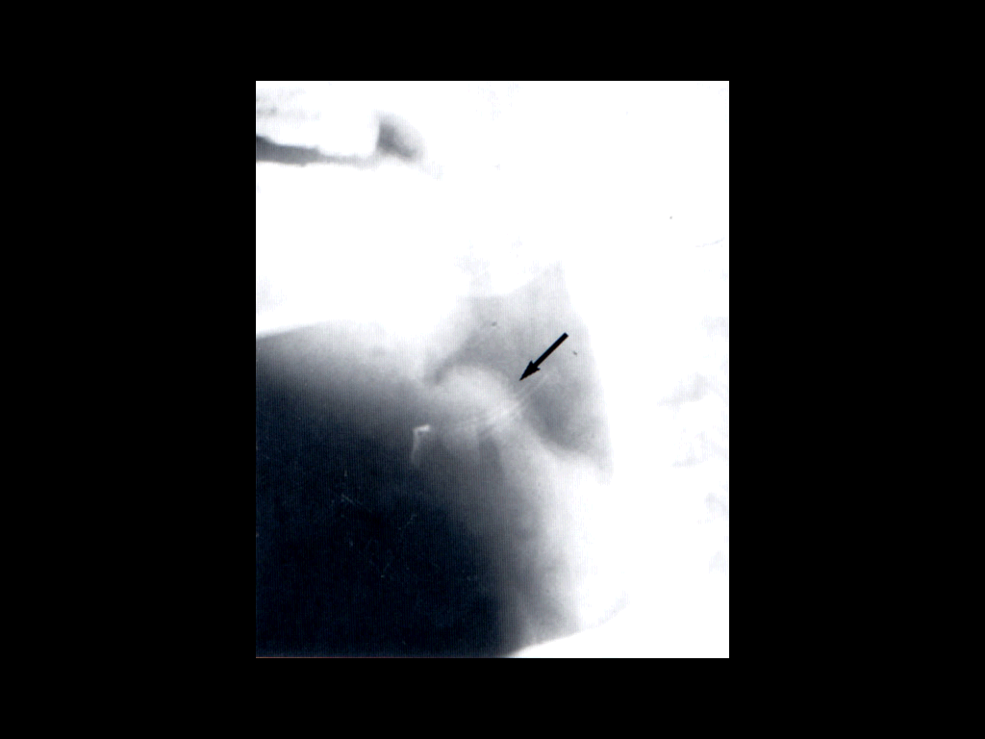
Epiglottitis
Usually young unimmunized children presented with dysphagia, drooling, and respiratory distress
Etiology
H. influenzae Type b
S. pneumonae
S. aureus
Beta hemolytic streptococci

Slide 15
Epiglottitis
Diagnosis:
Blood cultures
Culture of epigoltic surface (under controlled setting)
Management:
Maintenance of airway
Empiric treatment:
Ceftriaxone + Vancomycin
Prevention: HiB vaccination
Notes:
HiB vaccine (Haemophilus Influenzae Type B Vaccine) is part of routine childhood immunization

Slide 16
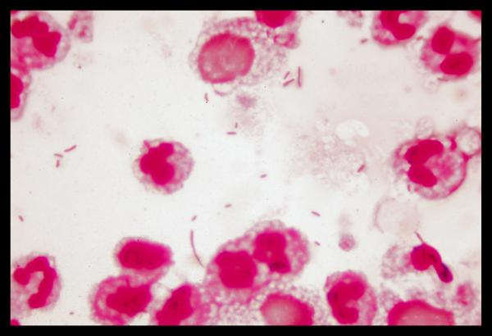
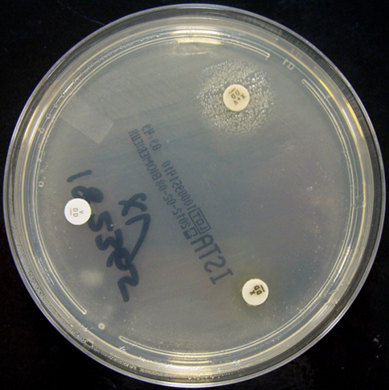
H. influenzae
Gram­ negative pleomorphic, coccoid to rod-shaped cells (coccobacilli)
Oxidase and catalase positive
Requires X (heme) and V (NAD) factors for growth
Used to confirm ID

Slide 17
H. influenzae
Divided into:
Encapsulated (typable) strains (main virulence factor)
A-F
Most important is type b
Prevention through vaccination
Causes invasive disease (e.g. epiglottis, meningitis)
Non­encapsulated (nontypable) strains
Causes local infections (e.g. sinusitis, otitis, pneumonia in elderly)
Treatment:
Amoxicillin-clavulanate, 2nd or 3rd generation cephalosporin
Notes:
Capsule: antiphagocytic
Can be resistant to ampicillin mainly though the production of a beta lactamase enzyme (enzyme that breaks down the antibiotic)

Slide 18
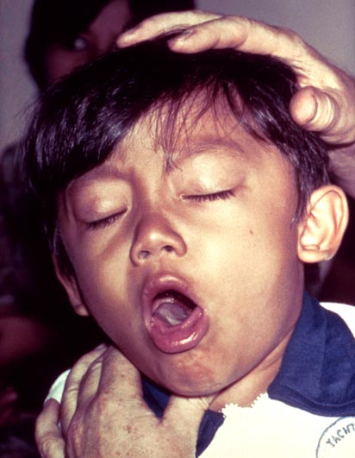
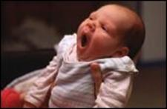
Pertussis (whooping cough)
Bordetella pertussis (GNB)
Virulence
Pertussis toxin *
Filamentous hemagglutinin
Pertactin
Incubation period 1 to 3 wks
Catarrhal Stage 1-2 weeks
Paroxysmal Stage 2-4 weeks
Convalescent Stage 1-2 weeks
Notes:
Pertussis toxin is the main virulence factor
FHA and PRN are important for adhesion and attachment

Slide 19
Pertussis (whooping cough)
Diagnosis:
Sample:
Nasopharyngeal (NP) swabs
Special media needed
Charcoal blood (Regan-Lowe)
Bordet-Gengou
Treatment:
Macrolide (erythromycin)
Prevention by vaccination
Acellular pertussis-containing vaccine
Notes:
Can also do molecular tests (PCR) on NP swab sample to diagnose pertussis
Acellular pertussis-containing vaccine is part of routine childhood immunization

Slide 20
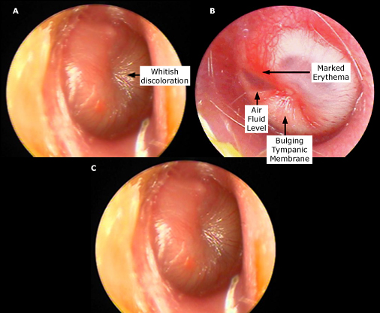
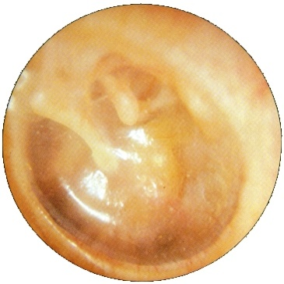
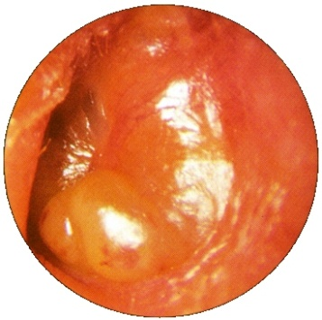
Acute Otitis Media
Fluid + inflammation of the mucosal lining of the middle ear
More common in children
Etiology:
S. pneumoniae
H. influenzae (non typable)
S. aureus
Moraxella catarrhalis
GAS
Viral (alone or with bacteria)
Notes:
Ear pain, bulging and erythema of tympanic membrane
GAS: group A Streptococcus

Slide 21
Acute Otitis Media
Diagnosis:
Mainly clinical diagnosis
Tympanocentesis sometimes needed
Middle ear fluid can be sent for culture
Treatment
Amoxicillin or Amoxicillin Clavulanic acid
Notes:
Tympanocentesis (aspiration of middle ear fluid): not done on all patients with otitis. Indications include critically ill patient, patient who has not responded to initial antimicrobial therapy and is toxic

Slide 22
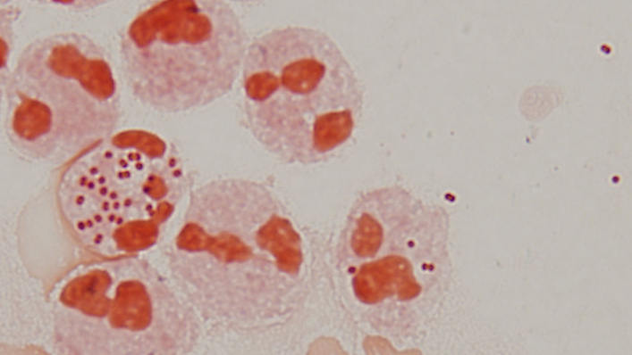
Moraxella catarrhalis
Gram negative diplococci
Catalase and oxidase positive
Causes:
Otitis
Sinusitis
Pneumonia
Treamtent:
Amox-Clav

Slide 23
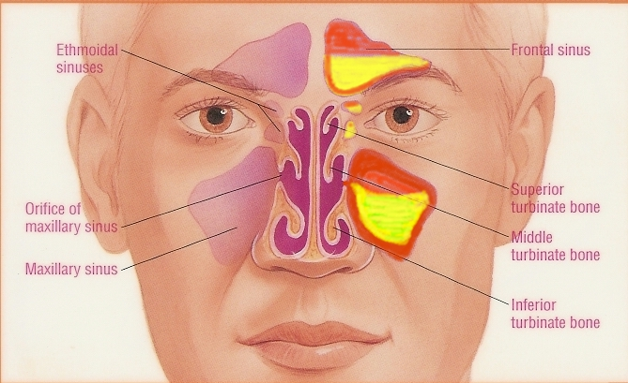
Acute Bacterial Sinusitis
More common in children
Occurs with viral URTI
Etiology:
S. pneumoniae,
H. infuenzae (non typable)
M. catarrhalis
Anaerobes
Viral
Notes:
Sinusitis: inflammation of the paranasal sinuses

Slide 24
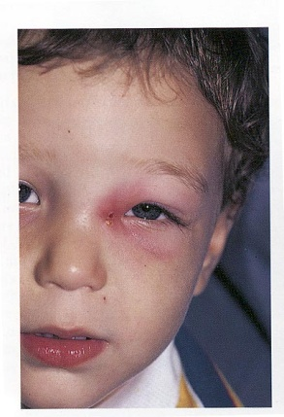
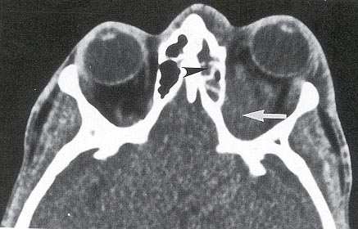
Acute Bacterial Sinusitis
Diagnosis:
Mainly clinical diagnosis
Imaging (CT/MRI) when there is suspension of complications
Treatment
Amoxicillin Clavulanic acid For 1-2 weeks
Notes:
Treatment When ongoing symptoms and fever
Potential complications: orbital infections (peri orbital or orbital cellulitis), CNS infections (meningitis, brain abscess)

Slide 25
Deep neck space infections
Lateral pharyngeal, retropharyngeal or prevertebral space
Patients are very sick and toxic
Neck stiffness can occur with retropharyngeal space infection/abscess
Retropharyngeal (danger space) infection may extend to mediastinum and present as mediastinitis

Slide 26
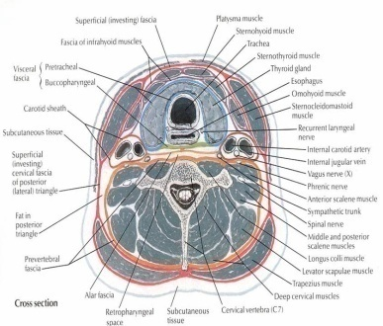
Deep neck space infections treatment
Usually polymicrobial
Mainly streptococci and oral anaerobes
Management
Surgery
Antibiotics
Meropenem
Piperacillin
Clindamycin
Duration
2-3 weeks

Slide 27
References
Ryan, Kenneth J.. Sherris Medical Microbiology, Seventh Edition. McGraw-Hill Education.
Ear and sinus infections, part of the chapter on Infectious Diseases: Syndromes and Etiologies
Upper respiratory tract infections, part of the chapter on Infectious Diseases: Syndromes and Etiologies
Streptococci, chapter 25
Corynebacterium, chapter 26
Haemophilus & Bordetella, chapter 31

