Slide 1
Respiratory Block PNEUMONIA
Dr. Wajd Althakfi, MD
Assistant Professor
KSU-KKUH
.

Slide 2
Objectives
Understand that pneumonia is an inflammatory condition of the lung characterized by consolidation (solidification) of the pulmonary tissue
To be aware of the pathogenesis of pneumonia and its classification which principally include bronchopneumonia, lobar pneumonia and atypical pneumonia
Can appreciate the etiology and pathogenesis of lung abscess

Slide 3
PULMONARY INFECTIONS
Pulmonary infections in the form of pneumonia are responsible for one sixth of all deaths in the United States
Pneumonia defined as any infection in the lung
Normally, the lung parenchyma remains sterile because of a number of highly effective immune and non- immune defense mechanisms that extend throughout the respiratory system from the nasopharynx to the alveolar air spaces
The vulnerability of the lung to infection despite these defenses is not surprising because
many microbes are airborne and readily inhaled into the lungs
nasopharyngeal flora are regularly aspirated during sleep, even by healthy individuals
lung diseases often lower local immune defenses
The vast majority are upper respiratory tract infections caused by viruses, but bacterial and fungal infections can also occur
Pneumonias are classified by the specific etiologic agent, which determines the treatment, or, if no pathogen can be isolated, by the clinical setting in which the infection occurs

Slide 4
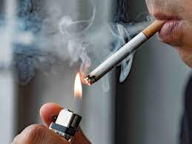
Who’s at risk ?
Loss or suppression of the cough reflex, as a result of coma, anesthesia, neuromuscular disorders, drugs, or chest pain (may lead to aspiration of gastric contents)
Injury to the mucociliary apparatus, by either impairment of ciliary function or destruction of ciliated epithelium, due to cigarette smoke, inhalation of hot or corrosive gases, viral diseases, or genetic defects of ciliary function (e.g., the immotile cilia syndrome)
Accumulation of secretions in conditions such as cystic fibrosis and bronchial obstruction
Interference with the phagocytic or bactericidal action of alveolar macrophages by alcohol, tobacco smoke, anoxia, or oxygen intoxication
Pulmonary congestion and edema

Slide 5
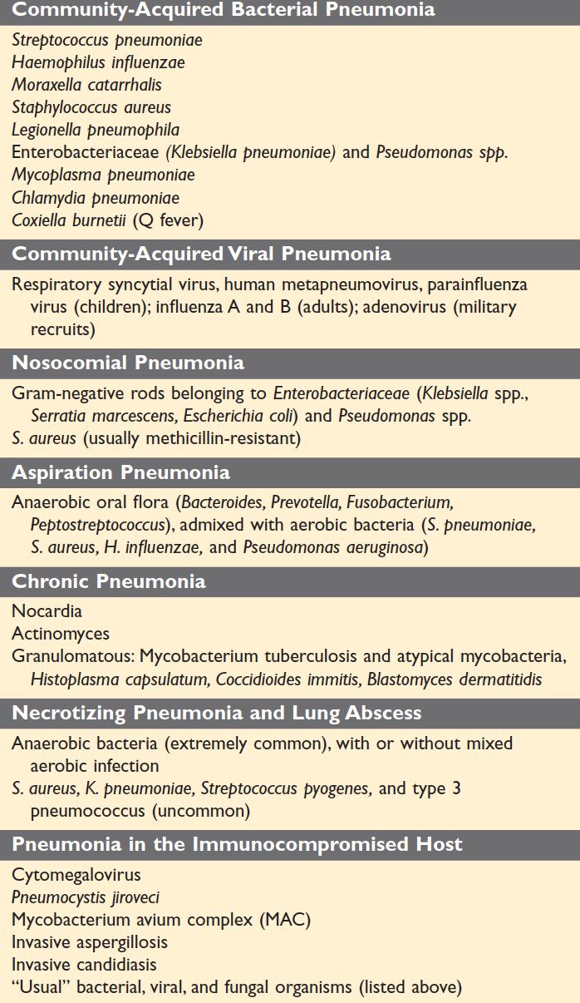
Pathogenesis & classification
Portal of entry for most pneumonias is
Inhalation of air droplets
Aspiration of infected secretions or objects
Hematogenous spread from one organ to other organs can occur
Classification of pneumonia can be made according to causative agent

Slide 6
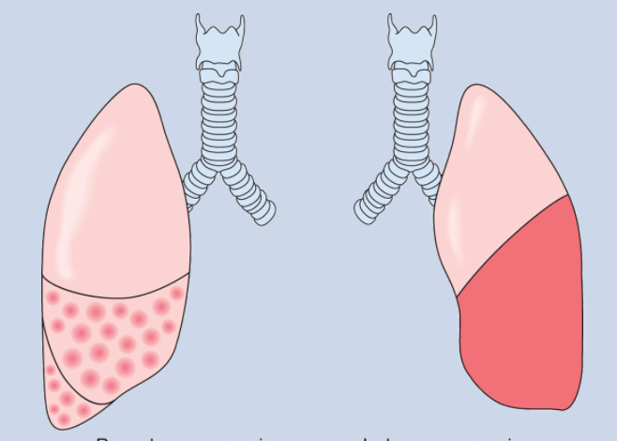
Anatomic classification of pneumonia
Classification of pneumonia also can be made according gross anatomic distribution of the disease:
1. Alveolar
Bronchopneumonia: (Streptococcus pneumoniae, Haemophilus influenza, Staphylococcus aureus) Represent an extension from preexisting bronchitis or bronchiolitis. Extremely common tends to occur in two extremes of life
Lobar pneumonia: (Streptococcus pneumoniae) Acute bacterial infection of a large portion of a lobe or entire lobe. Classic lobar pneumonia is now infrequent
Note: Overlap of the two patterns often occur
2. Interstitial:
Influenza virus (children), Mycoplasma pneumoniae

Slide 7
Community-Acquired Acute Pneumonia

Slide 8
Usually, Bacterial
Can follow URT infection
It can be lobar or bronchopneumonia
Clinical features: Sudden onset of high fever, chills, pleuritic chest pain and productive cough, may be with hemoptysis
Reduced air entry and dullness by percussion
Cause:
The most common cause of Community-Acquired Acute Pneumonia is Streptococcus pneumoniae
Other common causes: Haemophilus influenzae, Moraxella catarrhalis, Staphylococcus aureus, Legionella pneumophila, Klebsiella pneumoniae and Pseudomonas aeruginosa spp.
In intravenous drug abuser: Staphylococcus aureus
It is more common in:
Underlying chronic disease e.g., DM, COPD, and congestive heart failure
Congenital or acquired immune deficiency
Decreased or absent splenic function

Slide 9
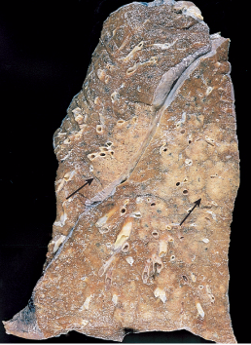
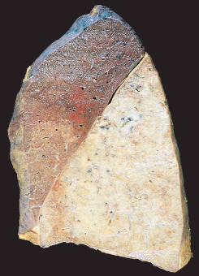
Bronchopneumonia
Most common agents are:
Streptococcus pneumoniae,
Haemophilus Influenza, in COPD
Pseudomonas Aeroginosa in CF
Coliform bacteria
Staphylococci
Lobar pneumonia
90-95% are caused by pneumococci(Streptococcus pneumoniae)
Rare agents: K. pneumoniae, staphylococci, streptococci, H. influenzae, Pseudomonas and Proteus

Slide 10
Bronchopneumonia
Are focal/patchy areas of consolidation with acute suppurative inflammation in one or more lobes
Usually it involves lower lobes (basal) and bilaterally because there is a tendency of the secretions to gravitate into the lower lobes
Well developed lesions are 3 to 4 cm
Grey red ill defined nodules

Slide 11
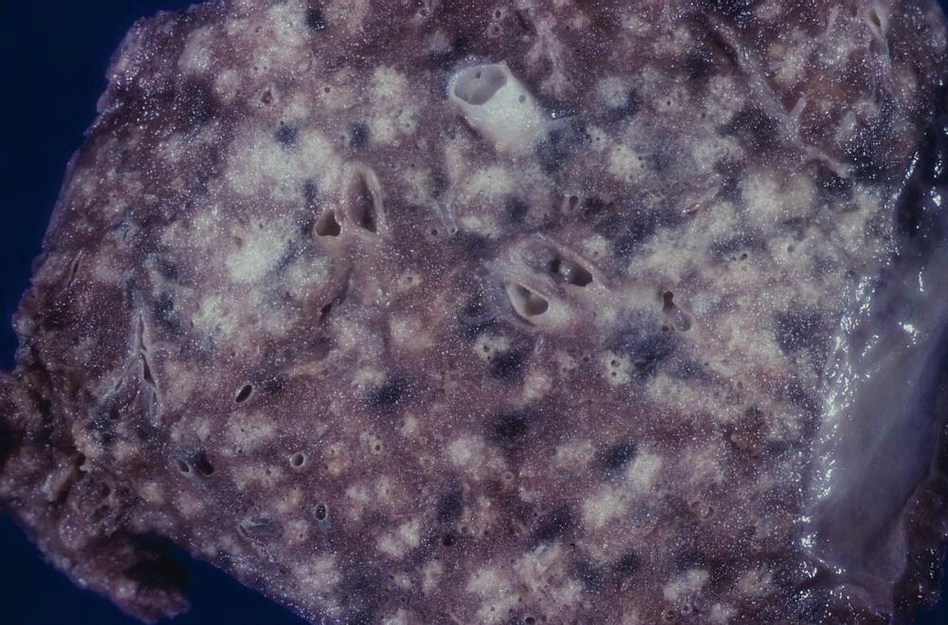
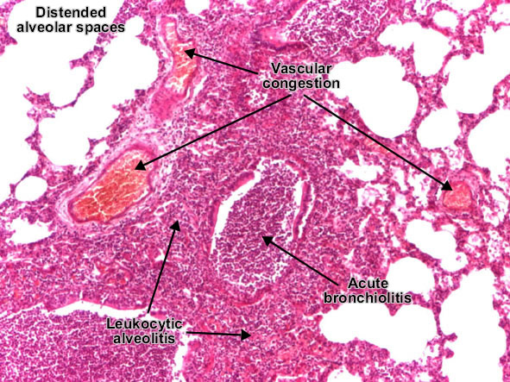
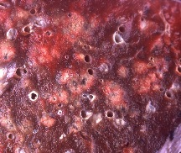
Bronchopneumonia
Grossly: patchy consolidation of the lung, slightly elevated, dry, granular, gray-red to yellow, and poorly delimited at their margins
Micro: suppurative, neutrophil-rich exudate that fills the bronchi, bronchioles, and adjacent alveolar spaces

Slide 12
Lobar pneumonia
It is widespread involvement of a large area and even an entire lobe of lung (widespread fibrinosuppurative consolidation)
There are 4 stages:
Stage I: Congestion: lung is heavy, boggy and red. The intra-alveolar space is filled with fluid, few scattered neutrophils and numerous bacteria
Stage II: Red hepatization (solidification): alveolar spaces are filled with neutrophils, red cells (congestion) and fibrin. Grossly the lung is firm/solid red and liver-like
Stage III: Gray hepatization: here the red cells are reduced but neutrophils and fibrin(fibrinopurulent/suppurative exudate) are still present. Grossly the lung is still firm/solid and liver-like but grey
Stage IV: Resolution: exudates within the alveoli are being enzymatically digested, resorbed, ingested by macrophages or coughed up

Slide 13
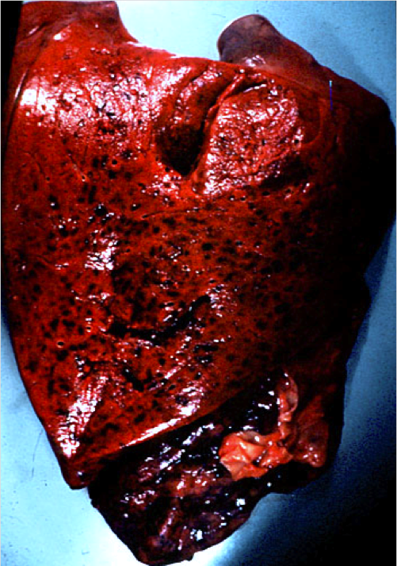
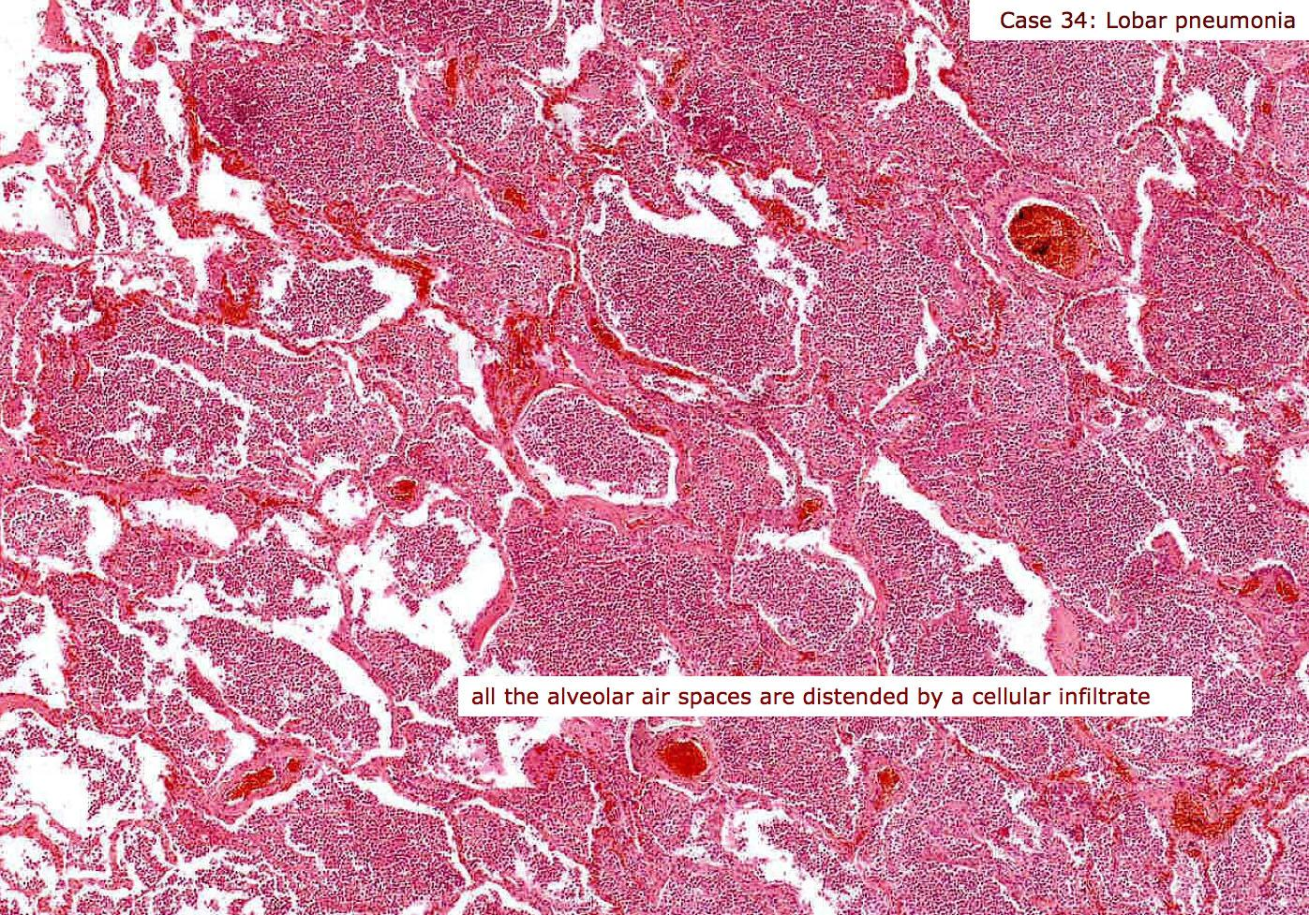
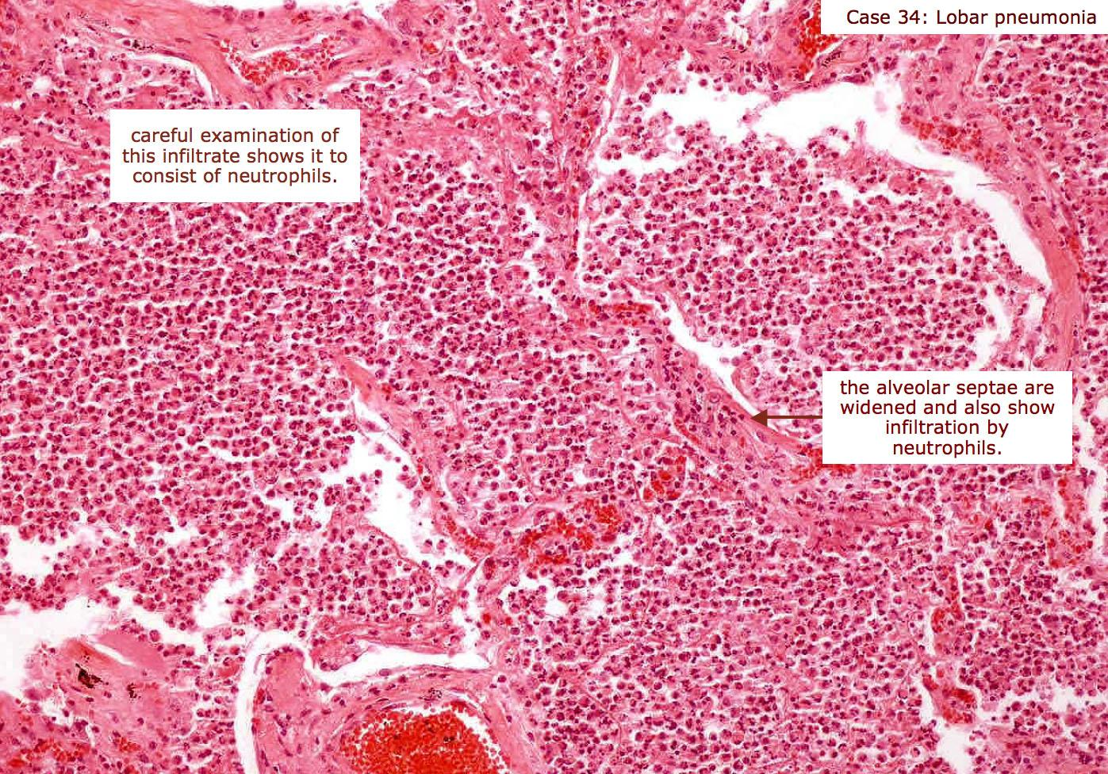
Red hepatization Alveoli are filled with fibrin, RBC’s and neutrophils

Slide 14
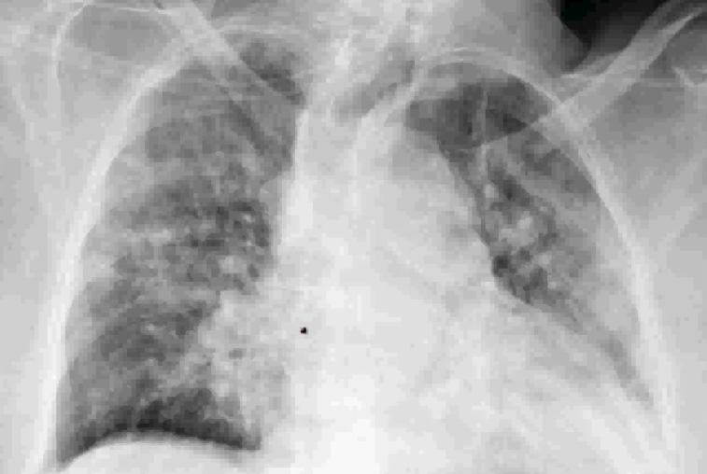
Clinical features
Abrupt onset of high fever, chills, cough and productive mucopurulent sputum
Some patients may have hemoptysis
When fibrinosuppurative pleuritis is present, it is accompanied by pleuritic pain and pleural friction rub
Radiology:
In lobar pneumonia there is a radio opaque (consolidation) well circumscribed lobe
In bronchopneumonia there are multiple small opacities usually basal and bilateral
Multiple small opacities (consolidation)

Slide 15
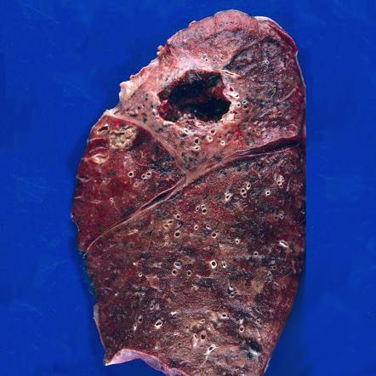
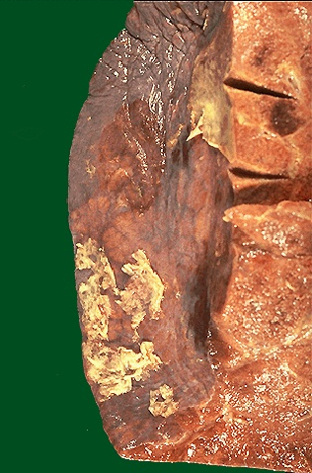
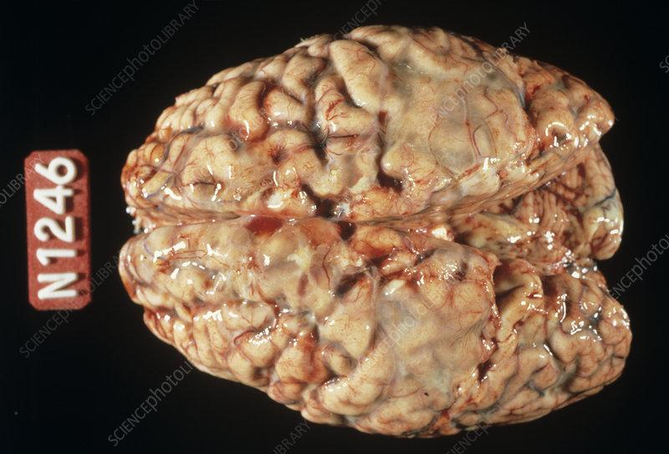
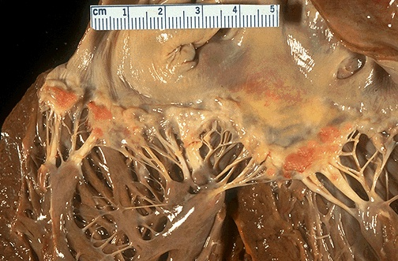
Complications
Tissue destruction and necrosis, causing abscess formation (particularly common with pneumococci or Klebsiella infections
Spread of infection to the pleural cavity, causing the intrapleural fibrinosuppurative reaction known as empyema
Bacteremic dissemination to the heart valves, pericardium, brain, kidneys, spleen, or joints, causing metastatic abscesses, endocarditis, meningitis, or suppurative arthritis

Slide 16
COMMUNITY-ACQUIRED ATYPICAL (VIRAL AND MYCOPLASMAL) PNEUMONIAS

Slide 17
Characterized by patchy inflammation in the lungs confined to the alveolar septae and pulmonary interstitium and therefore it is called interstitial pneumonitis
The term atypical denotes the moderate amount of sputum, no physical findings of consolidation, only moderate elevation of white cell count, and lack of alveolar exudate
It is caused by many organisms but the most common is Mycoplasma pneumonia (common in children and young adults)
Others include:
Viruses e.g., respiratory syncytial virus, influenza virus (children), influenza A and B (adults); adenovirus and SARS virus
Chlamydia spp. (C. pneumonia etc.) and Coxiella burnetti (Q fever). Chlamydia is transmitted by inhalation of dried excreta of infected birds and causes ornithosis/psittacosis
Predisposing factors: malnutrition, alcoholism and any underlying debilitating disease

Slide 18
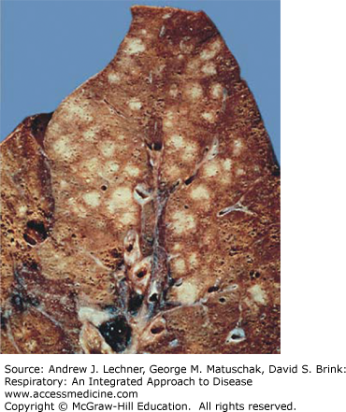
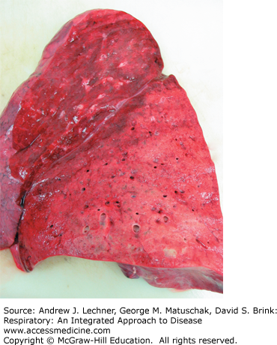
Gross:
All causal agents produce essentially similar morphologic patterns
The lung involvement may be quite patchy or may involve whole lobes bilaterally or unilaterally
The affected areas are red-blue and congested. The pleura is smooth, and pleuritis or pleural effusions are infrequent

Slide 19
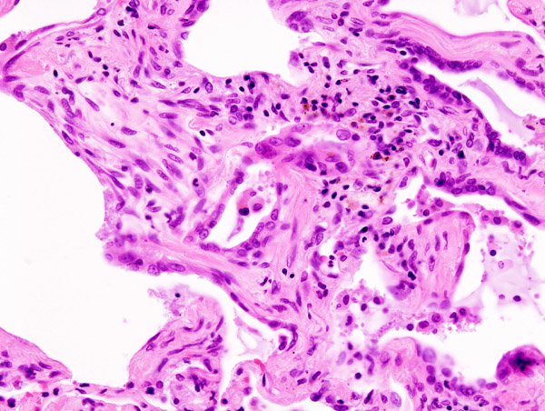
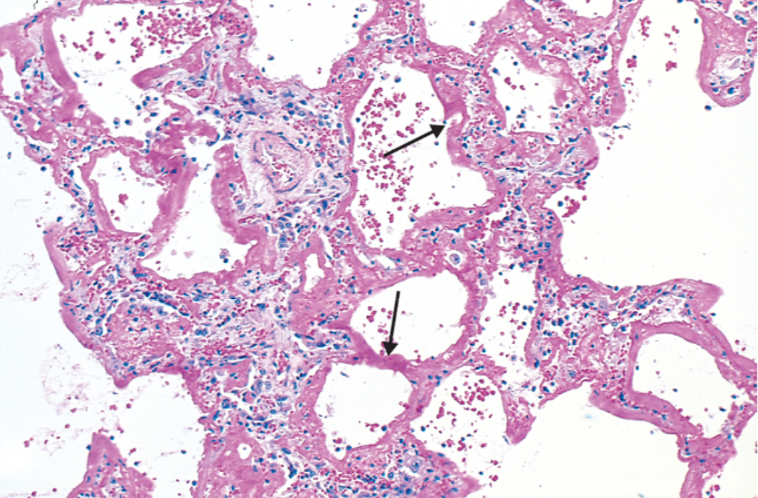
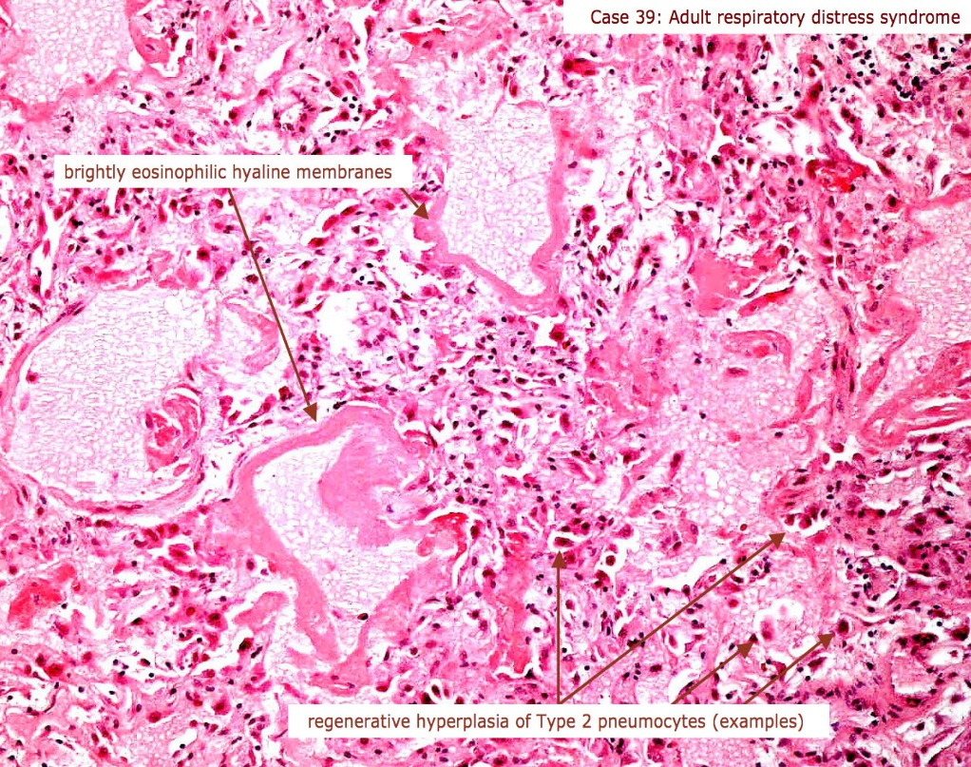
Micro:
Predominantly there is inflammation in the interstitium/alveolar wall
Alveolar septa are widened and edematous with mononuclear inflammatory infiltrate (and neutrophils in acute cases only)
Sever cases: Intra-alveolar proteinaceous material with pink hyaline membrane lining the alveolar walls (diffuse alveolar damage)

Slide 20
Clinical course
The clinical course is extremely varied
Many cases masquerade as severe upper respiratory tract infections or as chest colds
Cough may be absent, and the major manifestations may consist only of fever, headache, muscle aches, and pains in the legs
The ordinary sporadic form of the disease is usually mild with a low mortality rate, below 1%. Interstitial pneumonia (good prognosis)
Secondary bacterial infection by staphylococci or streptococci is common in such circumstances

Slide 21
HOSPITAL-ACQUIRED PNEUMONIA

Slide 22
acquire terminal pneumonias while hospitalized (nosocomial infection)
Predisposing factor: sever underlying conditions e.g., immunosuppression, prolonged antibiotic therapy, intravascular catheter and pt. with mechanical ventilator
Cause: Gram-negative organisms like Klebsiella, Pseudomonas aeruginosa and E. coli have been implicated

Slide 23
Aspiration pneumonia

Slide 24
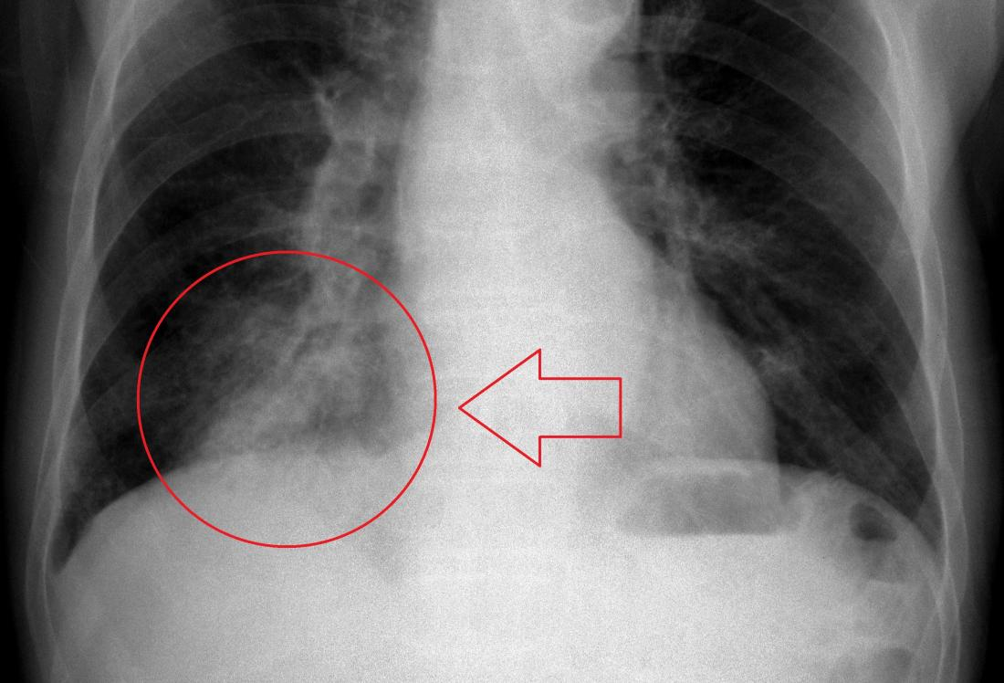
Occurs in markedly debilitated patients or those who aspirate gastric contents either while unconscious (e.g., after a stroke) or during repeated vomiting
These patients have abnormal gag and swallowing reflexes that predispose to aspiration
The resultant pneumonia is partly chemical because of the extremely irritating effects of the gastric acid, and partly bacterial from the oral flora
Typically, more than one organism is recovered on culture, aerobes being more common than anaerobes
This type of pneumonia is often necrotizing, pursues a fulminant clinical course, and is a frequent cause of death. In those who survive, lung abscess is a common complication

Slide 25
Chronic pneumonia

Slide 26
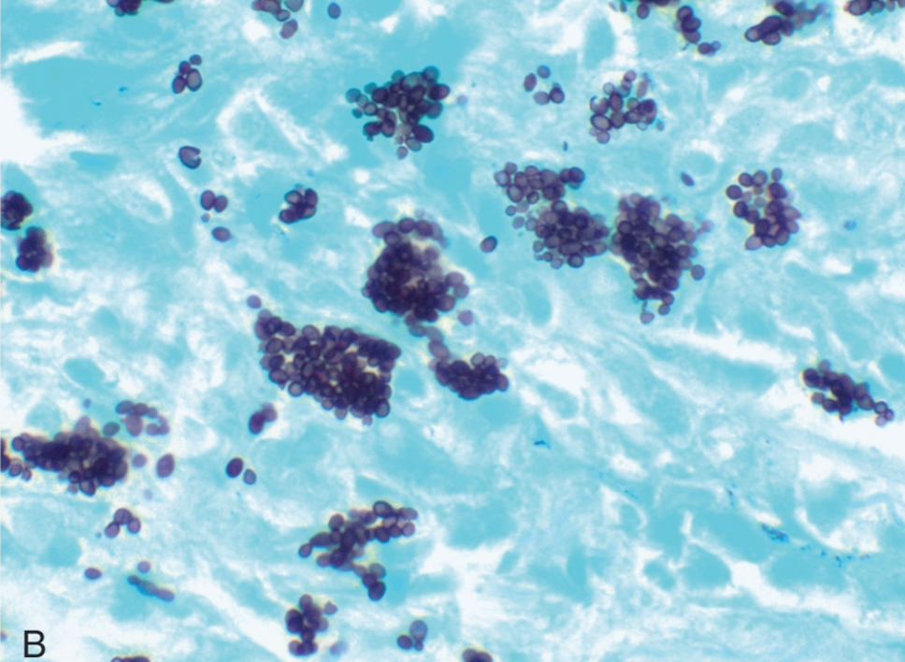
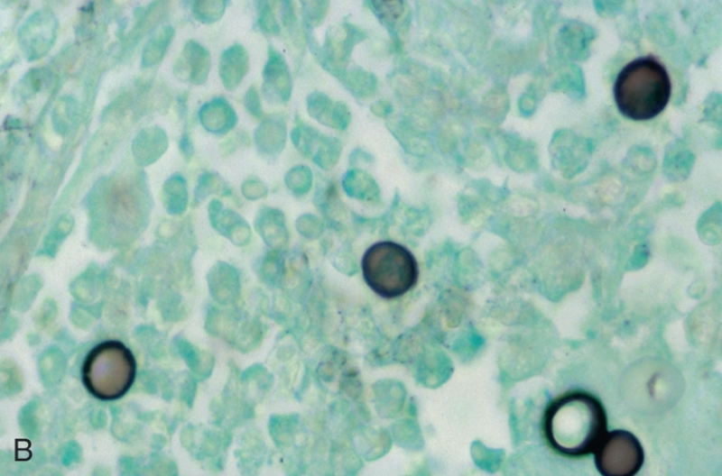
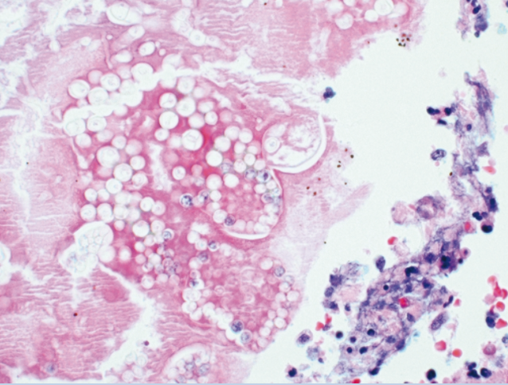
Most often a localized lesion in an immunocompetent person, with or without regional lymph node involvement
There is typically granulomatous inflammation
Bacteria (e.g., M. tuberculosis) or
Fungi (Histoplasma capsulatum, Coccidioides immitis, Blastomyces )
In the immunocompromised, there is usually systemic dissemination of the causative organism, accompanied by widespread disease
Tuberculosis is by far the most important entity within the spectrum of chronic pneumonias

Slide 27
Opportunistic pneumonia

Slide 28
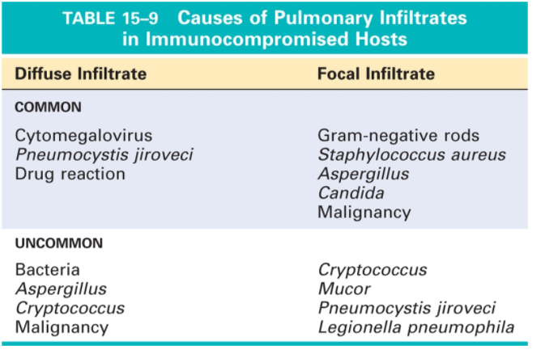
Infections that affect immunosuppressed patients (AIDS, cancer patients and transplant recipients)
The appearance of a pulmonary infiltrate, with or without signs of infection (e.g., fever)
Is one of the most common and serious complications in patients whose immune defenses are suppressed by disease, immunosuppressive therapy for organ transplants, chemotherapy for tumors, or irradiation

Slide 29
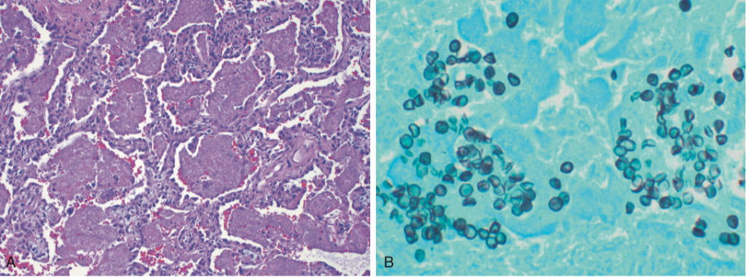
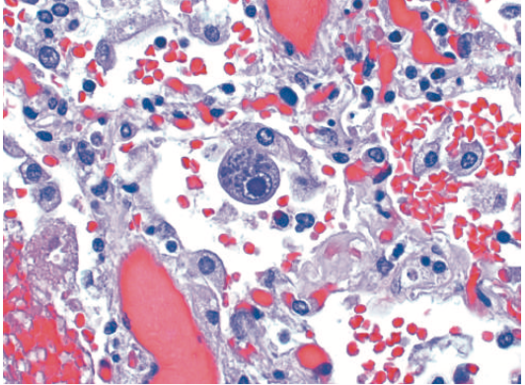
Cytomegalovirus

Slide 30
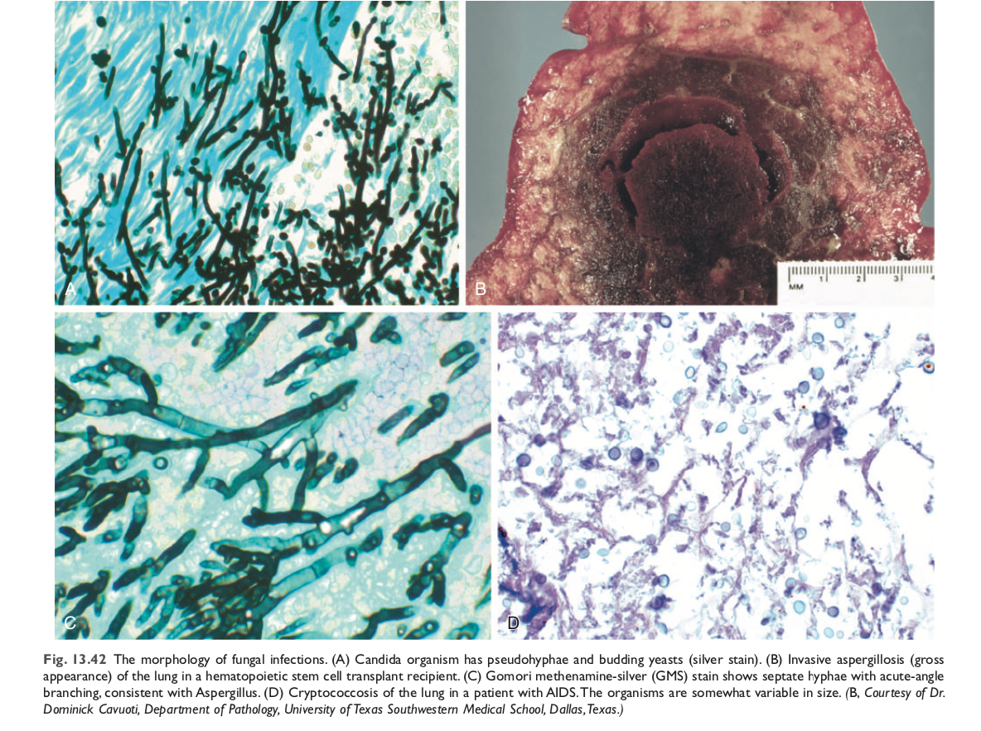

Slide 31
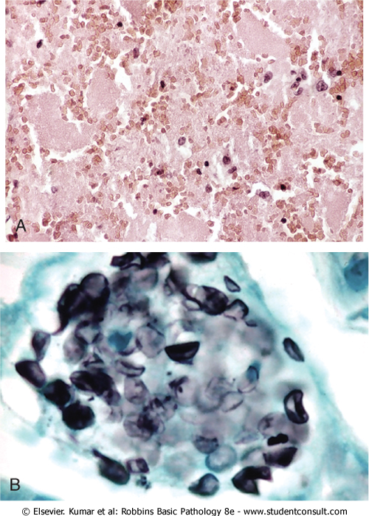
Pneumocystis Pneumonia
P. jiroveci (formerly P. carinii) is an opportunistic infectious agent considered as a fungus
Seen in immunocompromised individuals especially AIDS
Effective methods of diagnosis are:
Identify the organism in bronchoalveolar lavage fluids or in a transbronchial biopsy specimen
Immunofluorescence antibody kits and PCR-based assays
Microscopically:
characteristic intra-alveolar foamy “bubbly, pink-staining exudate” on H&E stains (A)
organism is trapped in the foamy material and can be seen on silver stain as oval cup shaped structures (B)

Slide 32
Lung abscess

Slide 33
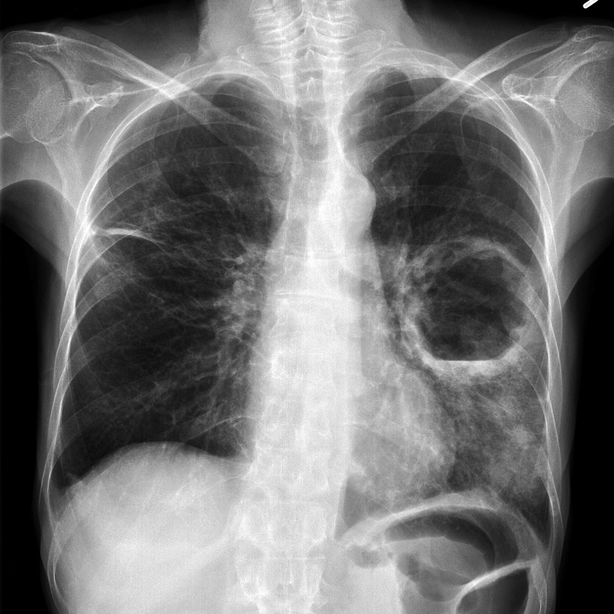
Lung abscess
Is localized suppurative necrotic process within the pulmonary parenchyma
Features: tissue necrosis and marked acute inflammation. Abscess is filled with necrotic suppurative debris
Organisms:
Staphylococci
Streptococci
Gram-negative organisms
Anaerobes
Pathogenesis:
Can follow aspiration
As a complication of pneumonia
Septic emboli
Tumors
Direct infection

Slide 34
Lung abscess
Clinical features
Prominent cough producing copious amount of foul smelling and bad-tasting purulent sputum
Change in position evoke paroxysm of cough
Fever malaise and clubbing of fingers
Radiology shows fluid filled cavity
Complications
Bronchopleural fistula and pleural involvement resulting in empyema
Massive hemoptysis, spontaneous rupture into uninvolved lung segments
Non-resolution of abscess cavity
Bacteremia could result in brain abscess and meningitis
Prognosis:
With antibiotic therapy 75% of abscess resolve

Slide 35
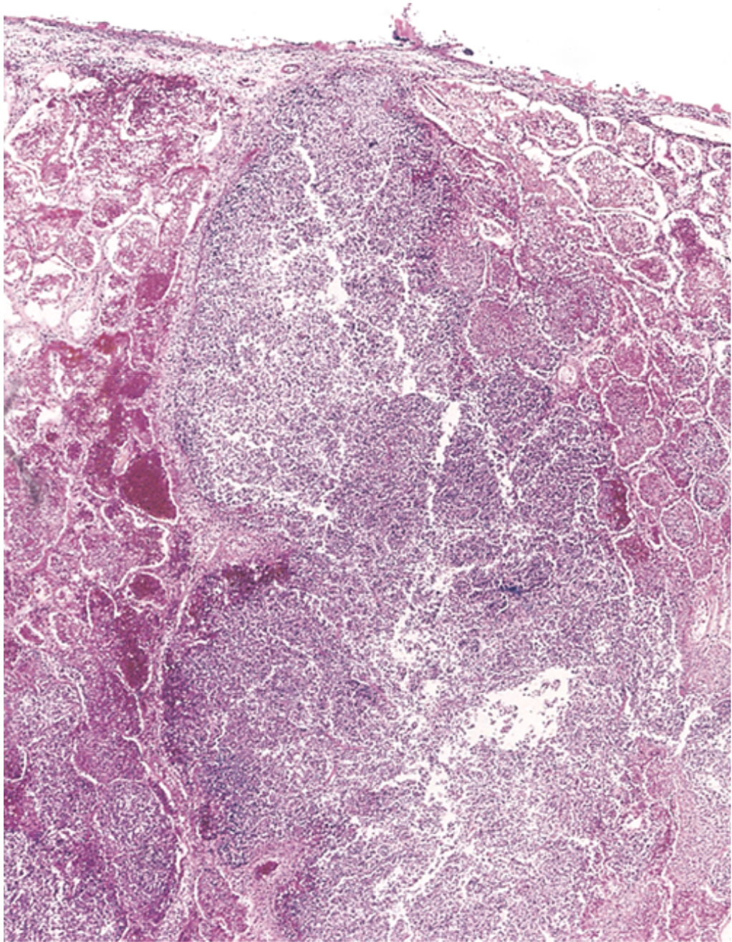
Morphology
Variable in size
Single or multiple
Pulmonary abscesses due to aspiration are more common on the right (because of the more vertical right main bronchus) and are most often single
Abscesses that develop during pneumonia or bronchiectasis are usually multiple, basal, and diffusely scattered
The cardinal histologic change in all abscesses is suppurative destruction of the lung parenchyma within the central area of cavitation

Slide 36
Summery
S. pneumoniae (the pneumococcus) is the most common cause of community-acquired bacterial pneumonia and usually has a lobar pattern of involvement.
Morphologically, lobar pneumonias evolve through four stages: congestion, red hepatization, gray hepatization, and resolution.
Other common causes of bacterial pneumonias in the community include H. influenzae and M. catarrhalis (both associated with acute exacerbations of COPD), S. aureus (usually secondary to viral respiratory infections), K. pneumoniae (observed in chronic alcoholics), P. aeruginosa (seen in individuals with cystic fibrosis, in burn victims, and in patients with neutropenia), and L. pneumophila, seen particularly in organ transplant recipients.
Viral pneumonias are characterized by respiratory distress out of proportion to the clinical and radiologic signs, and by inflammation that is predominantly confined to alveolar septa, with generally clear alveoli.
Common causes of viral pneumonia include influenza A and B, respiratory syncytial virus, human metapneumovirus, parainfluenza virus, and adenovirus.

Slide 37
Protect yourself

