Slide 1
Respiratory Block PATHOLOGY OF TUBERCULOSIS
Dr. Wajd Althakfi, MD
Assistant Professor
KSU-KKUH
.

Slide 2
Objectives
Define tuberculosis
Know the epidemiology of tuberculosis (TB)
List conditions associated with increased risk of Tuberculosis
Recognize the morphology of Mycobacteria and its special stain (the Ziehl-Neelsen) as well as the morphology of granulomas in TB (tubercles)
Know the Pathogenesis of tuberculosis
In regard to Mycobacterial lung infection: Compare and contrast the following in relation to their gross and histologic lung pathology:
Primary tuberculosis (include a definition of the Ghon complex)
Secondary or reactivation tuberculosis
Miliary tuberculosis
List organs other than lung that are commonly affected by tuberculosis
Know the basis and use of tuberculin skin (Mantoux) test
List the common clinical presentation of tuberculosis
List the complication and prognosis of tuberculosis

Slide 3
Tuberculosis is a communicable chronic granulomatous disease caused by Mycobacterium tuberculosis. It usually involves the lungs but may affect any organ or tissue in the body

Slide 4
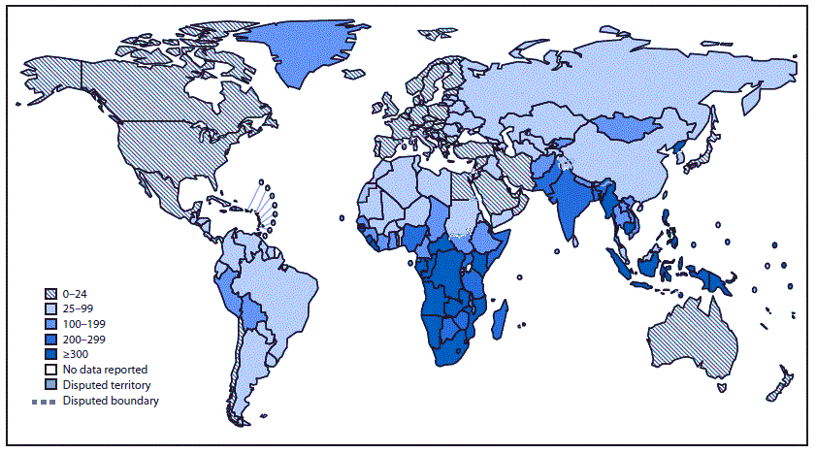
Epidemiology
TB bacilli are strict aerobe, acid-fast (due to mycolic acid in cell wall)
It is estimated that 1.7 billion individuals are infected by tuberculosis worldwide, with 8 to 10 million new cases and 1.5 million deaths per year
Tuberculosis flourishes under conditions of poverty, crowding, and chronic debilitating illness

Slide 5
Epidemiology
Certain disease states also increase the risk, such as:
Diabetes mellitus
Hodgkin lymphoma
Chronic lung disease (particularly silicosis)
Chronic renal failure
Malnutrition, alcoholism, and immunosuppression
In areas of the world where HIV infection is prevalent, HIV infection is the dominant risk factor for the development of tuberculosis

Slide 6
Etiology and Pathogenesis
Mycobacteria are slender rods that are acid-fast (i.e., they have a high content of complex lipids that readily bind the Ziehl-Neelsen stain
M. tuberculosis hominis is responsible for most cases of tuberculosis; the reservoir of infection typically is found in individuals with active pulmonary disease
Transmission usually is direct, by inhalation of airborne organisms in aerosols generated by expectoration or by exposure to contaminated secretions of infected individual
Oropharyngeal and intestinal tuberculosis contracted by drinking milk contaminated with Mycobacterium bovis infection
Other mycobacteria, particularly Mycobacterium avium complex, they cause disease in 10% to 30% of patients with AIDS

Slide 7
Primary TB
Events occurring in the first 3 weeks after exposure
Organism resides in phagosomes of alveolar macrophages
Produces a protein (cord factor) that prevents fusion of lysosomes with phagosome

Slide 8
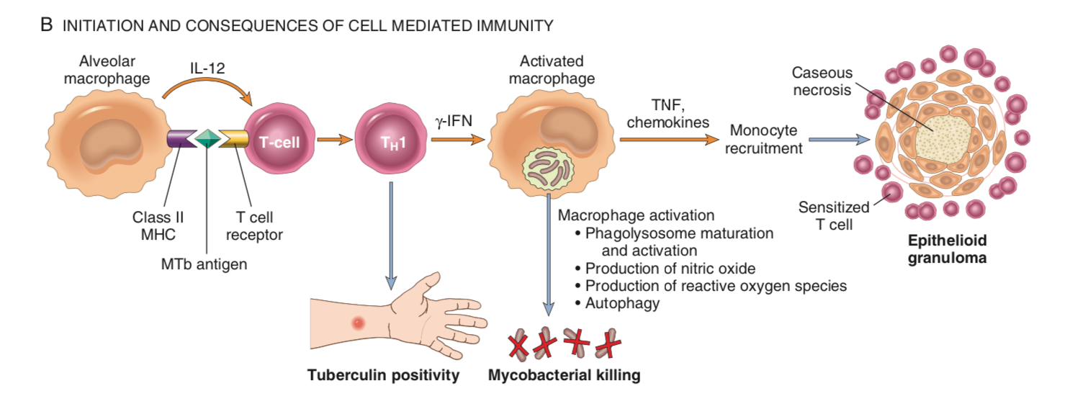
Primary TB
Processed Bacterial antigens reach the draining lymph nodes and are presented to CD4 T cells by dendritic cells and macrophages. Under the influence of IL-12, CD4+ T cells of the TH1 subset are generated and are capable of secreting IFN-γ.
Activated macrophages release a variety of mediators and including TNF, nitric oxide synthase (iNOS), which arises nitric oxide levels, helping to create reactive nitrogen intermediates that appear to be particularly important in killing of mycobacteria; anti-microbial peptides (defensins) that are also toxic to mycobacterial organisms

Slide 9
Pathogenesis
Immunity to a tubercular infection is primarily mediated by TH1 cells, which stimulate macrophages to kill mycobacteria
This immune response, while largely effective, comes at the cost of hypersensitivity and the accompanying tissue destruction
Defects in any of the steps of a TH1 T cell response (including IL-12, IFN-γ, TNF, or nitric oxide production) result in poorly formed granulomas, absence of resistance, and disease progression
Reactivation of the infection or reexposure to the bacilli in a previously sensitized host results in rapid mobilization of a defensive reaction but also increased tissue necrosis

Slide 10
Primary Tuberculosis | Secondary Tuberculosis (Reactivation Tuberculosis)
Form of disease that develops in a previously unexposed and therefore unsensitized patient (1st time exposure). About 5% of those newly infected acquire significant disease. | Pattern of disease that arises in a previously sensitized host (2nd time exposure). It may appear shortly after primary tuberculosis.
Method of infection: inhalation, ingestion | Endogenous due to reactivation of dormant primary lesions many decades after initial infection (specially in immunocompromised individuals or exogenous due to reinfection
lower part of the upper lobe or in the upper part of the lower lobe. | Apex of lungs or upper part of lower lobe
Ghon focus, Ghon complex | Associated with cavitation
Noninfectious | Highly infectious in +ve patients

Slide 11
MORPHOLOGY

Slide 12
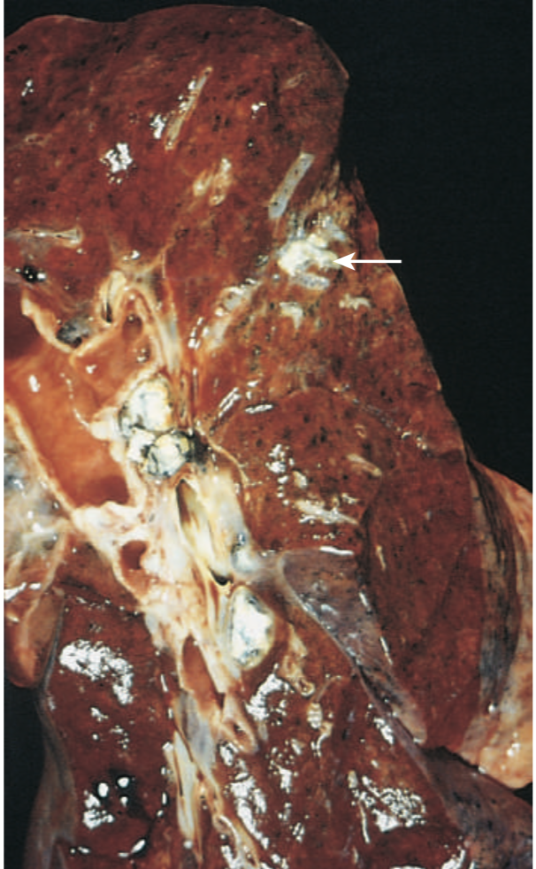
1ry TB: Gross morphology
Ghon complex:
Subpleural location, below interlobular fissure
Upper part of the lower lobes or lower part of the upper lobes
Ghon focus (caseous necrosis) in periphery
Ghon complex (caseous necrosis) in hilar lymph nodes
Hilar lymph nodes with caseation

Slide 13
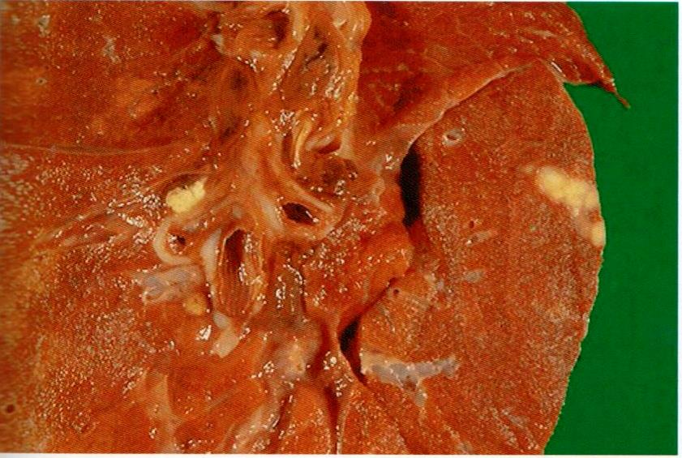
Primary tuberculosis, Ghon complex
1ry TB: Gross morphology
Gray-white parenchymal focus is under the pleura Hilar lymph nodes with caseation are seen

Slide 14
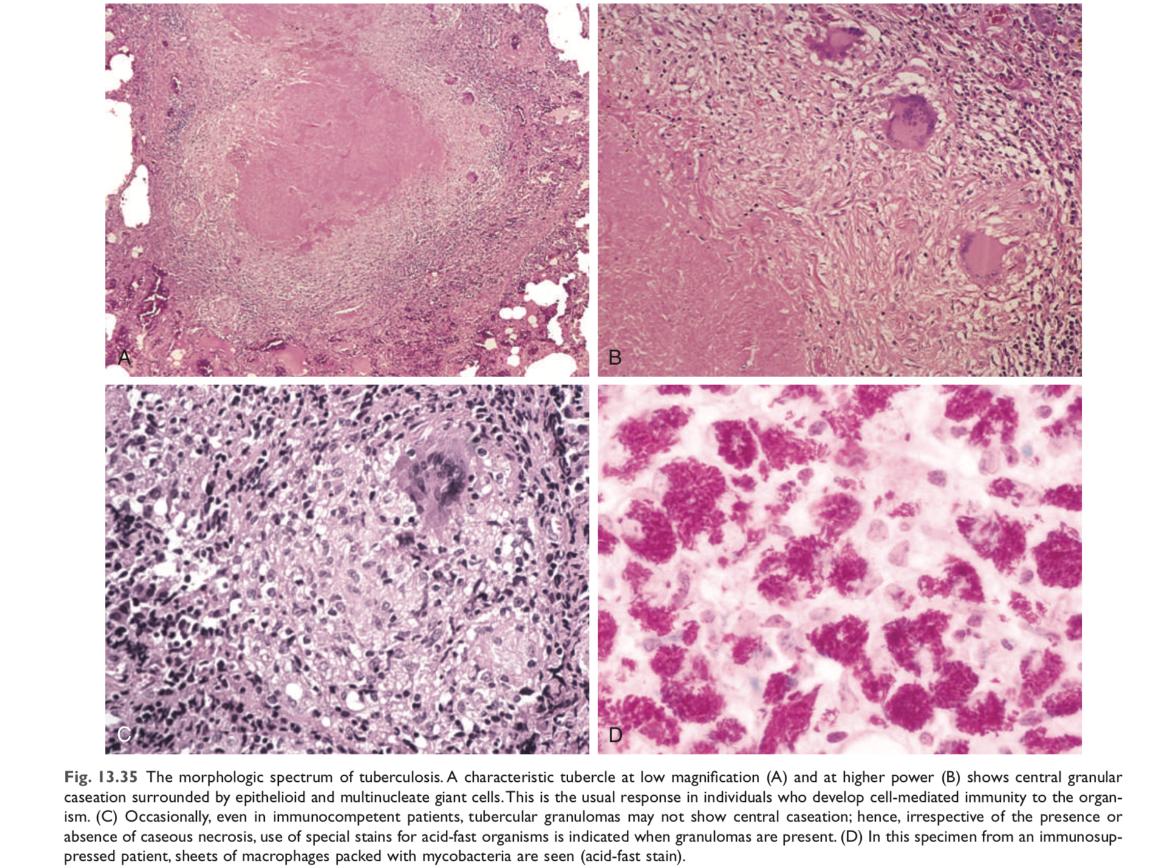

Slide 15
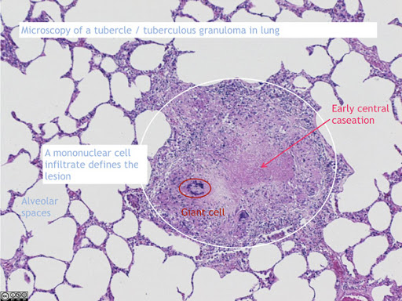

Slide 16
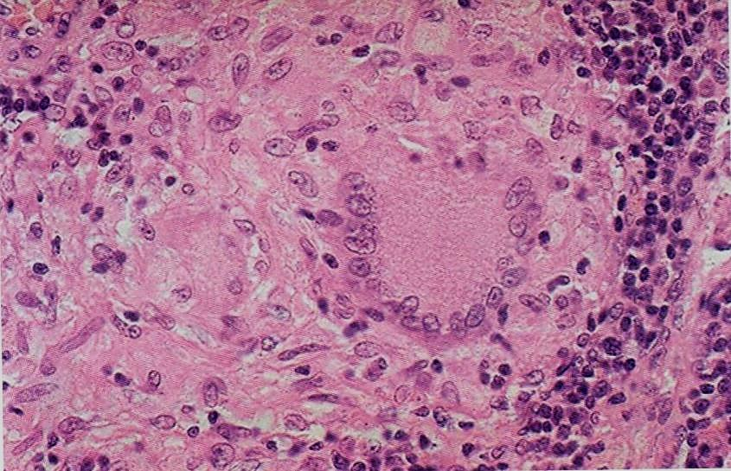

Slide 17
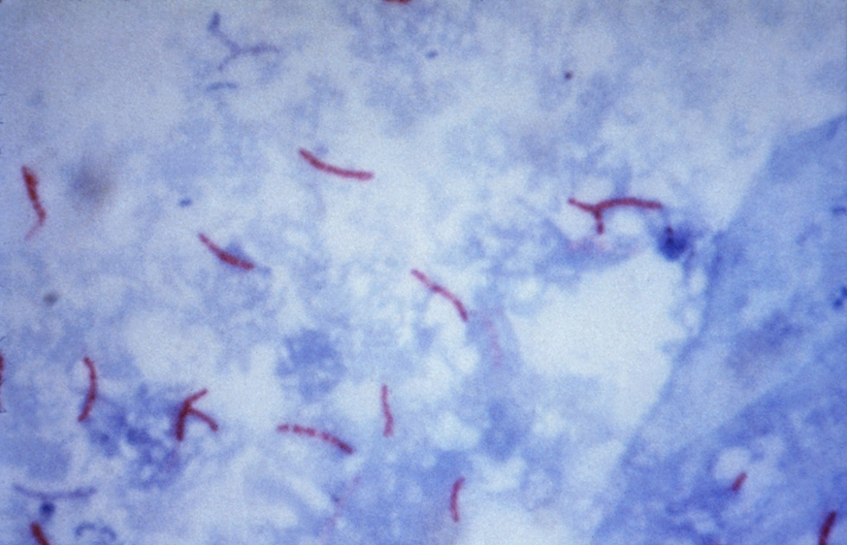
Morphology
Use of special stains for acid-fast organisms
(Zeil-Neilson stain) is indicated when granulomas are present (red/pink)

Slide 18
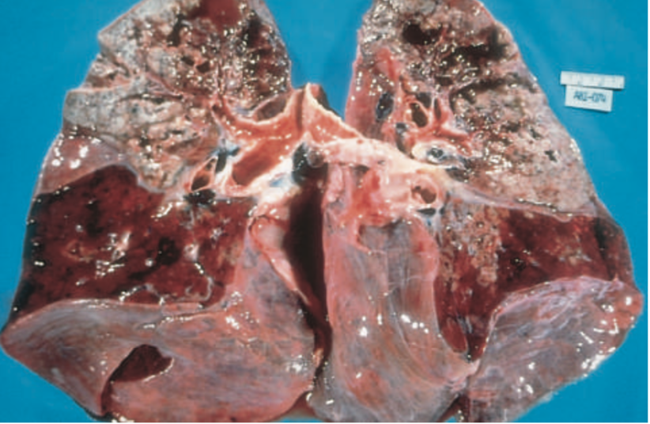
Secondary pulmonary TB
The apex of one or both upper lobes are affected with cavitation leading to erosion into and dissemination along airways, patient become infective

Slide 19
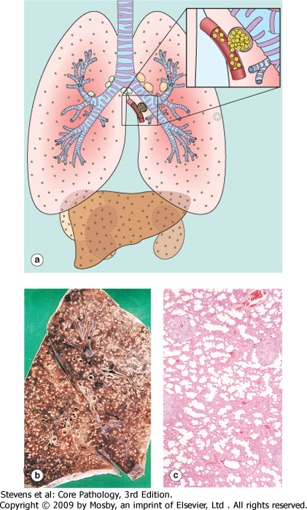
Miliary pulmonary disease
Hematogenous spread of TB organism throughout the body
When bacteria in the lungs enters the pulmonary venous return to the heart; the organisms subsequently disseminate through the systemic arterial system and the lymphatic channels

Slide 20
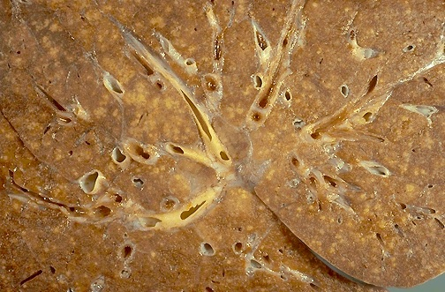
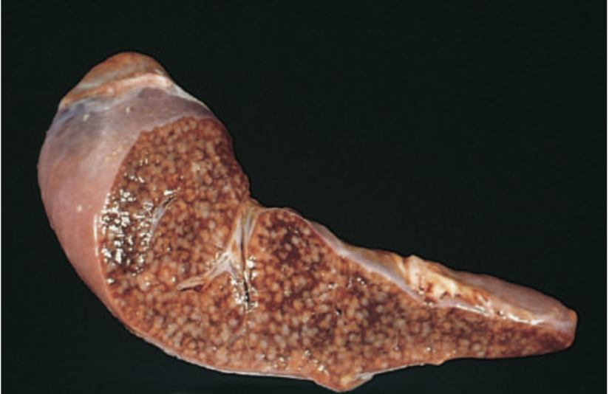
Miliary pulmonary disease
Multiple small yellow nodular lesions in several organs. Almost every organ in the body may be seeded. Lesions resemble those in the lung
In the lungs, there multiple lesions either microscopic or small, visible (2-mm) foci of yellow-white consolidation scattered through the lung parenchyma

Slide 21
Extrapulmonary tuberculosis
Lymph nodes (tuberculous llymphadenitis): are the most frequent form of extrapulmonary tuberculosis esp. in the cervical region
Pleura with pleural effusion (exudate)
Liver and spleen
adrenals
fallopian tube and endometrium
Epididymis and prostate
kidneys
meninges around the base of the brain (tuberculous meningitis),
Bone marrow
Vertebrae (Pott's disease)
Intestinal tuberculosis

Slide 22
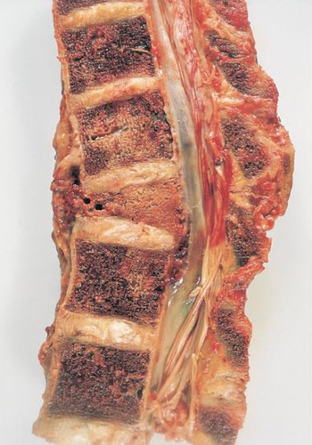
Pott’s disease
Vertebrae (Pott's disease). It collapses the spine and leads to pparaspinal "cold" abscesses
In these patients, infected material may track along the tissue planes to present as an abdominal or pelvic mass

Slide 23
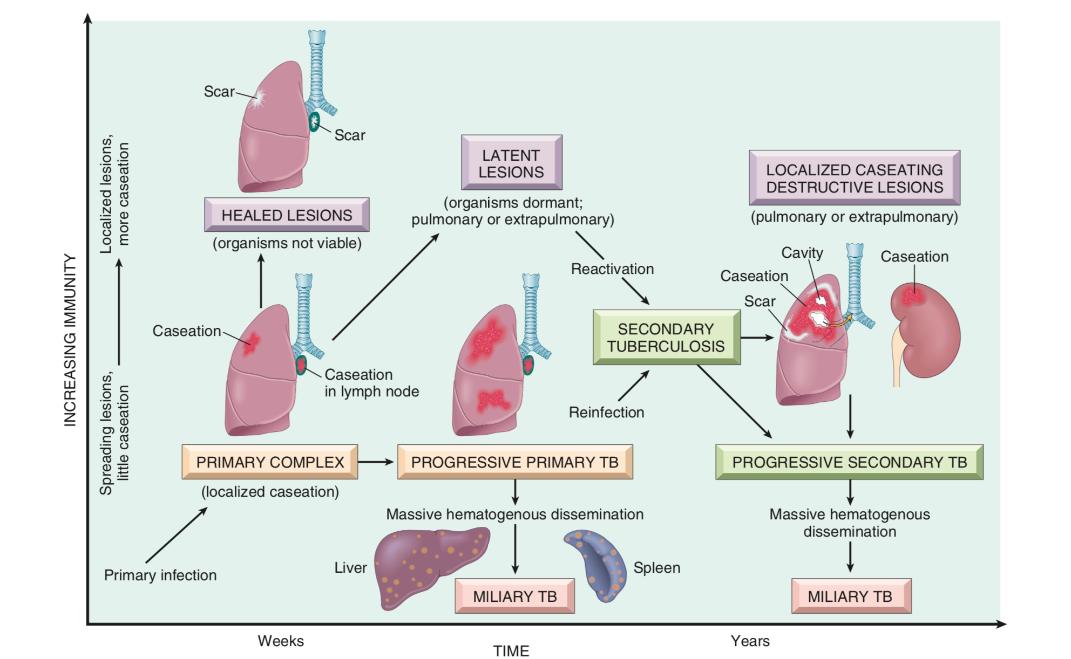

Slide 24
SYMPTOMS OF THE DISEASE
Cough
Fever
General
Hemoptysis
Low grade, night sweating
Malaise, wt. loss, anorexia

Slide 25
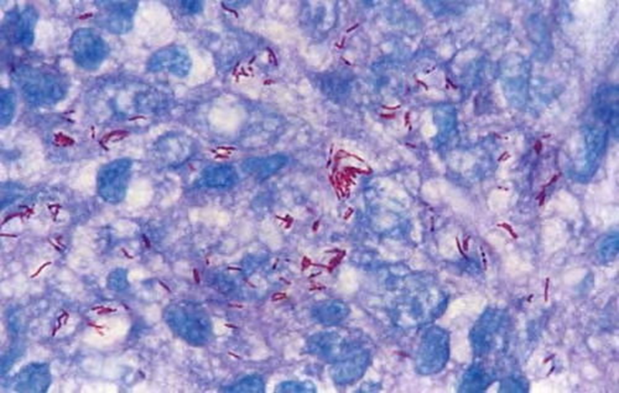
Diagnosis of TB
Based on the history ,physical and radiographic findings of consolidation or cavitation in the apices of the lungs.
Ultimately, tubercle bacilli must be identified by:
Radiology
Mantoux skin test
Zeil-Neilson stain→ the organism stains red/pink
Culture
PCR amplification of M. tuberculosis DNA allows for rapid diagnosis
Culture remains the gold standard
Ziehl-Neelsen stain shows red acid-fast staining M. tuberculi

Slide 26
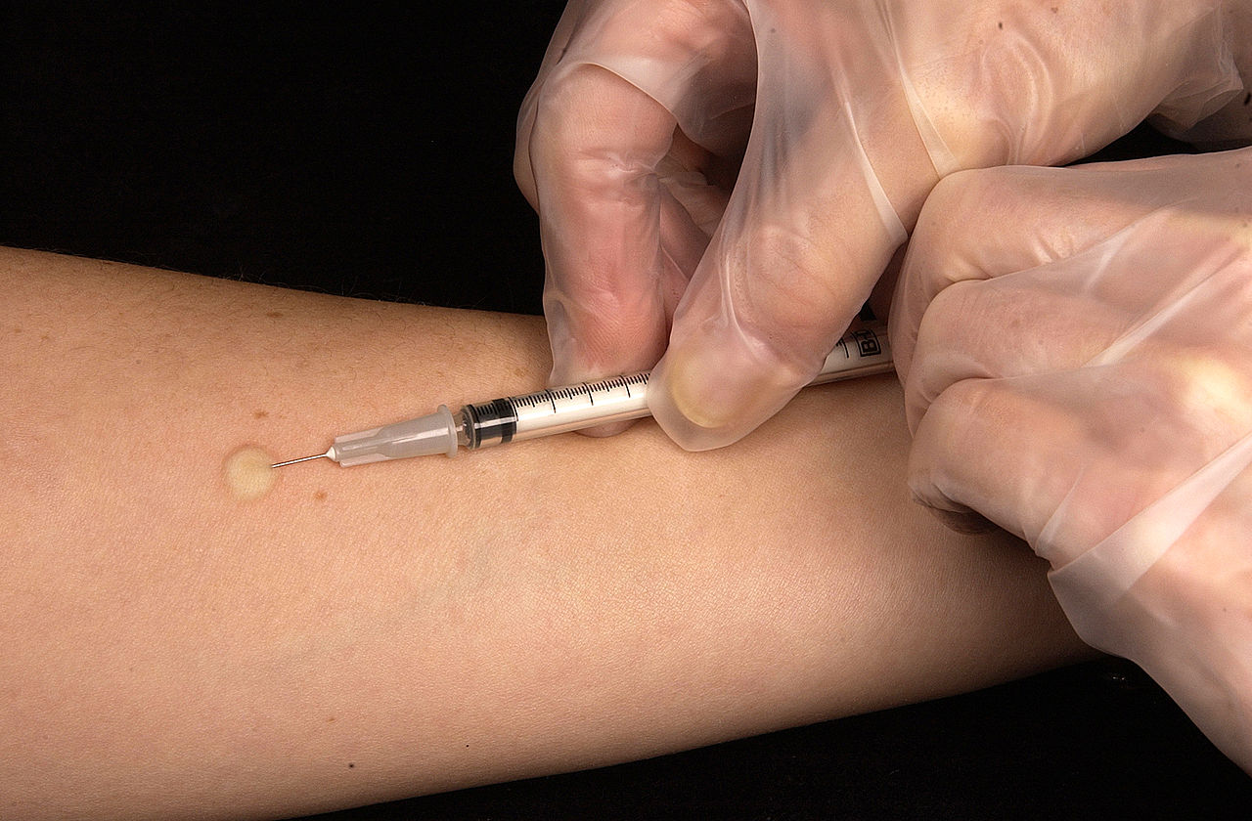
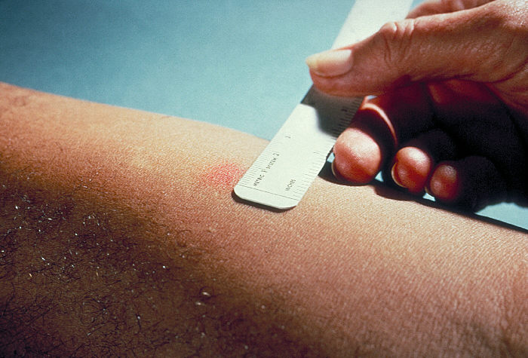
Mantoux skin test

Slide 27
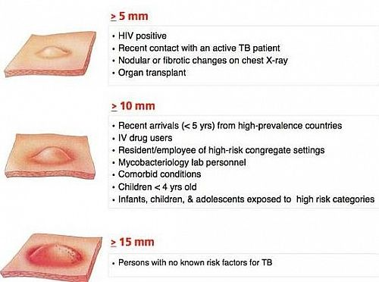
Mantoux skin test
A positive tuberculin skin test result signifies cell-mediated hypersensitivity to tubercular antigens but does not differentiate between infection and disease.
The size of induration is measured 48–72 hours later
Positive results: induces a visible and palpable induration (at least 5 mm in diameter)
False-negative reactions may be produced by certain viral infections, sarcoidosis, malnutrition, Hodgkin lymphoma, immunosuppression and AIDS
False-positive reactions may result from infection by atypical mycobacteria

Slide 28
Prognosis
The prognosis with proper treatment is generally good if infections are localized to the lungs, except when they are caused by drug-resistant strains or occur in aged debilitated, or immunosuppressed persons, who are at high risk for developing miliary TB
The outcome depends on the adequacy of the host immune response and treatment

Slide 29
Summery
Tuberculosis is a chronic granulomatous disease caused by M. tuberculosis, usually affecting the lungs, but virtually any extra- pulmonary organ can be involved.
• Initial exposure to mycobacteria results in development of a cellular immune response that confers resistance and leads to hypersensitivity (as determined by a positive result on the tuberculin skin test).
The TH1 subset of CD4+ T cells has a crucial role in cell- mediated immunity against mycobacteria; mediators of inflammation and bacterial containment include IFN-γ, TNF, and nitric oxide.
The histopathologic hallmark of host reaction to tuberculosis in immunocompetent individuals is the presence of granulomas, usually with caseous necrosis.
Primary pulmonary tuberculosis in immunocompetent individuals is asymptomatic and results only in healed lesions, typically in a sub-pleural focus and a draining lymph node.
Secondary (reactivation) tuberculosis arises in previously exposed individuals when host immune defenses are compromised, and usually manifests as cavitary lesions in the lung apices.
Both progressive primary tuberculosis and secondary tuberculosis can result in systemic seeding, causing life-threatening forms of disease such as miliary tuberculosis and tuberculous meningitis.
HIV-seropositive status is an important risk factor for development or recrudescence of active tuberculosis.

Slide 30
Protect your self

