Slide 1

Respiratory Block
Lung Cancer
Dr. Wajd Althakfi, MD
Assistant professor
KSU-KKUH
.

Slide 2
Objectives
Know the epidemiology of lung cancer
Aware of the new classification of bronchogenic carcinoma which include squamous carcinoma, adenocarcinoma, small cell and large cell (anaplastic) carcinomas
Understand the predisposing factors of bronchogenic carcinoma
Understands the clinical features and gross pathology of bronchogenic carcinoma. Know the precursors of squamous carcinoma (squamous dysplasia) and adenocarcinoma (adenocarcinoma in situ and atypical adenomatous hyperplasia)
Have a basic knowledge about neuroendocrine tumors with special emphasis on small cell carcinoma and bronchial carcinoid
Aware that the lung is a frequent site for metastatic neoplasms

Slide 3

Introduction
95% of primary lung tumors are carcinomas
Remaining 5% span a miscellaneous group that includes
carcinoids
mesenchymal malignancies (e.g., fibrosarcoma, leiomyomas)
lymphomas
benign lesions
Primary lung cancer is a common disease BUT metastatic tumors are more common than the primary tumors

Slide 4
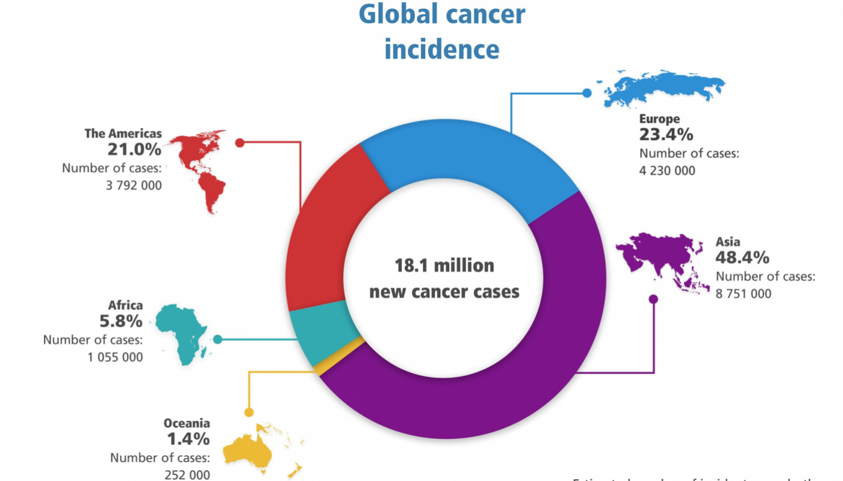
Epidemiology
Carcinoma of the lung is the most important cause of cancer-related deaths in industrialized countries
Accounts for >30% of cancer deaths in men
Accounts for >25% of cancer deaths in women
Incidence of lung cancer is declining in men but increasing in women
Peak incidence is at 55 to 65 years of age

Slide 5
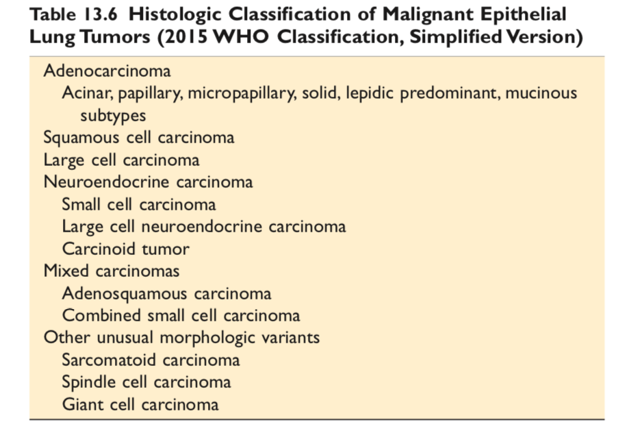
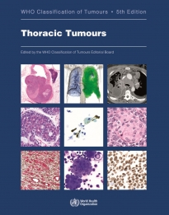
Newest edition released in 2021

Slide 6
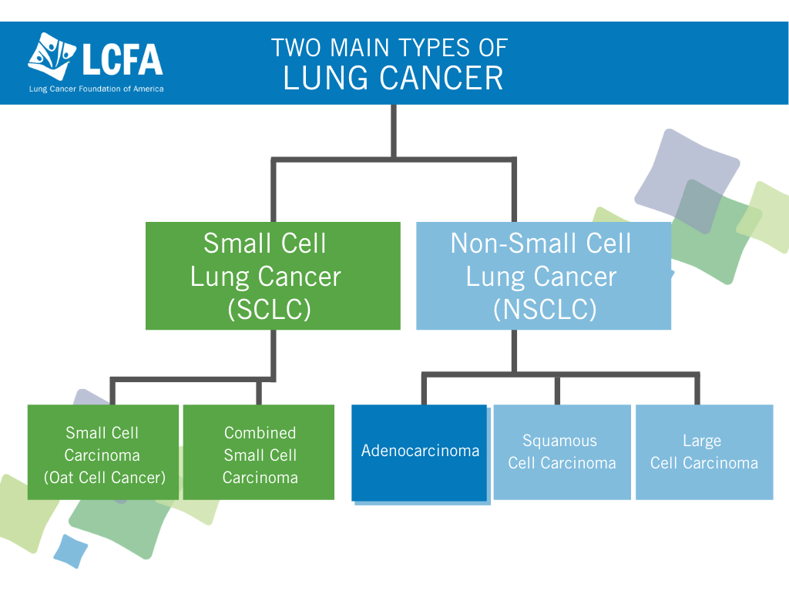

Slide 7

Etiology and Pathogenesis
85% of lung cancers occur in cigarette smokers
Most types are linked to cigarette smoking, but the strongest association is with squamous cell carcinoma and small cell carcinoma
Is directly proportional to the number of cigarettes smoked daily and the number of years of smoking
Cessation of cigarette smoking for at least 15 years brings the risk down
Passive smoking increases the risk to approximately twice than non-smokers
Cigarette smokers show various histologic changes, including squamous metaplasia of the respiratory epithelium which may progress to dysplasia, carcinoma in situ and ultimately invasive carcinoma

Slide 8
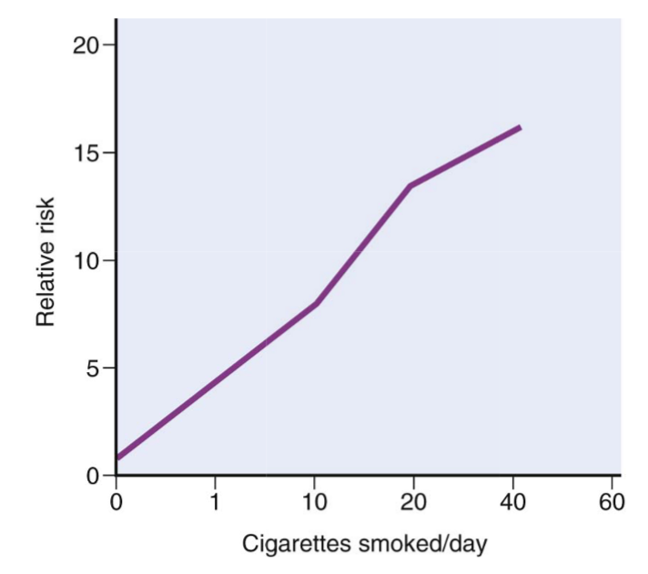
Etiology and Pathogenesis
The risk of lung cancer is determined by the number of cigarettes smoked
The risk is 20 to 40 times greater among habitual heavy smokers

Slide 9


Etiology and Pathogenesis
For unclear reasons, women are more susceptible to carcinogens in tobacco smoke than men
Female smokers have a much greater risk of death from lung cancer and COPD in recent years than female smokers 20 or 40 years ago
Female smokers today smoke more like men than women in previous generations, beginning earlier in adolescence and, until recently

Slide 10
Etiology and Pathogenesis
Radiation:. All types of radiation may be carcinogenic and increase the risk of developing lung cancer. radium and uranium workers are at risk
Asbestos: increased incidence of cancer with asbestos exposure, especially in combination with cigarette smoking
Industrial exposure to nickel and chromates, coal, mustard gas, arsenic, iron etc.
Air pollution: May play some role in increased incidence. Indoor air pollution especially by radon
Scarring: sometimes old infarcts, wounds, scar, granulomatous infections are associated with adenocarcinoma

Slide 11
Precursor lesions
Three types of precursor epithelial lesions are recognized:
  (1) Squamous dysplasia and carcinoma in situ can lead to:
  Squamous cell carcinoma
  (2) Atypical adenomatous hyperplasia can lead to:
  Adenocarcinoma
  (3) Diffuse idiopathic pulmonary neuroendocrine cell hyperplasia can lead :
  Neuroendocrine tumors
It should be noted that the term "precursor" does not
imply that progression to invasion will occur in all cases

Slide 12
ADENOCARCINOMA

Slide 13
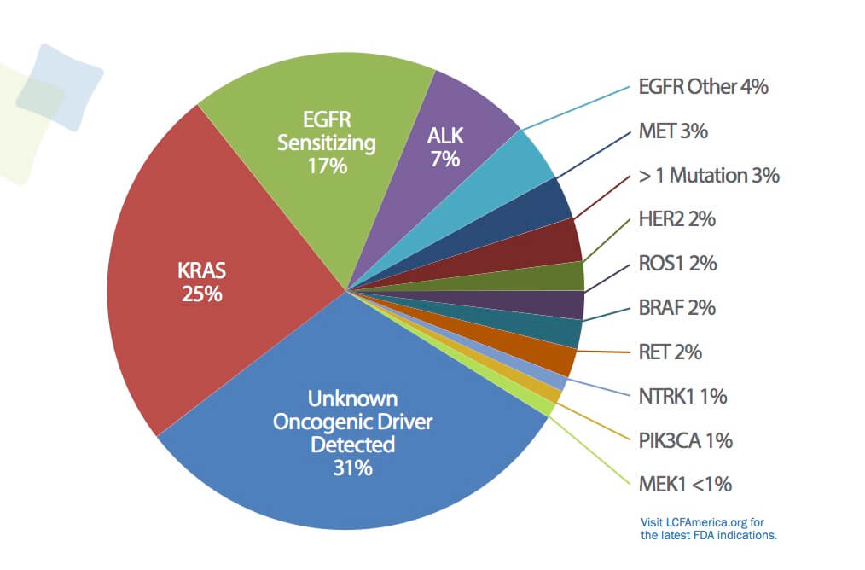
Adenocarcinomas is now the most frequent histologic carcinoma
More common in young women
About 10% in whites
30% in Asians, particularly those arising in non-smoking women, harbor mutations that activate the epidermal growth factor receptor (EGFR)
EGFR and KRAS mutations can occur and in 30% of adenocarcinomas
Usually, peripheral located tumors and arising from the peripheral airways and alveoli

Slide 14
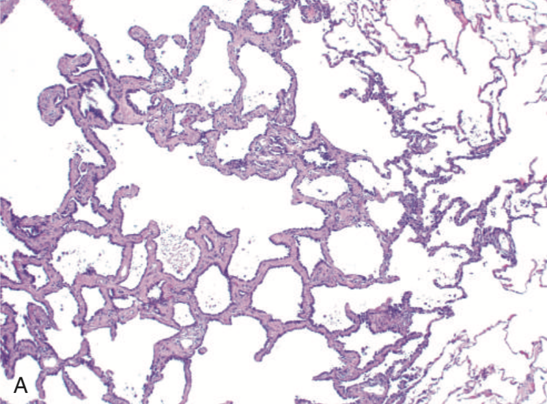
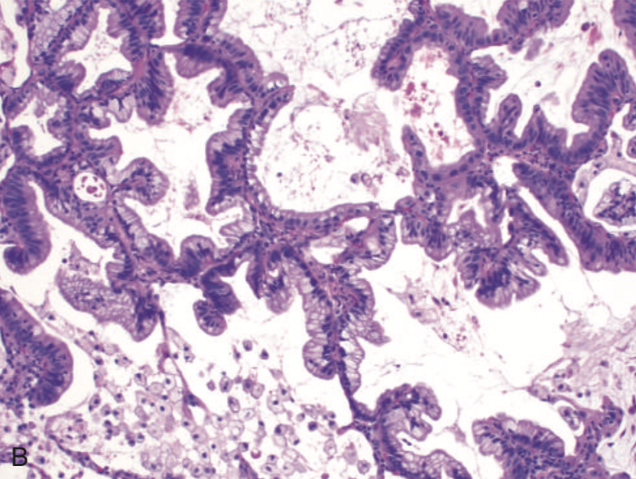
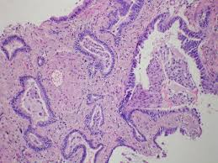
Atypical adenomatous hyperplasia | Adenocarcinoma in situ (AIS) | Minimally invasive adenocarcinoma (MIA)
Small lesion (≤5 mm) characterized by dysplastic pneumocytes lining alveolar walls that are mildly fibrotic | Lesion that is less than 3 cm and is composed entirely of dysplastic cells growing along preexisting alveolar septae, no growth patterns other than lepidic and no feature of invasion component, LVI, no necrosis | ≤3 cm, describes small solitary adenocarcinomas with either pure lepidic growth or predominant lepidic growth with ≤5 mm of stromal invasion.

Slide 15
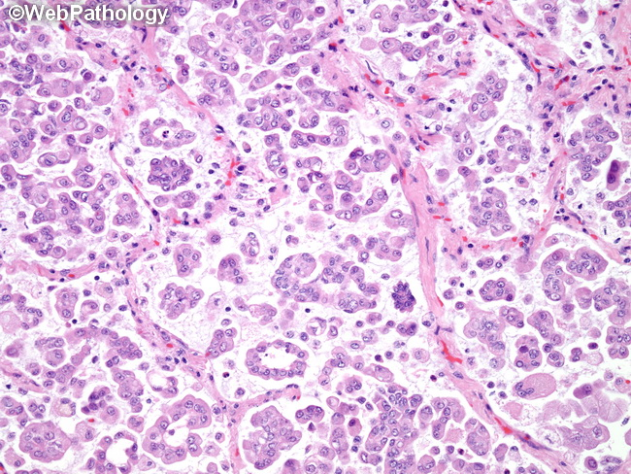
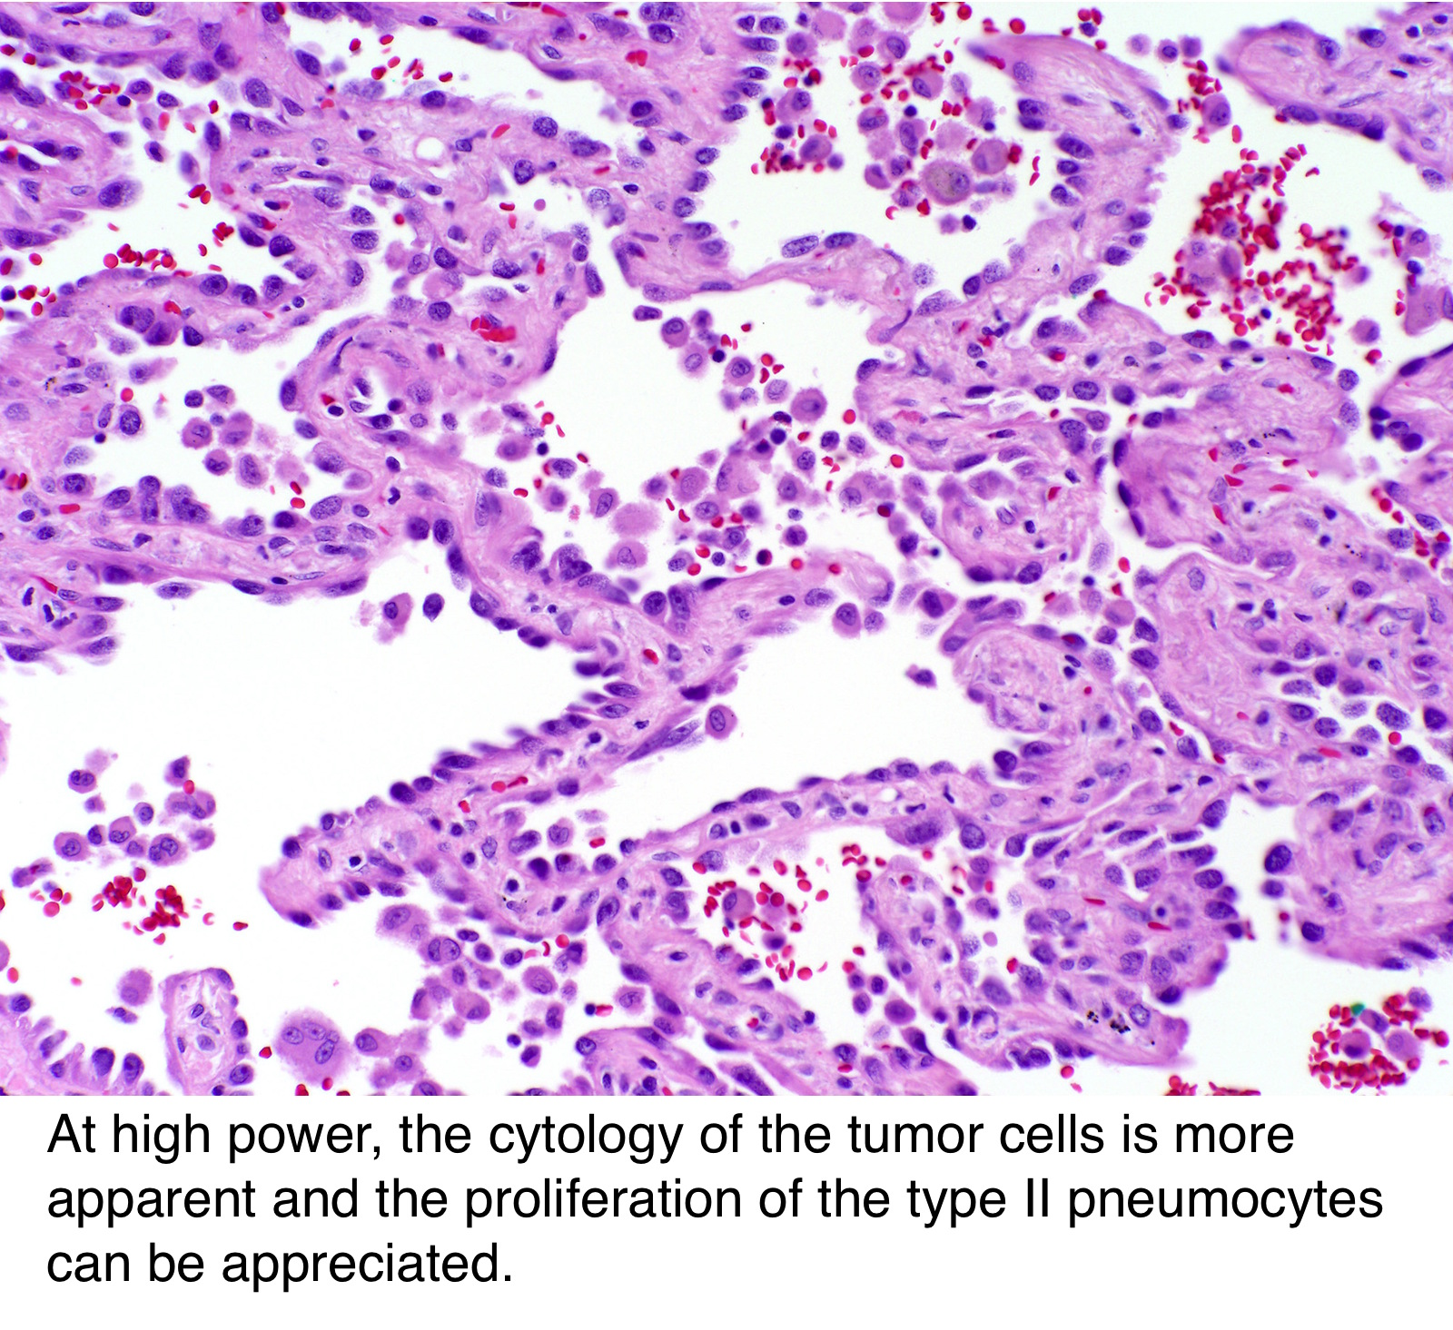
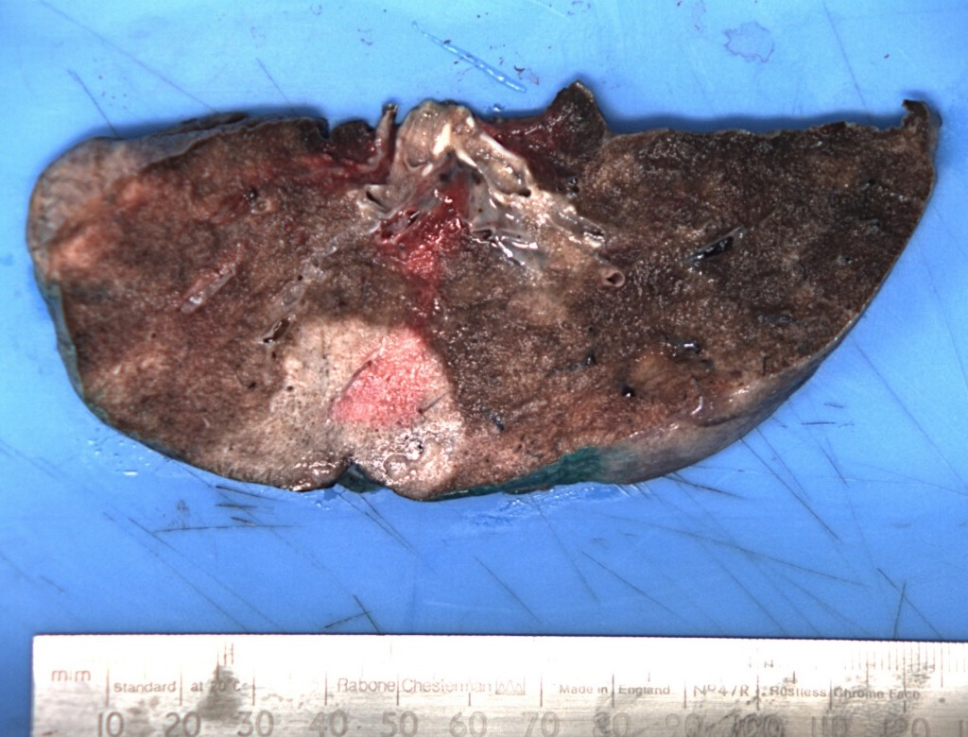
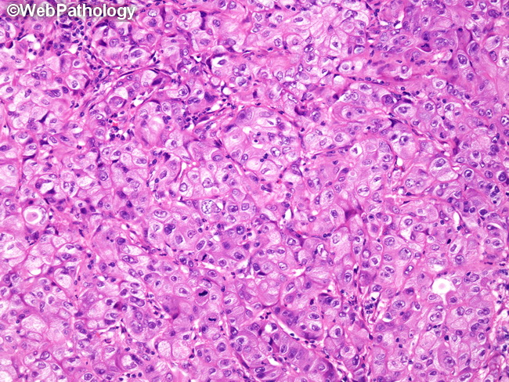
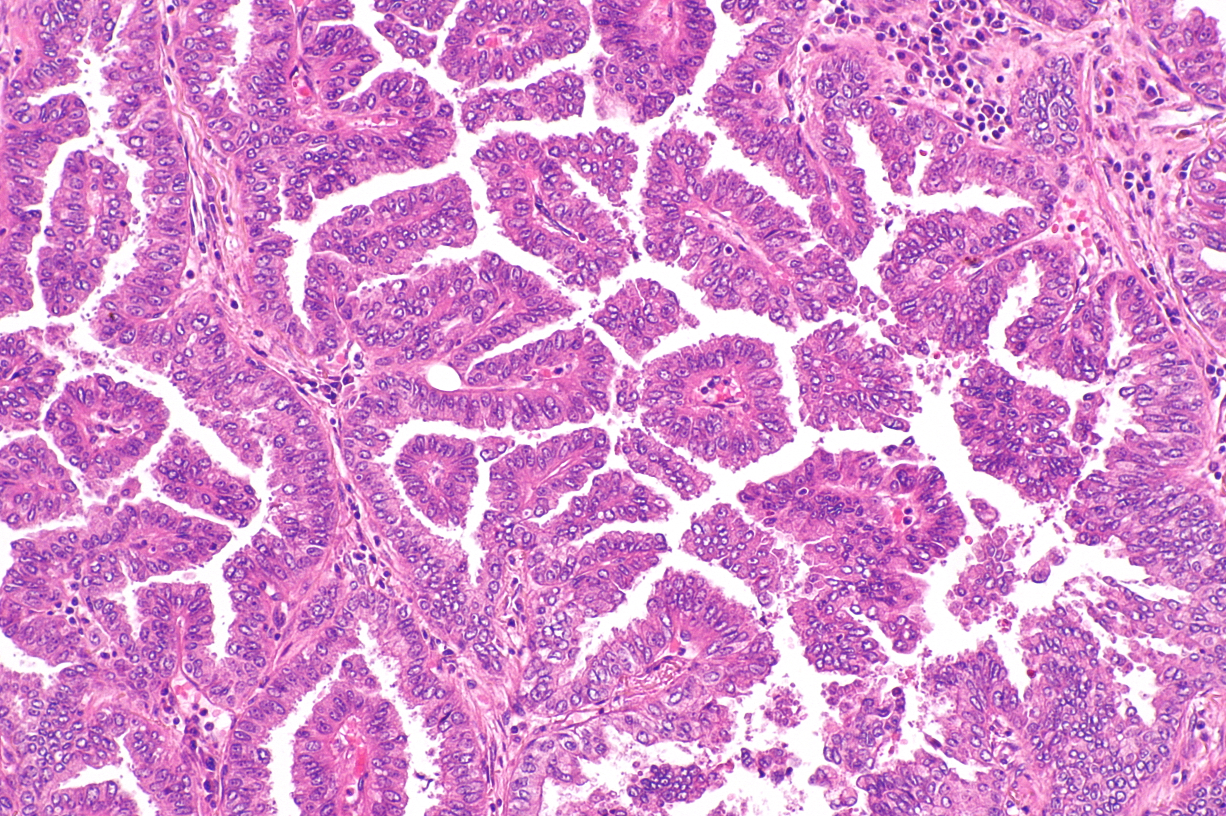
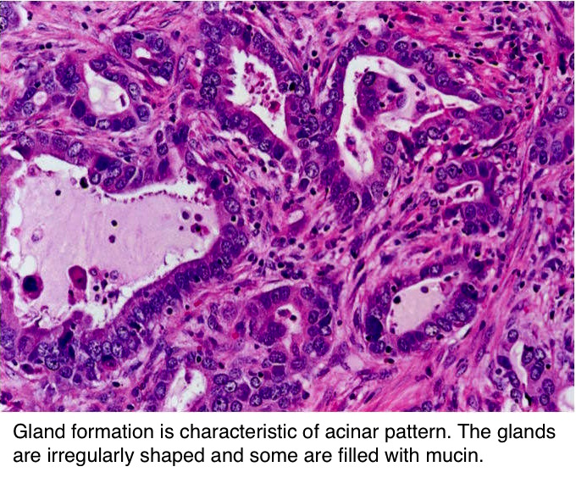

Slide 16
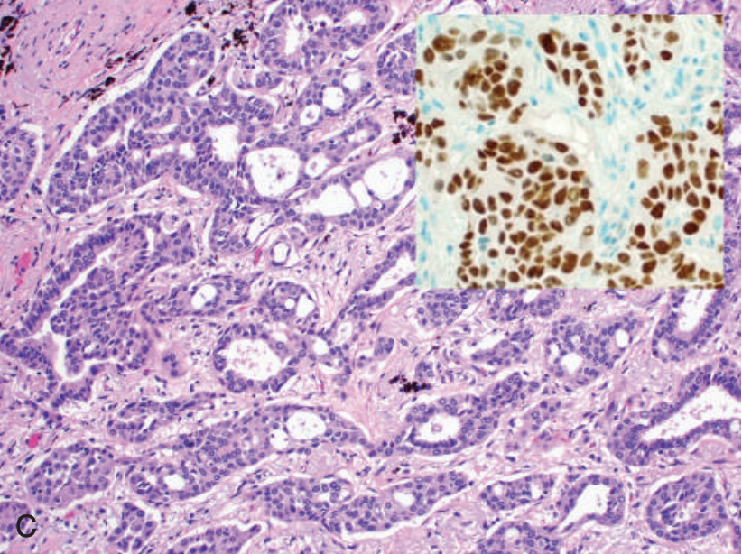
  IHC: TTF-1 positive
  Targeted therapies, such as EGFR inhibitor therapy for adenocarcinomas with EGFR mutations, can be effective

Slide 17
SQUAMOUS CELL CARCINOMA

Slide 18
More common in men than in women
Closely correlated with a smoking history
Large lesions may undergo central necrosis, giving rise to cavitation
Squamous cell carcinomas often are preceded by the development, over years, of squamous metaplasia or dysplasia in the bronchial epithelium, which then transforms to carcinoma in situ
Eventually, the small neoplasm reaches a symptomatic stage, when a well-defined tumor mass begins to obstruct the lumen of a major bronchus, often producing distal atelectasis and infection

Slide 19
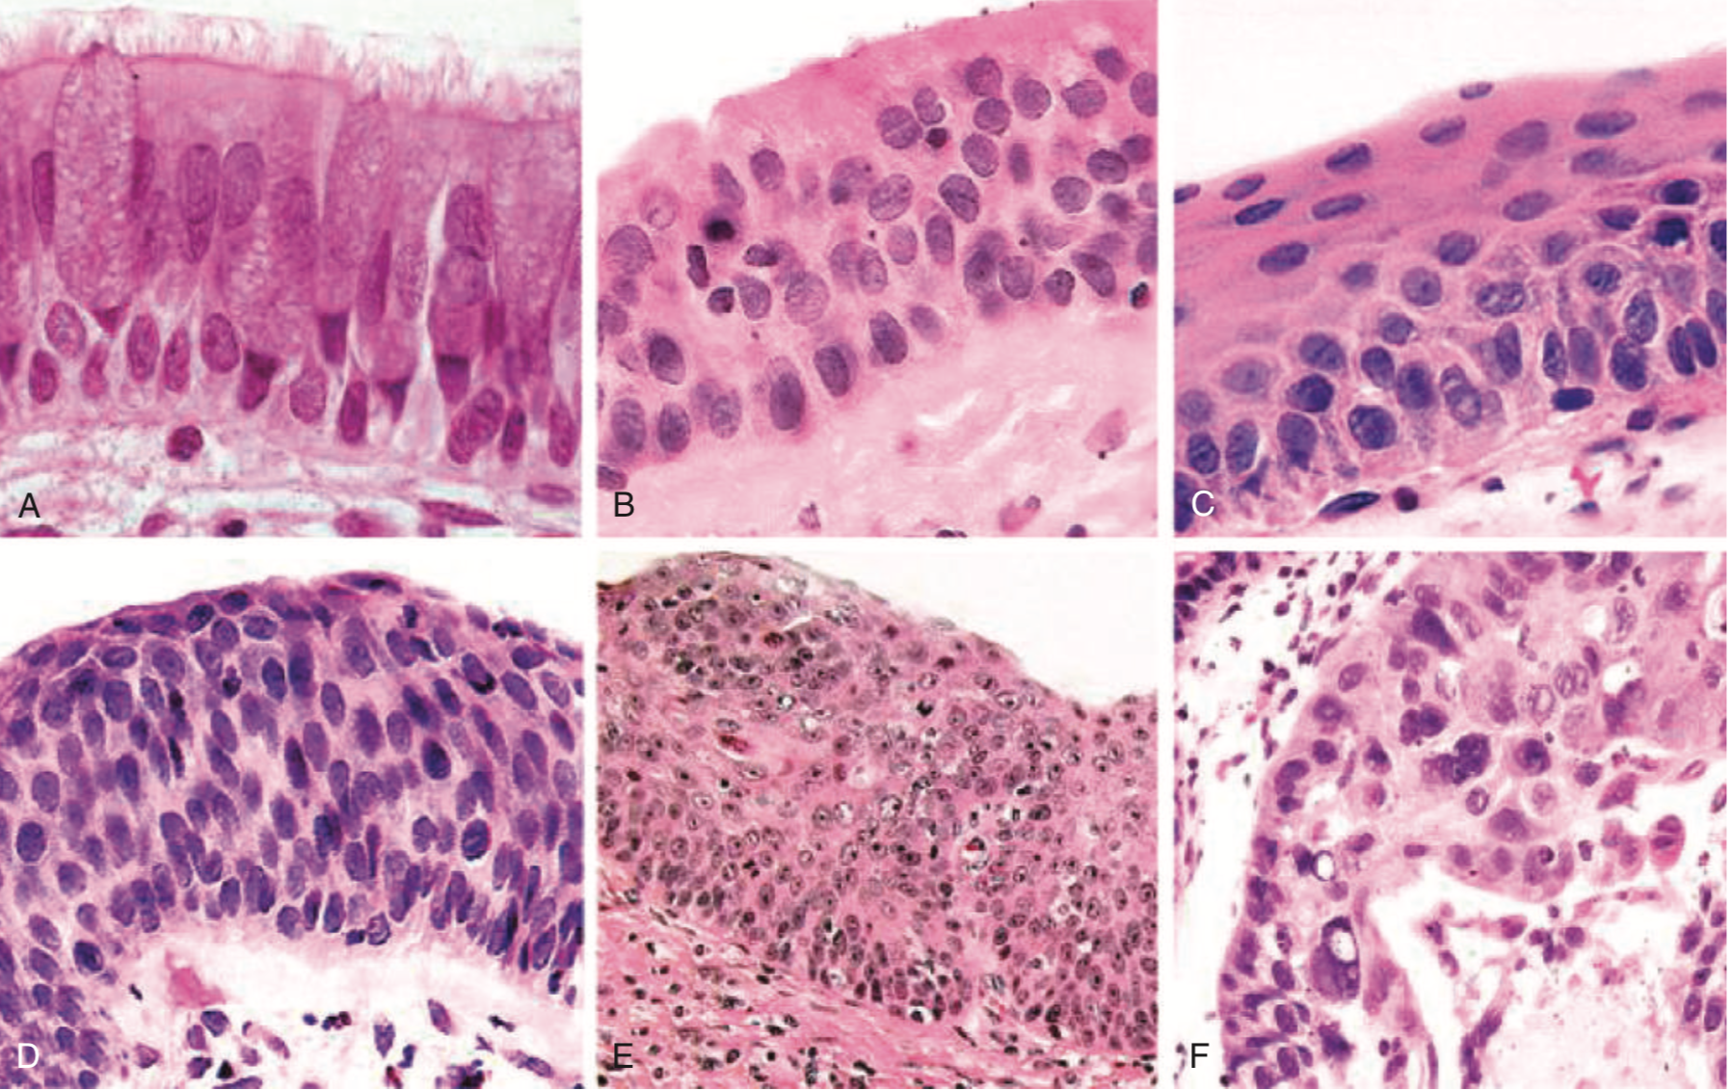

Slide 20
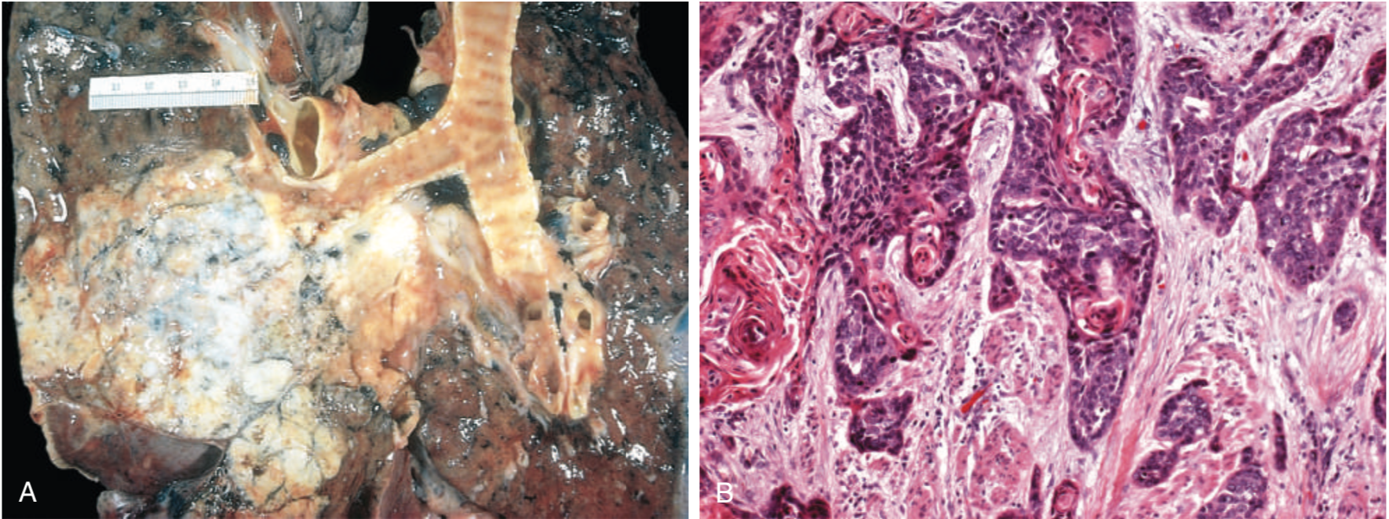
These tumors range from well- differentiated squamous cell neoplasms showing keratin pearls and intercellular bridges to poorly differentiated neoplasms exhibiting only minimal squamous cell features

Slide 21
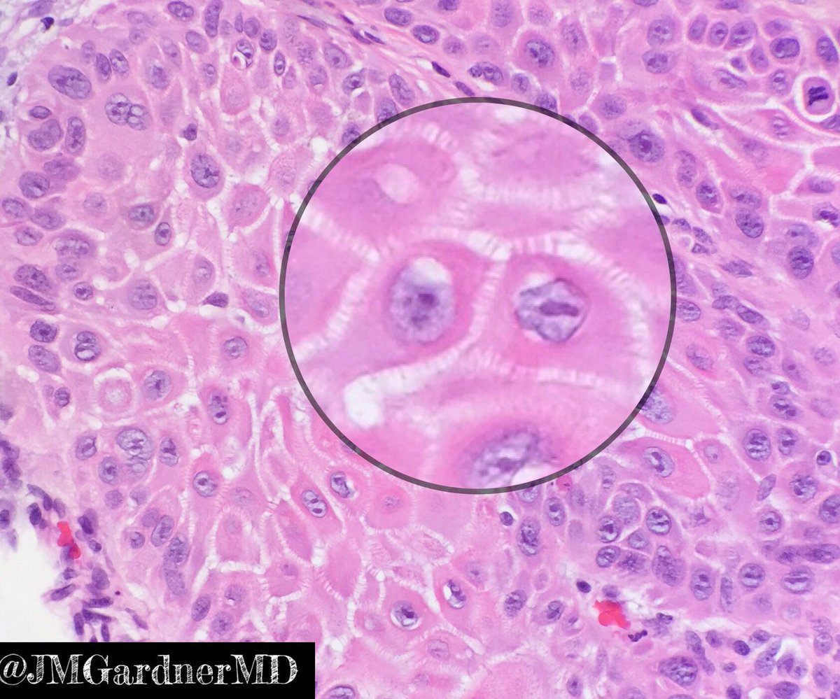
Large polygonal cells
Intercellular bridging

Slide 22
LARG CELL CARCINOMA

Slide 23
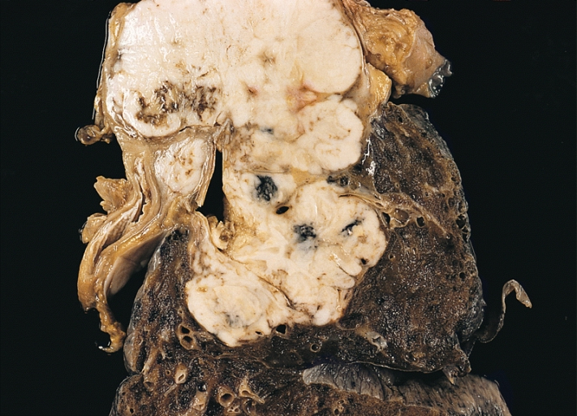
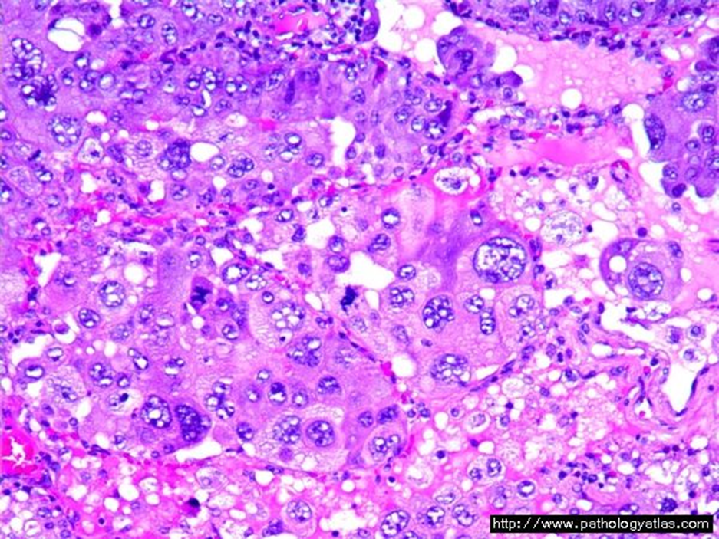
Frequency: 10 %
Strongly associated with smoking
Large-cell carcinoma are usually located peripherally
These group of carcinomas are undifferentiated
Uundifferentiated malignant epithelial tumors that lack the cytologic features of neuroendocrine carcinoma and show no evidence of glandular or squamous differentiation
The cells typically have large nuclei, prominent nucleoli, and moderate amounts of cytoplasm.
Poor prognosis

Slide 24
Carcinoid tumor

Slide 25
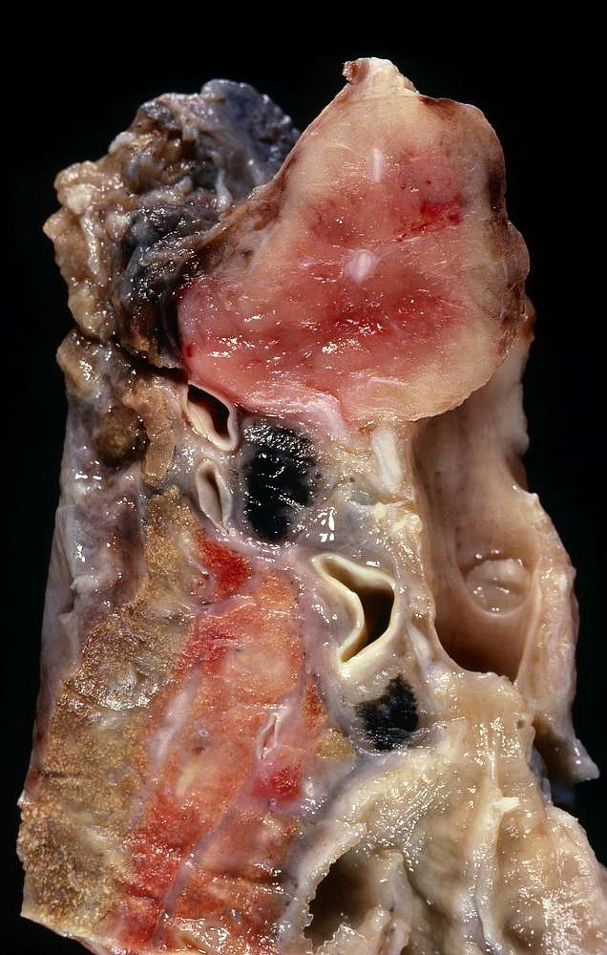
Malignant tumors composed of cells that contain dense-core neurosecretory granules in their cytoplasm
These neoplasms account for 2% of all primary lung cancers
It shows no sex predilection and are not related to cigarette smoking or other environmental factor
Usually seen in adults
Can be central or peripheral in location
Tumor cells produce serotonin and bradykinin leading to carcinoid syndrome
Can occur in patients with Multiple Endocrine Neoplasia (MEN-I)
Low malignancy, Often respectable and curable.
Spreads by direct extension into adjacent tissue
Mainly seen as endobronchial lesions

Slide 26
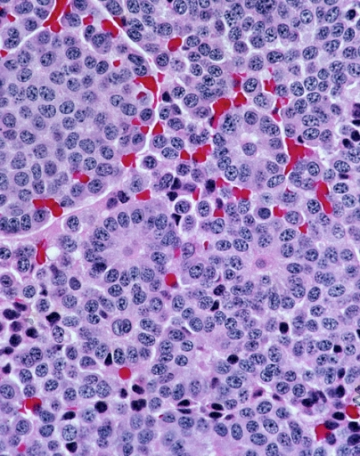
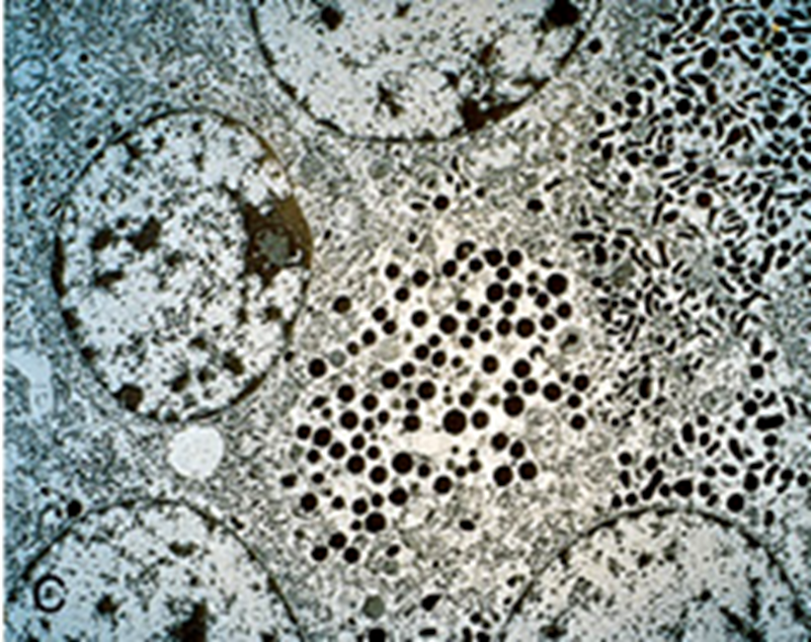
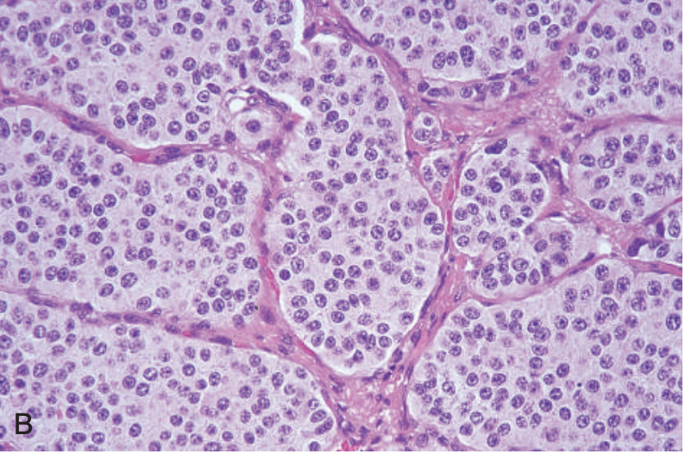
Two types:
  typical carcinoids: are composed of nests of uniform cells that have regular round nuclei with “salt-and-pepper” chromatin, absent or rare mitoses and little pleomorphism
  Atypical carcinoid: tumors display a higher mitotic rate and small foci of necrosis. These tumors have a higher incidence of lymph node and distant metastasis than typical carcinoids

Slide 27
SMALL CELL
CARCINOMA

Slide 28
SCLC are a type neuroendocrine tumors arising from neuroendocrine cells. More common in men
Highly malignant and aggressive tumor, poor prognosis, rarely respectable
Strongly associated with cigarette smoking. 95% of patients are smokers
Chemotherapy responsive
least likely form to be cured by surgery; usually already metastatic at diagnosis
Ability to secrete a host of polypeptide hormones like ACTH, antidiuretic hormone (ADH), calcitonin, gastrin-releasing peptide and chromogranin
It may be associated with paraneoplastic syndrome, Cushing’s, and Eaton-Lambert syndrome

Slide 29
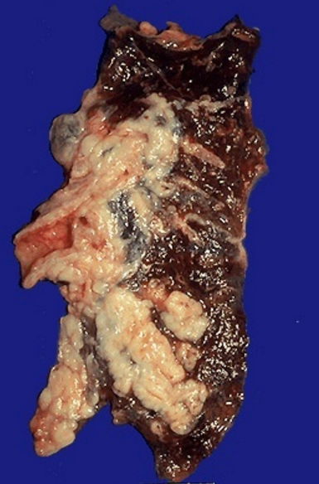
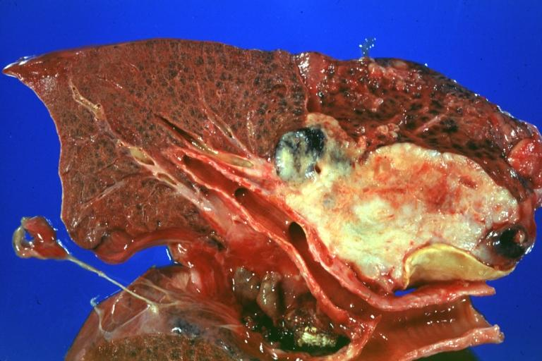
Centrally located perihilar mass with early metastases (Early involvement of the hilar and mediastinal nodes)

Slide 30
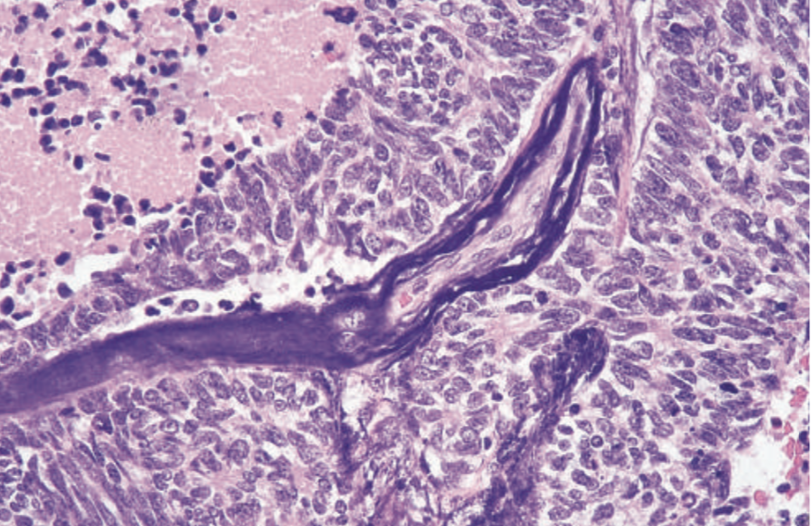
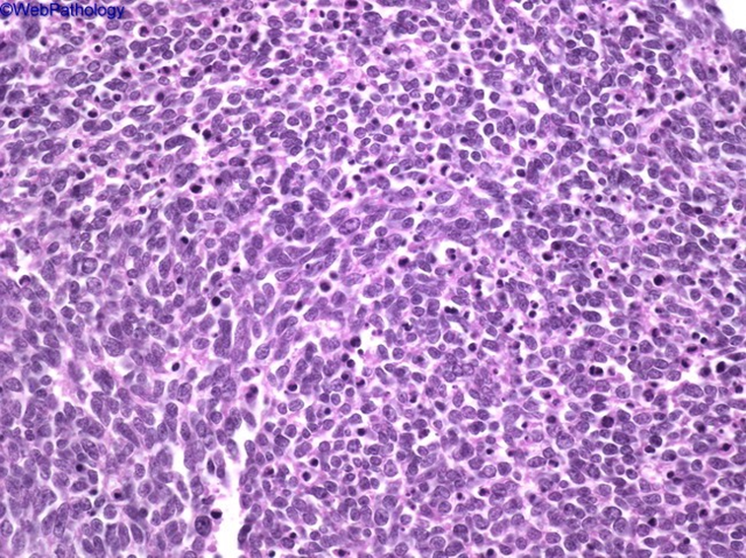
Microscopically composed of small, dark, round to oval, lymphocyte-like cells with little cytoplasm
Necrosis, apoptosis, crushing artifact
Electron microscopy: dense-core neurosecretory granules

Slide 31
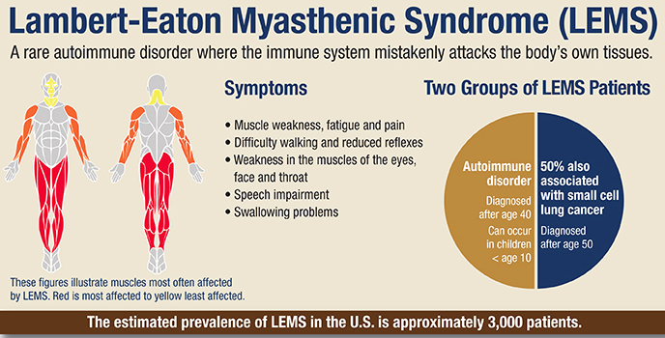

Slide 32
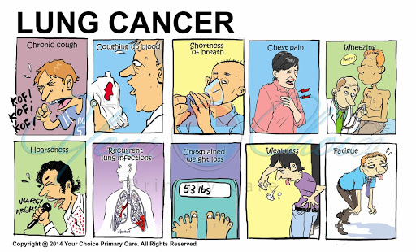
Clinical picture
Can be silent or insidious lesions
chronic cough and expectoration, hemoptysis, and bronchial obstruction, often with atelectasis.
Hoarseness, chest pain, superior vena cava syndrome, pericardial or pleural effusion
Symptoms due to metastatic spread

Slide 33
Clinical picture
Superior vena cava syndrome: invasion leads to obstruction of venous drainage which leads to dilation of veins in the upper part of the chest and neck resulting in swelling and cyanosis of the face, neck, and upper extremities
Pancoast tumor (superior sulcus tumor):
Apical neoplasms may invade the brachial sympathetic plexus to cause severe pain, numbness and weakness in the distribution of the ulnar nerve
Pancoast tumor is often accompanied by destruction of the first and second ribs and thoracic vertebrae. It often coexists with Horner syndrome
Horner syndrome: invasion of the cervical thoracic sympathetic nerves and it leads to ipsilateral enophthalmos, miosis, ptosis, and facial anhidrosis
Hoarseness from recurrent laryngeal nerve paralysis
Pleural effusion, often bloody

Slide 34
Paraneoplastic syndrome
Paraneoplastic syndromes of lung cancer, are extrapulmonary, remote effects of tumors.
3% to 10% of lung cancers develop paraneoplastic syndromes.
    Small cell carcinomas
    ACTH (leading to Cushing's syndrome)
    ADH ( water retention and hyponatremia
Carcinoid tumors
Produce serotonin and bradykinin leading to carcinoid syndrome (flushing, wheezing, diarrhea, and cardiac valvular lesions
Squamous cell carcinomas
may secrete parathyroid hormone-like peptide and prostaglandin E that lead to hypercalcemia
Adenocarcinomas can lead to hematologic manifestations

Slide 35
Complications and spread
Bronchiectasis
Obstructive pneumonia
Pleural effusion
Superior vena cava syndrome
Prognosis:
NSCLC have a better prognosis than SCLC
Poor for most patients

Slide 36
Complications and spread
Lymphatic spread
successive chains of nodes (scalene nodes)
involvement of the supraclavicular node (Virchow’s node)
Extend into the pericardial or pleural spaces. Infiltrate the superior vena cava
A tumor may extend directly into the esophagus, producing obstruction, sometimes complicated by a fistula
Phrenic nerve invasion usually causes diaphragmatic paralysis
May invade the brachial or cervical sympathetic plexus (Horner’s Syndrome)
Distant metastasis to liver (30-50%), adrenals (>50%), brain (20%) and bone (20%)

Slide 37
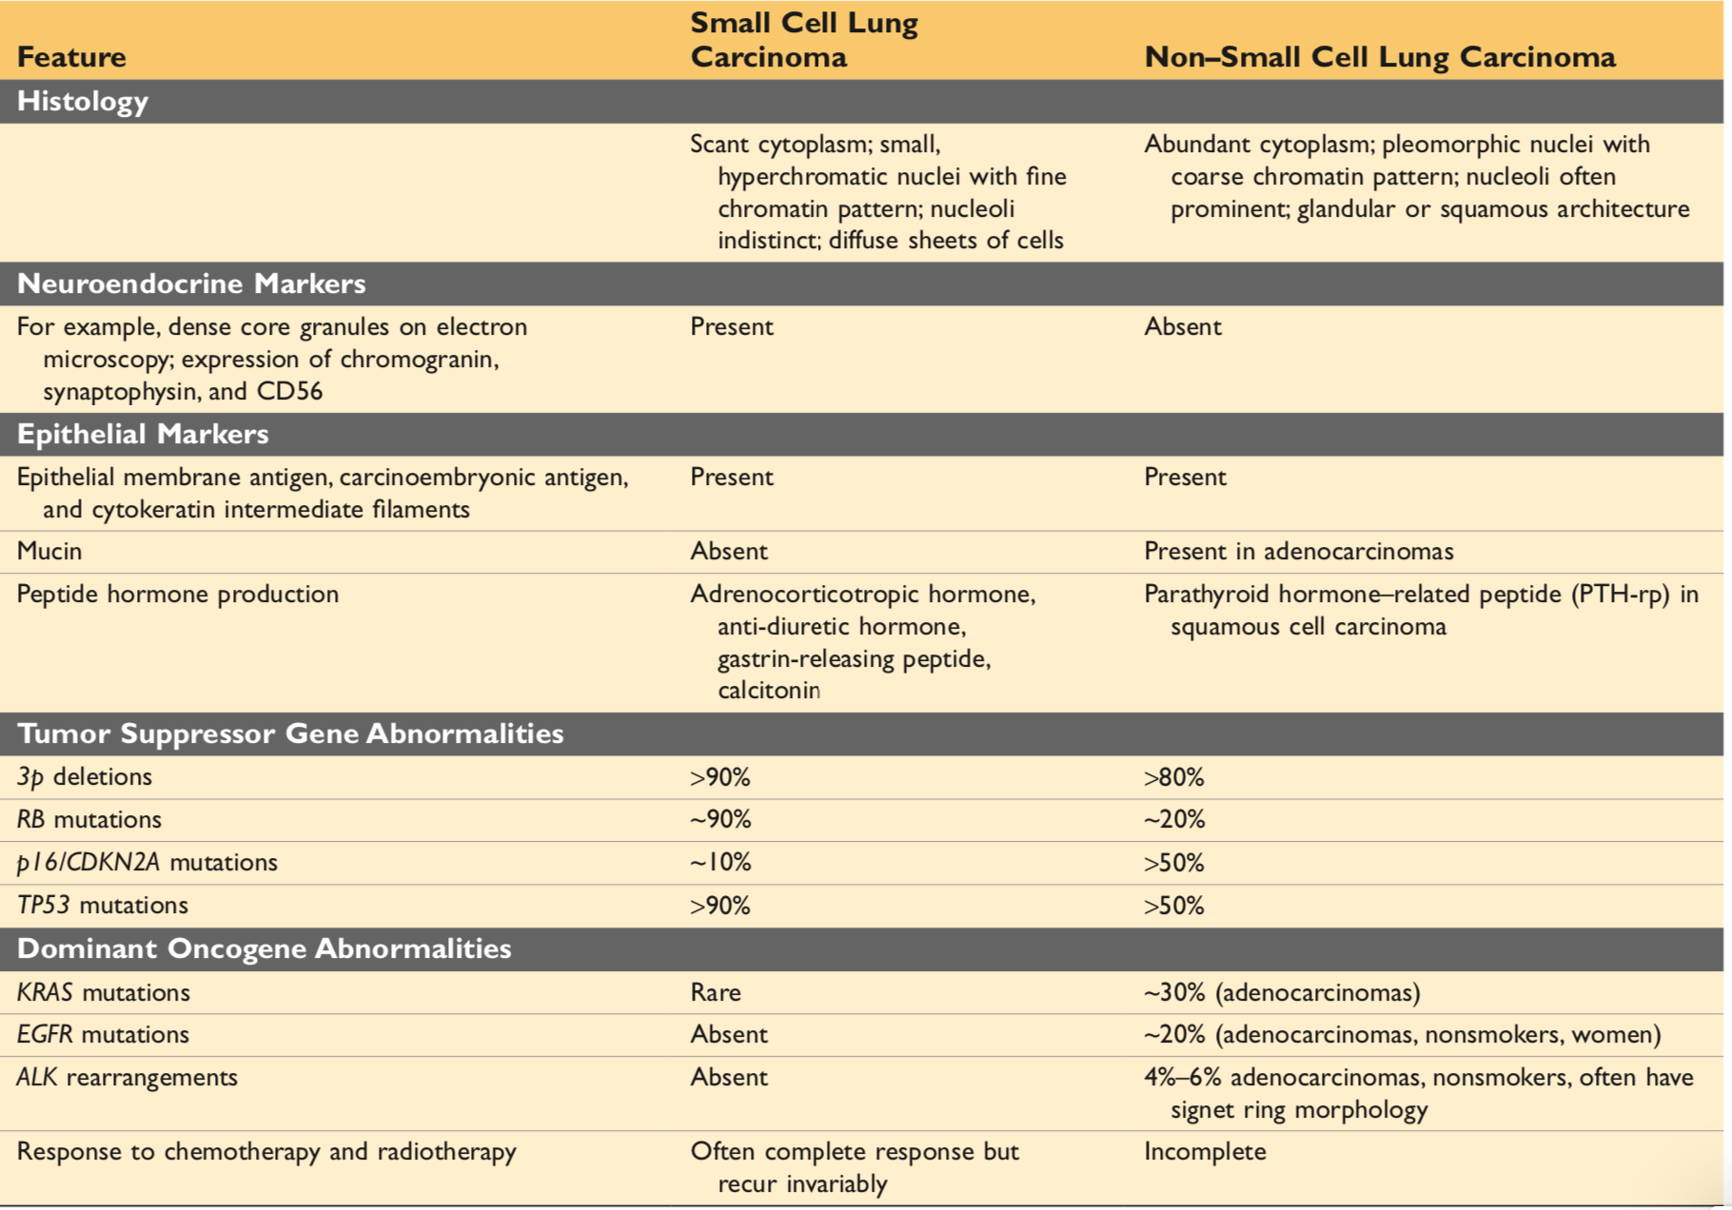

Slide 38
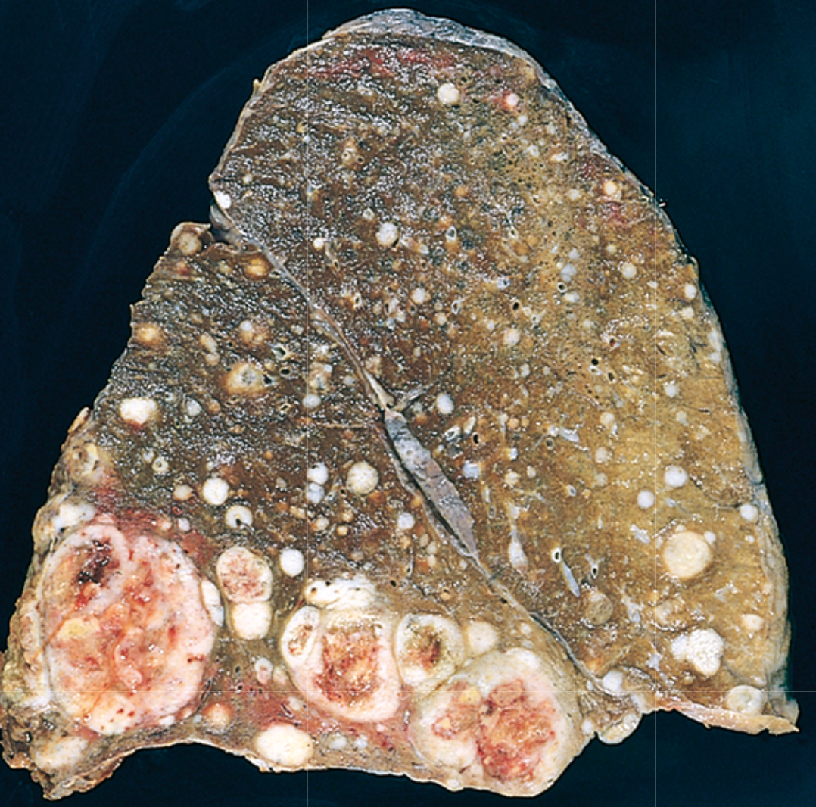
Metastatic Carcinoma of the lung
Pulmonary Metastases are More Common than Primary Lung Tumors
Metastatic tumors in the lung are typically multiple and circumscribed. When large nodules are seen in the lungs radiologically, they are called cannon ball metastases
The common primary sites are the breast, stomach, pancreas, and colon

Slide 39
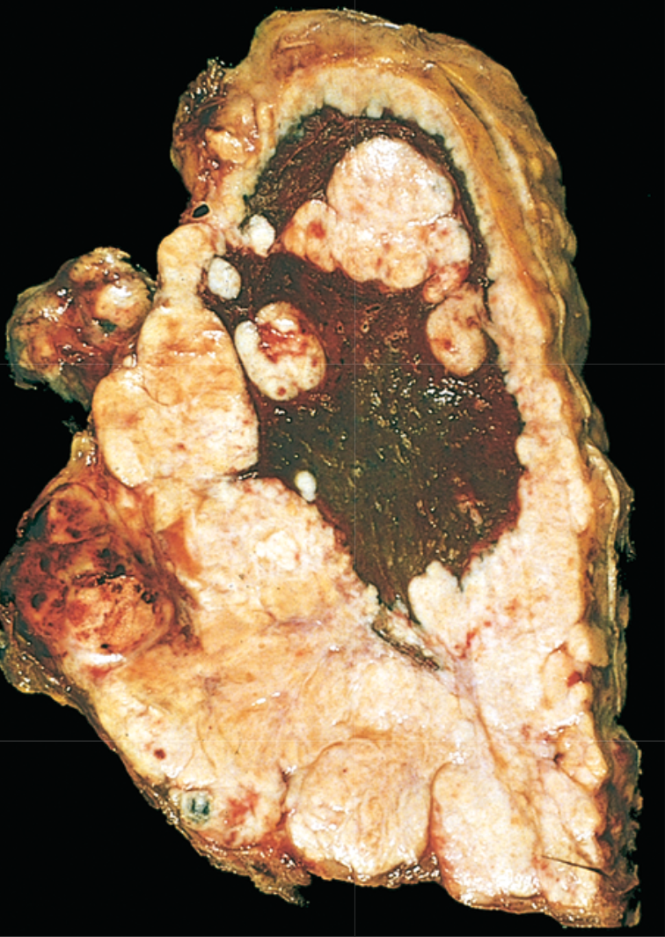
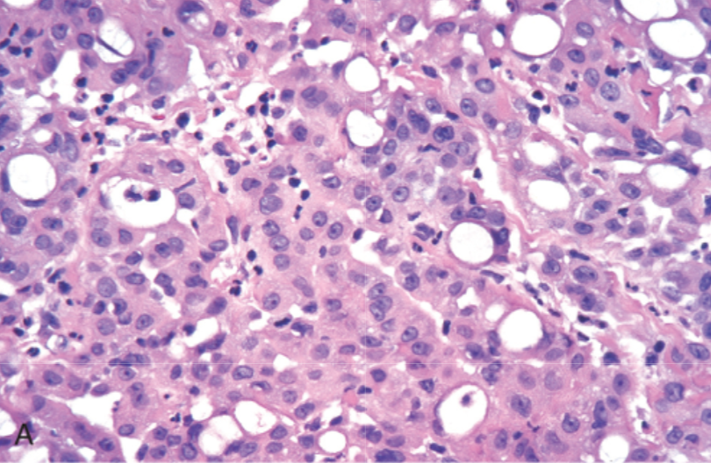
Mesothelioma
Malignant tumor of mesothelial cells lining the pleura
Highly malignant neoplasm
Most patients (70%) have a history of exposure to asbestos
Smoking is not related to mesothelioma
The average age of patients with mesothelioma is 60 years
Three main histological variants: epithelioid, spindle cell, biphasic
Pleural mesotheliomas tend to spread locally(started unilateral then spread to be bilateral) within the chest cavity, invading and compressing major structures
Metastases can occur to the lung parenchyma and mediastinal lymph nodes, as well as to extrathoracic sites e.g., liver, bones, peritoneum etc.
Treatment is largely ineffective, and prognosis is poor: few patients survive longer than 18 months after diagnosis

Slide 40
Summery
The three major histologic subtypes are adenocarcinoma (most common), squamous cell carcinoma, and small cell carcinoma, each of which is clinically and genetically distinct.
Adenocarcinomas are the most common cancers overall and are especially common in women and in non-smokers.
Precursor lesions include atypical adenomatous hyperplasia and adenocarcinoma in situ for adenocarcinomas and squamous dysplasia for squamous cancer.
Tumors 3 cm or less in diameter characterized by pure growth along pre-existing structures without stromal invasion are called adenocarcinoma in situ.
SCLCs are best treated with chemotherapy, because almost all are metastatic at presentation. The other carcinomas may be curable by surgery if limited to the lung.
Targeted therapies, such as EGFR inhibitor therapy for adenocarcinomas with EGFR mutations, can be effective, an excellent example of personalized cancer therapy. Immunotherapies are under development and show promise.
Lung cancers commonly cause a variety of paraneoplastic syndromes.

Slide 41
Protect your self

