Slide 1
Respiratory Block Obstructive Pulmonary Diseases
Dr. Wajd Althakfi, MD
Assistant Professor
KSU-KKUH
.

Slide 2
Lecture's objectives
Know that the major obstructive disorders and compare the major clinical and functional differences between them
Aware that the symptom common to all these disorders is "dyspnea" (difficulty in breathing) but each have their own clinical and anatomical characteristics
Define emphysema and the following forms of emphysema: panacinar emphysema, centriacinar emphysema
Define chronic bronchitis, describe its pathogenesis and the morphologic changes. Describe the mechanism of airway obstruction in a patient with chronic bronchitis
Define Bronchiectasis, its causes, presentation, morphology and significant

Slide 3
Table of contents
01
INTRODUCTION & DEFINITION
CHRONIC BRONCHITIS
03
Definition, pathogenesis, morphology, clinical picture, complication
EMPHYSEMA
BRONCHIECTASIS
02
04
Definition, types, pathogenesis, morphology, clinical picture, complication
Definition, pathogenesis, morphology, clinical picture, complication

Slide 4
Introduction
Obstructive (airway) disease is characterized by an increase in resistance to air flow caused by partial or complete obstruction at any level.
Chronic bronchitis
Bronchiectasis
Emphysema
Bronchial asthma

Slide 5
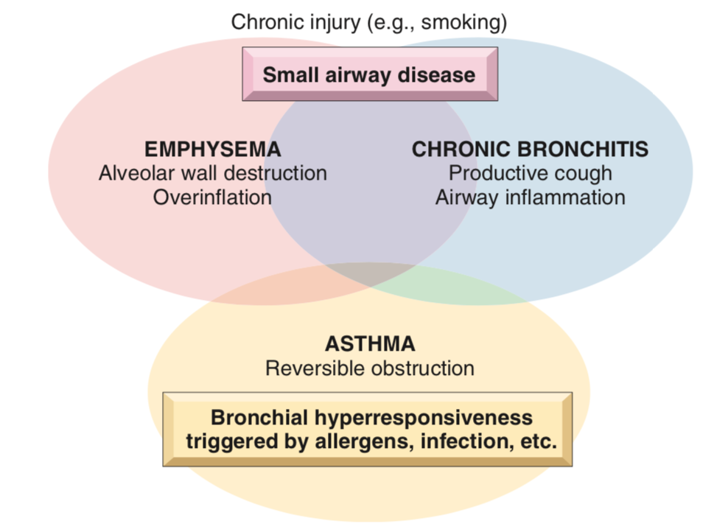
Introduction
Overlaps between emphysema, chronic bronchitis and asthma are common
The anatomic distribution of these disorders is somewhat different
Chronic bronchitis initially involves the large airways
Emphysema affects the acinus
Emphysema can exists without chronic bronchitis (particularly in α1-anti-trypsin deficiency), but usually coexist
Emphysema and chronic bronchitis often are grouped together under the rubric of chronic obstructive pulmonary disease (COPD)

Slide 6
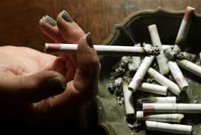
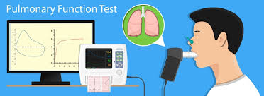
Remember
Chronic obstruction of lung airflow that interferes with normal breathing and not fully reversible
Traditionally, regarded as a combination of smoking-related lung disease: emphysema; chronic bronchitis
Pulmonary function tests:
Reduced FEV1
Normal or near-normal FVC
FEV/FVC ratio is reduced

Slide 7
Emphysema

Slide 8
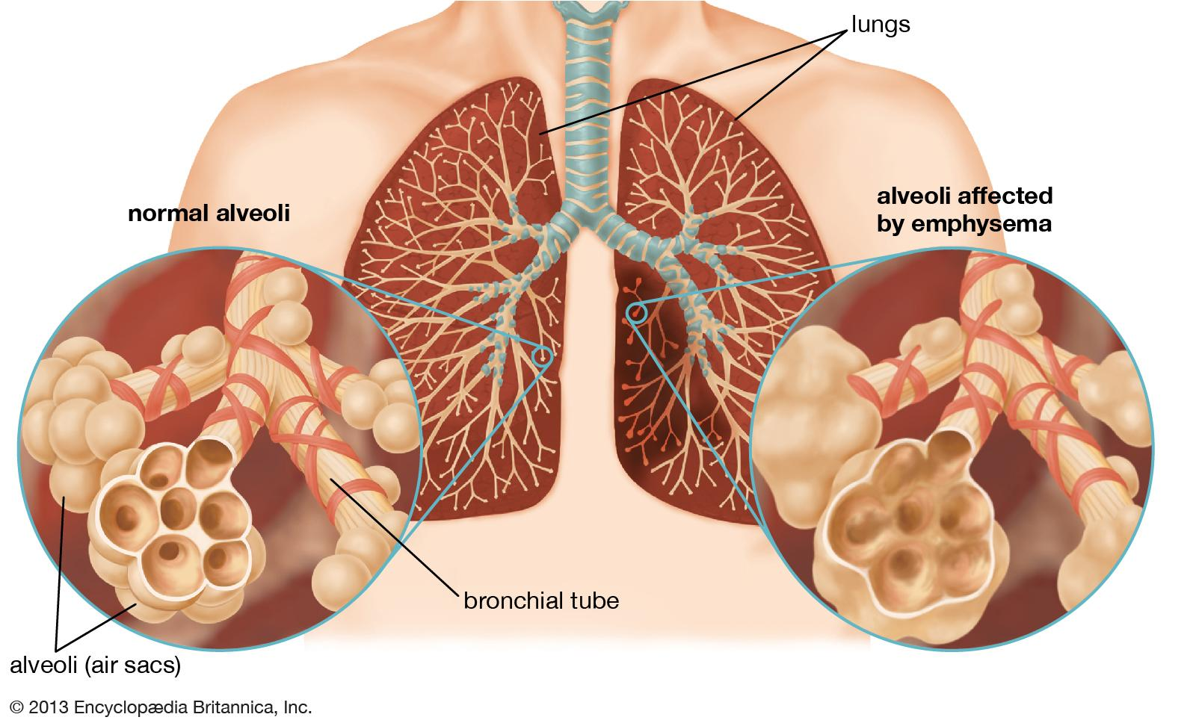
Definition and types
characterized by permanent enlargement of the air spaces distal to the terminal bronchioles, accompanied by destruction of their walls without significant fibrosis
There are four major types of emphysema:
Centriacinar
Panacinar
Distal acinar/paraseptal
Irregular
Only the first two types cause significant airway obstruction

Slide 9
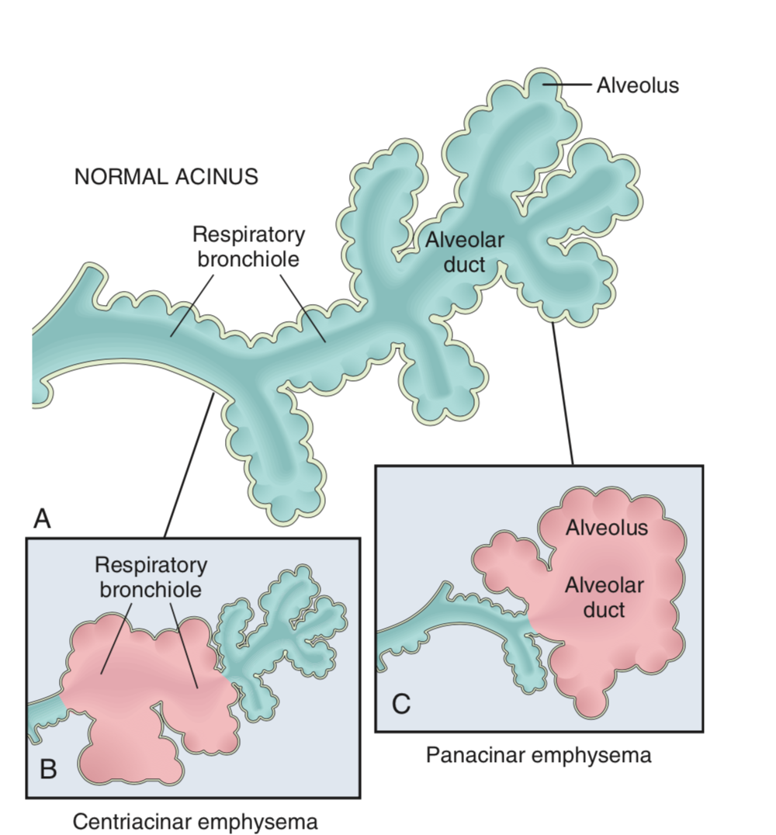
Major pattern of emphysema
Diagram of normal structure of the acinus
Centriacinar emphysema with dilation that initially affects the respiratory bronchioles
Panacinar emphysema with initial distention of all the peripheral structures (i.e., the alveolus and alveolar duct)
.

Slide 10
Centriacinar Emphysema
Panacinar Emphysema
The central or proximal parts of the acini, formed by respiratory bronchioles, are affected, while distal alveoli are spared. In other words: abnormal dilatation of respiratory bronchioles and alveolar ducts with normal alveolar sacs
More common and severe in the upper lobes
Most common in cigarette smokers, often in association with chronic bronchitis
About 20 times more common than panacinar disease
Abnormal dilatation of the whole acinus; the acini are uniformly enlarged, from the level of the respiratory bronchiole to the terminal blind alveoli
More commonly in the lower lung zones
Associated with α1-anti-trypsin deficiency

Slide 11
Distal acinar Emphysema
Irregular Emphysema
Also called paraseptal emphysema
Proximal portion of the acinus is normal, but the distal part is primarily involved
More striking adjacent to the pleura, along the lobular connective tissue septa,
Occurs adjacent to areas of fibrosis, scarring, or atelectasis
More severe in the upper half of the lungs
Spontaneous pneumothorax in young adults
The acinus is irregularly involved
Associated with scarring, such as that resulting from healed inflammatory diseases
Clinically asymptomatic

Slide 12
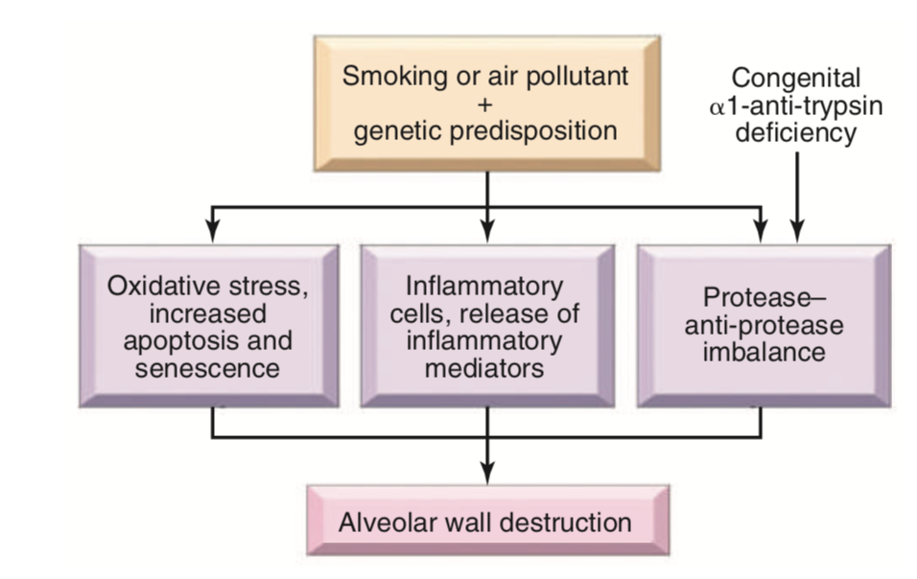
PATHOGENESIS

Slide 13
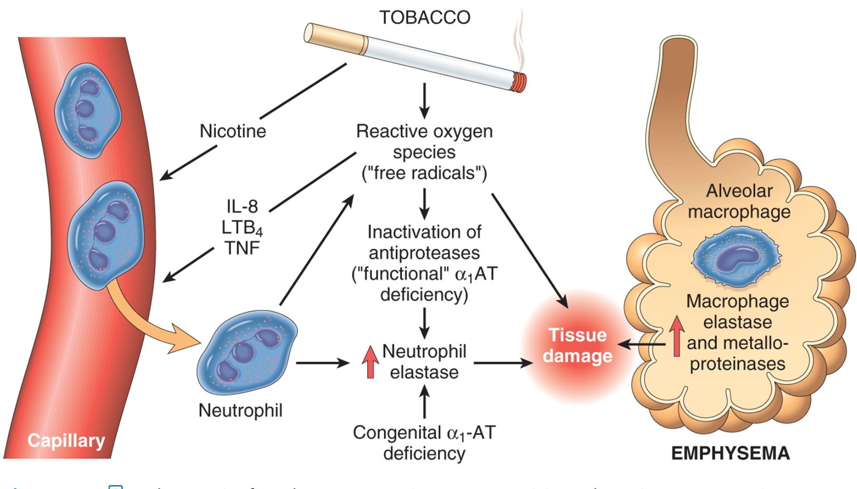

Slide 14
MORPHOLOGY

Slide 15
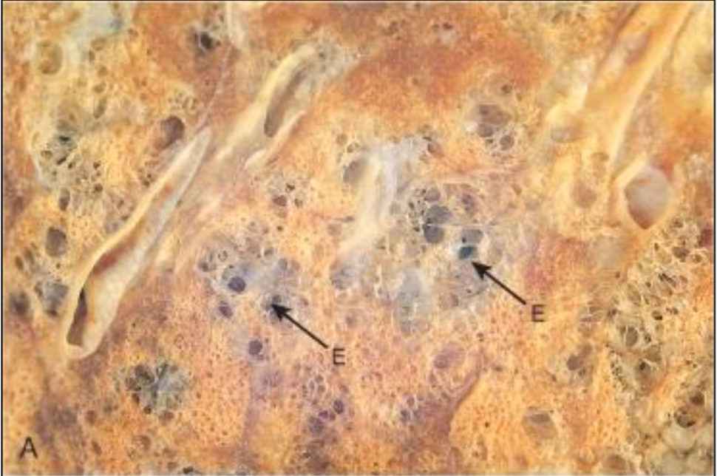
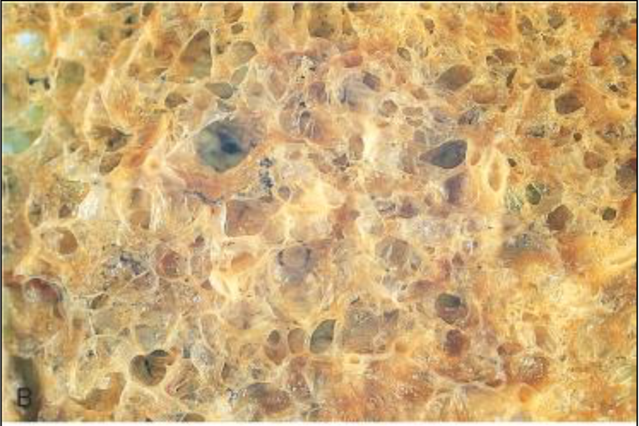
Gross morphology
Centriacinar Some parts are normal And some parts are dilated
Panacinar
Pale, voluminous lungs

Slide 16
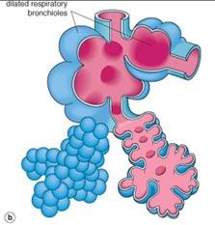
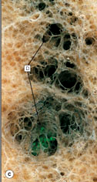
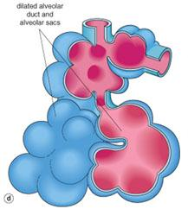

Slide 17
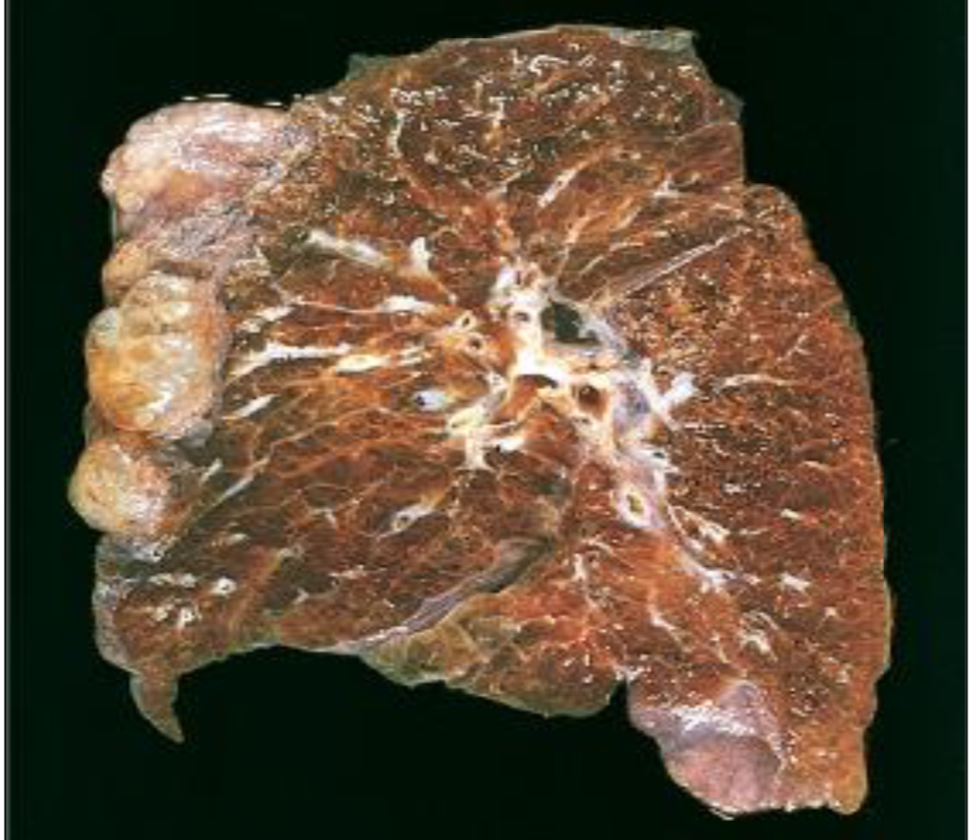
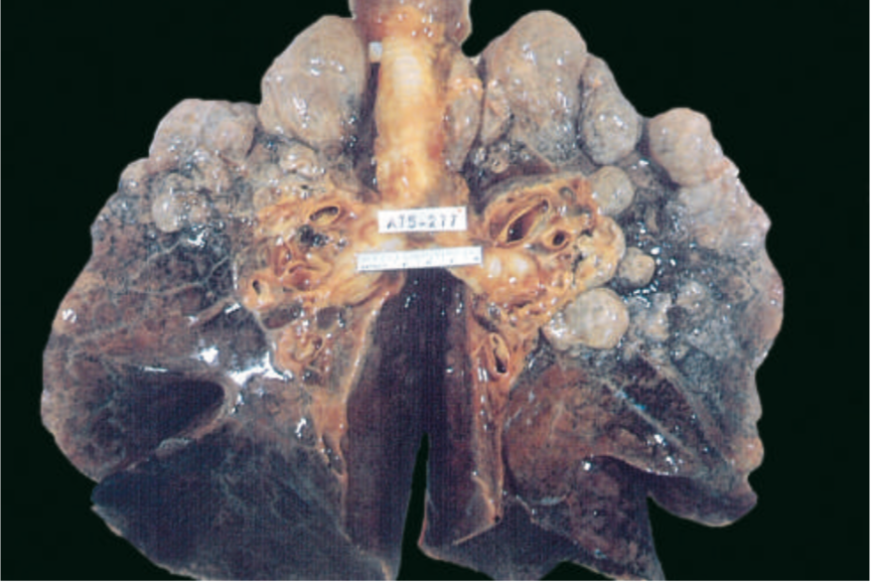
Bullous emphysema with large subpleural bullae (upper left)
Large apical blebs or bullae are more characteristic of irregular emphysema secondary to scarring and of distal acinar emphysema

Slide 18
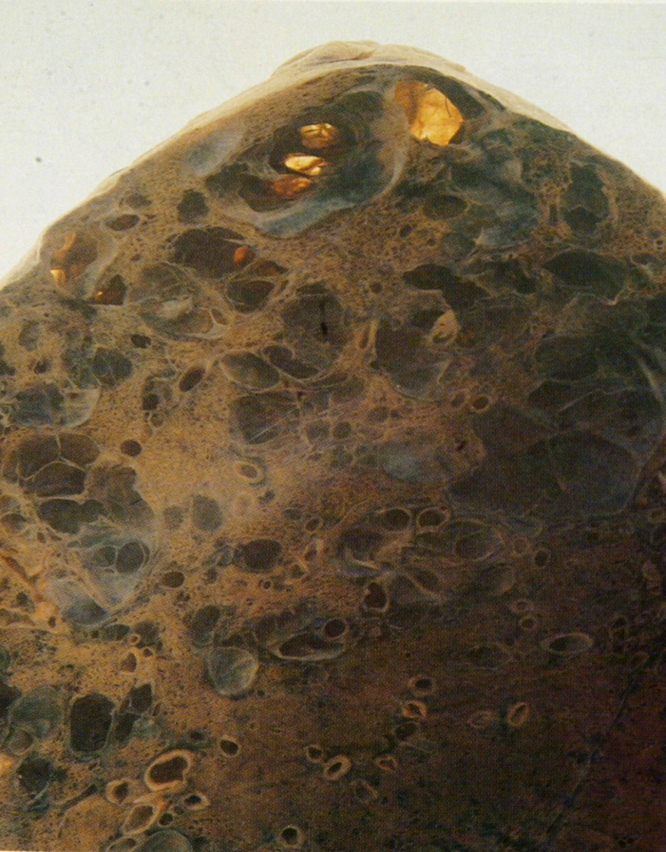
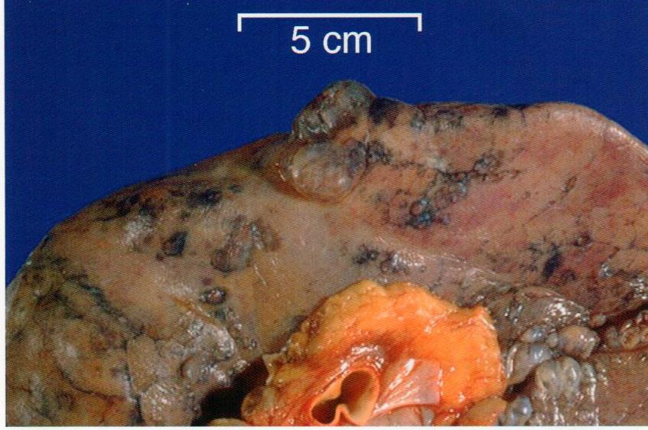
Distal acinar /paraseptal:
forming multiple cyst-like structures with spontaneous pneumothorax

Slide 19
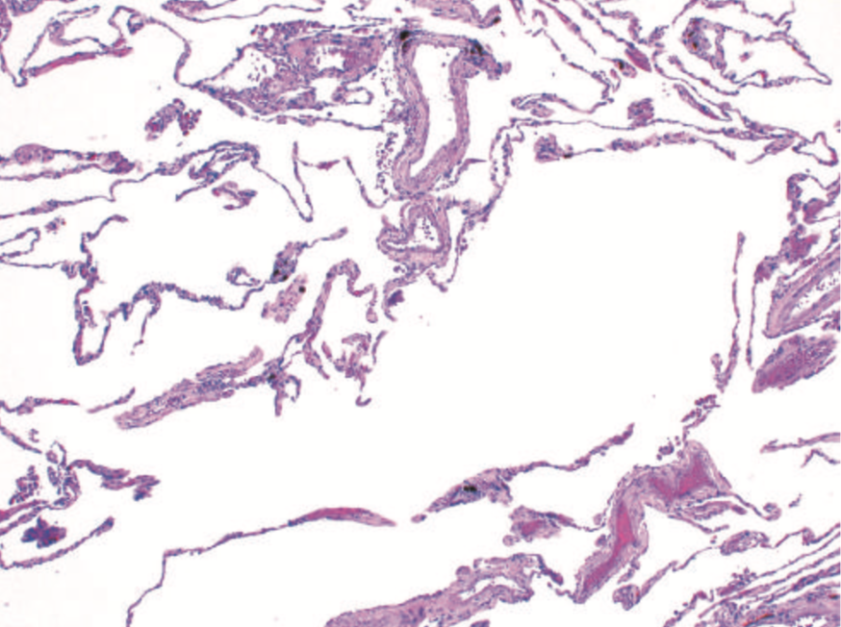
Microscopic examination
Thinning, dilated and destroyed alveolar walls (septa) with coalescence (fusion) of air spaces without fibrosis

Slide 20
Clinical Presentation
Dyspnea usually is the first symptom; it begins insidiously but is steadily progressive Cough and wheezing in patients with underlying chronic bronchitis or chronic asthmatic bronchitis Weight loss is common and may be severe enough to suggest an occult malignant tumor Secondary pulmonary hypertension can occur in 20% to 30% of patients leads to right-sided congestive heart failure (cor pulmonale)

Slide 21
Conditions Related to Emphysema
Compensatory emphysema: the dilation of residual alveoli in response to loss of lung substance else- where, such as occurs after surgical removal of a diseased lung or lobe
Obstructive overinflation: refers to expansion of the lung due to air trapping. A common cause is subtotal obstruction of an airway by a tumor or foreign object. Can be life-threatening if expansion of the affected portion produces compression of the remaining normal lung
Bullous emphysema refers to any form of emphysema that produces large subpleural blebs or bullae (spaces >1 cm)

Slide 22
Conditions Related to Emphysema
Mediastinal (interstitial) emphysema : caused by entry of air into the interstium of the lung, from where it may track to the mediastinum and sometimes the subcutaneous tissue
It may occur spontaneously if a sudden increase in intraalveolar pressure (as with vomiting or violent coughing) produces alveolar rupture
Can develop in children with whooping cough
Can occur in patients who have partial bronchiolar obstruction
In individuals with a perforating injury (e.g., fractured rib)
Subcutaneous emphysema: when the interstitial air gets into the subcutaneous tissue with marked swelling of the head and neck and crackling crepitation over the chest

Slide 23
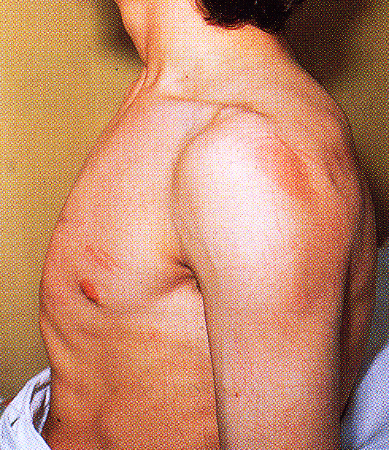
In sever cases..
Barrel-shaped chest in a patient with emphysema
As a result, from:
Air-trapping with inflammatory changes
Hypersecretion of viscid contraction in the small airways
Note the associated indrawing of the intercostal muscles. Similar changes are seen in patients with chronic bronchitis and asthma

Slide 24
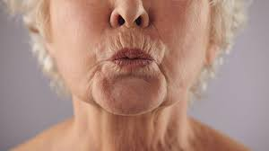
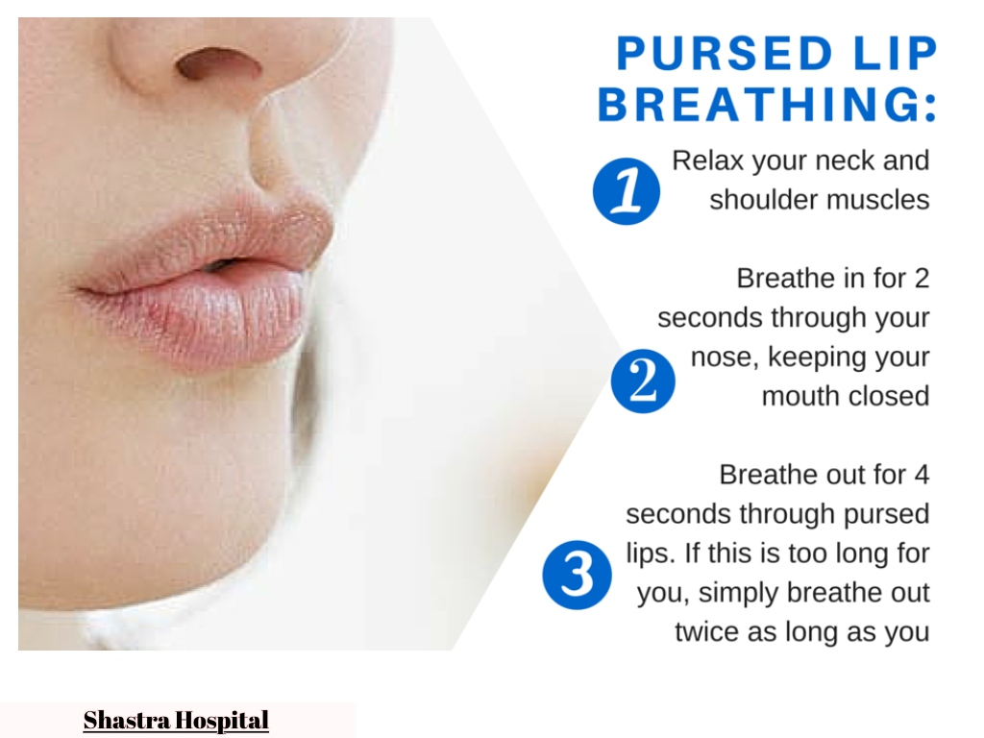
Fish-mouth breathing
Pursed lip expiration is a common maneuver adopted by patients with severe COPD including emphysema.
The patient starts to breathe out closed or nearly closed lips to keep the intrabronchial pressure high and prevent collapse of the bronchial wall and expiratory obstruction. Later in expiration the lips are blown forwards and open, often with a grunt

Slide 25
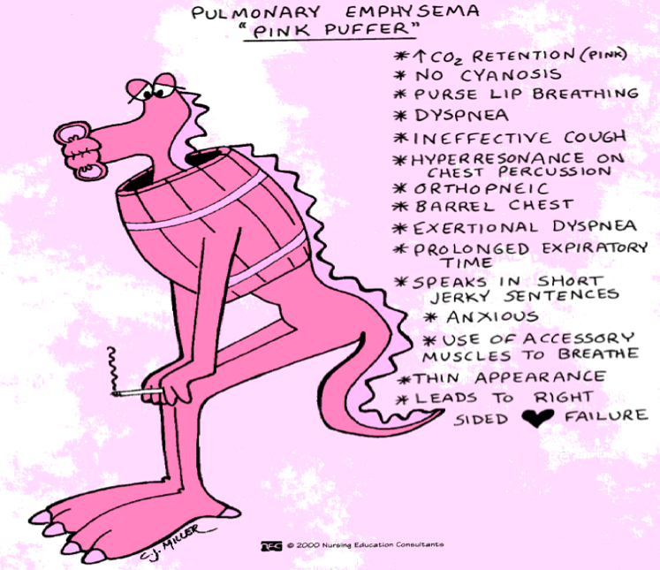
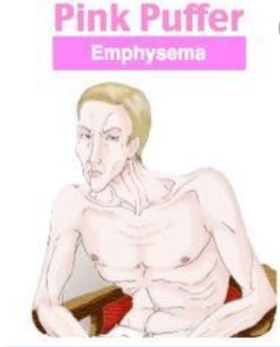
Because of prominent dyspnea and adequate oxygenation of hemoglobin

Slide 26
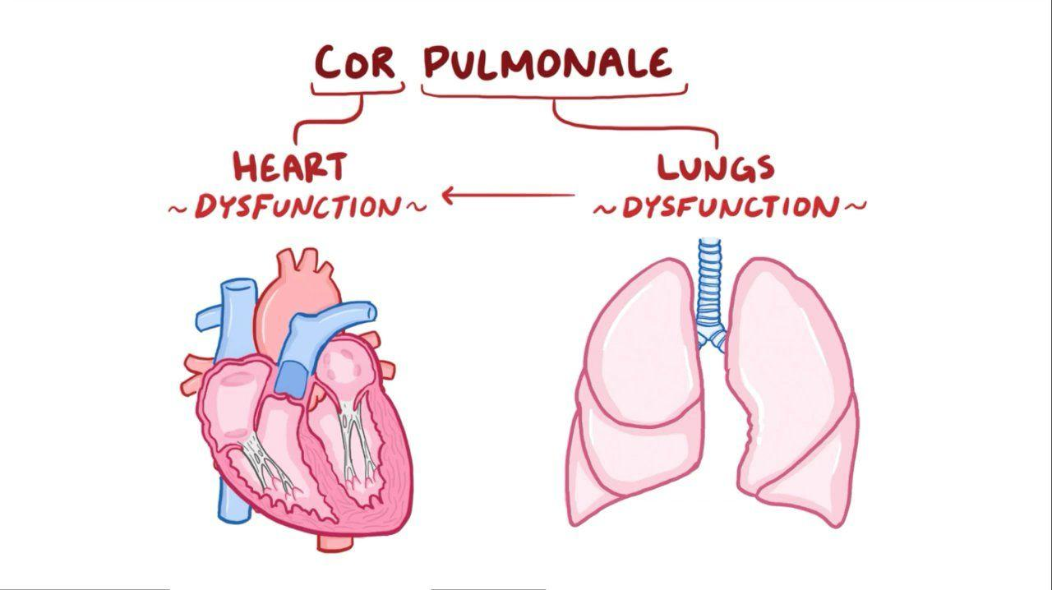
Complications
Pneumothorax
Death from emphysema is related to:
Pulmonary failure with respiratory acidosis, hypoxia and coma
Secondary pulmonary hypertension (arising from both hypoxia-induced pulmonary vascular spasm and loss of pulmonary capillary surface area from alveolar destruction)
Right-sided heart failure (Cor pulmonal)

Slide 27
Summery
Emphysema is a chronic obstructive airway disease characterized by enlargement of air spaces distal to terminal bronchioles
Subtypes include centriacinar (most common: smoking- related), panacinar (seen in α1-anti-trypsin deficiency), distal acinar, and irregular
Smoking and inhaled pollutants cause ongoing accumulation of inflammatory cells, which are the source of proteases such as elastases that irreversibly damage alveolar walls
Patients with uncomplicated emphysema present with increased chest volumes, dyspnea, and relatively normal blood oxygenation at rest (“pink puffers”)
Most patients with emphysema also have signs and symptoms of concurrent chronic bronchitis, since cigarette smoking is a risk factor for both

Slide 28
Chronic Bronchitis

Slide 29
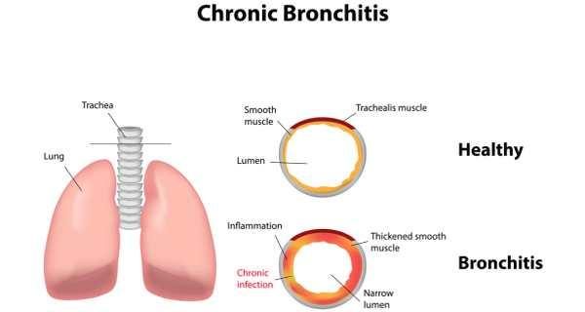
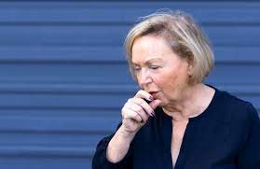
Definition
Is diagnosed on clinical grounds: it is defined by the presence of a persistent productive cough for at least 3 consecutive months in at least 2 consecutive years
Common among cigarette smokers ; air pollutants also contribute
20% to 25% of men
40- to 65-year-old age group

Slide 30
Pathogenesis
Cigarette smoking , air pollutants and Environmental irritants induce:
Hypertrophy of mucous secreting cells in trachea and bronchi Increase goblet cells in bronchiole
Chronic inflammation ; macrophages, neutrophils
Secretion of IL-13 by T lymphocytes
Chronic inflammation with increased mucous formation leads to bronchiolar obstruction along with fibrosis
As result; mild or significant air flow obstruction, which almost always complicated by emphysema

Slide 31
MORPHOLOGY

Slide 32
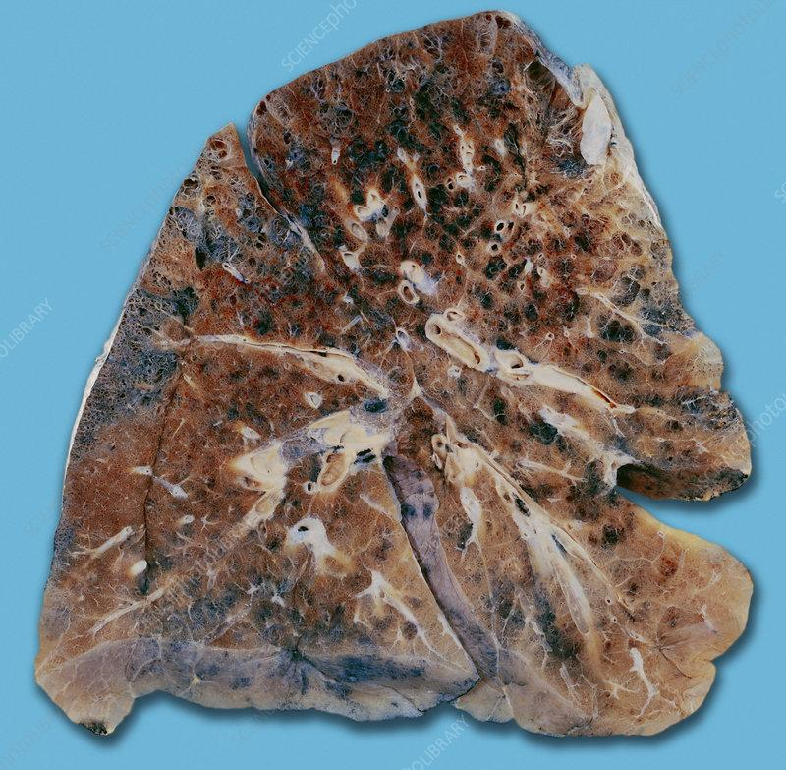
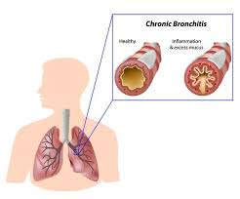
Gross Morphology
Larger airway shows redness, swelling and covered by mucous or mucopurulent Secretion
Thickening of the wall Mild narrowing of bronchial lumen
Small bronchioles are filled with secretion

Slide 33
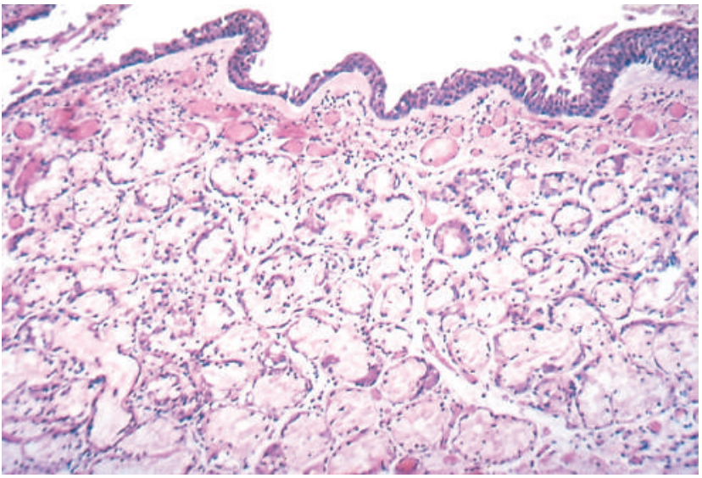
Microscopic morphology
Histologic examination
Chronic inflammation
Enlargement of mucus secreting glands
The magnitude of the increase in size is assessed by the ratio of the thickness of the submucosal gland layer to that of the bronchial wall (the Reid index— normally 0.4)
Goblet cell metaplasia
Bronchiolar wall fibrosis

Slide 34
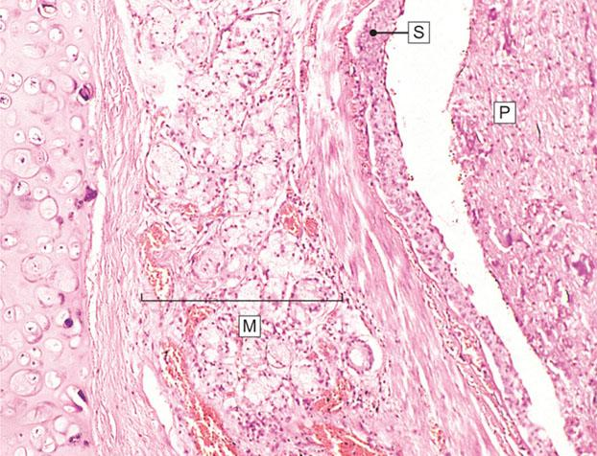
The main abnormality is secretion of abnormal amounts of mucus, causing plugging of the airway lumen

Slide 35
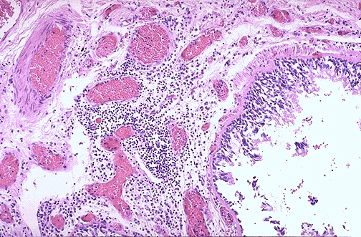
Chronic inflammation in the bronchial wall

Slide 36
Clinical Presentation & Complications
Cough and sputum production persist indefinitely without ventilatory dysfunction Outflow obstruction marked by hypercapnia, hypoxemia, and cyanosis Patients with chronic bronchitis and COPD have frequent exacerbations, more rapid disease progression, and poorer outcomes than those with emphysema alone Death due to further impairment of respiratory functions after superimposed acute bacterial infections

Slide 37
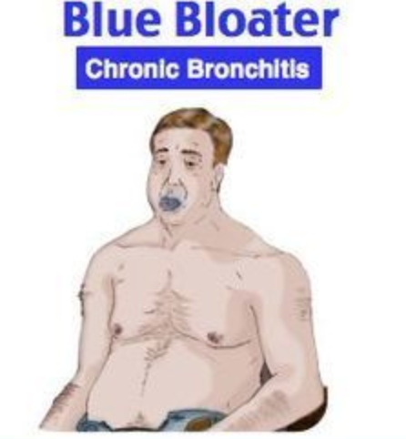
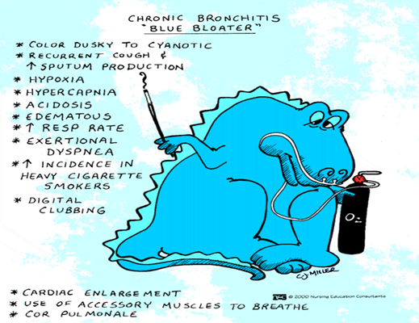
Patient with emphysema who also has pronounced chronic bronchitis and a history of recurrent infections. Dyspnea usually is less prominent, and in the absence of increased respiratory drive the patient retains carbon dioxide, becoming hypoxic and often cyanotic

Slide 38
Summery
Chronic bronchitis is defined as persistent productive cough for at least 3 consecutive months in at least 2 consecutive years
Cigarette smoking is the most important underlying risk factor; air pollutants also contribute
Chronic airway obstruction largely results from small airway disease (chronic bronchiolitis) and coexistent emphysema
Histologic examination demonstrates enlargement of mucus-secreting glands, goblet cell metaplasia, and bronchiolar wall fibrosis

Slide 39
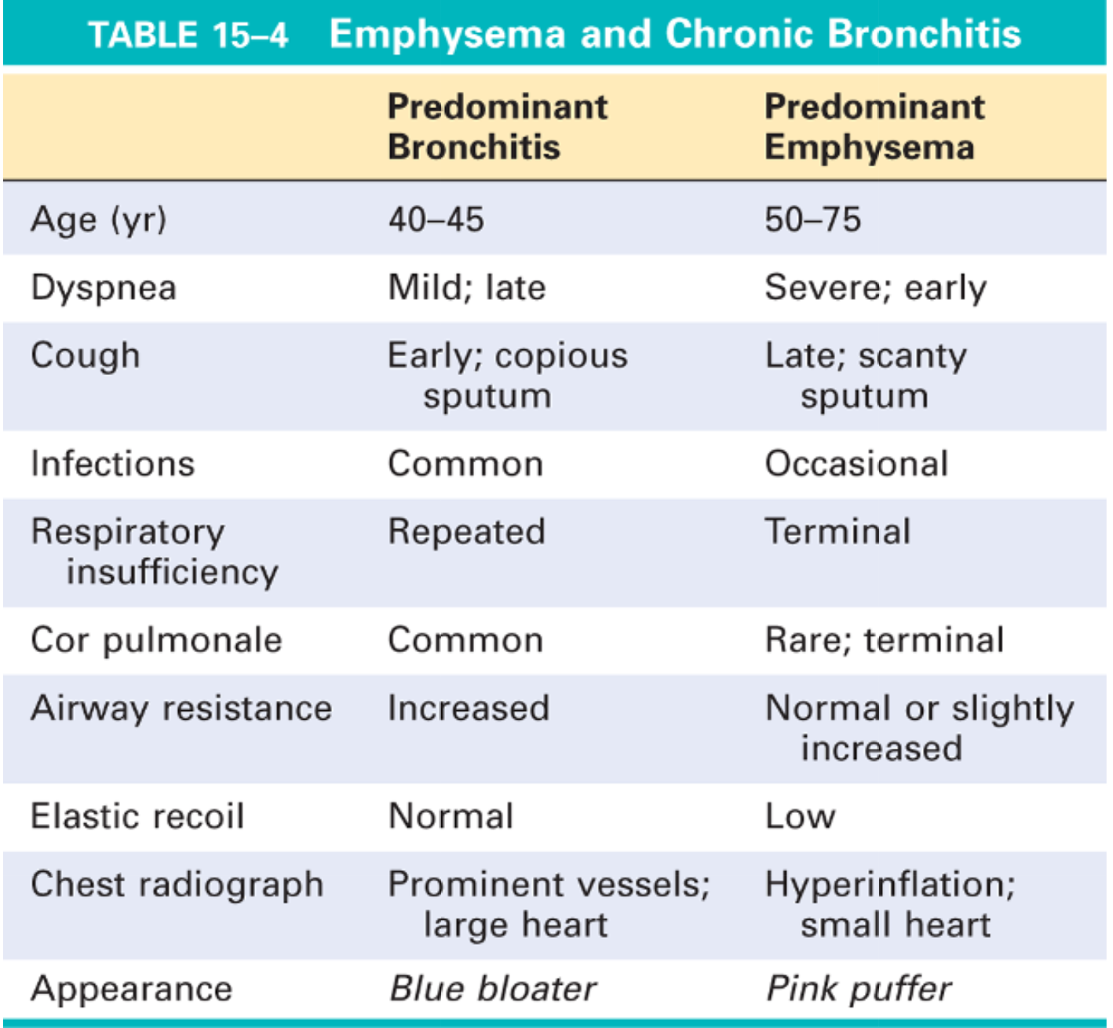

Slide 40
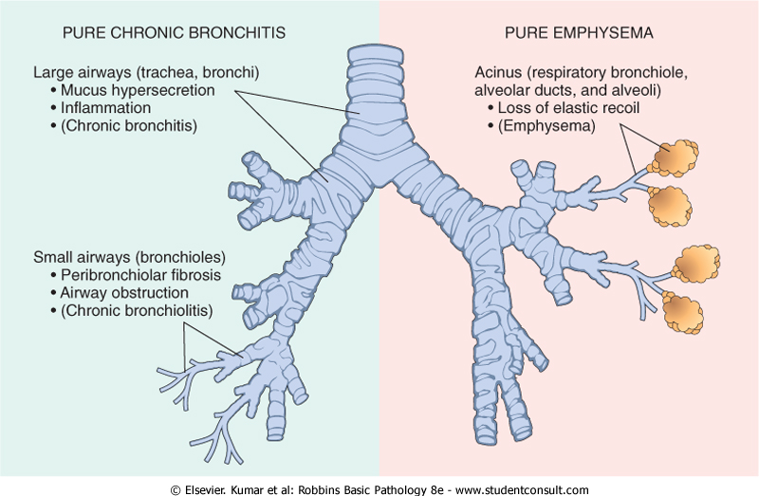

Slide 41
Bronchiectasis

Slide 42
Definition
Permanent dilation of bronchi and bronchioles caused by destruction of smooth muscle and the supporting elastic tissue; it typically results from or is associated with chronic necrotizing infections
Not a primary disorder, as it always occurs secondary to persistent infection or obstruction caused by a variety of conditions

Slide 43
Causes
Congenital or hereditary conditions
Postinfectious conditions
Bronchial obstruction
Other conditions
cystic fibrosis, intralobar sequestration, Immunodeficiency states
bacteria, viruses and fungi
RA, SLE
Tumors, foreign bodies

Slide 44
Pathogenesis
Obstruction & infections are the major cause
After obstruction→ air is resorbed from the airways distal to the obstruction→ atelectasis. Accumulation Of intraluminal secretions→ dilatation of the airways AND Bronchial wall inflammation
If the obstruction persists during the period of growth
These changes become irreversible
When superadded suppurative necrotizing type of infection
Extensive bronchial and bronchiolar wall damage (destruction with loss of elastic and smooth muscle fibers)

Slide 45
MORPHOLOGY

Slide 46
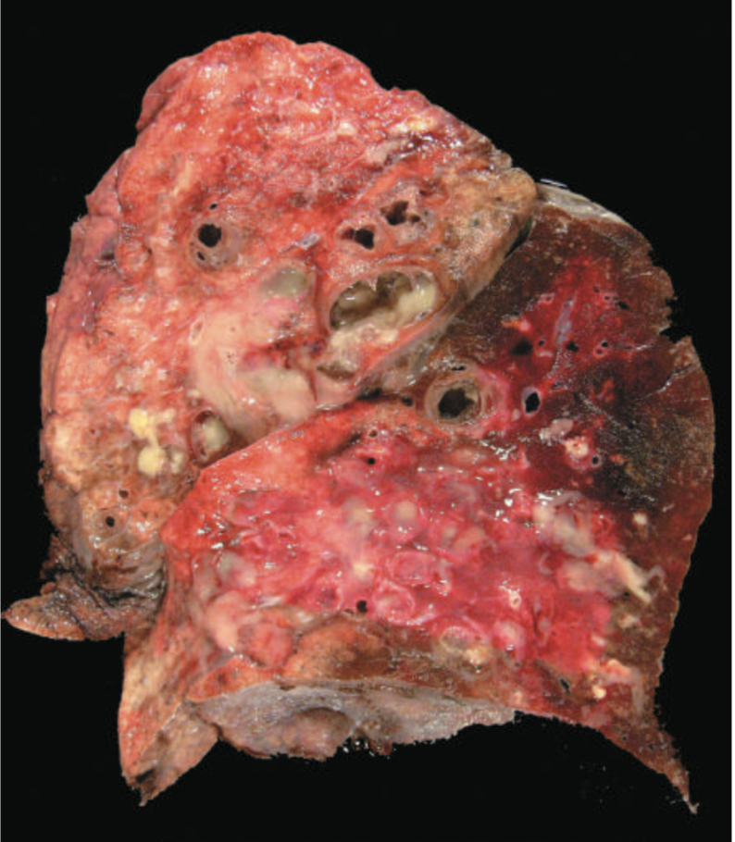
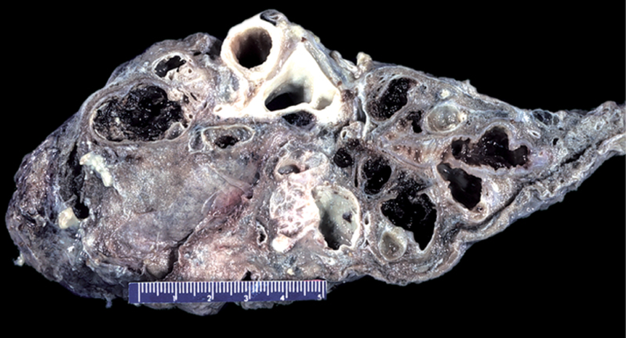
Gross examination
Usually, lower lobes or distal
Dilatation about Four times the normal diameter
Mucosa: congestion, ulcers

Slide 47
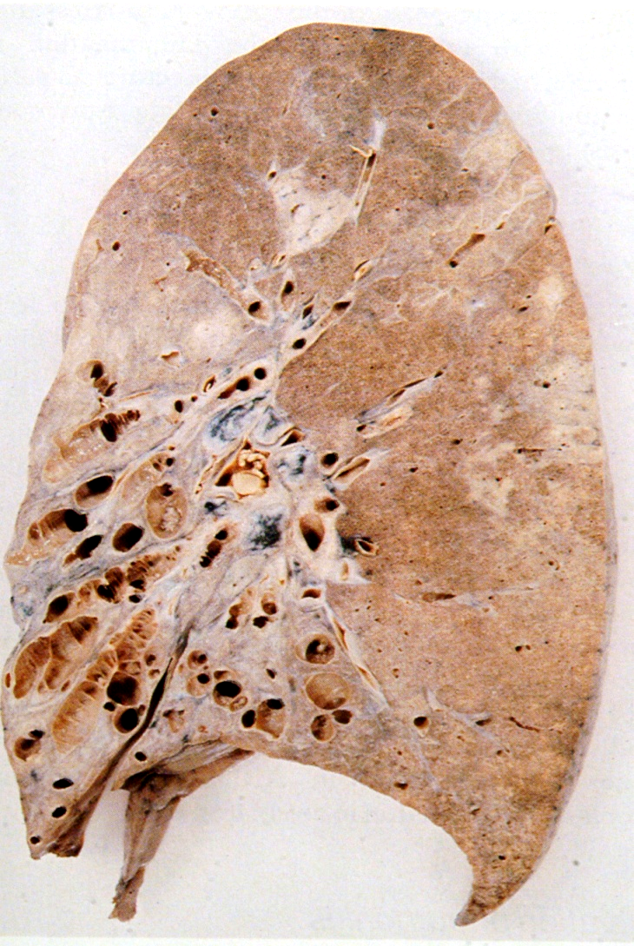
Gross examination
Dilatation of bronchi with destruction of bronchial walls

Slide 48
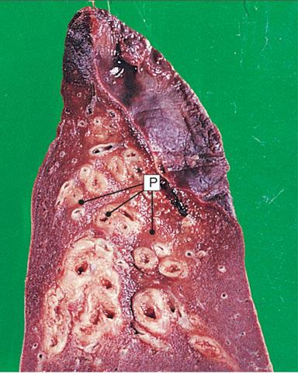
Gross examination
A lower lobe of lung surgically resected for bronchiectasis
The airways may be dilated as much as
four times their usual diameter

Slide 49
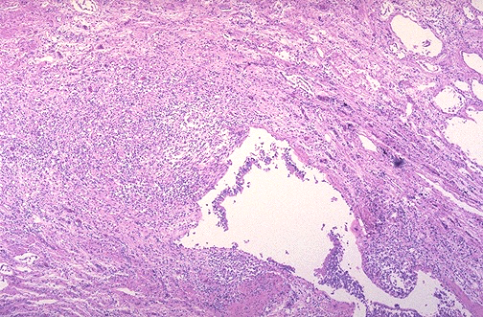
Microscopic examination
Acute and chronic inflammation
Destruction with abscesses
Epithelial ulcerations
+/- squamous metaplasia
Glandular atrophy
Fibrosis of bronchiolar wall

Slide 50
Clinical Presentation
Sever persistent cough with sputum (mucopurulent sputum) sometime with blood Dyspnea Hypoxia, hypercapnia, cyanosis Clubbing of fingers

Slide 51
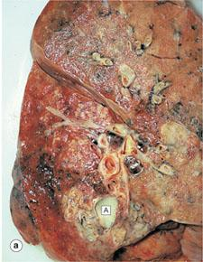
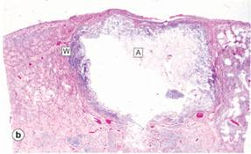
Complications
Significant obstructive ventilatory defects, with hypoxemia, hypercapnia, pulmonary hypertension, and cor pulmonale
Lung abscess
Brain abscess
Amyloidosis

Slide 52
The Spectrum of Chronic Obstructive Pulmonary Disease

Slide 53
Thanks for your attention

