Slide 1
ANTICHOLINERGIC DRUGS
Prof. Hanan Hagar Pharmacology Unit Medical College King Saud University

Slide 2
What students should know:
Student should be able to :
Identify the classification of anticholinergic drugs
Describe pharmacokinetics and dynamics of muscarinic antagonists
Identify the effects of atropine on the major organ systems.
list the clinical uses of muscarinic antagonists.
know adverse effects & contraindications of anticholinergic
drugs.
Identify at least one antimuscarinic agent for each of the
following special uses: mydriasis, cyclopedia, peptic ulcer &
parkinsonism.

Slide 3
Anticholinergic Drugs
Antimuscarinics
Antinicotinics
Ganglionic
blockers
Neuromuscular blockers

Slide 4
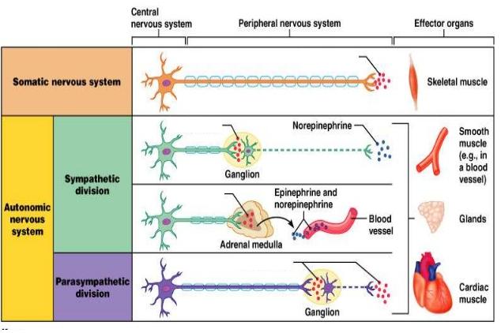
Anticholinergic Drugs
Neuromuscular blockers
Ganglionic blockers
Muscarinic blocker
Ach
Nn
Ganglionic blockers
Ganglionic blockers
M
Nm
Ach
Ach
Ach
Nn
Ach
Nn

Slide 5
Anticholinergic Drugs
Antimuscarinic Drugs
According to source
Atropine (Hyoscyamine)
Hyoscine (scopolamine)
Natural
Semisynthetic
Synthetic

Slide 6
Antimuscarinics
Muscarinic antagonists
Semisynthetic & Synthetic atropine substitutes
Homatropine (semisynthetic)
Tropicamaide
Benztropine
Pirenzepine
Ipratropium
Glycopyrrolate
Oxybutynin, Darifenacin

Slide 7
Anticholinergic Drugs
Antimuscarinic Drugs
According to structure
Tertiary amines
Atropine (Hyoscyamine)
Hyoscine (scopolamine)
lipid soluble
Quaternary ammonium
Glycopyrrolate
Ipratropium
water soluble

Slide 8
Anticholinergic Drugs
Antimuscarinic Drugs
According to selectivity
Atropine, Hyoscine
Ipratropium
Non-selective
Selective
Pirenzepine(M1)
Darifenacin(M3)

Slide 9

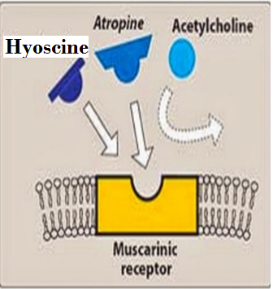
Mechanism of action
Reversible competitive blockade of muscarinic
Receptors (reverses muscarinic effects of cholinergic
drugs ).
Atropine & hyoscine can block all muscarinic
receptors (not selective).

Slide 10
Pharmacokinetics
Natural alkaloids
Atropine (Hyoscyamine)
Hyoscine (scopolamine)
Lipid soluble
Good oral absorption
Good distribution
Cross blood brain barrier (have CNS actions)
Hyoscine has better BBB penetration.

Slide 11
Pharmacodynamic Actions
CNS:
Atropine at clinical dose, initial stimulation
followed by depression (sedative effect).
Hyoscine →sedative effect
Antiemetic effect (block vomiting center).
Antiparkinsonian effect (block basal ganglia).

Slide 12

Anticholinergic actions | Cholinergic actions
relaxation (mydriasis) relaxation (cycloplegia) loss of accommodation | Eye Circular muscle of iris Contraction (miosis) Ciliary muscles Contraction accommodation for near vision
Tachycardia ( H.R) | Heart bradycardia ( H.R.)
Relaxation of muscles contraction of sphincter Urinary retention | Urinary bladder Contraction of muscles Relaxation of sphincter Urination

Slide 13
Anticholinergic drugs | Cholinergic drugs
Decrease all secretions | Exocrine glands Increase of sweat, saliva, lacrimal, bronchial, intestinal secretions
peristalsis secretion Contraction of sphincter constipation | GIT peristalsis secretion relaxation of sphincter Diarrhea
Bronchodilatation Decrease secretion | Lung Bronchoconstriction bronchial secretion

Slide 14
Pharmacodynamic Actions
CNS:
Atropine at clinical dose, initial stimulation
followed by depression (sedative effect).
Hyoscine →sedative effect
Antiemetic effect (block vomiting center).
Antiparkinsonian effect (block basal ganglia).

Slide 15
Pharmacodynamic Actions
CNS:
High doses of atropine cause cortical excitation, restlessness, disorientation, hallucinations, and delirium followed by respiratory depression and coma.

Slide 16
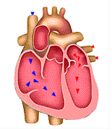
CVS:
Atropine causes initial bradycardia followed by tachycardia due to blockade of M2-receptors on SA node.
↑ AV conduction ( + ve dromotropic effect).
Atropine does not influence BP.
↓ Vasodilatation induced by cholinergic agonists.
Toxic dose: Cutaneous vasodilatation→ (atropine flush).

Slide 17
Eye:
  Passive mydriasis
  due to paralysis of circular muscle
  Cycloplegia (loss of near accommodation)
  due to paralysis of ciliary muscle.
  Loss of light reflex.
  Increase I.O.P # glaucoma.
  ↓ Lacrimal secretion → sandy eye

Slide 18
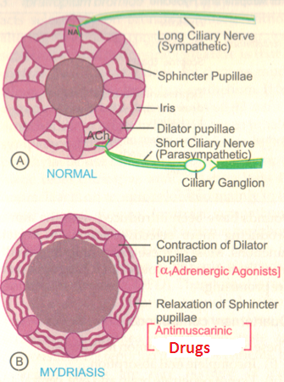
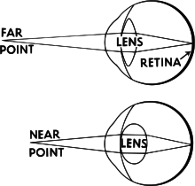
Eye:

Slide 19
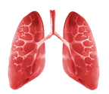
Respiratory system
Relaxation of bronchial muscles (bronchodilators)
↓ Bronchial secretion → ↑ viscosity

Slide 20
GIT:
  Dryness of mouth
  ↓ Gastric acid secretion
  Relaxation of smooth muscles.
  ↓ GIT motility → Antispasmodic effect.
  ↑ Sphincter contractions
  Constipation

Slide 21
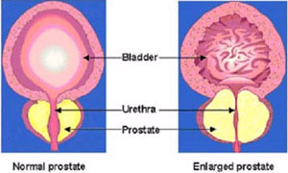
Genitourinary tract:
  Relaxation of smooth muscles of urinary bladder.
  Sphincter contraction.
  Urinary retention.
  # Contraindicated in old men with prostatic hyperplasia.

Slide 22
Secretions
↓ Salivary secretion → (Dry mouth).
↓ Sweating → dry skin
In children modest doses → “atropine fever”
↓ Bronchial secretion → ↑ Viscosity
↓ Lacrimal secretion → Sandy eye
Notes:
22

Slide 23
Clinical Uses
  Parkinsonism
  Vomiting (Motion sickness)
  Pre-anesthetic medication
  Asthma & COPD
  Peptic ulcer
  Intestinal spasm as antispasmodics
  Urinary urgency, urinary incontinence

Slide 24
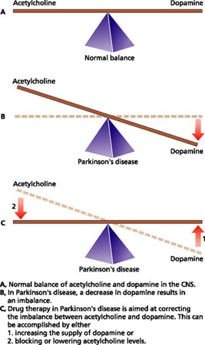
Clinical Uses
CNS:
  Parkinsonism
  e.g. Benztropine

Slide 25
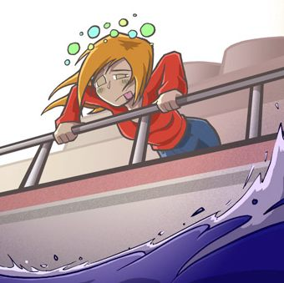
Clinical Uses
CNS:
  Motion sickness e.g. Hyoscine

Slide 26
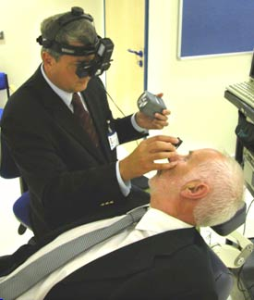
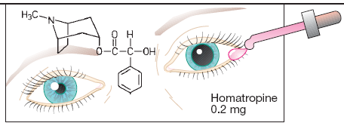
Ophthalmic disorders:
Ophthalmoscopic examination of retina
e.g. Tropicamide, homatropine

Slide 27
GIT:
e.g. Glycopyrrolate, Hyocine butyl bromide.
Intestinal spasm
Biliary and renal colics.
Irritable bowel syndrome
Atropine + diphenoxylate
used for treatment of Traveler's diarrhea with opioid

Slide 28
GUT:
Urinary incontinence & Urinary urgency caused by minor inflammatory bladder disorders
e.g. Oxybutynin
e.g. Darifenacin

Slide 29
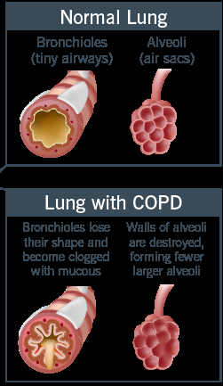
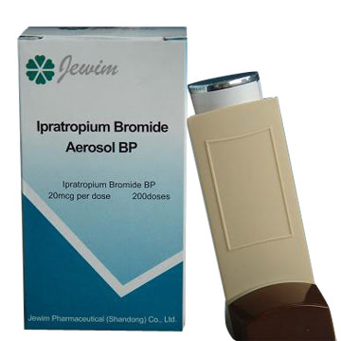
Respiratory disorders:
Bronchial asthma & chronic obstructive pulmonary disease (COPD)
e.g. Ipratropium (inhalation)

Slide 30
Cardiovascular uses:
Sinus bradycardia
atropine IV/IM
Used to increase heart rate through vagolytic effects, causing increase in cardiac output.

Slide 31
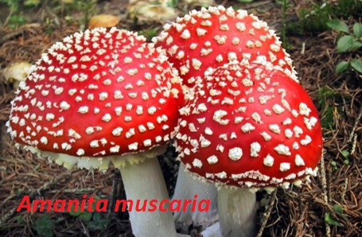
Cholinergic poisoning
Cholinesterase inhibitors “insecticides”.
Mushroom poisoning.
Atropine reverses muscarinic effects of cholinergic poisoning.

Slide 32
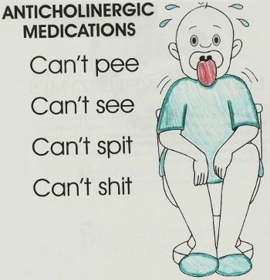
Adverse Effects
Confusion, agitation, delirium
Mydriasis, blurred vision
Dry mouth , hot flushed skin
Tachycardia
Constipation, urinary retention
↑ Body temperature
(hyperthermia)

Slide 33

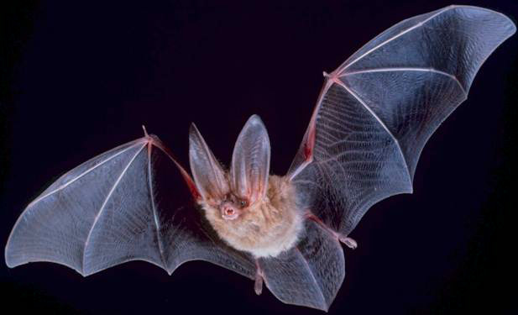
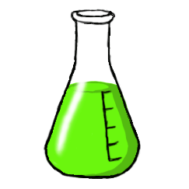
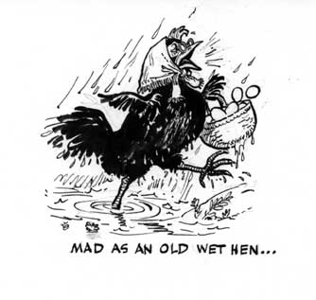
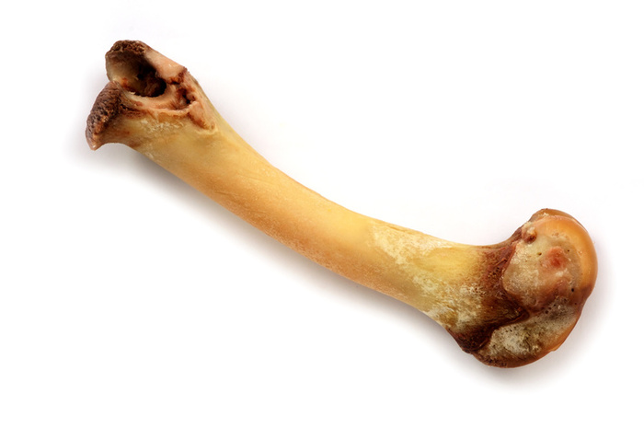
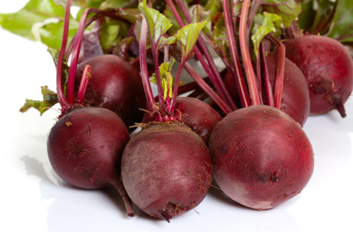
The Mnemonic
Red as a beet
Mad as a hen
Dry as a bone
Full as a Flask
Blind as a bat
Hot as Hell fire

Slide 34
Contra-indications
  Glaucoma (angle closure glaucoma)
  Tachycardia secondary to thyrotoxicosis or cardiac insufficiency
  Old patients with prostate hypertrophy.
  Paralytic ileus
  Constipation
  Children in case of atropine.

Slide 35
Uses of antimuscarinic drugs
Uses | organ | Drugs
Pre-anesthetic medication Antispasmodic | CNS | Atropine
Pre-anesthetic medication, Motion sickness, antispasmodic | CNS | Hyoscine
Parkinson's disease | CNS | Benztropine
Fundus examination | Eye | Homatropine Tropicamide
asthma, COPD, inhalation | Respiratory system | Ipratropium
Peptic ulcer | Stomach | Pirenzepine
Antispasmodics in hypermotility | GIT | Glycopyyrolate
Urinary urgency, Urinary incontinence | UT | Oxybutynin Darifenacin

Slide 36
SUMMARY
  Antimuscarinics reverse action of cholinomimetics on muscarinic receptors.
  Are useful in many applications including intestinal spasm, urinary urgency, vomiting, parkinsonism, asthma and peptic ulcer.
  Are contraindicated in constipation, Prostate hypertrophy, tachycardia and glaucoma.

Slide 37

Quiz 1?
A patient is brought into the emergency room. Upon examination you find the following: a high fever, rapid pulse, no bowel sounds and dilated pupils that do not respond to light. His lungs are clear. His face is flushed and his skin is dry. He is confused, disorientated and reports 'seeing monsters'. Based on these symptoms, you suspect he has been 'poisoned'. Which of the following, is the MOST obvious cause of poisoning?
A. Neostigmine
B. Physostigmine
C. Atropine sulfate
D. Acetylcholine

Slide 38
Quiz 2?
You are working in the post anesthesia care unit of a hospital. You have just received a patient back from surgery and you are monitoring his status. Knowing that the patient has received atropine, which of the following statements/observations is UNEXPECTED?
A. The patient is complaining of extreme thirst.
B. The patient complains he is unable to clearly see
the clock located just across from him.
C. The patient's heart rate is elevated.
D. The patient reports he has cramping and diarrhea.

Slide 39
Can antimuscarinic drugs reverse the action
of neostigmine on skeletal muscles?
What is the antidote that can be used in atropine toxicity?

Slide 40

Thank you
Questions ?

