Slide 1
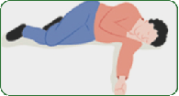
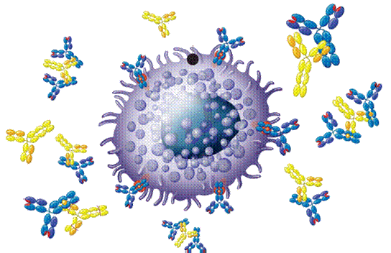
DRUGS USED IN
ANAPHYLAXSIS
Dr. Ishfaq
Dr. Aliah

Slide 2
DRUGS USED IN
ANAPHYLAXSIS
ILOs
By the end of this lecture you will be able to:
Perceive the differences between anaphylactic shock & other types of shock
Recognize its nature, causes & characteristics
Specify its diagnostic features
Identify its standard emergency management protocol
Justify the mechanism of action & method of administration of each of the different used drugs to limit its morbid outcomes.

Slide 3
ANAPHYLAXSIS
Is a sudden, severe allergic reaction affecting the whole body
symptoms including:
Rash
Mucosal swelling
Difficulty breathing
Reduced blood pressure
SHOCK
What TYPE of shock is it ???
ANAPHYLACTIC SHOCK
A life-threatening allergic reaction that causes shock (hypoperfusion) and airway swelling.

Slide 4
SHOCK
Generalized circulatory derangement causing multiple organ HYPOPERFUSION [Inadequate oxygen delivery to meet metabolic demands] & strong sympathetic activation
when intense or sustained enough, irreversible derangements sets 🠞 permanent functional deficit or death
Hypovolemic
Haemorrhage / fluid loss (plasma, ECF)
Cardiogenic
Inability to contract & pump🠞 myocardial infarction
Obstructive
Extracardiac obstruction 🠞 Pul. embolism, cardiac tamponade
Distributive
Septic shock, neurogenic, anaphylactic shock.
Severe, life-threatening, generalized or systemic hypersensitivity reaction in response to allergen.
Notes:
Anaphylactic shock & /related immediate (type I) IgE-mediated reactions affect both the respiratory & the CVS.
The syndrome of bronchospasm, mucous membrane congestion, angioedema, & severe hypotension usually responds rapidly to the
parenteral administration of epinephrine, 0.3–0.5 mg (0.3–0.5 mL of a 1:1000 epinephrine solution). IM injection may be the preferred route of administration, since skin blood flow (& hence systemic drug absorption from subcutaneous injection) is unpredictable in hypotensive patients. In some patients with impaired cardiovascular function, IV injection of epinephrine may be required.
Anaphylactic shock (caused by allergic reaction)
Cardiogenic shock (due to heart problems)
Hypovolemic shock (caused by too little blood volume)
Septic shock (due to infections)
Neurogenic shock (caused by damage to the nervous system)

Slide 5
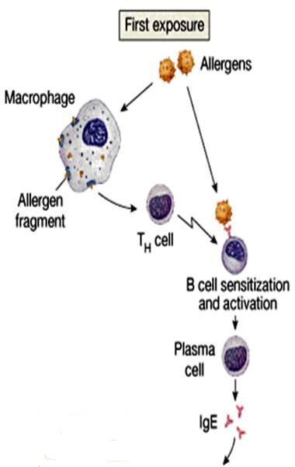
ANAPHYLACTIC SHOCK
Nature
⧫ Belong to TYPE I HYPERSENSITIVITY REACTION
Occurs after exposure to foreign substances [antigen ]; food, insect or animal venom, drugs, blood products, …..
⧫ IN PREVIOUSLY SENSITIZED PERSONS (antigen-specific IgE are present)
What happens ???
Mast Cell
N.B. Non-Immunologic Anaphylaxis
(ANAPHYLACTOID)
Exogenous substances directly degranulate mast cells🠞 Radiocontrast dye, Opiates, Depolarizing drugs, Dextrans
Notes:
There are a No. of different things that can cause allergic rxs.
Exposure to allergen causes synthesis of IgE, which binds to mast cells in the airway mucosa.
Haptens (antigen itself) are small molecules that elicit an immune response only when attached to a large carrier such as a protein; the carrier may be one that also does not elicit an immune response by itself. (In general, only large molecules, infectious agents, or insoluble foreign matter can elicit an immune response in the body.) Once the body has generated antibodies to a hapten-carrier adduct, the small-molecule hapten may also be able to bind to the antibody, but it will usually not initiate an immune response; usually only the hapten-carrier adduct can do this.
It can be mild like the seasonal allergy or severe that can lead to shock.
There are 2 types of anaphylaxis: 1- Immunologic & that’s actually the most common type. Caused by allergic material that’s in the food (like peanut), or sting (bee) >>> activating allergic response. Caused by allergen, when first get into ur body it interact with B cells, also macrophages are taking place. Macrophages, the characteristic cell type in inflammatory reactions, participate in a variety of immunological events.
B cells create Ab which are Y-shaped that react with the allergen. These Ab that are created in response to allergen are called IgE. IgE produced in plasma stimulate mast cells. This is called sensitization i.e the immune system sensitized to this allergen.
Immunoglobulin class E means immune protein binds to other immune cells which are called mast cells, these are mediators of the immune system.
2- Non-immunological. Same as immunologic but here the allergen are toxic to mast cells, specifically target the R on mast cells instead of mast cells being stimulated by IgE & same process hist & cytokines will be released.
Dextran is a polysaccharide that is frequently used for volume expansion. Possible side effects of dextran infusion include allergic reactions.
The frequency of life-threatening anaphylactic or anaphylactoid reactions occurring during anesthesia has been estimated to be between 1 in 1000 & 1 in 25,000 anesthetic procedures, with the neuromuscular blockers being involved in 80% of cases. The mortality from such serious reactions is reported to be in the range of 3.4 to 6%. The highly immunogenic drug, suxamethonium chloride (succinylcholine), was found to be the most hazardous agent.

Slide 6
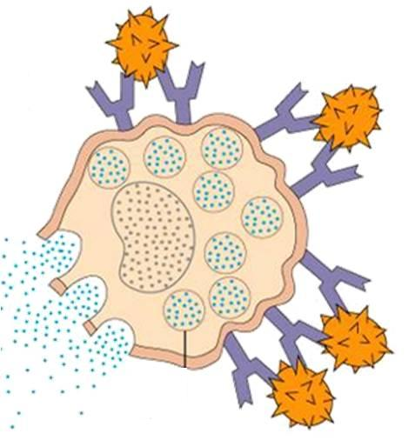
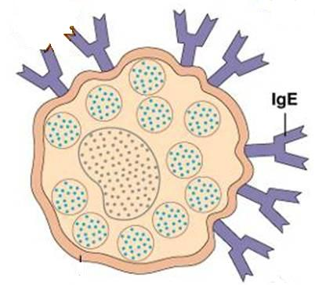
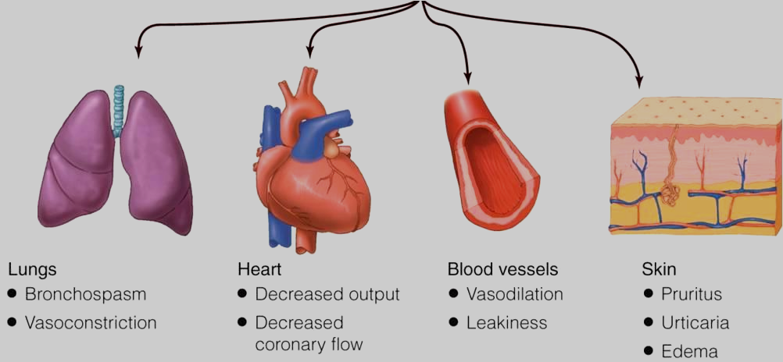
ANAPHYLACTIC SHOCK
Second or later exposure
Mast Cell DEGRANULATION
Characters
Antigen Re-exposure
Histamine, Leukotrienes, others
2.
Mucous Swelling
Rhinitis 16%
Angioedema 88%
Airway 56%
GIT 30%
4.
Circulatory Collapse
Hypo-perfusion
1.
3.
47%
88%
33%
Shortness of breath
Rapidly developing [ 5/30 min. 🠊 can be hours ]
Severe, life-threatening
Multisystem involvement
Mortality: due to respiratory (70%) or cardiovascular (25%).
Notes:
So in the next exposure to this allergen this allergen will bind to these Ab causing rapid allergic response from these sensitized cells.
Antigen-Ab interaction on mast cell surfaces triggers release of mediators of anaphylaxis: histamine, tryptase, prostaglandin D2 (PGD2), leukotriene (LT) C4, & platelet-activating factor (PAF). Mast cells will release immune molecules called CYTOKINEs (cellular communicators) to communicate with WBCs. These WBCs become recruited & activated.
There will be massive release of histamine in anaphylaxis which is potent inflammatory mediator & VD so dilate blood vessels
Leukotrienes: LTC4 and LTD4 are potent bronchoconstrictors & are recognized as the primary components of the slow-reacting substance of
anaphylaxis (SRS-A) that is secreted in asthma & anaphylaxis.
These agents provoke contraction of airway smooth muscle, causing the immediate fall in forced expiratory volume in 1 sec (FEV1). Reexposure to allergen also causes the synthesis & release of a variety of cytokines: interleukins (IL) 4 and 5, granulocyte-macrophage colony-stimulating factor (GM-CSF), TNF, & tissue growth factor (TGF) from T cells & mast cells.
These cytokines in turn attract & activate eosinophils & neutrophils, whose products include eosinophil cationic protein (ECP), major basic protein (MBP), proteases, & PAF. These mediators cause the edema, mucus hypersecretion, smooth muscle contraction, & increase in bronchial reactivity associated with the late asthmatic response, indicated by a second fall in FEV1 3–6 hours after the exposure.
Large drop in BP & the blood vessels become leaky, so the fluid escaping from the vasculature
% are the prevalence or % of ppl affected
Mortality if NOT treated.

Slide 7
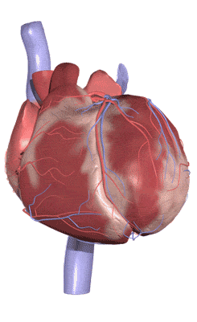
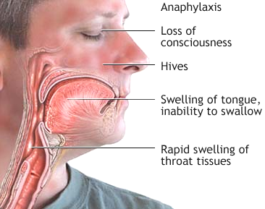
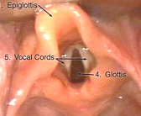
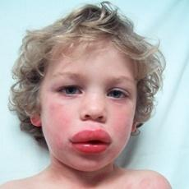
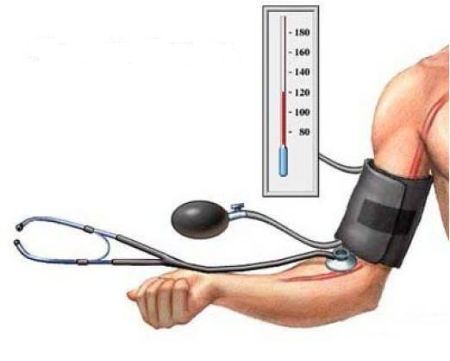
Fainting, Syncope
ANAPHYLACTIC SHOCK
IS A MEDICAL EMERGENCY WHERE IMMEDIATE TREATMENT IS NEEDED TO PREVENT POTENTIAL DEATH.
Notes:
So if u check the patient:
Non responsive
Flushing & severe swelling
Not able to breath & wheezing sound
V low BP
Heart: BC/ TC
with involvement of the skin, mucosal tissue, or both (eg, generalized hives, pruritus or flushing, swollen lips-tongue.
Respiratory compromise (eg, dyspnea, wheeze-bronchospasm, reduced PEF, hypoxemia)
b. or associated symptoms of end-organ dysfunction (eg, hypotonia [collapse], syncope, incontinence)

Slide 8
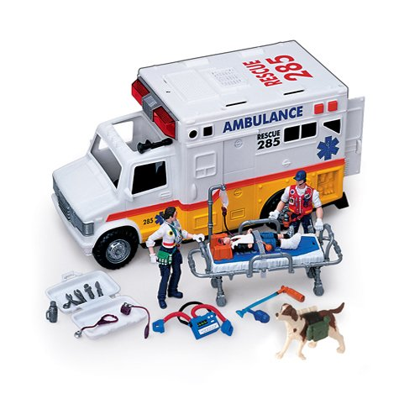
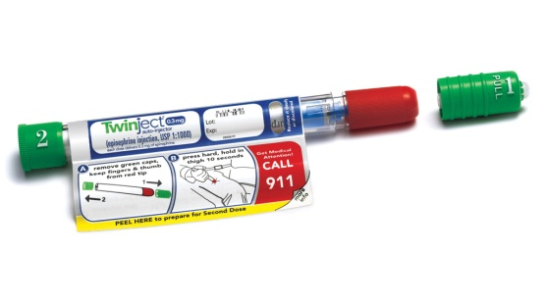
ANAPHYLACTIC SHOCK
Open Airway
O₂ Inhalation
Respiratory Support
DIAGNOSIS IS MADE
START
EMERGENCY
TREATMENT
Circulatory Support
Lay down / Legs up
Fluid Replacement
Adrenaline
IM by Auto-injector
Or by syringe

Slide 9
ANAPHYLACTIC SHOCK THERAPY PROTOCOL
RESCUE
1ST LINE
2ND LINE
ADJUVANT TO 2ND LINE
6. Bronchodilators
7. Glucagon
8. H₂ Blockers
Notes:
C: IV fluid replacement to increase plasma volume
Chlorphenamine: Antihistamine; H1 blocker, antiallergic
The most commonly used crystalloid fluid is normal saline, a solution of sodium chloride at 0.9% concentration, which is close to the concentration in the blood (isotonic).
Adjuvant = supportive

Slide 10
ANAPHYLACTIC SHOCK THERAPY PROTOCOL
ADJUVANT TO 2ND LINE
To support the respiratory & circulatory deficits
To halt the existing hyper-reaction
To prevent further hyper-reaction of immune system
Objective of Therapy
Biphasic phenomenon
2nd release of mediators without re-exposure to antigen (in up to 20% )
Clinically evident 3-4 h after the initial manifestations clear.
Notes:
Biphasic anaphylaxis is a recurrence of anaphylaxis after appropriate treatment. It happens with no additional exposure to the allergen. As anaphylaxis, part 2.
Biphasic phenomenon is variable & dependent on the patient & the type of allergen. Some allergens have like double action, or the remaining free allergens may trigger further rx
Symptoms of the second phase of anaphylaxis are typically mild or moderate. Recurrent symptoms generally appear in the first 4-6 hours.

Slide 11
ADRENALINE
A Sympathomimetic.
1ST LINE
Mechanism
A nonselective AD agonist [α₁, α₂, β₁, β₂ ]
Actions
As an α-AD agonist🠞
Reverses peripheral vasodilation 🠞 maintains BP & directs blood flow to major organs
🠋 edema 🠞 reverse hives, swelling around face & lips & angioedema in nasopharynex & larynx
As a β-AD agonist 🠞
Dilates bronchial airways +🠋 histamine & leukotriene release from mast cells 🠞 β₂ effect
🠉 force of myocardial contraction 🠞 β₁ effect
PHYSIOLOGICAL ANTAGONIST
Attenuates the severity of IgE-mediated allergic reactions.
Contraindications
Rare in a setting of anaphylaxsis
Not given > 40 y cardiac patient
Indication
DRUG OF CHOICE
ADRs
Dysrrhythmias
Notes:
Epinephrine activates α, β1, and β2 receptors, all of which may be important in reversing the pathophysiologic processes underlying anaphylaxis.
It is recommended that patients at risk for anaphylaxis carry epinephrine in an autoinjector (EpiPen, Auvi-Q) for self-administration.
This will be discussed in > detail in Adr agonists & bronchodilators.

Slide 12
ADRENALINE
1ST LINE
Administration
Best is (IM) route in anaphylaxis. Why ?
Easily accessible
Greater margin of safety 🠞 no dysrrhythmias as with IV
No need to wait for IV line 🠞 if present
🠞 given by physician under monitoring
Auto-injectors Kits;
Disposable, prefilled
devices 🠞 automatically administer a single dose of epinephrine in emergency
Repeat every 5-10 min as needed
Patients observed for 4-6 hours. Why ?
Fear of biphasic anaphylaxis
N.B. Caution
Patients taking β-blockers either are 🠞
Refractory; as it may antagonize β effects of adrenaline
Rebound hypertension 🠞 [unopposed α effect], specially when adrenaline is repeated
If hypotension persist 🠞 start dopamine. Why not noradrenaline?
Dopamine (act on D1 R, adrenergic vasopressor) is given in low dose to treat BP, COP & blood flow.
Notes:
Auto injector kit for patients with history of anaphylaxis
IV Adr can cause cardiac arrest.
Rebound HTN as a reflex compensatory mechanism bec u r blocking B & the alpha still active.
If Ad didn’t work in patients taking b-blockers NA a selective alpha is not going to work

Slide 13
CORTICOSTEROIDS
2ND LINE
It can not be used alone 🠞 not life saving
Given slowly IV or IM
Reverse hypotension & bronchoconstriction 🠞 🠋 release of inflammatory mediators (anti-chemotactic & mast cell stabilizing effects)
Also decrease mucosal swelling & skin reaction
This is through immediate GCs action on Membrane-bound receptors 🠞 modulating levels of 2nd messengers 🠞 (within seconds or minutes) 🠞 Non-genomic action
(genomic action is slow may take hrs - days)
May help to limit biphasic reactions 🠞 🠋 allergic mediators.
Notes:
GC Anti-inflammatory
GC glucocorticoids in mast cells
In mast cells the action of GC will be acute Non genomic : surface action thru R & 2nd messenger.
Genomic with chronic use

Slide 14
2ND LINE
H₁ BLOCKERS
It can not be used alone 🠞 not life saving
Given slowly IV or IM (e.g pheniramine)
Though mast cells have already de-granulated, yet these drugs can still help to counteract histamine-mediated vasodilatation & bronchoconstriction
May help to limit biphasic reactions by blocking histamine receptors
H₂ BLOCKERS
The significance of H2 blockers is not established, these drugs are associated with serious adverse drug interactions. Proton pump inhibitor (e.g. Pantoprazole) is safer & given once.

Slide 15
ANAPHYLACTIC SHOCK THERAPY PROTOCOL
ADJUVANT TO 2ND LINE
Bronchodilators : Salbutamol nebulizer / Ipratropium nebulizer / Aminophylline IV
Glucagon: For patients taking β-blockers & with refractory hypotension🠞1 mg IV q 5 minutes until hypotension resolves
H₂ blocker: Ranitidine 150 mg IV / No cimetidine in elderly, renal/ hepatic failure, or if on β-blockers.??
Notes:
Bronchodilators: to treat bronchospasm.
Studies have shown that treatment with a combination of H1 and H2 antagonists is more effective than treatment with H1 antagonists alone.
Cimetidine is no more recommended bec of its DI (Cyt P450 enz inhibition) & liver toxicity.
H2 blocker is given only in epigastric pain.

Slide 16
BRONCHODILATORS
Inhalational
Salbutamol🠊β₂-AD agonist 🠊short acting, rapid relief onset relax bronchial smooth muscle & may decrease mediators release from mast cells & basophils
It may also inhibit airway microvascular leakage
Ipratropium🠊 Anticholinergic 🠊longer duration of action 🠊 🠋 secretion
Less rapid in action
Parentral
Aminophylline IV 🠊 may be useful in the treatment of anaphylaxis when inhaled broncho-dilators are not effective & bronchospasm is persistent
Given in hospital setting as levels of drug should be Therapeutically Monitored (has narrow therapeutic index).
Notes:
Salbutamol: highly selective β2-adrenergic R stimulating drug that has a bronchodilator effect. Salbutamol Nebuliser Solution is indicated for use in the routine management of chronic bronchospasm unresponsive to conventional therapy & the treatment of acute severe asthma. Should be administered by a suitable nebuliser, via a face mask or T piece or via an endotracheal tube.
Ipratropium bromide is an anticholinergic agent, blocks muscarinic cholinergic Rs, without specificity for subtypes, resulting in a decrease in the formation of cyclic guanosine monophosphate (cGMP). Most likely due to actions of cGMP on intracellular calcium, this results in decreased contractility of smooth muscle.
Aminophylline acts by increasing concentrations of intracellular cAMP, in some tissues, cGMP. Cyclic AMP regulates many cellular functions including, but not limited to, stimulation of cardiac function, relaxation of smooth muscle, & reduction in the immune & inflammatory activity of specific cells.
Glucagon: raise blood glucose at the expense of stored hepatic glycogen.
Glucagon is sometimes useful for reversing the cardiac effects of an overdose of β-blocking agents because of its ability to increase cAMP production in the heart. Glucagon increase cAMP & has a potent inotropic & chronotropic effect on the heart, mediated by the cAMP mechanism. Thus, it produces an effect very similar to that of β-adrenoceptor agonists without requiring functioning β receptors.

Slide 17
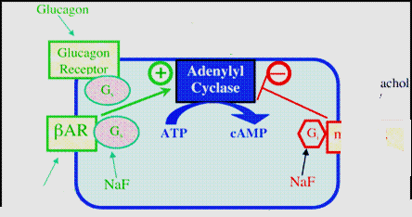
GLUCAGON
2ND LINE
Drug of choice for severe anaphylaxis in patients taking β-blockers
Has both positive inotropic & chronotropic effects on heart 🠊 🠉 cardiac cyclic AMP 🠊 an effect entirely independent of adrenergic receptors, that is why effective in spite of β-adrenergic blockade.
Efficacy of acting on bronchi < heart 🠊 no evident bronchodilation.
Glucagon
G_{s}
G_{s}
M₂ & M₃
Sympathomimetics
Ipratropium
Notes:
AR adrenergic

