Slide 1
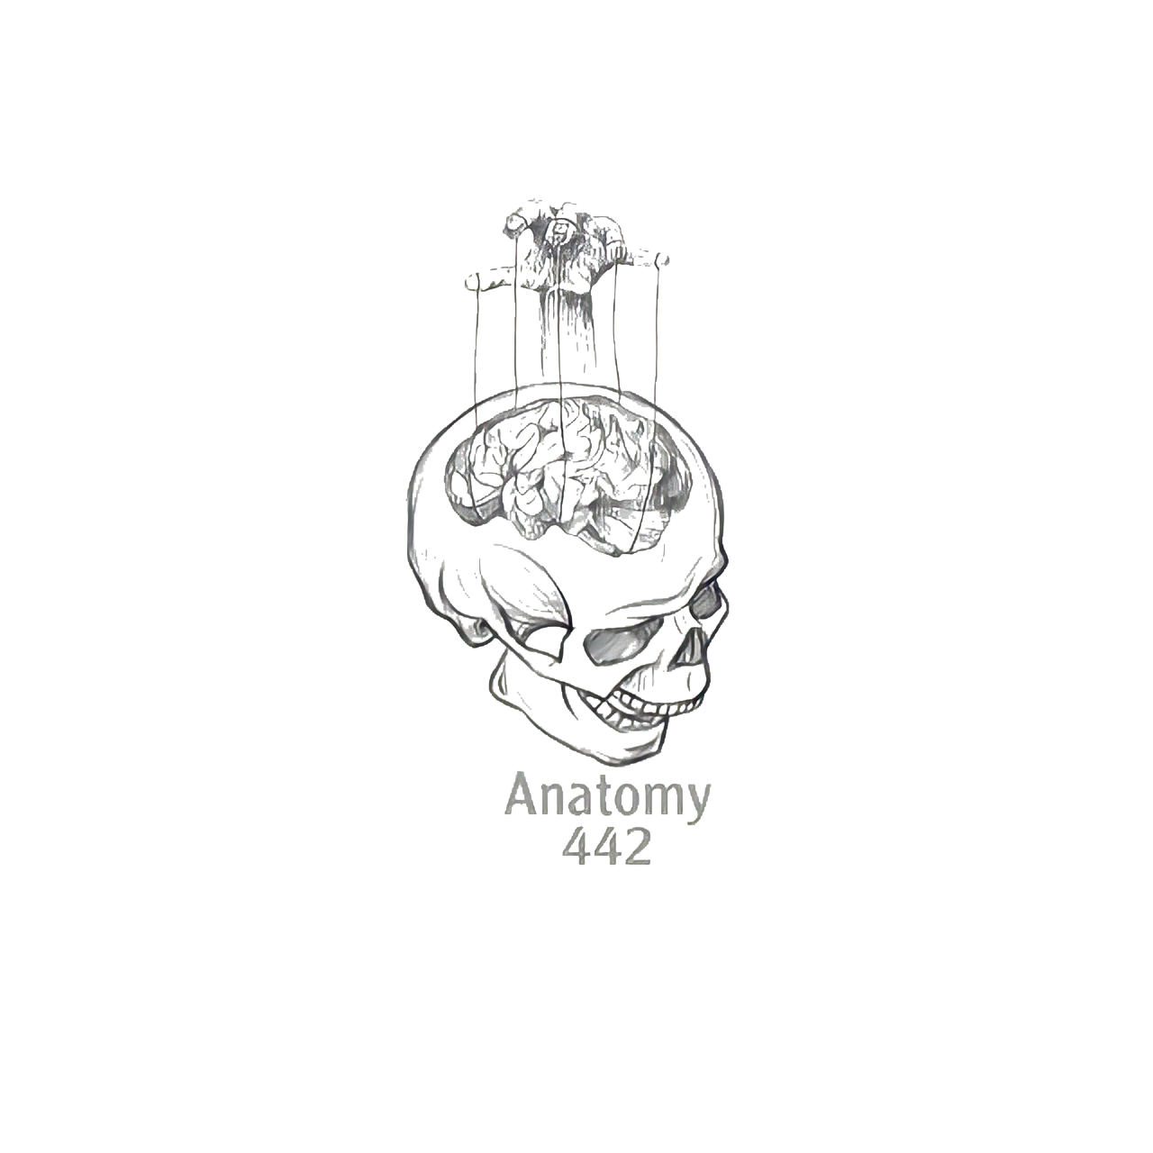
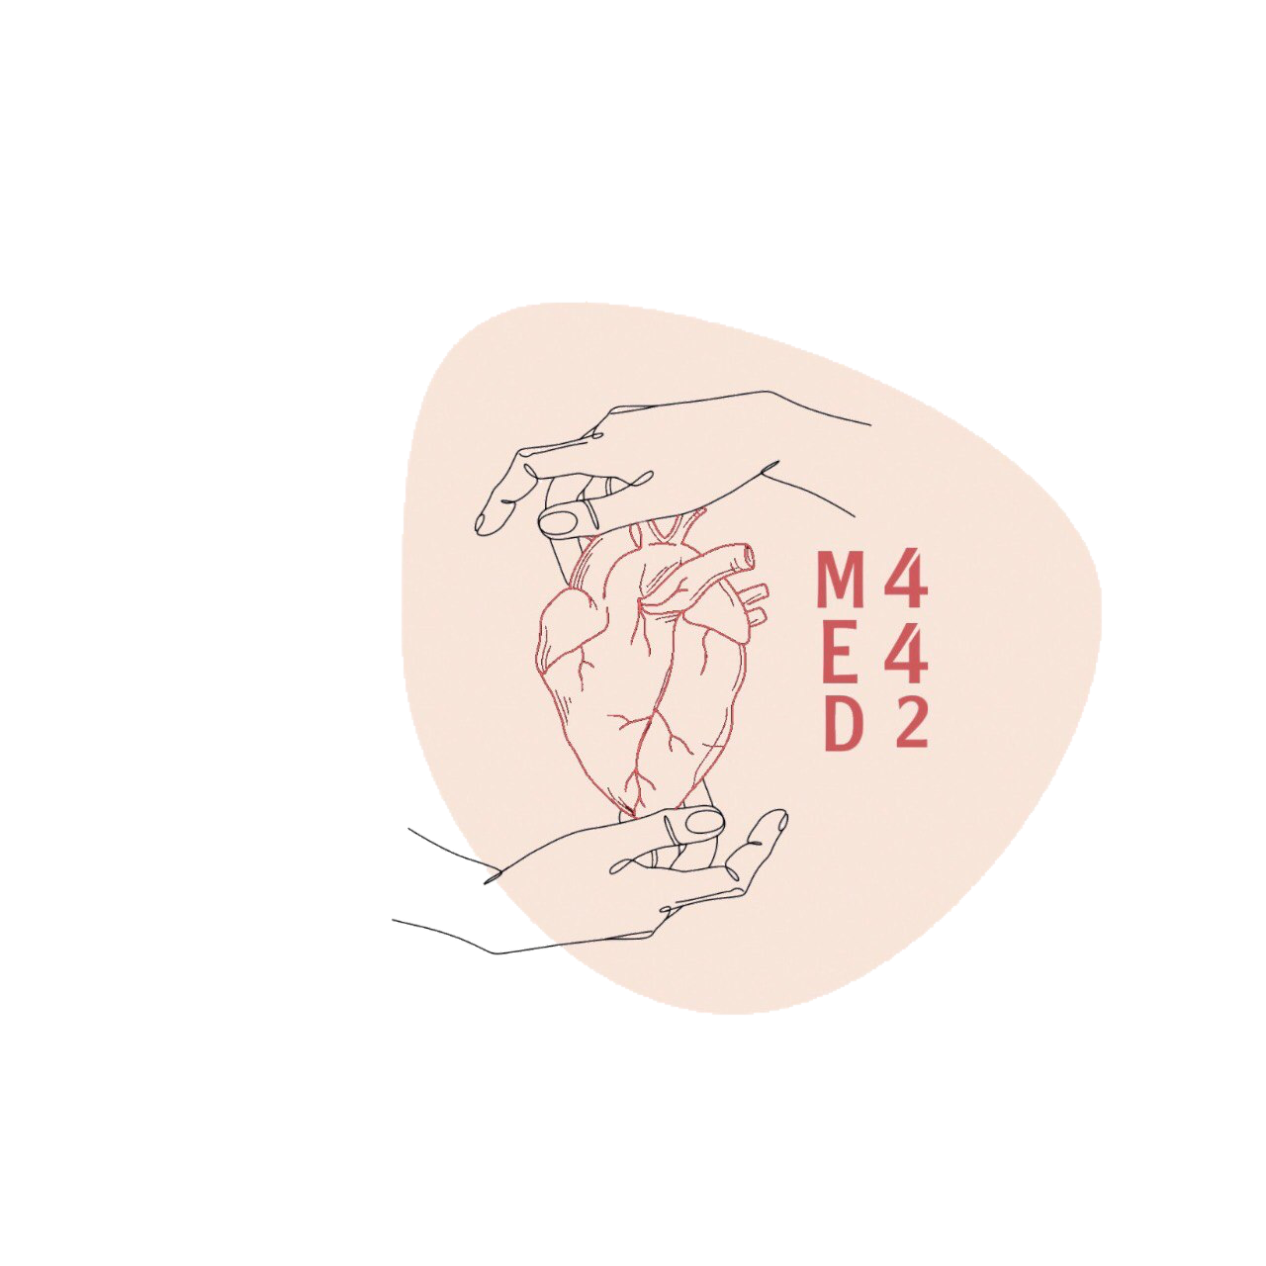
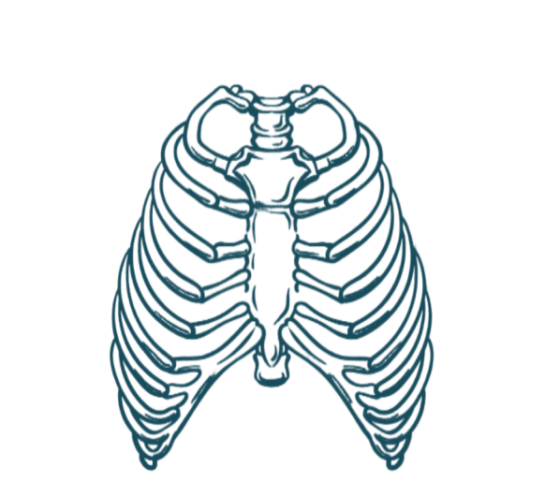
1
Muscles Involved In Normal Respiration
____________
Respiratory Block
Color Index:
Main Text
Male’s Slides
Female’s Slides
Important
Doctor’s Notes
Extra Info
Editing File
Notes:
This slide is already done, please don’t change anything here

Slide 2
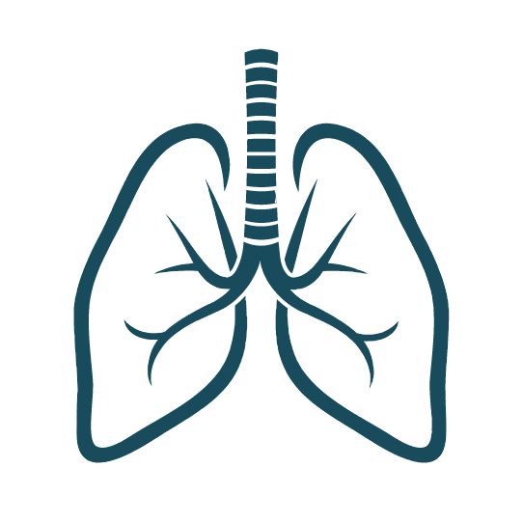
Objectives
Describe the components of the thoracic cage and their articulations.
Describe in brief the respiratory movements.
List the muscles involved in inspiration and
in expiration.
Describe the attachments of each muscle to
the thoracic cage and its nerve supply.
Describe the origin, insertion, nerve supply
of diaphragm.
1
2
3
4
5
Notes:
If your objectives are less than 6 delete the extra points

Slide 3
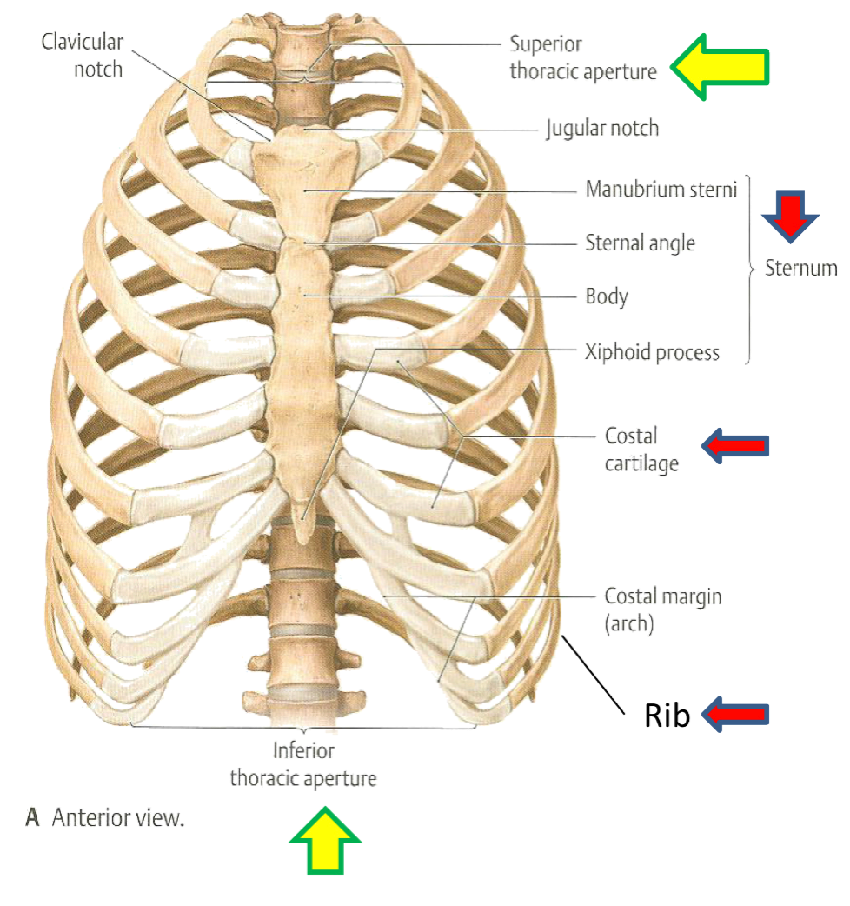
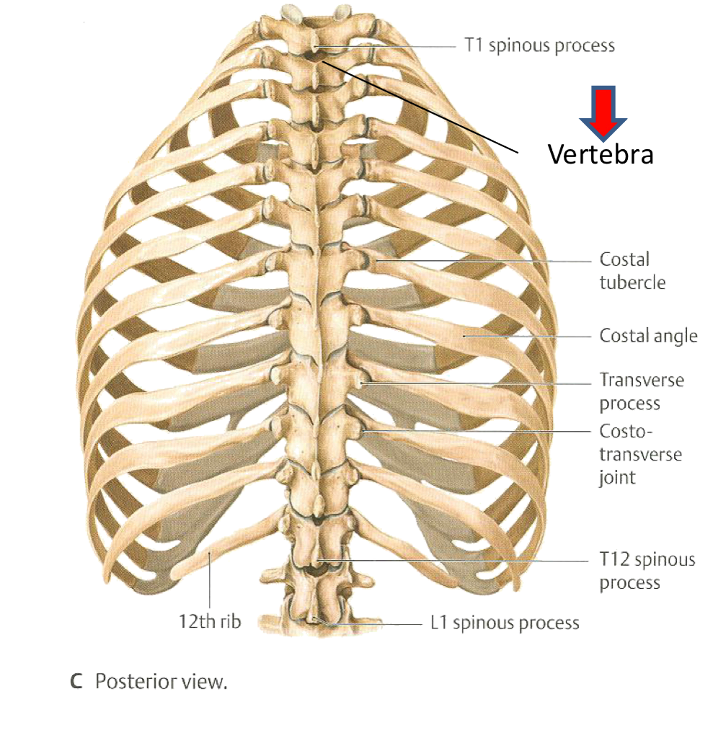
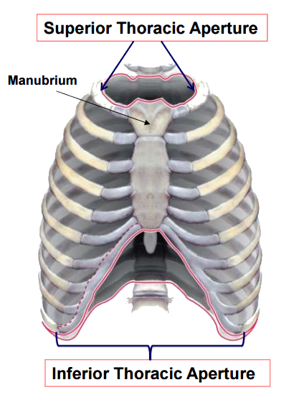
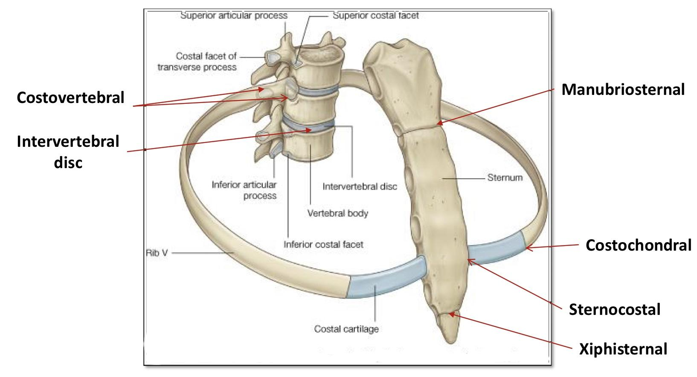
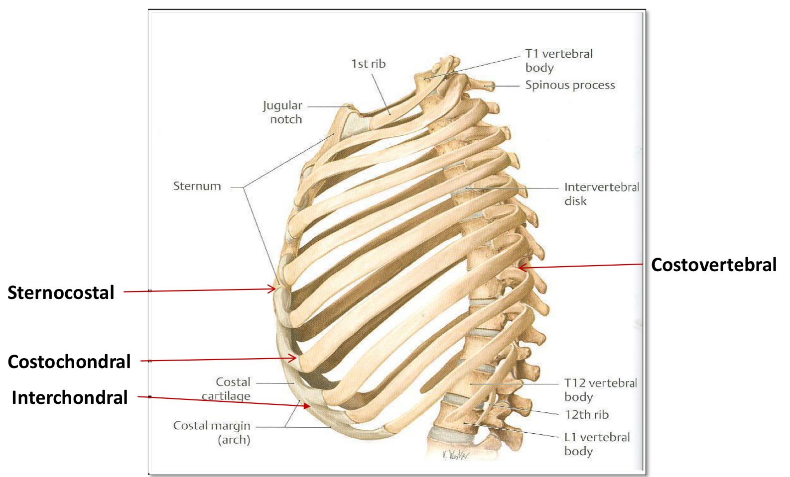
Thoracic Cage:
Conical in shape (like a cone قمع)
Formed by :
Anteriorly | Sternum Costal cartilages
Laterally | 12 pairs of Ribs
Posteriorly | 12 thoracic vertebrae
Superior
(thoracic outlet ):
narrow, open, continuous with neck
Apertures (opening)
Inferior
wide, closed by diaphragm
Articulations:
Primary Cartilaginous (Hyaline) | Secondary Cartilaginous | Plane Synovial Joints
First Sternocostal joint (1st costal cartilage articulates with manubrium) Costochondral joints (between the costal cartilage and the ribs) Interchondral joints. | Manubriosternal joint Xiphisternal joint Intervertebral discs. | Costovertebral joints (Between heads of ribs & thoracic vertebrae) 2. the rest of Sternocostal joints(2-7) (2nd to 7th cartilages articulate with sternum )

Slide 4
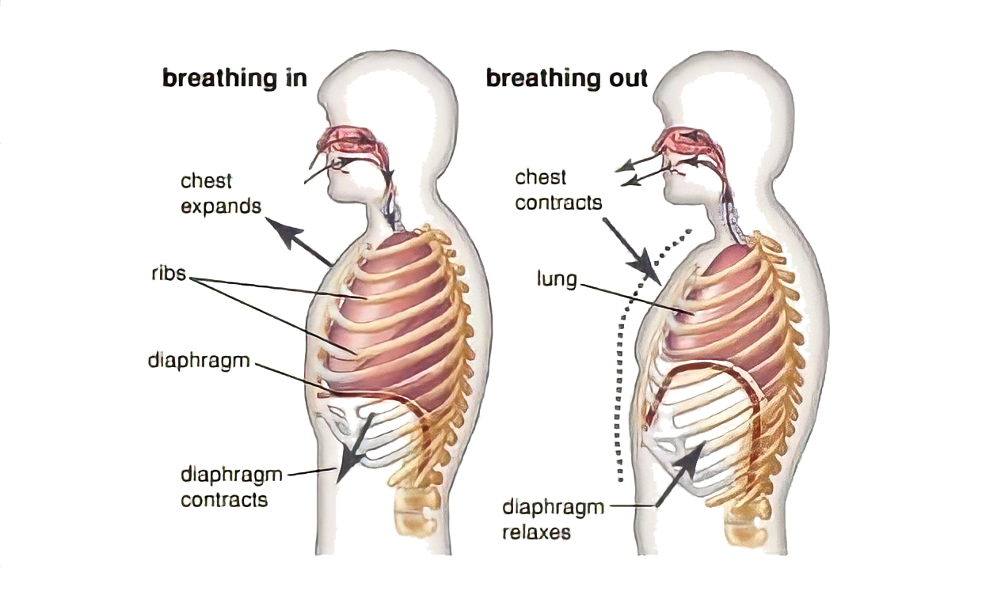
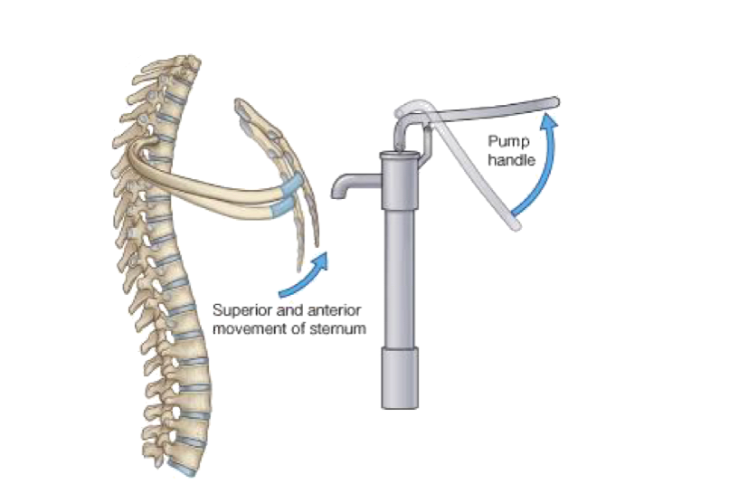
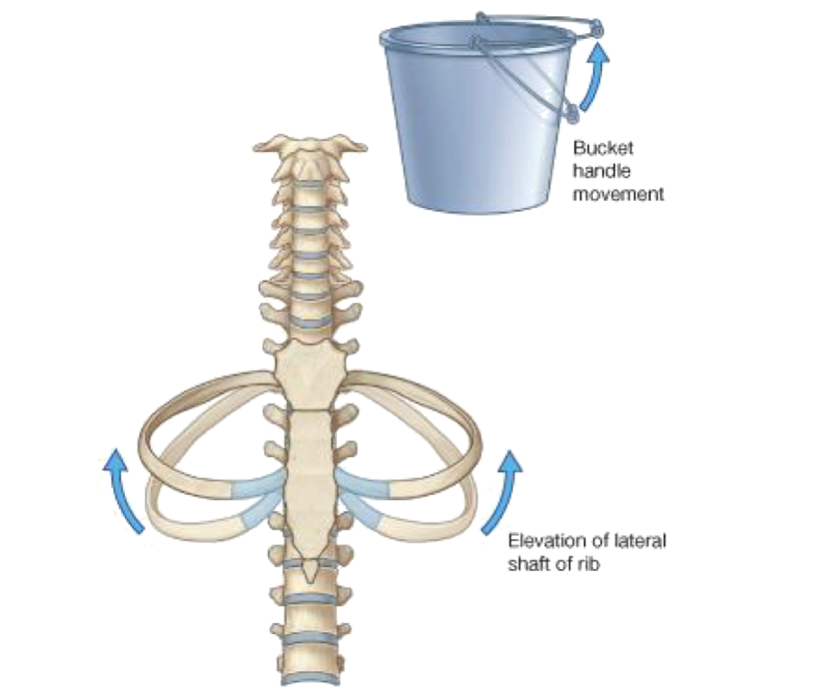
Respiratory movements
Helpful Video
MOVEMENTS OF
DIAPHRAGM
inspiration
expiration
Contraction (descent) of
diaphragm
Relaxation (ascent) of diaphragm
Increase of vertical
diameter of thoracic cavity
MOVEMENTS OF
RIBS
PUMP HANDLE MOVEMENT
Elevation of ribs
Increase in antero-posterior diameter of thoracic cavity
BUCKET HANDLE MOVEMENT
Elevation of ribs
Increase in lateral (transverse) diameter of thoracic cavity

Slide 5
Respiratory muscles
INSPIRATORY | EXPIRATORY ( only during forced expiration)
Diaphragm (most important) | Rib depressors: 1. Internal intercostal 2. Innermost intercostal 3. Subcostals 4. Transversus thoracis
Rib elevators: External intercostal muscles
Accessory muscles: (Only during forced inspiration) 1.Muscles attaching cervical vertebrae to first & second rib ex; scalene muscles 2.Muscles attaching thoracic cage to upper limb ex; pectoralis major, pectoralis minor, serratus anterior 3.Muscles attaching thoracic cage to skull ex; sternocleidomastoid | Anterior abdominal wall muscles: 1.External oblique 2. Internal oblique 3. Transversus abdominis 4. Rectus abdominis - (Compression of abdominal viscera to help in ascent of diaphragm )

Slide 6
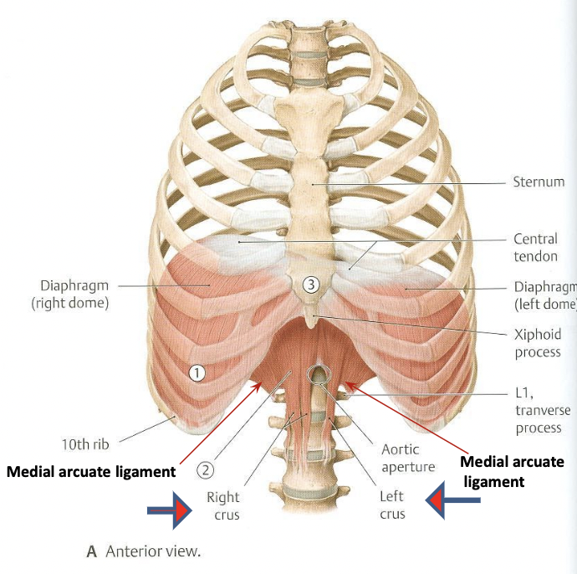
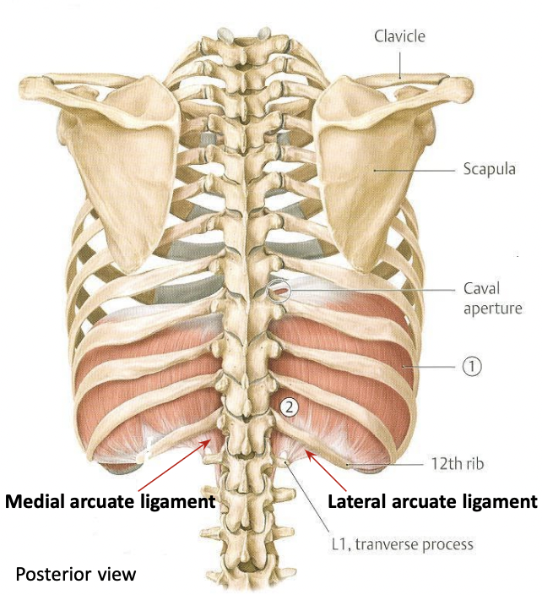
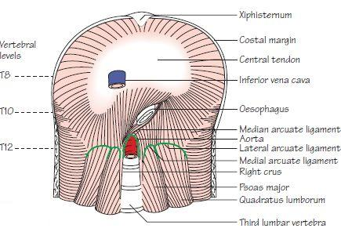
Diaphragm:
A musculotendinous partition between thoracic & abdominal cavity.
Convex toward thoracic.
Concave toward abdominal cavity.
Attachments | Nerve supply | Action
1. Sternum. 2. Costal cartilages. 3. 12th rib. 4. lumbar vertebrae. | Phrenic nerve (C3,4,5).* - Penetrates diaphragm & innervates it from abdominal surface. | contraction (descent) of diaphragm increase vertical diameter of thoracic cavity (essential for normal breathing).
origin | insertion
1. Costal : lower 6 costal cartilages. 2. Sternal : xiphoid process of sternum. 3. Vertebral : upper 3 lumbar vertebrae (right & left crus + arcuate ligaments) | - Fibers converge to join and inserted into The Central Tendon - Lies at the level of xiphisternal joint, at 9th thoracic Vertebra
*Mnemonic for the phrenic nerve: “3 4 5 keeps you alive”
The thickness of the fascia covering quadratus lumborum forms the lateral arcuate ligament
The thickness of the fascia covering psoas major forms the medial arcuate ligament
Median Arcuate ligament: Connects right and left crus
Left crus is shorter and attached to the upper 2 lumbar vertebrae
Right crus is longer and attached to the upper 3 lumbar vertebrae

Slide 7
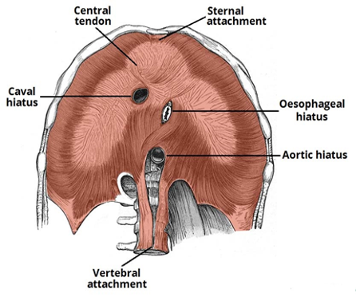
Major openings in the diaphragm:
In boys slides Don’t skip | Level | Site | Structures passing through it
1. Aortic openings (hiatus) | T12 | Between right & left crus | 1. Aorta. 2. Azygos vein. 3. Thoracic duct.
2. Esophageal opening (hiatus) | T10 | In the right crus | 1. Esophagus. 2. Right & left vagus nerves. 3. Esophageal branches of left gastric artery and corresponding veins.
3. Inferior vena caval opening (hiatus) | T8 | In the central tendon | 1. Inferior vena caval (IVC). 2. Right phrenic nerve. 3. Lymphatics.

Slide 8
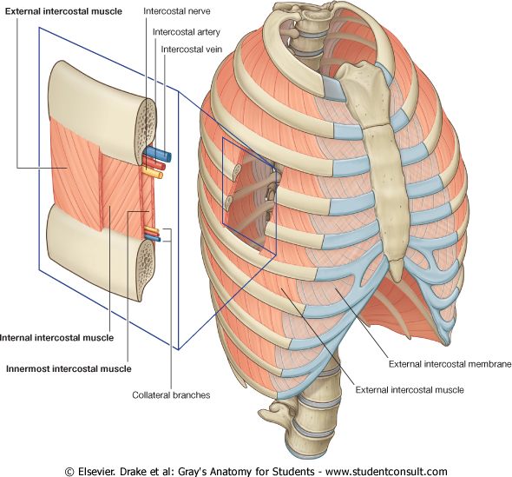
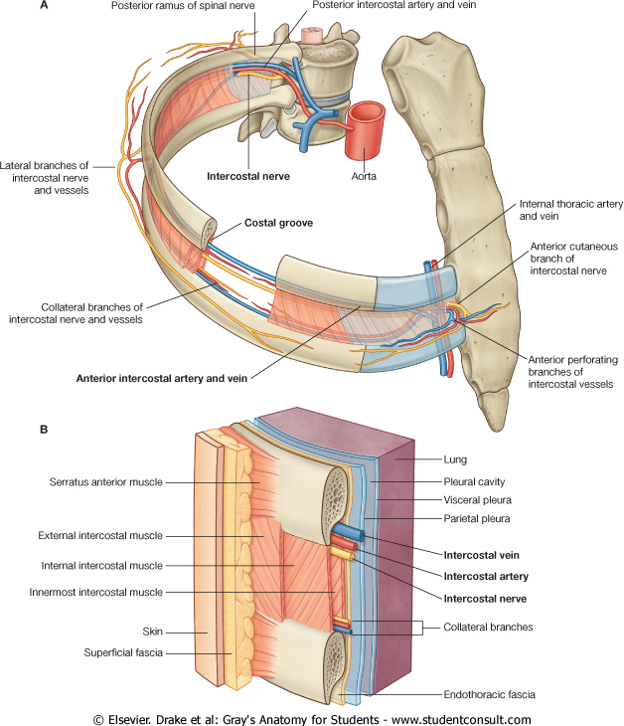
Cont. Inspiratory muscle:
External intercostal muscle
Attachments | from lower border of rib above to upper border of rib below
Direction of fibers | downward & medially
Action | rib elevators (inspiratory)
Nerve supply | intercostal nerves

Slide 9
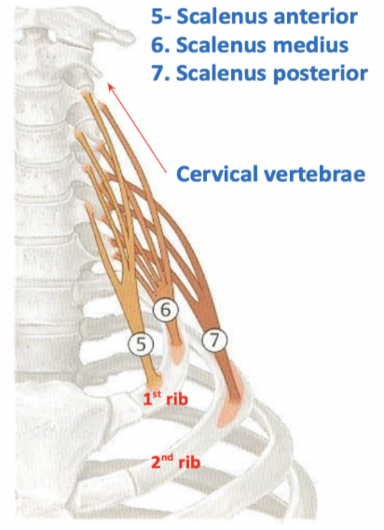
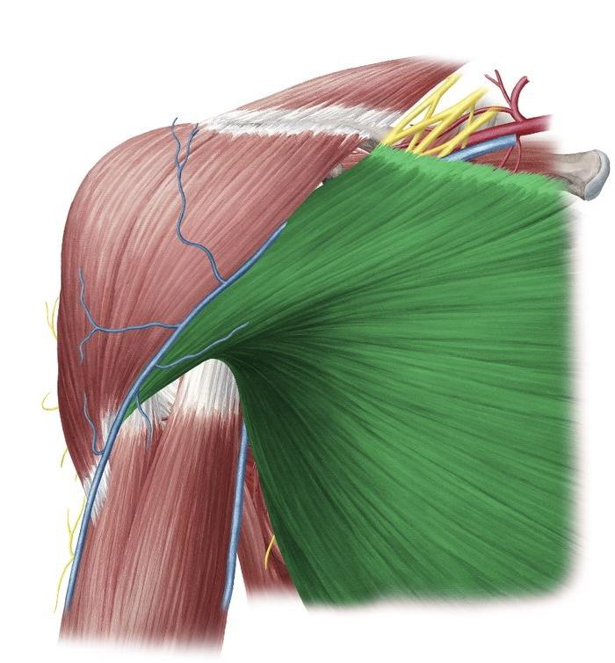
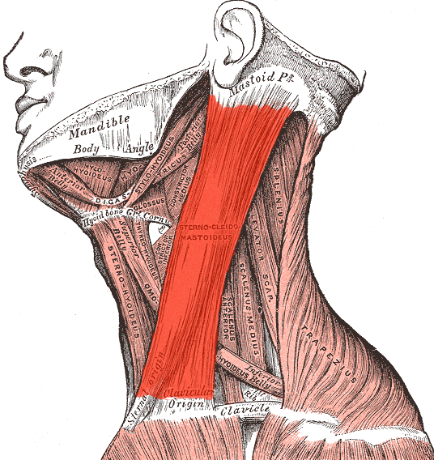
Accessory muscles of inspiration:
During forced inspiration only
Muscle | Scalene muscles | Pectoralis major | Sternocleidomastoid in boys slides only
Origin | Cervical vertebrae | Clavicle + sternum + costal cartilages | Sternal head: Front of Manubrium sterni Clavicular head: medial 1/3 of clavicle
Insertion | 1st rib (scalenus anterior and medius) 2nd rib (scalenus posterior) | Humerus (lateral lip of the bicipital groove) | Mastoid process
Action | Elevate 1st & 2nd ribs (inspiratory) | Increases antero-posterior diameter of thoracic cavity, when arm is fixed (inspiratory) | Elevates the manubrium

Slide 10
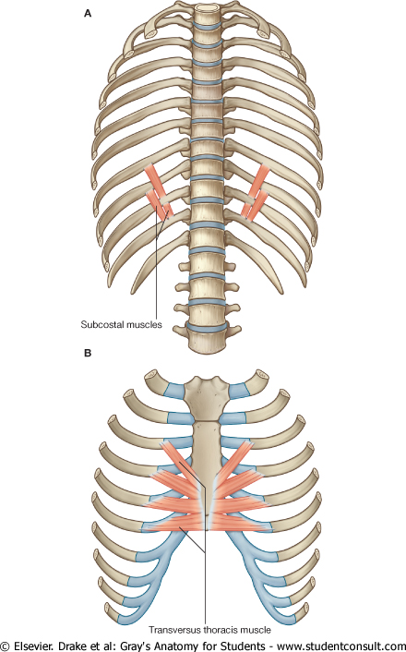
Expiratory muscles:
Helpful Video
Act only during forced expiration
A- Ribs depressors
Muscle | Internal intercostal | Innermost intercostal | Subcostal | Transversus thoracis
Direction | Backward & laterally Upward & medially* |  | -
Nerve | Intercostal nerves (ventral rami of T1-T11)
Action | depression of the ribs
T12 Nerve (subcostal N.).
Intercostal vessels & nerve lie in intercostal space behind the internal intercostal muscle.
2-5 intercostal Ns.
*both directions are right, اختلاف مراجع فقط
Notes:
Add nerves for subcostal and

Slide 11
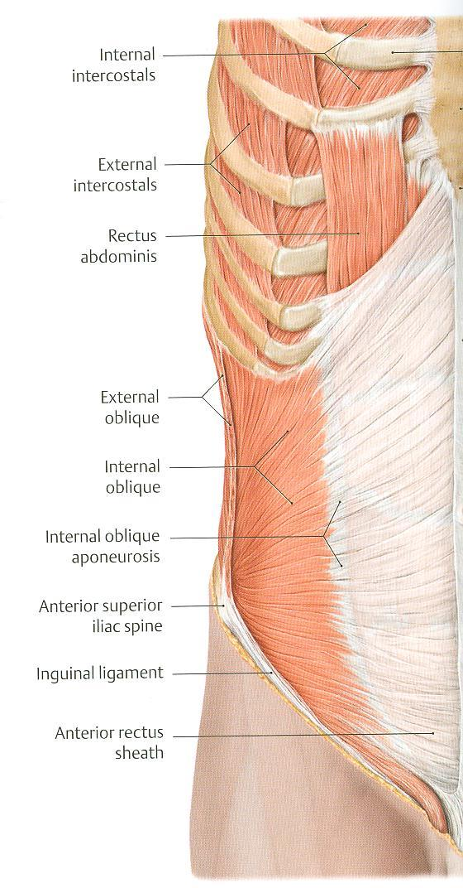
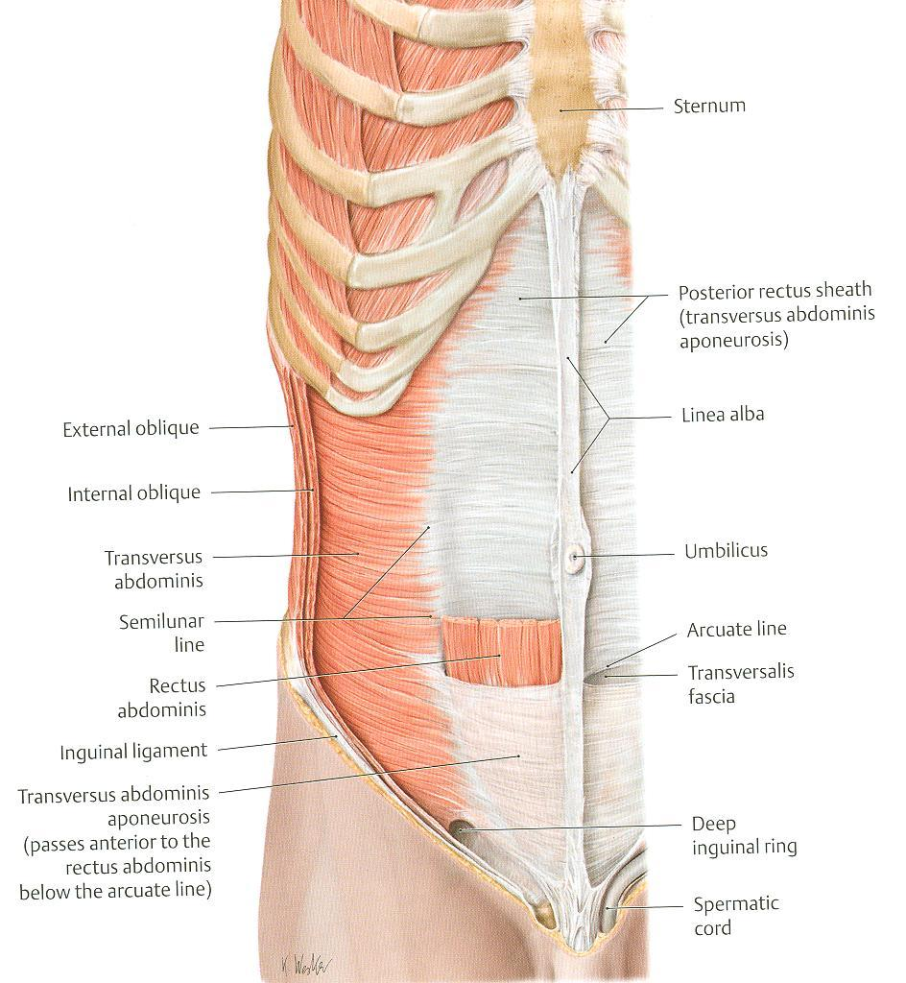
Cont. Expiratory muscles:
B- Anterior abdominal wall muscles
It Is formed of 3 layers of muscles of fibers running in different directions to increase strength of anterior abdominal wall. The 3 muscles form a sheath in which a fourth muscles lies rectus abdominis. Muscles are attached to: sternum, costal cartilages and ribs + hip bones. The aponeurosis of the 3 muscles on both sides fuse in the midline to form linea alba.
Muscle | External oblique Outer layer | Internal oblique Middle layer | Transversus abdominis Inner layer | Rectus abdominis
Direction | Downward & medially | Upward & medially | Transverse | Vertical
Nerve | lower 5 intercostal nerves (T7-T11), subcostal nerve (T12) and first lumbar nerve (L1).
Action | during forced expiration: Compression of abdominal viscera to help in ascent of diaphragm

Slide 12
Summary of respiratory movements:
Inspiration | Expiration
Quiet inspiration (active) | Quiet expiration (passive)
1.Contraction (descent) of diaphragm: Increase in vertical diameter. 2.Elevation of ribs (external intercostal): Increase in anteroposterior and lateral diameter. | 1. Elastic recoil of lung. 2. Relaxation of diaphragm & external intercostal.
Forced inspiration (active) | Forced expiration (active)
Accessory muscles of inspiration: 1. Pectoralis major. 2. Scalene muscle. | 1.Contraction of anterior abdominal wall muscles: Compression of abdominal viscera Ascent of diaphragm 2.Depression of ribs Rest of intercostal muscles

Slide 13
MCQs
1.The esophageal opening of diaphragm found at the level of:
A.T12 | B. T11 | C.T10 | D.T8
2. Internal oblique muscle forms which layer of anterior abdominal wall?
A.Middle | B.Inner | C.Outer | D.Lateral
3. What is the direction of inner and innermost intercostal muscles?
A.Downward medially | B.Upward laterly | C.Backward & laterally | D.Backward medially
4. Which one of the following is involved in the forced expiration?
A.Internal intercostal | B.Scalenes | C.Pectoralis minor | D.External intercostal
5. What is the root of phrenic nerve that supply the diaphragm?
A.C5,C6,C7 | B.C4,C5,C6 | C.C3,C4,C5 | D.C2,C3,C4
Answers: 1-C 2-A 3-C 4-A 5-C
Click on the icon for more questions from Med442’s QBank
Notes:
لا تآخذون اسئله من تيمات قديمه <- الاكاديمك ليدر

Slide 14
SAQs
Enumerate the apertures of thoracic cage?
Slide 1
2. Enumerate the inspiratory and expiratory muscles?
Slide 5
3. Enumerate the openings of diaphragm, it’s level, site and the structures passing through it?
Slide 7
Notes:
لا تآخذون اسئله من تيمات قديمه <- الاكاديمك ليدر

Slide 15
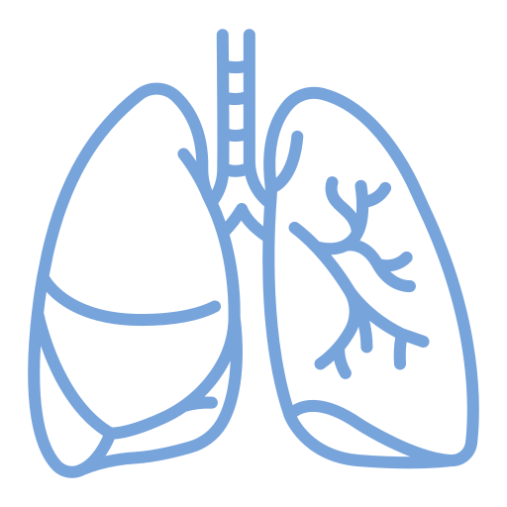
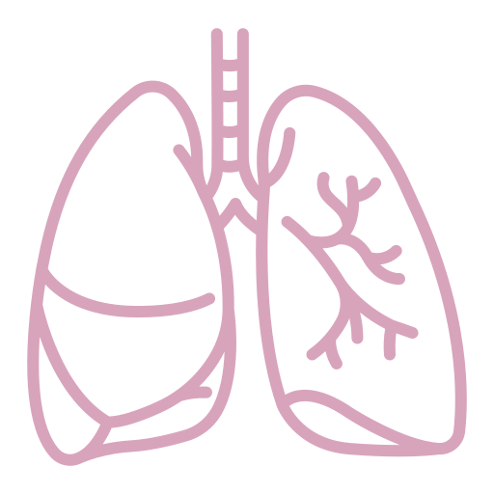
Team Leaders
Team Members
Mohammad Alrashed
Najla
Aldhbiban
Faisal Alomar
Nouf Aldalaqan
Mishal Alsuwayegh
Nouf Aldhalaan
Hazem Almalki
Atheer Alahmari
Zyad Alodan
Shatha Alshabani
Salman Albader
Aljazi AlBabtain
Abdulaziz Alnasser
Reema Alshehri
Faris Alseraye
Sarah Alzahrani
Ahmad Alemam
Maha Alkoryshy
Alwaleed Faqihi
Nada Albedaiwi
Abdullah Alnajres
Razan Almohanna
Meshari Alshathri
Atheer AlKanhal
Nawaf Alturki
Raneem AlWatban
Nasser Alghaith

