Slide 1
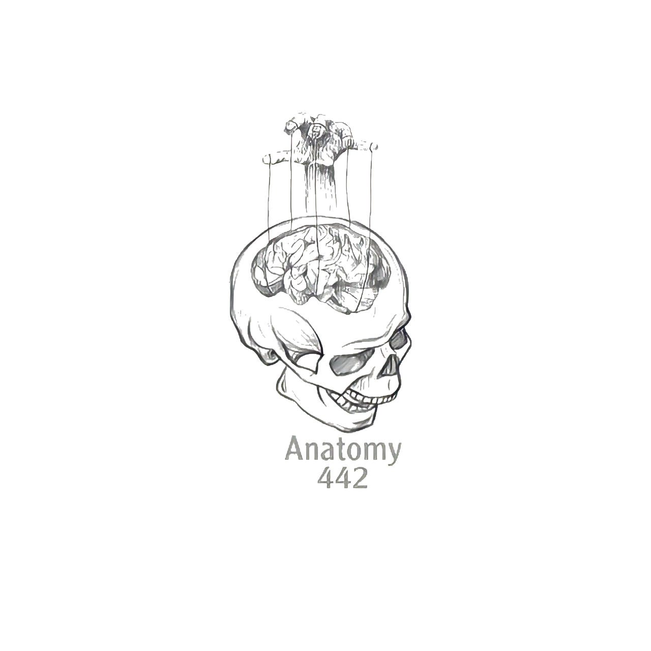
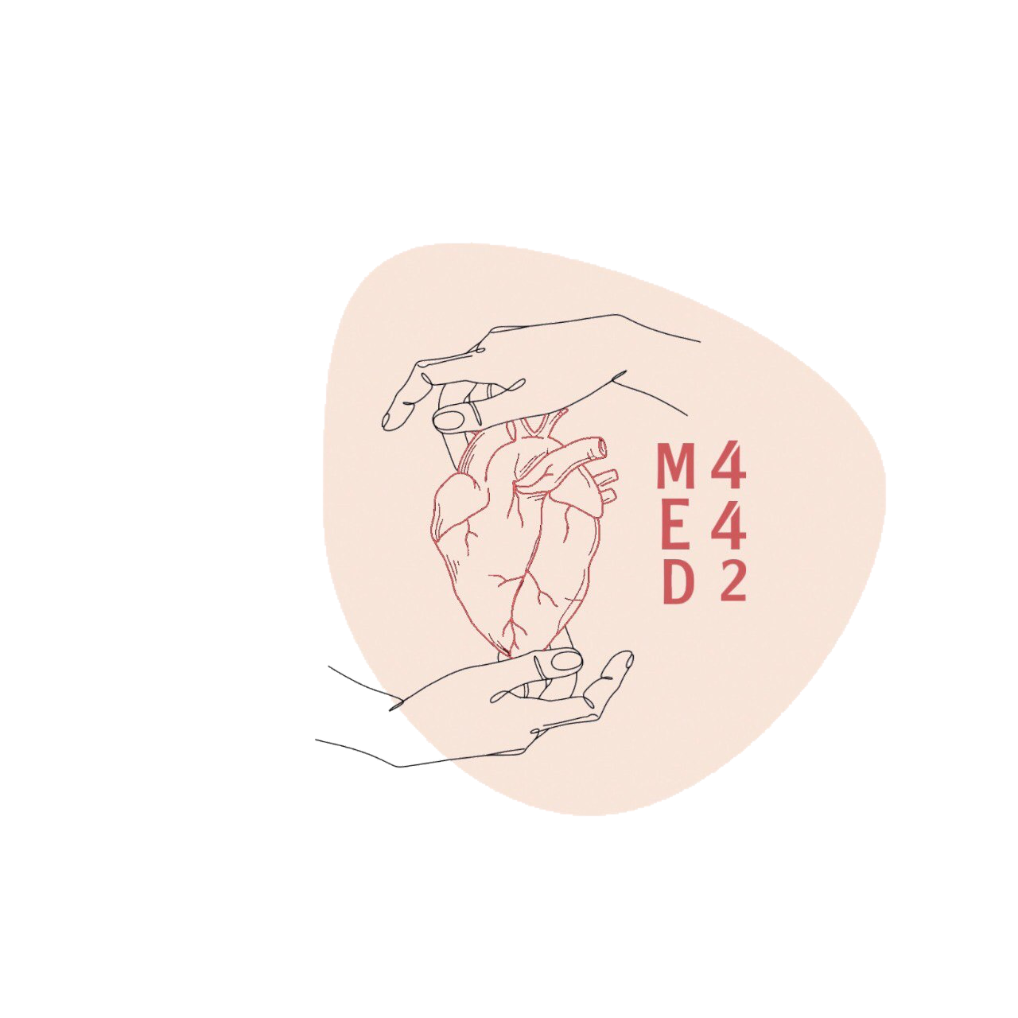
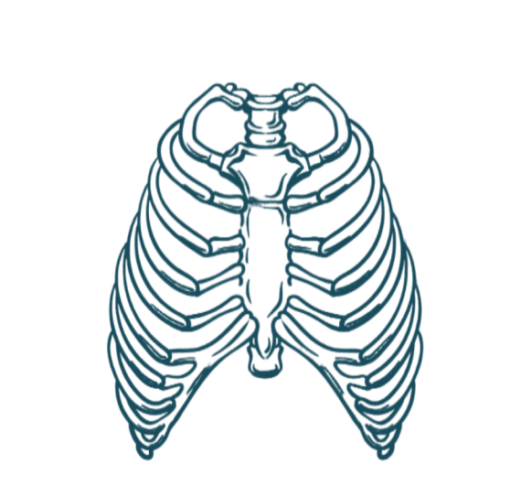
2
Nose, Nasal Cavity, Paranasal Sinuses and Pharynx
____________
Respiratory Block
Color Index:
Main Text
Male’s Slides
Female’s Slides
Important
Doctor’s Notes
Extra Info
Editing File
Notes:
This slide is already done, please don’t change anything here

Slide 2
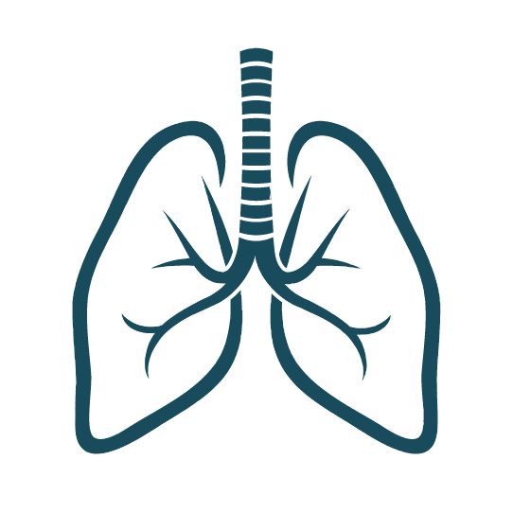
Objectives
1
Describe the boundaries of the nasal cavity.
2
Describe the nasal conchae and meati.
3
Demonstrate the openings in each meatus.
4
Describe the paranasal sinuses and their functions.
5
Describe the pharynx, its parts, and the related structures.
Notes:
If your objectives are less than 6 delete the extra points

Slide 3
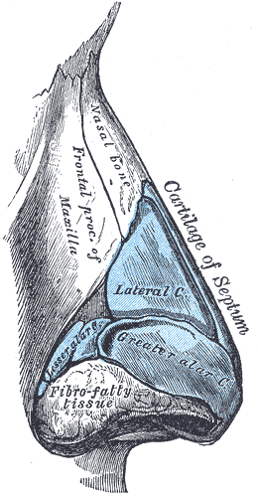
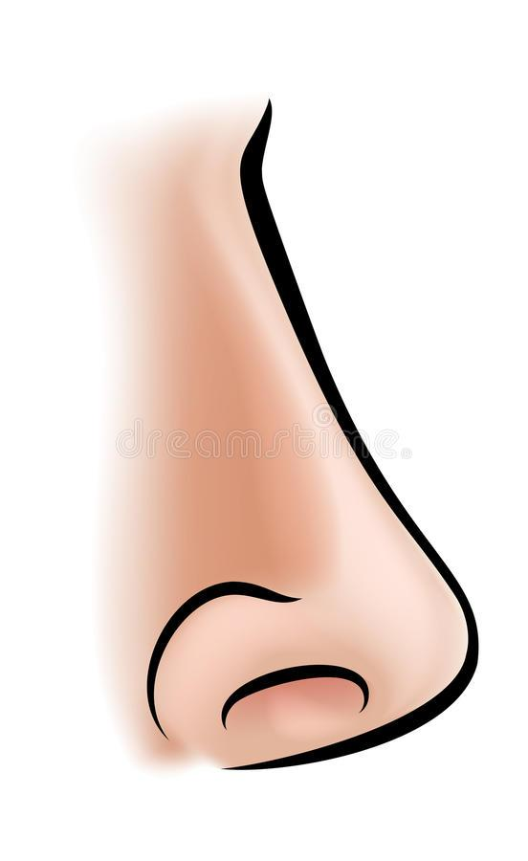
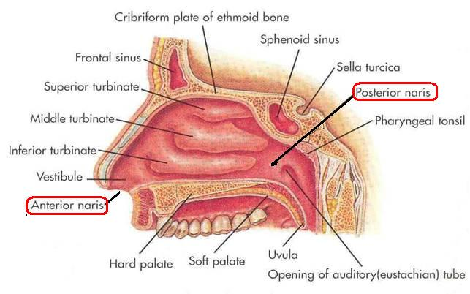
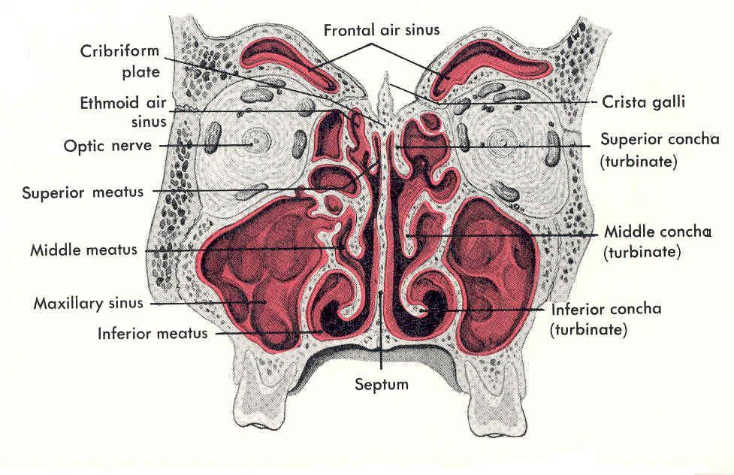
recommended to watch
Nose
The external (anterior) nares or nostrils, lead
to the nasal cavity.
Formed above by:
Bony skeleton
root
Formed below by:
Plates of hyaline cartilage
ala
Tip
septum
External nares
Nasal Cavity
Extends from the external (anterior) nares to the posterior nares (choanae).
Divided into right & left halves by the nasal septum.
Each half has a:
Roof
Lateral wall
Medial wall (Septum)
Floor

Slide 4
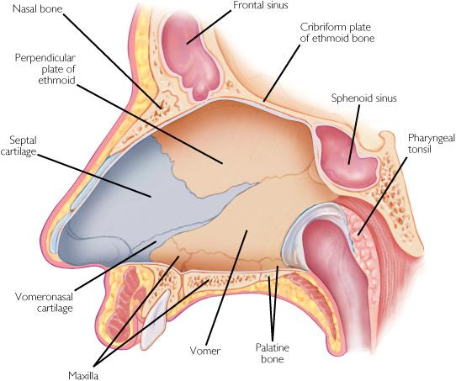
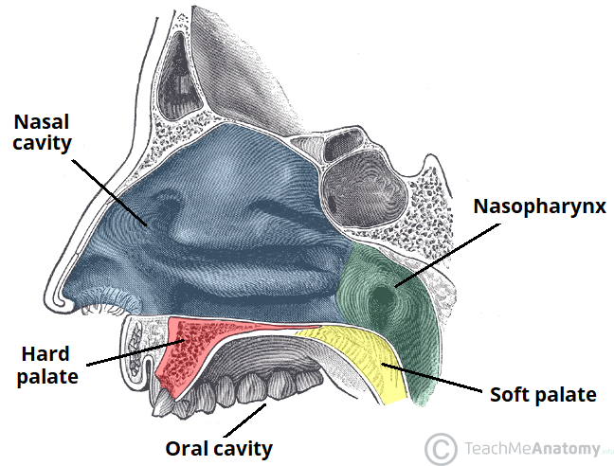
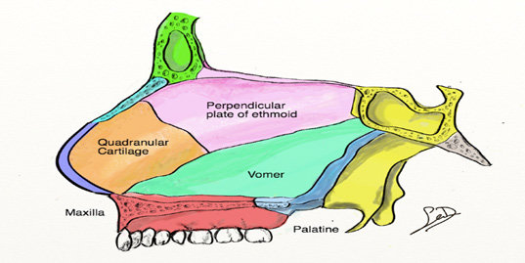
Nasal cavity
Nasal cavity
Roof | Narrow & formed (from behind forward) by the: 1- Body of sphenoid 2- Cribriform plate of ethmoid bone. 3- Frontal bone. 4- Nasal bone & cartilage
Floor | Formed by the hard (bony) palate. Separates it from the oral cavity.
Lateral wall | Shows three horizontal bony projections, the superior, middle & inferior conchae, the conchae increases the surface area of the nasal cavity. The cavity below each concha is called a meatus and are named as superior, middle & inferior corresponding to the conchae. The small space above the superior concha is the sphenoethmoidal recess. The recess & meati receive the openings of the: Paranasal sinuses & Nasolacrimal duct.
Medial wall (Nasal Septum) | Osteocartilaginous partition. Formed by: 1-Perpendicular plate of ethmoid bone. 2-Vomer. 3-Septal cartilage.
3
4
2
1
Very Important Table
The Drainage (Drains into) | The Sinus
Sphenoethmoidal Recess | Sphenoidal Sinus
Superior Meatus | Posterior Ethmoidal Sinus
Middle Meatus | Middle Ethmoidal, Maxillary, Frontal and The Anterior Ethmoidal Sinuses
Inferior meatus | Nasolacrimal duct.

Slide 5
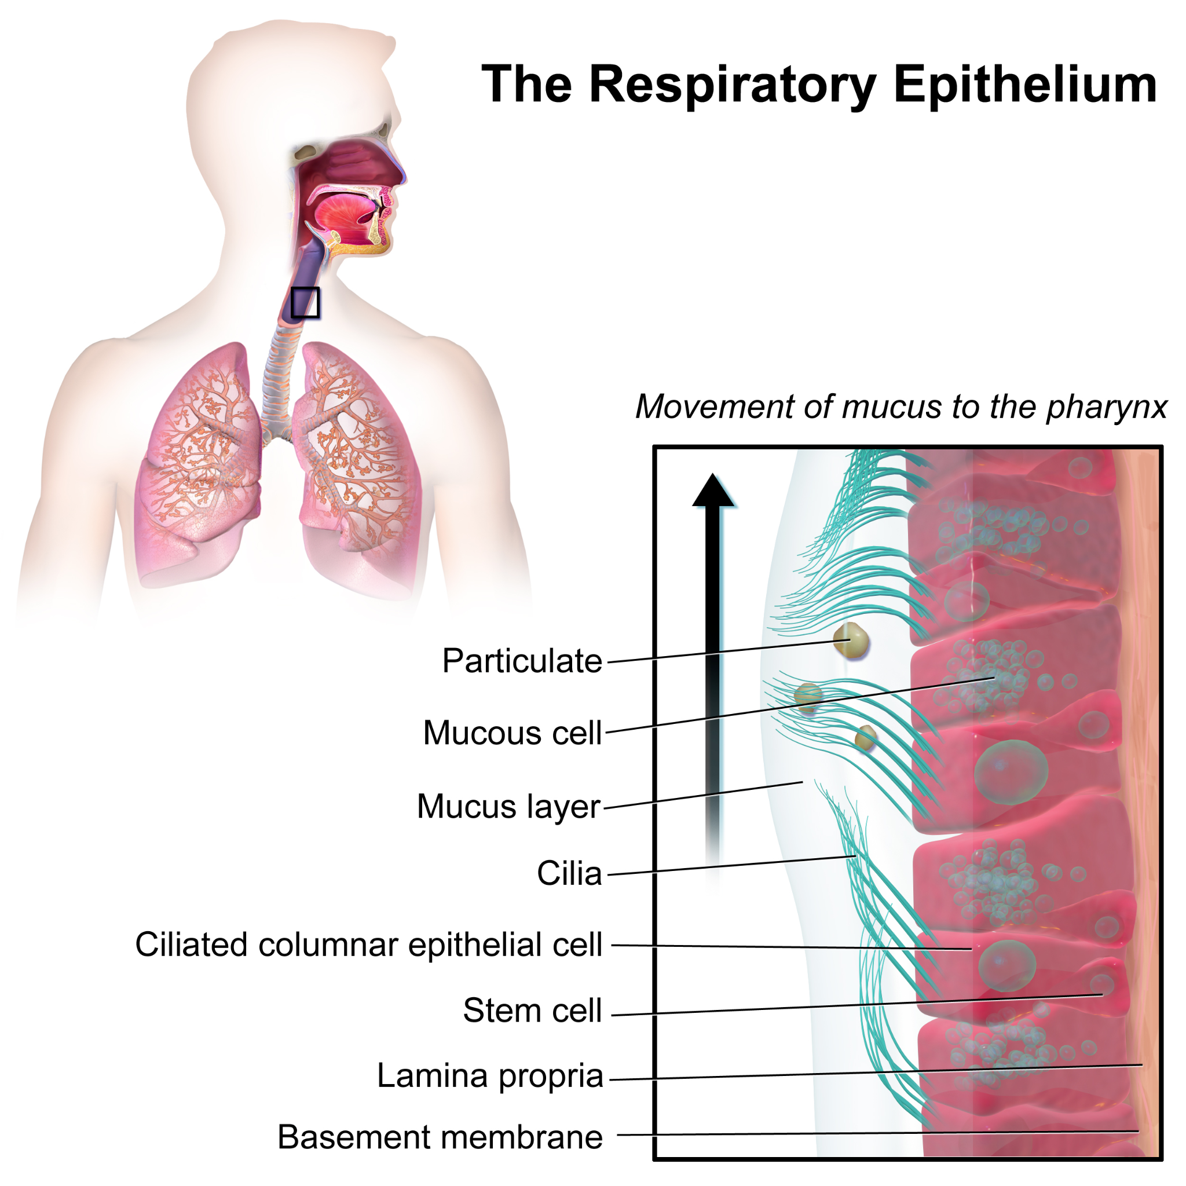
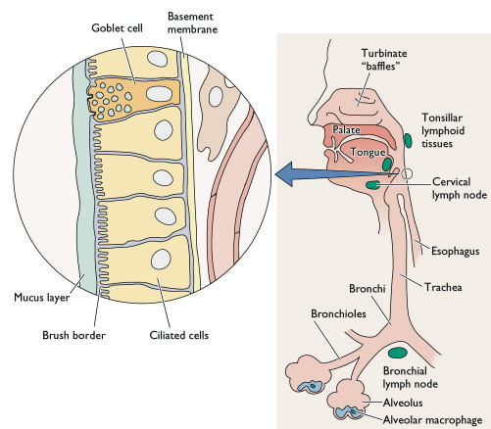
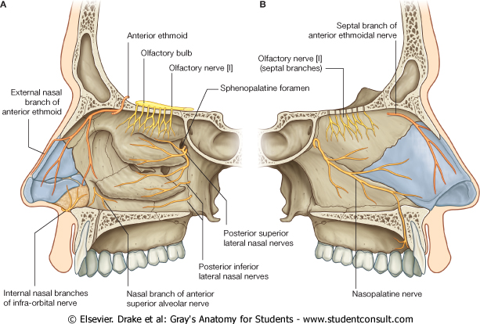
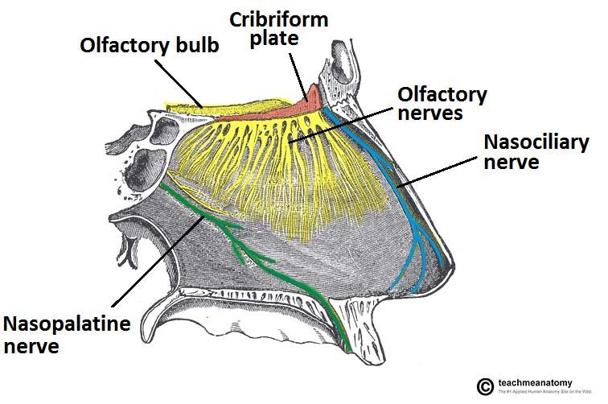
Nasal mucosa | Olfactory: It is delicate and contains olfactory nerve cells. (receptors for smell) It is present in the upper part of nasal cavity (superior surface of the cribriform plate): Roof Lateral wall: it lines the upper surface of the superior concha and the sphenoethmoidal recess. Medial wall: It lines the superior part of the nasal septum
Respiratory Mucosa | It is thick ciliated highly vascular and contains mucous glands & goblet cells, It lines the Lower part of the nasal cavity. It functions to moisten, clean and warm the inspired air. - The air is moistened by the secretion of numerous serous glands. - the air cleaned by the removal of the dust particles by the ciliary action of the columnar ciliated epithelium that covers the mucosa. - it warmed by a submucous venous plexus, the Vestibule is lined by Skin.
Nerve supply
Olfactory mucosa supplied by olfactory nerves. Nerves of general sensation (الاحساس بالشي الدافئ او البارد) are derived from: - Ophthalmic, and Maxillary division of the trigeminal nerve. - The anterior part is supplied by: Anterior Ethmoidal nerve. - The posterior part is supplied by: Nasopalatine Nasal Palatine (branches of the pterygopalatine ganglion).

Slide 6
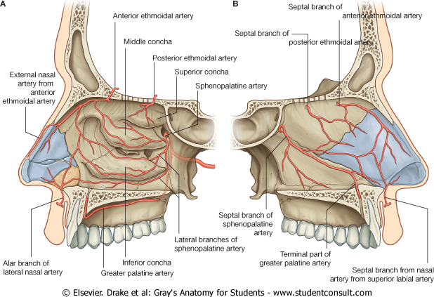
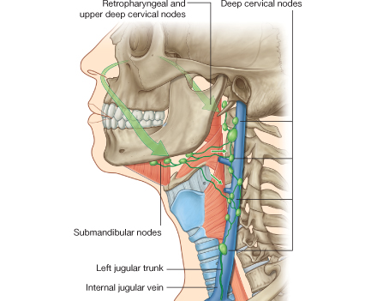
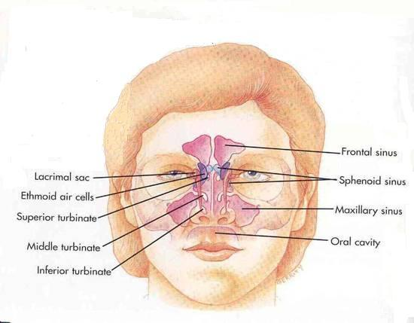
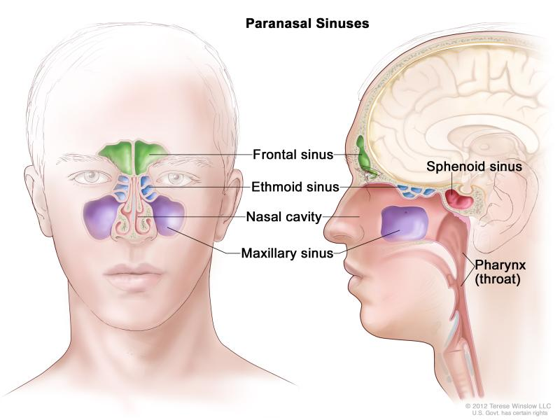
Blood supply
Arterial Supply | Venous Drainage
Branches of the Maxillary (sphenopalatine artery) Facial (superior labial) Ophthalmic (ethmoidal arteries). The arteries make a rich anastomosis in the region of the vestibule, and anterior portion of the septum (little area). the most common site for epistaxis رعاف | Submucosal plexus by veins accompany the arteries which drain into the facial, ophthalmic, and spheno-palatine veins.
Lymphatic Drainage
The lymphatics from the: Vestibule drains into the submandibular lymph nodes. Rest of the cavity drains into the upper deep cervical lymph nodes.
Paranasal Sinuses
Air filled cavities located in the bones around the nasal cavity: ethmoid, sphenoid, frontal bones & maxillae (the largest sinus).
Lined by respiratory mucosa which is continuous with the mucosa of the nasal cavity.
Drain into the nasal cavity.
Functions:
Lighten the skull.
Act as resonant chambers for speech.
Air conditioning: The respiratory mucosal lining helps in warming, cleaning and moistening the incoming air.

Slide 7
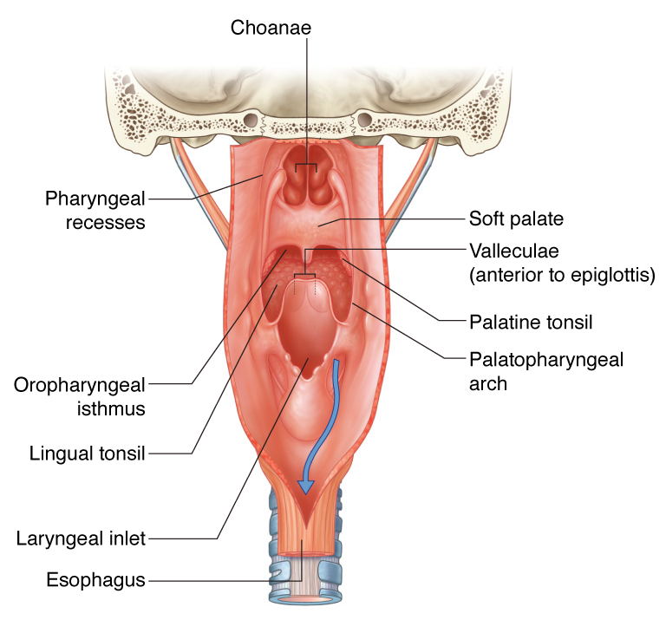
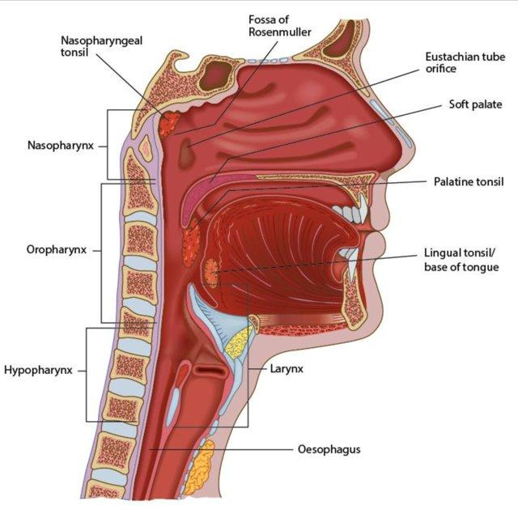
Pharynx
Pharynx
Location | Muscular tube lying behind the nose, oral cavity & larynx
Extended From | the base of the skull to level of the 6th cervical vertebra, where it is continuous with the esophagus
Features | The anterior wall is deficient and shows (from above downward): Posterior nasal apertures. (Choanae) Opening of the oral cavity. Laryngeal inlet. The muscles arranged in circular and longitudinal layers.
Picture
Parts | Circular (Constrictor) Muscles of Pharynx (Overlap Each other) | Longitudinal Muscles of Pharynx
 | Three in number: 1- superior Constrictor 2- Middle Constrictor 3- Inferior Constrictor The three muscles overlap each other. | Three in number: 1- Stylopharyngeus 2- Salpingopharyngeus 3- Palatopharyngeus
Function | Propel the bolus of food (الطعام الممضوغ) down into the esophagus. Lower ﬁbers of the inferior constrictor (Cricopharyngeus) act as a sphincter, preventing the entry of air into the esophagus between the acts of swallowing. | Elevate the Larynx & Pharynx during swallowing Easy to memorize: styl:ستايل Sapling: كأنها sleep Palat: كأنها بلاط ستايل بلاط بيتكم نايم

Slide 8
Pharynx Branches (divided to 3 parts) | 1. Nasopharynx | 2. Oropharynx | 3. Laryngopharynx
Location | - | behind the mouth cavity | behind the laryngeal inlet & the posterior surface of larynx
Extending | from the base of skull to the soft palate. | from soft palate to upper border of epiglottis | from upper border of epiglottis to lower border of cricoid cartilage
Connections | communicates with the nasal cavity through posterior nasal apertures | communicates with the oral cavity through the oropharyngeal isthmus | communicates with the larynx through the laryngeal inlet
Features / Observations | Pharyngeal tonsils (adenoides) present in the submucosa covering the roof. The tensile is big in children, and it will decrease as the child become older, When it’s over size in children will close the posterior nasal opening, so the air will not pass into the nasal cavity and the child will breath using his mouth اللحمية | Lateral wall shows: Palatopharyngeal folds. Palatoglossal fold Palatine tonsil located between them in a depression called the ‘tonsillar fossa’. | A small depression situated on either side of the laryngeal inlet is called ‘piriform fossa’. يعتبر ممر من pharynx الى esophagus ومكان تجمع الforeign bodies common site for the lodging of foreign bodies مثل شوك السمك

Slide 9
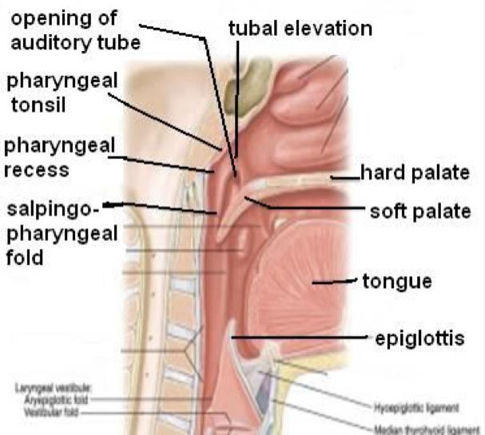
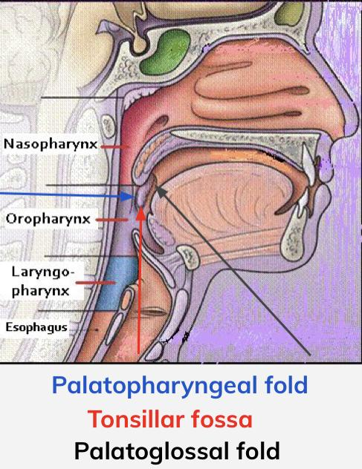
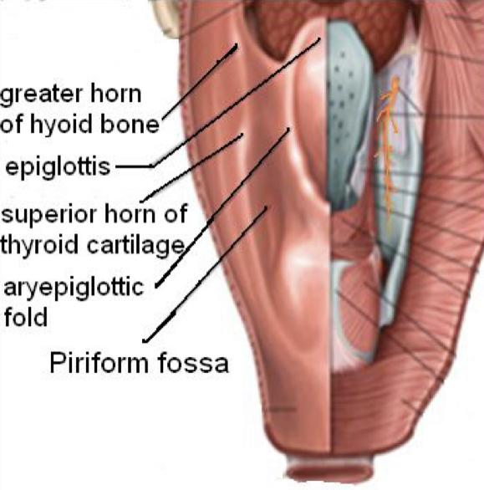
Continue | Nasopharynx | Oropharynx | Laryngopharynx
Observations | Lateral Wall Shows: Opening of auditory tube Tubal elevation (produced by posterior margin of the auditory tube) Tubal tonsil Salpingopharynge-al fold (raised by salpingo-pharynges muscle) Pharyngeal recess It can spread infections to middle ear | Lateral Wall Shows: ●Palatopharyngeal Folds ●Palatoglossal fold ●Palatine tonsil (located between them in a depression called the) “Tonsillar fossa” | Branches of internal Laryngeal & Recurrent Laryngeal nerve: Lie deep to the mucous membrane of the fossa Vulnerable to injury during removal of a foreign body
Pictures: Palatine Tonsils

Slide 10
Continue | Nasopharynx | Oropharynx | Laryngopharynx
Nerve Supply (Sensory) | Maxillary Nerve (V2) Trigeminal. | Glossopharyngeal Nerve | Vagus Nerve
Nerve Supply (Motor) | All the muscles of pharynx are supplied by the pharyngeal plexus except the Stylopharyngeus is supplied by the glossopharyngeal nerve.
Arterial Supply | Ascending pharyngeal artery Facial artery (Ascending palatine artery, Tonsillar Branches) Lingual artery Maxillary artery
Veins Drain | ● First: into Pharyngeal Venous Plexus ● Second: into Internal Jugular Vein
Lymphatics Drain | Into the deep cervical lymph nodes Either directly or indirectly via the Retropharyngeal or paratracheal lymph nodes.
Palatine Tonsils | Two masses of lymphoid tissue located in the lateral wall of the oropharynx in the tonsillar fossa. Each one is covered laterally by: 1. fibrous tissue (capsule) 2. mucous membrane. It reaches a maximum size during childhood It diminishes in size after puberty.

Slide 11
MCQs
The small space above the superior concha is
A. inferior conchae | B. vomer | C. sphenoethmoid-al recess | D. nasal septum
2. Functions of paranasal sinuses
A. air conditioner | B. lighten the skull | C. resonant chambers for speech | D. All above
3. Superior meatus drains into
A. Nasolacrimal duct | B. Posterior Ethmoidal Sinus | C. Sphenoidal Sinus | D. Middle Ethmoidal
4. What is the function of longitudinal muscle of pharynx?
A. Propel the bolus of food | B. Lower fibers | C. Elevate the Larynx & Pharynx | D. act as a sphincter
5. Vagus Nerve Innervate which of the following?
A. Laryngopharynx | B. Nasopharynx | C. Oropharynx | D. All
Answers: 1- C 2- D 3- B 4- C 5- A
Notes:
لا تآخذون اسئله من تيمات قديمه <- الاكاديمك ليدر

Slide 12
MCQs
6. hard (bony) palate is found in which of the following sites of nasal cavity
A. Roof | B. lateral wall | C. floor | D. septum
7. Nasolacrimal duct drains into which of the following
A. Sphenoethmoidal Recess | B. Superior Meatus | C. middle meatus | D. inferior meatus
8. Which of the following features is found in laryngopharynx LaryngopharynxLaryngopharynxLaryngopharynx
A. Pharyngeal tonsils | B. piriform fossa | C. Palatoglossal fold | D. B & C
9. Lateral Wall of nasopharyngeal Shows
A. Palatopharyngeal Folds | B. Palatine tonsil | C. Palatoglossal fold | D. Opening of auditory tube
10. Which of the following is communicate with the nasal cavity through posterior nasal apertures
A. Nasopharynx | B. oropharynx | C. laryngopharynx | D. None of these
Answers: 6-C 7-D 8-B 9-D 10-A
Click on the icon for more questions from Med442’s QBank
Notes:
لا تآخذون اسئله من تيمات قديمه <- الاكاديمك ليدر

Slide 13
SAQs
1. The medial wall of nasal cavity is divided into ?
Answer:
1-Perpendicular plate of ethmoid bone.
2-Vomer.
3-Septal cartilage.
2. Which arteries supply the nasal cavity ?
Answer:
Branches of the Maxillary (sphenopalatine artery)
Facial (superior labial)
Ophthalmic (ethmoidal arteries).
Notes:
لا تآخذون اسئله من تيمات قديمه <- الاكاديمك ليدر

Slide 14
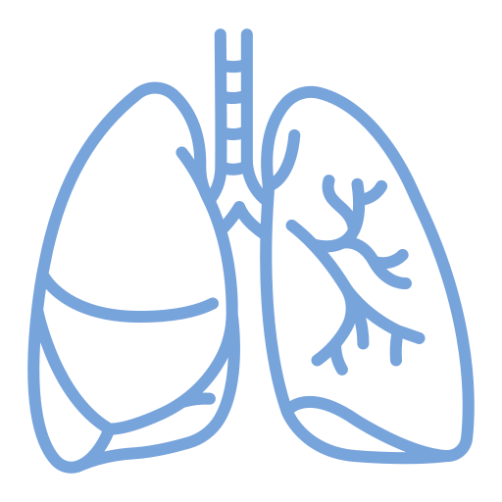
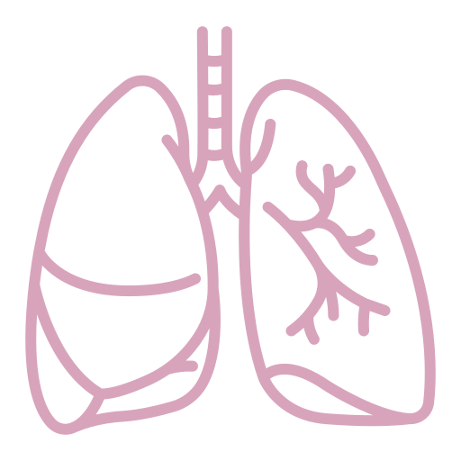
Team Leaders
Team Members
Mohammad Alrashed
Najla
Aldhbiban
Faisal Alomar
Nouf Aldalaqan
Mishal Alsuwayegh
Nouf Aldhalaan
Hazem Almalki
Atheer Alahmari
Zyad Alodan
Shatha Alshabani
Salman Albadr
Aljazi AlBabtain
Abdulaziz Alnasser
Reema Alshehri
Faris Alseraye
Sarah Alzahrani
Ahmad Alemam
Maha Alkoryshy
Alwaleed Faqihi
Nada Albedaiwi
Abdullah Alnajres
Razan Almohanna
Meshari Alshathri
Atheer AlKanhal
Nawaf Alturki
Raneem AlWatban
Nasser Alghaith

