Slide 1
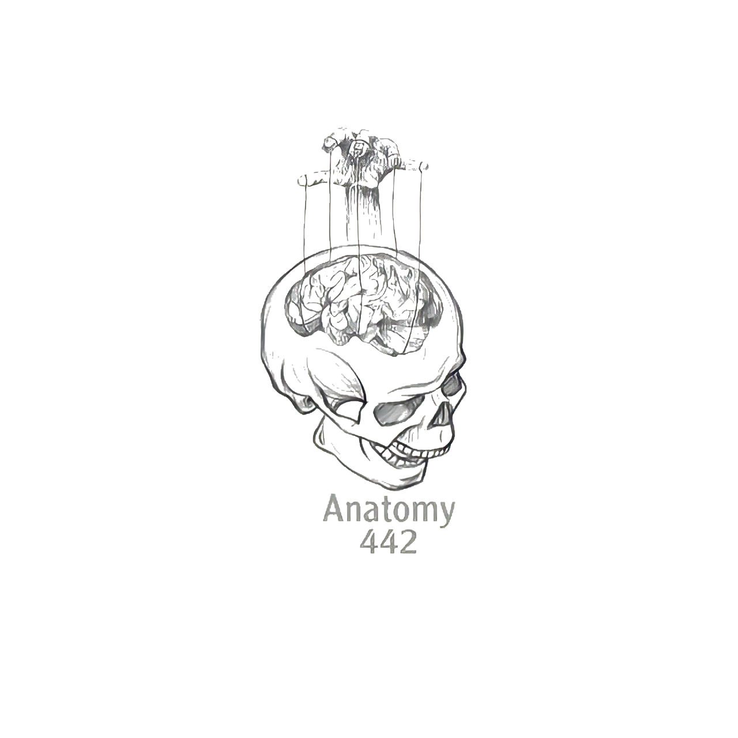
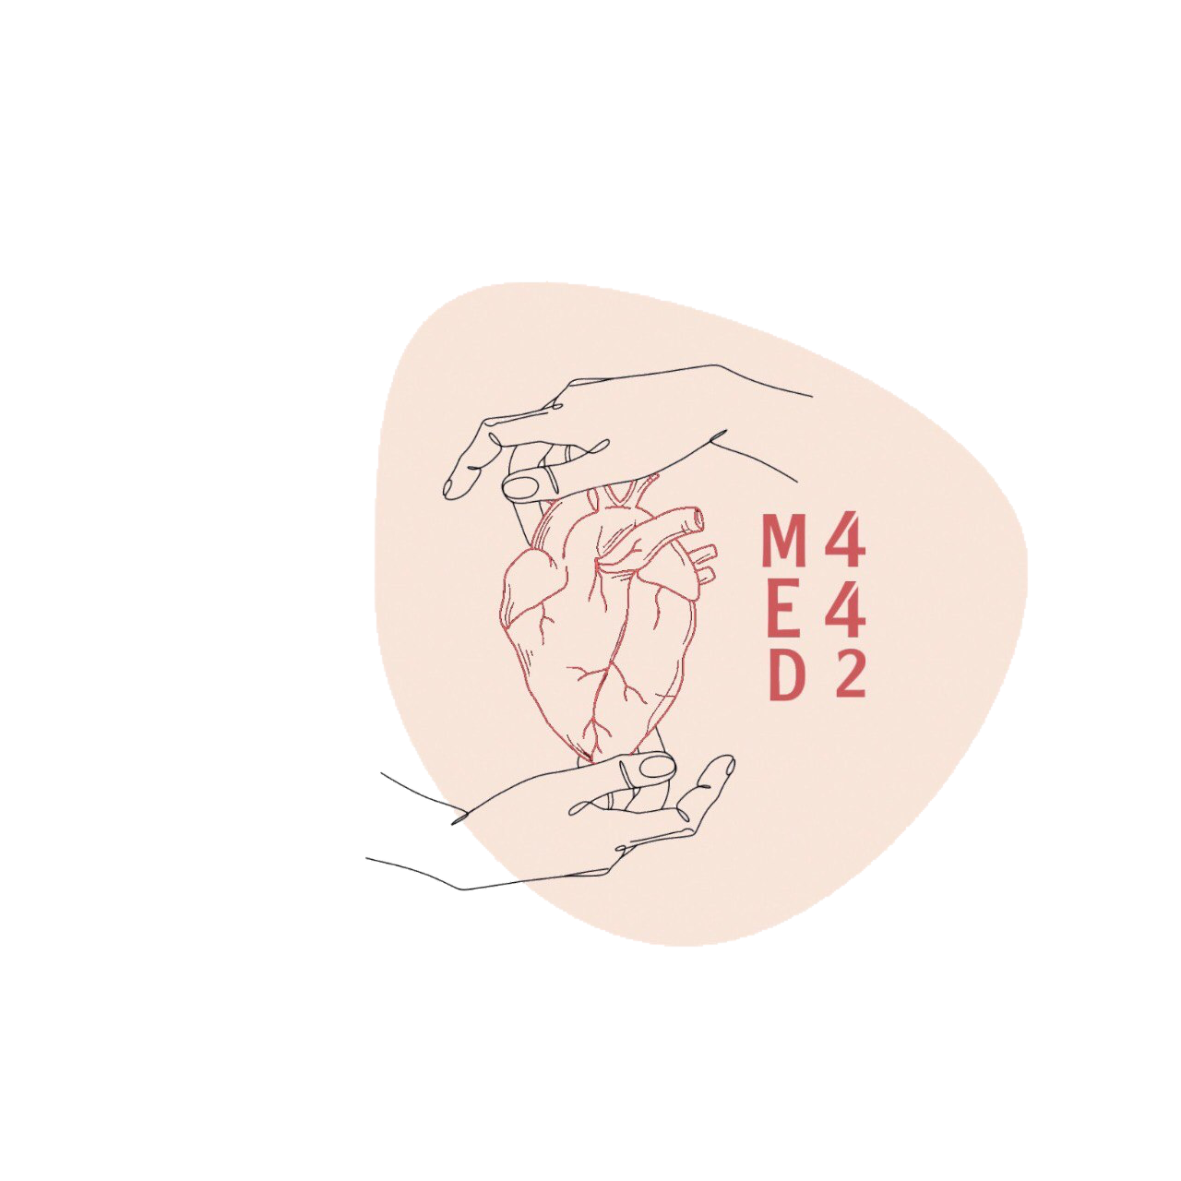
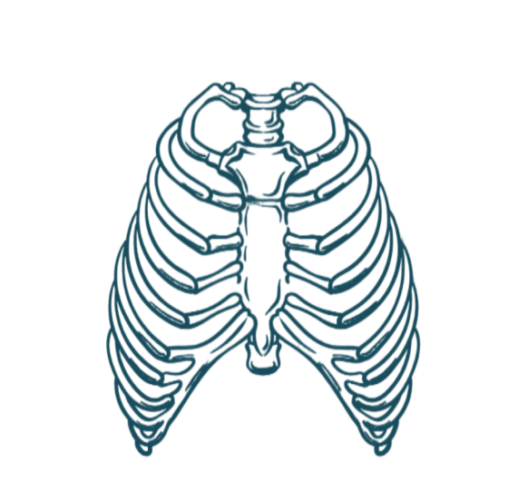
3
Anatomy of the Larynx, Trachea & Bronchi
____________
Respiratory Block
Color Index:
Main Text
Male’s Slides
Female’s Slides
Important
Doctor’s Notes
Extra Info
Editing File
Notes:
This slide is already done, please don’t change anything here

Slide 2
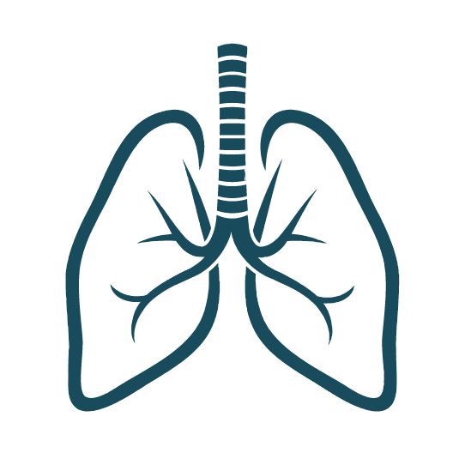
Objectives
1
Describe the Extent, structure and functions of the larynx
Describe the Extent, structure and functions of the trachea
Describe the bronchi and branching of the bronchial tree
2
3
4
Describe the functions of bronchi and their divisions.
5
Clinical anatomy
Watch Video
Before start studying this lecture, we highly recommend that you watch this video first!
thanks to team 441
Notes:
If your objectives are less than 6 delete the extra points
Add the 5th objective from boys slides in blue color

Slide 3
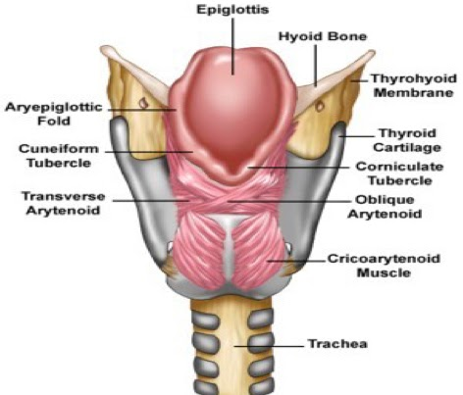
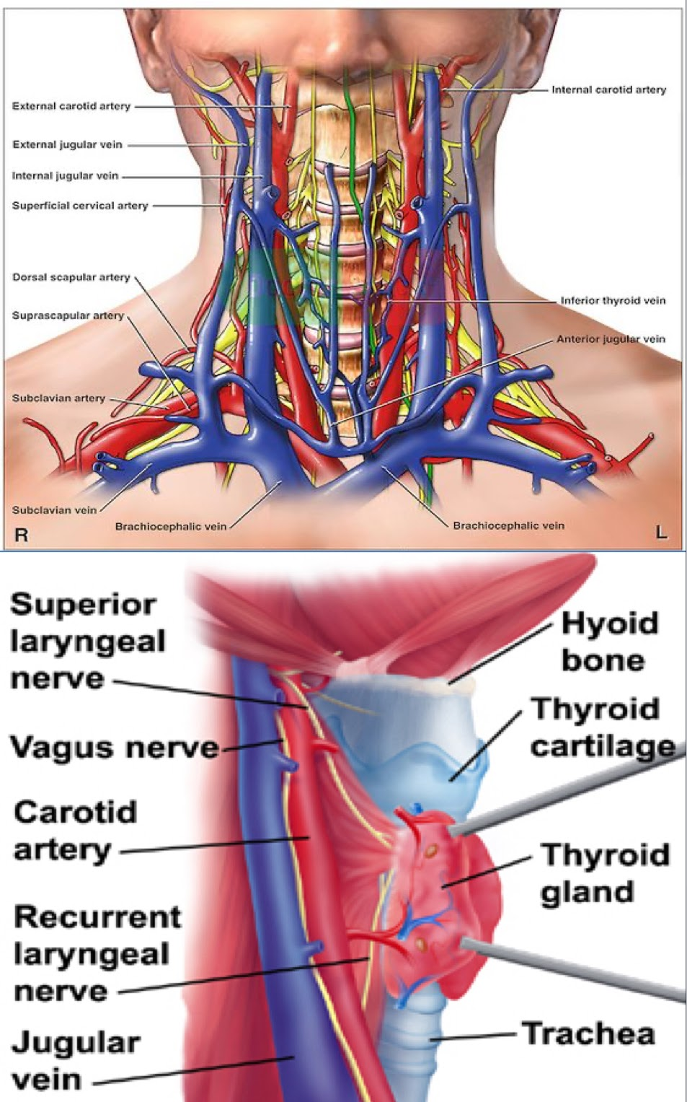
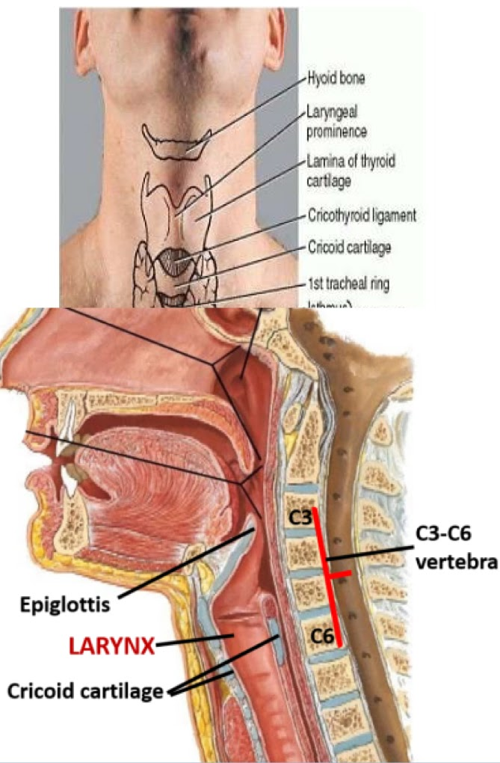
Larynx
It is part of the respiratory tract which contains the vocal cords.
❖ In adults it is a 2-inch-long tube.
❖ It opens above into the laryngeal part of the pharynx.
❖ Below, it is continuous with the trachea.
Functions | Respiration (breathing). Phonation (voice production) because of vocal cords. Deglutition (swallowing)
Relations | The larynx is related to major critical structures in the neck: ➢Arteries: Carotid arteries: 3 (common, external and internal) Thyroid arteries: 3 (superior & inferior thyroid arteries) ➢ Veins: Jugular veins (external & internal) ➢ Nerves: Laryngeal nerves (Superior laryngeal & recurrent laryngeal) vagus nerve. Carotid sheath (deep cervical fascia) consists of: Carotid arteries (common and internal) & internal jugular vein & vagus nerve.
Situation & Extent | ➢ Lies in the anterior midline of the neck. ➢ From root of tongue to trachea, from laryngeal inlet up to lower border of cricoid cartilage. ➢ Opposite to C3-C6 vertebrae in men, ➢ Slightly higher in female & children. ➢ In males, after puberty thyroid cartilage becomes prominent- Adam’s Apple (or laryngeal prominence).
Notes:
Situation and extent are only in girls slides

Slide 4
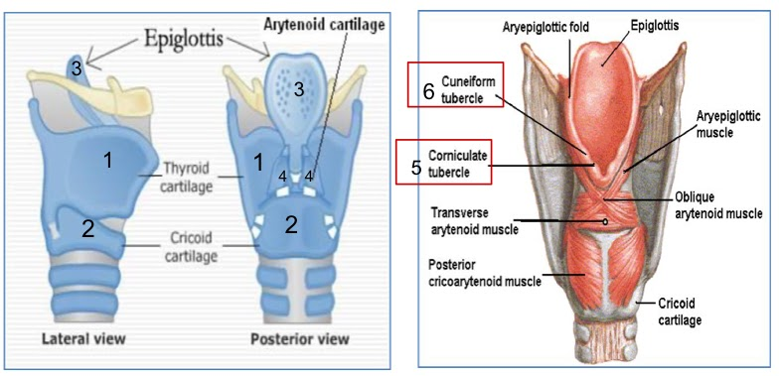
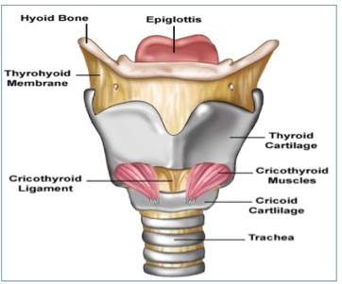
Structure:
The larynx consists of four basic components:
1) Cartilaginous skeleton (Mainly)
2) Membranes and ligaments (connect the cartilage together)
3) Muscles (Intrinsic & extrinsic muscles) In other words (internal: within the larynx & external: surrounding the larynx)(they are helping to move of cartilage)
4) Mucosal lining (Lubrication)
Functions:
Protective sphincter at the air passage.
Phonation.
Regulates air passage in inspiration and expiration.
Opens & closes during swallowing, coughing & sneezing
3 single:
(Large)
1. Thyroid
2. Cricoid
3. Epiglottis
3 paired:
(Small)
4. Arytenoid
(pyramid shape)
5. Corniculate
(very small)
6. Cuneiform
The cartilages
❖ All the cartilages are hyaline except the epiglottis which is Elastic cartilage. (For more elasticity to open & close the inlet) ❖ The cartilages are connected by joints, ligaments, lined by membranes, and moved by muscles.
posterior
anterior
Notes:
Add Functions in boys slides(slide8)

Slide 5
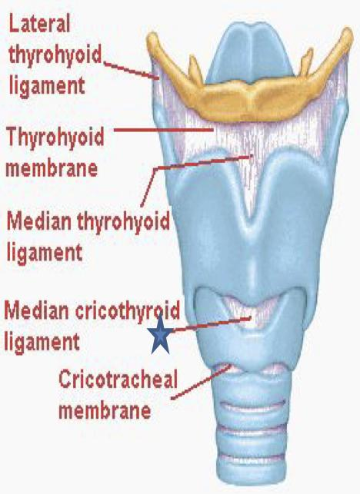
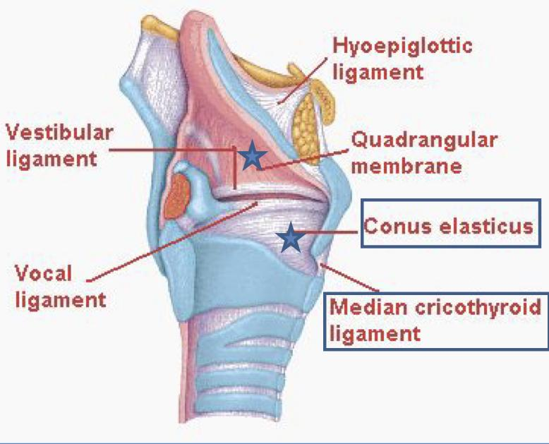
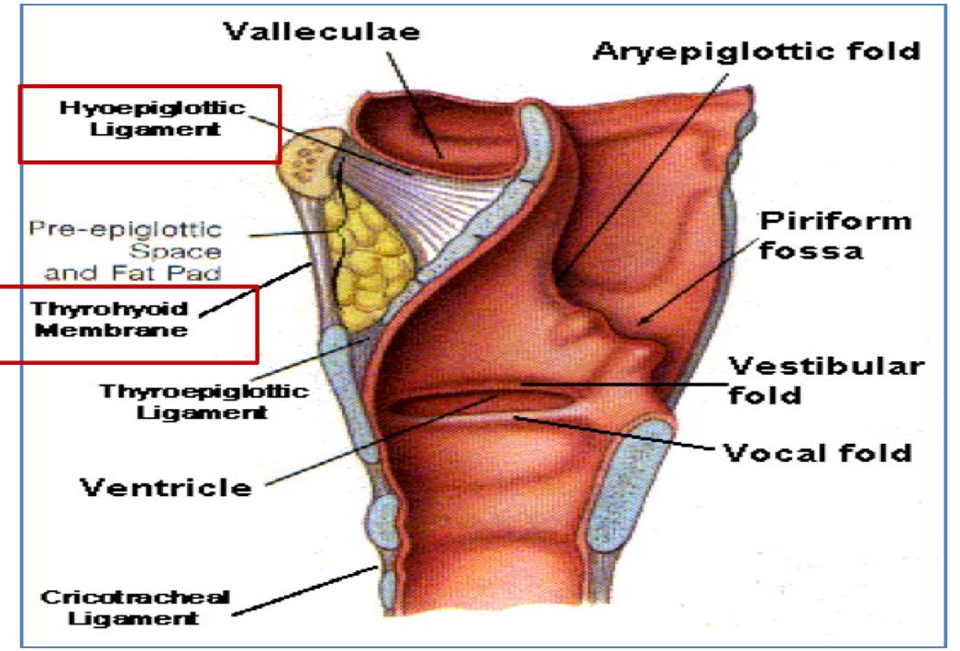
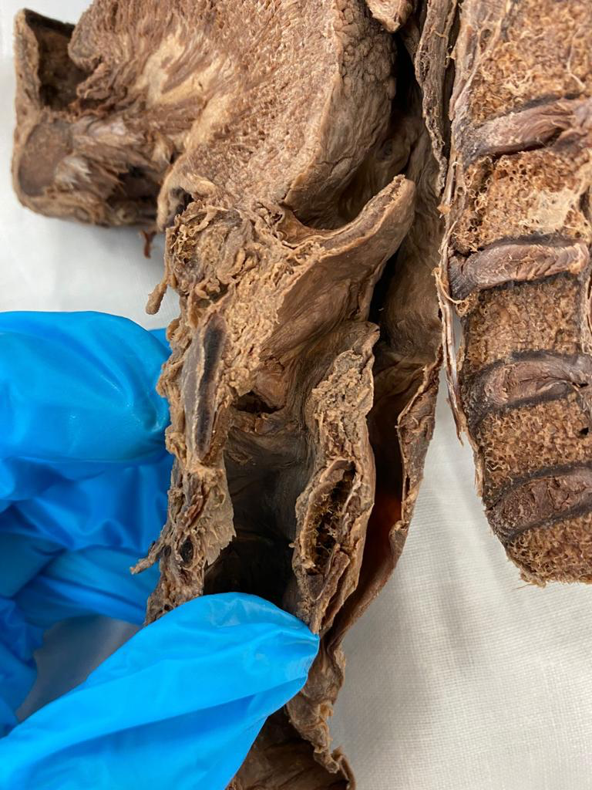
Membranes & Ligaments
1
2
Quadrangular membrane (aryepiglottic membrane)
Thyrohyoid membrane
The thyrohyoid membrane is thickened in the median plane to form
median thyrohyoid ligament
and on both sides to form lateral thyrohyoid ligaments.
- It extends between the arytenoid and epiglottis.
- Its lower free margin forms
the vestibular ligament (it’s form by quadrangular membrane) which forms the vestibular fold
(false vocal cord).
3
4
Cricothyroid membrane
(conus elasticus)
Cricotracheal membrane
- Its lower margin is attached
to the upper border of
cricoid cartilage.
- Upper free margin forms Vocal ligament which forms the true vocal cord.
Ligaments:
1- Hyoepiglottic ligament
2- Thyroepiglottic ligament
In girls slides only
Related to the previous slide
The Arytenoid cartilage has two processes:
the vocal process where the vocal ligament is attached and the muscular process where the cricoarytenoid dorsalis muscle( the laryngeal abductor muscle) inserts
midsagittal
Hyo: U shape
Oid: bone

Slide 6
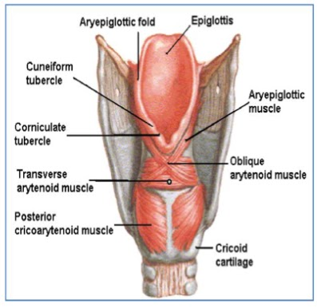
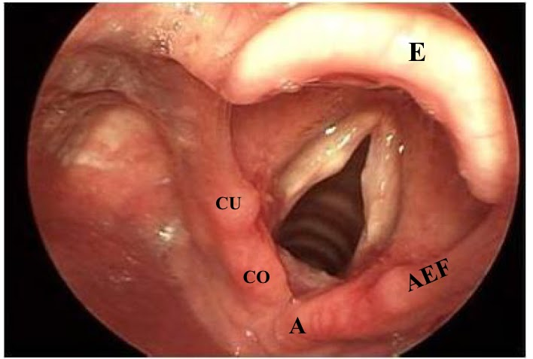
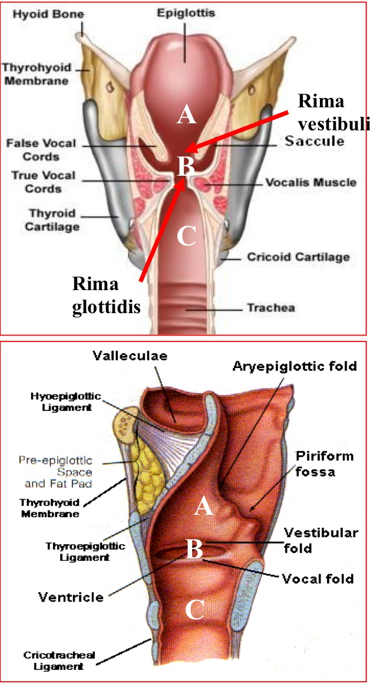
Laryngeal Inlet:
It is the upper opening of the
larynx. It faces upward and backward and opens into the laryngeal part of the pharynx, ( laryngopharynx).
Bounded by:
• Anteriorly: by the upper margin of epiglottis (E)
• Posteriorly & below by:
arytenoid cartilages (A), corniculate & cuneiform
• Laterally: by the Aryepiglottic folds (AEF)
• Closure by apposition of AEF.
Larynx
Laryngeal Cavity:
Coronal plane
• Extends from laryngeal inlet to lower border of the cricoid cartilage.
• Narrow in the region of the vestibular folds
(rima vestibuli). (False vocal cords)
• Narrowest in the region of the vocal folds
(rima glottidis). (True vocal cords)
Divided into three parts:
A. Supraglottic part or vestibule: it is the part above the vestibular folds.
B. Ventricle (glottic): it is the part between the vestibular folds & the vocal folds.
C. Infraglottic (subglottic) part: the part below the vocal folds.
NB. The ventricle has an upward invagination called saccule which is rich in goblet cells.
lateral plane

Slide 7
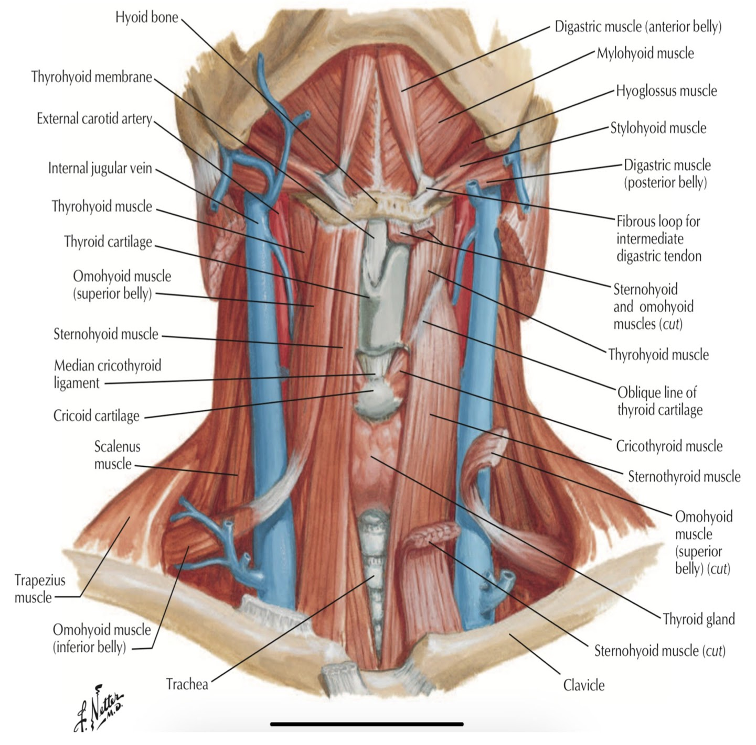
Larynx
Mucous Membrane
The cavity is lined with ciliated columnar epithelium
Except the surface of the vocal cords.
The surface of vocal folds is covered with stratiﬁed squamous epithelium because of exposure to continuous trauma during phonation. (talking exposes your vocal cords to trauma, so it’s more suitable to be lined with stratified squamous than delicate ciliated columnar).
It contains many mucous glands, more numerous in the region of the saccule (for lubrication of vocal folds).
Laryngeal muscles
Laryngeal muscles are divided into two main groups:
• Extrinsic muscles: subdivided into two groups:
1- Elevators of the larynx
2- Depressors of the larynx
• Intrinsic muscles: subdivided into two groups:
1- Muscles controlling the laryngeal inlet. (close and open)
2- Muscles controlling the movements of the vocal cords.
(adduct and abduct)

Slide 8
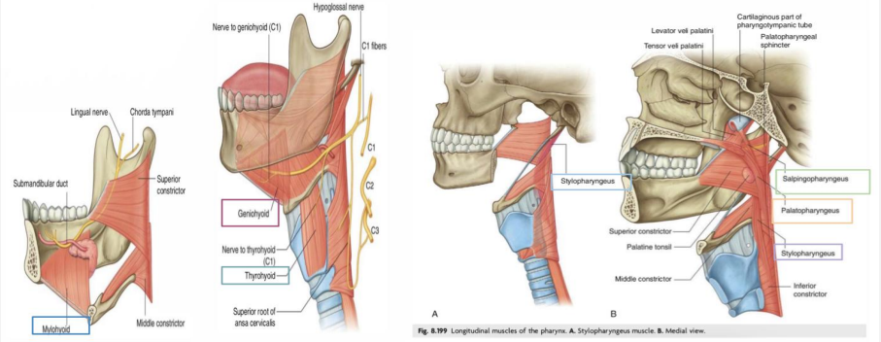
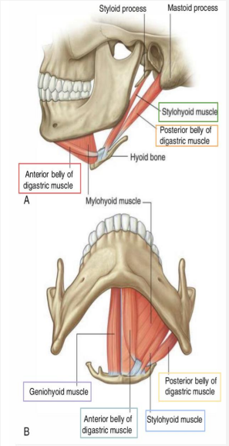
Extrinsic Muscles
Elevators of the larynx A) -The Suprahyoid (MSGD): ➔ Mylohyoid ➔ Stylohyoid ➔ Geniohyoid ➔ Digastric
Depressors of the larynx The Infrahyoid Muscles: ➔ Sternohyoid ➔ Sternothyroid ➔ Omohyoid
B)
-The longitudinal muscles of pharynx:
➔Stylopharyngeus
➔Salpingopharyngeus
➔Palatopharyngeus
Omo: relating to the shoulder

Slide 9
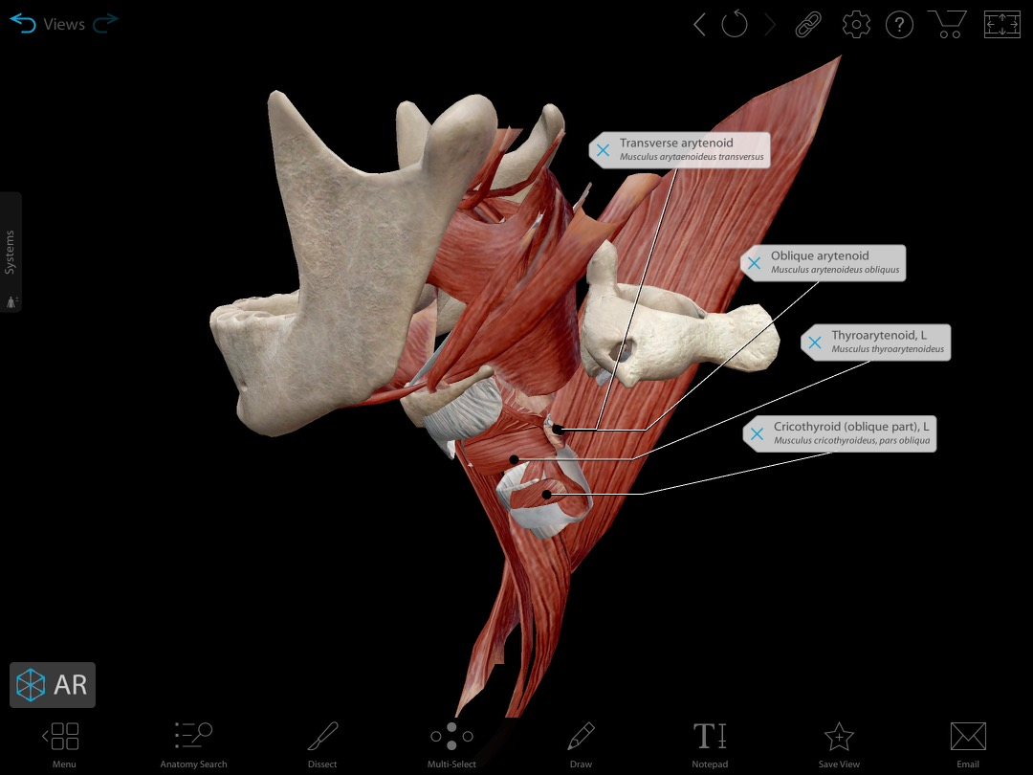
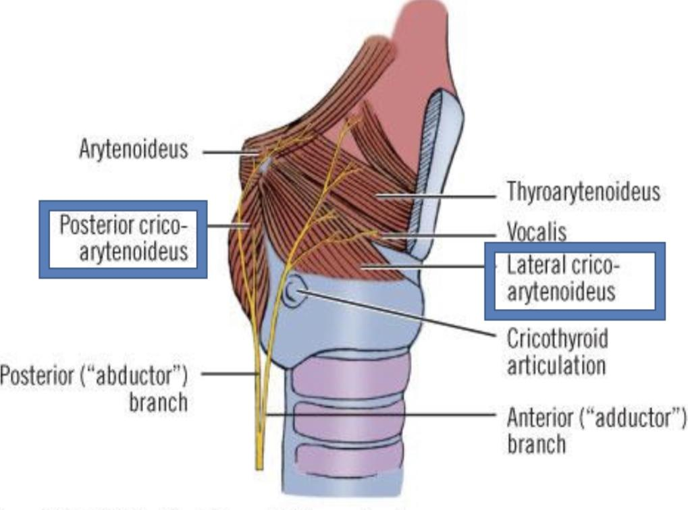
Intrinsic Muscles
Muscles controlling the vocal cords -Muscle decreasing the Length & Tension of Vocal Cords (relax vocal cords): ➔ Thyroarytenoid. (vocalis) - Muscle increasing the Length & Tension of Vocal Cords: ➔ Cricothyroid. *the only intrinsic muscle which found outside the larynx. - Adductors (close rima glottis): ➔ Lateral cricoarytenoid. ➔ Transverse arytenoid. - Abductor (open rima glottis): ➔ Posterior cricoarytenoid.
Muscles Controlling the Laryngeal Inlet Close inlet. Open inlet. ➔ Oblique arytenoid. ➔Thyro-epiglottics ➔ Aryepiglottic muscle.
the lower fibers of thyroarytenoid muscles
Notes:
Add muscles which open inlet of larynx in girls slides (slide 15)
Slide 16 in girls slides (the lower part…) add this part

Slide 10
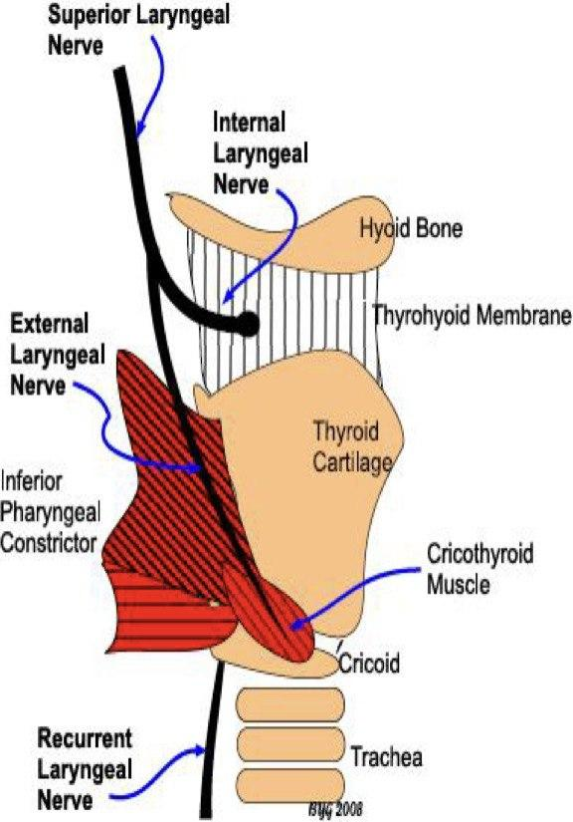
Arteries
Upper Half:
Superior Laryngeal
Artery
Lower Half:
Inferior Laryngeal
Artery
Branch of Superior thyroid artery
Branch of inferior thyroid artery from thyrocervical trunk of subclavian artery
Blood Supply of Larynx:
Drain into Superior thyroid vein, which empty into Internal jugular vein.
Drain into Inferior thyroid vein, which empty into Left brachiocephalic vein.
Veins
Superior Laryngeal
Vein
Inferior
Laryngeal
Vein
▪The superior and inferior laryngeal veins drain the larynx and share the same course as the arteries (accompany corresponding arteries).
The lymph vessels drain into:
Innervation
Lymphatics
Sensory:
Above the vocal cords: Internal laryngeal nerve, branch of the superior laryngeal of vagus nerve.
Below the vocal cords: Recurrent laryngeal of vagus nerve.
Motor:
All intrinsic muscles: Recurrent laryngeal nerve, except cricothyroid muscle.
Cricothyroid muscle: External laryngeal nerve, of superior laryngeal of vagus.
the deep cervical lymph nodes.
The lymph vessels drain into:
the deep cervical lymph nodes
Notes:
Add vines and lymphatic in Slide 18 in girls slides
Slide16 in boys slides add the first part of veins
Semon’s law put it in a different slide with Slide 21 in girls slides last part in the green box+ slide 22 in girls slides

Slide 11
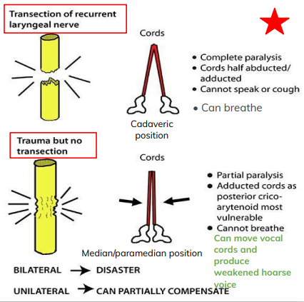
Semon’s law
❖ Damage to the Recurrent laryngeal nerve
❖ It indicates the different effect between damage (surgical trauma) & transection of Recurrent laryngeal nerve due to surgery in region of the neck. (e.g. thyroidectomy or parathyroidectomy)
N.B: the nerve fibers supplying the abductors of the vocal folds lie in the periphery of the recurrent laryngeal nerve and any progressive lesion involves these fibers first before involving the deeper fibers that supply the adductors.
Abductors of V.C are first to be paralysed & last to recover.
found in Girls Only
THE RECURRENT LARYNGEAL NERVE (RLN)
❖R.L.N is responsible about coaptation of vocal cord so, produce Voice.
❖For inspiration: complete abduction of cords is needed.
❖ RLN has outer fibers for Abductor muscles and
has Inner fibers for Adductor muscles.
❖ So, with RLN injury:
A.In partial injury, adductor only are acting so, cords in midline.
B. In complete injury, abductors and adductors are paralysed
so, cords placed midway cadaveric position.
The effect of injury of RLN as follows:
Unilateral partial | Dyspnea
Bilateral partial | stridor & suffocation
Unilateral complete | hoarseness of voice
Bilateral complete | Aphonia

Slide 12
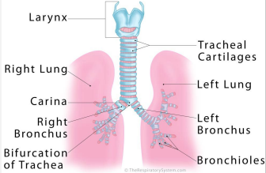
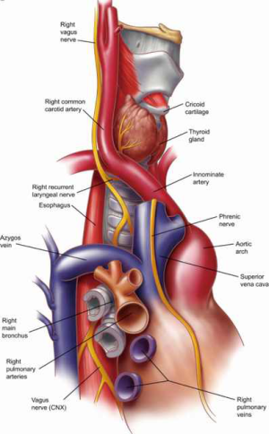
Trachea | ❖ The windpipe ❖ Mobile, fibrocartilaginous tube, 5 inches long, 1 inch in diameter. ❖ Beginning: in the neck below the cricoid cartilage of the larynx (at lower border of cricoid cartilage at (C6). ❖ End: in the thorax at the level of sternal angle (lower border of T4), by dividing into right and left principal (main, primary) bronchi. ❖ The ridge at the bifurcation from inside is called Carina, It’s the most sensitive part of the respiratory tract and is associated with the cough reflex.
Relations | Remember: only the right side has “Right’’ structures, every thing else has “Left’’ Structures.
Anterior | -Sternum. - Thymus (remains of thymus glands) - Left brachiocephalic vein. - Arch of Aorta. -Origin of: - Brachiocephalic artery - Left common carotid artery
Right side | - Azygos vein - Right vagus nerve - Pleura
Left side | - Arch of Aorta - Left common carotid artery - Left subclavian artery - Left vagus nerve - Left phrenic nerve - Pleura
Posterior | - Esophagus - Left recurrent laryngeal nerve
This picture is here to help you understand the Anatomy
This picture is here to help you understand the Relations

Slide 13
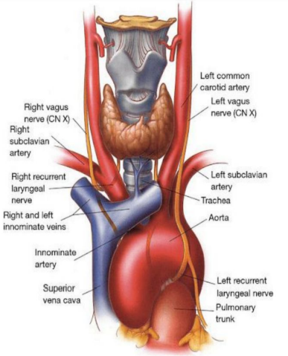
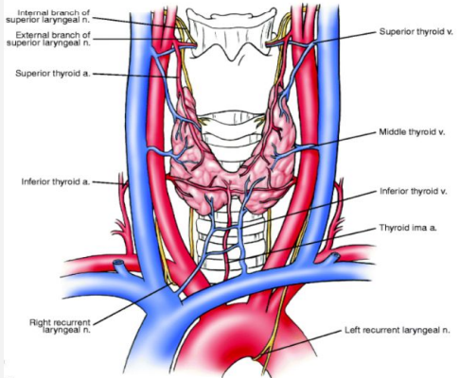
Blood Supply of Trachea:
Arteries
Veins
Branches of:
Drain into the inferior thyroid veins
inferior thyroid artery
bronchial arteries
From descending thoracic aorta
Innervation:
Lymphatic Drainage:
Branches from the sympathetic trunks.
Branches of the vagus nerve and recurrent laryngeal nerve.
Pretracheal Lymph Node
Paratracheal Lymph Node
Trachealis muscle and the blood vessels
Sensory fibers of Mucous membrane:
Notes:
Switch between the two boxes of innervation

Slide 14
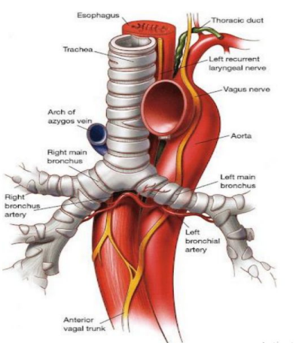
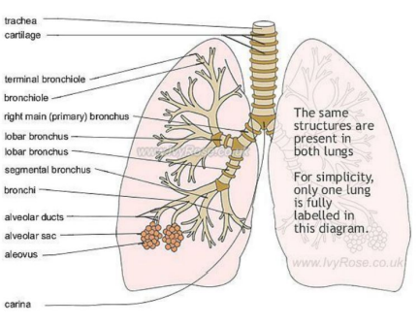
Bronchi
Right Principal Bronchus | Left Principal Bronchus
About one inch long. | About two inches long.
Wider, shorter and more vertical than the left. | Narrower, longer and more horizontal than the right.
Gives superior lobar bronchus before entering the hilum (hilas) of the right lung. | Passes to the left below the aortic arch and in front of esophagus.
On entering the hilum, it divides into middle and inferior lobar bronchi. | On entering the hilum of the left lung, it divides into superior and inferior lobar bronchi.
Anything that goes down the windpipe commonly gets stuck in it because it is wide.
Within the lung, each bronchus divides to branches that can be classified into:
Conduction zone branches | Respiratory zone branches
Primary (main) bronchi Secondary (lobar) bronchi Tertiary (segmental) bronchi (supply the bronchopulmonary segment) Smaller bronchi Bronchioles Terminal bronchioles | - Respiratory bronchioles - Alveolar ducts - Alveolar sacs - Alveoli
Notes:
Add slide 27 in boys slides (asthma)

Slide 15
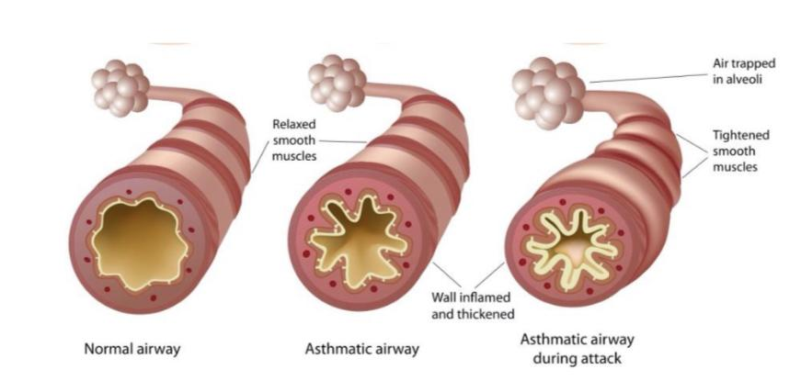
Boys only slide
Asthma
Asthma is a chronic inflammatory condition of the airways characterized by airway obstruction.
▪ It causes bronchoconstriction, shortness of breath, wheezing, chest tightness, increased mucus production and coughing.
▪ The symptoms can be triggered by inhaling allergens such as animal dander, dust mites, mould spores, pollens, certain chemicals and tobacco smoke.
▪ Other factors such as cold weather, exercise, stressful situations and respiratory infections can trigger an attack of asthma.
▪ During an asthma attack a person may experience tachycardia, difficulty breathing and severe anxiety.
▪ Patients should try to avoid exposure to allergens or factors Customer that can trigger an attack
There are Two Types of treatment for asthma:
Corticosteroid | Used to prevent an attack
BronchoDilators | Used as a Quick-Relief Drug for use During an attack

Slide 16
MCQs
1. Which one of the following is a paired cartilage?
A.Thyroid | B. Corniculate | C.Epiglottis | D.Cricoid
2. What is the most posterior structure of the laryngeal inlet?
A.Arytenoid cartilage | B.Epiglottis | C. Conus elasticus | D.Vocal folds
3. Wider, shorter and more vertical is the description of which of the following?
A.Right Principal Bronchus | B.Left Principal Bronchus | C.Inferior thyroid artery | D.Quadrangular membrane
4. Which one of the following muscles decreases the length and tension of the vocal cords?
A. Cricothyroid | B.Oblique arytenoid | C.Transverse arytenoid | D.Vocalis
5. Right side of the trachea?
A.Sternum | B.Right vagus nerve | C.Pleura | D.Both B and C
1)B ,2) A ,3) A , 4)D ,5) D
Answers:
Notes:
لا تآخذون اسئله من تيمات قديمه <- الاكاديمك ليدر

Slide 17
MCQs
6. Larynx below is continuous with?
A.Pharynx | B. Esophagus | C. Bronchus | D.Trachea
7. Which of the following is not a basic component of the Larynx?
A.Mucosal lining | B.Cartilaginous skeleton | C.Membranes and ligaments | D.Joints
8. It extends between the arytenoid and epiglottis?
A.Cricoid cartilage | B.Thyrohyoid membrane | C.Quadrangular membrane | D.Mylohyoid
9. Which of the following structures is covered with stratiﬁed squamous epithelium?
A.Vestibular folds | B.Aryepiglottic folds | C.Vocal folds | D.Saccule
10. Veins of the trachea drain into?
A.Inferior laryngeal Veins | B.Bronchial veins | C. Inferior thyroid veins | D.Superior thyroid veins
6) D , 7) D , 8) C , 9) C , 10) C
Answers:
Click on the icon for more questions from Med442’s QBank
Notes:
لا تآخذون اسئله من تيمات قديمه <- الاكاديمك ليدر

Slide 18
SAQs
Mention 2 ligaments in the larynx?
1- Hyoepiglottic ligament
2- Thyroepiglottic ligament
2. Mention 4 of the Extrinsic Suprahyoid muscles that elevate the Larynx
Mylohyoid
Stylohyoid
Geniohyoid
Digastric
(MSGD)
3. Mention three of the conduction zone branches
Primary Bronchi (main)
Secondary Bronchi (lobar)
Tertiary bronchi (segmental)
Notes:
لا تآخذون اسئله من تيمات قديمه <- الاكاديمك ليدر

Slide 19
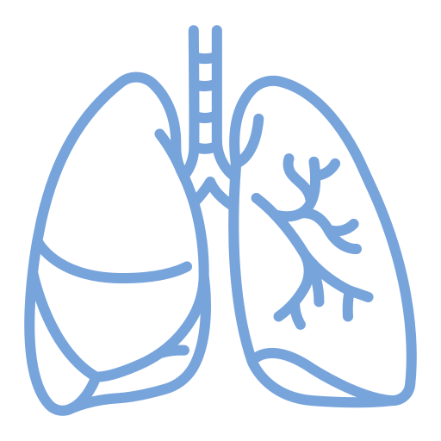
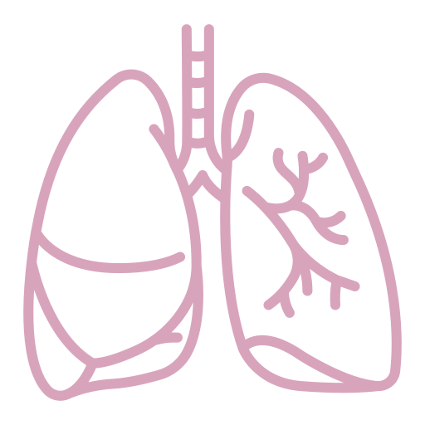
Team Leaders
Team Members
Mohammad Alrashed
Najla
Aldhbiban
Faisal Alomar
Nouf Aldalaqan
Mishal Alsuwayegh
Nouf Aldhalaan
Hazem Almalki
Atheer Alahmari
Zyad Alodan
Shatha Alshabani
Salman Albader
Aljazi AlBabtain
Abdulaziz Alnasser
Reema Alshehri
Faris Alseraye
Sarah Alzahrani
Ahmad Alemam
Maha Alkoryshy
Alwaleed Faqihi
Nada Albedaiwi
Abdullah Alnajres
Razan Almohanna
Meshari Alshathri
Atheer AlKanhal
Nawaf Alturki
Raneem AlWatban
Nasser Alghaith

