Slide 1
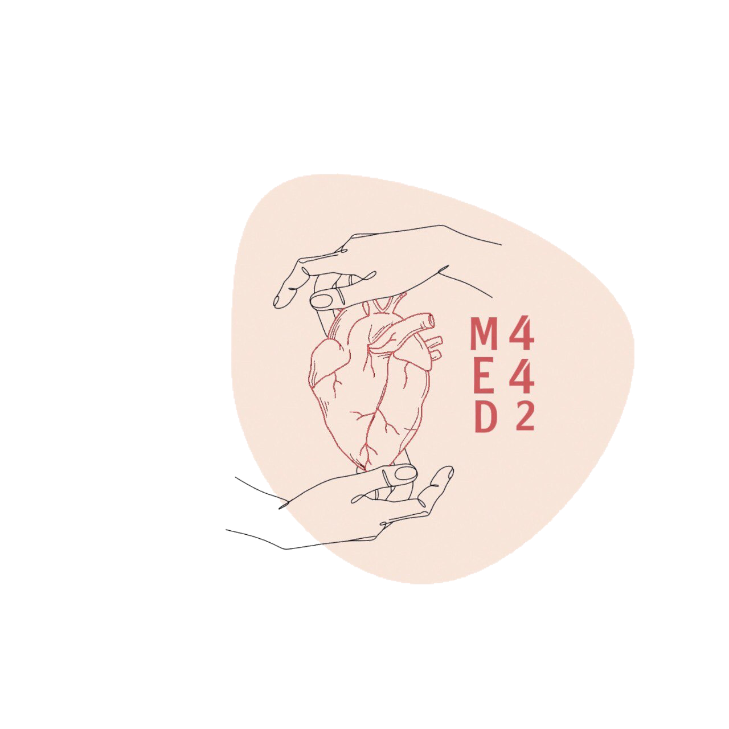
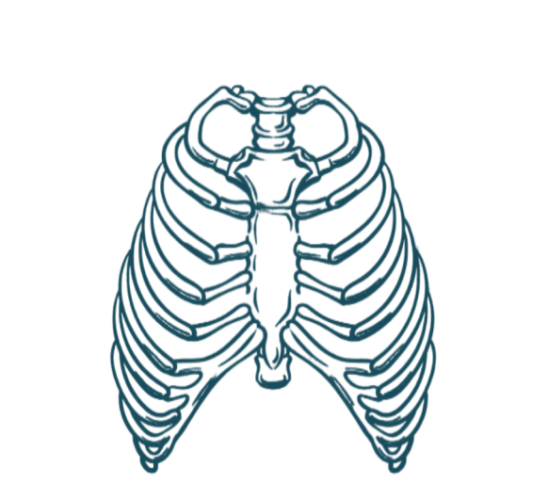
4
Anatomy of the Lungs and Pleura
____________
Respiratory Block
Color Index:
Main Text
Male’s Slides
Female’s Slides
Important
Doctor’s Notes
Extra Info
Editing File
Notes:
This slide is already done, please don’t change anything here

Slide 2
Objectives
1
Describe the anatomy of the pleura: subdivisions into parietal & visceral pleurae, nerve supply of each of them.
2
List the parts of parietal pleura and its recesses.
3
Describe the surface anatomy of both pleurae
and lungs.
4
Describe the anatomy of lungs : shape, relations,
nerve supply & blood supply.
5
Describe the difference between right & left lungs.
6
Describe the formation of bronchopulmonary
segments and the main characteristics of
each segment in the lung.
Notes:
If your objectives are less than 6 delete the extra points

Slide 3
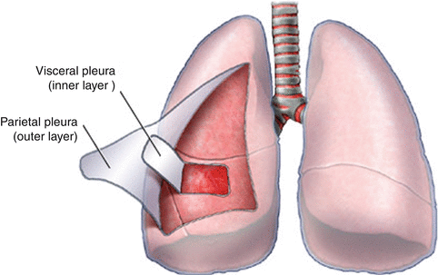
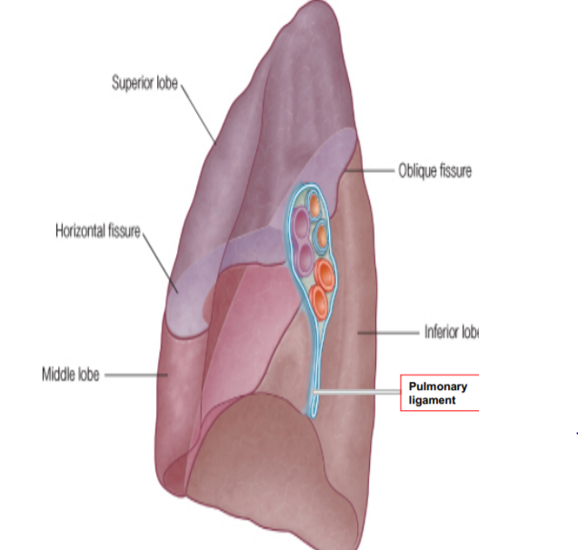
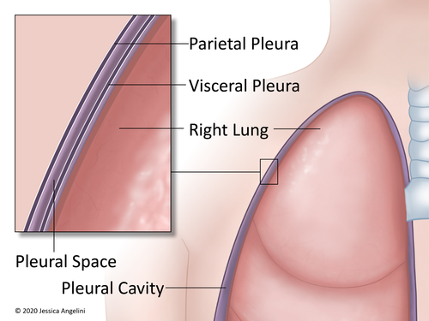
Pleura:
Is a double-layered serous membrane enclosing the lung Has two layers:
Parietal layer | which lines the thoracic walls.
Visceral layer | which covers the surfaces of the lung. (attached to the lung) (inner layer)
(outer layer)
The two layers continue with each other around the root of the lung, where it forms a loose cuff hanging down called the pulmonary ligament.
The space between the two layers, the pleural cavity, contains a thin film of pleural serous fluid (5-10 ml.)
The volume of serous fluid is increased in some diseases
Hilum of lung
Contain artery vein and bronchi

Slide 4
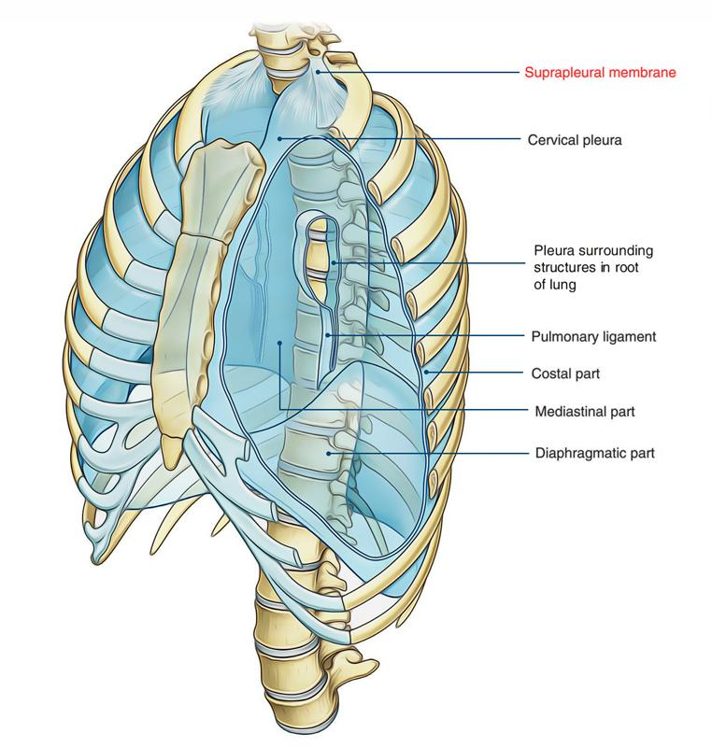
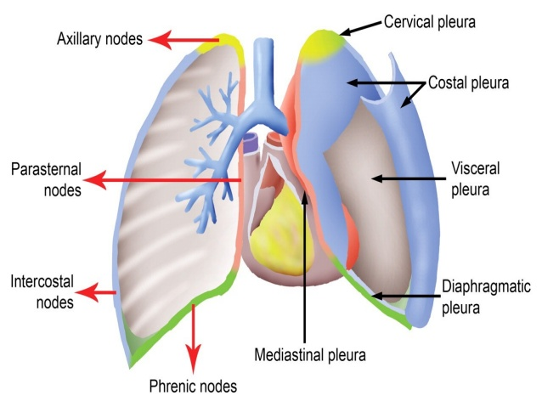
Parietal Pleura:
It is divided according to the region in which it lies and the surfaces it covers, into:
Cervical pleura.cervical vertebra
Mediastinal pleura.heart
Costal pleura. Costal cartilage
Diaphragmatic pleura. Diaphragm
1
Cervical Pleura
2
Mediastinal Pleura
Projects upward into the neck: About one inch above the medial 1/3rd of clavicle. It lines the under surface of the Suprapleural membrane*.
Covers the Mediastinum:
At the Hilum, It is reflected on to the vessels and bronchi, It is continuous with the visceral pleura.
*Suprapleural membrane: fascial layer extends from 1st rib to transverse process of c7
3
Costal Pleura
4
Diaphragmatic Pleura
lines, the back of the:
- Sternum
- Ribs
- Costal cartilages
- Intercostal spaces
- Sides of vertebral bodies
Covers the: thoracic (upper) surface of the Diaphragm.

Slide 5
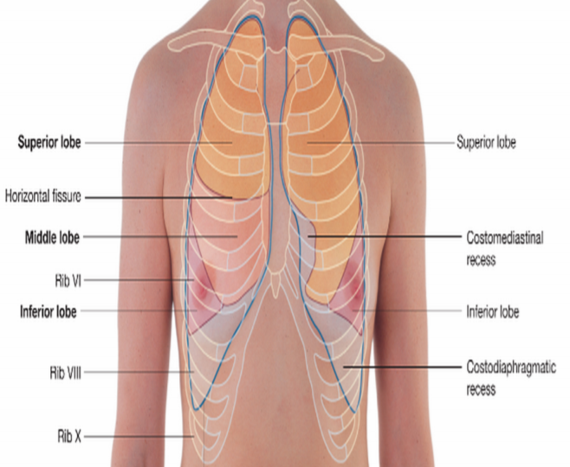
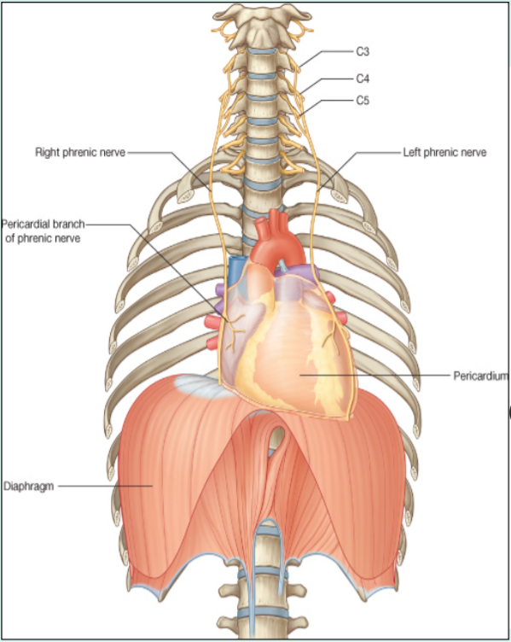
Pleural Recesses:
Pleura Nerve Supply:
Costodiaphragmatic Recess | Costomediastinal Recess
Slit like space between costal and diaphragmatic pleura, along the inferior border of the lung which enters through it in deep inspiration. | Slit like space between costal and mediastinal pleura, along the anterior border of the lung which enters through it in deep inspiration.
Pleural recesses function is to provide additional space for the lungs to expand during forced inspiration
Parietal pleura | It is sensitive to (PPTT) pain, pressure, temperature, and touch. It is supplied as follows: Costal pleura is segmentally supplied by the intercostal nerves. Mediastinal pleura is supplied by phrenic nerves. Diaphragmatic pleura is supplied as follows: over the domes by phrenic nerves, around the periphery by lower 6 intercostal nerves.
Visceral pleura | Sensitive to stretch only (no pain) and is supplied by the autonomic fibers from the pulmonary plexus.
Stretch: يكون داخلي احنا مانحس فيه
E.g: stimulation of glands for secretion

Slide 6
Surface Anatomy of Pleura:
Surface Anatomy of the Lung:
Apex | Lies one inch above the medial 1/3 of the clavicle. (The anterior margin).
Anterior margin | Right pleura: extends vertically from sternoclavicular joint to xiphisternal joint (6th costal cartilage).
 | Left pleura: similar course but at the level the 4th costal cartilage deviates laterally and extends to lateral margin of the sternum to form cardiac notch* then turns sharply downward to xiphisternal joint (6th costal cartilage). *Cardiac notch: allows space for the heart
Inferior margin | Passes around the chest wall, on the 8th rib in midclavicular line, 10th rib in mid-axillary line and finally reaching to 12th rib adjacent to vertebral column posteriorly (T12 spine)
Posterior margin | Along the vertebral column from the apex (C7) to the inferior margin (T12 spine).
Apex, anterior border | correspond nearly to the lines of pleura but are slightly away from the median plane.
Inferior margin | -passes around the chest wall, on the 6th rib in midclavicular line, 8th rib in mid-axillary line and finally reaching to 10th rib adjacent to vertebral column posteriorly. -as the pleura but more horizontally and finally reaching to the 10th thoracic spine.
Posterior margin (purple in the pic) | along the vertebral column from the apex (C7) to the inferior margin (T10 spine).
Oblique fissure | Represented by a line extending from 4th thoracic spine, obliquely ending at 6th costal cartilage. (on both right and left lungs)
Transverse fissure (Only in the right lung) | represented by a line extending from 4th right costal cartilage to meet the oblique fissure.

Slide 7
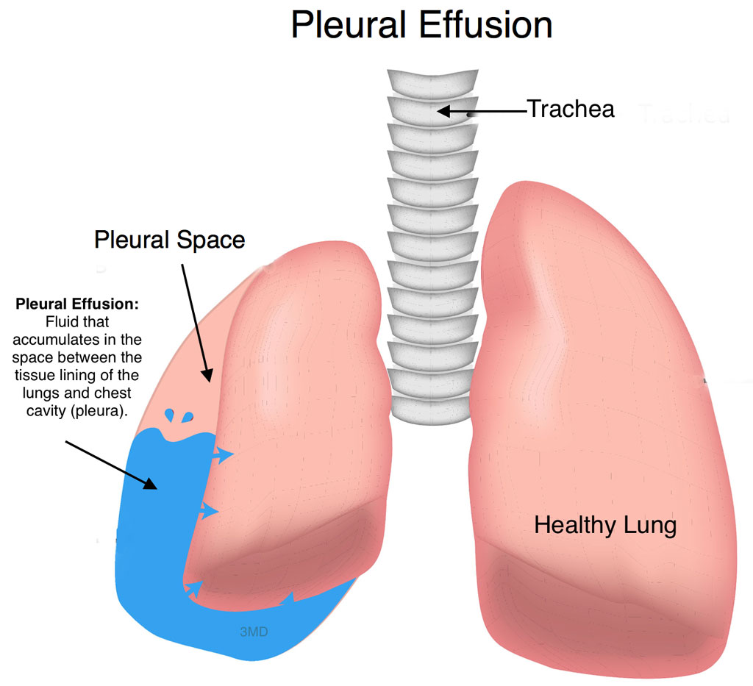
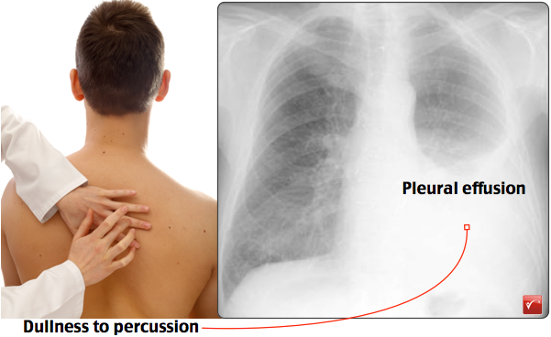
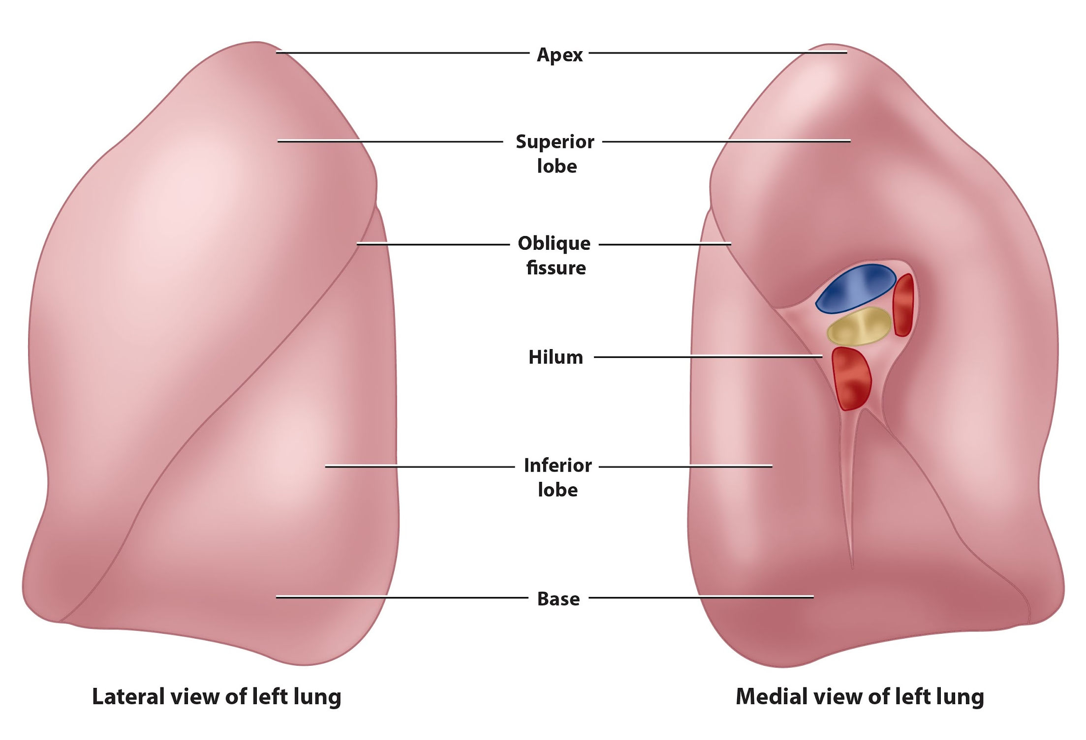
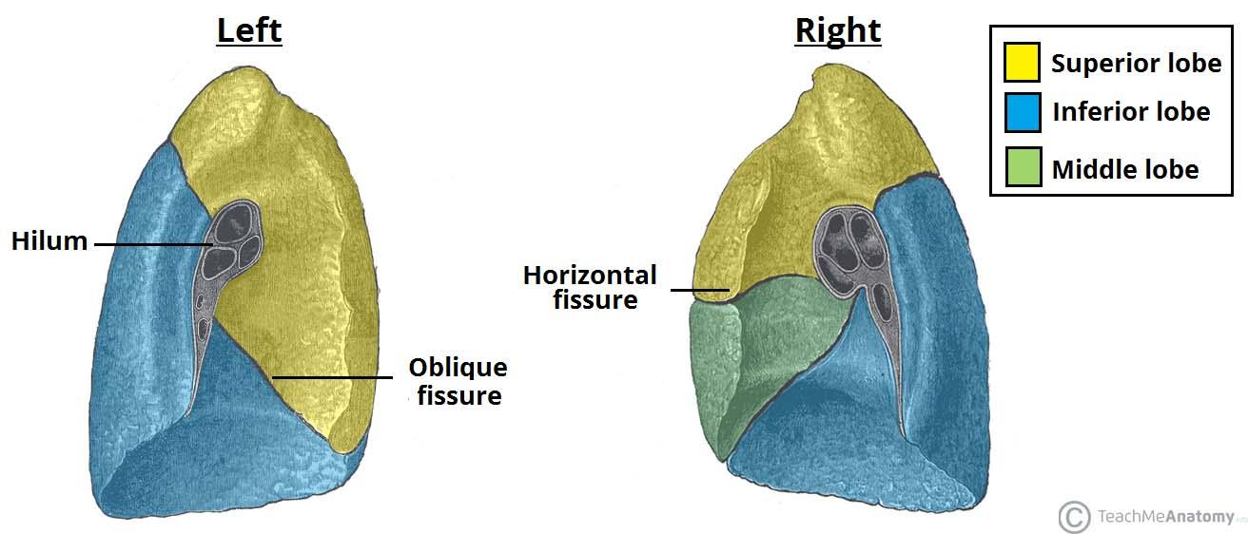
Pleural Effusion:
It is an abnormal accumulation of pleural fluid about 300 ml, in the Costodiaphragmatic pleural recess , (normally 5-10 ml fluid). (no air can enter)
Causes:
Inflammation.
Tuberculosis.
Congestive heart disease.
Malignancy,.
The lung is compressed & the bronchi are narrowed.
Auscultation would reveal only faint & decreased breathing sounds over compressed or collapsed lung lobe.
Dullness on percussion (اختبار عن طريق القرع) over the effusion.
(مكان وجود السائل يصير كانه صندوق مسكر ما يصدر صوت قوي. أما الوضع الطبيعي يصدر صوت مثل طبل)
(441)
Lungs:
Located in the thoracic cavity, one on each side of the mediastinum.
Each lung is: | Each lung has:
Conical in shape. Covered by the visceral pleura. Suspended free in its own pleural cavity. Attached to the mediastinum only by its root. | Apex and Base: Identify the top and bottom of the lung, respectively. Costal surface (Lateral): Surrounded by the ribs from front & back. Medial surface (Mediastinal) : Where the bronchi, blood vessels, and lymphatic vessels enter the lung at the Hilum. It is also related to the structures forming the Mediastinum.

Slide 8
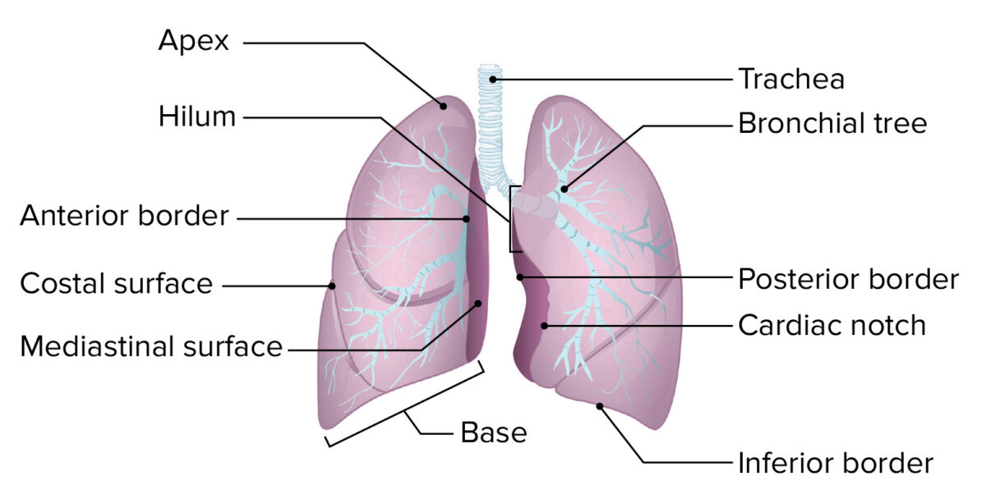
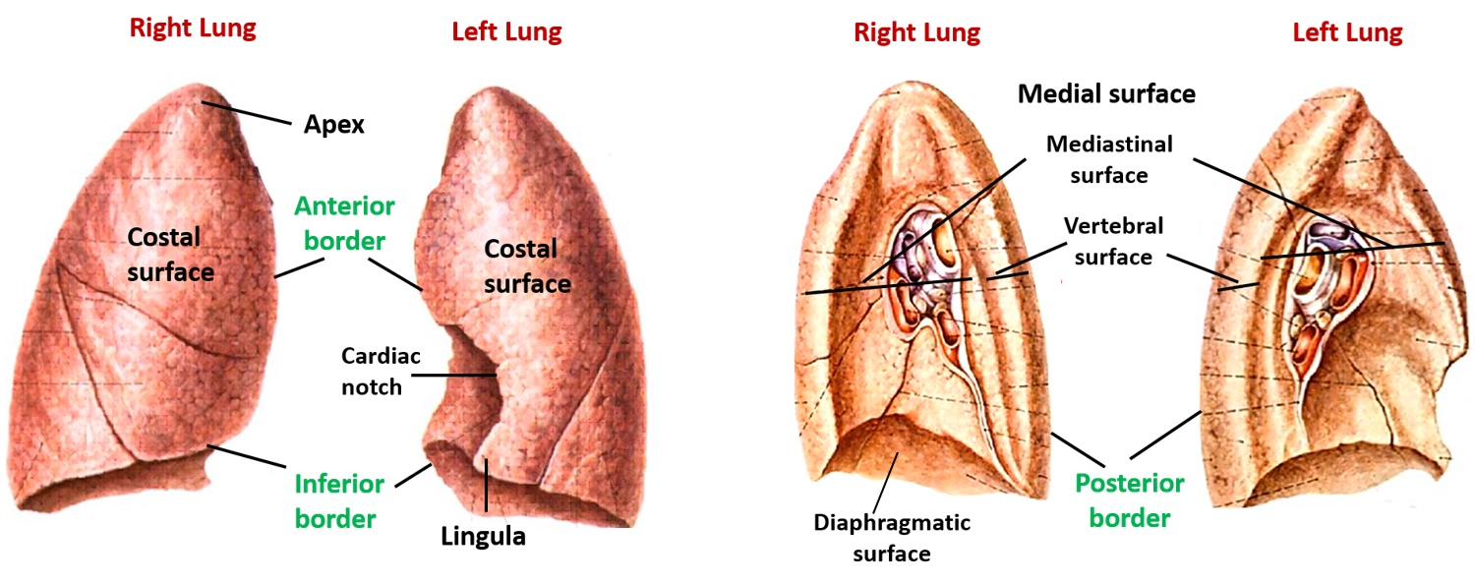
Lungs
Apex | Base
- Projects into the root of the neck (1 inch above medial 1/3 of clavicle). - It is covered by cervical pleura. - It is grooved anteriorly by subclavian artery | -inferior or diaphragmatic surface is concave and rests on the diaphragm
Apex
Borders of Lungs
Anterior border | Posterior border
-Is sharp, thin and overlaps the heart. -Anterior border of left lung presents a cardiac notch at its lower end, has a thin projection called the lingula below the cardiac notch. | -is rounded, thick and lies beside the vertebral column.

Slide 9
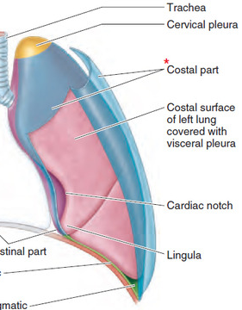
Lungs
Surfaces of Lungs
Lateral (costal) surface | Medial surface
-Convex -Covered by costal pleura which separates lung from: ribs, costal cartilages & intercostal muscles. | It is divided into 2 parts: 1- Anterior (mediastinal) part: Contains a hilum in the middle (it is a depression in which bronchi, vessels, & nerves forming the root of lung). 2-Posterior (vertebral) part: It is related to: Bodies of thoracic vertebrae, Intervertebral discs, Posterior intercostal vessels, Sympathetic trunk.
Medial view
(Anterior)
(Posterior)
Roots of Lungs
Right lung root | Left lung root
1- Two bronchi lie: posterior 2- Pulmonary artery: superior 3- Pulmonary veins: inferior and anterior | 1- One bronchus lie: posterior 2- Pulmonary artery: superior 3- Pulmonary veins: inferior and anterior
2-
1-
3-
3-
2-
1-
Anterior
Posterior
Posterior
Anterior
Medial view of right lung
Medial view of
left lung

Slide 10
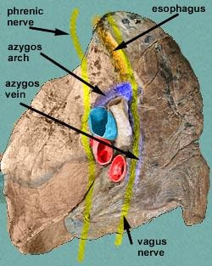
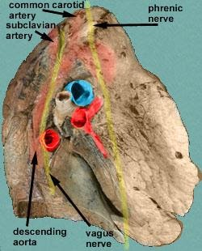
Lungs
Right and Left Lungs
Right lung | Left lung
-Larger & shorter than left lung -It’s divided by 2 fissures oblique & horizontal (transverse) into 3 lobes (upper, middle and lower lobes). | -Divided by one oblique fissure. into 2 lobes, upper and lower. -There’s no horizontal fissure -It has a cardiac notch at lower part of its anterior border.
Horizontal (transverse) fissure
Oblique fissure
Upper lobe
Upper
lobe
Oblique fissure
Middle lobe
Cardiac notch
Lower
lobe
Lower
lobe
Mediastinal Surface of Lungs تقريبا كلهم نفس الstructures لكن الفرق بينهم اليمين في veins ويسار arteries
Right Lung | Left Lung
1- Azygos vein and its arch (posterior and over the root of the lung). 2- Vagus nerve posterior to the root of the lung. 3- Phrenic nerve anterior to the root of the lung. 4- Cardiac impression: Cardiac related to right atrium. 5- Esophagus posterior to the root. 6- Below hilum and in front of pulmonary ligament: groove for I.V.C (inferior vena cava). | 1- Descending aorta and its arches posterior and over to the root of the lung). 2- Vagus nerve posterior to the root of the lung over the root of the lung. 3- Phrenic nerve anterior to the root of the lung. 4- Cardiac impression: related to left ventricle. 5- Groove for left common carotid and left subclavian arteries.
الفرق بالخط ال bold
Cardiac
impression
Cardiac
impression

Slide 11
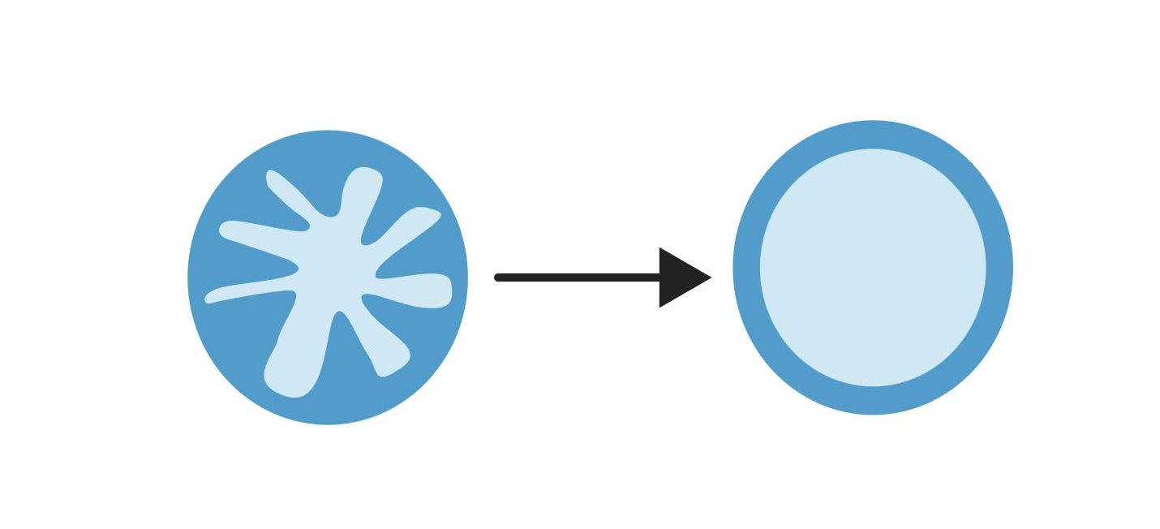
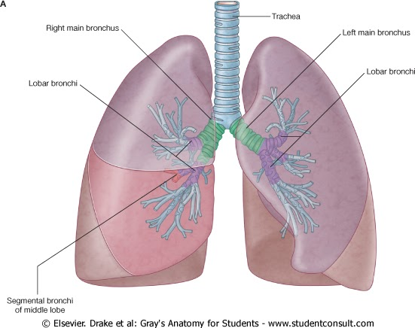
Lungs
Bronchi
Blood supply
Arteries | Veins
1- Bronchial arteries (From descending aorta) It supplies oxygenated blood to bronchi, lung tissue & visceral pleura. 2- Pulmonary artery which carries non-oxygenated blood from right ventricle to the lung alveoli. | 1- Bronchial veins: drain into azygos & hemiazygos veins. 2- Two pulmonary veins: carry oxygenated blood from lung alveoli to the left atrium of the heart.
(441)
Bronchial: الوضع المتعارف عليه الطبيعي
Pulmonary: نعكس
Artery: O2 , vein: CO2
Artery: CO2 , vein: O2
Nerve Supply
Pulmonary plexus at the root of lung is formed of autonomic N.S. from sympathetic & parasympathetic fibers.
1- Sympathetic fibers | 2- Parasympathetic fibers
-From sympathetic trunk Action: broncho-dilatation and vasoconstriction | -From vagus nerve Action: broncho-constriction and vasodilatation and secretomotor to bronchial glands.
The trachea divides into 2 main bronchi:
1- Right main bronchus: which divides before entering the hilum, it gives: superior lobar (secondary) bronchus.
On entering hilum, it divides into middle & inferior lobar bronchi.
2- Left main bronchus: On entering hilum, it divides into superior & inferior lobar bronchi.

Slide 12
Bronchopulmonary Segments
They are the anatomic, functional, and surgical
units of the lungs.
Each lobar (secondary) bronchus
gives
segmental (tertiary) bronchi.
Each segmental bronchus
divides repeatedly
into bronchioles.
Bronchioles divide into
terminal bronchioles
which show delicate outpouchings
‘the respiratory bronchioles’
They end by branching into alveolar ducts
which lead into alveolar sacs.
Alveolar sacs consist of several alveoli
(Alveolar sac contains alveoli الكور الصغيره
Singular is alveolus )
Each alveolus is surrounded by a network of blood capillaries for gas exchange.

Slide 13
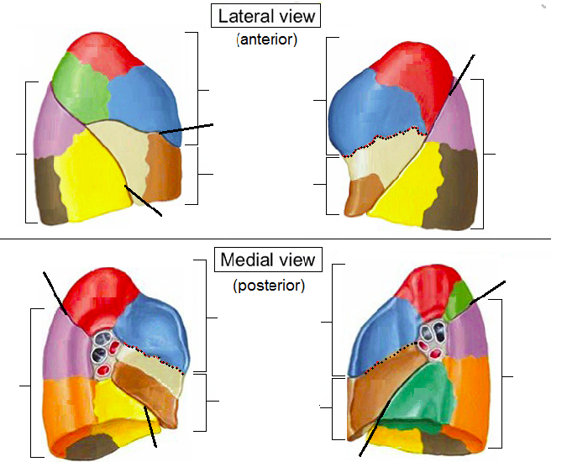
Bronchopulmonary Segments
-The main characteristics of a bronchopulmonary segment:
- It is a subdivision of a lung lobe.
- It is pyramidal shaped (each segment) , its apex is toward the lung root.
- It is surrounded by connective tissue septa.
- It has a segmental bronchus, a segmental artery, lymph vessels, and autonomic nerves.
- The segmental vein lies in the inter- segmental C.T. septa between the segments.
- A diseased segment can be removed surgically, because it is a structural unit.
One segment

Slide 14
MCQs
The right lung is divided into?
A. 2 lobes | B. 1 lobes | C. 4 lobes | D. 3 lobes
2. The left lung is divided by?
A. 2 lobes | B. 2 fissures | C. 1 fissure | D. 3 lobes
3. What is below the right hilum and in front of pulmonary ligament?
A. Groove for I.V.C | B. Groove for left common carotid | C. Groove for left subclavian | D. Azygos vein
4. Esophagus is found on?
A. Anterior to the right lung root | B. posterior to the left lung root | C. posterior to the right lung root | D. anterior to the left lung
5. The normal range of pleural serous fluid?
A. (15-20 ml) | B. (6-10 ml) | C. (5-10 ml) | D. (5-15 ml)
Answers: 1- D 2- C 3- A 4- C 5- C
Click on the icon for more questions from Med442’s QBank
Notes:
لا تآخذون اسئله من تيمات قديمه <- الاكاديمك ليدر

Slide 15
SAQs
1. List 3 special features of Left Lung?
Answer:
1- Divided by one oblique fissure.
into 2 lobes, Upper and lower.
2- There’s no horizontal fissure
3- It has a cardiac notch at lower part of its anterior border.
2. What are the causes of Pleural Effusion
Answer:
inflammation, TB, congestive heart disease and malignancy.
3. Visceral pleura is supplied by?
Answer:
autonomic fibers from the pulmonary plexus
Notes:
لا تآخذون اسئله من تيمات قديمه <- الاكاديمك ليدر

Slide 16
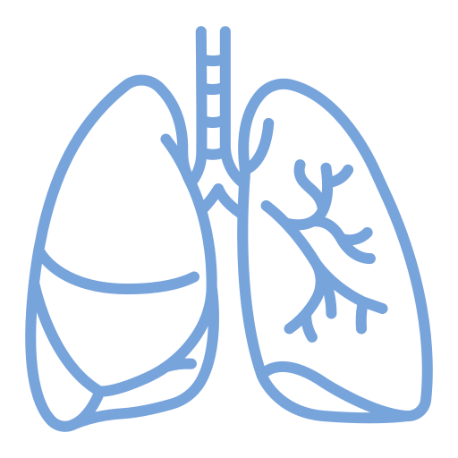
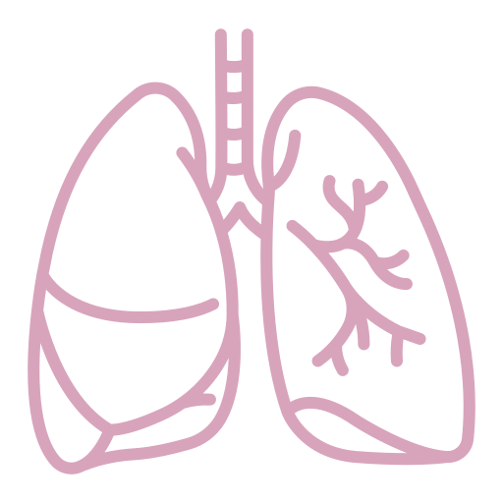
Team Leaders
Team Members
Mohammad Alrashed
Najla
Aldhbiban
Faisal Alomar
Nouf Aldalaqan
Mishal Alsuwayegh
Nouf Aldhalaan
Hazem Almalki
Atheer Alahmari
Zyad Alodan
Shatha Alshabani
Salman Albader
Aljazi AlBabtain
Abdulaziz Alnasser
Reema Alshehri
Faris Alseraye
Sarah Alzahrani
Ahmad Alemam
Maha Alkoryshy
Alwaleed Faqihi
Nada Albedaiwi
Abdullah Alnajres
Razan Almohanna
Meshari Alshathri
Atheer AlKanhal
Nawaf Alturki
Raneem AlWatban
Nasser Alghaith

