Slide 1
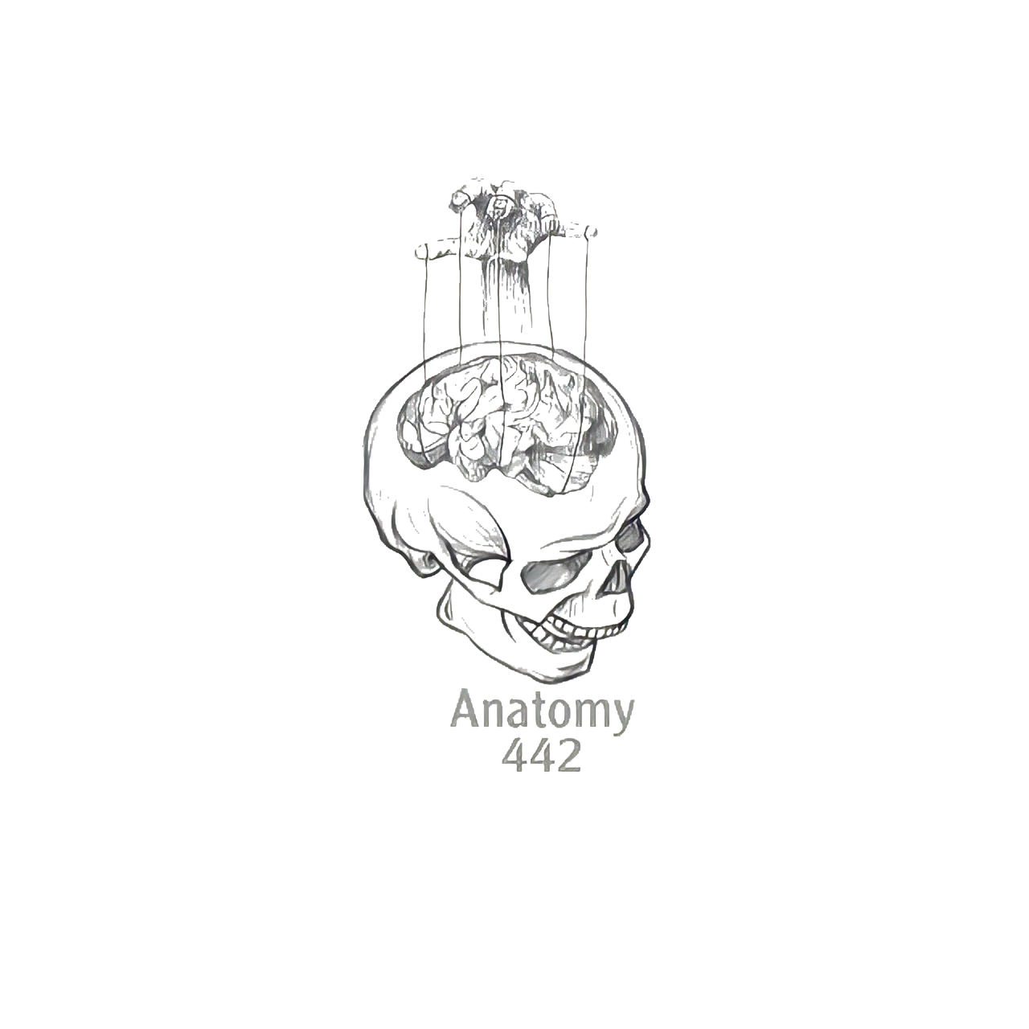
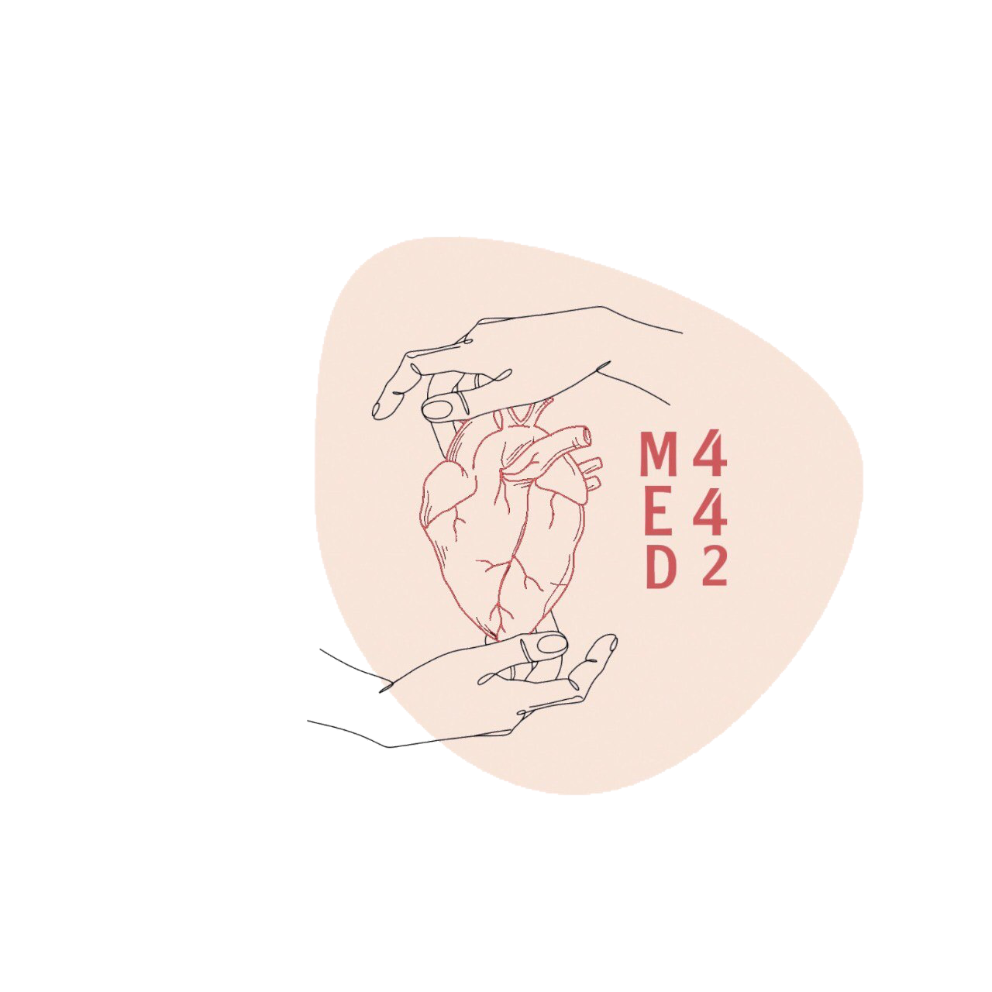
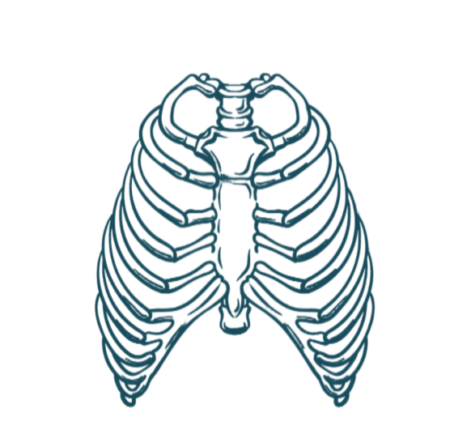
5
Mediastinum
____________
Respiratory Block
Color Index:
Main Text
Male’s Slides
Female’s Slides
Important
Doctor’s Notes
Extra Info
Editing File
Notes:
This slide is already done, please don’t change anything here

Slide 2
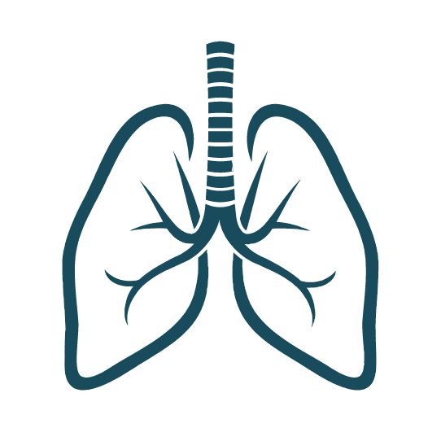
Objectives
Define the Mediastinum
1
Differentiate between the divisions of the Mediastinum
2
List the boundaries and contents of each division
3
Describe the relations between the important structures in each division
4
Notes:
If your objectives are less than 6 delete the extra points

Slide 3
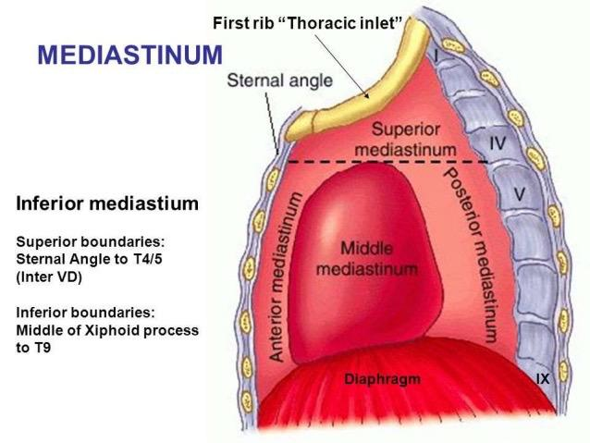
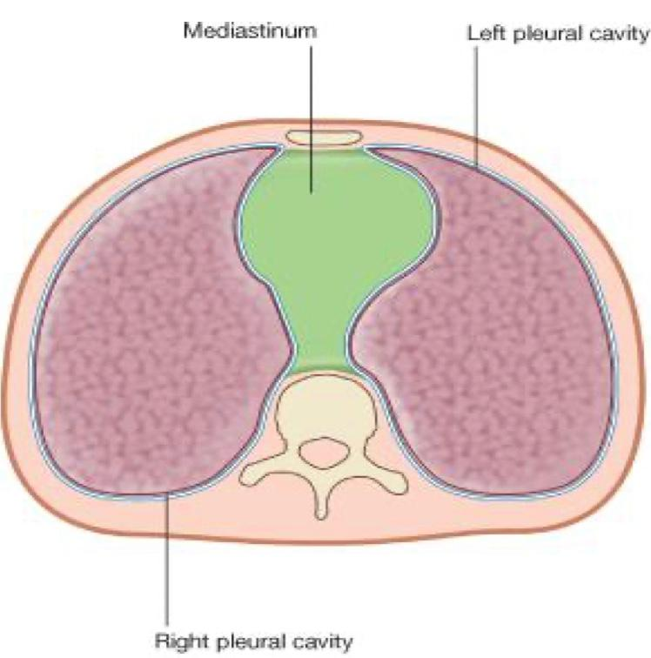
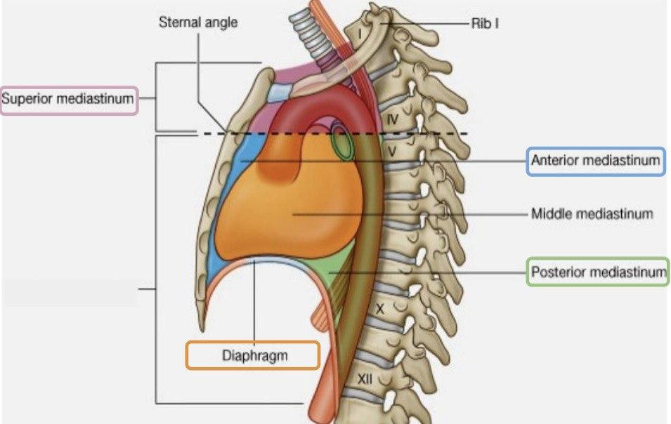
The Mediastinum
1
It is a thick movable partition between the two pleural sacs & lungs.
2
It contains all the structures which lie in the intermediate compartments of the thoracic cavity ( except the lungs ).
Boundaries
Superior | Inferior | Anterior | Posterior | Lateral
Thoracic outlet (manubrium, 1st rib & 1st thoracic vertebrae) | Diaphragm | Sternum | 12 Thoracic vertebrae | Lungs & pleurae
(In Male slides)
lung

Slide 4
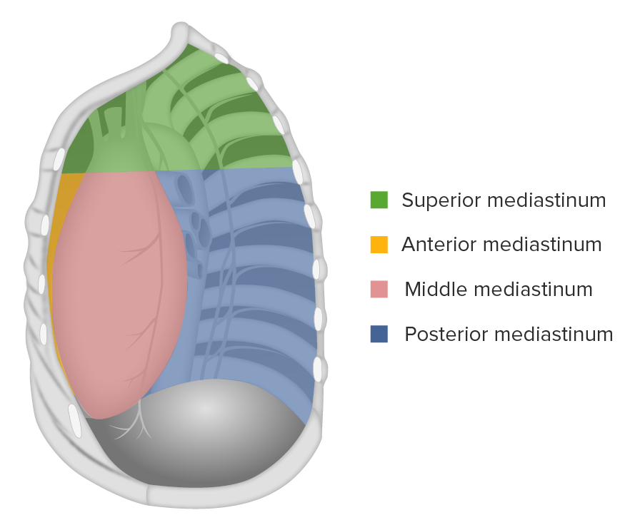
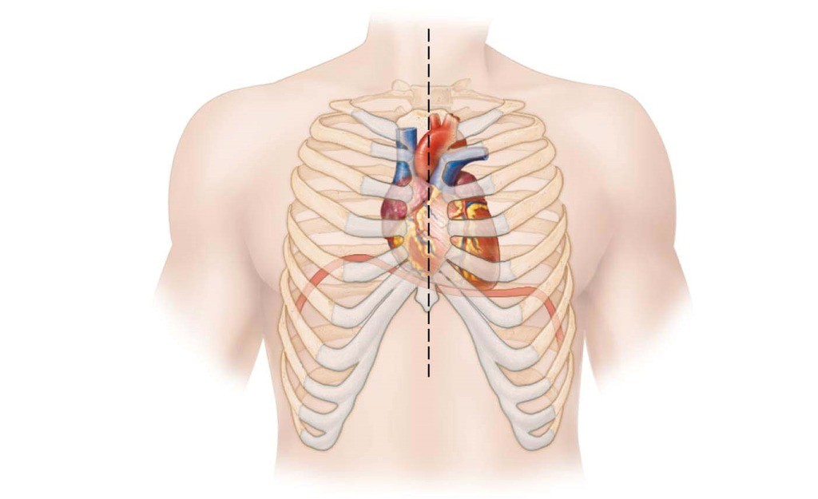
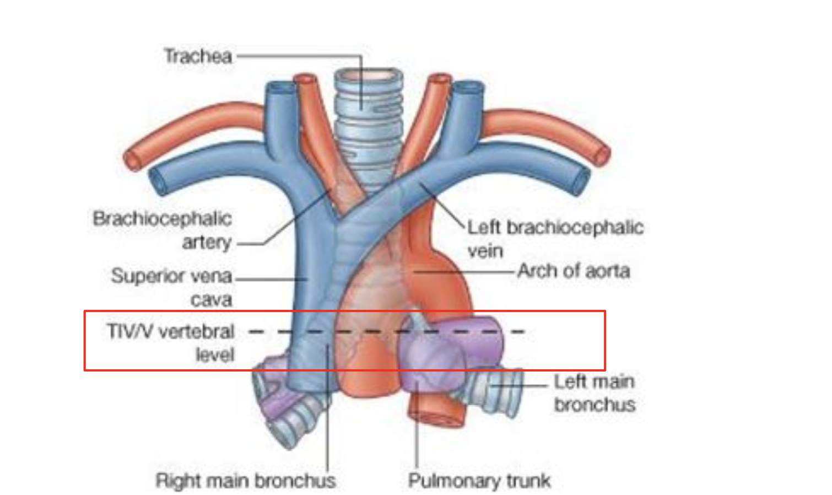
Divisions of Mediastinum
It is divided by a horizontal plane extending from sternal angle to lower border of T4 into:
Superior mediastinum
Inferior mediastinum
Above the Horizontal plane
Below the Horizontal plane
➔ Anterior mediastinum:
In front of the heart
➔ Middle mediastinum:
Contains the heart
➔ Posterior mediastinum:
Behind the heart
Subdivided into:
Level of T4
It is at the level of:
Sternal angle
Second costal cartilage
Why is this level important?
It is the level of :
Bifurcation of trachea
Bifurcation of pulmonary trunk
Beginning & termination of arch of aorta
Termination of arch of azygos vein into SVC

Slide 5
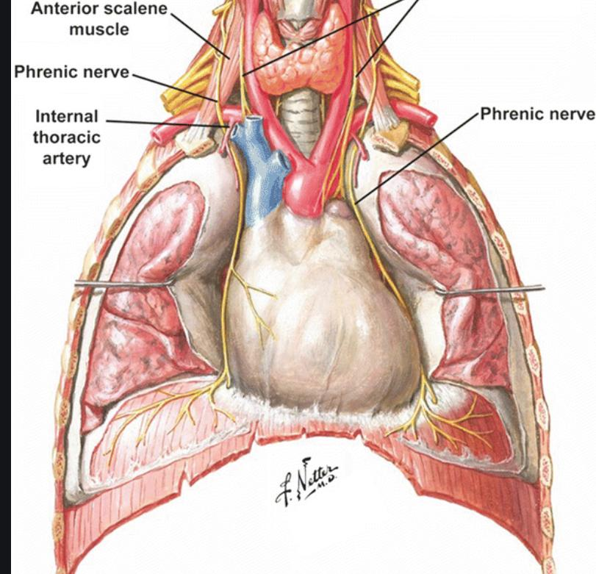
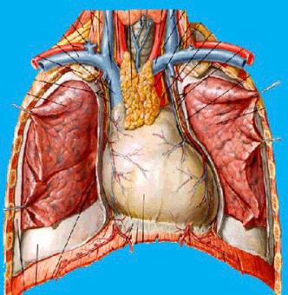
Superior Mediastinum
Boundaries
Superior | Inferior | Anterior | Posterior | Lateral
Thoracic outlet | Horizontal plane | Manubrium of sternum | Upper 4 thoracic vertebrae | Lungs & pleurae
Contents
Superficial | Intermediate | Deep
1 Gland: -Thymus gland 3 Veins: -Right brachiocephalic vein -Left brachiocephalic vein -Superior vena cava | 4 Arteries: - Arch of aorta & its three branches: - Brachiocephalic artery - Left common carotid artery - Left subclavian artery 2 Nerves: - Right & left Vagus nerve - Right & left Phrenic nerve | - Trachea - Esophagus - Thoracic duct - Lymph nodes
LBV
LCC
TD
RBV
Vagus
Brachiocephalic
L Sub
T
SVC
Phrenic
A arch
TG
ES

Slide 6
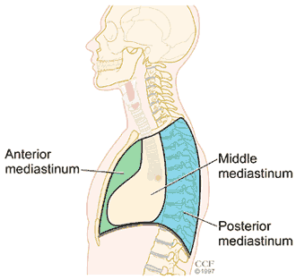
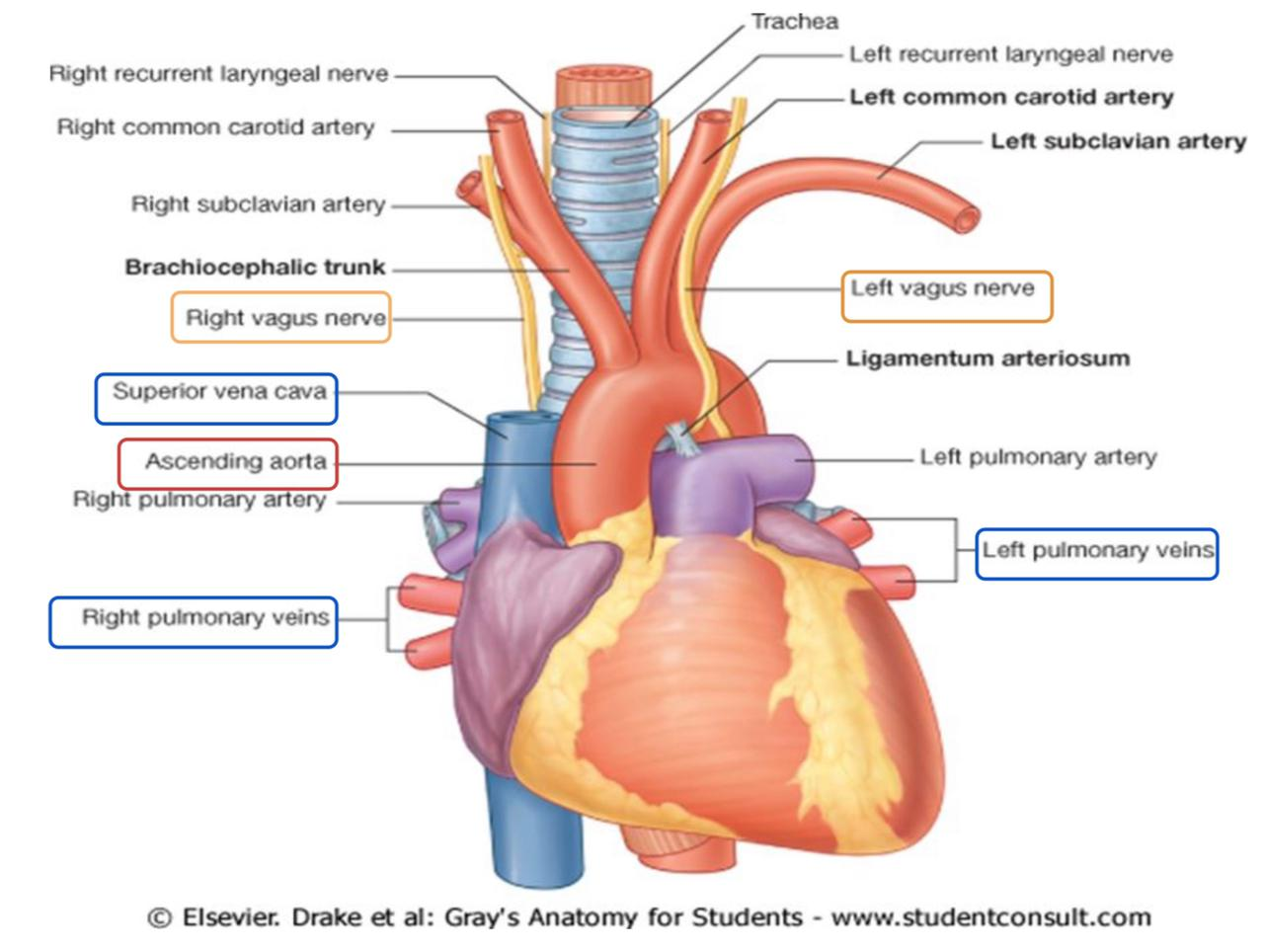
Inferior Mediastinum Subdivisions
Anterior Mediastinum
1. Inferior Mediastinum Subdivisions
Middle Mediastinum
Posterior Mediastinum
Boundaries
Superior | Inferior | Anterior | Posterior | Lateral
Horizontal plane | Diaphragm | Body and xiphoid of sternum | Heart | Lungs & pleurae
Contents
Thymus gland
Lymph nodes
Anterior Mediastinum
2. Inferior Mediastinum Subdivisions
Middle Mediastinum
Posterior Mediastinum
Site
Between anterior & posterior mediastina
Contents
Heart and pericardium
Ascending aorta
Pulmonary trunk
Superior and inferior vena cava
Right and left pulmonary veins
Right and left phrenic nerves
Lymph nodes

Slide 7
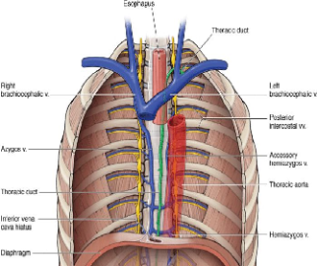
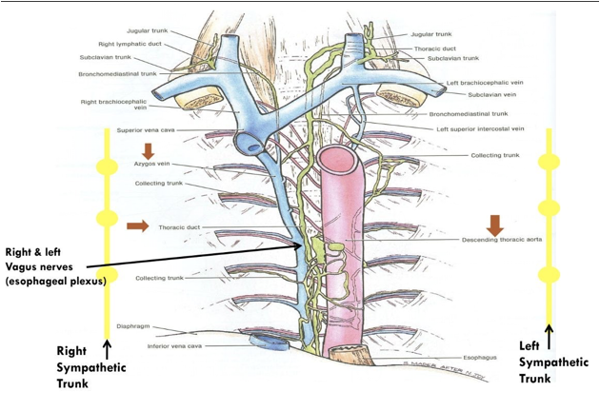
Inferior Mediastinum Subdivisions
Anterior Mediastinum
3. Inferior Mediastinum Subdivisions
Middle Mediastinum
Posterior Mediastinum
Boundaries
Superior | Inferior | Anterior | Posterior | Lateral
Horizontal plane | Diaphragm | Heart | Thoracic vertebrae from T5 to T12 | Lungs & pleurae
Contents
Esophagus
Vagus nerves Around esophagus
Thoracic duct Posterior to esophagus
Azygos system of veins Posterior & to the right of esophagus
Descending aorta Posterior & to the left of esophagus
”Ascending Aorta is present in the Middle Mediastinum"
Right & left thoracic sympathetic trunks
Mediastinal lymph nodes
Structures present in more than one mediastinum
عشان توقفين ضياع
Don’t skip it
Superior & Posterior Mediastinum: | Superior & Anterior Mediastinum: | Superior & Middle Mediastinum:
Esophagus. Thoracic duct. Right & left vagus nerves. | Thymus gland. | Superior vena cava. Right & left phrenic nerves

Slide 8
Mediastinum summary
Superior: Horizontal Plane
Boundaries
Inferior: Diaphragm
Superior & Posterior Mediastinum:
Esophagus.
Thoracic duct.
Right & left vagus nerves.
Superior & Middle Mediastinum:
Superior vena cava.
Right & left phrenic nerves
Superior & Anterior Mediastinum:
Thymus gland.
Anterior Mediastinum
Anterior: Body of Xiphoid processes of sternum
Posterior: Heart
Content
Thymus Gland
Lymph node
Site : Between anterior & posterior mediastina
Content
Heart and pericardium
Ascending aorta
Pulmonary trunk
Superior and inferior vena cava
R & L pulmonary V.
R & L phrenic nerves
Lymph nodes
Middle Mediastinum
Inferior Mediastinum
Below the Horizontal plane
Superior: Horizontal Plane
Boundaries
Inferior: Diaphragm
Mediastinum
Posterior Mediastinum
Anterior: Heart
Posterior: Thoracic vertebrae from T5 to T12
Content
Esophagus (most anterior structure)
Vagus nerves
Thoracic duct Posterior to esophagus
Azygos system of veins Posterior & to the right of esophagus
Descending aorta Posterior & to the left of esophagus
R & L thoracic sympathetic trunks
Mediastinal lymph nodes
Above the Horizontal plane
Superior Mediastinum
Superior: Thoracic Outlet
Boundaries
Inferior: Horizontal Plane
Content
Anterior: Manubrium
Posterior: Upper 4 thoracic vertebrae
Superficial:
Thymus gland
L & R brachiocephalic V.
Superior vena cava
Intermediates: :
Arch of aorta & its branches
Brachiocephalic artery
L common carotid artery
Left subclavian
Nerves :
Phrenic
Vagus
Deep:
Trachea
Esophagus
Thoracic duct
Thanks to shatha almutib !

Slide 9
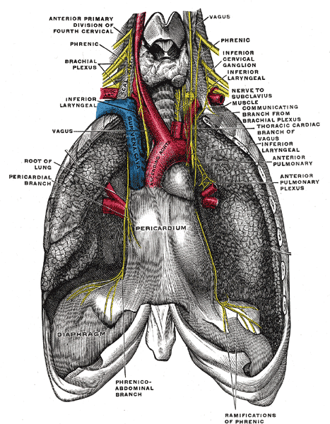
Important Structures In Mediastinum
Phrenic nerve | Vagus nerve
Root value: C3,4,5 They pass through the Superior & Middle mediastina Course in thorax: -The right phrenic descends on the right side of SVC & heart then passes through IVC opening. -The left phrenic descends on the left side of Heart then pierces the left cupola of diaphragm. Both nerves terminate in the abdominal surface of diaphragm. Branches: Motor & Sensory fibers to Diaphragm Sensory fibers to pleurae* & pericardium** *(Mediastinal and central part of diaphragmatic pleura) **(Fibrous and parietal layer of serous pericardium) | It is the 10th cranial nerve. It descends through the Superior & Posterior mediastina The right vagus descends to the right side of trachea, forms the posterior esophageal plexus & continues in abdomen as posterior gastric nerve. The left vagus descends between left common carotid & left subclavian arteries, forms the anterior esophageal plexus & continues in abdomen as anterior gastric nerve.

Slide 10
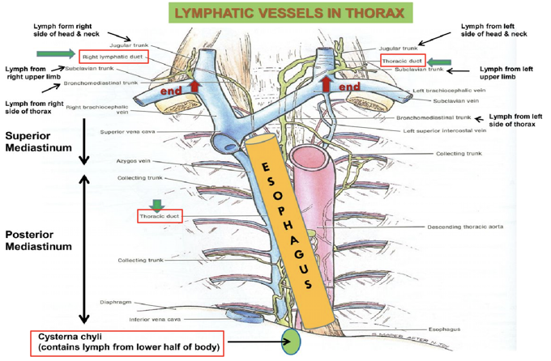
Lymphatic Vessels In Thorax
Thoracic Duct
Beginning:
It is the continuation of Cisterna Chyli
Course:
- Passes through the aortic opening of the diaphragm
- Ascends in posterior mediastinum (posterior to esophagus)
- Ascends in superior mediastinum (to the left of esophagus)
Tributaries: (it receives):
Lymphatics from all the body, EXCEPT:
1- Right side of the thorax 2- Right upper limb 3- Right side of the head and neck.
End:
It opens in the left brachiocephalic vein. N.B: the right lymphatic duct receives lymphatic from right side of the thorax, right upper limb, and right side of the head and neck. It ends in the right brachiocephalic vein.
Function: extra
While the arteries are passing between the tissue, they filtrate some fluids, those fluids may accumulate and cause damage to the tissue. So, the thoracic ducts pass between those tissue and remove the excessive fluids.
Lymph from the right side of the head, neck, thorax, & upper limb drains into the Right lymphatic duct and ends in the right brachiocephalic vein.
Lymph from the left side of the head, neck, thorax, & upper limb drains directly into the Thoracic duct.
Lymph from the lower half of the body drains into the Cisterna chyli then to the Thoracic duct.

Slide 11
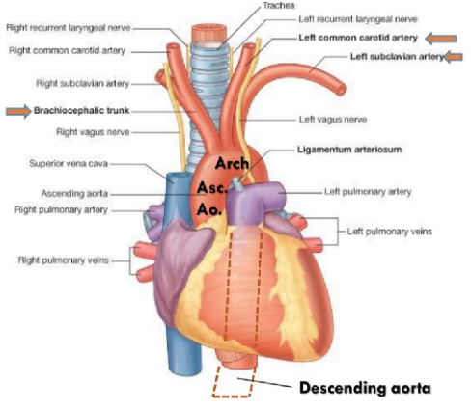
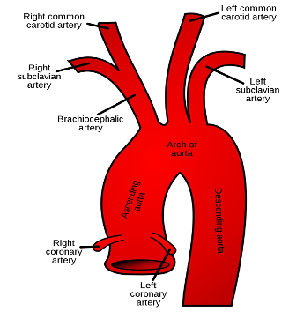
Aorta
Ascending Aorta
Beginning: at aortic orifice of left ventricle
Course: in middle mediastinum
End: continues as arch of aorta (at level of T4)
Arch of Aorta
Course: in superior mediastinum
End: continues as descending thoracic aorta (at level of T4)
Descending Aorta
Course: in posterior mediastinum
End: continues as abdominal aorta after it passes through diaphragm
Branches of the Aortic arch: ABC’S
- Brachiocephalic
- Left Common Carotid
- Left Subclavian

Slide 12
MCQs
Which one of the following is a deep content of superior mediastinum?
Thymus gland | B. Left subclavian artery | C. Esophagus | D. Phrenic nerve
2. Which one of the following boundaries lies inferior to the anterior mediastinum?
A. Diaphragm | B. Thymus gland | C. Lungs and Pleura | D. Heart
3. Where does the Phrenic nerve terminate?
At level of T4 | B.Manubrium of sternum | C.Diaphragm | D.Arch of Aorta
4. Where does the lymph coming from the left side of the head, neck, thorax and upper limb drain?
A.Thoracic duct | B.Right lymphatic duct | C.Left brachiocephalic vein | D. Cisterna chyli
5. The descending Aorta continues as ………….
A. Arch of Aorta | B. Abdominal Aorta | C.Descending Thoracic Aorta | D. Inferior vena cava
Answers: 1- C 2- A 3- C 4- A 5- B
Click on the icon for more questions from Med442’s QBank
Notes:
لا تآخذون اسئله من تيمات قديمه <- الاكاديمك ليدر

Slide 13
MCQs
Which one of the following structures is present in the superior mediastinum?
Ascending aorta | B. arch of aorta | C. Descending of aorta | D. pulmonary trunk
2. Which one of the following structures is present in both superior & posterior mediastinum?
A. superior vena cava | B. pulmonary trunk | C. trachea | D. esophagus
3. Which one of the following structures lies on the left side of the esophagus in the posterior mediastinum?
superior vena cava | B. descending aorta | C. azygos vein | D. Pulmonary trunk
Answers: 1- B 2- D 3- B
Click on the icon for more questions from Med442’s QBank
Notes:
لا تآخذون اسئله من تيمات قديمه <- الاكاديمك ليدر

Slide 14
SAQs
1. Enumarate 3 contents of the Middle Mediastinum
Answer:
Heart and pericardium
Ascending Aorta
Pulmonary trunk
2. What is the Posterior boundary of the Posterior Mediastinum?
Answer:
Thoracic vertebrae from T5 to T12
3. Where does the Vagus nerve descend?
Answer:
Through the Superior & Posterior mediastina
Notes:
لا تآخذون اسئله من تيمات قديمه <- الاكاديمك ليدر

Slide 15
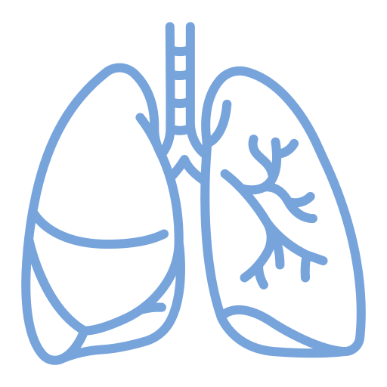
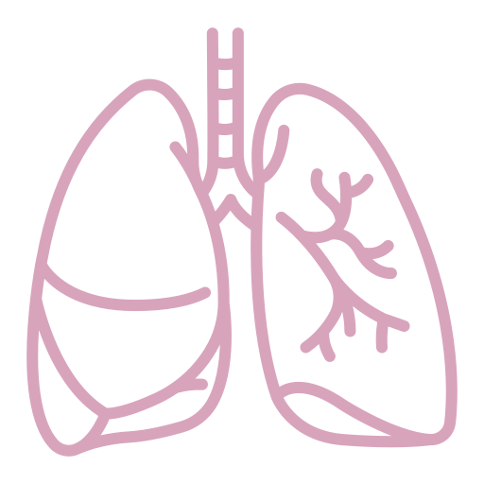
Team Leaders
Team Members
Mohammad Alrashed
Najla
Aldhbiban
Faisal Alomar
Nouf Aldalaqan
Mishal Alsuwayegh
Nouf Aldhalaan
Hazem Almalki
Atheer Alahmari
Zyad Alodan
Shatha Alshabani
Salman Albader
Aljazi AlBabtain
Abdulaziz Alnasser
Reema Alshehri
Faris Alseraye
Sarah Alzahrani
Ahmad Alemam
Maha Alkoryshy
Alwaleed Faqihi
Nada Albedaiwi
Abdullah Alnajres
Razan Almohanna
Meshari Alshathri
Atheer AlKanhal
Nawaf Alturki
Raneem AlWatban
Nasser Alghaith

