Slide 1
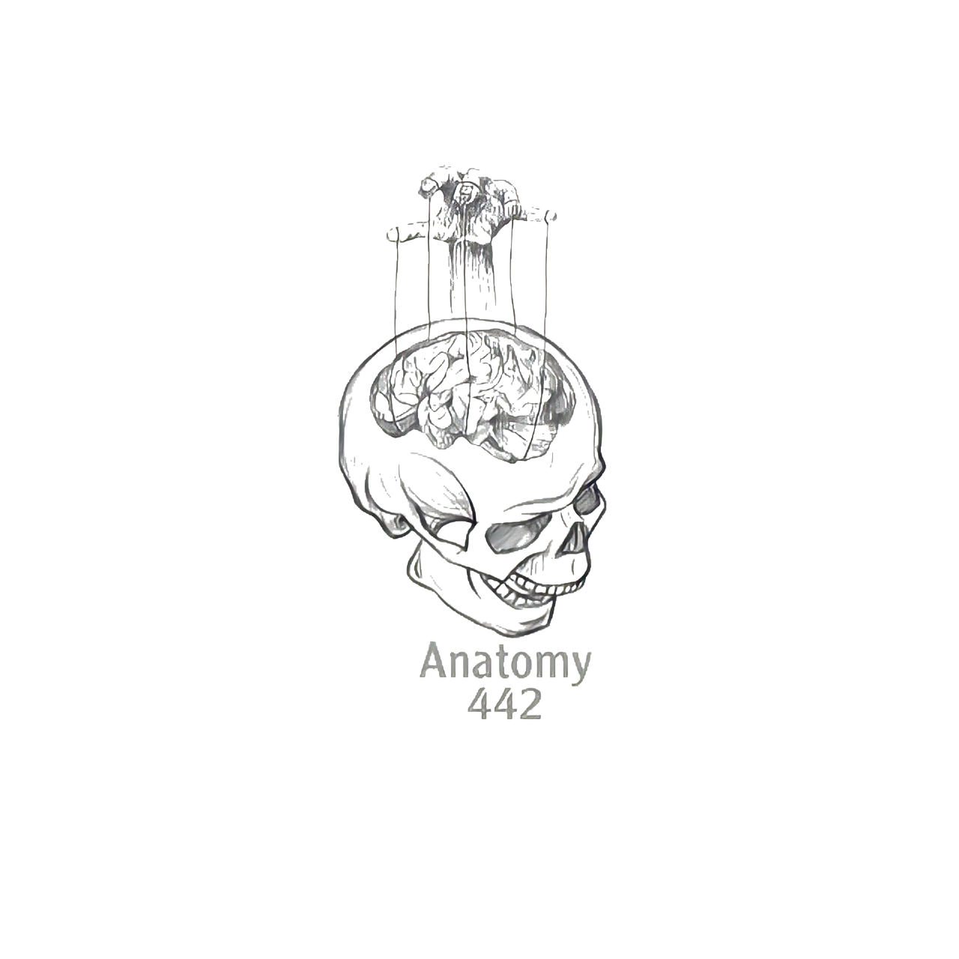
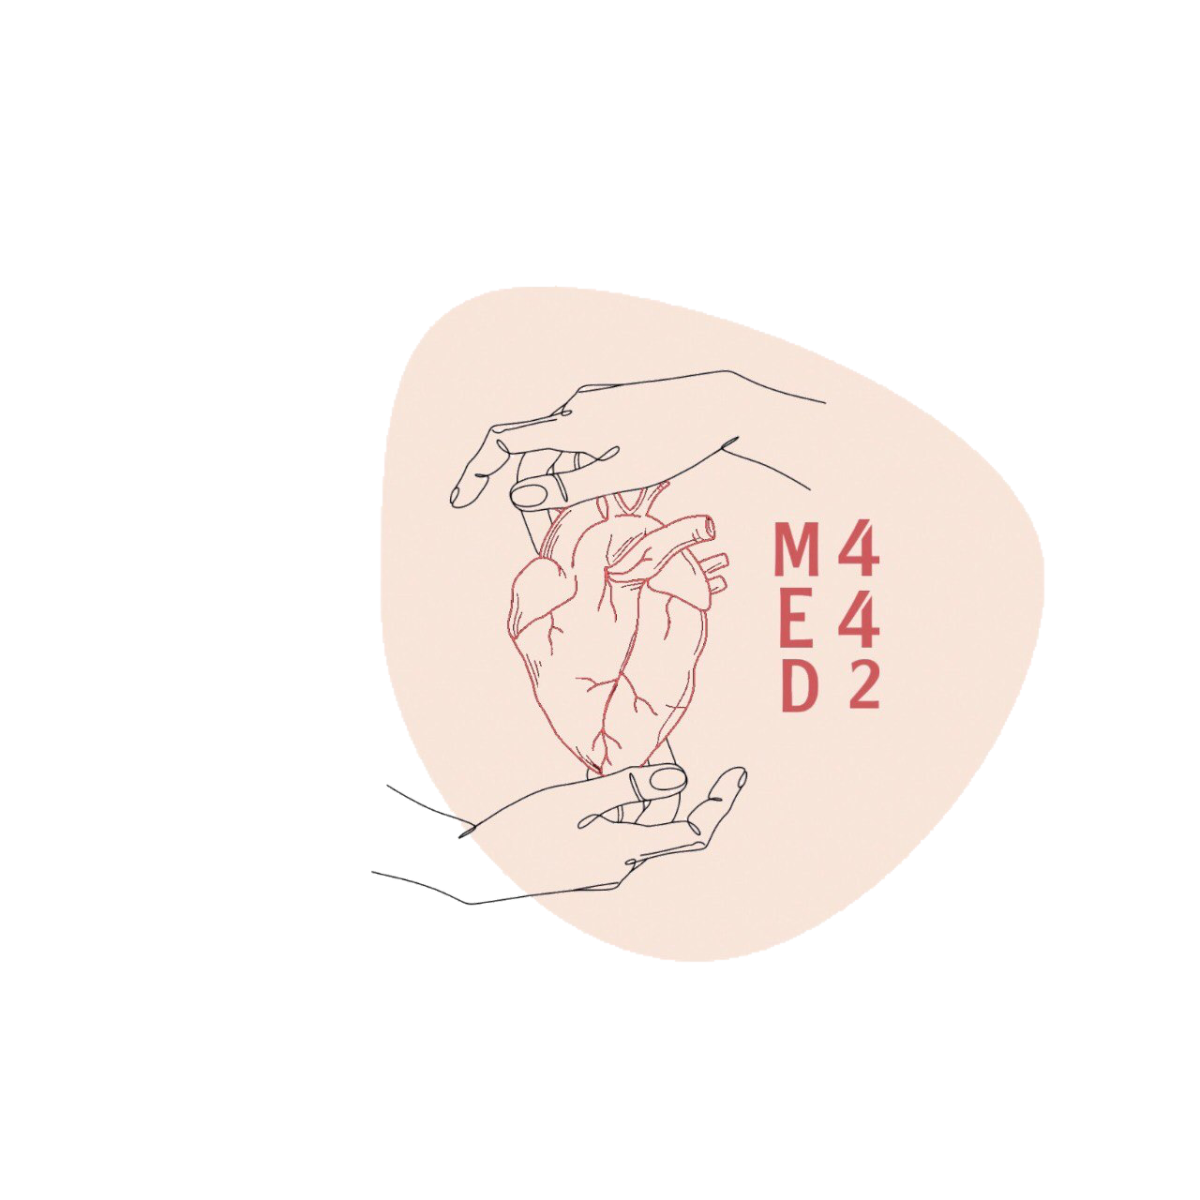
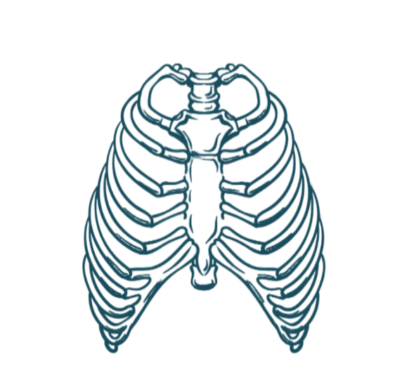
6
Radiological Anatomy of the Chest
____________
Respiratory Block
Color Index:
Main Text
Male’s Slides
Female’s Slides
Important
Doctor’s Notes
Extra Info
Editing File
Notes:
This slide is already done, please don’t change anything here

Slide 2
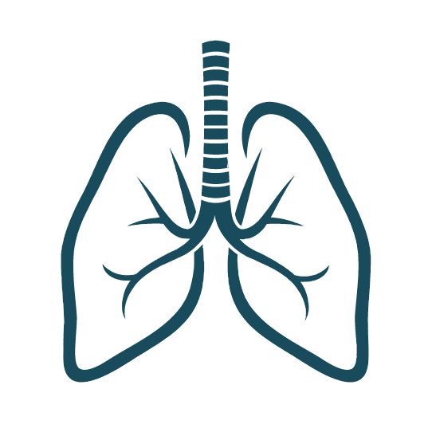
Objectives
1
Recognize the indications for chest X-Ray.
2
Differentiate between chest X-Ray views.
3
Identify different structures in a PA chest X-Ray.
Recognise some imaging techniques such as bronchography, coronary angiography, and barium contrast imaging techniques.
4
Notes:
If your objectives are less than 6 delete the extra points

Slide 3
Indications for Chest X-Ray
A chest x-ray may be used to diagnose and plan treatment for various conditions
including:
Diseases / Fractures of the bones of the chest (ribs, sternum, clavicle, scapula and the vertebrae)
Heart Disorders
Lung Disorders
Chest Radiographs
are also used to screen for job-related lung disease in industries such as mining where workers are exposed to dust, asbestos-exposed workers (carcinogenic agent), silica-exposed workers (silicosis causing lung fibrosis).

Slide 4
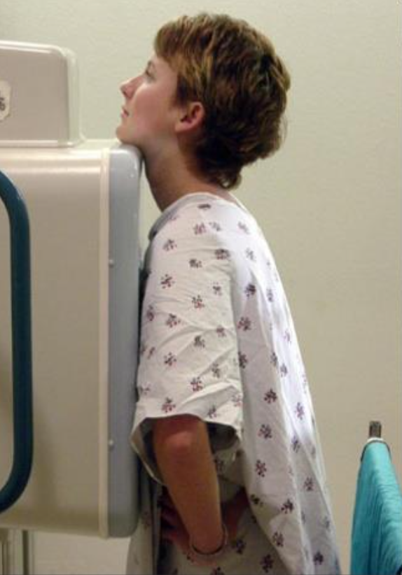
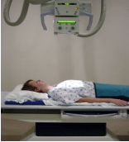
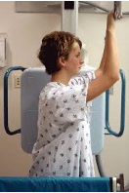
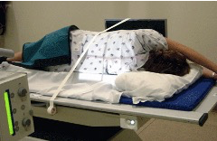
Radiography
Different views of the chest can be obtained by changing the orientation of the body and the direction of the x-ray beams:
1:
Posteroanterior (PA) View:
❖ The x-rays enter through the posterior aspect of the chest, and exit out of the anterior aspect where they are detected by an x-ray film.
❖ It is the most frequently requested imaging test
❖ PA view gives a good assessment of the Cardiac Size.
❖ It avoids magnification of the heart as the film is close to the anterior chest wall.
2:
Anteroposterior (AP) View:
❖ The x-rays enter through the anterior aspect and exit through the posterior aspect of the chest.
❖ AP chest x-rays are done where it is difficult for the patient to obtain a normal chest x-ray, such as when the patient cannot get out of bed.
❖ It is often used frequently to aid diagnosis of acute and chronic conditions in intensive care units and wards.
Heart is larger than PA view
3:
Lateral View:
4:
Decubitus:
❖ Obtained with the left chest against the cassette to diminish the effect of magnification of the heart.
❖ Used for more interpretation of certain lung and heart conditions.
❖ lying at the side
❖ Helps in assessment of volume of pleural fluid.

Slide 5
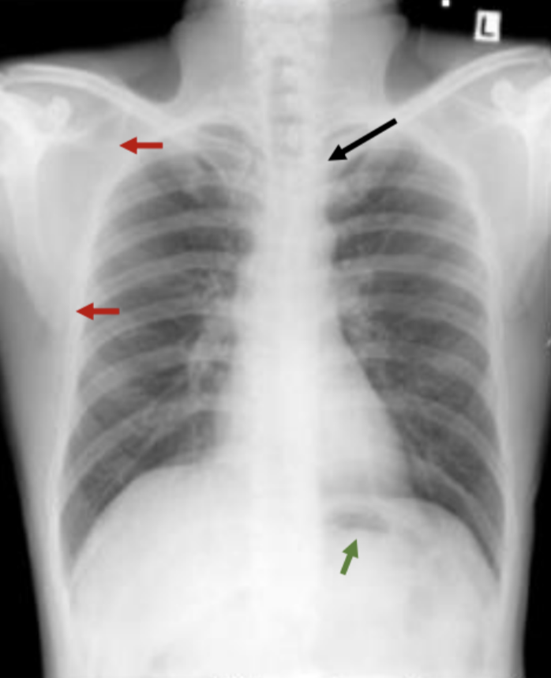
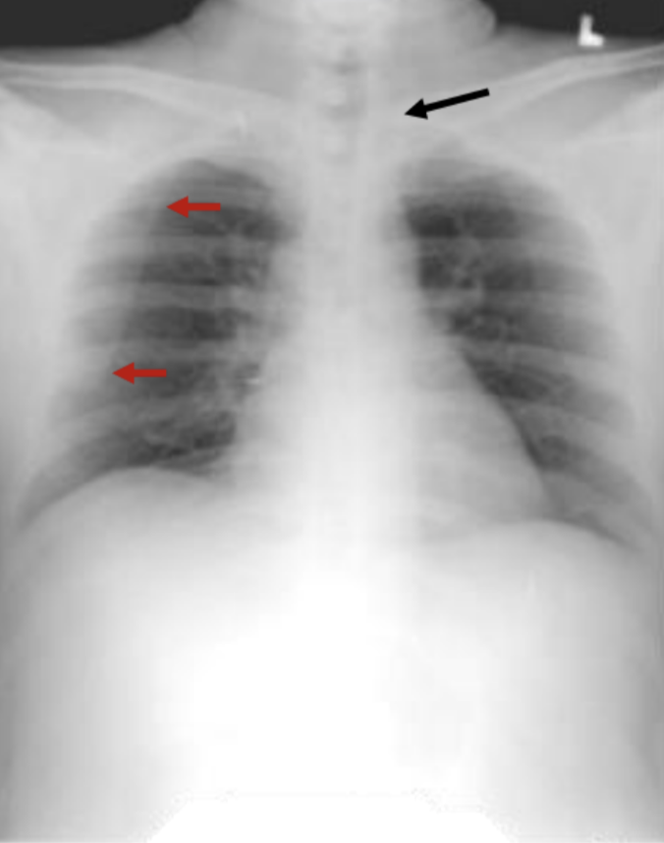
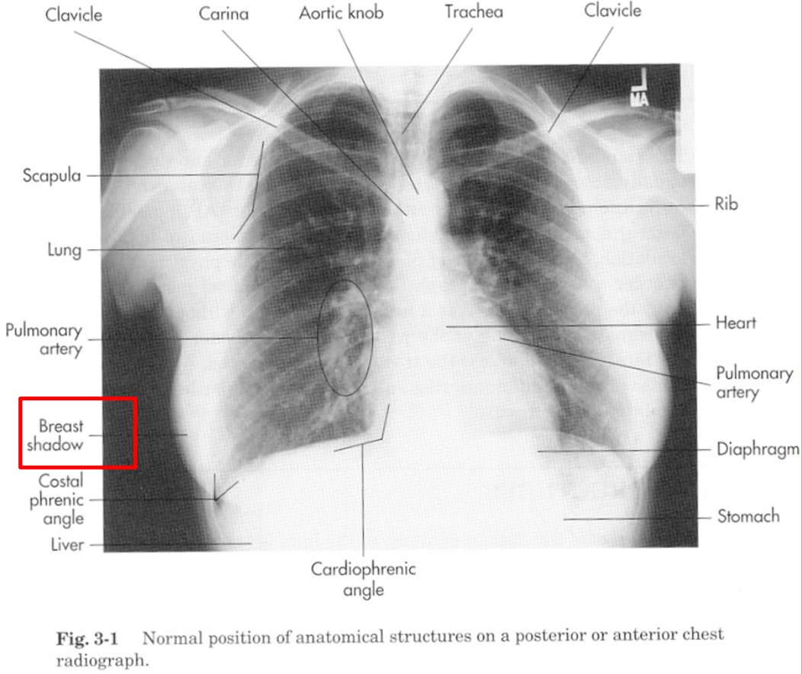
In boys slide only
PA
(Posteroanterior)
Scapulae lie in the periphery
Clavicles are projecting over lung fields
Fundal gas bubbles are seen
AP
(Anteroposterior)
Scapulae are projecting over lung fields
Clavicles are above the apex of lung fields
Heart shadow is apparently enlarged
Posteroanterior
For Posteroanterior radiograph (PA), the following structures must be examined:
1
2
3
Superficial
soft tissues
Bones of thoracic cage, clavicle & scapula
Diaphragm
4
5
6
Trachea
Lungs and bronchi
Heart and Greater Vessels
Superficial Soft Tissues
❖ Nipples in both sexes ❖ Breast shadows in (females) are seen superimposed on the lung fields.

Slide 6
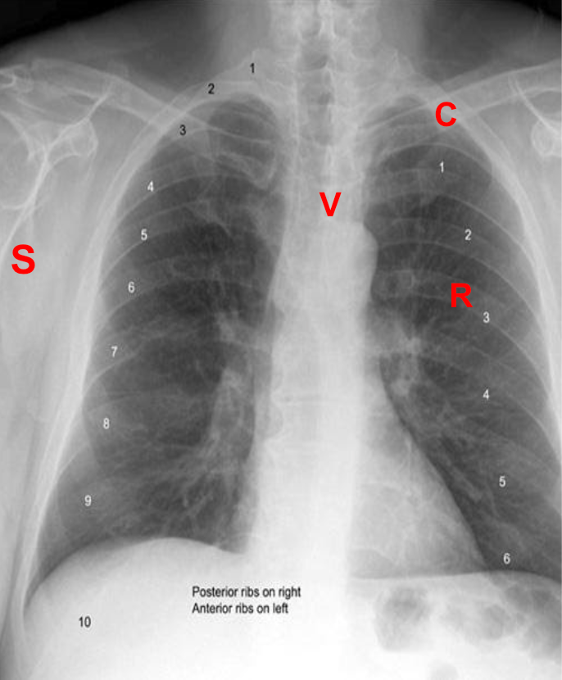
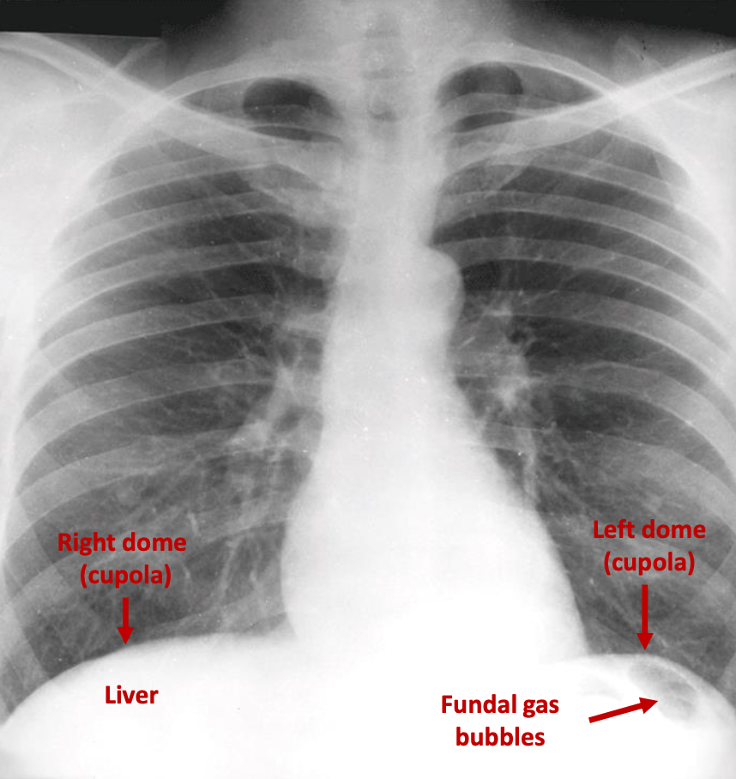
Bones of the Thoracic Cage
❖ The Thoracic Vertebrae are usually imperfectly seen.
❖ The Costotransverse joints and each Rib should be examined in order from above downward and compared to their fellows of the opposite side (The comparison based on quantity and shape )
❖ The Costal Cartilages are not usually seen, but if calcified at the first costal cartilage, they will be visible.
❖ The Clavicles are seen clearly crossing the upper part of each lung field.
❖ The medial borders of the Scapulae may overlap the periphery of each lung field. It is seen in the periphery of each lung field.
( If there was a problem in the scapulae it won’t be seen in the posteroanterior )
❖ Anterior and Posterior parts of the ribs are superimposed.
❖ The humerus are occasionally seen
Diaphragm
❖ The diaphragm shows Dome-shaped shadows on each side.
❖ The right dome (cupola) is slightly higher than the left dome (cupola).
❖ Beneath the right dome is the homogeneous, dense shadow of the liver.
❖ Beneath the left dome a gas bubble may be seen in the fundus of the stomach.

Slide 7
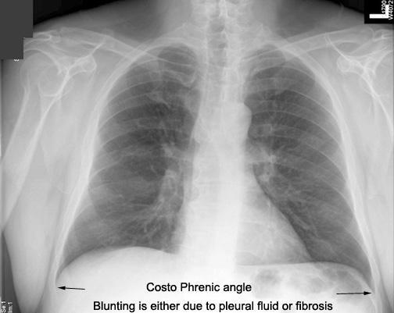
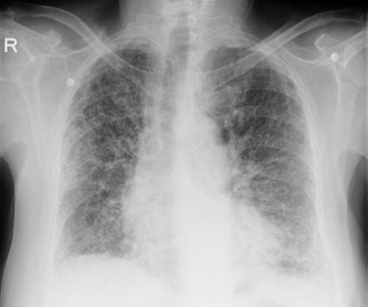
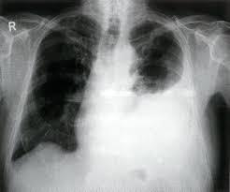
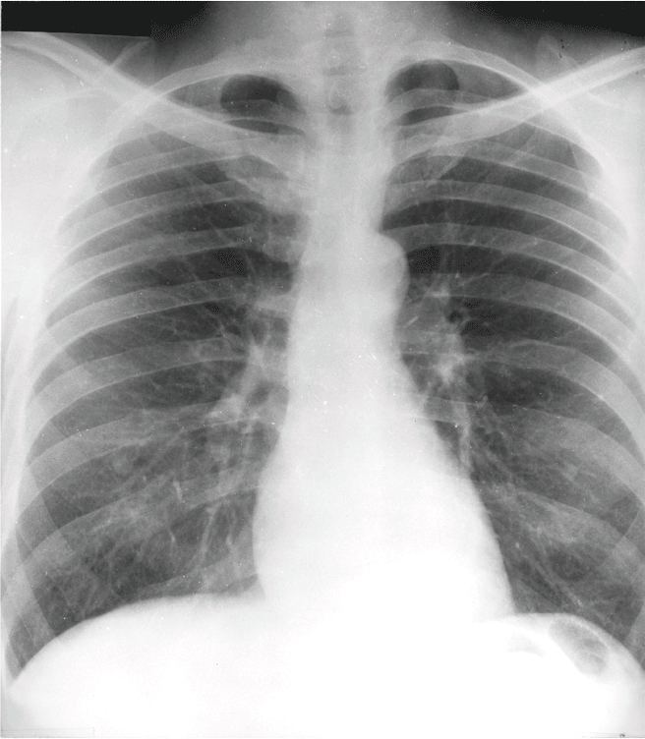
Costo-diaphragmatic (costo-phrenic) Angles
❖ They are at the sites where the diaphragm meets the thoracic wall. ❖ The angles become blunt or obscured in case of presence of pleural fluid (effusion) or fibrosis
Dr: Abnormal cases pictures are just for your knowledge
Left lung is blunt
Pleural fibrosis
Trachea
❖ The radio-translucent, air-filled shadow of the trachea is seen in the midline of the neck as a dark area. ❖ It is superimposed on the lower cervical and upper thoracic vertebrae.

Slide 8
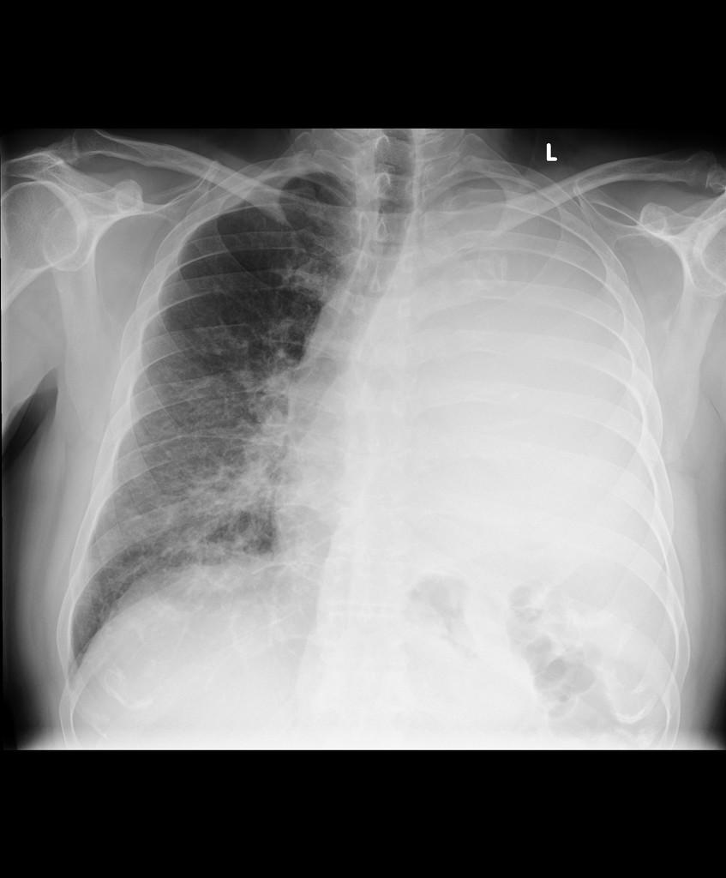
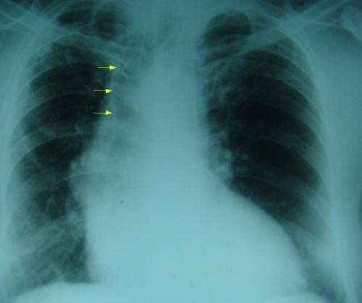
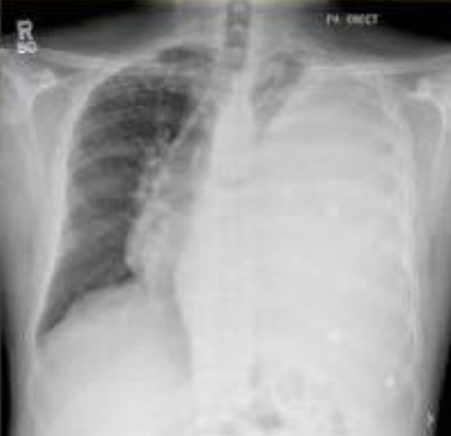
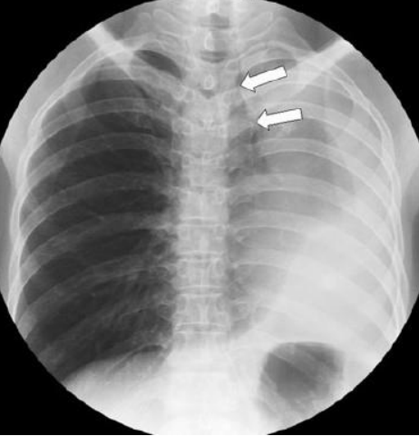
Tracheal Shift
Tracheal air column is seen shifted to right on X-ray chest PA view. (it could be to the left but here we are talking about this picture)
It Indicates:
A loss of volume of the right upper lobe of the lung ، either due to lung collapse or fibrosis.
OR
•A massive pleural effusion on the left side. (But in this x ray, no pleural effusion is seen on the left)
Trachea رح تميل جهة الانكماش (collapse, fibrosis)
ورح تبعد عن جهة الانتفاخ (effusion)
Left pleural effusion
To the opposite side of the lesion (as in massive pleural effusion)
To the same side of the lesion
(as in lung collapse)

Slide 9
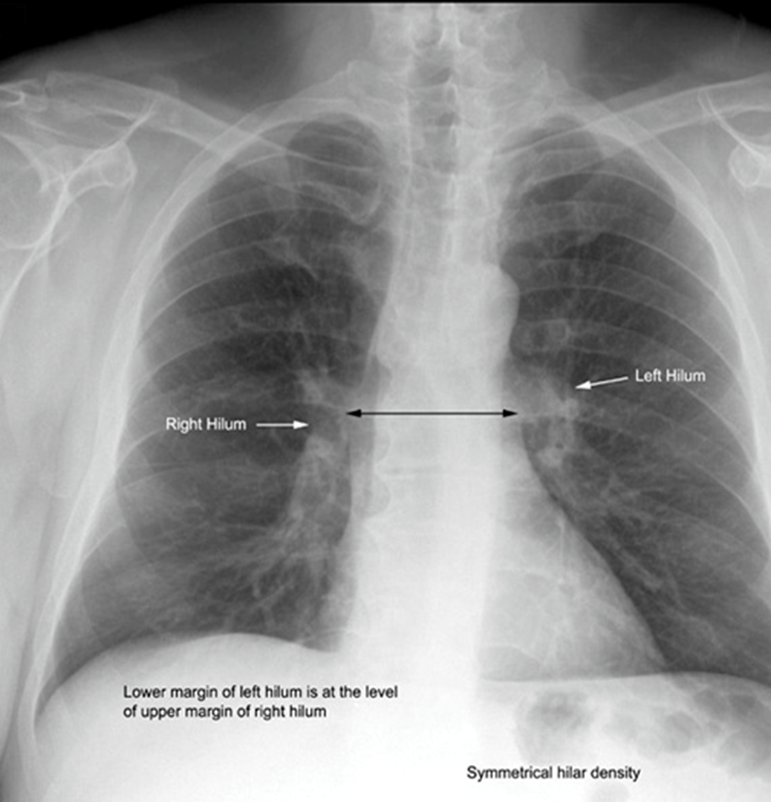
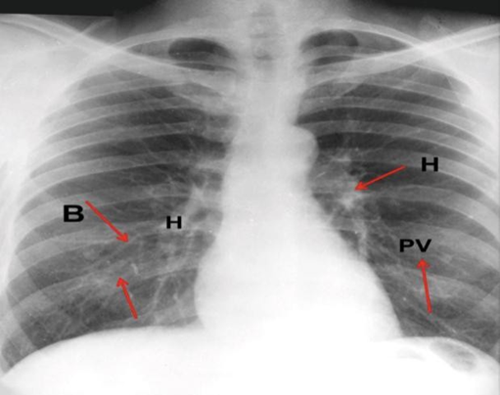
Lungs
Lung Roots: (Girls Slides Only)
Relatively dense shadows caused by the presence of the:
Blood-filled pulmonary and bronchial vessels.
Large bronchi.
Lymph nodes.
Lung Fields:
Lungs are translucent (especially on full inspiration) due to the air they contain which readily permits the passage of X-rays
by virtue of the air they contain, readily permit the passage of x-rays. For this reason, the lungs are more translucent on full inspiration than on expiration.
The pulmonary blood vessels are seen as a series of small, rounded, dense white shadows radiating from the lung root (hilum of the lung).
The large bronchi, are seen as similar round shadows. The smaller bronchi are not seen
The large airways are visible on most good quality chest X -rays. They contain air and so are of lower density (more black) than the surrounding soft tissues. The trachea branches into the left and right main bronchi, which can be followed as they branch beyond the hila into the lungs.

Slide 10
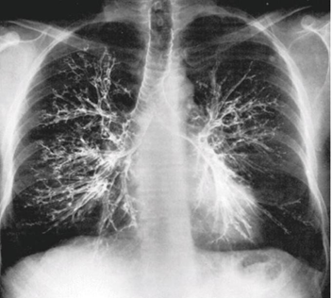
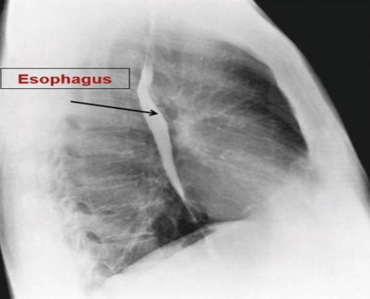
Bronchography:
Bronchography is a special study of the bronchial tree by means of the introduction of contrast medium into a particular bronchus or bronchi, and performing plain radiographic imaging usually under fluoroscopic control. The contrast media are non irritating and sufficiently radiopaque to allow good visualization of the bronchi. After the radiographic examination is completed, the patient is asked to cough and expectorate the contrast medium.
Contrast visualization of esophagus using barium swallow:
Lateral radiograph of the chest of a normal adult man after a barium swallow.
Other barium contrast studies:
Barium meal: stomach.
Barium follow through: small intestine.
Barium enema: large intestine.

Slide 11
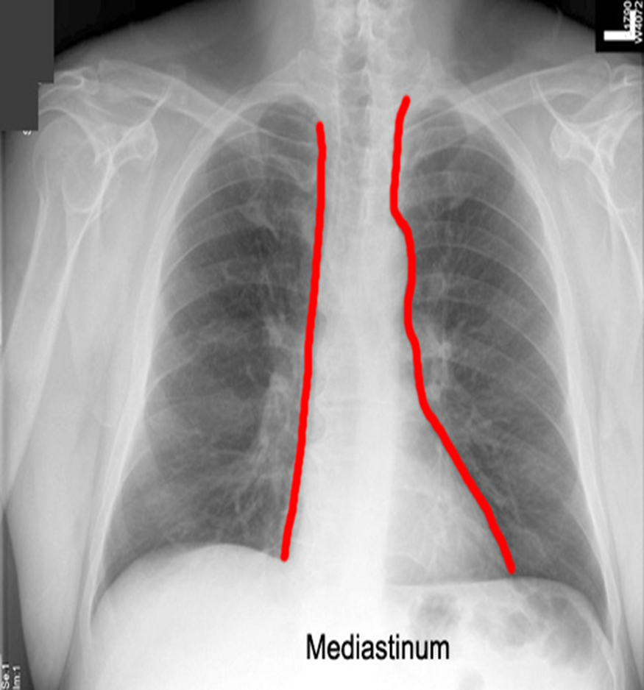
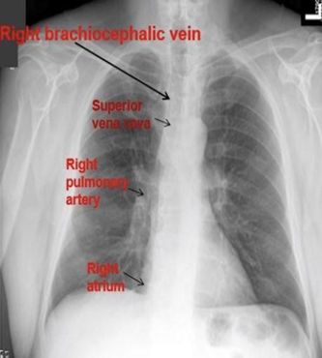
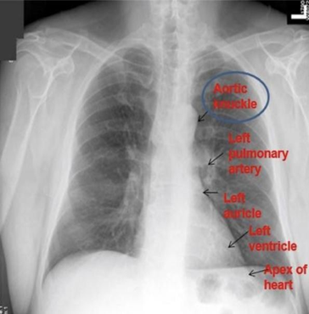
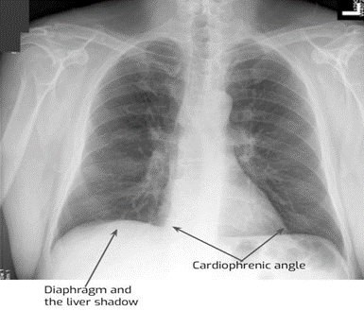
Mediastinum
The shadow is produced by the various structures within the mediastinum, superimposed one on the other.
Note the outline of the heart and great vessels.
1
Right Border:
2
Left Border:
From above downward :
1.Right brachiocephalic vein
2.Superior vena cava
3.Right atrium
4. Sometimes the Inferior vena cava
1.The Aortic knuckle (or knob) caused by the aortic arch
2.The Pulmonary Trunk
3.The Left Auricle (atrium)
4.The Left Ventricle
5.Apex of heart
3
Inferior Border:
1.blends with the diaphragm and liver shadow.
2.Note the cardiophrenic angles (the angle between the diaphragm and heart).

Slide 12
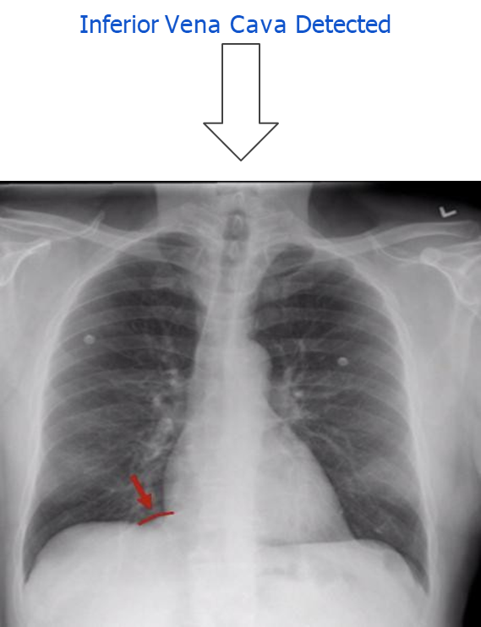
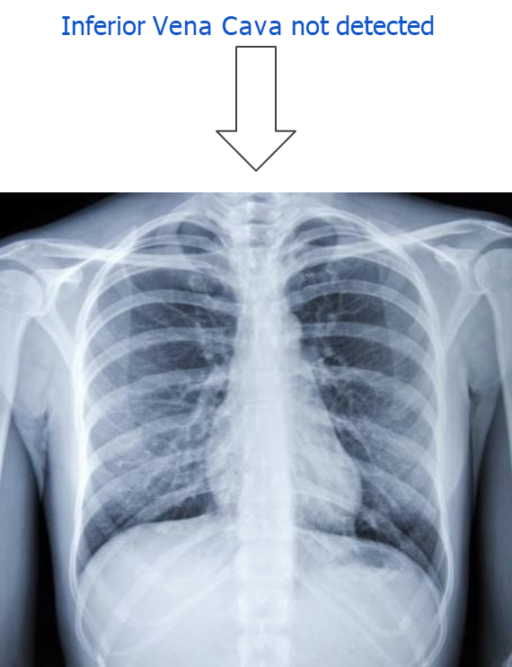
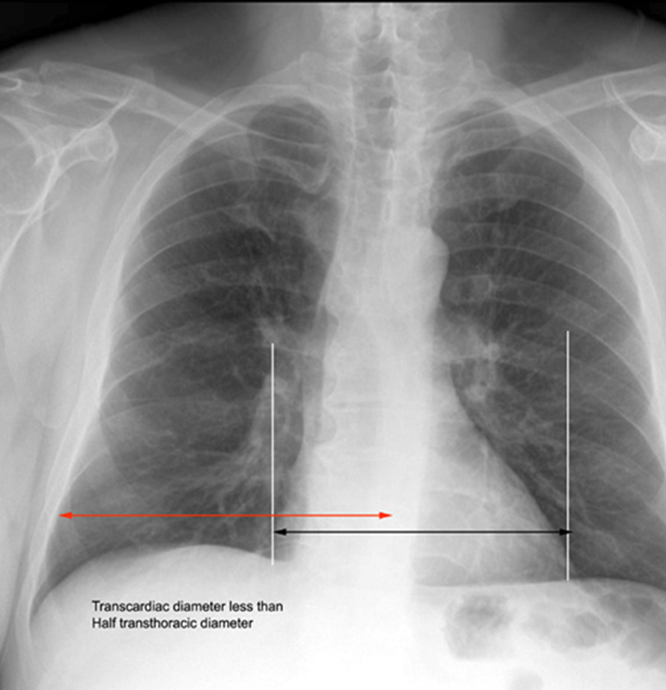
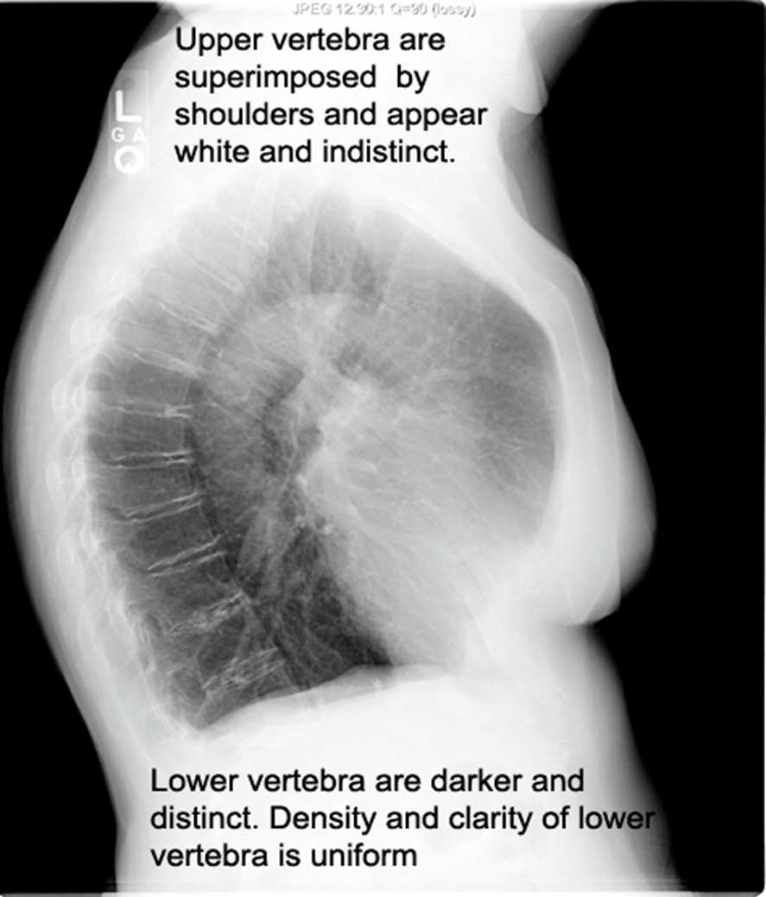
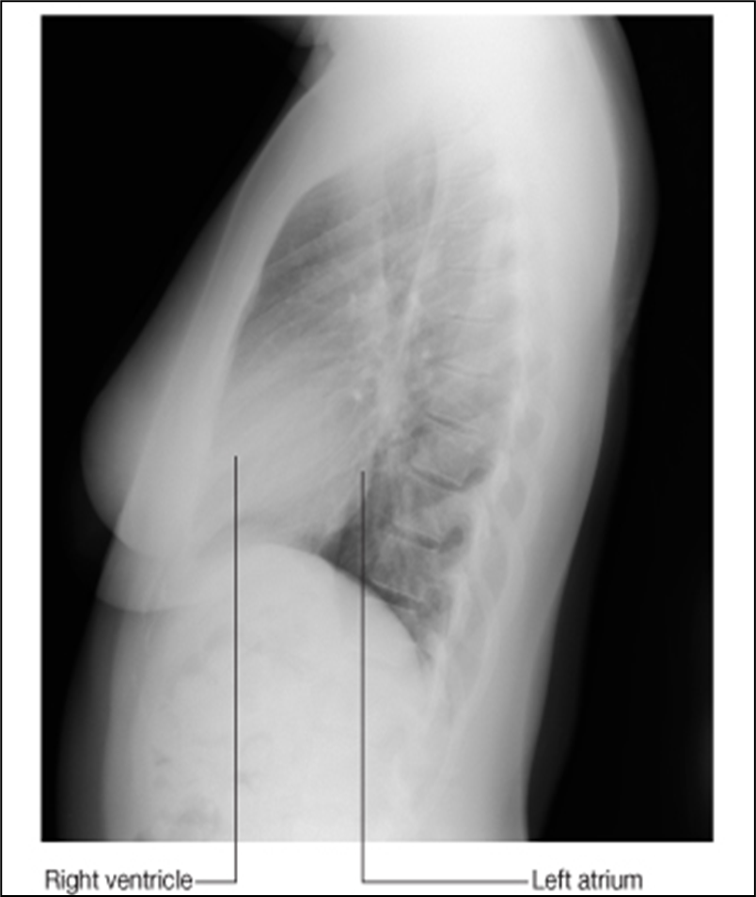
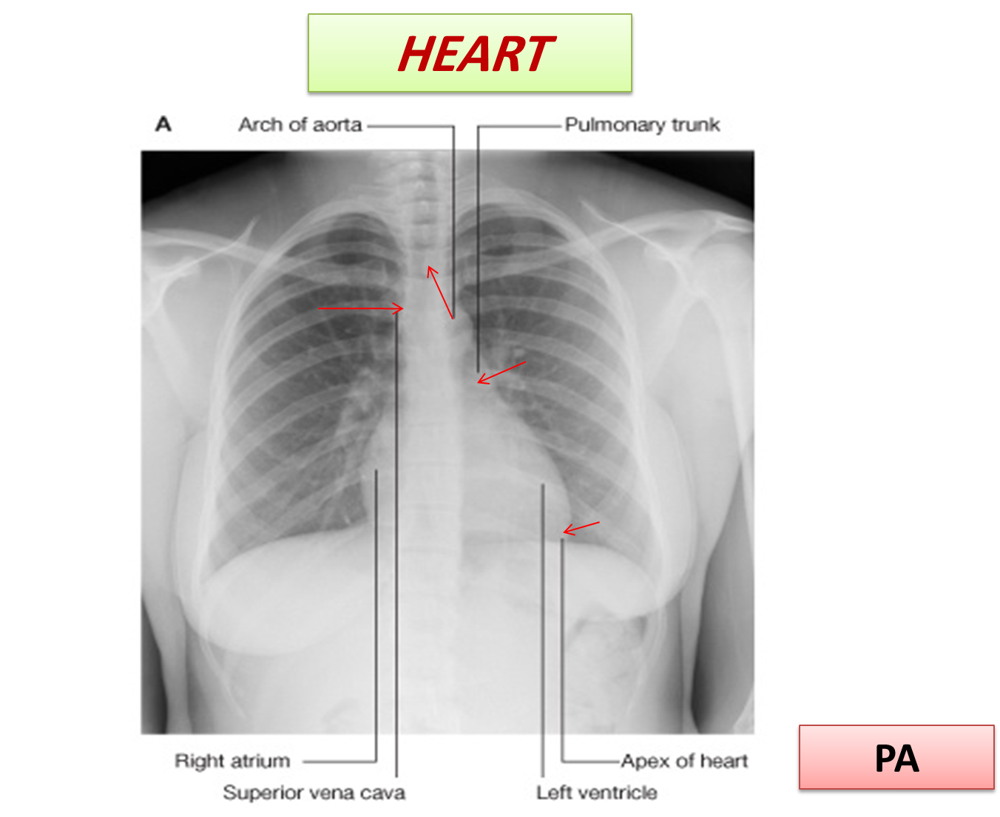
Inferior vena cava detected
Inferior vena cava not detected
Heart
Transverse Diameter of the heart should
not exceed half the width of the thoracic cage.
On deep inspiration, when the diaphragm descends, the vertical length of the heart increases and the transverse diameter is narrowed.
The heart in infants is always wider and more globular than in adults.
IV Disc
Lateral Radiograph of the Chest
Vertebral Body

Slide 13
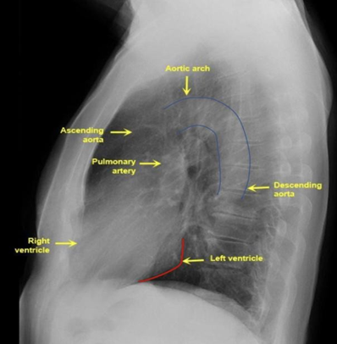
Lateral Radiograph of the Chest
Note that the upper vertebrae are indistinct compared to the lower vertebrae because they are superimposed by the shoulder.
Coronary Angiogram
A procedure that uses a radio-opaque contrast dye and X-ray imaging to detect blockages in the coronary arteries
Right Coronary
Left Coronary

Slide 14
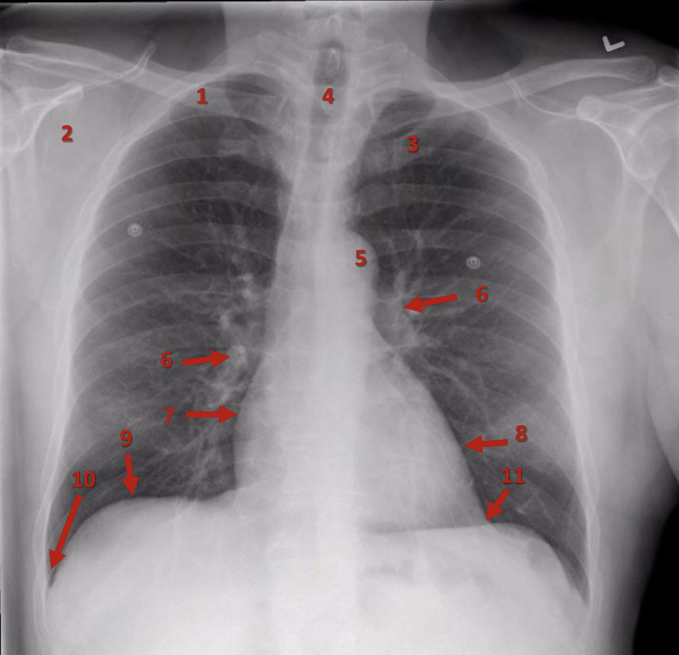
PA (Posteroanterior) Chest X-Ray
Clavicle
Scapula
First rib
Trachea
Aortic knuckle (knob – arch)
Pulmonary vessels
Right atrium
Left ventricle
Right dome (cupola) of diaphragm
Right costophrenic angle
Left cardiophrenic angle

Slide 15
MCQs
From Female’s Dr
1. Which one of these views gives a good assessment of the Cardiac Size?
A. Posteroanterior | B. Anteroposterior | C. Lateral | D. Decubitus
2. Patient admitted to ICU, which of the following views can be used?
A. Posteroanterior | B. Anteroposterior | C. Lateral | D. Decubitus
3. Which of the following structures are NOT clear in an X-ray?
A. Ribs | B. Scapulae | C. Clavicles | D. Costal Cartilages
4. Which one of the following structures is present in the right border of the mediastinum?
A. Aortic knuckle | B. Left ventricle | C. Superior vena cava | D. Apex of heart
5. Patient complaining from dysphagia, which kind of barium can be used to detect stomach?
A. Barium meal | B. Barium swallow | C. Barium enema | D. Barium follow through
Answers: 1. A, 2. B, 3. D, 4. C, 5. A.
Click on the icon for more questions from Med442’s QBank
Notes:
لا تآخذون اسئله من تيمات قديمه <- الاكاديمك ليدر

Slide 16
SAQs
1 . What are the most common views of the chest X-Ray ?
Answer
The most common views are Posteroanterior (PA), Anteroposterior (AP), lateral (L) & Decubitus
2. What causes a right shift of the trachea?
Answer
fibrosis of the right upper lobe
3. what type of x-Ray film is used for bedridden patients?
Answer
anteroposterior
Notes:
لا تآخذون اسئله من تيمات قديمه <- الاكاديمك ليدر

Slide 17
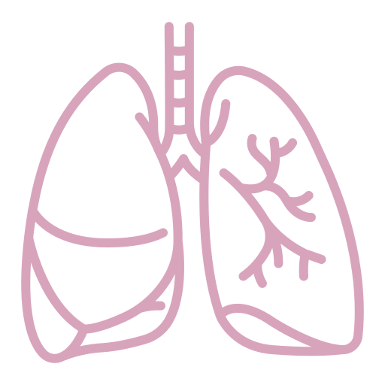
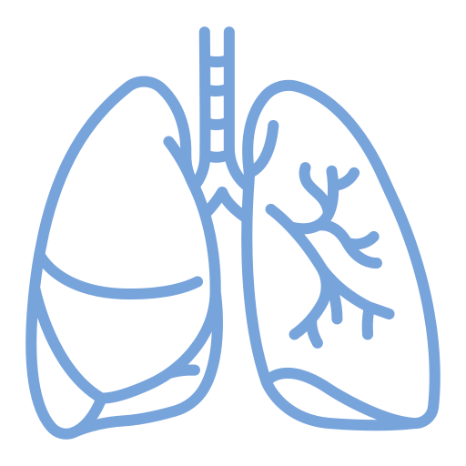
Team Leaders
Team Members
Mohammad Alrashed
Najla
Aldhbiban
Faisal Alomar
Nouf Aldalaqan
Mishal Alsuwayegh
Nouf Aldhalaan
Hazem Almalki
Atheer Alahmari
Zyad Alodan
Shatha Alshabani
Salman Albader
Aljazi AlBabtain
Abdulaziz Alnasser
Reema Alshehri
Faris Alseraye
Sarah Alzahrani
Ahmad Alemam
Maha Alkoryshy
Alwaleed Faqihi
Nada Albedaiwi
Abdullah Alnajres
Razan Almohanna
Meshari Alshathri
Atheer AlKanhal
Nawaf Alturki
Raneem AlWatban
Nasser Alghaith

