Slide 1
Phospholipids of clinical significance
Color Index:
● Main text
● Important
● Notes
● Boys slides
● Girls slides
● Extra
L1
W1

Slide 2
Objectives
Identify the types and functions of phospholipids.
.
Discuss the physiological importance of phospholipids.
Understand the role of glycerophospholipids in lung surfactant and their clinical implications in respiratory distress syndrome (RDS).
Identify the classes and physiological functions of phospholipase enzymes.

Slide 3
Overview
Types and functions of phospholipids
Glycerophospholipids: Types, functions and role in lung surfactant, cell signaling and protein anchoring
Respiratory distress syndrome (RDS)
Sphingophospholipids
Phospholipids in lipoprotein particles
Phospholipases: Types and functions

Slide 4
Classes :
Definition
Properties
Phospholipids
Phospholipids are polar, ionic compounds that contain an alcohol group attached either to : 1- Diacylglycerol or 2- Sphingosine
They are the major lipids of cell membranes Two classes:
1-Glycerophospholipids
2-Sphingophospholipids
That is a Glycerophospholipids
-Their hydrophobic (nonpolar): portion is attached to the membrane
-Their hydrophilic (polar):
portion extends outward interacting with the aqueous environment
The polar head is changeable ( here it’s serin so the lipd name is
Phosphatidyl-serine)
Glycerol

Slide 5
Phospholipids
Function
Membrane bound phospholipids
Non-membrane bound phospholipids
Reservoir for intracellular messengers.
Anchors for cell membranes
Lung surfactant.
Components of bile
( as detergents to solubilize cholesterol ).
Anchors: attached to proteins Bile: produced by the outside the cell membrane.

Slide 6
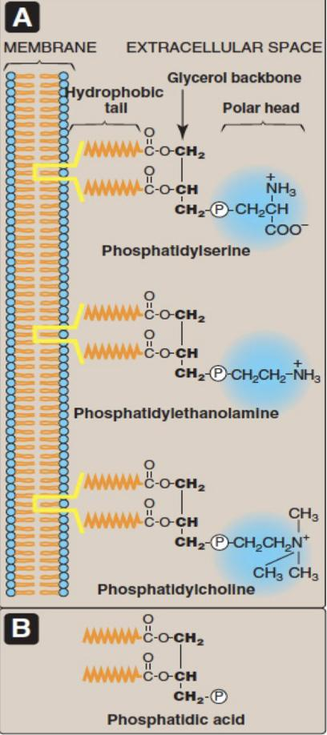
Glycerophospholipids (phosphoglycerides)
It’s the major class of phospholipids
Contain glycerol
All contain phosphatidic acid (PA) (it is the
Glycerol backbone and the hydrophobic tall and a phosphate ion
{everything except the polar head })
PA is the simplest phospholipid
Phospholipids are derived from PA such as:
Serine + PA | Phosphatidylserine (PS) | Cell signaling, Blood clotting
Ethanolamine + PA | Phosphatidylethanolamine (PE) (Cephalin) | Cell membrane
Choline + PA | Phosphatidylcholine (PC) (lecithin) | Lung surfactant
Inositol + PA | Phosphatidylinositol (PI) | Cell signaling
Glycerol + PA | Phosphatidylglycerol (PG) | Lung surfactant

Slide 7
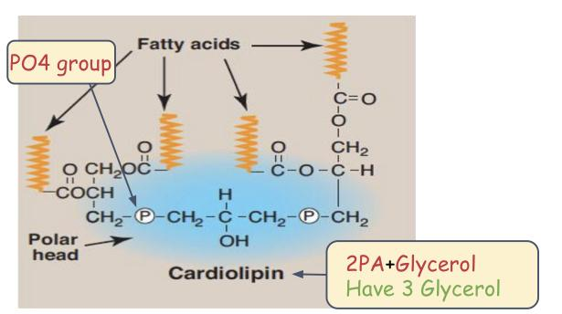
Some Examples of Glycerophospholipids
1- Cardiolipin
Location
Structure
Function
Two molecules of PA (phosphatidic acid) joined to an additional molecule of glycerol through PO4 group.
In the inner mitochondrial membrane.
Maintenance of respiratory complexes of electron transport chain.
So it has 3 glycerol group

Slide 8
Some Examples of Glycerophospholipids
2-Platelet activating factor (PAF)
Structure
Location
Function
Fatty acid attached to glycerol by Ether linkage, and instead of having fatty acid at carbon No2 it has an acetyl group.
(441 Dr note)
Binds to cell surface receptors.
Triggers thrombotic and acute inflammatory reaction.
( and mediates hypersensitivity and lowers blood pressure )

Slide 9
Role of PC in Lung
surfactant
- Alveolar cells of the lungs are lined by the extracellular fluid layer
- Alveolar cells secrete DPPC (a major lung surfactant)
Consists of
Lung surfactant
Function
Lipids (90%) including Dipalmitoylphosphatidylcholine (DPPC)
Reduces pressure needed to re-inflate alveoli
Proteins (10%)
Decreases the surface tension of the fluid layer
Decreases the surface tension of the fluid layer
Prevents alveolar collapse (atelectasis)

Slide 10
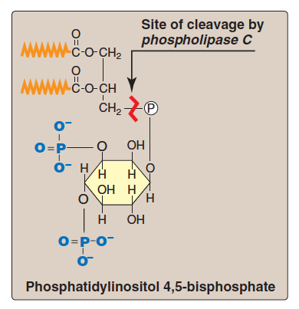
Roles of PI
Role of PC in Lung surfactant
PI: Phosphatidylinositol
In cell signaling
Respiratory distress syndrome (RDS)
The alveoli won’t be able to re-inflate because of the collapse of the lung.
• Plays important role in intracellular signaling
• PI is part of
calcium-phosphatidylinositol system
In preterm infants due to deficiency of lung surfactant
A major cause of neonatal death
Treatment: Glucocorticoids to mother to promote lung maturation
موجود في Membrane جهه ال Cytoplasm وفيه انزيم اسمه phospholipase C يقسمه الى Diacylglycerol و IP3
IP3 بيرتبط مع المستقبل الموجود على الاندوبلازم عشان يطلعCa
Ca and Diacylglycerol will activate protein kinase C
In adults due to damaged alveoli by infection or trauma
IP3
لو كان فيه احتماليه ان الحامل تولد بالجنين وهو ما اكتمل نمو الرئة عنده يعطون الام Glucocorticoids عشان يسرع من Lung maturation ولو ولدت وهو مو مكتمل نمو رئته فراح يصاب ب RDS
Next slide for extra explanation

Slide 11
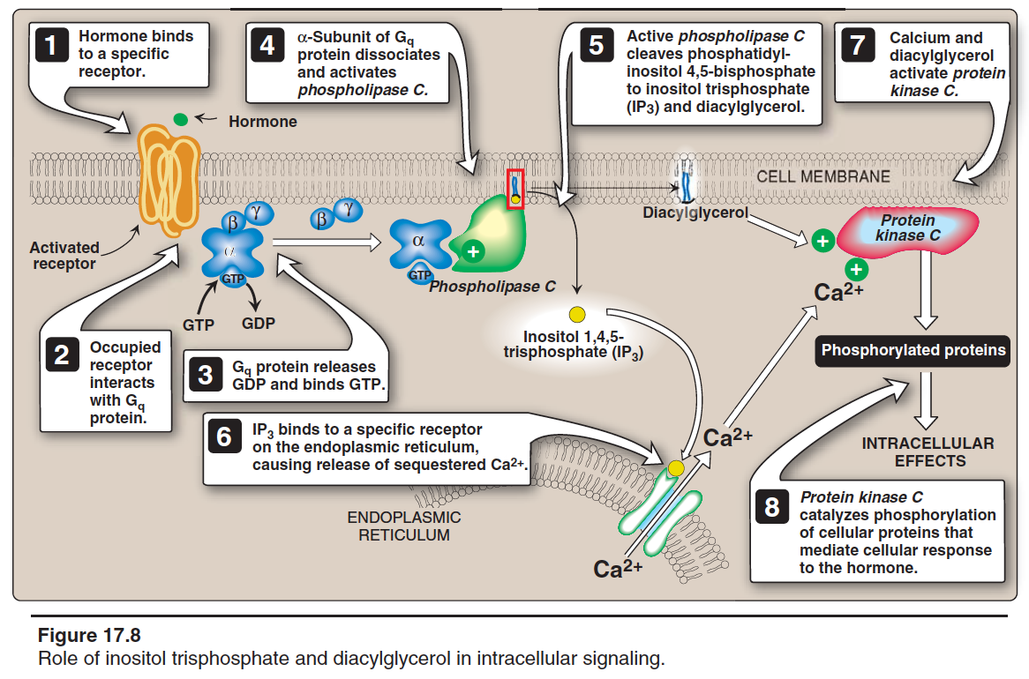
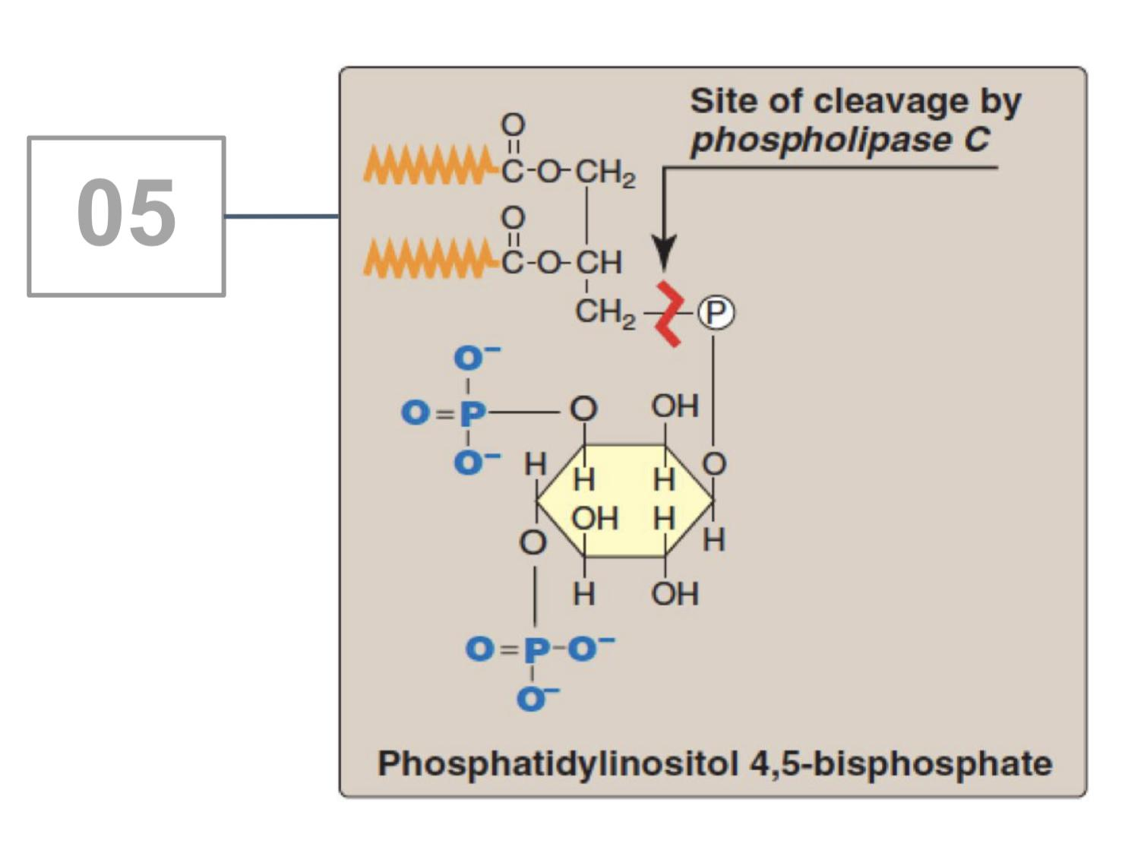
Roles of PI
1
Hormone or neurotransmitter binds to a specific receptor.
2
Occupied receptor interacts with Gq protein.
G q protein releases GDP and binds GTP.
3
4
α subunit of G q protein dissociates and activates phospholipase C (enzyme attached to the cell membrane).
Active phospholipase C cleaves phosphatidylinositol 4,5-bisphosphate to inositol trisphosphate (IP3 ) and diacylglycerol.
5
6
IP binds to a specific receptor on the endoplasmic reticulum causing release of sequestered Ca2+ .
7
Calcium and diacylglycerol activate protein kinase C.
8
Protein kinase C catalyzes phosphorylation of cellular proteins that mediate cellular response to the hormone.

Slide 12
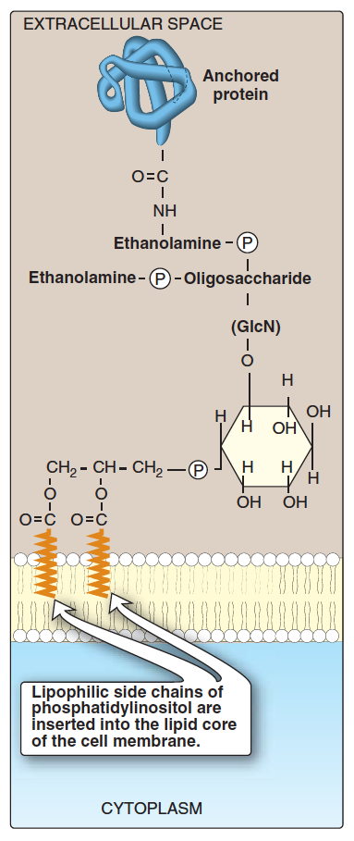
Roles of PI
In membrane protein anchoring
Carbohydrates
Anchoring mean
تستقبل بعض البروتينات من خارج الخليه ( زي اللي بالازرق بالصوره ) وبعد ما يخلص البروتين شغله تتركه ويجي بروتين ثاني ( كله خارج الخليه ما فيه بروتين يدخل )
Anchoring of proteins to membranes through carbohydrate-PI bridge (by a covalent bond ).
Anchoring proteins can be cleaved by phospholipase C enzyme.
PI
Outside the cell
Examples:
• Alkaline phosphatase (on the surface of small intestine)
• Acetylcholine esterase (on postsynaptic membrane of neurons)
كل واحد منهم يرتبط مكان البروتين ( مثل الازرق الي بالصوره ) وبعد ما يخلصون شغلهم يروحون

Slide 13
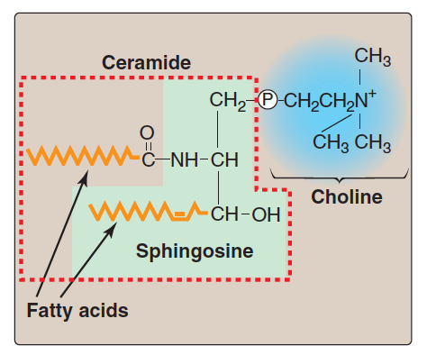
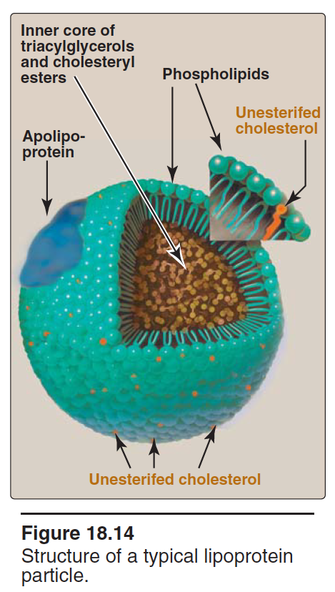
Sphingophospholipids
sphingosine+ fatty acid
definition
example
function
A long-chain Fatty acid attached to Sphingosine
An important component of myelin that protects and insulates nerve fibers.
Sphingomyelin
(Sphingosine+fatty acid + phosphorylcholine)
or
(ceramide + phosphorylcholine)
3C —> 1C attached to OH and fatty acid
1C attached to NH2
1C just attached to H
phospholipids in lipoprotein particles
The outer core→ hydrophilic (protein) The inner part → hydrophobic (lipid)
Examples include plasma lipoprotein particles (HDL, LDL, IDL, VLDL)
Function: Allows transport of core Lipids in aqueous plasma.
Outer core contains Phospholipids and free cholesterol
What is the importance of phospholipids in lipoprotein particles?
مهمه في نقل lipids،فكيف ننقل الlipids في محلول مائي؟ لازم يكون حول lipids جزء hydrophilic فراح يكون حوله phospholipids لان جزء منها محب للماء وهو على برا وجزء كاره للماء وهو داخل

Slide 14
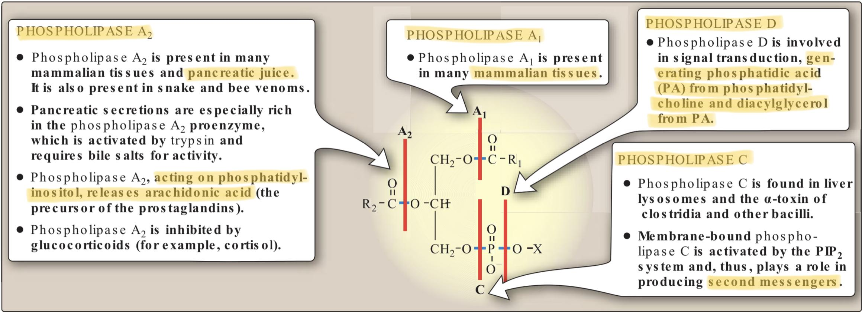
Phospholipases
• Phospholipids are degraded by phospholipase enzymes
• Present in all tissues including pancreatic juice عشان الهضم
• Glycerophospholipids are degraded by Phospholipase A1 , A2 , C, D
• Sphingophospholipids are degraded by Sphingomyelinase
Dr focus on phospholibase D and A2
FUNCTIONS OF PHOSPHOLIPASES:
• Digestion of phospholipids by pancreatic juice
• Important for remodeling of phospholipids
• Production of second messengers
• Pathogenic bacteria produce phospholipases to dissolve cell membranes and spread infection
- remodeling is like when there's a removal of fatty acids and putting other fatty acids so the basic structure remain the same but the phospholipid molecule changed one type to another.

Slide 15
TAKE HOME MESSAGE
• Phospholipids are complex lipids that perform important physiological functions in the body
• Membrane-bound phospholipids are involved in cell signaling, protein anchoring and myelin protective functions
• Nonmembrane-bound phospholipids function as lung surfactant and as detergent in the bile
• Phospholipases are enzymes that degrade phospholipids
• They are important for remodeling of phospholipids

Slide 16
Quiz
Summary
From 441
1)Which ONE of the following is the simplest phosphoglyceride?
A) Phosphoinositol | B) Phosphatidic acid | C) Phosphatidylcholine | D) Phosphoserine
2) The inner mitochondrial membrane is rich in?
A) Cardiolipin | B) Platelet activating factor | C)Phosphatidylethanolamine | D) Sphingomyelin
3) Which phospholipid triggers thrombotic and acute inflammatory effect?
A)Cardiolipin | B) Platelet activating factor | C) Sphingomyelin | D) Cephalin
4) Sphingolipids is involved in which one of these?
A)Myelin formation | B) Surfactant formation | C) Hormones | D) None of them
5) What is the phospholipid that anchors alkaline phosphatase in the intestinal wall?
A)Diacylglycerol | B)sphingophospholipids | C)Phosphatidylinositol | D) lipoprotein
SAQ/
1)What are the functions of phospholipase?
2) Give two functions of Non-Membrane bound phospholipid?
3)What is the importance of phospholipids in lipoprotein particles?
4)name 3 phospholipids are derived from PA and their function? Answer in slide 5
Answer Key:
1)
• Digestion of phospholipids by pancreatic juice
• Important for remodeling of phospholipids
• Production of second messengers
• Pathogenic bacteria produce phospholipases to dissolve cell membranes and spread infection
2)Lung surfactant,Components of bile
3) Allows transport of core Lipids in aqueous plasma.
Answer Key: 1)B 2)A 3) B 4)A 5)C

Slide 17
Our creative team:
Team leader:
Mohamed ibn Saqyan
العلم مغرس كل فخر فافتخر
واحذر يفوتك فخر ذاك المغرس
واعلم بأن العلم ليس يناله
من همهُ في مطعمٍ أو ملبسِ
إلا أخو العلم الذي يعنى به
في حالتيه عاريا أو مكتسي
فاجعل لنفسك منه حظا وافراً
واهجر له طيب الرقاد و عبّسِ
فلعل يوما إن حضرت بمجلسٍ
كنت الرئيس وفخر ذاك المجلسِ
محمد بن إدريس الشافعي
Team leader:
Sara alotaebe
Mohammed Alrashoud
Saad Alahmari
Ahmad Almarshed
Abdullah Almissaind
Ibrahim Alohali
Raseel Alwehibi
Rand Jarallah
Noura Alshafi

