Slide 1
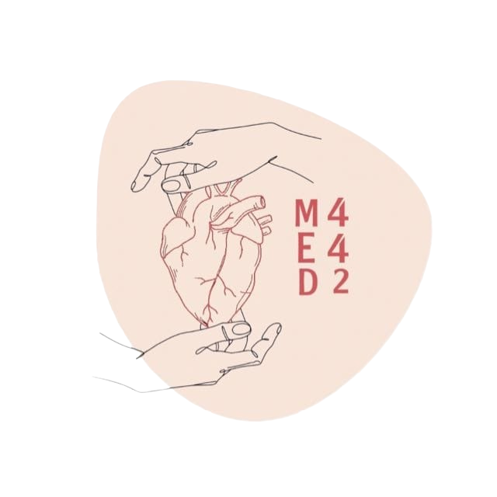
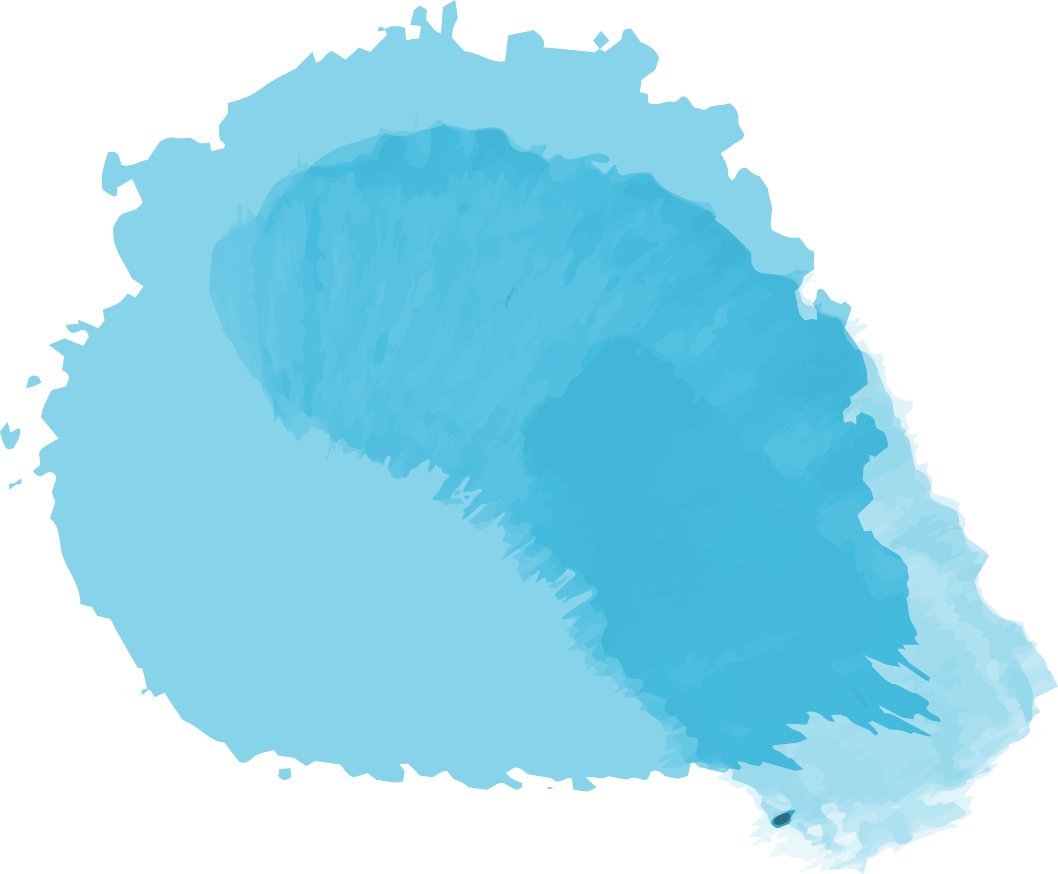
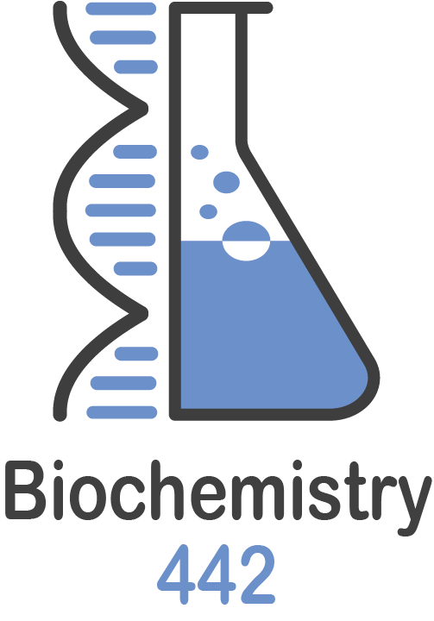
Electron Transport Chain (Respiratory Chain)
Color Index:
● Main text
● Important
● Notes
● Boys slides
● Girls slides
● Extra
L2
W1
Editing file

Slide 2
Objectives
Understand how energy-rich molecules including glucose are metabolized by a series of oxidation-reduction reactions ultimately yielding CO2 and water.
Explain the process of electron transport chain that releases free energy, which is used for ATP synthesis and heat production.
Recognize the reactions of electron transport chain taking place in mitochondria that are coupled to oxidative phosphorylation

Slide 3
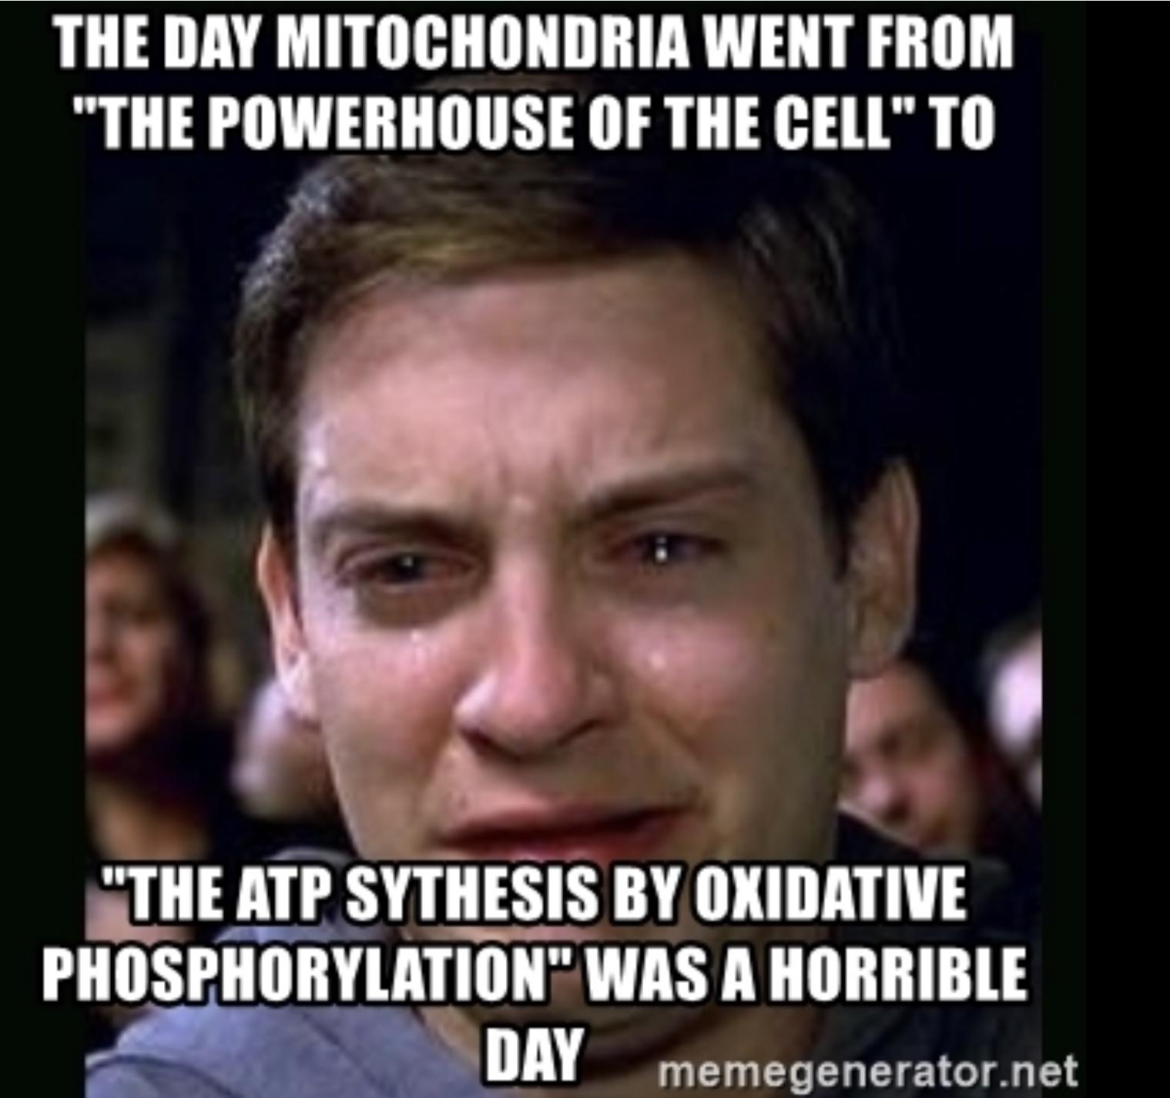
Electron Transport Chain (ETC) Overview
Remember when we learnt in Foundation block Glycolysis and Krebs Cycle we will
end with 10NADH and 2FADH2.
- Now we will study how these molecules transfer their electrons
through ETC to benefit from their energy.

Slide 4
Electron Transport Chain (ETC)
What is ETC?
A system of electron transport that uses respiratory O2 to finally produce ATP (energy)
1
Location?
In the inner mitochondrial membrane
2
Characteristics?
- Final common pathway of metabolism.
- Uses maximum amount of body’s oxygen
3
4
Mechanism?
Transports electrons from food metabolism to O2 (which will be reduced to form H2O.)

Slide 5
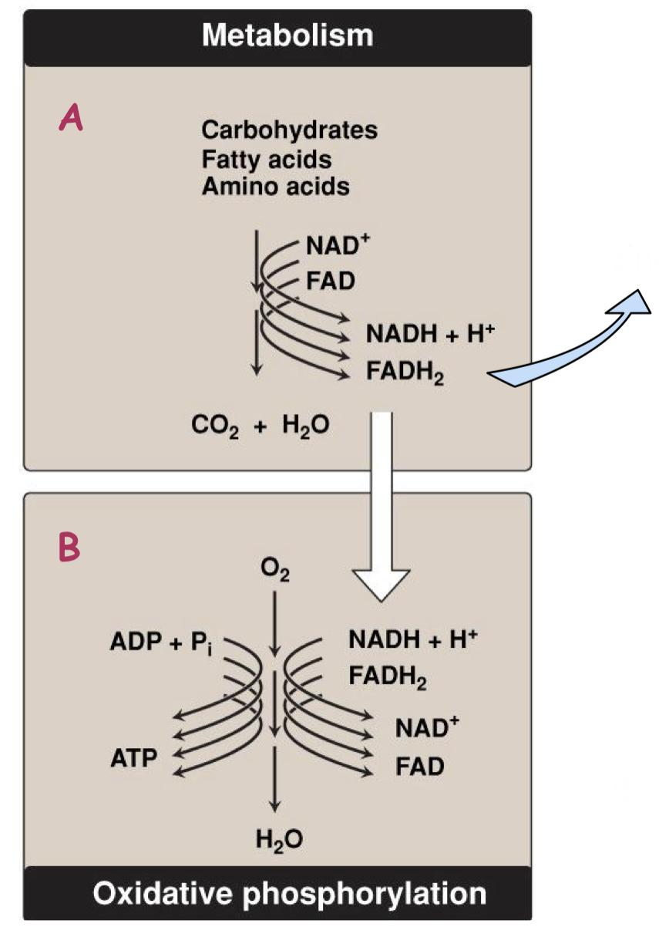
Energy-rich reduced coenzymes
Electrons (e-) lose their free energy
In pic A, the macromolecules are metabolized and NADH, FADH2 are produced.
In pic B, the O2 ,final ETC destination, is reduced to H2O.
Excess energy generates heat

Slide 6
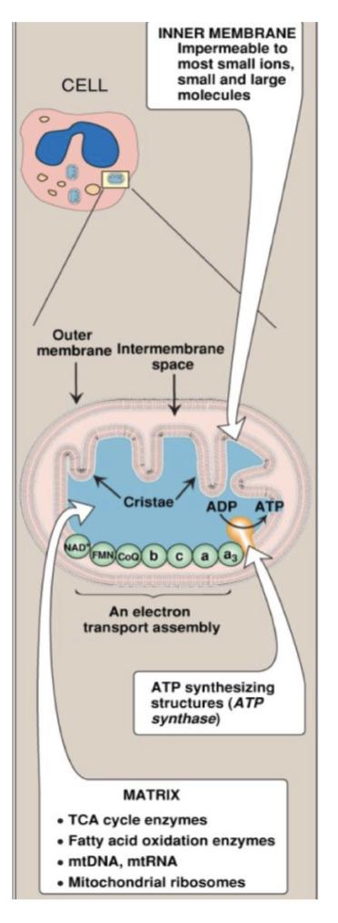
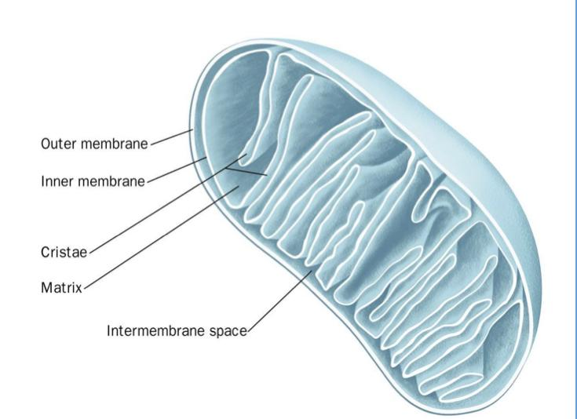
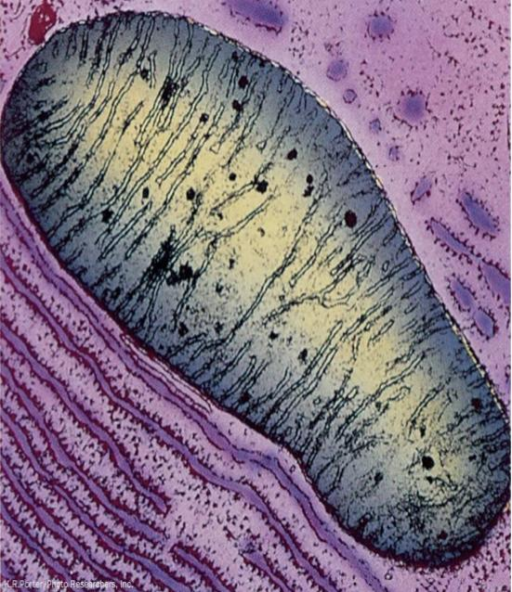
Structures of the mitochondria :
Not part of ETC but it’s coupled to it.
Intermediate space: b/w outer & inner
membrane.
An electron micrograph of an animal mitochondrion
Outer membrane: Highly permeable.
Cristae: Folding of the inner membrane.
Increase the surface area.
Inner membrane: Highly selective
Mitachondrion matrix

Slide 7
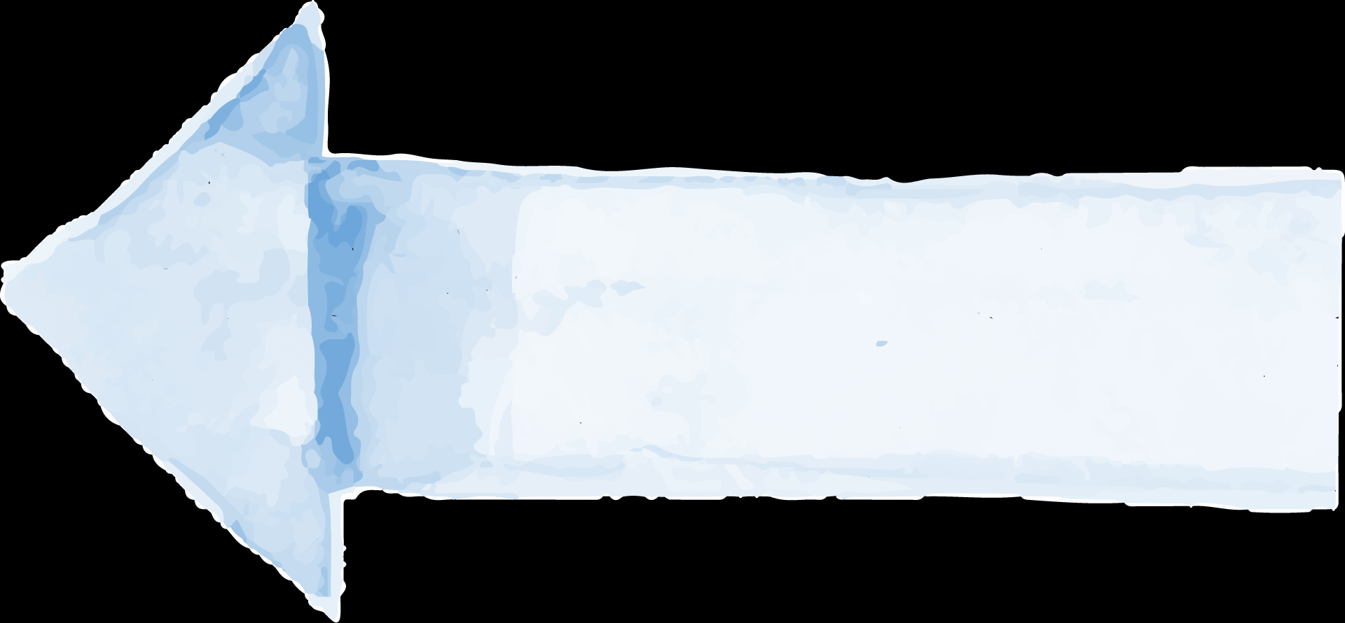
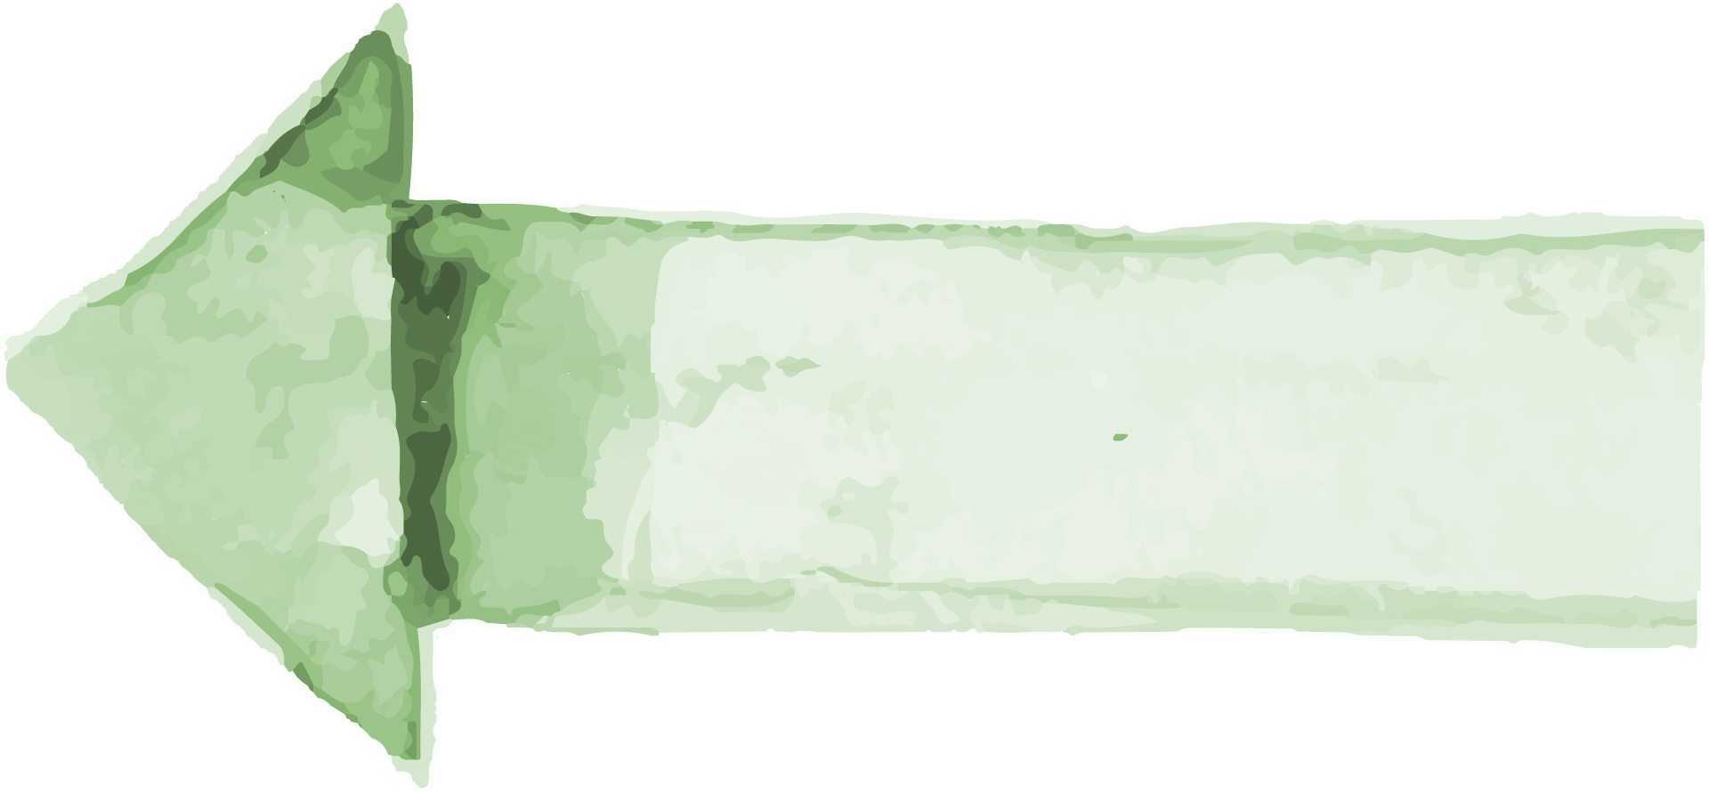
Components of ETC
All components are located in the inner mitochondrial membrane (IMM) (except cytochrome C in intermembrane space)
Parts of ETC
Not parts of ETC
Mobile Electron Carriers
Complex I
Complex II
Complex III
Complex IV
NADH dehydrogenase
Succinate dehydrogenase
Also in krebs cycle (or TCA)
Cytochrome bc1
Cytochrome c oxidase
Cytochrome c
Coenzyme Q (CoQ)
Complex V
(ATP synthase that catalyzes ATP synthesis)

Slide 8
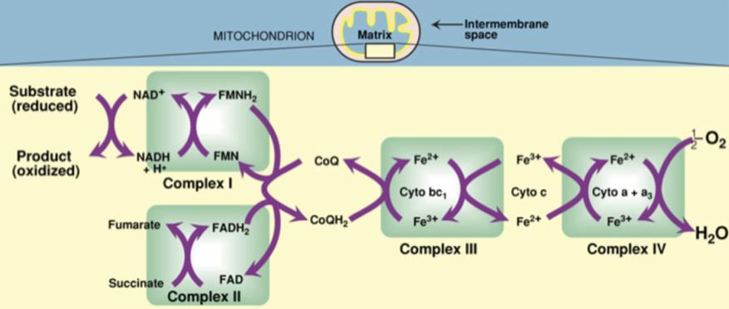
Organization of ETC
Each complex accepts or donates electrons to mobile carriers (CoQ & cytochrome C).
Carriers accept electrons from donors and then donate to the next carrier in chain
Electrons finally combine with oxygen and protons to form water
Oxygen is required as a final acceptor (respiratory chain)
You don’t have to memorize it
member of krebs (TCA) cycle

Slide 9
Organization of ETC
Complexes
NADH
Dehydrogenase
● Collects pair of electrons from NADH.
● Passes them of electron to CoQ.
Complex I
Complex II
Succinate Dehydrogenase
● Transfers electrons to CoQ.
● Part of the Krebs cycle.
Cytochrome bc1
● Collects electrons from CoQ.
● Passes electrons to Cytochrome c.
Complex III
Cytochrome c oxidase
(cyto a+a3)
● Collects electrons from Cyt. c.
Complex IV
Cyto = cytochrome

Slide 10
Organization of ETC -Carriers-
Fe3+: ferric
Fe2+: ferrus
1
2
Coenzyme Q (CoQ)
Cytochromes
Also called ubi-quinone (ubiquitous in
biological systems).
A protein that contains:
Heme group (porphyrin ring + iron in Fe3+ state).
A non-protein member of the ETC.
When cytochromes accepts e-
– Fe3+ is converted to Fe2+.
Lipid soluble and mobile.
When cytochromes donates e-
– Fe2+ is reoxidized to Fe3+.
“Cytochrome C” is a carrier
“Cytochrome bc3” &
“Cytochrome a + a3” are complexes.

Slide 11
Electron Transport Chain
Result of glycolysis & krebs cycle:
● 10 NADH → goes to Complex I
● 2 FADH2 → goes to Complex II
Glycolysis & Krebs Cycle
Complex I
Cytochrome c -carrier-
NADH
FMN → FMNH2
Takes e- from: complexes III to give it to complex IV
Fe3+
Fe2+
NAD+
e-
Coenzyme Q -carrier-
Complex III
Complex IV
Takes e- from:
NADH & gives it to CoQ.
e-
½ 02
e-
e-
CoQ
CoQH2
Fe3+
Cyto bc1
Fe2+
Fe3+
Cyto a+a3
Fe2+
Complex II
H20
Takes e- from:
complexes I & II
to give it to complex III
- Cytochrome bc1 takes e-
(from CoQ) → iron becomes Fe2+
- Cytochrome a + a3 Takes e-
(from Cyto C) → iron becomes Fe2+
Succinate → Fumarate
FAD → FADH2
e-
- Cytochrome bc1 passes e- to Cytochrome C → iron becomes Fe3+ again.
- Cytochrome a + a3 Passes e- to Oxygen → iron becomes Fe3+ again.
Takes e- from:
FADH2 & gives it to CoQ.
CoQ doesn’t have to take an e- from both Complex I and an e- from Complex II in order to transport it to Complex III.
O2 receives e- & H+ that will
make ATP (detailed in slide14)

Slide 12
Site-specific inhibitors of Electron transport chain
Any stop in this cycle will lead to poisoning (Death).
Any complex before the inhibition is reduced (after the inhibition site).
The complexes after the inhibition are oxidized (before the inhibition site).

Slide 13
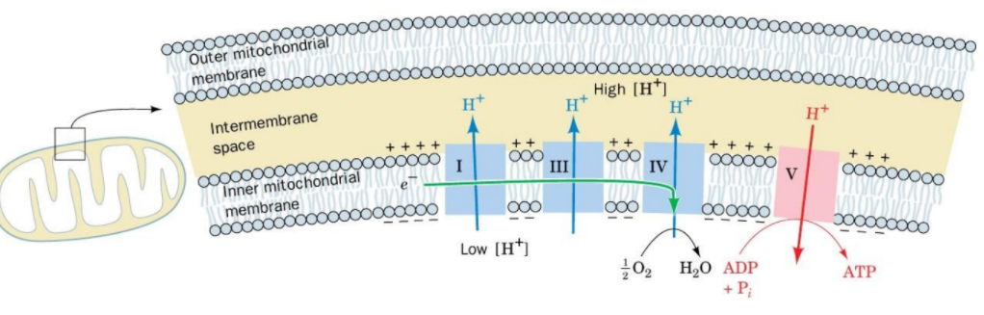
ETC is coupled to proton transport for ATP synthesis
The energy of electron transfer is used to drive the protons out of the matrix.
It is done by complexes I, III and IV
(proton pumps){H+}.
This creates a proton {H+} gradient ( electrical gradient ) across the
IMM to synthesize ATP.
- All the complexes except complex II and V are going to pump H+ ions from the matrix to the Intra Mitochondrial Membrane (IMM)
- The ATP synthase will use the gradient of H+ ions
to ATP synthesis
More positive charges on the outside of the membrane (intermembrane space) than on the inside

Slide 14
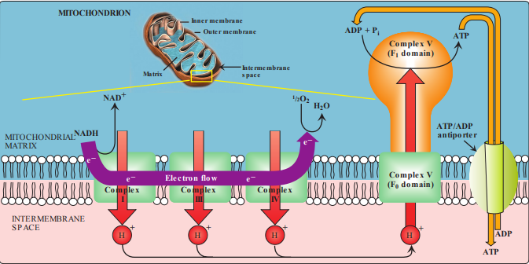
ATP synthase
4 min only
Explains the process in detail
ATP synthase (Complex V) synthesizes ATP
Contain two domains:
1- F0 - membrane spanning domain
2- F1 - extramembranous domain (in the matrix)
Transport of Protons
Each stations (Complex I,III,IV) donate protons H+ outside the matrix to the intermembrane space.
These protons will bind to Complex V at F0 then transferred into F1 and make a conformational changes that lead to the synthesis of ATP:
ADP+Pi → ATP
The purple arrow → ETC
F0 domain is the main incentive for ATP Synthase.

Slide 15
Energetics of ATP synthesis
1
The energy required for phosphorylation of
ADP to ATP = 7.3kcal/mol.
For each ATP we need 7.3 kcal/mol of energy to produce it. And since we have 3 ATP ( 3 x 7.3=21.9) the remaining energy (Excess energy) is used for other reactions or released as heat.
2
Energy produced from the transport of a pair of electrons from NADH to O2 = 52.58 kcal.
3
Number of ATP molecules produced is 3 ( NADH to O2). (FADH2 produce 2 ATP)
4
Excess energy is used for other reactions or released as heat.

Slide 16
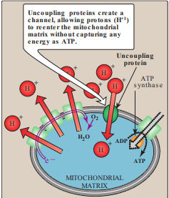
P:O ratio
Inhibitors of ATP synthesis
1
Oligomycin:
ATP made per O atom reduced
Binds to F0 domain of ATP synthase and closes the H+ channel.
For NADH
P:O = 2:1
2
Uncoupling proteins (UCPs):
For FADH2
P:O = 3:1
Create proton leaks (allow protons to reenter the matrix without ATP synthesis).
FADH2 Produce just 2 ATP that’s why it’s not the main source for ATP.
Energy is released as heat (nonshivering thermogenesis).
P = Phosphorylation
0 = Oxidation
*extra
Uncoupling protein 1 (UCP1): also called thermogenin is responsible for heat production in the brown adipocytes (fat) of mammals.
Brown fat is a special type of body fat that is (activated) when you get cold.

Slide 17
Take home message
ETC is a common pathway of transferring energy-rich electrons from metabolism finally yielding CO2 and water.
The energy of the electrons transferred is used for ATP synthesis and heat production.

Slide 18
Quiz:
Q6/ what is the difference between Coenzyme Q (CoQ) and Cytochromes?
You can find it on Slide 10
Q7/ what is the structure and the function of complex V?
ATP synthase (Complex V) synthesizes ATP
1- F0 - membrane spanning domain
2- F1 - extramembranous domain (in the matrix)
Q8/What is the final electron acceptor in the electron transport system, and what is formed?
Oxygen,H2O
Q1: P:O ratio in NADH is:
A | 1:3 | B | 3:1 | C | 2:1 | D | 1:2
Q2: Which of these complexes passes their electron to Cytochrome c ?
A | Complex I | B | Complex III | C | Complex V | D | Complex IV
Q3: Where does the electron transport chain happen?
A | Outer mitochondrial membrane | B | Mitochondrial matrix | C | Inner mitochondrial membrane | D | Cytoplasm
Q4: Which of the following complexes is not part of the ETC?
A | Complex V | B | Complex II | C | Complex IV | D | Complex III
Q5: which of the following is required as a final acceptor in respiratory chain to produce water?
A | Oxygen | B | H2O molecules | C | NADH | D | FADH2
Q1) B Q2)B Q3)C Q4)A Q5)A

Slide 19
Summary
Cellular respiration
Glycolysis
Krebs cycle
Oxidative phosphorylation
respiratory chain ( ETC )
Chemiosmosis = phosphorylation
Definition
Location
Component
Result
Inhibitors
Definition
Location
Component
Result
Inhibitors of ATP synthesis
The process which the NADH and FADH2 shuttle high-energy electrons extracted glycolysis and the krebs cycle into the electrons transport chain
Inner membrane of the mitochondria
Electrons are finally passed to a terminal acceptor ( O2) at the end of chain , forming water by oxygen
Rotenone
The process in which the ions = hydrogen H+ move by diffusion through ATP synthase from high concentration to low concentration
Inner membrane oÿ the mitochondria
Protein
Produce ATP from ADP by ATP synthase
UCPs
Antimycin A
Oligomycin
6- ATP synthase = Complex V
First part
Cytochromes (second part of ETC)
CN- ( Cyanides )
1- NADH --> complex | ( NADH Dehydrogenase )
Proteins
Proteins
3- Complex II ( Cytochrome bc1 )
1- FADH2 --> Complex II ( Succinate dehydrogenase )
Mobile electron carriers
4- Cytochrome C
2- Coenzyme Q = ubiquinone
Mobile electron carriers
Proteins
5- Complex IV Cytochrome a +a3
Thx to #MED439 team

Slide 20
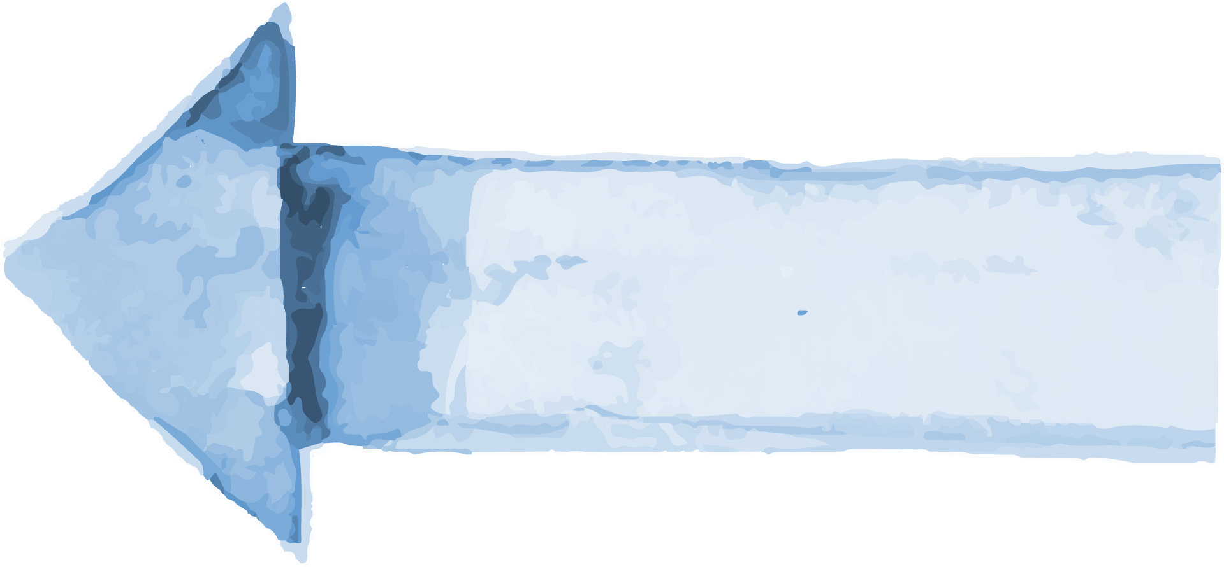
Our creative team:
Special thanks to biochemistry Team (441).
Team leader:
Sara alotaebe
Team leader:
Mohamed ibn Saqyan
رأيت العلم صاحبه كريم
ولو ولدته آباء لئامُ
وليس يزال يرفعه إلى أن
يعظم أمره القوم الكرامُ
ويتبعونه في كل حال
كراعي الضأن تتبعه السوامُ
فلولا العلم ما سعدت رجال
ولا عرف الحلال من الحرام ُ
محمد بن ادريس الشافعي
Mohammed Alrashod
Saad Alahmari
Ahmad Almarshed
Abdullah Almissaind
Ibrahim Alohali
Raseel Alwehibi
Rand Jarallah
Noura Alshafi
biochemksumed442@gmail.com

