Slide 1
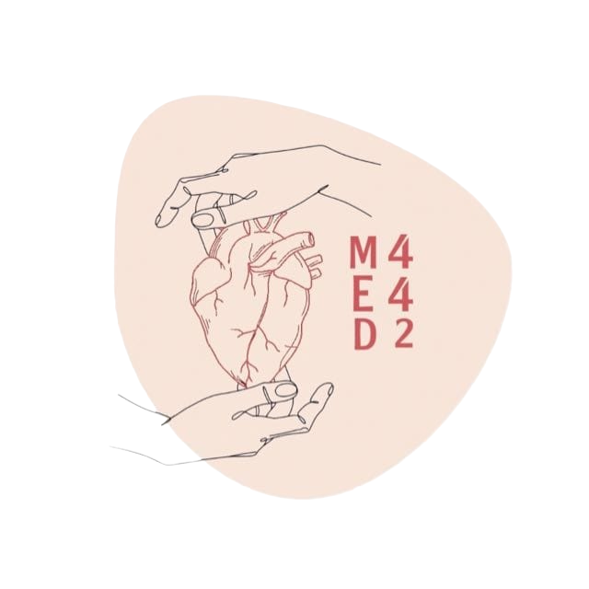
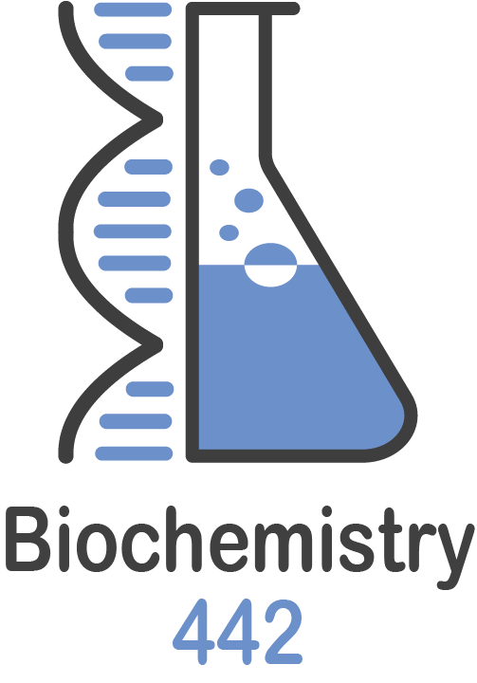
Globular Proteins
Color Index:
● Main text
● Important
● Notes
● Boys slides
● Girls slides
● Extra
L3
W1
Editing file

Slide 2
Objectives :
To describe the globular proteins using common examples like hemoglobin and myoglobin.
To study the structure and functions of globular proteins like:
- Hemoglobin (a major globular protein)
- Myoglobin
- 𝛄-globulins (immunoglobulins)
To know the different types of hemoglobin and difference between normal
and abnormal hemoglobin
To understand the diseases associated with globular proteins

Slide 3
Globular Proteins
Amino acid chains fold into shapes that resemble spheres are called globular proteins
This type of folding increases solubility of proteins in water - Polar(hydrophilic)groups on the protein’s surface - (non polar)hydrophobic groups in the interior (core of protein)
Fibrous proteins are mainly insoluble structural proteins
- Fibrous proteins :provide structural support for cells and tissues.

Slide 4
Globular Proteins
1
Hemoglobin:
oxygen transport function
Myoglobin: oxygen storage/supply function in heart and muscle
Globular Proteins examples
2
3
α1, α2, β-globulins: various functions
4
γ-globulins (immunoglobulins): immune function
5
Enzymes: catalysis of biochemical reactions
Note:
There is a difference between
globin ( in hemoglobin + myoglobin) and globulins
Globin :proteins with functions related to oxygen Globulin : proteins with functions not related to oxygen.

Slide 5
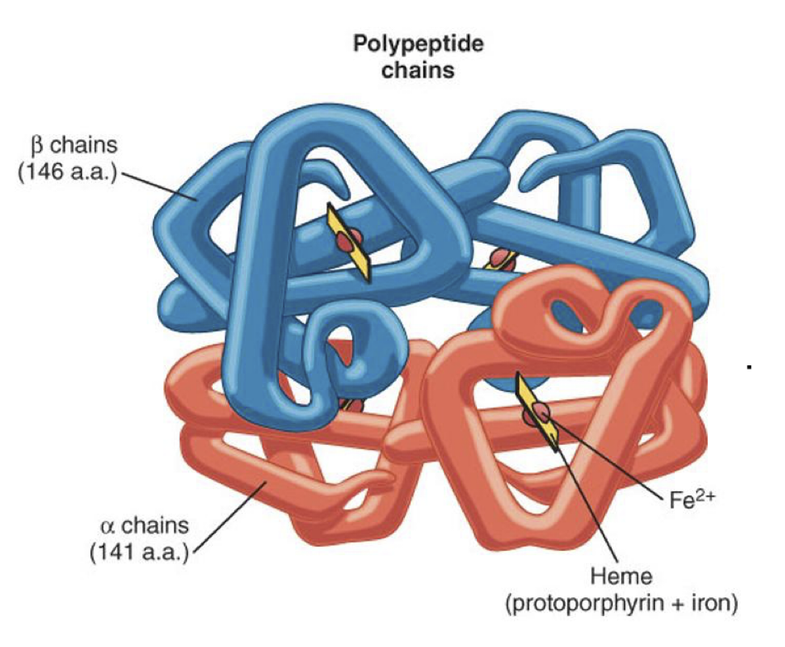
Hemoglobin
A major globular protein in humans
Composed of four polypeptide chains: - Two α and two β chains
Contains two dimers of αβ subunits - Held together by non-covalent interactions
Each chain is a subunit with a heme group in the center that carries oxygen
A Hb molecule contains 4 heme groups and carries 4 molecules of O2
-In normal hemoglobin Heme in ferrous state(Fe+2 )
Types of Hb:
Note that each heme group carries one oxygen molecule
( 2 oxygen atoms)
More details in next slides
HbA (97%)
HbA2 (2%)
HbF (1%)
HbA1C
Can bind to oxygen and deliver it
1-
Normal
Can’t bind to oxygen
Carboxy Hb
Met Hb
Sulf Hb
2-
Abnormal

Slide 6
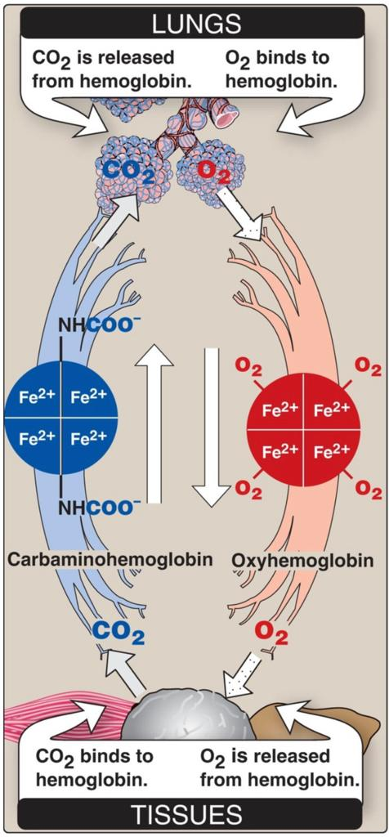
Hemoglobin function
Carries oxygen from the lungs to tissues
Carries carbon dioxide from tissues back to the lungs
Normal level (g/dL):
Males
14-16 (g/dL)
Females
13-15 (g/dL)
Gas transport
-( oxyhemoglobin ) (when the Hb is saturated with O2)
- (carbaminohemoglobin ) (when the Hb is saturated with CO2) (CO2 binds with NH2 of one of the amino acid) So the site where CO2 bind is different from where O2 bind [this is normal because the site is different than the O2 while carboxy-Hb is not ]

Slide 7
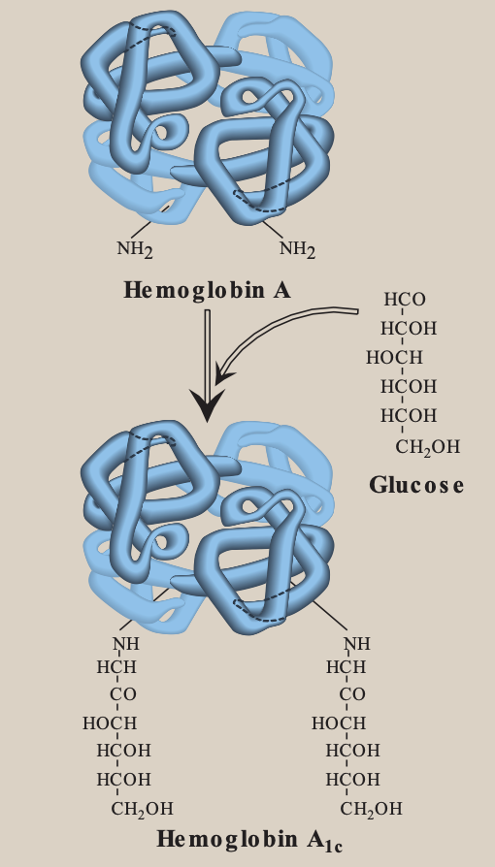
Normal hemoglobin
HbA
HbA2
3
1
2α, 2β
( details in next slide)
- Appears shortly before birth
-Constitutes ~2% of total Hb
-Composed of two α and two δ (delta) globin chains
2
Fetal hemoglobin (HbF):
HbA1c
4
- HbA undergoes non-enzymatic glycosylation
-Glycosylation depends on plasma glucose levels -HbA1c levels are high in patients with diabetes mellitus
-NH2 group of the N-terminal valines of β chains
- Major hemoglobin found in the fetus and newborn
- Tetramer with two α and two γ (gamma) chains
- Higher affinity for O2 than HbA
- Transfers O2 from maternal to fetal circulation across placenta
( no need for
Enzymes or energy)
Med 441 : A folded polypeptide chain → Tertiary protein (Subunit)
2 x subunits (can be α, β, γ, δ..) → Dimer
2 x αβ dimer → Hemoglobin (tetramer protein)

Slide 8
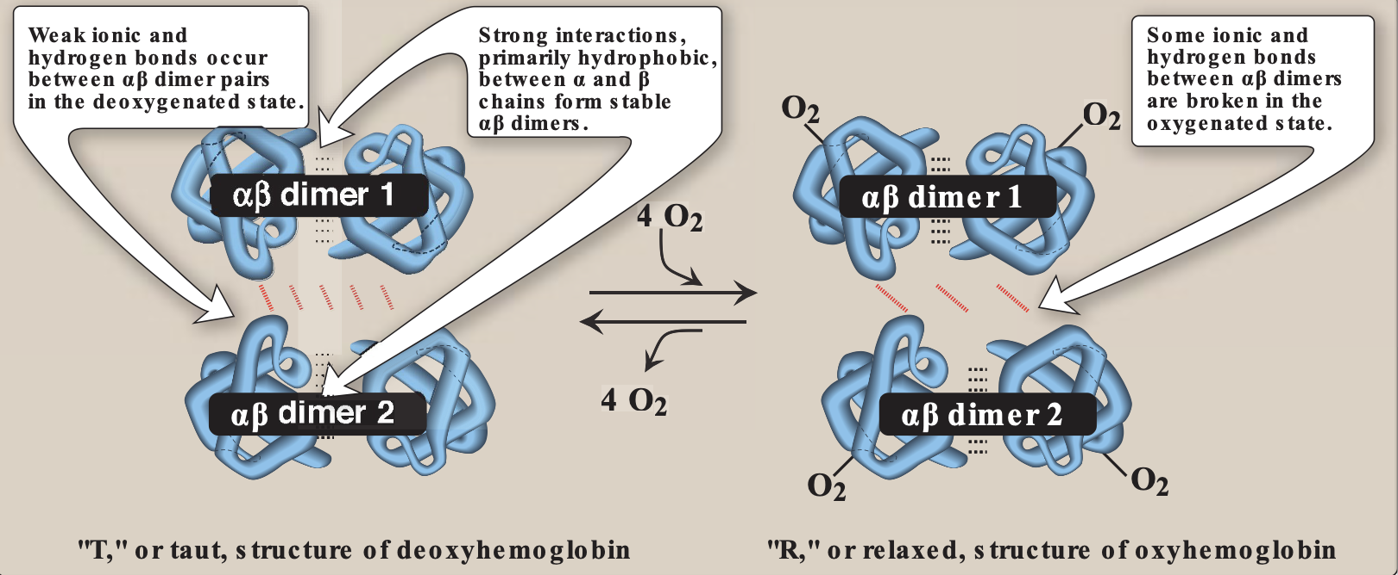
HbA structure
2-
Intra-dimer
bond
3-
1-
There are two types of bonding in the HbA structure:
1- intra-dimer bonding: strong bonds between two subunits
2- inter-dimer bonding : weak bonds between two dimers
Inter-dimer bond
1- Strong interactions primarily hydrophobic ( bond ) between ⍺ and β chain to form stable ⍺β dimers.
2- Week ionic and hydrogen bonds occur between ⍺β dimer pairs in the deoxygenated state-not binding to O2- (“T” or taut, structure of deoxyhemoglobin)
3-Some ionic & Hydrogen bonds between ⍺β dimers are broken in the oxygenated state -binding to O2-(“R” or relaxed, structure of oxyhemoglobin )

Slide 9
Abnormal Hbs (this slide is very important)
Unable to transport O2 due to abnormal structure:
CO binds 200X tighter than O2 (in smokers) and stabilize the oxyhemoglobin
Contains oxidized ferric (ferrous is normal)state(Fe3+) (~2%) that cannot carry O2
Forms due to high sulfur levels in blood (irreversible reaction)
carboxy-Hb
Met-Hb
Sulf-Hb
Note 441: Hemoglobin has 4 sits where O2 can bind. if CO bind with one -or all- of these, even if the other 3 sits bind with O2, then :
-CO binding has very high affinity so it can’t be remove easily.
-Once it is bond, it stabilize carboxy Hb structure.So the other O2 molecules will not be giving off. even if there is a pressure difference with the tissues. (which cause hypoxia)

Slide 10
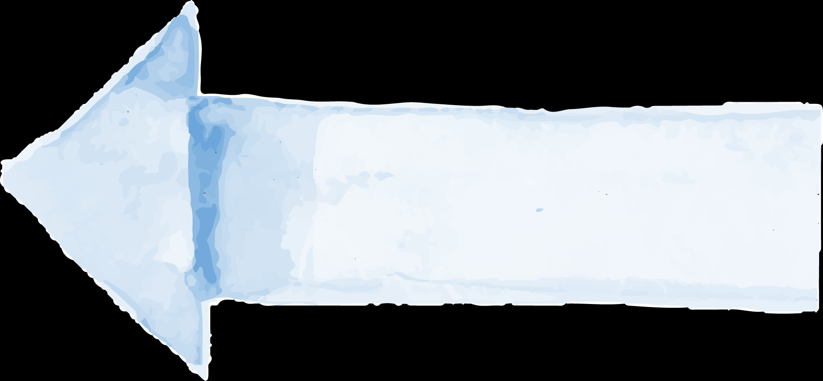
Hemoglobinopathies
Disorders of hemoglobin caused by:
Sickle cell (HbS)
Hemoglobin C
disease
Methemoglobinemia
Thalassemia (α-β)
synthesis of structurally
abnormal Hb.
Hemoglobinopathies
Synthesis of insufficient
quantities of normal Hb.
Combination of both

Slide 11
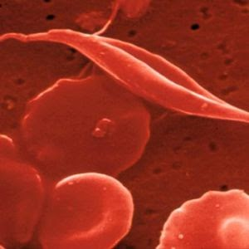
Hemoglobinopathies(this slide is important)
1
Sickle cell (HbS)
- Caused by a single mutation in β -globin gene.
- Glutamic acid (polar -) at position 6 in HbA is replaced by valine (nonpolar).
- The mutant HbS contains βs chain.
- The shape of RBCs become sickled.
- Causes sickle cell anemia.
- it’s an autosomal recessive.
2
Hemoglobin C disease
- Caused by a single mutation in β-globin gene (same as sickle cell).
- Glutamic acid (polar -) at position 6 in HbA is replaced by lysine (polar +).
- causes a mild form of hemolytic anemia.

Slide 12
Hemoglobinopathies (this slide is important)
NADH- cytochrome b5 reductase enzyme is responsible for converting ferric to ferrous
( deficiency→ high level of metHb) .
3
Methemoglobinemia
- Caused by oxidation of Hb to ferric ( Fe3+ ) state.
- Methemoglobin cannot bind oxygen.
- [very important) Caused by certain drugs, reactive oxygen species and (NADH-cytochrome b5 reductase deficiency) .
- Chocolate cyanosis: brownish-blue color of the skin and blood (less amount of O2 in blood).
4
Thalassemia (recessive)
- defective synthesis of either α or β- globin chain due to gene mutation.
1- α- Thalassemia:
- synthesis of α-globin chain is decreased or absent.
- causes mild to moderate hemolytic anemia.
2- β- Thalassemia:
- synthesis of β-globin chain is decreased or absent.
- causes severe anemia.
- patients need regular blood transfusions.

Slide 13
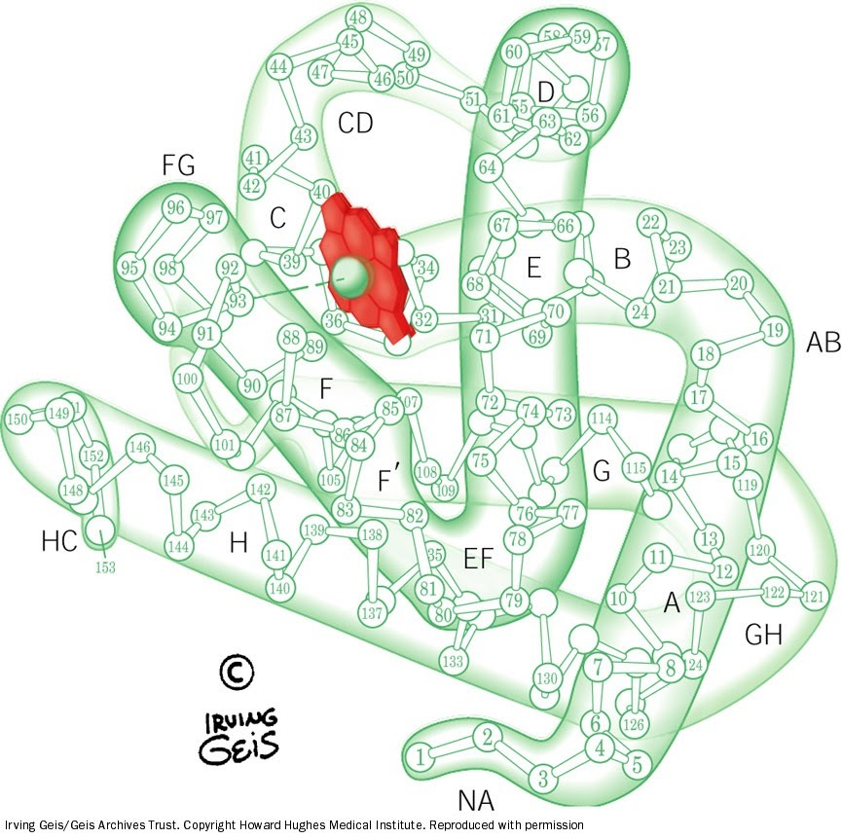
Myoglobin
MED39:
Myoglobin has 1 subunit &
bind to one O2 molecule
A globular
hemeprotien in heart
and muscle
Stores and supplies
oxygen to the heart
and skeletal muscle
only
Contains a single polypeptide
chain forming a single
subunit with eight α-helix
Structure
Myoglobin gives the red
colour to skeletal muscles
Supplies oxygen during
aerobic exercise
The interior subunit → nonpolar amino acids
The surface → charged amino acids
The center of the molecule → heme group
Structure of myoglobin

Slide 14
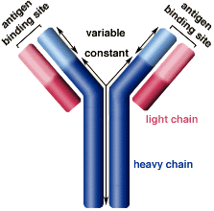
Myoglobin in disease
Immunoglobulins
Myoglobinuria: Myoglobin is excreted in urine due to muscle damage (rhabdomyolysis)
Immunoglobulins: defensive proteins produced by the B-cells of the immune system.
Rhabdomyolysis is a serious syndrome
due to destruction of skeletal muscles
and cardiac muscles to a lesser extent
Y-shaped structure
with 2 heavy and 2 light polypeptide chains.
May cause acute renal
failure
Specific marker for
muscle injury
Neutralize
bacteria and viruses.
Less specific marker for
heart attack
Types:
IgA, IgD, IgE, IgG, IgM
(MAGED).
↑ in blood → Know that there’s muscle
injury (can be skeletal or heart muscle)
↑ in urine → High chance for skeletal
you can just confirm it by heart specific biomarker

Slide 15
Take home messages
✦Amino acid chains fold into shapes that resemble spheres are called globular proteins.
✦Fibrous proteins are mainly insoluble, while globular proteins are soluble structural proteins.
✦Hb, Myoglobin, globulines and enzymes are examples of globular proteins.
✦Functionally, Hb is for O2 and CO2 transport.
✦HbA, HbA2 and HbF are examples of normal Hb, in which the tetrameric structure is composed of 2α
constant subunits with 2 changeable β subunits according to Hb type.
✦HbA1C is a HbA which undergoes non-enzymatic glycosylation, depending on plasma glucose levels.
✦Carboxy-Hb, Met-Hb and Sulf-Hb are examples of abnormal Hb, in which O2 molecules are not
transported due to abnormal Hb structure.
✦Disorders of Hb caused by synthesis of structurally abnormal Hb and/or insufficient quantities of
normal Hb.

Slide 16
Take home messages
✦Sickle cell (HbS) and HbC diseases are caused by a single mutation in β-globin gene.
✦Glu6 in HbS is replaced by Val, while it is replaced by Lys in HbC.
✦Methemoglobinemia is caused by oxidation of Hb, inhibiting O2 binding leading to chocolate cyanosis.
✦Thalassemia is caused by a defect in synthesis of either α- or β-globulin chain, as a result of gene
mutation.
✦α-Thalassemia causes less sever anemia than β-Thalassemia.
✦Myoglobin is a globular hemeprotein, which stores and supplies O2 to the heart and muscle only.
✦Hb is composed of 4 chains (subunits), while Myoglobin is composed of a single chain.
✦Myoglobinuria is a specific marker for muscle injury and may cause acute renal failure.
✦Immunoglobulins are defensive proteins produced by the B-cells.
✦Immunoglobulins consist of 5 types: IgA, IgD,IgE, IgG and IgM.

Slide 17
Quiz:
Q1: A major globular protein in humans :
A | Hemoglobin | B | Myoglobin | C | immunoglobulins | D | enzymes
Q2:Which of the following hemoglobin undergoes non-enzymatic glycosylation?
A | HbA1C | B | HbA | C | HbA2 | D | HbF
Q3:Which of the following bond will broken at oxygenated state?
A | Hydrophobic | B | Ionic | C | Hydrogen | D | B AND C
Q4: it is a myoglobin disease ?
A | Sickle cell (HbS) | B | Thalassemia (α-β) | C | Methemoglobinemia | D | Myoglobinuria
Q5:Which of the following caused by the oxidation oh Hb to ferric state?
A | Thalassemia (α-β | B | Hemoglobin C disease | C | Methemoglobinemia | D | Sickle cell (HbS)
SAQ: very important
Q6: what are the the types of normal hemoglobin and what are they made of ?
Q7: give three differences between hemoglobin and myoglobin?
Q8: Name two abnormal-Hbs and what makes them abnormal?
Q6: slide 7
Q7: slide 5 and 13
Q8: slide 9
Q1) A Q2) B Q3)D Q4) D Q5)C
Quizlet team

Slide 18
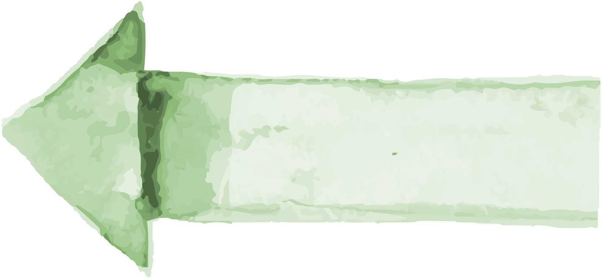
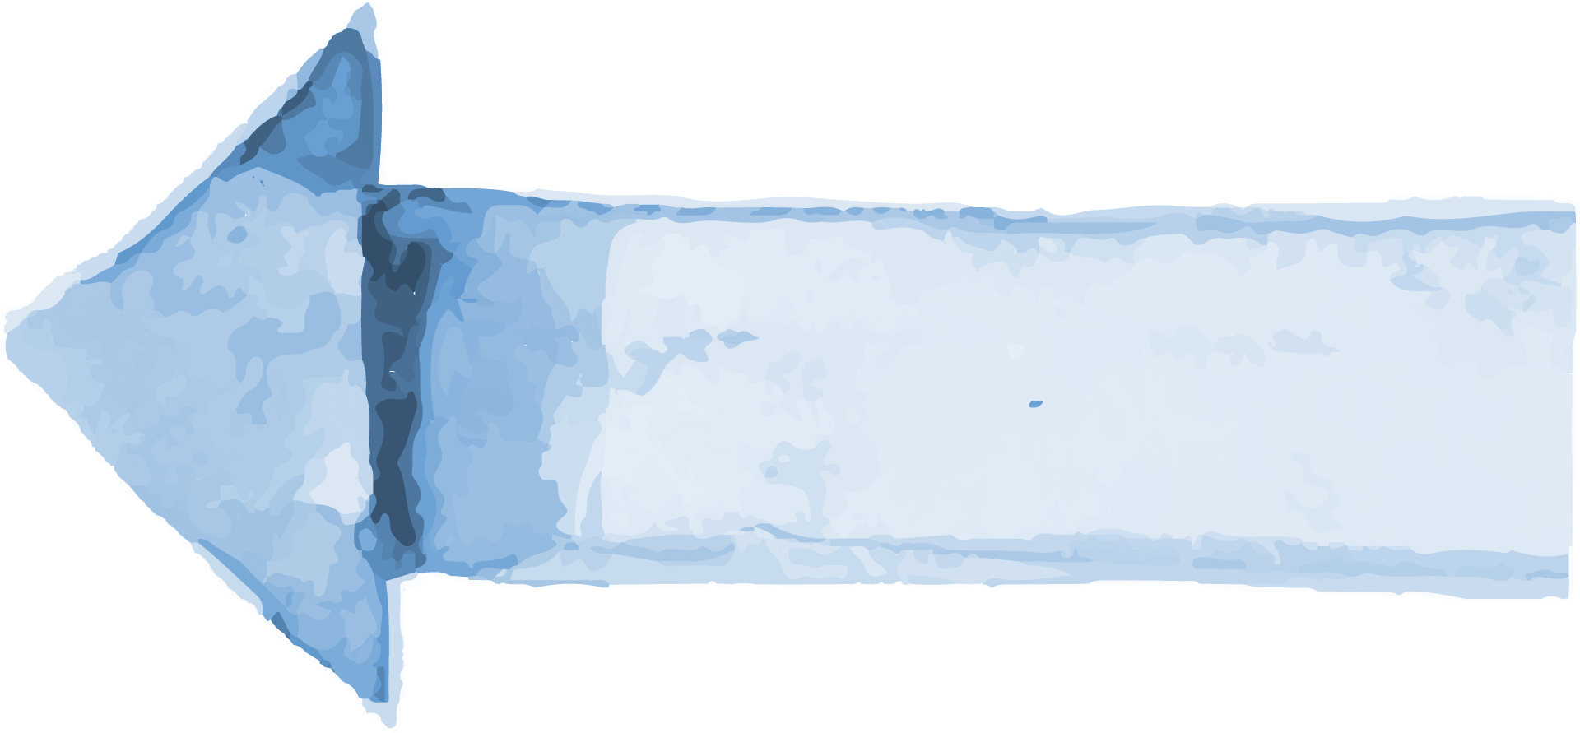
Our creative team:
Team leader:
Sara alotaebe
Team leader:
Mohamed ibn Saqyan
Mohammed Alrashod
Saad Alahmari
Ahmad Almarshed
Abdullah Almissaind
Ibrahim Alohali
Raseel Alwehibi
Rand Jarallah
Noura Alshafi
لأستسهلن الصعب أو أدرك المنى
فما انقادت الآمال إلا لصابر
جاسم بن عوف

