Slide 1
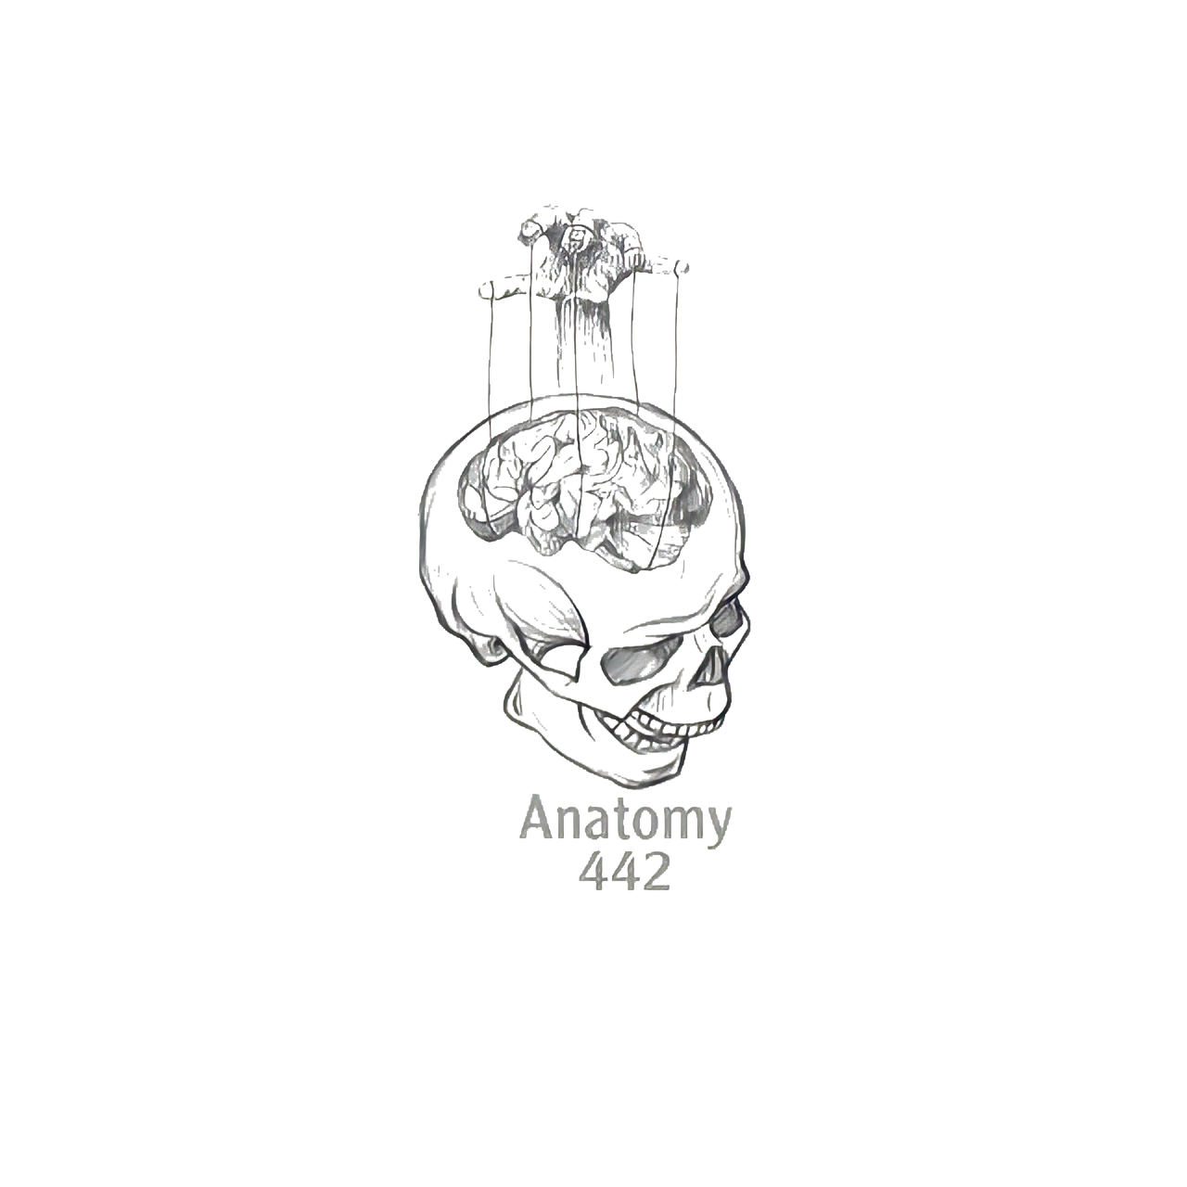
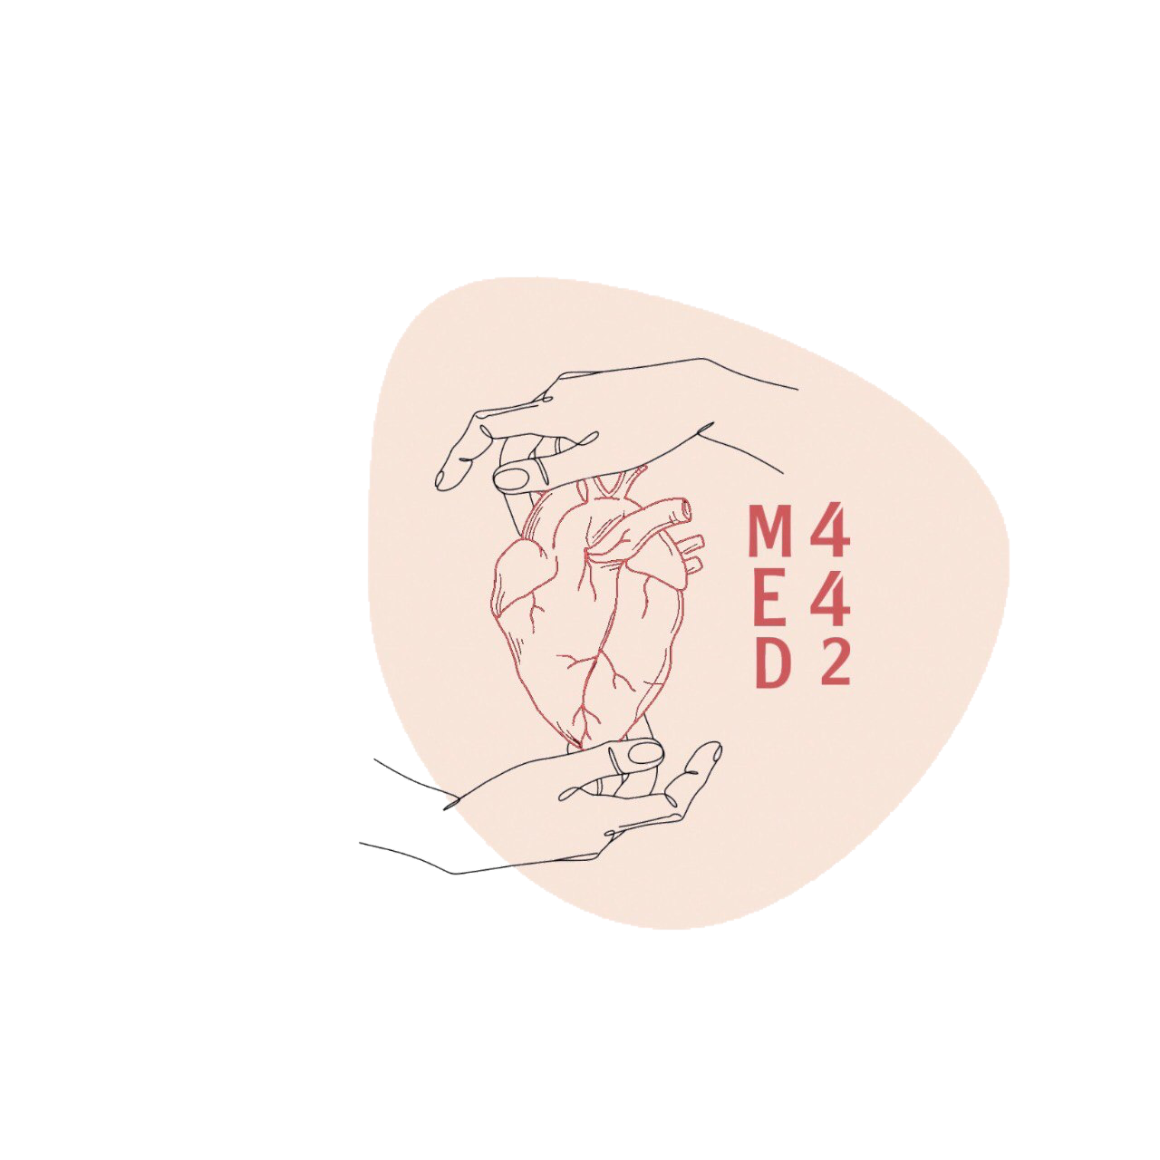
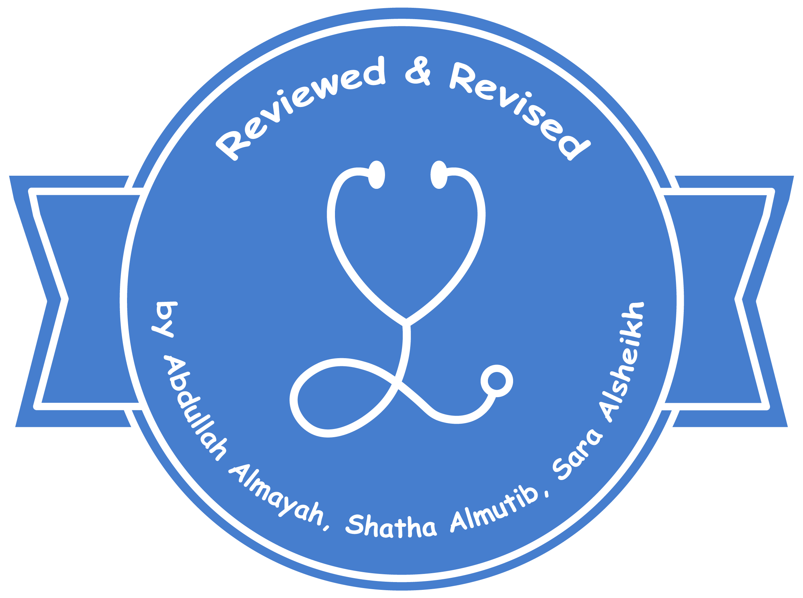
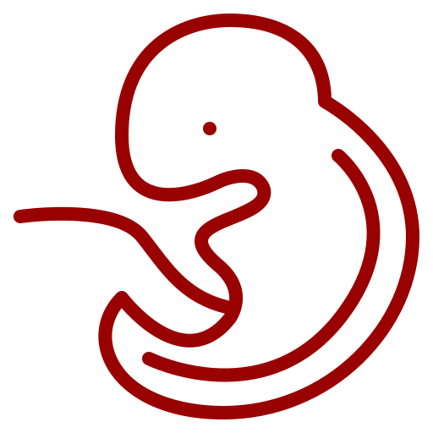
1
Development of the Respiratory System
____________
Respiratory Block
Color Index:
Main Text
Male’s Slides
Female’s Slides
Important
Doctor’s Notes
Extra Info
Editing File
Notes:
This slide is already done, please don’t change anything here

Slide 2
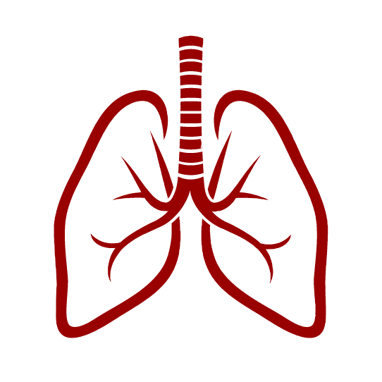
Objectives
1
Identify the development of the laryngotracheal (respiratory) diverticulum.
2
Identify the development of the larynx.
3
Identify the development of the bronchi and lungs.
4
Identify the development of the trachea.
5
Describe the periods of the lung maturation.
6
Identify the most congenital anomaly.
Watch Video
Before you start studying this lecture, we highly recommend that you watch this video first!
Notes:
If your objectives are less than 6 delete the extra points

Slide 3
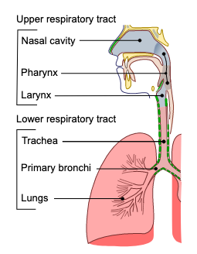
Respiratory System:
Upper Respiratory System
Lower Respiratory System
Nose
Trachea
Nasal Cavity & Paranasal Sinuses
Bronchi
Laryngo-pharynx
Lungs
Larynx
In embryology the lower respiratory tract includes larynx

Slide 4
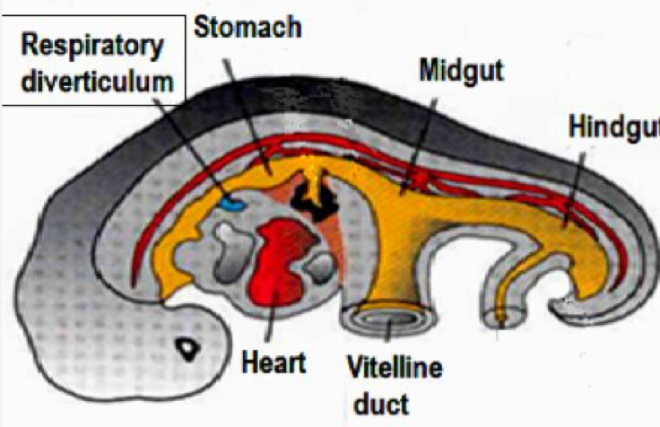
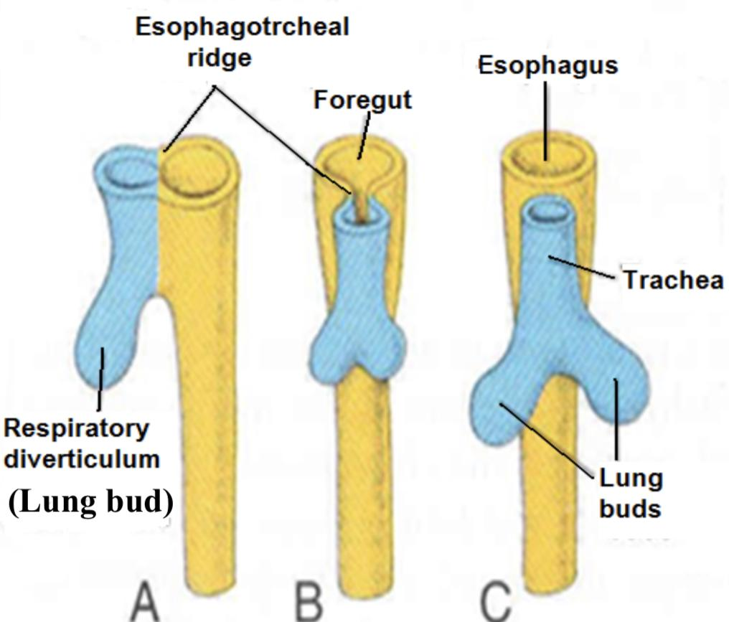
Development of the respiratory tract:
Begins during the middle of the 4th week of development .
Respiratory Diverticulum:
Begins as a median outgrowth (laryngotracheal groove) from: the caudal part of the ventral wall of the primitive pharynx (foregut).
The groove envaginates and forms the laryngotracheal diverticulum
Primordium of the oropharynx and esophagus (digestive)
Dorsal portion:
A longitudinal tracheo-esophageal septum develops and divides the primitive foregut / diverticulum into:
Tracheoesophageal septum:
Primordium of larynx, trachea, bronchi and lungs (respiratory)
Ventral portion:
proximal part of the respiratory diverticulum | remains tubular and forms larynx and trachea.
distal end of the respiratory diverticulum | dilates to form lung bud, which divides to give rise to 2 lung buds (primary bronchial buds).
endoderm lining the laryngotracheal diverticulum (respiratory) gives rise to the: | The Epithelium and Glands of the respiratory tract.
surrounding splanchnic mesoderm gives rise to the: | The Connective tissue, cartilage and smooth muscles of the respiratory tract.

Slide 5
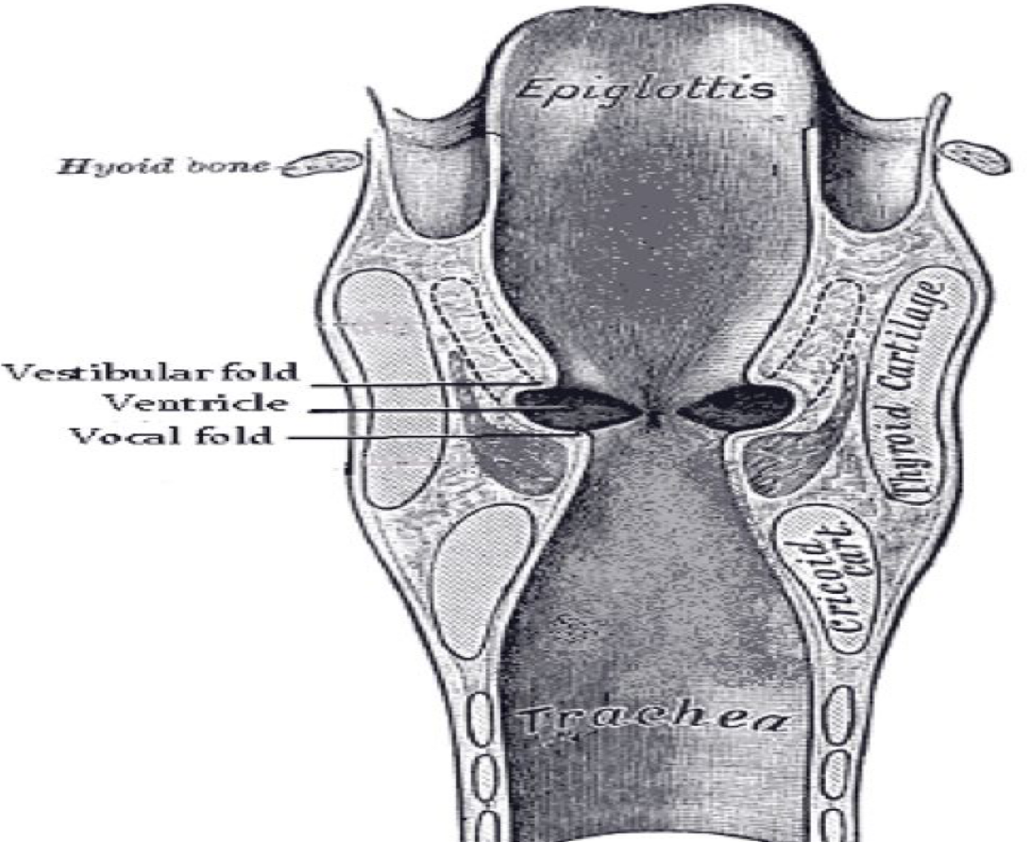
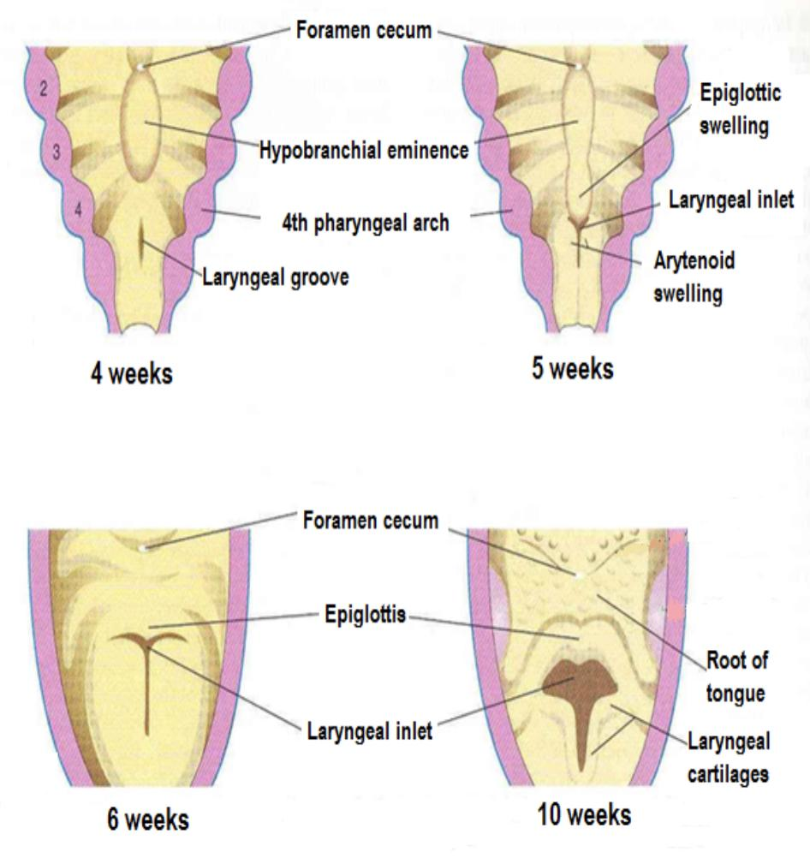
Development
Larynx :
Recanalization
Laryngeal muscles and cartilages of the larynx except epiglottis (more details in the next slide) develop from the mesoderm of : 4th and 6th pairs of pharyngeal arches
The epithelium and glands are derived from endoderm of respiratory diverticulum.
All laryngeal muscles are innervated by 10th CN (vagus nerve)
-the superior laryngeal innervates the 4th ph. arch derivatives
-the recurrent laryngeal innervates the 6th ph. arch derivatives
The opening of laryngotracheal diverticulum into the primitive foregut becomes the laryngeal oriﬁce.
1
2
3
4
1
2
3
The laryngeal epithelium proliferates rapidly resulting in temporary occlusion of the laryngeal lumen.
normally occurs by the 10th week.
Laryngeal ventricles, vocal folds (true vocal cord) and vestibular folds (false vocal cord) are formed during recanalization.
This is Important

Slide 6
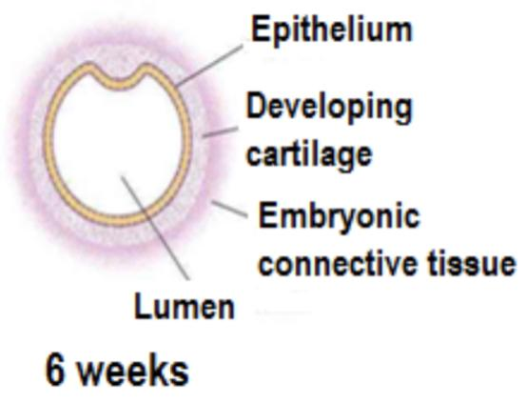
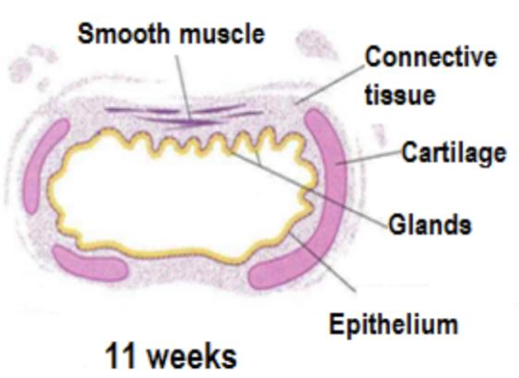
Epiglottis:
Development
of The trachea:
It develops from the caudal part (lower) of the hypopharyngeal eminence, a swelling formed by the proliferation of mesoderm in the floor of the pharynx.
Growth of the larynx and epiglottis is rapid during the first three years after birth. By this time the epiglottis has reached its adult form.
Distal endodermal lining of the laryngotracheal tube differentiates into: the epithelium and glands of the trachea and pulmonary epithelium
The cartilages, connective tissue, muscles of the trachea are derived from splanchnic mesoderm
remember that: endoderm gives rise to epithelium and glands mesoderm gives rise to cartilage, C.T. and muscles. (Team 441)

Slide 7
Summary:
Special thanks for 441 team**
Laryngotracheal groove —> Laryngotracheal Diverticulum—>Tracheoesophageal Septum
Tracheoesophageal Septum:
Dorsal portion —> 1) Oropharynx 2) Esophagus
Ventral portion —> 1) Lungs 2) Bronchi 3) Trachea 4)Larynx
Proximally —>Forms the Larynx & Trachea
Distally —>Forms the 2 Lung buds
Endoderm lining of L.D. —> Epithelium & Glands
Splanchnic Mesoderm —>C.T. + Cartilage + Smooth muscle
Larynx:
Laryngeal oriﬁce: develops from the opening of the L.D. into the foregut
Endoderm —> Laryngeal Epithelium & Glands
Mesenchyme (4/6 pharyngeal arches) —> Laryngeal Muscles & Cartilage
Caudal part of Hypopharyngeal eminence —>The Epiglottis
Trachea:
Endodermal lining of Laryngotracheal tube —> Epithelium & Glands of trachea
Surrounding Splanchnic mesoderm —> Muscles, Cartilage, & C.T. of trachea

Slide 8
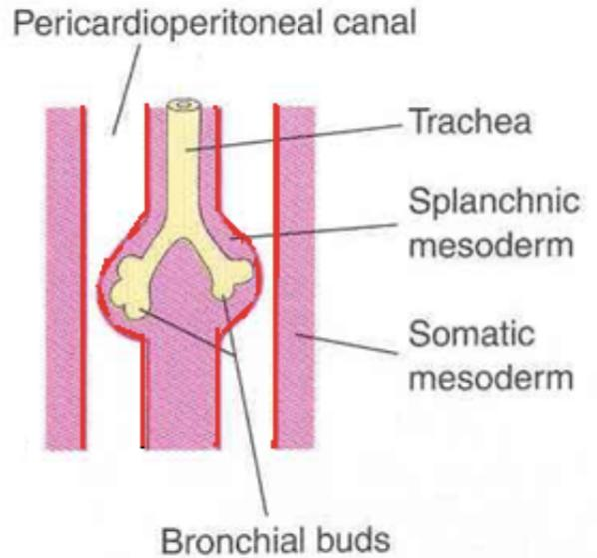
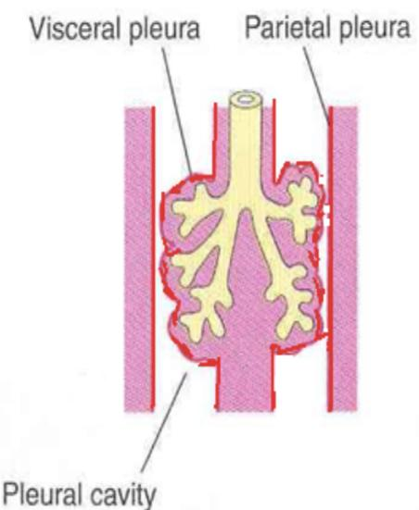
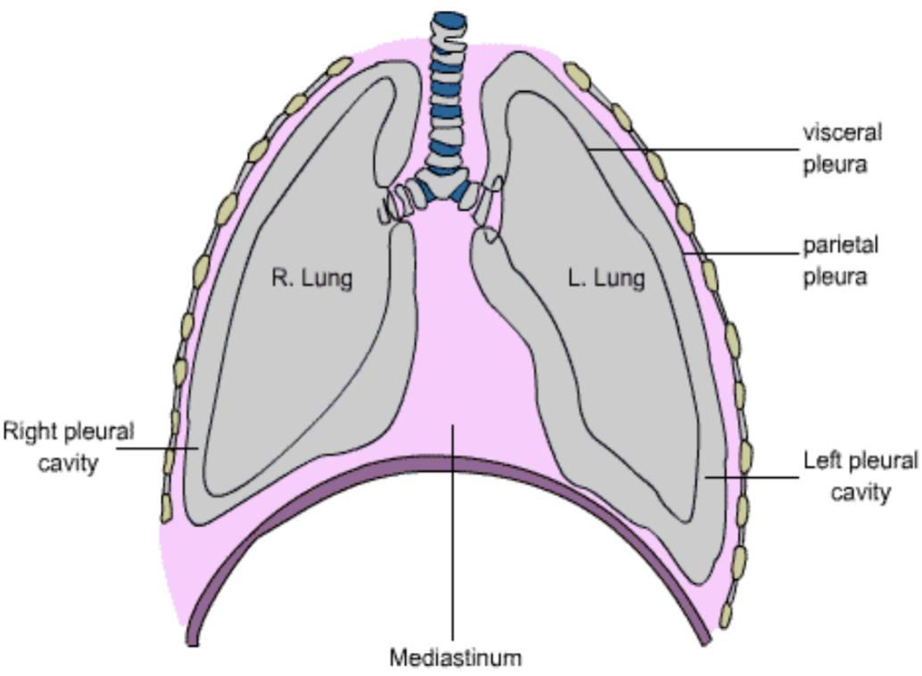
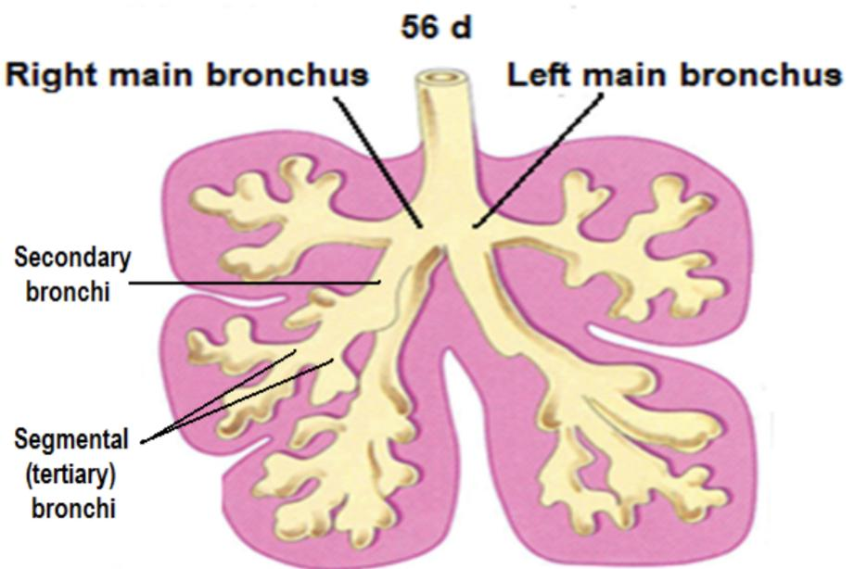
Development of the Bronchi & Lungs:
Development of the pleura
The 2 primary bronchial buds grow laterally into the pericardio-peritoneal canals which are the primordia of pleural cavities.
Bronchial buds divide and re-divide to give the bronchial tree.
The right main bronchus is shorter & wider than the left one and is oriented more vertically.
This embryonic relationship persists in the adult.
The main bronchi subdivide into secondary and tertiary (segmental) bronchi which give rise to further branches
The segmental bronchi 10 in right lung and 8/9 in the left lung begin to form by the 7th week
The surrounding mesenchyme also divides.
Each segmental bronchus with its surrounding mass of mesenchyme is the primordium of a bronchopulmonary segment.
As the lungs develop they acquire a layer of:
visceral pleura —> from splanchnic mesenchyme.
The thoracic body wall becomes lined by a layer of:
parietal pleura —> from the somatic mesoderm.

Slide 9
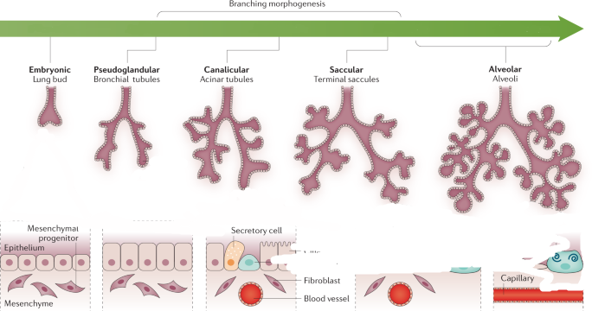
Stages of Lung Development (Maturation) :
Its divided into 4 Periods :-
These periods overlap each other because the cranial segments of the lungs mature faster than the caudal ones.
Stage (Period) | Duration
Pseudoglandular | 5-16/17 weeks
Canalicular | 16-25/26 weeks
Terminal sac | 24/26 weeks - birth
Alveolar | 32 weeks - 8 years (8 months to childhood) (late fetal period - childhood)

Slide 10
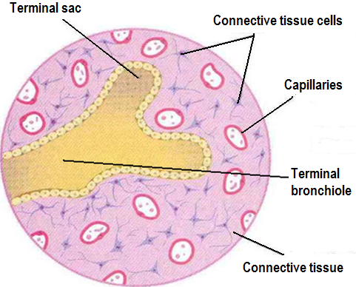
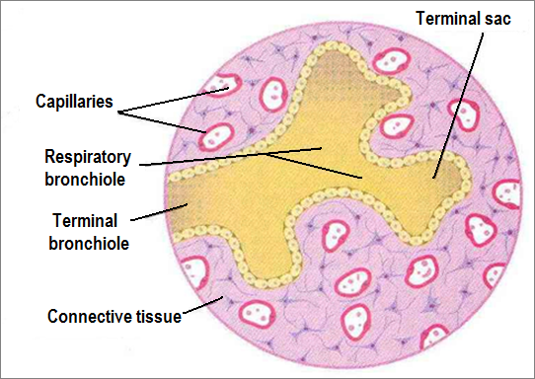
Pseudoglandular Period of Lung Development [5-16/17 weeks] :
Canalicular Period of Lung Development
[16-26 weeks] :
Developing lungs somewhat resembles an exocrine gland during this period.
By 16(17) weeks all major elements of the lung have formed EXCEPT those involved with gas exchange i.e. ALVEOLI.
Respiration is NOT possible.
Fetuses born during this period are unable to survive.
Lung tissue becomes highly vascular..
Lumina of bronchi and terminal bronchioles become larger.
By 24 weeks each terminal bronchiole has given rise to two or more respiratory bronchioles.
The respiratory bronchioles divide into 3 to 6 tubular passages called alveolar ducts.
Some thin-walled terminal sacs (primordial alveoli) develop at the end of respiratory bronchioles.
Respiration is possible at end of this period → premature fetus may survive with intensive care but usually die. (because of the immaturity of respiratory as well as other systems)

Slide 11
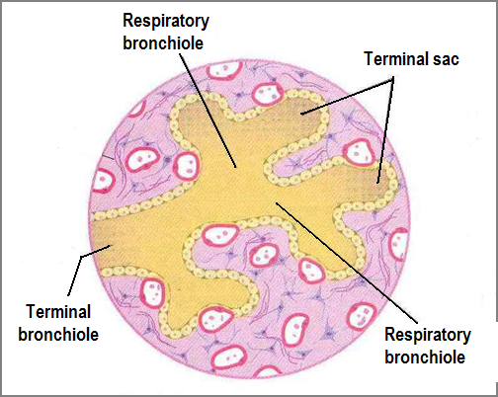
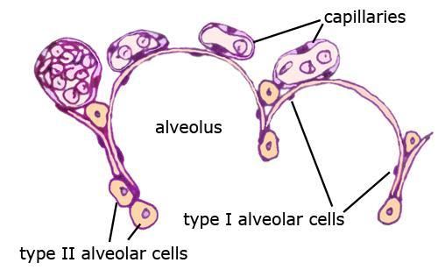
Terminal Sac Period of Lung Development
[26 weeks - birth] :
Terminal Sac Period
Many more terminal sacs develop.
Their epithelium becomes very thin. (type I & type II pneumocytes)
Capillaries begin to bulge into developing alveoli.
Alveoli epithelial cells + Capillary endothelial cells =
Blood-air barrier is established.
Adequate gas exchange can occur which allows the prematurely born fetus to survive.
By 24 weeks, the terminal sacs are lined by:-
1- Squamous type I alveolar cells or pneumocytes.
2- Rounded secretory, type II pneumocytes, that secrete a mixture of
phospholipids called surfactant.
Surfactant production begins by 24 weeks and increases during the terminal stages of pregnancy particularly in last 2 weeks
Sufficient terminal sacs, pulmonary vasculature & surfactant permit survival of a prematurely born infants
Fetuses born prematurely at 24-26 weeks may suffer from respiratory distress due to surfactant deficiency but may survive if given intensive care.
RDS (Hyaline membrane disease)

Slide 12
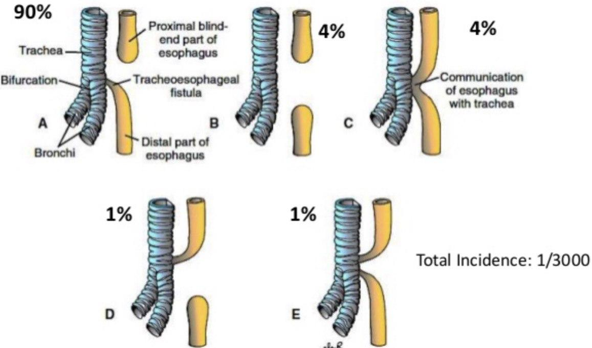
Alveolar Period of Lung Development [32 weeks - 8 years]
01
At the beginning of the alveolar period, each respiratory bronchiole terminates in a cluster of thin-walled terminal saccules (future alveoli)
02
terminal saccules are separated from one another by loose connective tissue.
03
These terminal saccules or alveoli represent future alveolar sac.
04
Characteristic mature alveoli do not form until after birth, 95% of alveoli develop postnatally.
05
About 50 million alveoli, one sixth of the adult number are present in the lungs of a full-term newborn infant.
06
From 3-8 year or so, the number of alveoli continues to increase, forming additional primordial alveoli.
And by about the eighth year, the adult complement of 300 million alveoli is present.
1
​​Fistula: An abnormal passage between the trachea and esophagus.
In more than 90% of cases, the fistula is associated with esophageal atresia.
(Esophagus ends in a blind-ended pouch rather than connecting normally to the stomach)
VACTERAL association
4
Lung Development Anomalies: Tracheoesophageal Fistula
2
Results from incomplete division of the cranial part of the foregut into respiratory and esophageal parts by the tracheo-esophageal septum. Occurs once in 3000 births.
3
Most affected infants are males.

Slide 13
MCQs
Which one of the following develops in the mesoderm
A. Cartilage | B. Glands | C.Epithelium | D.Spinal cord
2. For the lung to develop it acquire a layer of visceral pleura that get raised from:
A.Somatic mesoderm | B.Ectoderm | C. Splanchnic mesenchyme | D.Endoderm
3. Which of the following is a part of the lower respiratory system ?
A.Nose | B.Bronchi | C.Larynx | D.Kidney
4. Recanalization of larynx occur at the:
A.4th week | B.10th month | C.6th week | D.10th week
5. The Respiration is Not possible in:
A.Pseudoglandular period | B.Canalicular | C.Terminal sac | D.Alveolar
Answers: 1-A 2-C 3-B 4-D 5-A
Click on the icon for more questions from Med442’s QBank
Notes:
لا تآخذون اسئله من تيمات قديمه <- الاكاديمك ليدر

Slide 14
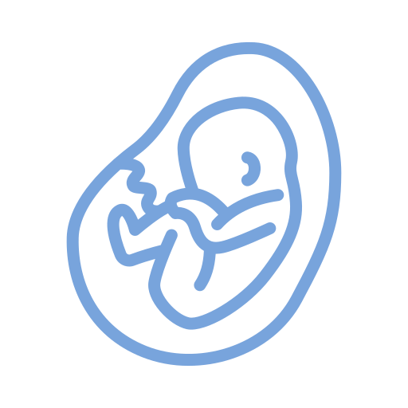
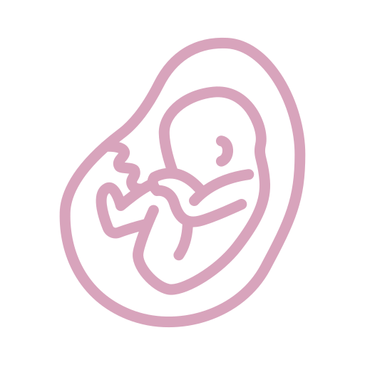
Team Leaders
Team Members
Mohammad Alrashed
Najla
Aldhbiban
Faisal Alomar
Nouf Aldalaqan
Mishal Alsuwayegh
Nouf Aldhalaan
Hazem Almalki
Atheer Alahmari
Zyad Alodan
Shatha Alshabani
Salman Albader
Aljazi AlBabtain
Abdulaziz Alnasser
Reema Alshehri
Faris Alseraye
Sarah Alzahrani
Ahmad Alemam
Maha Alkoryshy
Alwaleed Faqihi
Nada Albedaiwi
Abdullah Alnajres
Razan Almohanna
Meshari Alshathri
Atheer AlKanhal
Nawaf Alturki
Raneem AlWatban
Nasser Alghaith

